Slide 1
ORACLES Forecast Briefing (Aerosols)
10 August 2017
Morning

Slide 2
BC AOD 08-18/Aug

Slide 3
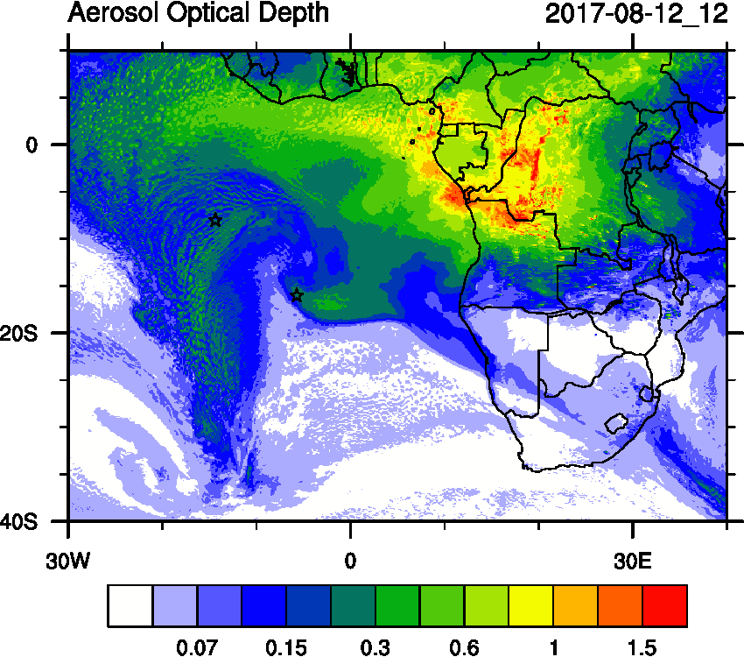
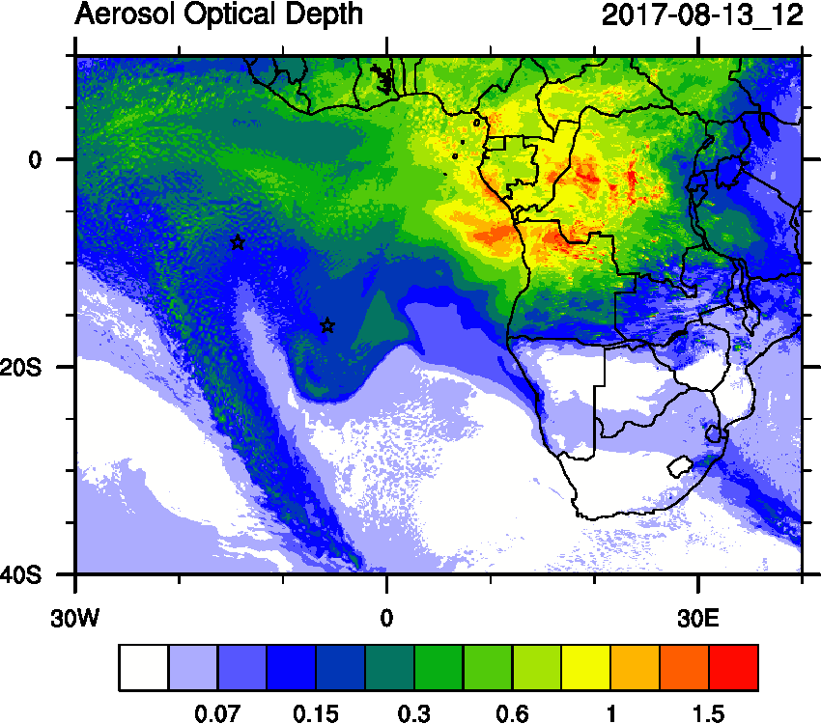
Sat Sun Mon

Slide 4
Sat Sun Mon

Slide 5
Sat

Slide 6
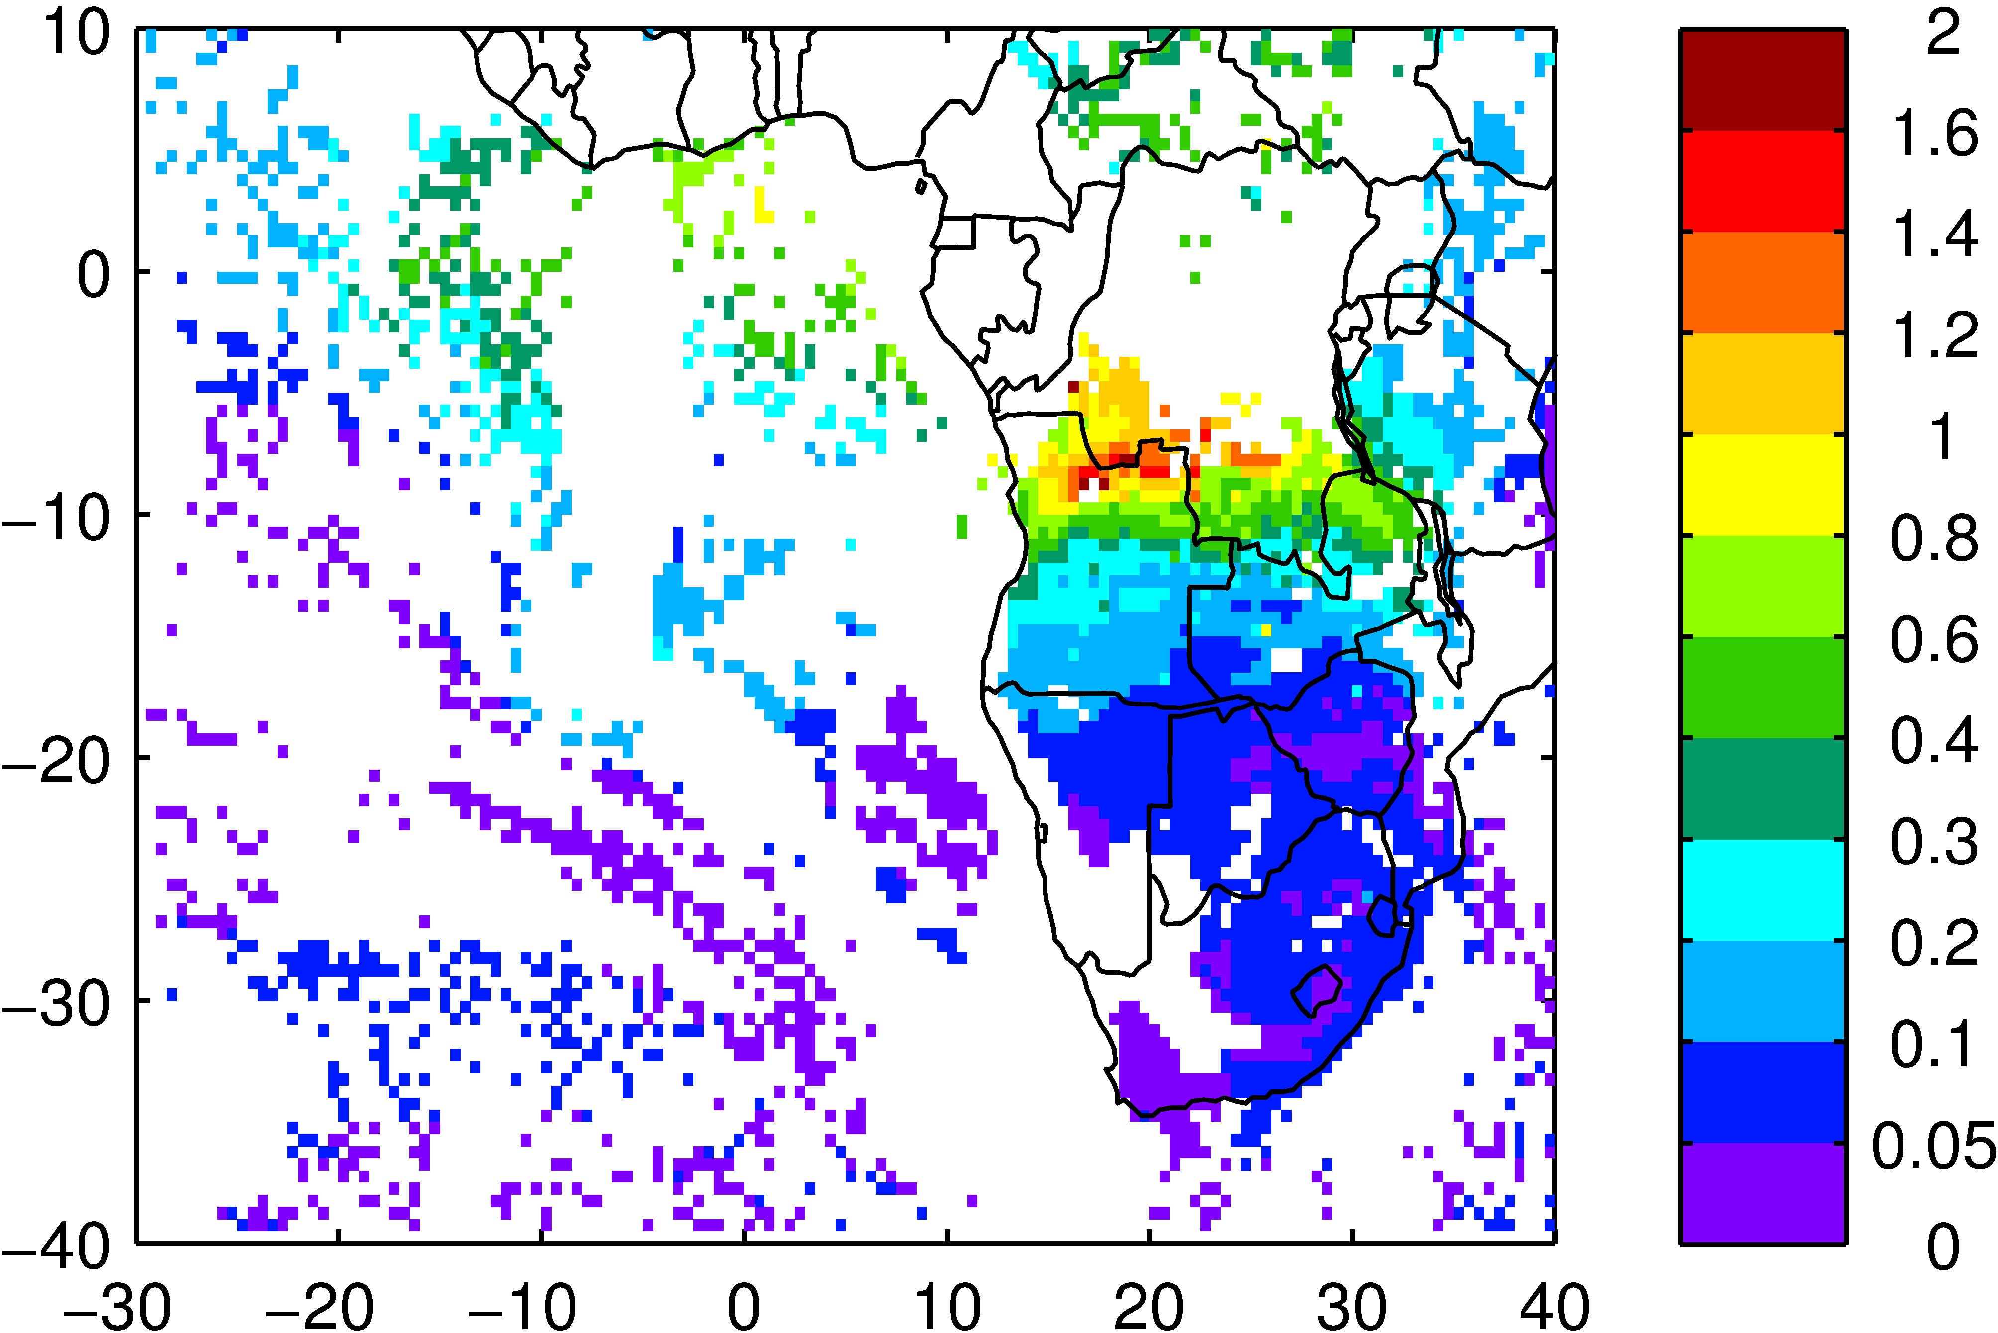

Slide 7
Saturday August 12

Slide 8
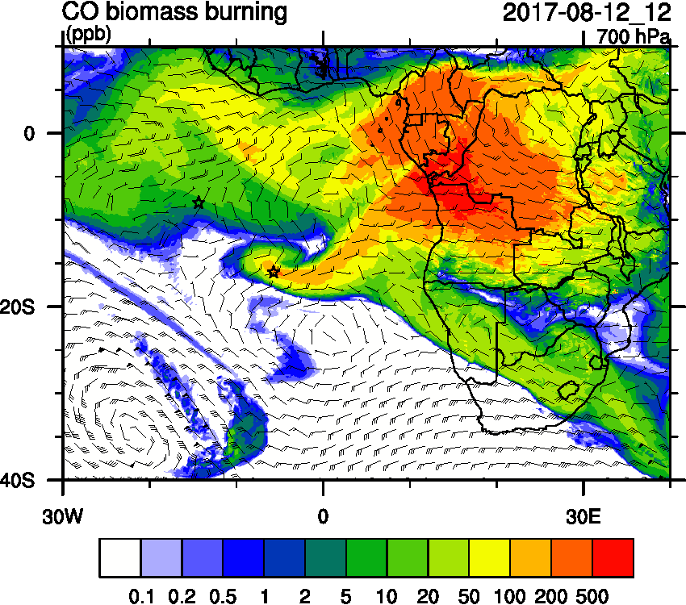
Saturday August 12 (12z)

Slide 9
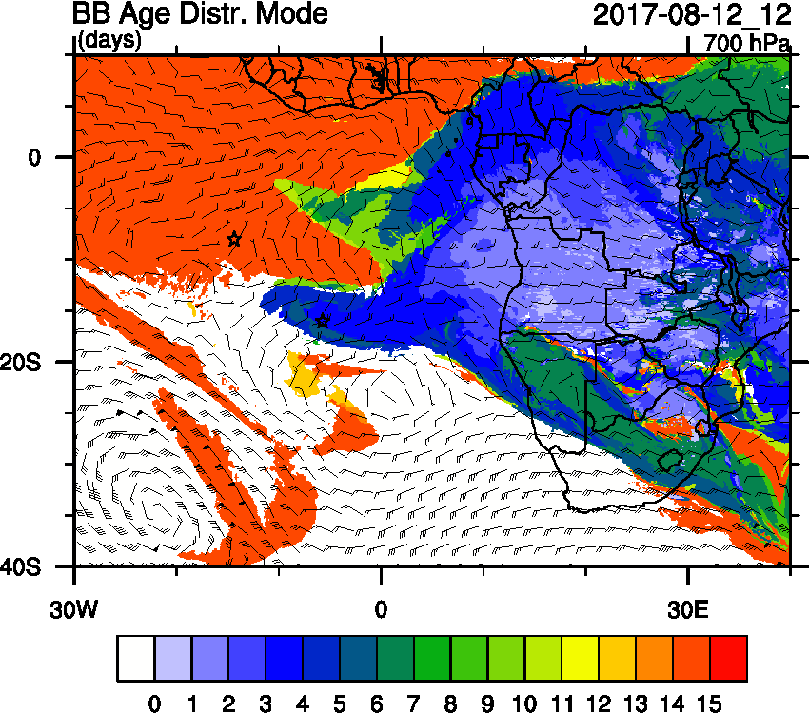
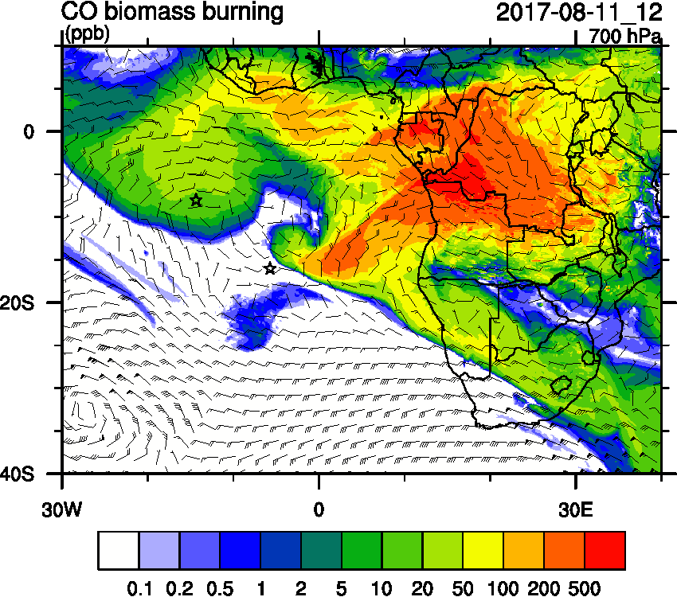
Saturday August 12 (12z)

Slide 10
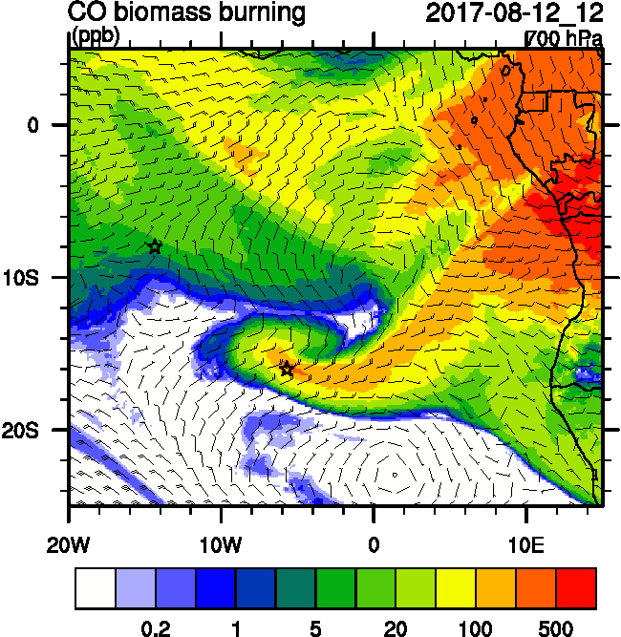
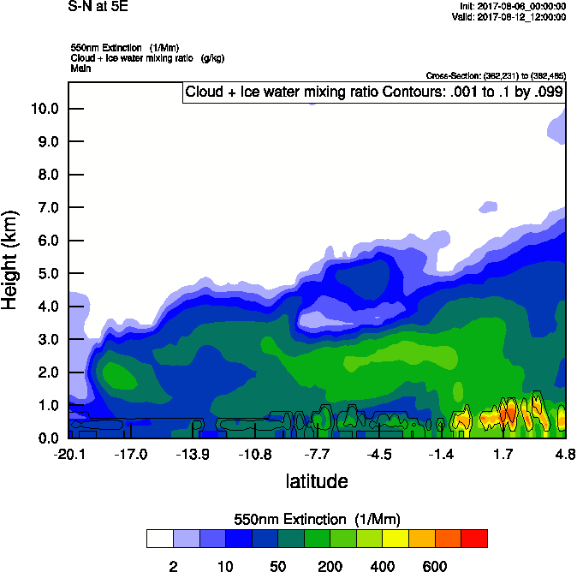
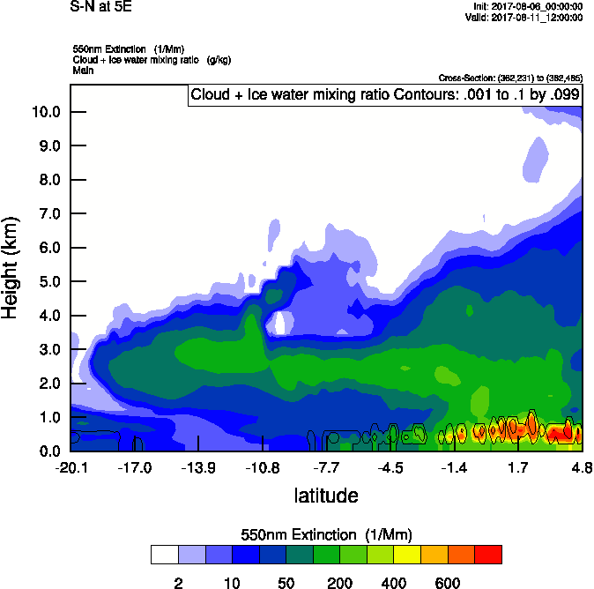
Saturday August 12 (12z)

Slide 11
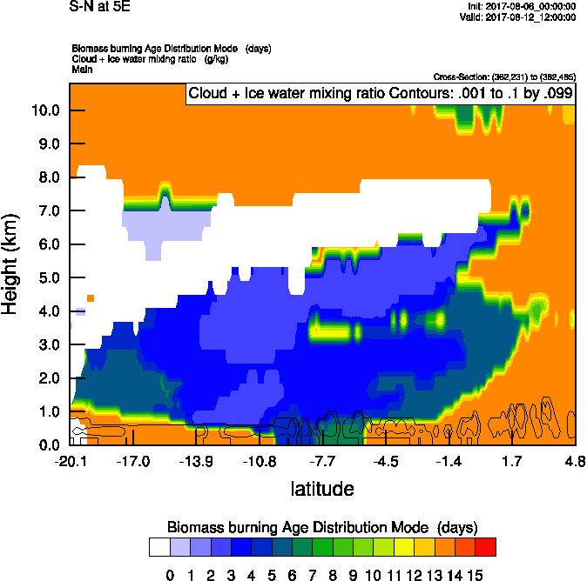
Saturday August 12 (12z)

Slide 12
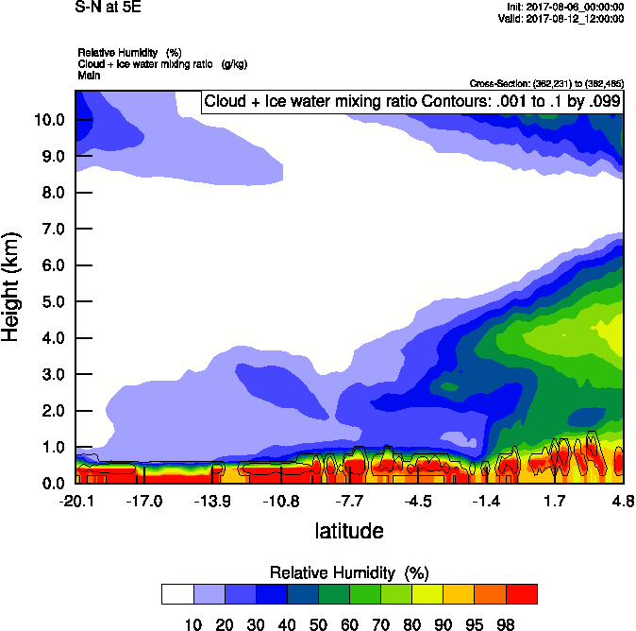
Saturday August 12 (12z)

Slide 13
Saturday August 12 (12z)

Slide 14
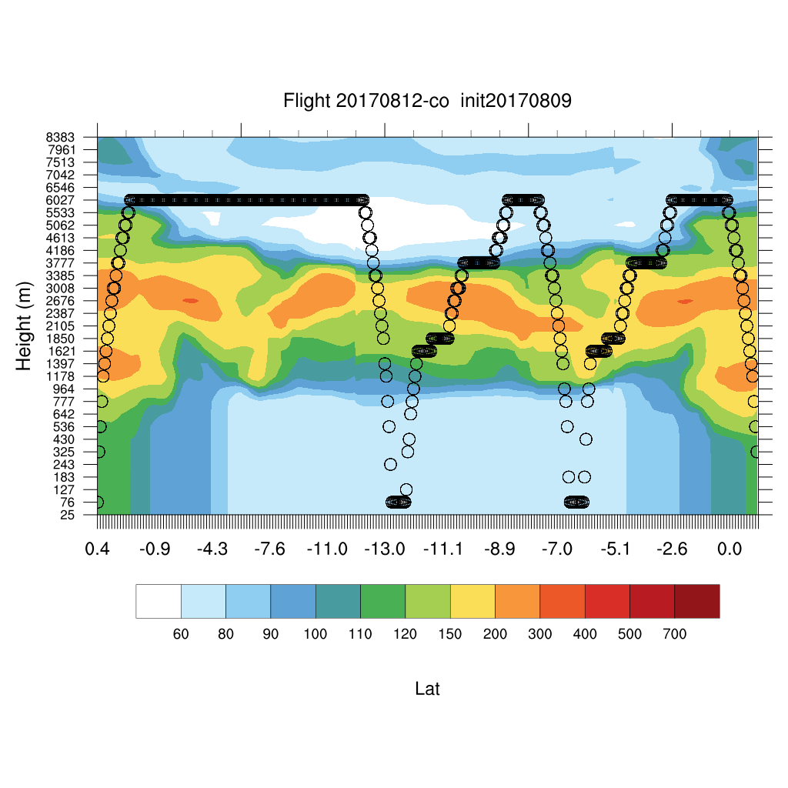
Saturday August 12 (12z)

Slide 15
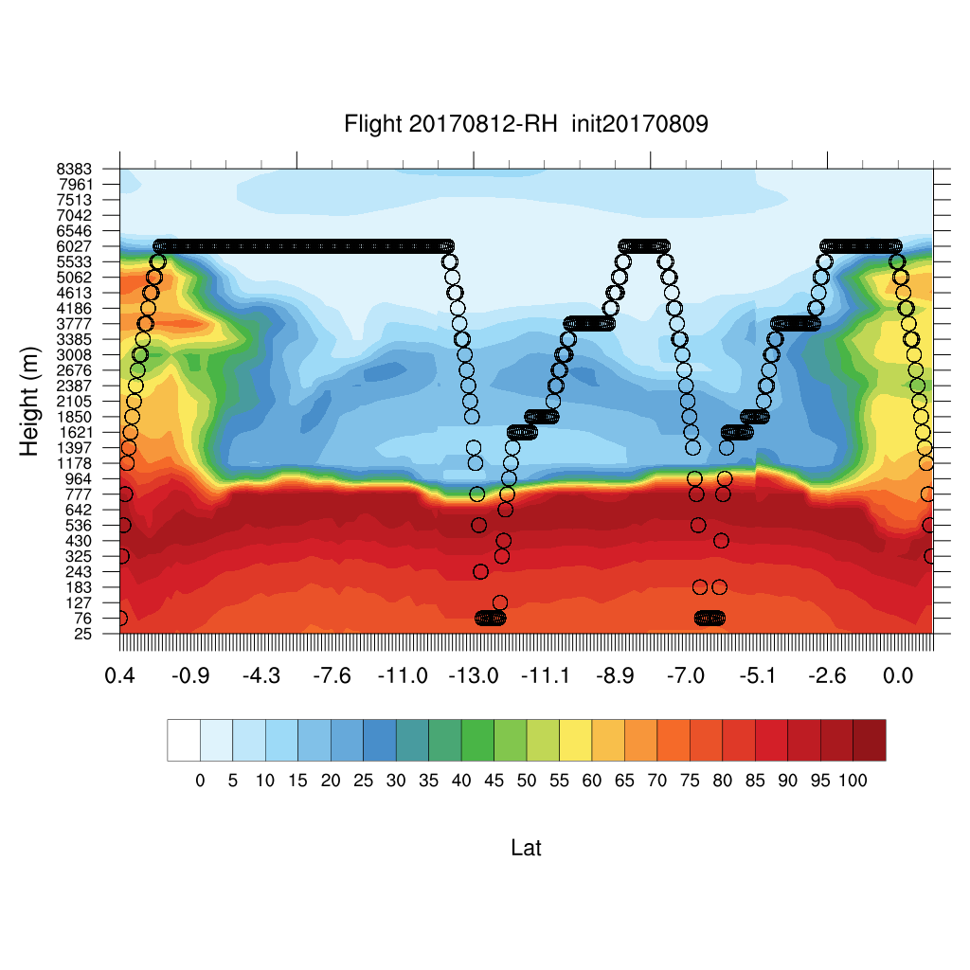
Saturday August 12 (12z)

Slide 16
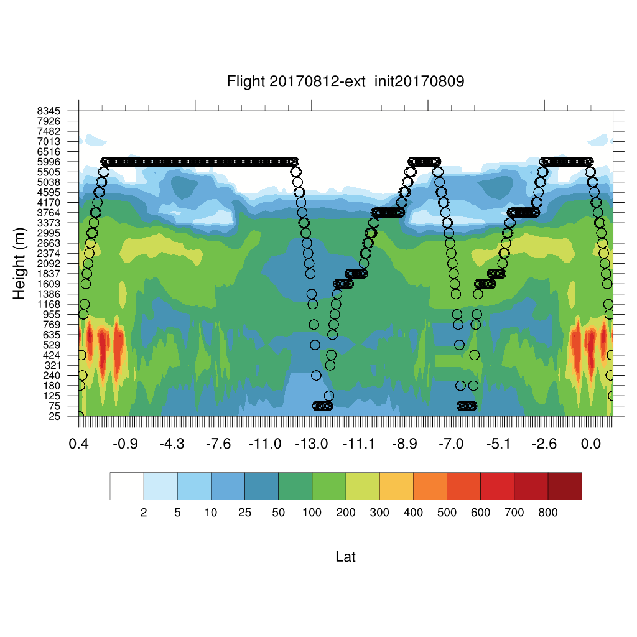
Saturday August 12 (12z)

Slide 17
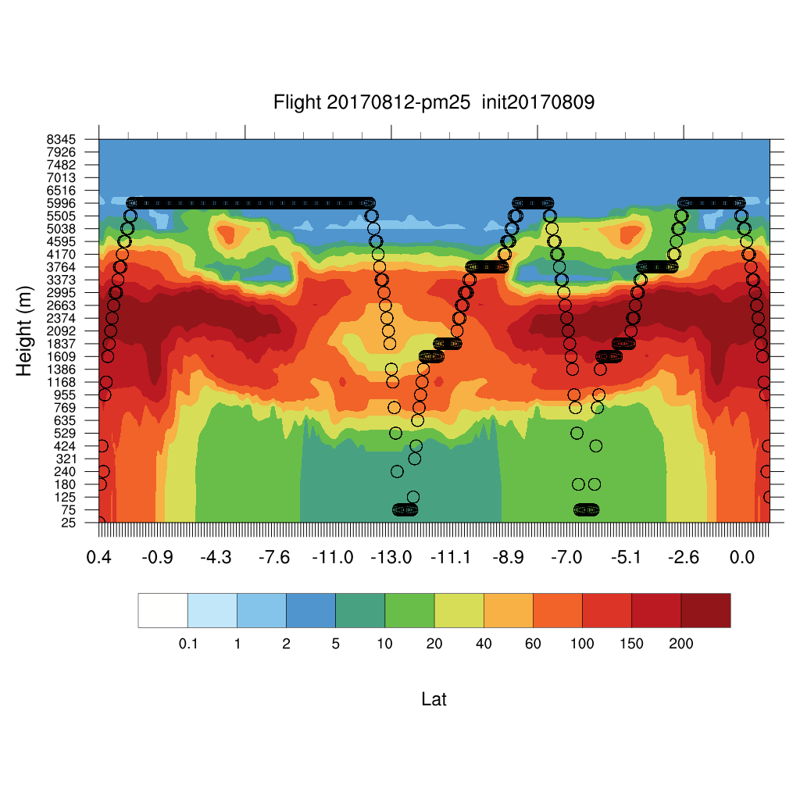
Saturday August 12 (12z)

Slide 18
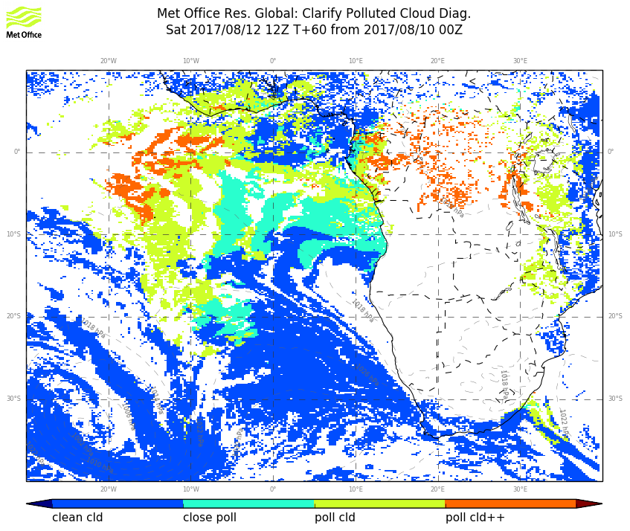
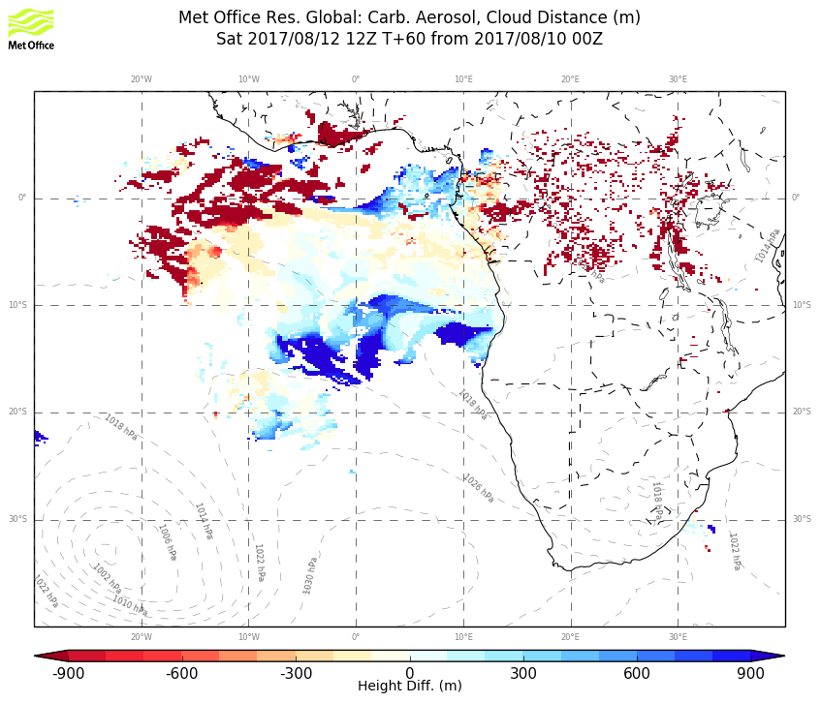
Saturday August 12 (12z)

Slide 19
Sunday August 13

Slide 20
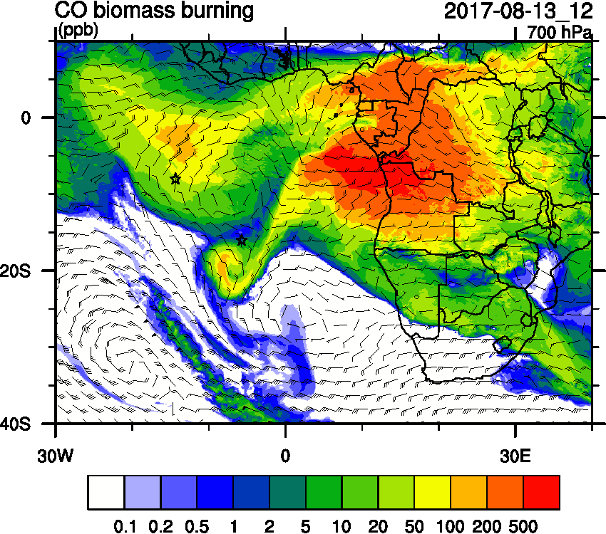
Sunday August 13 (12z)

Slide 21
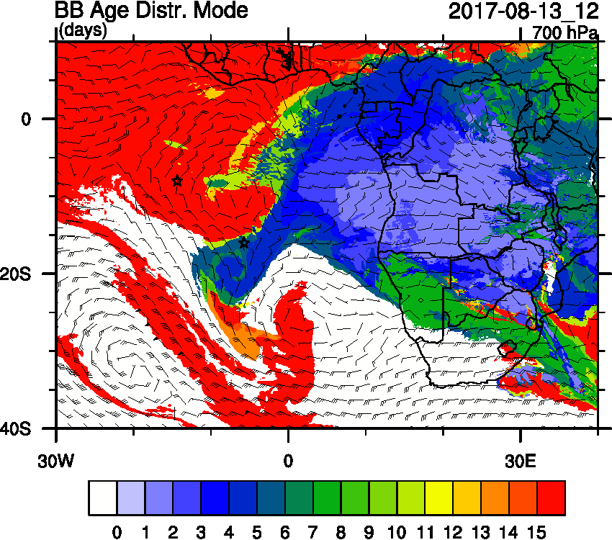
Sunday August 13 (12z)

Slide 22
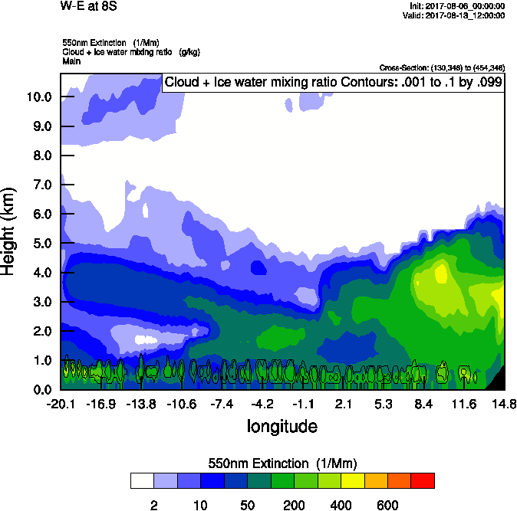
Sunday August 13 (12z)

Slide 23
Saturday August 12 (12z)

Slide 24
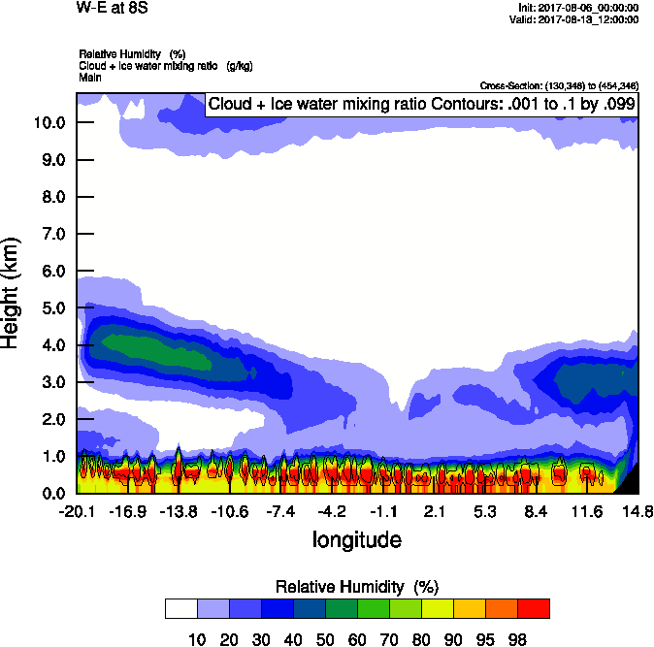
Sunday August 13 (12z)

Slide 25
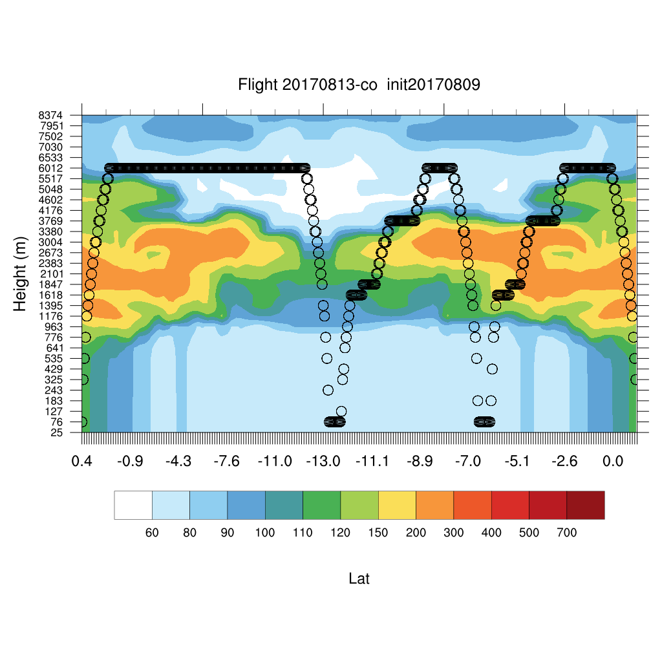
Sunday August 13 (12z)

Slide 26
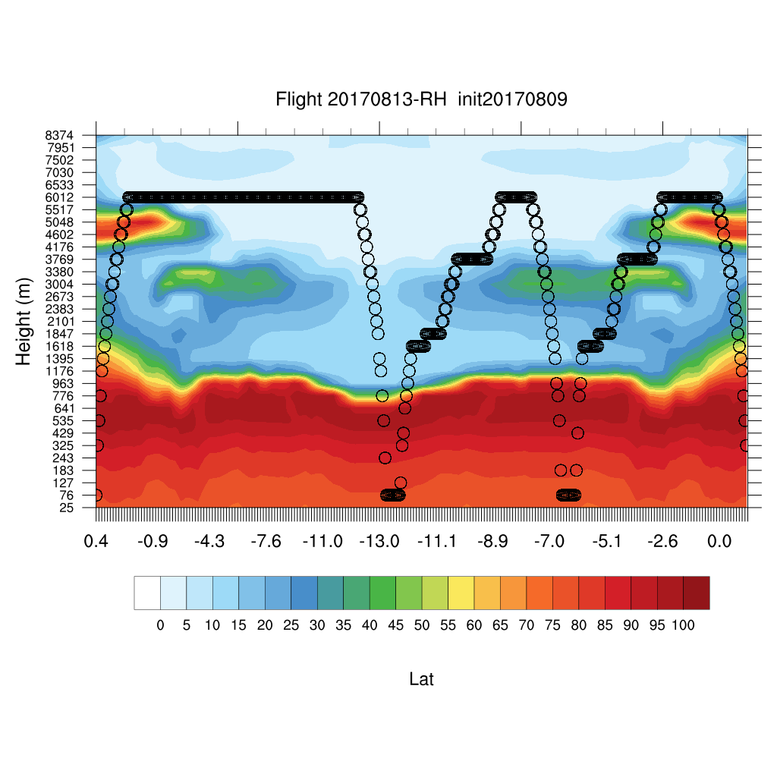
Sunday August 13 (12z)

Slide 27
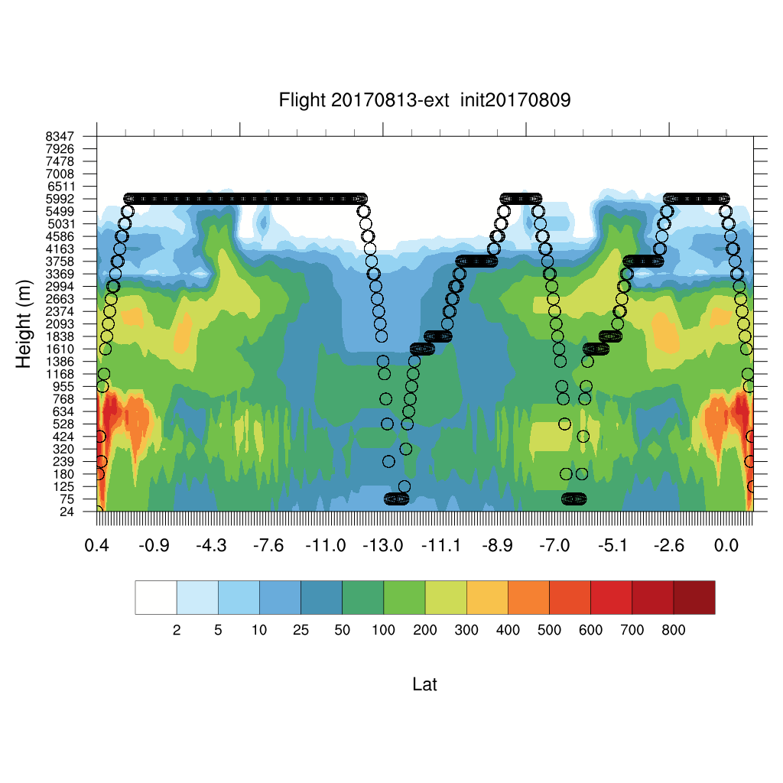
Sunday August 13 (12z)

Slide 28
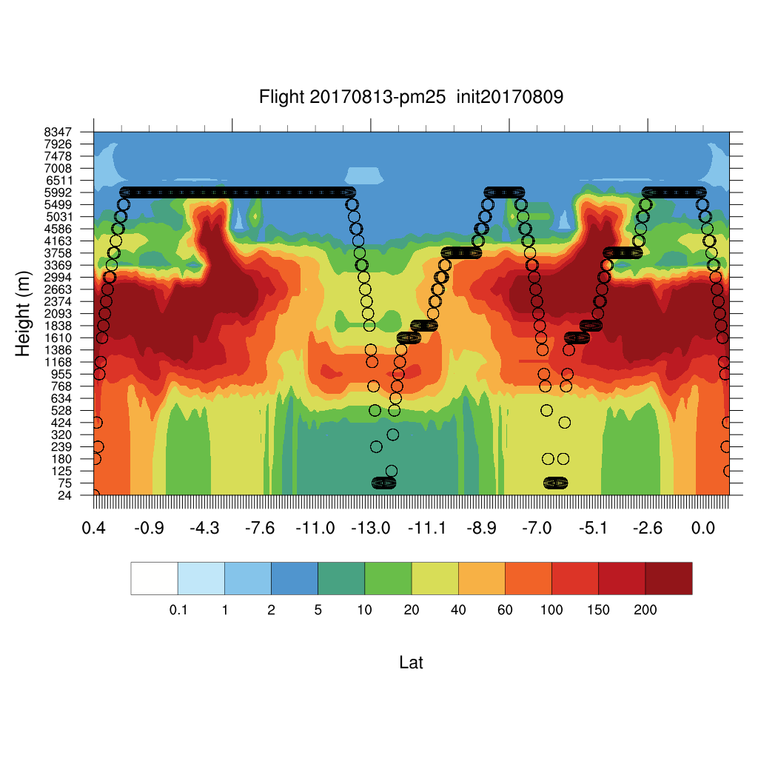
Sunday August 13 (12z)

Slide 29
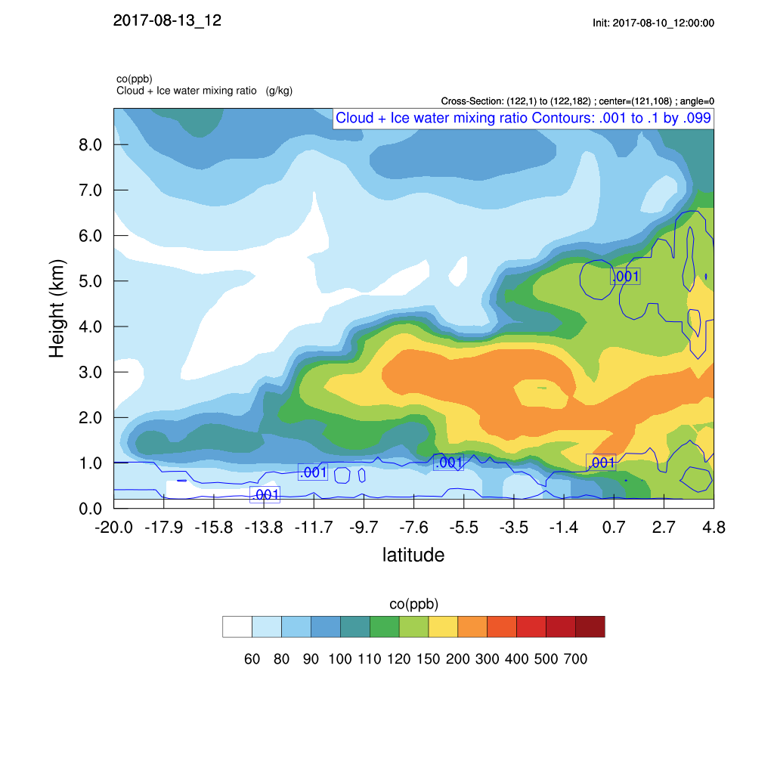

Slide 30
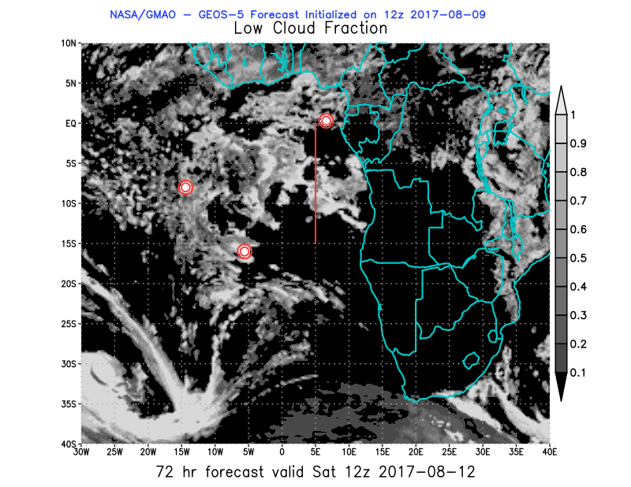
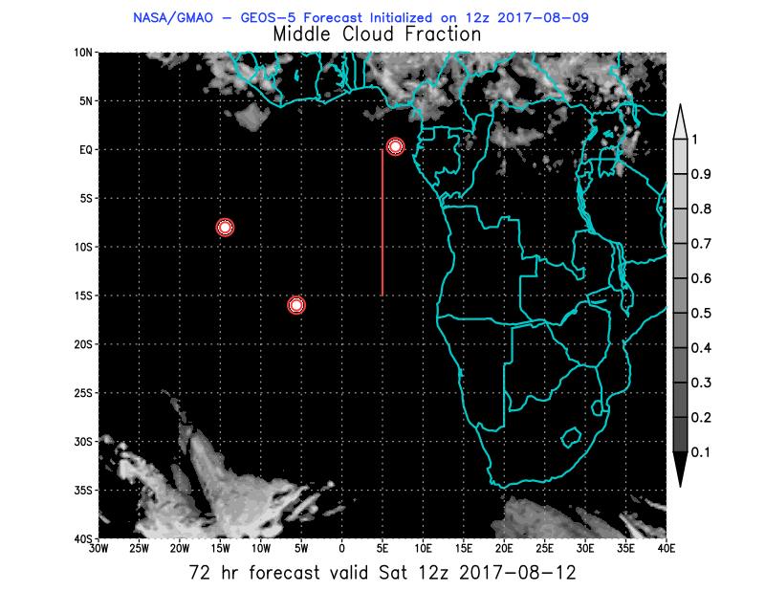
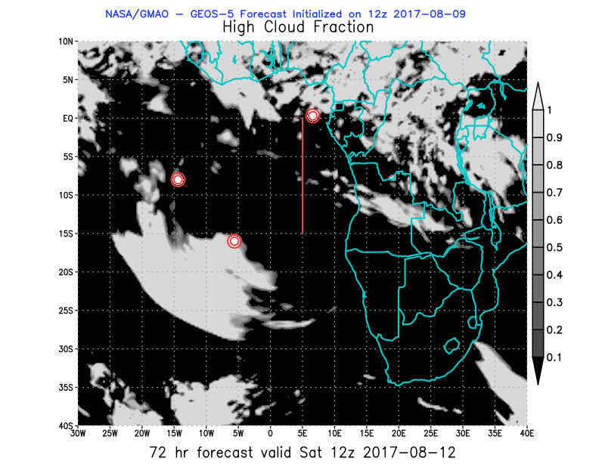
Sat – 12Z

Slide 31
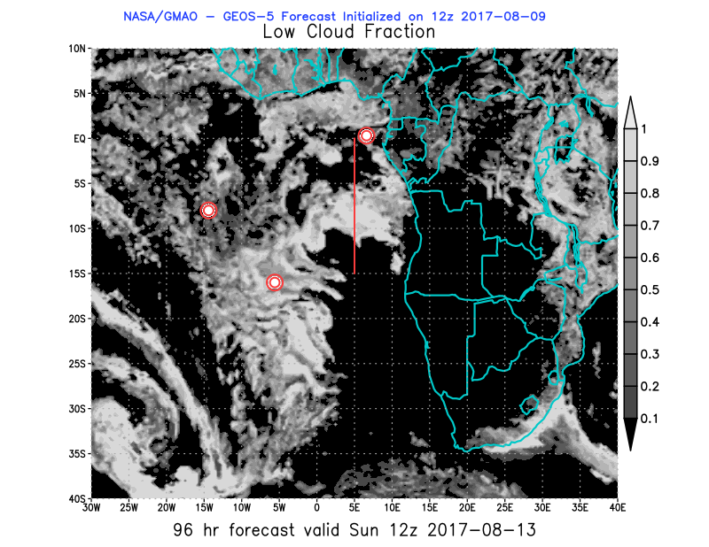
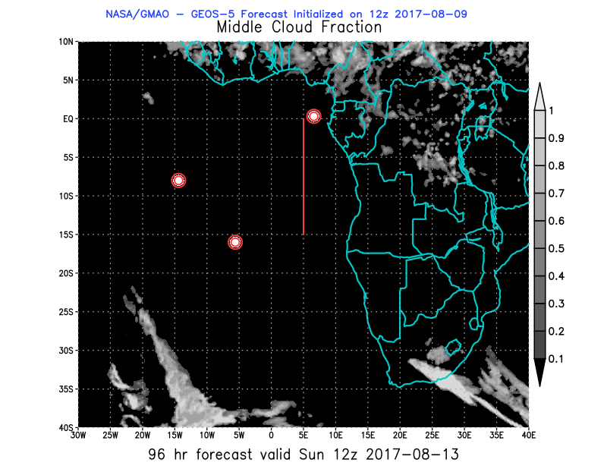
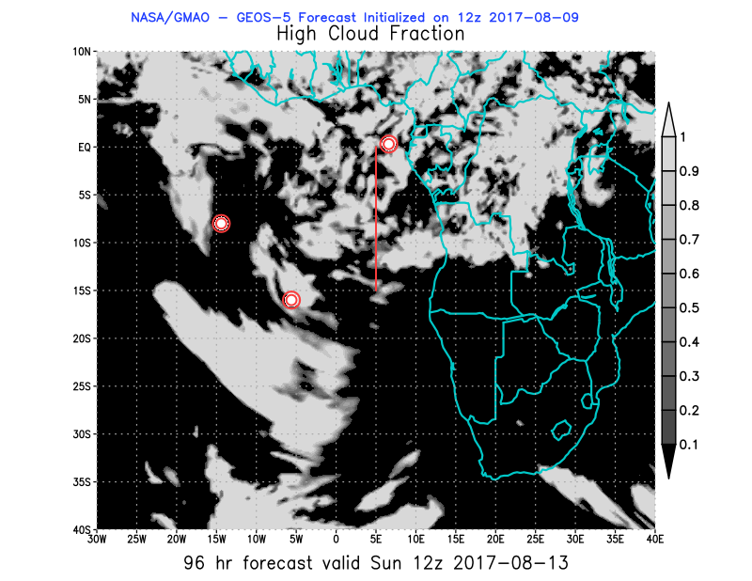
Sun – 12Z

Slide 32
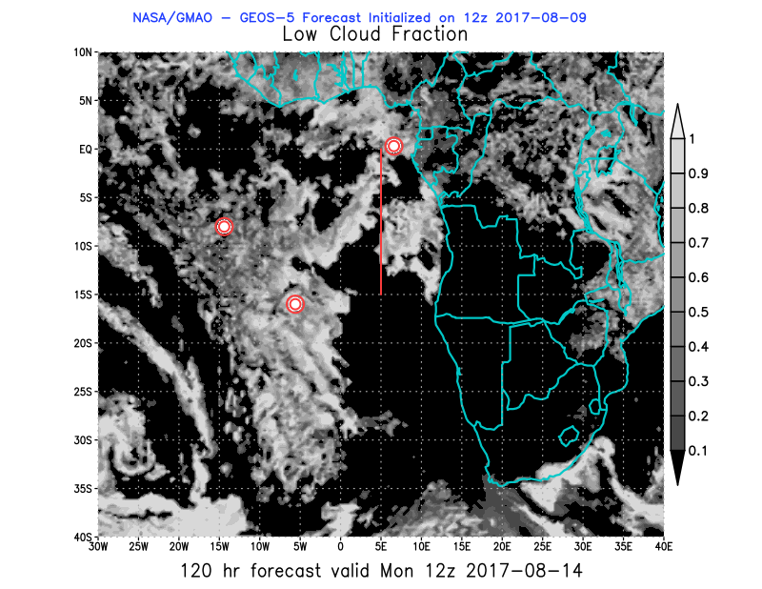
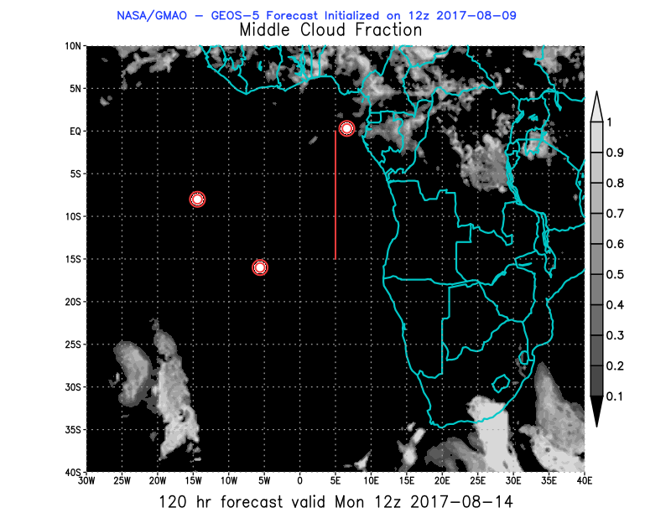
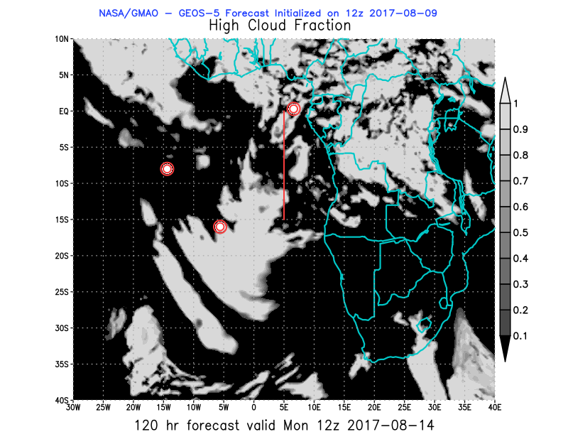
Mon – 12Z

Slide 33
BC AOD 08-18/Aug

Slide 34
https://portal.nccs.nasa.gov/cgi-mission/mission_3d_chem.cgi?region=oracles_lg&dtg=2017080912&prod=8bc&model=fp&level=850&tau=000&&region_old=oracles_lg&dtg_old=2017080912&prod_old=&model_old=fp&level_old=&tau_old=000&&loop=1
https://portal.nccs.nasa.gov/cgi-mission/mission_3d_chem.cgi?region=oracles_lg&dtg=2017080912&prod=8bc&model=fp&level=700&tau=000&&region_old=oracles_lg&dtg_old=2017080912&prod_old=&model_old=fp&level_old=&tau_old=000&&loop=1

Slide 35
Ascension São Tomé e Príncipe Sta Helena

Slide 36
Global AOD and CO
https://portal.nccs.nasa.gov/cgi-mission/mission_2d_chem.cgi?region=global&dtg=2017080912&prod=3bcaot&model=f516_fp&tau=000&&region_old=global&dtg_old=2017080918&prod_old=3bcaot&model_old=f516_fp&tau_old=000&&loop=1
https://portal.nccs.nasa.gov/cgi-mission/mission_2d_chem.cgi?region=global&dtg=2017080912&prod=cocl&model=f516_fp&tau=000&&region_old=global&dtg_old=2017080912&prod_old=coclbbla&model_old=f516_fp&tau_old=000&&loop=1

