Slide 1
ORACLES weather briefing
9-Aug-2017
Lenny Pfister and Rei Ueyama

Slide 2
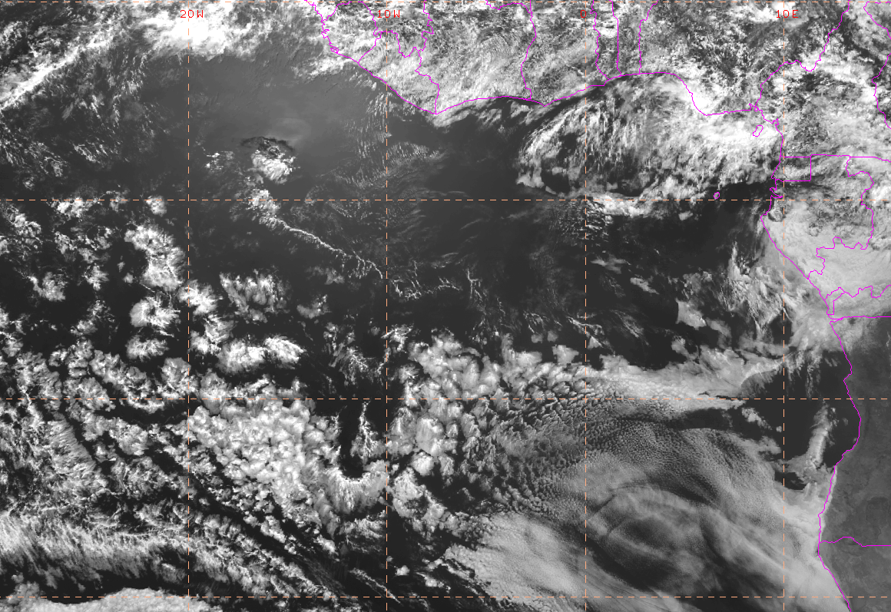
Visible satellite imager at 8/9 Wed @ 2PM
20W
10W
0
Clouds in the vicinity of the flight track are dissipating; expect relatively clear skies rest of the way
P3
This one growing slightly

Slide 3
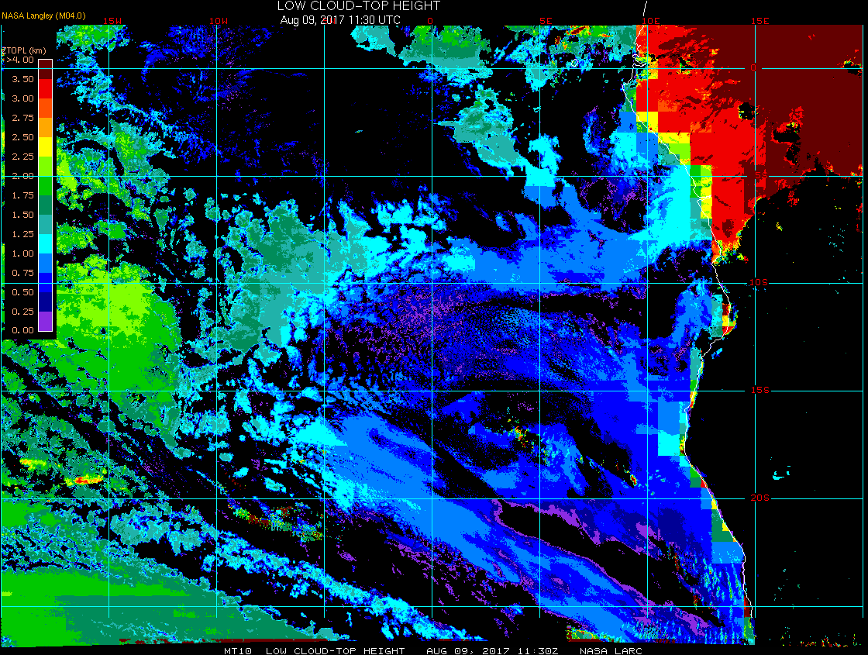
Low cloud top heights at 8/9 Wed @ 11:30AM
15W
10W
5W
0
5E
These low clouds not forecasted by all models, but EC model did pretty well otherwise
Square spiral at this time at 7.5W
Satellite estimates indicate cloud top heights of 5000 – 5500 ft

Slide 4
How good are the low cloud forecasts, and for how long?

Slide 5
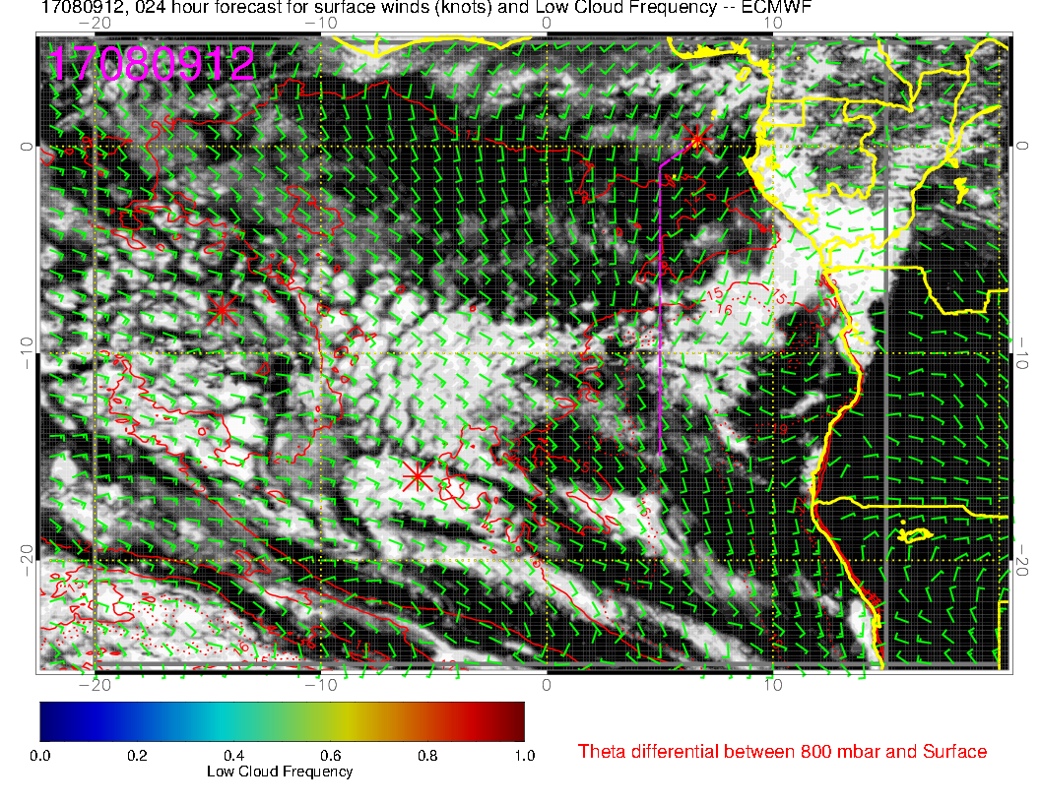
Today, 12Z: comparison of visible image (below) with 24 hour forecast from EC (left)
Major features are well captured, other than the excessive cloud clearing in the EC model where the boundary layer is thin (and clouds are thin).

Slide 6
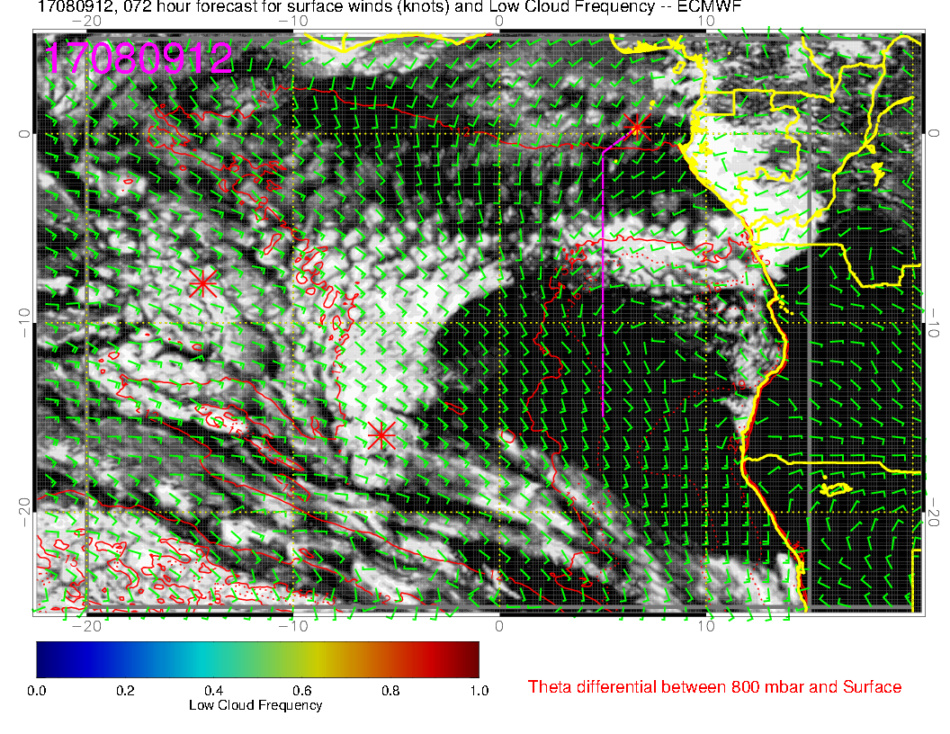
Today, 12Z: comparison with 72 hour forecast
We have excessive cloud clearing, but even some of the gross features are not well placed with 3 day fcsts. Perhaps all we can hope for is that the model is getting less than normal overall cloud.

Slide 7
Evolution of surface wind speed and BL height over the forecast period: an explanation for an overall increase in low cloud over the next 5 days

Slide 8
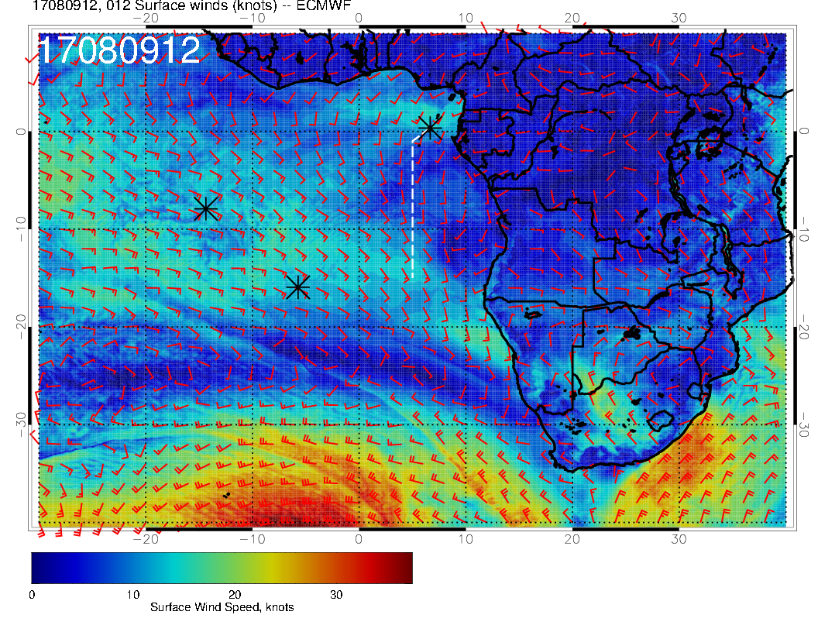
H
Surface winds are weak in SC region, SH high is scrunched.

Slide 9
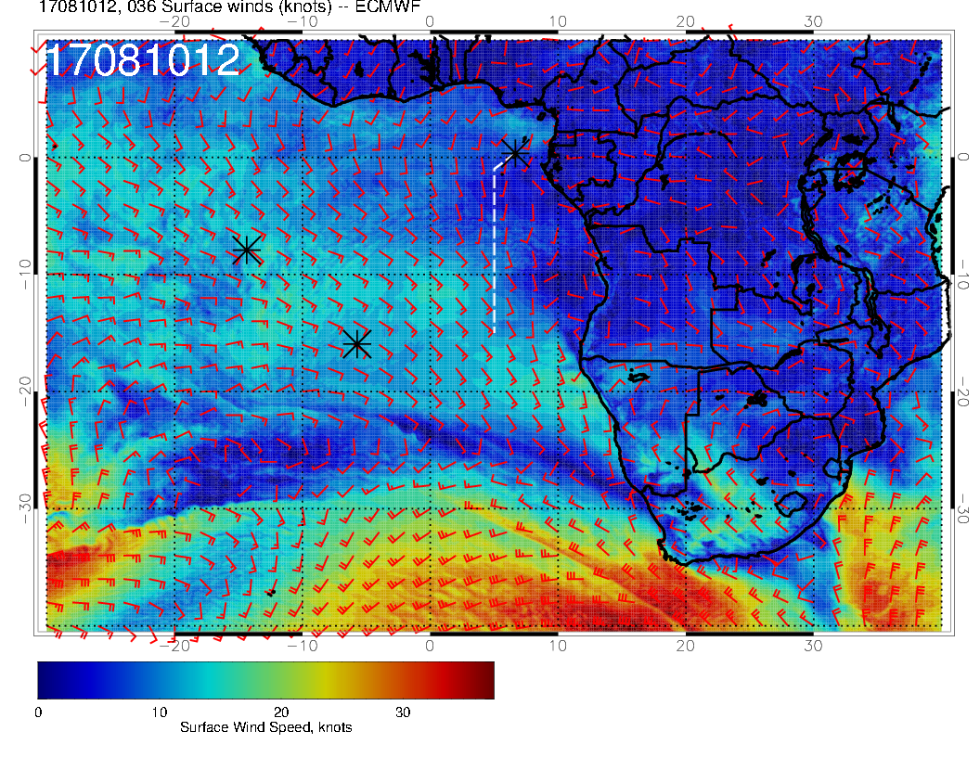
H
Surface winds still weak, SH high west of typical position.

Slide 10
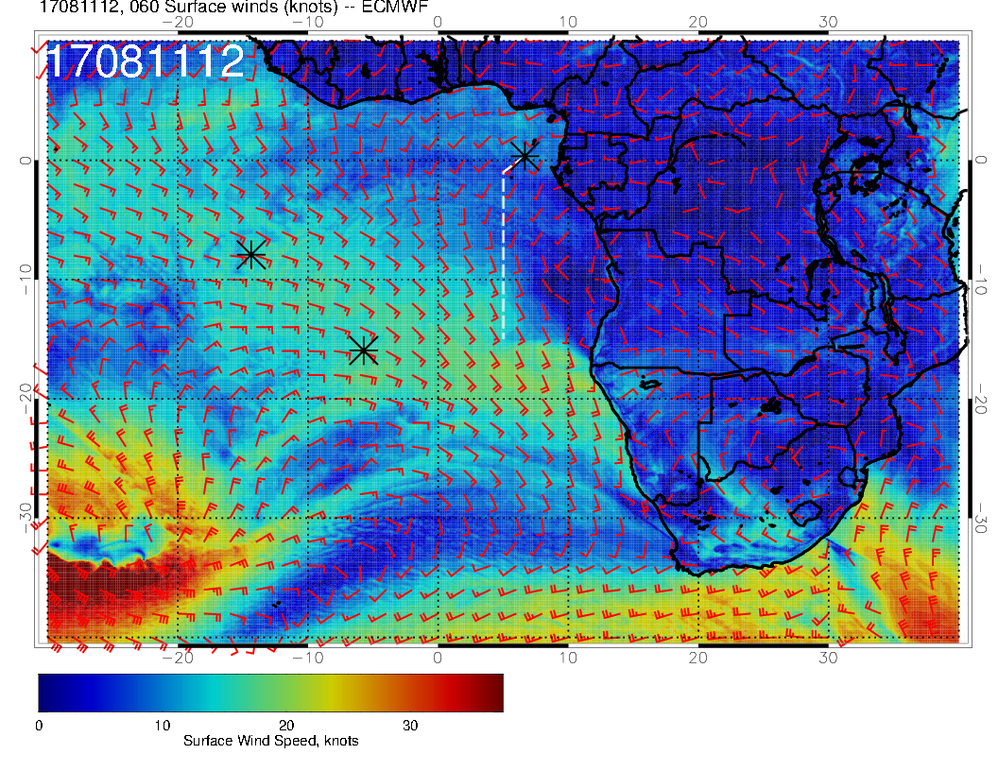
H
Surface winds strengthen as SH high reforms further east

Slide 11
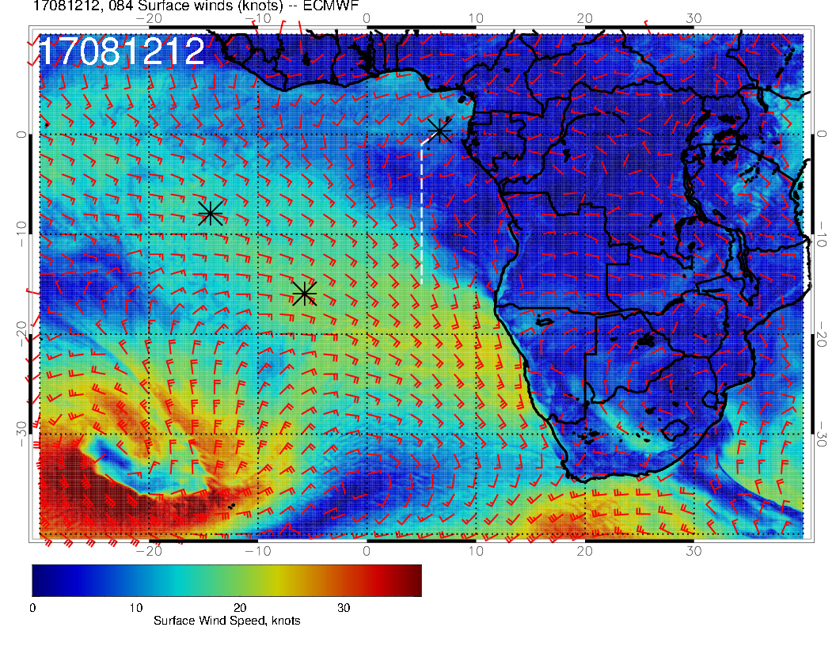
H
SH high more coherent and stronger, moving east, higher winds. Note that winds near TMS to 5S are now westerly.

Slide 12
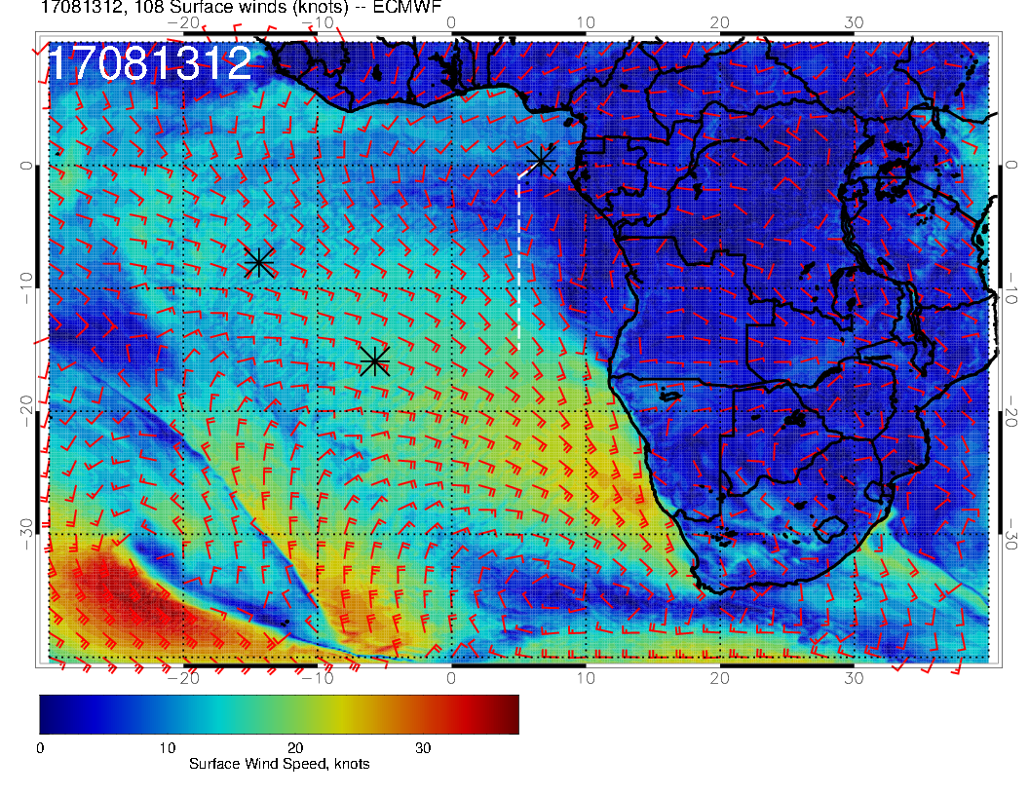
H
Surface winds weaken in northern SC region, but still stronger than at
start. Still westerly winds near TMS.

Slide 13
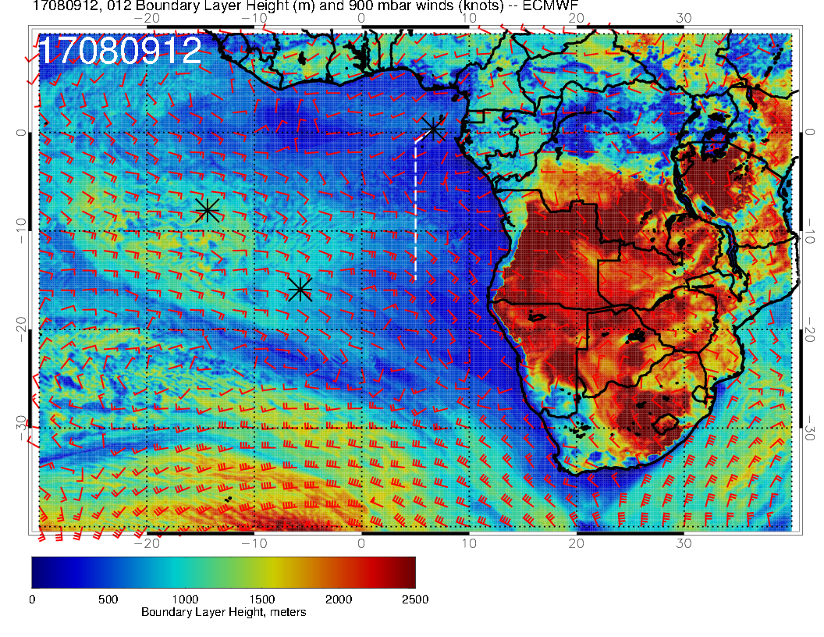
H
Low BL heights throughout SC region (relatively) on August 9.

Slide 14
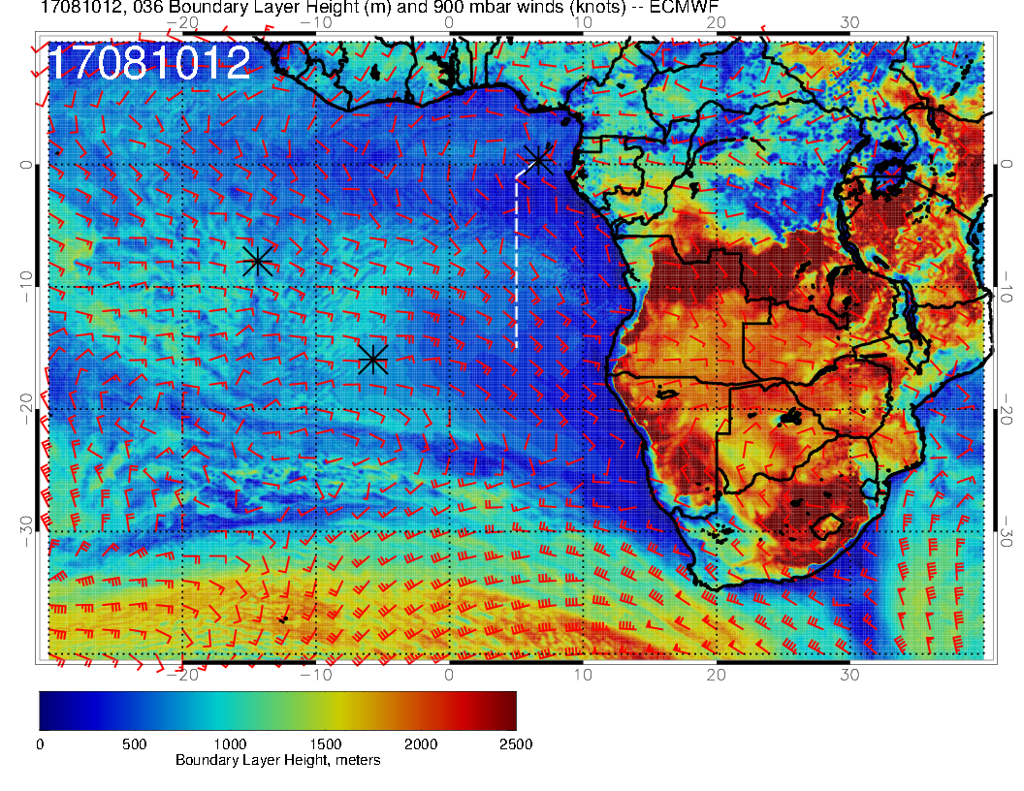
H
Continued low BL heights

Slide 15
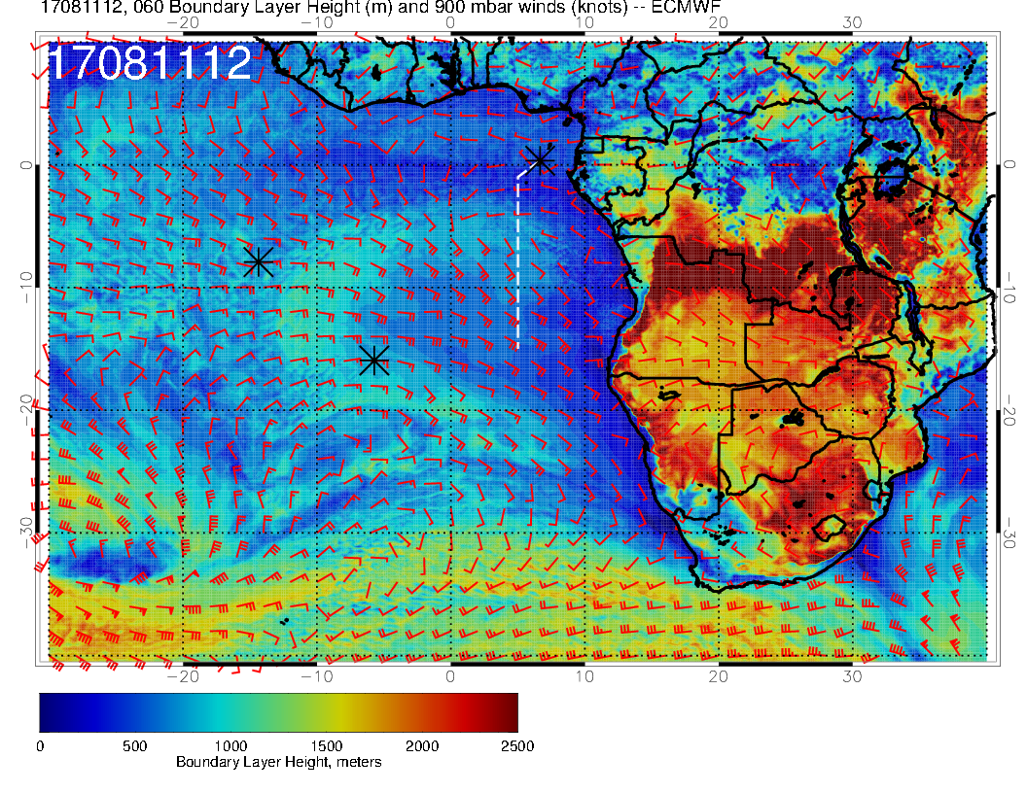
H
Going up a little.

Slide 16
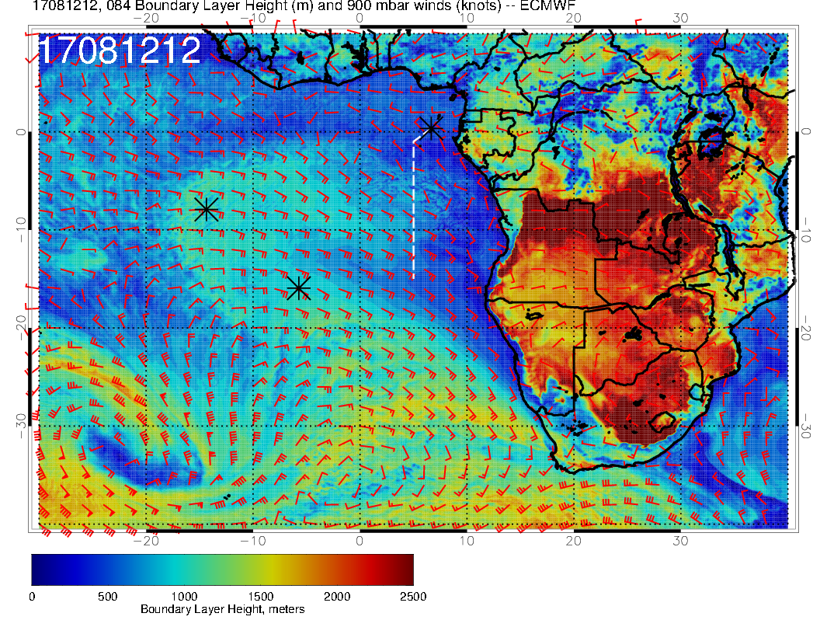
H
Thicker BL, both north and south.

Slide 17
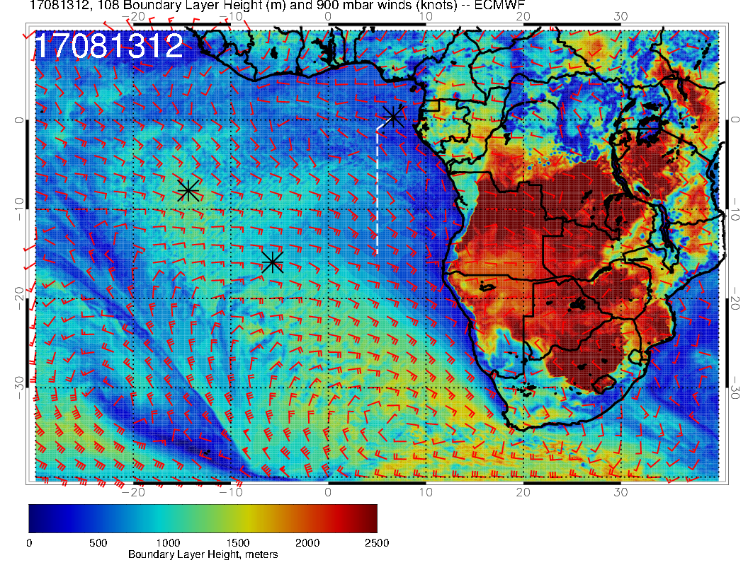
H
Slightly less elevated BL heights than on August 12, but still greater than at start of forecast period.

Slide 18
Forecast for Friday, August 11

Slide 19
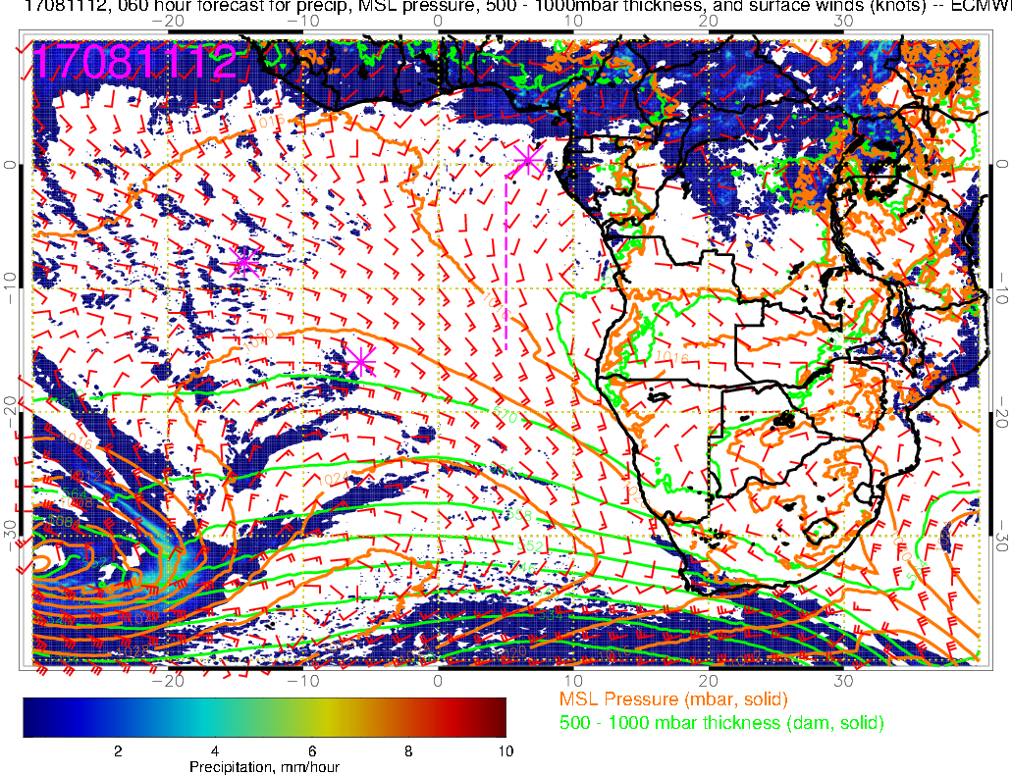
Precip, surface winds, 500-1000mb thickness for 8/11 @ 12PM
Temperature at TMS in the past two days:
24C @ 7am
25C @ 8am
26C @ 9am
St. Helena High compressed by the Low to its west
(surface flow in the flight region close to climatology)
L
H

Slide 20
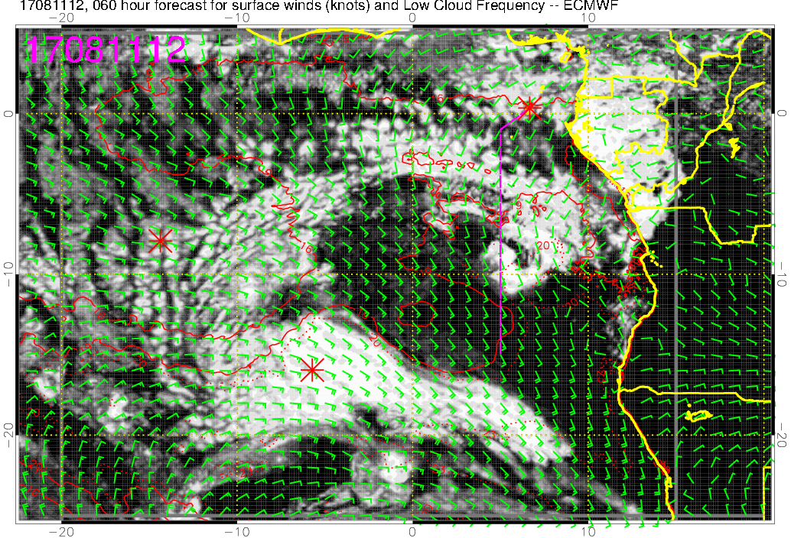
Low cloud forecast on 8/11 Fri @ 12PM
Low clouds throughout most of the flight

Slide 21
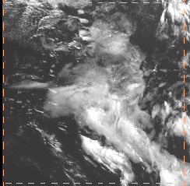
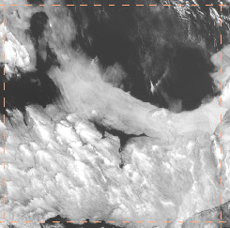
5 deg lon x 5 deg lat
Low cloud forecast on 8/11 Fri @ 12PM

Slide 22
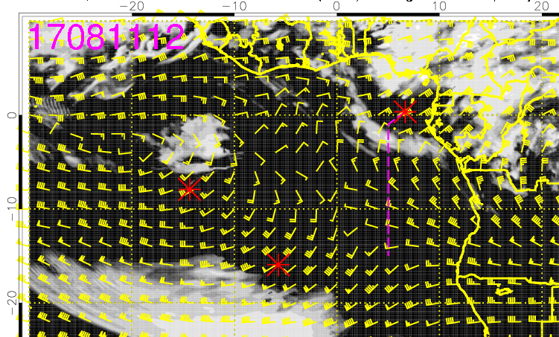
High cloud forecast on 8/11 Fri @ 12PM
High clouds mainly to the north of TMS, but some to the south as well

Slide 23
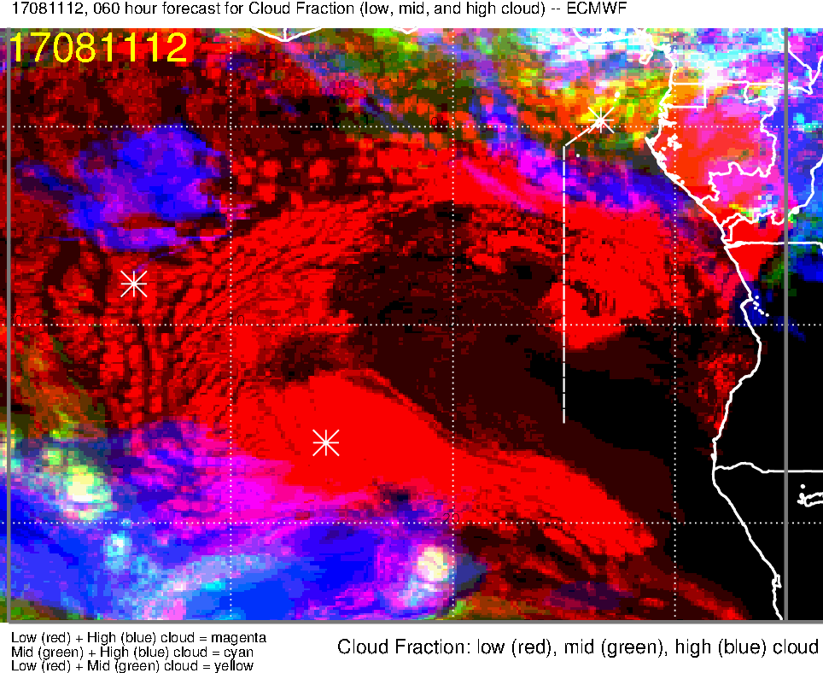
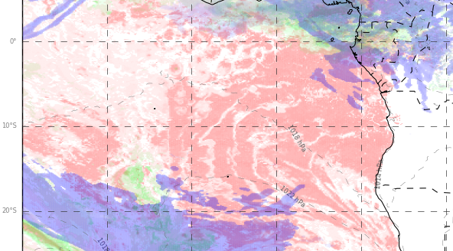
Low, middle, high cloud forecast for 8/11 Fri @ 12PM
ECMWF (60-hr)
UKMO (60-hr)
High clouds
High clouds
Good model agreement overall: (1) low clouds along most of the flight track, but relatively clear (smaller cells) near the southernmost point; (2) mid and high clouds over TMS; (3) high clouds from convection may approach flight track ~3-4S
Clear region south of TMS in EC model, but not in UKMO (EC likely more accurate)

Slide 24
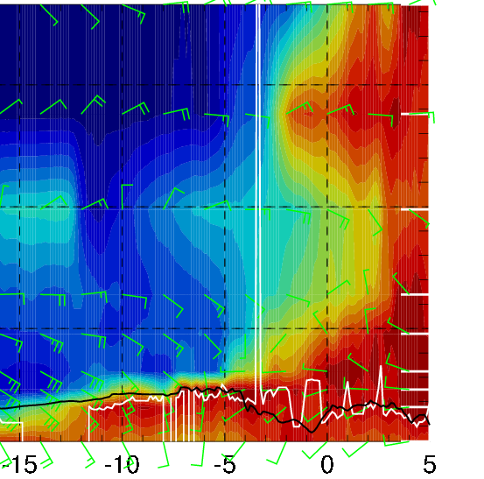
RH (color), wind, BL and cloud base heights along 5E, 8/11 Fri @ 12PM
Cross winds (from E) of 10-20 knots at 10-15 kft
Plume of dry convection at 10 kft south of 12S
Cloud bases (3 to 1 kft) and tops (4 to 1 kft) decrease from N to S along the flight track

Slide 25
Forecast for Saturday, August 12

Slide 26
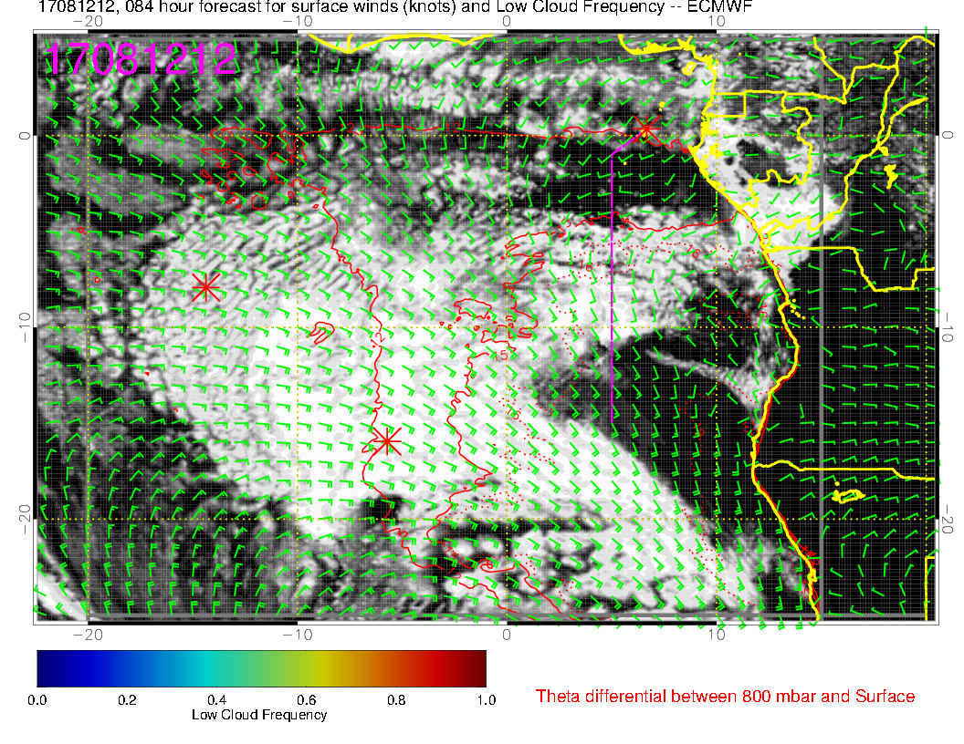
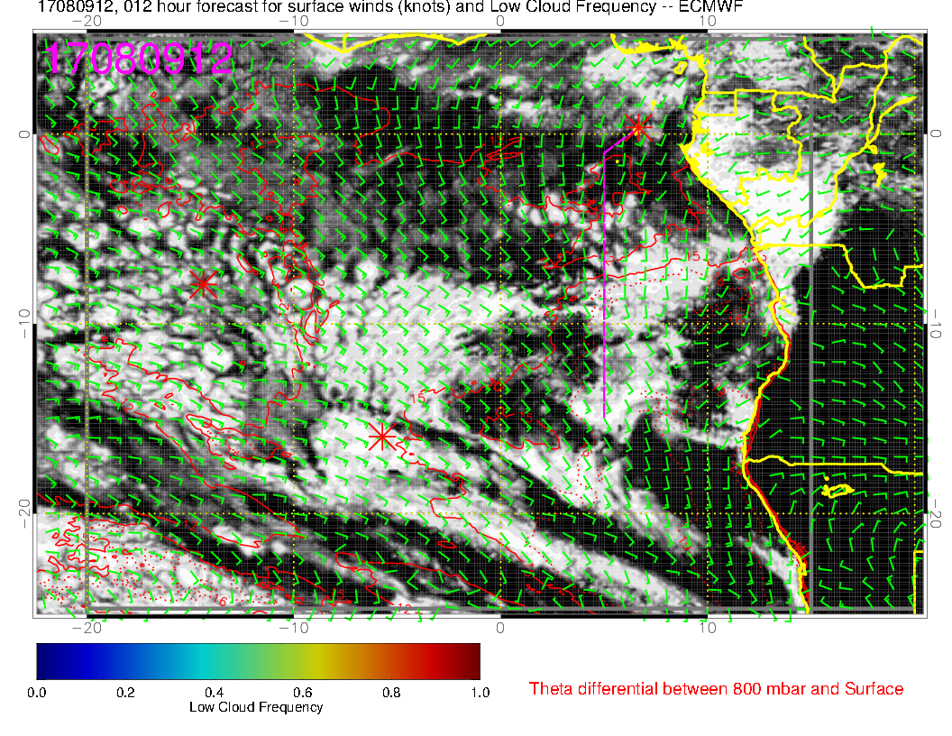
SATURDAY
More extensive low cloud field forecast for Saturday than forecast for today. This (the more extensive part) I believe is robust (though details of placement are not)
TODAY
T

Slide 27
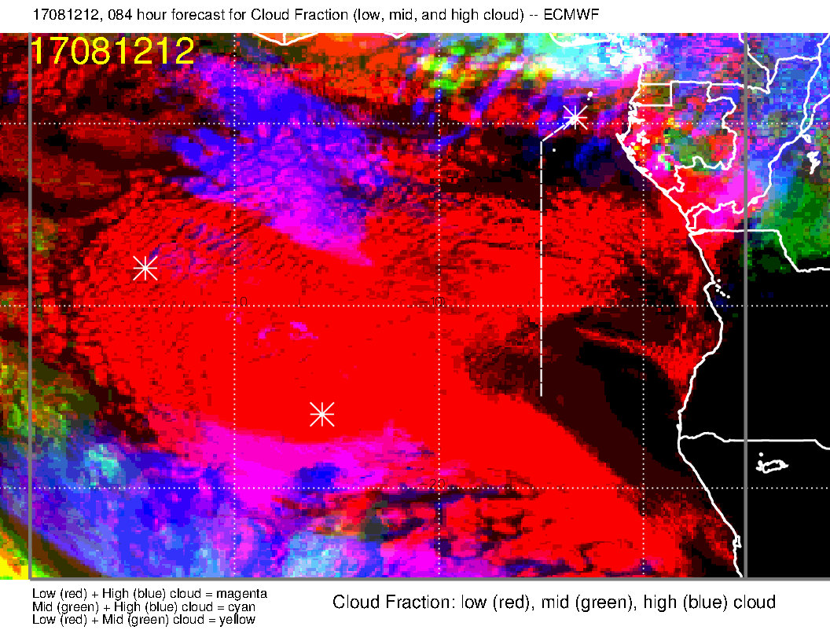
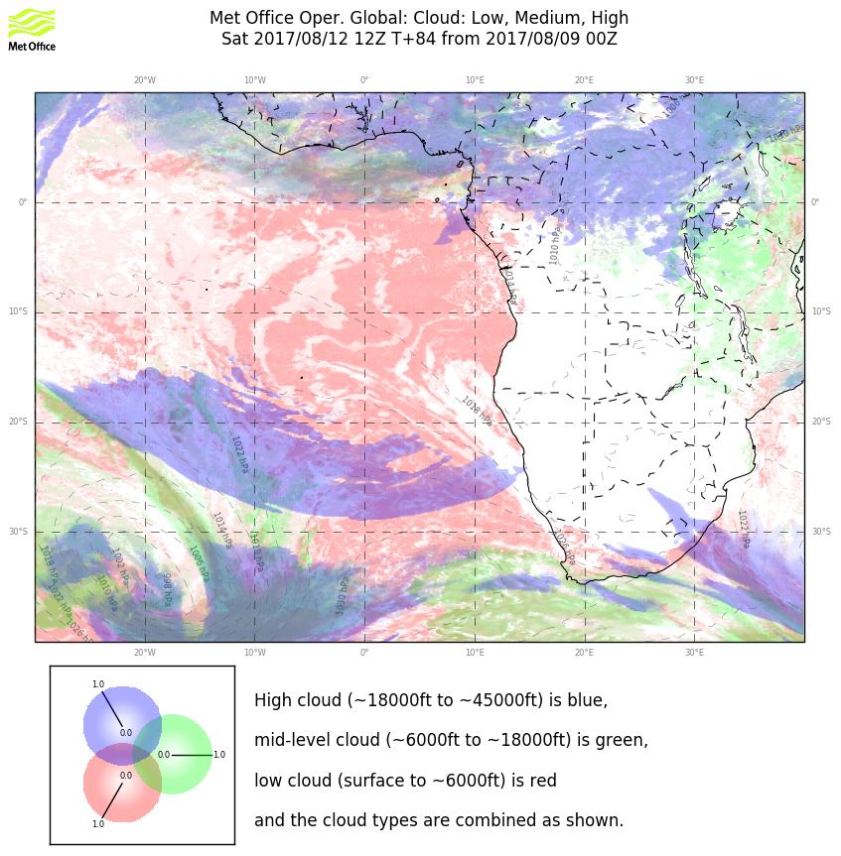
A bit far out, but my judgment is that the high cloud blob NE of Ascension in the EC forecast (left) is overdone.

Slide 28
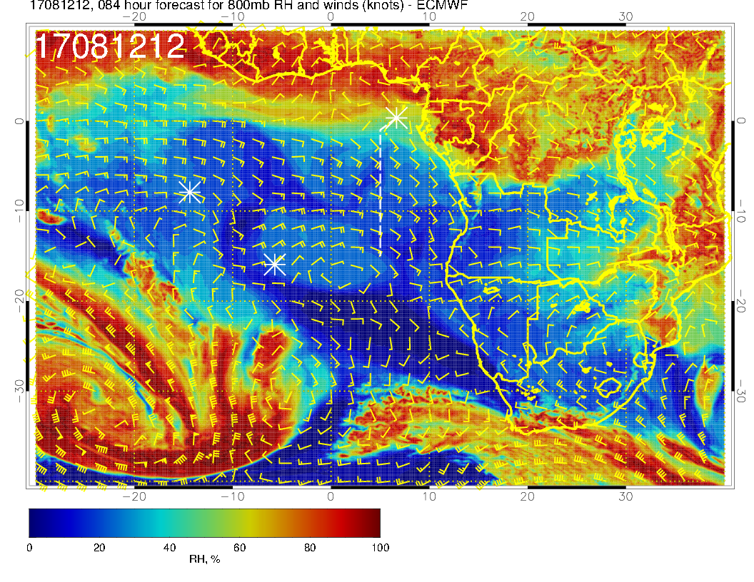
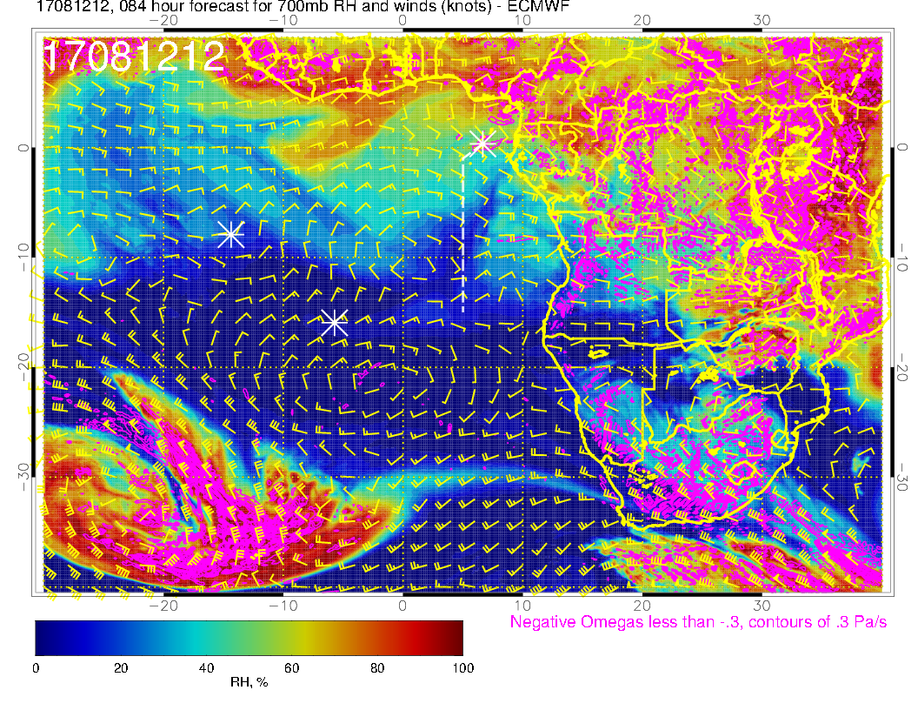
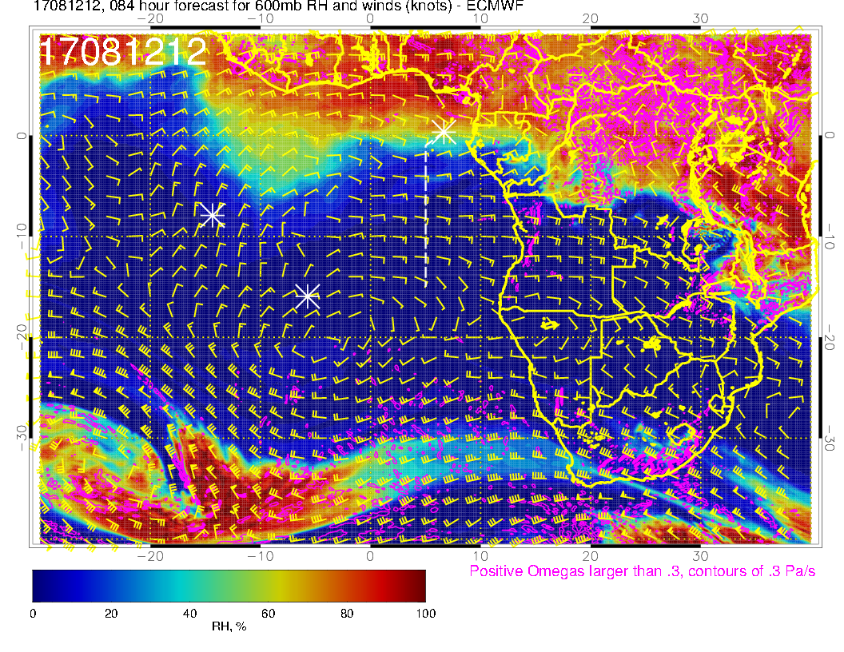
800 mb
700 mb
Mid levels are unusually dry, moisture is at Sao Tome and northward.
600 mb

Slide 29
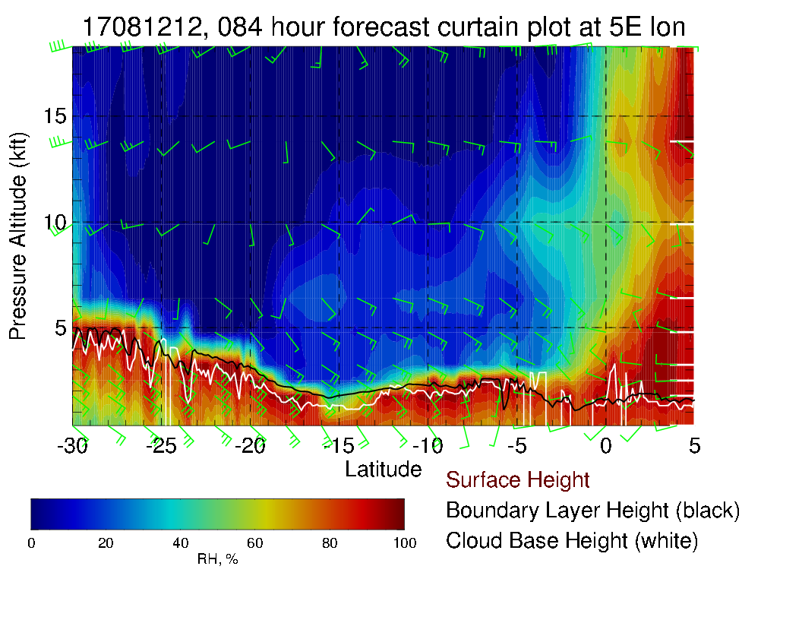
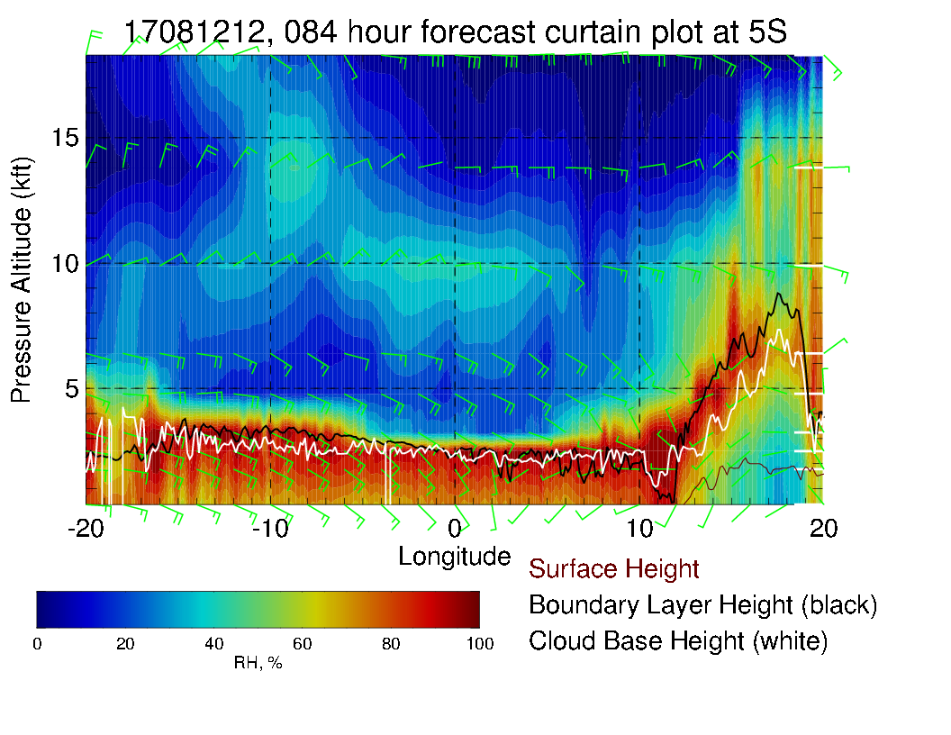
N/S (above) and E/W (right) cross sections. Cloud top heights about .8 km near extensive low cloud band at 5-10 S, very low (< 500m) near 15S.

Slide 30
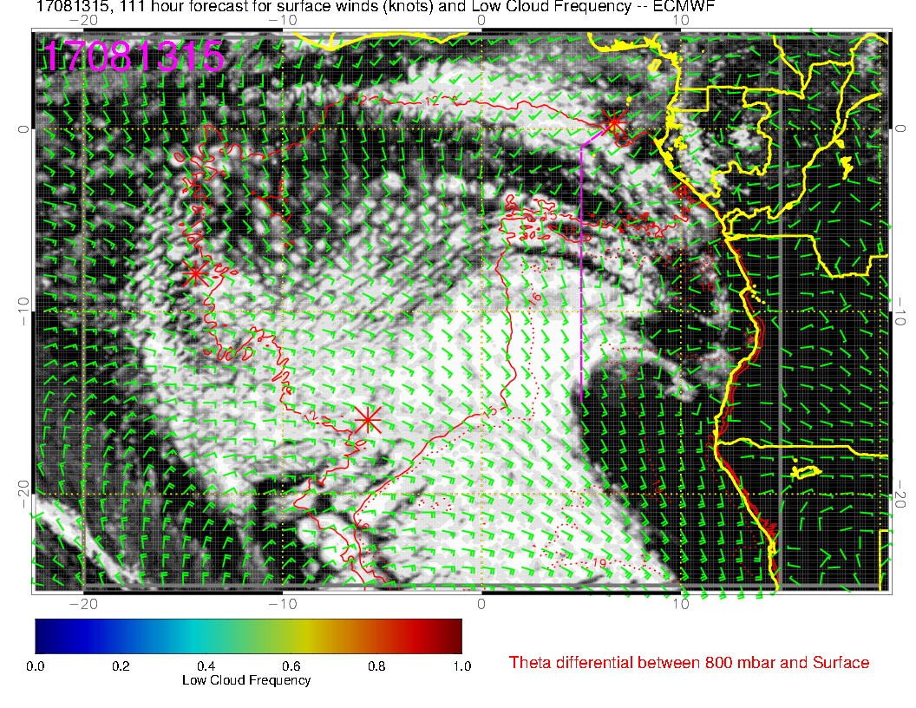
SATURDAY
This far out, can say that we should have ample low cloud south of us if we don’t go too far east. Both days are similar
SUNDAY
T

Slide 31
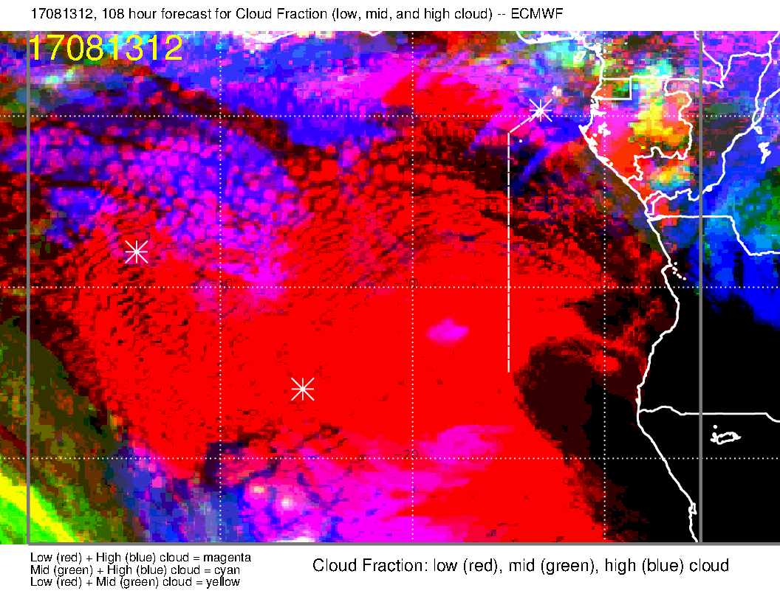
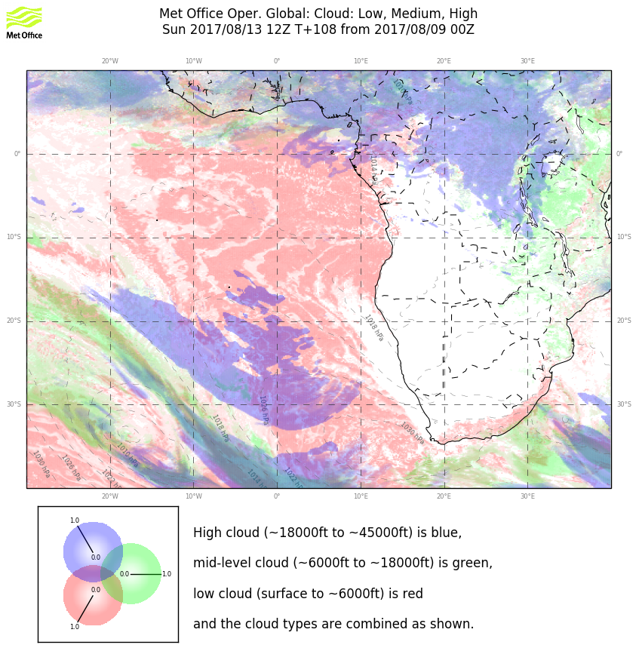
We see some high cloud near TMS, and this may be an issue, but not over low cloud band.

Slide 32
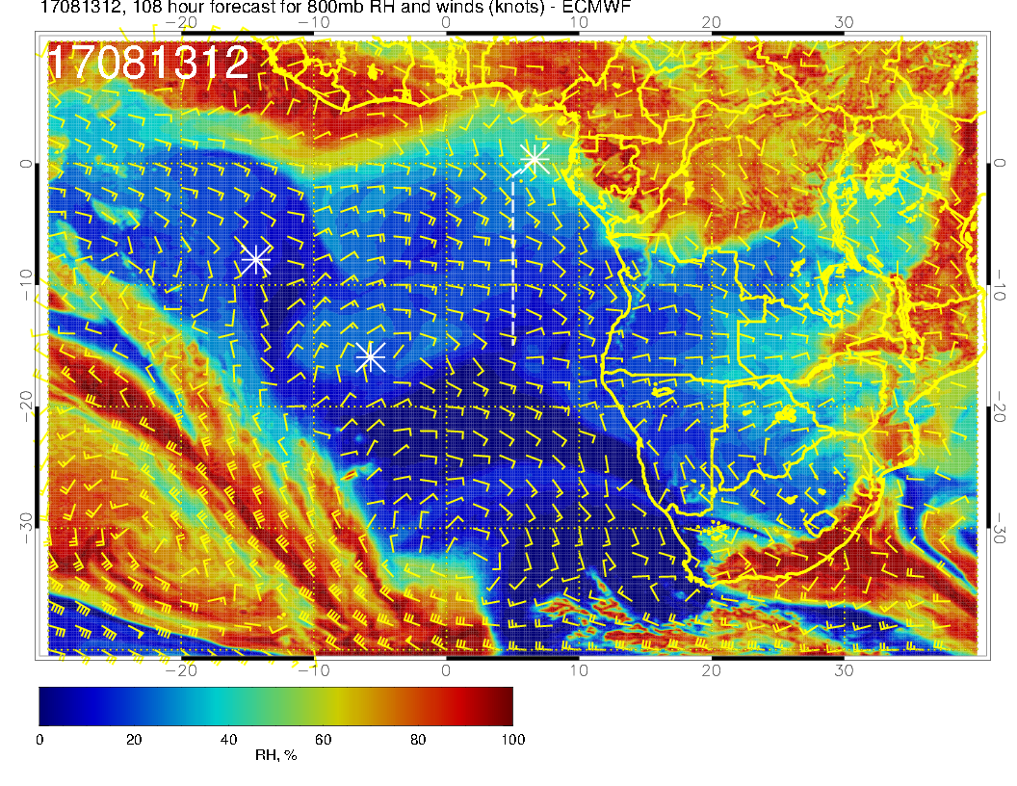
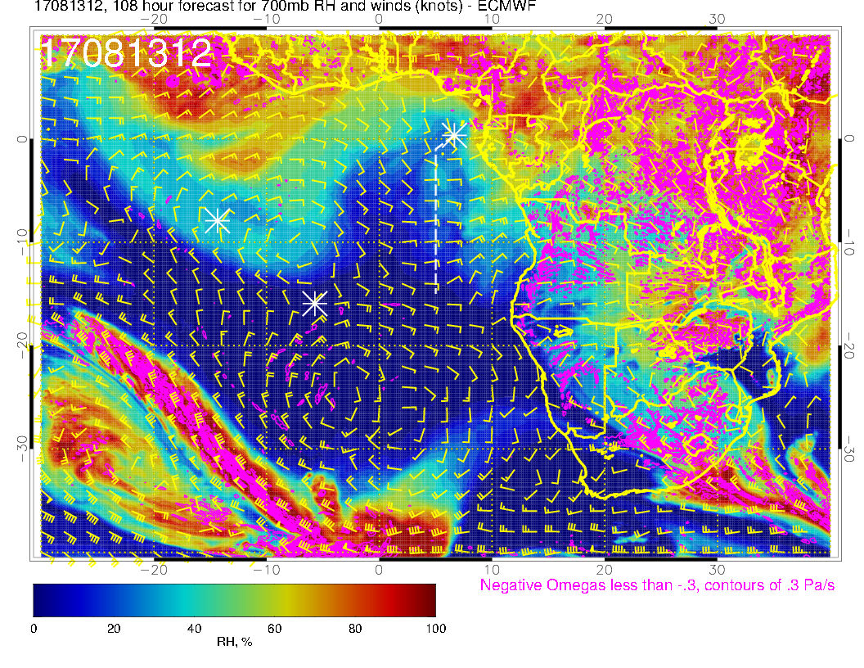
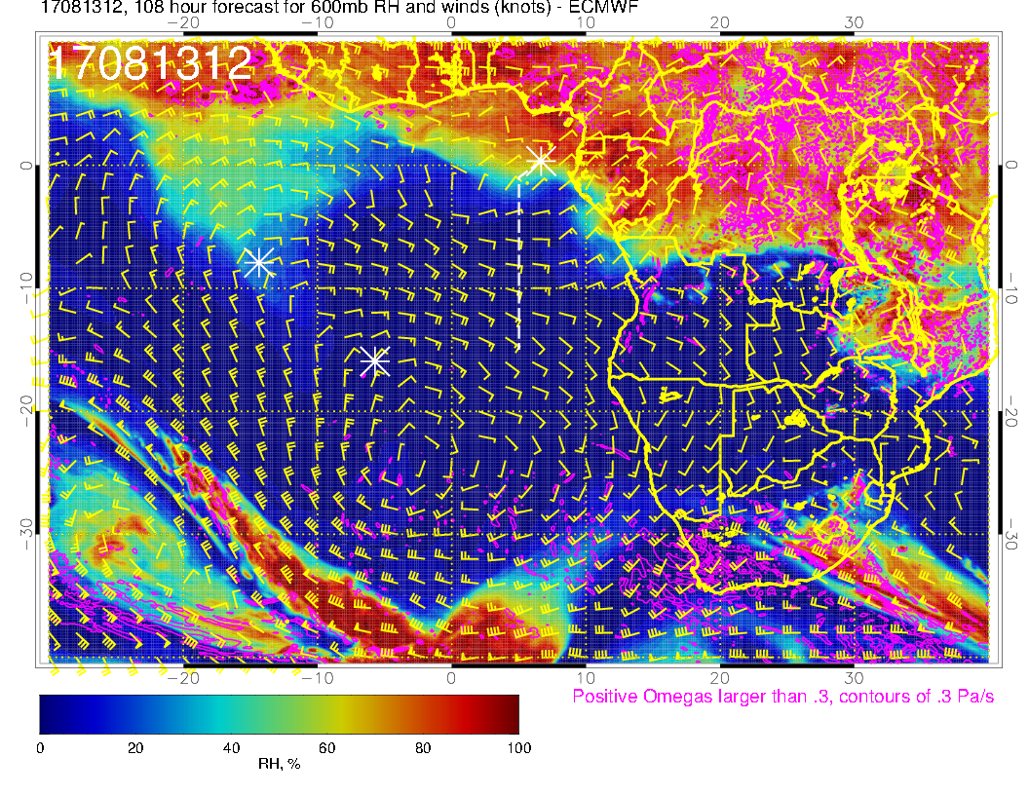
800 mb
700 mb
Similarly quite dry at midlevels
600 mb

Slide 33
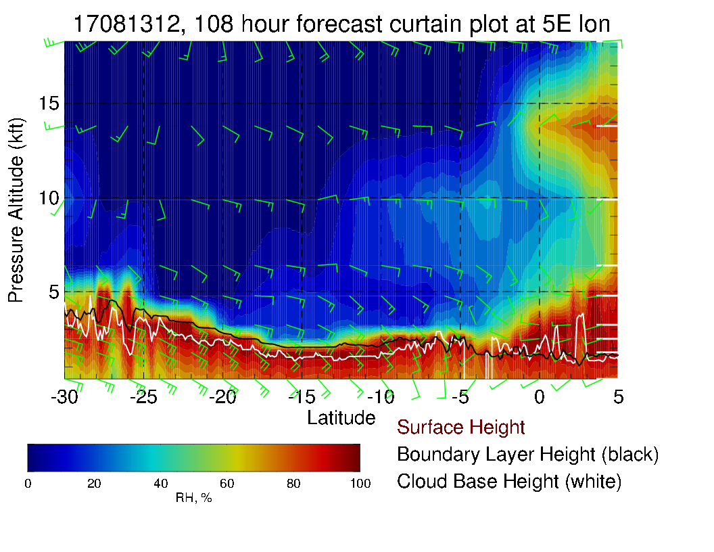
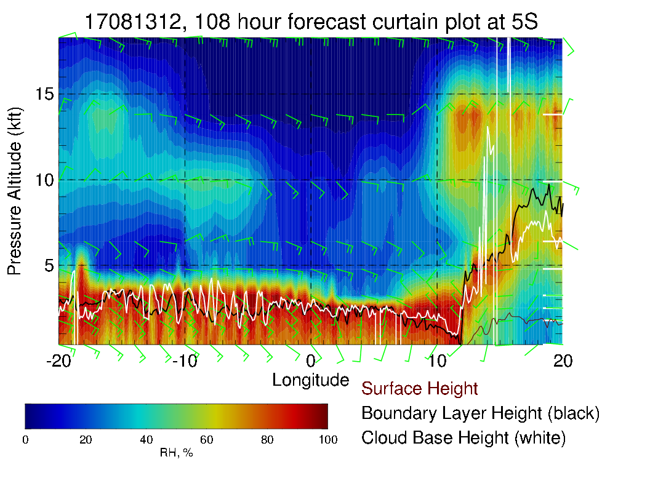
N/S (above) and E/W (right) cross sections. Cloud top heights about .8 km near extensive low cloud band at 5-10 S, somewhat lower (not as low as August 12) between 10 and 15S.

Slide 34
Summary
Routine flight: Friday 8/11
Condition at TMS: SW 10-15 knot winds, temperature varies little day by day
Low clouds throughout most of the flight, few smaller StratCu cells south of ~11S
Mid and high clouds over TMS (mostly to the north)
Some high clouds may appear along the flight track north of ~5S
Plume transport from dry convection at ~10 kft at southernmost point of the flight track

Slide 35
Summary
Target-of-opportunity flight: Sat 8/12, Sun 8/13
Low clouds expected to be more extensive on both days than today and tomorrow, due to increased BL heights and stronger regional surface winds.
Mid levels are drier than typical.
Expect that high and middle cloud cover will NOT be a problem, except near TMS (a bit more on Sunday).
In region of cloud gradient just south of TMS, winds will actually be weak and westerly, not typical.
Weaker than typical winds expected at TMS (westerly component). I have to say that I am still not sure how this translates to local winds. If we have weak westerlies and limited cloud cover, it could heat up faster in the morning.

Slide 36
Happy Birthday, Lenny!

Slide 37
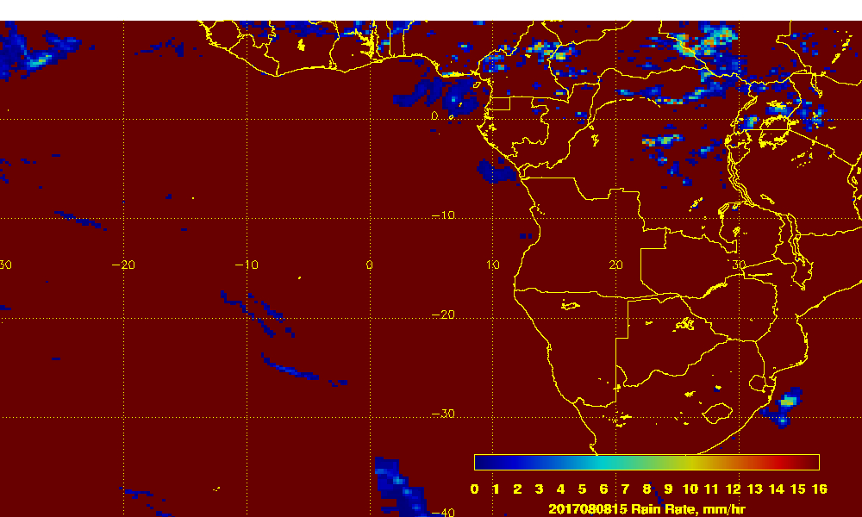
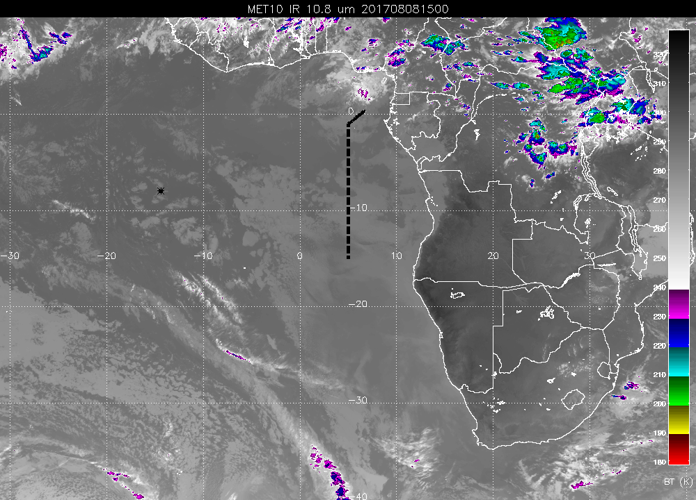

Slide 38
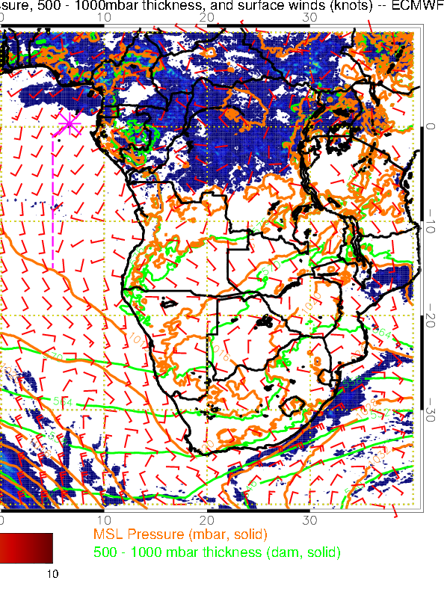
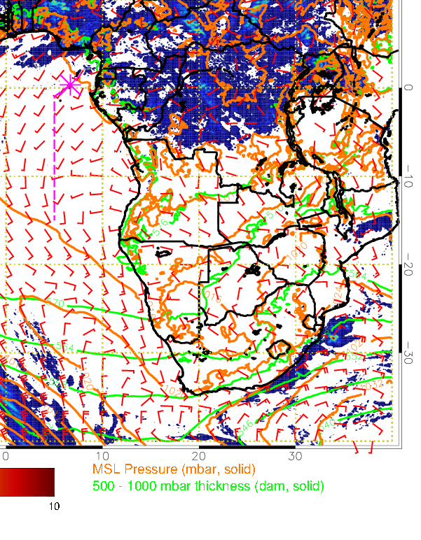
27 hour fcst
51 hour fcst

Slide 39
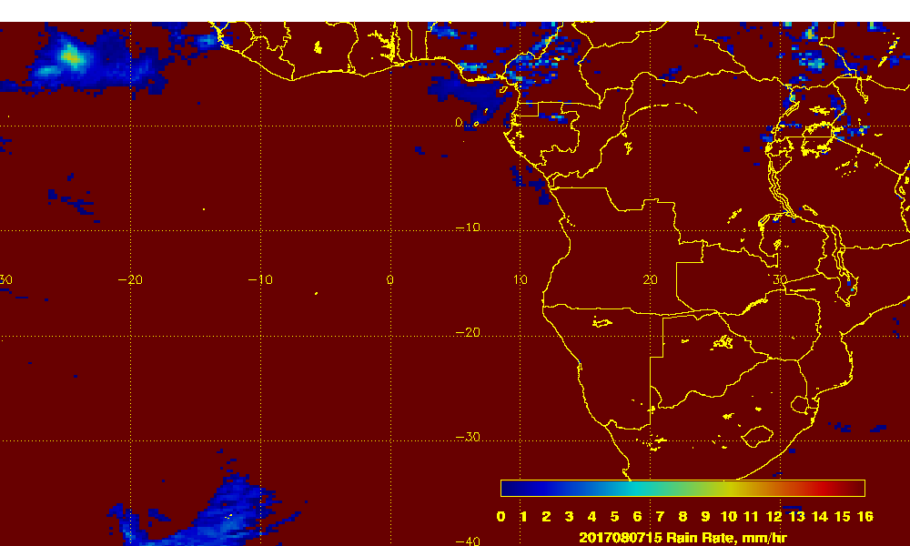
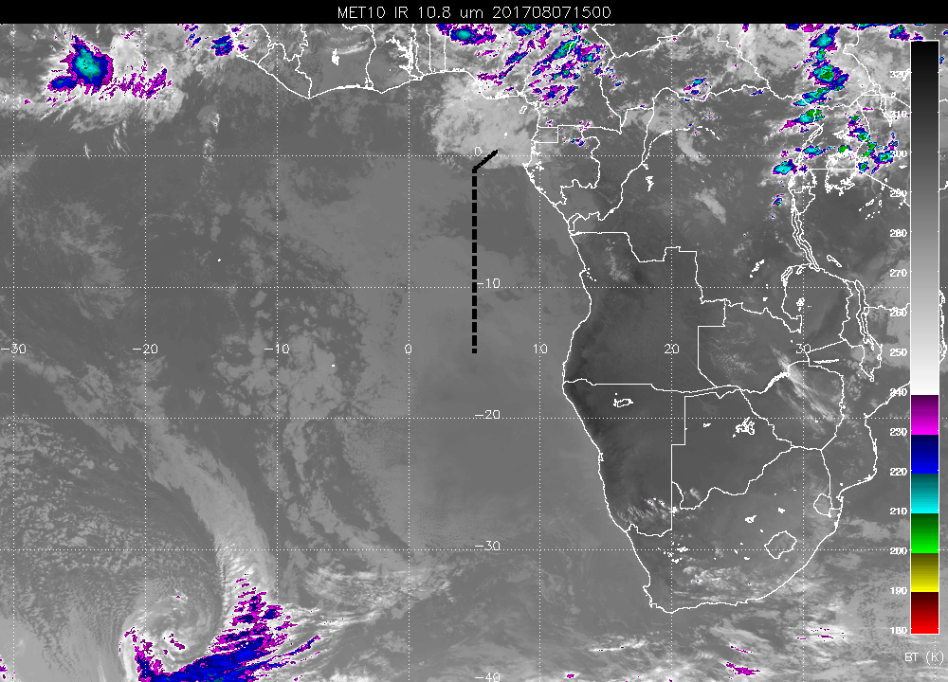
Precip on August 7 at 15Z.

Slide 40
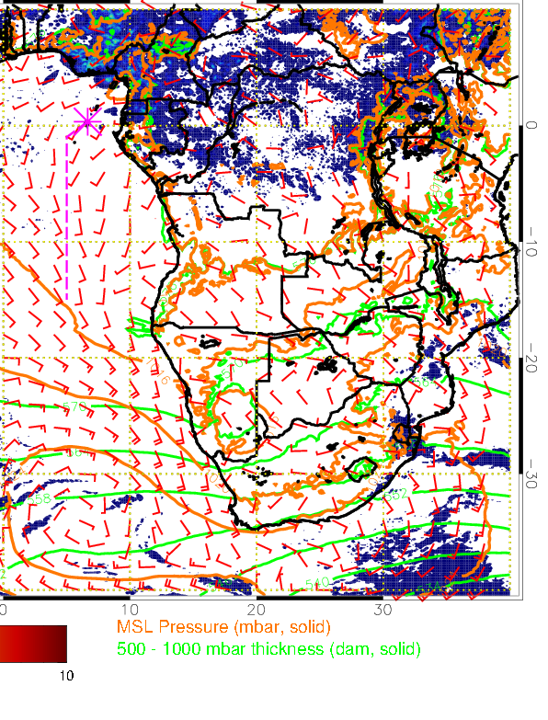
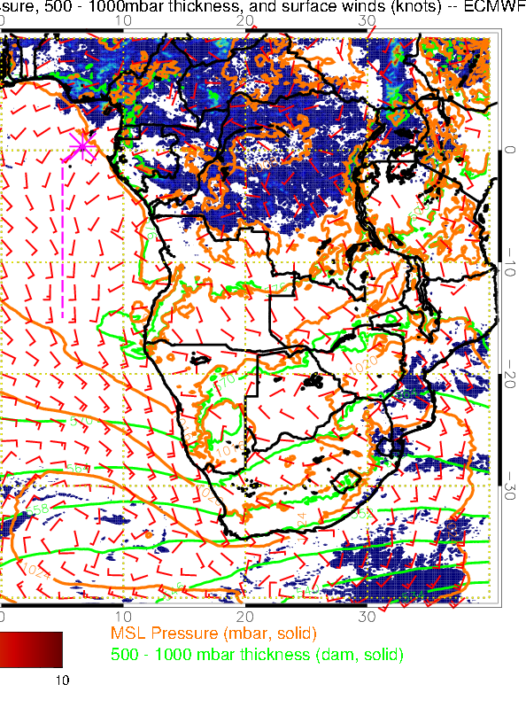
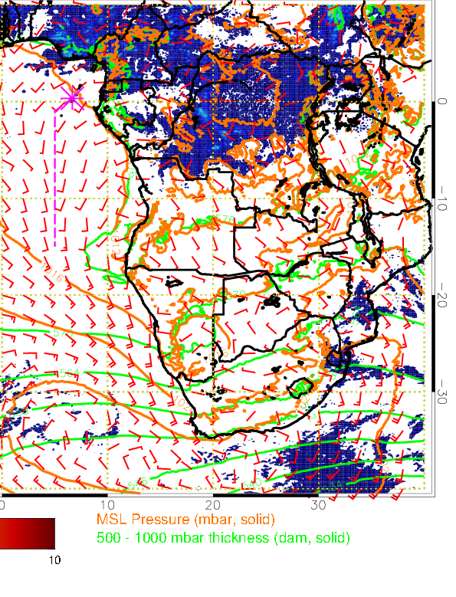
27 hour fcst
51 hour fcst
75 hour fcst

