Slide 1
ORACLES weather briefing
9-Aug-2017
Lenny Pfister and Rei Ueyama

Slide 2
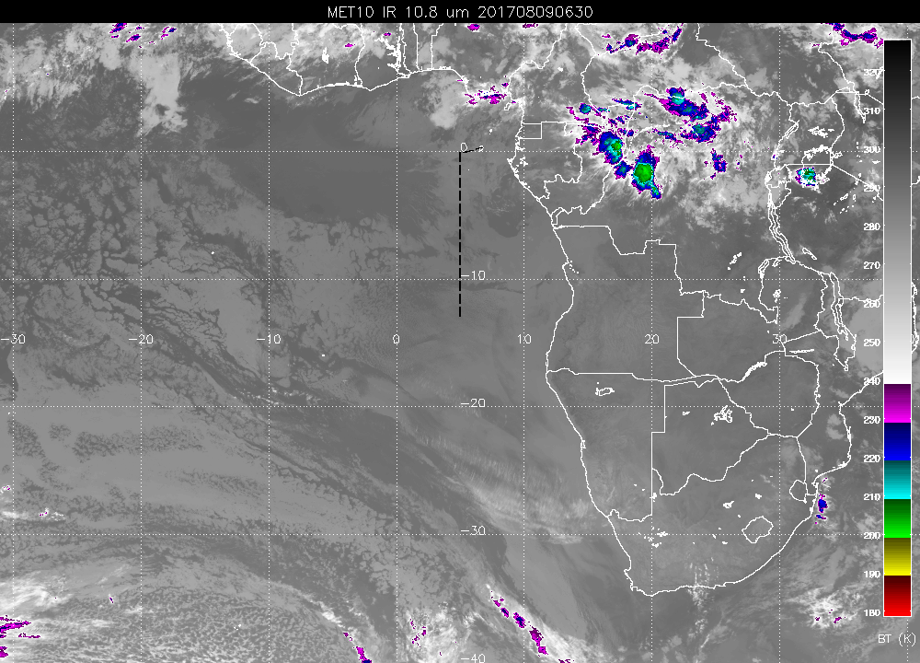
Some high cloud from yesterday’s Gabon convection, very thin. Expect it to dissipate or not reach flight track
Cloud clearing forecast in this general area by early afternoon. Judging by history of forecasts, expect scattered to broken clouds to remain by the time we get to prime meridian

Slide 3
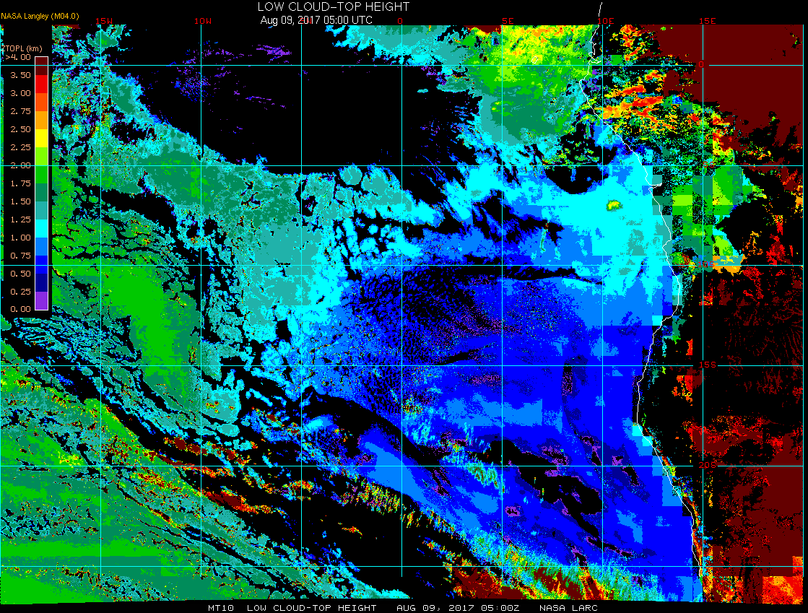
Low cloud top heights at 8/9 Wed @ 5AM
15W
10W
5W
0
5E
ASI
ESE 14 knot winds
Few clouds 2300 ft
Scattered clouds 5000 ft

Slide 4
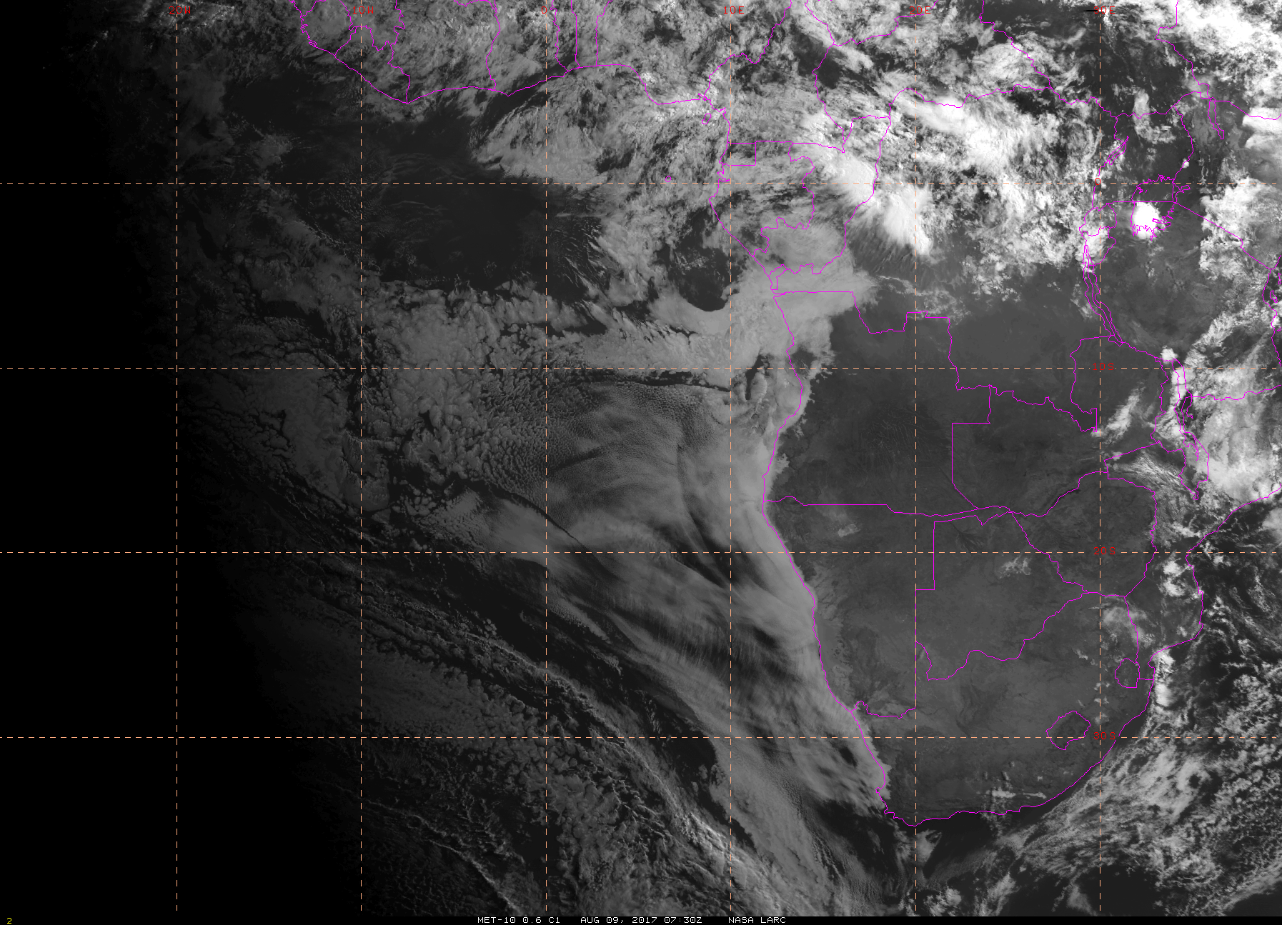
Visible satellite imager at 8/9 Wed @ 7:30AM
20W
10W
0
10E

Slide 5
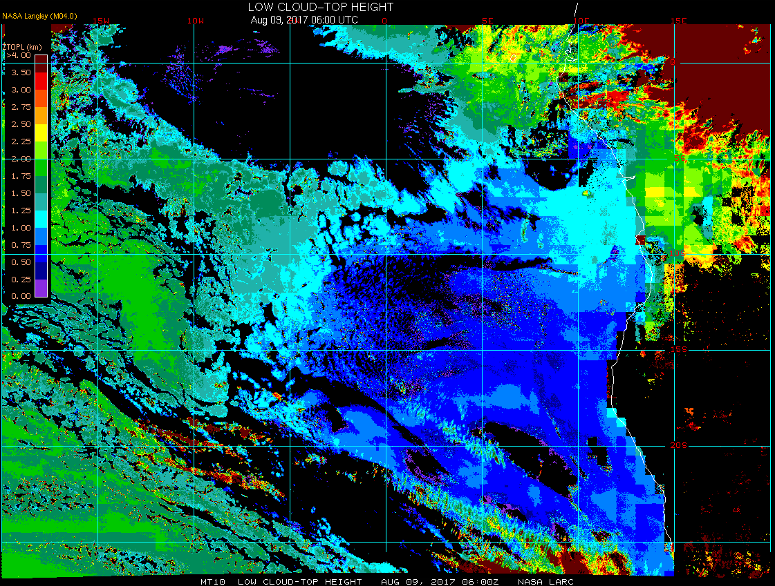
Low cloud top heights at 8/9 Wed @ 6AM
15W
10W
5W
0
5E
Some high cloud from yesterday’s Gabon convection, very thin. Expect it to dissipate or not reach flight track.
Cloud clearing forecast along 8S by early afternoon. Judging by history of forecasts, expect scattered to broken clouds to remain by the time we get to prime meridian.
ASI
ESE 13 knot winds
Few clouds 2300 ft

Slide 6
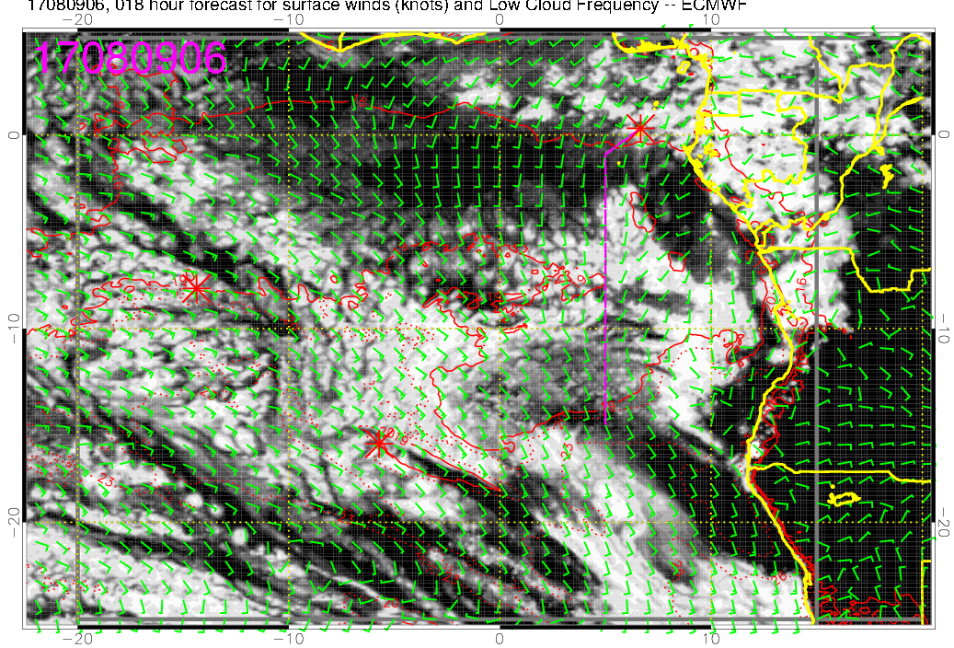
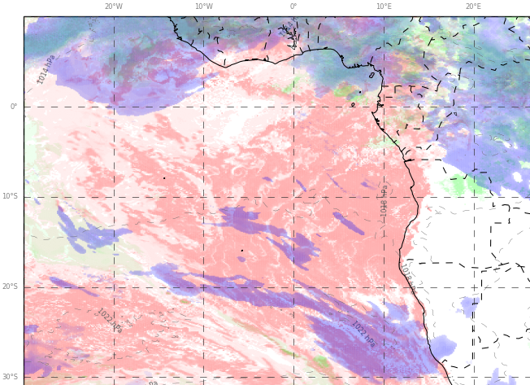
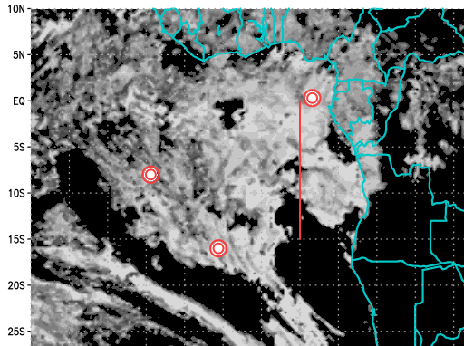
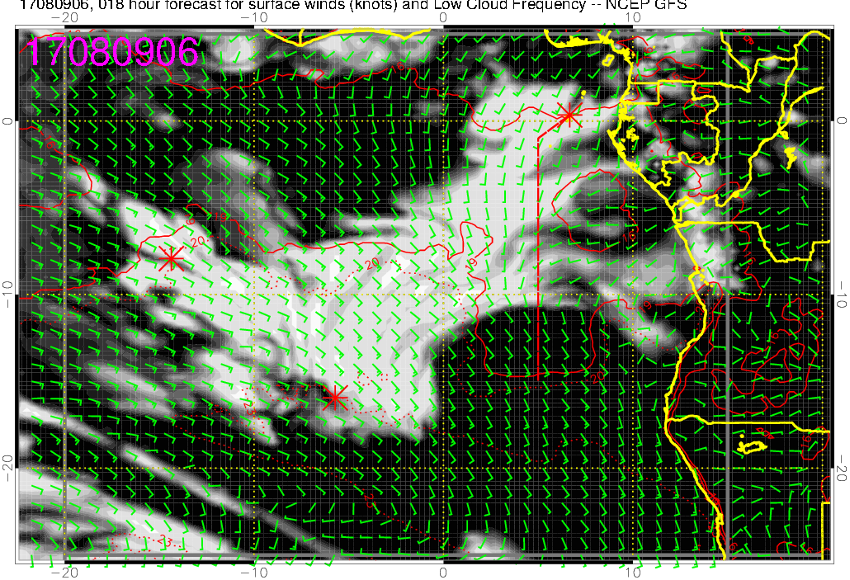
Low cloud forecast for 8/9 Wed @ 6AM
ECMWF
UKMO
GMAO
GFS

Slide 7
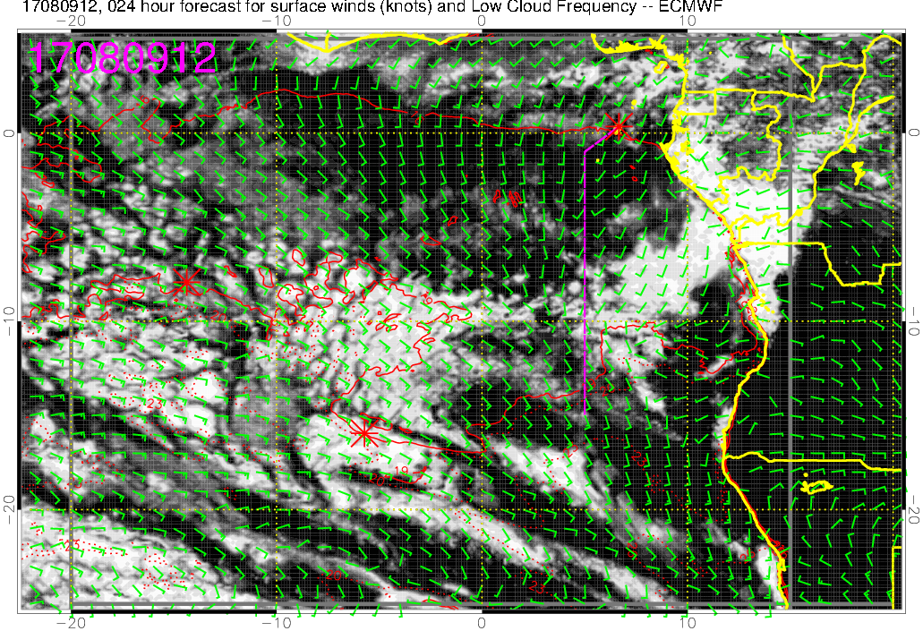
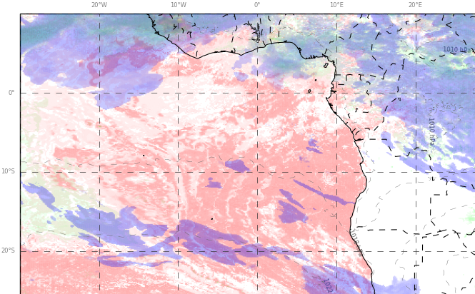
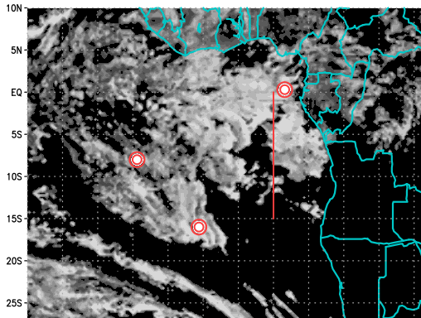
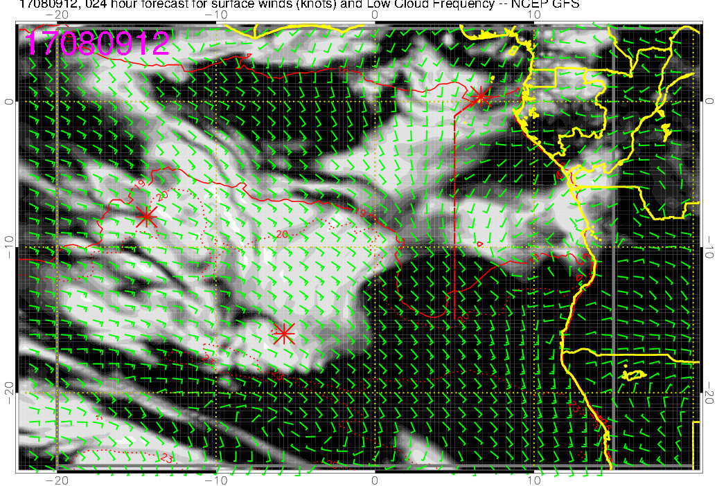
Low cloud forecast for 8/9 Wed @ 12PM
ECMWF
UKMO
GMAO
GFS

Slide 8
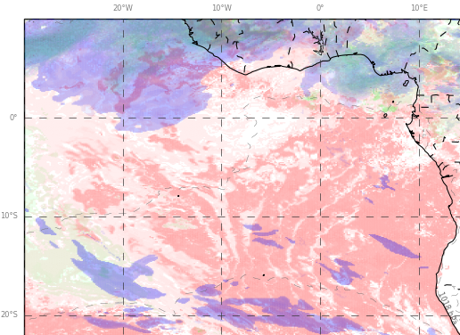
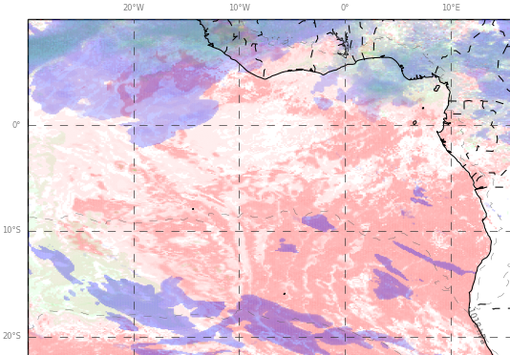
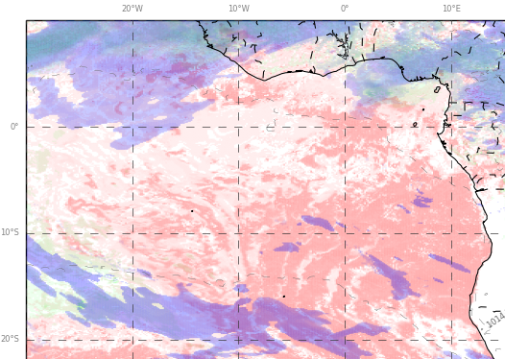
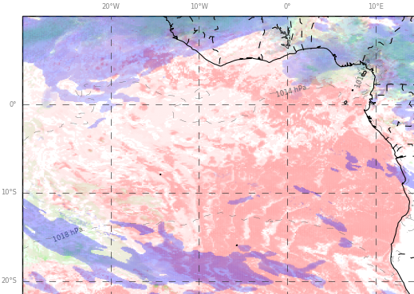
UKMO low, mid, high cloud forecasts for 8/9 Wed @ 9AM - 6PM
9AM
12PM
3PM
6PM

Slide 9
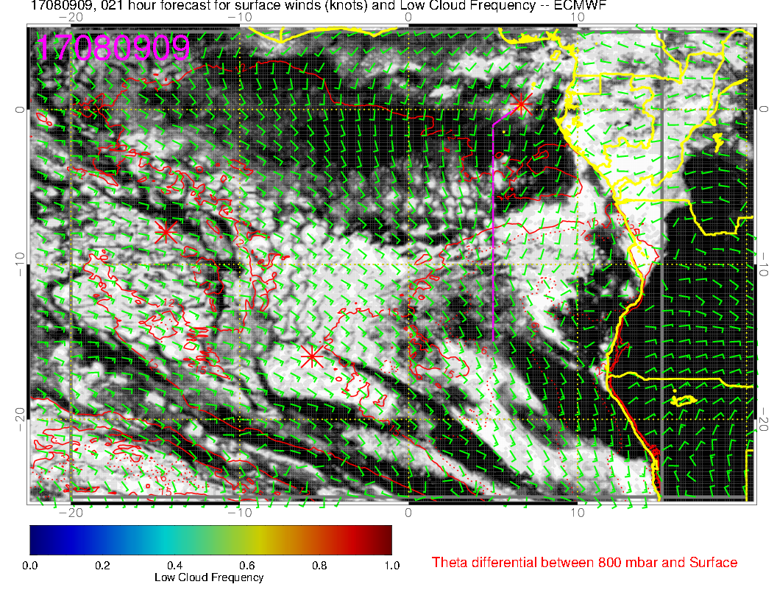
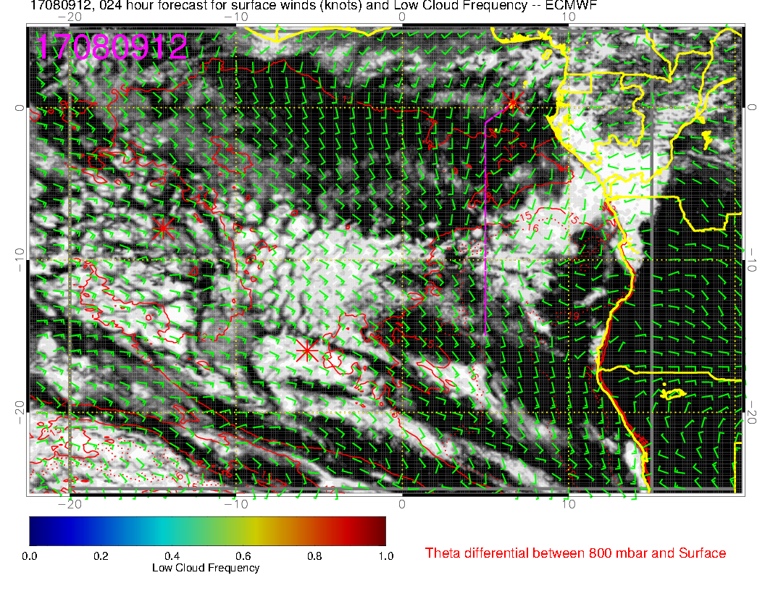
Cloud clearing starts at 9. “Boundary” exists, but placement uncertain (current satpic has it north of track)

Slide 10
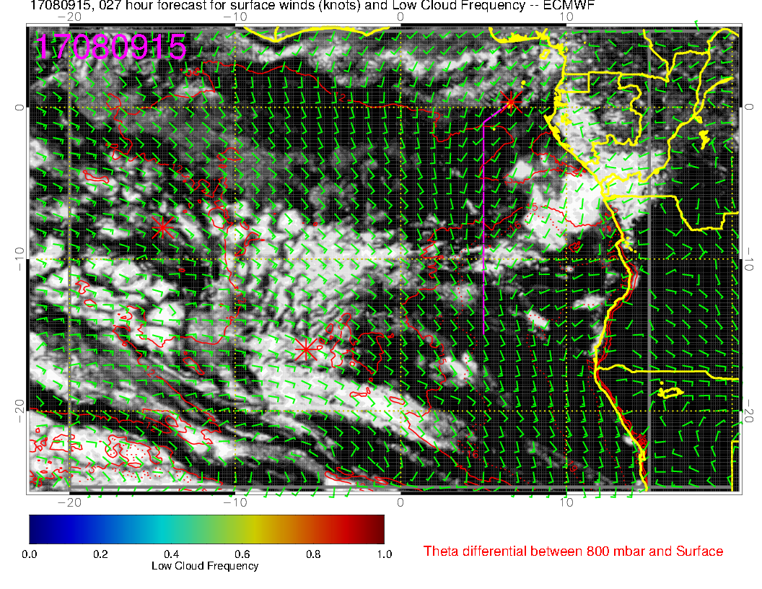
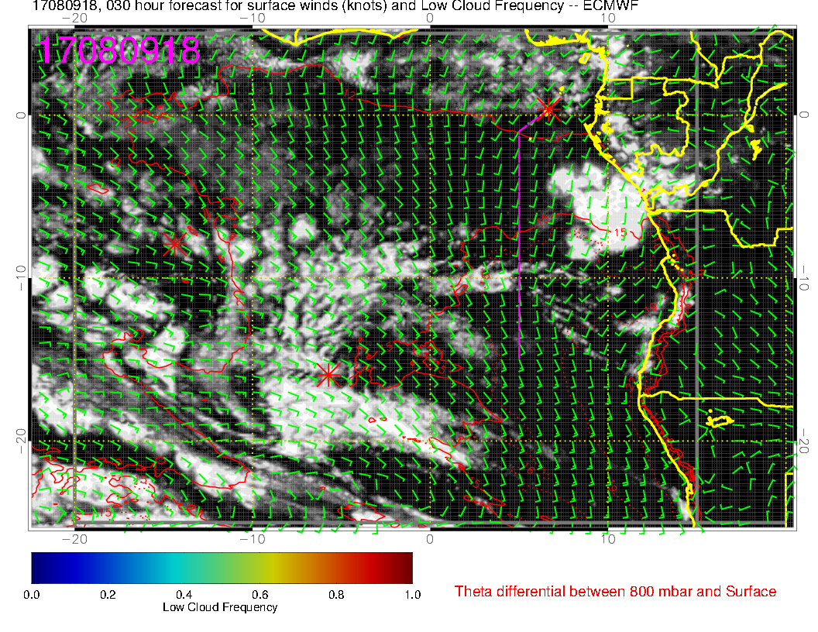
Based on this forecast we should have cloud sampling opportunities at least to the prime meridian

Slide 11
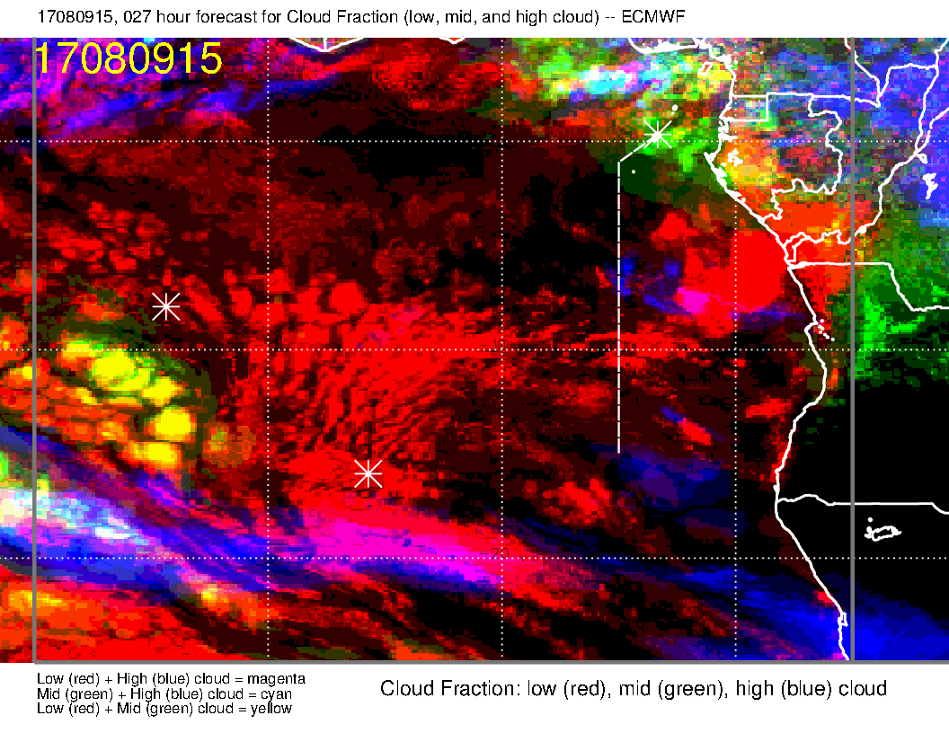
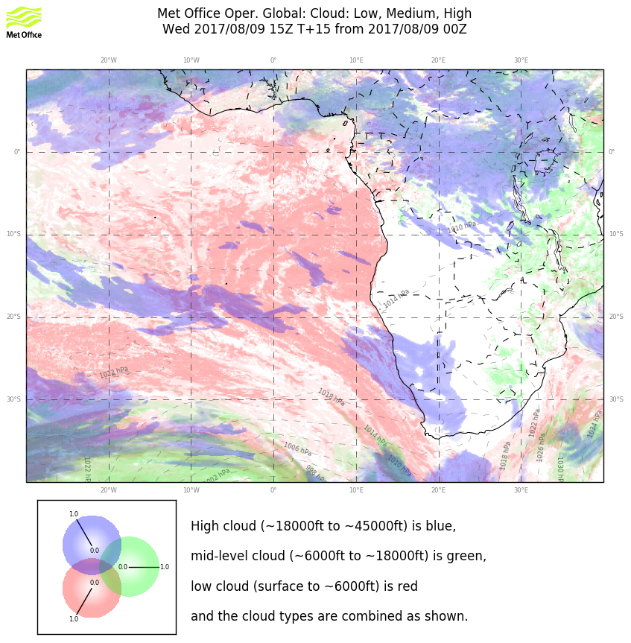
No evidence of high cloud on this morning’s image (also forecast for this morning by UKMO.
EC middle cloud (minimal in any case) is overdone based on dissipating middle/high cloud this morning.

Slide 12
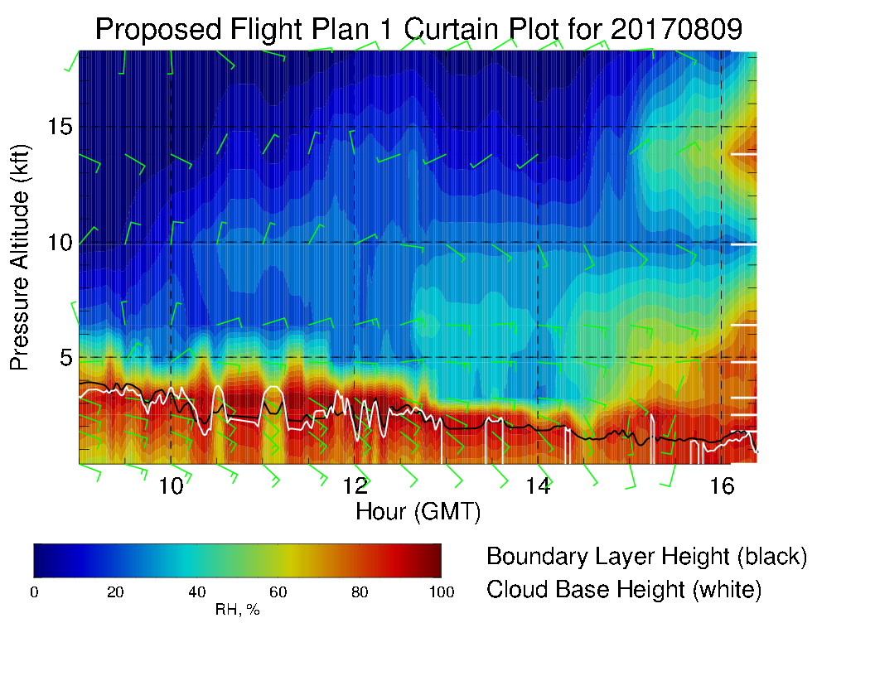
Cloud top heights start a bit above 1 km (consistent with obs), going below 1 km in middle of flight. Expect more cloud than forecast in middle of flight (too much cloud clearing)

Slide 13
TAF at ASI and TMS today (8/9)
ASI, takeoff ~10am
SE winds, 12 knots
Few (to scattered) clouds at 2000 ft, scattered clouds at 4500 ft
TMS, landing ~5:30pm
S winds, 10 knots
Few clouds at 2000 ft, broken clouds at 4000 ft

Slide 14
Morning briefing for 20170809
Diurnal cloud “clearing” started around 0730 yesterday near Ascension, did not become “substantial” until noon. Fcsts for today do about the same thing.
Big “gap” apparent north of 6S in region between 10W and 4W
Expect this gap to expand, but LESS than EC model forecasts.
Cloud tops observed at 1-2 km near Ascension, decreasing to less than 1 km by prime meridian (model consistent with current obs).
High/middle cloud coverage over Sao Tome area is substantially less than yesterday morning.
Expect no middle/high cloud issues today except right near Sao Tome.
TAF is favorable – 10 knot south wind, 4kft ceiling.

Slide 15
Happy Birthday, Lenny!

