Slide 1
ORACLES Forecast Briefing (Aerosols)
09 August 2017
Morning

Slide 2
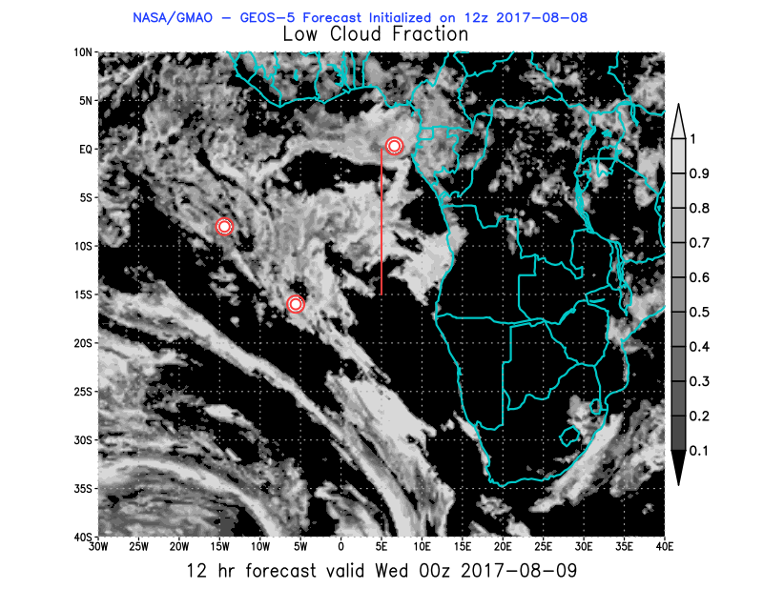
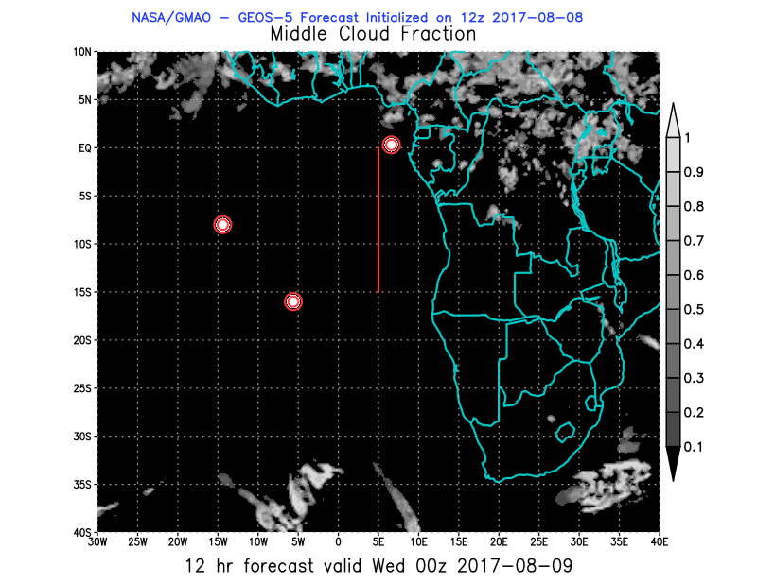
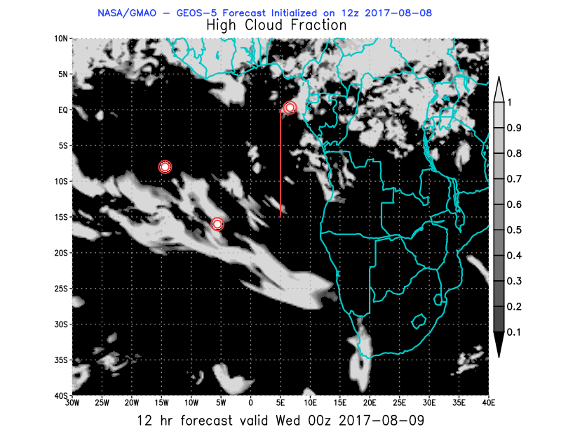
Wed

Slide 3
BC AOD 07-12/Aug

Slide 4
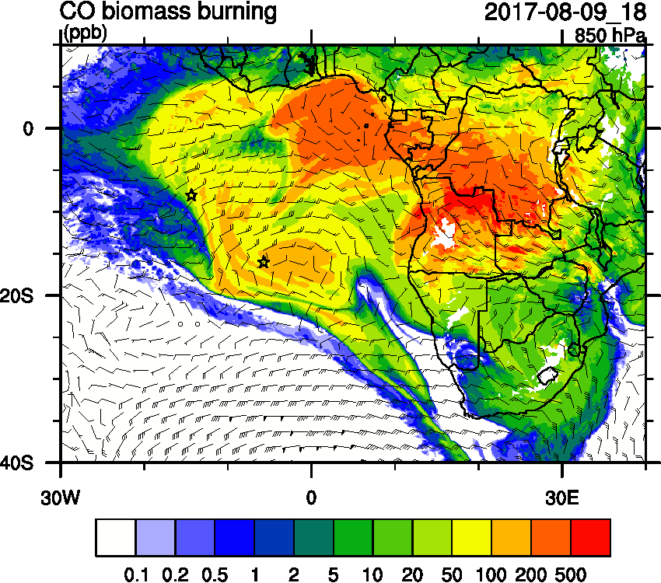
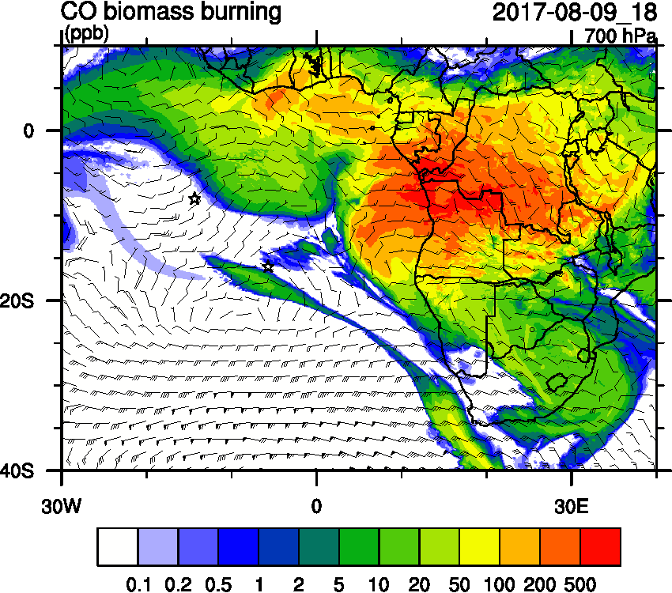
Wednesday Aug 9 12z

Slide 5
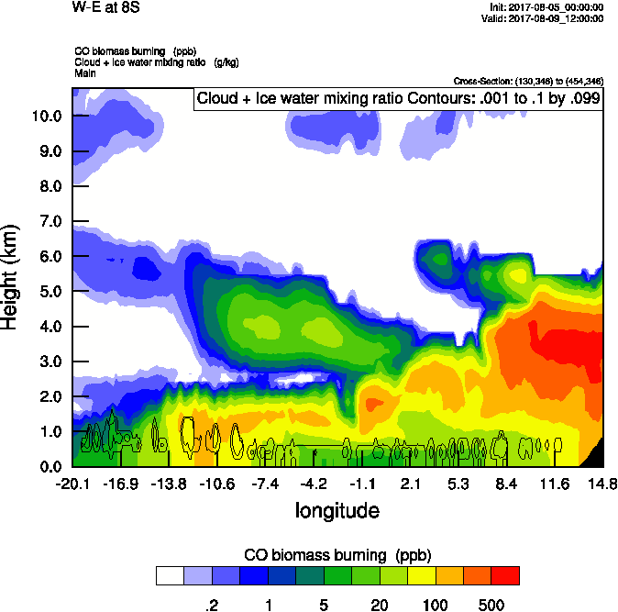
Wednesday Aug 9 12z

Slide 6
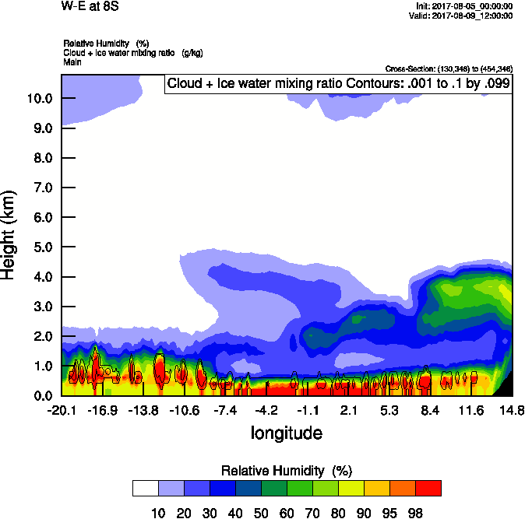
Wednesday Aug 9 12z

Slide 7
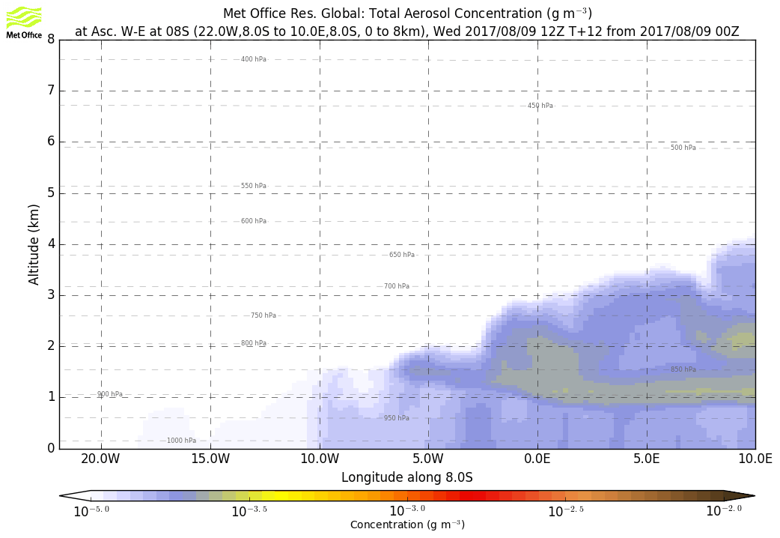
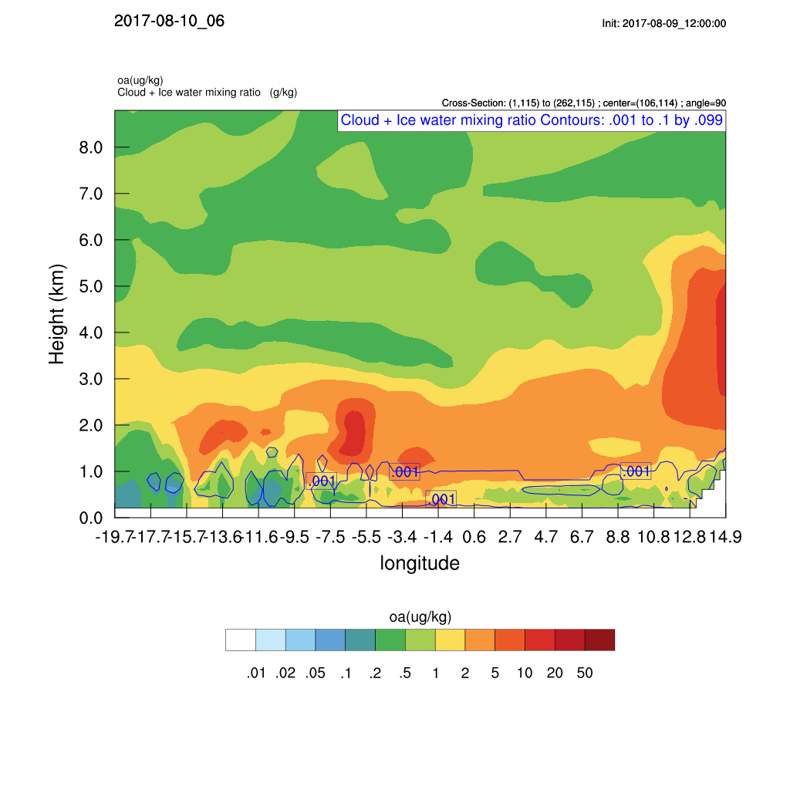
Wednesday Aug 9 12z

Slide 8
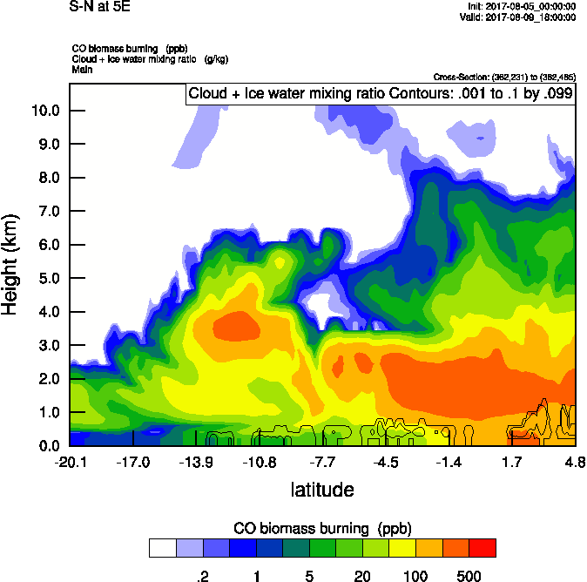
Wednesday Aug 9 12z
5W
5E

Slide 9
Ascension São Tomé e Príncipe

Slide 10
Wed Thu Fri

Slide 11
Wed

Slide 13
ORACLES Forecast Briefing (Aerosols)
09 August 2017
Afternoon

Slide 14
Updated forecast Wed 12 and 18 Z

Slide 15
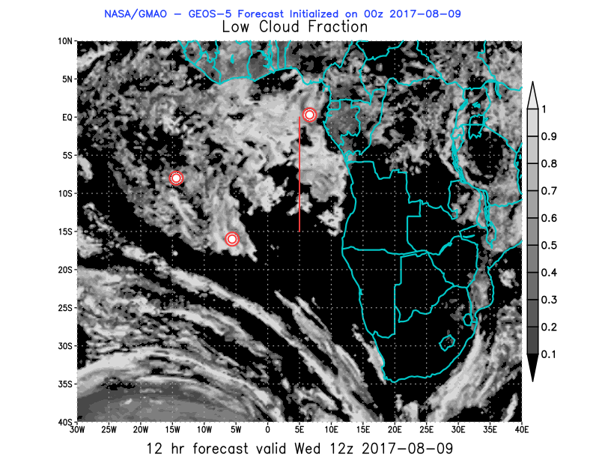
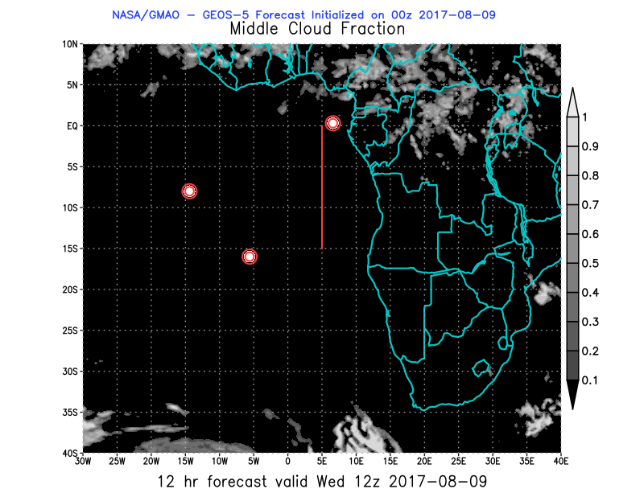
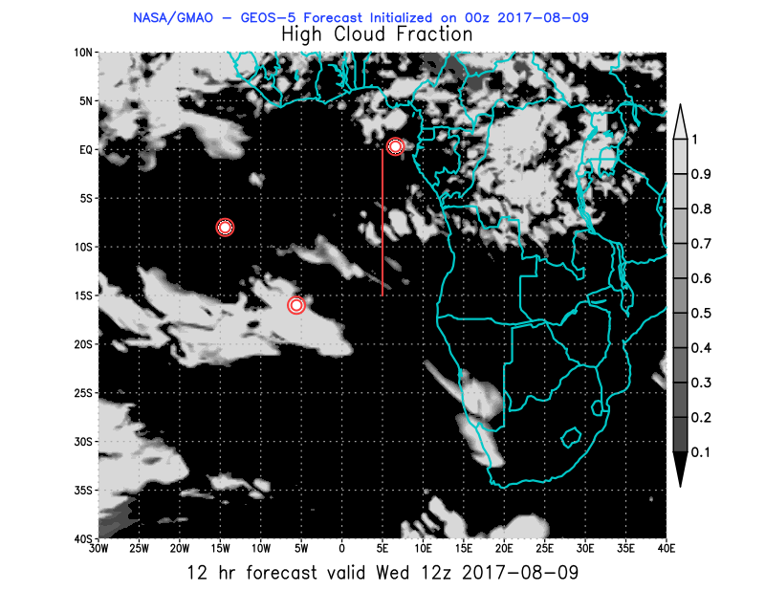
Wed – 12Z

Slide 16
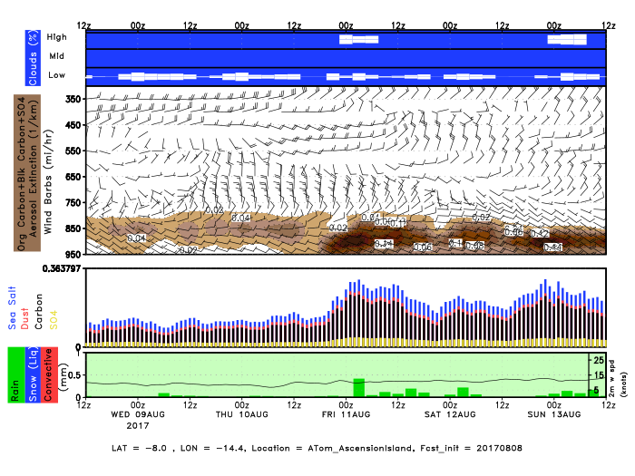
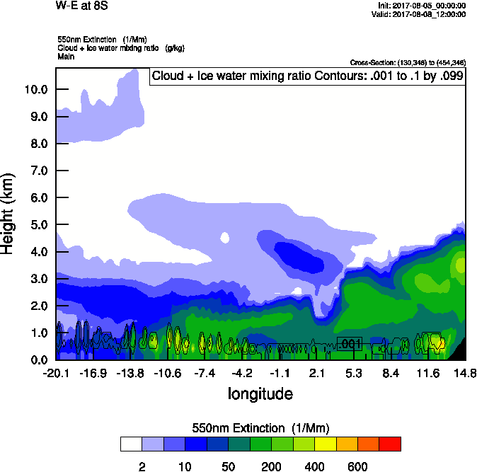
Ascension

Slide 20
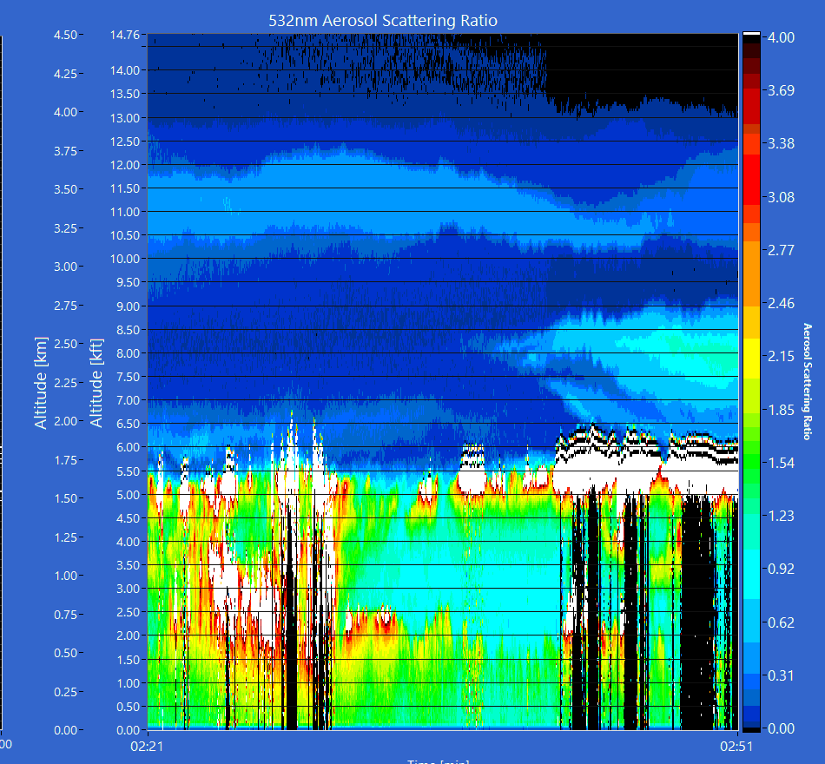
Wednesday Aug 9 12z

Slide 21
Thu Fri Sat

Slide 22
Sun Mon Tue

Slide 23
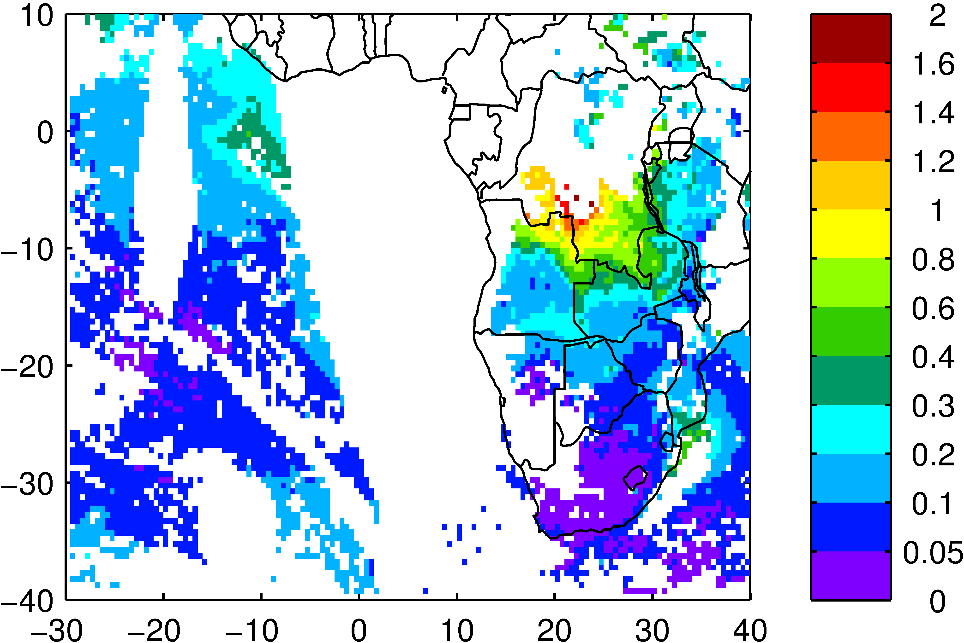
August 8 MODIS AOD
OBS Aqa/Terra
MOD Aqa/Terra

Slide 24
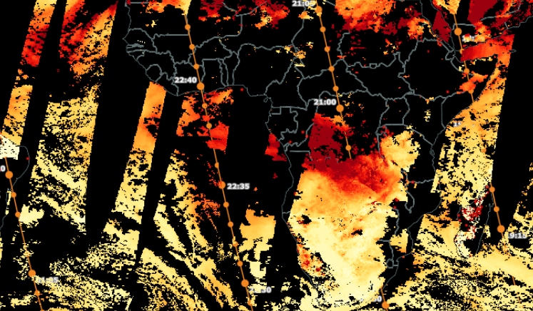
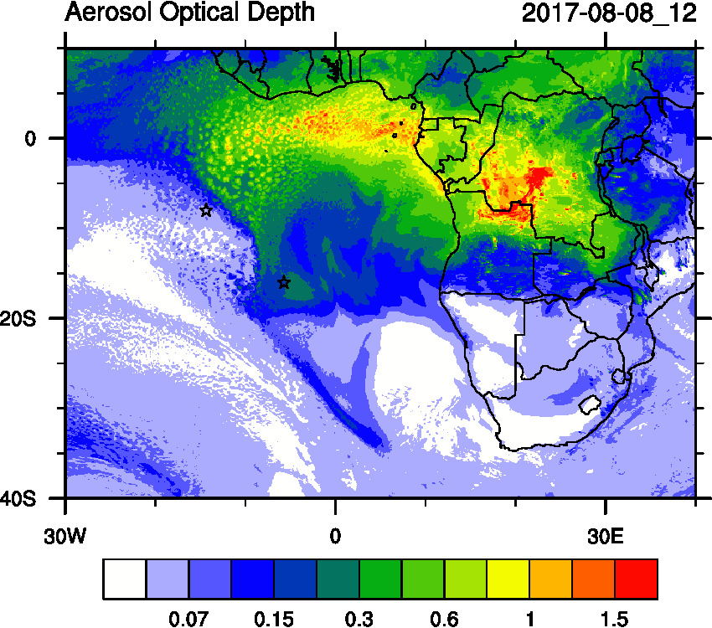
August 8 MODIS AOD

Slide 25
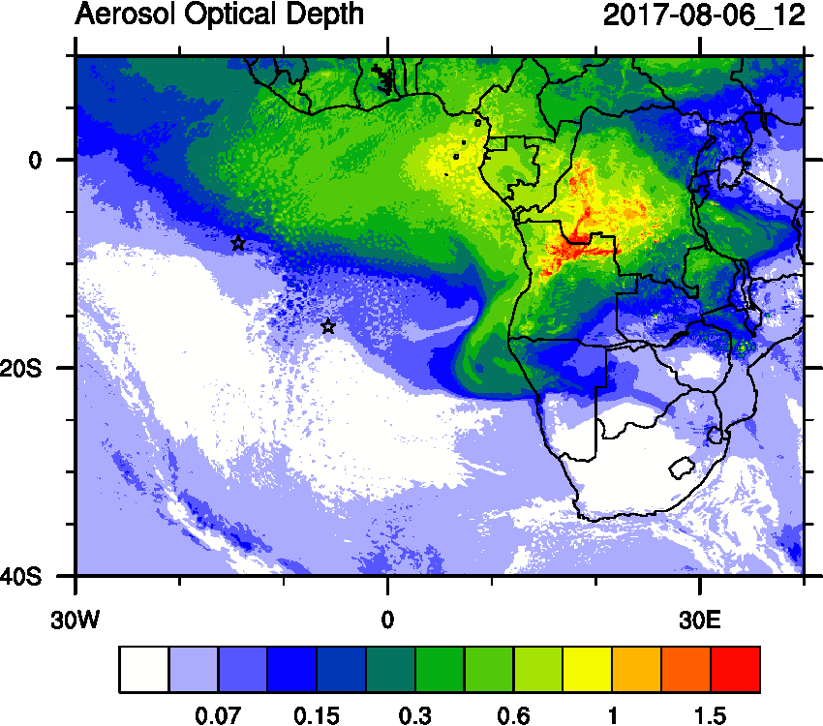
EPIC UV aerosol index

Slide 26
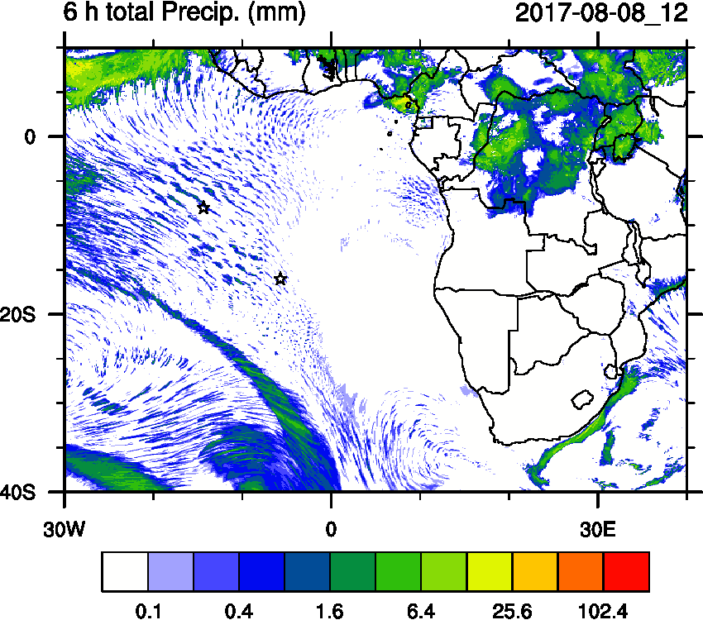
Precip Aug 9 (Obs 00z/ Mod 12z)

Slide 27
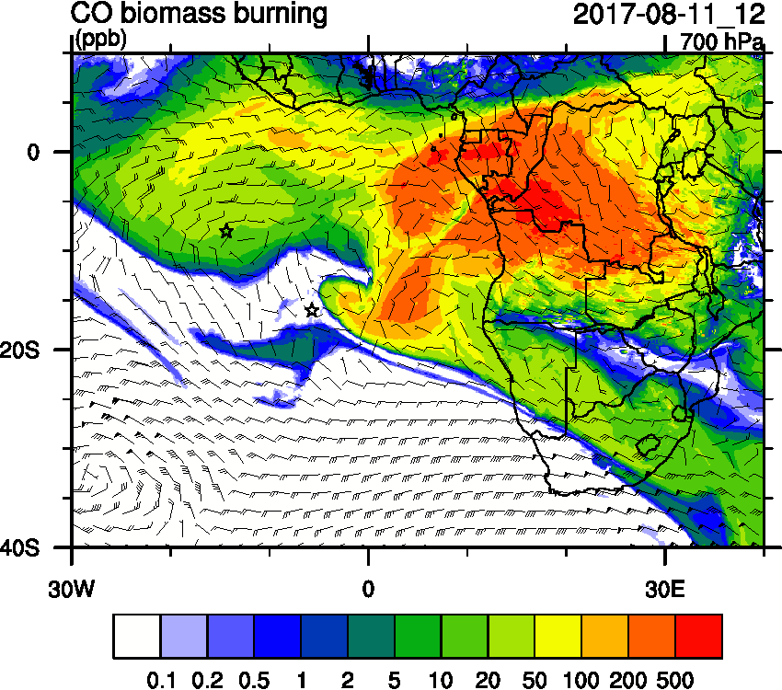
Friday Aug 11 (12z)

Slide 28
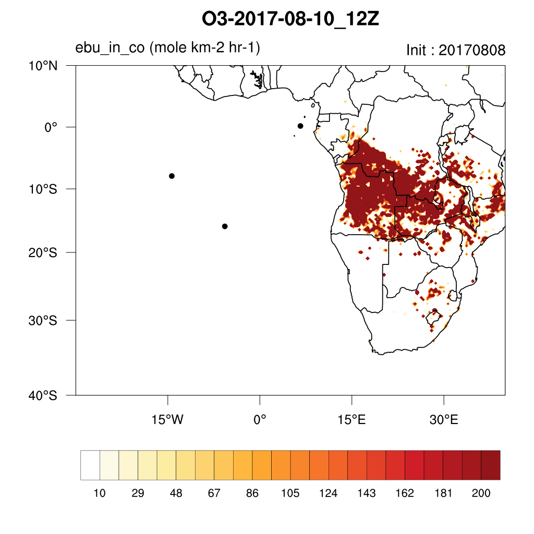
Friday Aug 11 (12z)

Slide 29
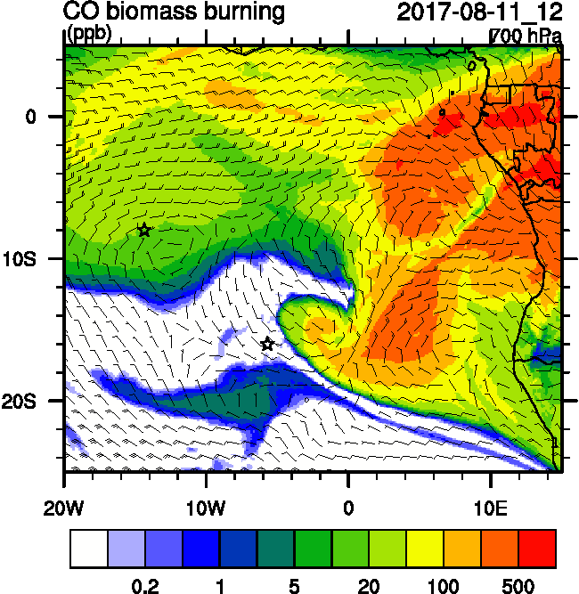
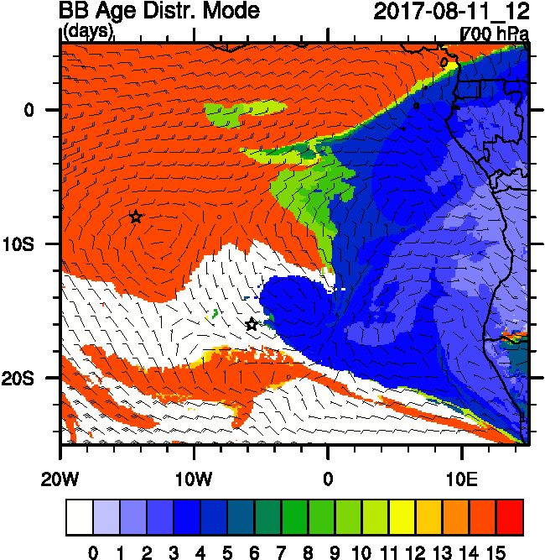
Friday Aug 11 (12z)

Slide 30
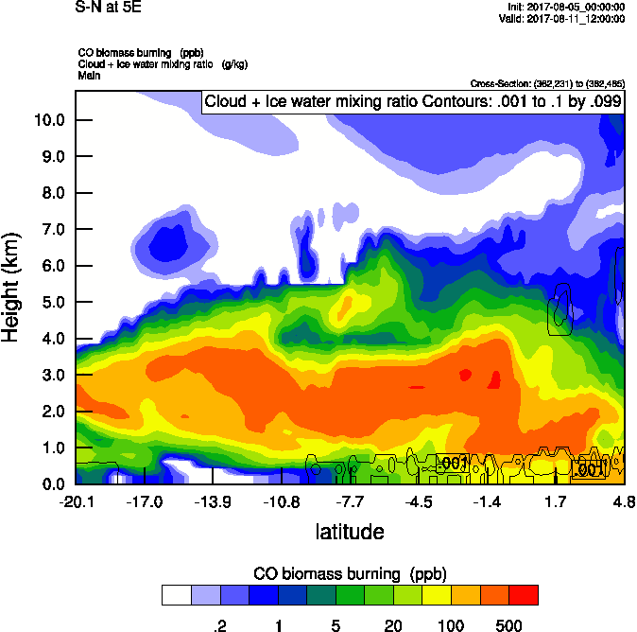
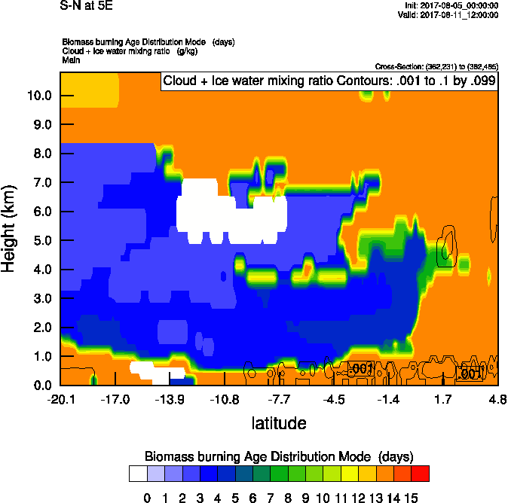
Friday Aug 11 (12z)

Slide 31
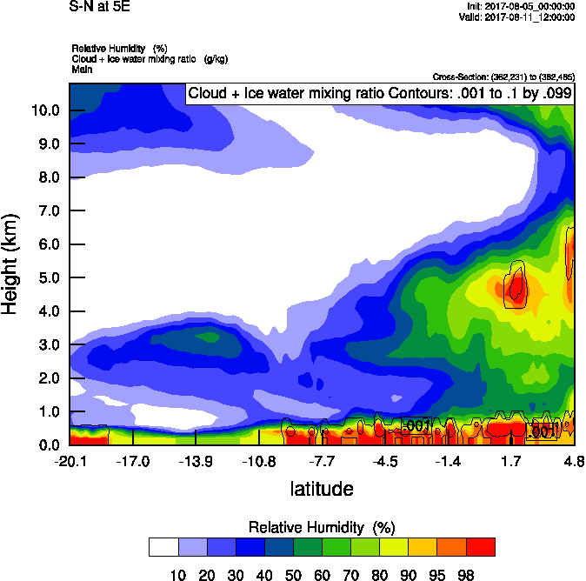
Friday Aug 11 (12z)
Saturday Aug 11 Flight Path Curtains

Slide 32
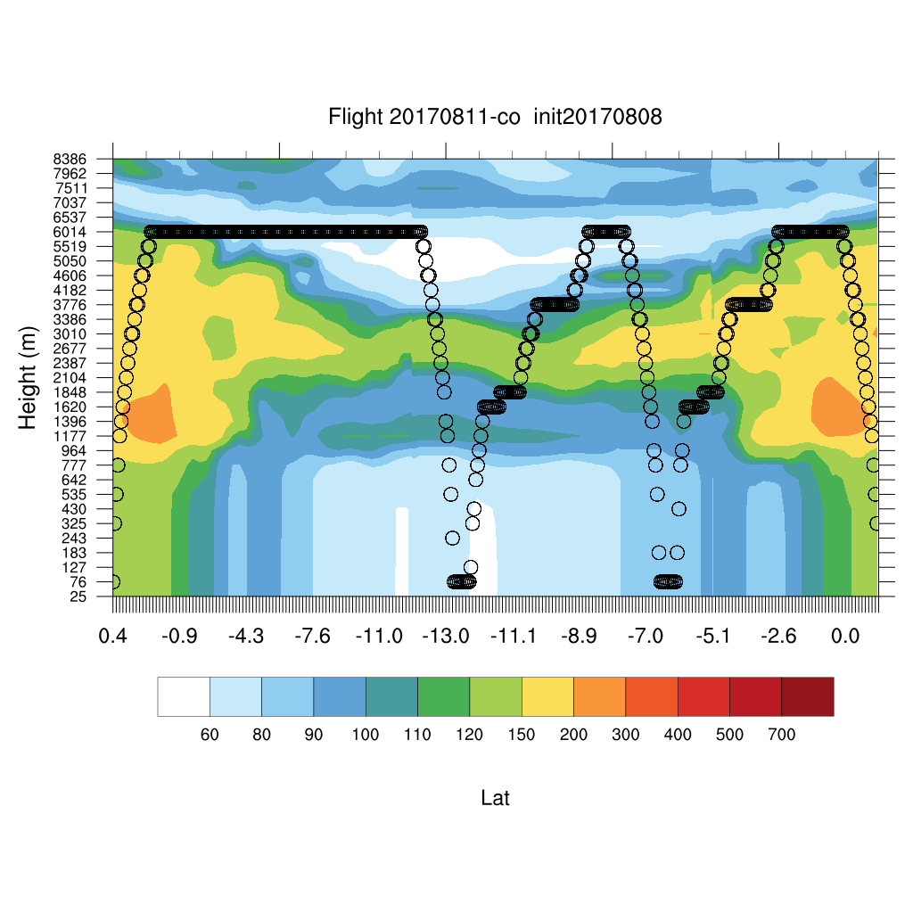
Friday Aug 11 Flight Path Curtains
7
3
1

Slide 33
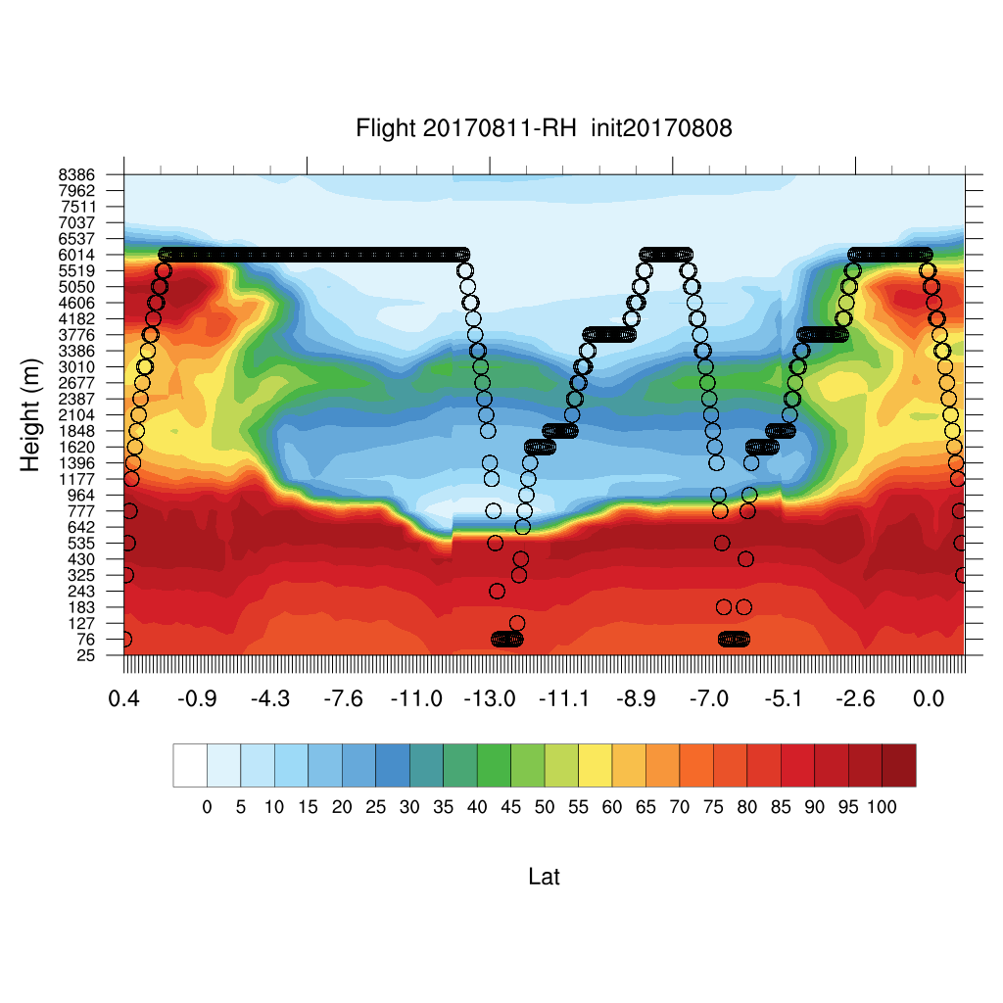
Friday Aug 11 Flight Path Curtains
7
3
1

Slide 34
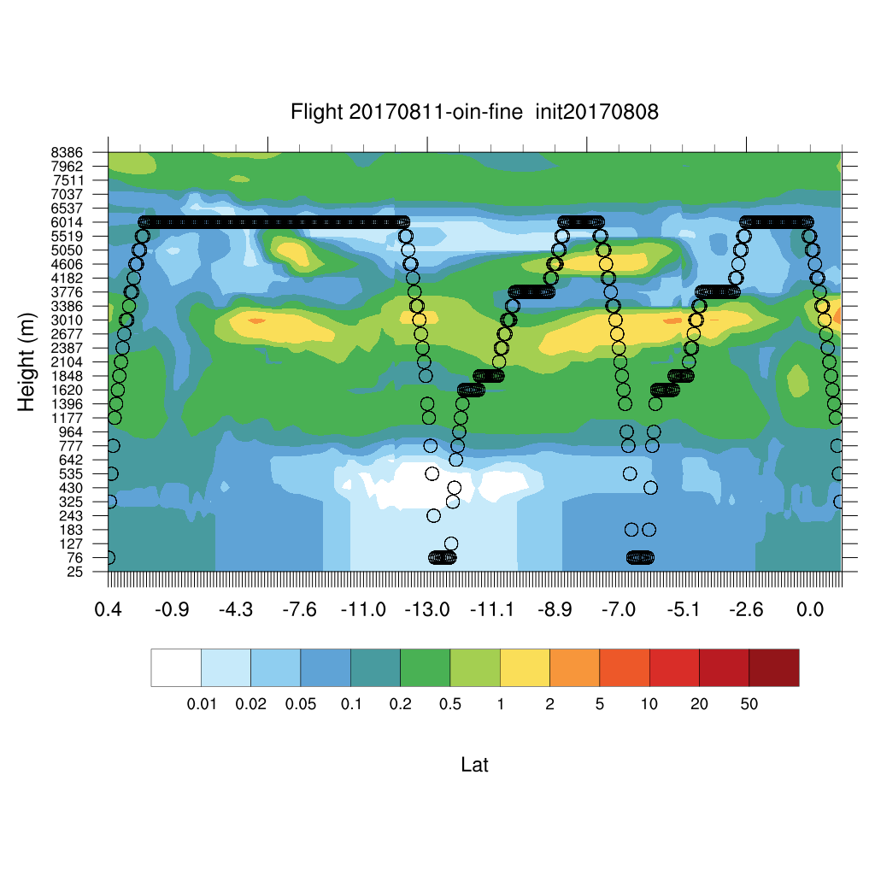
Friday Aug 11 Flight Path Curtains
7
3
1

Slide 35
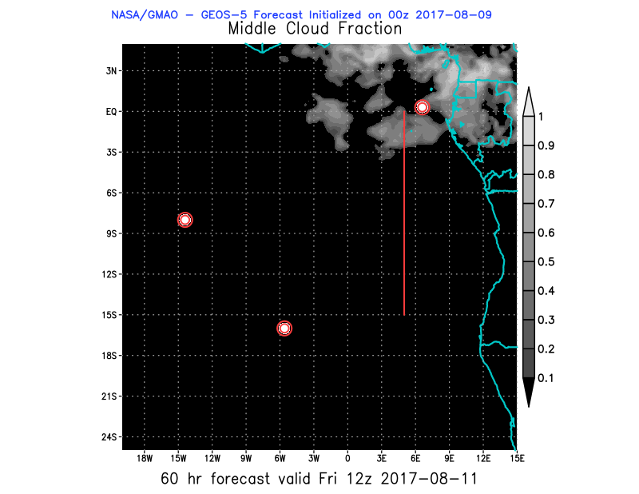
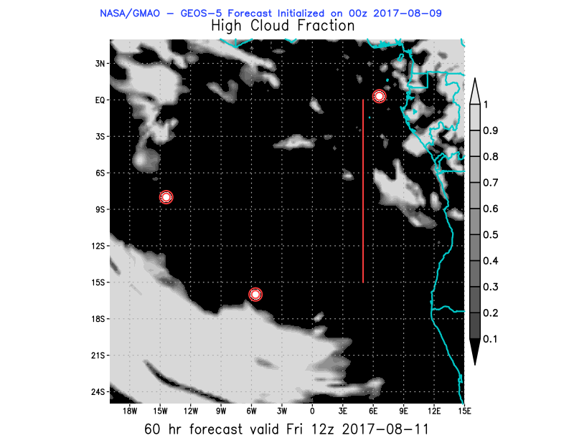
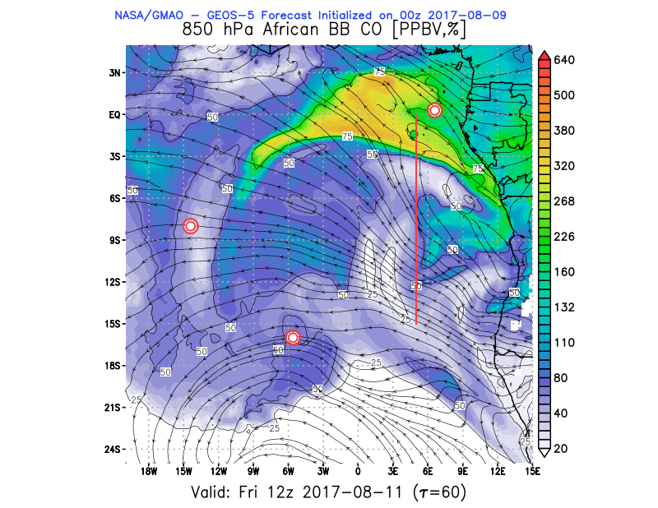
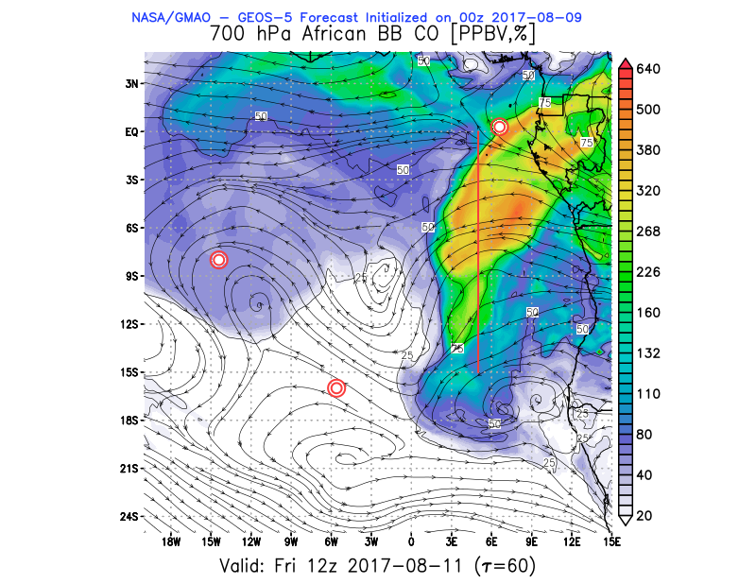
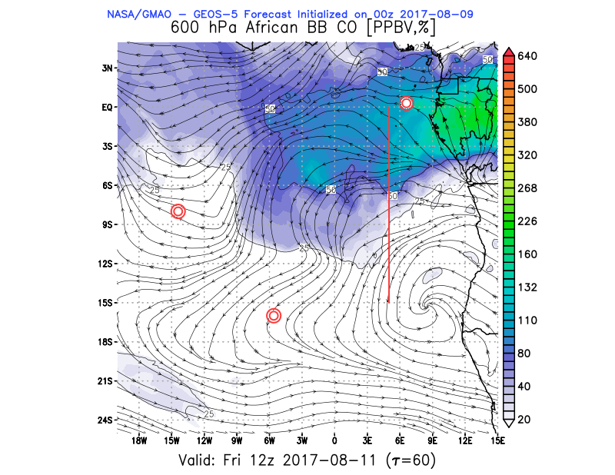
Friday Aug 11 (12z)

Slide 36
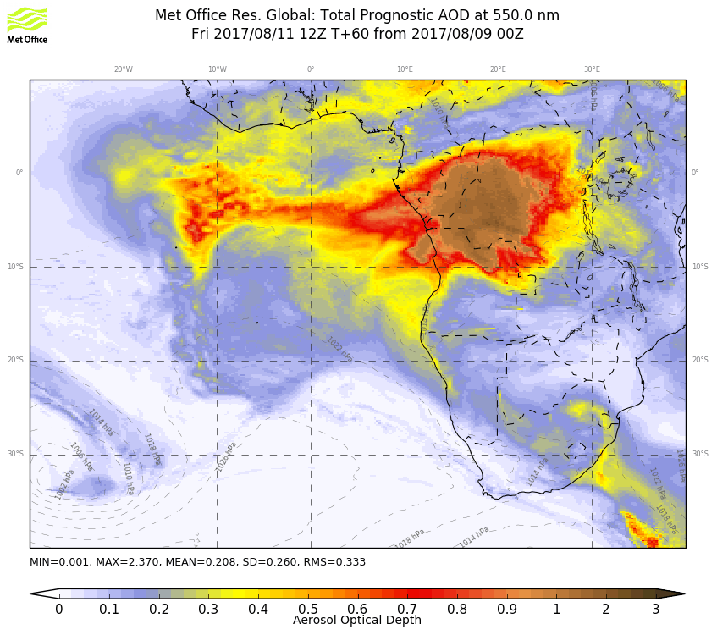
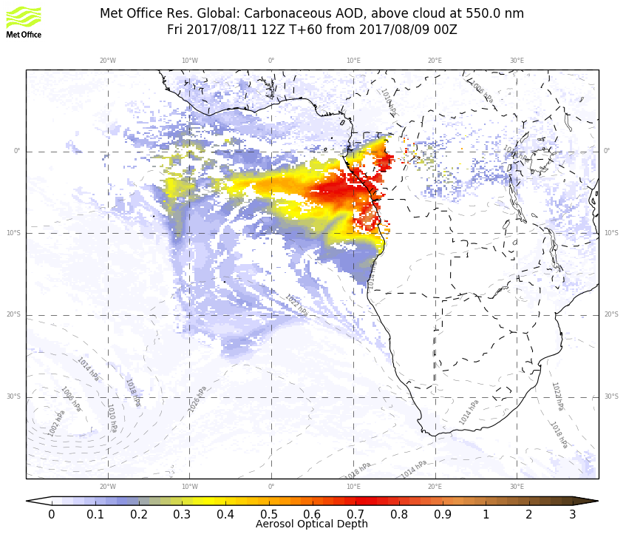
Friday Aug 11 (12z)

Slide 37
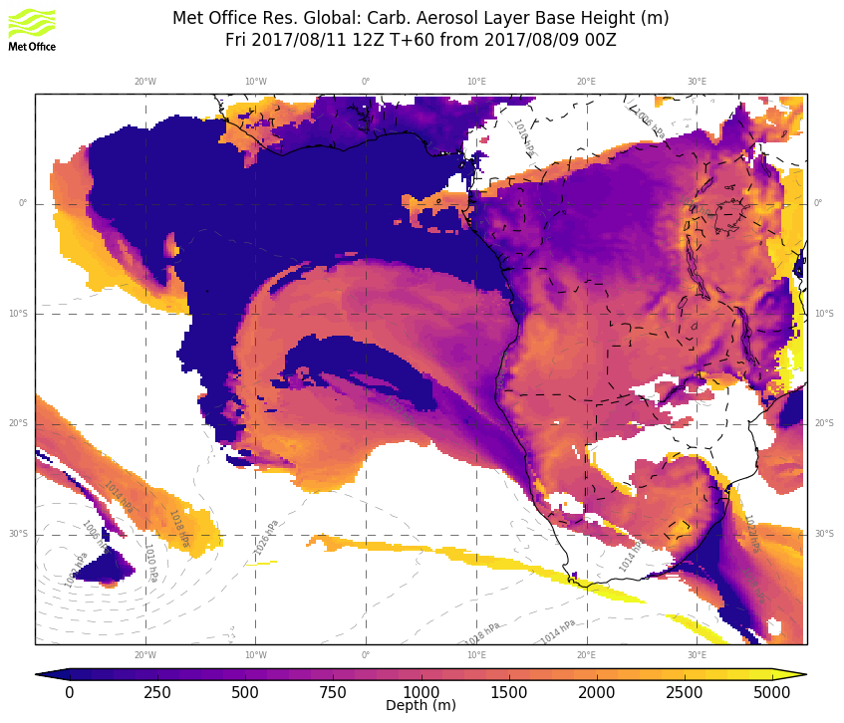
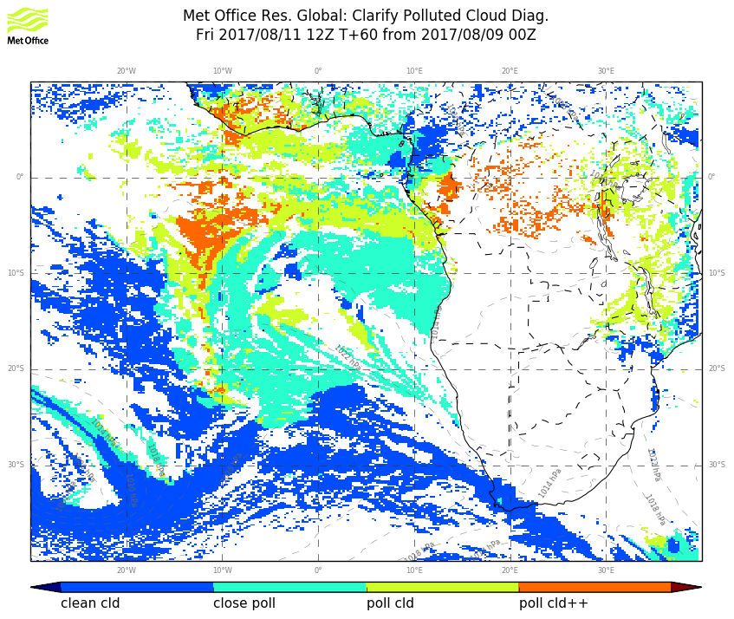
Friday Aug 11 (12z)

Slide 38
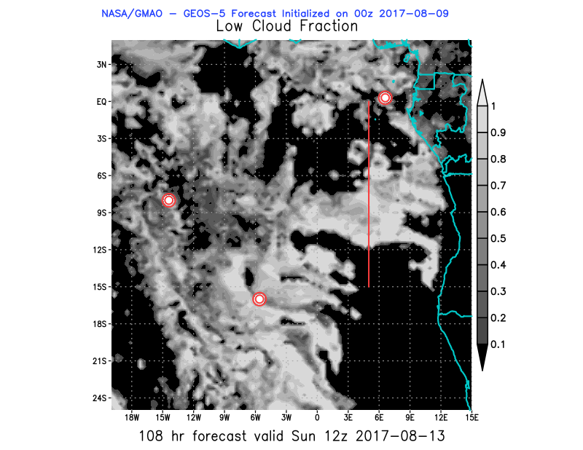
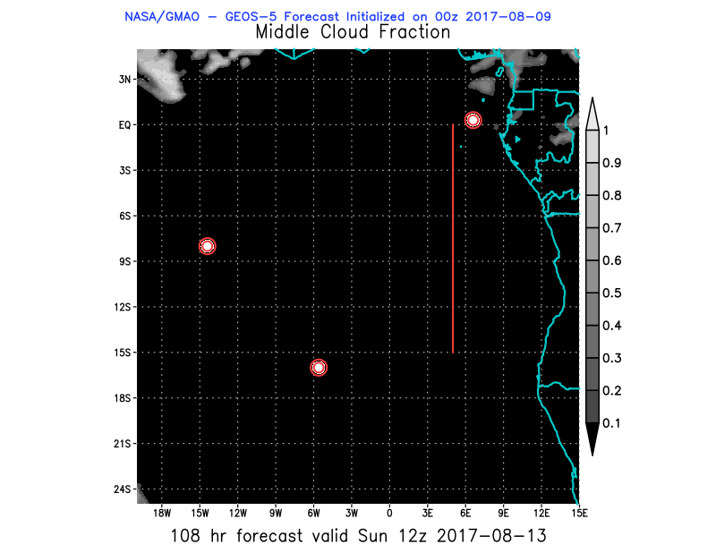
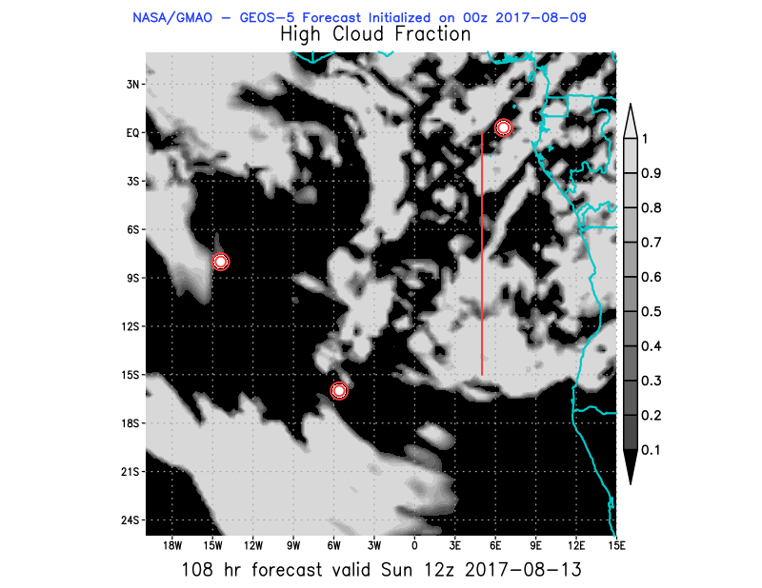
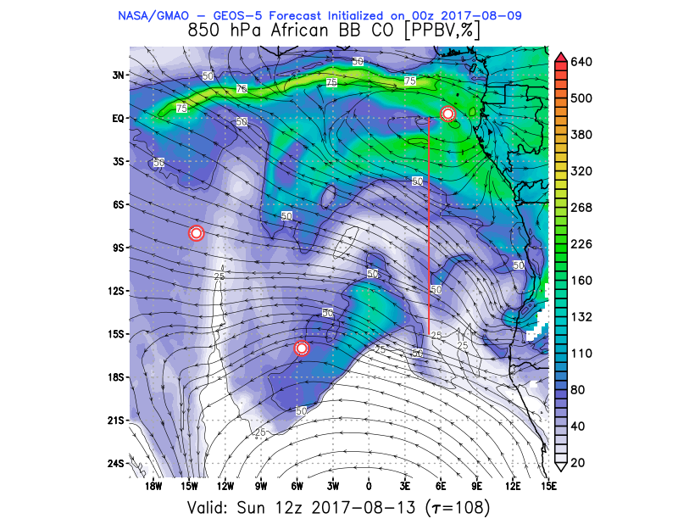
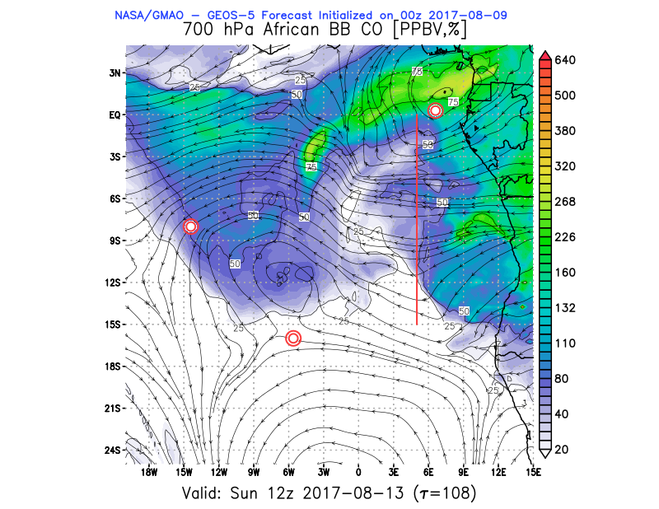
Sunday Aug 13 (12z)

Slide 39
BC AOD 09-18/Aug

Slide 40
Ascension São Tomé e Príncipe

