Slide 1
ORACLES Forecast Briefing (Aerosols)
09 August 2017

Slide 2
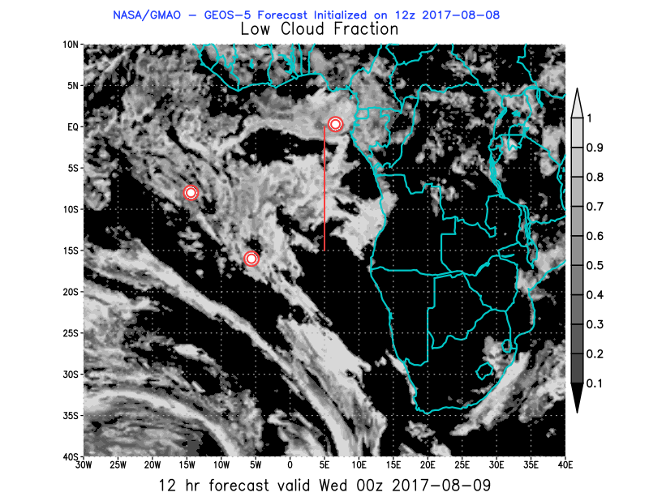
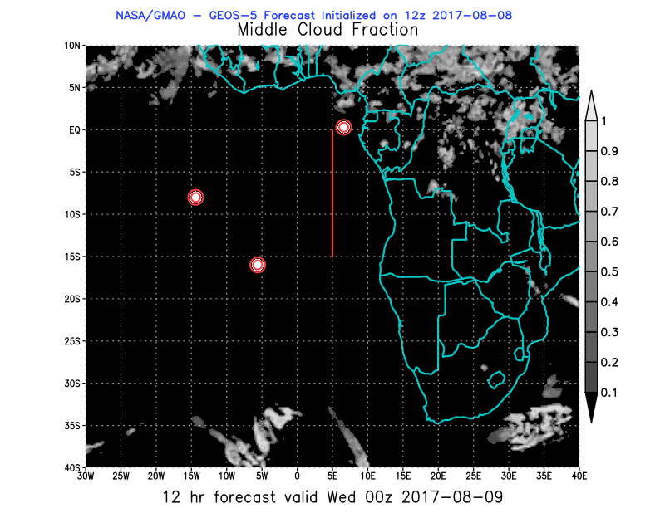
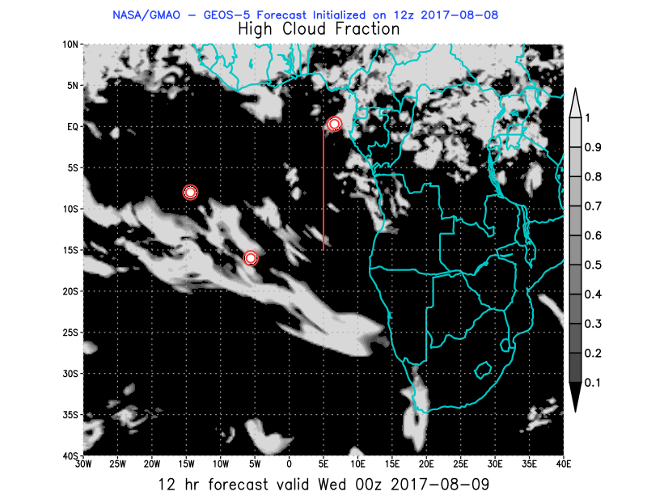
Wed

Slide 3
BC AOD 07-12/Aug

Slide 4
Ascension São Tomé e Príncipe

Slide 6
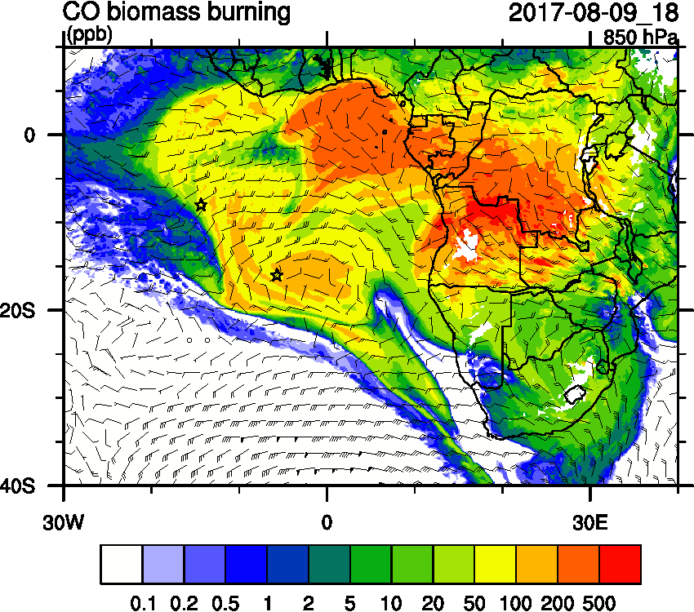
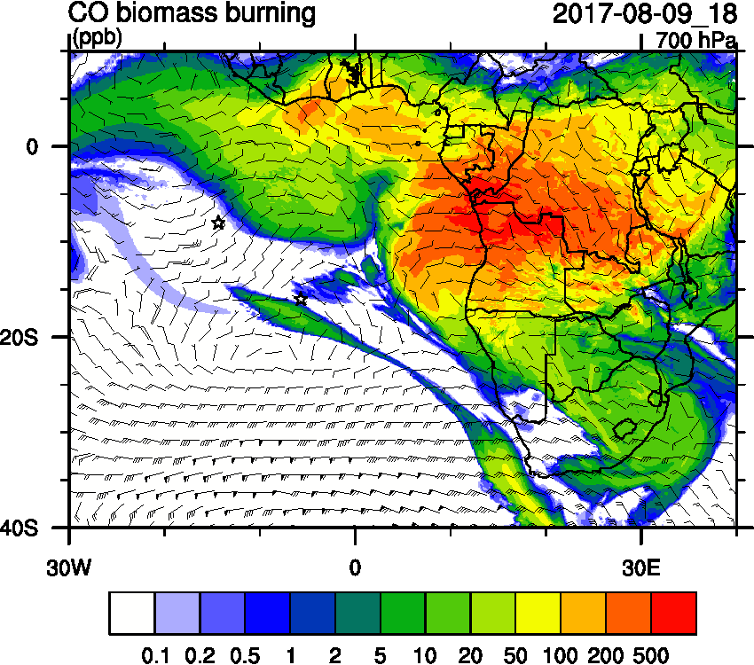
Wednesday Aug 9

Slide 7
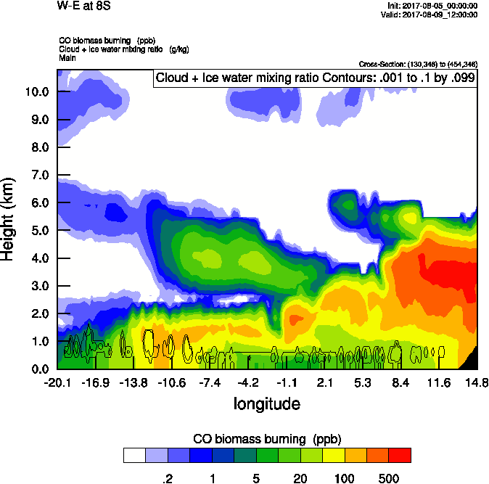
Wed

Slide 8
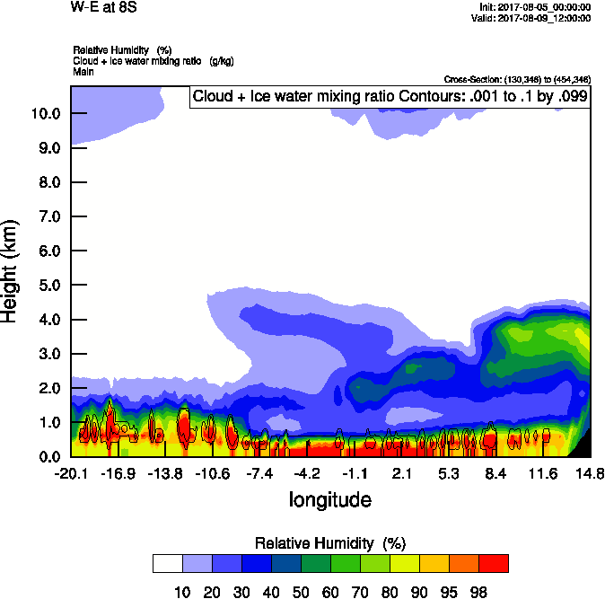
Wed

Slide 9
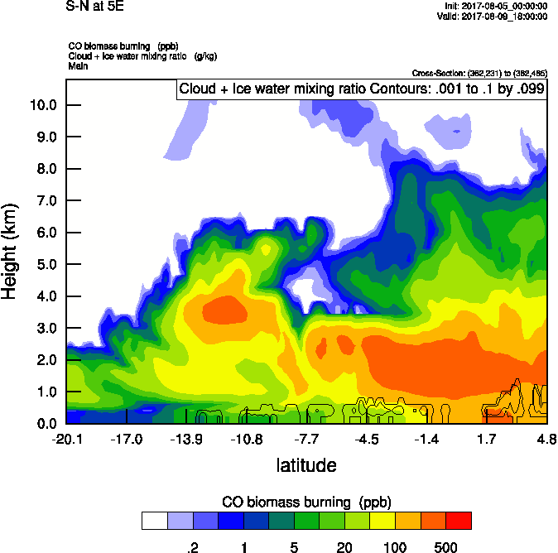
Wed

Slide 10
Wed Thu Fri

Slide 11
Wed

