Slide 1
ORACLES weather briefing
8-Aug-2017
Lenny Pfister and Rei Ueyama

Slide 2
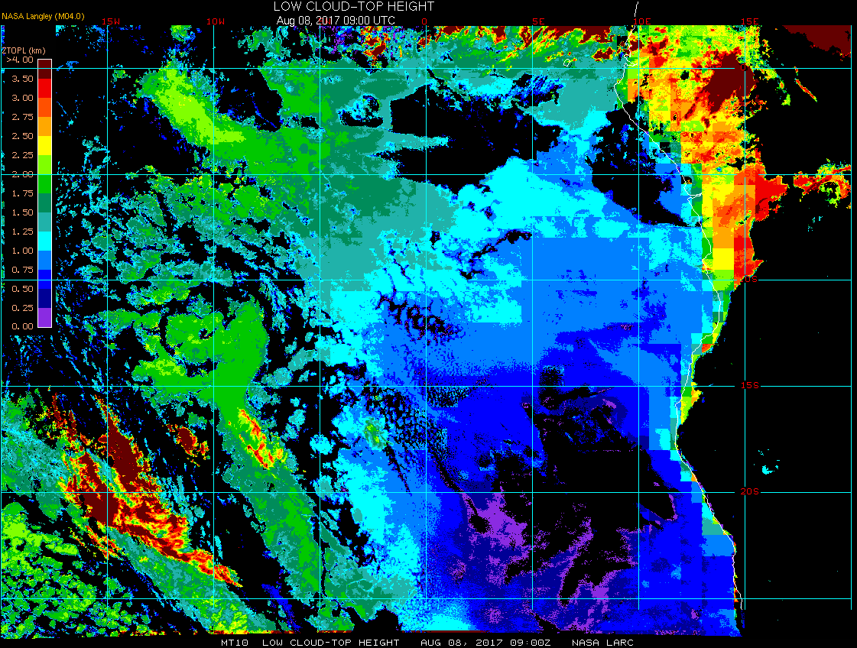
TMS
Scattered clouds 2000 ft
Overcast clouds 5000 ft
Low cloud top heights at 8/8 Tue @ 9AM
15W
10W
5W
0
5E
Clear-sky region is expanding (west-end of the clear-sky region is spreading westward)
Cloud-top heights 1.5-2 km
ASI
Few clouds 2400 ft
Broken clouds 4500 ft

Slide 3
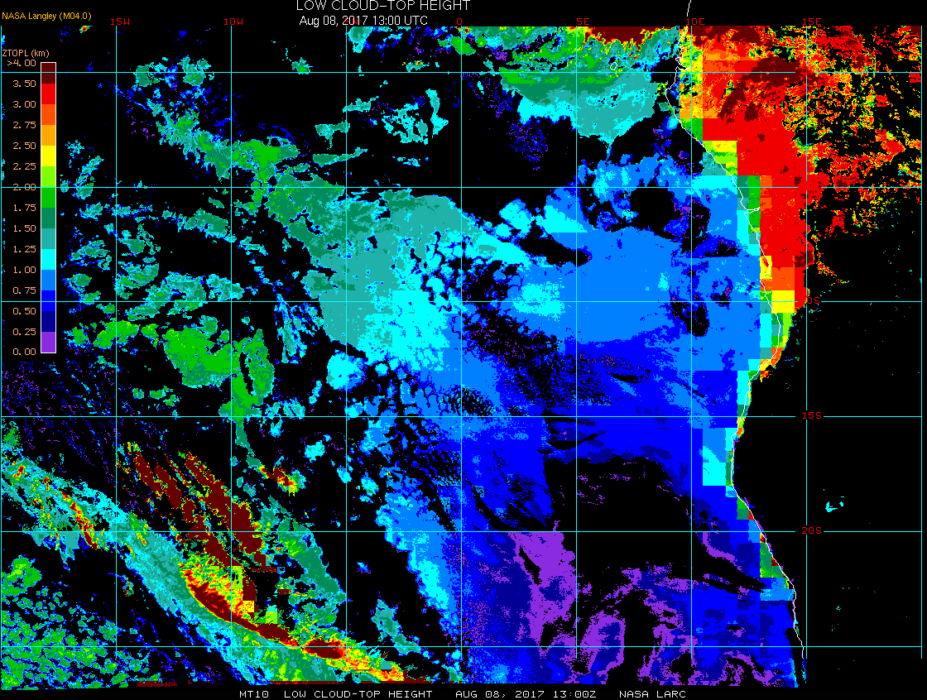
TMS
Few clouds 2000 ft
Broken clouds 4000 ft
Low cloud top heights at 8/8 Tue @ 1PM
15W
10W
5W
0
5E
Model forecasts agree pretty well, but slight overestimation of low clouds here
ASI
Few clouds 2300 ft

Slide 4
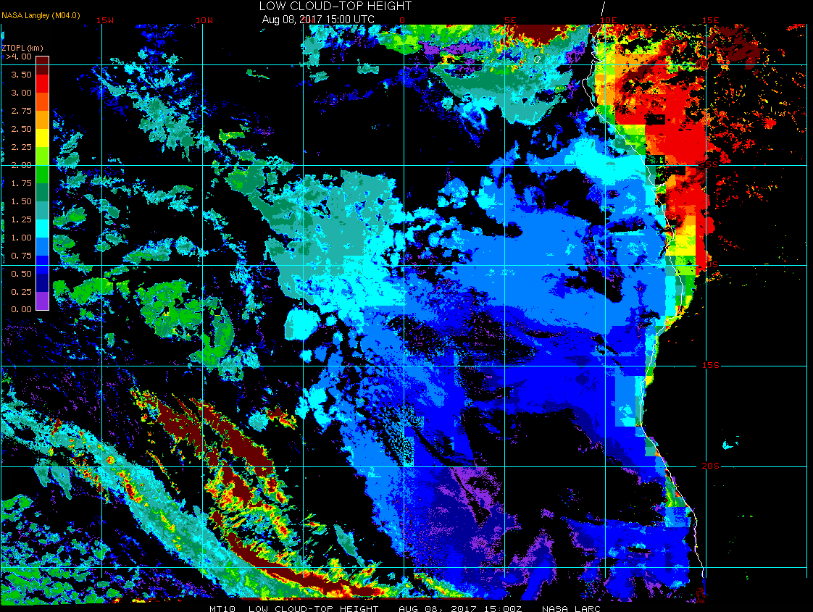
TMS
Scattered clouds 2000 ft
Broken clouds 4000 ft
Low cloud top heights at 8/8 Tue @ 3PM
15W
10W
5W
0
5E
Model forecasts agree pretty well, but slight overestimation of low clouds here
ASI
Scattered clouds 3000 ft

Slide 5
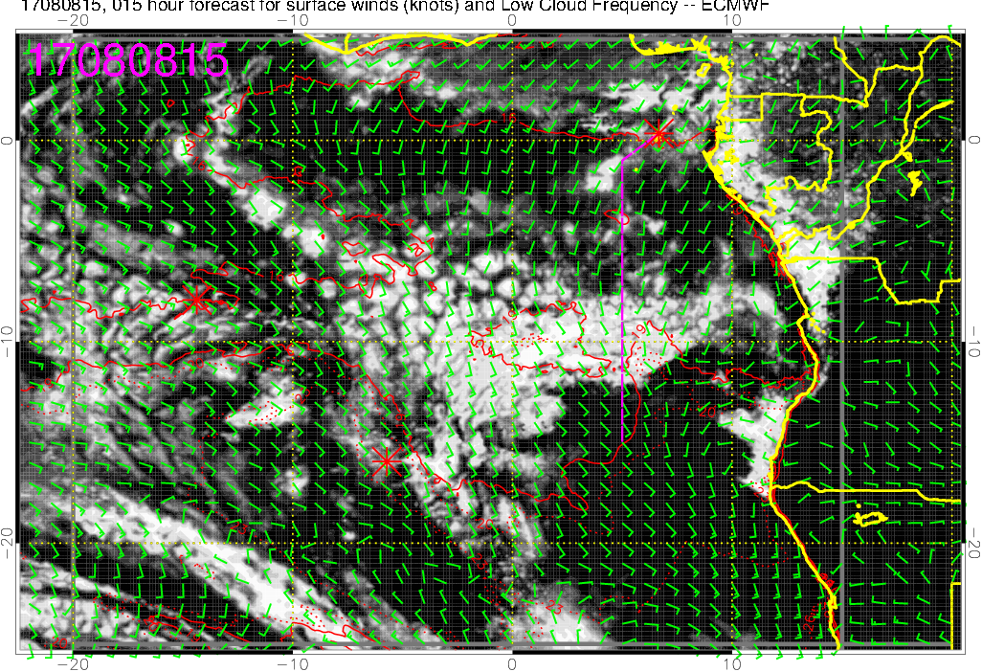
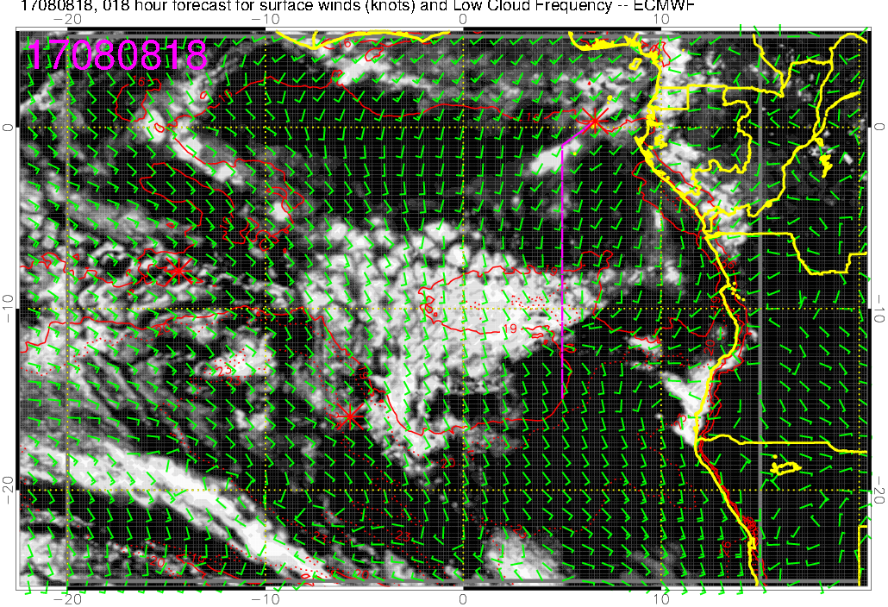
Low cloud forecast on 8/8 Tue @ 3 and 6PM
Diurnal cycle of clouds (decreasing from 3 to 6PM
Most low clouds between 5-10W along the flight track
3PM
6PM

Slide 6
TAF at ASI and TMS today (8/8)
ASI, takeoff after 12Z
SE winds, 15 knots
Few (to scattered) clouds at 2000 ft, scattered clouds at 4500 ft
TMS, landing after 17Z
S winds, 4 knots
Few clouds at 2300 ft, broken clouds at 11000 ft

Slide 7
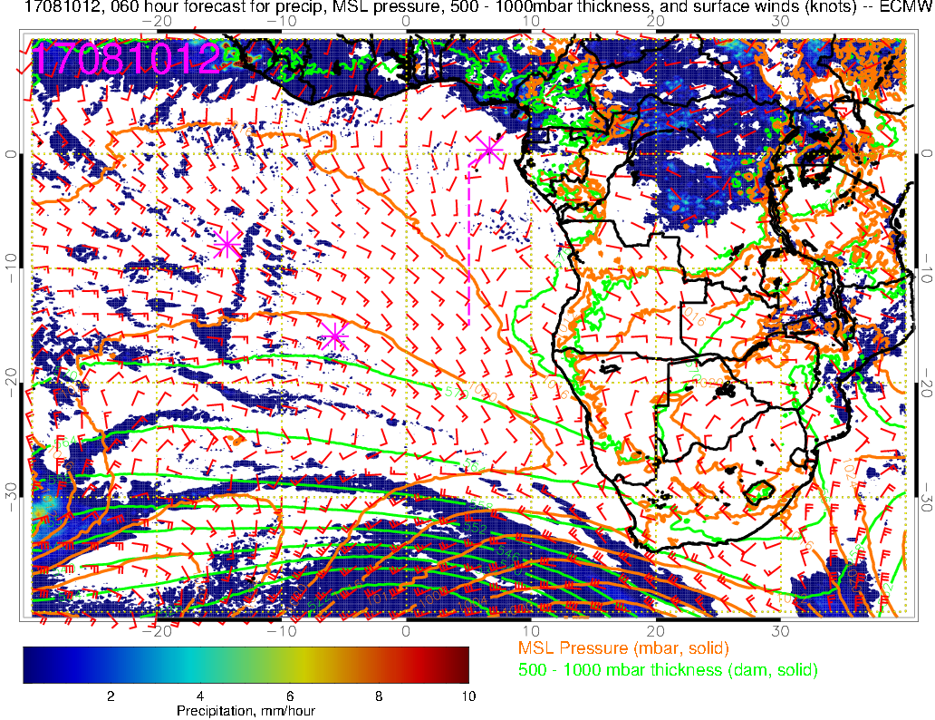
Precip, surface winds, 500-1000mb thickness for 8/10 @ 12PM
Weak surface winds near TMS, shifting SW by 8/11 Friday
H
St. Helena high developing again
Surface low moving away (eastward);
Another low entering our region

Slide 8
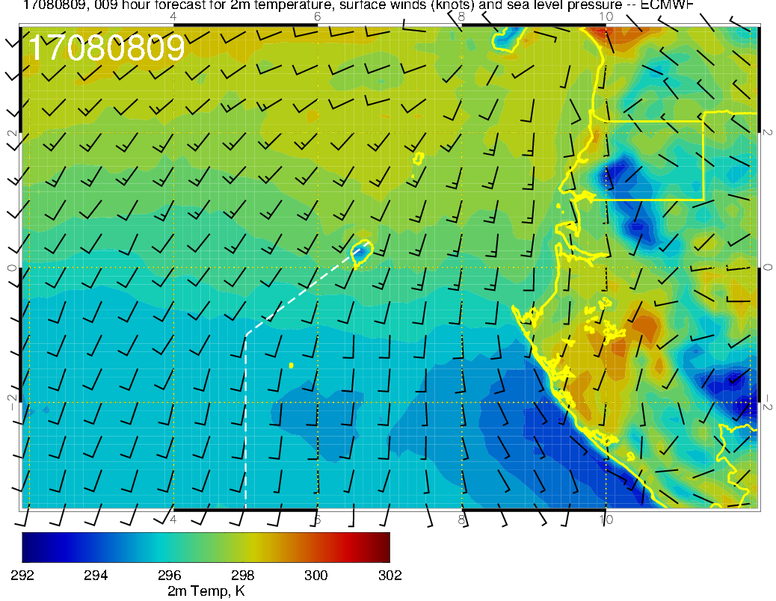
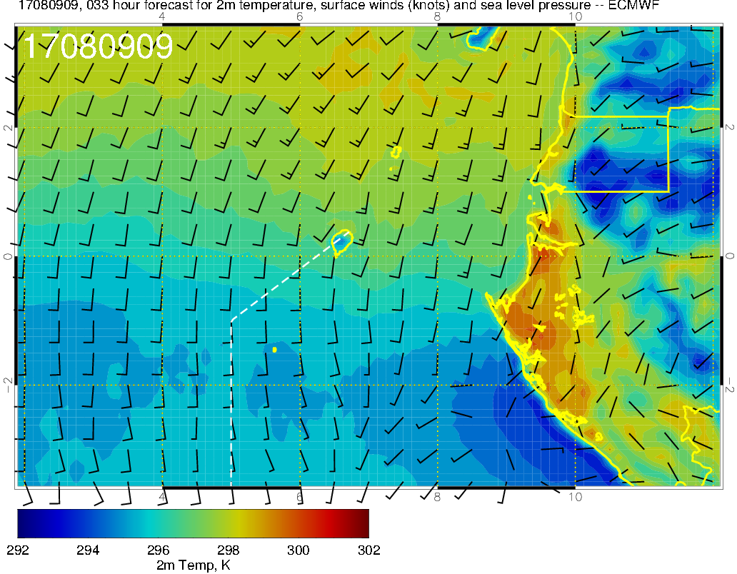
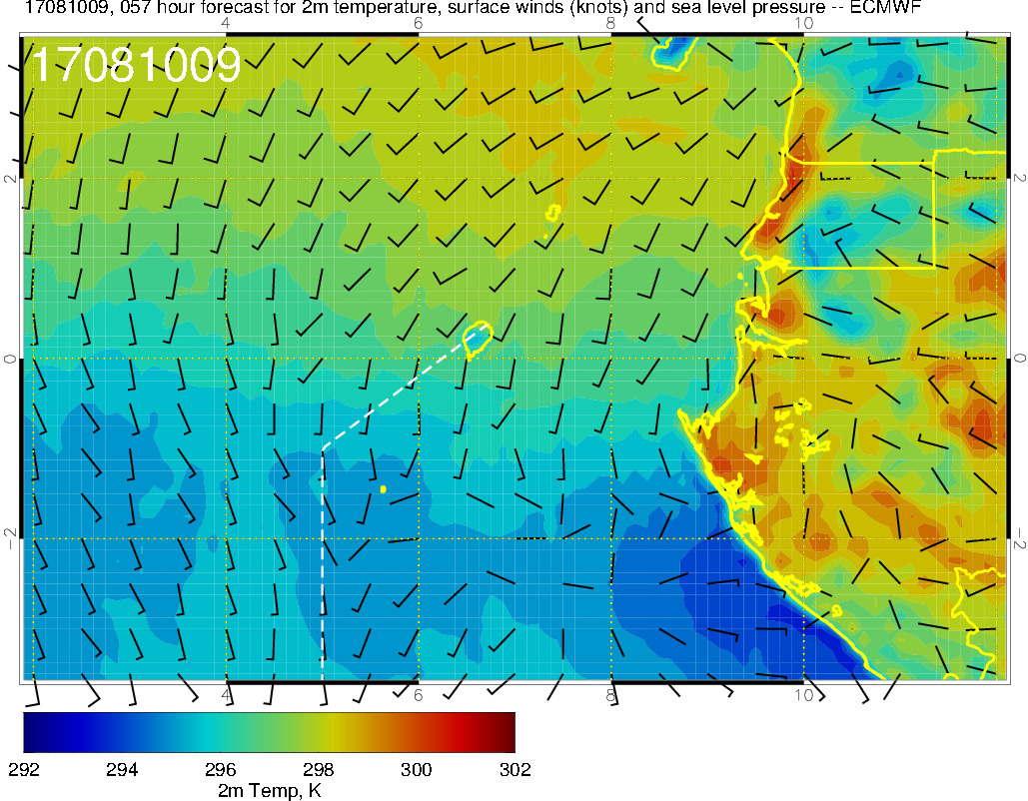
2m Temperature, surface winds, SLP for 8/8-10 @ 9AM (around takeoff)
8/8
8/9
Today 8/8 Tue:
7am 24C, 8am 25C, 9am 26C
Low cloud cover over TMS relatively unchanged (not shown)
SSW winds weakening
Temperature at takeoff on 8/10 expected to be similar to today or slightly cooler
8/10

Slide 9
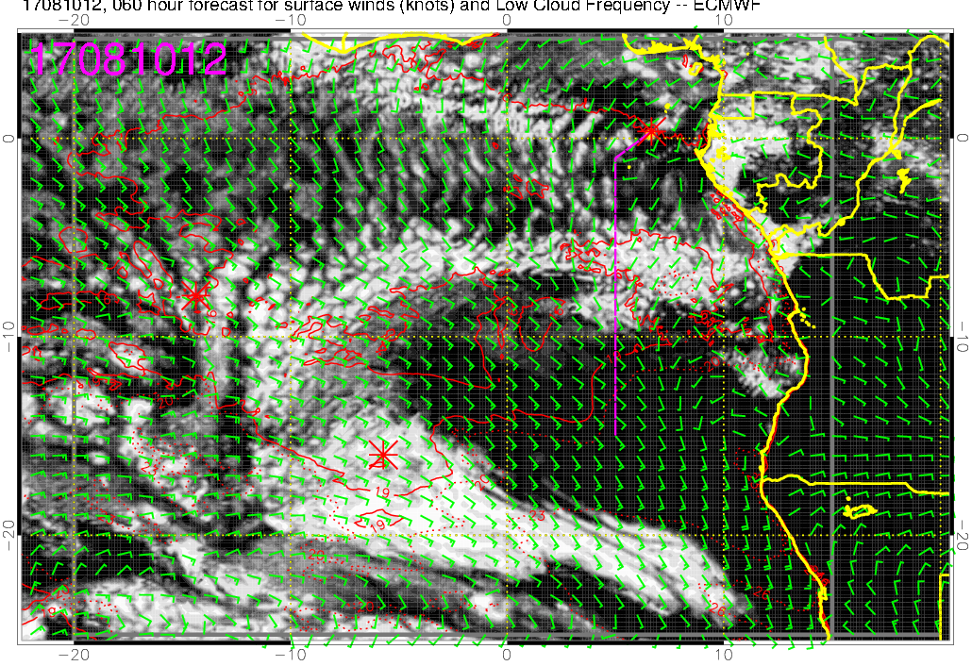
Low cloud forecast on 8/10 Thu @ 12PM
Low clouds south of 10S (region of low BL heights) are of a different character, smaller StratCu cells

Slide 10
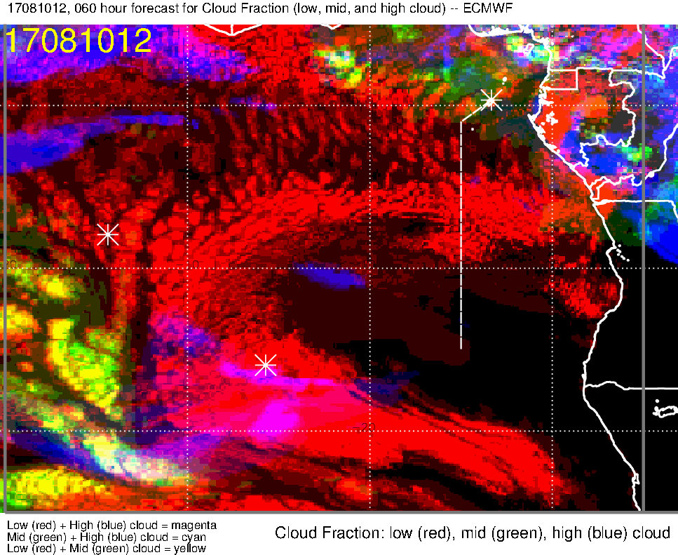
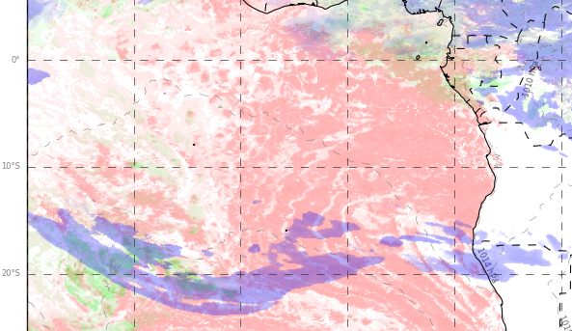
Low, middle, high cloud forecast for 8/10 Thu @ 12PM
ECMWF (60-hr)
UKMO (60-hr)
low + middle clouds
Low + mid (+ some high) clouds
Good model agreement over TMS: low + mid clouds, some high clouds further north
Low cloud cover max in the middle of the flight 5-10S, few clouds south of 10S
UKMO likely overestimating low clouds

Slide 11
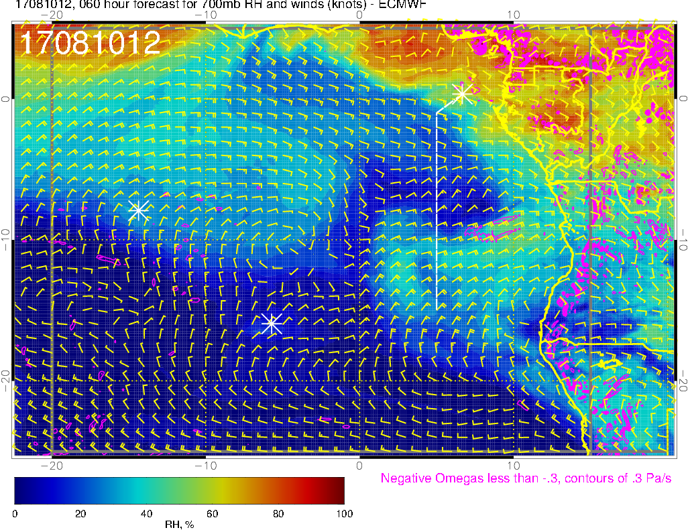
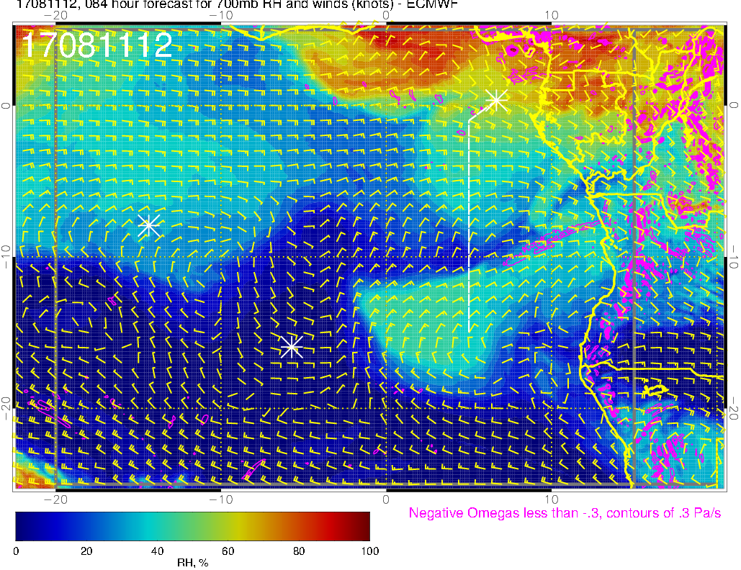
700mb RH (color), UV wind (vectors), vert. velocity (pink contours) forecast for
8/10 Thu @ 12PM
8/11 Fri @ 12PM
8/10 Thu
Plume of high RH air from dry convection over land
Easterly (cross) winds at 600 and 800mb levels as well, but this plume is not evident
8/11 Fri

Slide 12
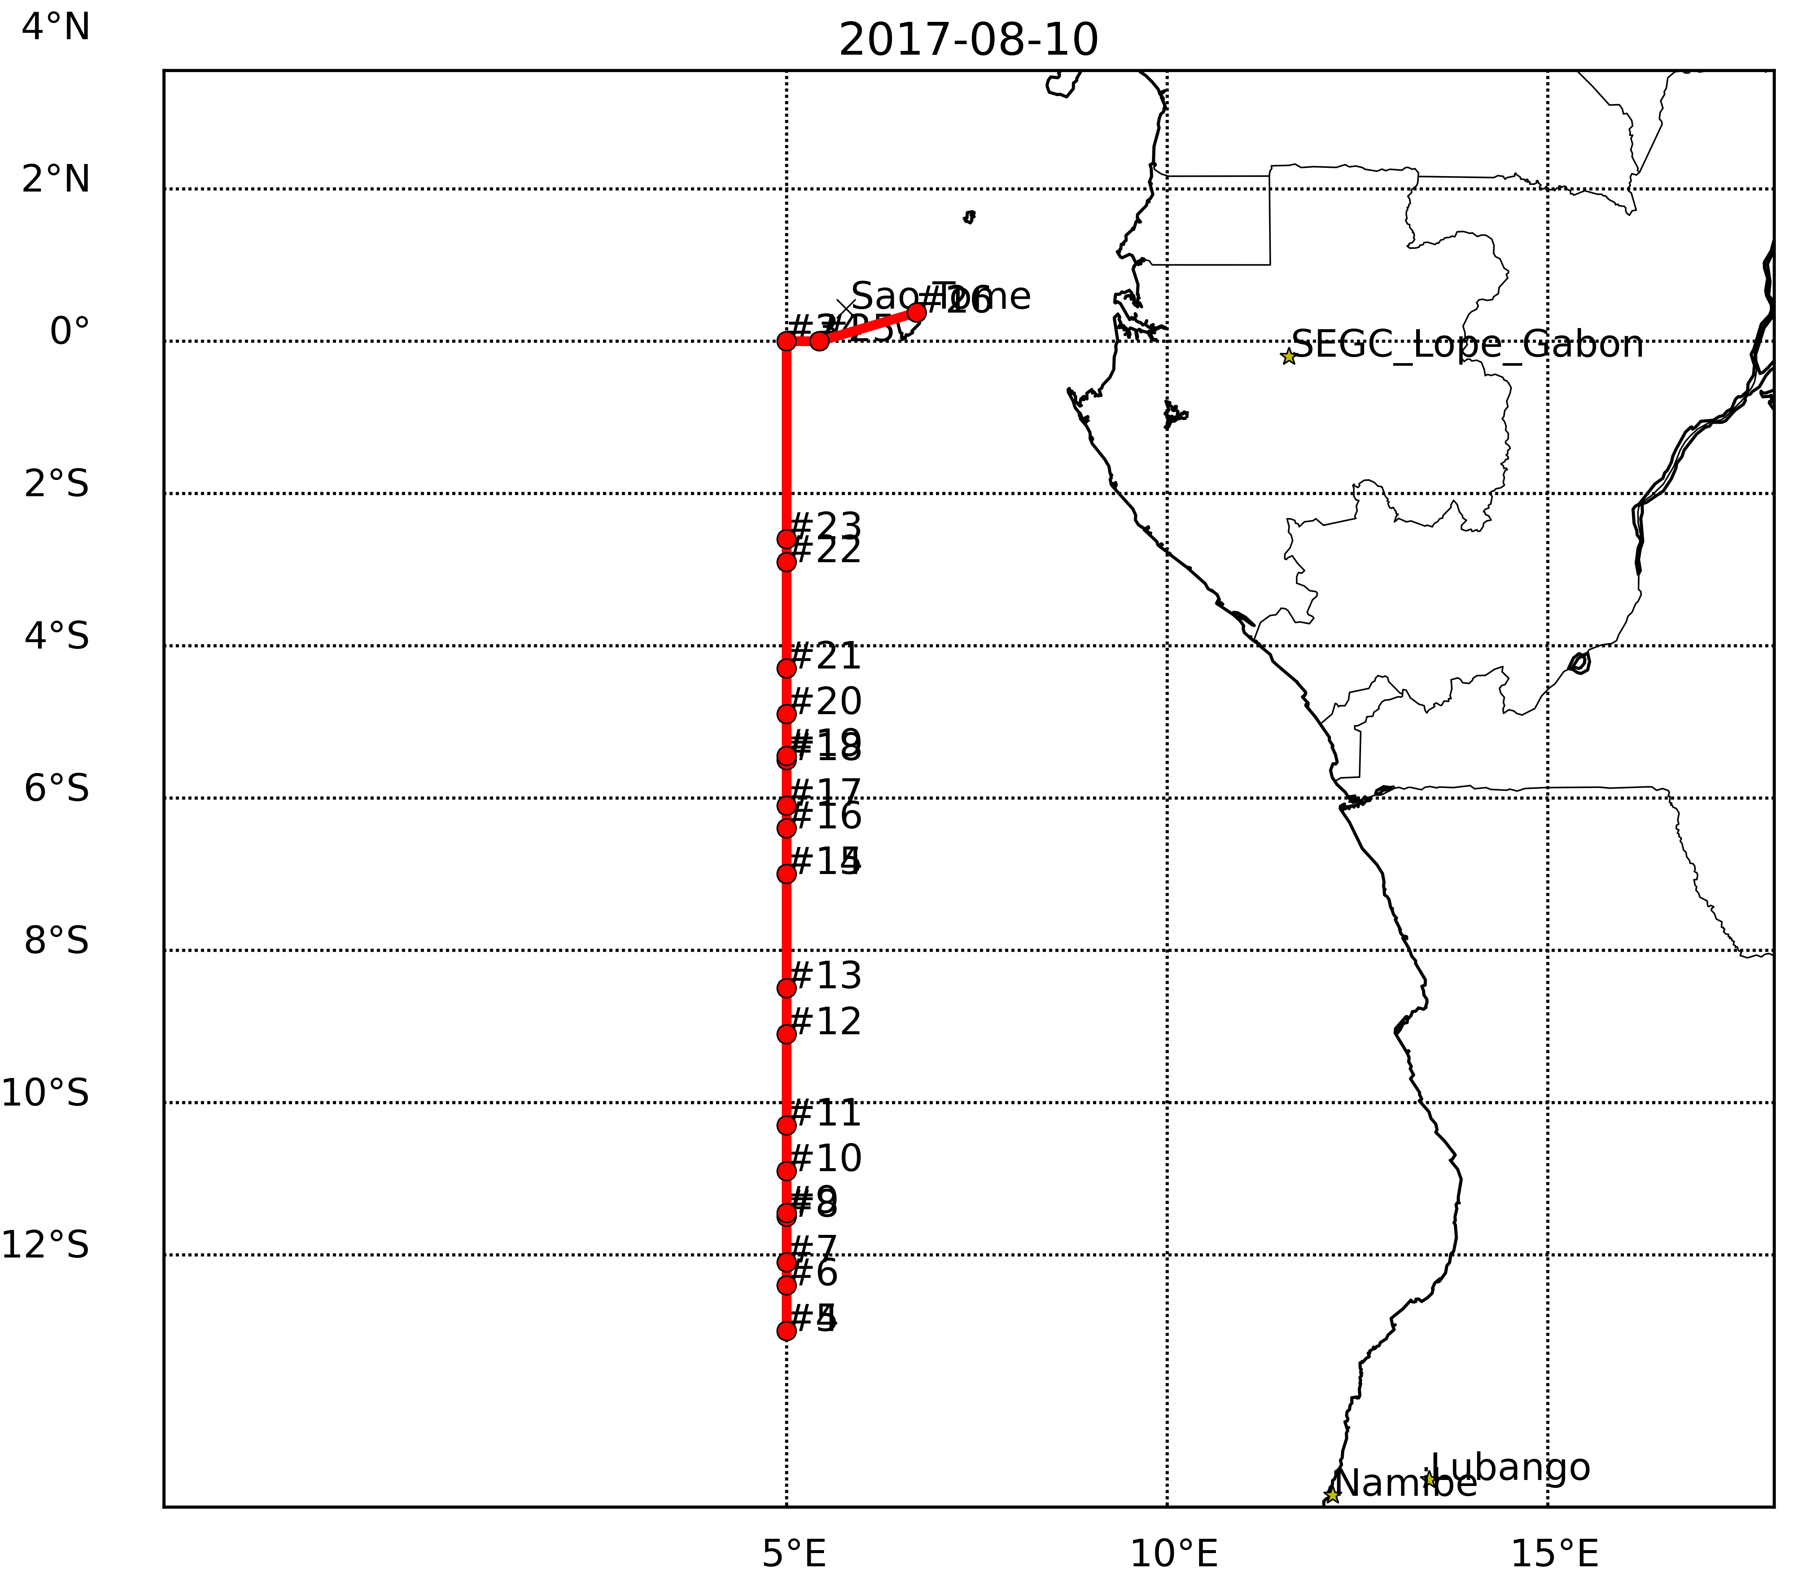
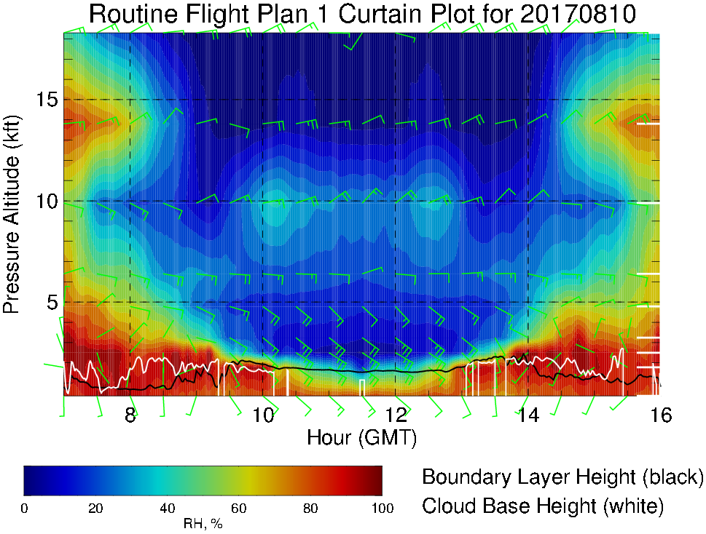
RH (color) along routine flight track, 8/10 Thu 7AM – 4PM
Cross winds ~15-20 knots at 10-15 kft altitude
Enhanced RH at 10 kft
Cloud bases 1-2 kft; “cloud-free” near end of flight track

Slide 13
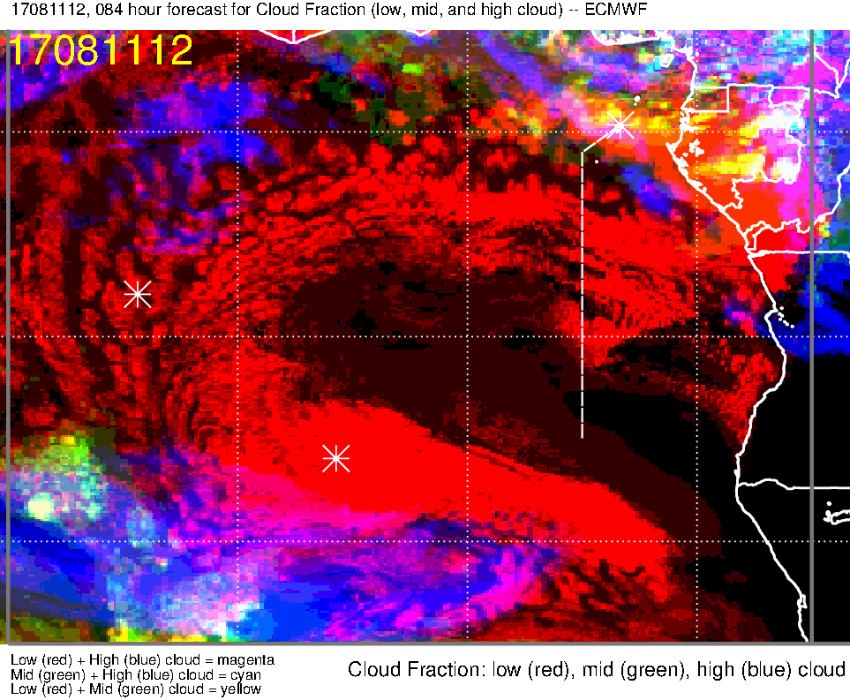
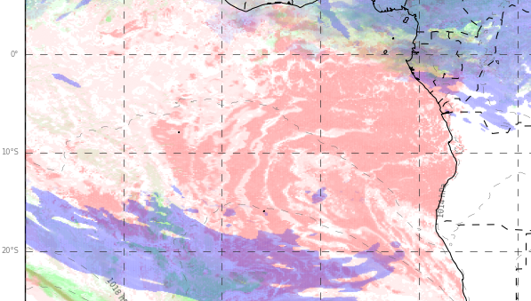
Low, middle, high cloud forecast for 8/11 Fri @ 12PM
ECMWF (84-hr)
UKMO (84-hr)
low + middle clouds
Low + mid (+ some high) clouds
Northern edge of StratCu cloud deck further northward compared to 8/10 Thu
Region of low cloud-free region off Namibia coast expands NW (only few clouds at southernmost point of the flight track)
Increased low, mid and high cloud cover over TMS (strong upper-level winds transport more high clouds offshore)

Slide 14
Summary
Transit flight ASI-TMS: Tuesday 8/8
Most of the low clouds between 5-10W along flight track
Headwinds up to 20 knots in the middle of the flight at ~15 kft
Routine flight: Thursday 8/10
Low clouds in the middle of the flight (5-10S), few smaller StratCu cells south of ~10S
Low and mid clouds over TMS, some high clouds to the north
Plume transport from dry convection towards the end of the flight track (south of 10S) at ~10 kft
Contingency Routine flight: Friday 8/11
Low clouds down to ~10S, very few south of that point
Increased low, mid and high clouds near TMS compared to 8/10
Similar plume situation as 8/10

Slide 15
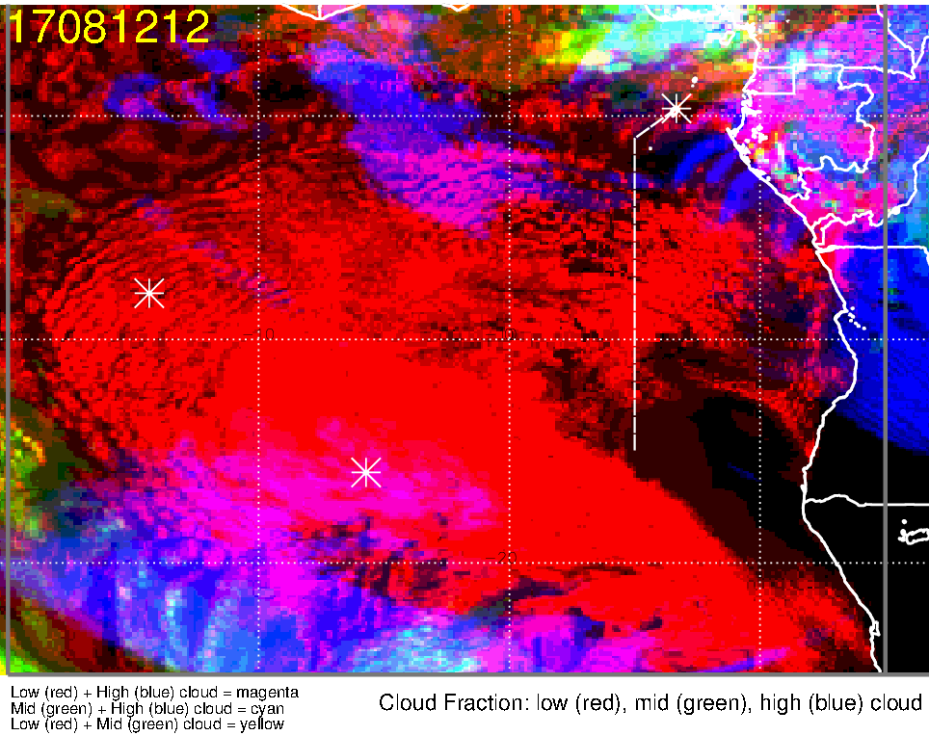
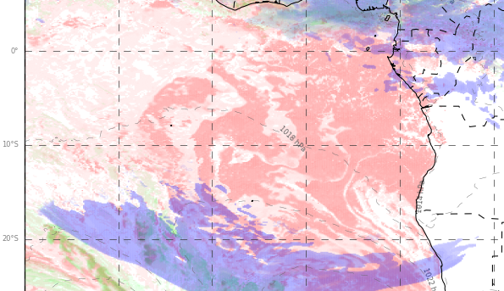
Low, middle, high cloud forecast for 8/12 Sat @ 12PM
ECMWF (108-hr)
UKMO (108-hr)
Middle + high clouds
middle clouds
high clouds
high clouds
Stratocumulus cloud layer filling in
Stronger upper-level winds transport high clouds offshore (i.e., expect more high clouds than previous days)

Slide 16
Saturday, August 12

Slide 17
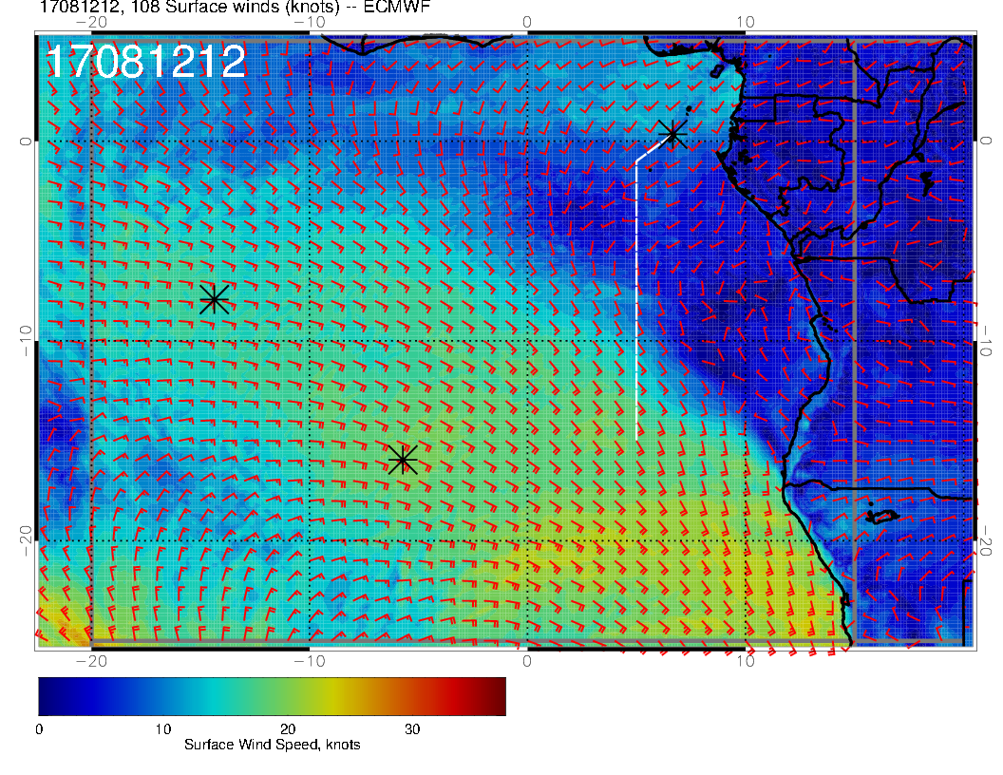
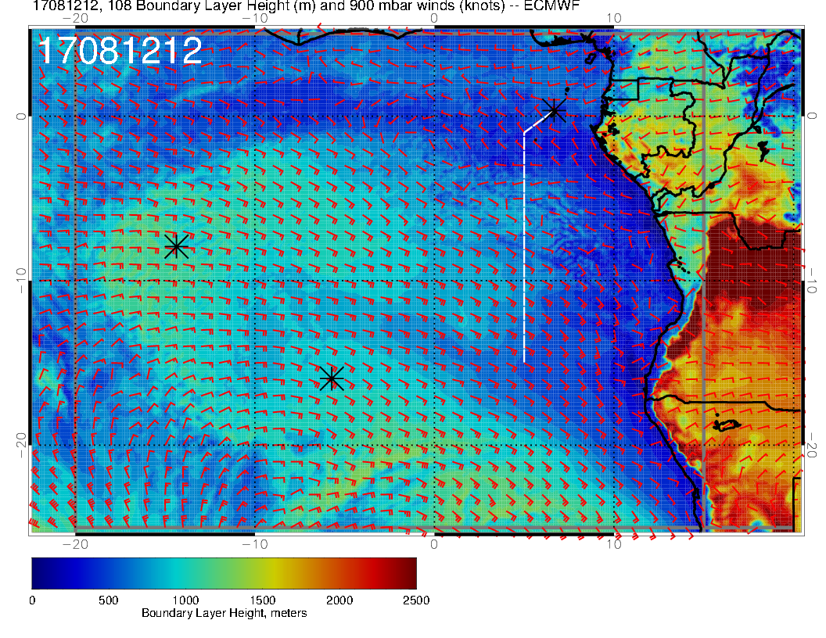
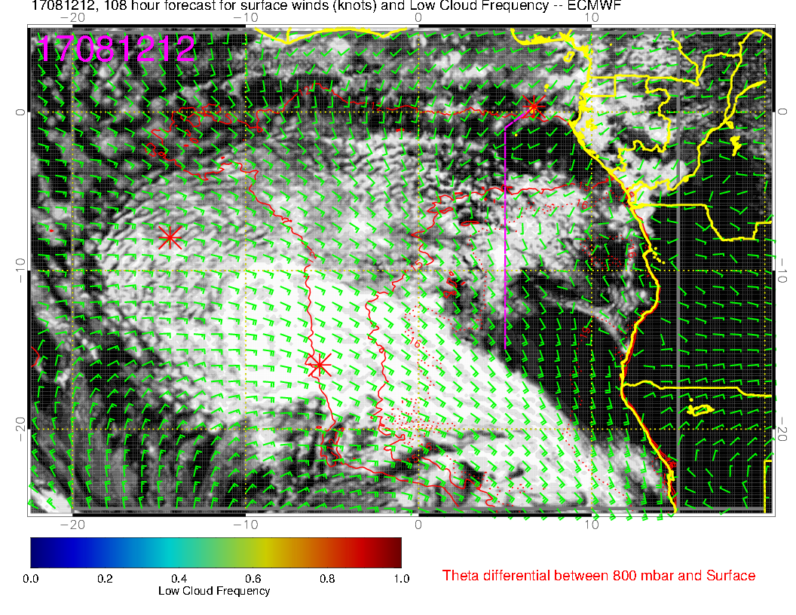
SURFACE WIND SPEED
BOUNDARY LAYER HGT
Surface wind speed, BL hgt, and low clouds for Saturday 12Z.
Region of low cloud gradient also has very low wind speeds, actually from the west.

Slide 18
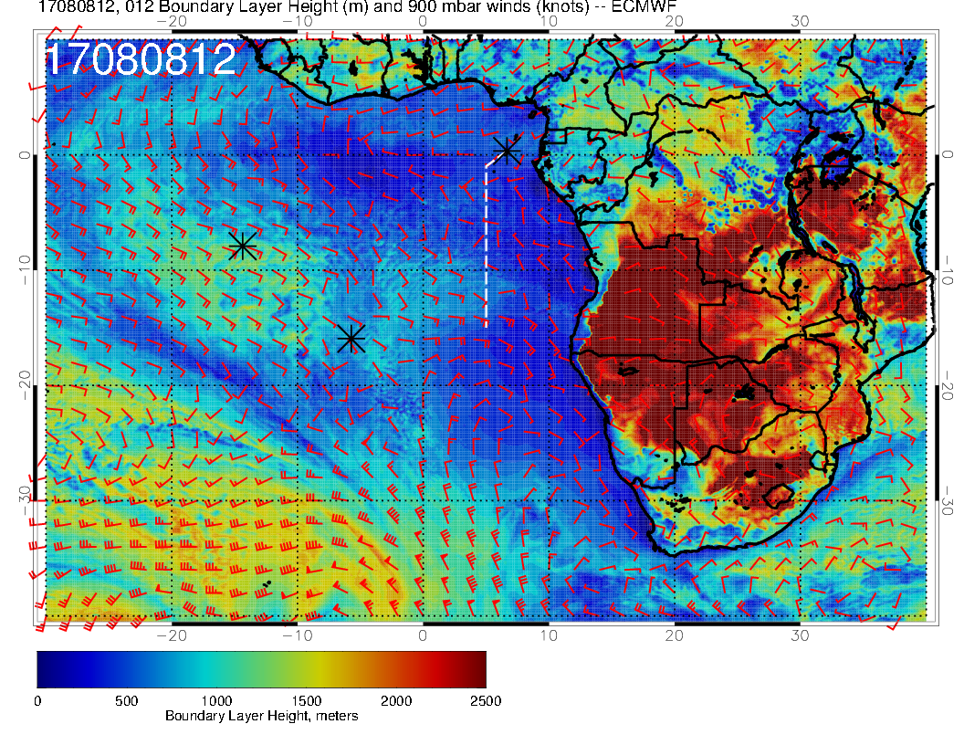
SURFACE WIND SPEED
BOUNDARY LAYER HGT
Boundary layer heights will be higher than today, so expect less clearing to the south

Slide 19
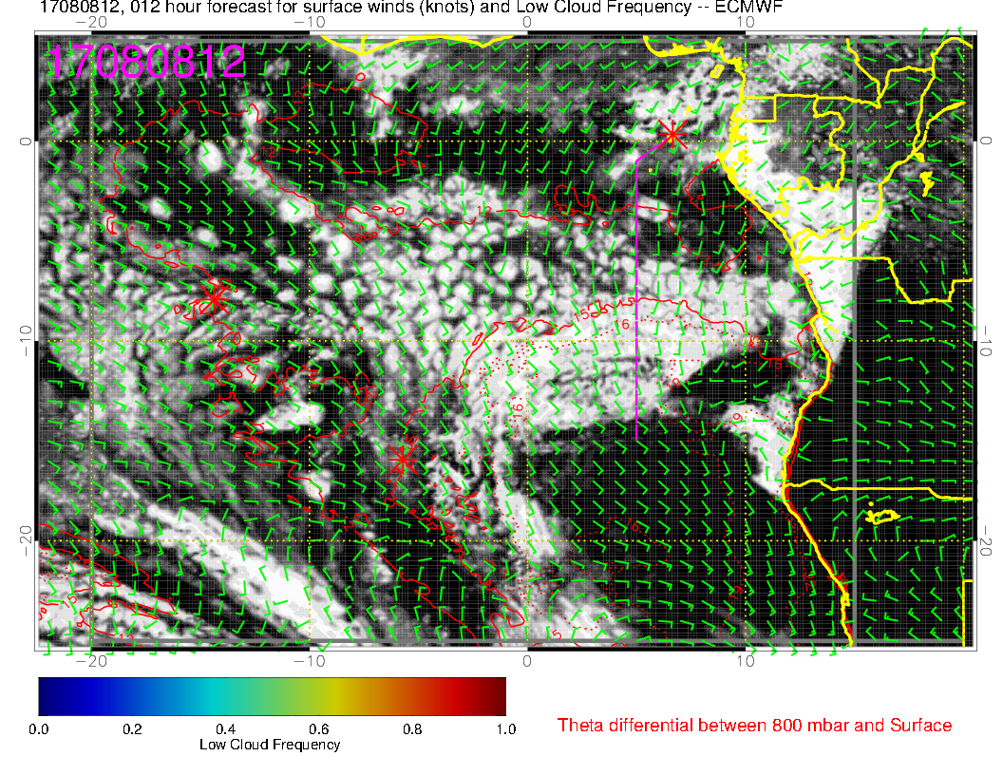
BOUNDARY LAYER HGT
12Z today, visible image (above), 12 hour
forecast (right), BL height (above right)
Hypothesis: Use today as an analogy for Saturday (taking persistence to the limit!!)
We have seen this gap for a few days now, and might expect something like it. This might be a good gradient to work for a radiation flight.

Slide 20
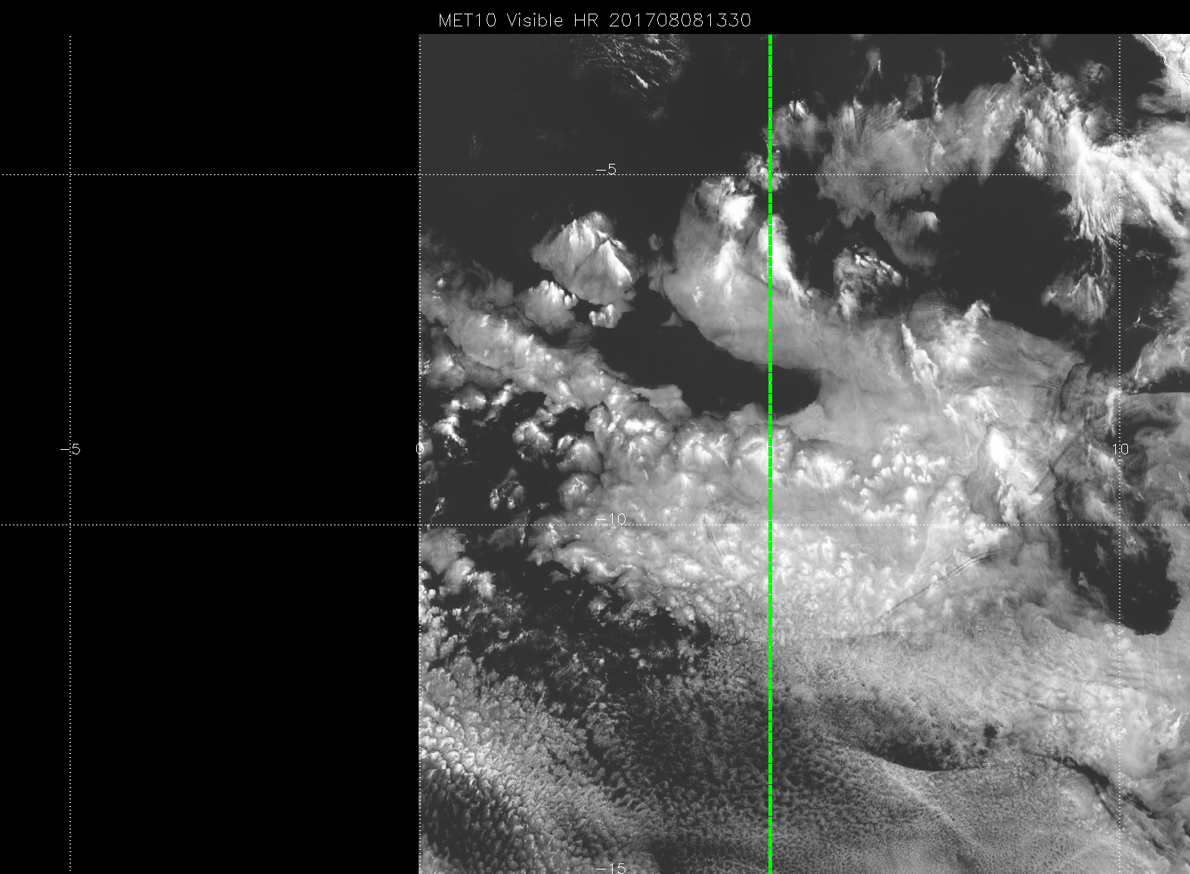
Just an idea of what we might see. Some clear, some large cells, and small cells where BL height is lower.

Slide 21
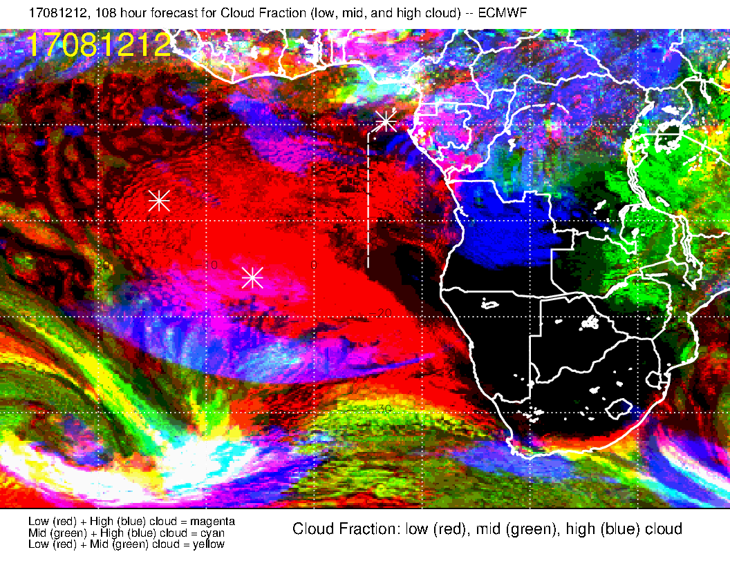
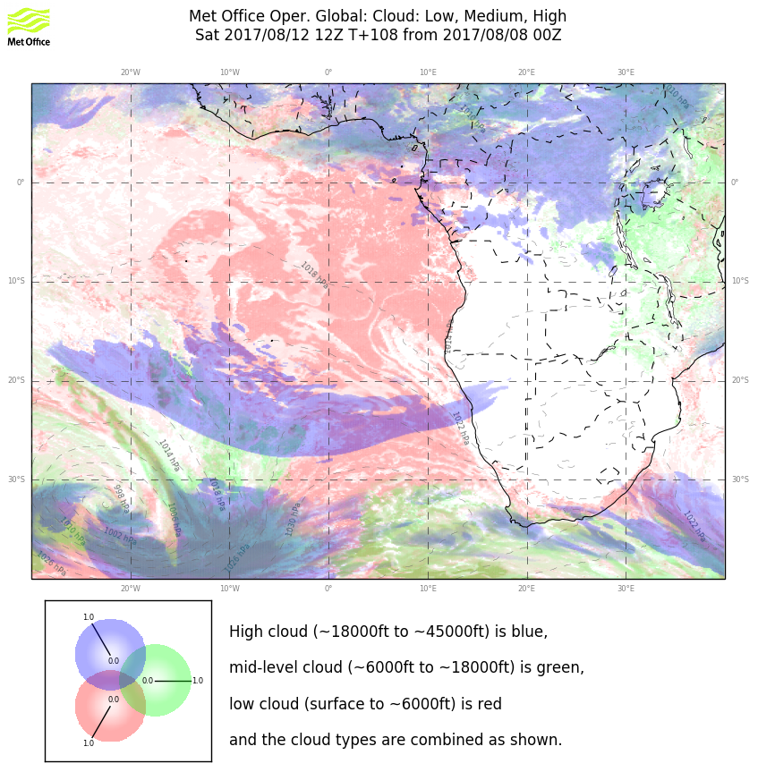
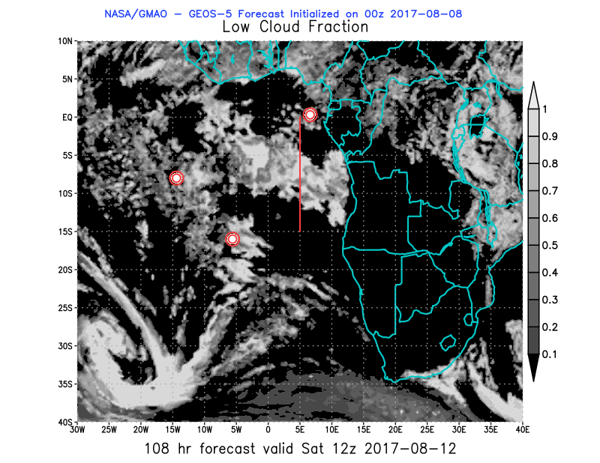
3 model cloud fields.
UK and EC low clouds good agreement except for “northern gap”.
EC has more high cloud. If we work cloud gradient at northern end will have to worry about this and look carefully at later fcsts.
GMAO has some high cloud near 10S (not shown)

Slide 22
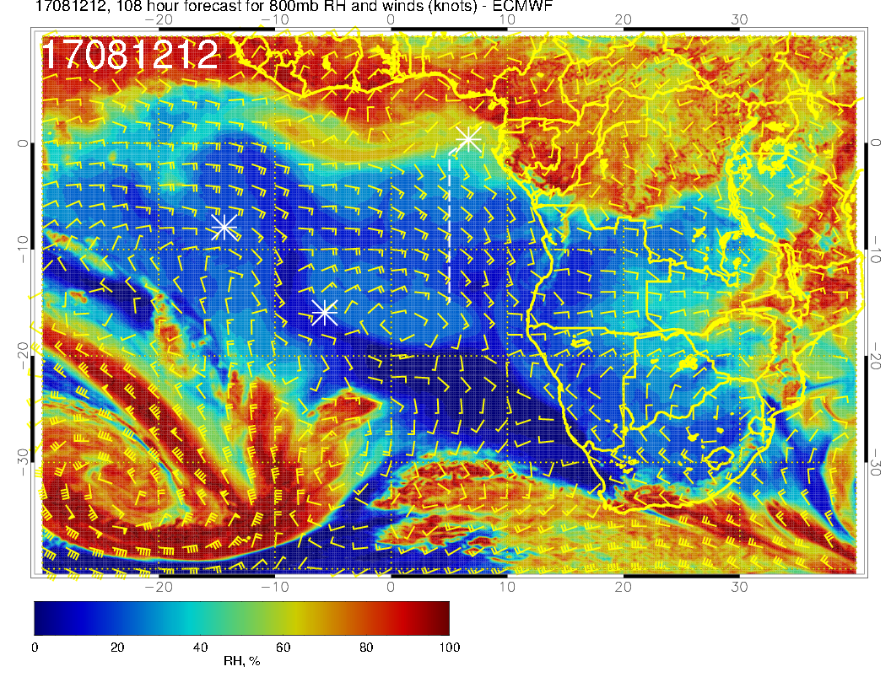
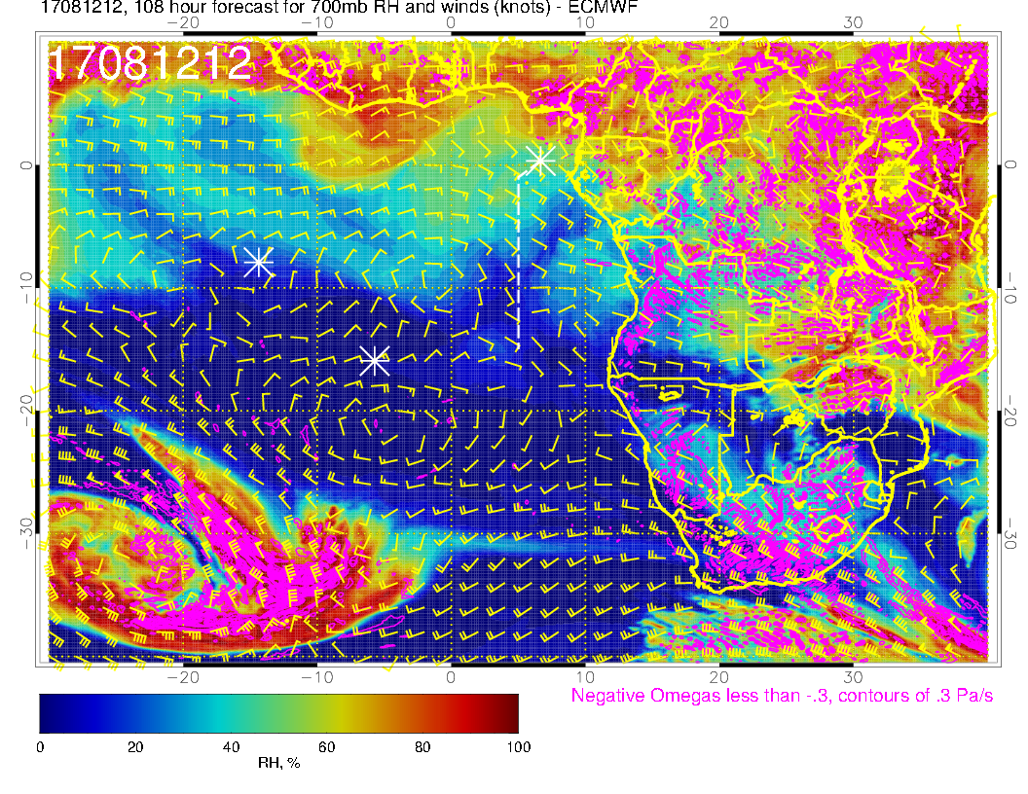
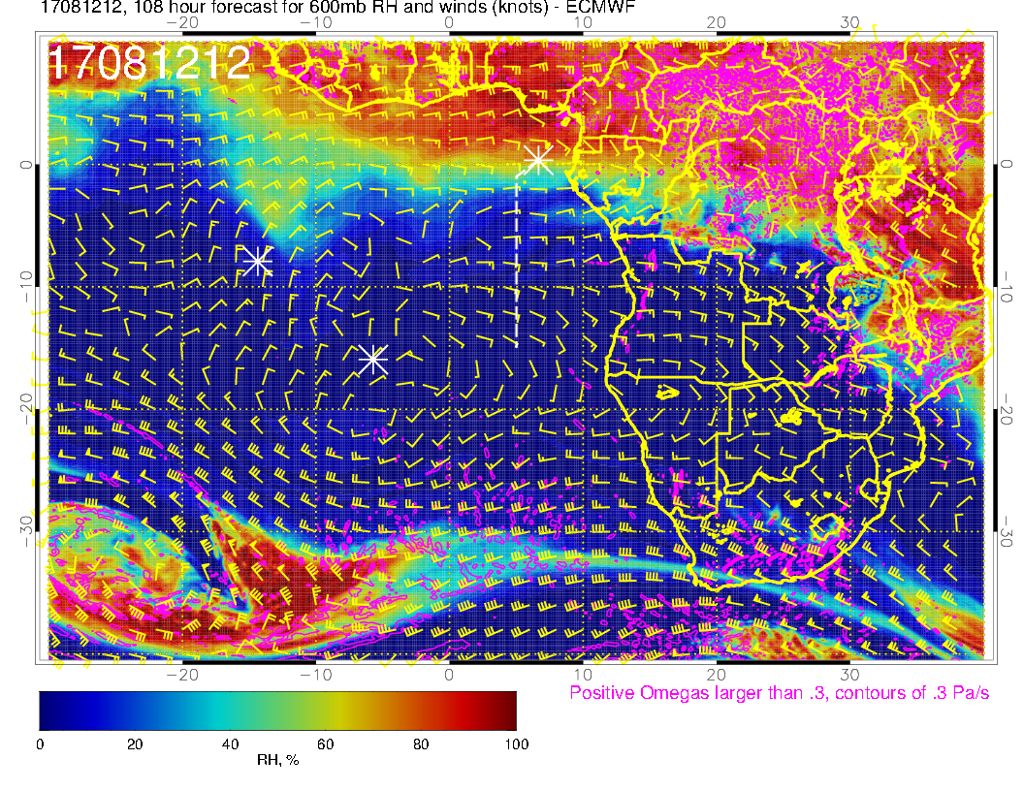
700mb
800mb
600mb
Mid level RH and flow. Situation quite dry even at the northern end. Flow has a northwestward tilt, so air is coming from drier parts of the continent (no precip).

Slide 23
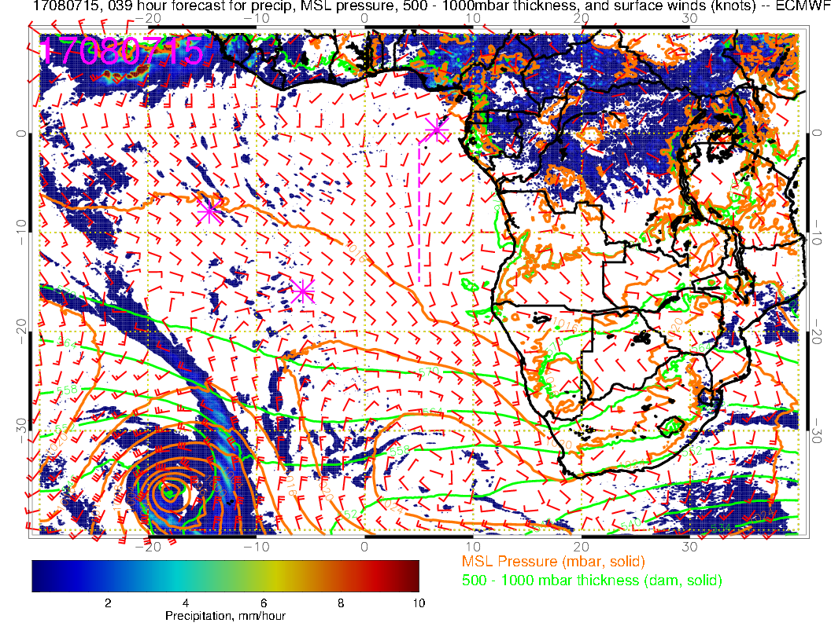
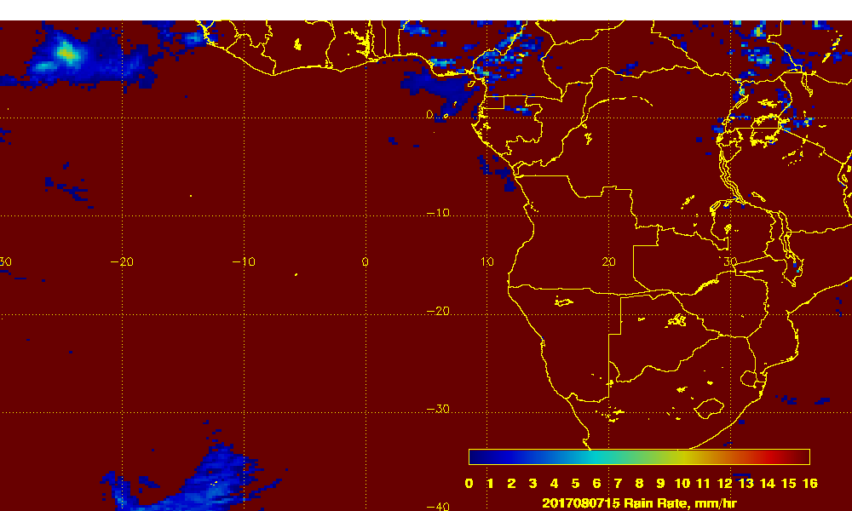
Just a note on precip. EC model 39 hour forecast (above) for yesterday at 3 PM. Satellite precip product (near real time, not final) at right. Model is overestimating precip. Model does better with the shorter term forecasts (not shown).

Slide 24
Summary
GMAO and EC model show the cloud gap, as seen today, near 5S on Saturday.
Wind speeds are very low in this region on Saturday, with westerlies instead of southerlies.
Based on today’s satellite picture we can expect a gradient of cloud properties, from clear north of ~5S, to large cells, to smaller cells south of 10S. Gradient likely to be less sharp than today
High clouds between 0 and 5S are a concern on Saturday
Mid levels are relatively dry – northwestward flow from the continent
Longer range model precipitation (more than 24 hour) over continent may be marginal.

