Slide 1
ORACLES Forecast Briefing (Aerosols)
08 August 2017

Slide 2
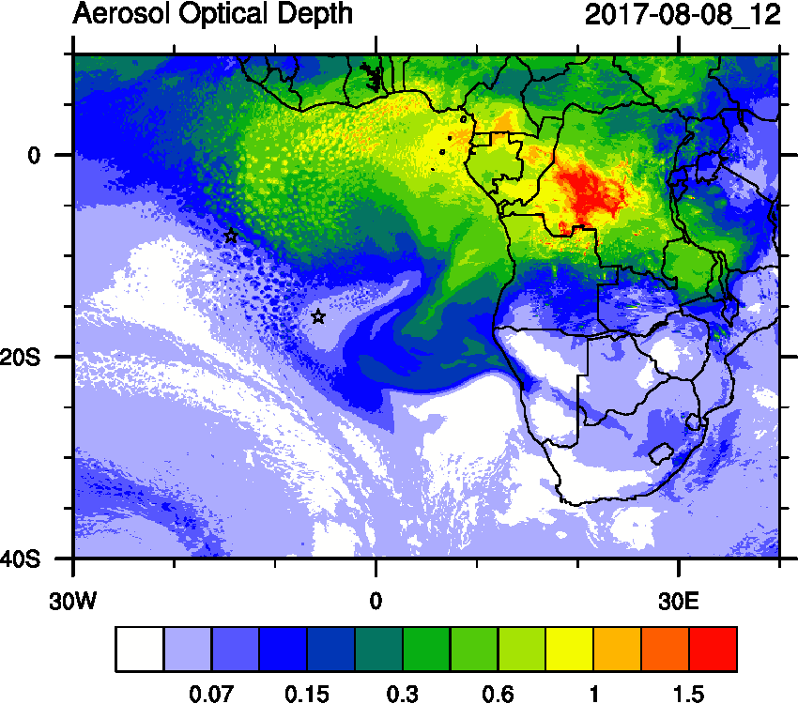
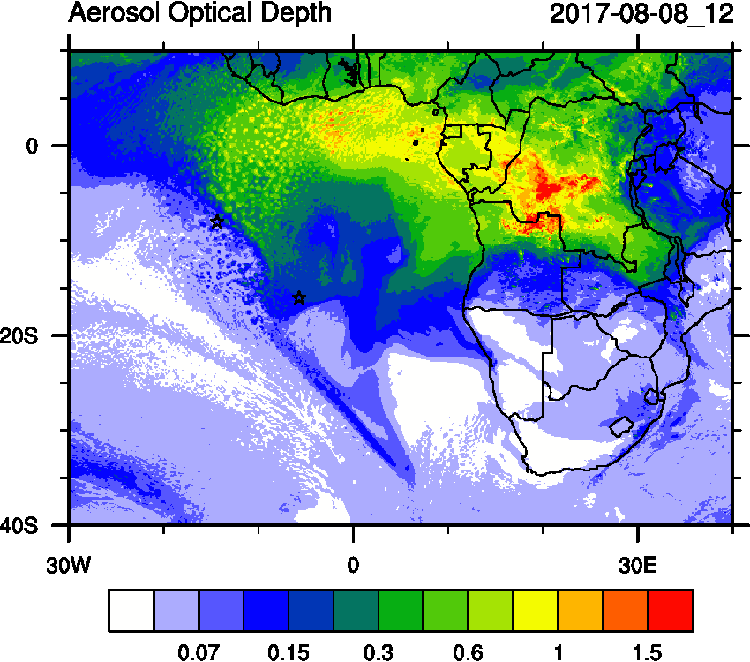
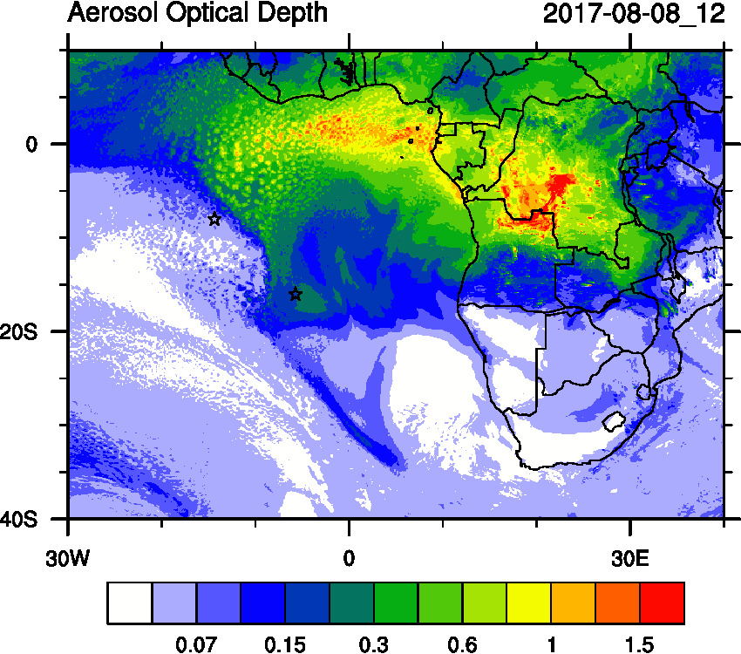
Tuesday (08) August 2017 12Z
3-d forecast
2-d forecast
todays forecast

Slide 3
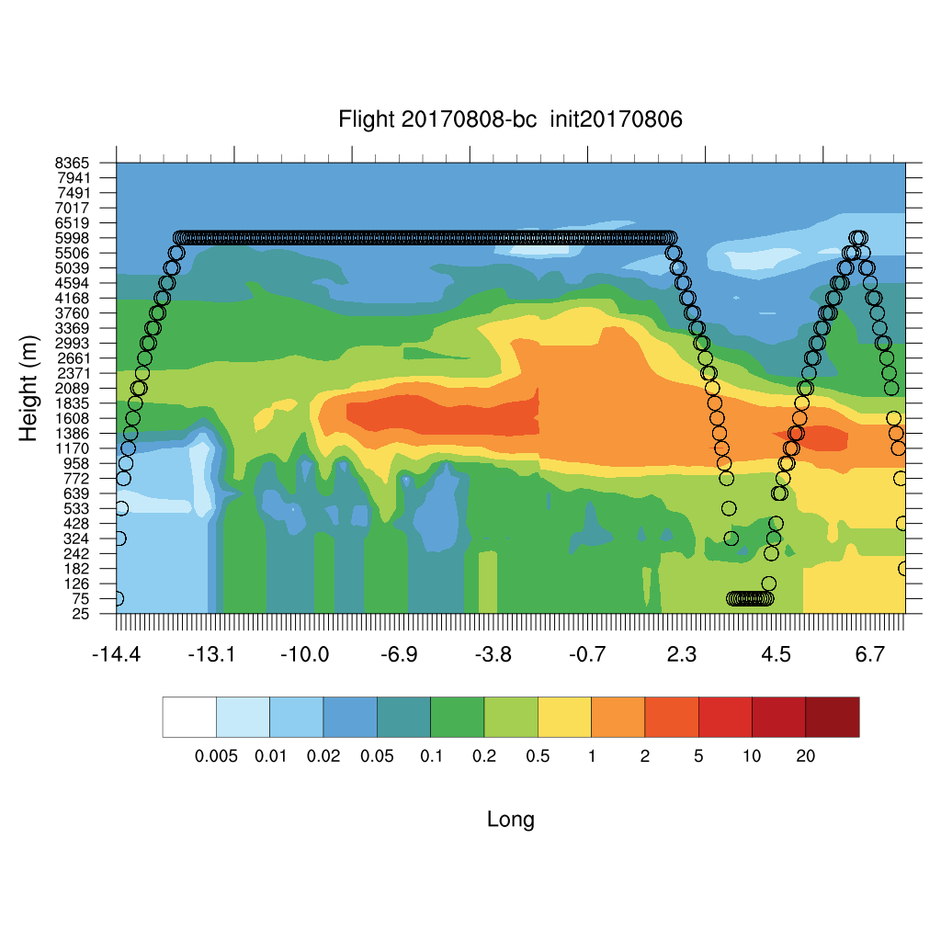
Tuesday (08) August 2017 12Z (yesterday)

Slide 4
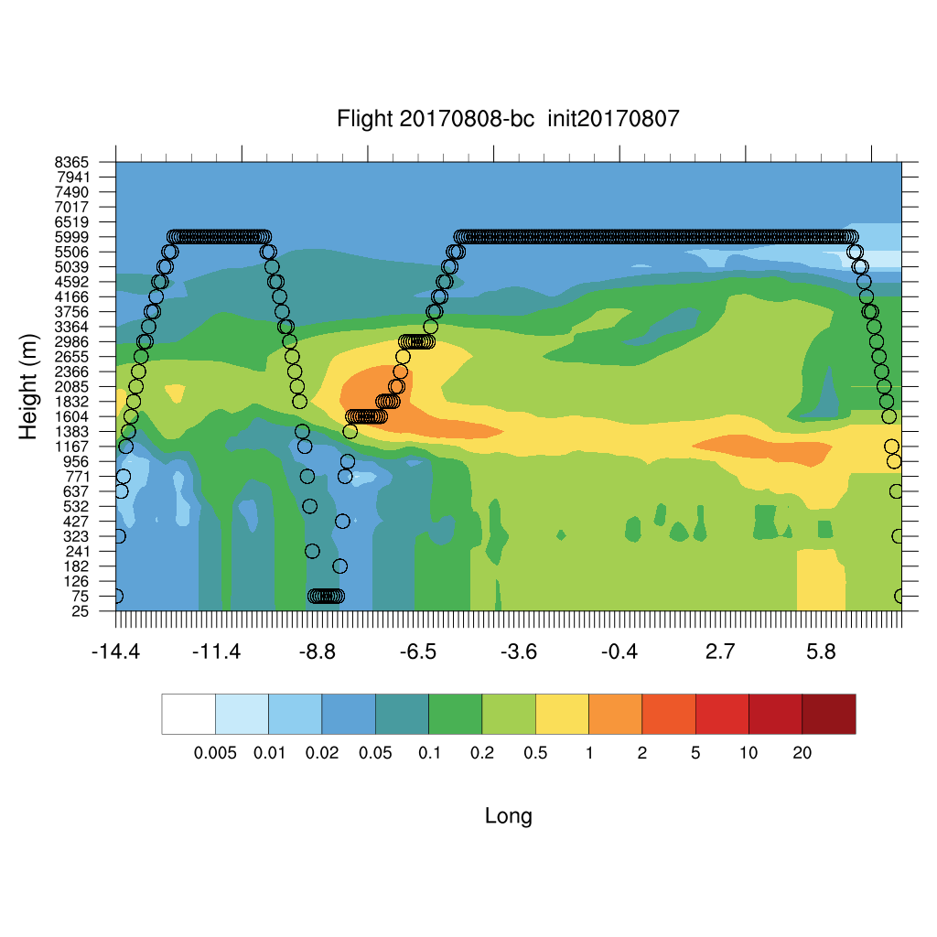
Tuesday (08) August 2017 12Z (Today)

Slide 5
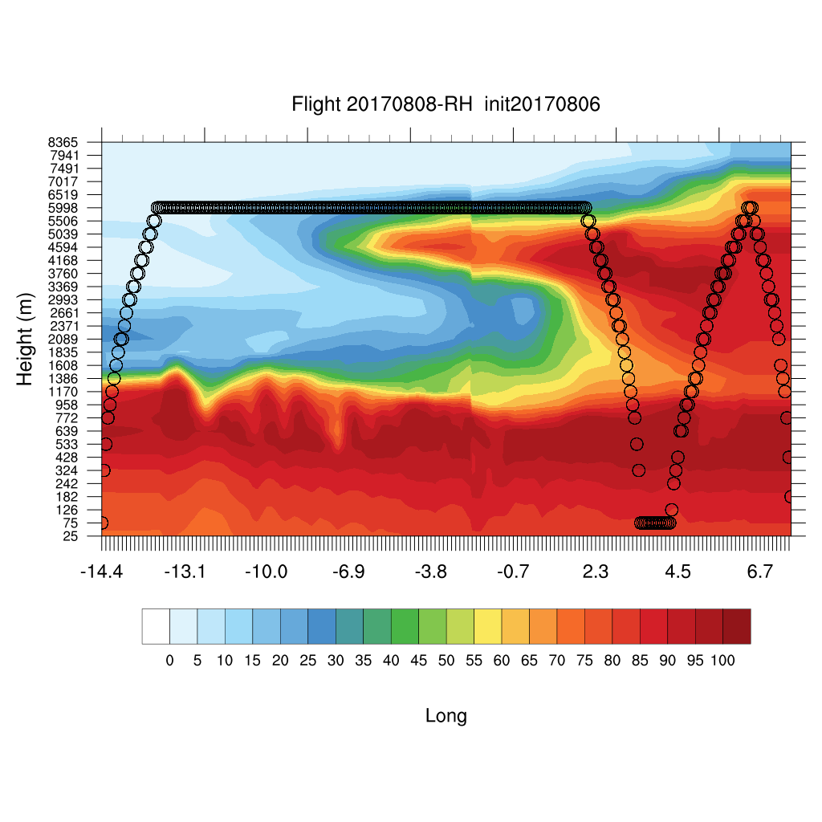
Tuesday (08) August 2017 12Z yesterday

Slide 6
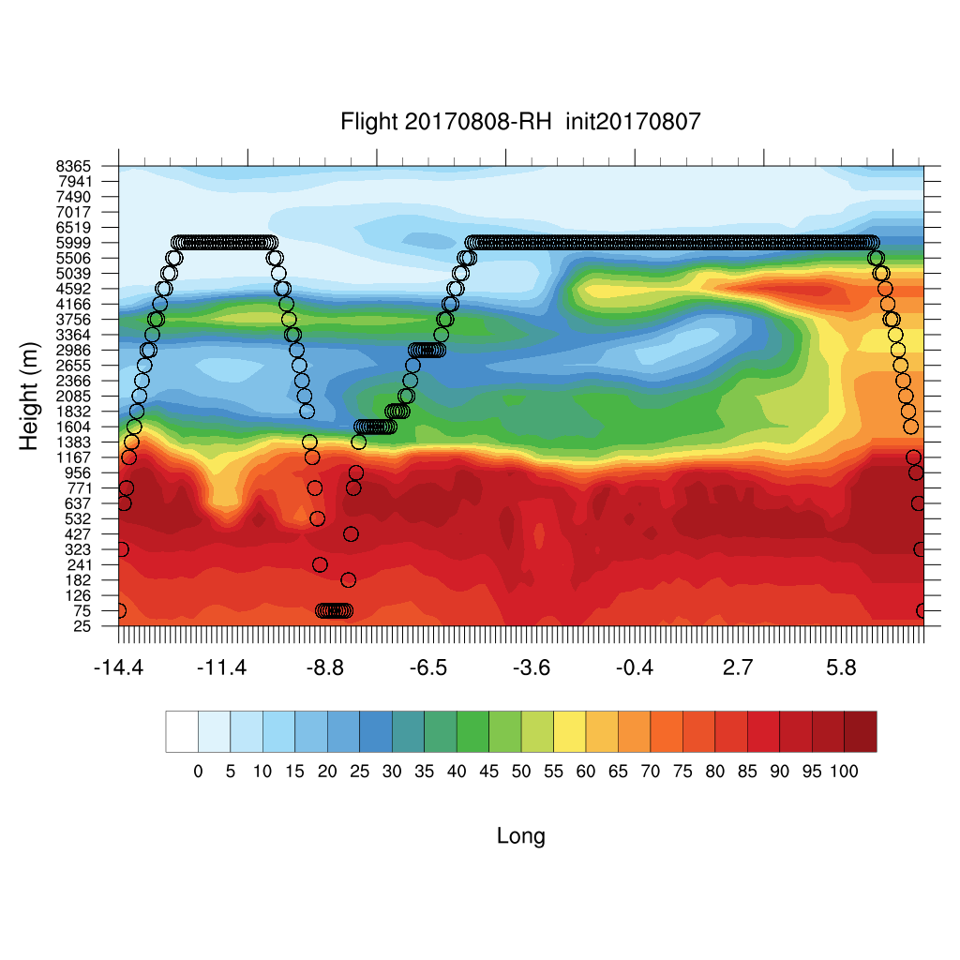
Tuesday (08) August 2017 12Z (Today)

Slide 7
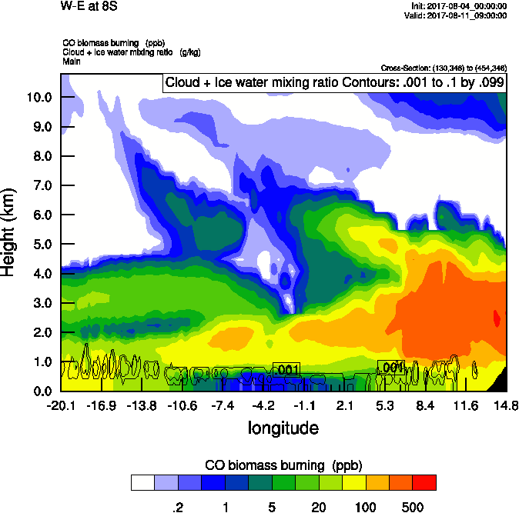
Wednesday (09) August 2017 12Z

Slide 8
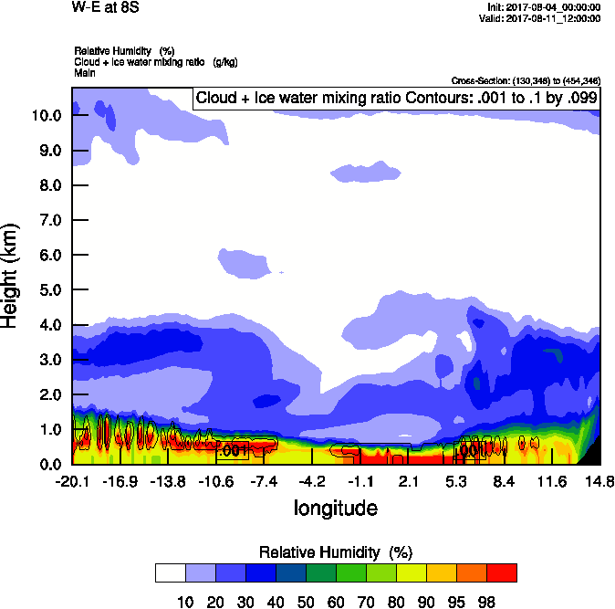
Wednesday (09) August 2017 12Z

Slide 9
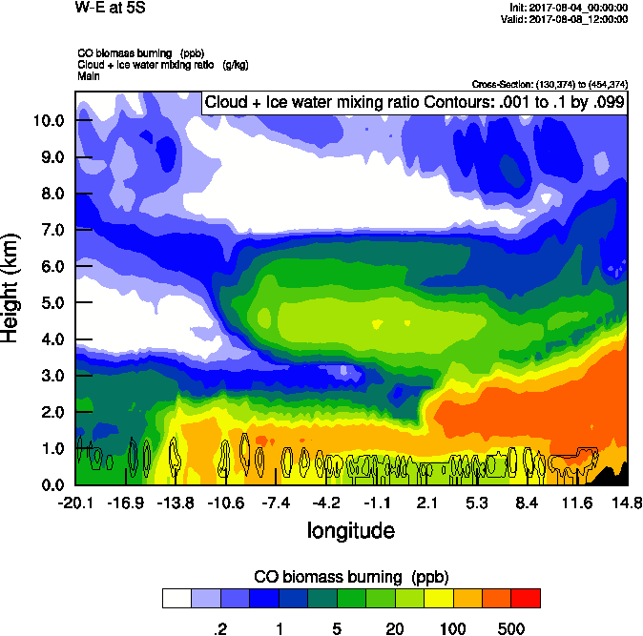
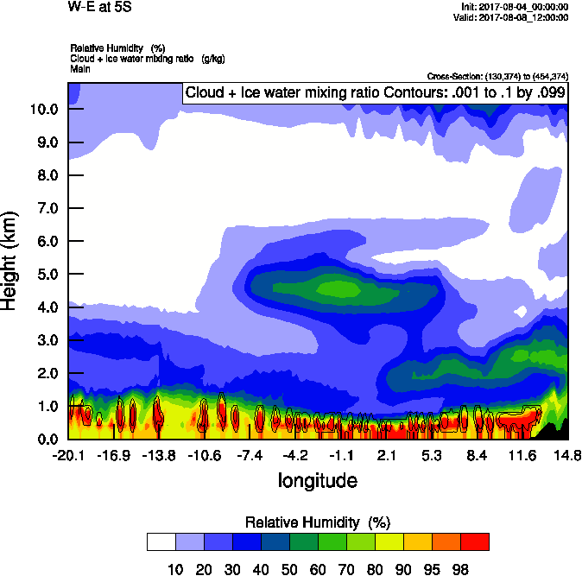

Slide 11
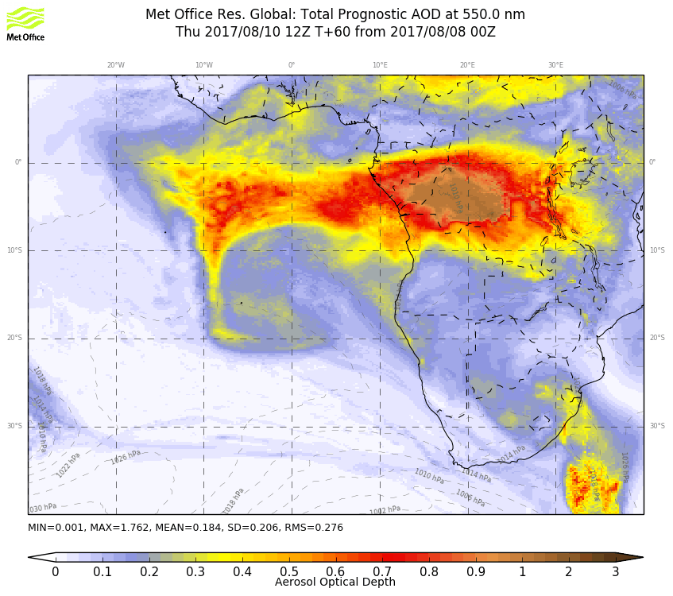
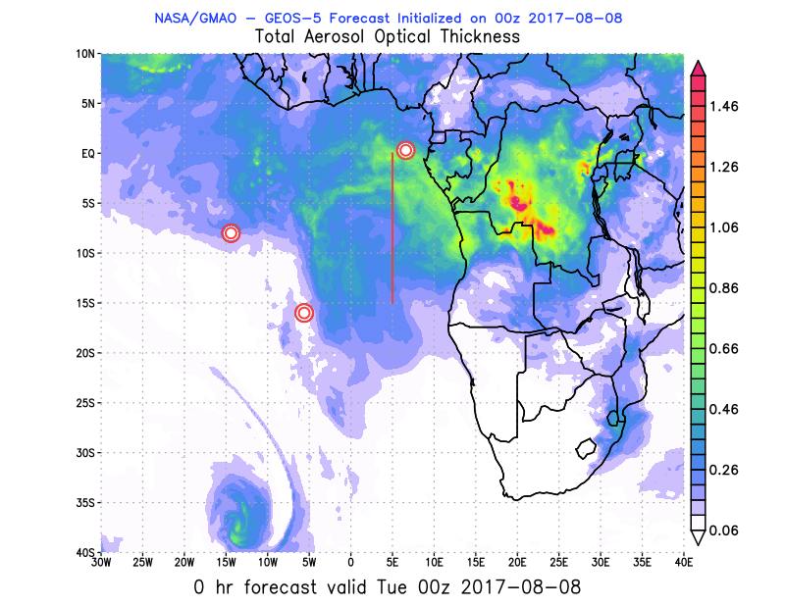
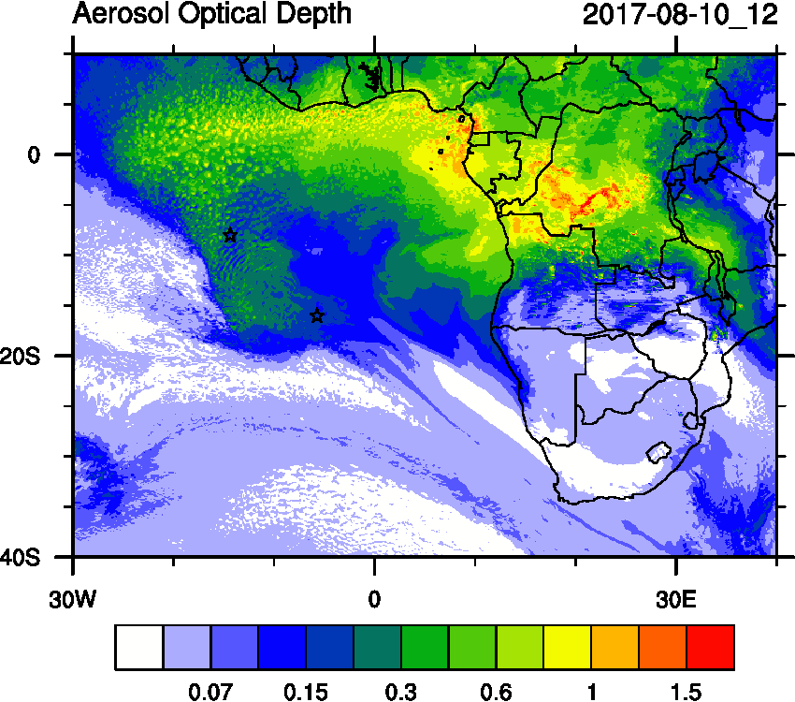
Thursday August 10 12 z (NEW)

Slide 12
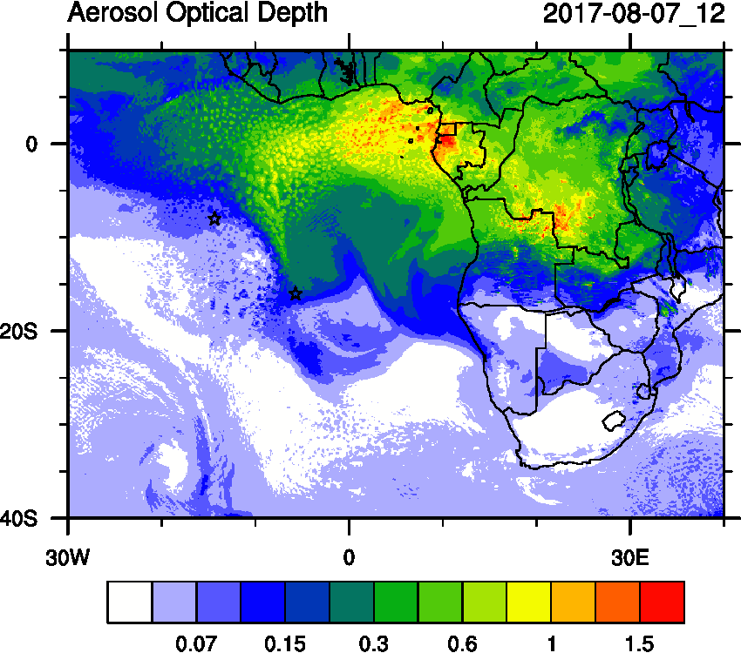
August 7 AOD

Slide 13
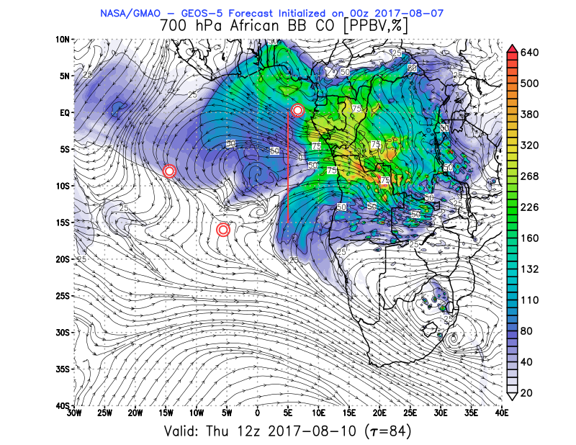
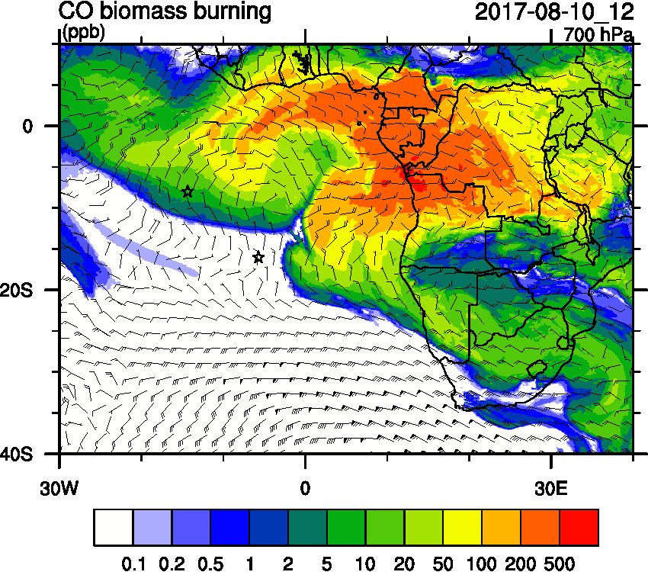
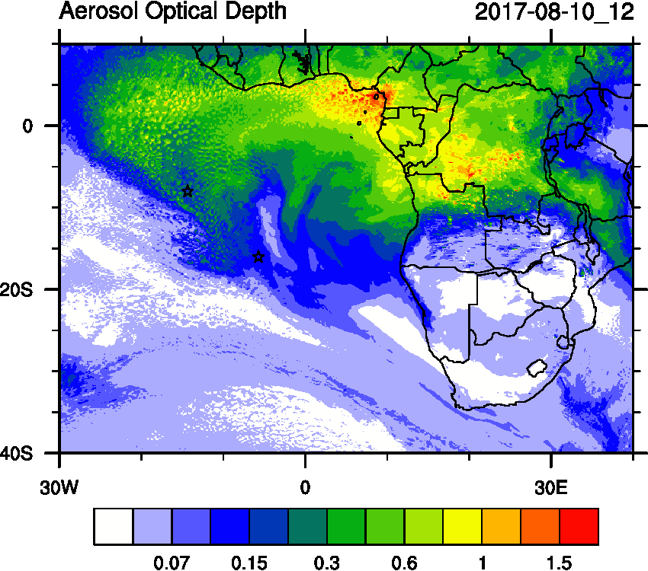
Thursday August 10 12 z (old)

Slide 14
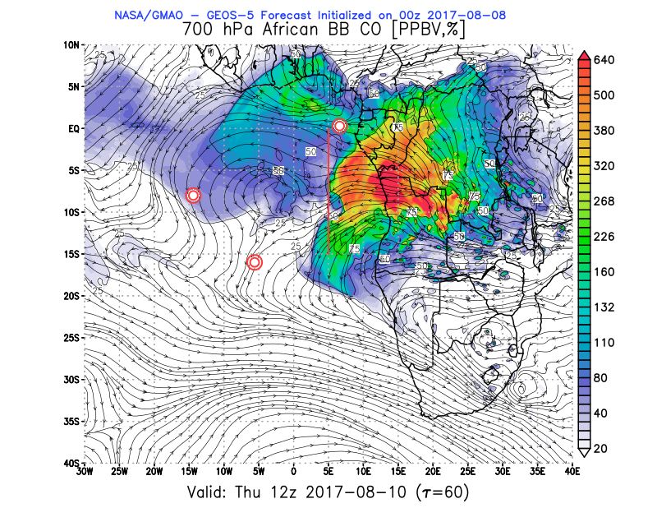
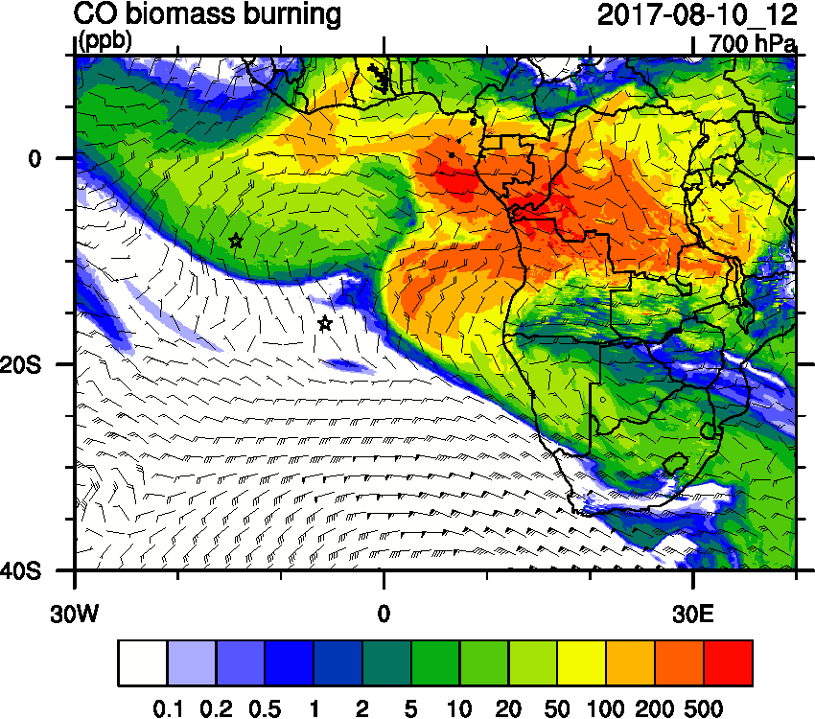
Thursday August 10 12 z (NEW)

Slide 15
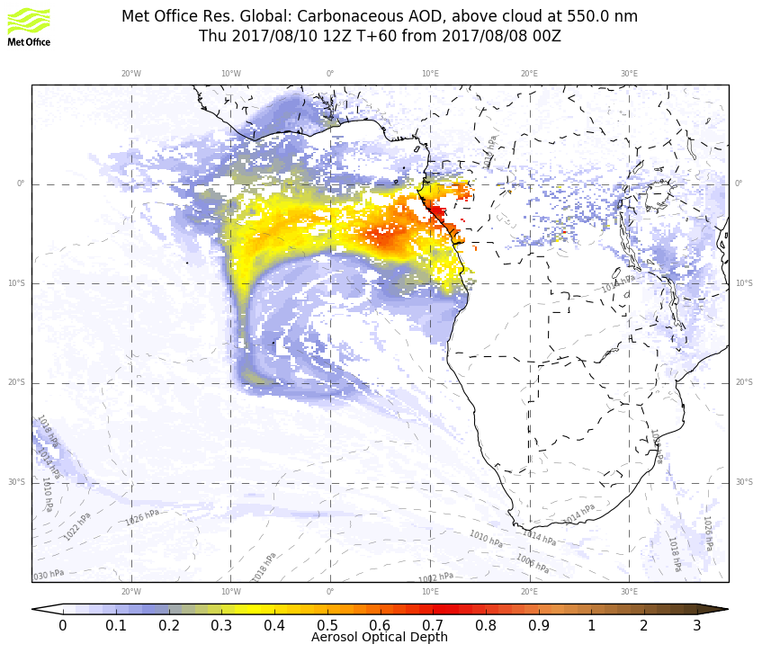
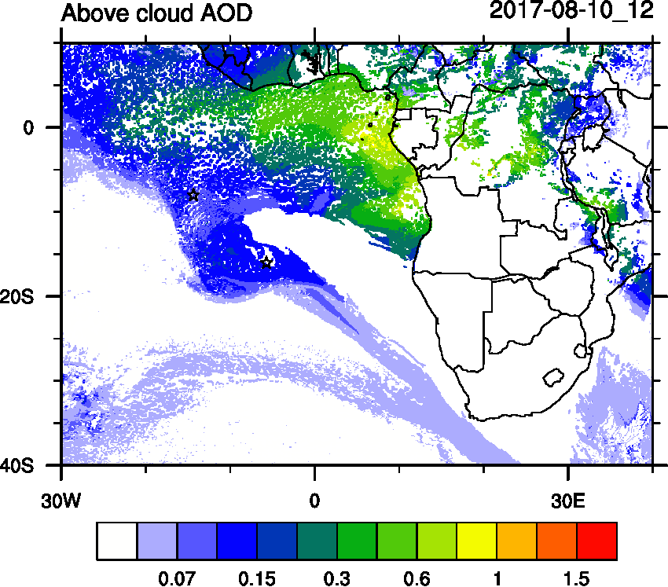
Thursday August 10 12 z (NEW)

Slide 16
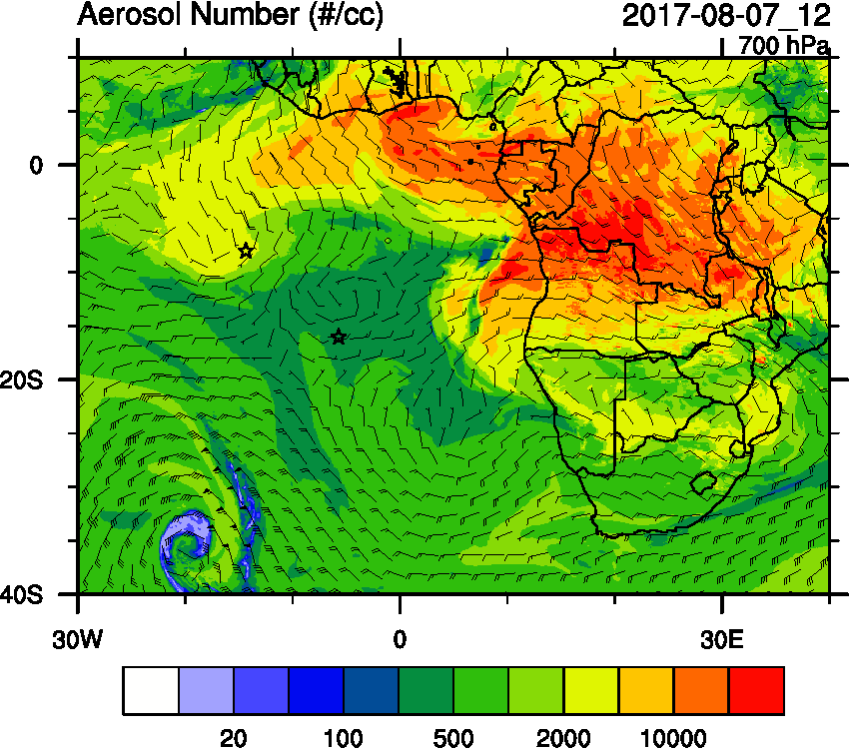
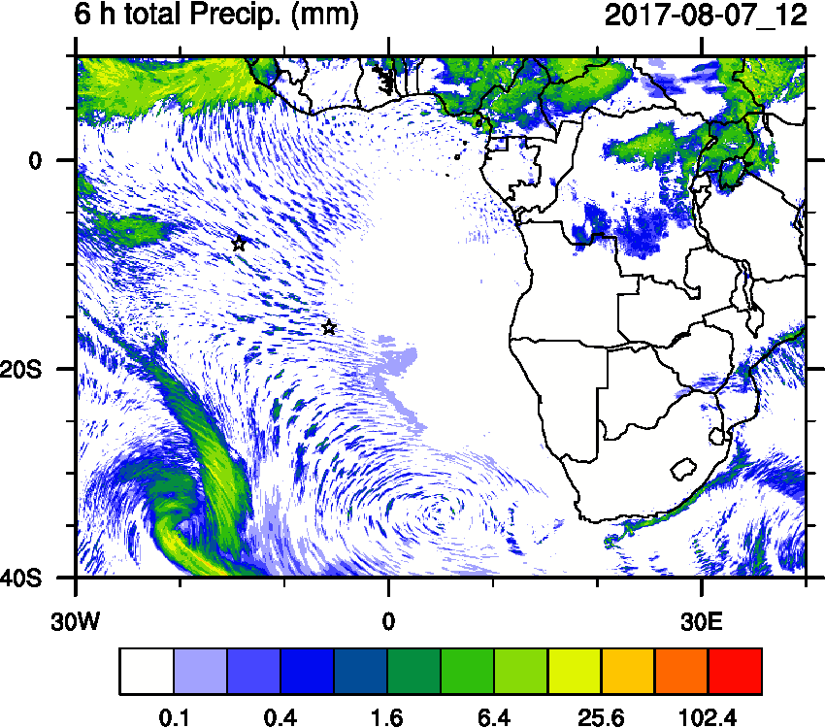
August 7 AOD

Slide 17
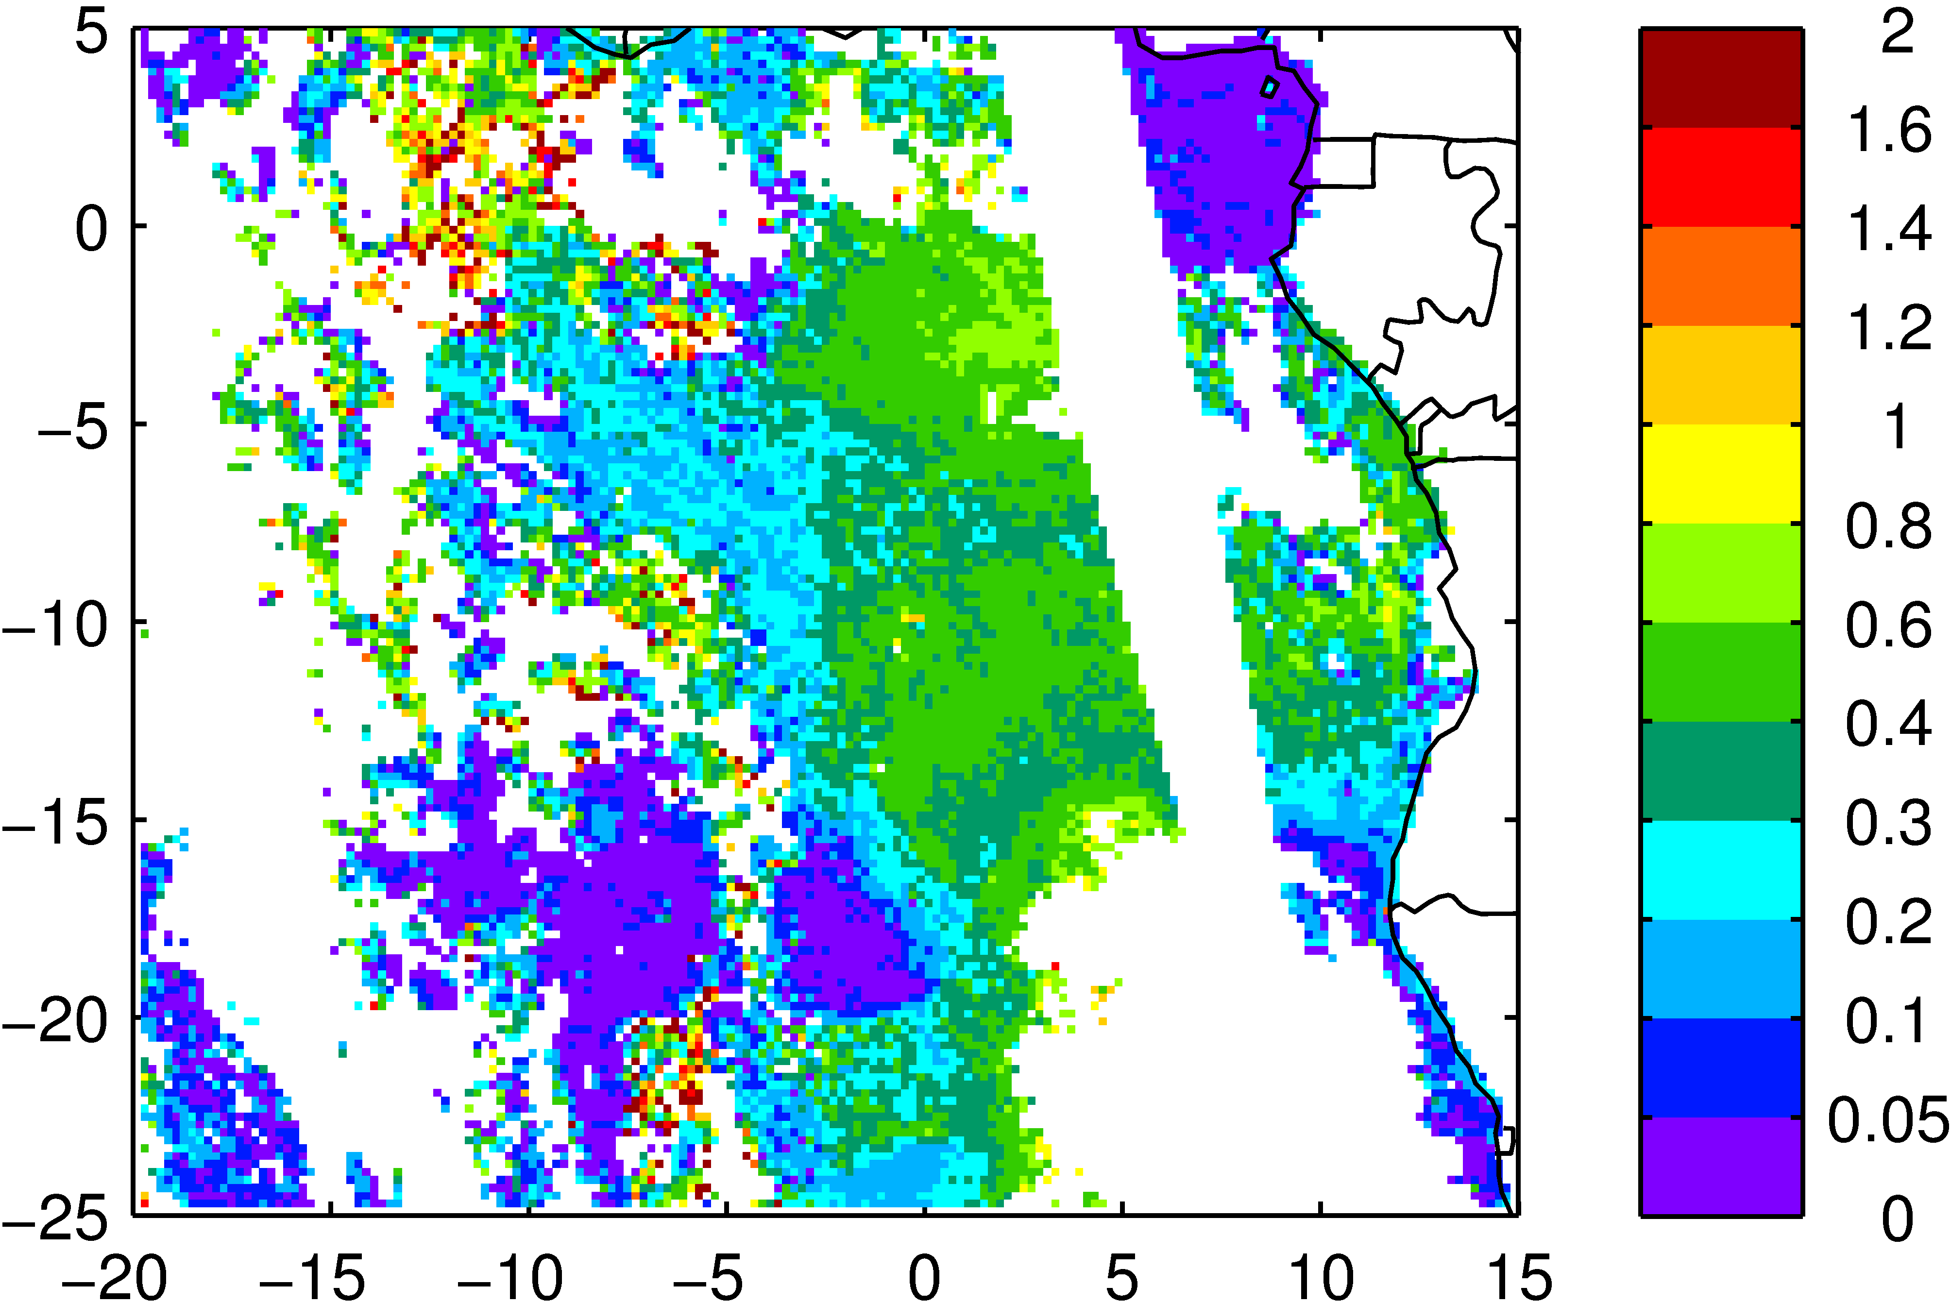
August 7 Aqua ACAOD
WRF
Obs

Slide 18
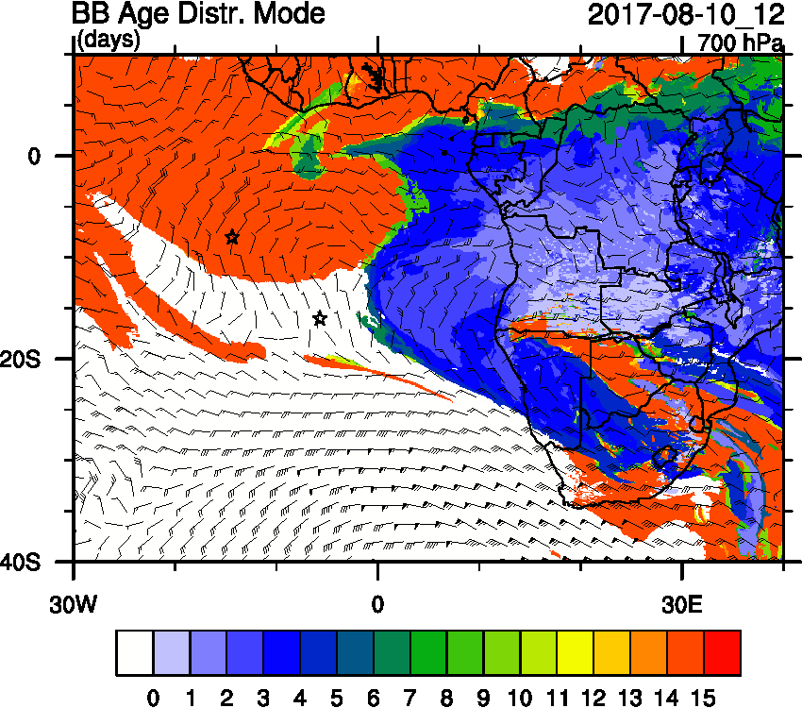
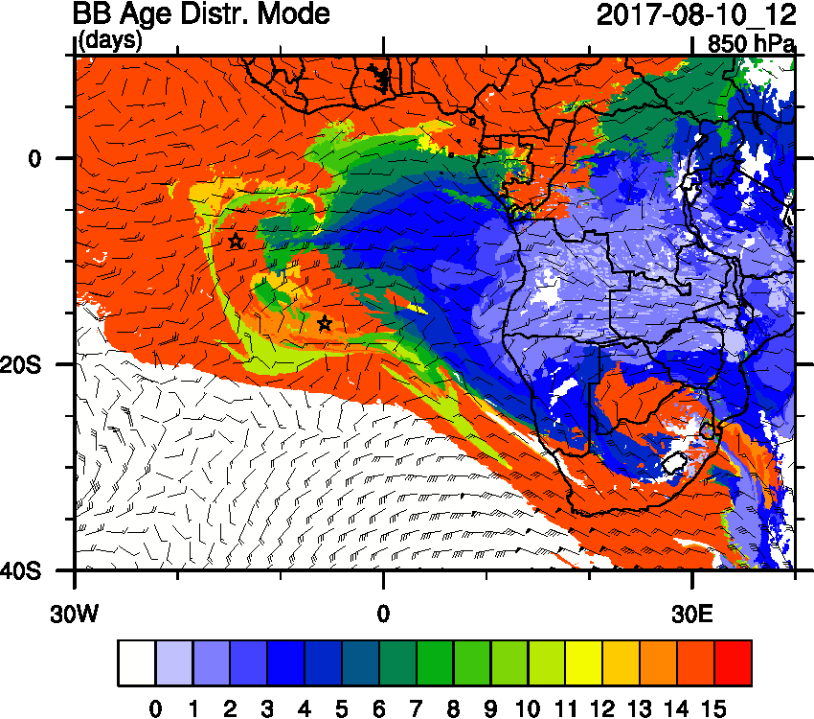
Thursday August 10 12 z

Slide 19
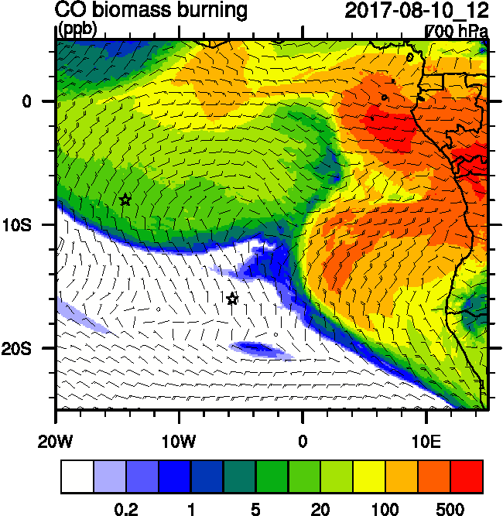
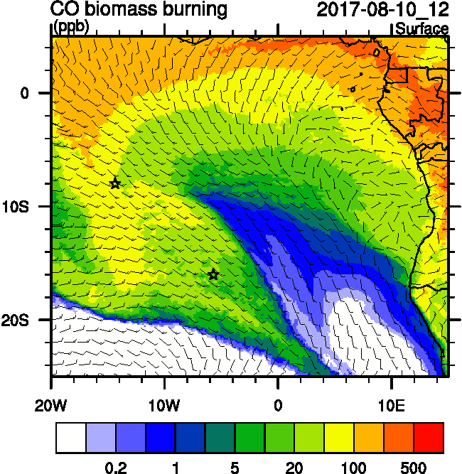
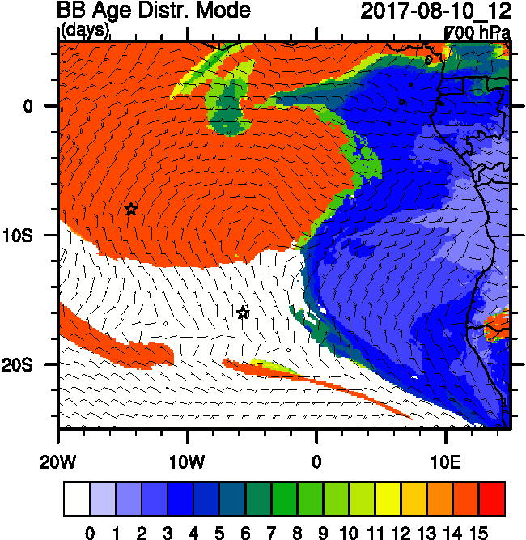
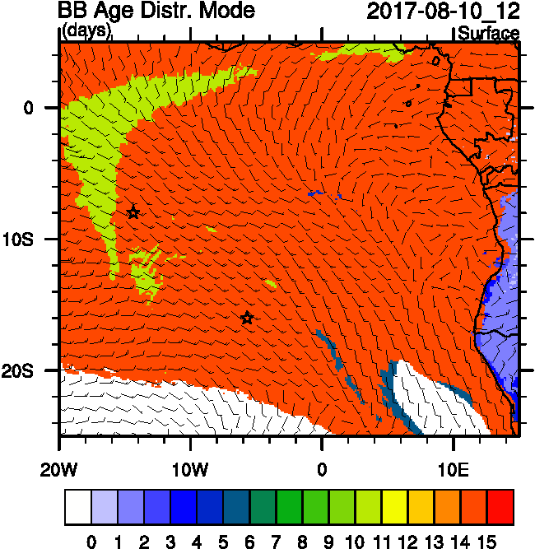
Thursday August 10 12 z

Slide 20
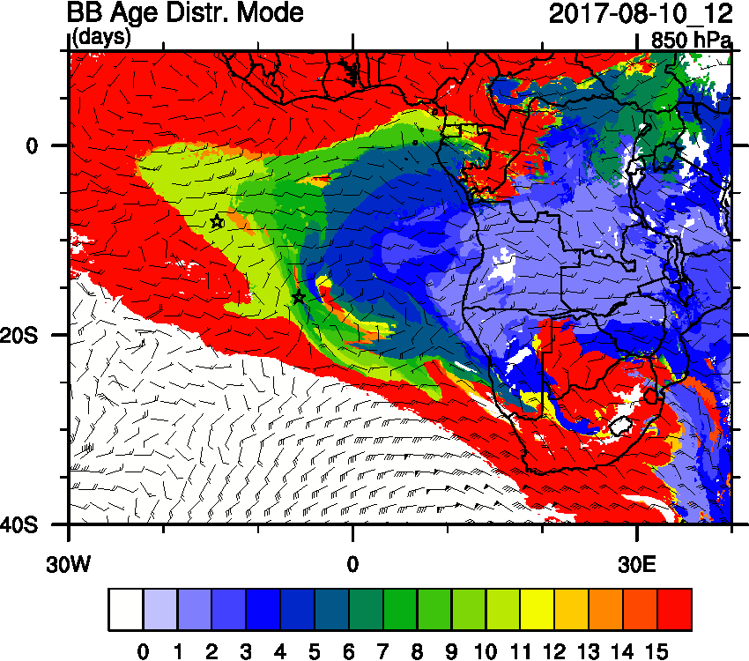
Thursday August 10 12 z OLD

Slide 21
Thursday August 10 12 z

Slide 22
Thursday August 10 12 z

Slide 23
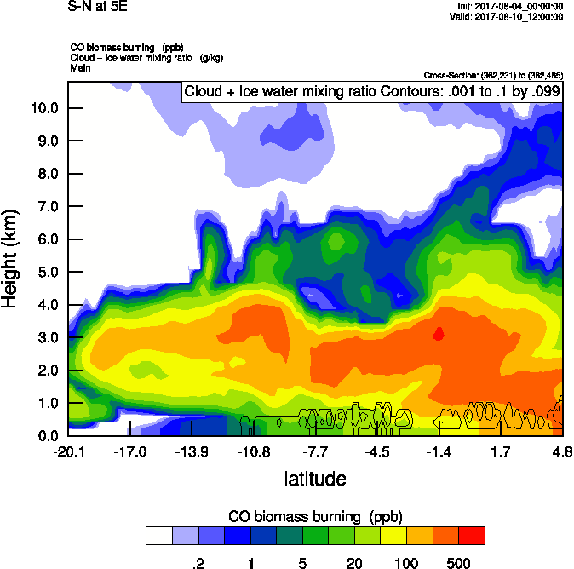
Thursday August 10 12 z

Slide 24
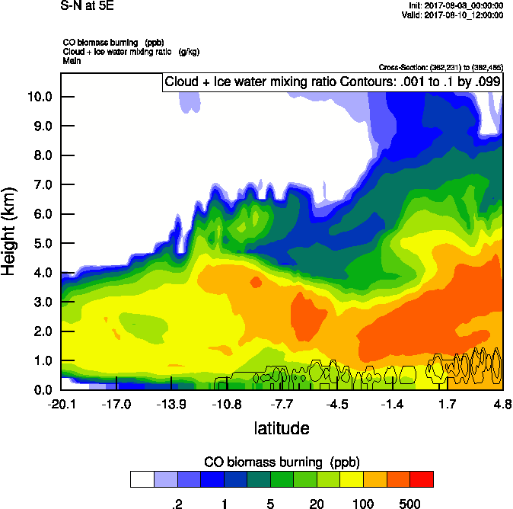
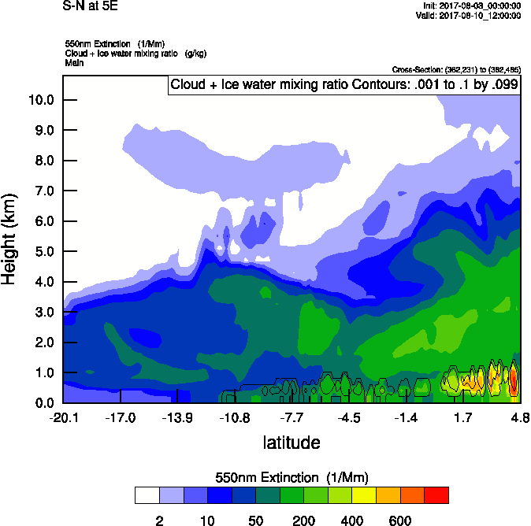
Thursday August 10 12 z (OLD)

Slide 25
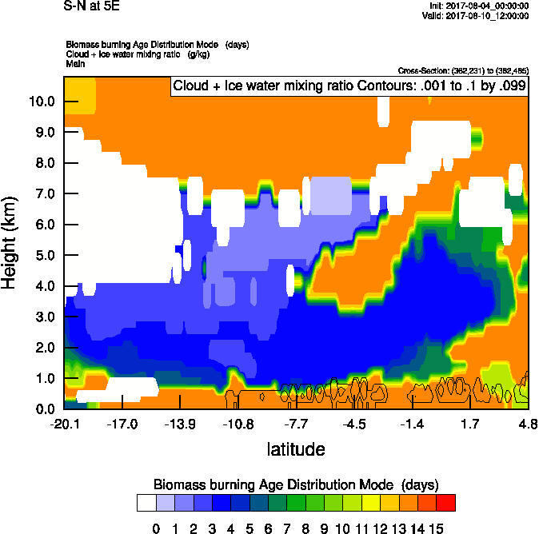
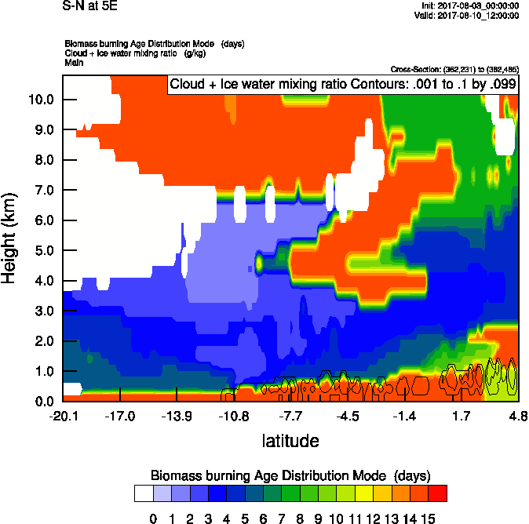
Thursday August 10 12 z

Slide 26
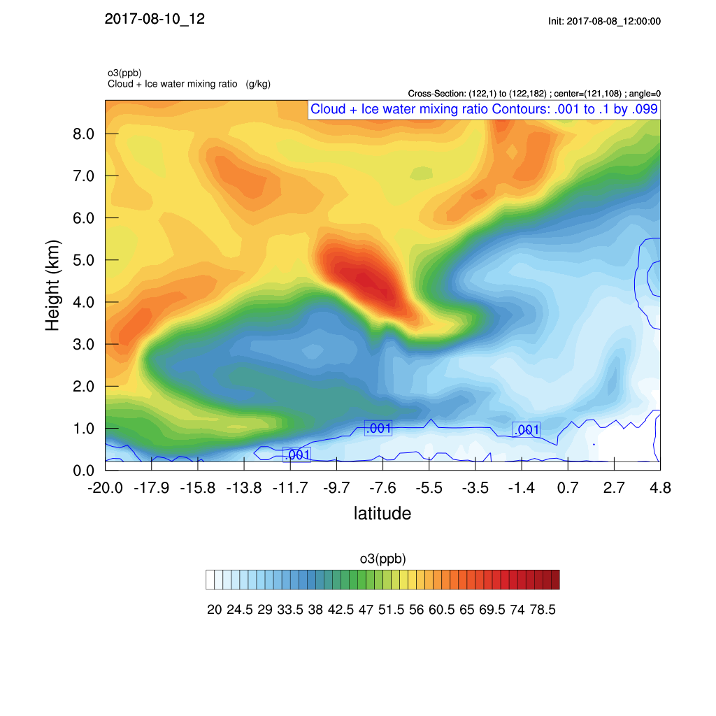
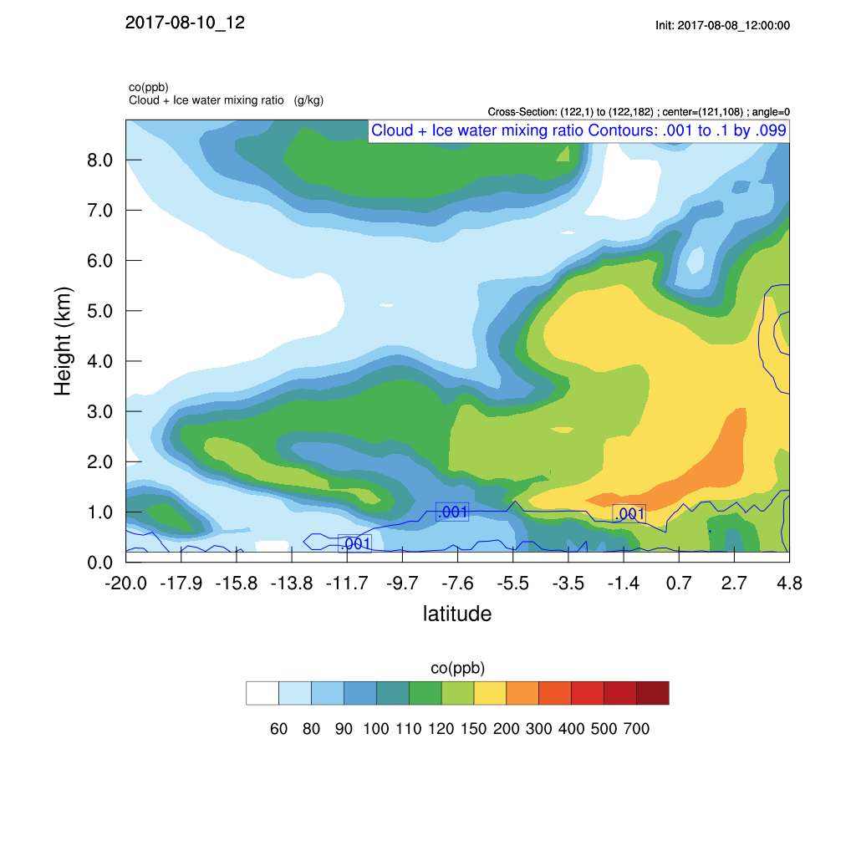
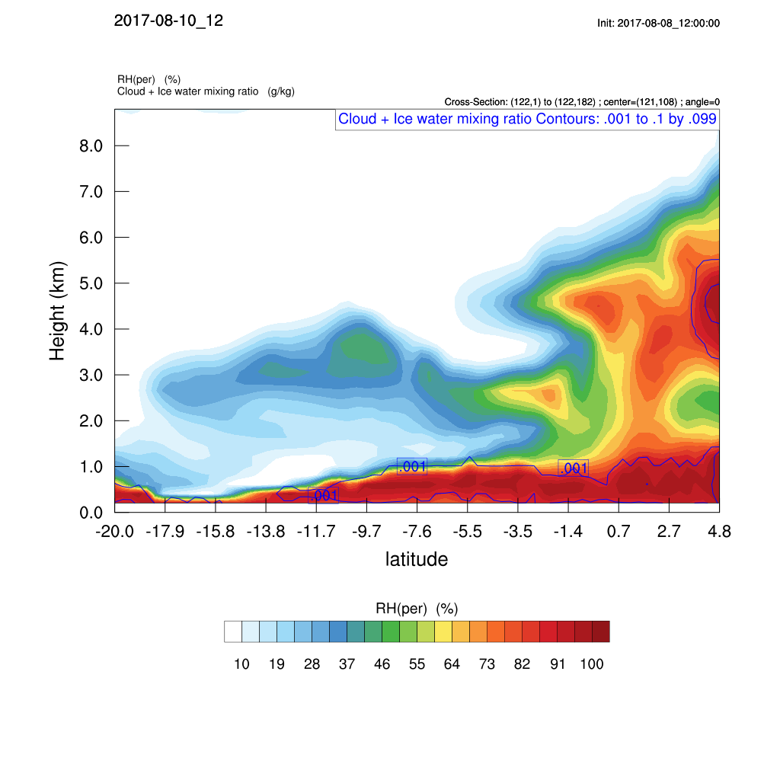
Thursday August 10 12 z
O3
CO
RH

Slide 27
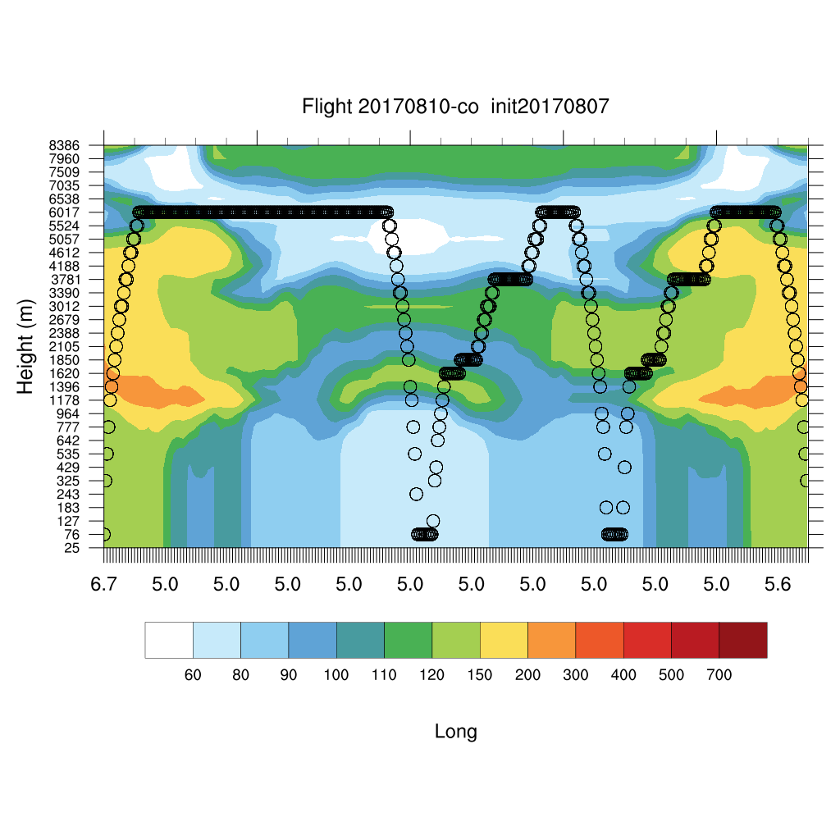
Thursday August 10
O3
7
4
CO
1
RH

Slide 28
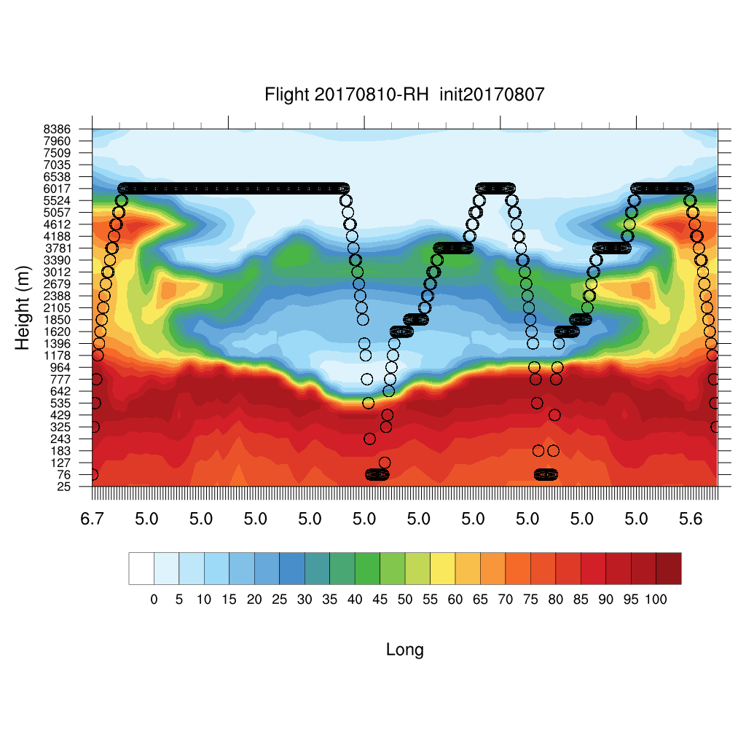
Thursday August 10
O3
7
4
CO
1
RH

Slide 30
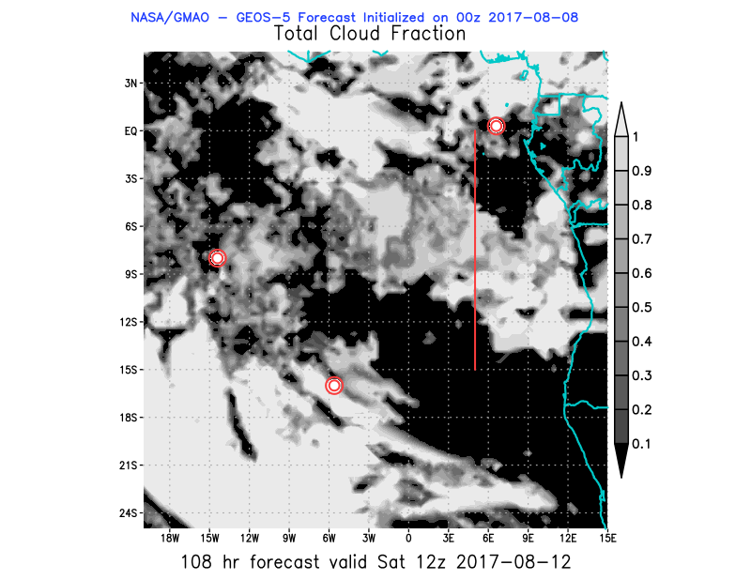
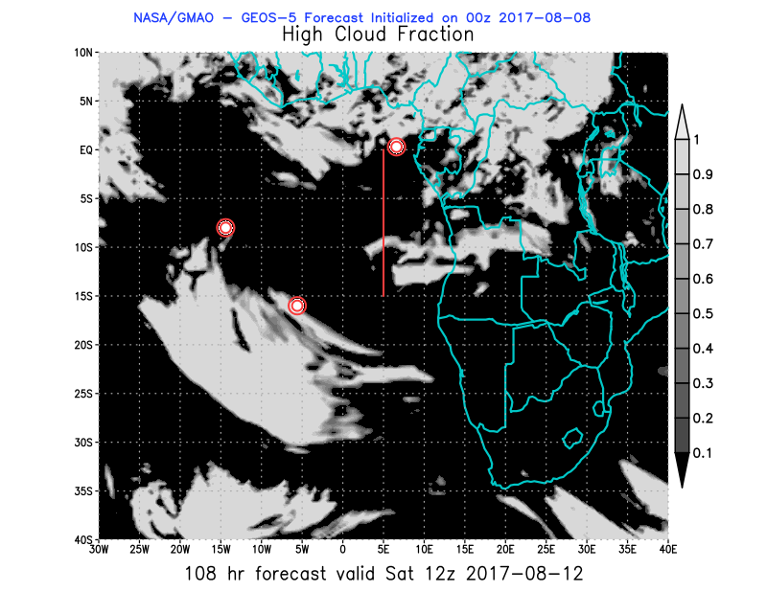
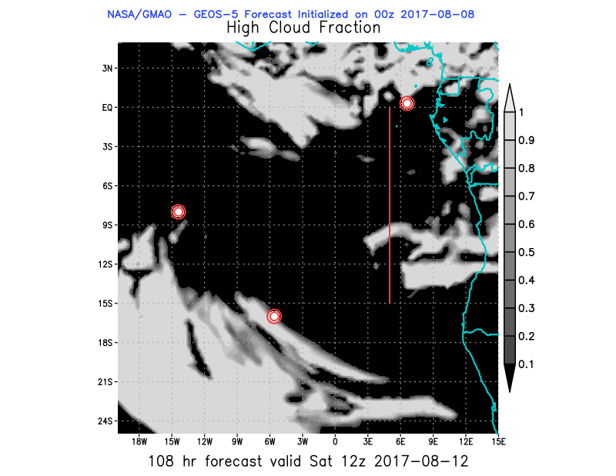
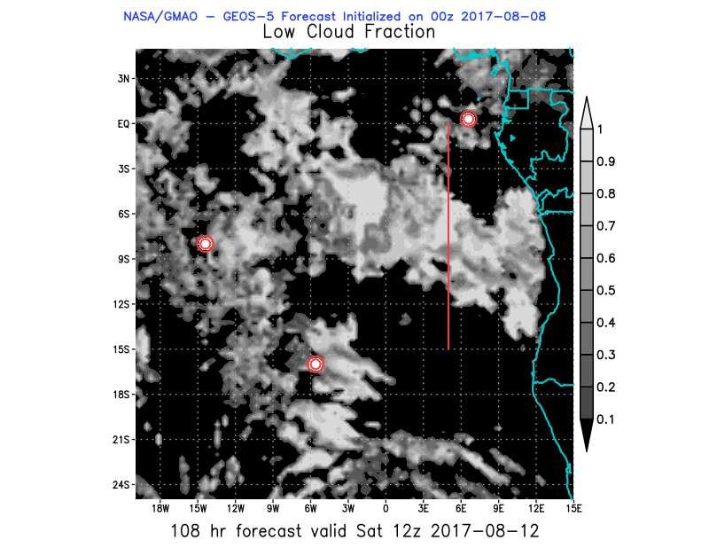
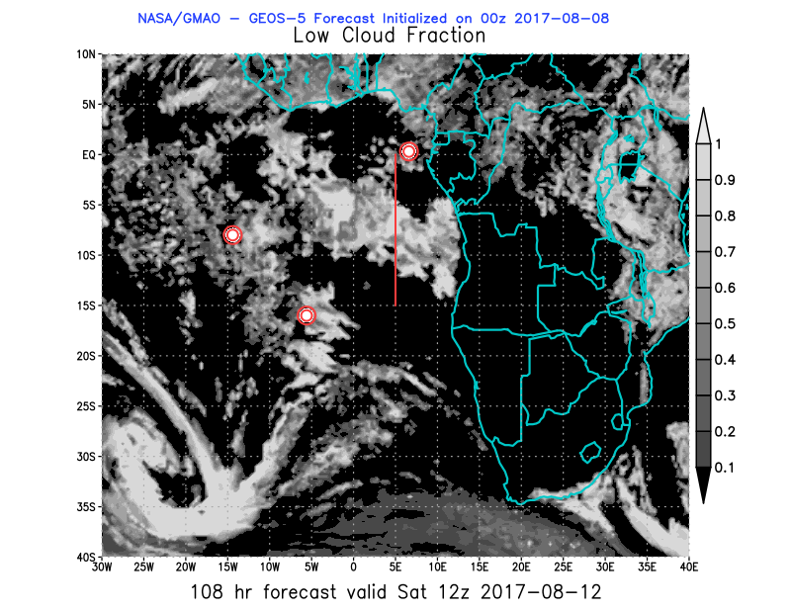
Saturday August 12 12z

Slide 31
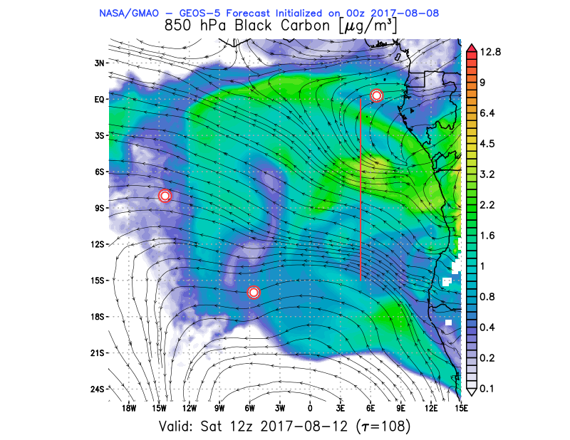
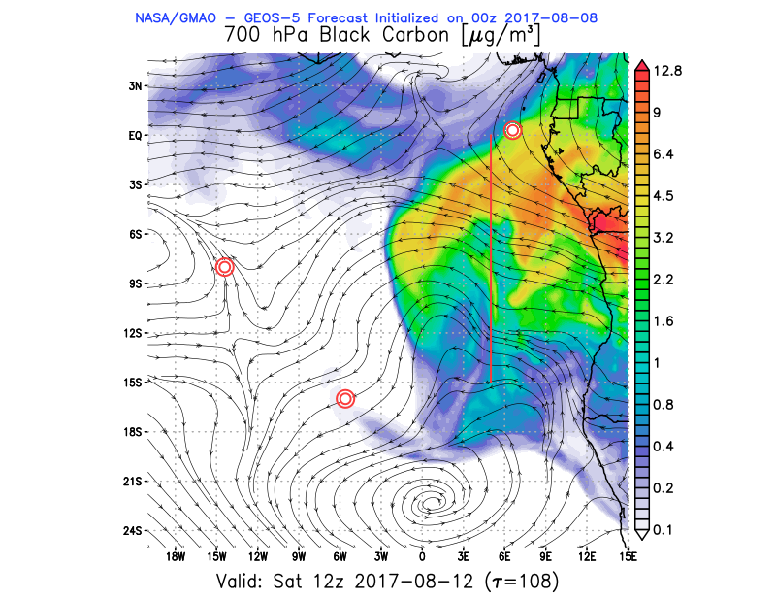
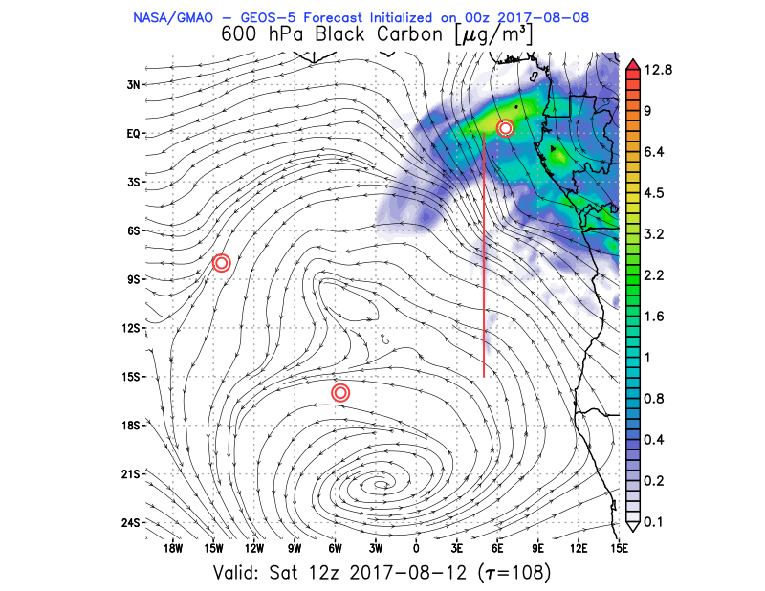
Saturday August 12 12z

Slide 32
https://portal.nccs.nasa.gov/cgi-mission/mission_2d_chem.cgi?region=oracles_lg&dtg=2017080800&prod=7totaot&model=f516_fp&tau=180&&region_old=oracles_lg&dtg_old=2017080800&prod_old=7totaot&model_old=f516_fp&tau_old=180&&loop=1
https://portal.nccs.nasa.gov/cgi-mission/mission_wx.cgi?region=oracles_lg&dtg=2017080800&prod=2cldtot&model=fp&level=sfc&tau=000&&region_old=oracles_lg&dtg_old=2017080712&prod_old=&model_old=fp&level_old=&tau_old=000&&loop=1

