Slide 1
ORACLES weather briefing
7-Aug-2017
Lenny Pfister and Rei Ueyama

Slide 2
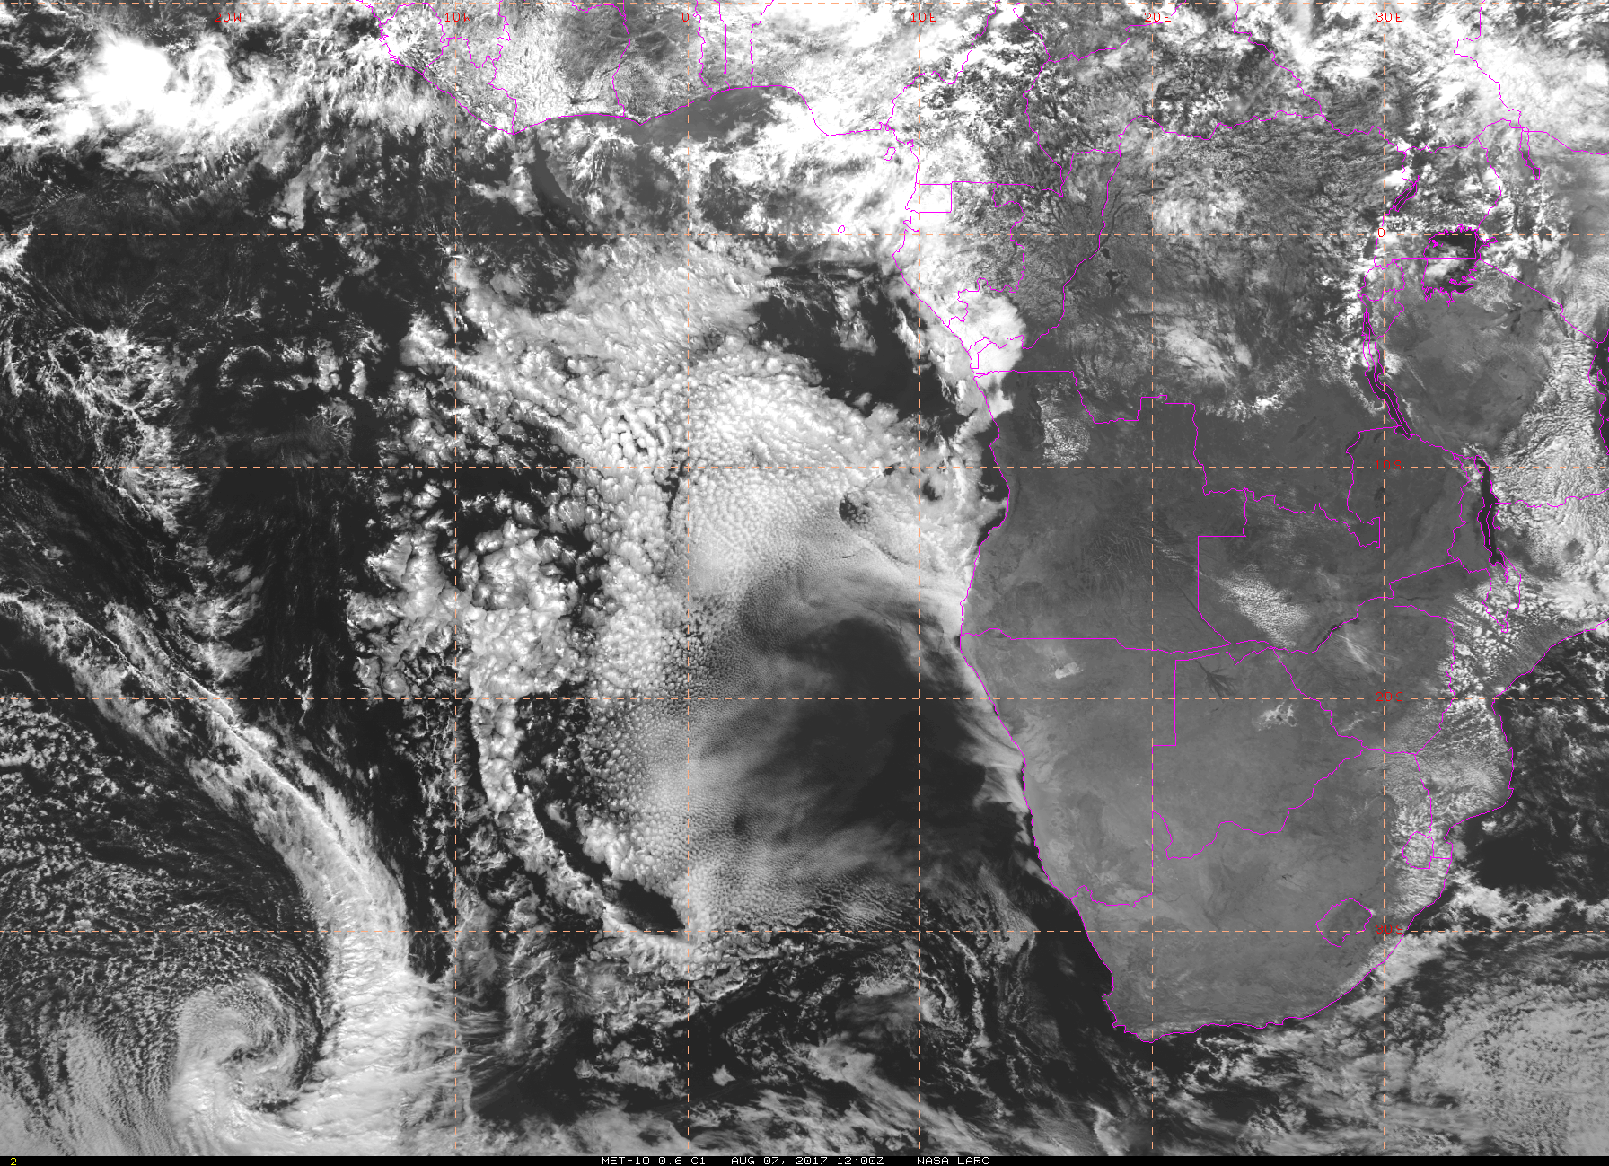
Visible satellite imagery at 8/7 Mon @ 12PM
Low and middle clouds over TMS
Clear-sky region

Slide 3
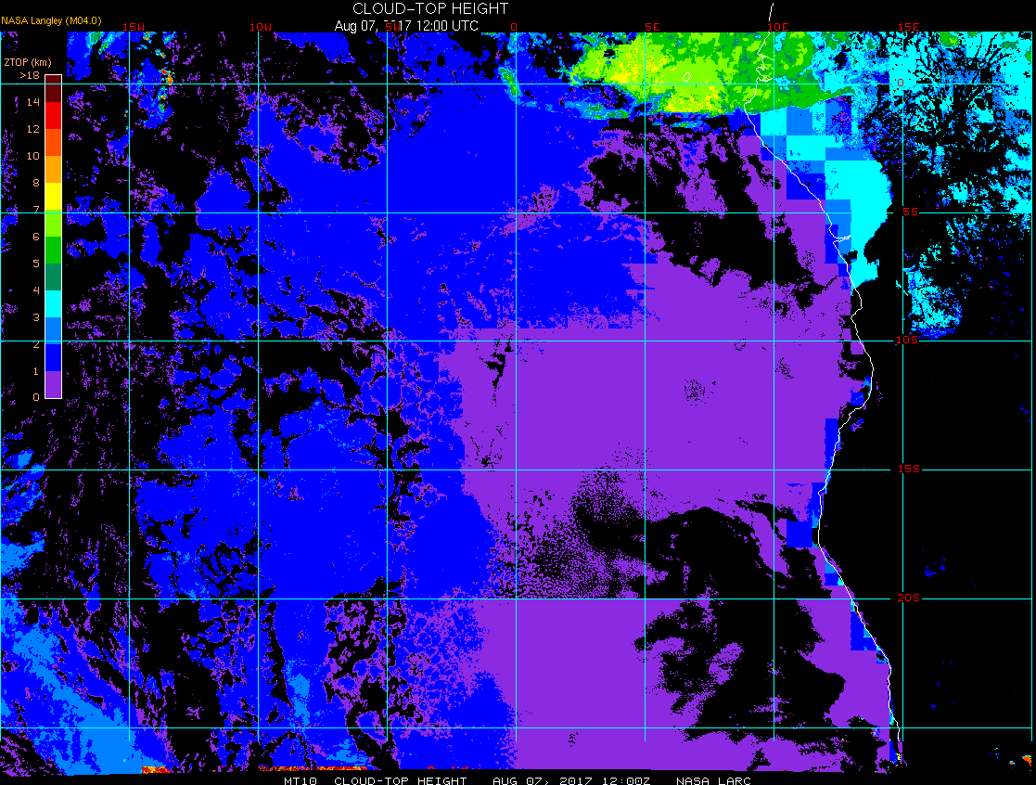
Cloud-top heights (satellite estimate) at 8/7 Mon @ 12PM
Middle clouds (tops 6-8 km) above low clouds (tops 0.6-1.2 km) over TMS
Low clouds (tops ~1.5km) over ASI

Slide 4
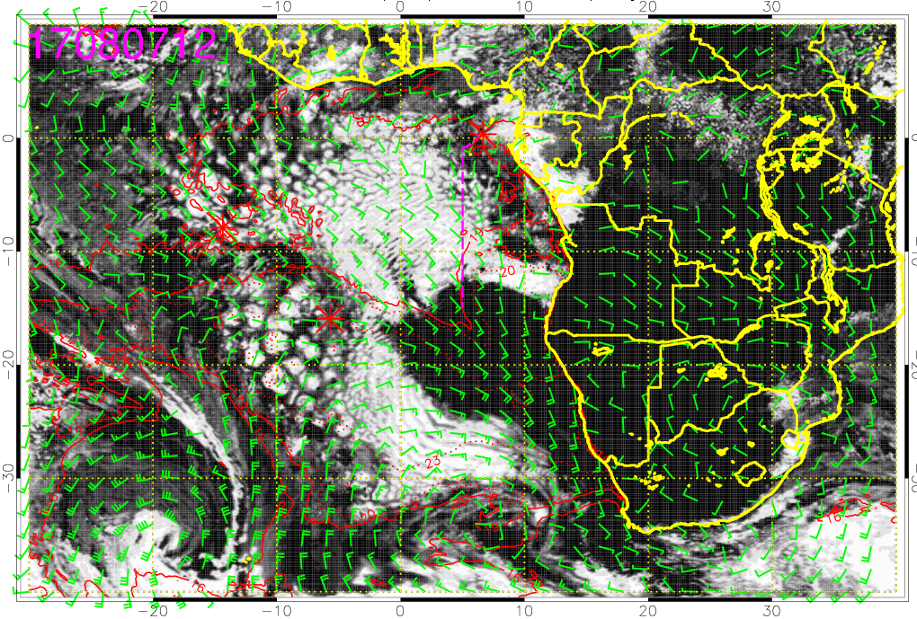
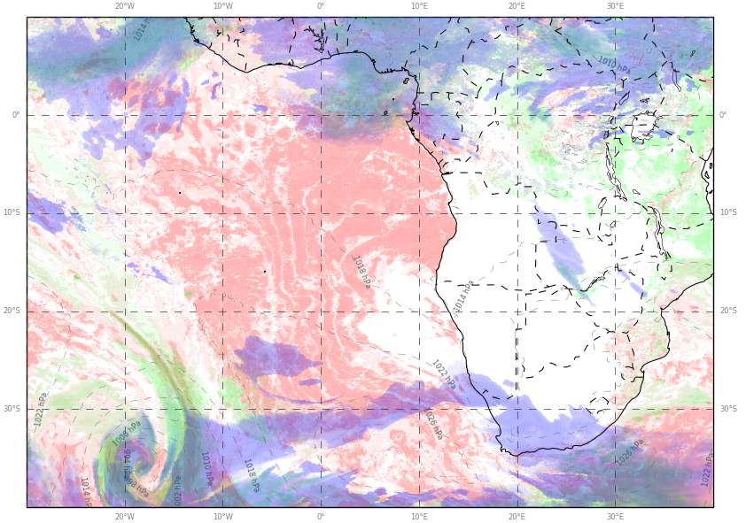
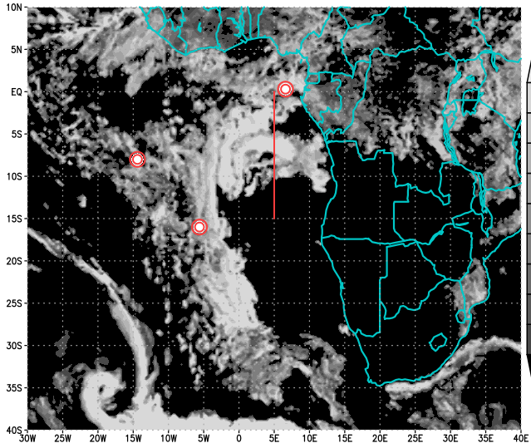
Visible satellite imagery at 8/7 Mon @ 12PM
ECMWF
GMAO
UKMO
(pink)
Low cloud forecasts

Slide 5
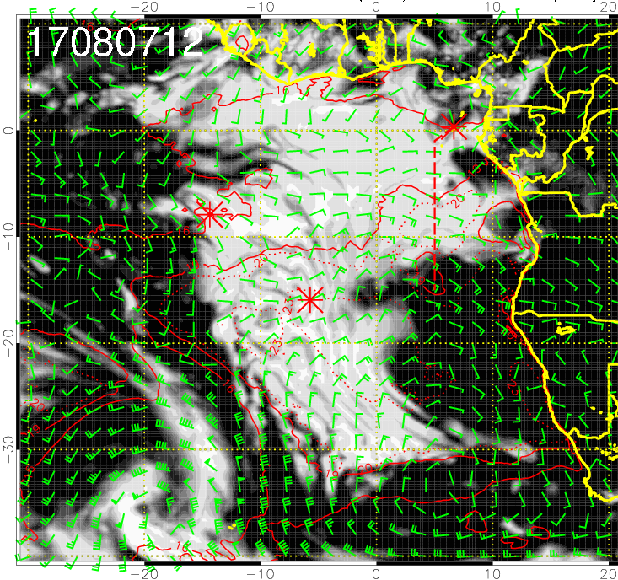
Visible satellite imagery at 8/7 Mon @ 12PM
ECMWF
GFS
UKMO
(pink)
Low cloud forecasts

Slide 6
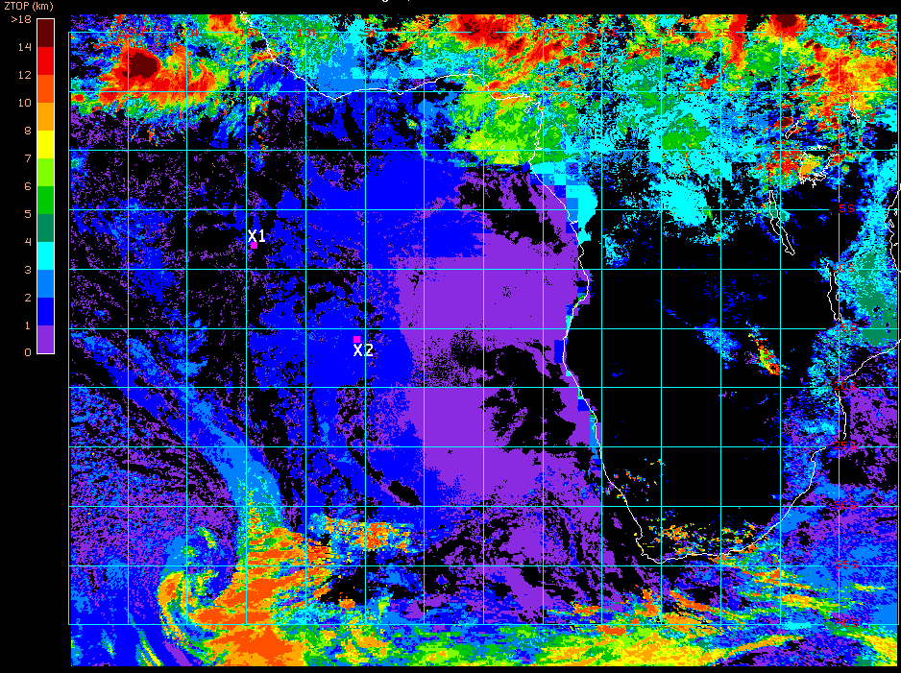
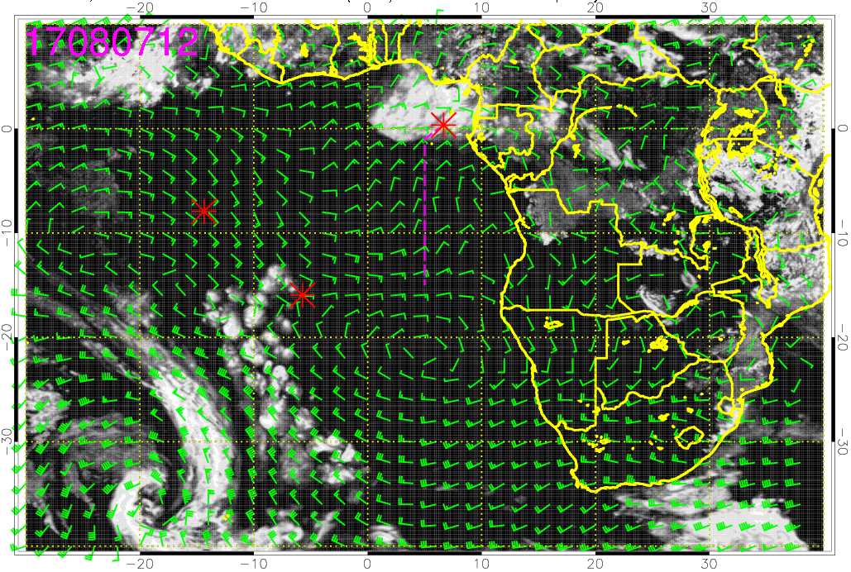
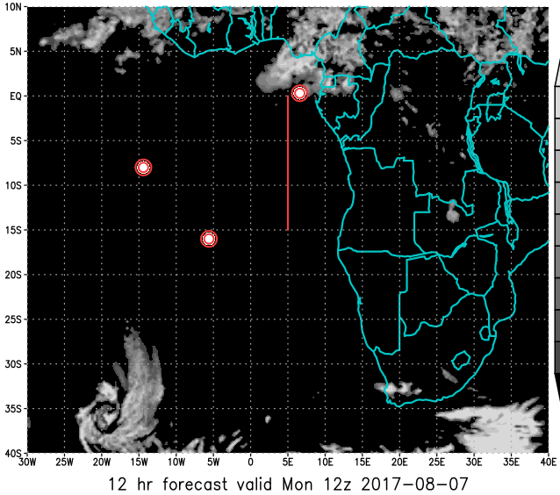
Cloud-top heights (satellite) at 8/7 Mon @ 12PM
ECMWF
GMAO
UKMO
(green)
Mid cloud forecasts

Slide 7
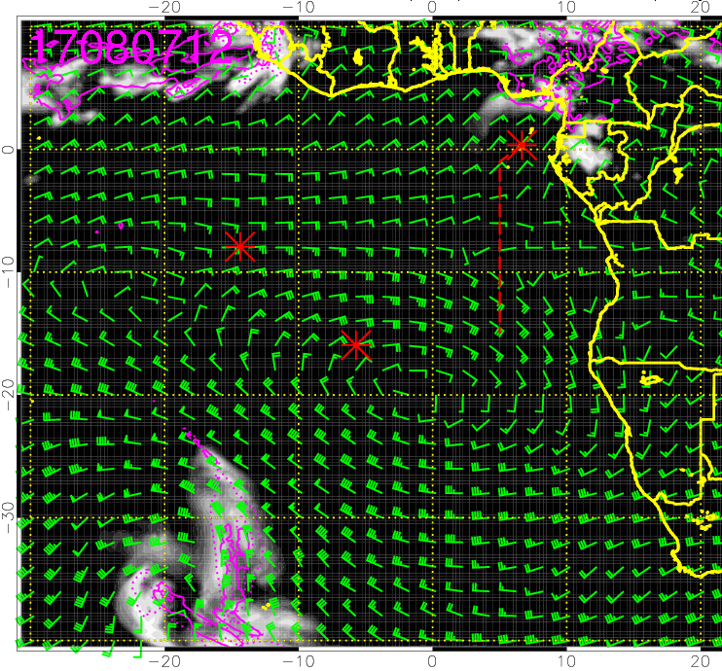
Cloud-top heights (satellite) at 8/7 Mon @ 12PM
ECMWF
GFS
UKMO
(green)
Mid cloud forecasts

Slide 8
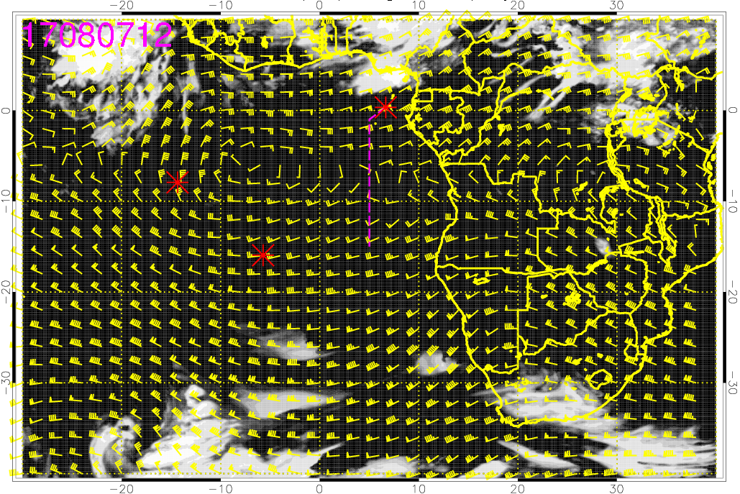
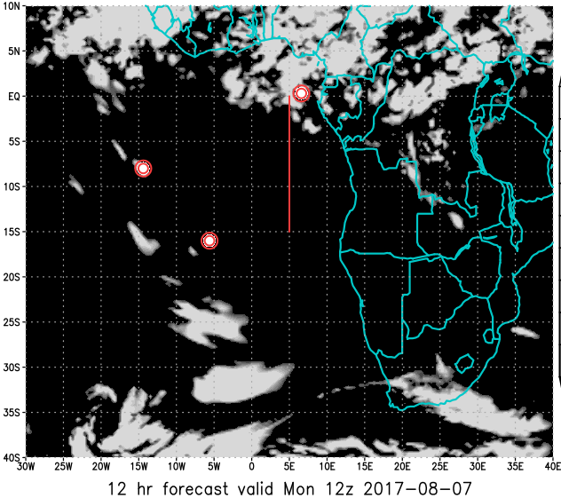
ECMWF
GMAO
UKMO
(blue)
High cloud forecasts

Slide 9
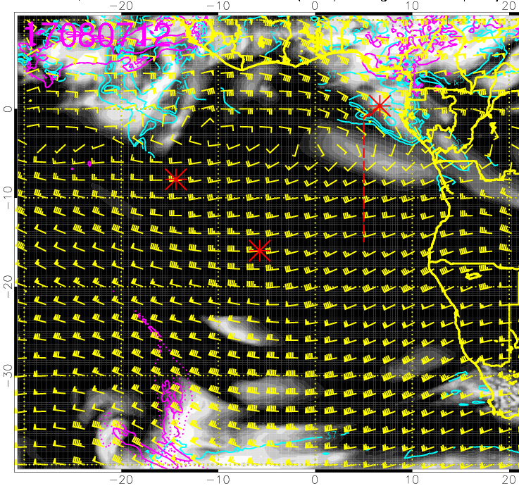
ECMWF
GFS
UKMO
(blue)
High cloud forecasts

Slide 10
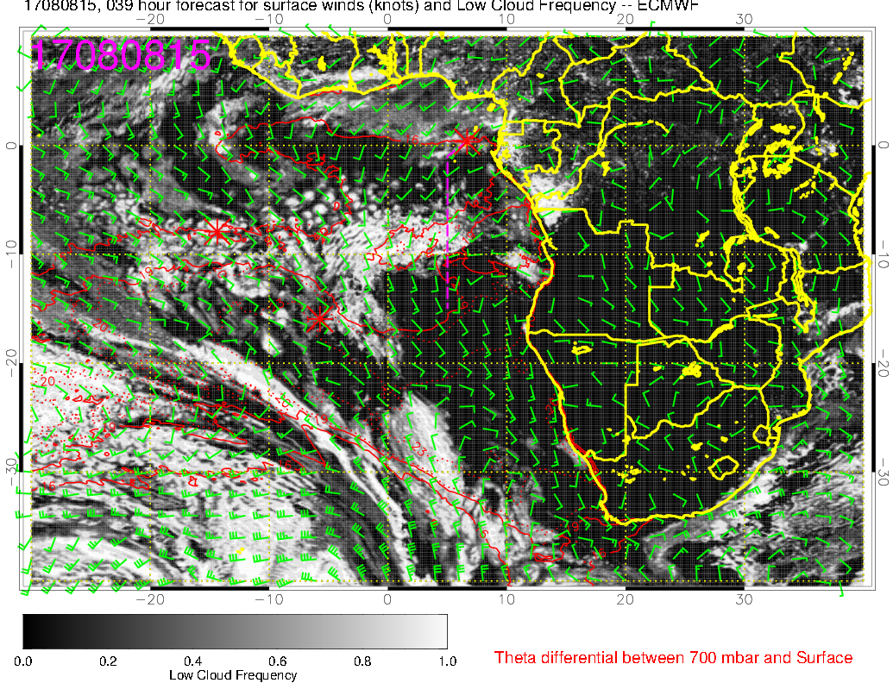
Low cloud forecast on 8/8 Tue @ 3PM
Flight track is at the northern edge of the low cloud region (more along the first half of the flight)

Slide 11
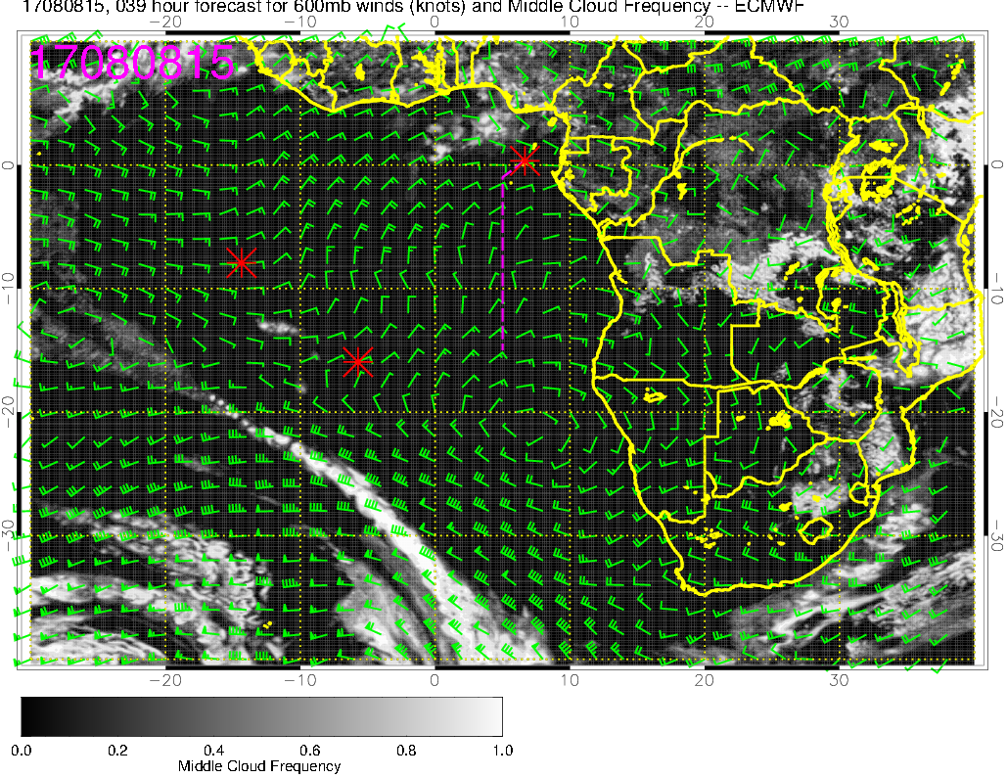
Middle cloud forecast on 8/8 Tue @ 3PM
middle clouds north of the flight track

Slide 12
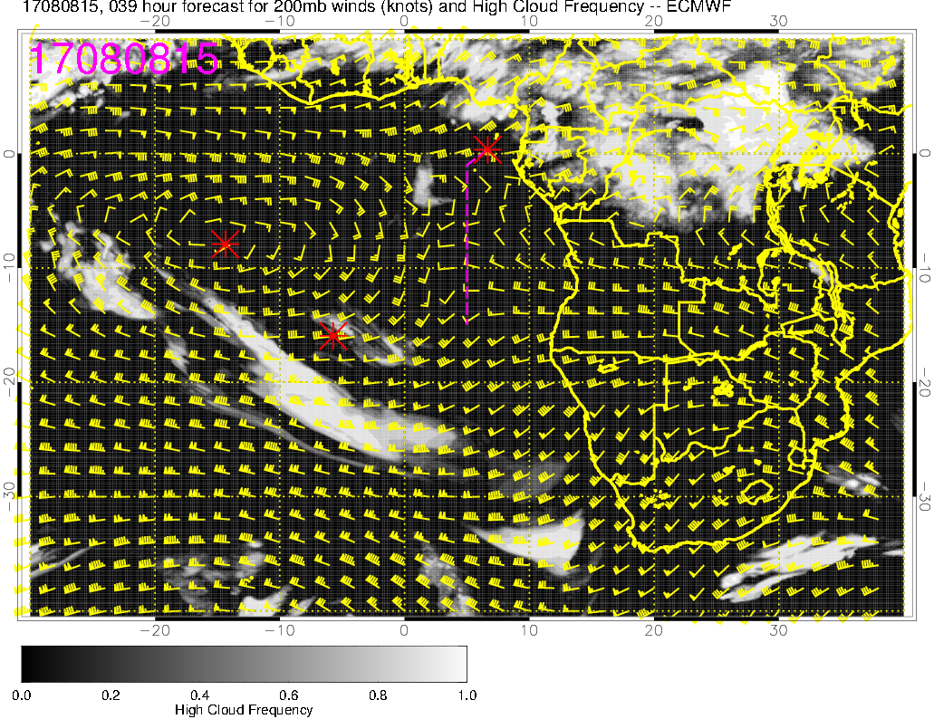
High cloud forecast on 8/8 Tue @ 3PM
High clouds mainly N-NE of TMS
These high cloud “streamers” are uncertain

Slide 13
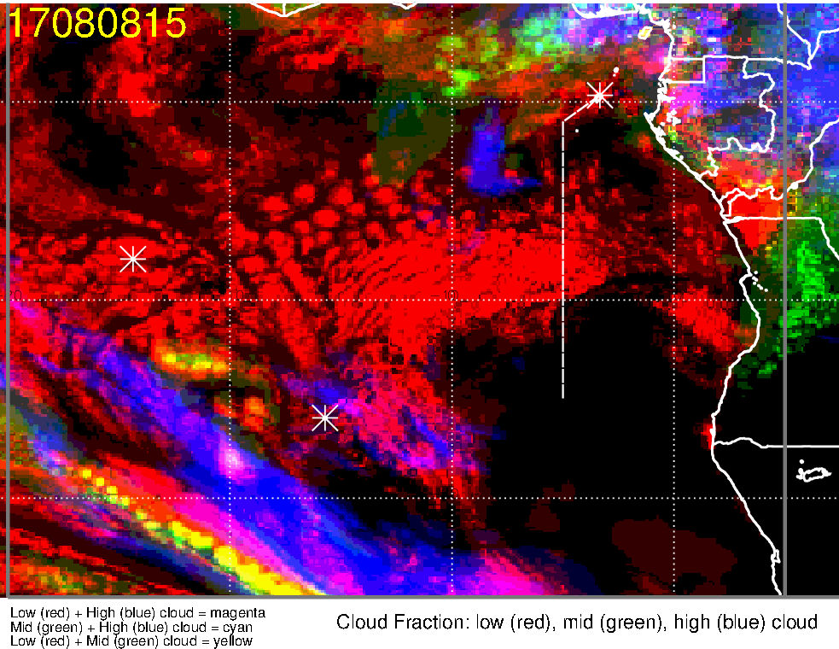
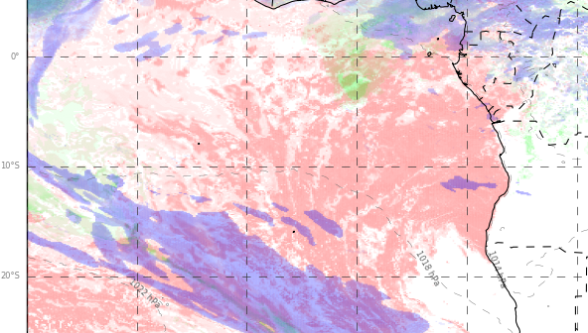
Low, middle, high cloud forecast for 8/8 Tue @ 3PM
ECMWF (39-hr)
UKMO (39-hr)
low + middle clouds
Low + middle clouds
?
Low + high clouds
low + high clouds
Good model agreement (though UKMO probably overestimating the northern extent of low cloud deck, near the flight track)
mid and high clouds during the second half of the flight, but primarily north of the flight track

Slide 14
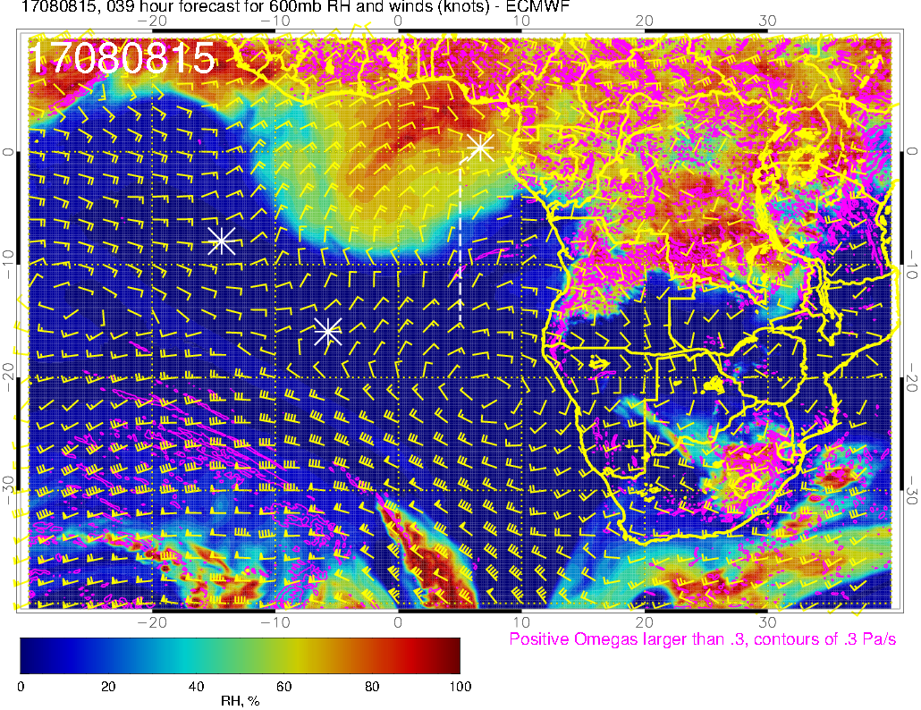
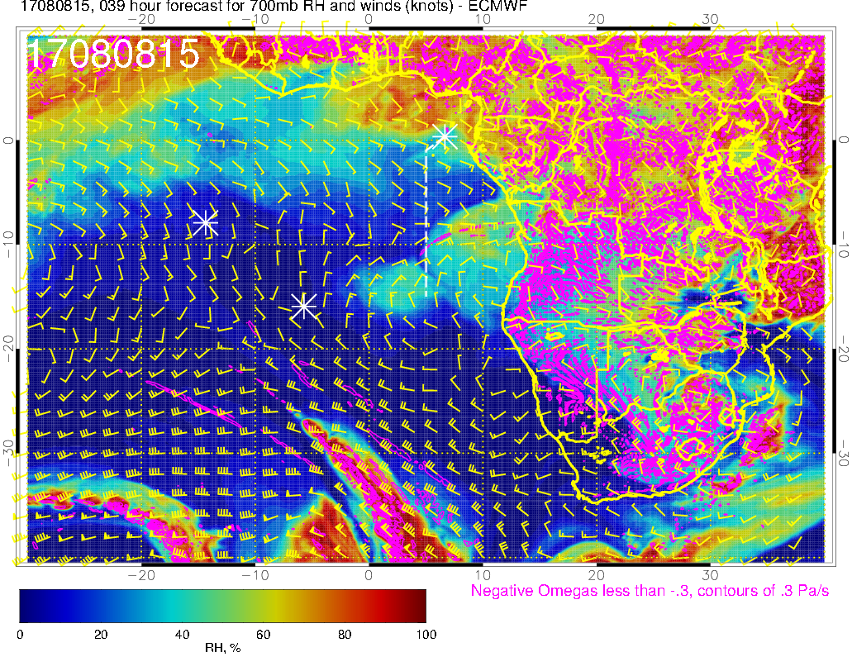
RH (color), UV wind (vectors), vert. velocity (pink contours) forecast for 8/8 Tue @ 3PM
600 mb
Plume of high RH air influenced by moist convection at 600mb, but RH along the flight track is lower than yesterday’s forecast
700 mb

Slide 15
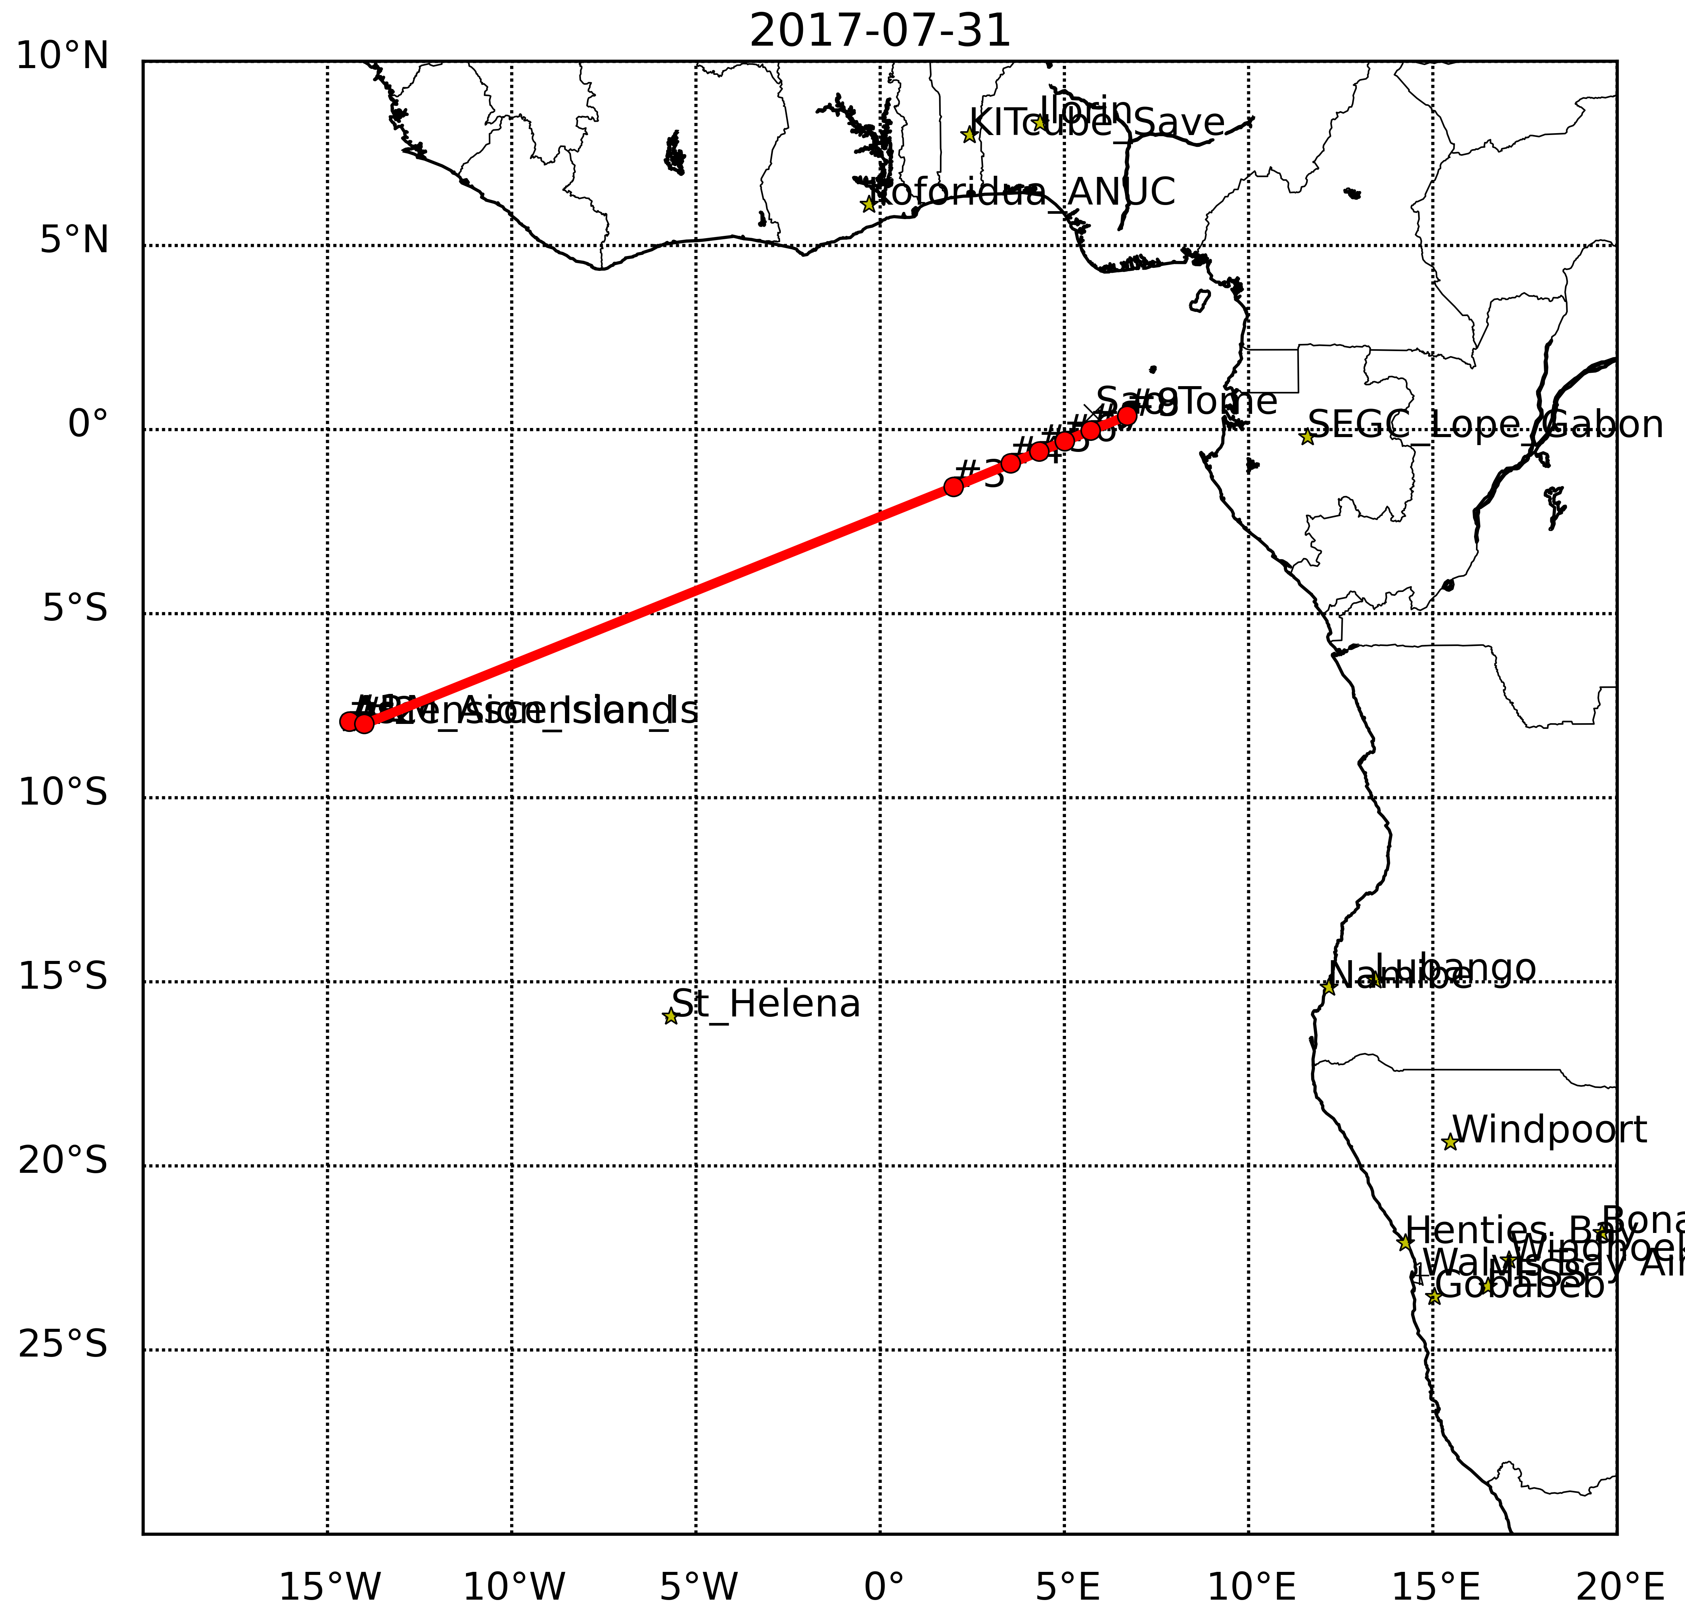
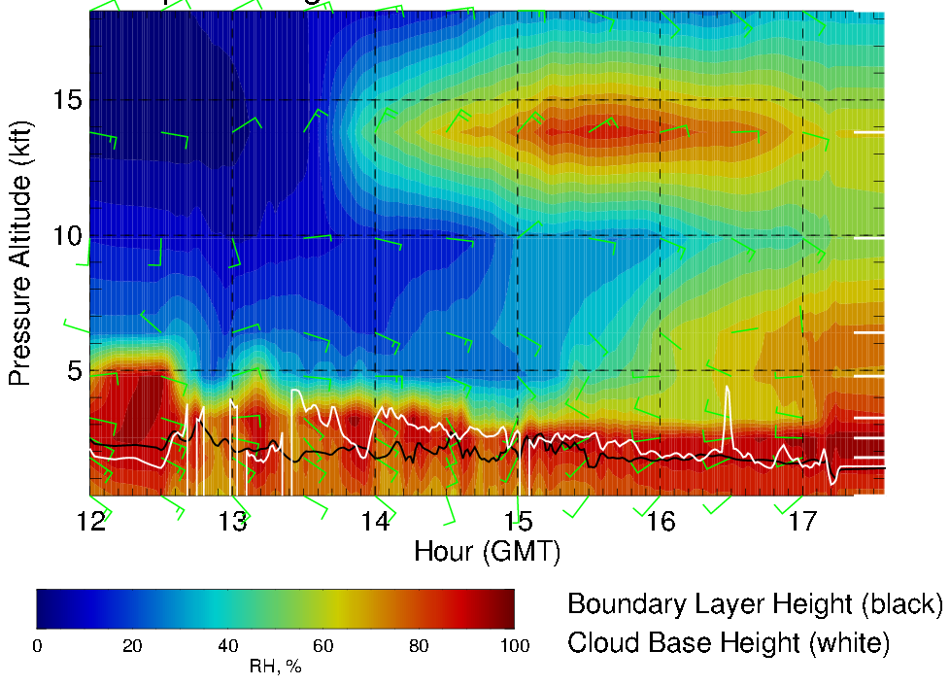
RH (color) along transit flight track, 8/8 Tue 12 – 5:30PM
High RH air at 600mb (influenced by moist convection) during second half of flight
Headwinds of ≤ 20 knots mid-flight at 600mb
Yesterday’s forecast

Slide 16
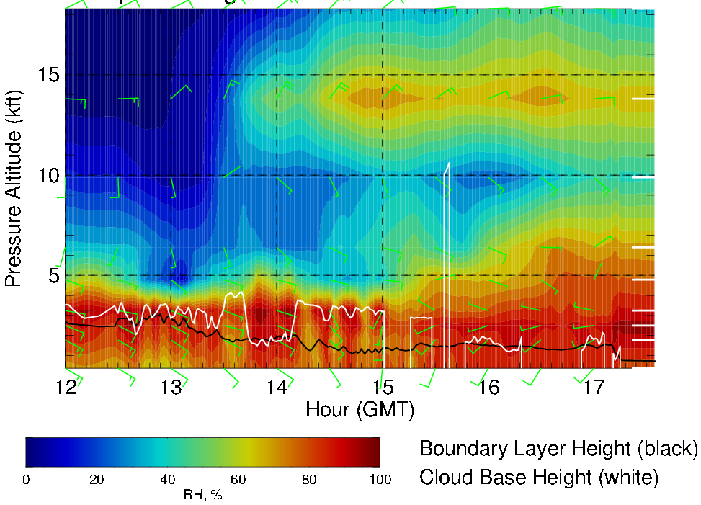
RH (color) along transit flight track, 8/8 Tue 12 – 5:30PM
RH ~60-70% along the flight track; higher values to the north
Headwinds of ≤ 20 knots mid-flight at 600mb

Slide 17
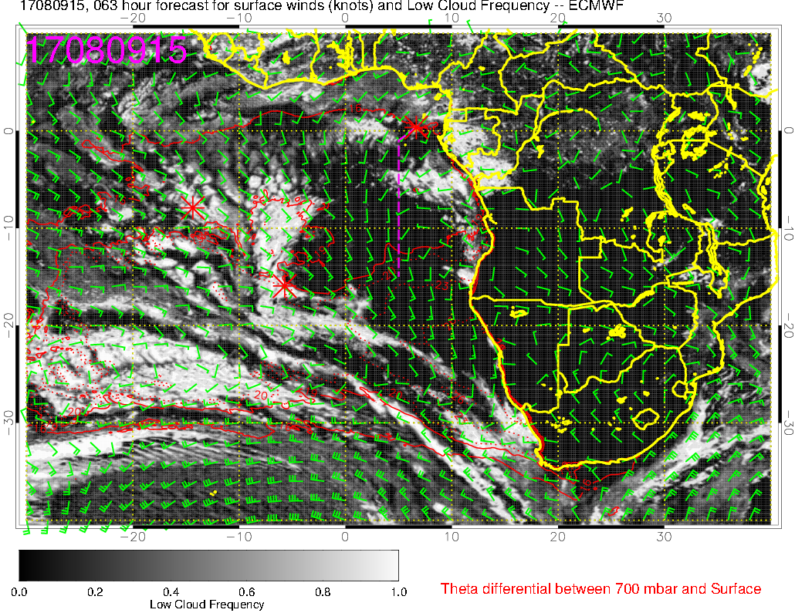
Low cloud forecast on 8/9 Wed @ 3PM

Slide 18
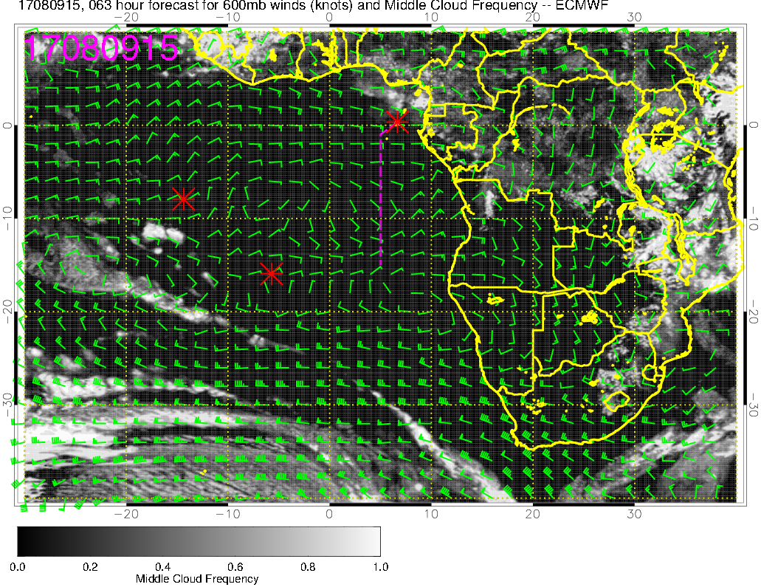
Middle cloud forecast on 8/9 Wed @ 3PM

Slide 19
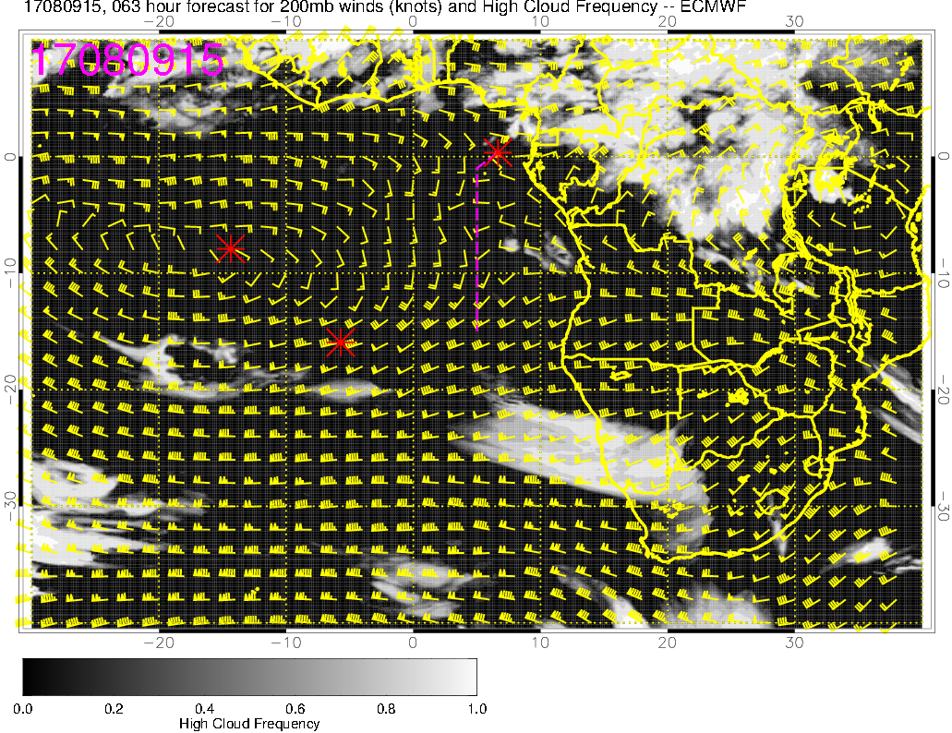
High cloud forecast on 8/9 Wed @ 3PM

Slide 20
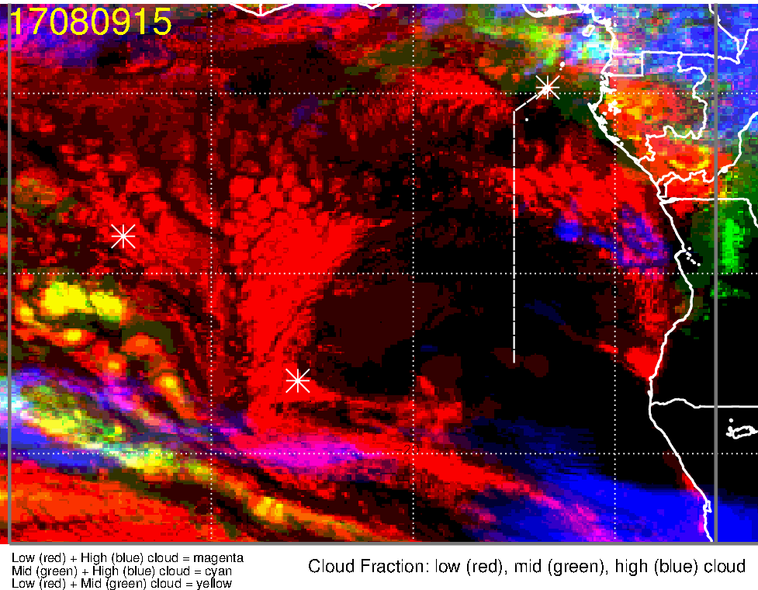
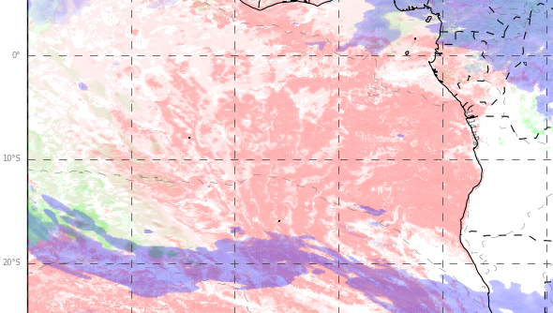
Low, middle, high cloud forecast for 8/9 Wed @ 3PM
ECMWF (63-hr)
UKMO (63-hr)
low + mid + high clouds
low + mid + high clouds
More low clouds along the first half of the transit flight
Very little mid and high clouds along the flight track

Slide 21
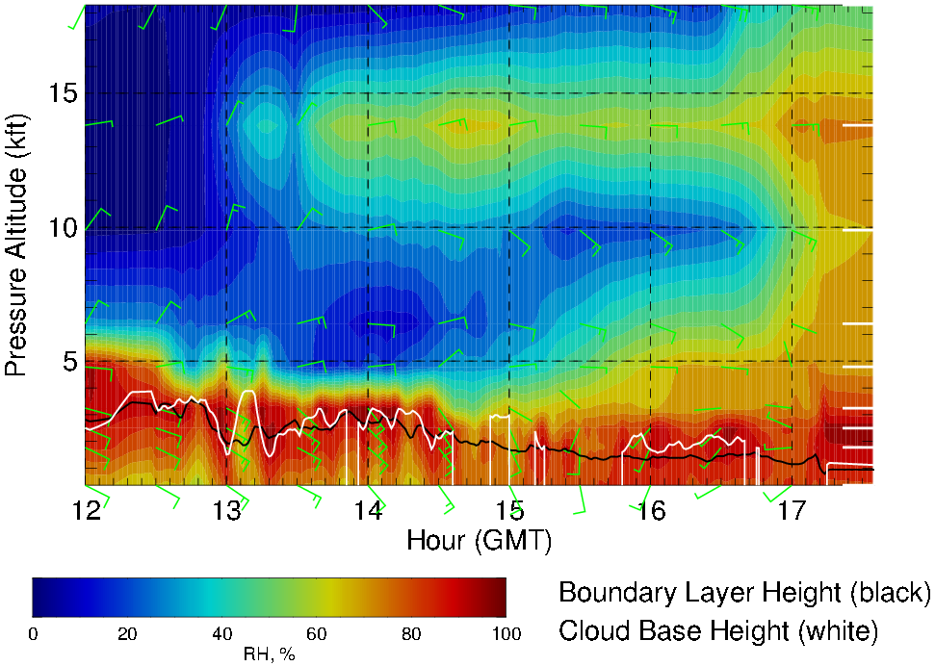
RH along transit flight track, 8/9 Wed 12 – 5:30PM
High RH air at 600mb has moved westward away from our flight track; some remnants here
Weaker winds (5-15 knots) compared to 8/8

Slide 22
Summary
Cloud forecast comparison
Low clouds:
EC and GMAO overestimate cloud clearing off Namibia coast;
UKMO and GFS overestimate cloud cover on the NW extent of StratCu layer;
UKMO misses “cloud-free” pocket south of TMS
Mid clouds:
EC and UKMO forecasts pretty good near TMS, GMAO and GFS underestimate;
EC classifies the low clouds in NW StratCu region as “mid clouds”
High clouds:
overestimated by all models, but EC forecasts are best

Slide 23
Summary
Transit flight ASI-TMS: Tuesday 8/8
TAF (@TMS, landing) indicates SW 10 knot winds, broken clouds (ceiling) at 3300 ft
Scattered low clouds (and minimal mid-high clouds) during first half of the flight
Few low clouds and some mid-high clouds during second half of the flight
Enhanced RH air (~600mb) influenced by moist convection during second half of the flight
Headwinds of up to 20 knots at 600mb (~15 kft) in the middle of the flight
Contingency Transit flight ASI-TMS: Wednesday 8/9
Low clouds during first half of the flight
Mid and high clouds NE of TMS (i.e., not many expected over the flight track)

Slide 24
Thursday, 8/10 (routine flight)

Slide 25
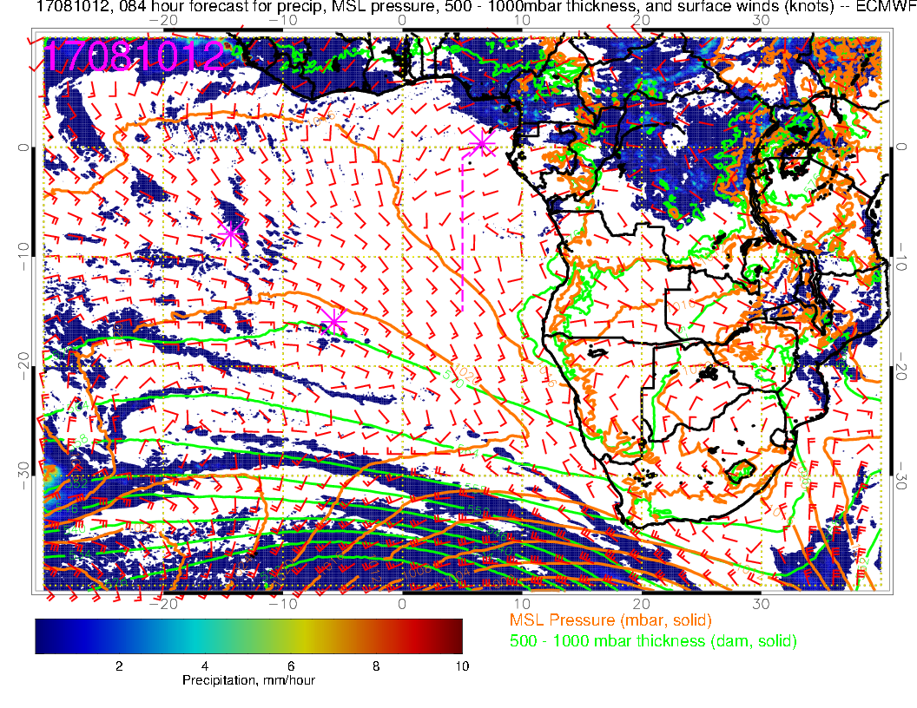
Surface chart for Thursday: Weak winds locally, strong eastward curve in winds around TMS, winds are weaker than normal locally, and forecast is consistent with old forecast.

Slide 26
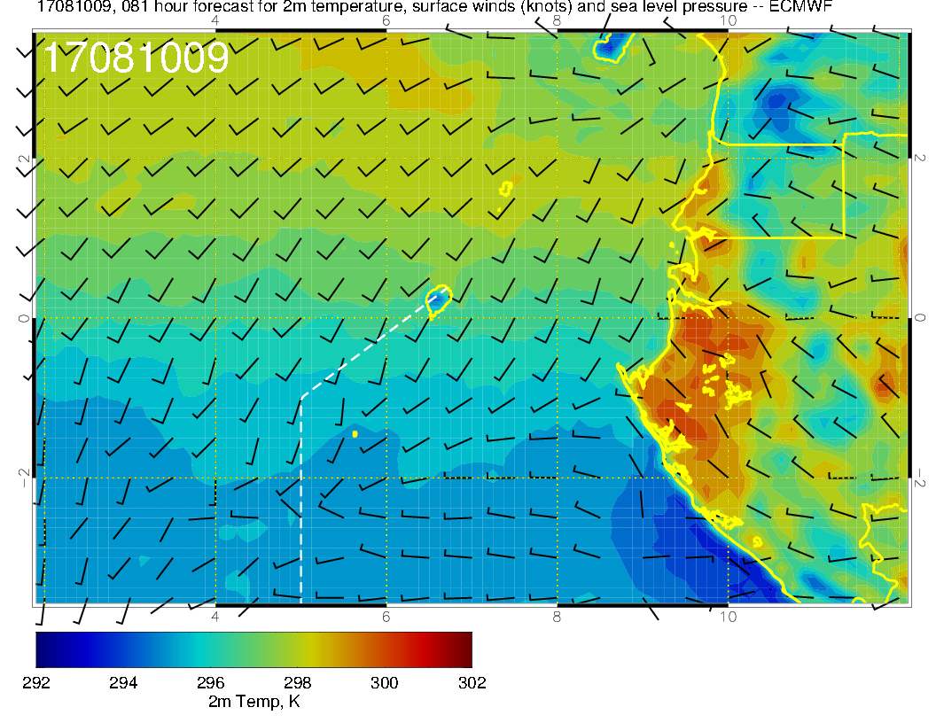
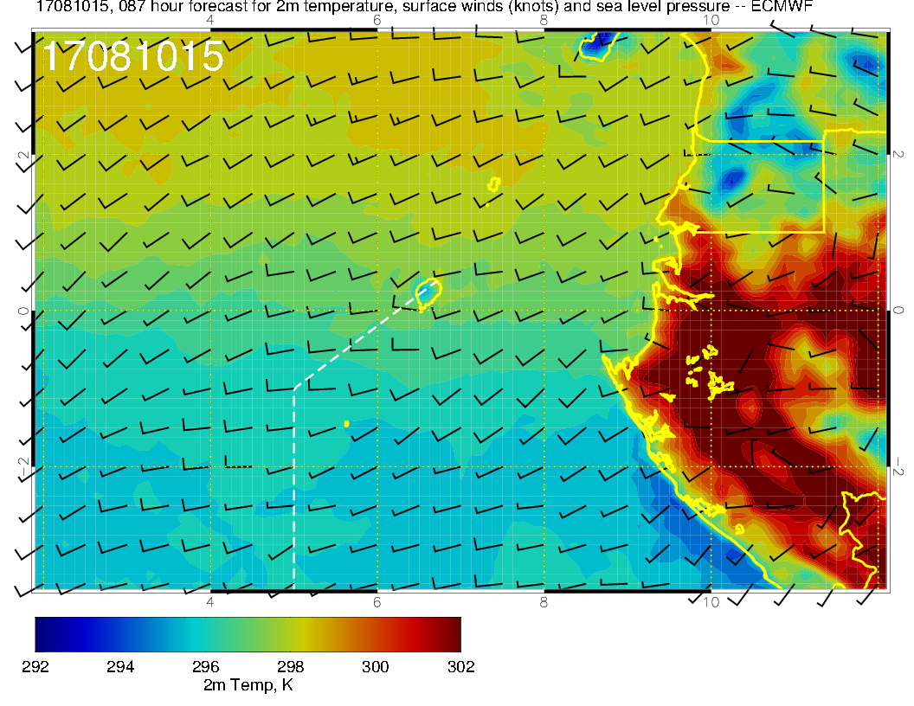
TAKEOFF
LANDING
Winds around TMS on Thursday. Probably still SSE in the morning, but may shift around and come from the other direction (from west) on landing.

Slide 27
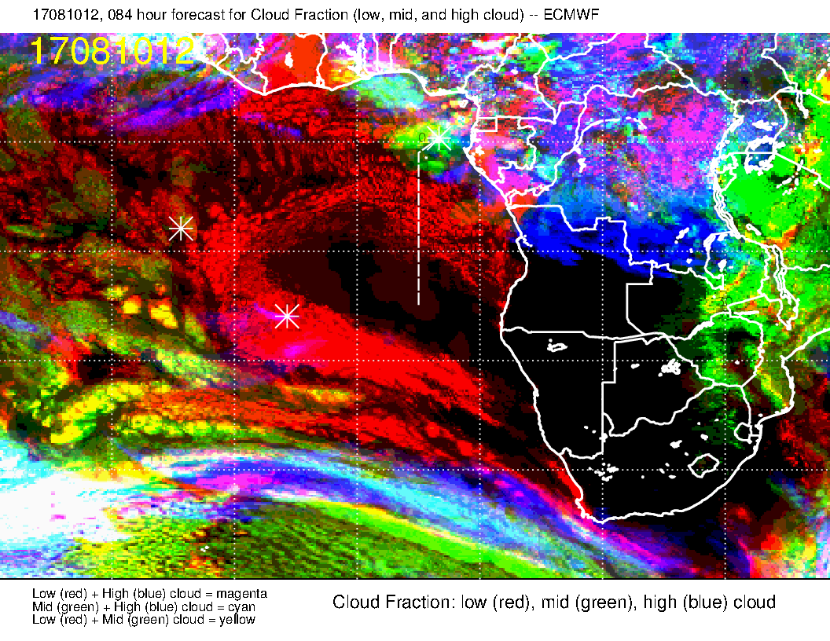
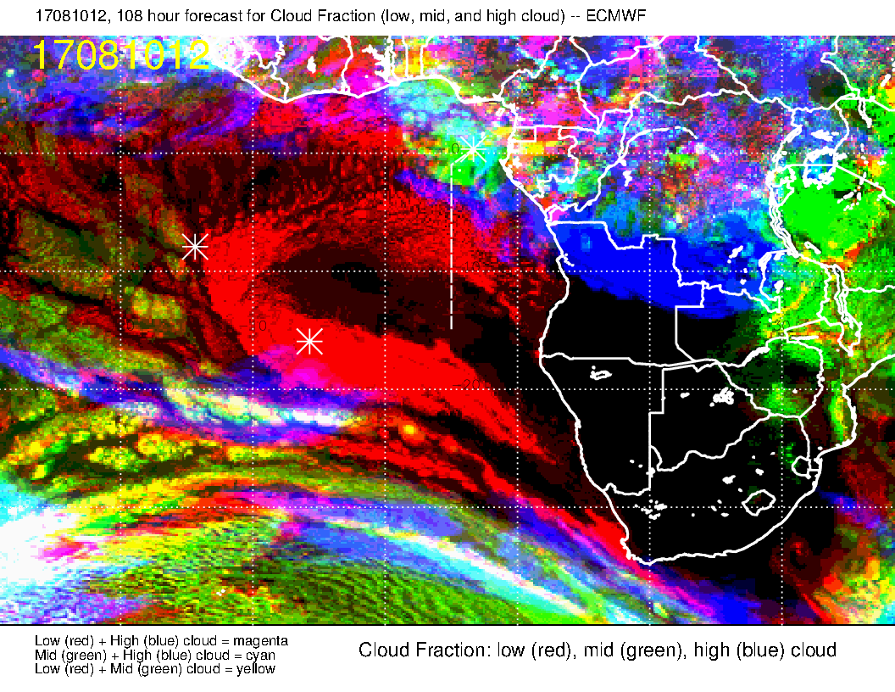
NEW FORECAST
Cloud forecast for Thursday, new forecast above, old forecast to right – very little change. Expect:
Some middle and high cloud at north end
“Gap” in low clouds until we get to 3-4S.
Low BL heights, low cloud tops, and low cloud fraction south of 10S.
OLD FORECAST

Slide 28
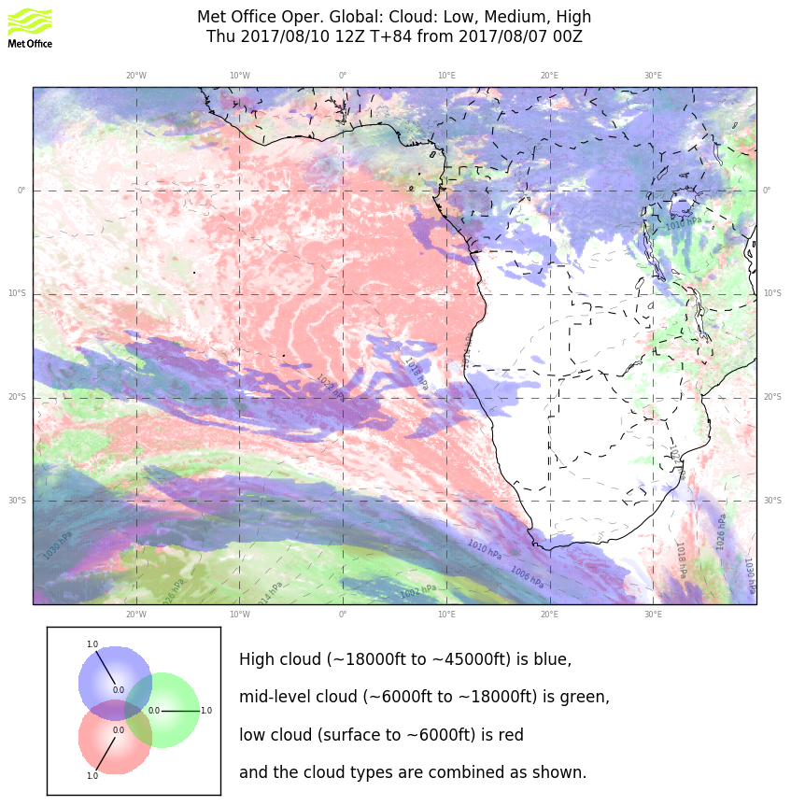
ECMWF
UKMO
EC forecast (above) and UKMO (right).
Fair agreement on low clouds (UKMO has less clearing.
High and mid clouds near north end in reasonable agreement.
More UKMO high cloud beyond south end.

Slide 29
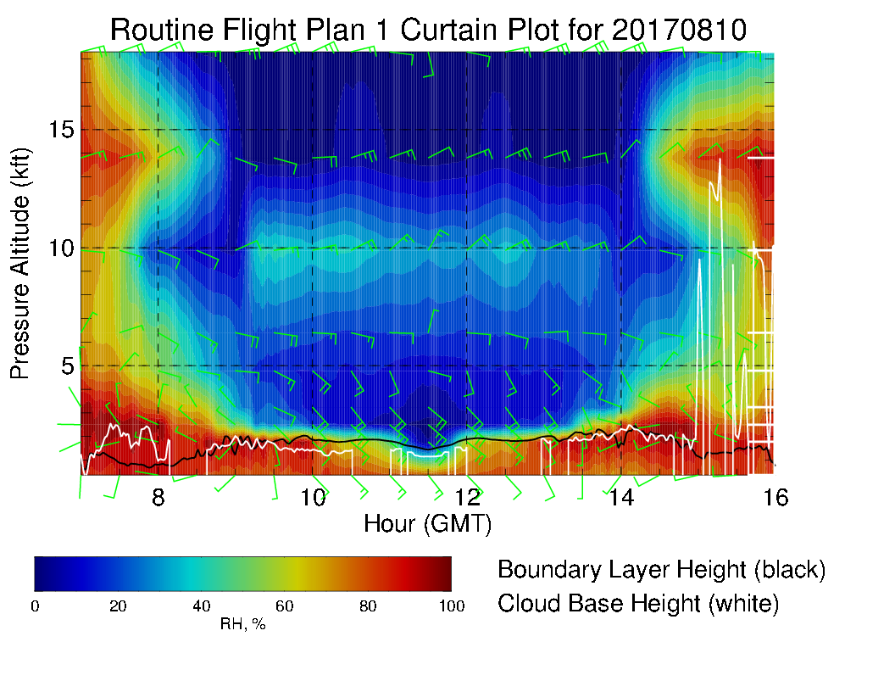
Low cloud bases (1-2 kft) are forecast (white curve)
Expect some clear areas near beginning and end of flight.
Cross winds at high altitude, 15-20 knots
Layer of enhanced RH near 10kft.

Slide 30
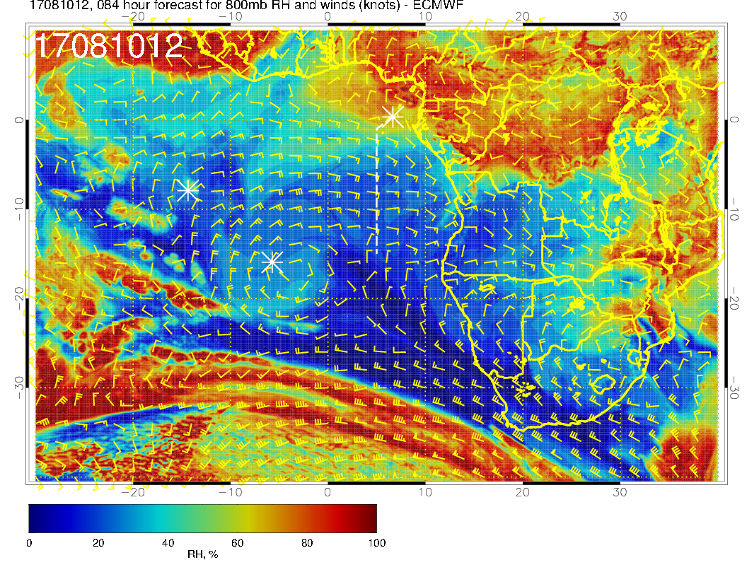
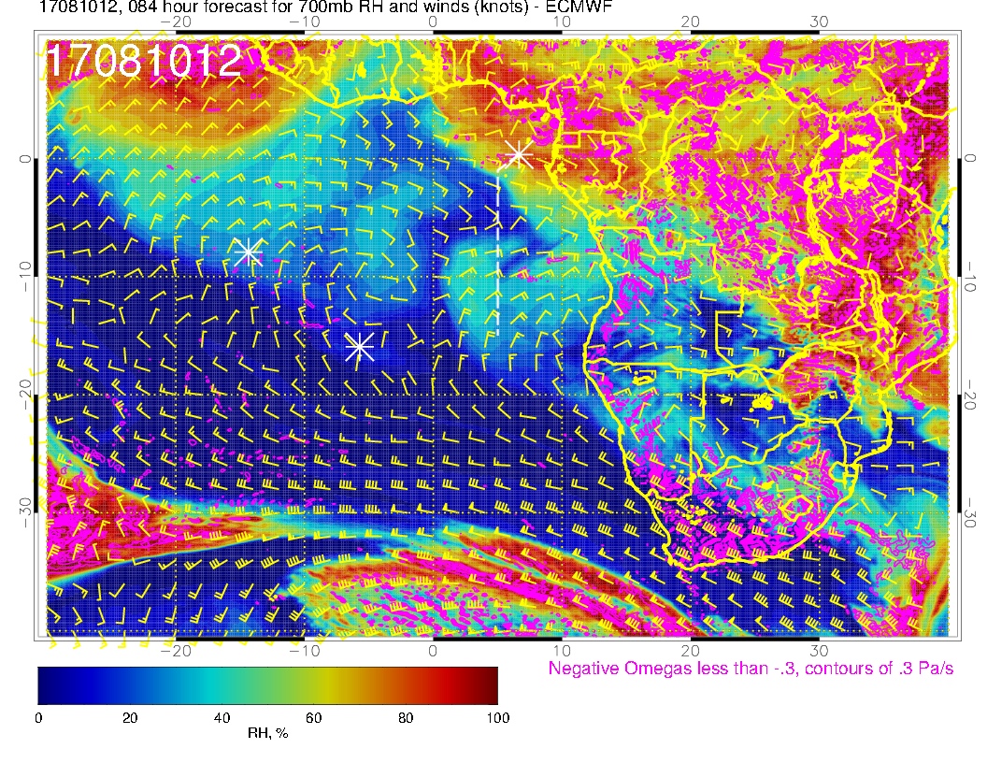
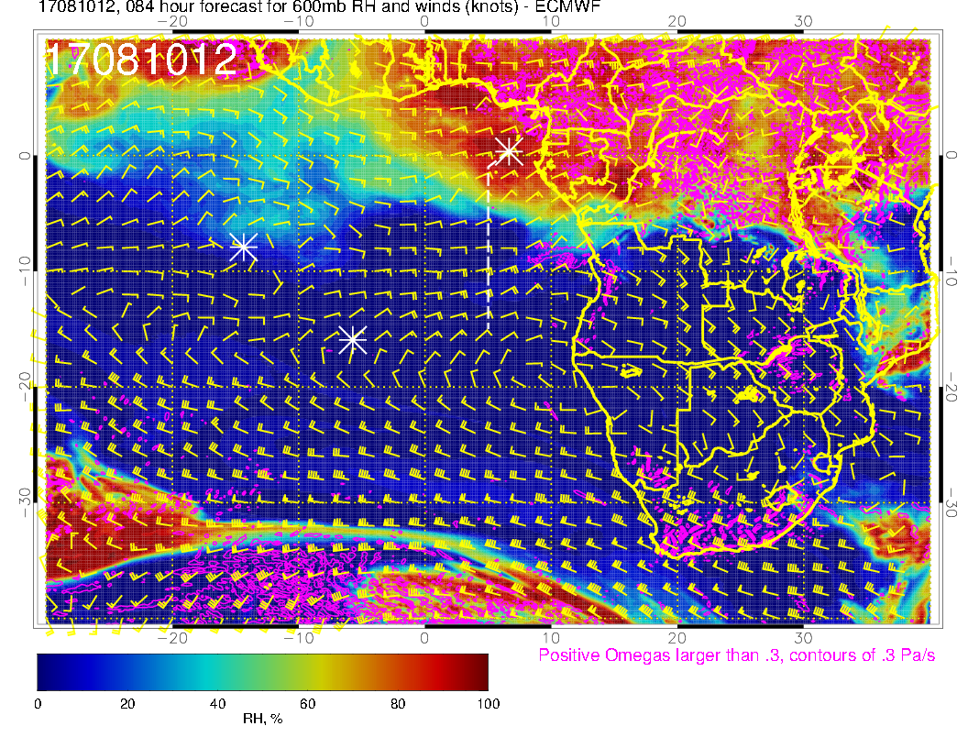
800 mb
700 mb
Clear offshore flow at all three mid levels. Dry at 800 and 600, moist at 700mb. Why?
600 mb

Slide 31
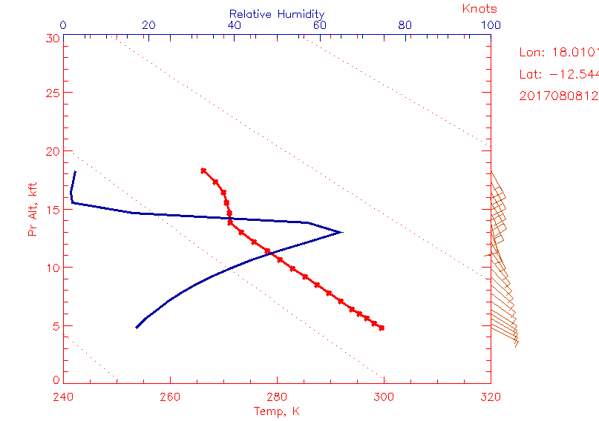
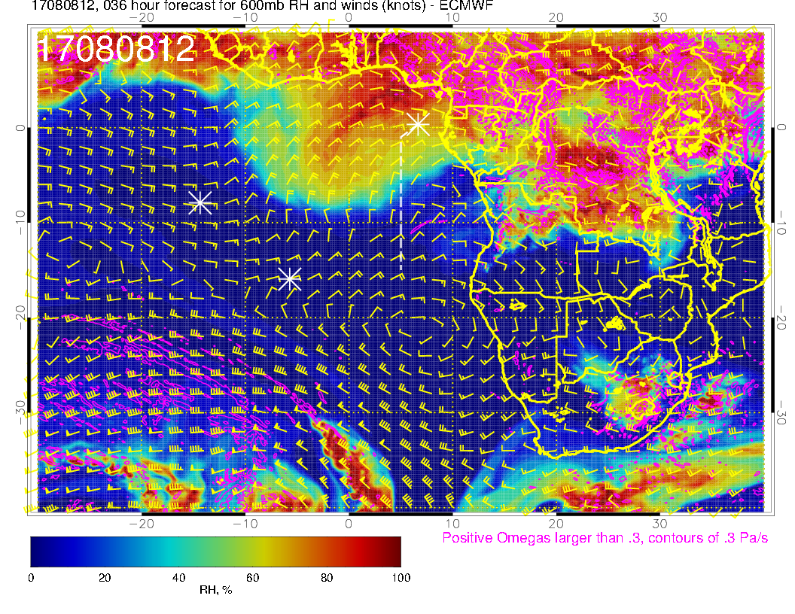
2017080812
RH
14 kft (600mb)
Temp
0 kft
Two days earlier (tomorrow). Sounding shows dry convection to near 600mb (dry adiabat, RH increasing as temperature decreases. Can see “bubbling up” of moisture at 600mb at 12Z tomorrow.

Slide 32
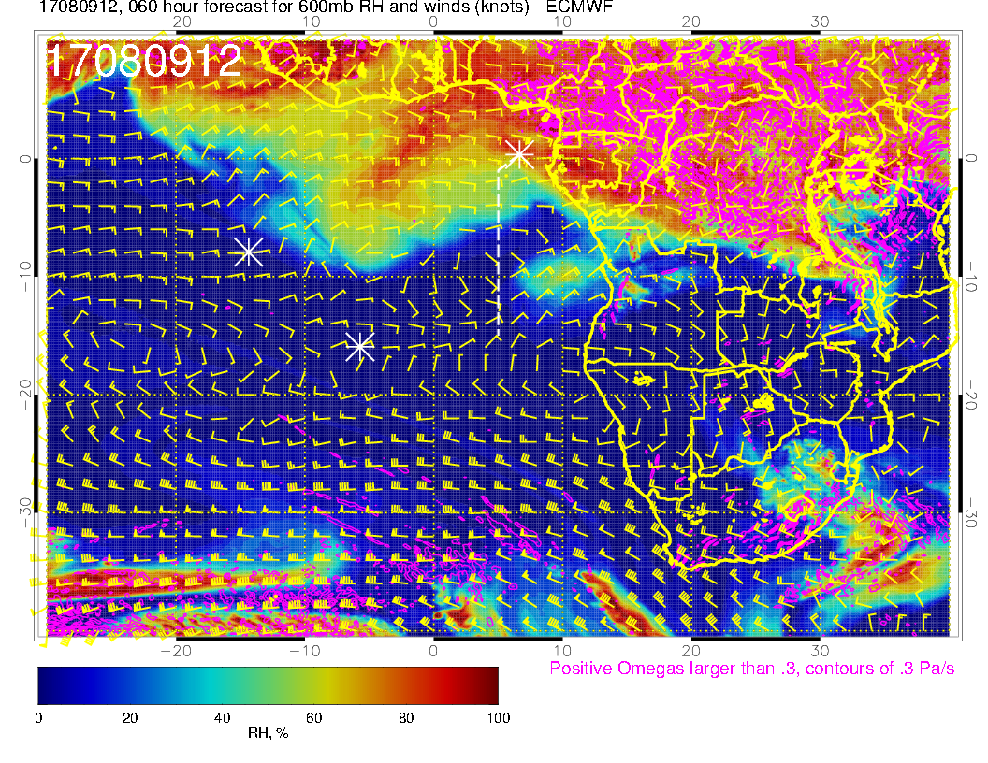
Wednesday (left) and Thursday (below) at 600mb
600m,b
Wednesday (above), and Thursday (right). It looks like blob of moisture mixed up on August 8 is moving offshore. Descent (diabatic cooling) “removes” the moisture from the 600mb level.
600m,b

Slide 33
Thursday, 8/10 (routine flight)
Surface winds at TMS will be weaker than typical, possibly shifting to west on landing
Forecast for clouds is consistent with yesterday’s fcst.
Expect a gap in low cloud coverage at the north end
Low cloud tops, BL heights, cloud bases, and cloud fraction south of about 10S.
Cross winds at mid levels expected.
Some high clouds near north end of track
Pronounced outflow from continent from 1800 – 5000 meters.

Slide 34
Friday, 8/11 (contingency routine flight)

Slide 35
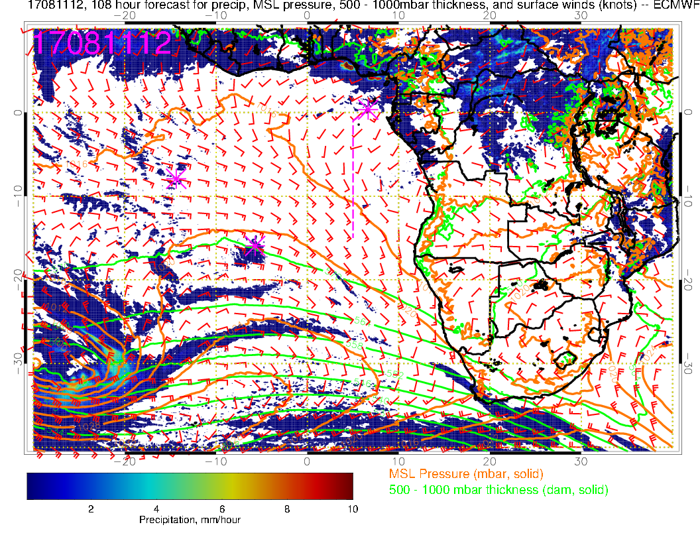
Surface Chart. Another system marches in near 30S, 20W. Model forecasts convection near Nigerian coast. Flow angle at Sao Tome becomes less westerly.

Slide 36
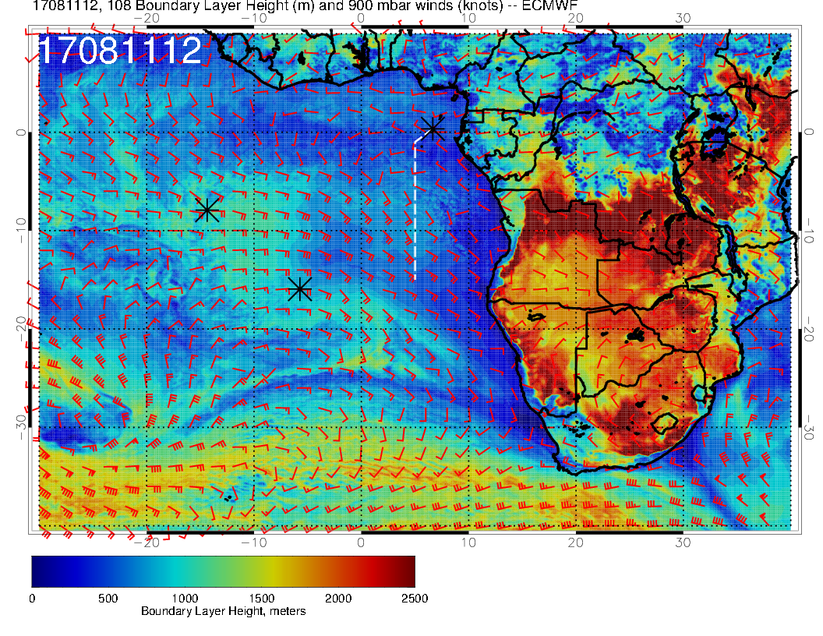
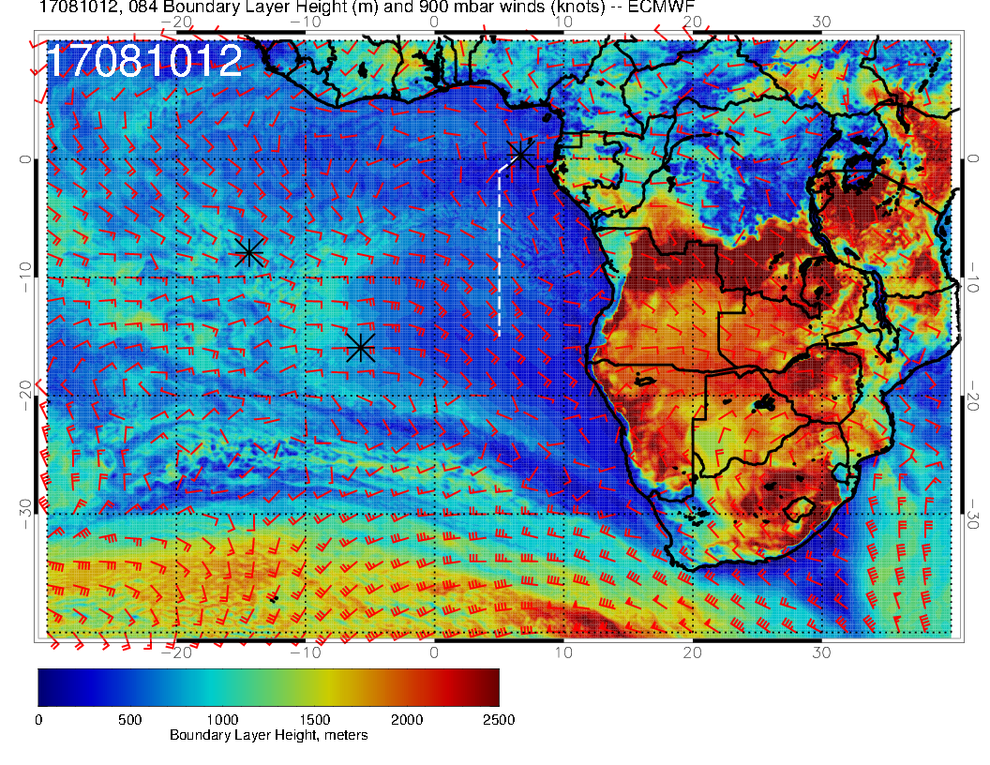
FRIDAY
Boundary Layer heights for Friday and Thursday. BL heights are rising from Thursday’s depressed values
THURSDAY

Slide 37
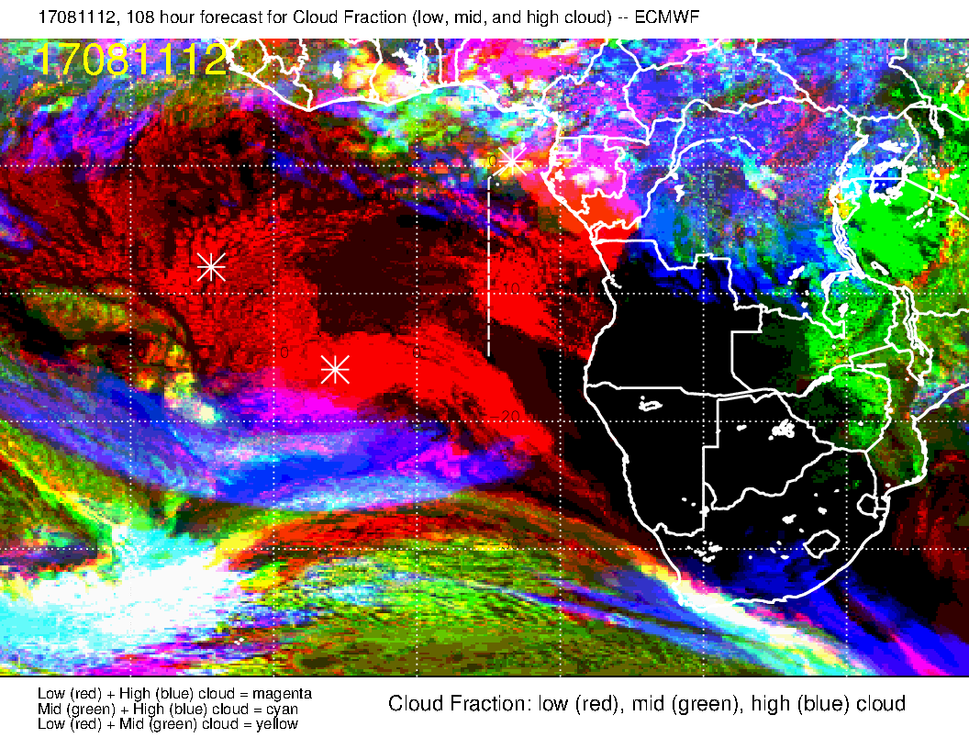
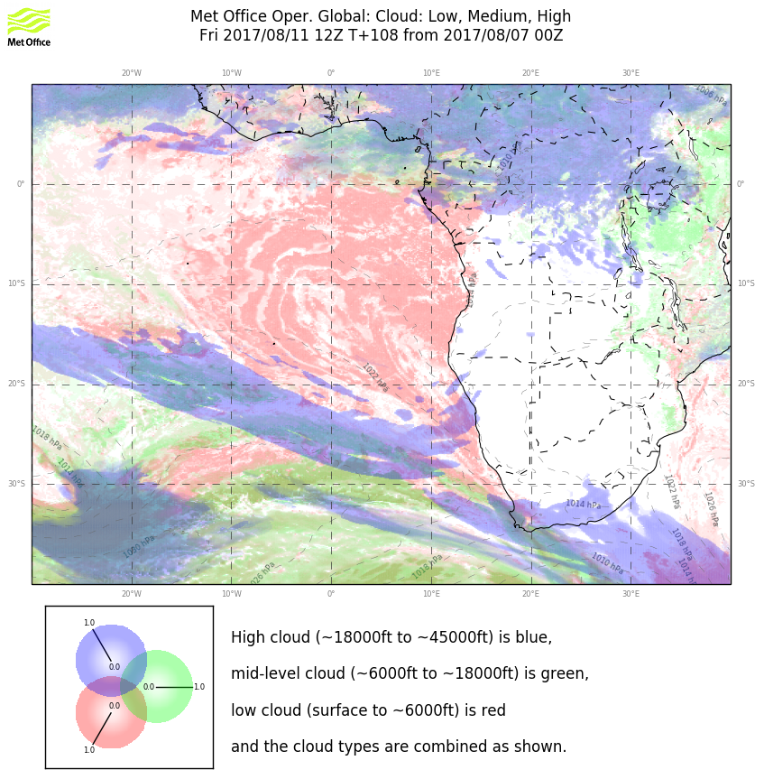
ECMWF
Sharp differences in the low cloud forecast for this day. My assessment. UKMO seems to put stuff everywhere, EC clears out too much. Along routine track, situation appears very similar to Thursday’s forecast.
For high cloud, I think EC overdoes it, and expect UKMO forecast to prevail (based on experience).
UKMO

Slide 38
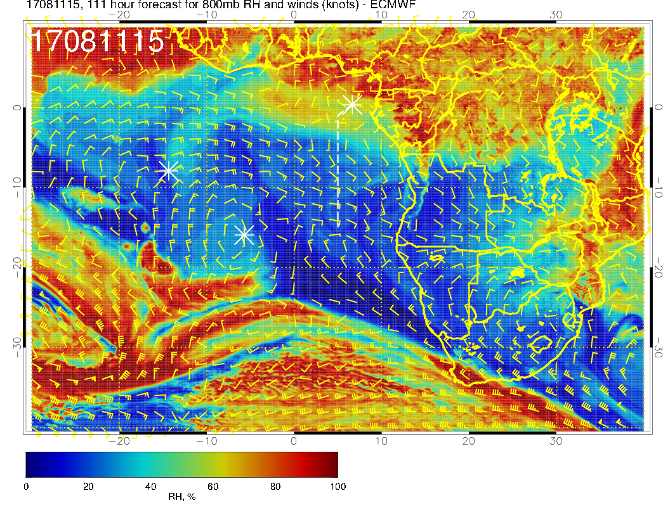
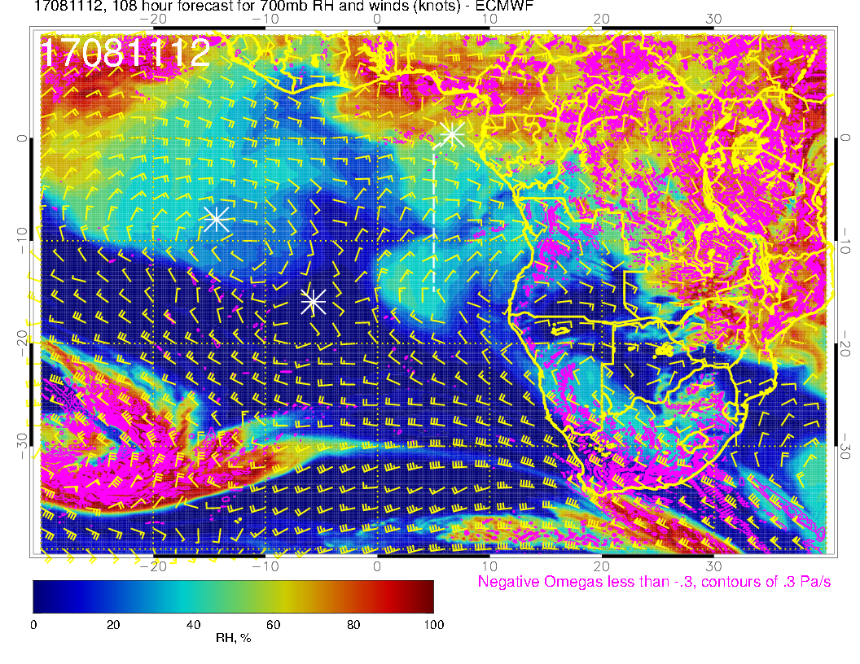
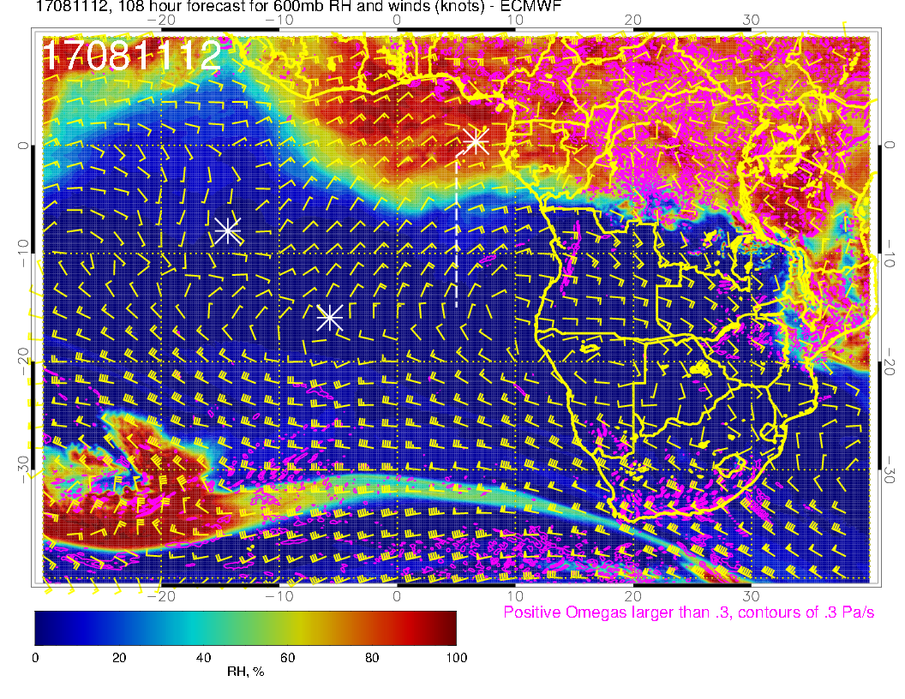
800 mb
700mb
Again, basic outflow pattern at all three levels holds, with moist layer at 700mb. 600mb anticyclone is slightly south of its August mean
600mb

Slide 39
Friday, 8/11 (contingency routine flight)
Surface winds at TMS will start shifting back to SW.
Substantial model disagreement for low and high clouds.
But, actually expect a similar low cloud structure to August 10 along routine track.
Fewer high clouds along north end than August 10 (go with UKMO forecast on this).
Pronounced outflow from continent from 1800 – 5000 meters. Similar pattern as August 10.

