Slide 1
ORACLES weather briefing
6-Aug-2017
Lenny Pfister and Rei Ueyama

Slide 2
Meteorological overview Lenny Pfister and Rei Ueyama
Tomorrow, two foci of precipitation will develop in Africa, affecting surface circulation.
Approaching midlatitude system will produce low BL heights in center of SC region by Thursday (routine flight)
By Thursday, focus of convection will shift to Gabon, Congo, CAR, Nigeria region. This could enhance high clouds on Thursday (routine flight)

Slide 3
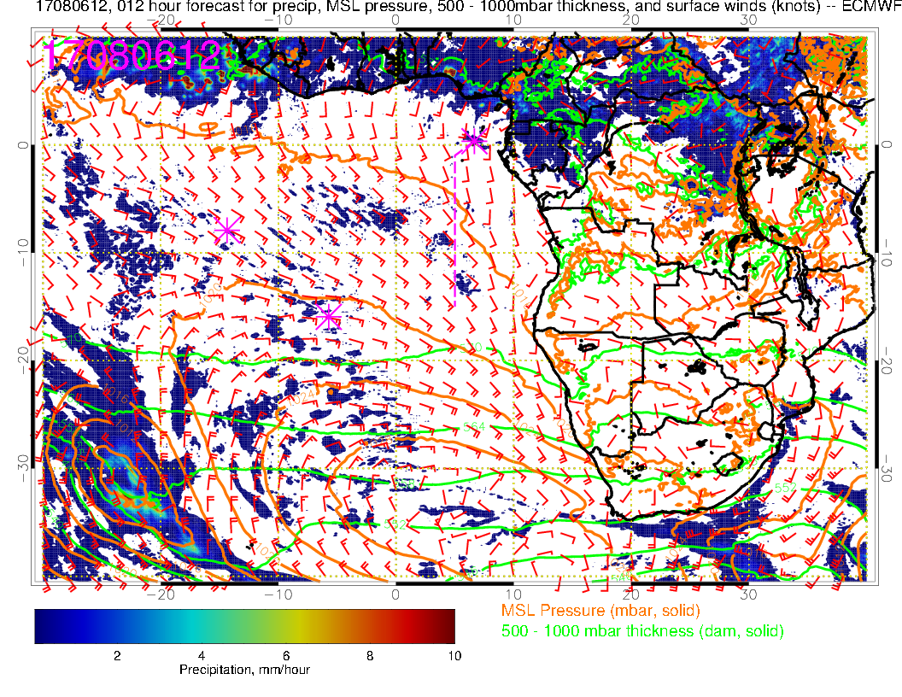
Surface chart noon today. Strong low approaching, surface circulation typical

Slide 4
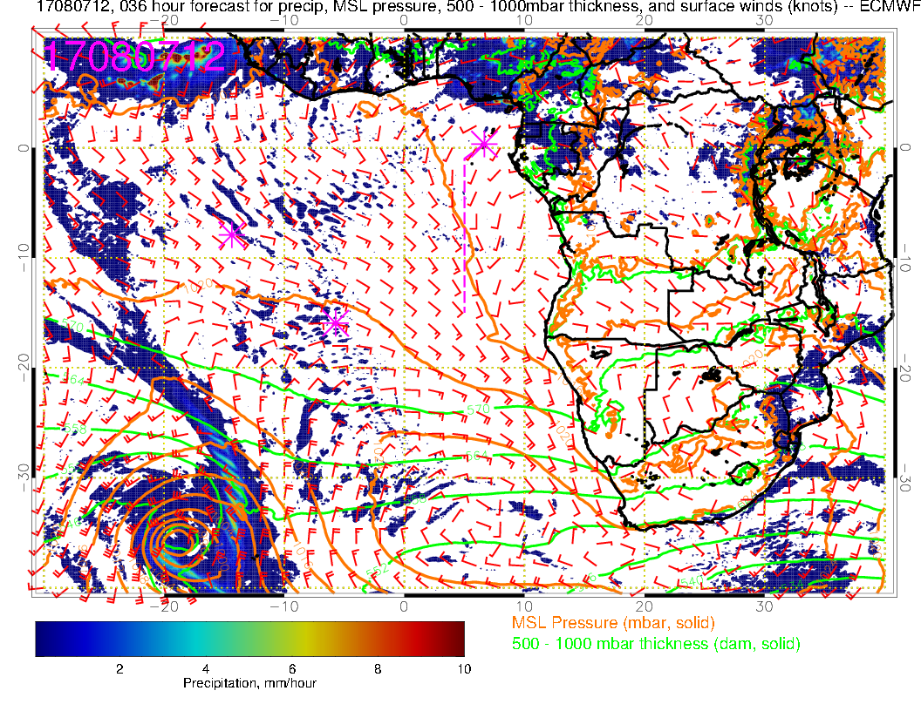
Surface chart noon tomorrow. SH high squeezed to east. Start to develop two foci of precip in Africa, and surface flow responds.

Slide 5
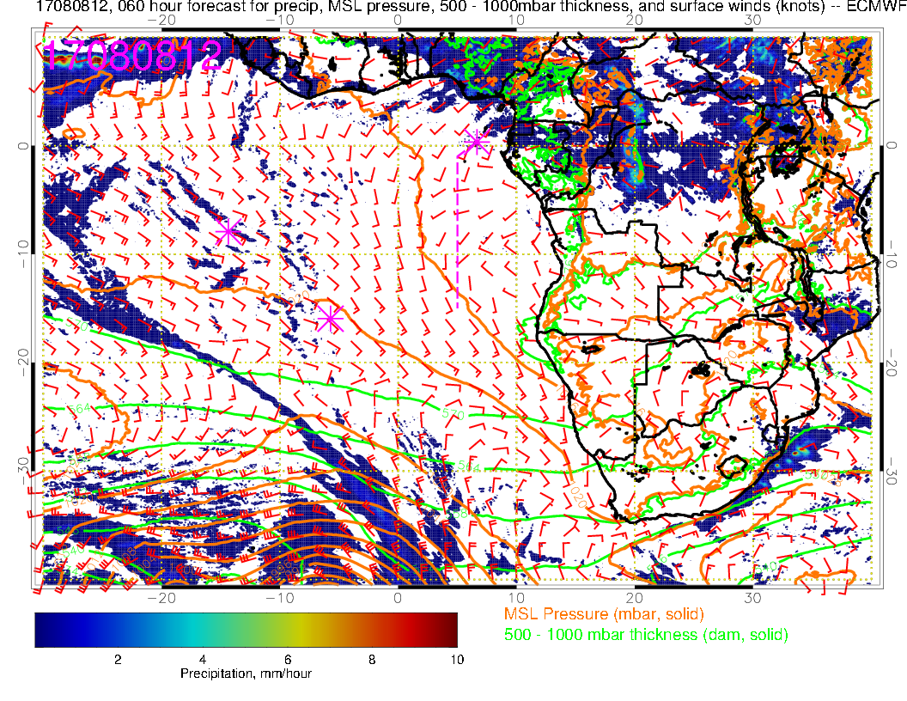
Surface chart noon Tuesday. Midlatitude front starts to affect SC region flow with more northerly component to flow.

Slide 6
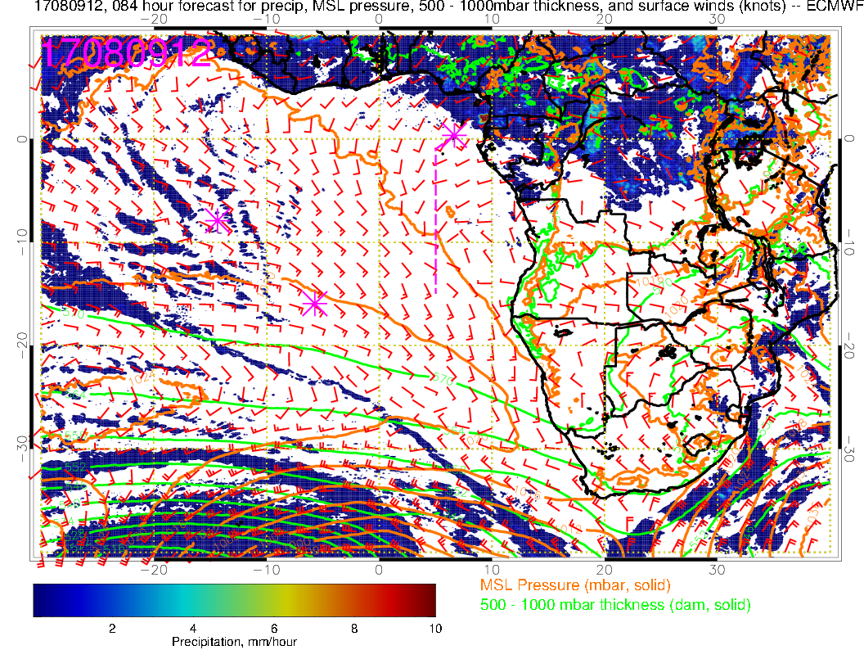
Surface chart noon Wednesday. AC squeezed northward by strong midlatitude front. Focus of precip clearly over Gabon, Congo, Nigeria.

Slide 7
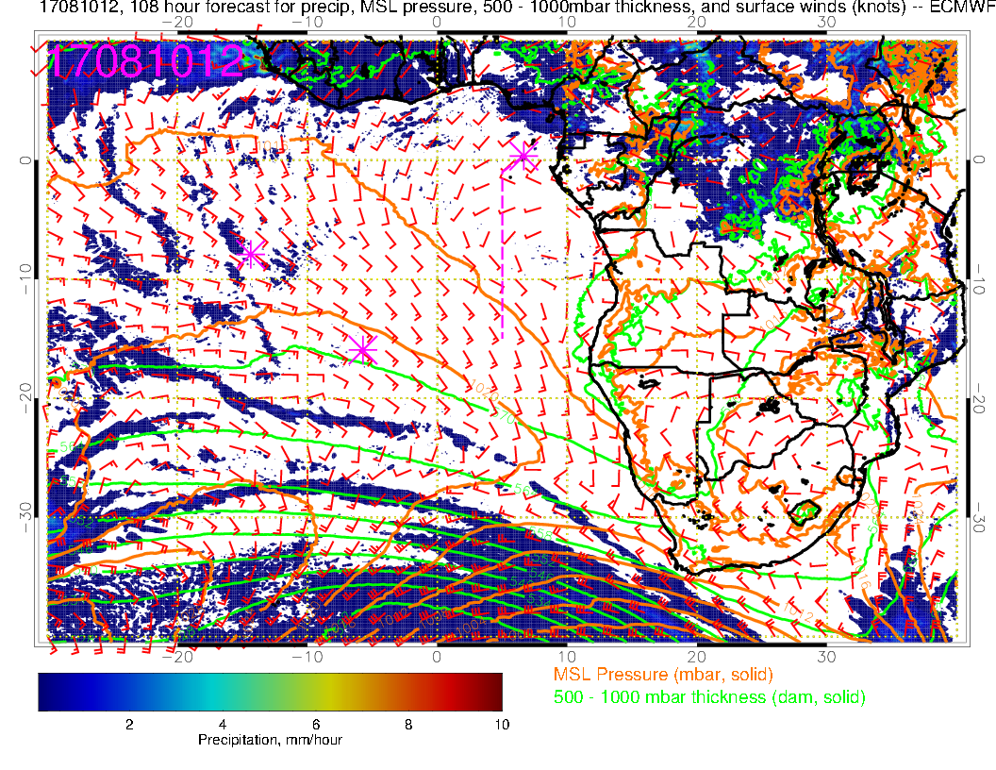
Surface chart noon Thursday. Midlatitude influence from front extending to 20N

Slide 8
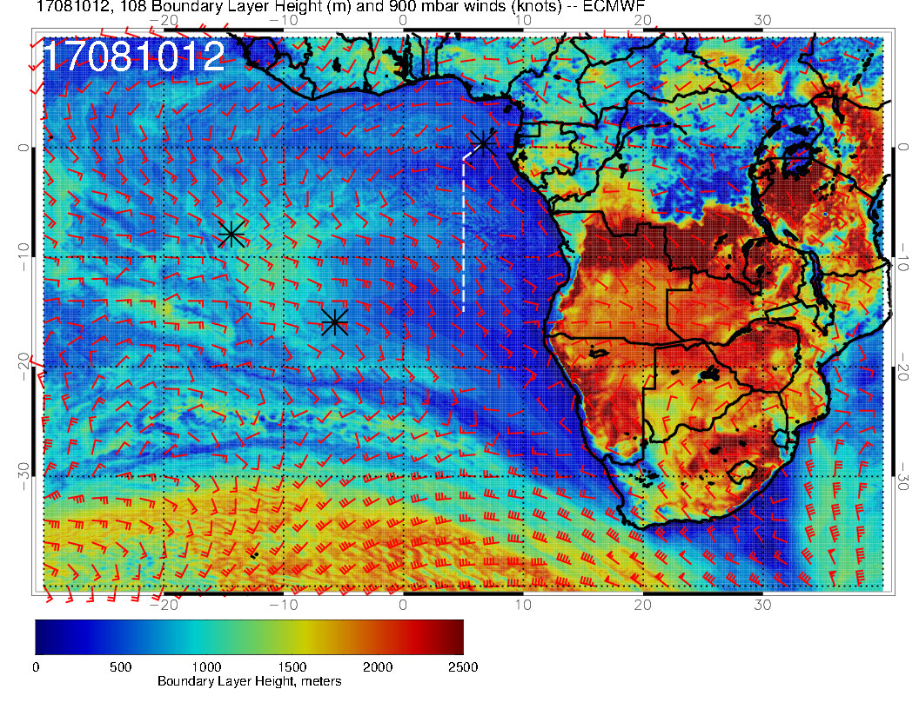
Thursday, BL height and flow near top of BL. Midlatitude penetration influences SC region with a low BL height. This will affect character of the low cloud on Thursday.

Slide 9
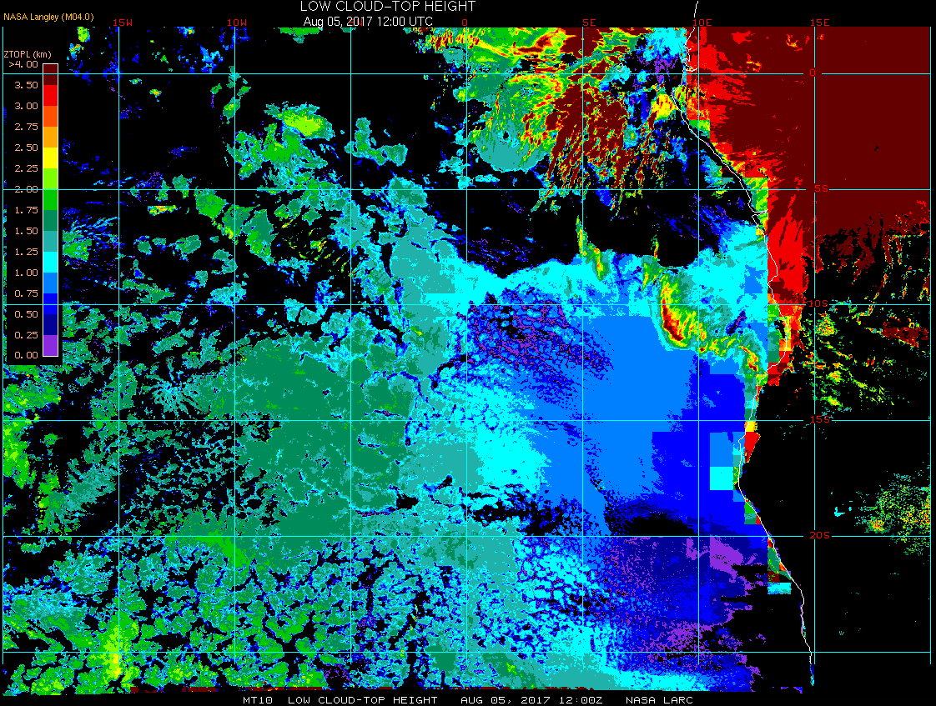
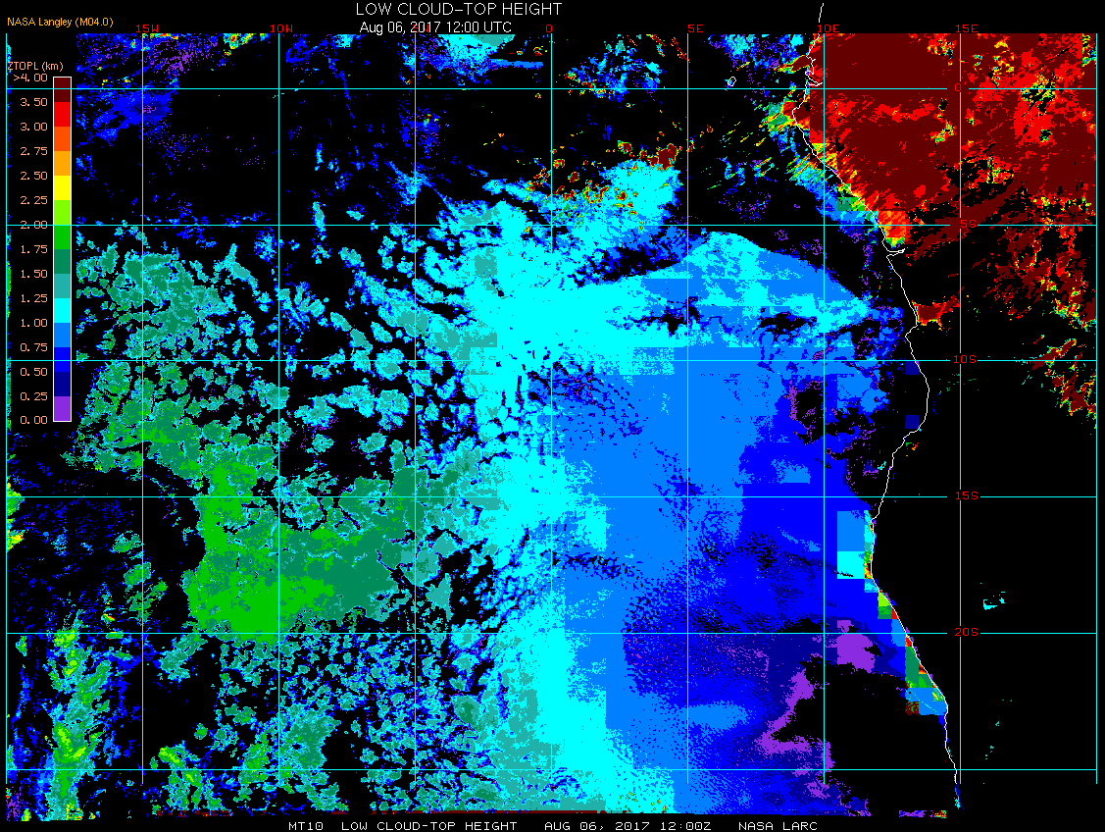
8/5 Sat @ 12PM
Low cloud-top heights (satellite estimate)
Abundant mid and high clouds over TMS yesterday, clearer today
8/6 Sun @ 12PM
Cloud-top heights ~1.5 km over ASI

Slide 10
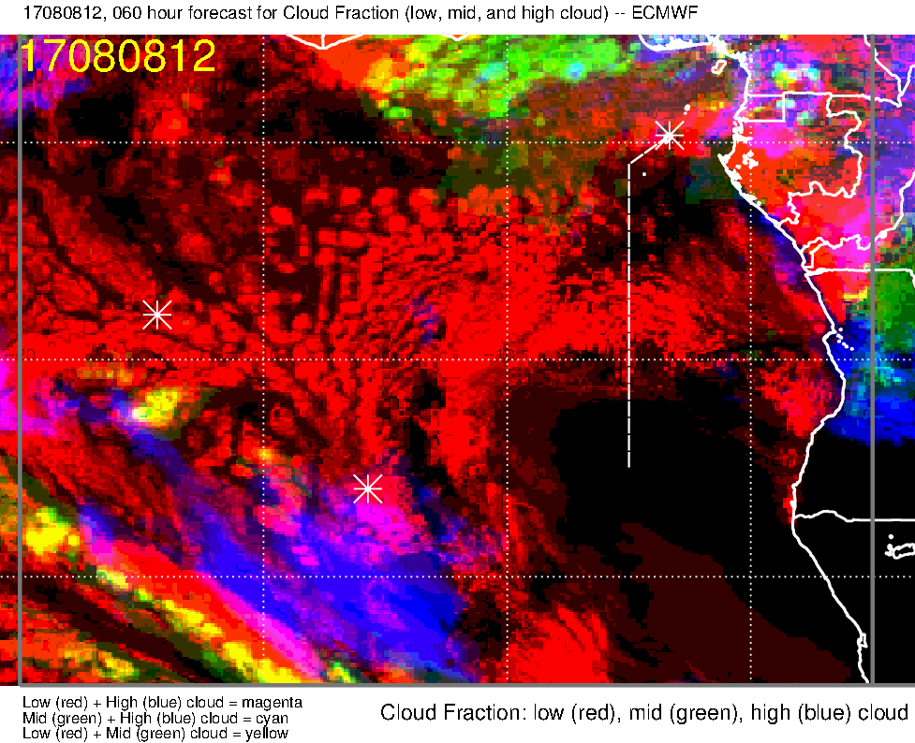
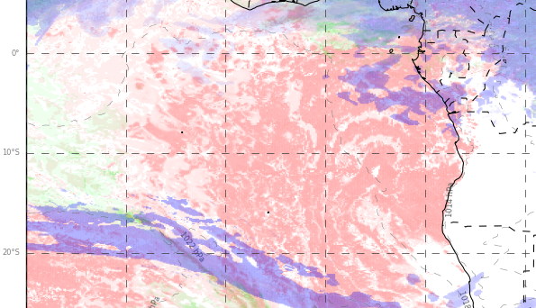
Low, middle, high cloud forecast for 8/8 Tue @ 12PM
ECMWF (60-hr)
UKMO (108-hr)
low + middle clouds
Low + middle clouds
Low + high clouds
low + high clouds
Scattered low clouds from ASI to TMS (less low clouds than previous days, previous slide)
Expect some mid to high clouds towards the end of the transit flight
but (1) mid-high clouds generally decrease from 12 to 3PM and (2) models tend to overestimate high cloud cover so probably less than what’s shown here
* Note the much older (108-hr) forecast from UKMO

Slide 11
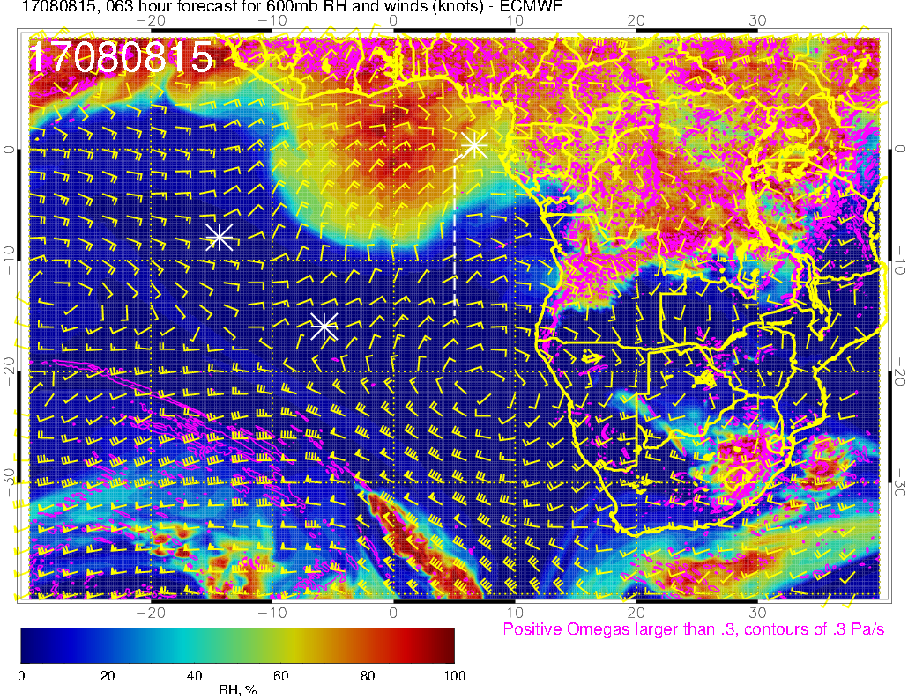
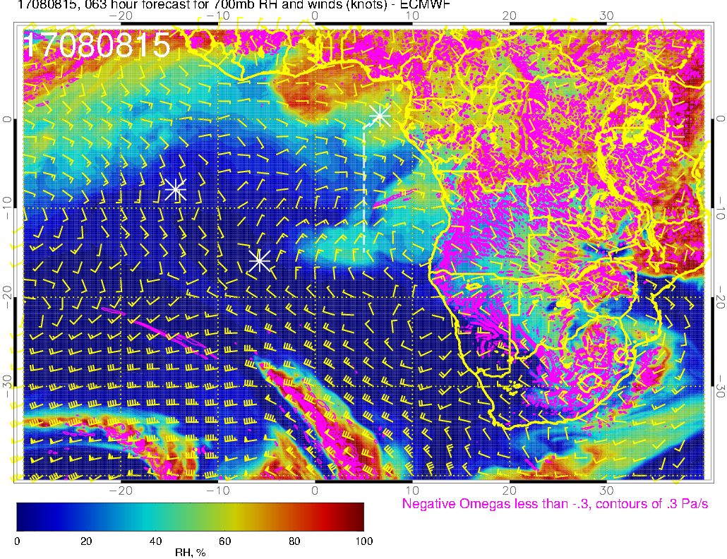
RH (color), UV wind (vectors), vert. velocity (pink contours) forecast for 8/8 Tue @ 3PM
600 mb
Plume of high RH air influenced by moist convection at 600mb, less at 700mb (aerosol layer?)
700 mb

Slide 12
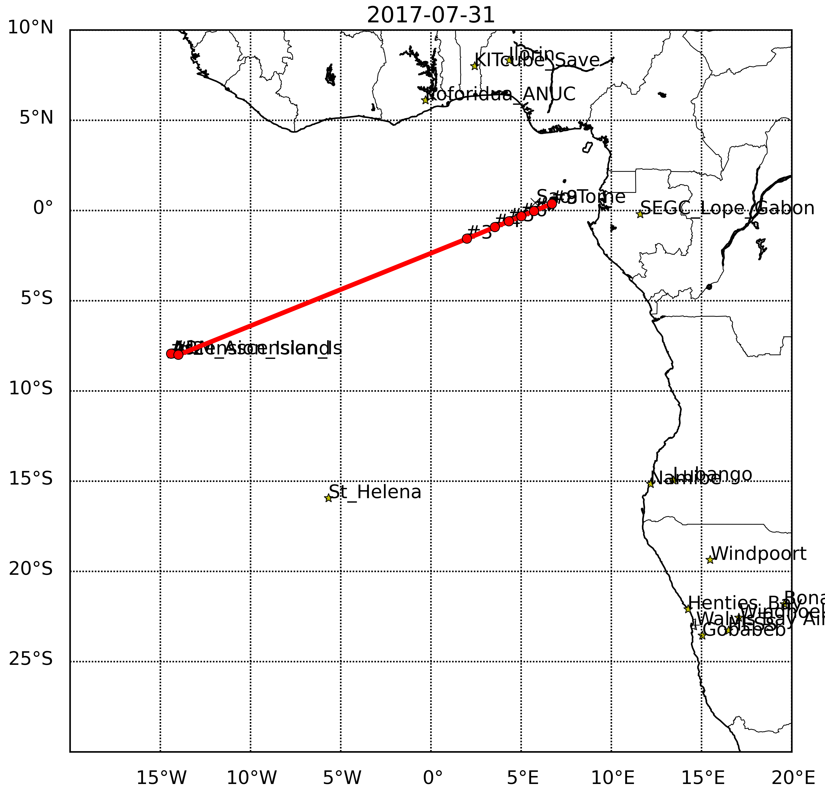
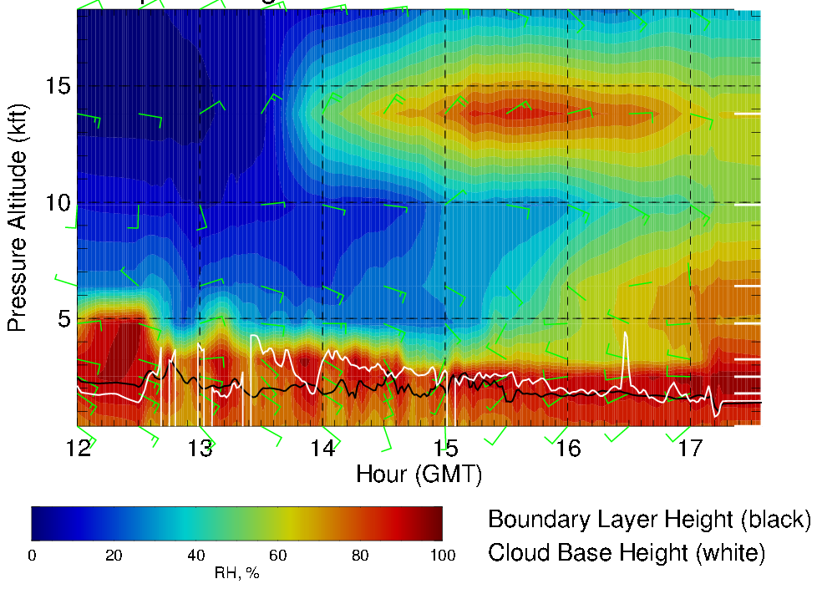
RH (color) along transit flight track, 8/8 Tue 12 – 5:30PM
High RH air at 600mb (influenced by moist convection) during second half of flight
Headwinds of ≤ 20 knots mid-flight at 600mb

Slide 13
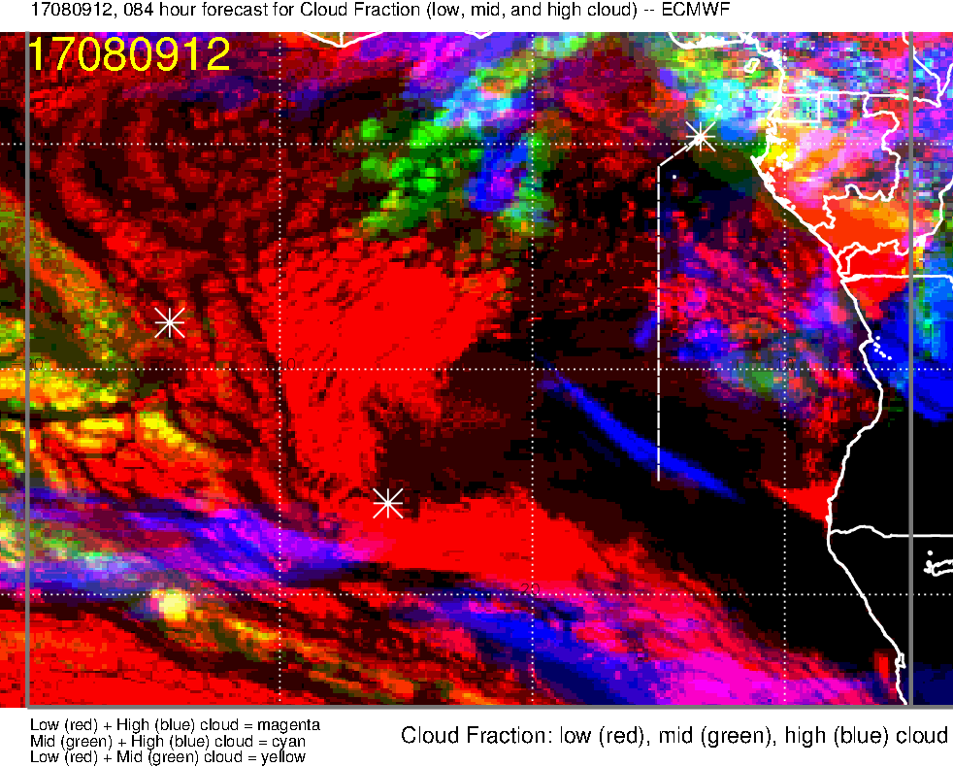
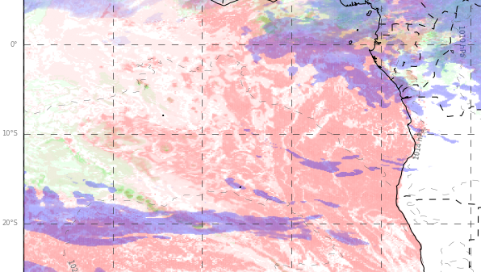
Low, middle, high cloud forecast for 8/9 Wed @ 12PM
ECMWF (84-hr)
UKMO (132-hr)
mid + high clouds
Low + high clouds
low +mid + high clouds
More low clouds along the first half of the transit flight
Expect some mid to high clouds during the second half of the flight, but mainly to the NW of the flight track (moving westward)
* Note the much older (132-hr) forecast from UKMO

Slide 14
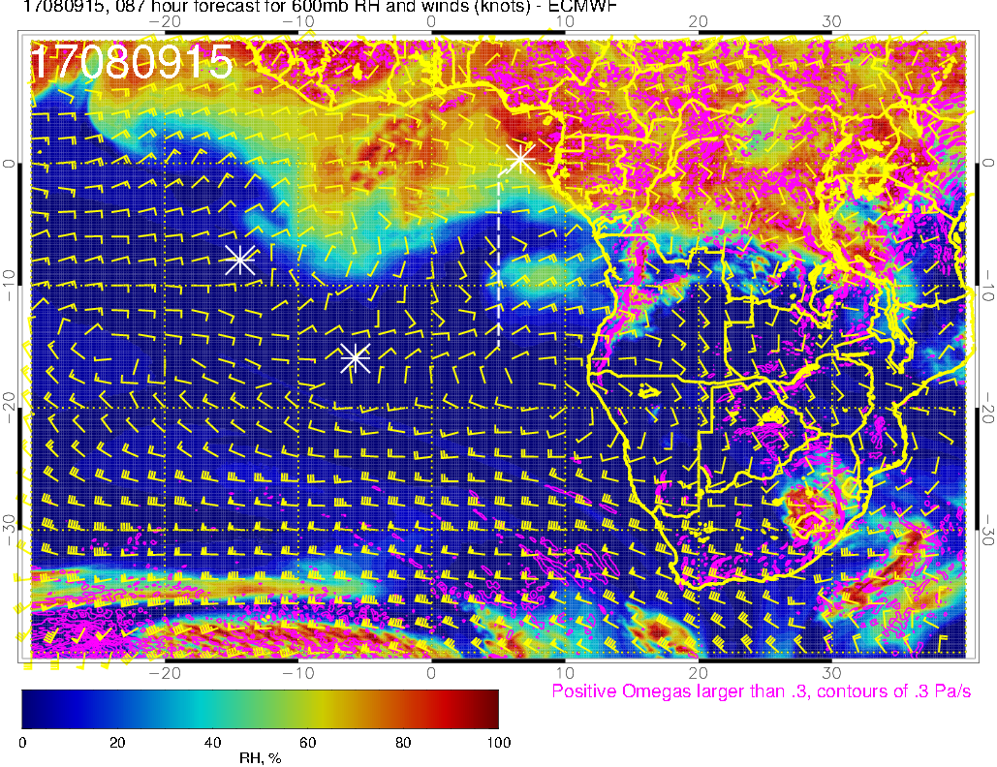
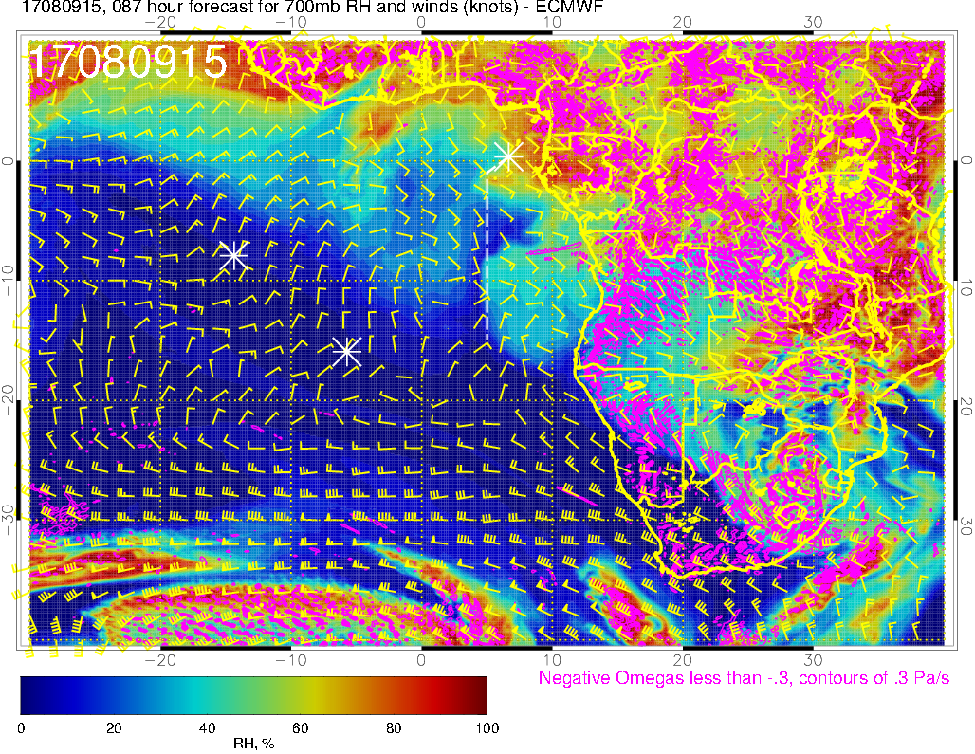
RH (color), UV wind (vectors), vert. velocity (pink contours) forecast for 8/9 Wed @ 3PM
600 mb
Plume of high RH air getting dispersed horizontally as it moves westward
700 mb

Slide 15
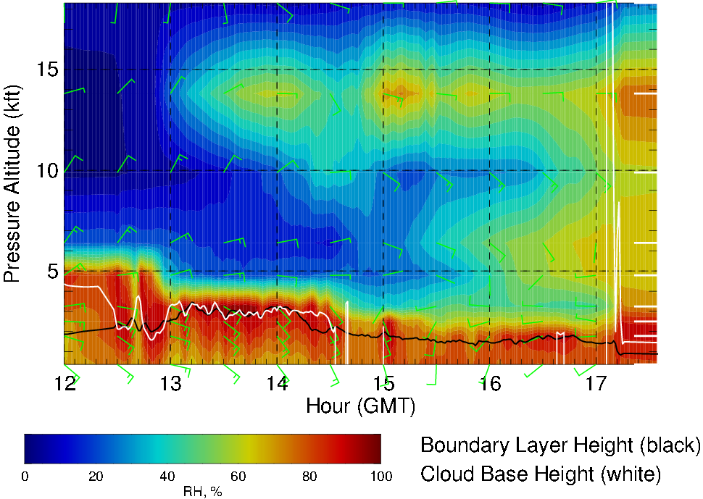
RH along transit flight track, 8/9 Wed 12 – 5:30PM
High RH air at 600mb is dispersed horizontally
Weaker winds (5-15 knots) compared to 8/8

Slide 16
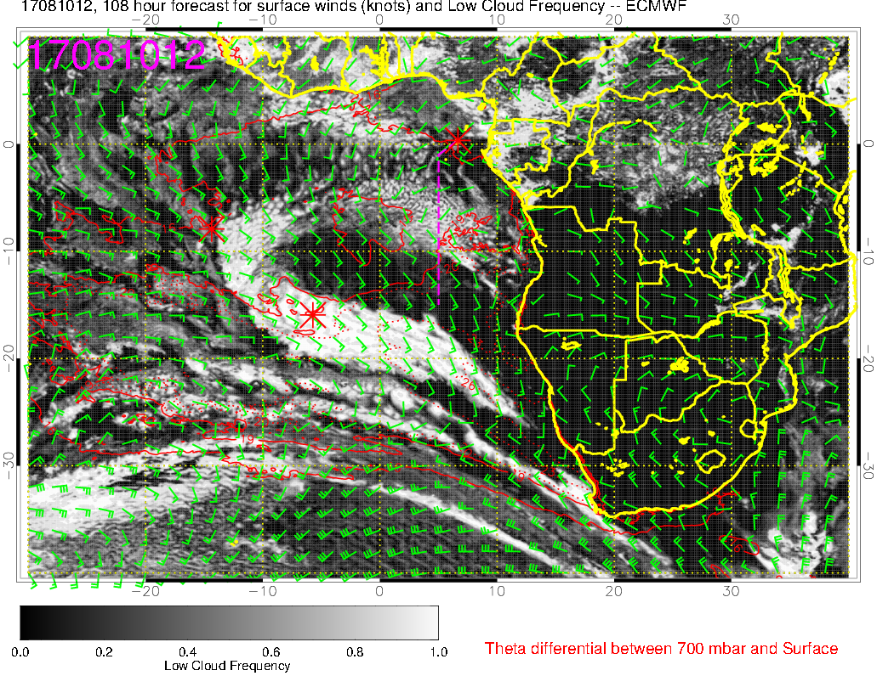
Low cloud forecast on 8/10 Thu @ 12PM
Few low clouds at the end of the flight track (and NW of it)
Not entirely cloud free, but much less than climatology (coincides with region of low BL heights)

Slide 17
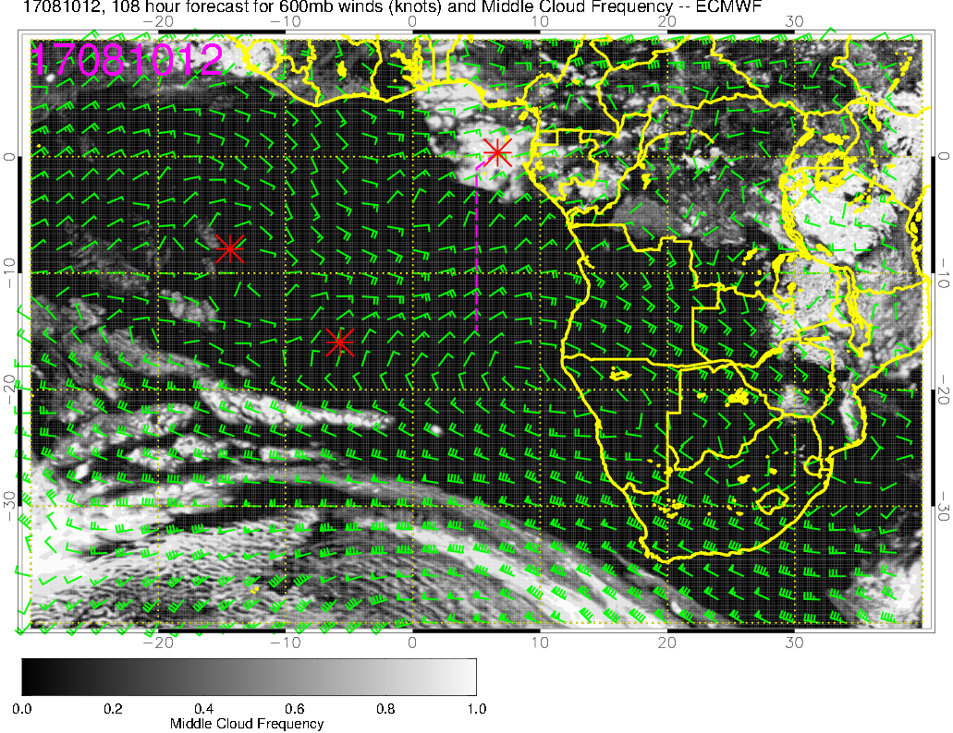
Middle cloud forecast on 8/10 Thu @ 12PM
Substantial middle clouds predicted over TMS

Slide 18
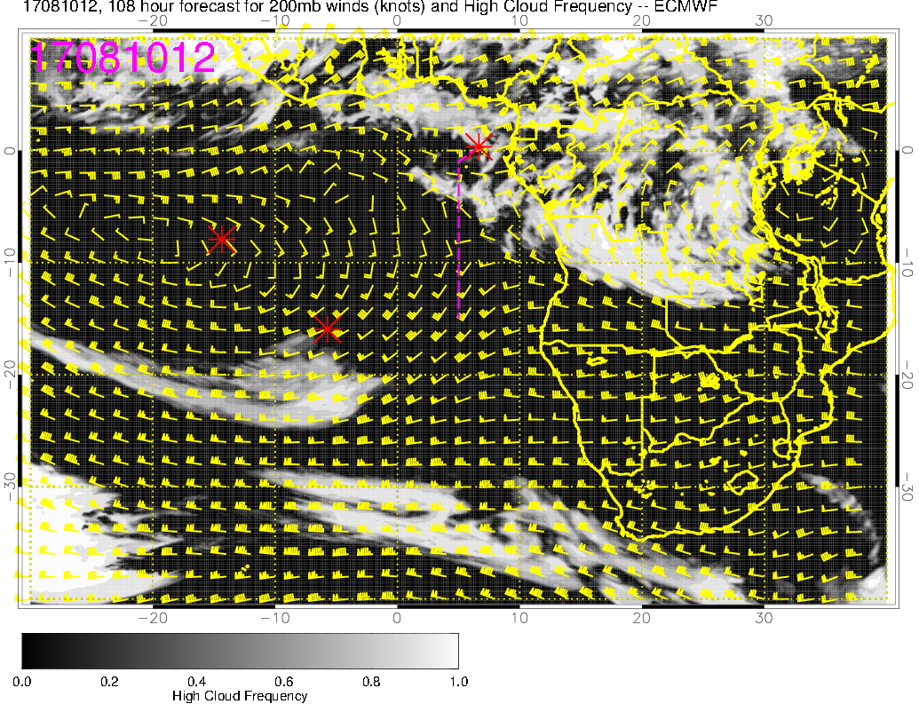
High cloud forecast on 8/10 Thu @ 12PM
These high clouds (and mid clouds, previous slide) appear to be associated with enhanced westerly component of the surface winds over TMS and the increase in convection over land

Slide 19
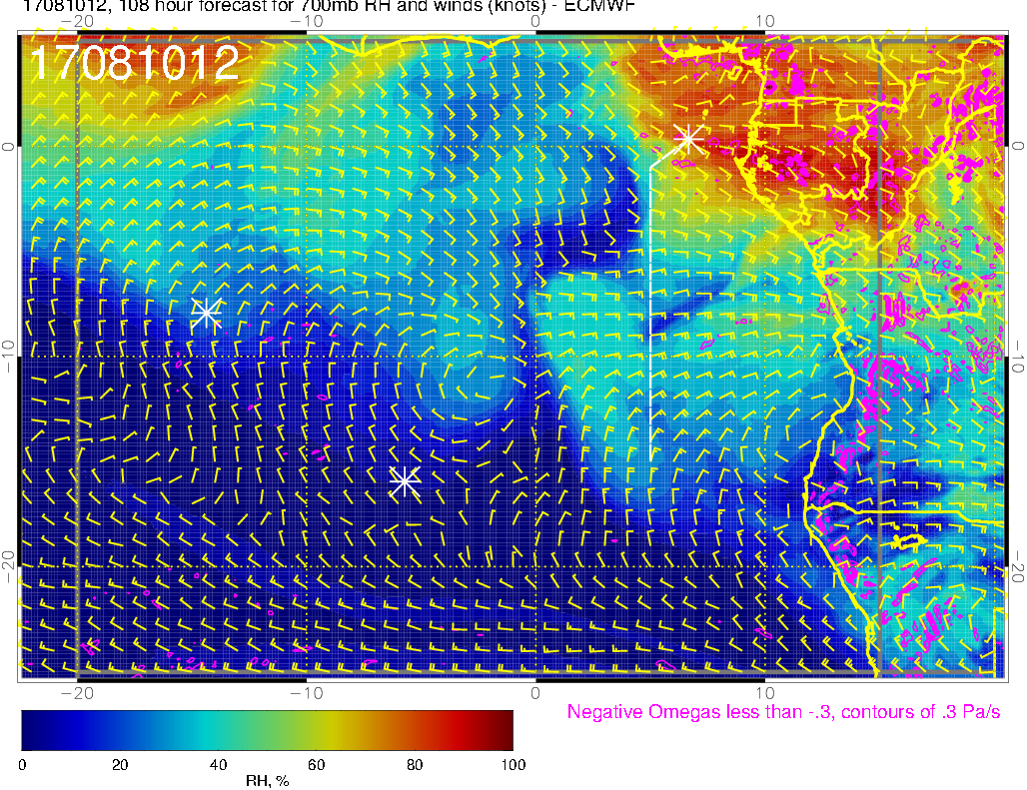
700mb RH (color), UV wind (vectors), vert. velocity (pink contours) forecast for 8/10 Thu @ 12PM
Easterly wind along the routine flight track (aerosol transport from dry convection along southern portion?)

Slide 20
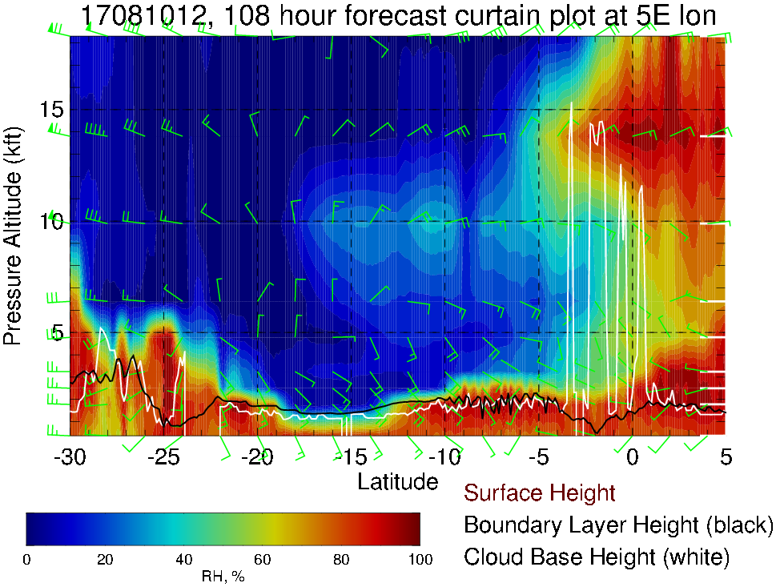
RH, winds, BL and cloud base heights along 5E, 8/10 Thu @ 12PM
Plume transport at 700mb

Slide 21
Summary
Transit flight ASI-TMS: Tuesday 8/8
Scattered low clouds along the flight track (less than previous days)
Some mid and high clouds near TMS
Enhanced RH air (~600mb) influenced by moist convection during second half of the flight
Headwinds of up to 20 knots at 600mb (~15 kft) in the middle of the flight
Contingency Transit flight ASI-TMS: Wednesday 8/9
Low clouds during first half of the flight
Mid and high clouds in the second half of the flight (NW of the flight track)
Plume of enhanced RH air at 600mb is more diffused, moving west
Routine flight: Thursday 8/10
Low clouds diminish south of ~10S (low BL heights)
Mid and high clouds over TMS (from enhanced land convection)
Plume transport from moist and dry convection at 700mb

