Slide 1
ORACLES Forecast Briefing
(Aerosols)
06 August 2017

Slide 2
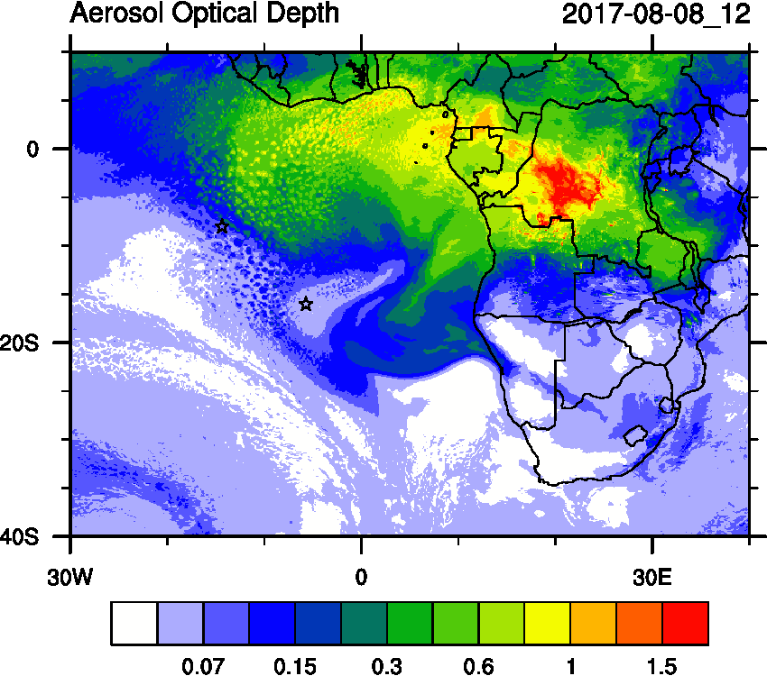
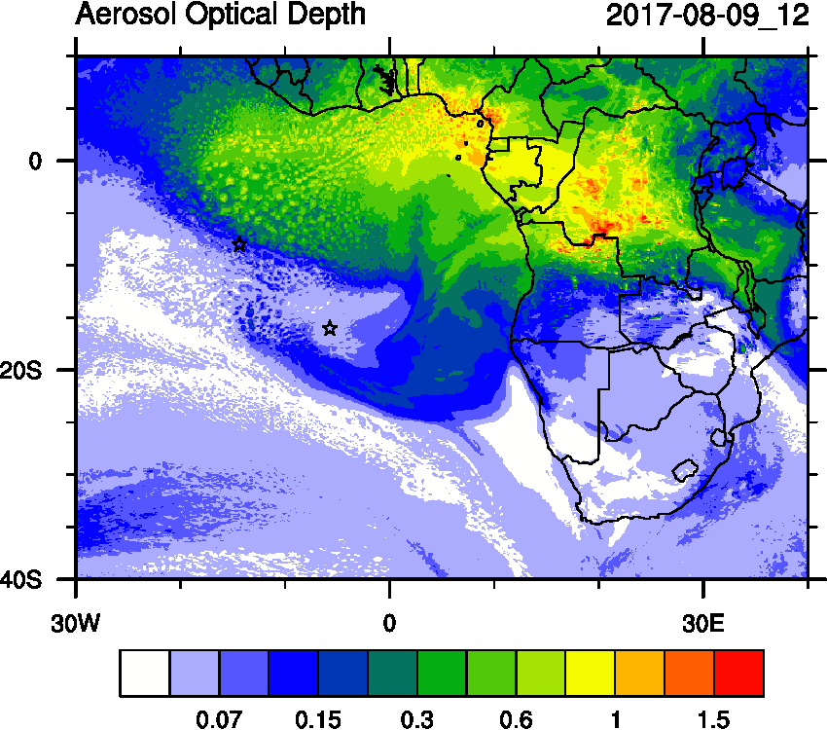
Tuesday (08) & Wed (09) August 2017 12Z

Slide 3
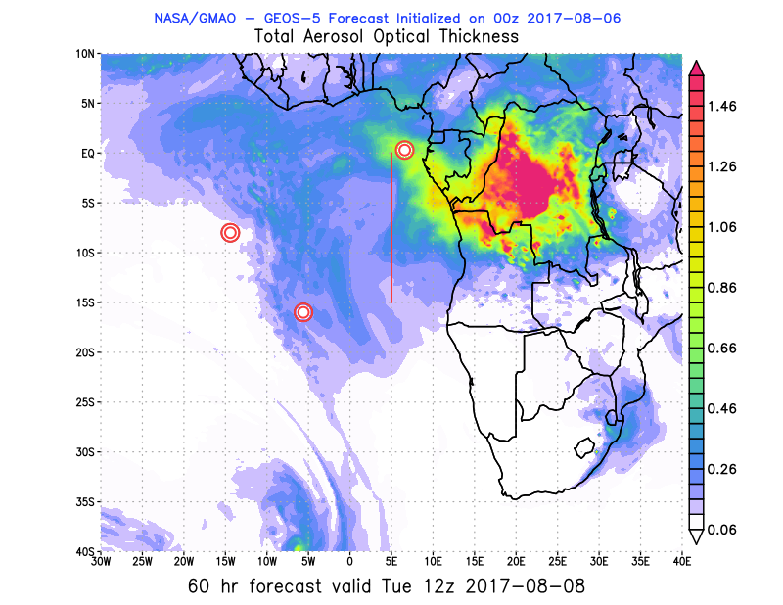
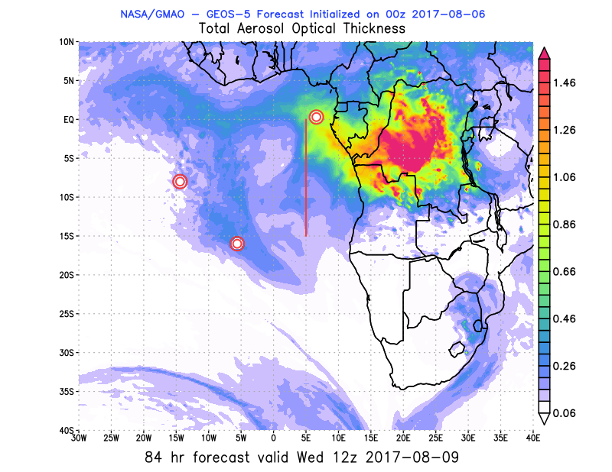
Tuesday (08) & Wed (09) August 2017 12Z

Slide 4
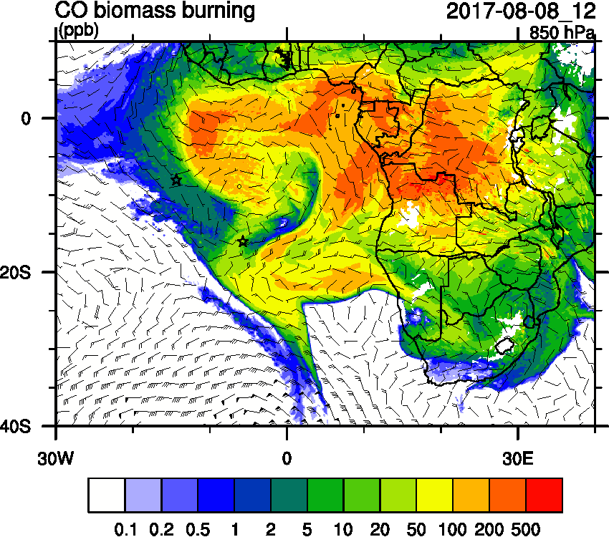
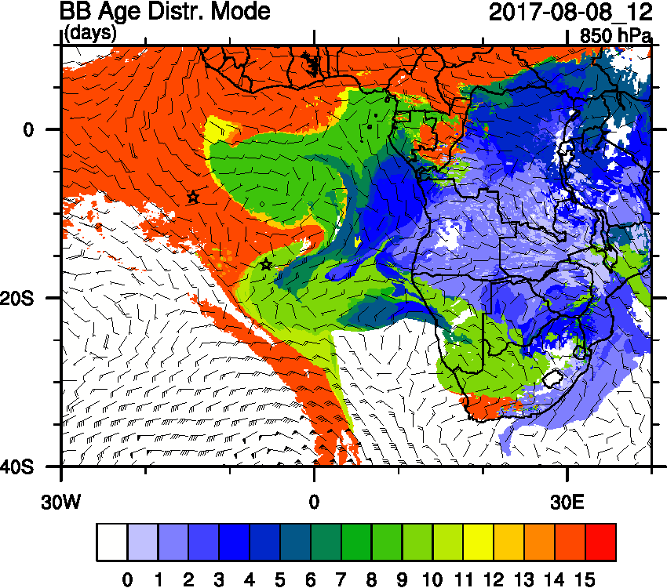
Tuesday (08) August 2017 12Z

Slide 5
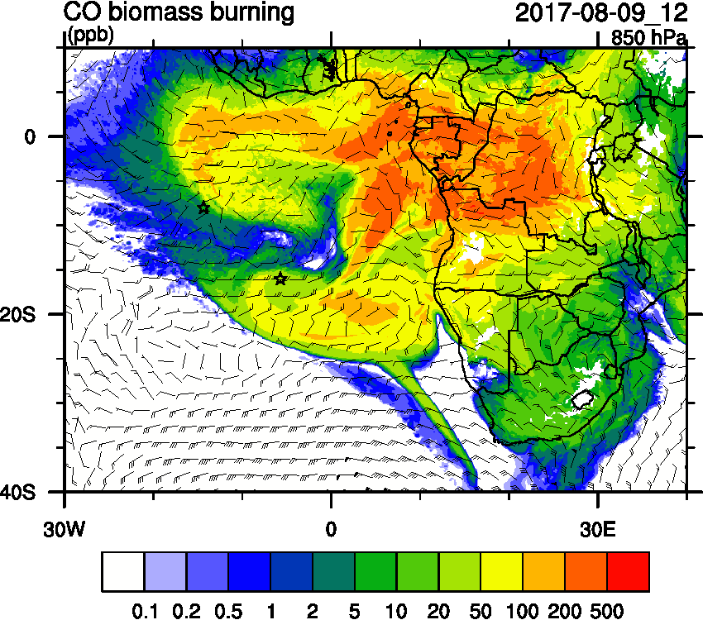
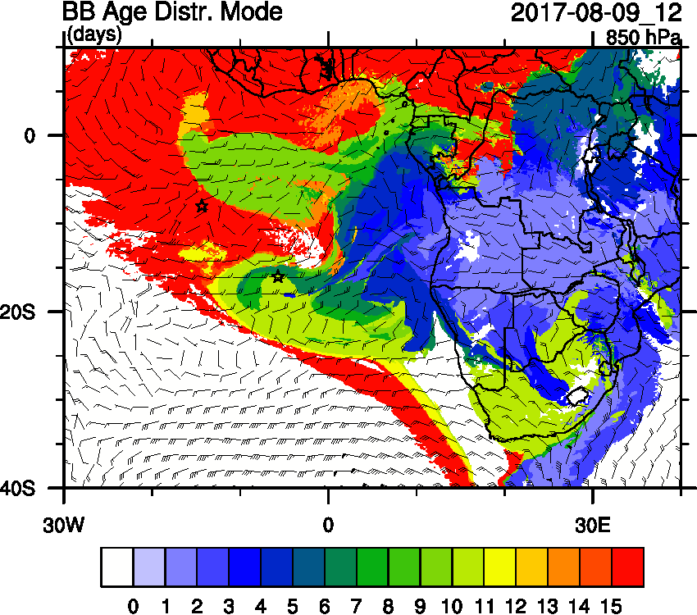
Wednesday (09) August 2017 12Z

Slide 6
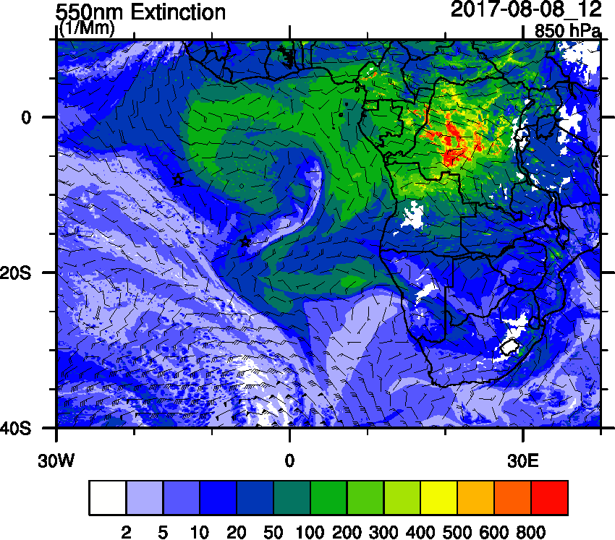
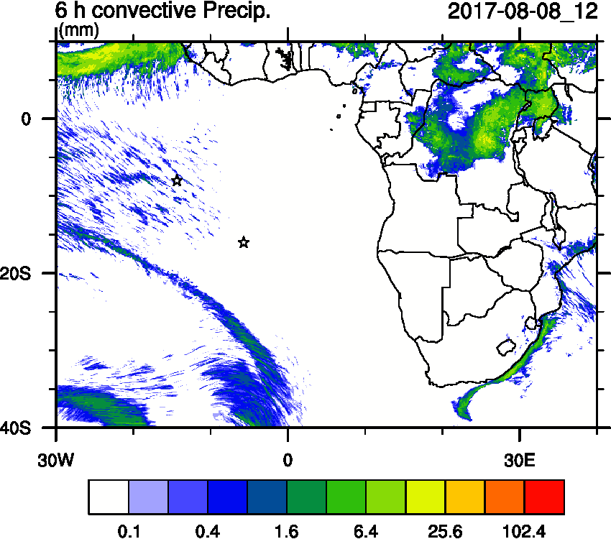
Tuesday (08) August 2017 12Z

Slide 7
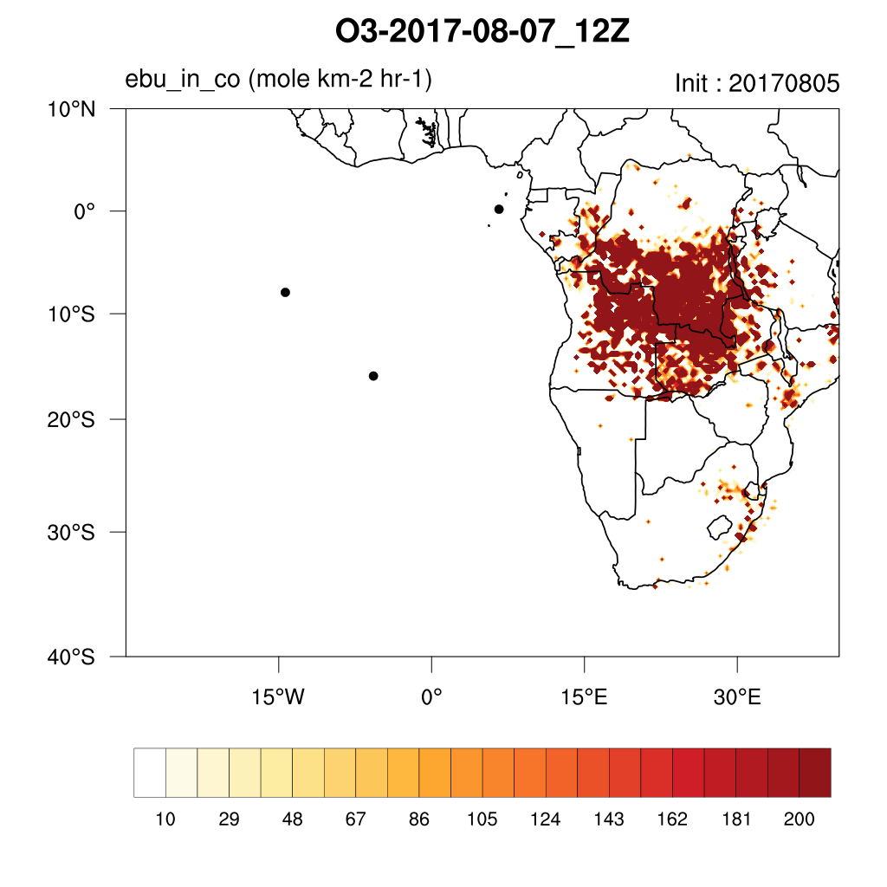
Tuesday (08) August 2017 12Z

Slide 8
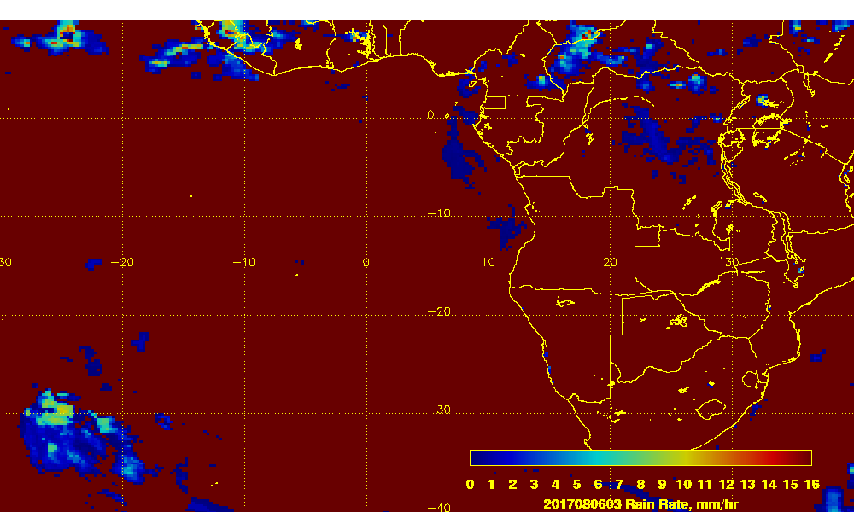
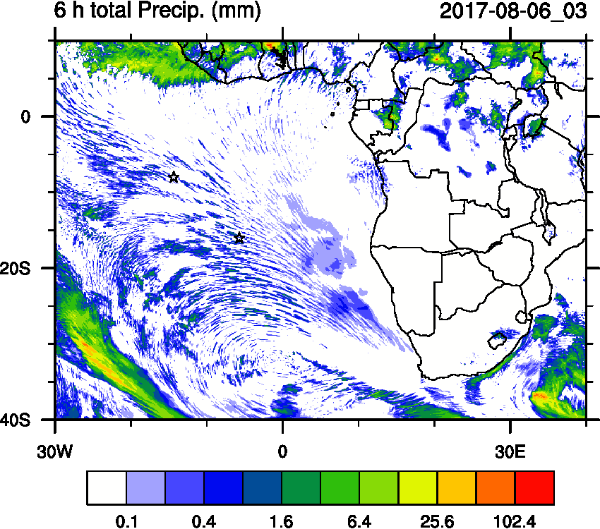
Prec Comparison Sunday (06) August 2017 03Z
OBS

Slide 9
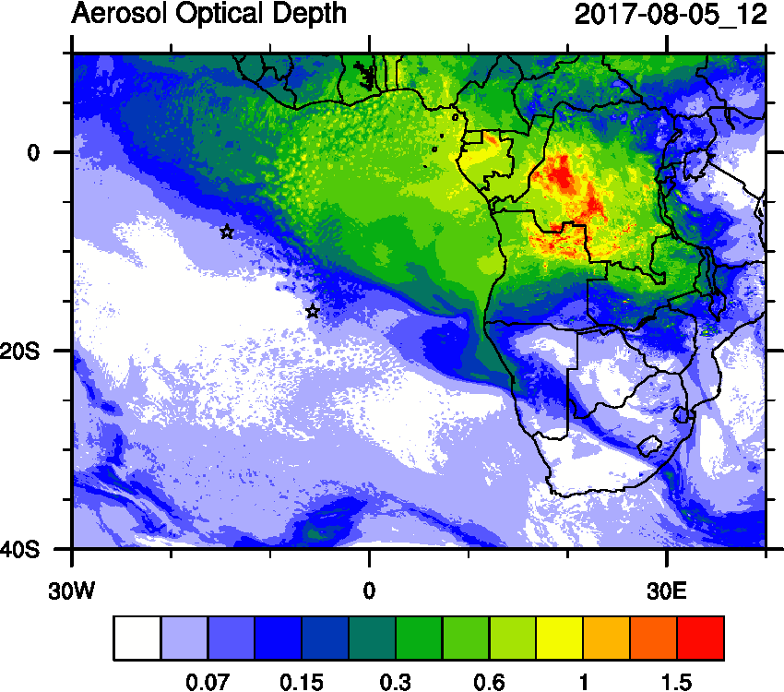
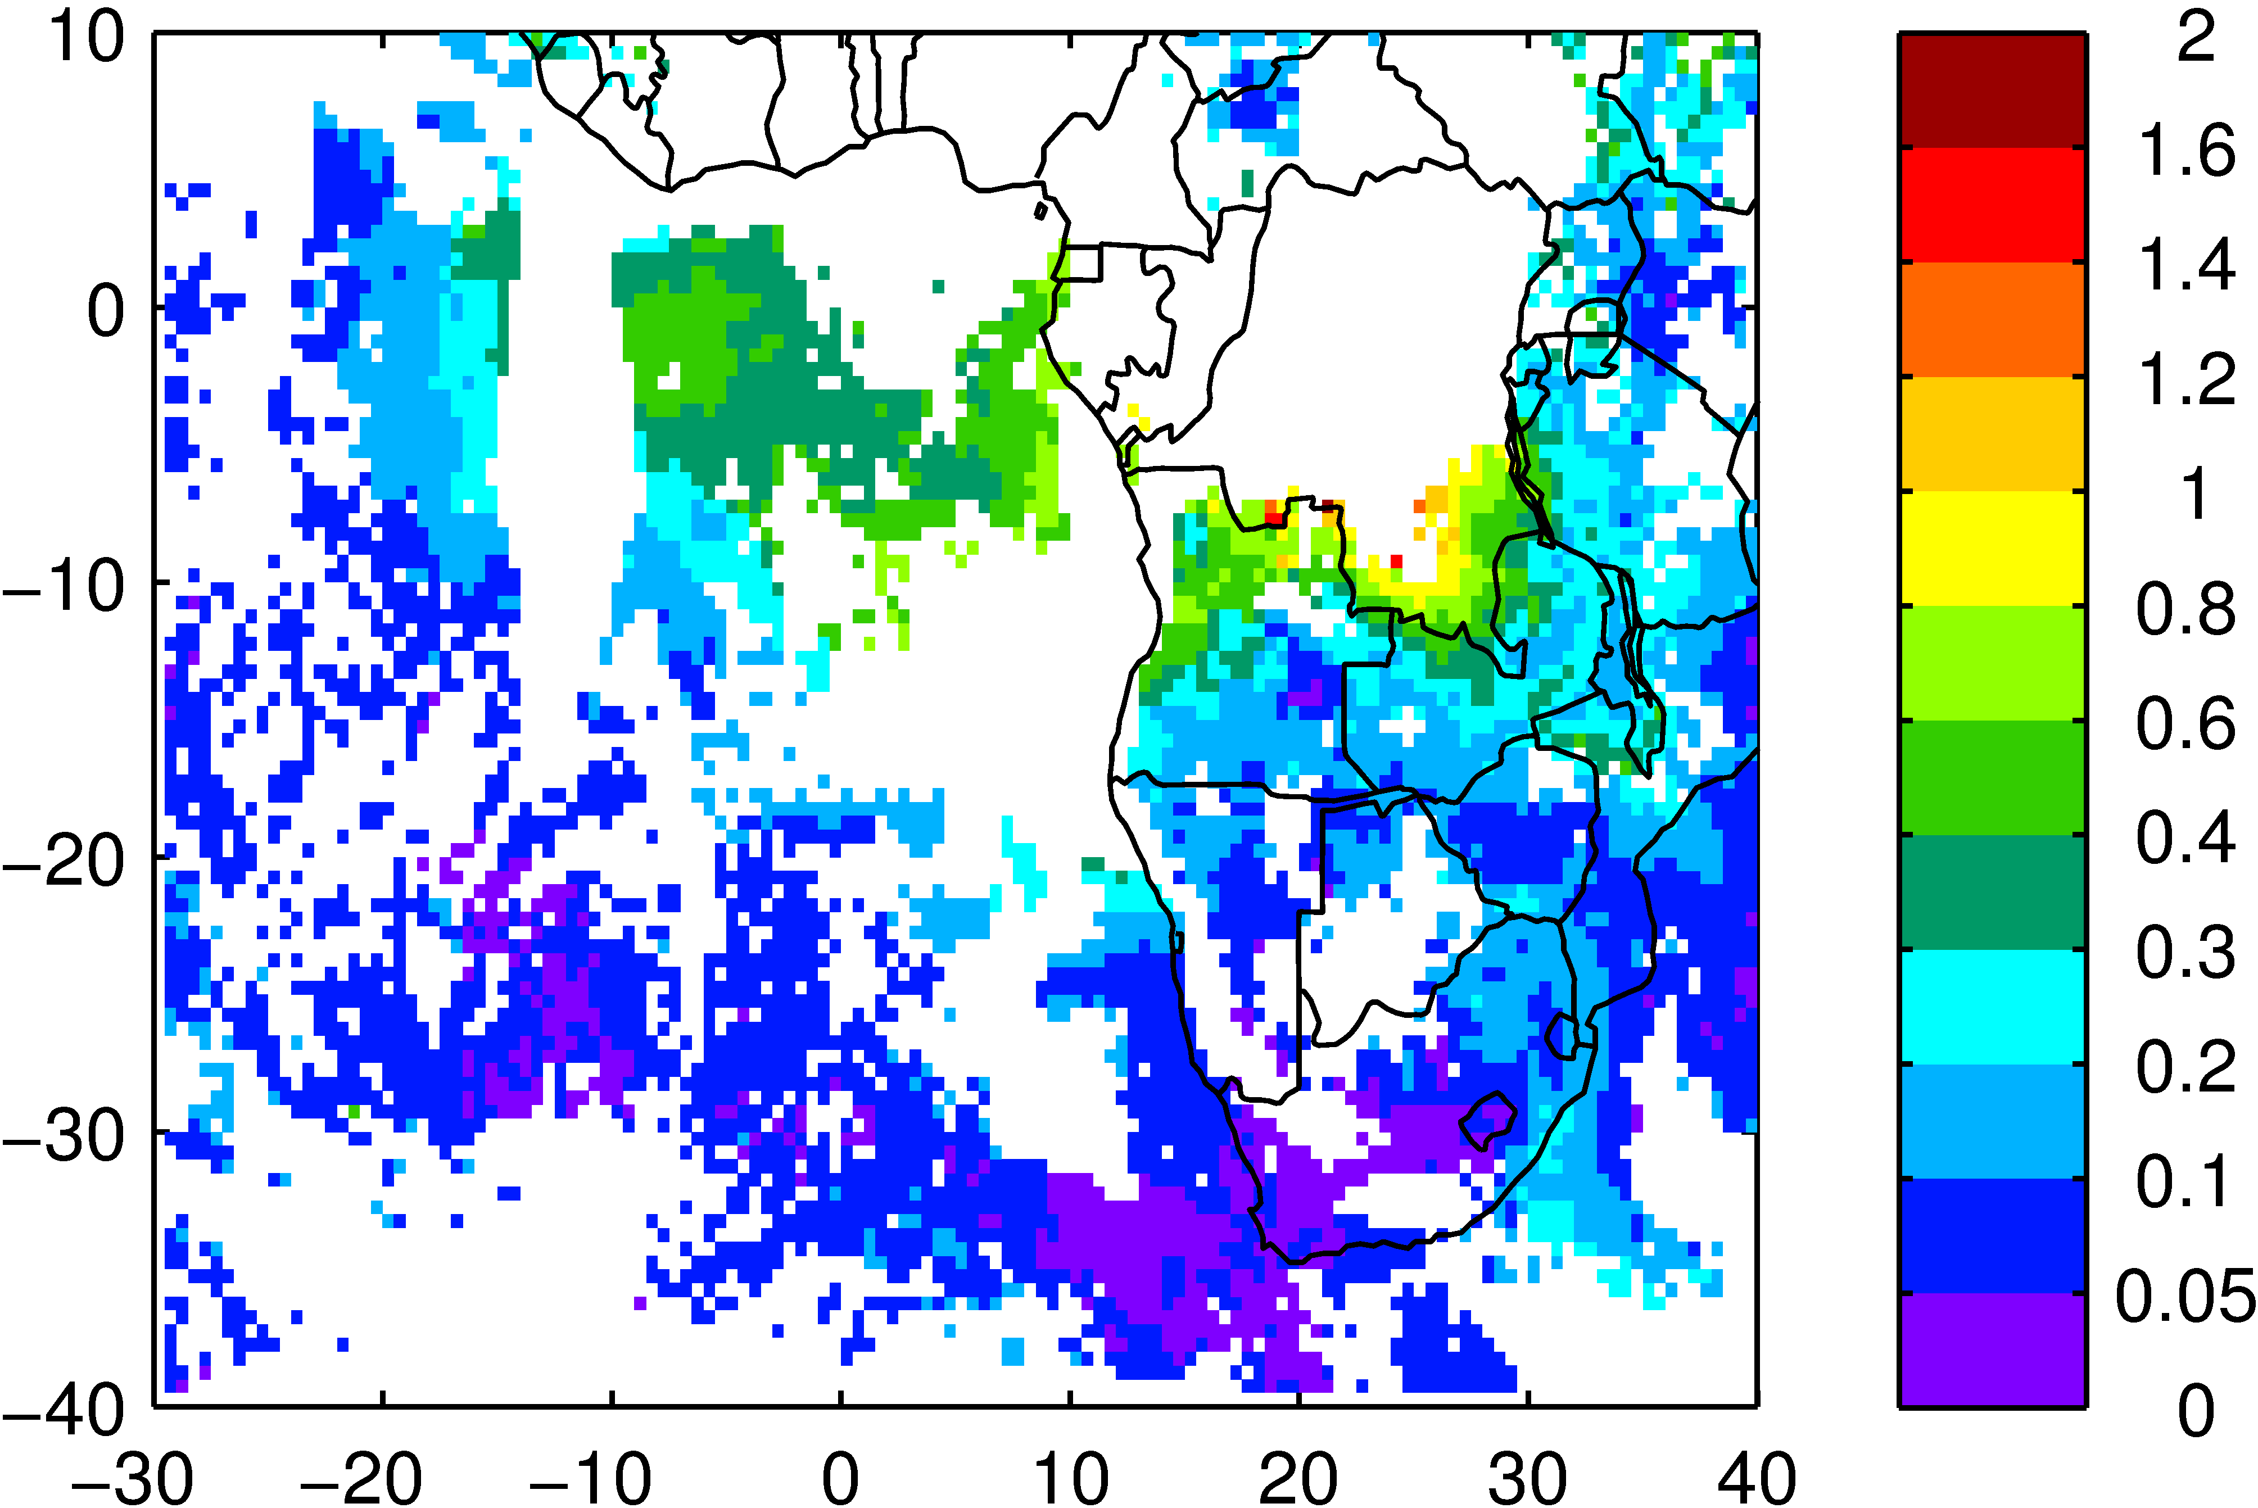
AOD Comparison Saturday (05) August 2017
OBS
OBS Terra/Aqua

Slide 10
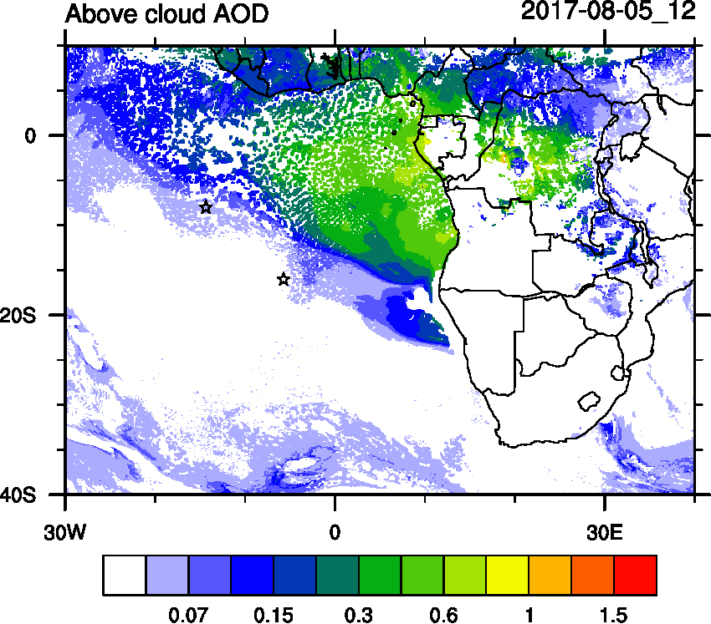
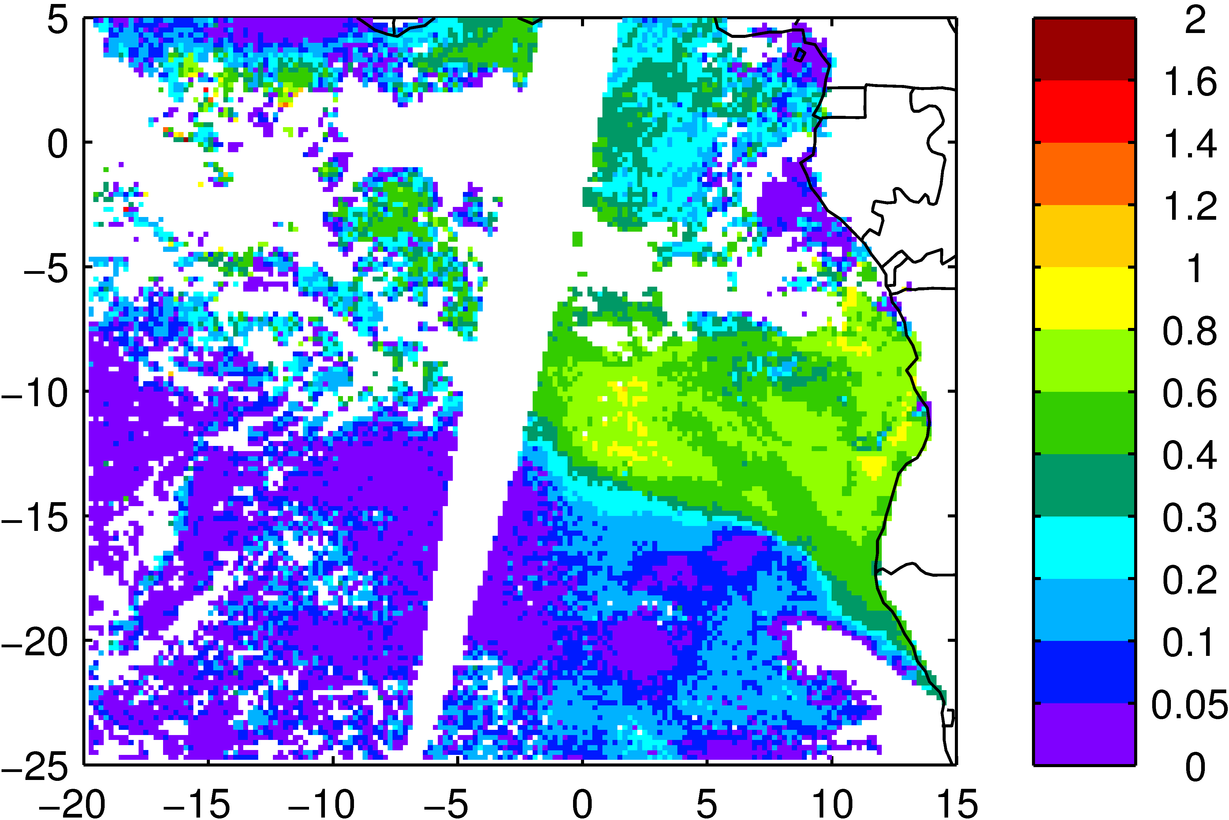
ACAOD Comparison Saturday (05) August 2017
OBS
OBS Terra

Slide 11
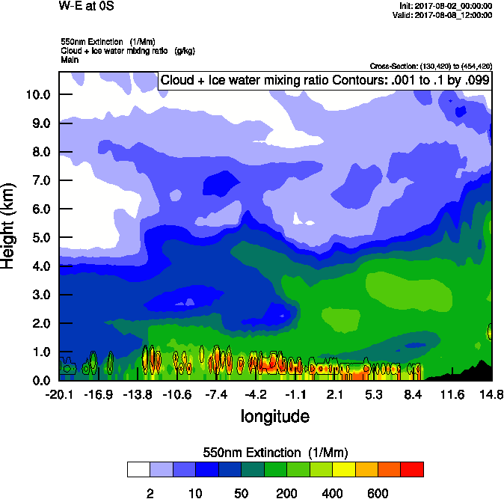
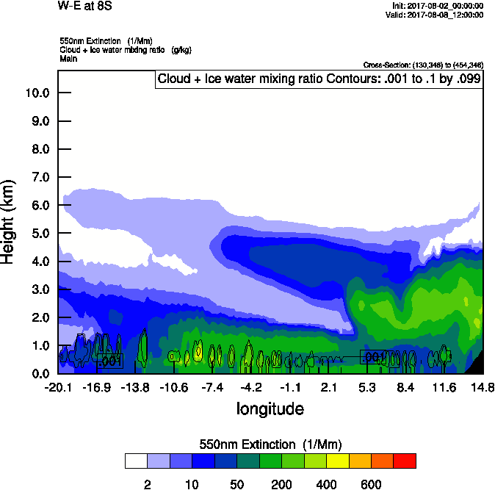
Tuesday (08) August 2017 12Z
W-E 0S
W-E 8S

Slide 12
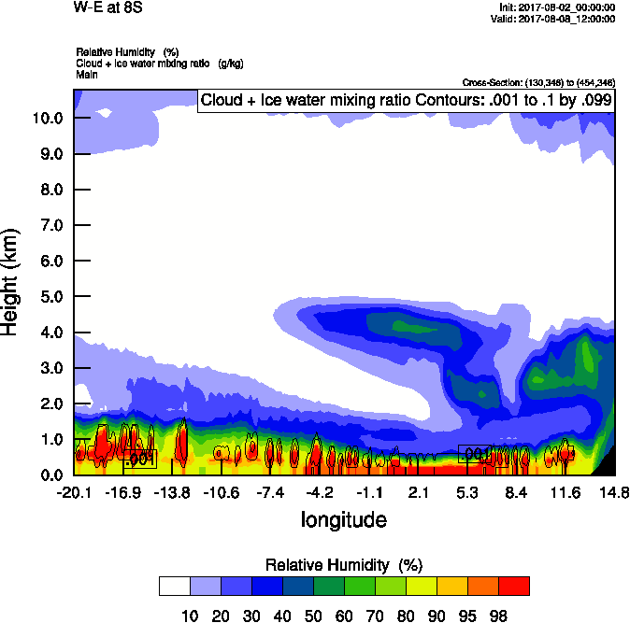
Tuesday (08) August 2017 12Z
W-E 8S

Slide 13
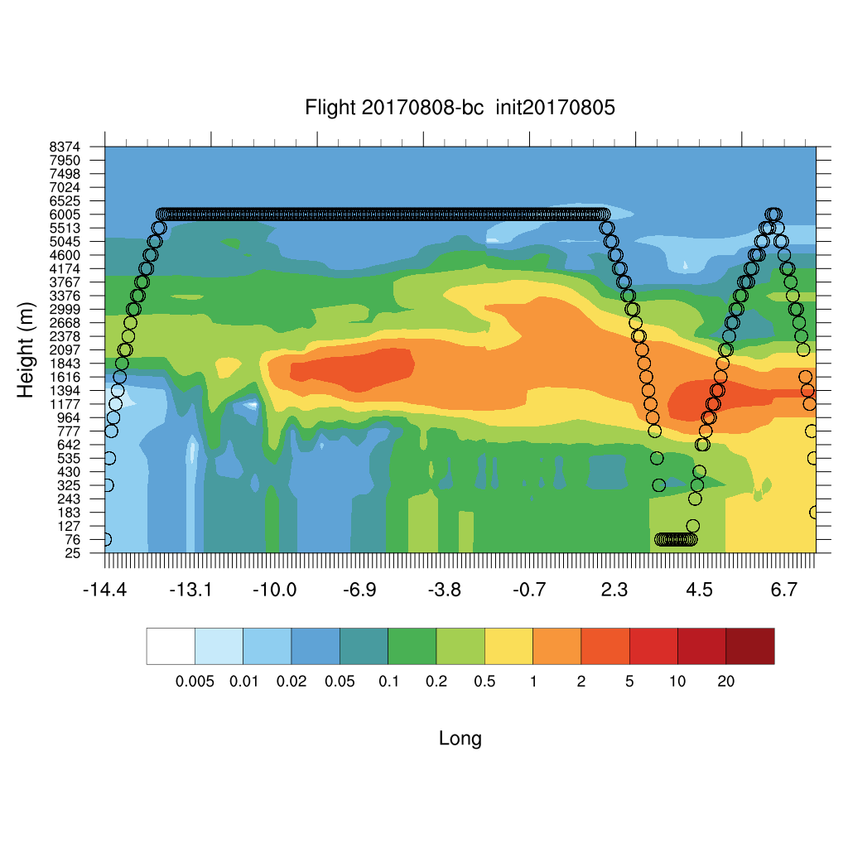
Tuesday (08) August 2017 12Z

Slide 14
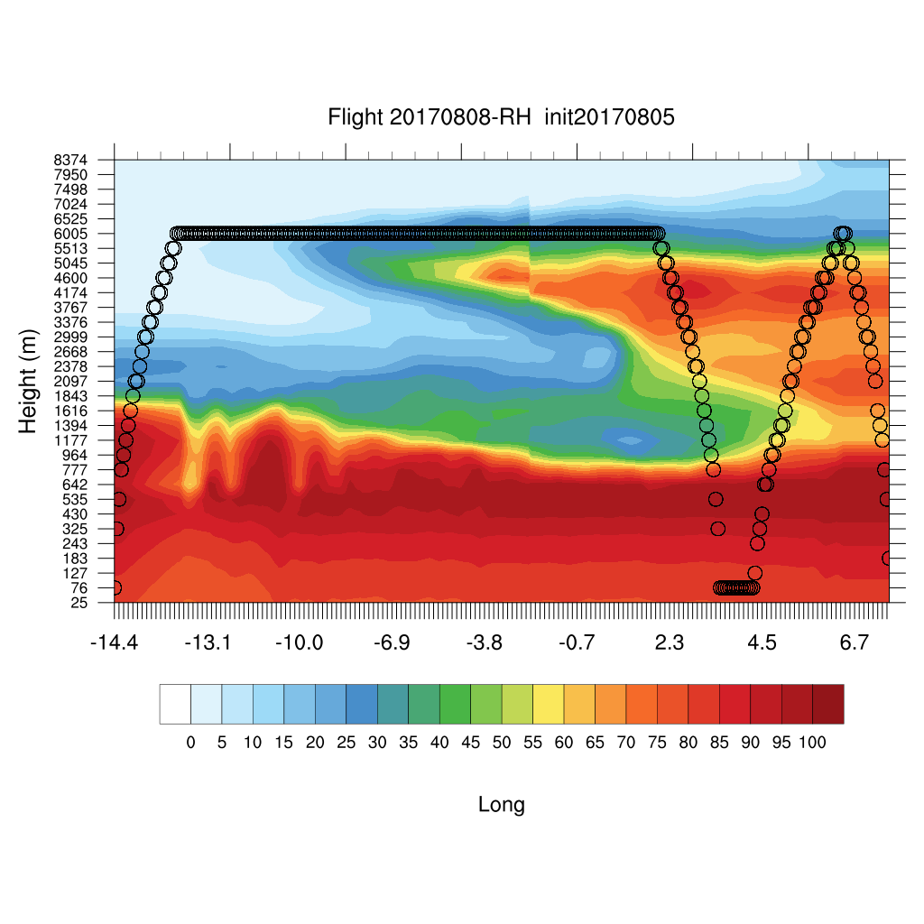
Tuesday (08) August 2017 12Z

Slide 15
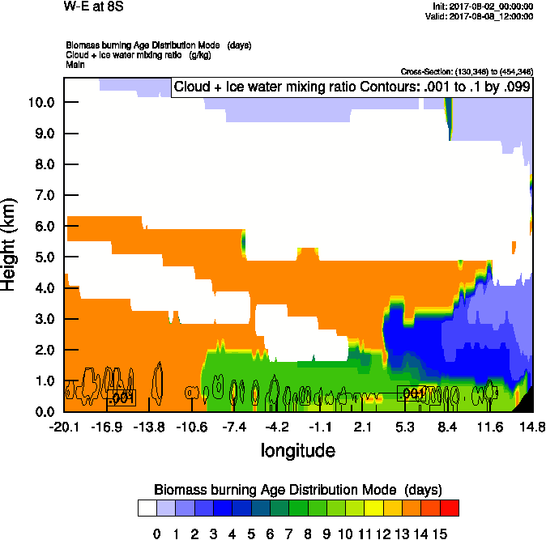
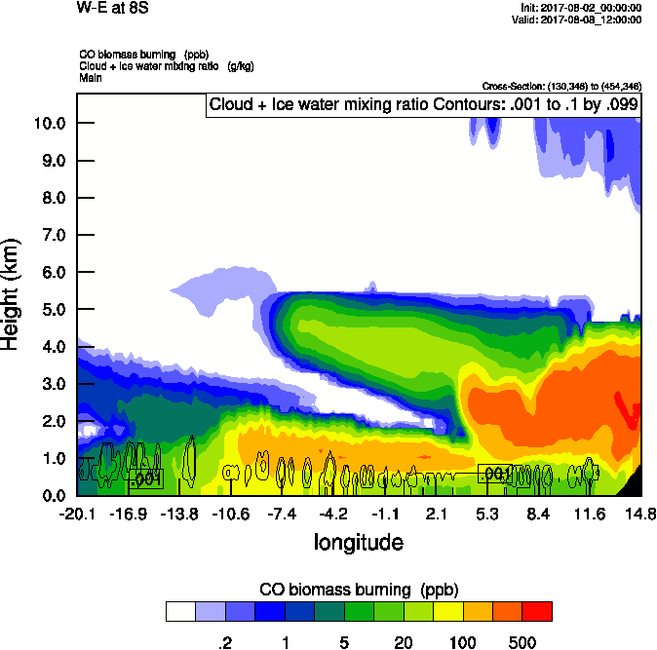
Tuesday (08) August 2017 12Z

Slide 16
Tuesday (08) August 2017 12Z

Slide 17
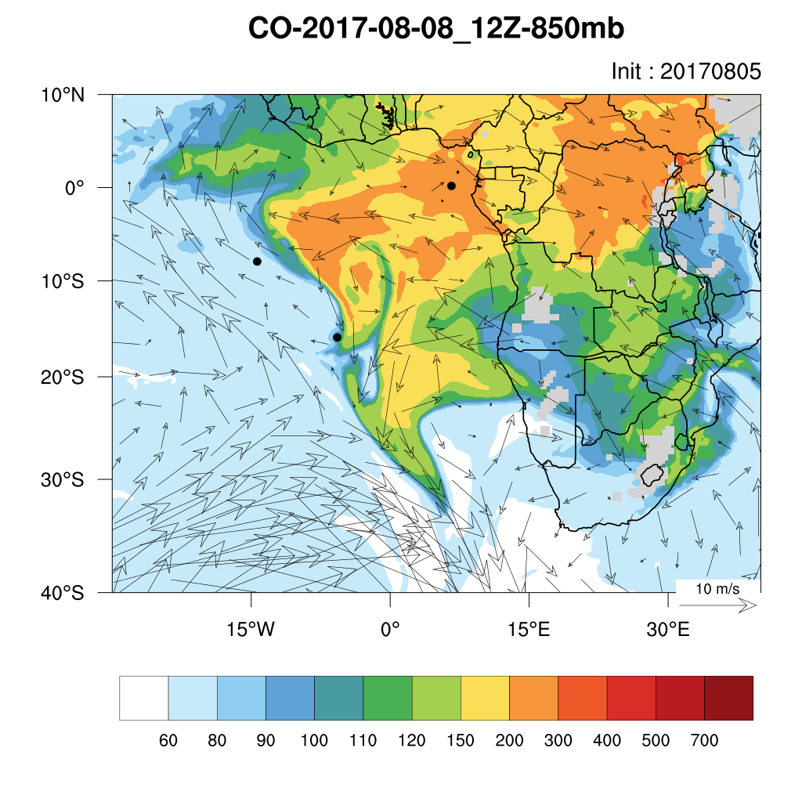
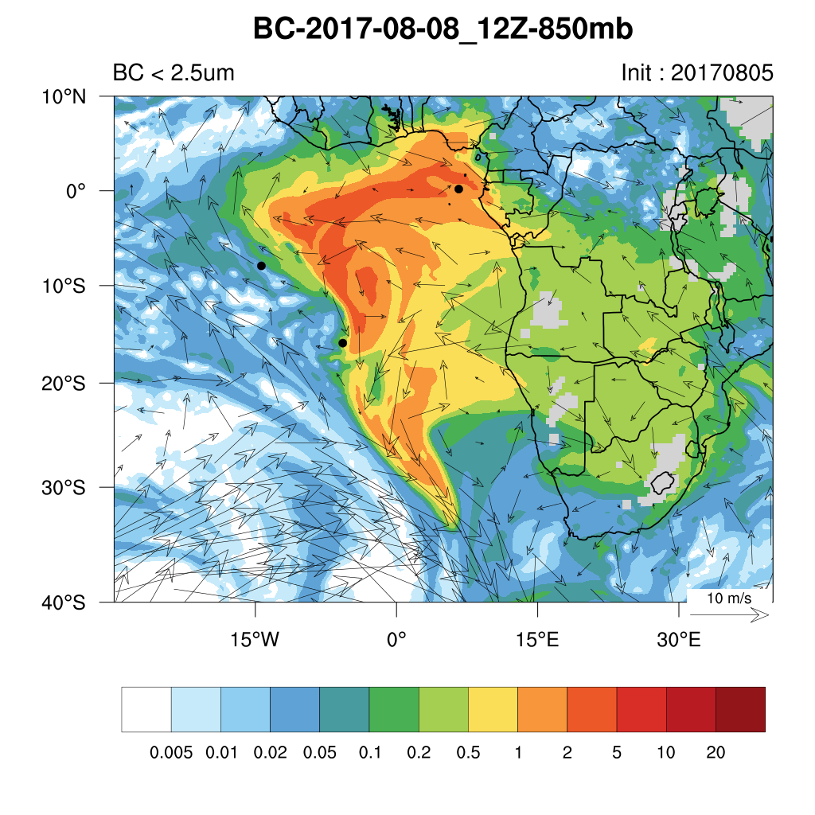
Tuesday (08) August 2017 12Z

Slide 18
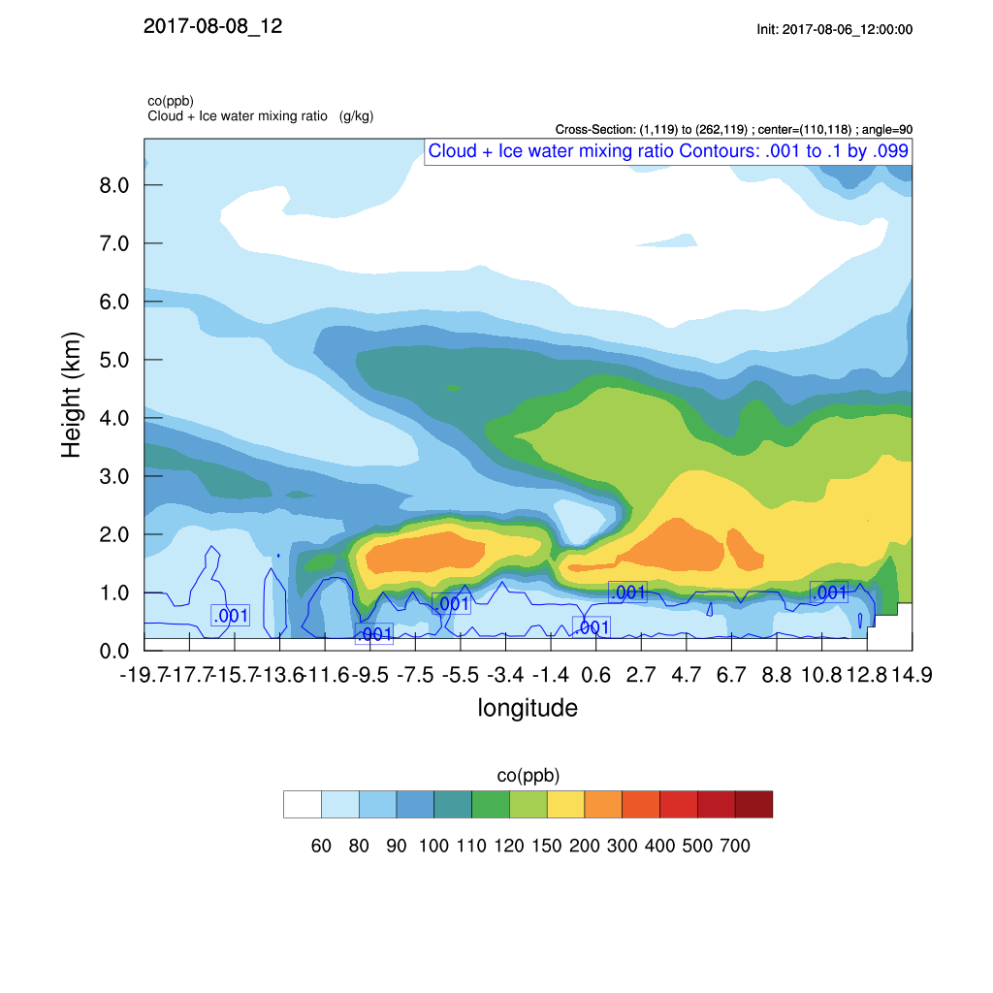
Tuesday (08) August 2017 12Z

Slide 19
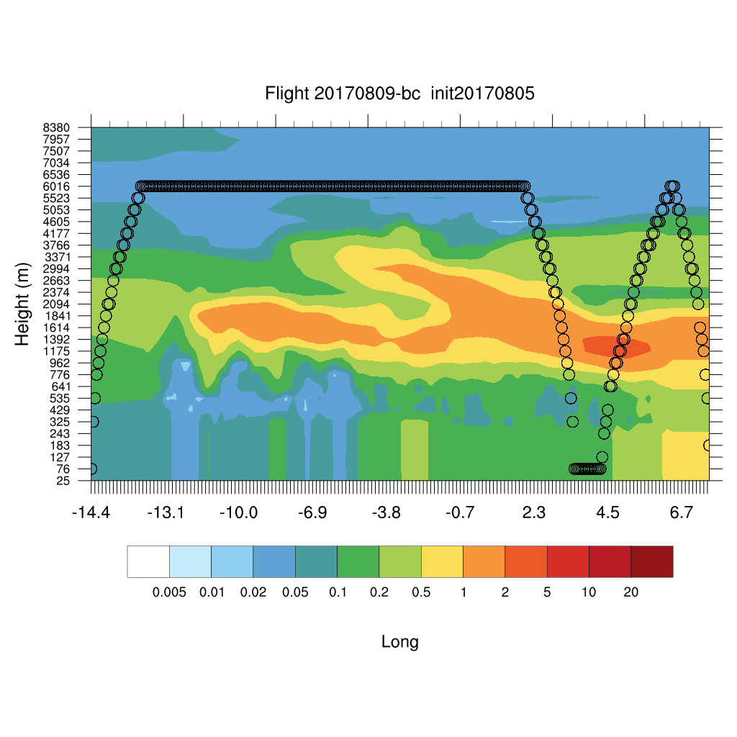
Wednesday (09) August 2017 12Z

Slide 20
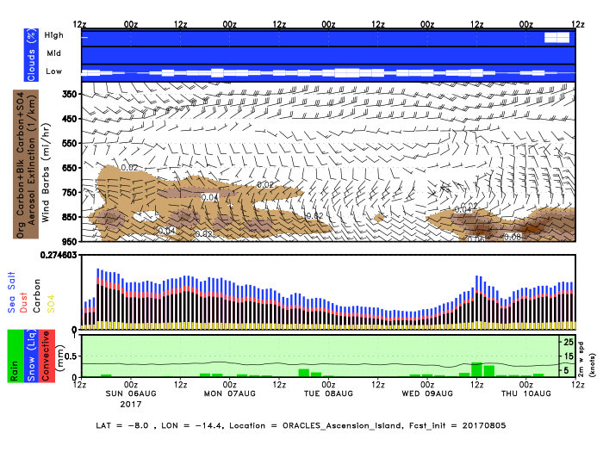
Ascension Island

Slide 21
Ascension Island

Slide 22
Ascension Island

Slide 23
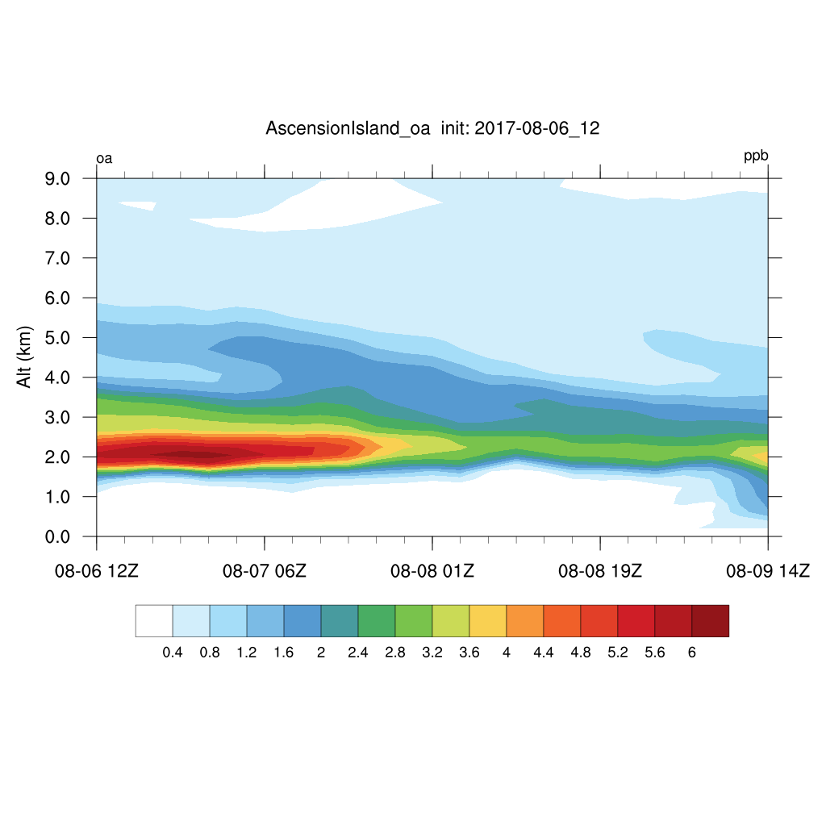
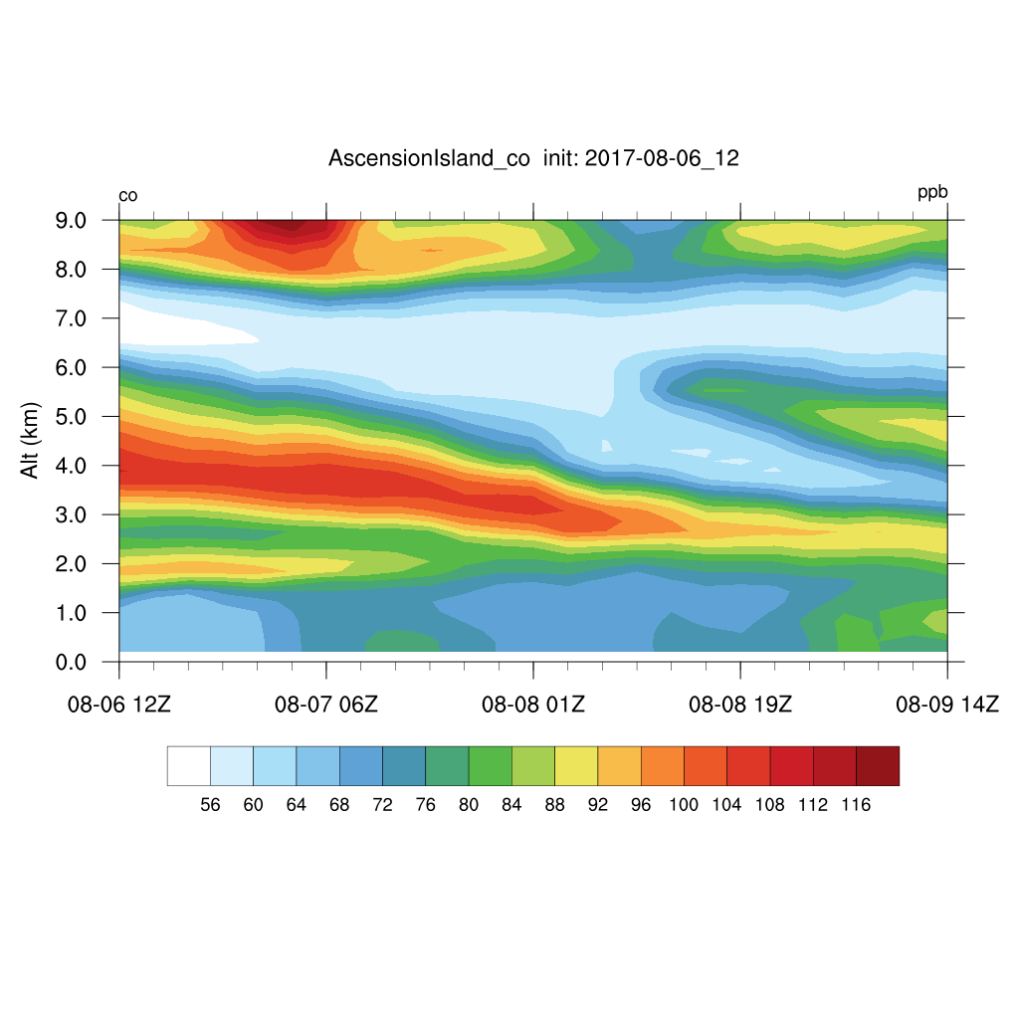
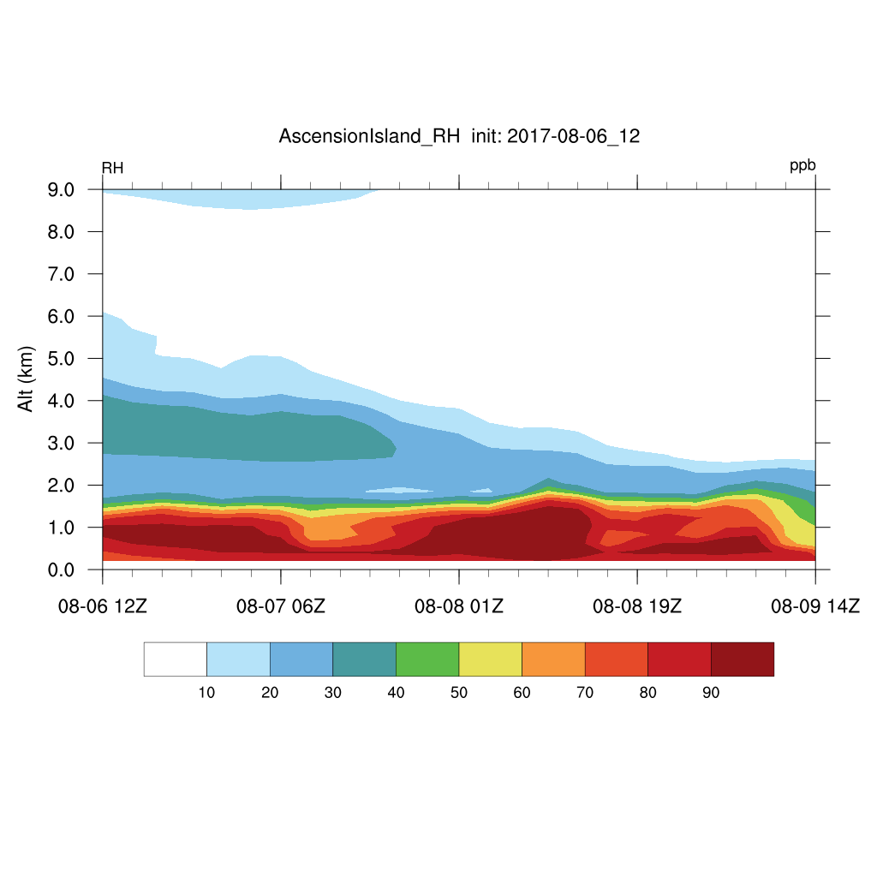
Ascension Island

Slide 24
Ascension Island

Slide 25
Ascension Island

Slide 26
Ascension Island

Slide 27
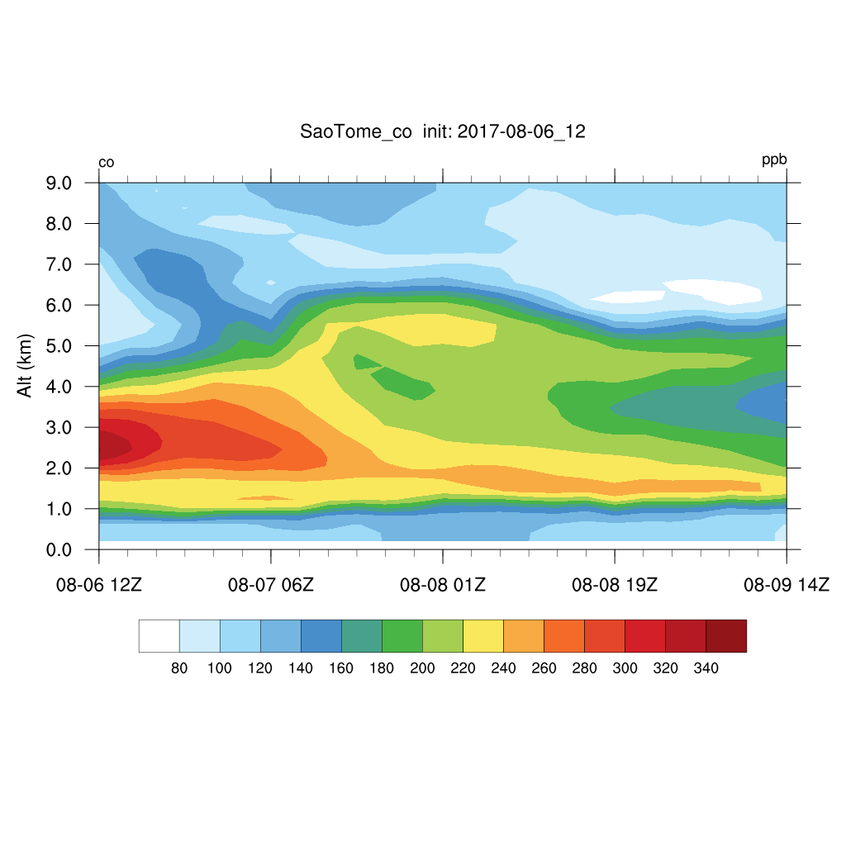
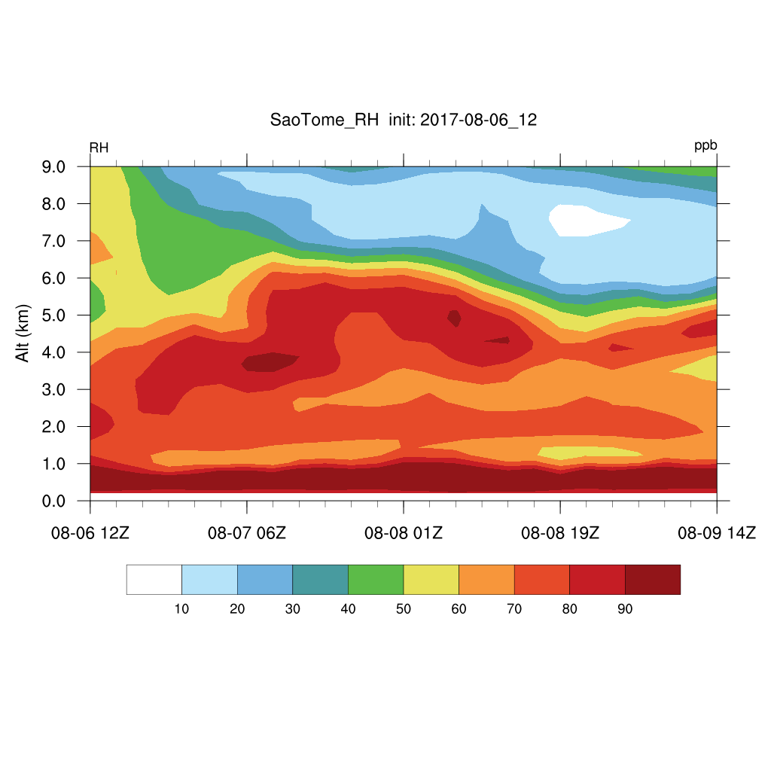
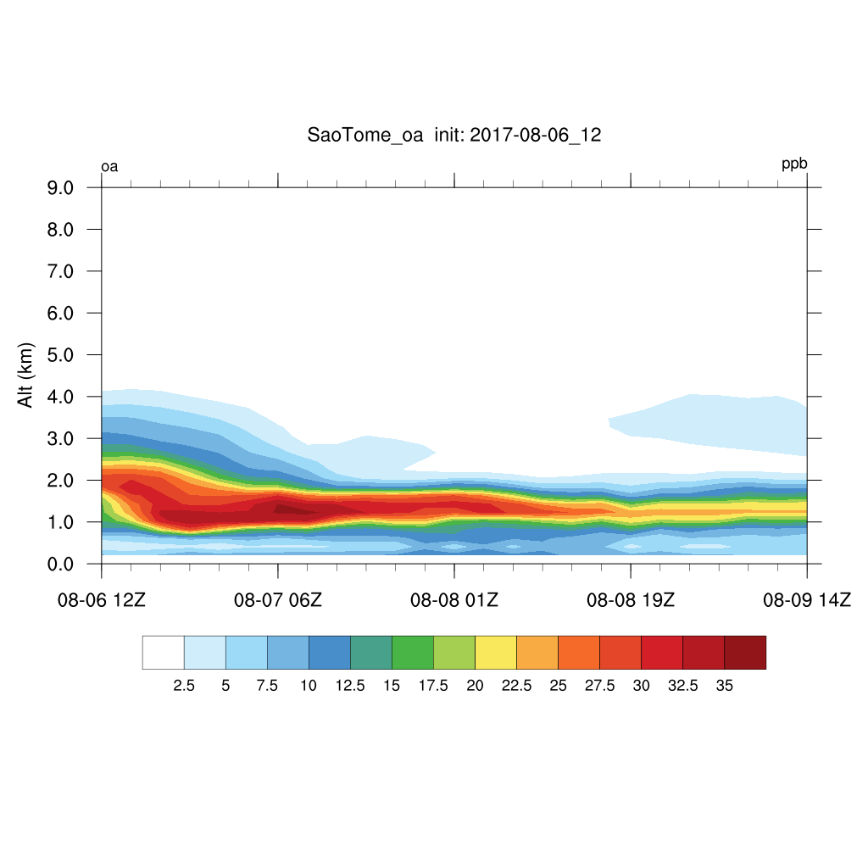
Sao Tome

Slide 28
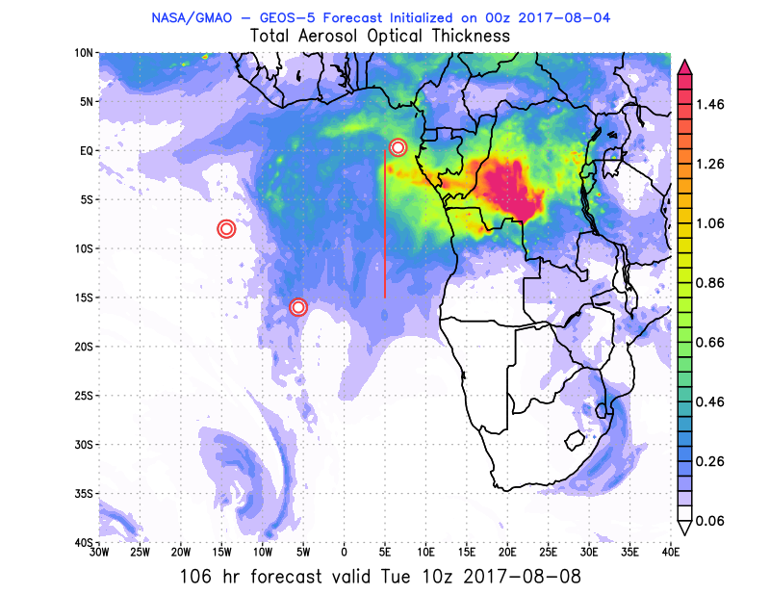
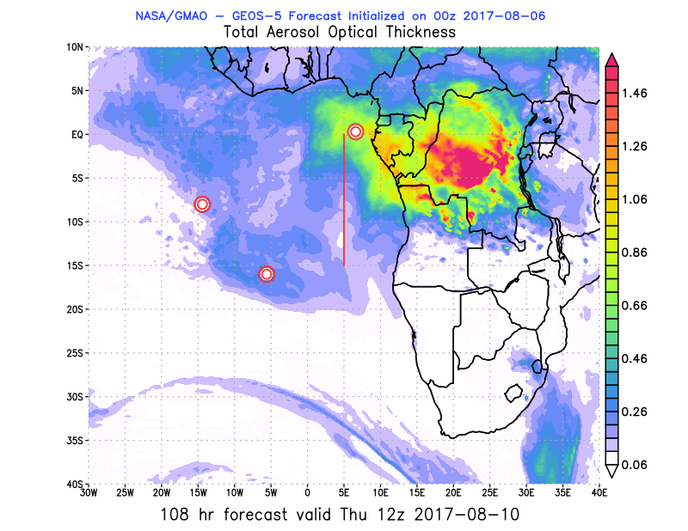
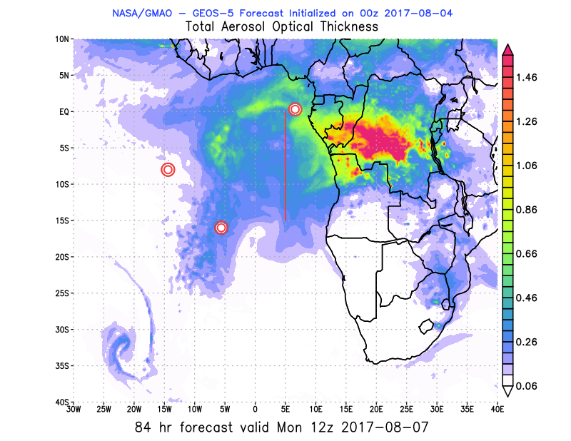
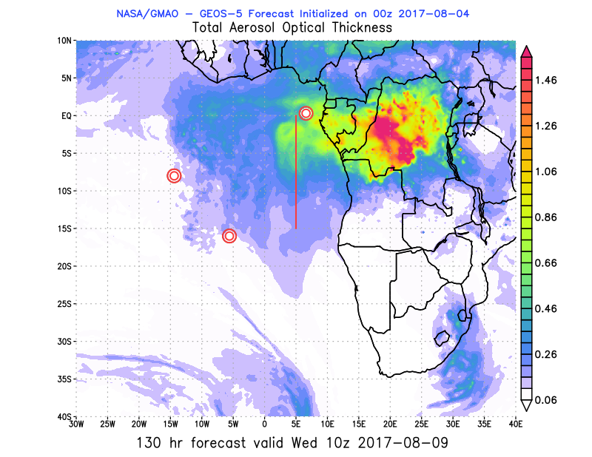
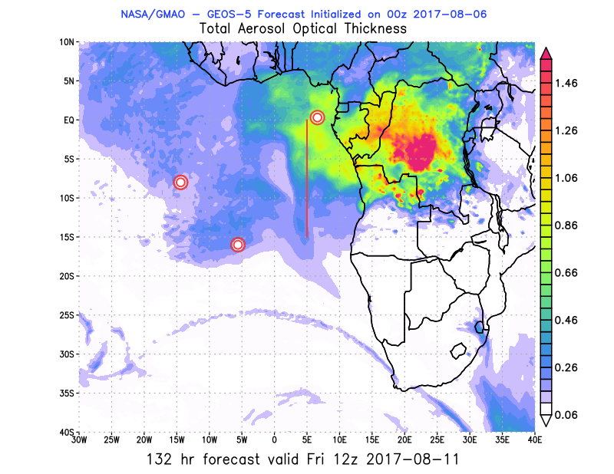
Outlook Tues - Fri (07-10) August 2017 12Z
Tues Wed Thurs Fri

Slide 29
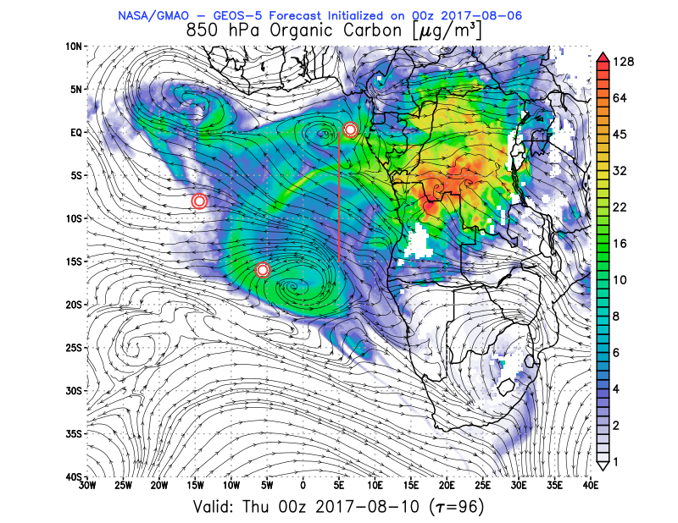
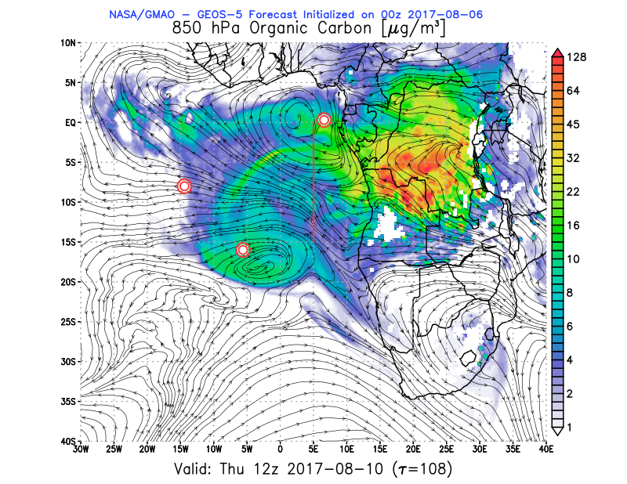
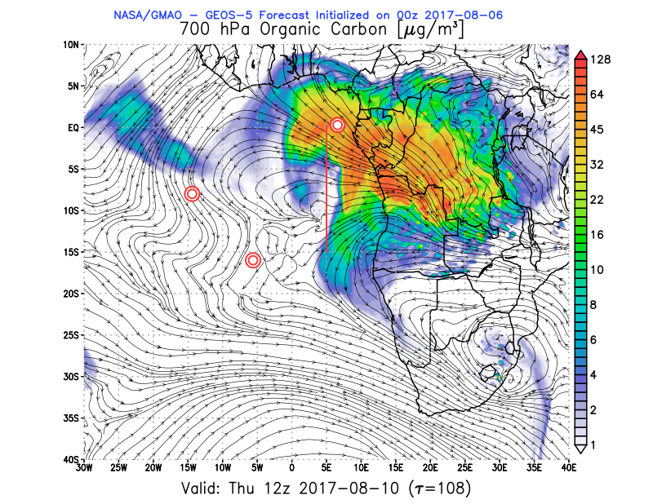
Thursday 10 AUG 12Z

Slide 30
Show animation
https://portal.nccs.nasa.gov/cgi-mission/mission_3d_chem.cgi?region=oracles_lg&dtg=2017080600&prod=8bc&model=fp&level=850&tau=000&&region_old=oracles_lg&dtg_old=2017080606&prod_old=&model_old=fp&level_old=&tau_old=000&&loop=1

