Slide 1
ORACLES weather briefing
4-Aug-2017
Rei Ueyama and Lenny Pfister

Slide 2
Summary
Transit flight ASI-TMS: Monday 8/7
Scattered low clouds along the flight track
Some high clouds over TMS (similar situation on 8/8)
Enhanced RH air (~700mb near ASI, ~600mb near TMS) influenced by moist convection moving westward
Headwinds of up to 20 knots at 600mb (~15 kft) along the second half of the flight track
Contingency Transit flight ASI-TMS: Tuesday 8/8
Strong surface low to the SW induces anomalous surface flow in the flight area – southwesterlies at TMS and much weaker surface winds in Stratocumulus region.
Low cloud cover displaced northward, but less so than on 8/7
Some high clouds over TMS
Enhanced RH air at 700mb and 600mb over TMS
Headwinds of up to 20 knots at both 600mb and 700mb (10-15kft)

Slide 3
Outline
Clouds today – the “gap”
Cloud forecast verification
Forecasts for transit flight (8/7) and contingency transit flight (8/8)

Slide 4
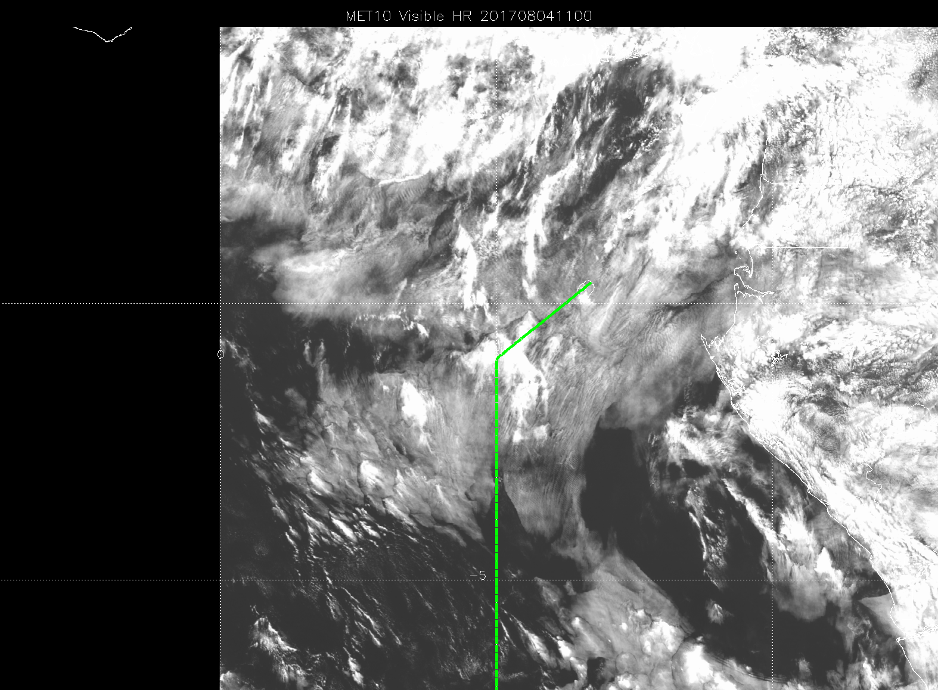
11Z image (vis) showing low cloud. Wind from the south, less strong than typical. Airport warming up more than usual. Can see thicker cloud on south (windward) side of the island.

Slide 5
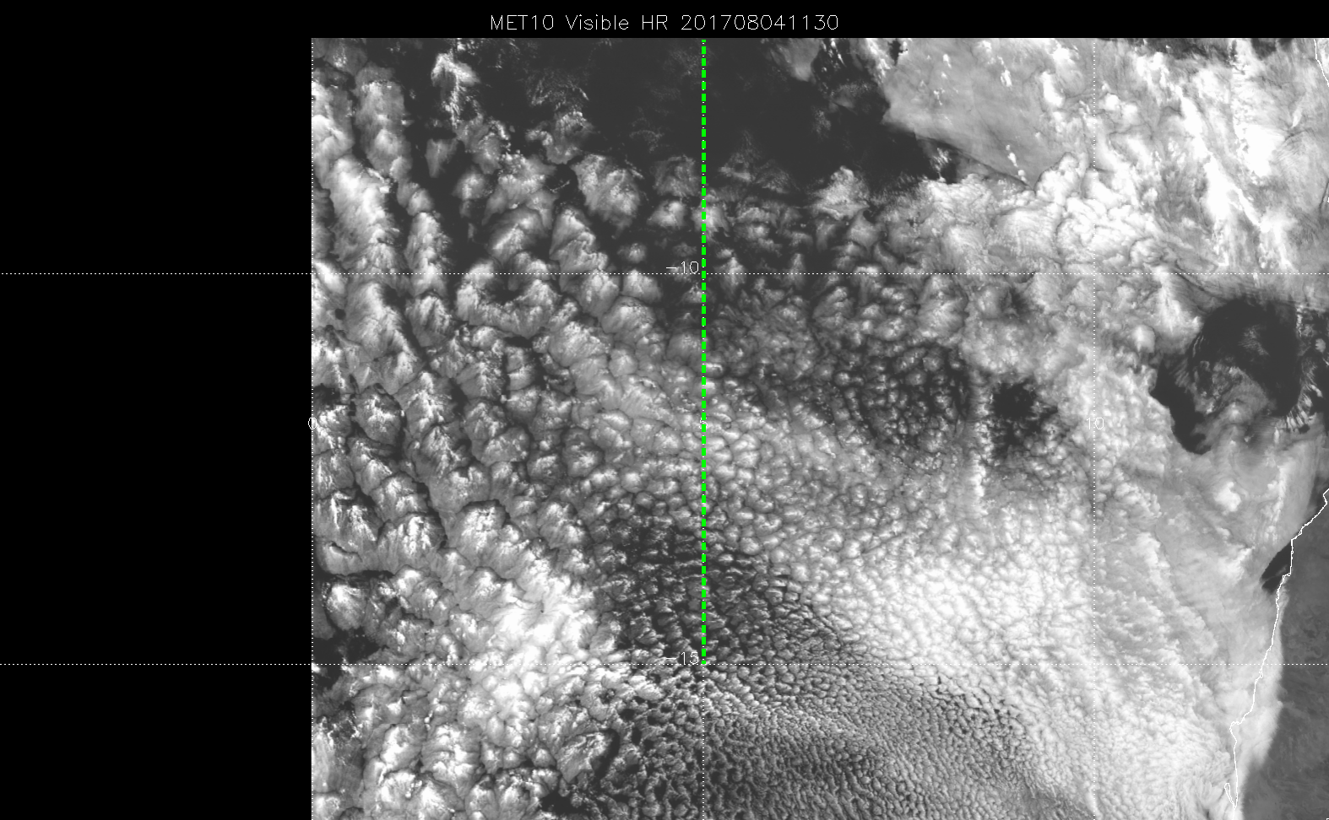
Southern section (routine track) 1130Z vis. Stratocumulus (large to north, smaller cells to south. “Gap” from 4S to 8.5S.

Slide 6
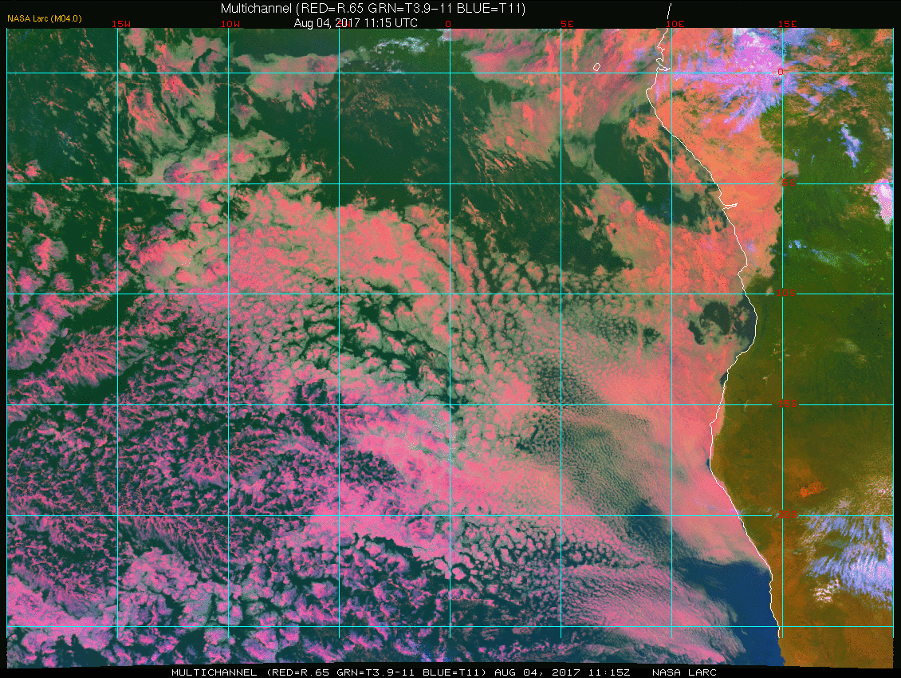
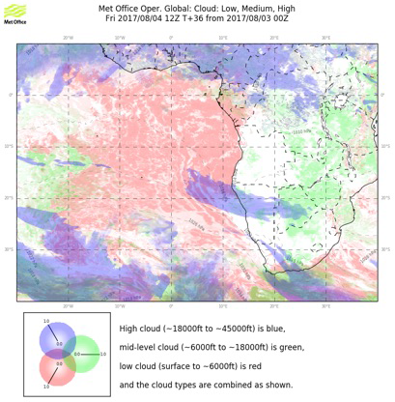
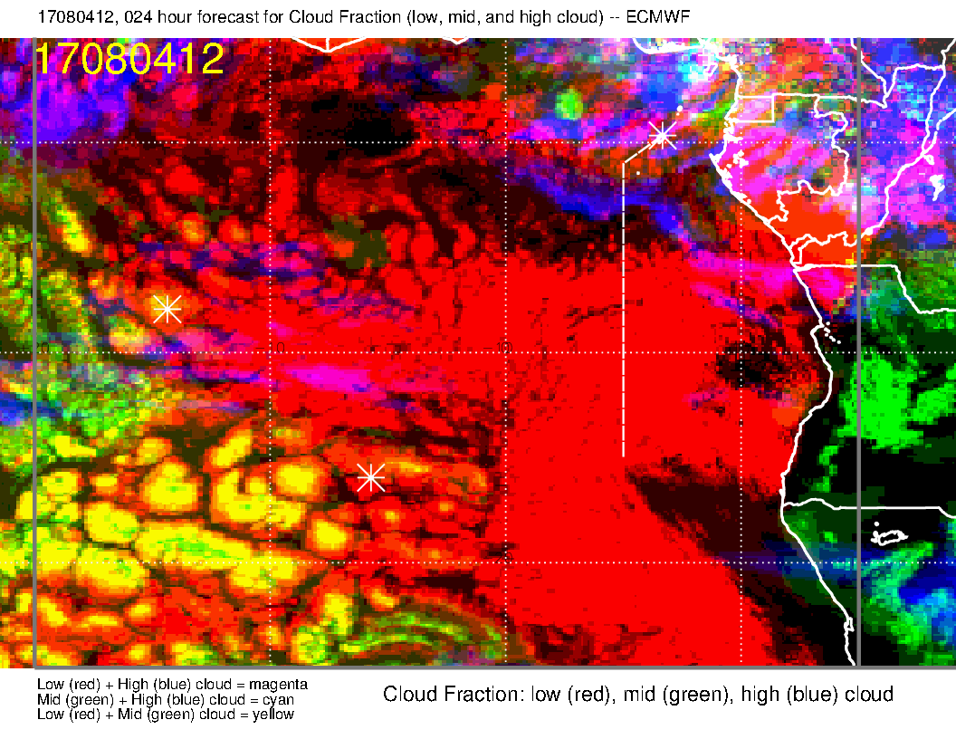
Comparison of today’s satellite image to 24 hour cloud forecast
12Z satellite image with two forecasts.
EC (left) overpredicting high clouds again. EC underpredicts the “gap”, but gets the Angola bay clearing. UKMO misses the “gap” completely.
Today at ~12Z.
EC model again has bogus high cloud near 5-10S.
Light rain reported this AM at the airport – middle and high cloud penetrating towards TMS.
Other low cloud features OK

Slide 7
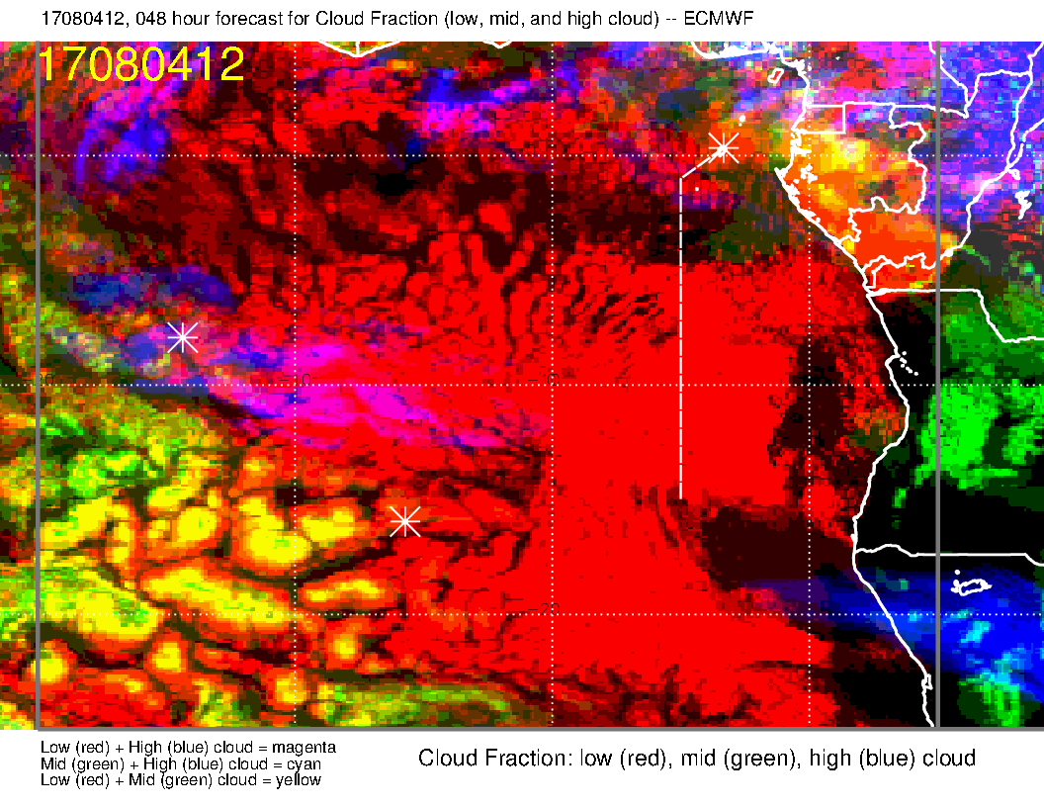
Comparison of today’s satellite image to 48 hour cloud forecast
EC forecast only – a little worse on underpredicting the gap and overpredicting Namibian clearing. High cloud forecast actually better.

Slide 8
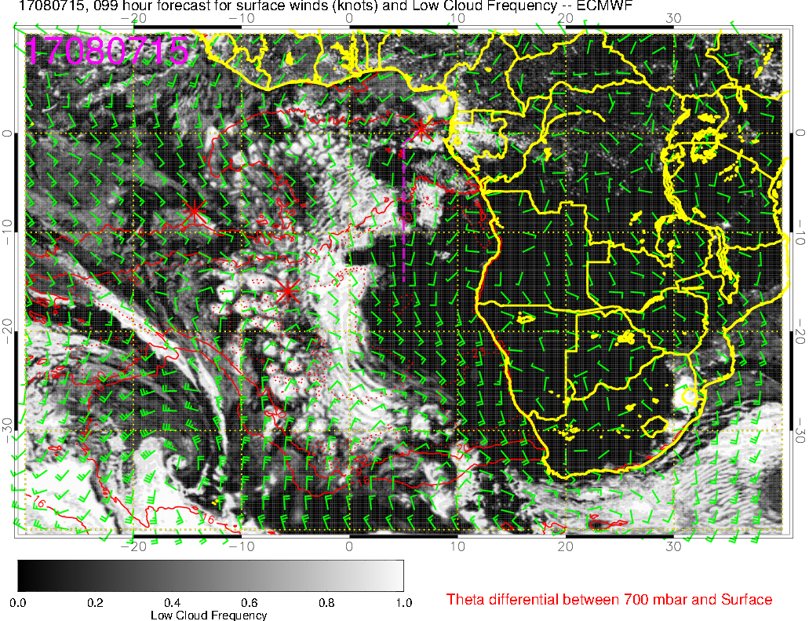
Low cloud forecast at 8/7 Mon @ 3PM
Patches of low cloud along the transit flight

Slide 9
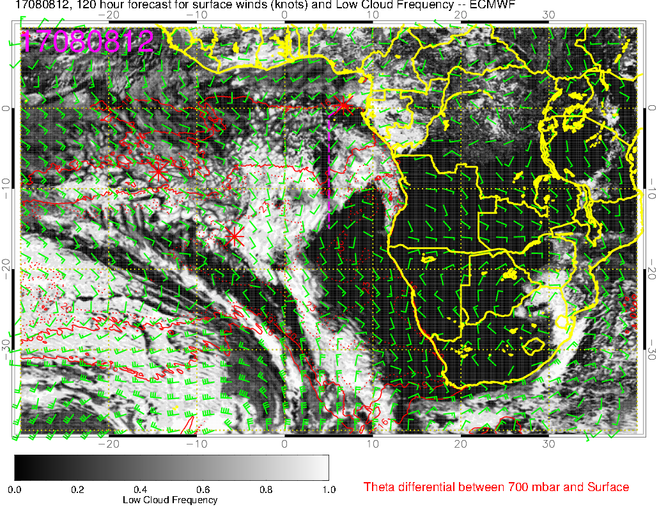
Low cloud forecast at 8/8 Tue @ 12PM – don’t have 3PM forecast yet
Less low clouds along transit flight compared to 8/7 12PM
Cloud-free region off Namibia coast expand starting 8/7; EC model probably overestimating its northward extent

Slide 10
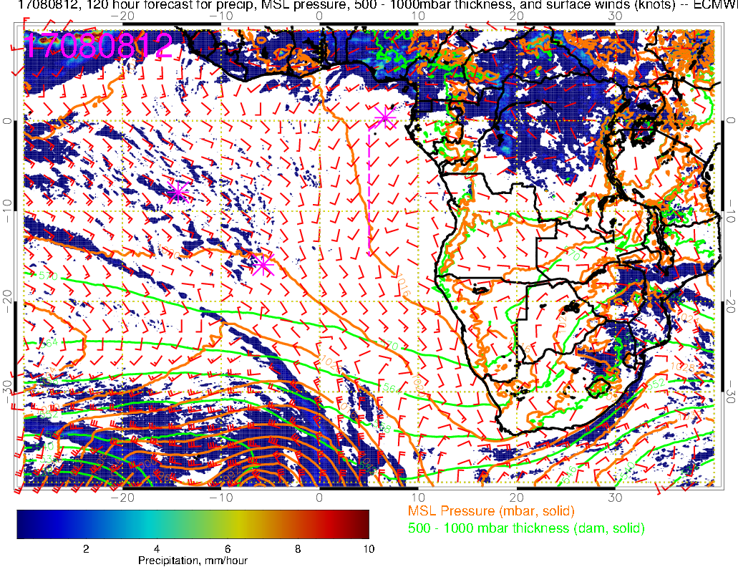
Precip, sfc wind, MSLP, thickness forecast at 8/8 Tue @ 12PM
SW winds ~10 knots across routine flight track (typically more SSW)
Anomalously weak ~10 knot SE winds over the stratocumulus region

Slide 11
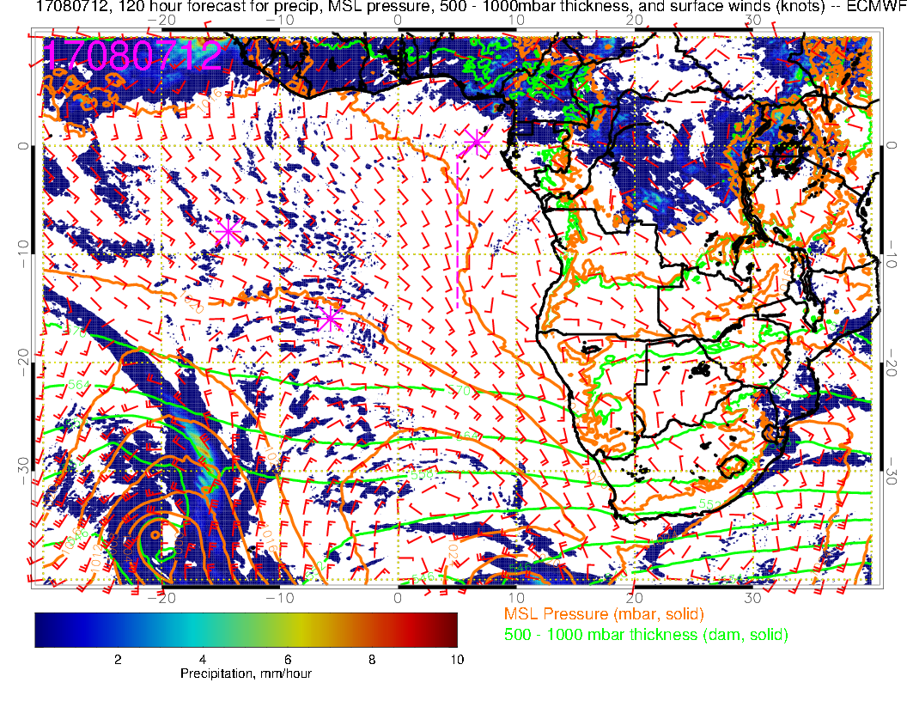
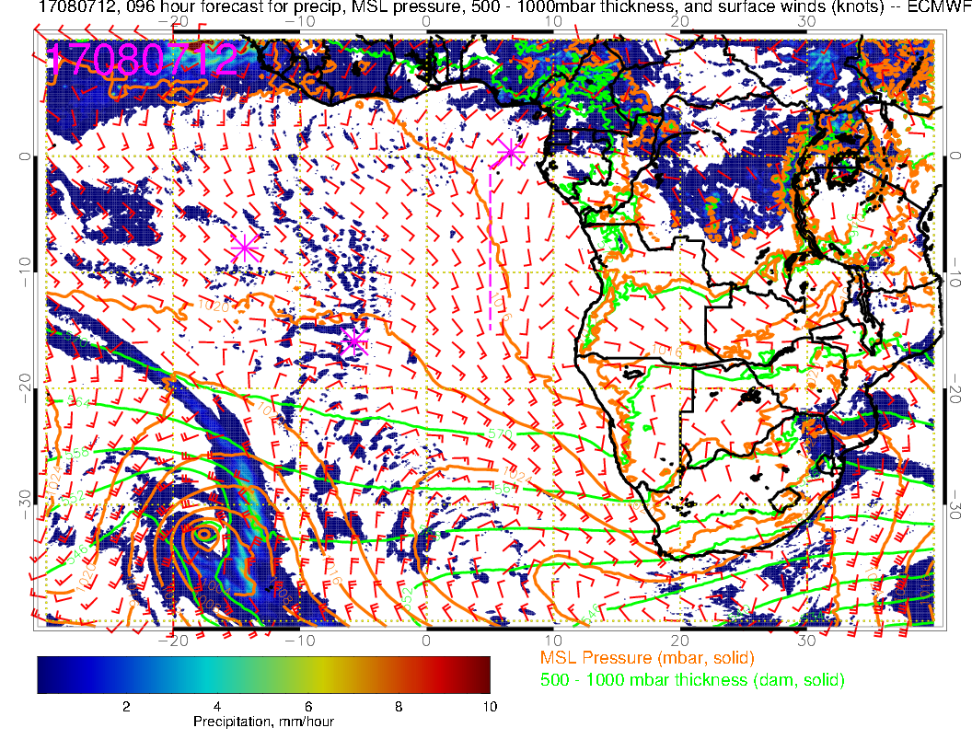
Continuity of fcsts: older fcst at right
Midlatitude low at the southwest corner more advanced in newer fcst. Low near 10E 40S is also more advanced. For Monday, not much effect at our latitudes.

Slide 12
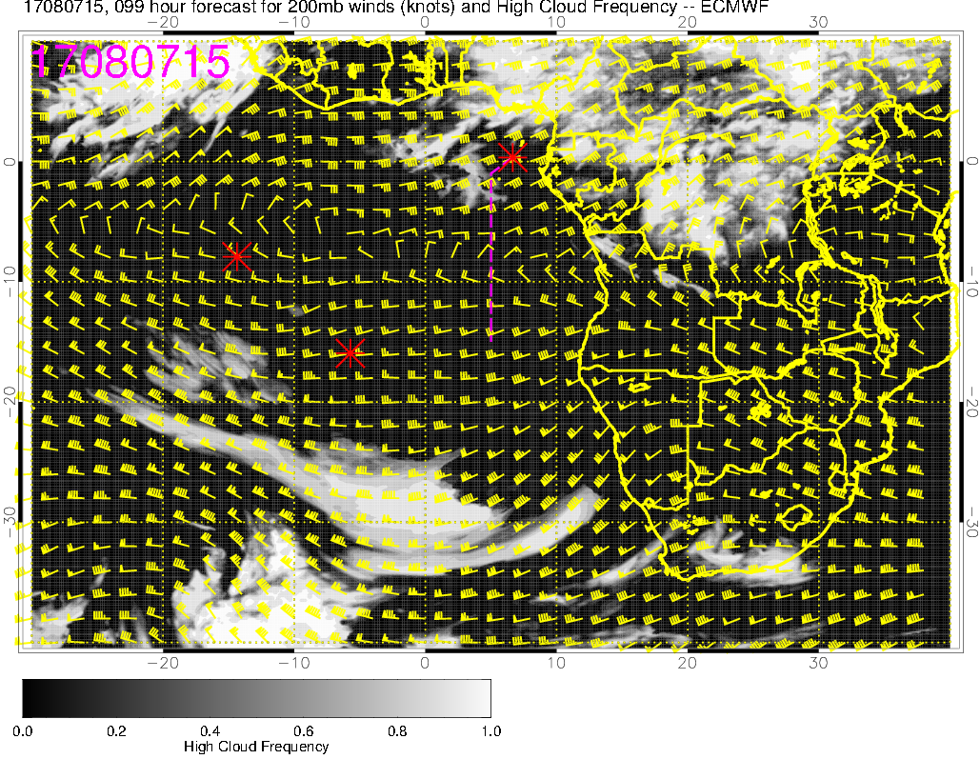
High cloud forecast at 8/7 Mon @ 3PM
Expect some high clouds towards the end of transit flight track (associated with NE winds from convention on land, which has moved further south compared to 8/6)

Slide 13
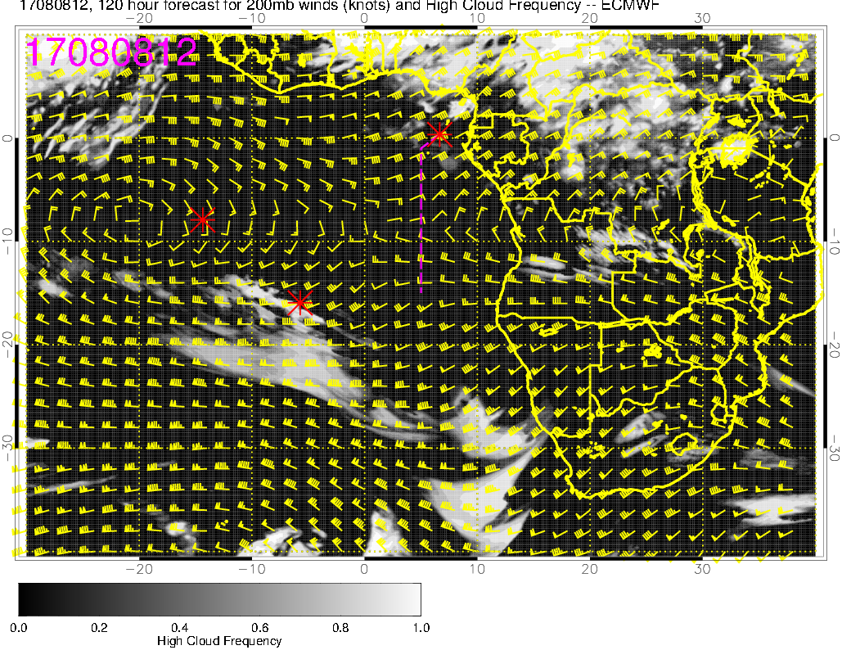
High cloud forecast at 8/8 Tue @ 12PM – don’t have 3PM forecast yet yet
High cloud forecasts mostly unchanged (i.e., over TMS)

Slide 14
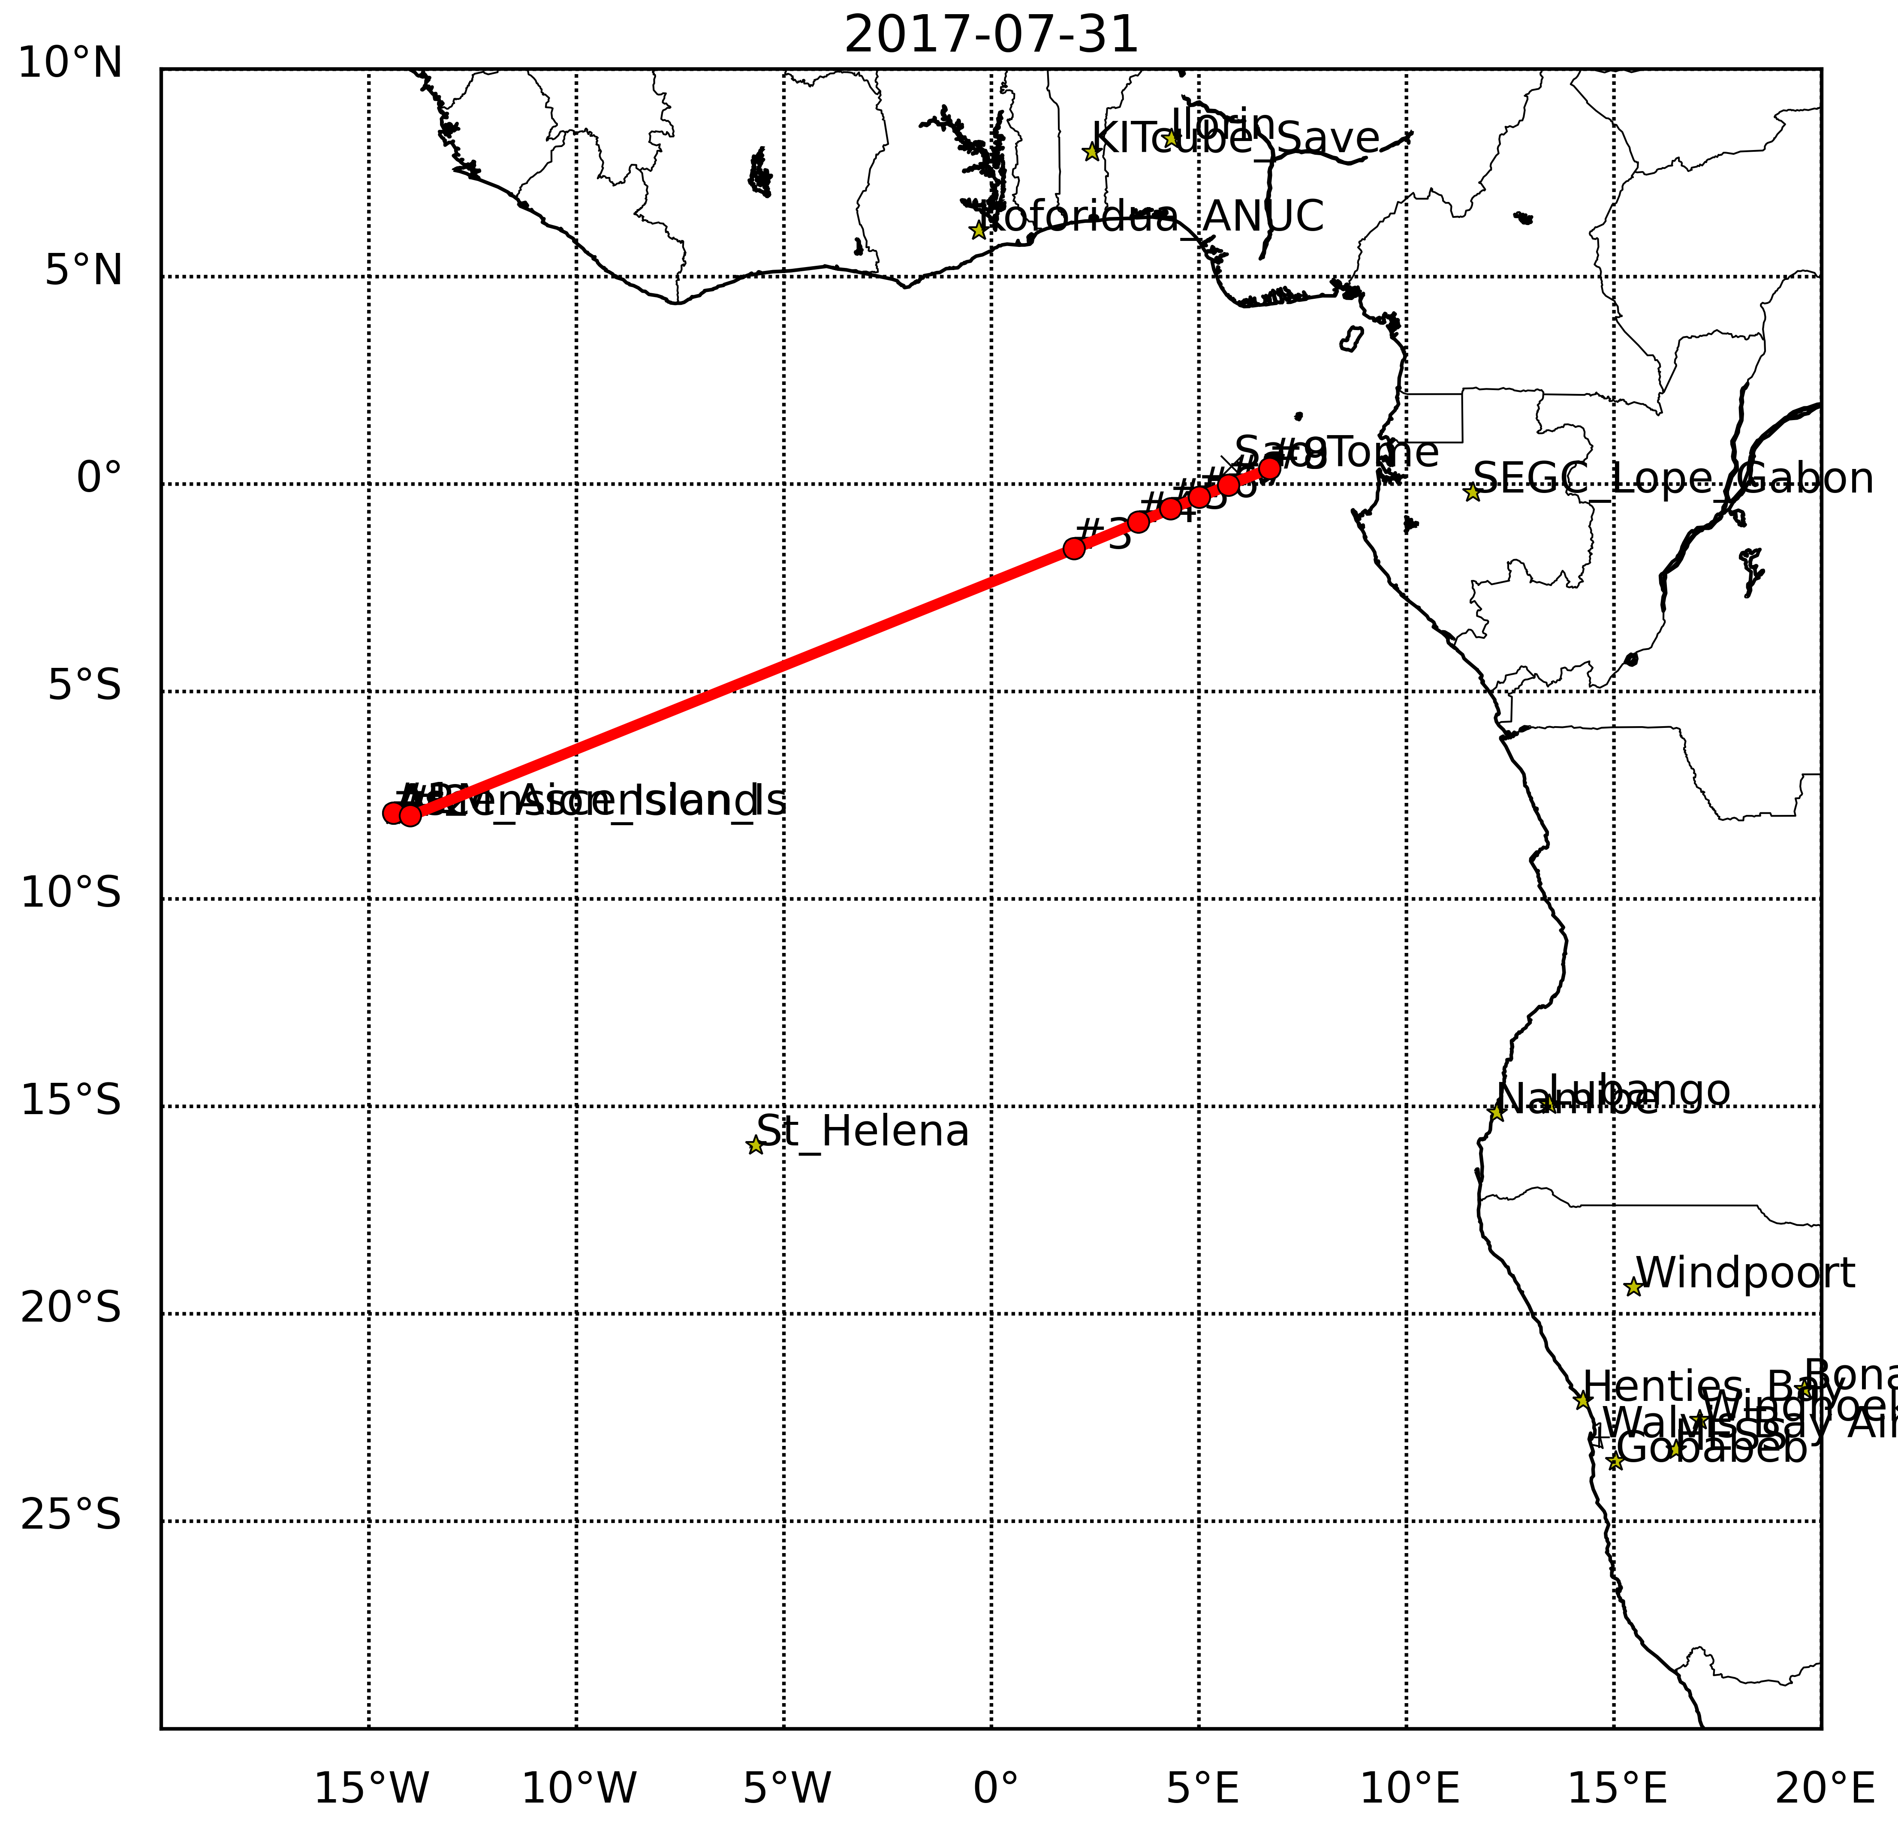
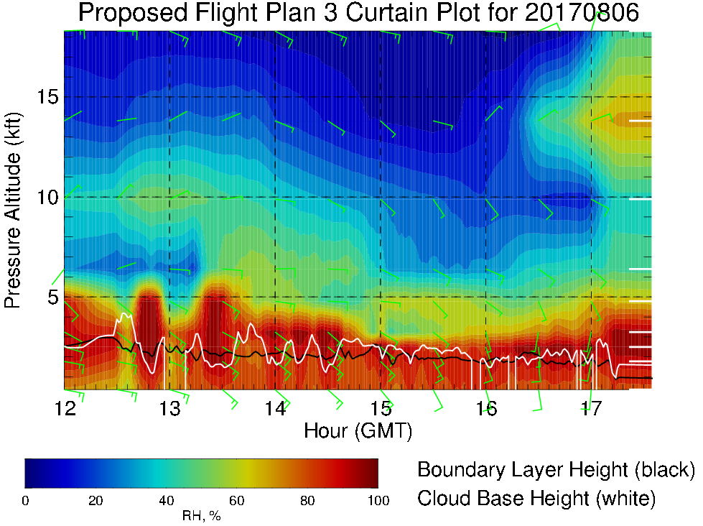
RH along transit flight track, takeoff 8/6 Sun 12PM
Stronger headwind at ~15kft / 600mb on 8/7 and 8/8 (≤ 20 knots, 2nd half of flight)
High RH air (“old” and “new” plumes) moves west

Slide 15
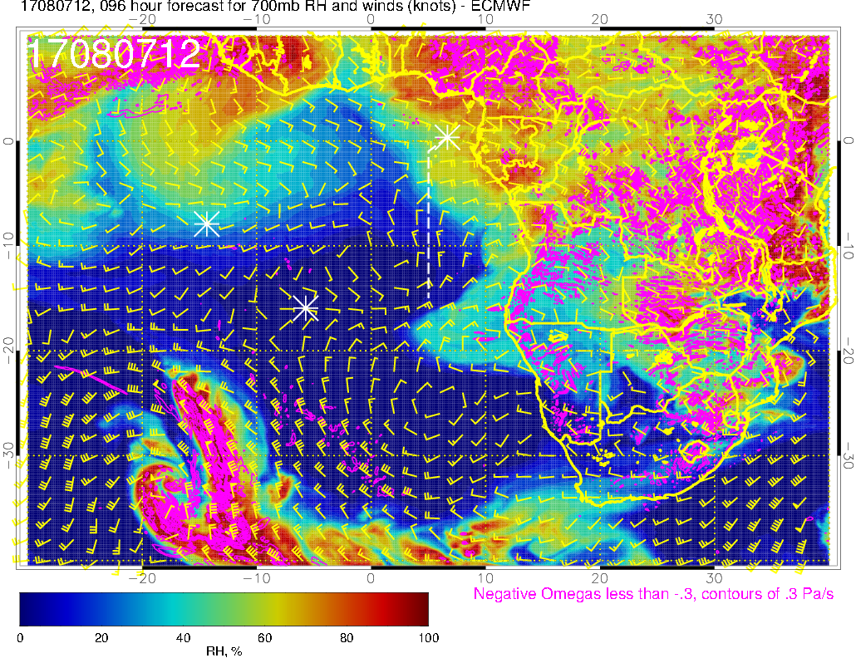
700mb RH forecast at 8/7 Mon @ 12PM
“old plume” influenced by moist convection
“new plume” influenced by moist convection
Transport from dry convection (plume transport)

Slide 16
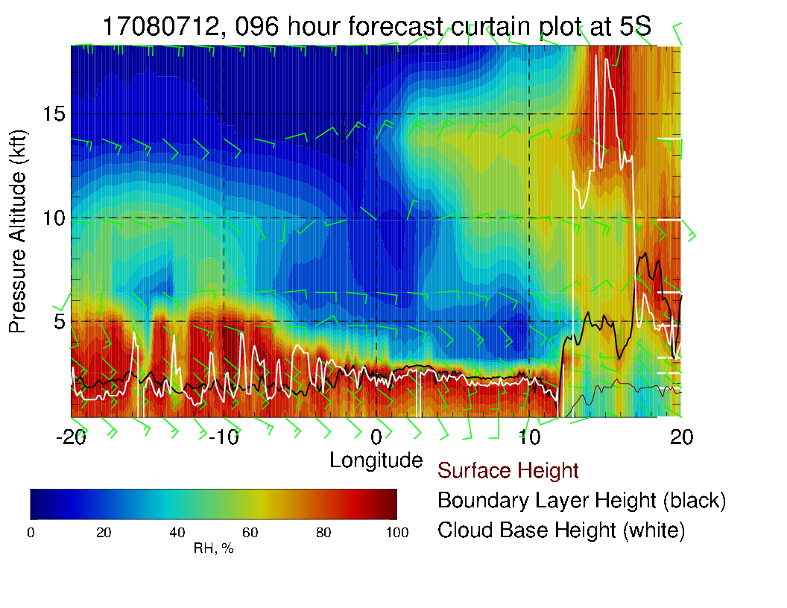
X-section at 5S for Monday 8/7. Have old 700mb plume near Ascension’s longitude, and new RH plume at 600mb near TMS.

Slide 17
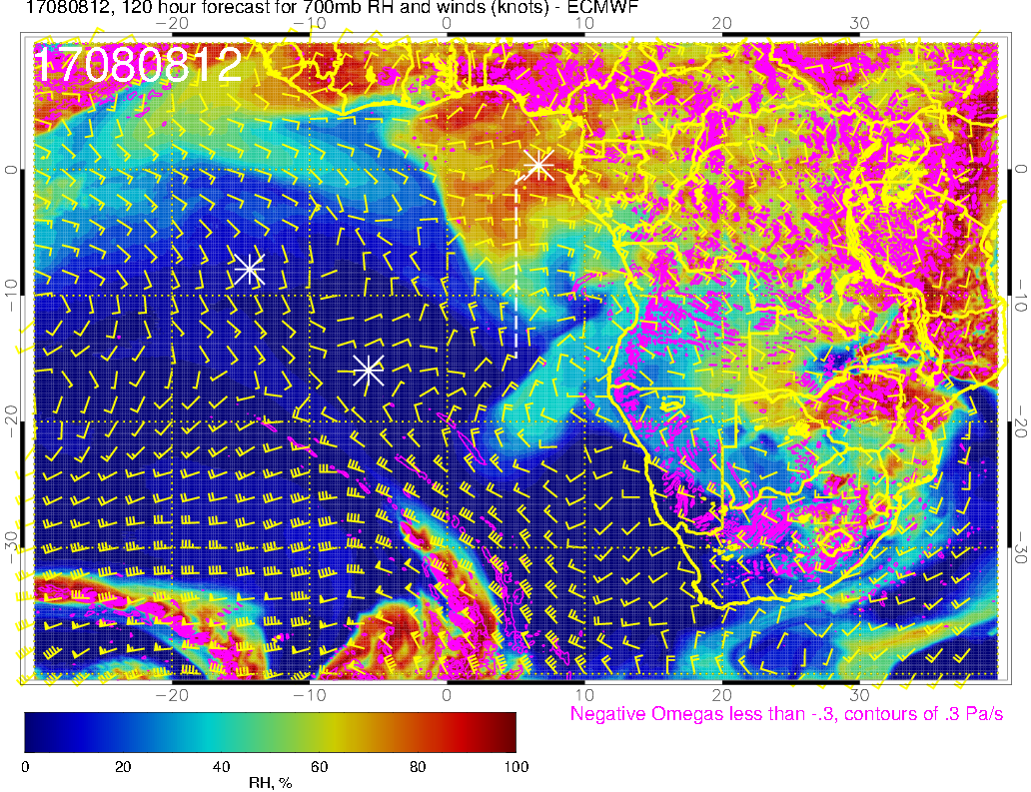
700mb RH forecast at 8/8 Tue @ 12PM
“old plume” moved away from our flight track
“new plume” moving westward
Transport from dry convection (plume transport)

Slide 18
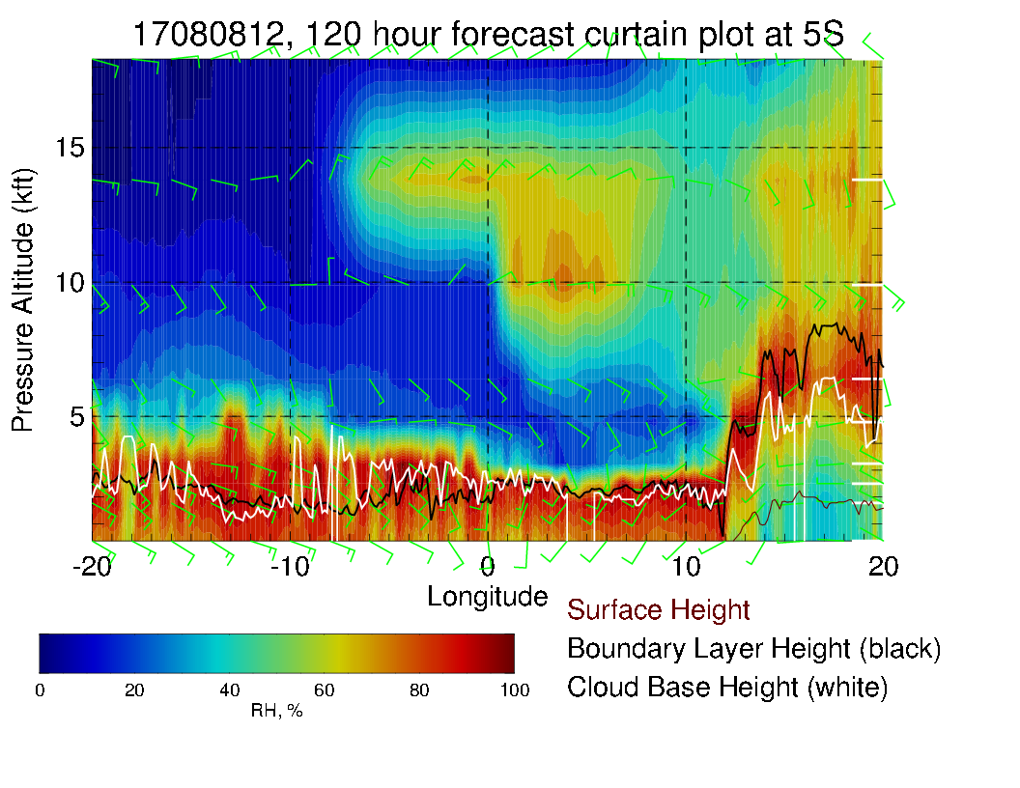
By Tuesday 8/8, “new” RH plume is also at 700mb

