Slide 1
ORACLES Forecast Briefing (Aerosols)
04 August 2017

Slide 2
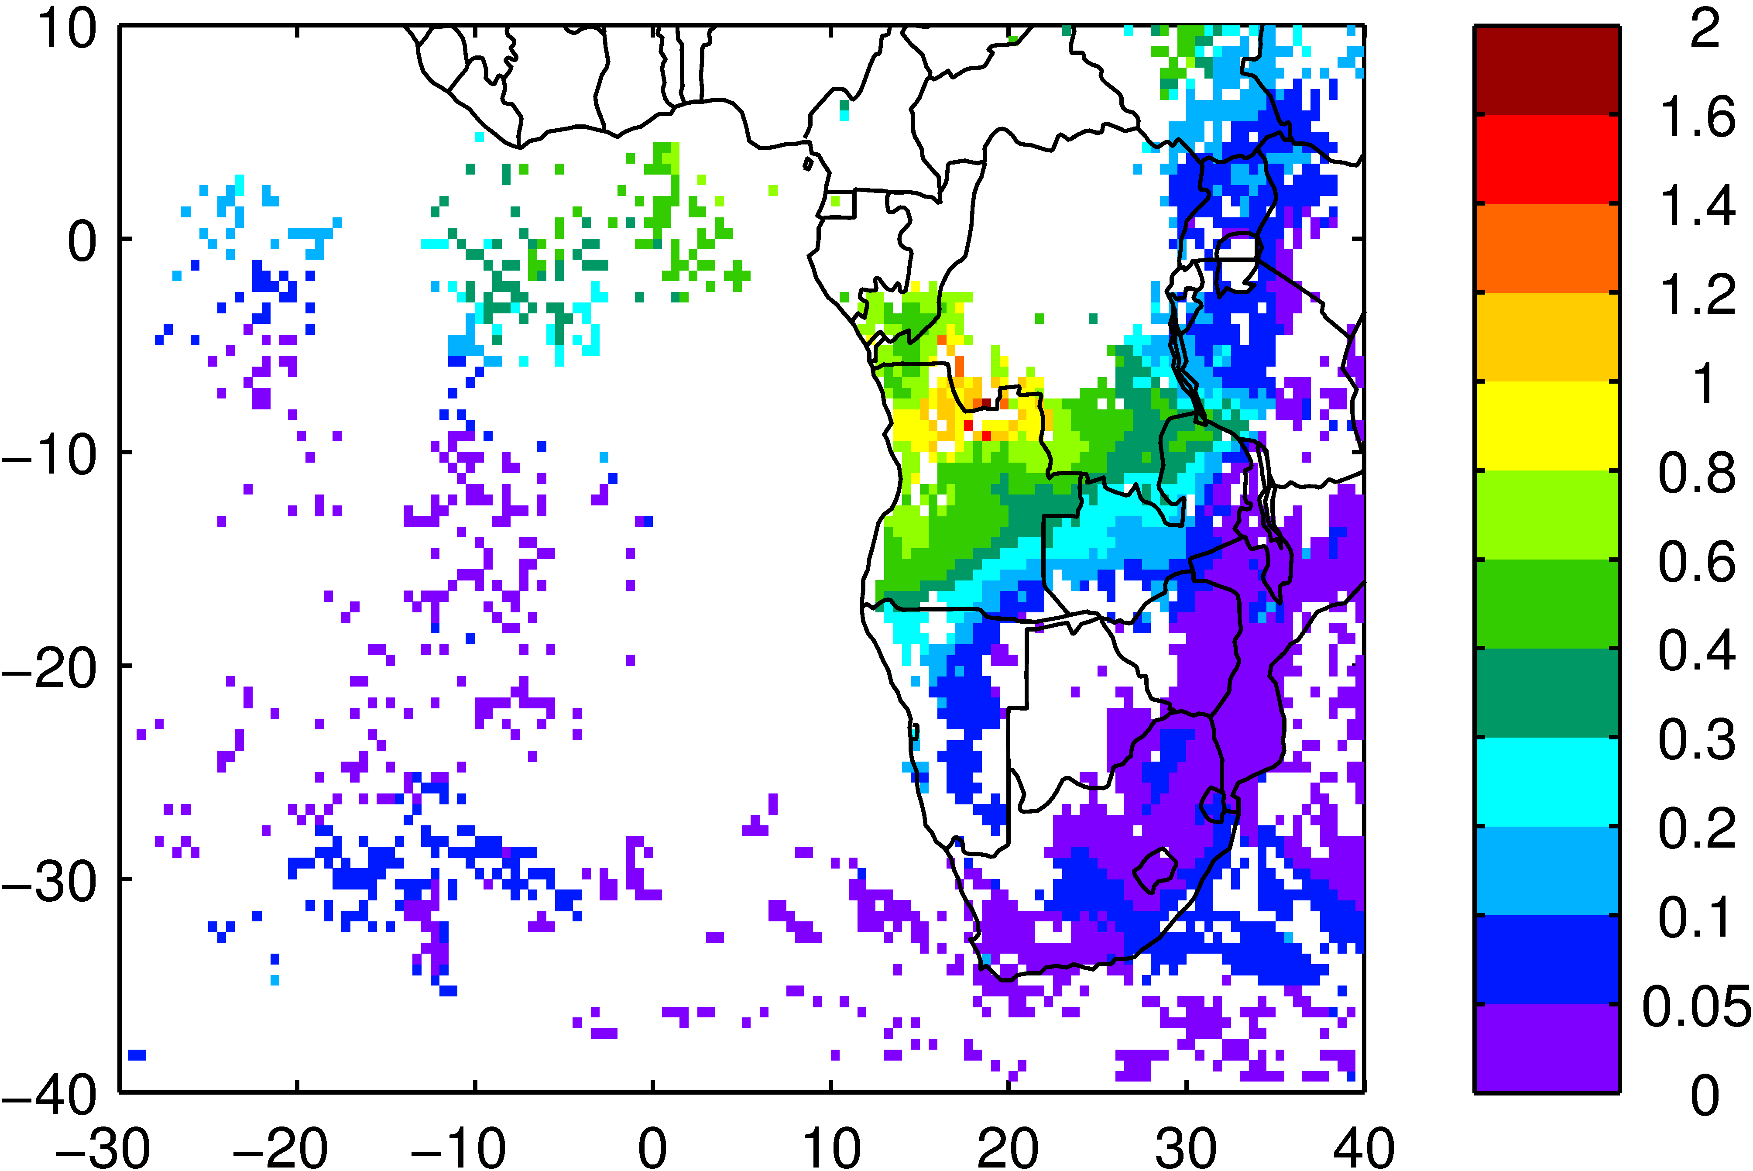
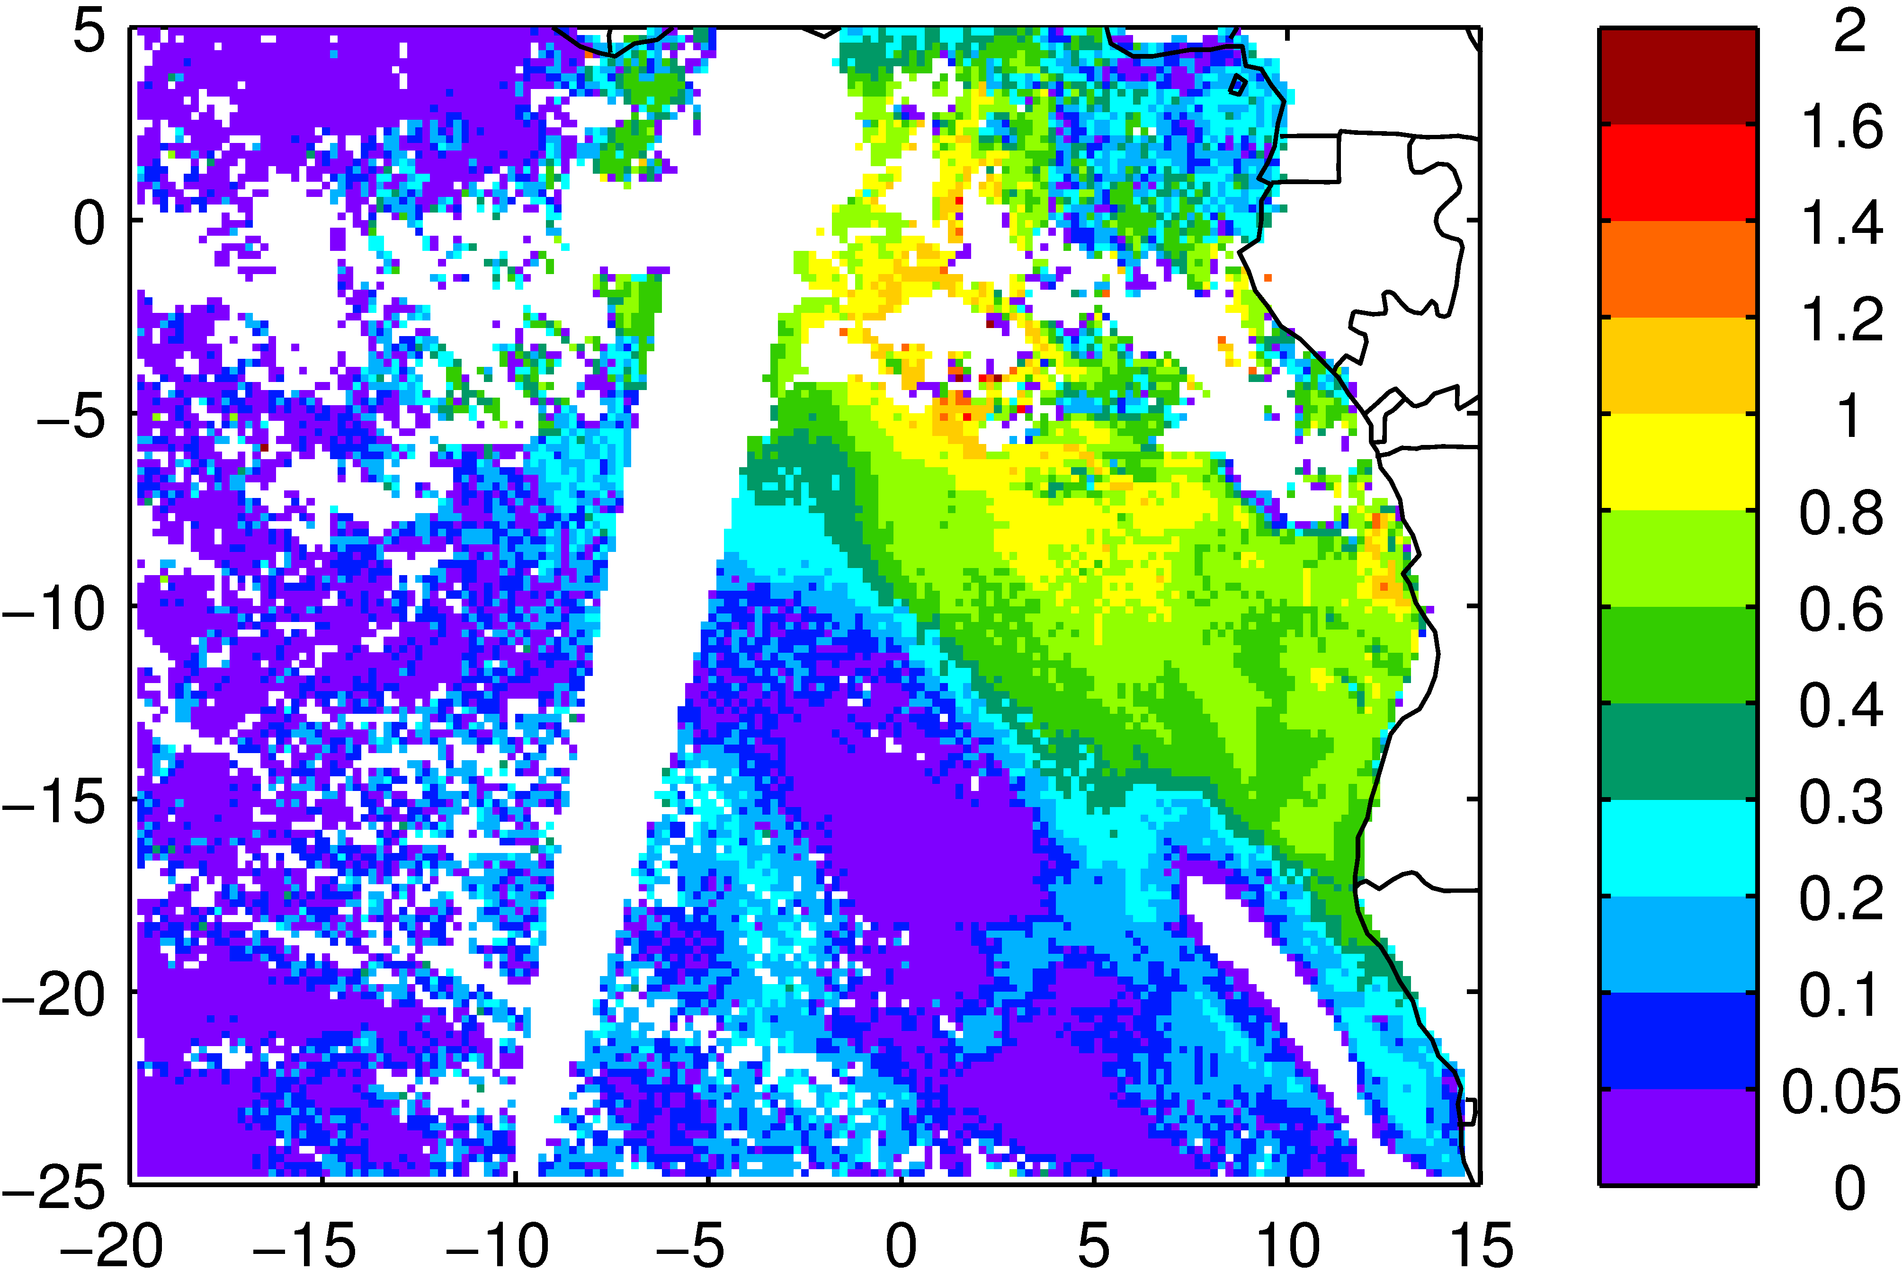
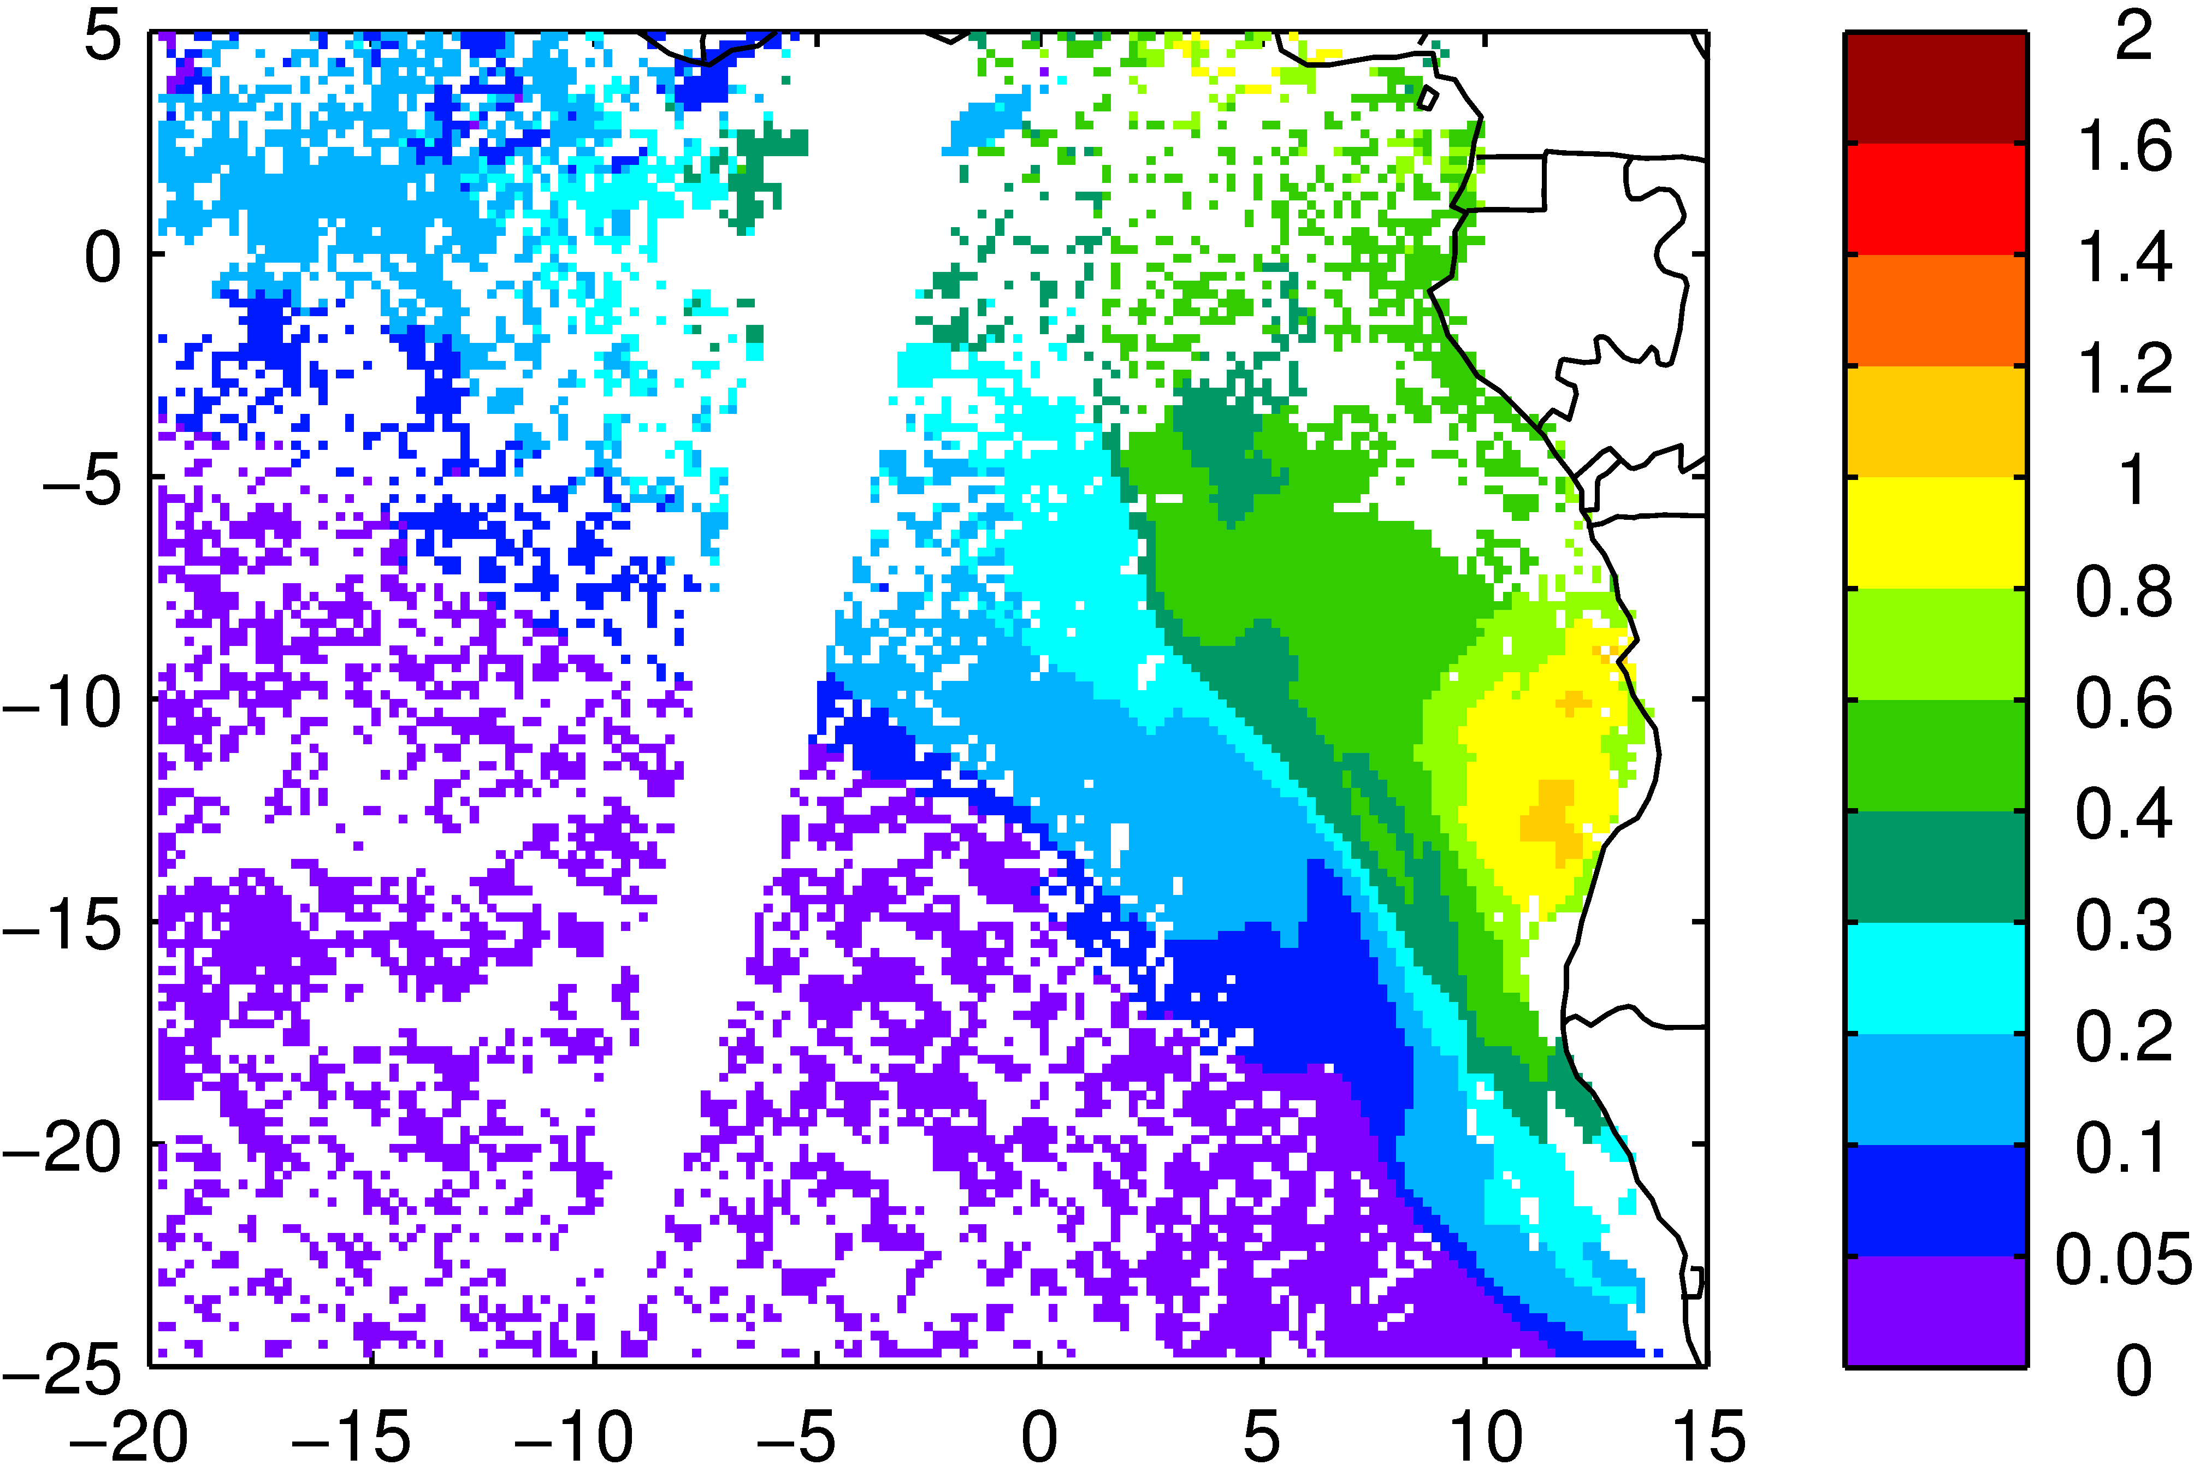
August 03 Comparison AOD and ACAOD
AOD MODIS AQUA/TERRA
(NASA NNR)
ACAOD MODIS TERRA

Slide 3
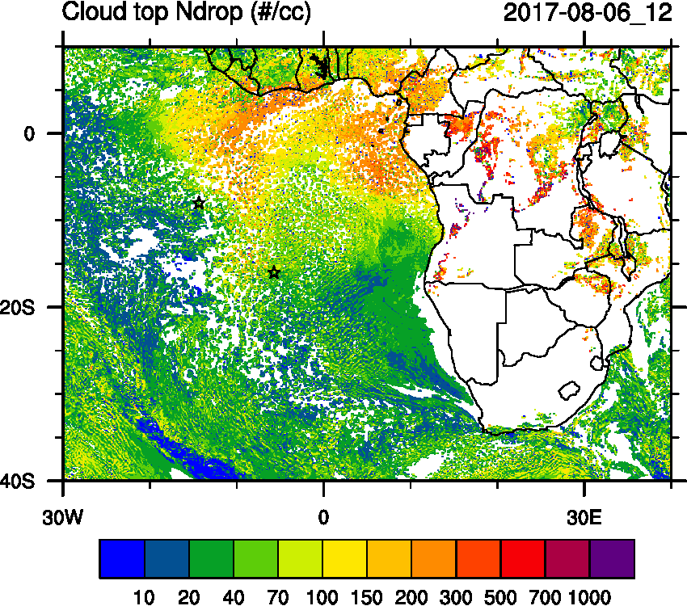
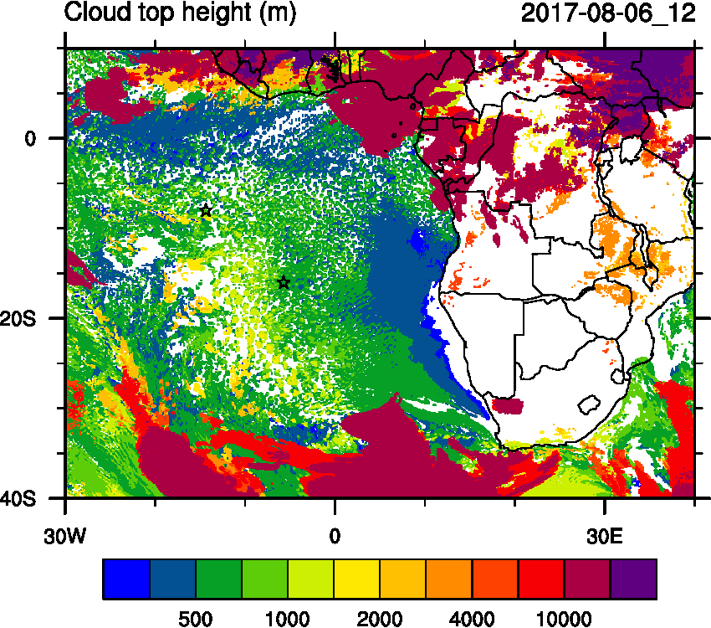
Sunday (06) August 2017 12Z

Slide 4
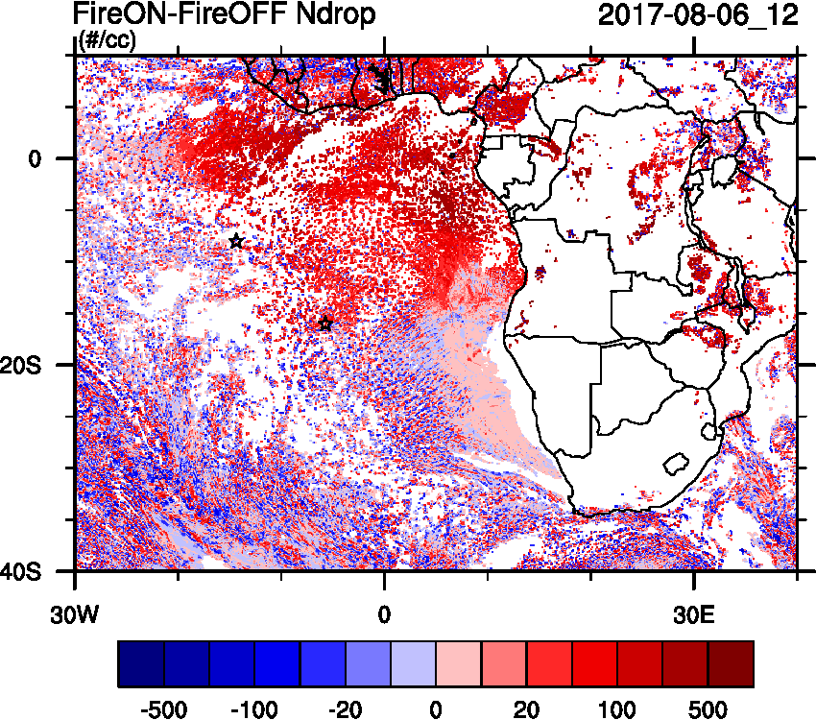
Sunday (06) August 2017 12Z

Slide 5
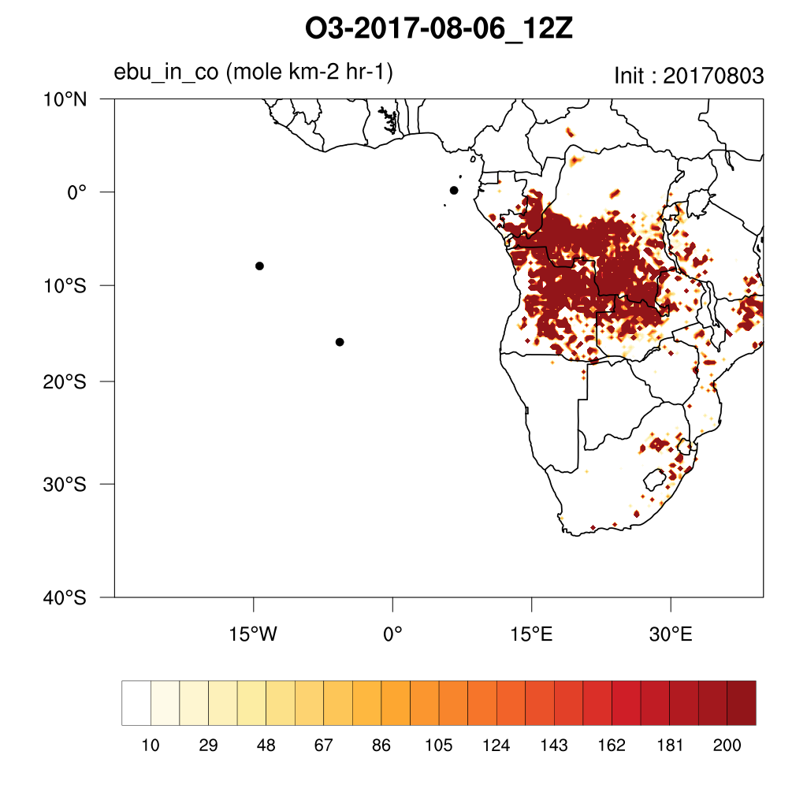
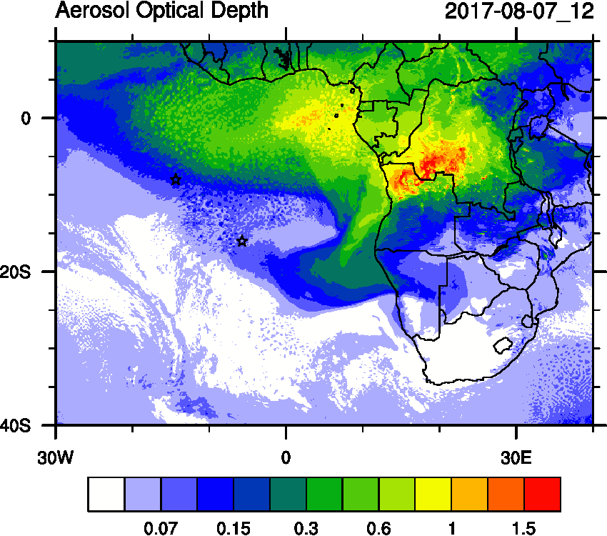
Monday (07) August 2017 12Z

Slide 6
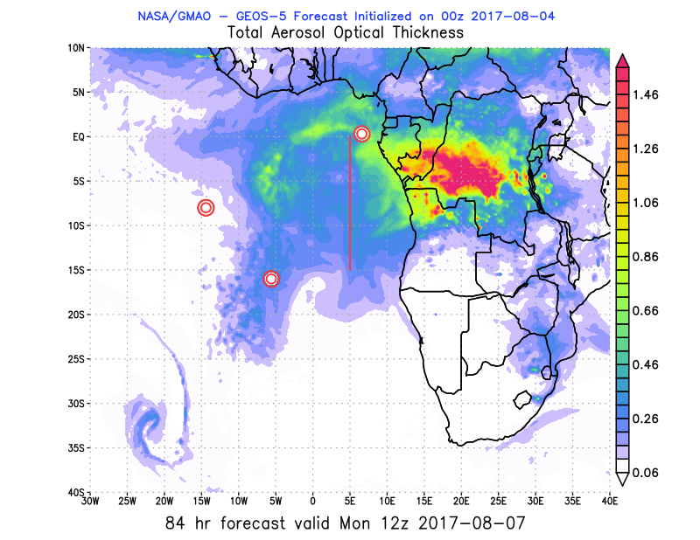
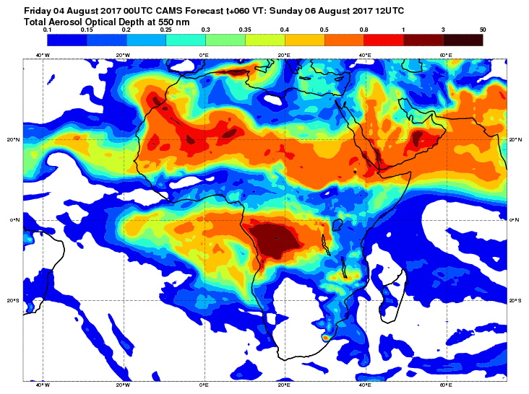
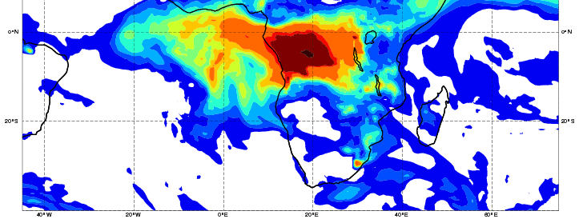
Monday (07) August 2017 12Z
>0.45

Slide 7
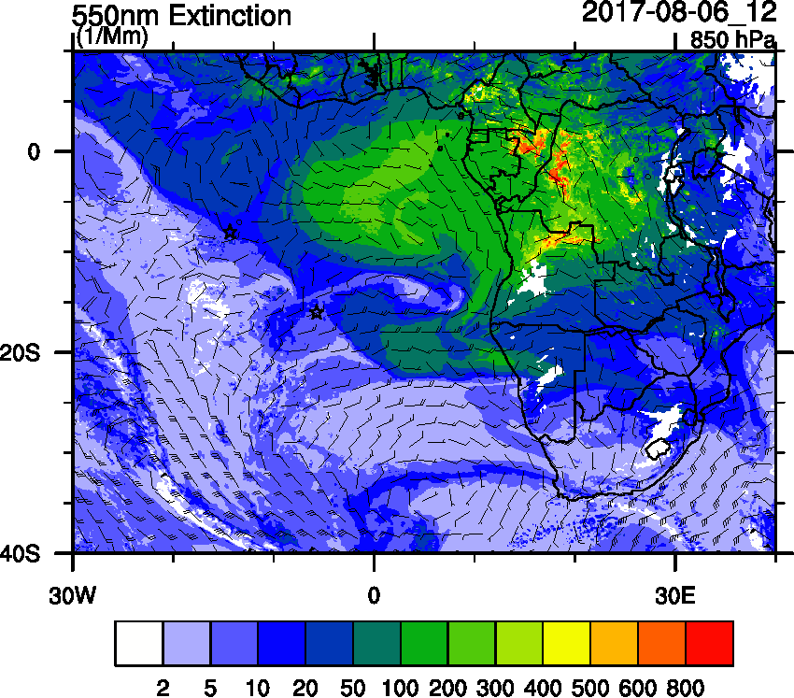
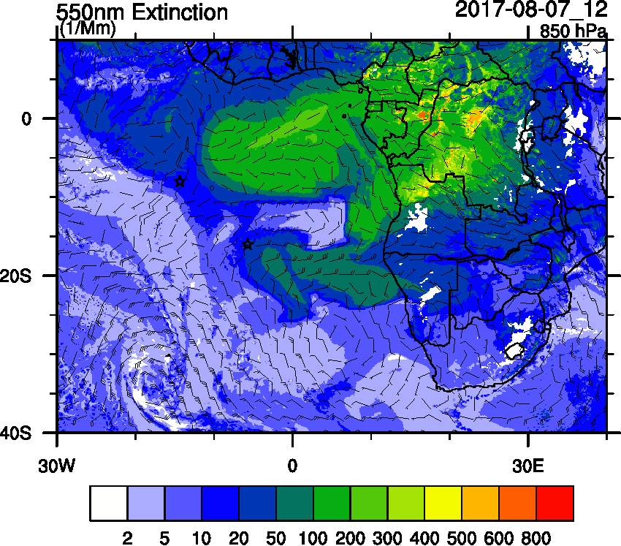
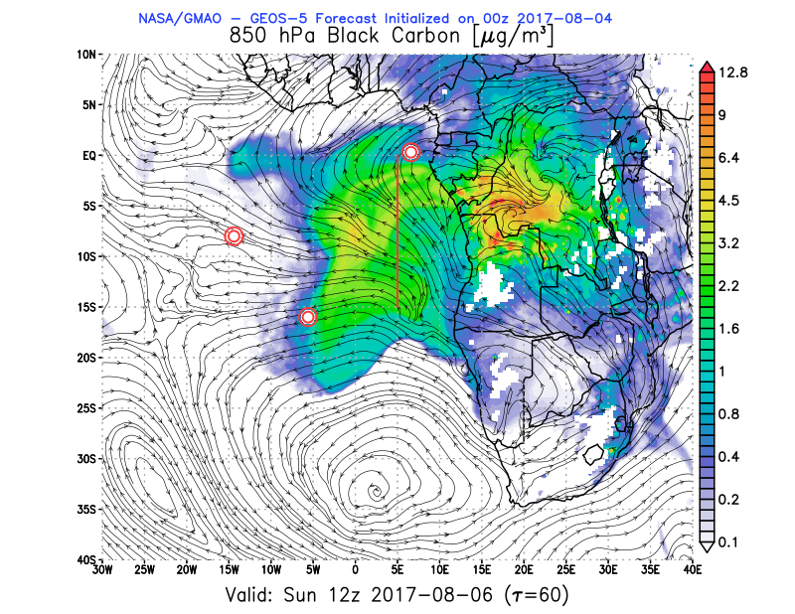
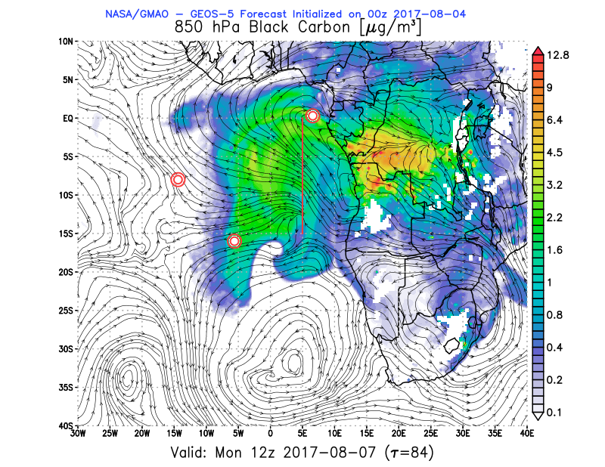
Monday (07) August 2017 12Z

Slide 8
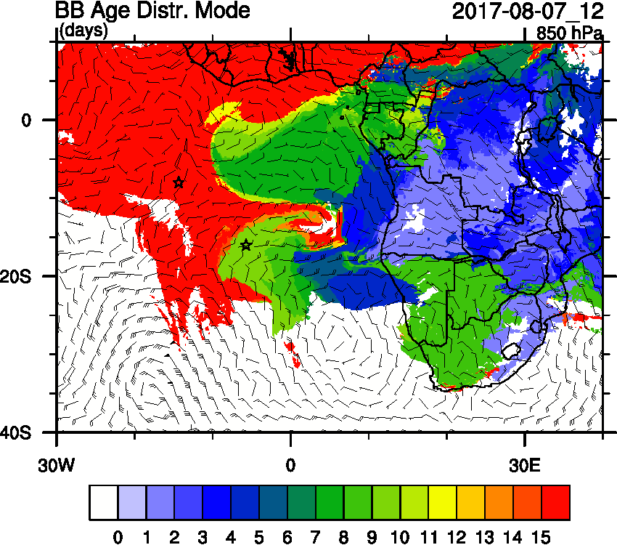
Monday (07) August 2017 12Z

Slide 9
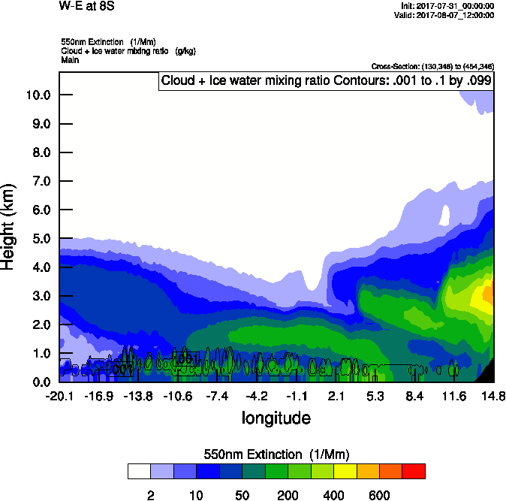
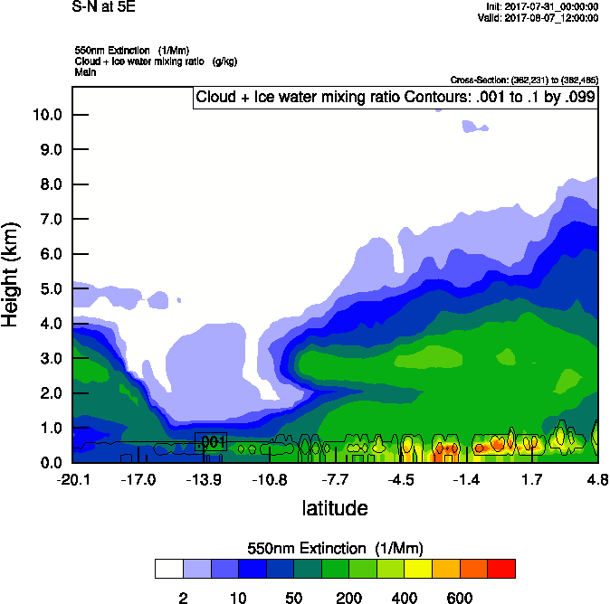
Monday (07) August 2017 12Z
W-E 8S
S-N 5E

Slide 10
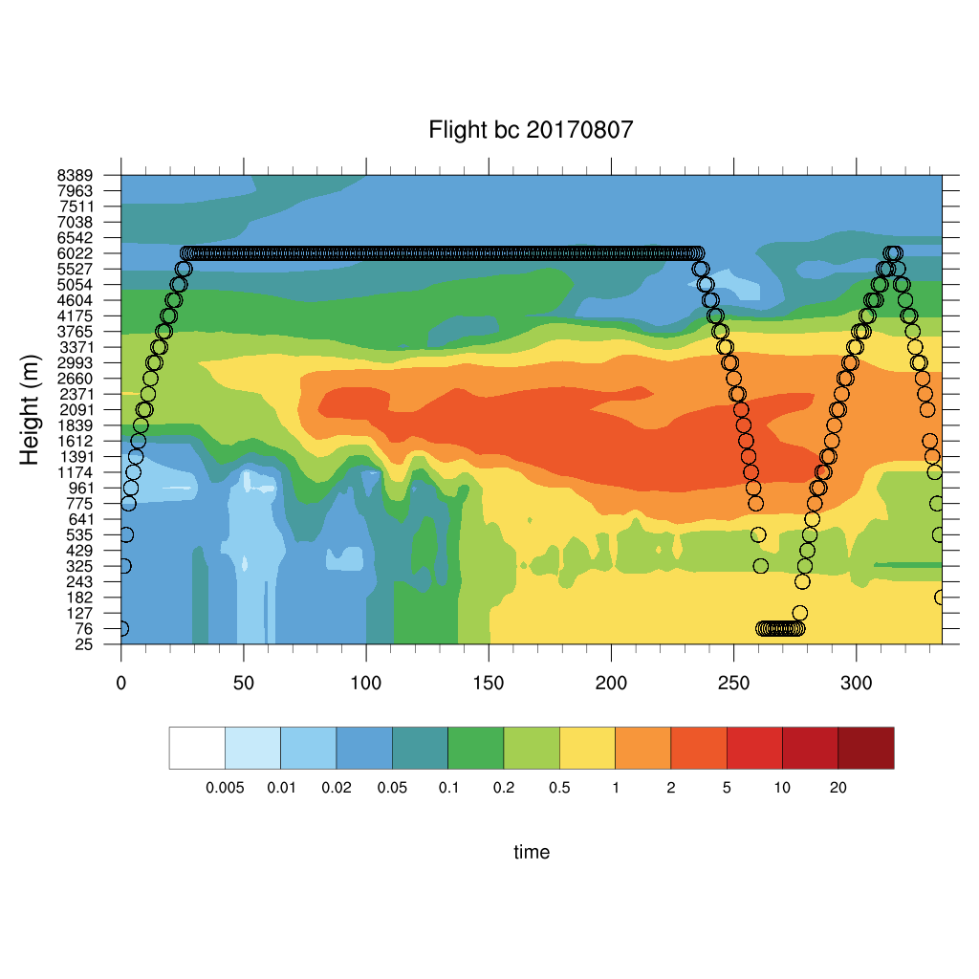
Monday (07) August 2017 12Z

Slide 11
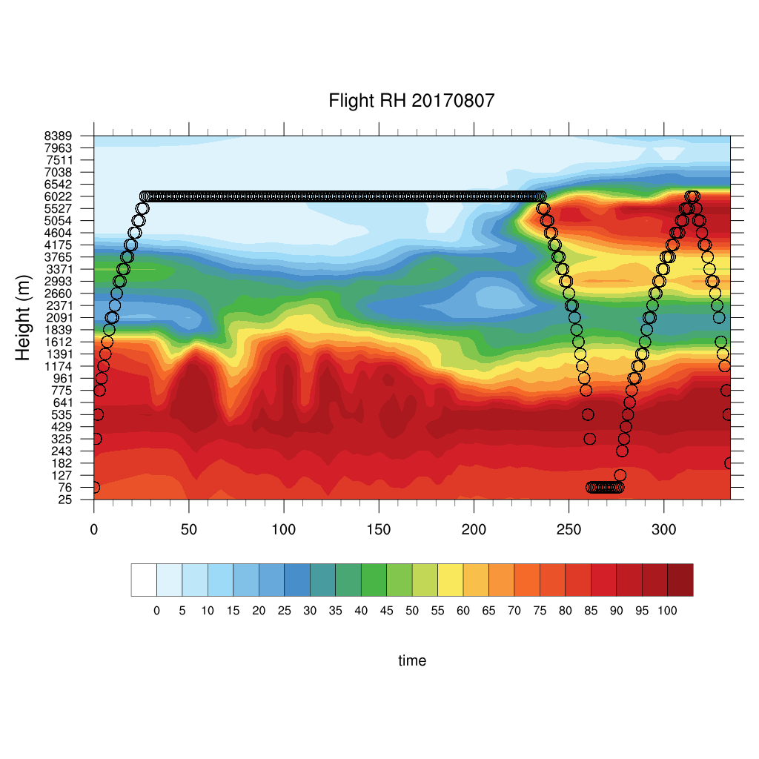
Monday (07) August 2017 12Z

Slide 12
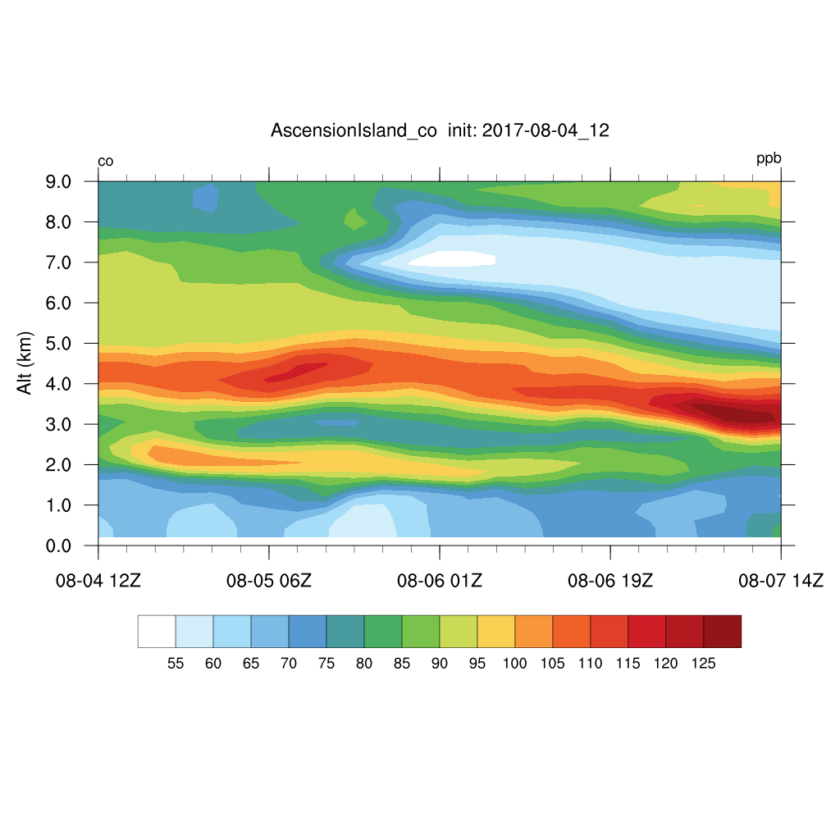
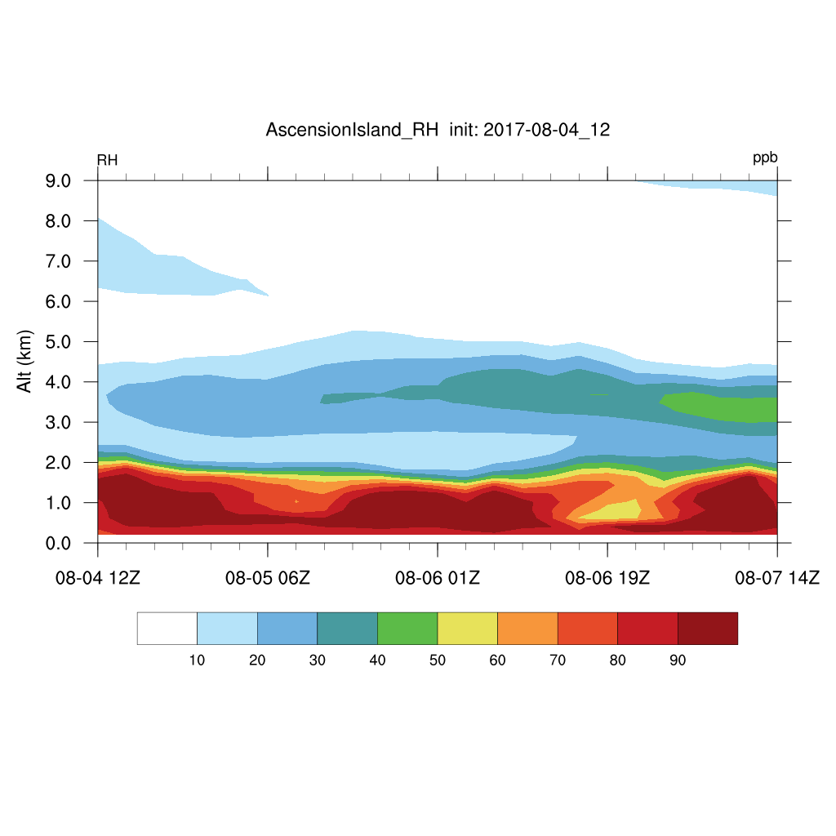
Friday – Monday August 2017

Slide 13
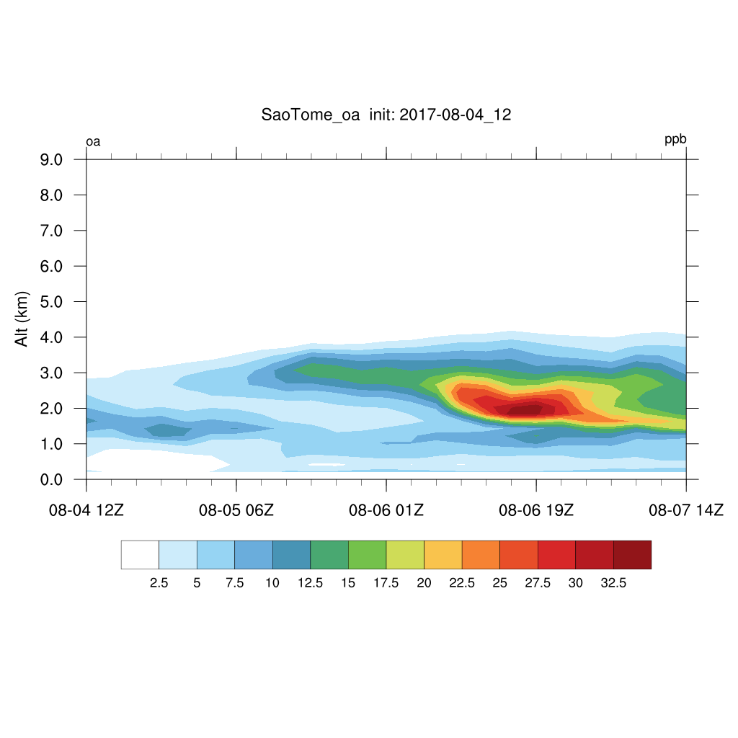
Friday – Monday August 2017
OA

Slide 14
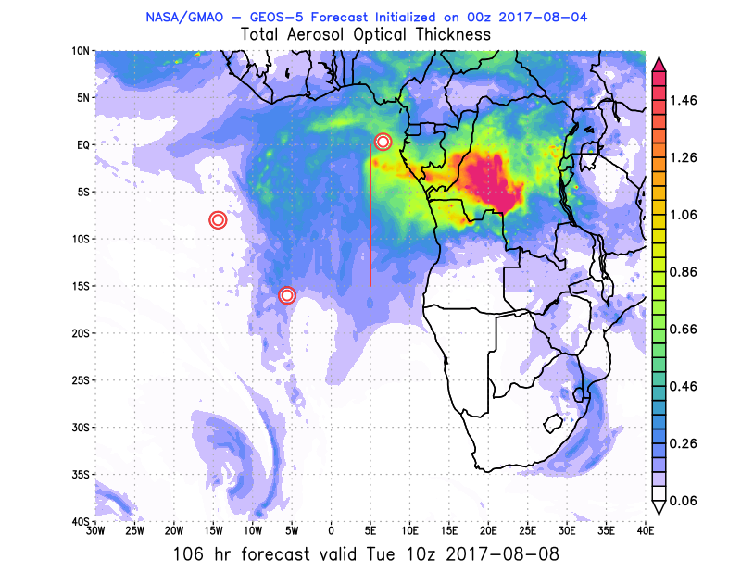
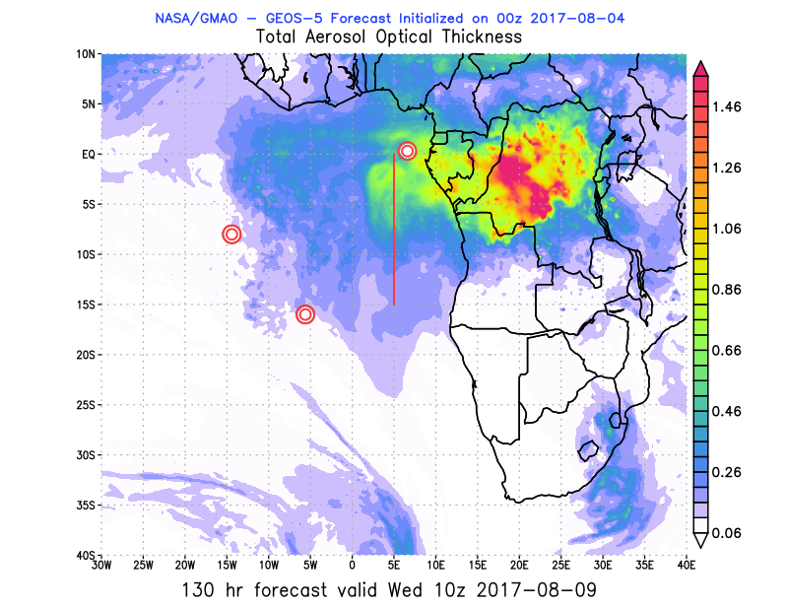
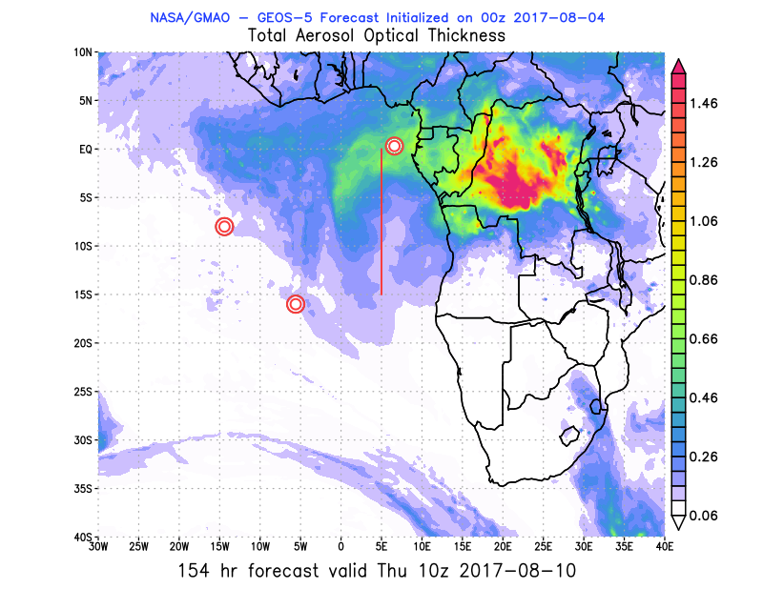
Outlook Mon - Thurs (07-10) August 2017 12Z
Mon Tues Wed Thurs

Slide 15
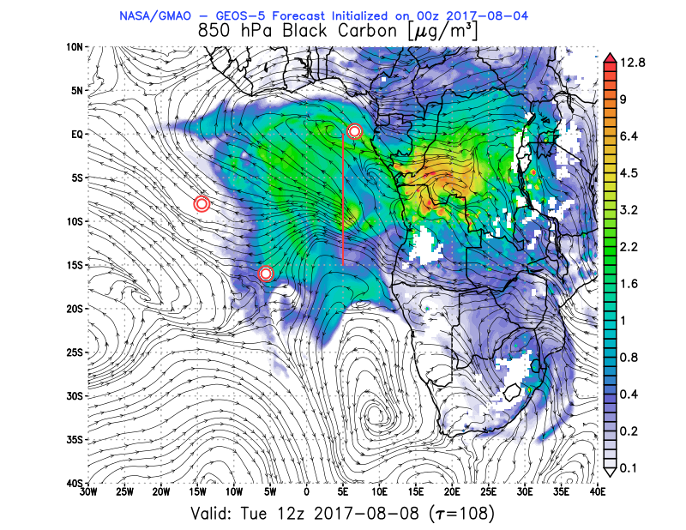
Outlook Mon - Tues (07-10) August 2017 12Z
Mon Tues

Slide 16
Show animation

