Slide 1
ORACLES met forecasting briefing
2-Aug-2017
Rei Ueyama and Lenny Pfister

Slide 2
Outline
Cloud forecast – satellite image comparison
Forecast for 8/5
Forecast for 8/6

Slide 3
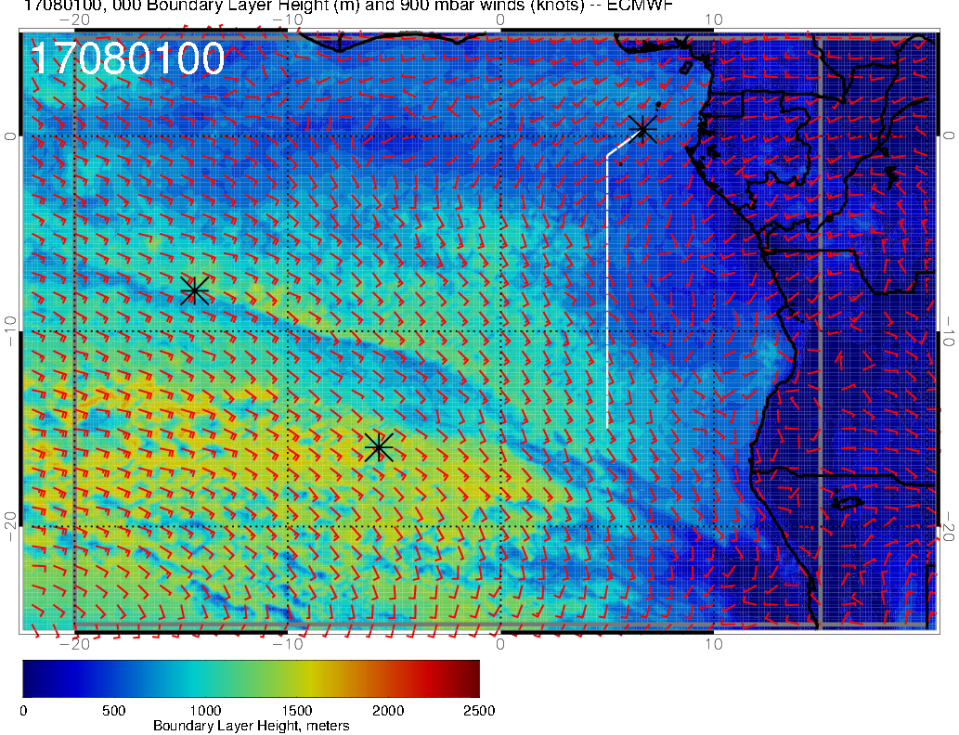
Lidar observations over ASI yesterday (8/1) (courtesy Paquita et al.)
Deep boundary layer (~2km), consistent with EC model
increasing BL height from the SE towards ASI (right)
substantial “mid clouds” (low cloud top heights >2km) over ASI (not shown)
Double cloud layers
Double aerosol layers
BL heights (8/1 @12AM)
See “02August_ASI.pdf” by Paquita for details

Slide 4
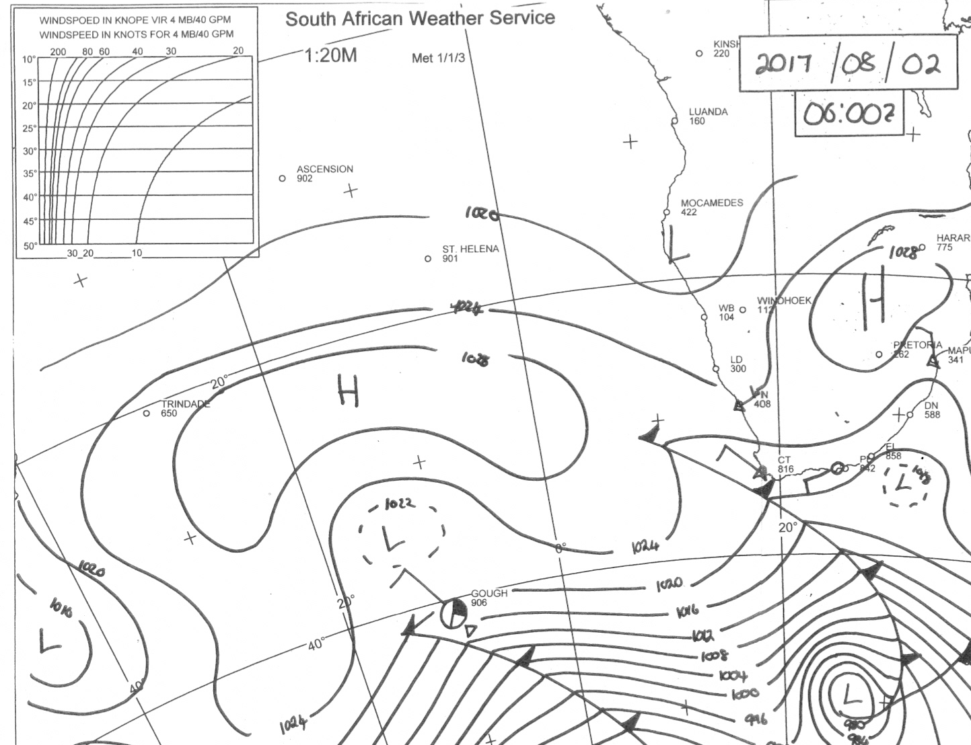
Surface weather analysis
8/2 Wed @ 6AM
ASI
St. Helena high moves E-SE, increasing surface winds off Namibia coast (~25 knots) by Fri 8/4
(in contrast, winds near TMS weaken to ~5-10 knots)
Low pressure system has moved east

Slide 5
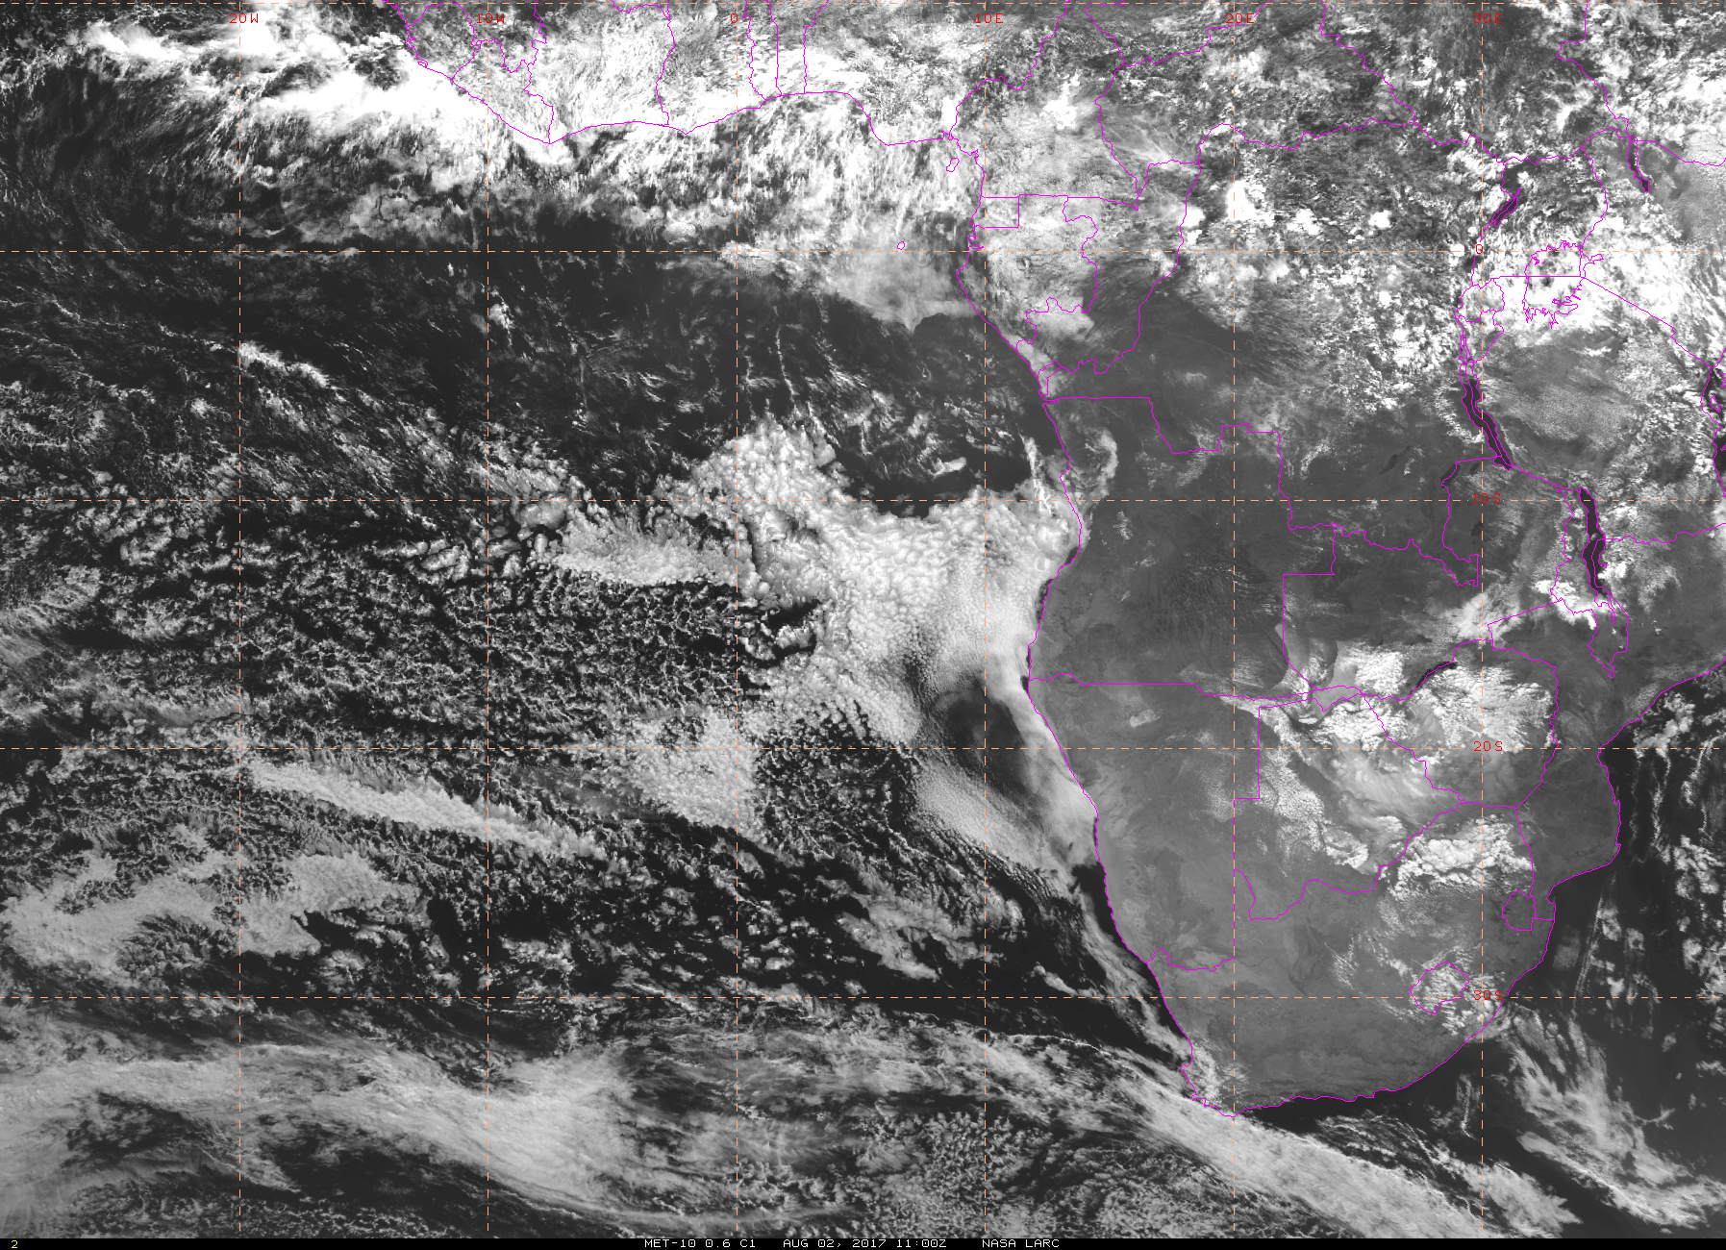
Visible imagery at 8/2 Wed @ 11AM
Middle clouds (base 10 kft) above few and scattered low clouds over TMS
TMS
ASI
“clear” sky with patches of low clouds south of TMS; models getting this approximately correct (relatively persistent feature during the forecast period)
Few low clouds over ASI
EC model overestimated low cloud occurrence SE of the transit flight track

Slide 6
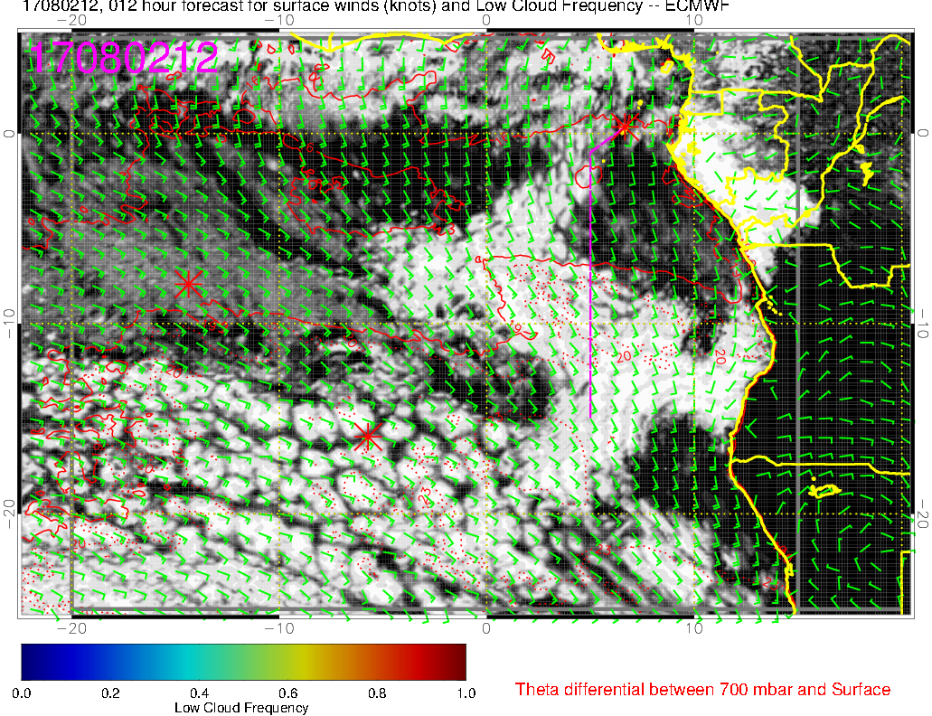
Low cloud forecast at 8/2 Wed @ 12PM
TMS
A: Sao Tome
A
B
ASI
B: “clear sky” region
C
C: classic stratocumulous region

Slide 7
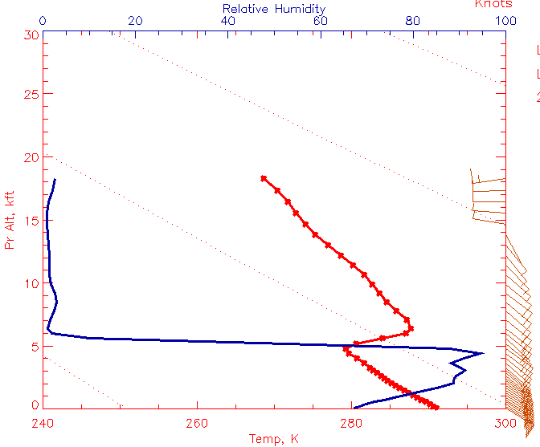
EC model forecast soundings at 8/2 Wed @ 12PM
C: classic StratCu region
Strong inversion
RH profile (blue)
T profile (red)
Clouds at the top of the inversion

Slide 8
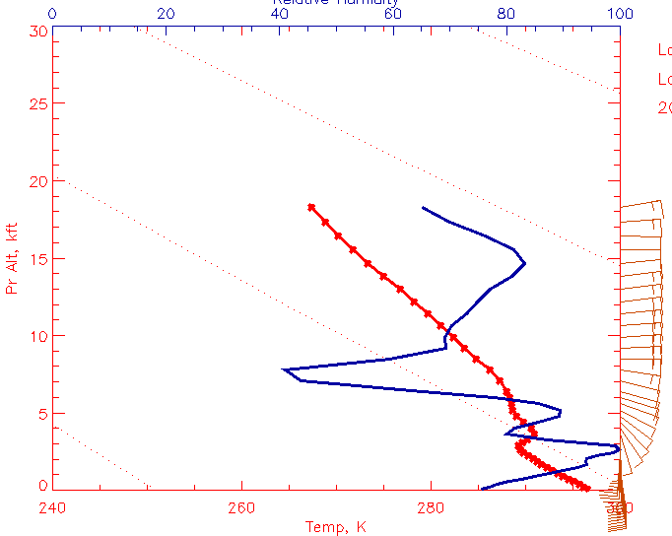
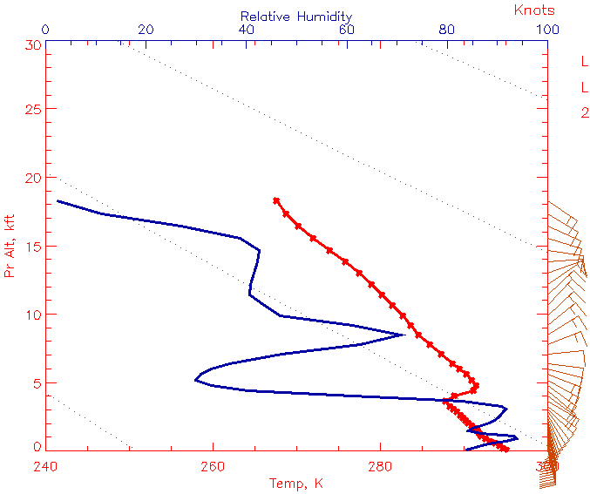
Forecast soundings at 8/2 Wed @ 12PM
T profile (red)
RH profile (blue)
A: Sao Tome
B: clear-sky region
C: classic StratCu region
Weak inversion over TMS (A)
RH penetrates above the weak inversion (A)
Mixing out of the moisture leads to the clear-sky region south of TMS?

Slide 9
8/5, Saturday

Slide 10
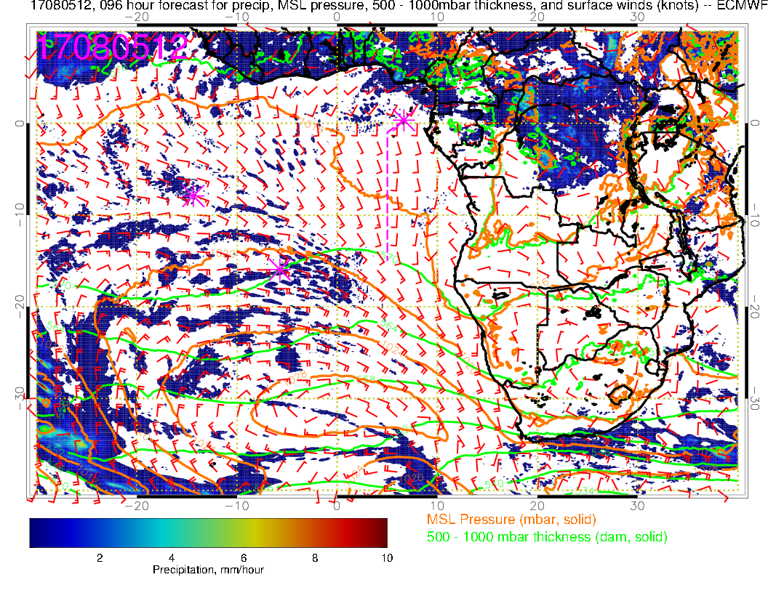
Southerly flow progged to be weaker than average, 10 vs 15 knots
SH high slightly east of climo position – enhanced SSE winds near Namibia
Convection down to northern and central Congo

Slide 11
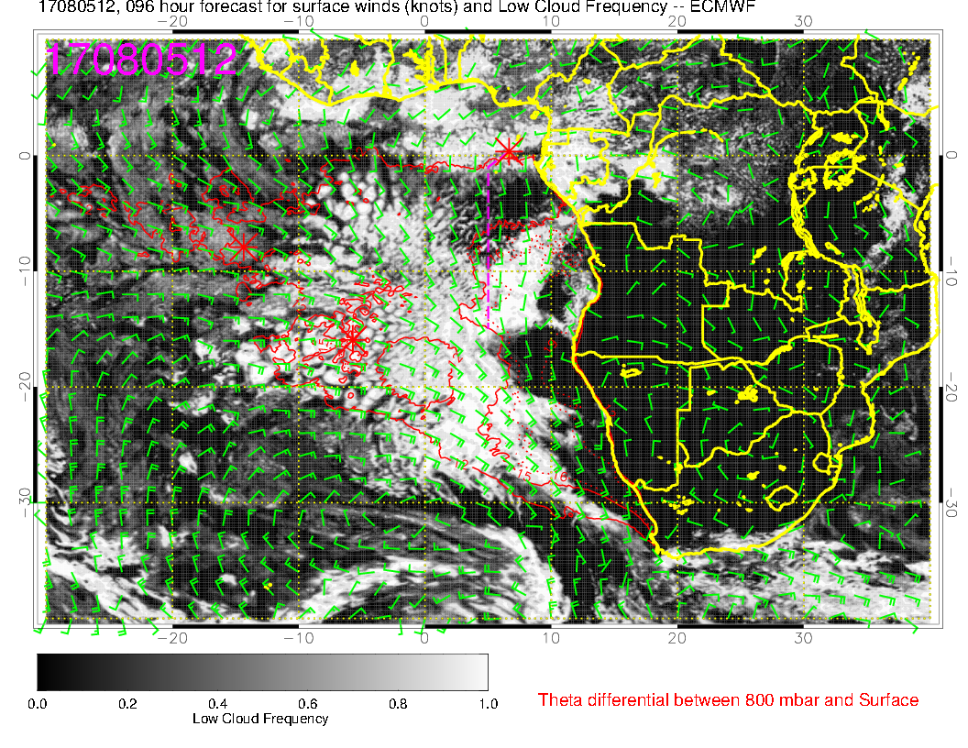
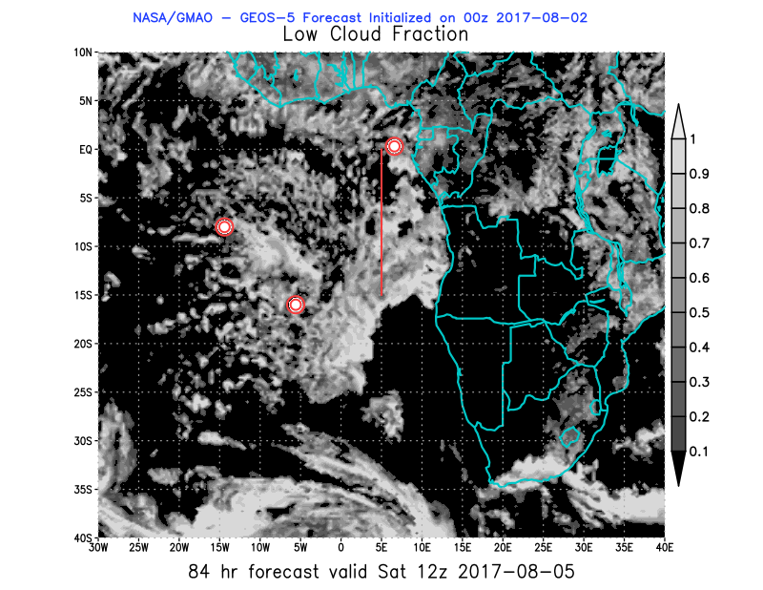
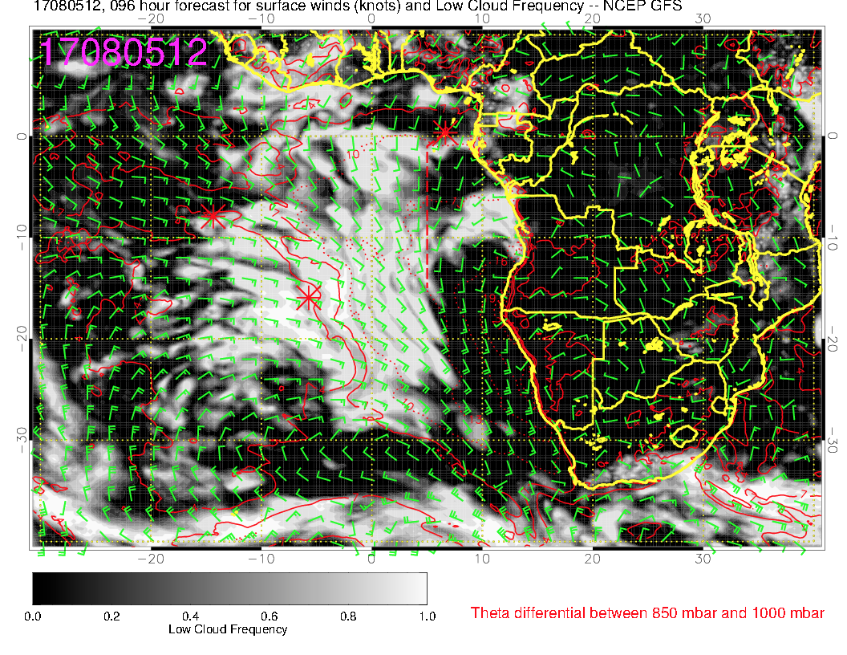

Slide 12
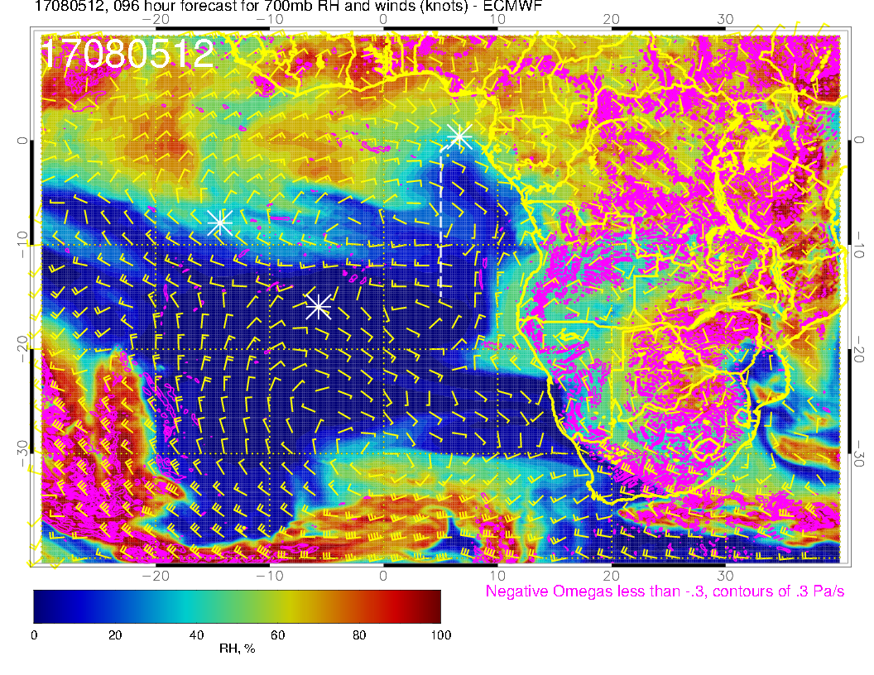
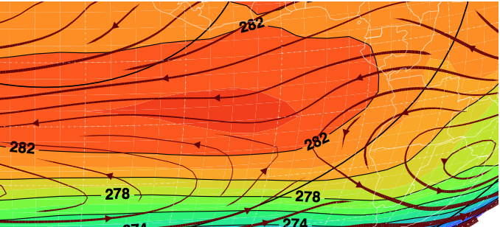
700mb, Saturday
Very disturbed pattern is forecast, with anticyclone offshore, and northwestward instead of westward flow.

Slide 13
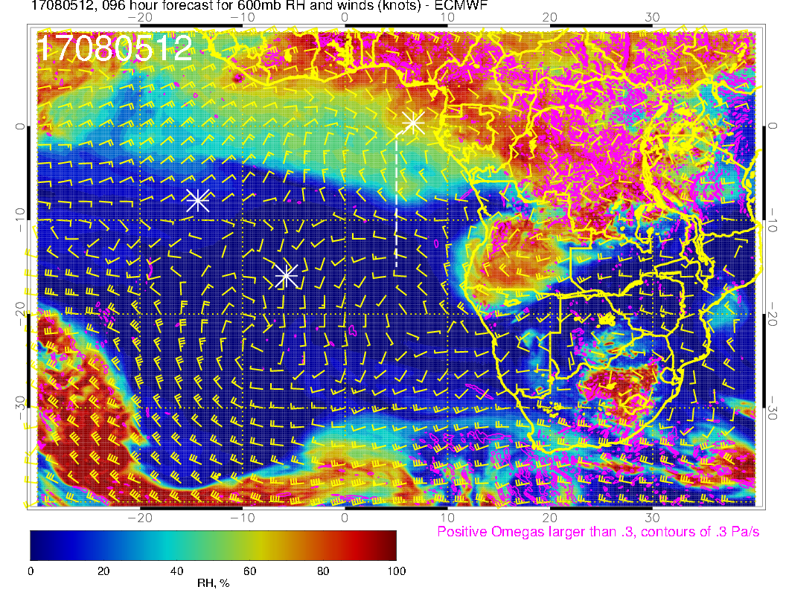
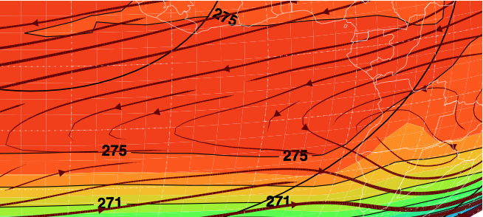
600mb, Saturday
At 600mb, anticyclone is NOT offshore, but is displaced northward from its mean position in the middle of the Angolan coast
Bottom line is that the offshore flow at midlevels is forecast to be confined to north
BUT, flow curves south quickly.

Slide 14
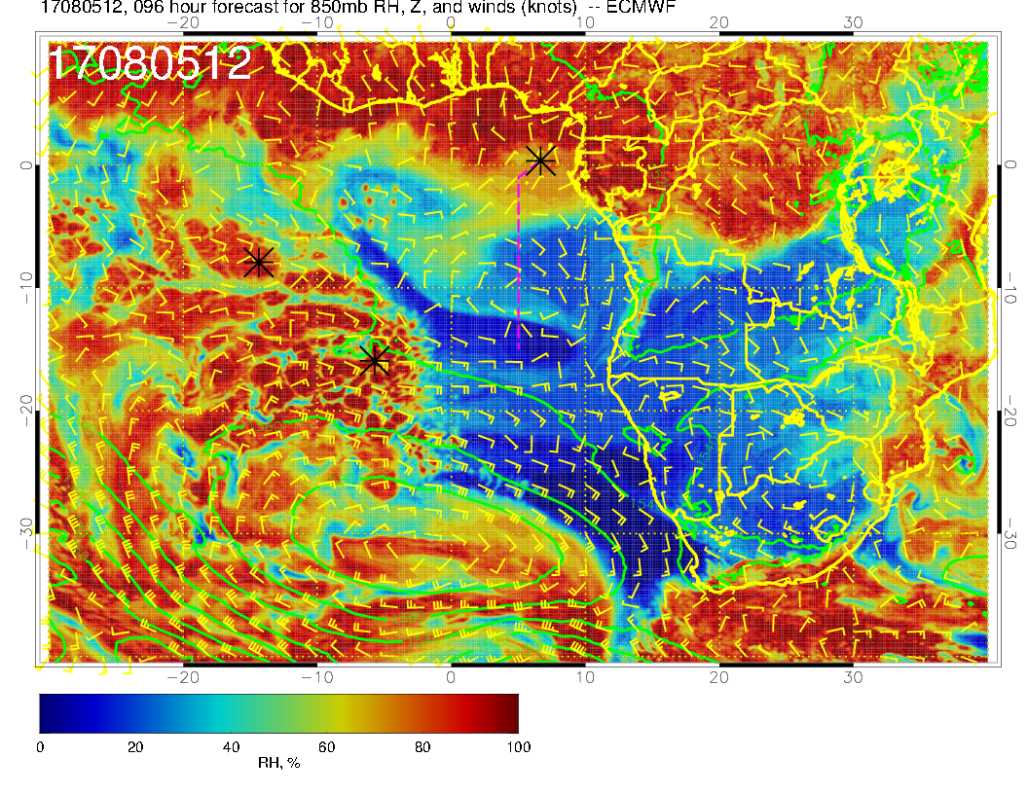
Generally dry, but note small plume heading southwestward

Slide 15
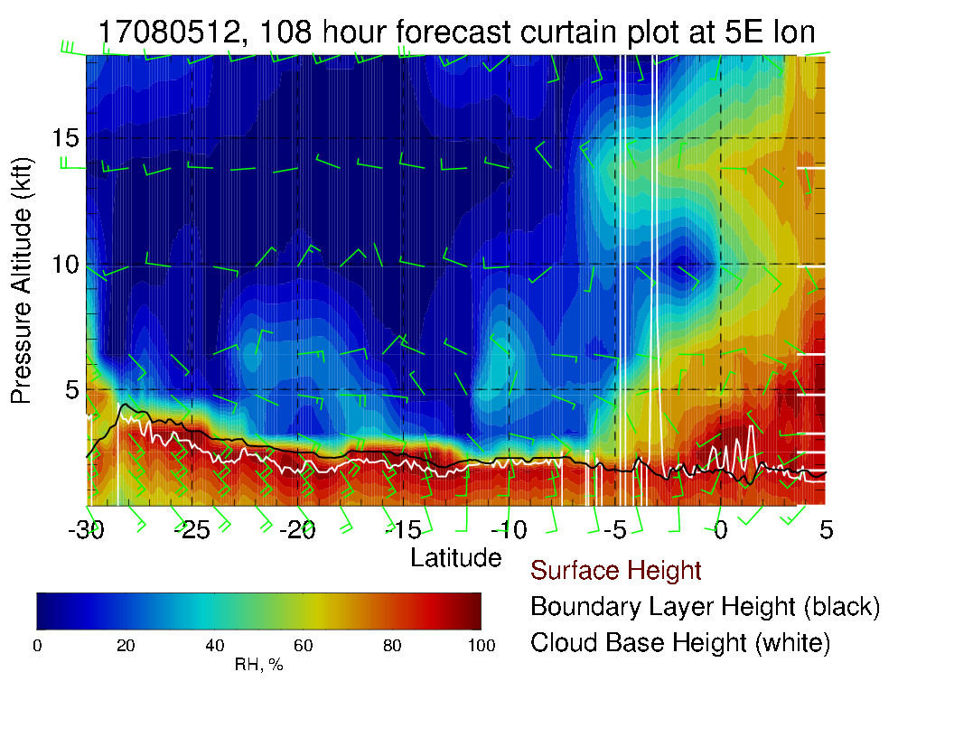
RH “gap” due to the anomalous winds described in previous three slides

Slide 16
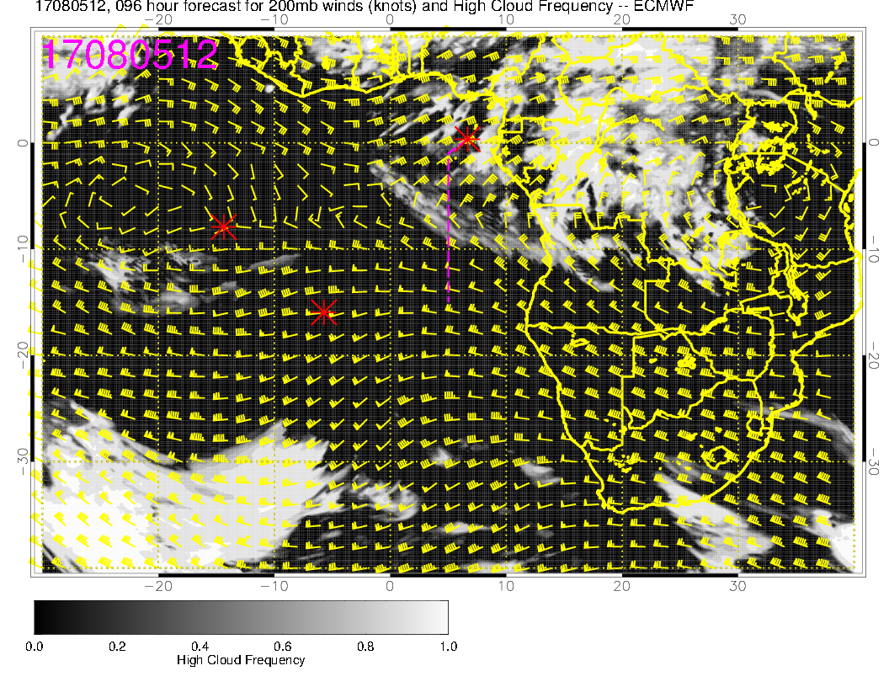
We have been noting some overprediction of high clouds by EC model. Still, expect high cloud in the vicinity because of northeasterly winds from the convective regions.
Have noted a diurnal cycle – max at nighttime, less during the day. We will see wispy cloud.

Slide 17
8/6, Sunday

Slide 18
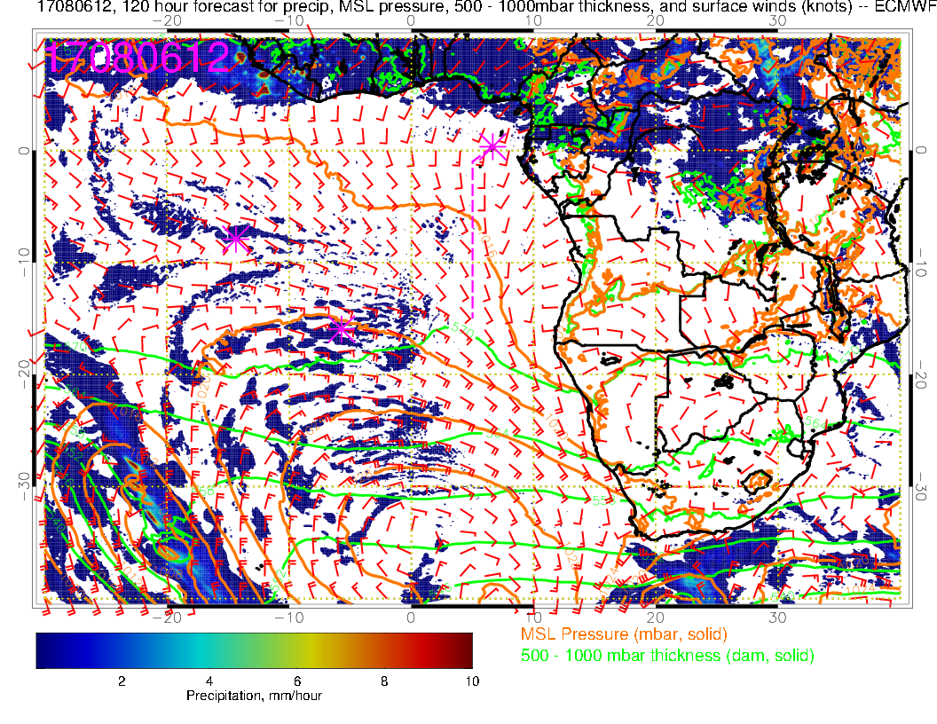
Flow in Sao Tome region still weaker than normal and more southerly than normal
Another whopper front around 30-40S approaching – not affecting our region yet
Angolan eddy is about average.

Slide 19
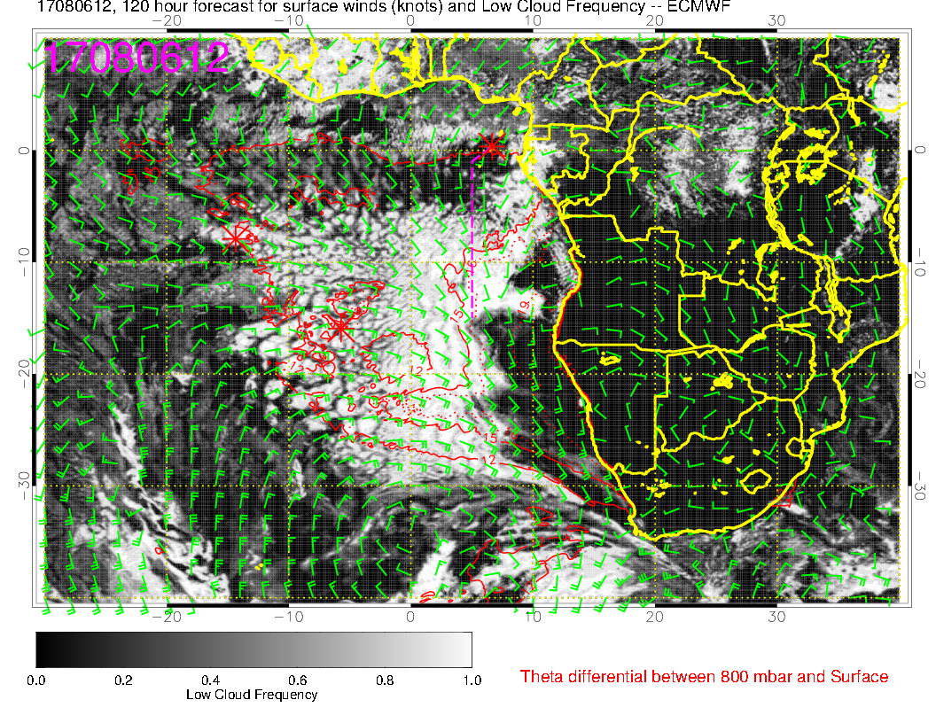
Low cloud seems to have filled in south of 10S, but there is arguably less along the flight track (HAW-TMS) than on Saturday – we see the “gap” down to 5S.

Slide 20
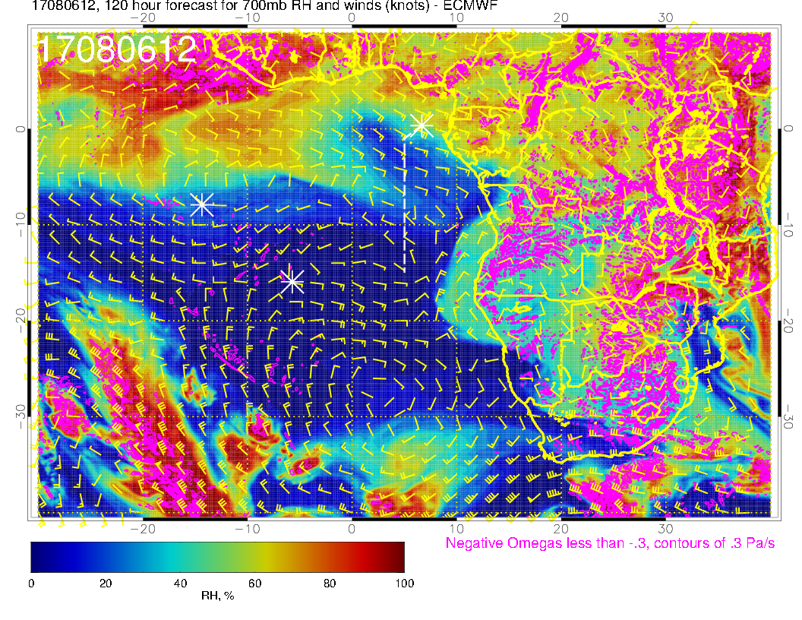
Still pretty dry as the anticyclone remains offshore.
Have another anticyclone pushing some high RH (related to dry convection – magenta contours) off of southern Angola.

Slide 21
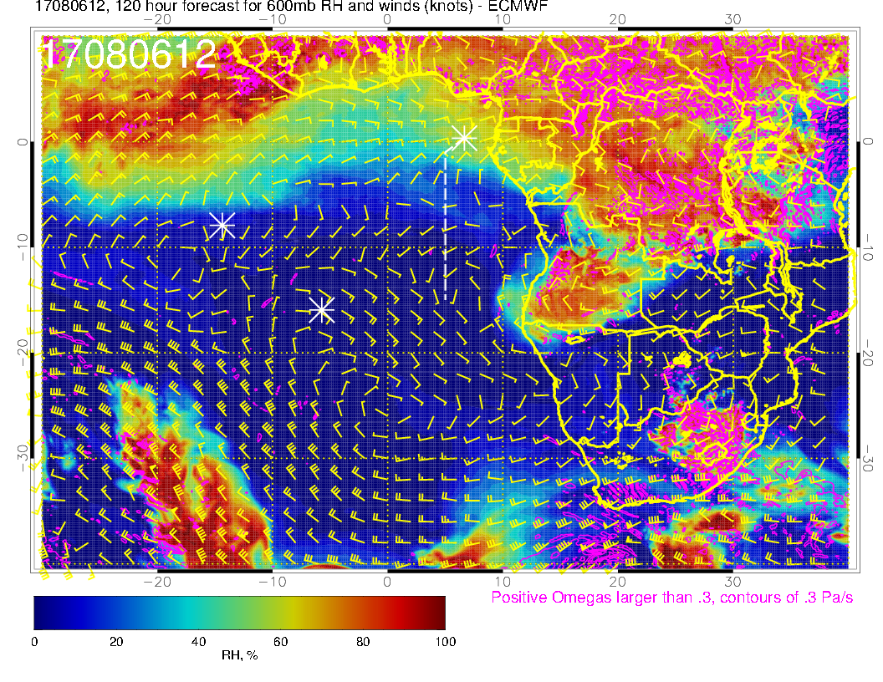
Southward flow near TMS that brought high RH to routine flight track is now gone – drier than Saturday.
Note bulge of high RH off of southern Angola.

Slide 22
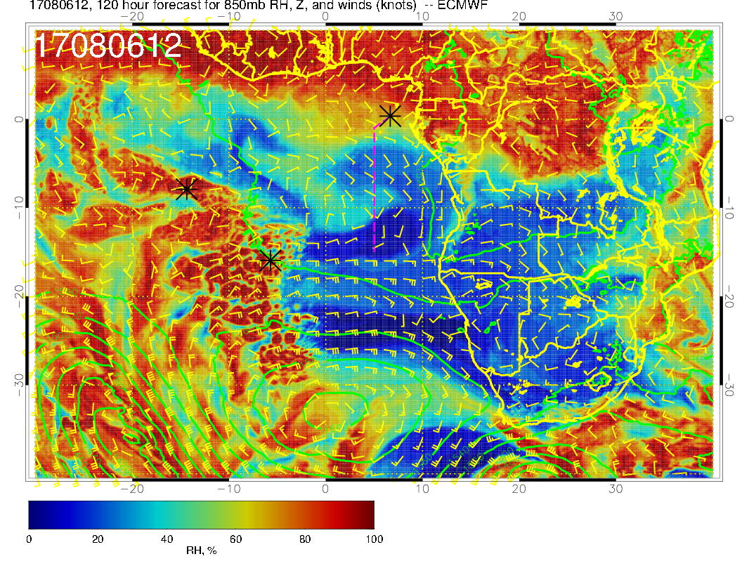
Equatorward flow, expect dry situation at 850mb.

Slide 23
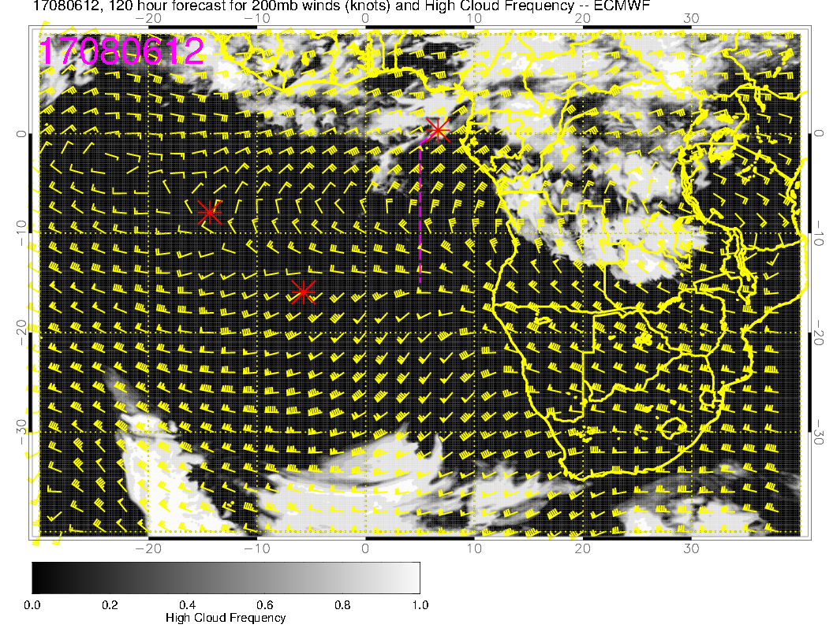
I wouldn’t argue that we have less high cloud Sunday than Saturday so far out. Flow is from the NE, so am inclined to think we will have some high cloud
Poleward flow at these levels is often downward, so may see a bit more subsidence and drying.

Slide 24
Summary
South of “gap” near 5S or so, expect ample low cloud on both Saturday and Sunday. Based on today’s satpics, even “gap” regions have some cloud. For transit, first half of flight looks to have more low cloud, especially on Sunday
Mid-levels look to be anomalously dry, with flow from the south rather than from the east because of anomalous position of anticyclones at the 700mb and 600mb levels. Saturday more favorable than Sunday for seeing high RH air at mid-levels.
Mid-level flow (700 and 600mb) is highly anomalous for these two days.
Northeasterly flow should lead to some high cloud north of 5S.

