Slide 1
ORACLES Forecast Briefing (Aerosols)
02 August 2017

Slide 2
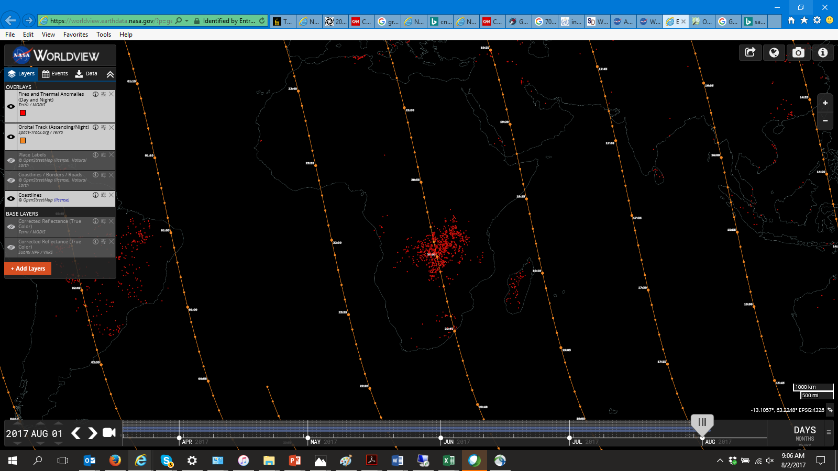
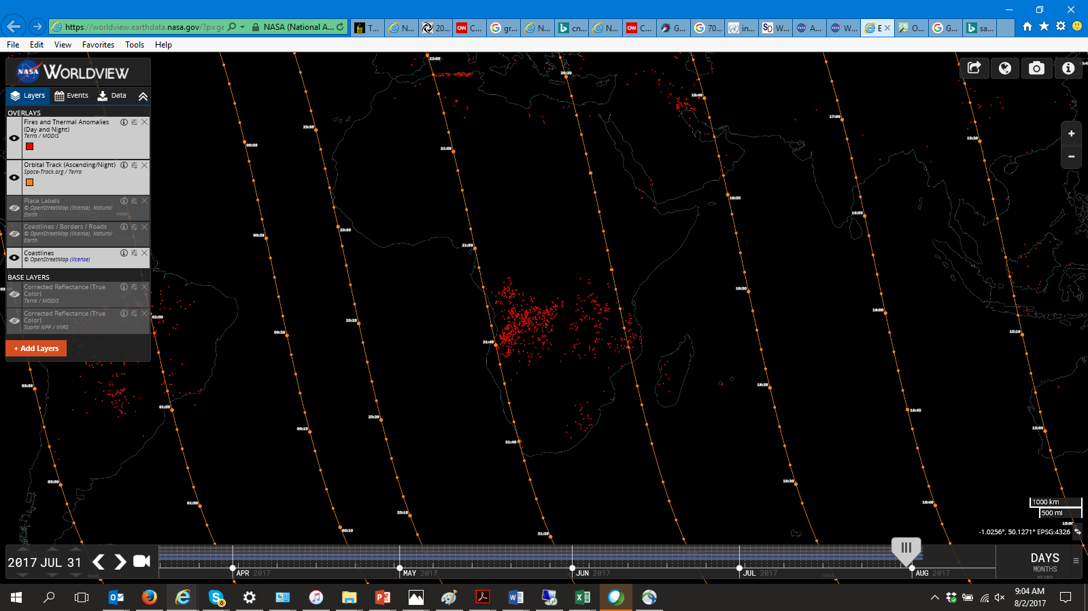
Current (Aug 1) Fire Activity

Slide 3
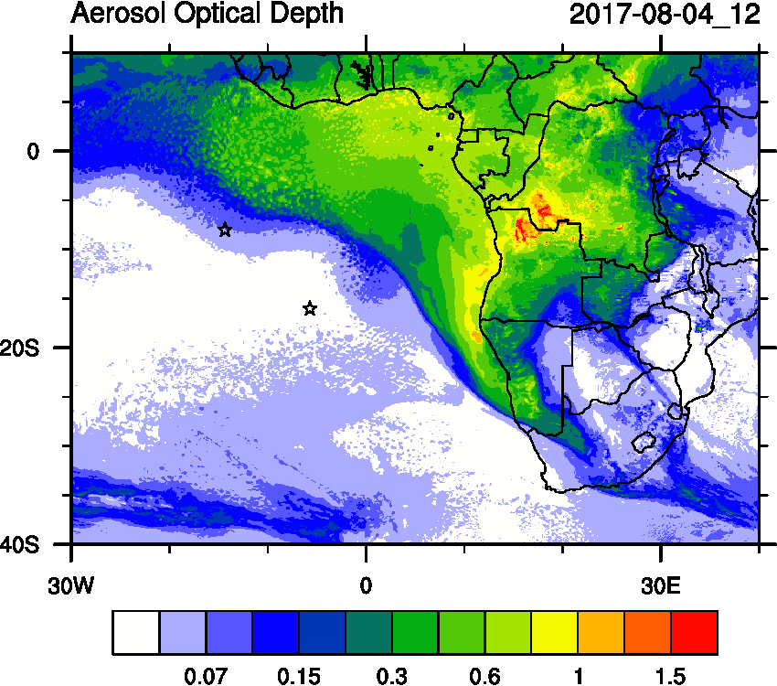
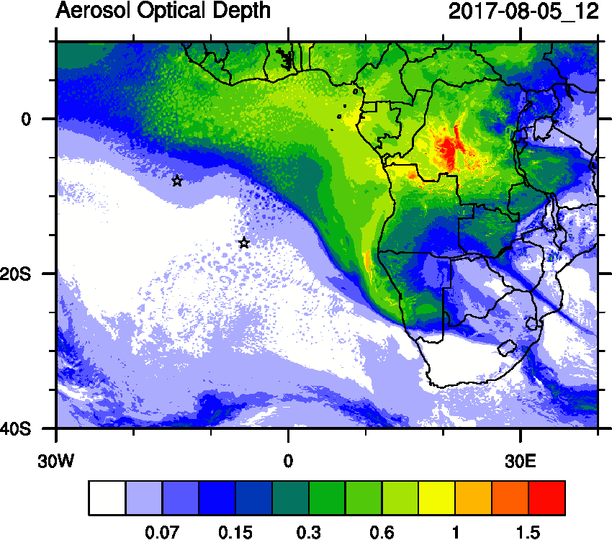
Friday (04) and Saturday (05) August 2017 12Z
WRF-AAM

Slide 4
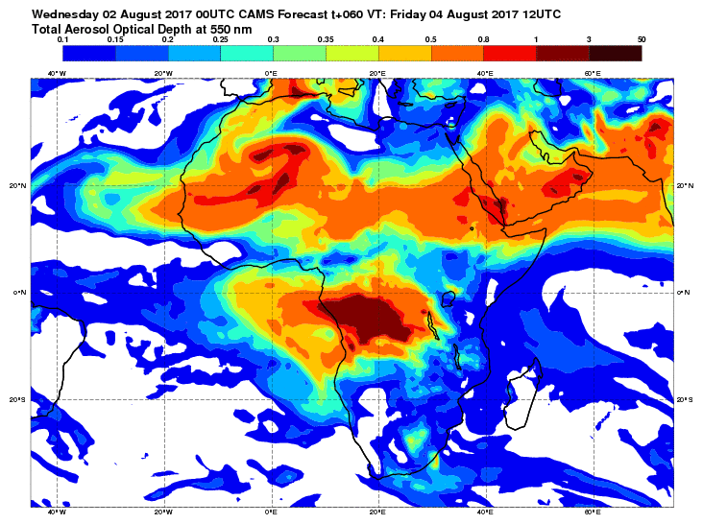
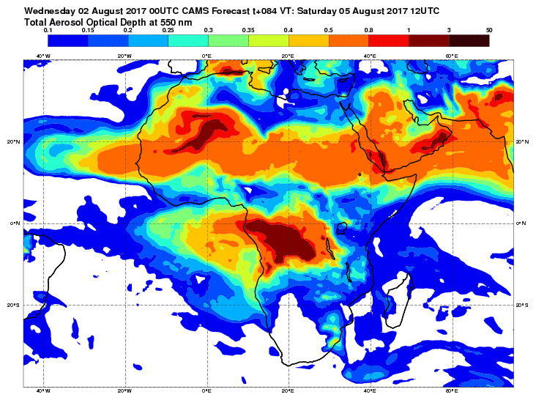
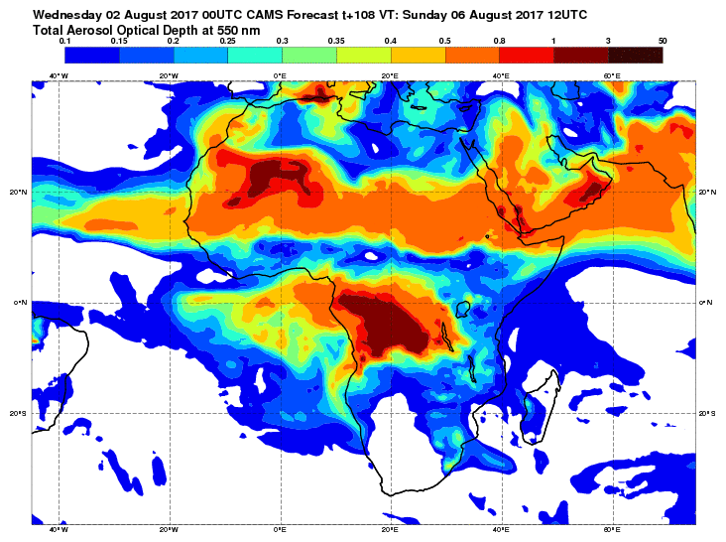
Friday (04), Saturday (05), Sun (06) Aug 2017 12Z
EU-CAMS

Slide 5
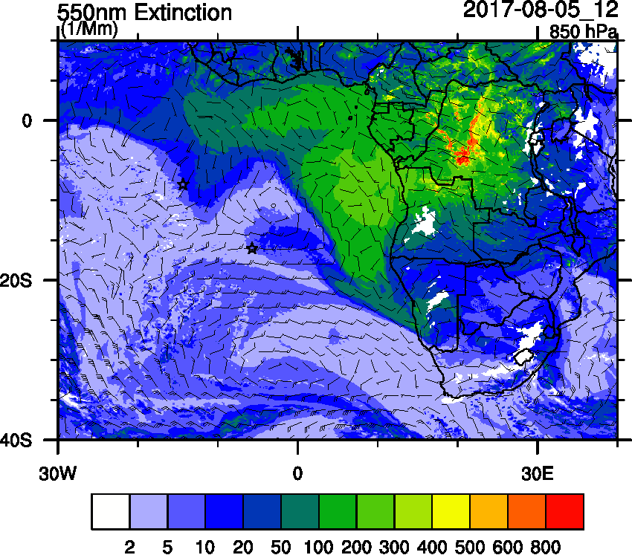
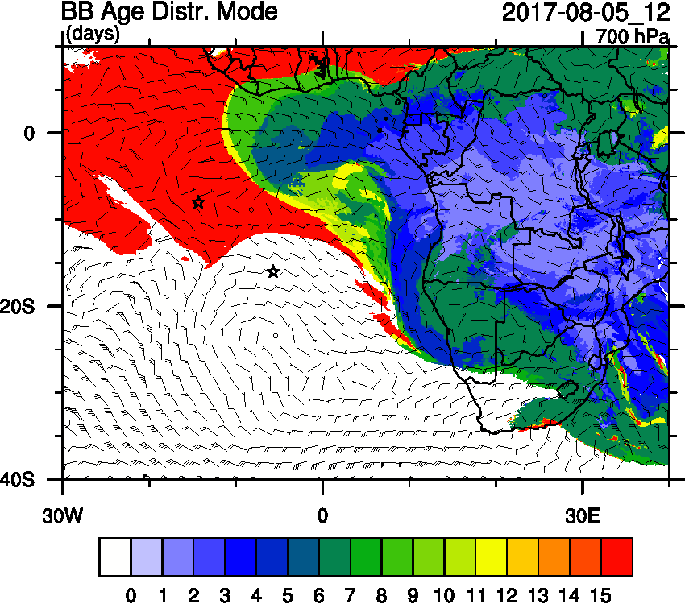
Saturday, 05 August 2017 12Z

Slide 6
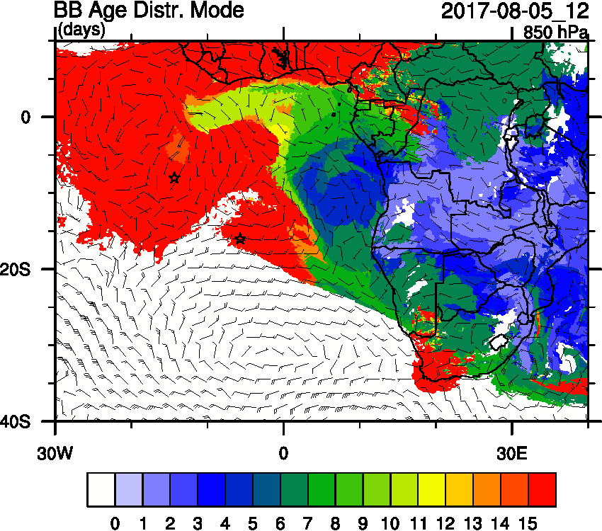
Saturday, 05 August 2017 12Z

Slide 7
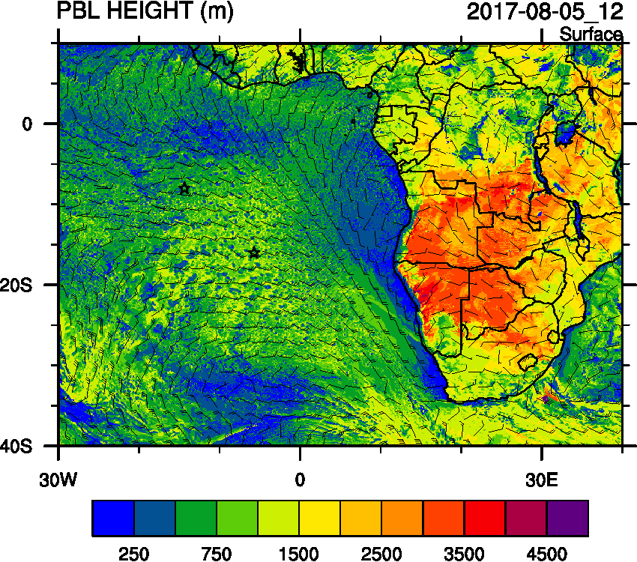
Saturday, 05 August 2017 12Z

Slide 8
Saturday, 05 August 2017 12Z

Slide 9
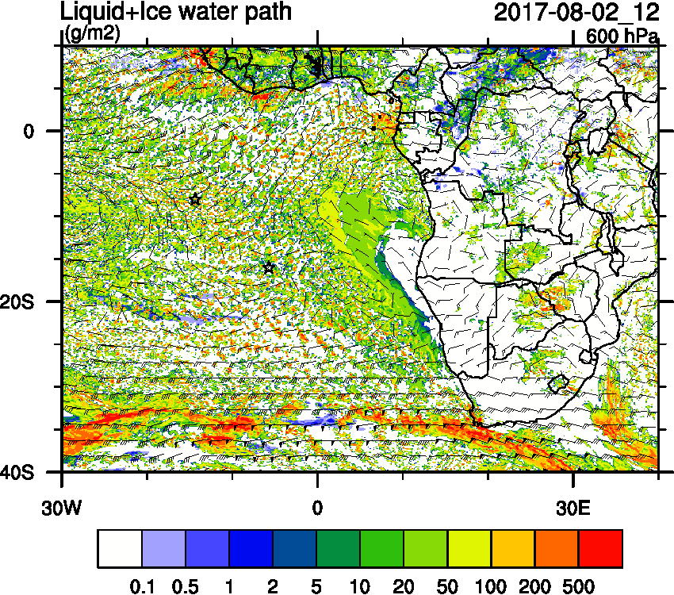
Saturday, 05 August 2017 12Z

Slide 10
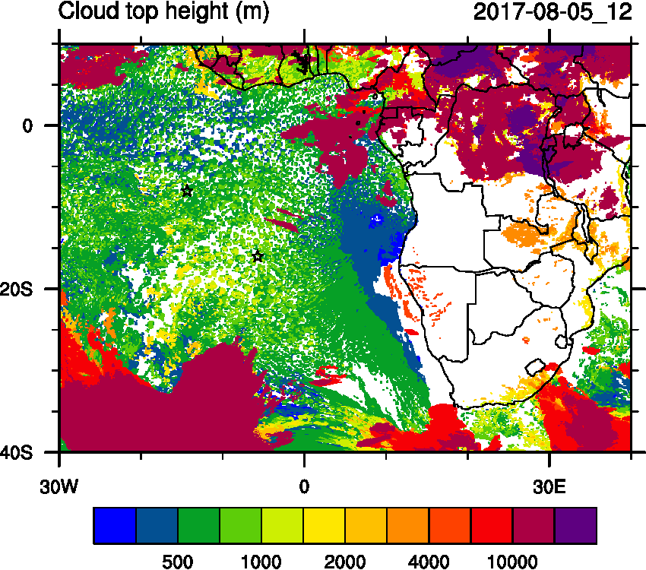
Saturday, 05 August 2017 12Z

Slide 11
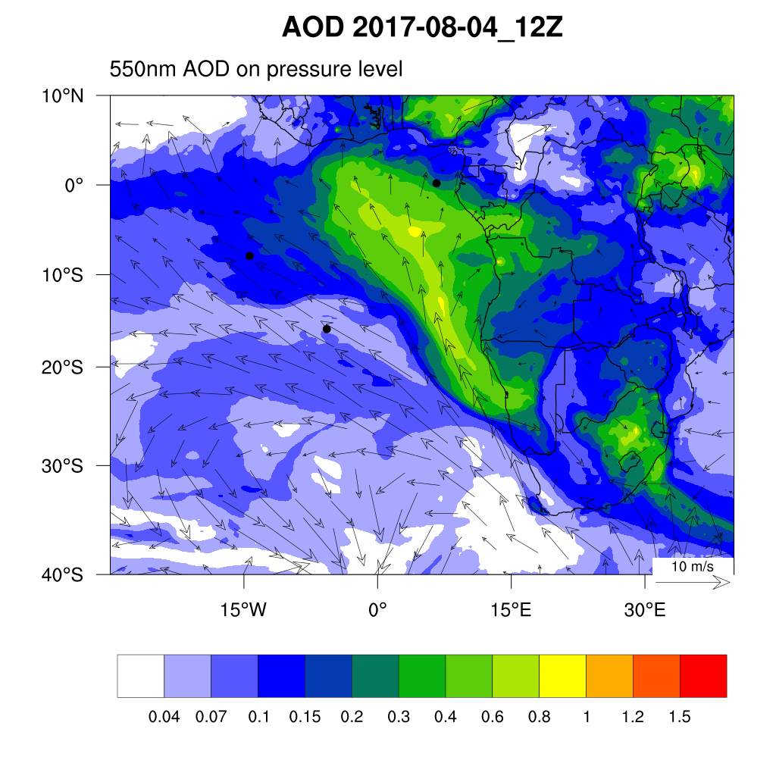
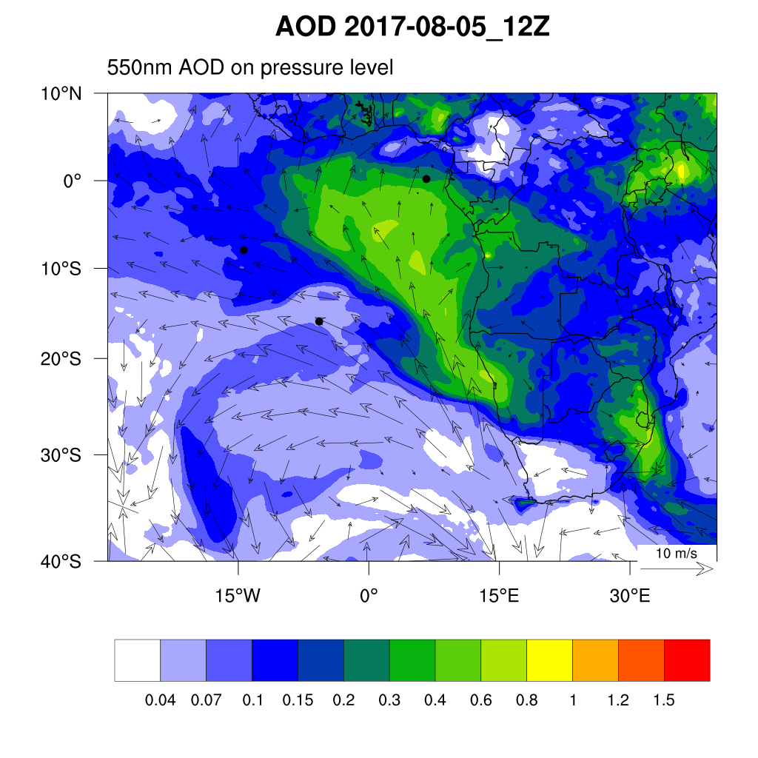
Friday (04) and Saturday (05) August 2017 12Z
WRF-AAM
WRF-CAM5

Slide 12
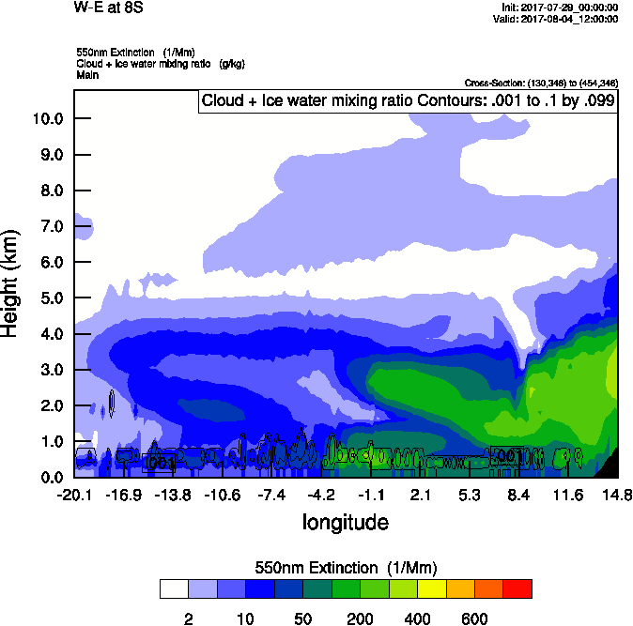
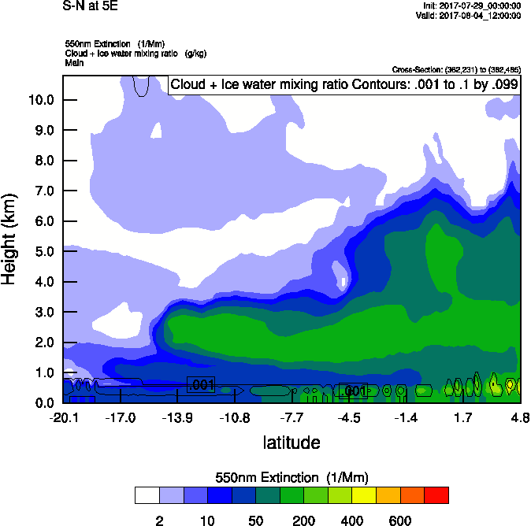
Friday, 04 August 2017 12Z
W-E 8S
S-N 5E

Slide 13
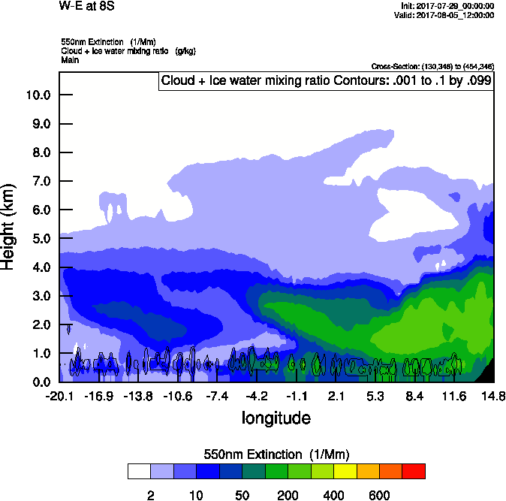
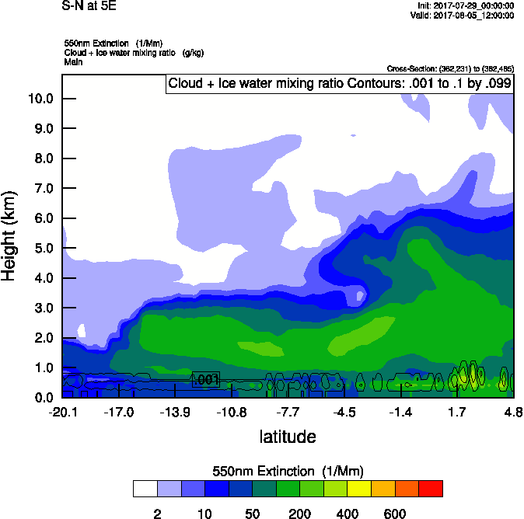
Saturday, 05 August 2017 12Z
W-E 8S
S-N 5E

Slide 14
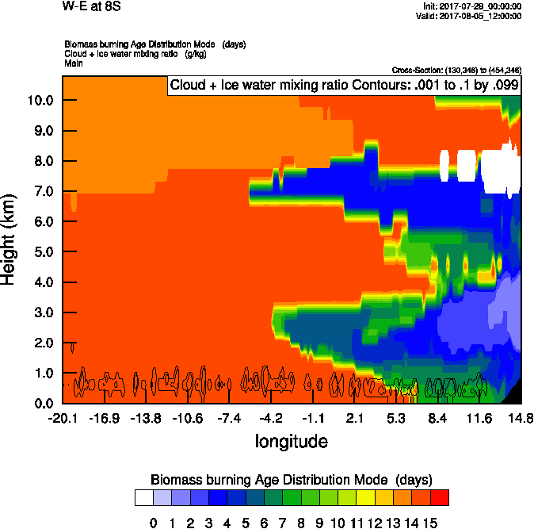
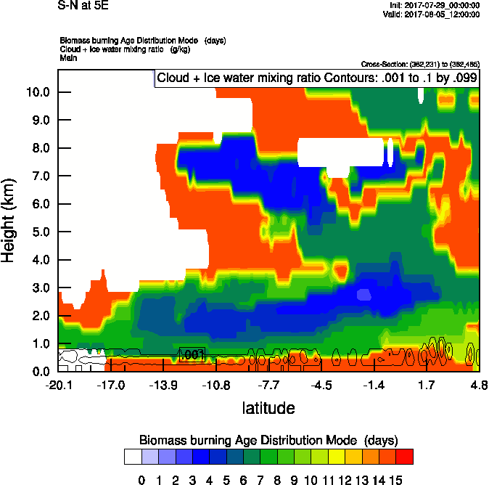
Saturday, 05 August 2017 12Z
W-E 8S
S-N 5E

Slide 15
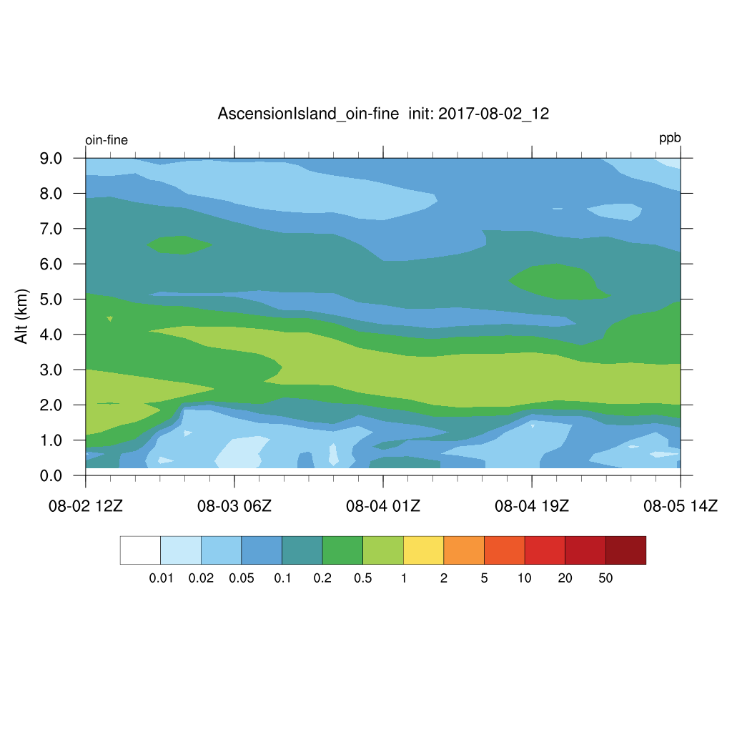
Thursday – Saturday (02-05) August 2017
DUST
BC

