Slide 1
ORACLES met forecast briefing
1-Aug-2017
Lenny Pfister and Rei Ueyama

Slide 2
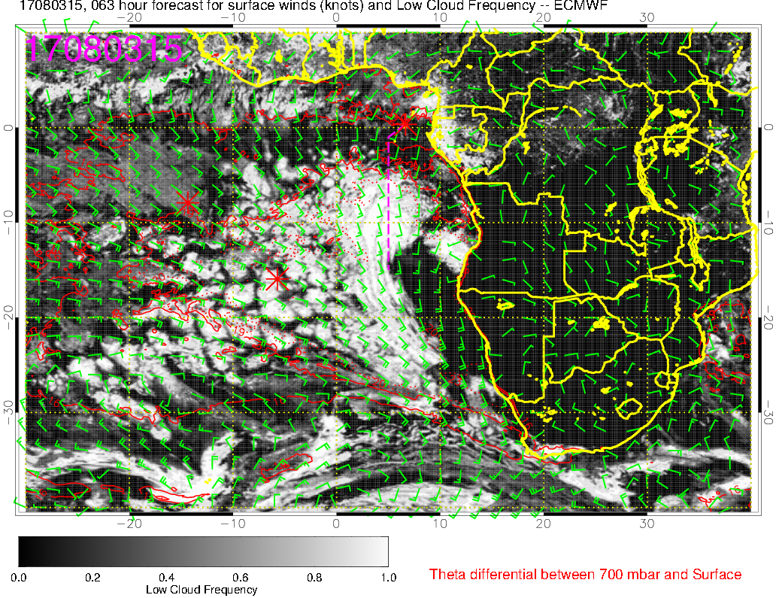
Low clouds (8/3 @3PM)
B
Transit flight track at the edge of low cloud region (A) with cloud base/BL heights ≤ 1.5km
Less frequent low clouds near TMS (B)
A

Slide 3
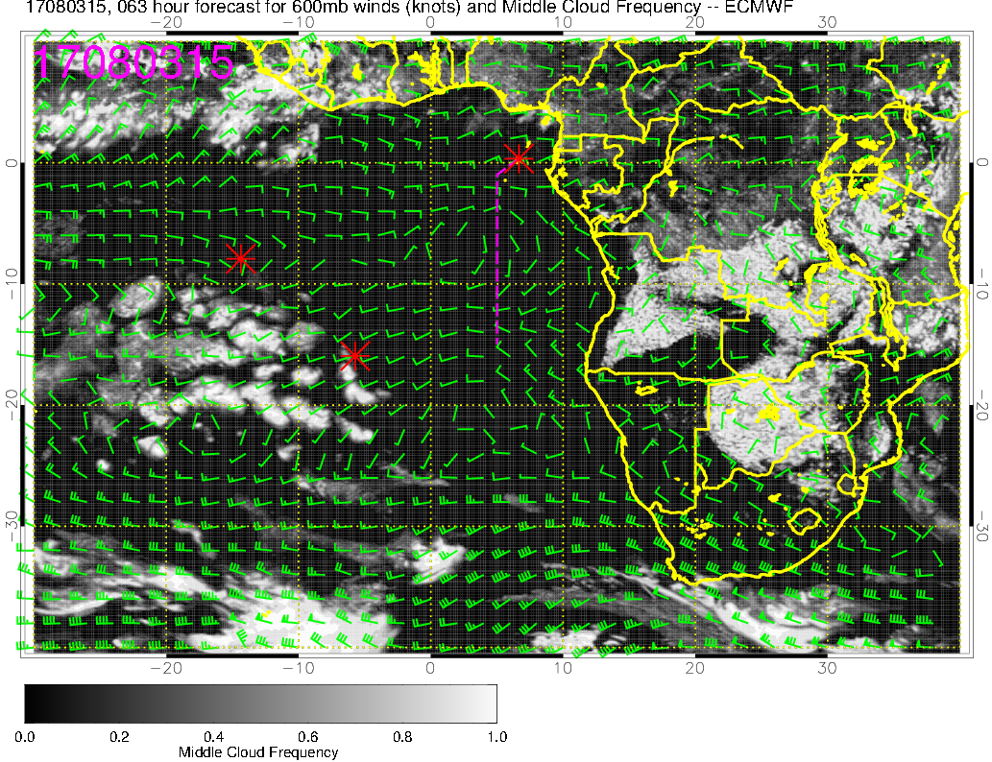
Mid clouds (8/3 @3PM)
Middle clouds to the south of ASI (A) are essentially the NW extension of low StratCu clouds above higher BL heights
Expect a few of them over ASI in the morning (cloud top height ~2km)
A

Slide 4
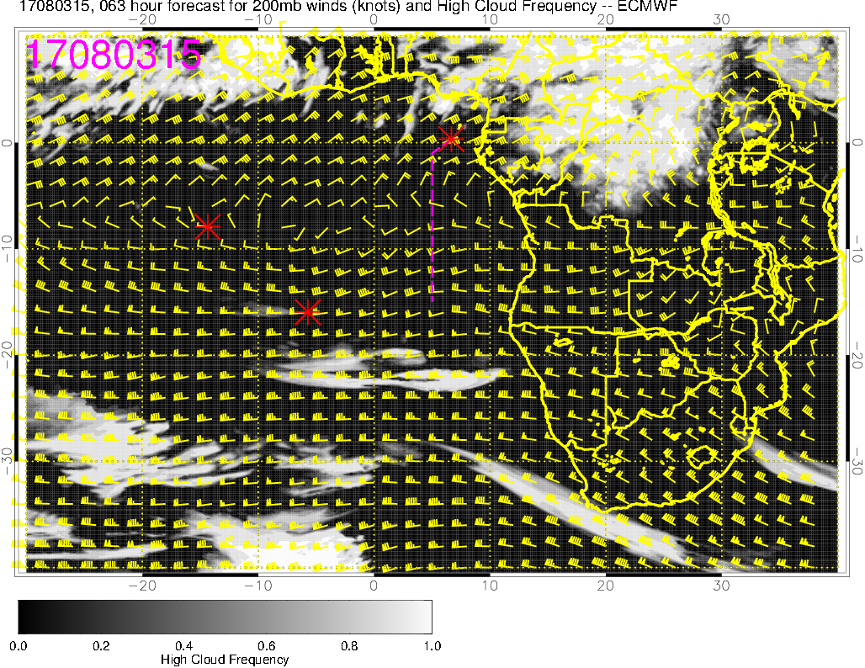
High clouds (8/3 @3PM)
A
High clouds mainly to the north of TMS (A) associated with inland convection

Slide 5
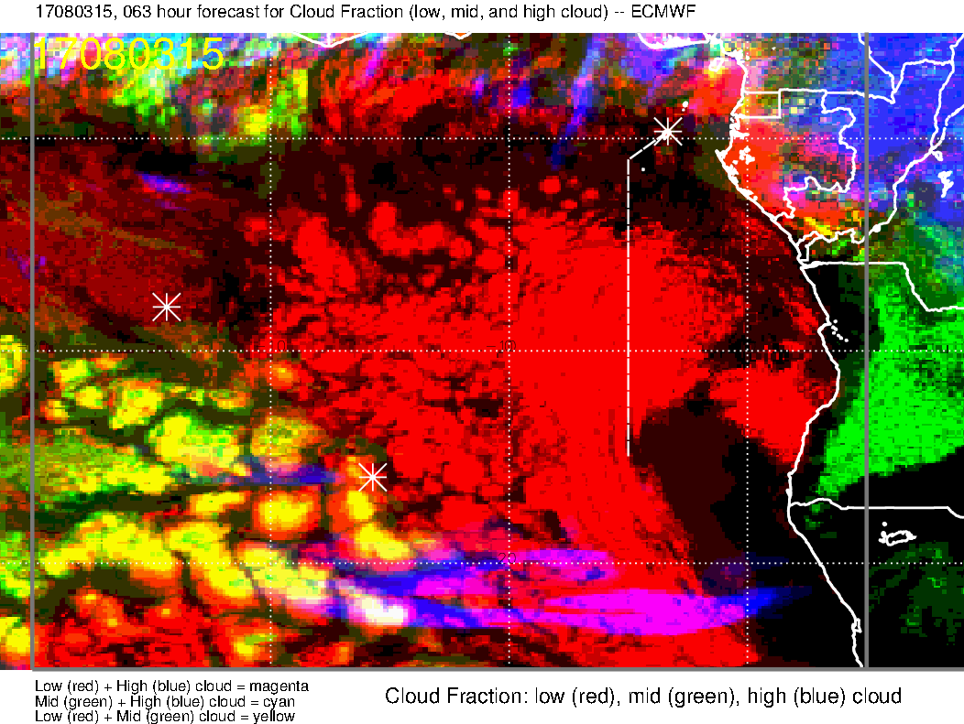
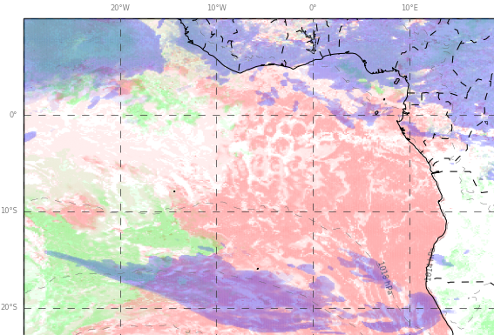
Low, Middle, High clouds (8/3 @3PM)
UKMO
ECMWF
63-hr forecast (EC) vs. 87-hr forecast (UKMO) – MetOffice forecasts have been down since yesterday
Would like to see if more recent UKMO forecasts show less high clouds over TMS

Slide 6
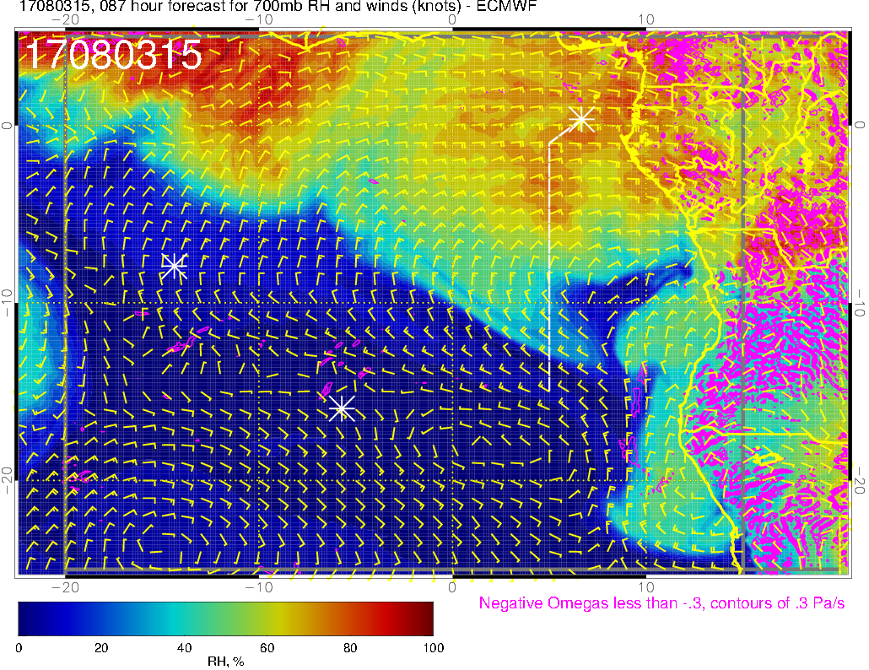
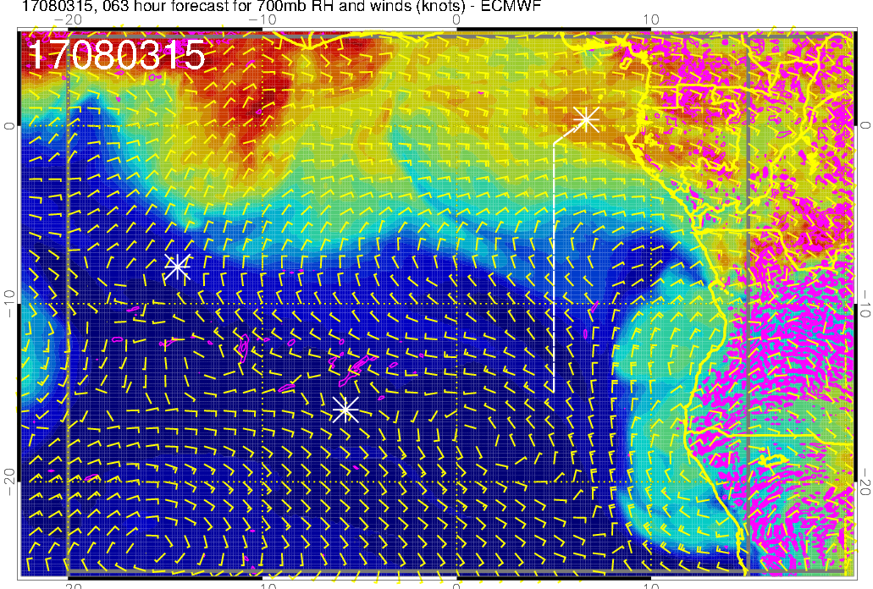
RH, omega (pink = ascent) @700mb
A
B
87-hr forecast (from yesterday)
63-hr forecast (today)
Today’s forecast shows less S extension
of high RH south of TMS (A) and features are
more indicative of transport from moist convection
Dry convection (B) and plume transport (no higher than ~700mb) south of ~8S, but only reaching as west as ~8-9E

Slide 7
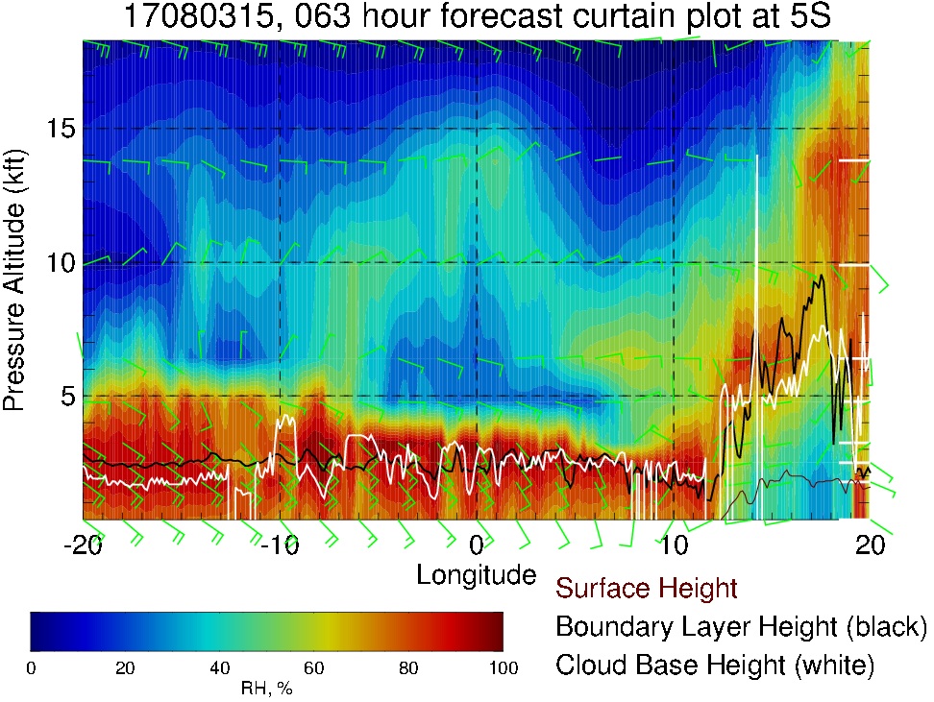
RH (color), BL height (black), cloud base height (white) cross section at 5S
8/3 @3PM
600mb
700mb
Most likely from moist convection
(no indication of plume transport)
Cloud base heights are probably near the level of sharp vertical gradient in RH, higher than estimated here (white)

Slide 8
Thursday (8/3)
Transit flight track is near the edge of the low cloud region (more abundant low clouds to the SE)
less frequent low clouds over TMS
Some high clouds over TMS, associated with blow off from inland convection; details are uncertain
Plume transport (up to 700mb) is evident across Angola-Namibia coast and as far west as ~8E – i.e., not in the vicinity of the flight track
high RH (moist) air at 700mb over the flight region is most likely do to moist (not dry) convection

Slide 9
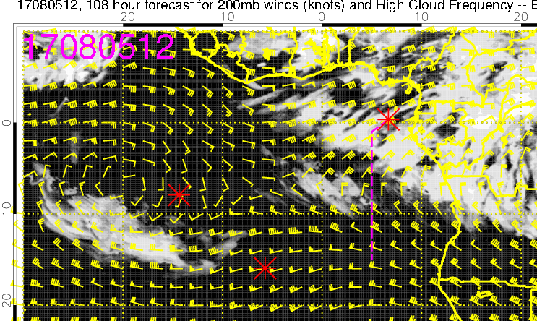
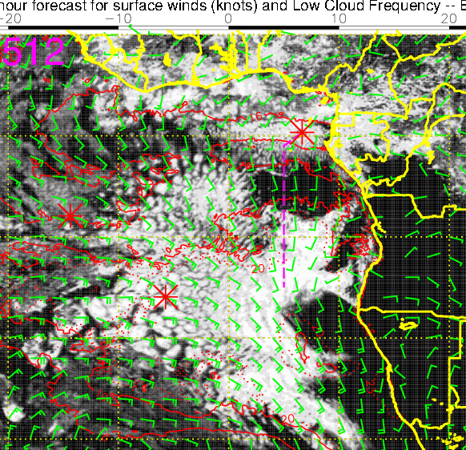
High (left) and Low (right) clouds (8/5 @12PM)
Increased high cloud cover from the NE
Little or no middle clouds in the vicinity (not shown)
Low clouds along the routine flight track, but may be patchy along a segment of the N-S leg

Slide 10
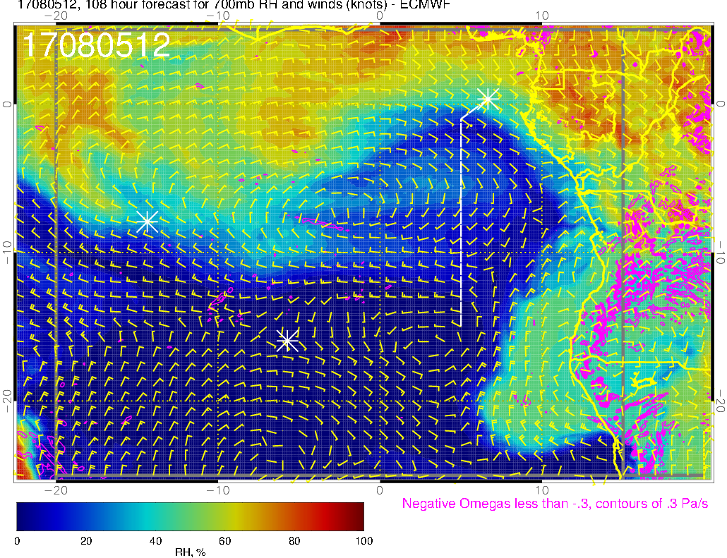
RH, omega (pink = ascent) @700mb
8/5 12Z
Plume extends further west and deepens slightly (up to ~600mb), but doesn’t reach our flight track

Slide 11
Saturday (8/5) – first science flight in the original schedule
Low clouds along the routine flight track, with possible clear-sky condition along a segment
High cloud distribution is difficult to forecast +4 days in advance, but NE flow from inland convection suggests that some degree of high clouds are expected over TMS
Plume transport across the Angola-Namibia coast extends further west and deepens (up to 600mb) compared to 8/3

