Slide 1
ORACLES met forecasting briefing
1-Aug-2017
Lenny Pfister and Rei Ueyama

Slide 2
Outline
Cloud forecast – satellite image comparison
Overview of surface (BL) meteorology
Overview of 850mb meteorology
Overview of 700mb (plume level) meteorology

Slide 3
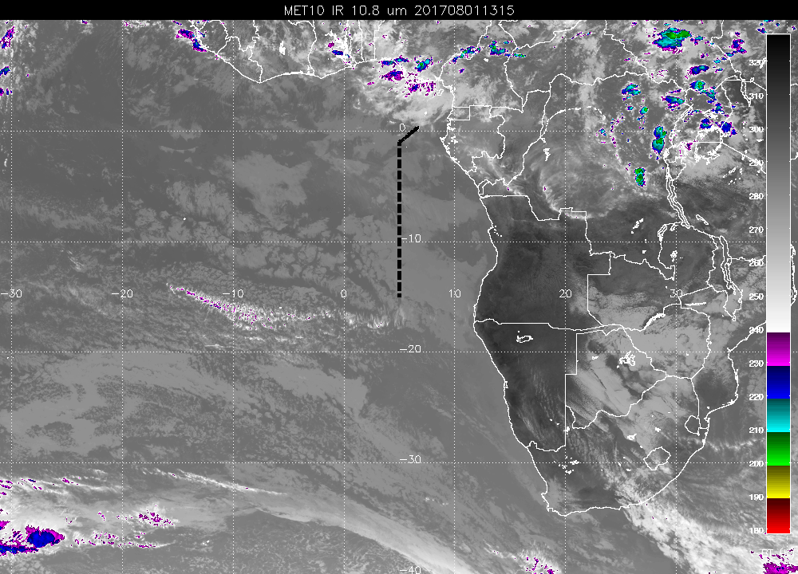
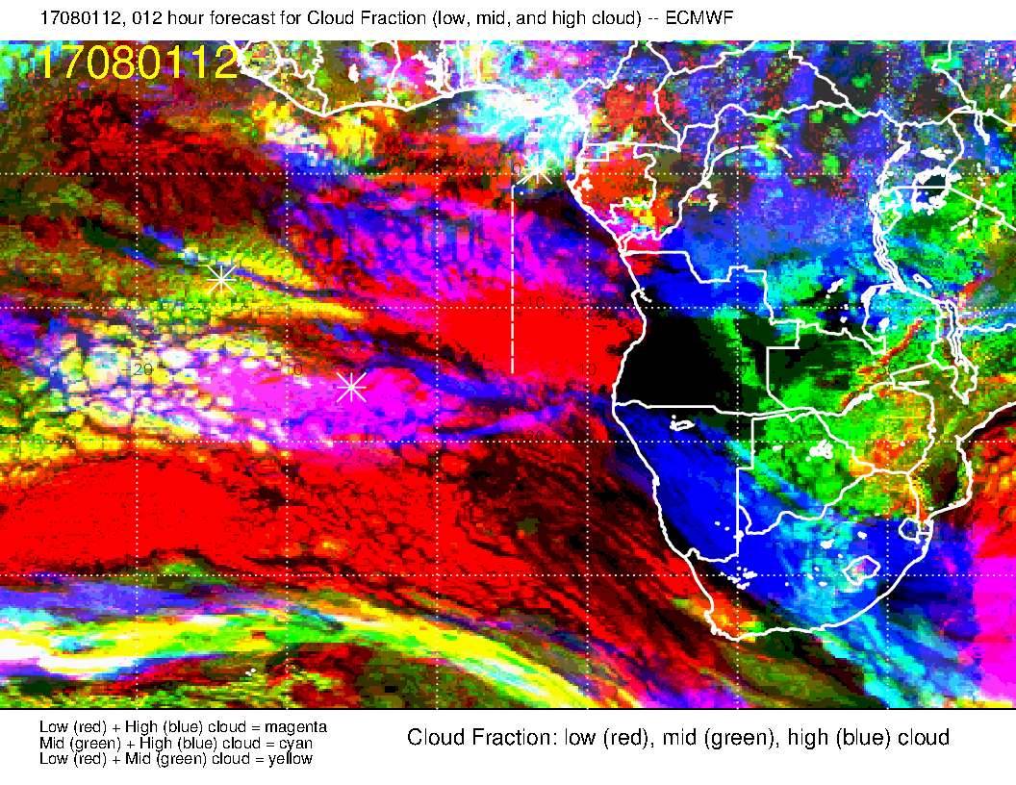
Comparison of today’s satellite image to 12 hour cloud forecast
Today at ~12Z.
EC model again has bogus high cloud near 5-10S.
Light rain reported this AM at the airport – middle and high cloud penetrating towards TMS.
Other low cloud features OK

Slide 4
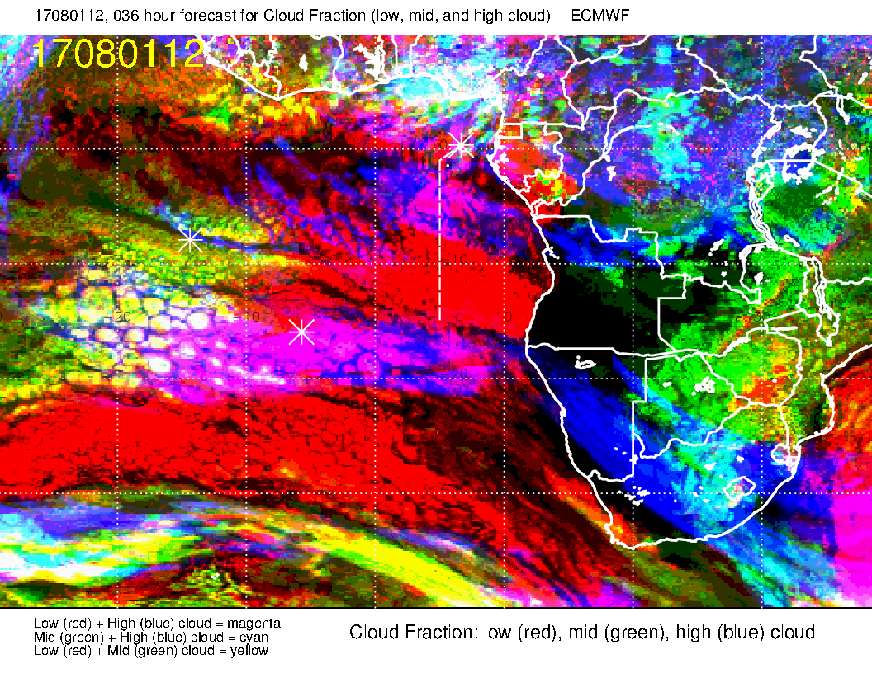
Comparison of today’s satellite image to 36 hour cloud forecast
Today at ~12Z, yesterday’s fcst.
Penetration of high cloud not as well represented.
Other low cloud features are about as good as today’s fcst.
Same bogus high cloud near 5S.

Slide 5
Surface evolution 8/2-8/5

Slide 6
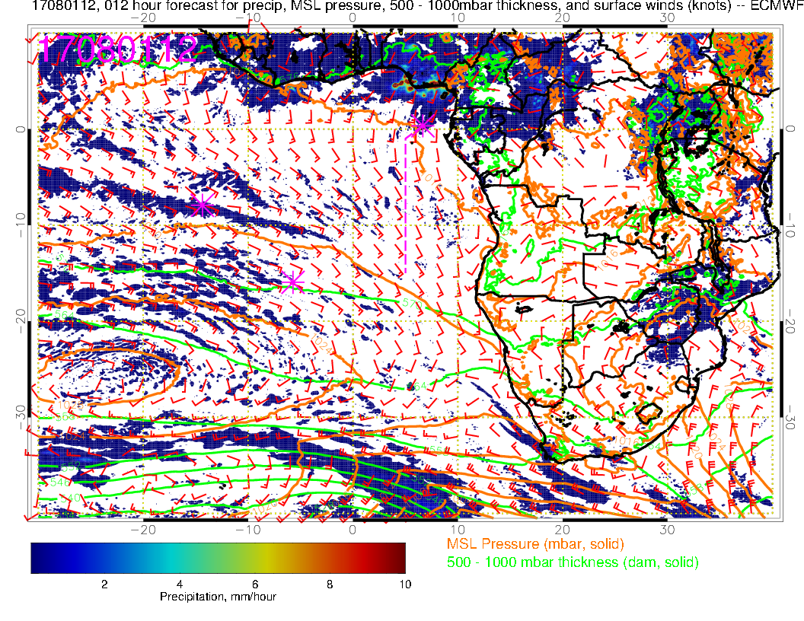
Tuesday, 8/1
Flow off of Namibian coast still disrupted from previous low
SH high well west of typical position.
New front coming through

Slide 7
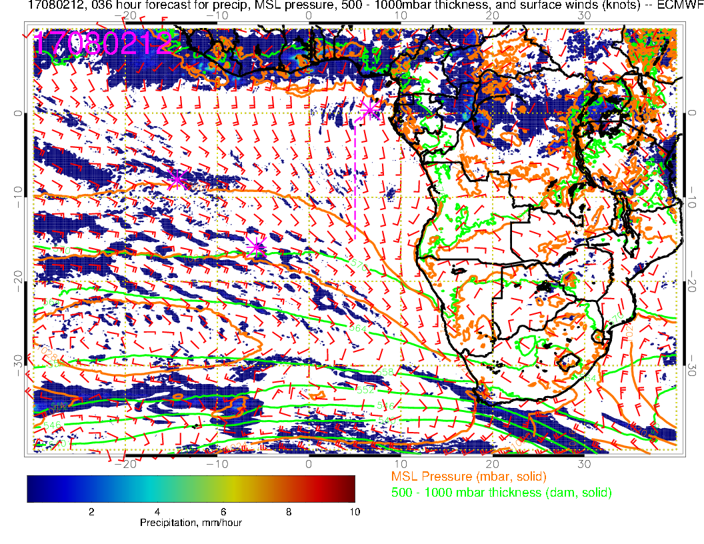
Wednesday
By tomorrow, flow off of Namibian coast is back to SSE
SH high heading eastward toward climo position of 5W.
Surface winds over SE Atlantic near typical values
Precip just north of TMS on 8/1 has retreated northward
Moist convection in northern half of Congo

Slide 8
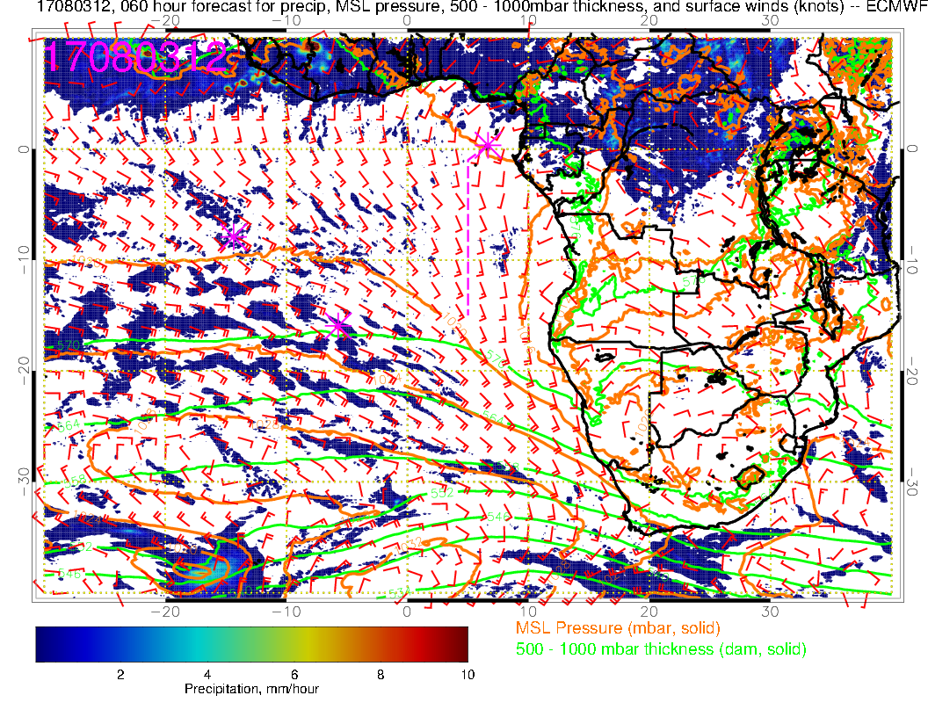
TMS
Thursday
ASC
Strong southerlies off of Namibian coast
More convection in northern Congo.
Winds near ASC-TMS typical

Slide 9
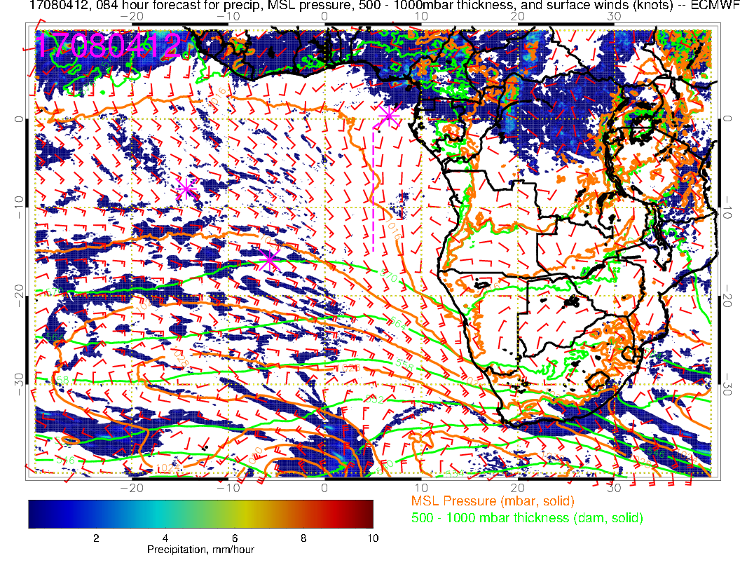
Friday
Precip approaching TMS from the north again
Winds at our longitude are weakening, more southwesterly component
Stronger “Angolan Eddy”

Slide 10
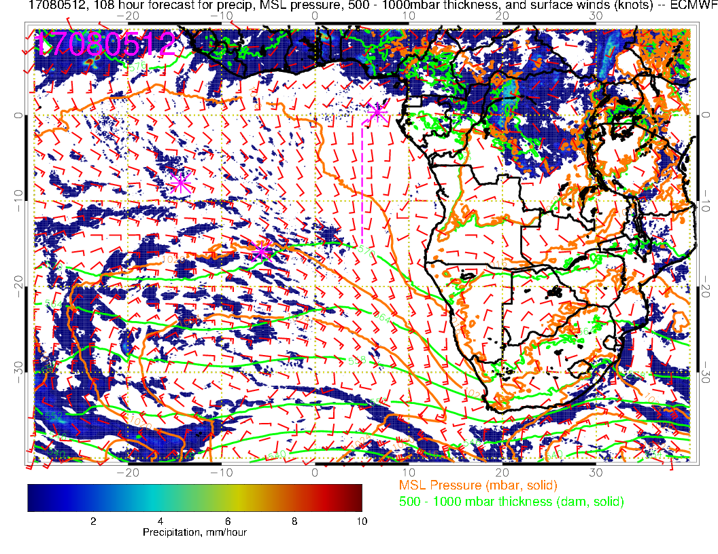
Saturday
Strong Angolan eddy, weaker winds near TMS/ASC than typical

Slide 11
850 mb 8/2-8/5

Slide 12
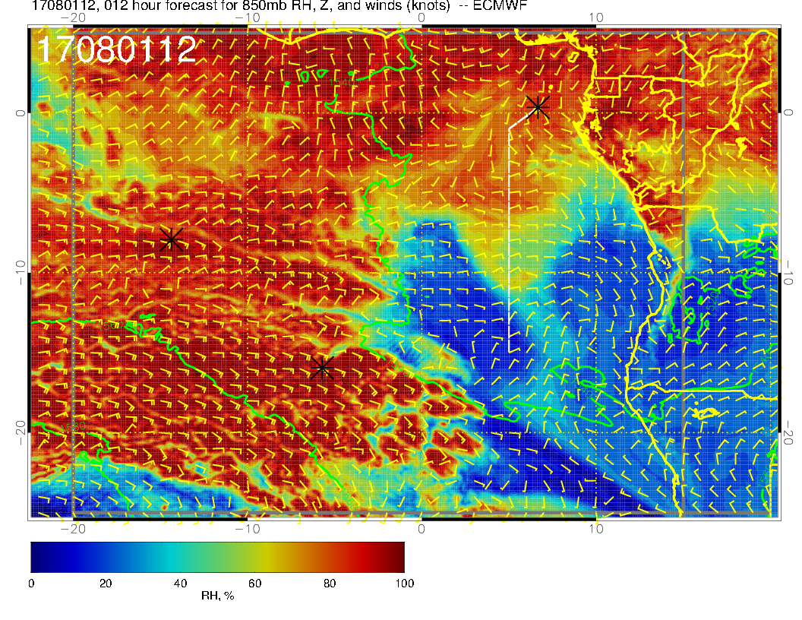
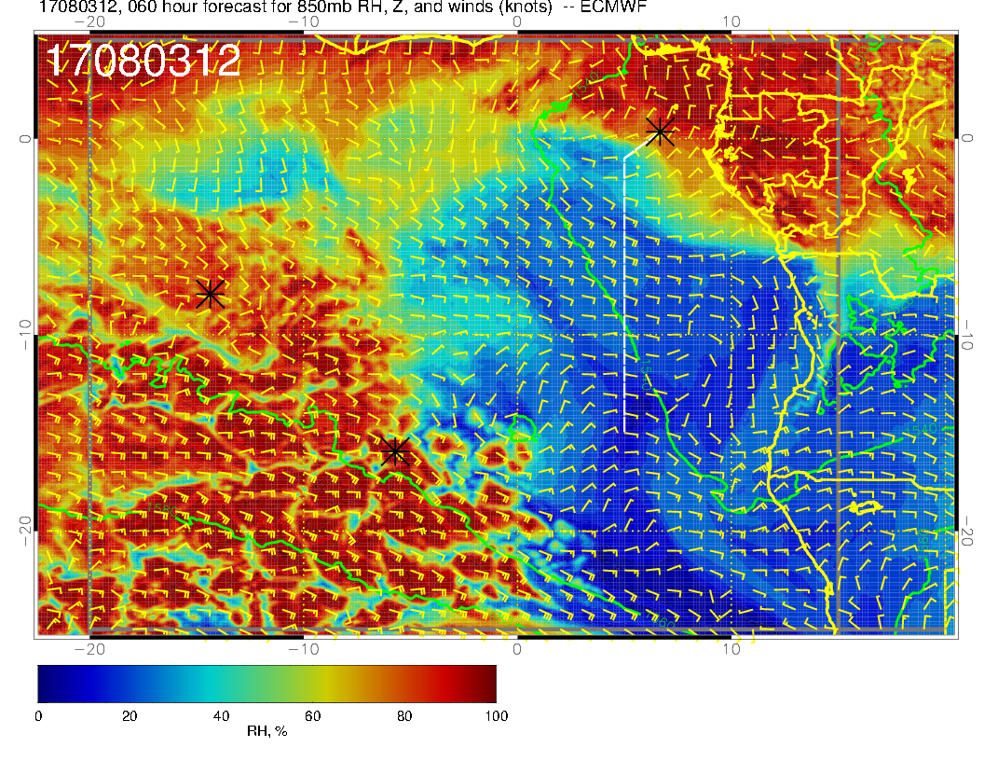
RH and winds at 850mb today (above)
and Thursday (right).
Note pronounced drying and change in wind direction in region between ASC and TMS.
Moist region to west is where the clouds and low level high RH reaches 850mb (rising BL).
More westward wind tendency on Thursday (smoke transport?)

Slide 13
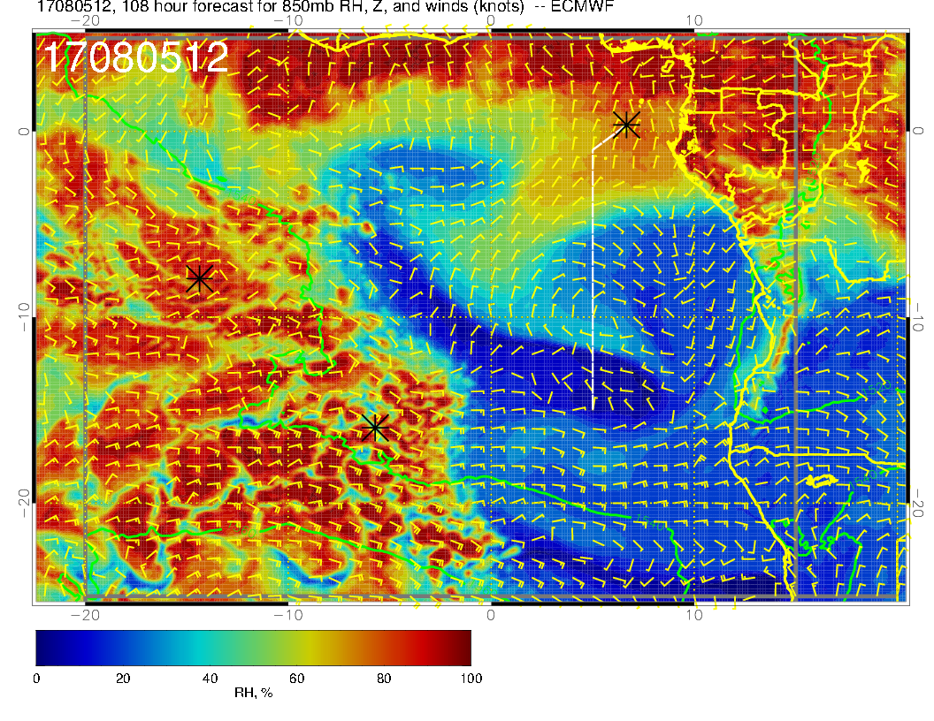
By Saturday, get another surge from the north that moistens this level

Slide 14
700 mb 8/2-8/5

Slide 15
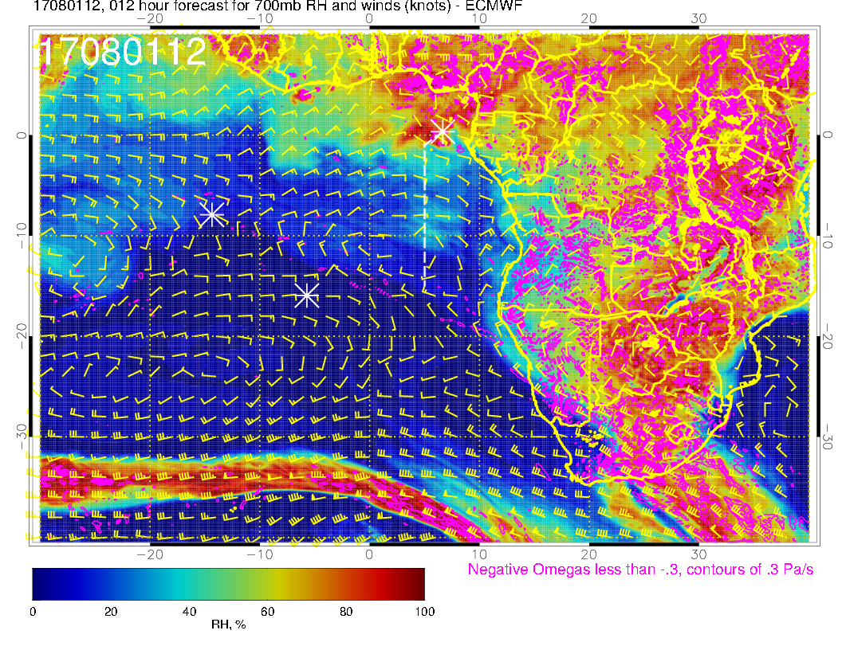
Today
Well established westward flow to about 10S – moist convection to about 5S over Congo

Slide 16
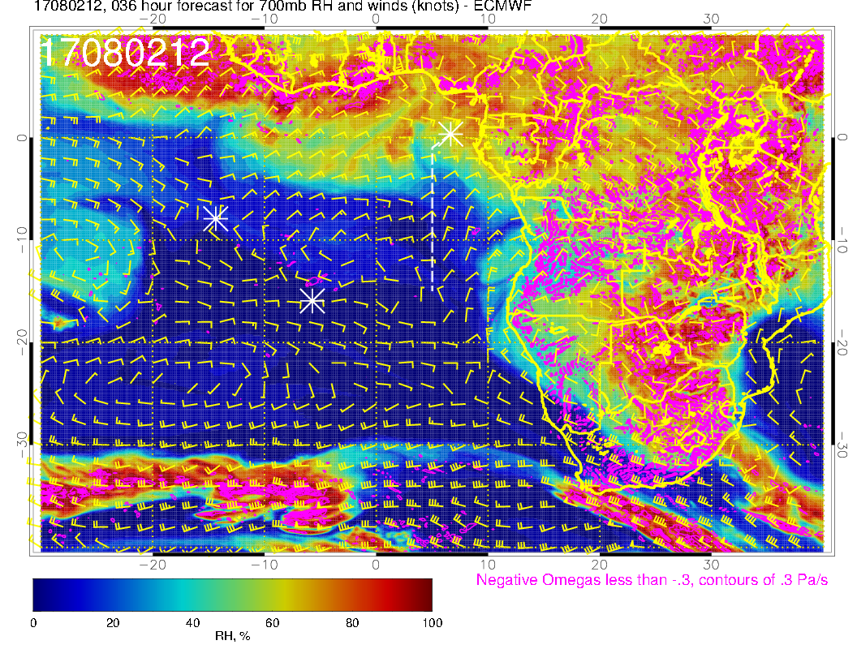
Wednesday
Flow looks like it is bending southward, but mostly a transient wave

Slide 17
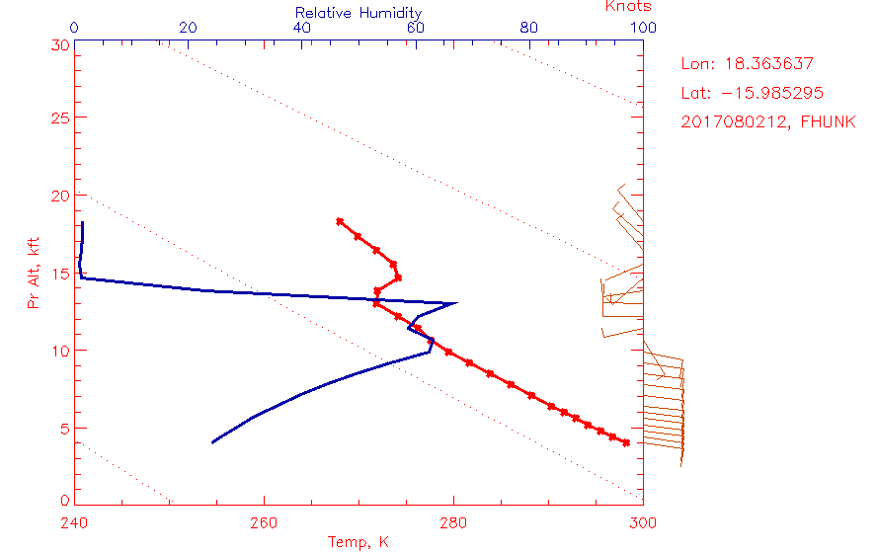
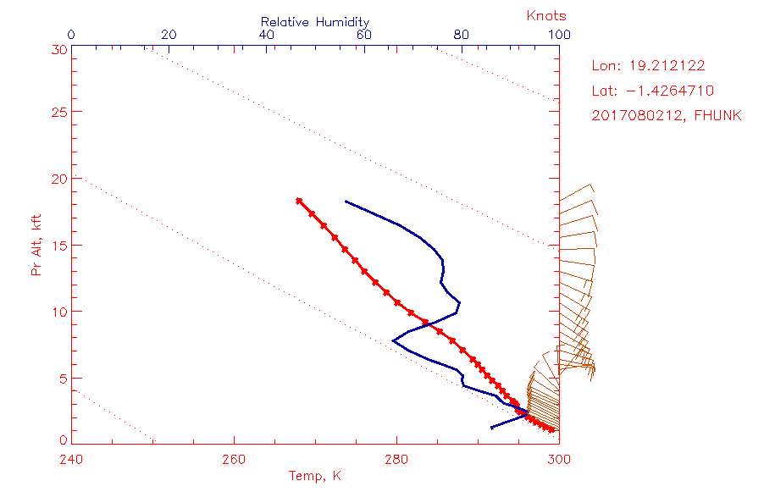
Angola sounding – note
adiabatic layer to 14kft
Northeastern Congo. So upper
branch is probably moist
convection

Slide 18
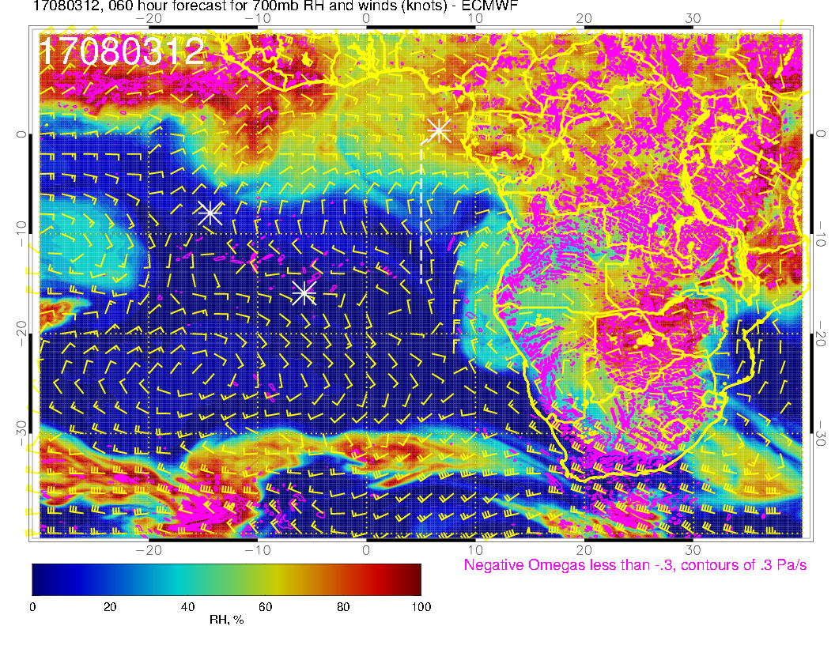
Thursday
Two streams – one a straight shot westward, and another branch curving southward.

Slide 19
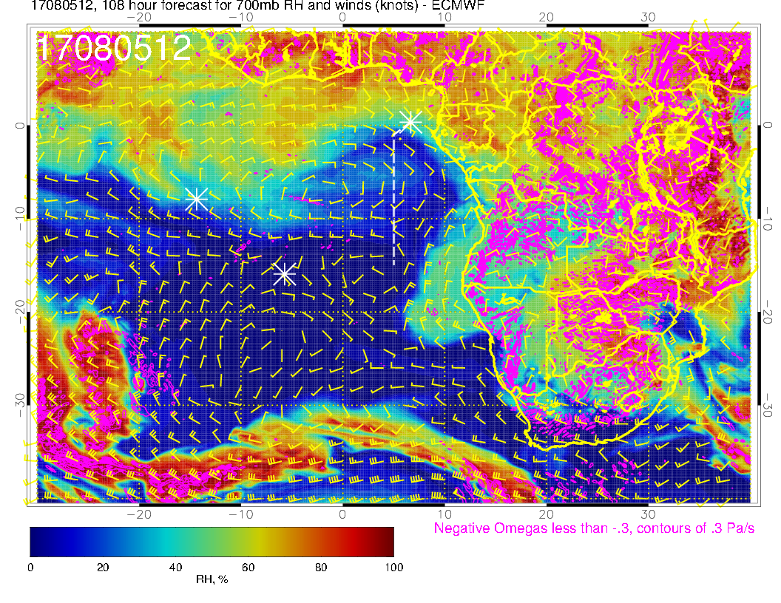
Saturday
By Saturday, northern branch of westward flow has broken up.

Slide 20
Summary
Cloud comparison shows marginal ability to forecast high clouds associated with convection.
Low cloud forecasts are reasonable for the overall pattern.
Surface evolution shows the anticyclonic flow pattern recovering to climo over the southeast Atlantic. Weaker winds and strong Angolan eddy develop toward end of the forecast period.
Pronounced drying in the region at 850mb (between the stratocumulus and the burning plume) from today to Thursday.
Two paths of High RH air advecting westward at 700mb, one from moist convection (north, around 5S), and another from dry convection

