Slide 1
ORACLES Forecast Briefing (Aerosols)
01 August 2017

Slide 2
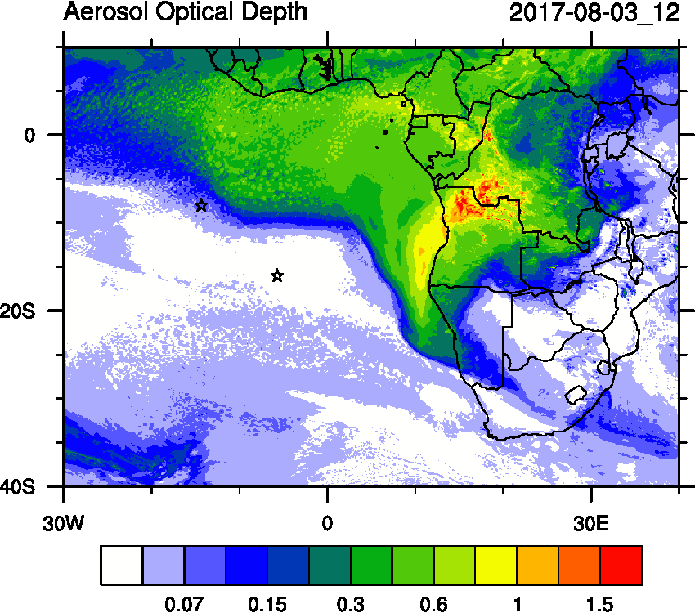
Thursday, 03 August 2017 12Z
WRF-AAM

Slide 3
Thursday, 03 August 2017 12Z
WRF-CAM5

Slide 4
Thursday, 03 August 2017 12Z
WRF-AAM
CAMS

Slide 5
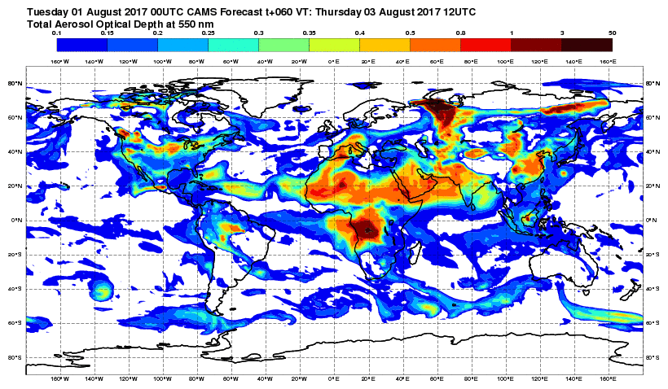
Thursday, 03 August 2017 12Z
CAMS

Slide 6
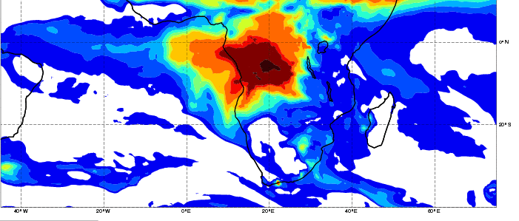
Thursday, 03 August 2017 12Z

Slide 7
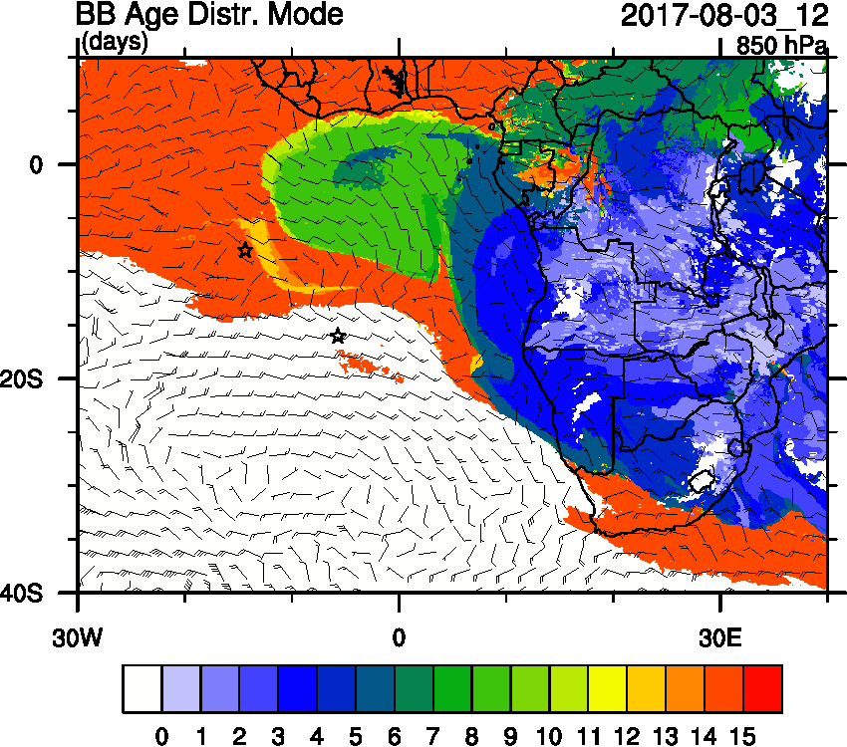
Thursday, 03 August 2017 12Z

Slide 8
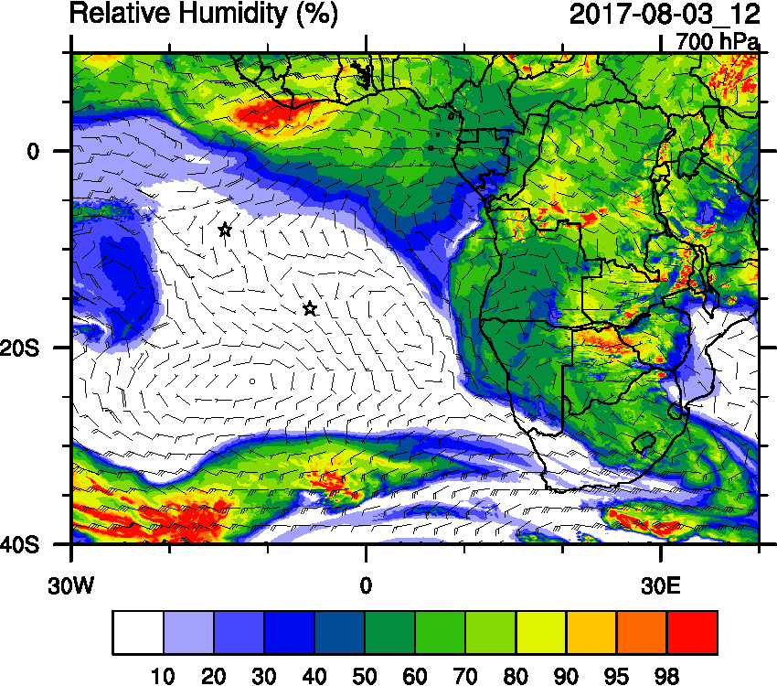
Thursday, 03 August 2017 12Z

Slide 9
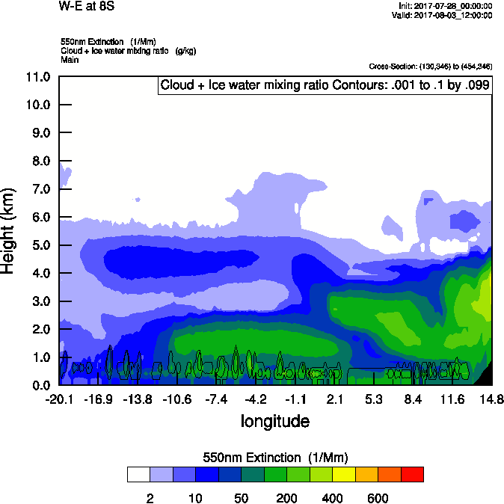
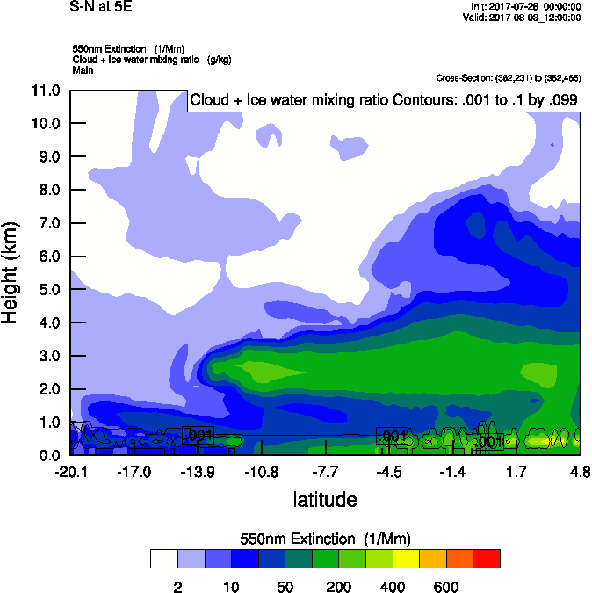
Thursday, 03 August 2017 12Z
W-E 8S
S-N 5E

Slide 10
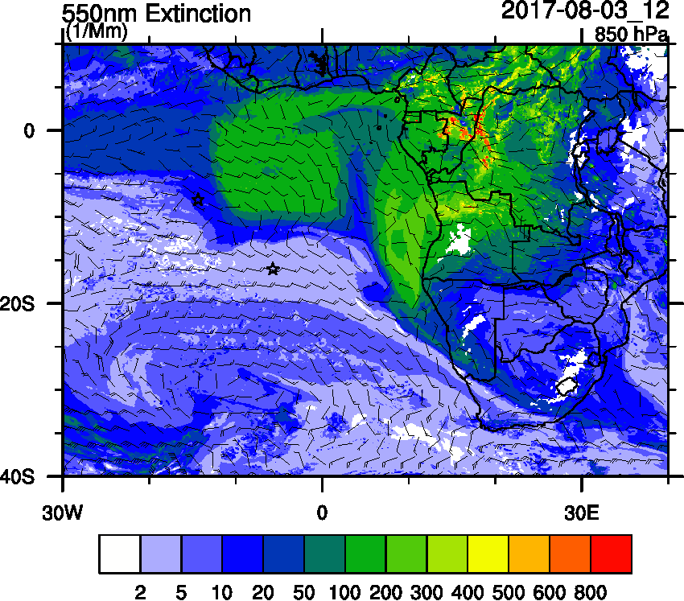
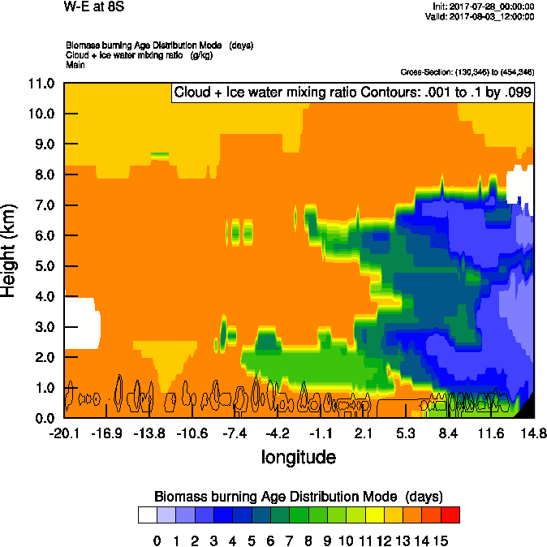
Thursday, 03 August 2017 12Z
W-E 8S

Slide 11
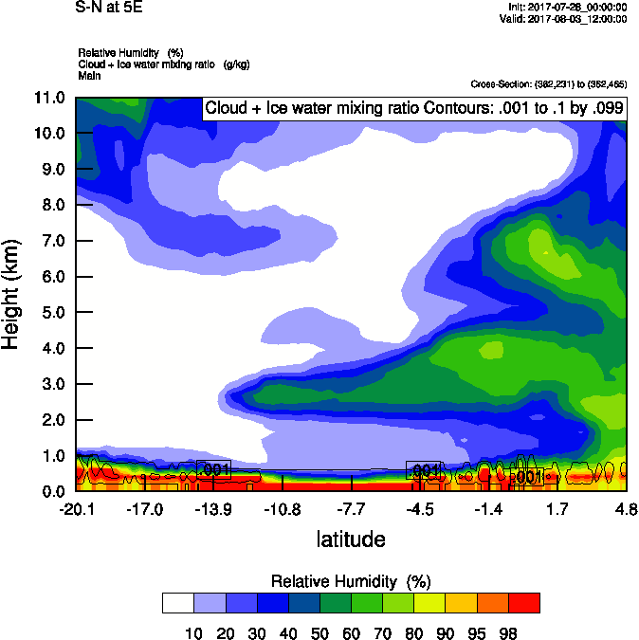
Thursday, 03 August 2017 12Z
S-N 5E

Slide 12
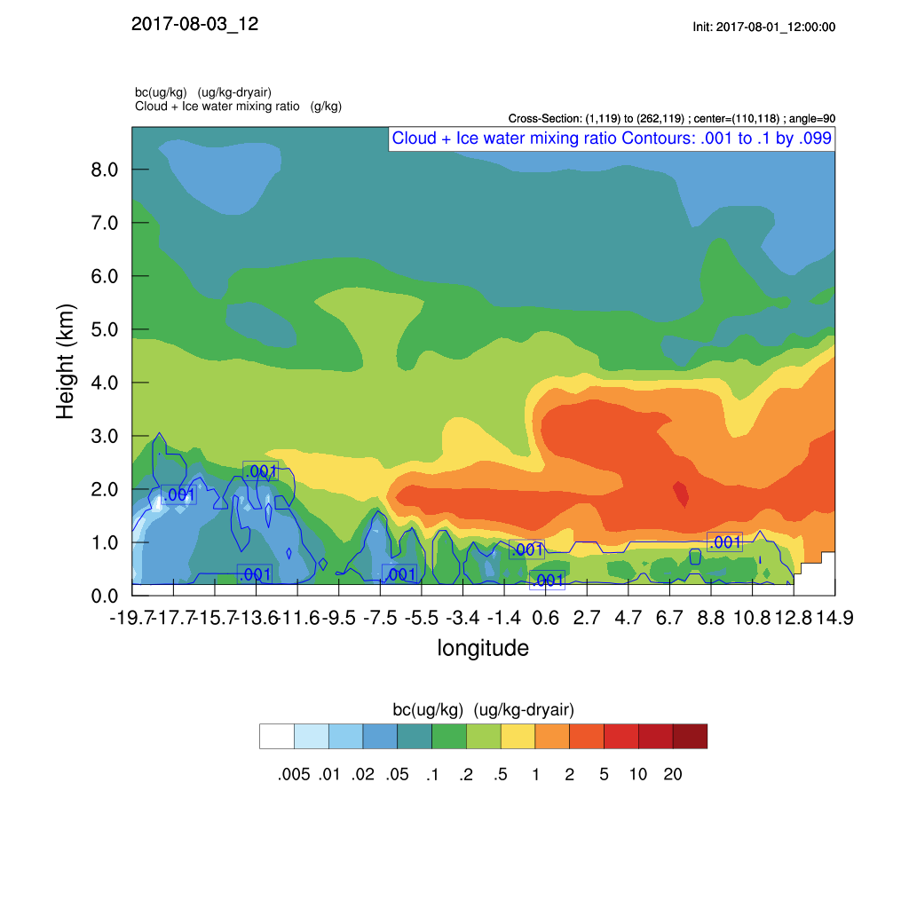
Thursday, 03 August 2017 12Z
W-E 8S
WRF-CAM5

Slide 13
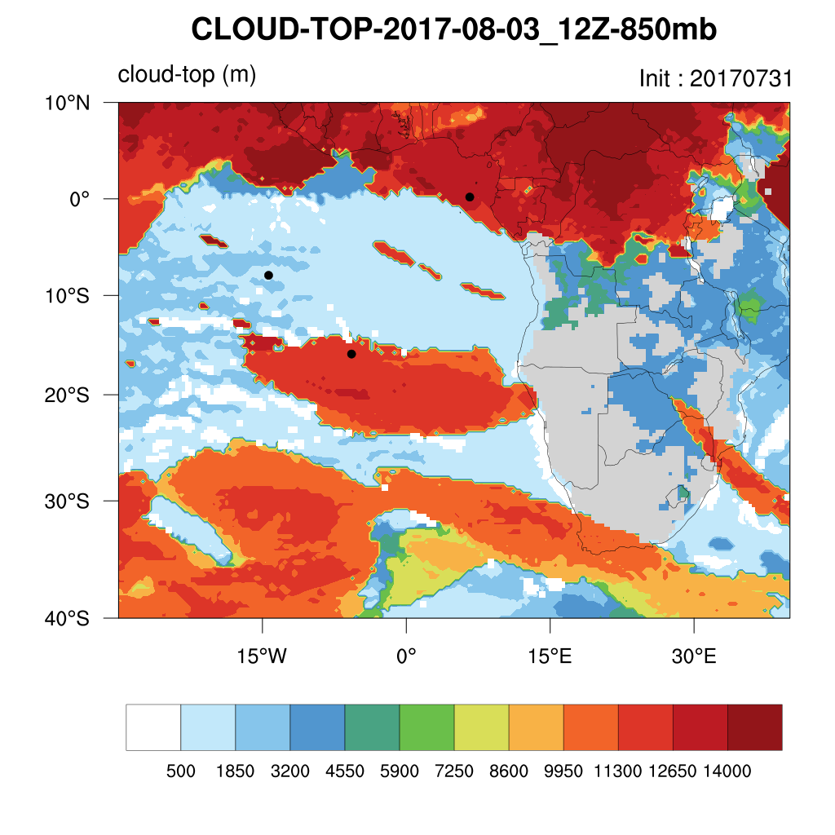
Thursday, 03 August 2017 12Z
WRF-CAM5

Slide 14
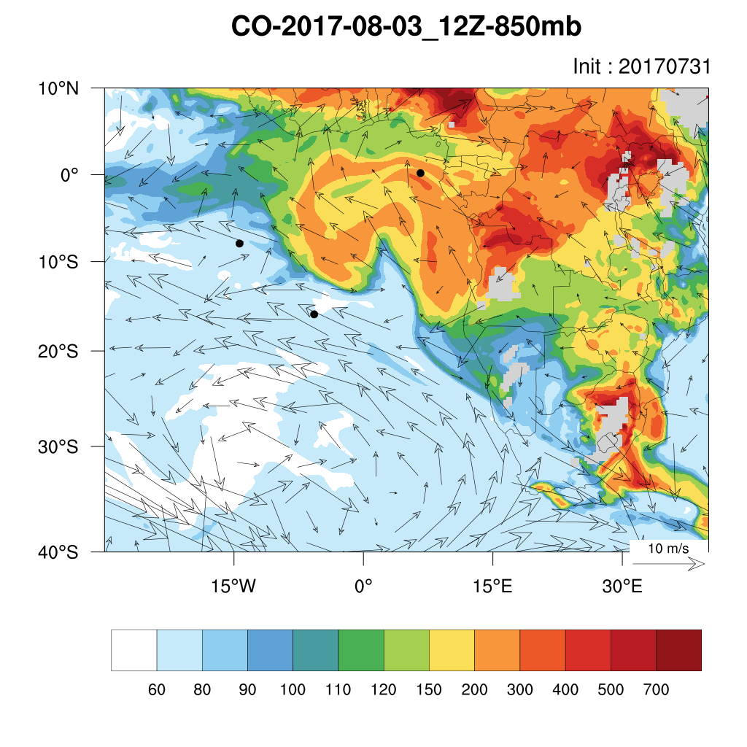
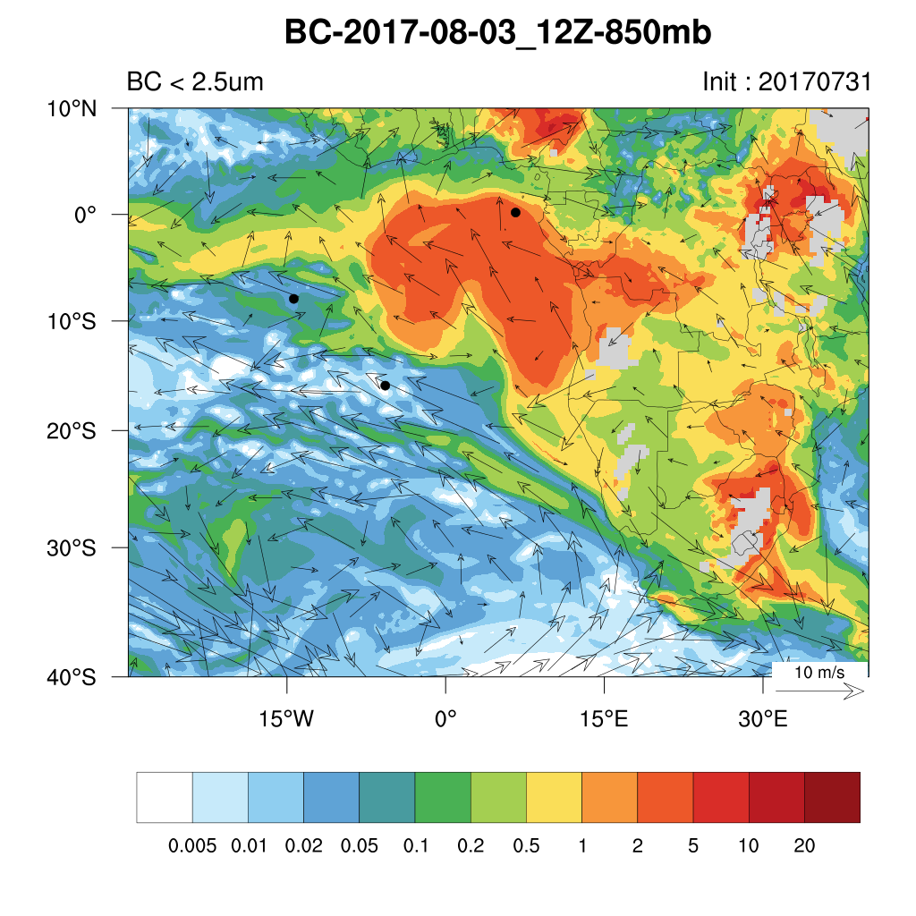
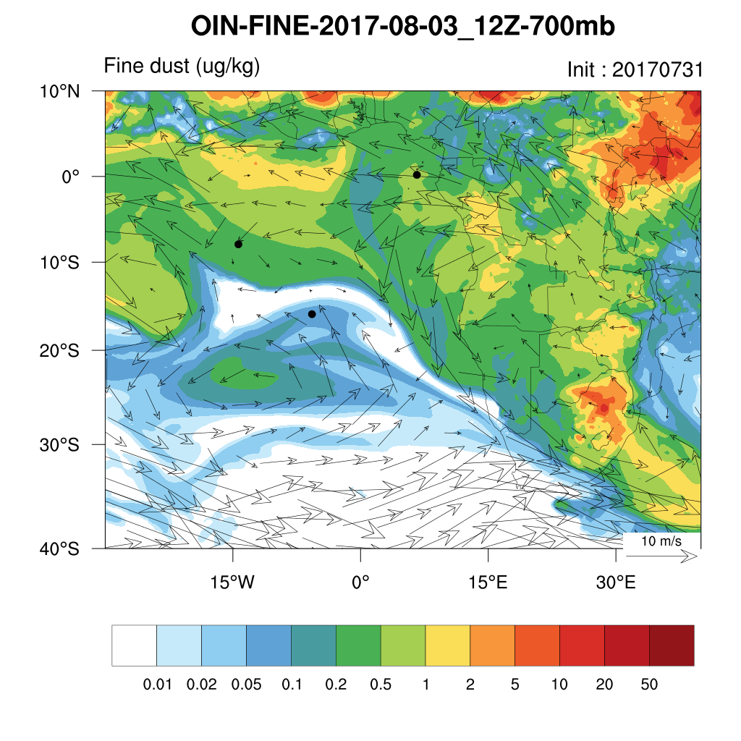
Thursday, 03 August 2017 12Z

Slide 15
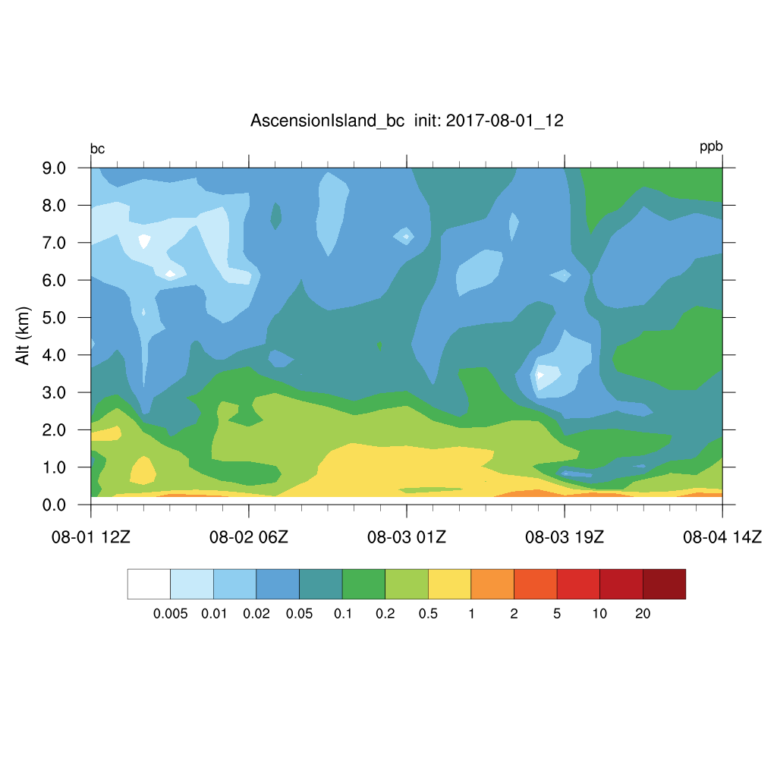
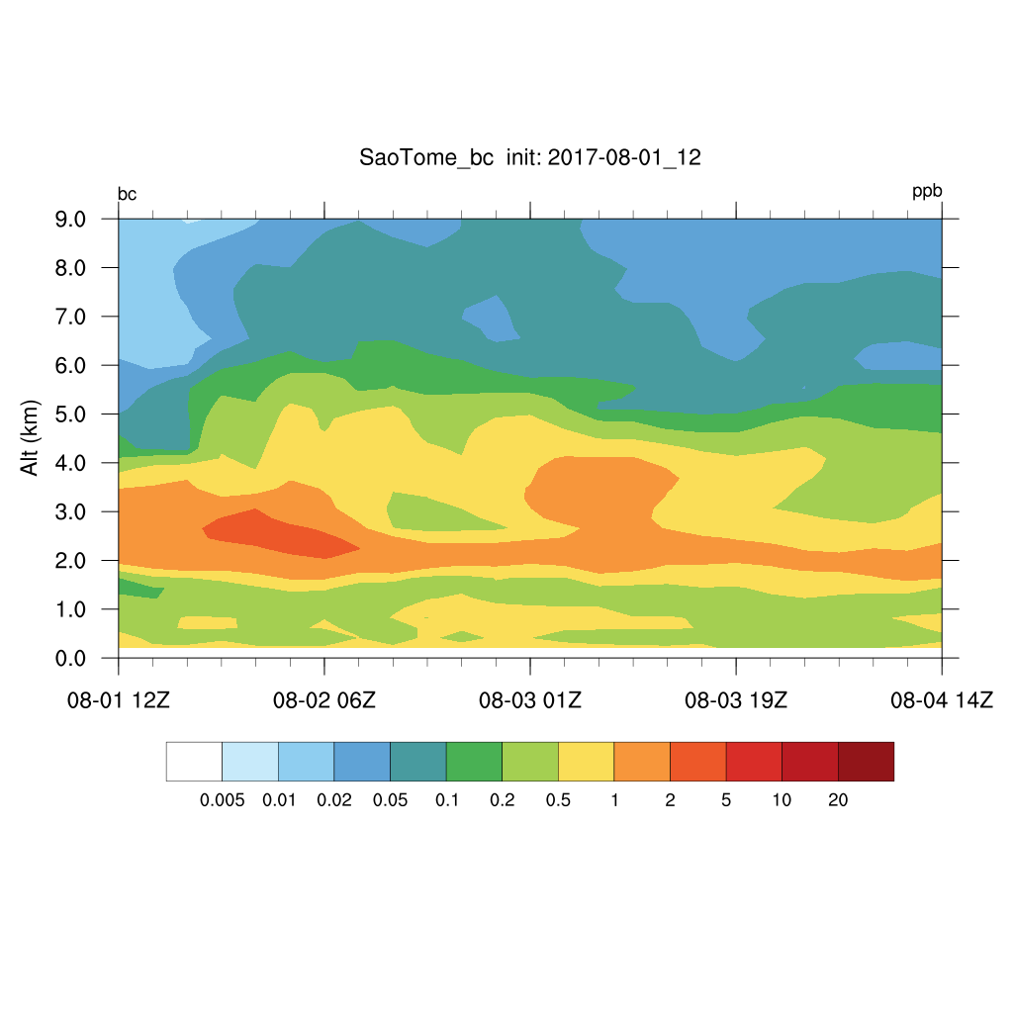
Thursday, 03 August 2017 12Z

