Slide 1
ORACLES forecasting briefing
31-Jul-2017
Lenny Pfister and Rei Ueyama
Cloud model forecast vs observations for today
Surface evolution during forecast period
Mid-level evolution during forecast period
Discussion of situation on 8/3 (ASI-TMS flight)

Slide 2
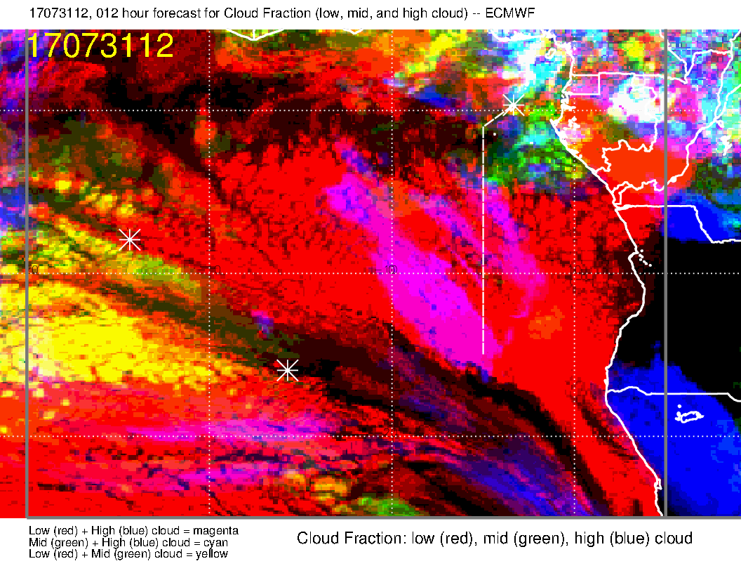
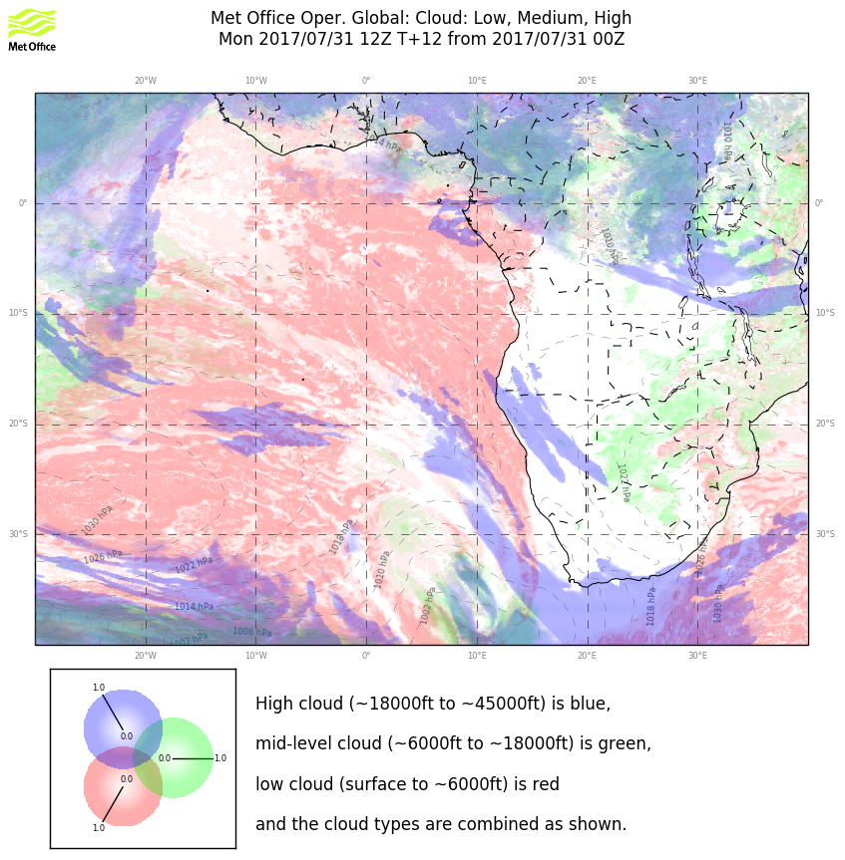
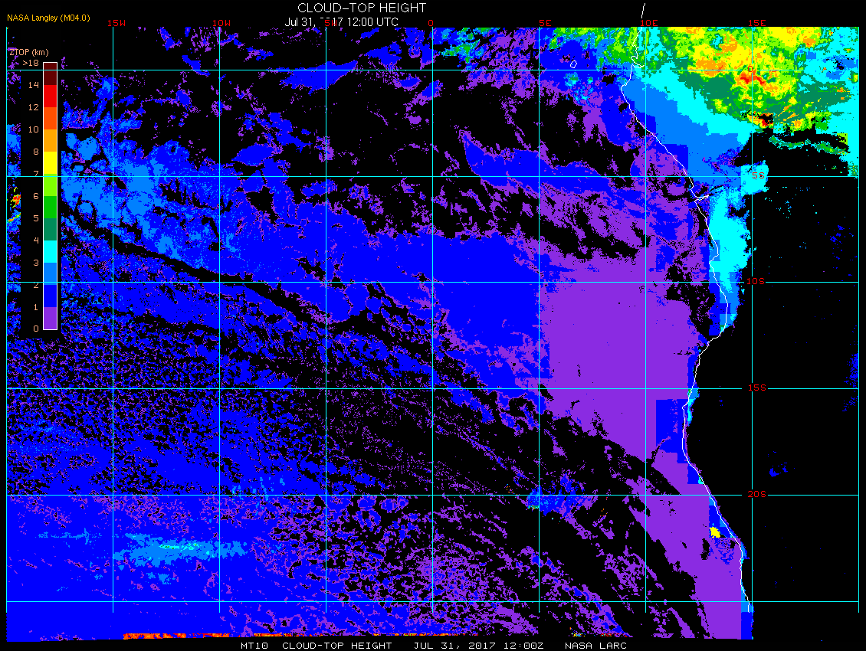
Model (12 hour cloud forecast) vs observations near Sao Tome:
Excessive high cloud in EC model
Reasonable middle/high cloud (perhaps too much) in both forecasts around TMS
EC model is getting the gap in low cloud south of TMS

Slide 3
Surface Evolution
Strong midlatitude surface low strongly perturbs the surface flow in the first part of the forecast period.
Wind components weaker and more southerly than normal through 8/1.

Slide 4
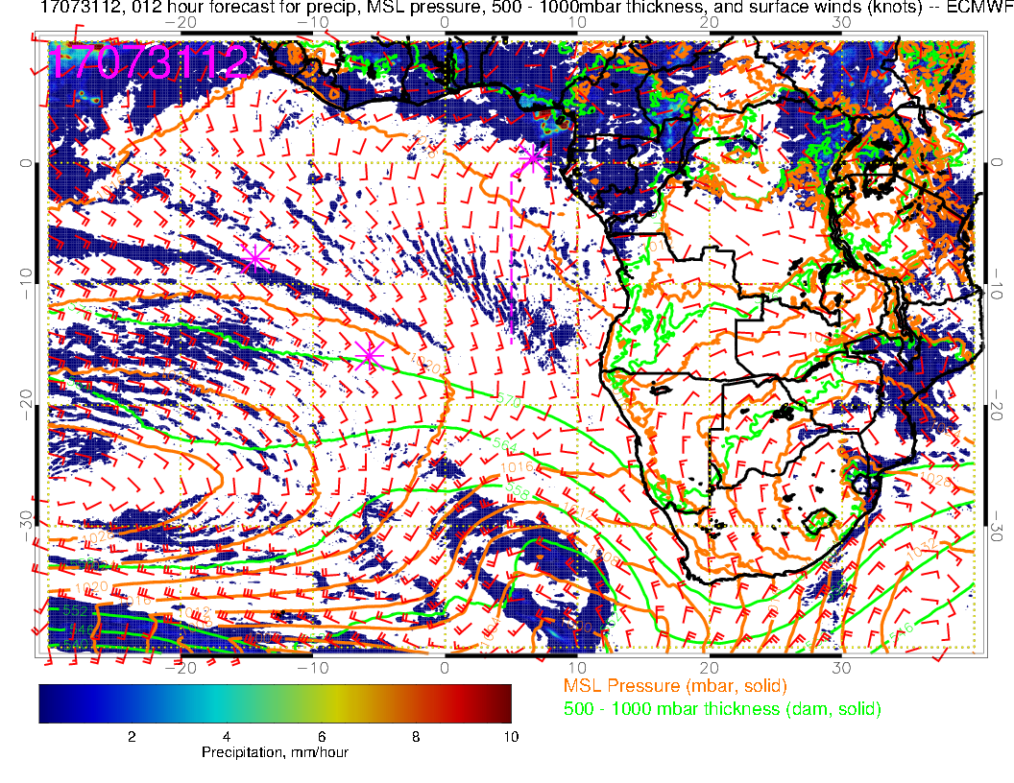
Strong low reverses flow off the Namibian coast and weakens it at lower latitudes

Slide 5
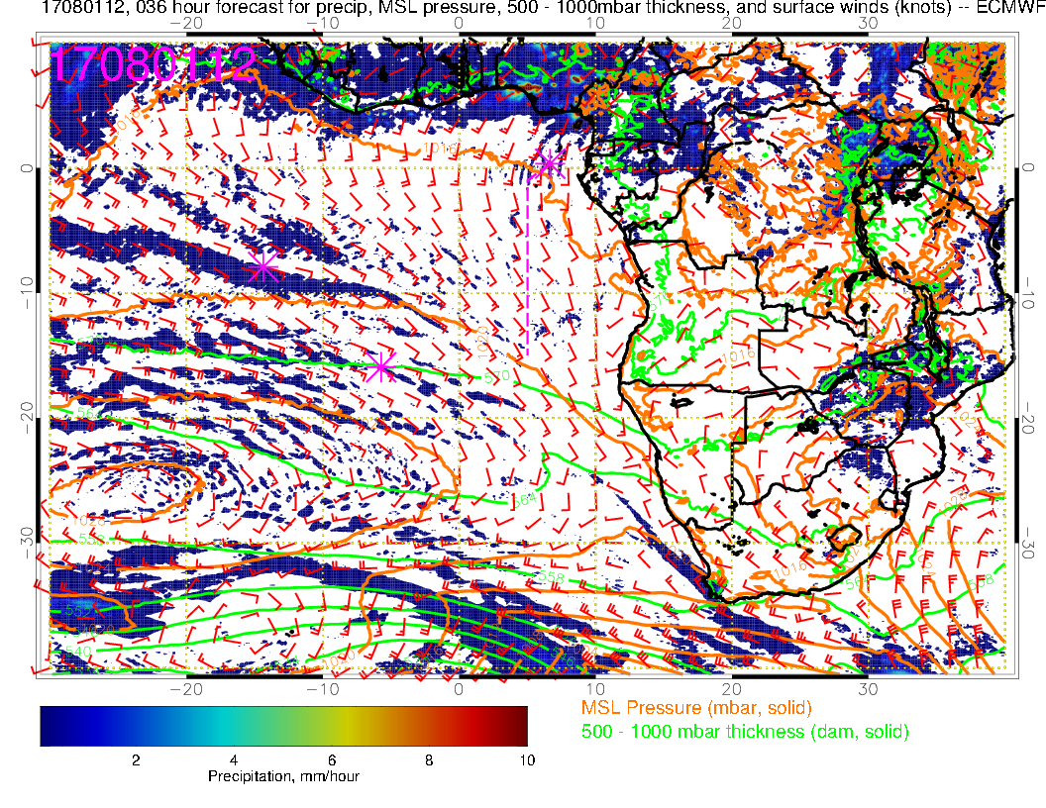

Slide 6
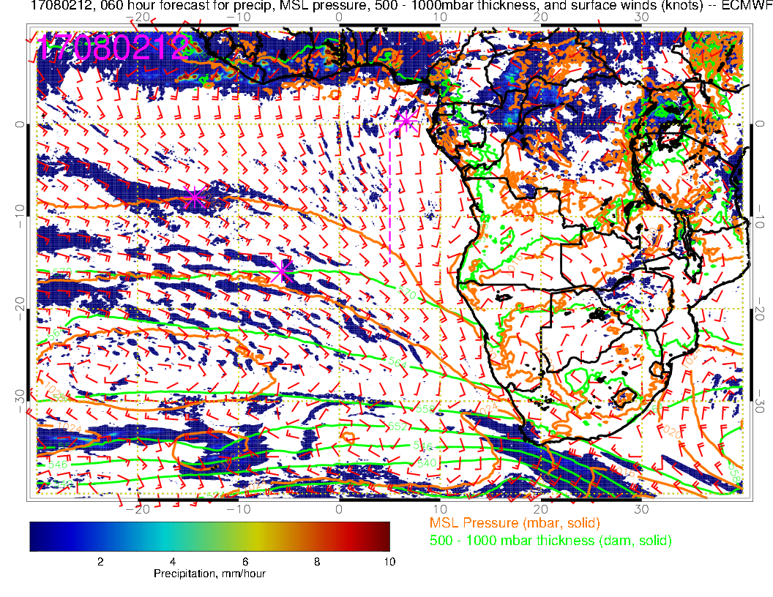

Slide 7
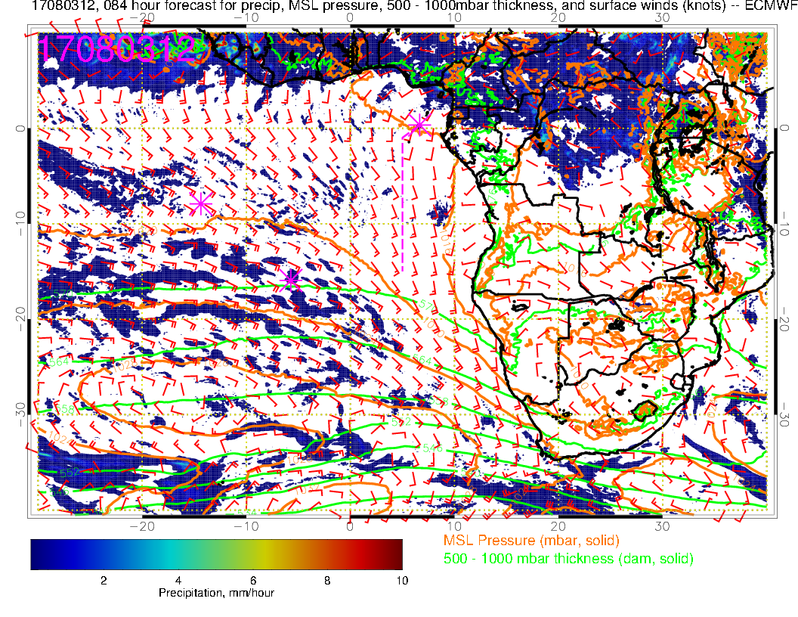
By Thursday, St Helena High is close to its climatological position, southeasterlies are restored off the Namibian coast

Slide 8
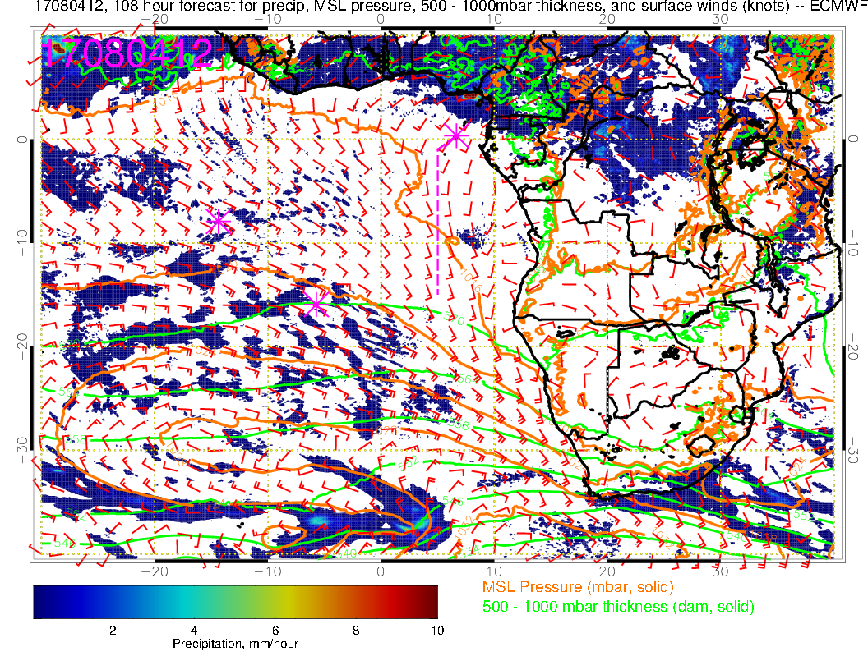

Slide 9
Mid-level evolution
Strong trough (associated with surface low discussed above) pushes the 700mb anticyclonic flow northward relative to climatology
By Thursday, a plume of RH, created by dry (and some moist) convection over the continent has moved over the TMS region
700mb anticyclone and westward flow still displaced north of climo by end of forecast period

Slide 10
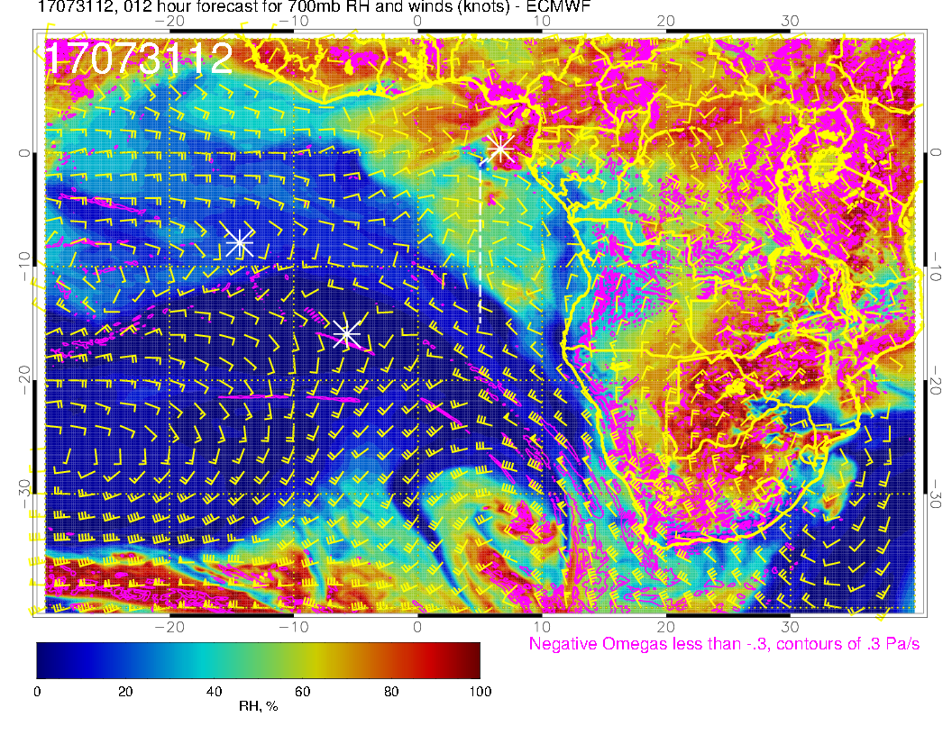
700mb anticyclone weak and pushed northward by strong trough

Slide 11
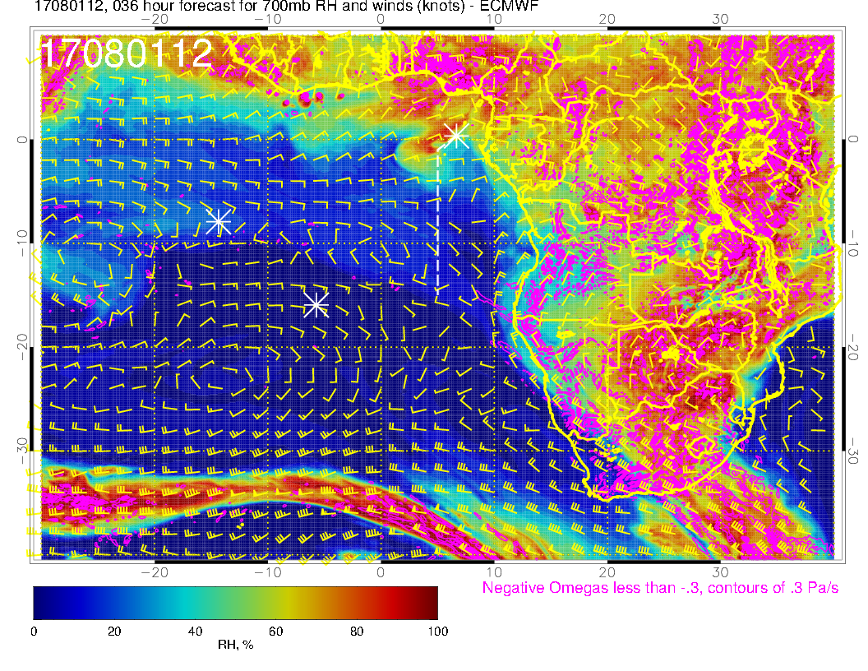

Slide 12
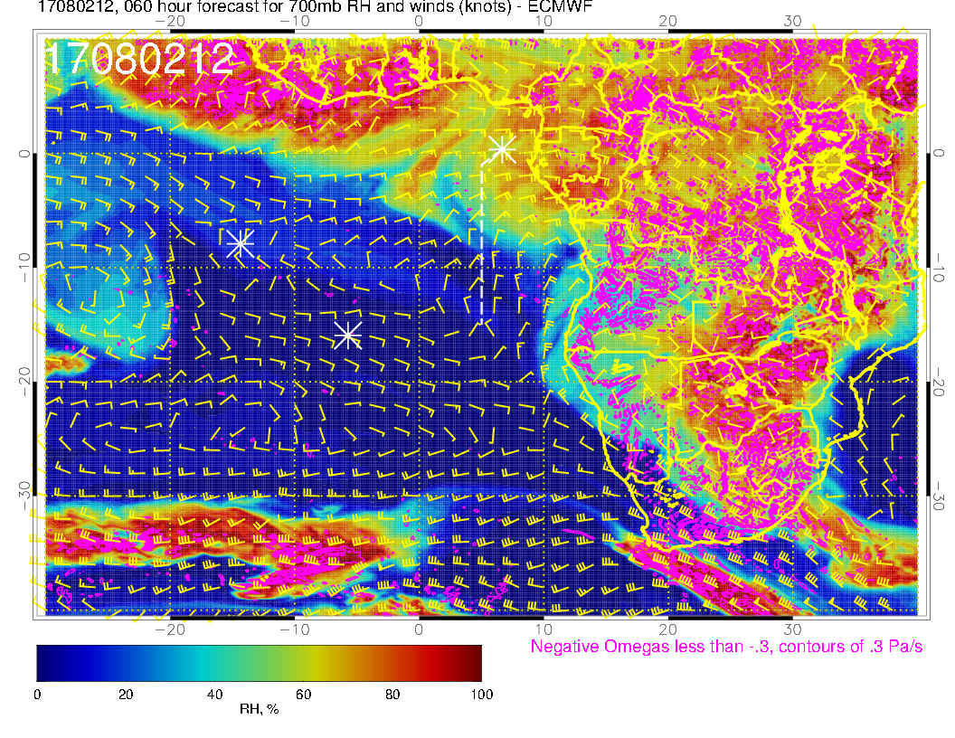

Slide 13
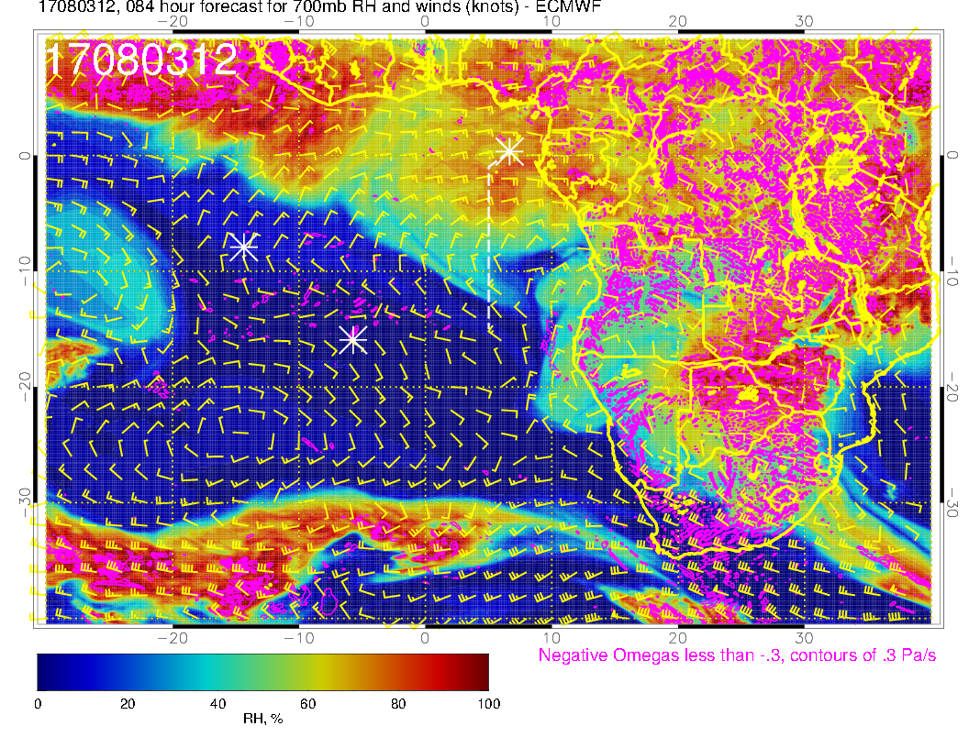
Another plume of high RH moving westward by Thursday. Stronger westward flow than
on Monday, but 700mb anticyclone is still not fully established.

Slide 14
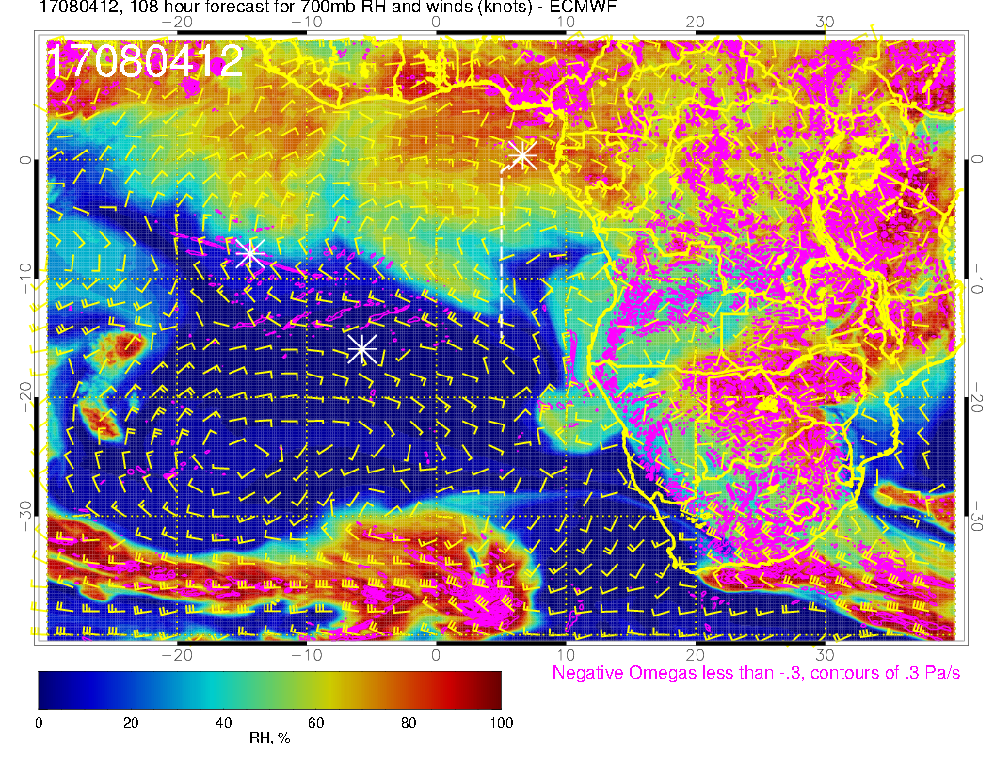

Slide 15
Cloud forecast (8/3)
Transit flight track is near the edge of the low cloud region (more abundant low clouds to the SE)
expect increase in low clouds from ASI to TMS
Few middle clouds near ASI (which could be simply classified as middle clouds relative to the higher BL height)
Some high clouds over TMS, associated with blow off from inland convection; models disagree on the southward extent
Expect some plume transport (up to ~600-700mb) along the second half of the transit flight track

Slide 16
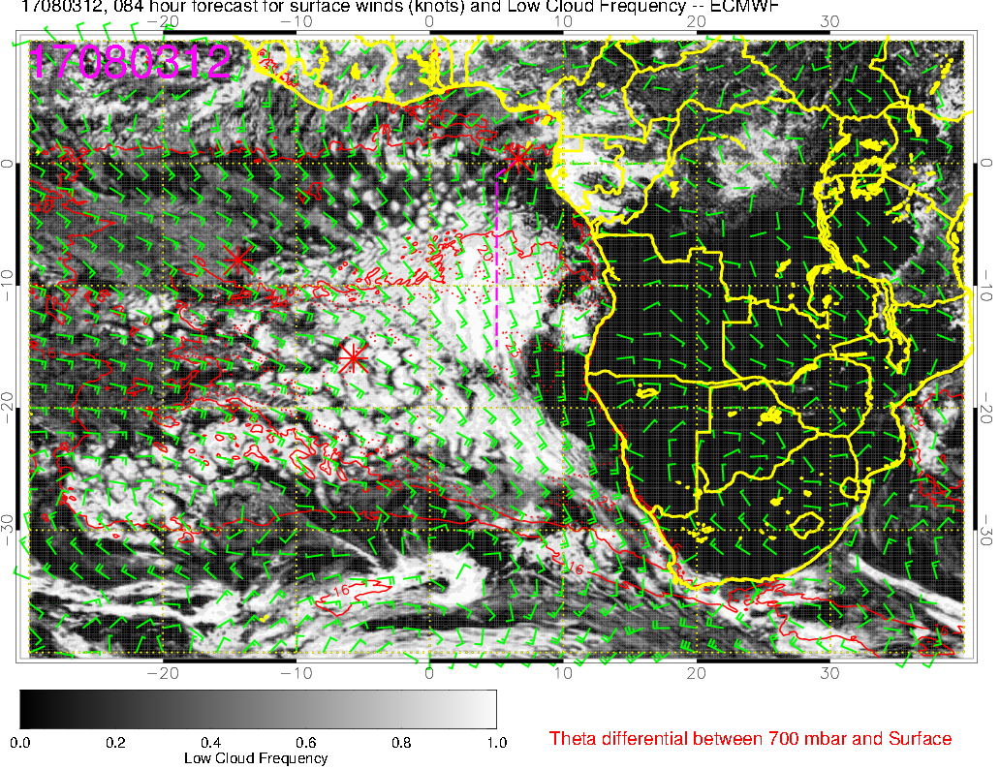
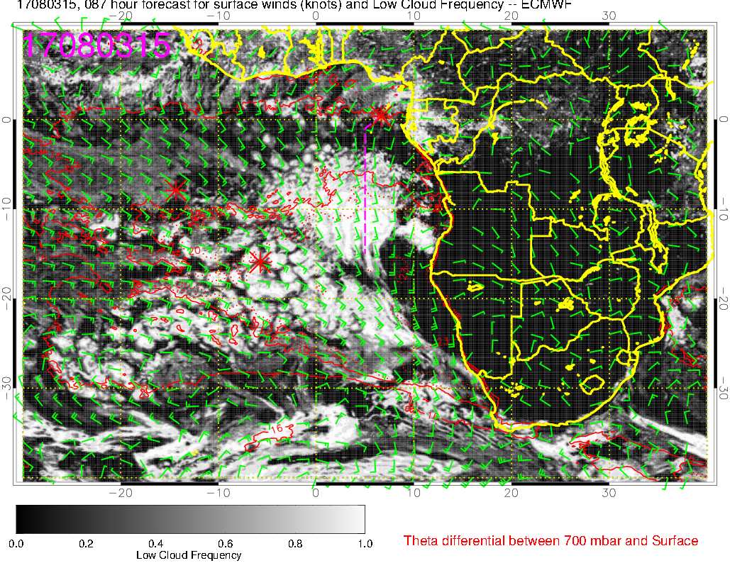
Low clouds (8/3 @12PM)
(8/3 @3PM)
Transit flight track near the edge of low cloud region
Low cloud occurrence generally increases from ASI to TMS
Clouds retreat towards the SE from 12PM to 3PM (diurnal cycle)

Slide 17
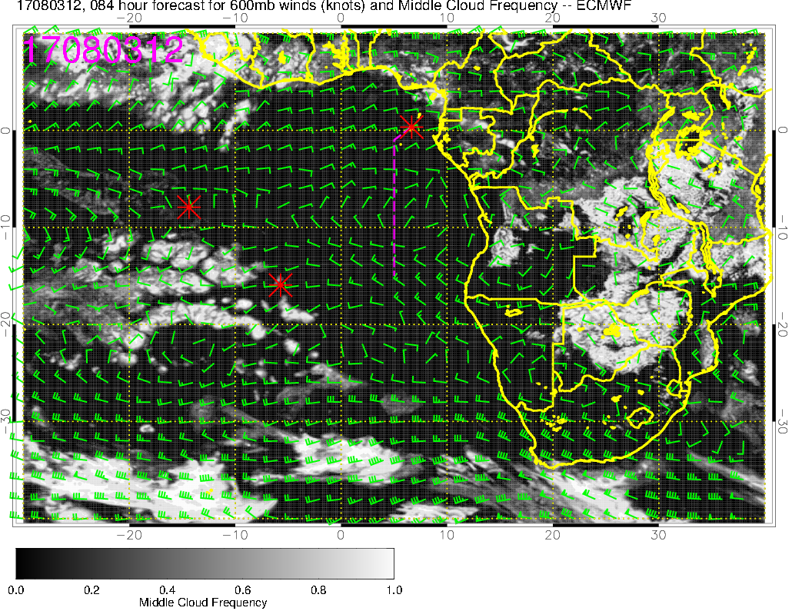
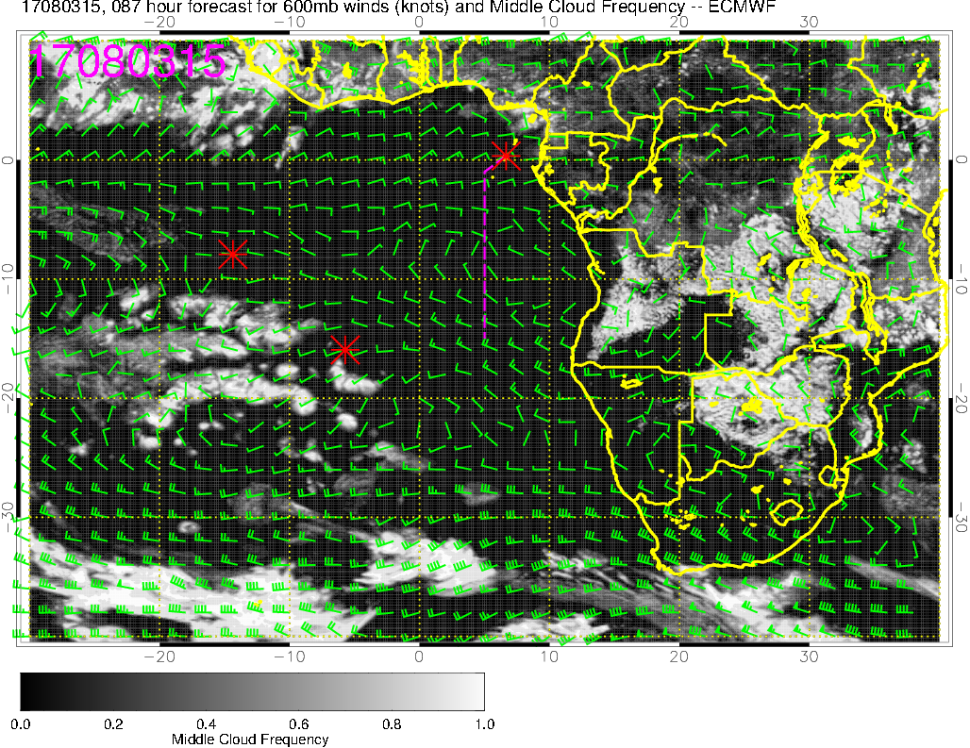
Middle clouds (8/3 @12PM)
(8/3 @3PM)
Few middle clouds over ASI, which are probably related to the higher BL height near ASI compared to SE

Slide 18
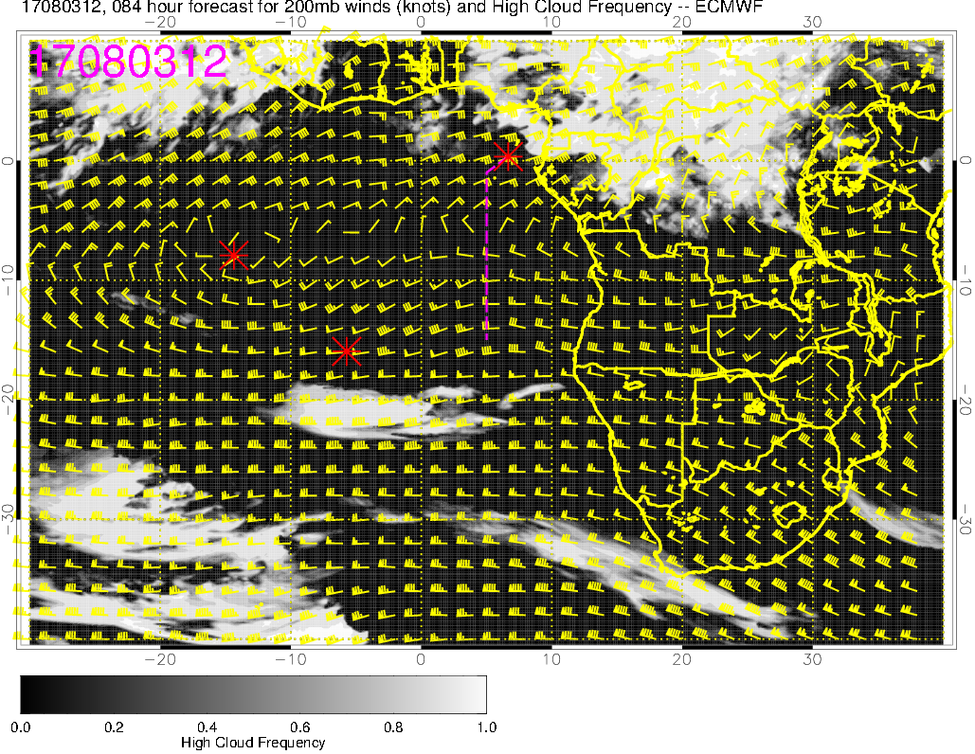
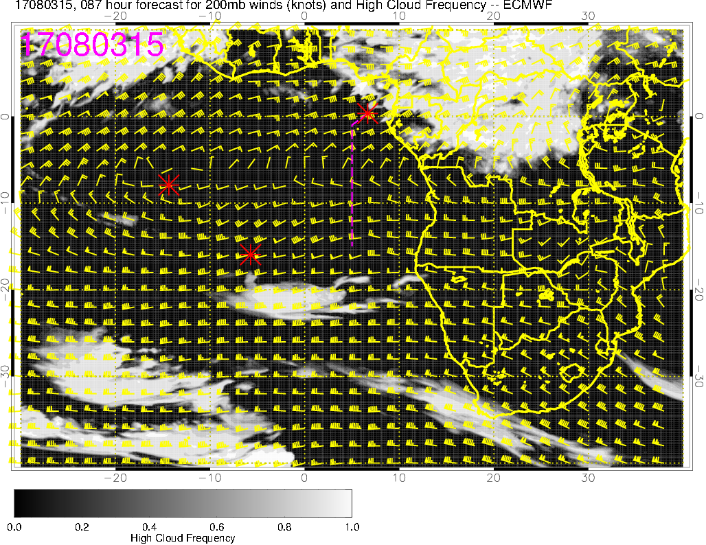
High clouds (8/3 @12PM)
(8/3 @3PM)
High clouds over TMS, (westward) blow off from convection over land

Slide 19
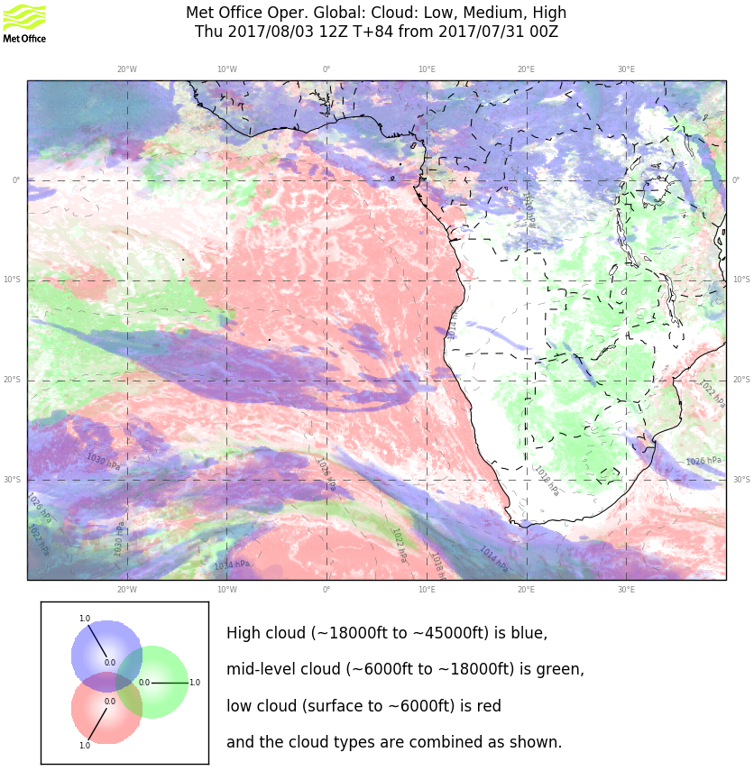
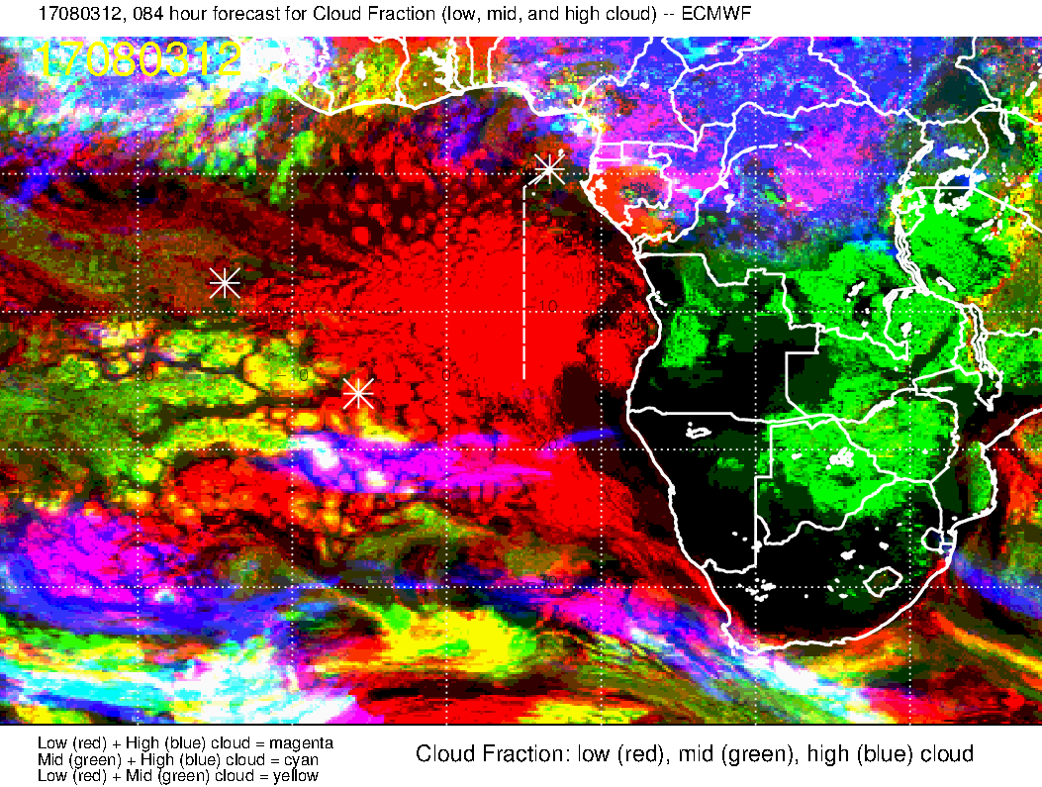
Low, Middle, High clouds (8/3 @12PM)
UKMO
ECMWF
low + high clouds
low + middle clouds
General model agreement
UKMO model forecasts some middle clouds between ASI and TMS (moving westward), and more high clouds over TMS

Slide 20
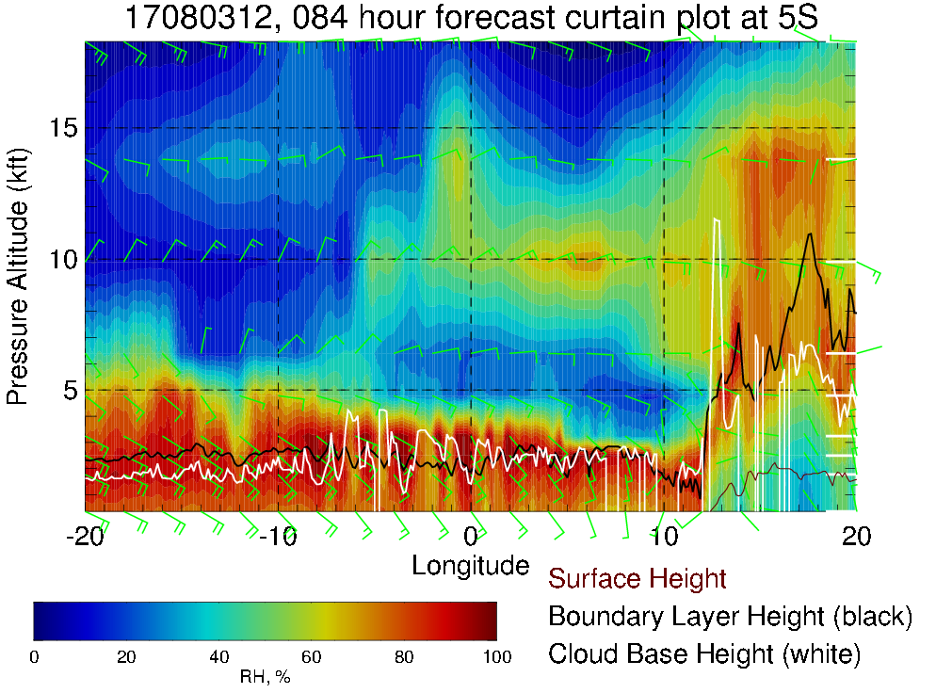
RH (color), BL height (black), cloud base height (white) cross section at 5S
8/3 @12PM
600mb
700mb
Plumes reach up to 600-700mb

Slide 21
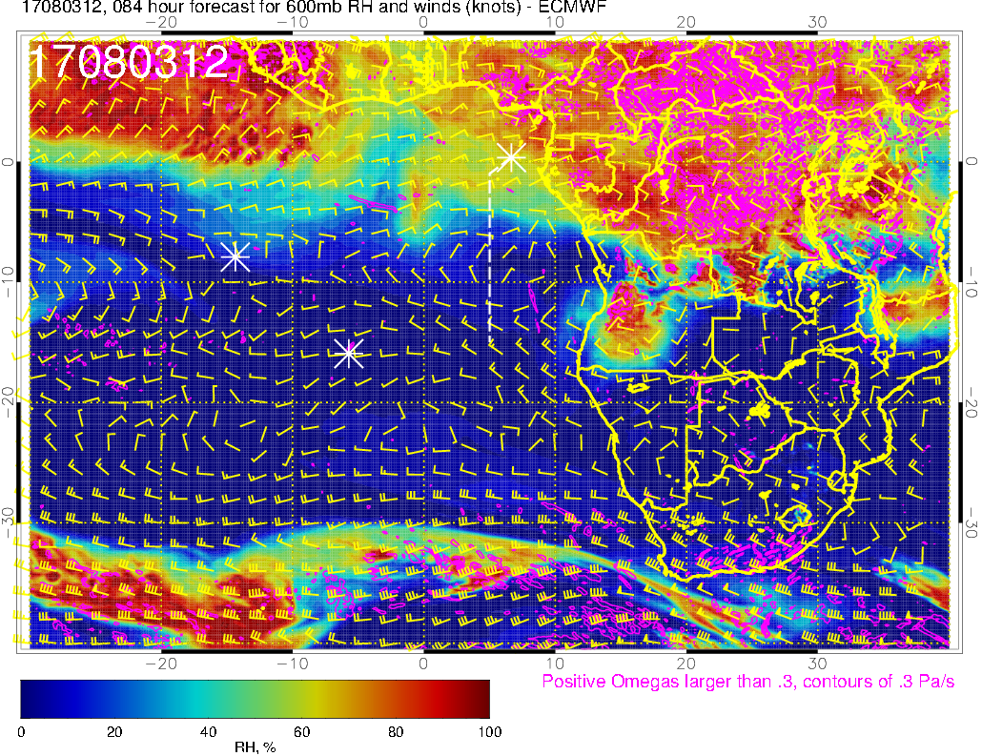
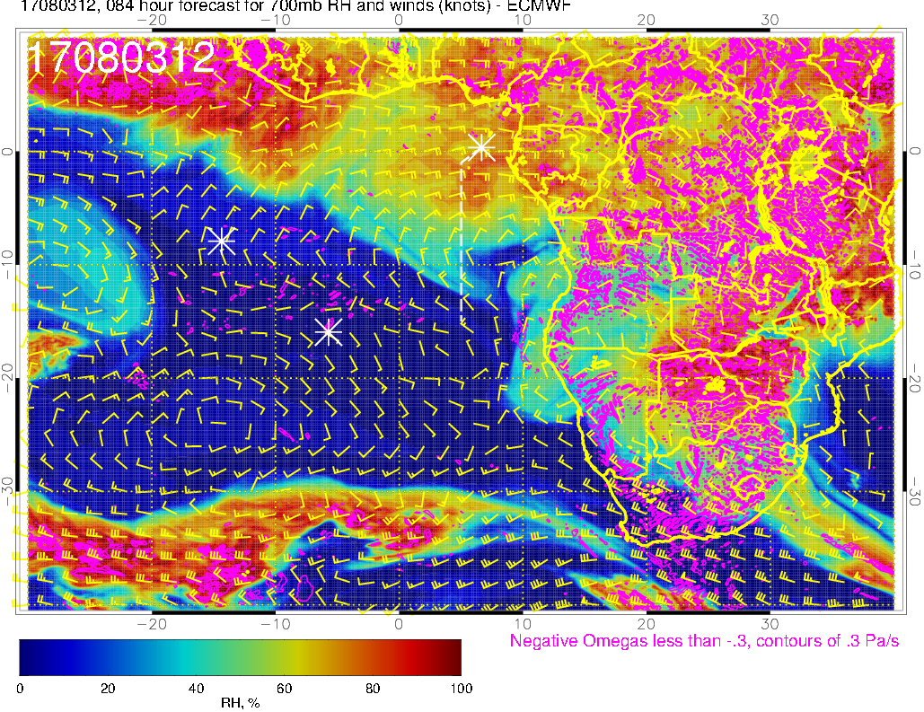
RH, omega (vertical velocity)
@600mb
@700mb
- Easterly flow over TMS
- Enhanced RH south of TMS suggests plume transport (by dry convection), while the high RH region further north is probably from moist convection

