Slide 1
WRF modeling
Pablo Saide, Greg Carmichael, Gonzalo Ferrada, Maryam Abdioskouei, and Meng Gao
ORACLES
July/August 2017

Slide 2
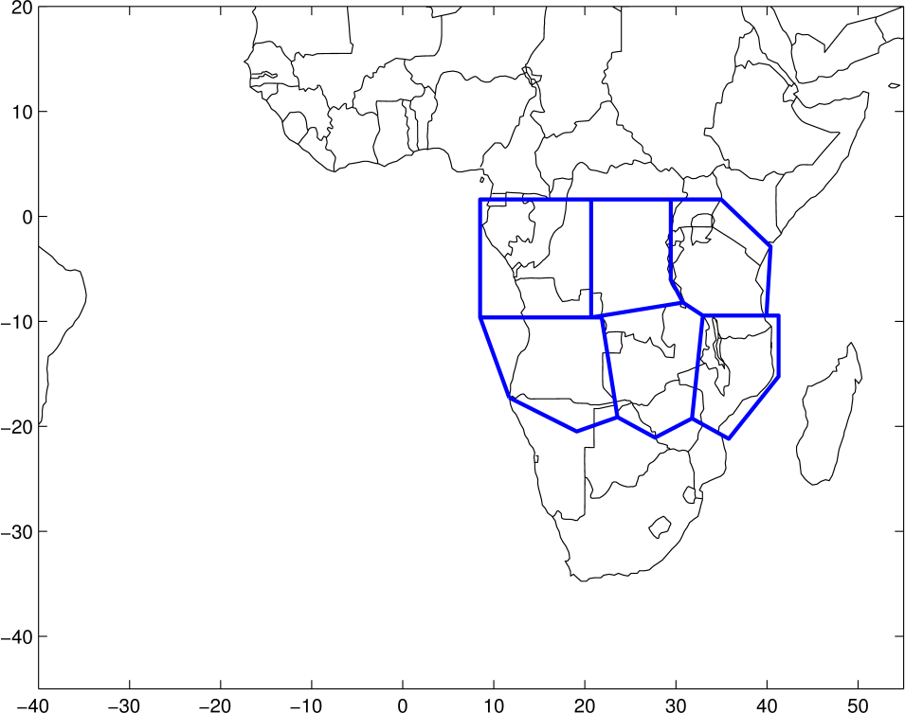
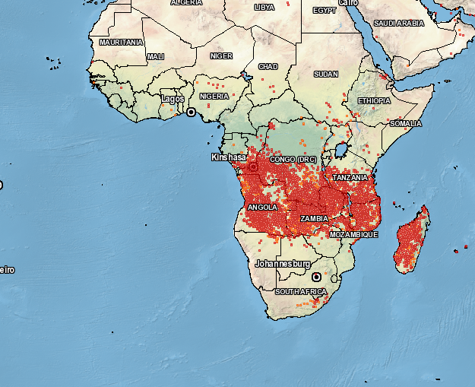
Forecasting systems
WRF with aerosol-aware microphysics (AAM): 96 hrs
Based on Thompson and Eidhammer (JAS, 2014) and Saide et al. (JGR, 2016), 12km resolution
Smoke emissions constrained in near-real time using Saide et al. (GRL 2015) over 6 regions for 8 hour intervals
Simulations turning on and off fires to assess aerosol-cloud-radiation interactions
Tracers for 15 days of smoke emissions used for assessing age
WRF-CAM5 72 hrs
MAM3 aerosols (3 aerosol modes)
Fountoukis and Nenes (FN) series cloud droplet activation (includes giant CCN and dust activation), Niemand et al. (2012) ice nucleation
UW (Bretherton and Park) Boundary layer scheme
CESM cloud microphysics, cumulus and shallow cumulus schemes
Full chemistry (gases and aerosol composition)
WRF-AAM
12 km
36 km for WRF-CAM5

Slide 3
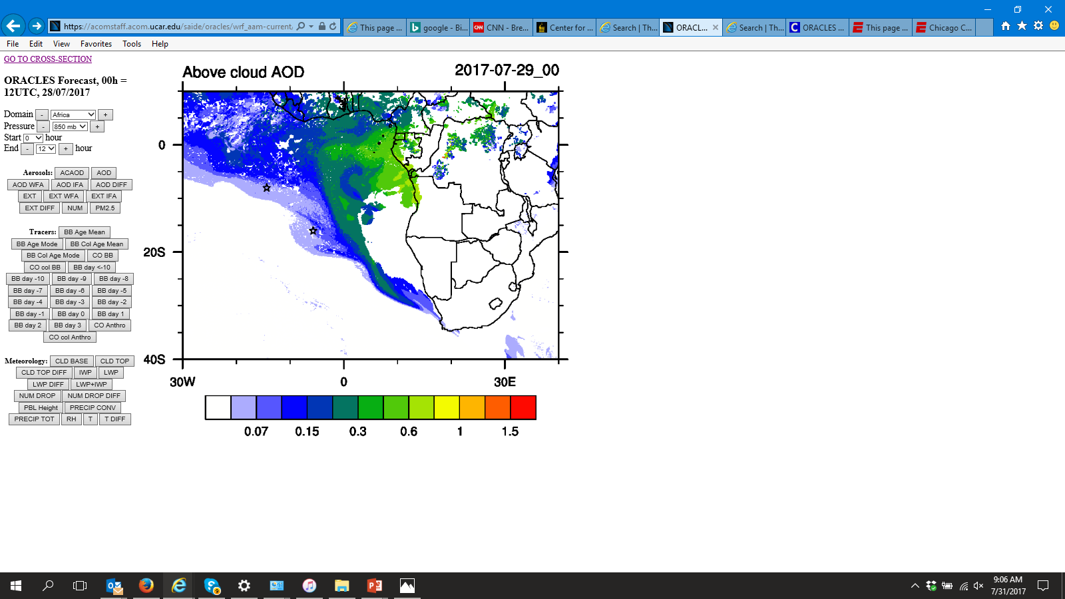
WRF-AAM

Slide 4
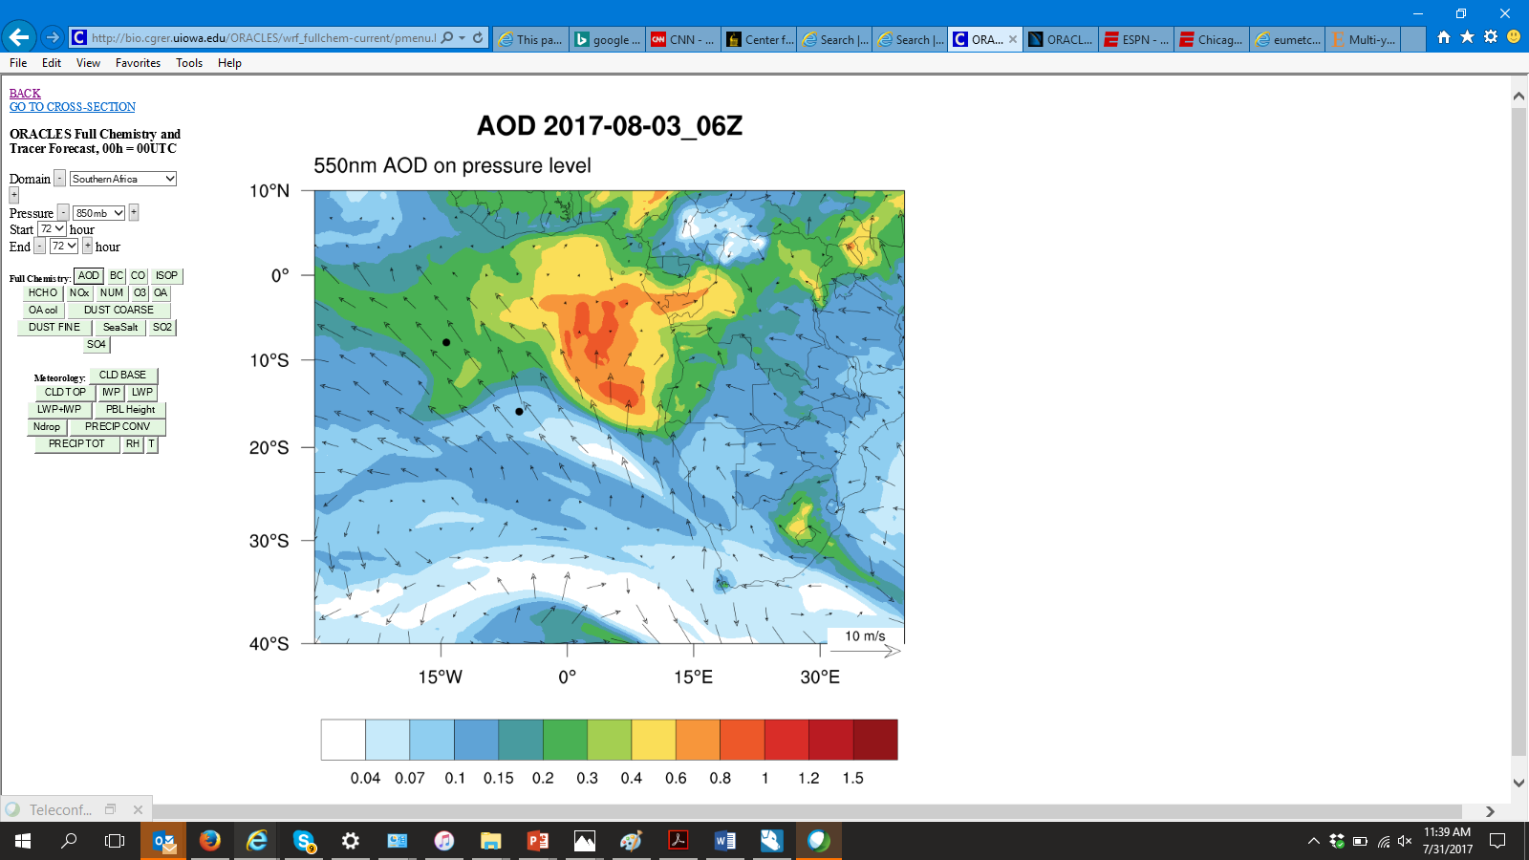
WRF-CAM5

Slide 5
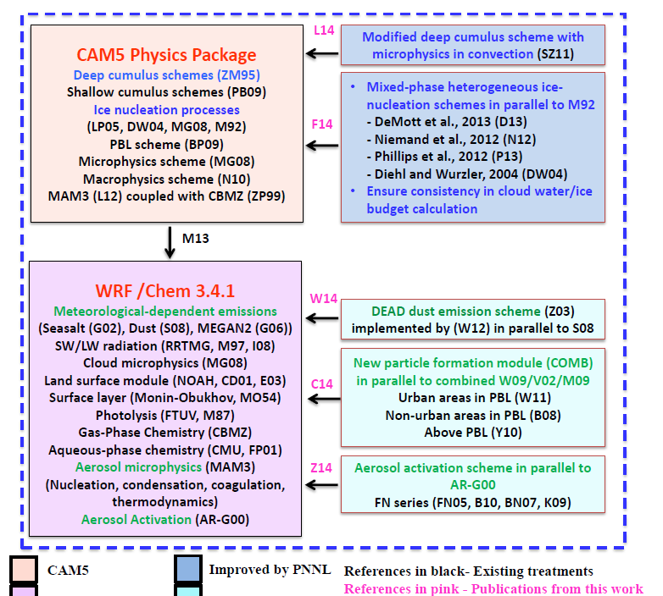

Slide 6
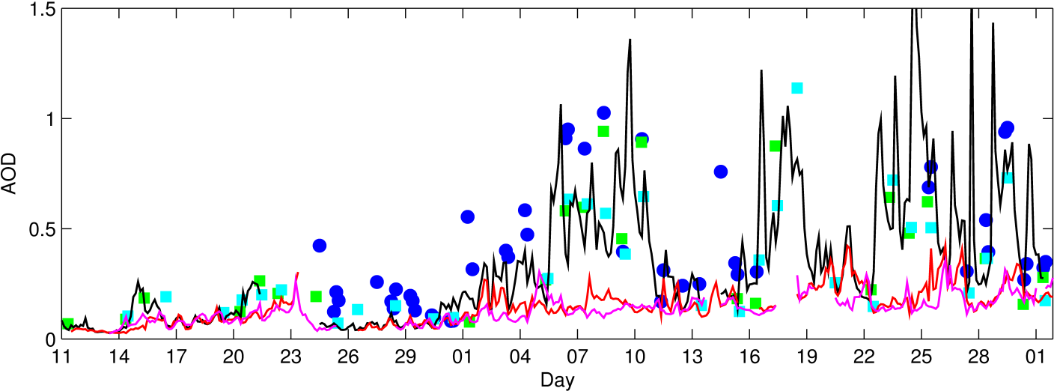
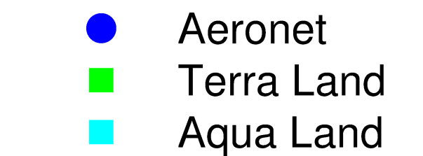
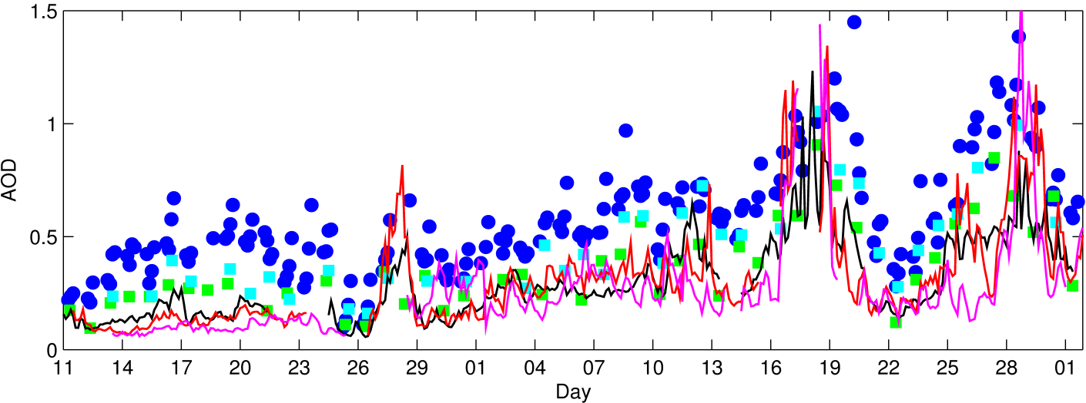
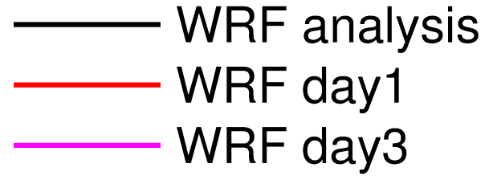
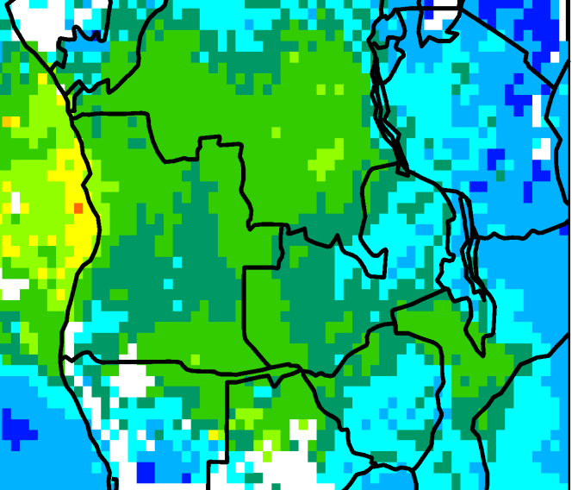
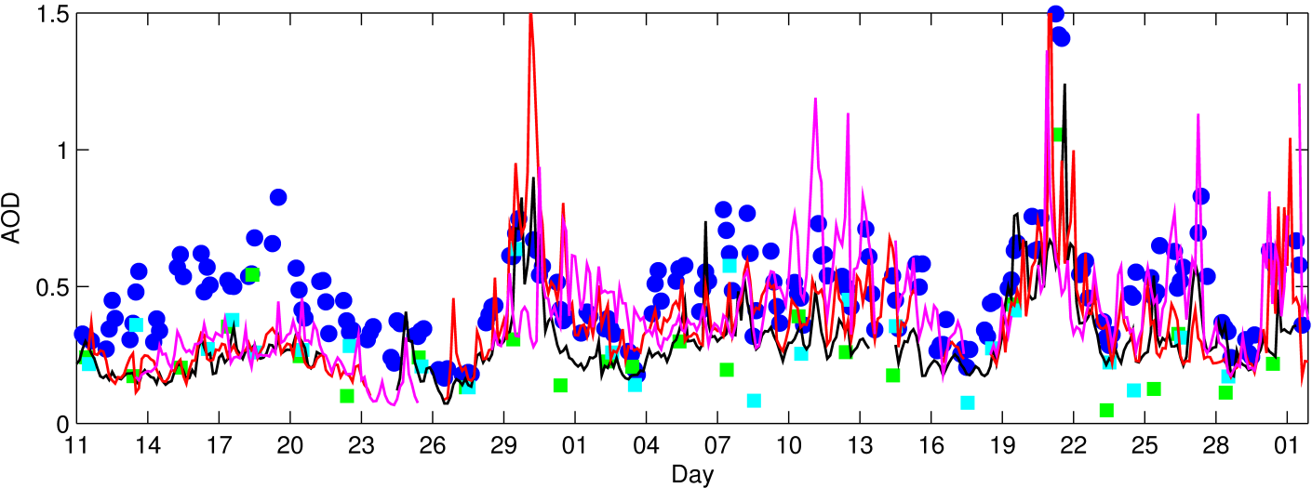
AERONET over fire regions
1) Gorongosa
(Mozambique)
Aug
Sept
2) Mongu Inn (Zambia)
3) Lubango (Angola)
3
2
1
Aug
Sept
Acknowledgements to the AERONET Team, specially Brent Holben, Joel Schafer and David Giles

Slide 7
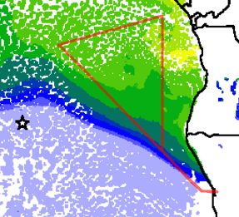
HSRL2 data from ER-2 aircraft (Sept 12th)
Model AOD
Acknowledgements to the HSRL2 and ER-2 teams, specially Sharon Burton and Rich Ferrare

Slide 8
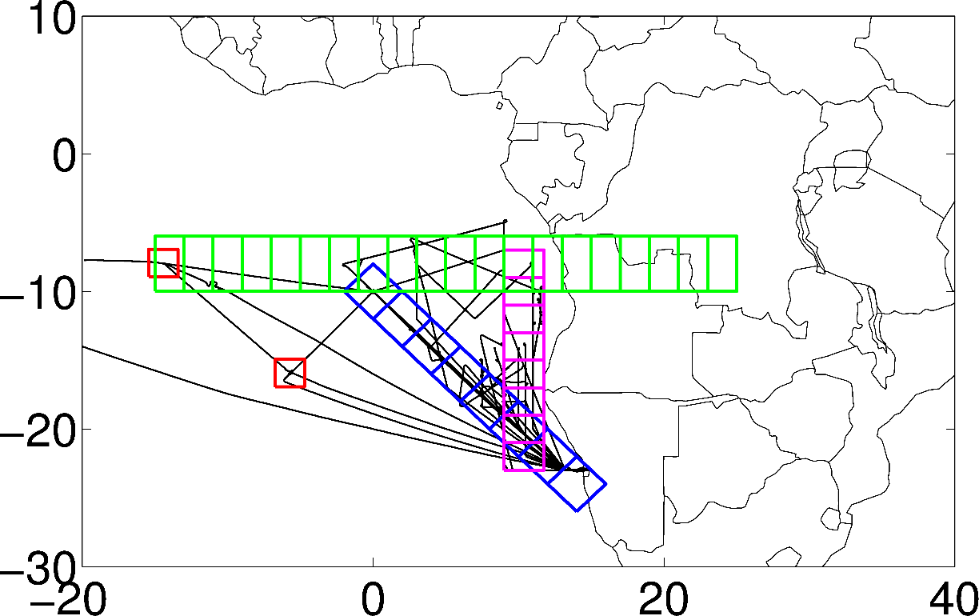
Modeling inter-comparison project
How do models compare to observations?
How well did we sampled a “monthly” climatology?

Slide 9
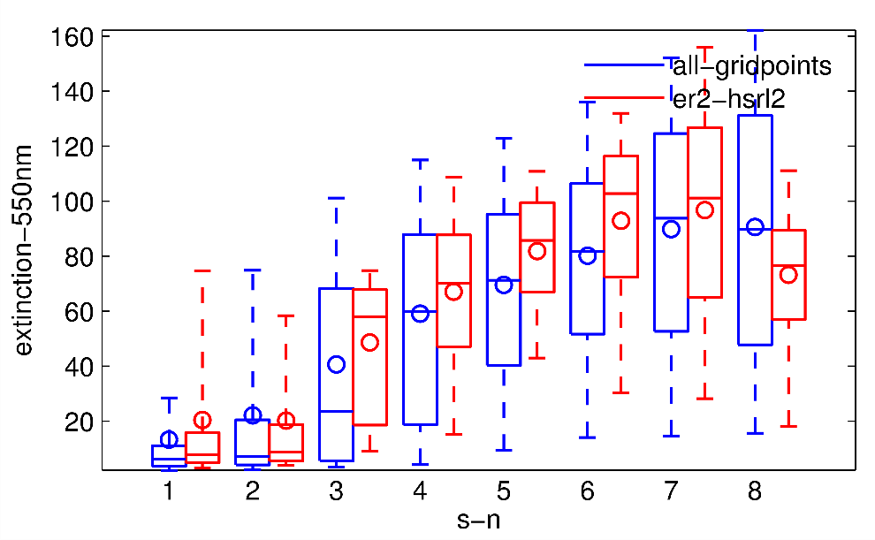
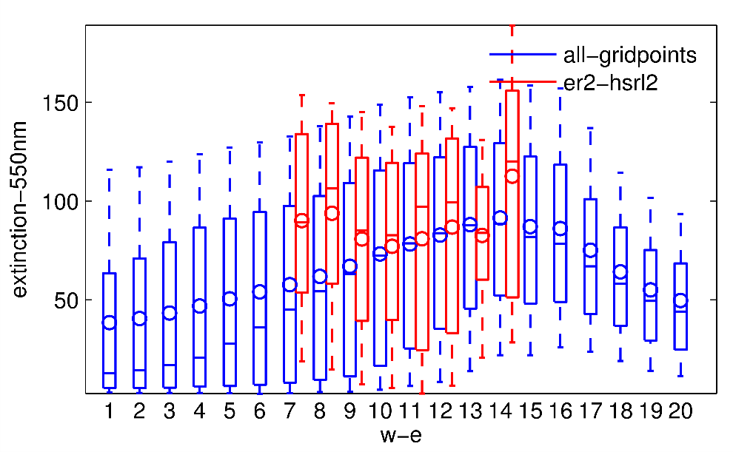
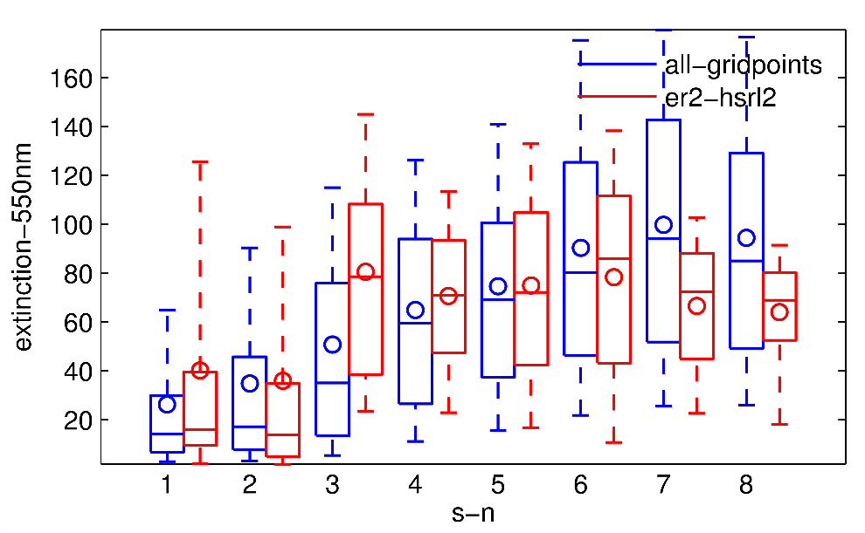
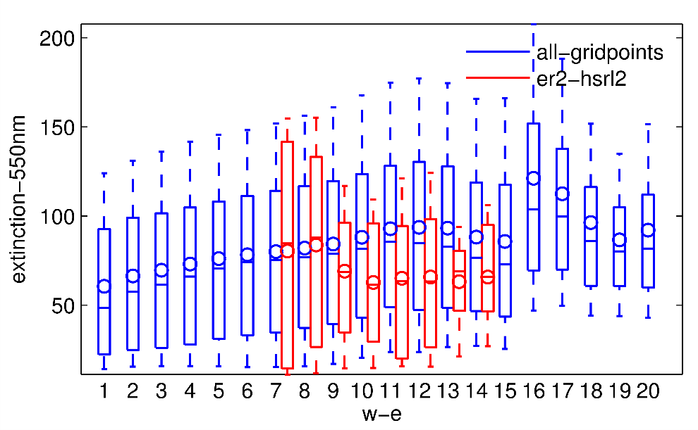
ER-2-HSRL2 extinction sampling vs climatology
WRF-CAM5
3-6 km
3-6 km
EXT550 [1/mM]
EXT550 [1/mM]
BLH-3KM
BLH-3KM
EXT550 [1/mM]
EXT550 [1/mM]

Slide 10
Modeling inter-comparison project
How do models compare to observations?
How well did we sampled a “monthly” climatology?
Obs + Model
(2750 – 3000 m)
Plot by Yohei

Slide 11
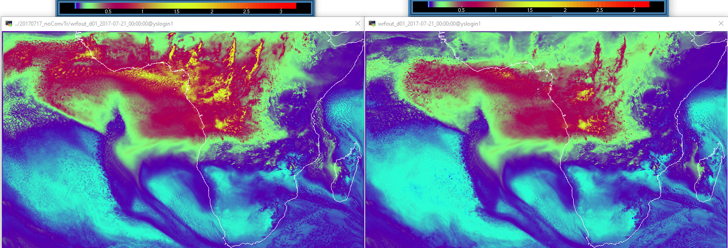
Several Improvements to WRF-AMA - e.g., wet removal due to convective precipitation added
Without wr (2017/07/17) With wr

Slide 12
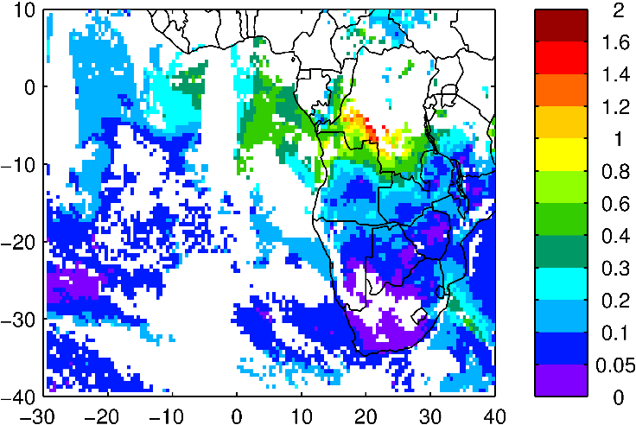
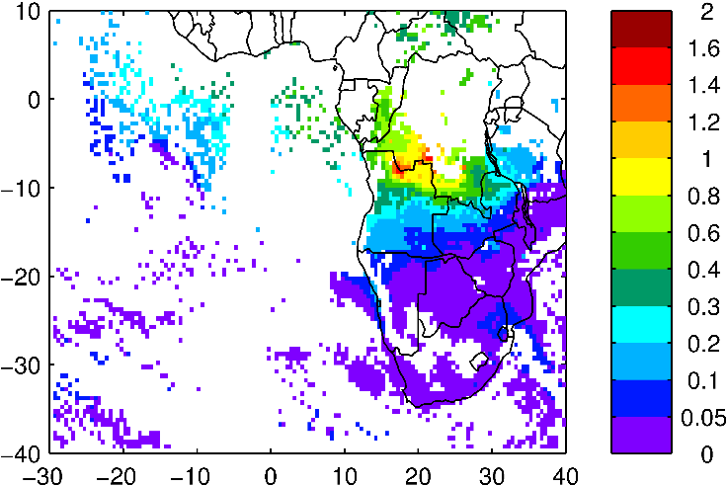
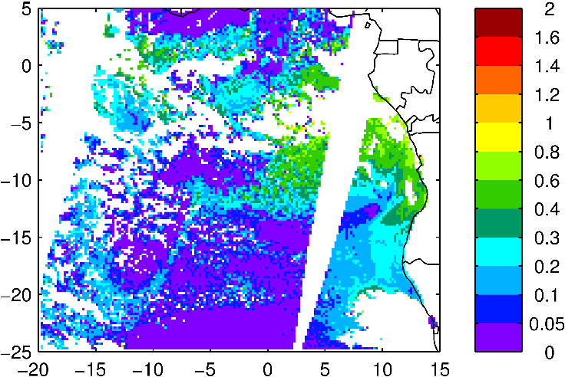
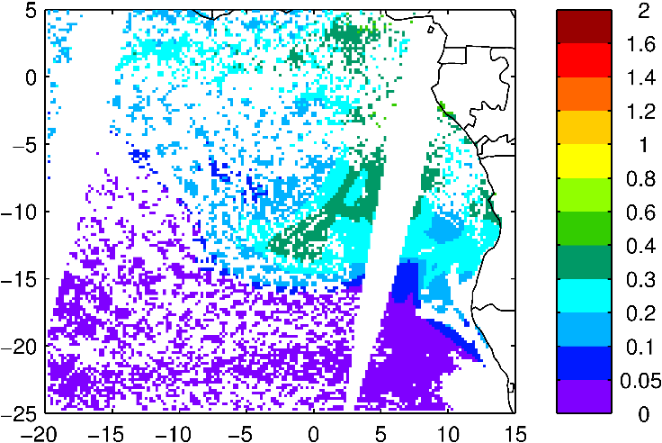
Obs July 26 2017 Aqua/Terra AOD Model
Obs July 26 Terra ACAOD Model

Slide 13
WRF modeling
http://bio.cgrer.uiowa.edu/ORACLES/wrf_fullchem-current/pmenu.html
https://acomstaff.acom.ucar.edu/saide/oracles/wrf_aam-current/pmenu.html

