Slide 1
ORACLES forecasting briefing Meteorology for 26-Jul-2017 (Wed) to 29-Jul-2017 (Sat)
25-Jul-2017
Lenny Pfister and Rei Ueyama

Slide 2
Overall Summary (see bullet points for each day)
Current low cloud distribution and circulation close to climo
Evidence for an RH plume to about 600-700mb over central part of routine track
Strong front and subsequent cutoff low expected to lead to clearing near the coast to near 15S by 7/27.
RH plumes over routine track today (7/25) and 7/26, moving to west by 7/27.
Low clouds near middle of transit track on 7/28 and 7/29.
Forecasts for high clouds disagree on 7/28 and 7/29, which has implications for the last portion of transit track.

Slide 3
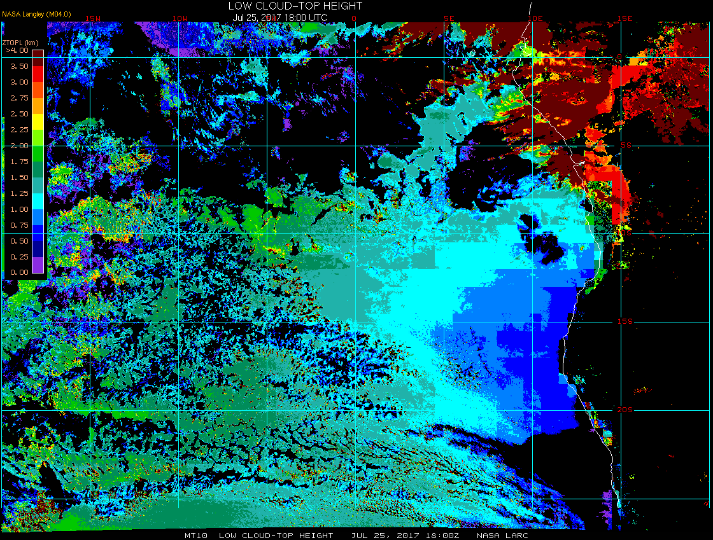
Satellite-derived low cloud-top heights (7/25 6PM)
Models had problems forecasting (over predicting) high clouds near Sao Tome; currently have broken high clouds and scattered low clouds
Cloud top heights mainly <1.5 km along the N-S leg of routine flight track (5E)
Cloud free region expands and pushes northward starting 7/26

Slide 4
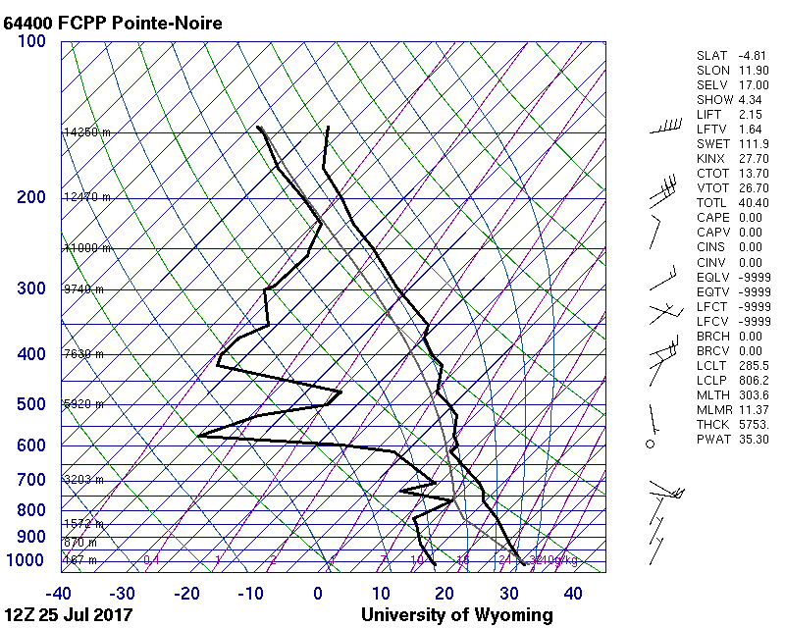
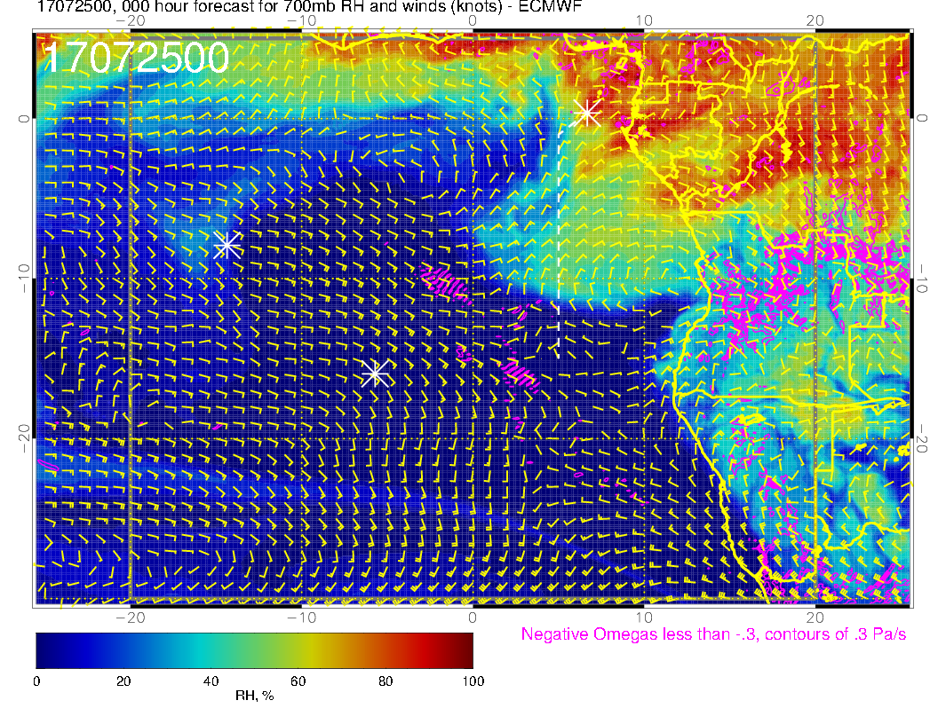
Small moist, adiabatic layer near 700mb, associated with offshore flow plume at Point Noire.

Slide 5
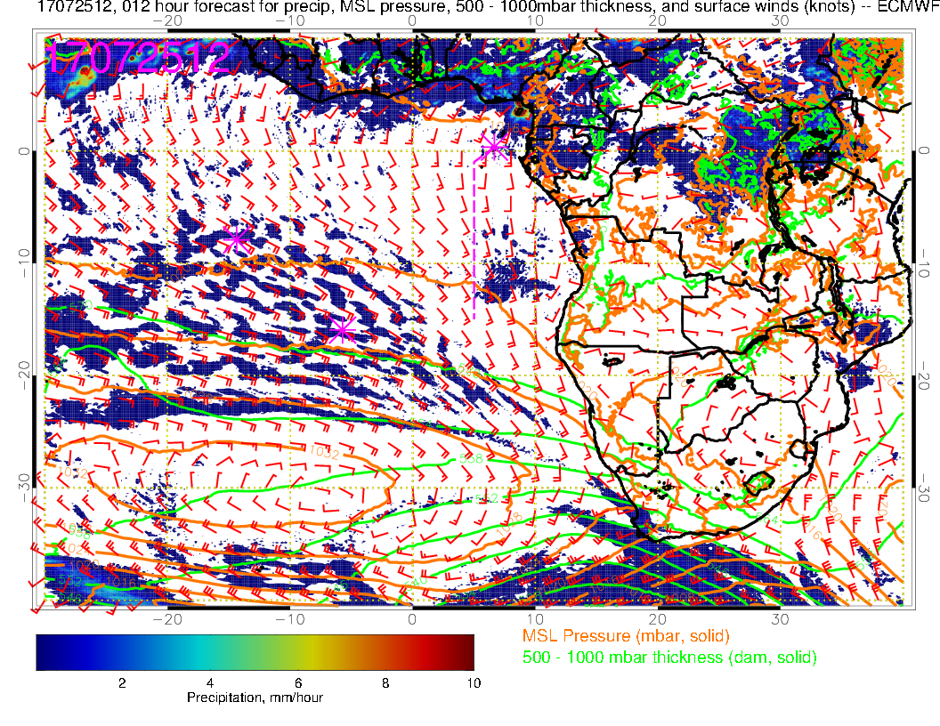
Typical surface flow pattern for this time of year. Front just passing Cape Town (light rain reported). Stronger front in evidence near [25W, 40S]

Slide 6
Wednesday (7/26)
Post midlatitude front get cloud clearing off of Namibia. Subsidence and offshore flow component are probably responsible
Some high cloud streamers on northern portion of routine track.
Plume of RH seen 7/25 has moved to the west – only reaches to 700mb (seems consistent with radiosonde shown for 7/25)

Slide 7
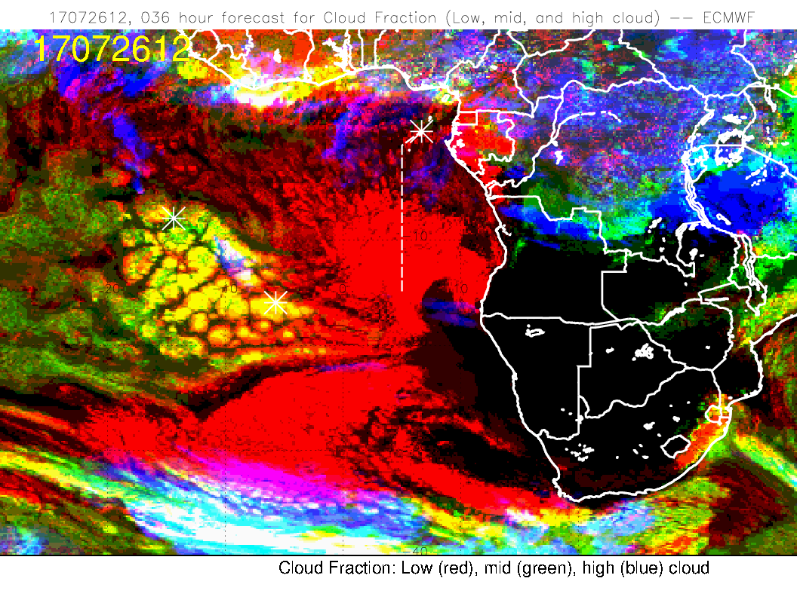
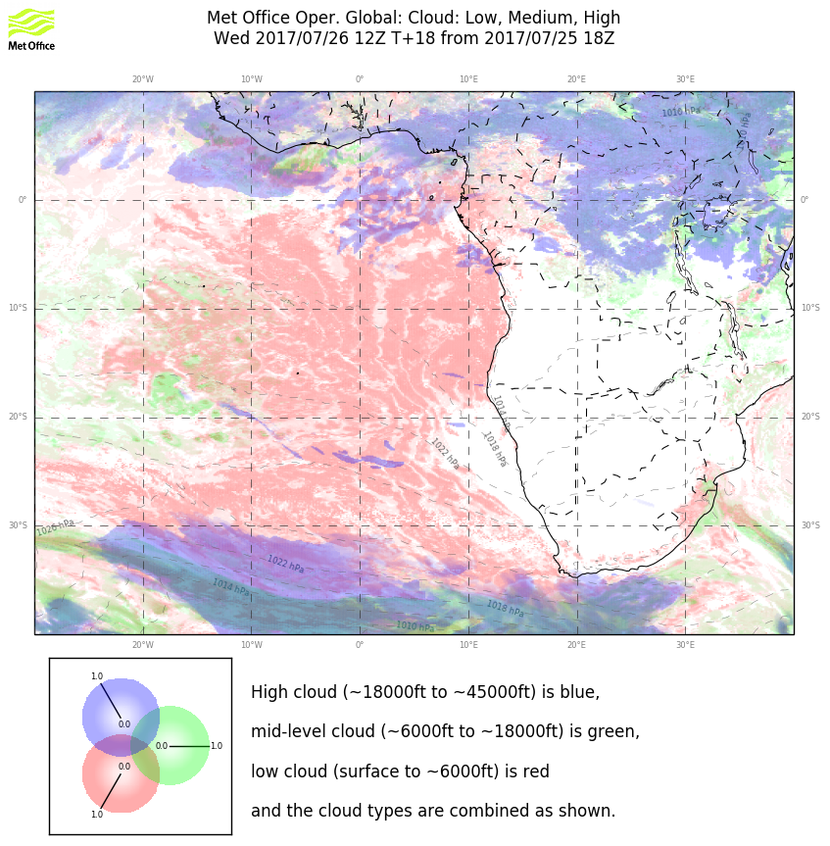
Some cloud clearing near southern coast post front (see next slide). EC (left) probably overdone. Ample low cloud near routine flight track. Expect some patchy cirrus outflow north of 5S. Models differ on the exact position of the high cloud – this is the state of the art on outflow from convection

Slide 8
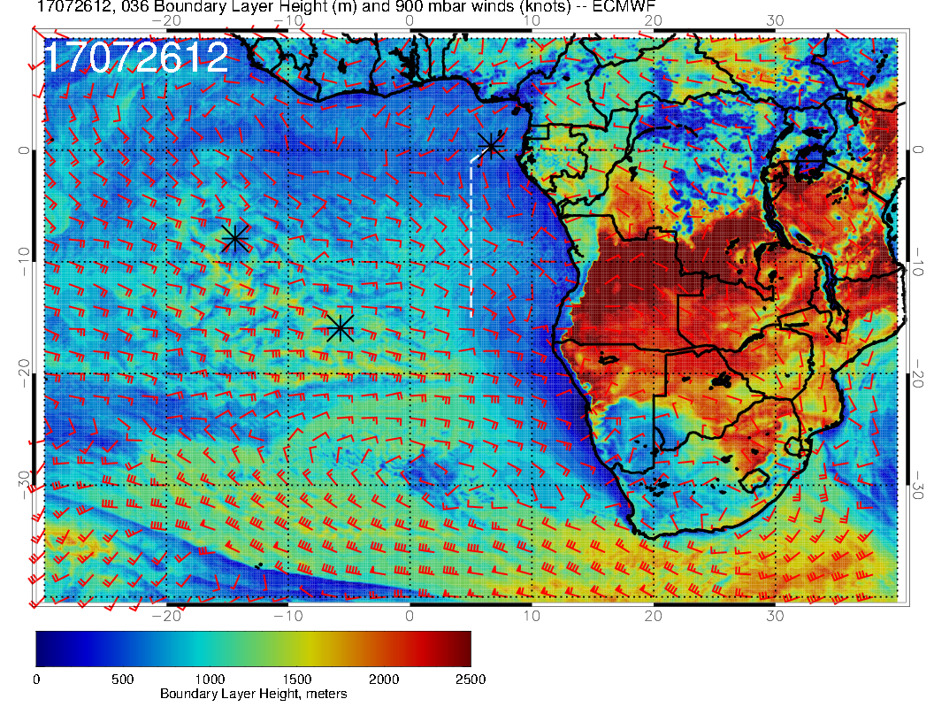
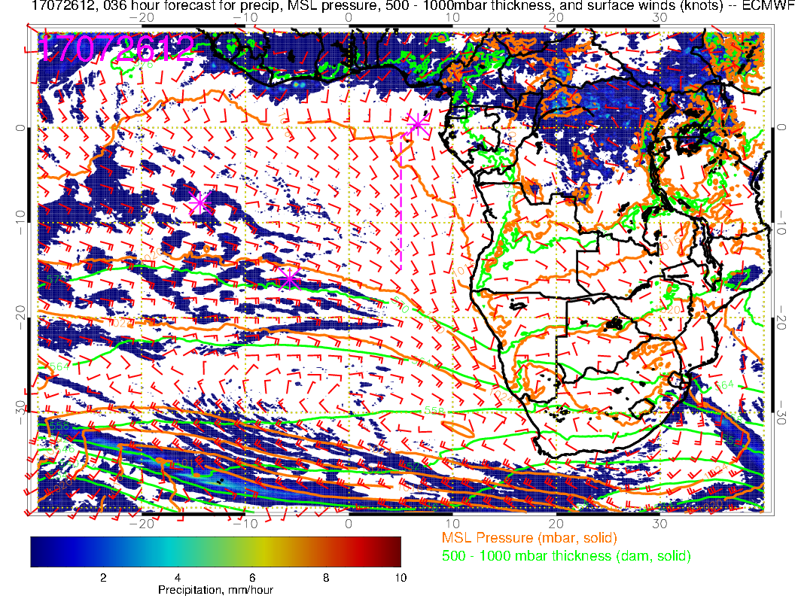
Boundary layer heights go down, and offshore flow component increases after front moves through leading to cloud clearing near the coast

Slide 9
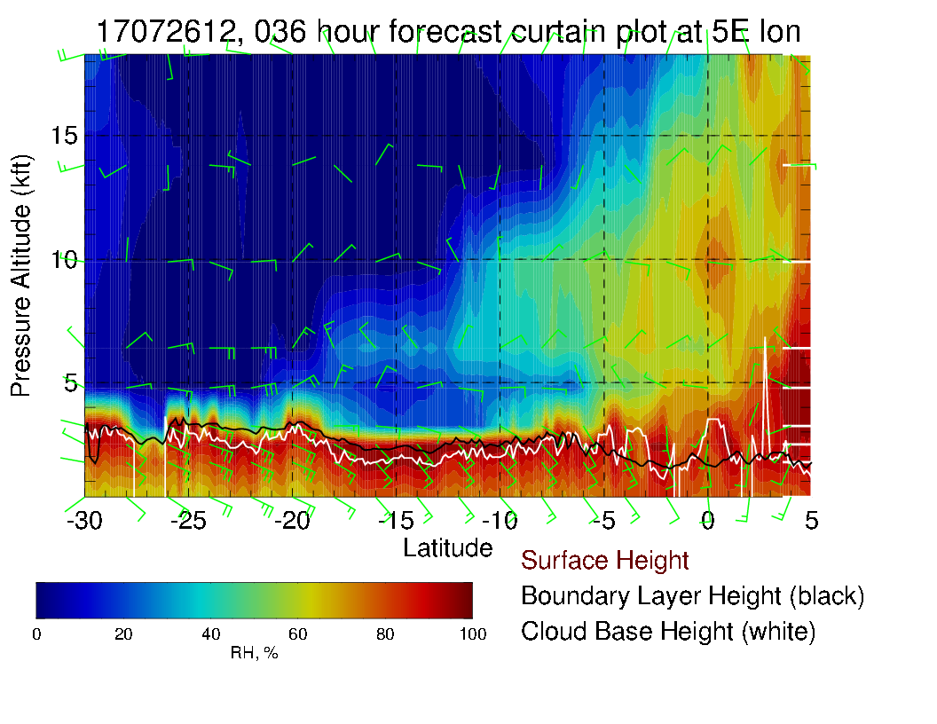
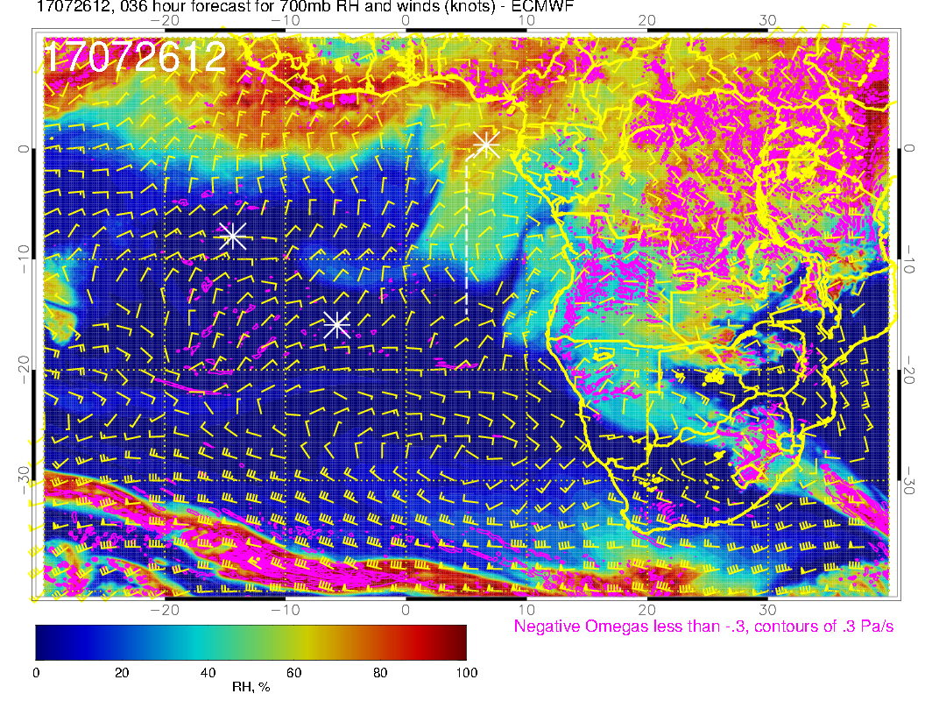
X-sect along routine track (left) and 700mb plan view shows an RH blob – only getting to 700mb

Slide 10
Thursday (7/27)
Further low cloud clearing off the coast of Namibia and southern Angola (along with low BL heights) as a strong midlatitude system approaches from the SW.
Forecasts differ on extent of clearing, but this should not affect the routine flight track.
High clouds are no longer in the forecast.
No RH plume on routine track, but there is one off the Angolan coast in the region of low BL heights.

Slide 11
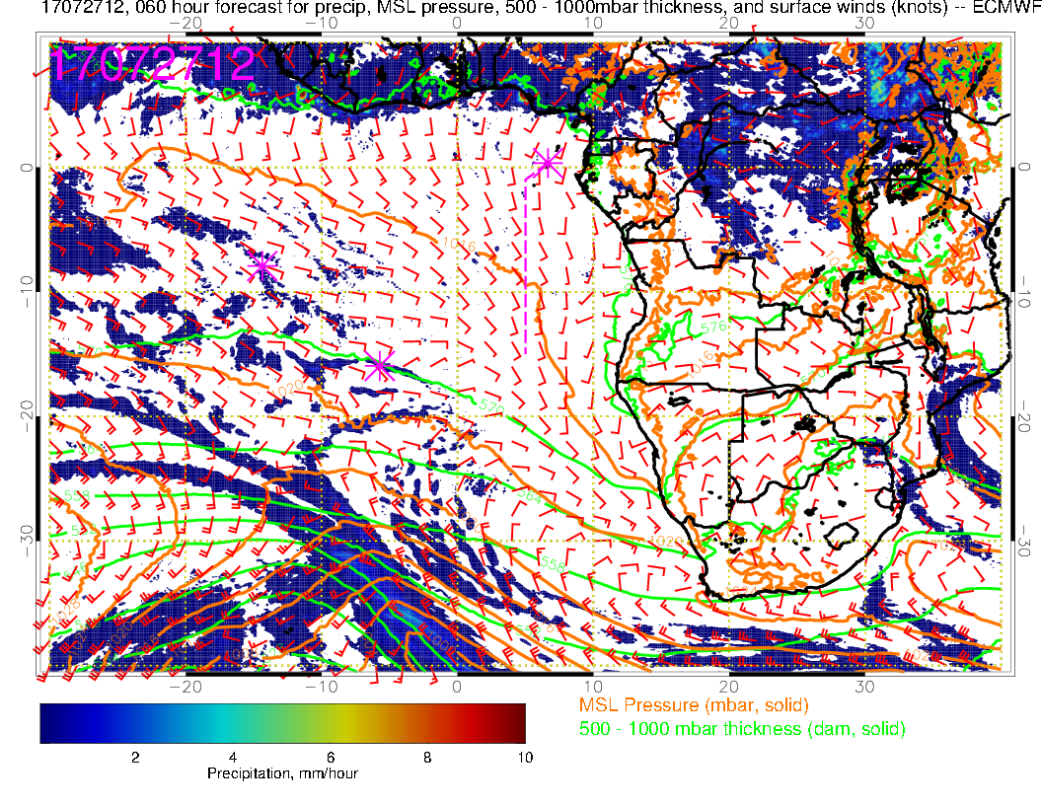
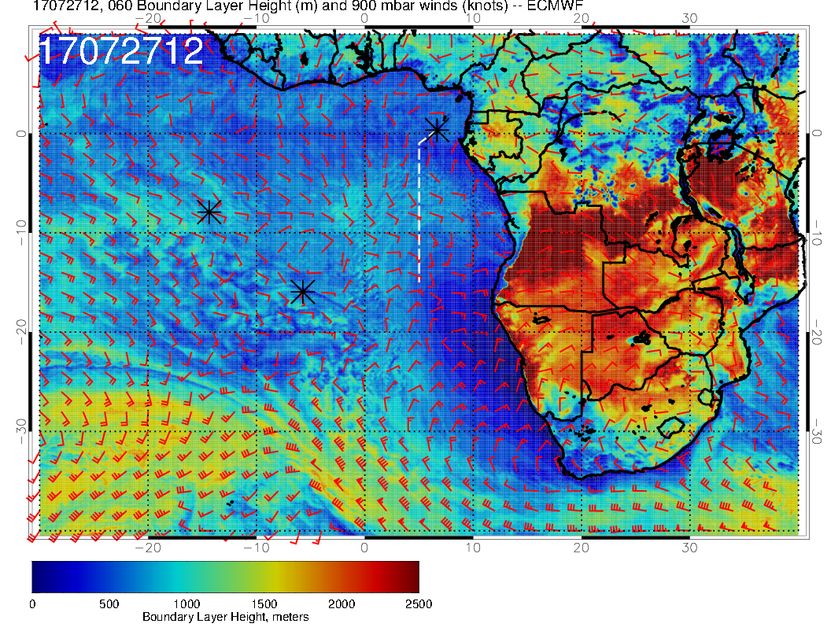
Very strong front to the west distorts what is left of the Saint Helena high.
Offshore flow components coupled with strong subsidence leads to drying and low BL heights.
UKMO model (not shown) agrees on frontal position

Slide 12
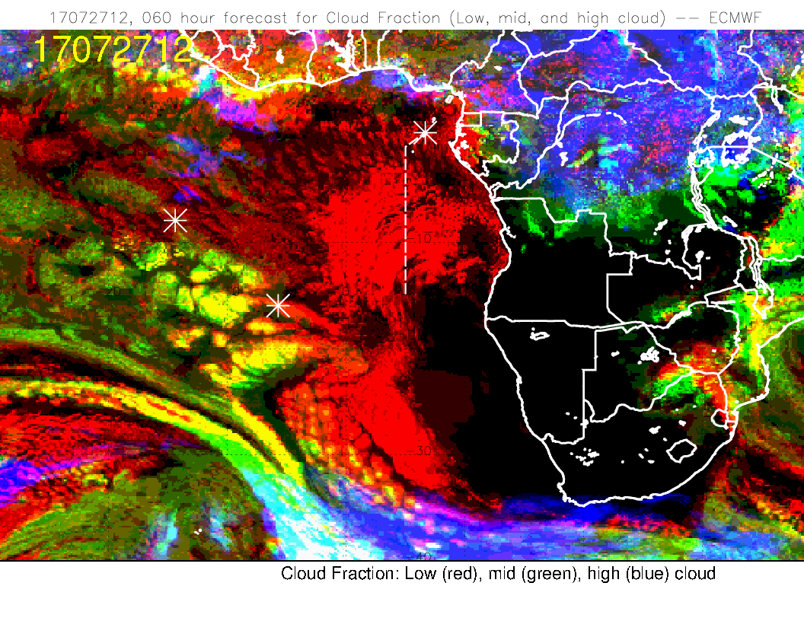
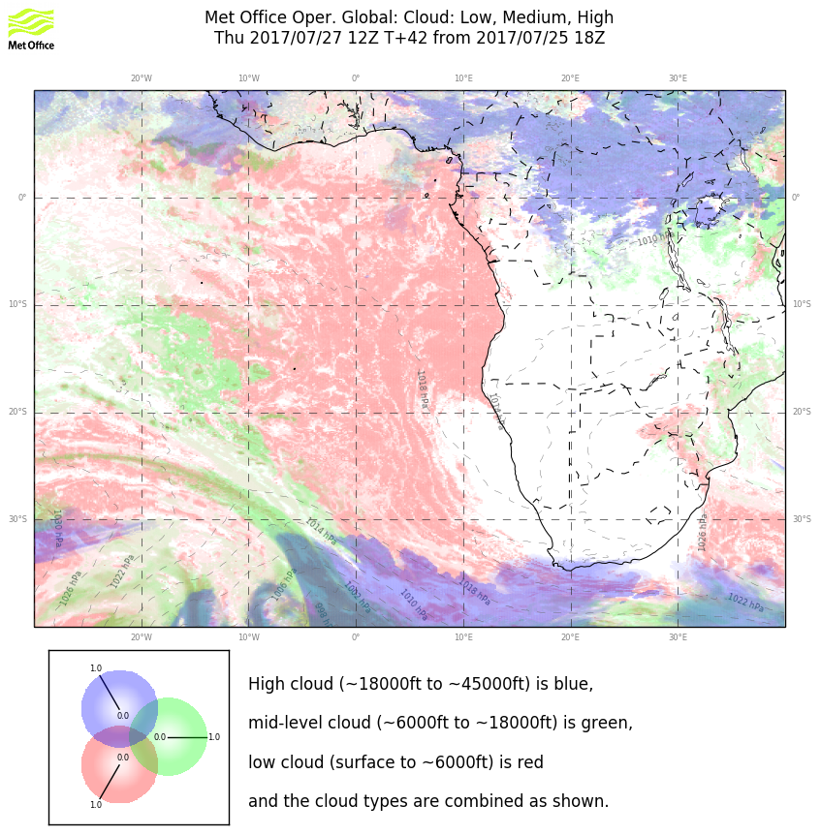
EC cloud clearing resulting from approaching low is overdone. In any case, expect substantial low cloud along routine track. High cloud streamers have disappeared from the forecast (related to change in flow direction from north easterlies to easterlies at low latitudes.

Slide 13
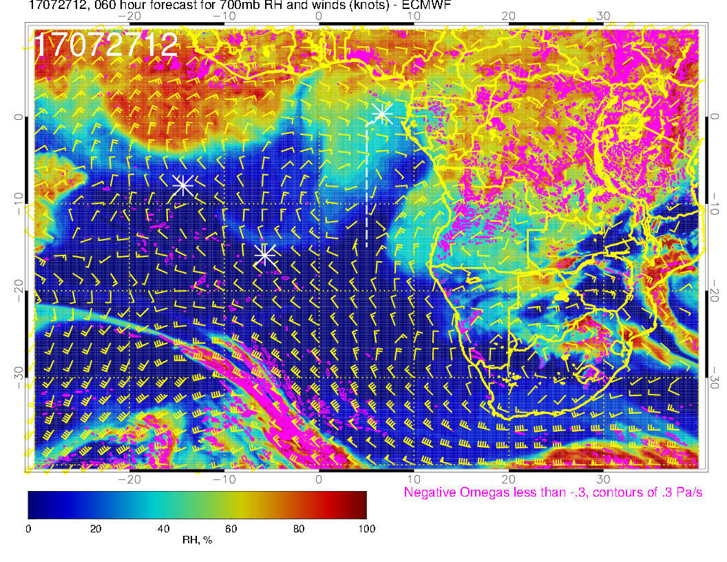
RH plume from 7/25 and 7/26 moves off the routine track. A new one starts to move out over southern Angola. Note low BL heights in this region (slide 11)

Slide 14
Friday (7/28)
The development of surface low pressure (~40S, 13W) virtually eliminates the climatological mean anticyclone, accounting for the anomalous low-level wind pattern and cloud distribution south of ~20S
Expect low clouds throughout the transit flight track (increasing from Ascension Island to Sao Tome)
Models disagree on the evolution of low clouds off the coast of Angola and Namibia
ECMWF predicts northward expansion (~10S) of little or no cloud region
UKMO places the northward extent of cloud-free region at ~20S (shrinking since 7/27)
We may see few middle and high clouds over Ascension (and north of it) but forecasts are uncertain

Slide 15
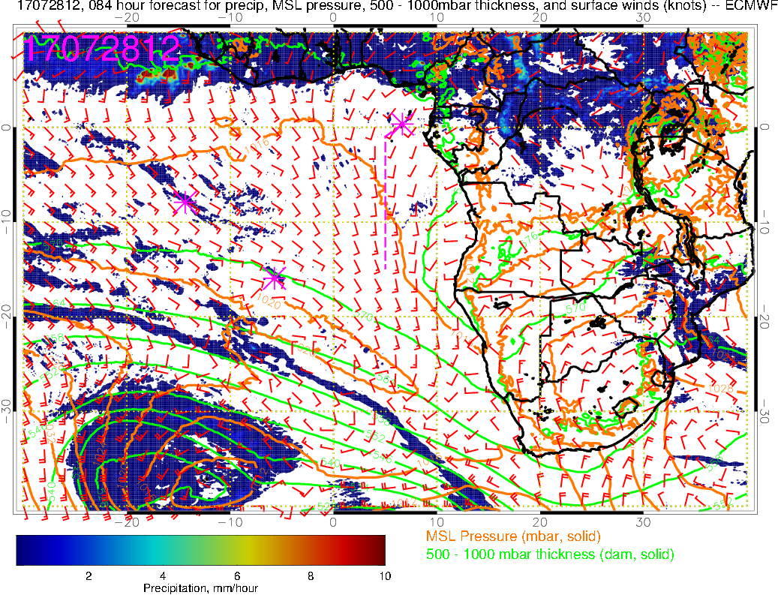
Precip
Mean SLP
500-1000mb thickness
Sfc winds
(7/28 12PM, ECMWF)
Surface pattern between Ascension and Sao Tome is quite typical, but the pattern is perturbed south of ~20S
Anomalous flow pattern is due to frontal passage and surface low development
LOW

Slide 16
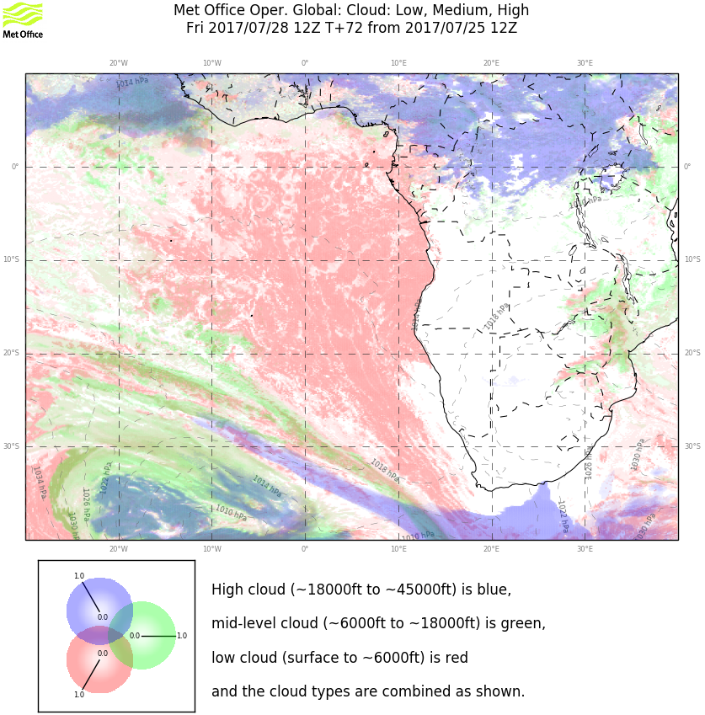
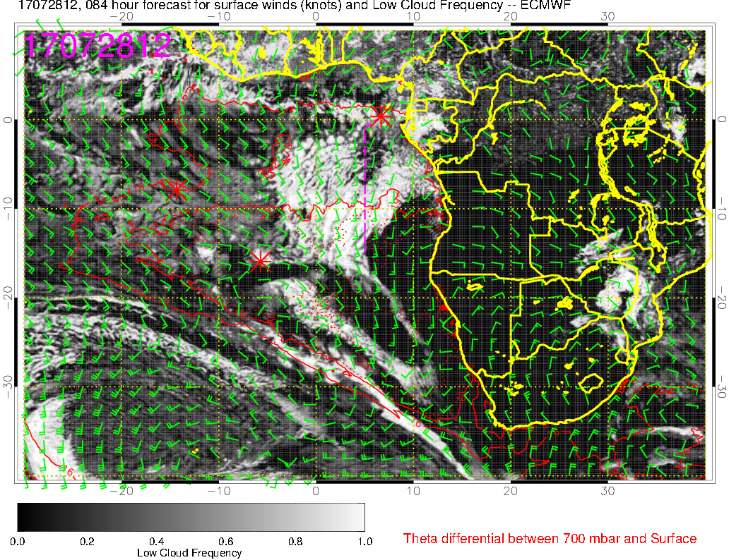
Low clouds (7/28 12PM)
ECMWF
UKMO
Low cloud frequency increases from Ascension to Sao Tome along the transit flight track
Model disagreement in low cloud cover off the Angola-Namibia coast: pocket of little or no clouds (off Namibia coast) extends northward to ~10S in ECMWF, shrinks south of ~20S in UKMO

Slide 17
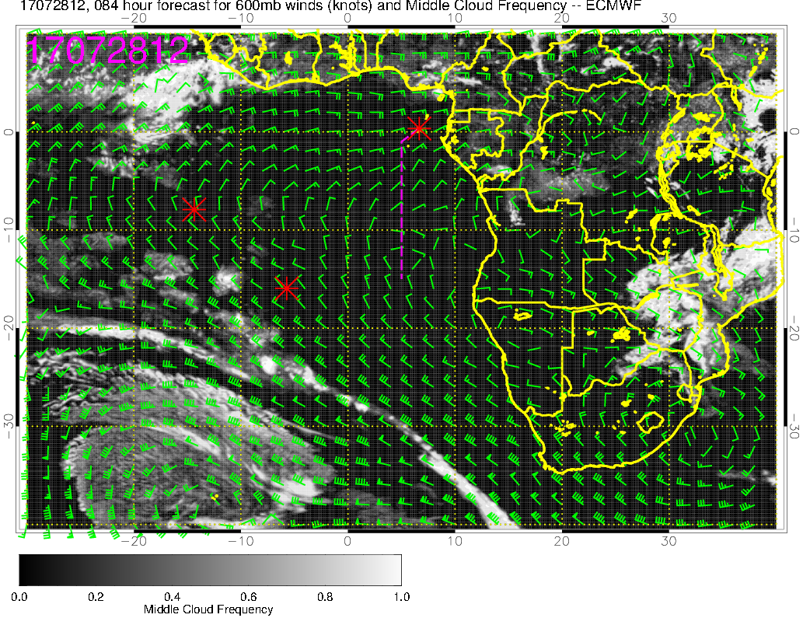
Middle clouds (7/28 12PM)
ECMWF
UKMO
Little or no middle clouds in general
There may be a few middle clouds near Ascension (more to the north of the island)

Slide 18
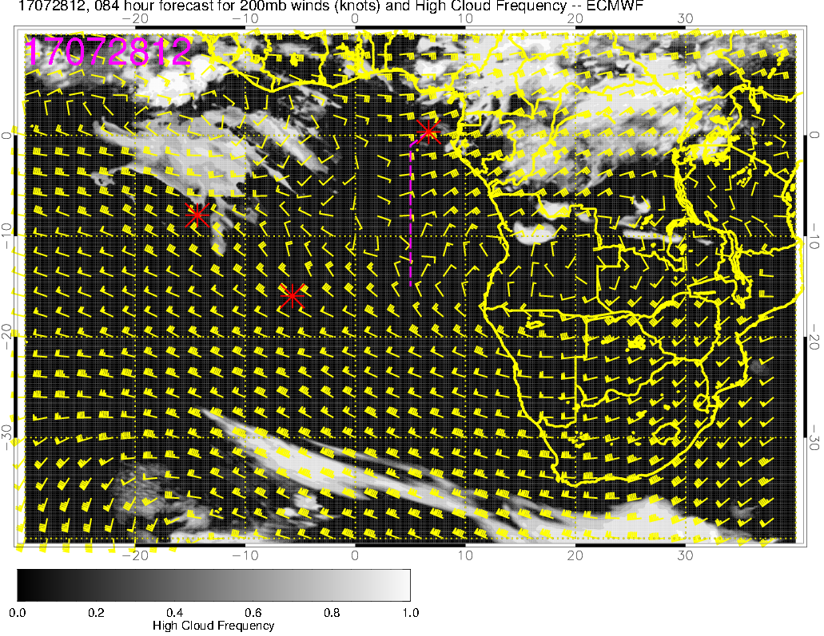
High clouds (7/28 12PM)
ECMWF
UKMO
ECMWF forecasts cirrus clouds north of Ascension and over Sao Tome (only low or middle clouds in UKMO), but these forecasts are highly uncertain at this point as they relate to transport of convective moisture and dynamical forcing

Slide 19
Saturday (7/29)
Surface low propagates eastward and stalls near 35S, 5W
Models continue to disagree on low cloud cover
Significant model disagreement in high cloud cover as well

Slide 20
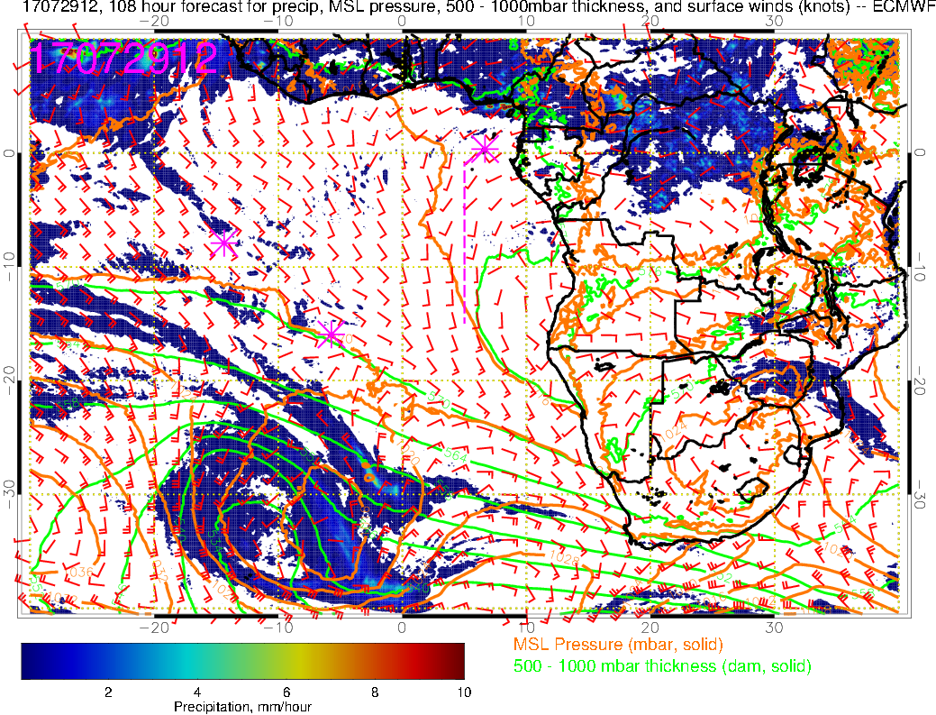
Precip
Mean SLP
500-1000mb thickness
Sfc winds
(7/29 12PM, ECMWF)
Surface low has propagated eastward and stalling
LOW

Slide 21
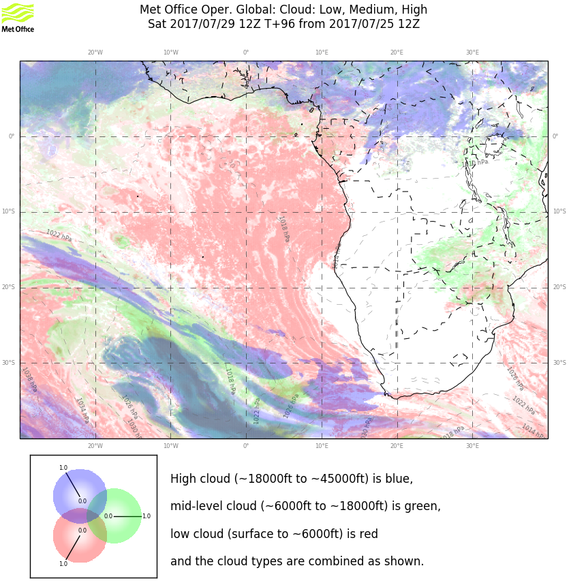
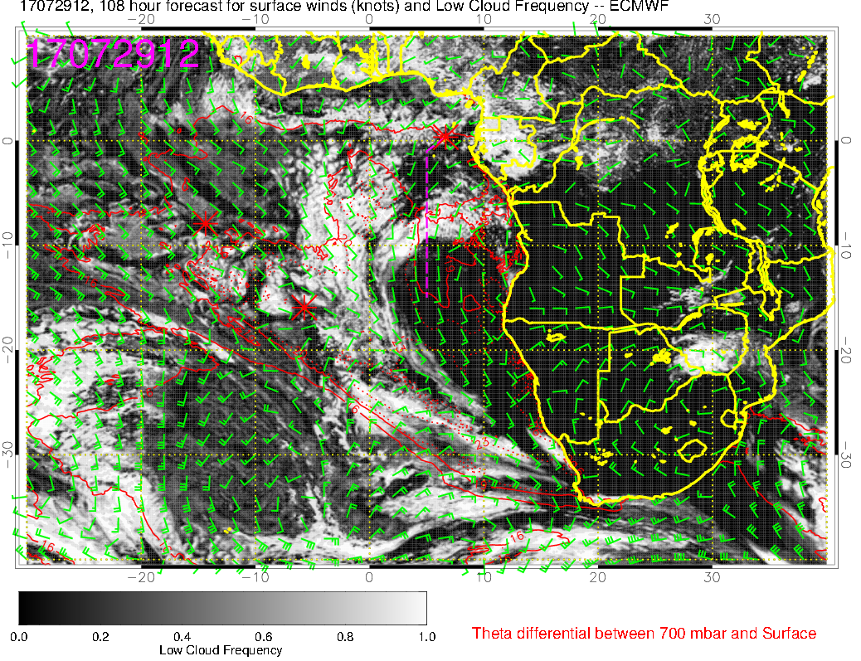
Low clouds (7/29 12PM)
ECMWF
UKMO
Not a lot of change (from 7/28) in low cloud forecasts along the routine flight track
Cloud-free region off Namibia coast expands in both models, but to a much larger extent in ECMWF model
Few middle clouds expected over Sao Tome (model agreement)

Slide 22
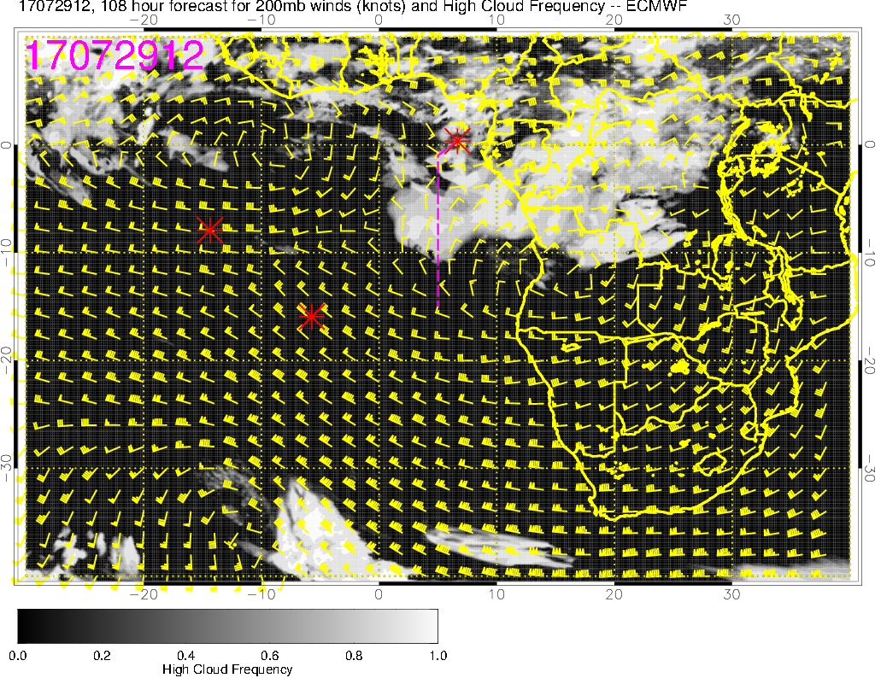
High clouds (7/29 12PM)
ECMWF
UKMO
Significant disagreement in high cloud forecast
ECMWF forecasts abundant high clouds north of 10S and over Sao Tome, while UKMO forecasts no high clouds in the vicinity

Slide 23
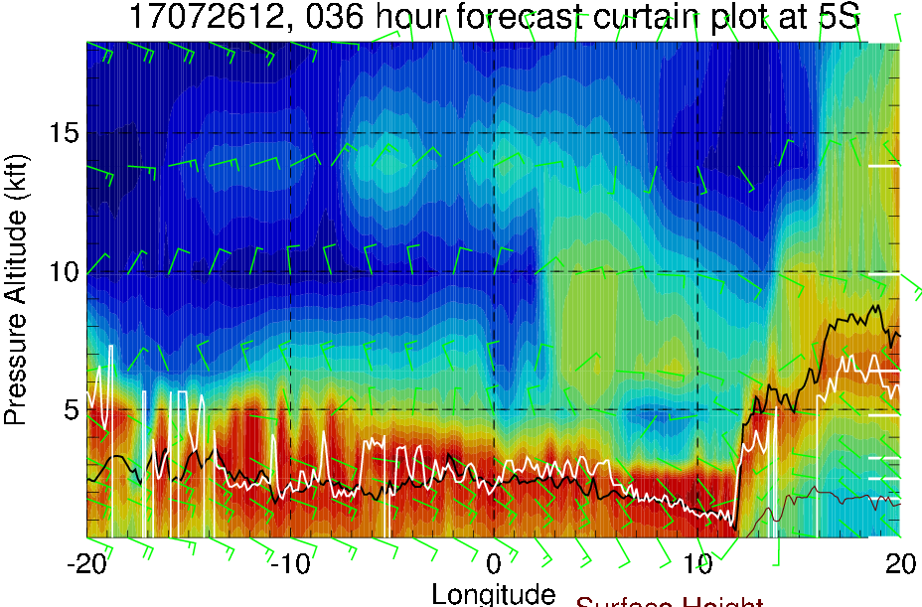
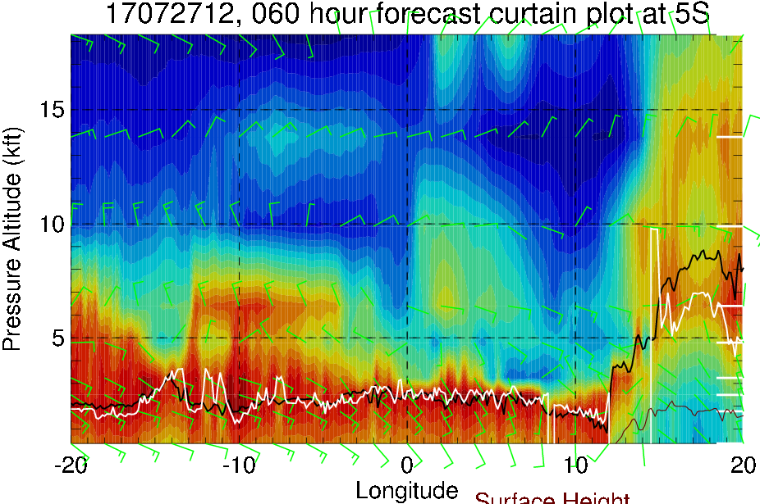
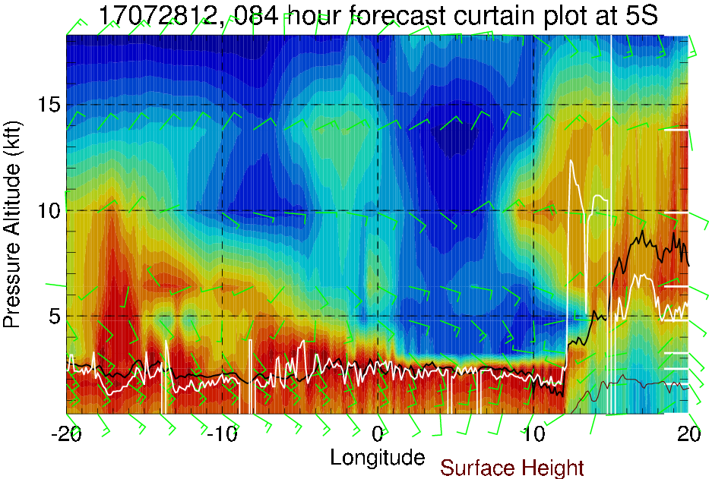
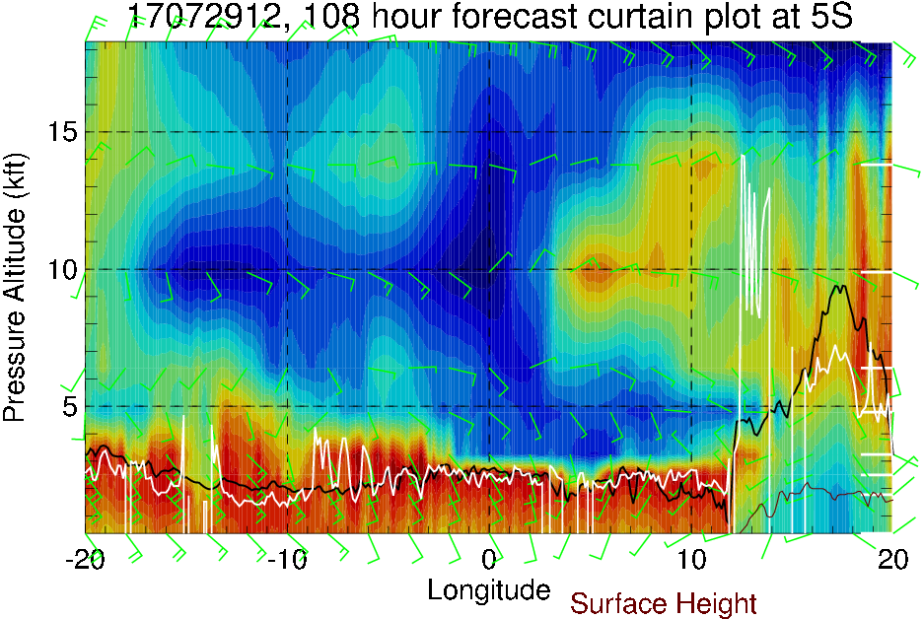
RH (color), BL height (black), cloud base height (white) cross sections at 5S
(ECMWF)
(7/26 12PM)
(7/27 12PM)
600mb
700mb
Boundary layer and cloud base heights are ~2-3 km west of 12E
(7/28 12PM)
(7/29 12PM)

Slide 24
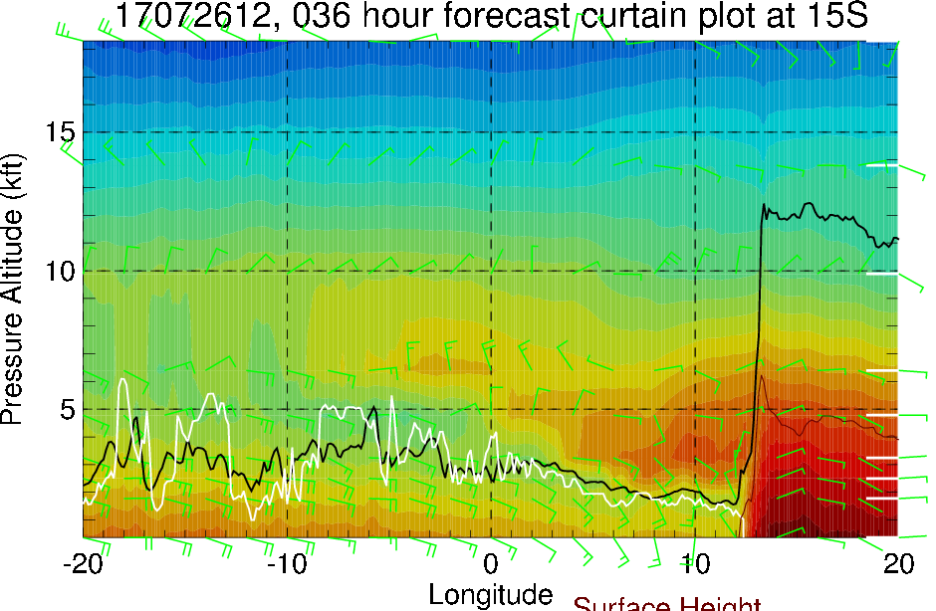
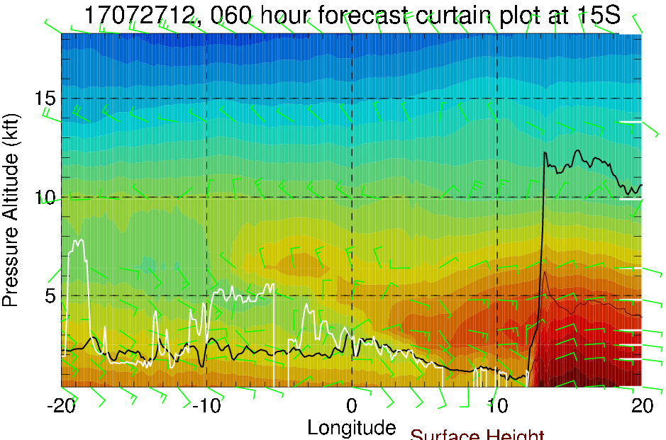
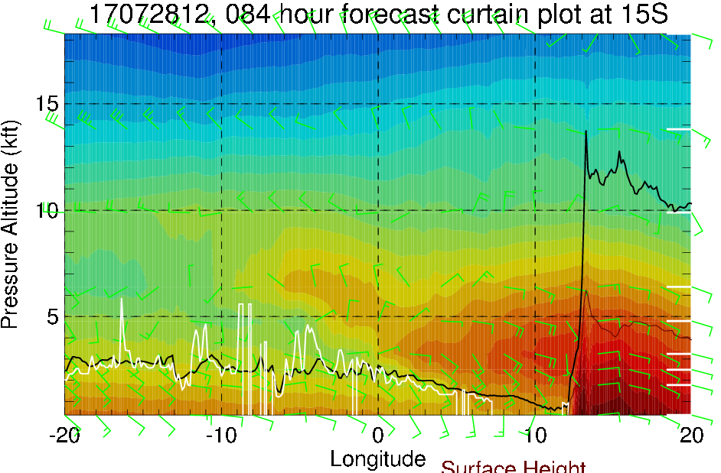
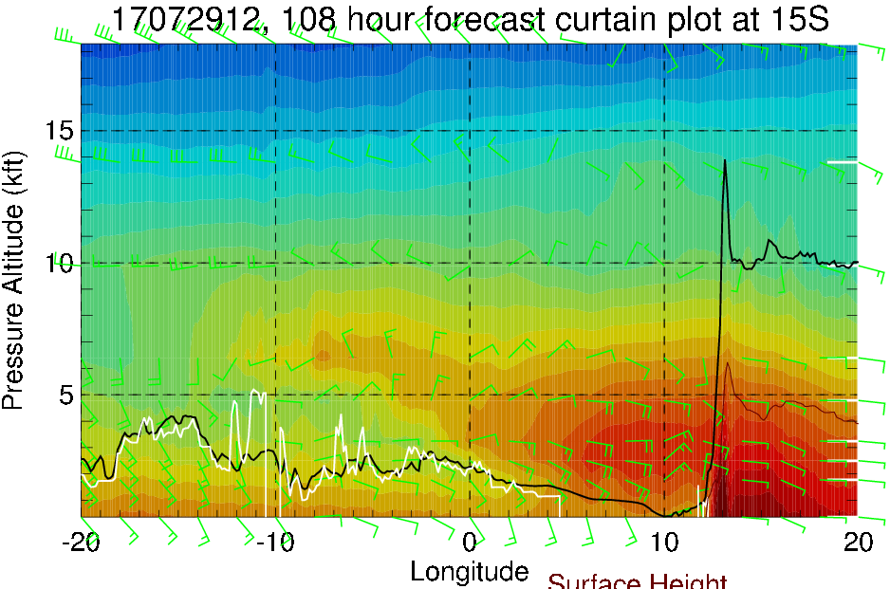
Possible explanation for the development of cloud-free region off Namibia coast…
Temperature (color), BL height (black), cloud base height (white) cross sections at 15S
(ECMWF)
(7/26 12PM)
(7/27 12PM)
600mb
700mb
Boundary layer east of the equator decreases with time (≤1 km at ~5E by 7/29)
Warm T and drying above the BL (most likely due to subsidence associated with the anticyclone) inhibit cloud formation near the coast
(7/28 12PM)
(7/29 12PM)

