Slide 1
ORACLES forecasting briefing Meteorology for 21-Jul-2017 (Fri) to 24-Jul-2017 (Mon)
20-Jul-2017
Lenny Pfister and Rei Ueyama

Slide 2
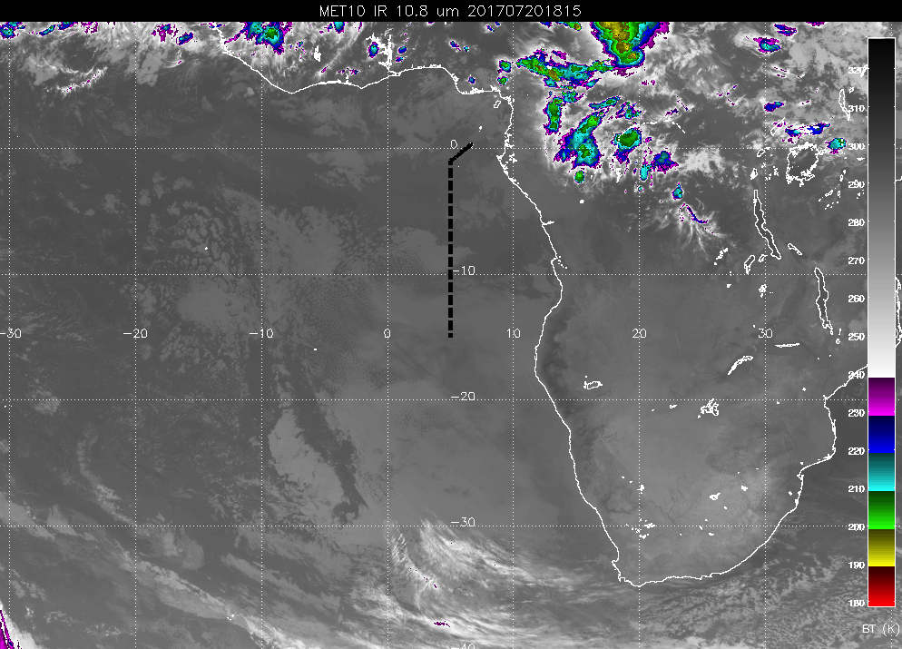
Latest IR image
(7/20 615PM)
low clouds (cloud top height ≤1.25 km) along flight track
cloud free

Slide 3
Friday (7/21)
Returning to climatological mean pattern of low clouds (i.e., low clouds filling in off Namibia coast) by early Saturday morning
TAF indicates cloud ceiling of ~3 kft (low clouds) at takeoff
Expect patches of low clouds along the routine flight track north of ~5S, and abundant low clouds southward
Very few (if any) middle and high clouds along flight track
Possible high clouds over Sao Tome at landing associated with offshore flow from inland daytime convection

Slide 4
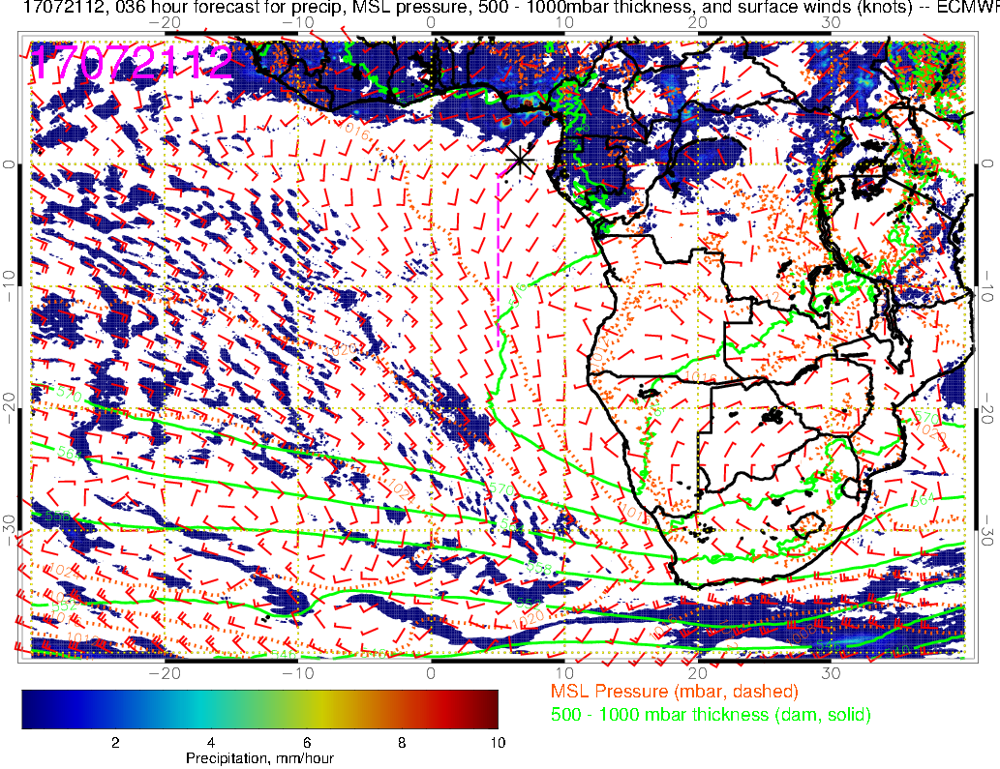
Precip
Mean SLP
500-1000mb thickness
Sfc winds
(7/21 12PM, ECMWF)

Slide 5
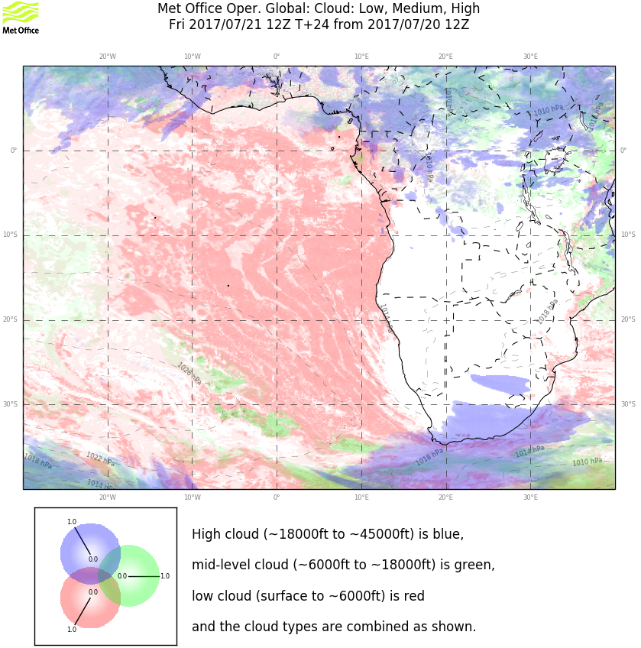
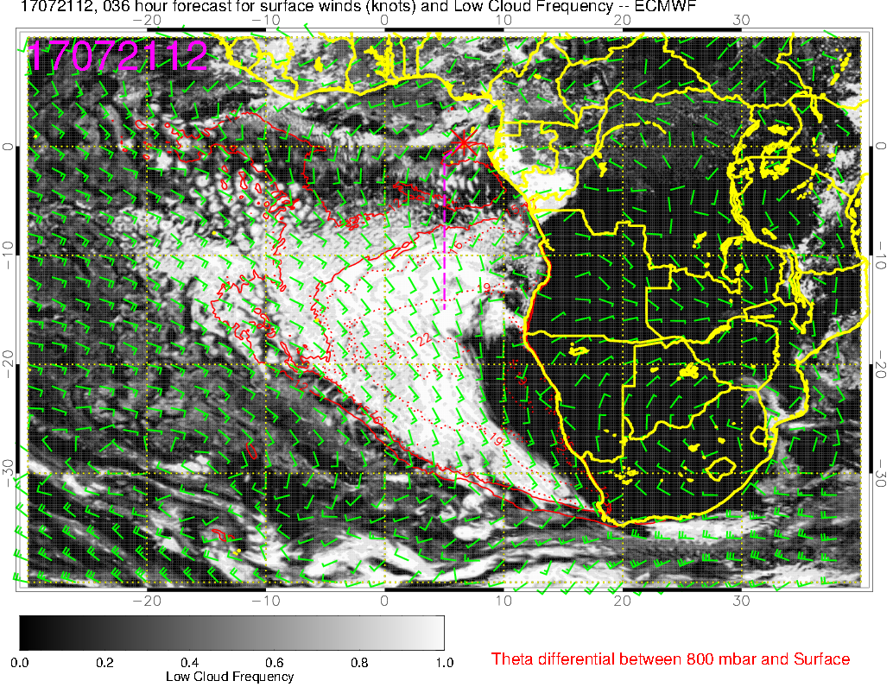
Low clouds (7/21 12PM)
ECMWF
UKMO
Cloud-free region off Namibia coast, gradually filling in
Abundant low clouds expected along flight track south of ~5S
Very few middle and high clouds (ECMWF not shown but agrees with UKMO)

Slide 6
Saturday (7/22)
Climatological mean conditions: surface high, low cloud deck with ~15 knot SSE winds off the Namibia coast
Abundant low clouds along the flight track
Very few (if any) middle clouds
Expect high clouds over Sao Tome. There is some model disagreement on the southward extent of these high clouds (down to ~5S); clear of high clouds south of 5S

Slide 7
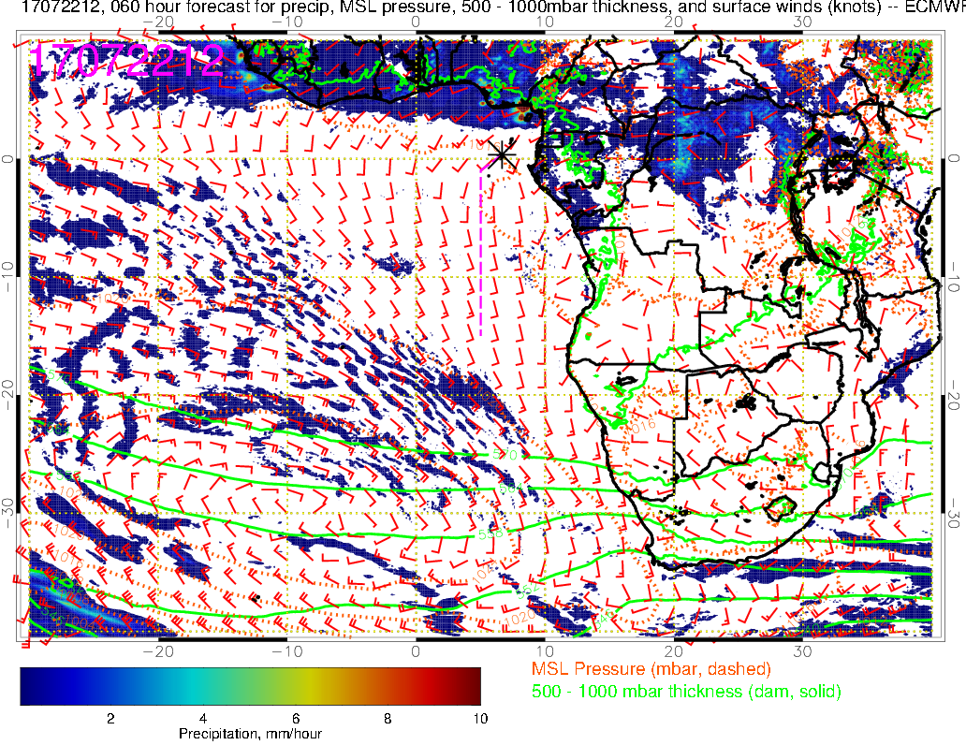
Precip
Mean SLP
500-1000mb thickness
Sfc winds
(7/22 12PM, ECMWF)
Stronger SEly winds (~15 kts) compared to previous day, closer to climatology

Slide 8
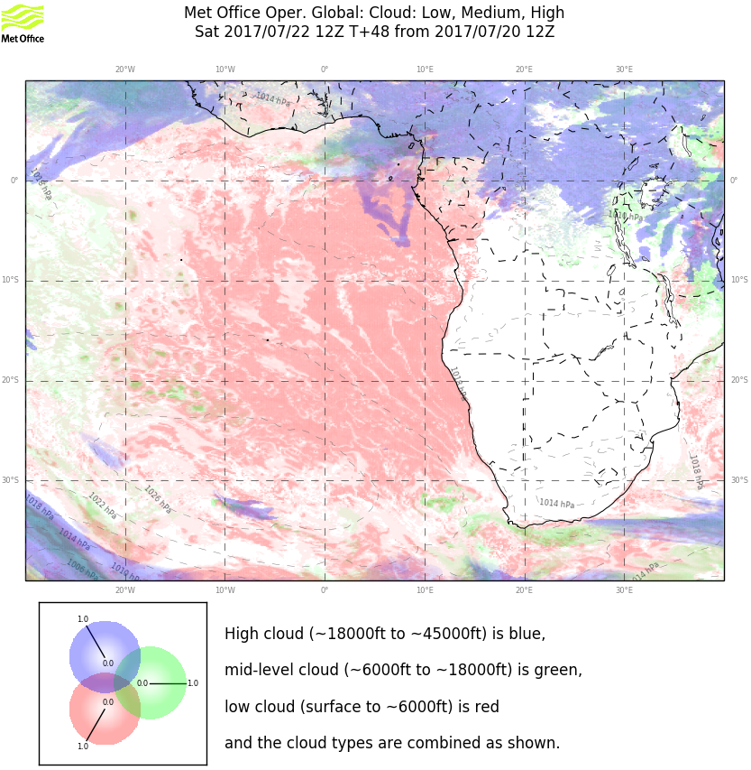
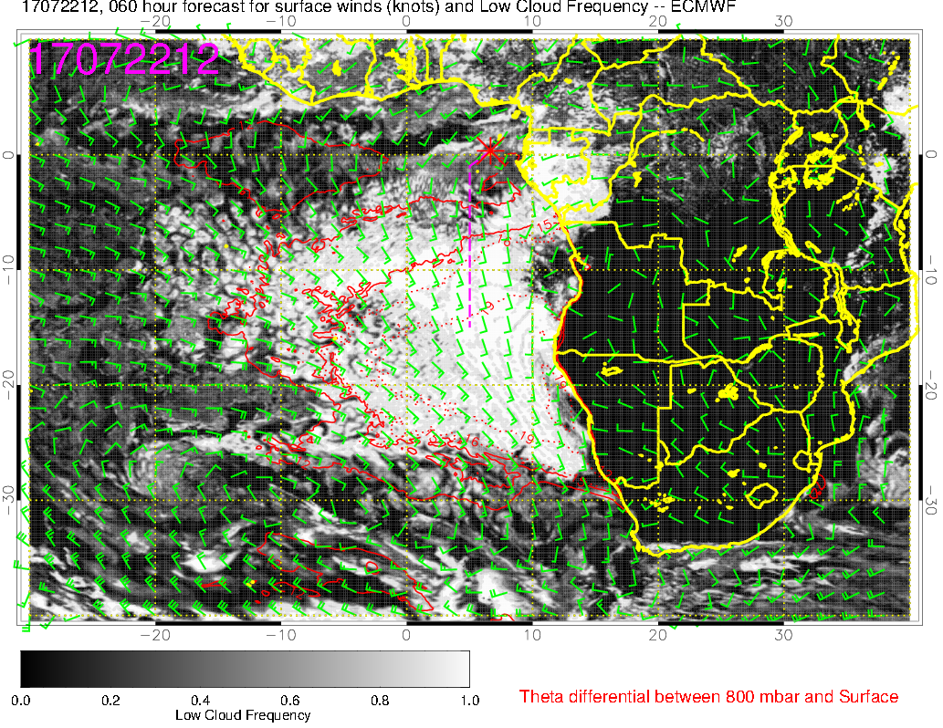
Low clouds (7/22 12PM)
ECMWF
UKMO
Vast region of low cloud cover, resembling climatology (greater southward extent)
Little or no middle clouds

Slide 9
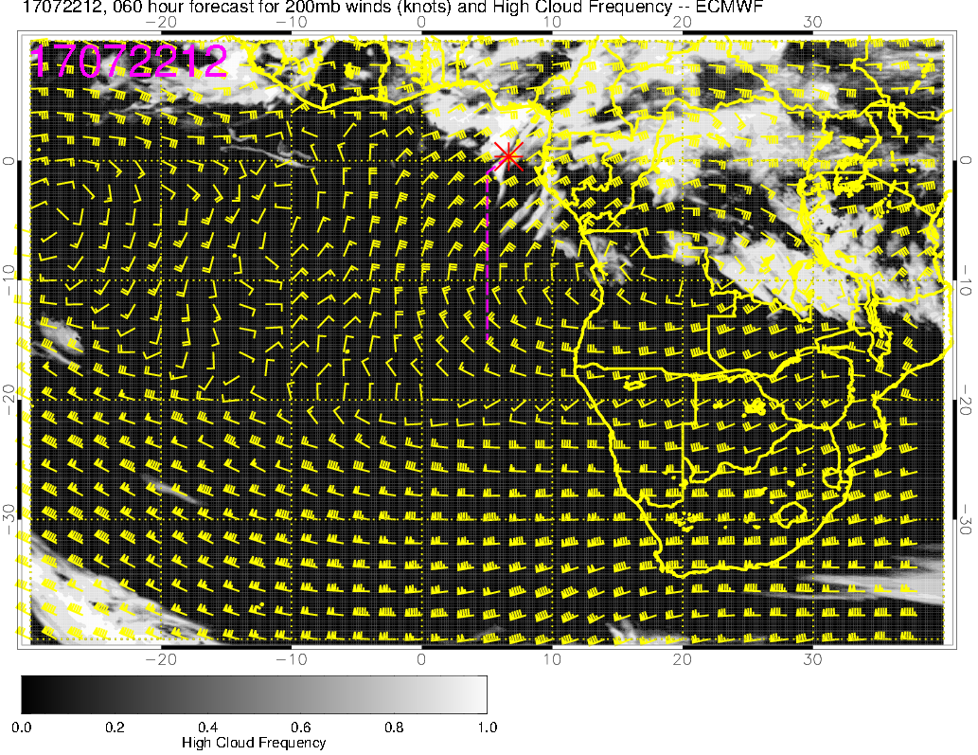
High clouds (7/22 12PM)
ECMWF
UKMO
High clouds expected over Sao Tome
Model disagreement on the southward extent of the high clouds along the flight track; clear south of ~5S

Slide 10
Sunday (7/23)
Upper-level (150-200mb) high moves offshore, with strong easterlies transporting convective moisture and high clouds offshore
Mid to upper level moisture starts to increase over the African continent east of Sao Tome (more on Monday)
Low and middle cloud forecasts similar to 7/22 forecasts
abundant low clouds along the flight track
very few (if any) middle clouds, but anomalously strong (compared to climatology) easterly flow at mid-levels (600mb) from inland fire region due to latitudinally displaced anticyclone)
Models disagree on the placement of high clouds: ECMWF predicts some high clouds along the flight track (north of 5S) while UKMO does not

Slide 11
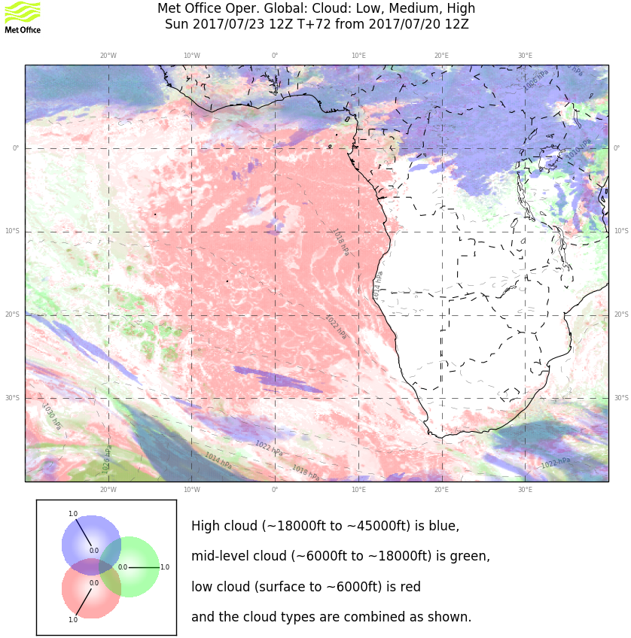
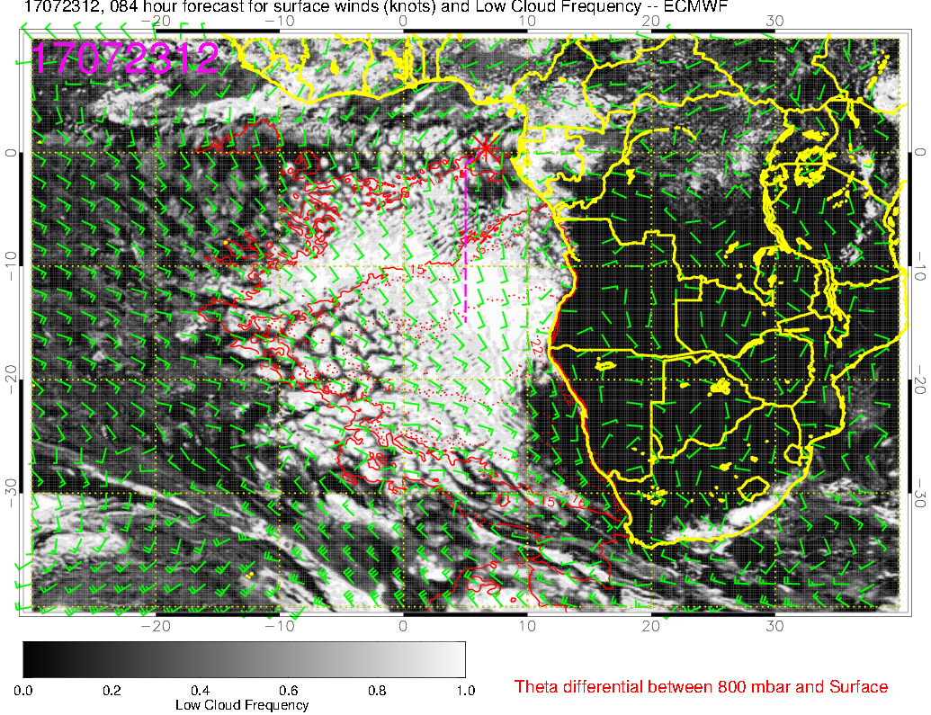
Low clouds (7/23 12PM)
ECMWF
UKMO
Not a lot of change in low clouds near flight track
little or no middle clouds (same as 7/22)

Slide 12
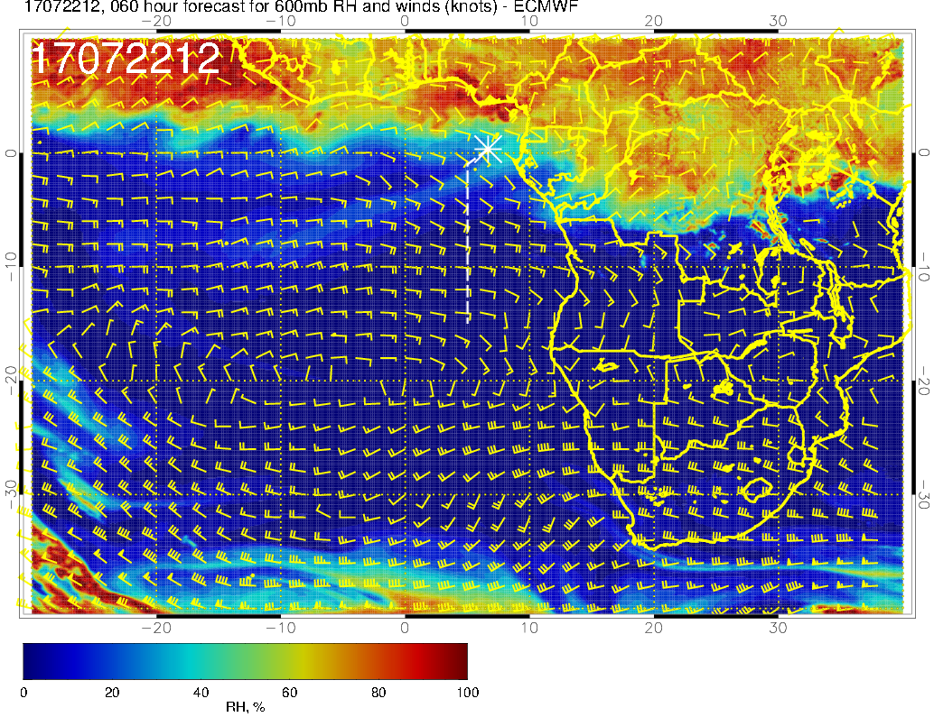
RH and winds @ 600mb
(7/22 12PM, ECMWF)
Some indications of dry convection (capped below 700mb) south of the moist convection region
H
Ely winds from the coast (and inland fire region) to the N-S leg of the flight track due to displaced high offshore; typically see NE winds here

Slide 13
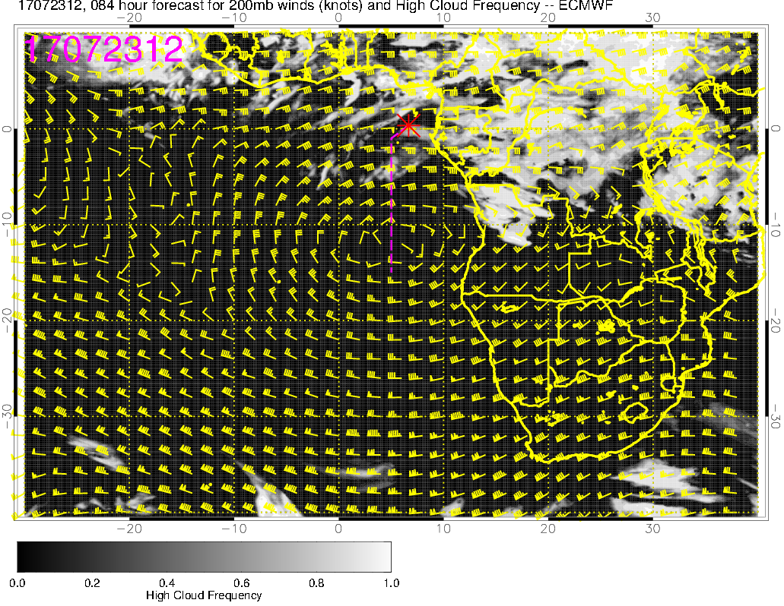
High clouds (7/23 12PM)
ECMWF
UKMO
Models disagree on the placement of the high clouds
ECMWF predicts high clouds along the flight track, while UKMO does not (opposite of Saturday 7/22 12Z forecasts)

Slide 14
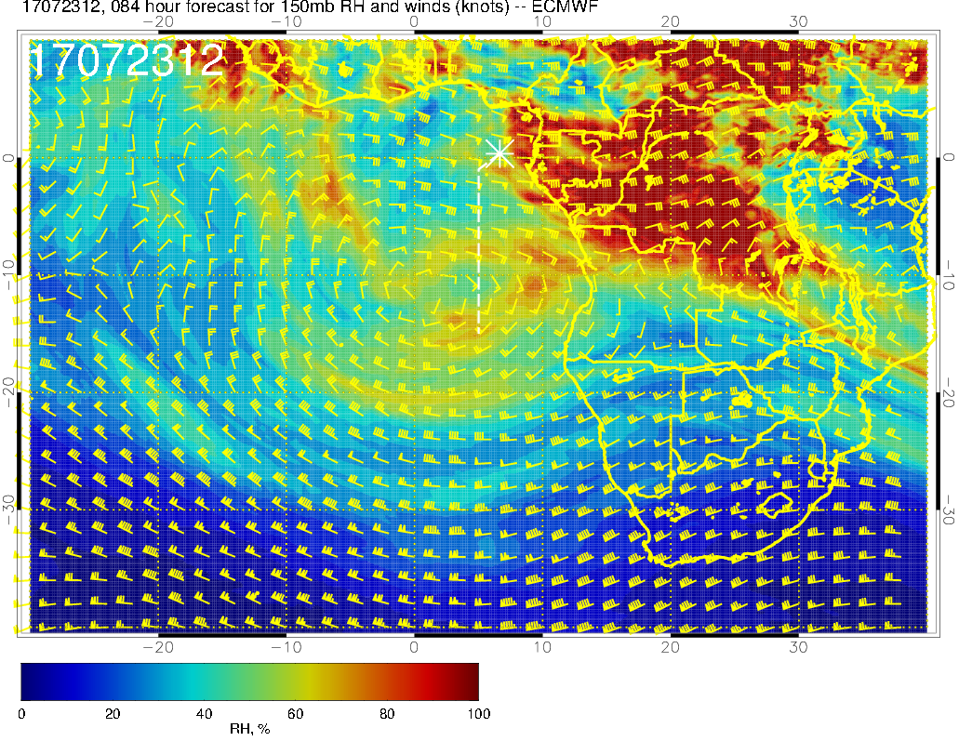
High clouds (7/23 12PM)
RH @ 150mb
ECMWF
High cloud forecasts are associated with a region of high RH at upper levels and easterly flow through them
This region of high RH air expands westward on Monday 7/24

Slide 15
Monday (7/24)
Mid to upper level moisture increases over the African continent east of Sao Tome
Abundant low clouds throughout the flight region (slightly higher cloud bases due to increasing BL height from 7/21 to 7/24)
Expect some middle clouds at Sao Tome associated with the westward push of mid-level moisture
Models disagree on high cloud cover: ECMWF predicts extensive high clouds at Sao Tome, while UKMO forecasts place them further north

Slide 16
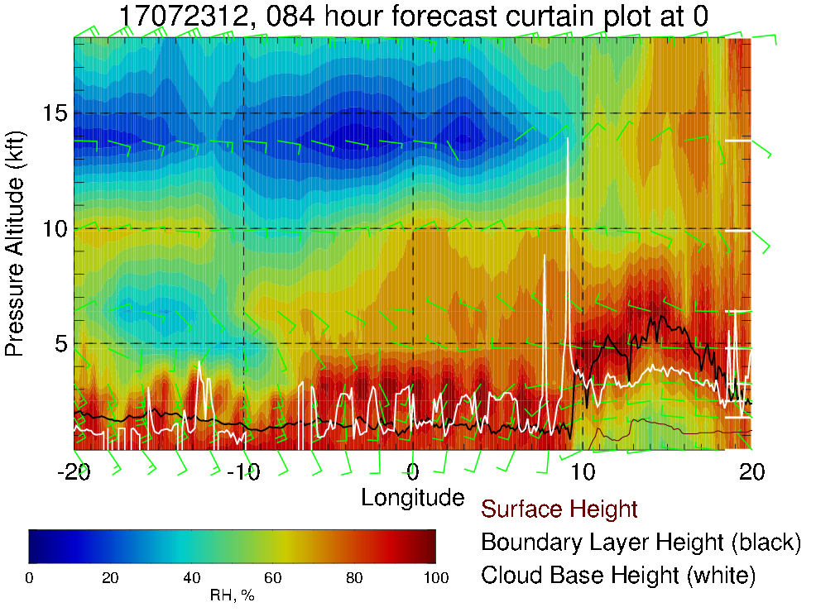
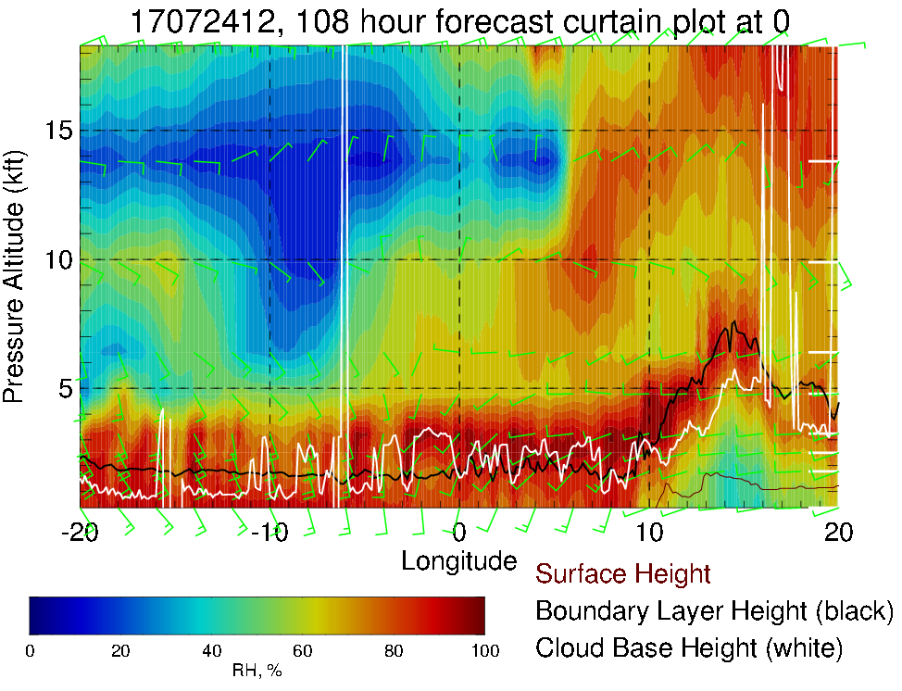
RH cross-section along the equator
(7/23 12PM)
ECMWF
(7/24 12PM)
600mb
700mb
Westward intrusion of high RH air at mid levels (600mb) from Sun 7/23 to Mon 7/24

Slide 17
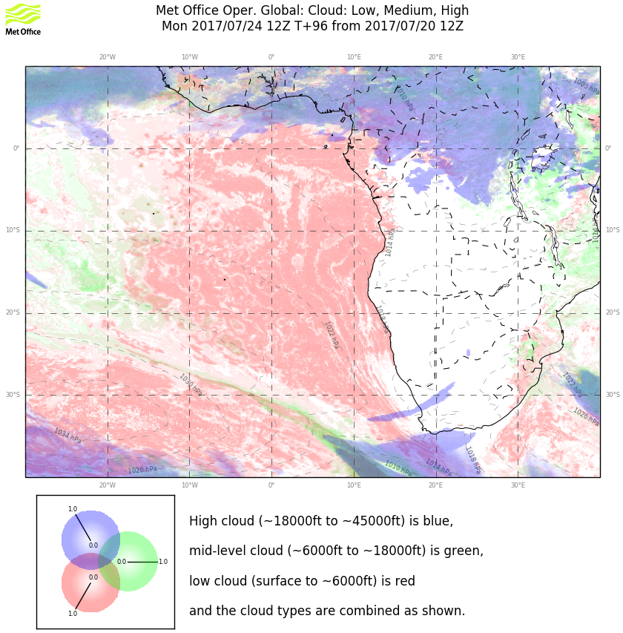
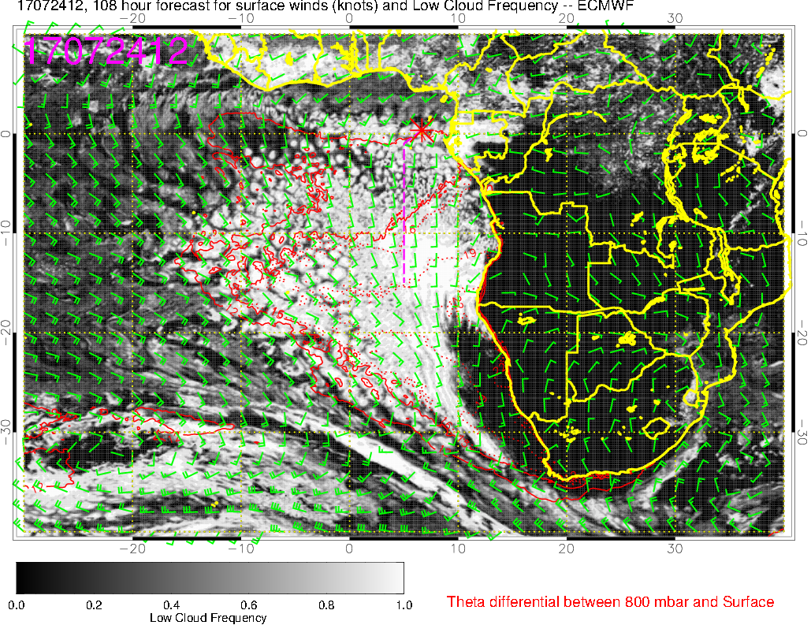
Low clouds (7/24 12PM)
ECMWF
UKMO
Abundant low clouds in the flight region
Cloud free region begins to develop off Namibia coast

Slide 18
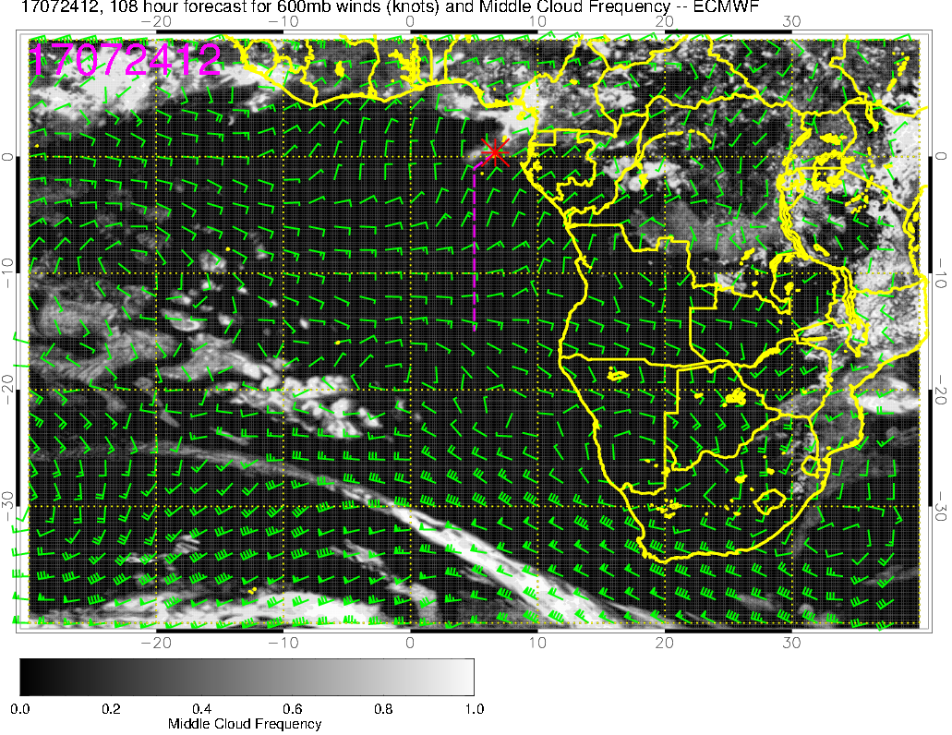
Middle clouds (7/24 12PM)
ECMWF
UKMO
General agreement between models
ECMWF forecasts middle clouds over Sao Tome, less in UKMO

Slide 19
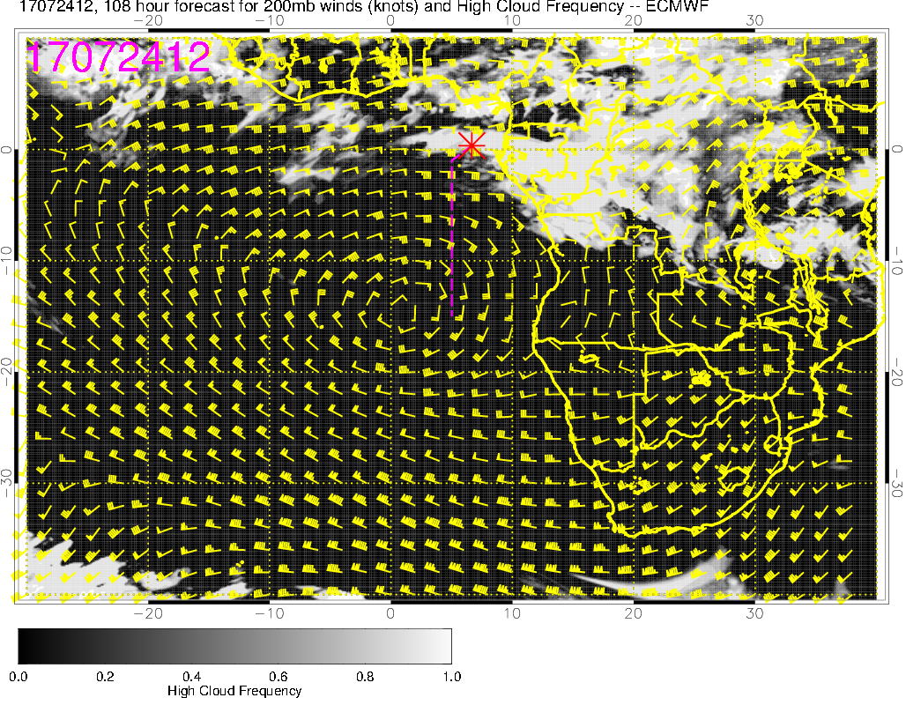
High clouds (7/24 12PM)
ECMWF
UKMO
Models disagree on the distribution of high clouds
ECMWF predicts extensive high cloud cover over Sao Tome, while UKMO high clouds are concentrated further north

