Slide 1
ORACLES Weather Briefing Saturday, July 15
Lenny Pfister and Rei Ueyama

Slide 2
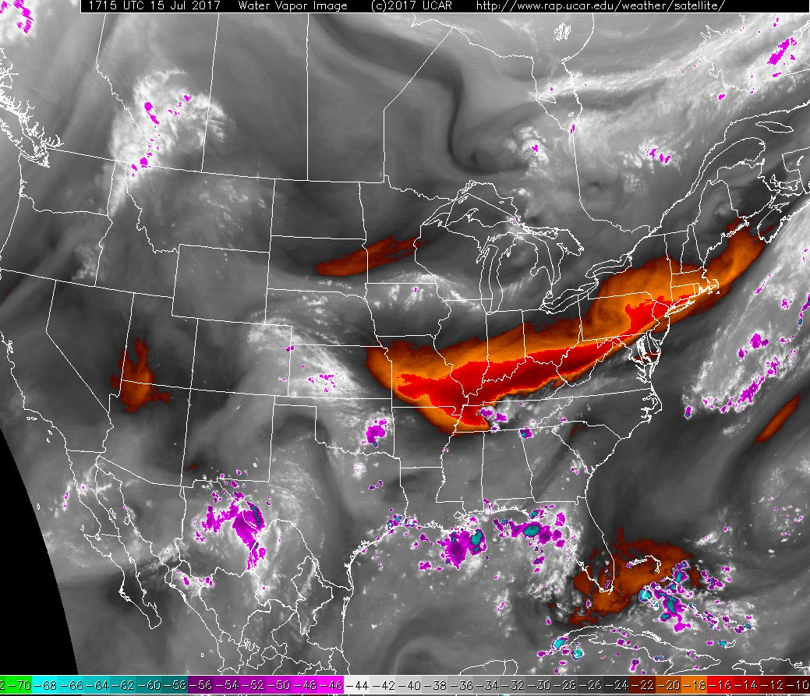
Water Vapor imagery on Saturday 7/15 at 1:15PM

Slide 3
Summary
As forecasted, had a lot of T-storm activity last night. Shortwave trough has passed through. Today, significant precip will be confined to VA/NC border region.
The main upper level trough that drove this development is well to the northwest (around the eastern Great Lakes) and slowly moving eastward. Will stall and amplify, giving us ample high clouds offshore on Monday (more than Sunday). Latest runs have this trough moving through a bit faster than yesterday’s runs, but it will still not be out to sea until Wednesday. (This change in the forecast has no substantial implications for us unless we do test flights past Tuesday.)
High cloud forecasts are generally stable for Sunday and Monday. Sunday shows substantially less high cloud than Monday with high cloud-free region off the coast of NJ on Sunday.
Low cloud forecasts are also stable. Very few low clouds on Sunday, except some near VA/NC border (and offshore from that). A bit more low clouds offshore from KWAL (accessible by aircraft) on Monday.
Precip on Sunday to the S and SE of KWAL. EC model shows significant forecast-to-forecast changes in Monday’s precip. Given the amplifying upper-level trough on Monday and its associated high clouds off the east coast, some precip ought to be expected in our region on Monday.

Slide 4
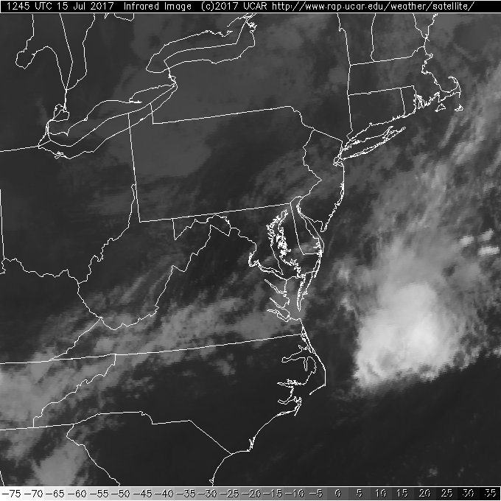
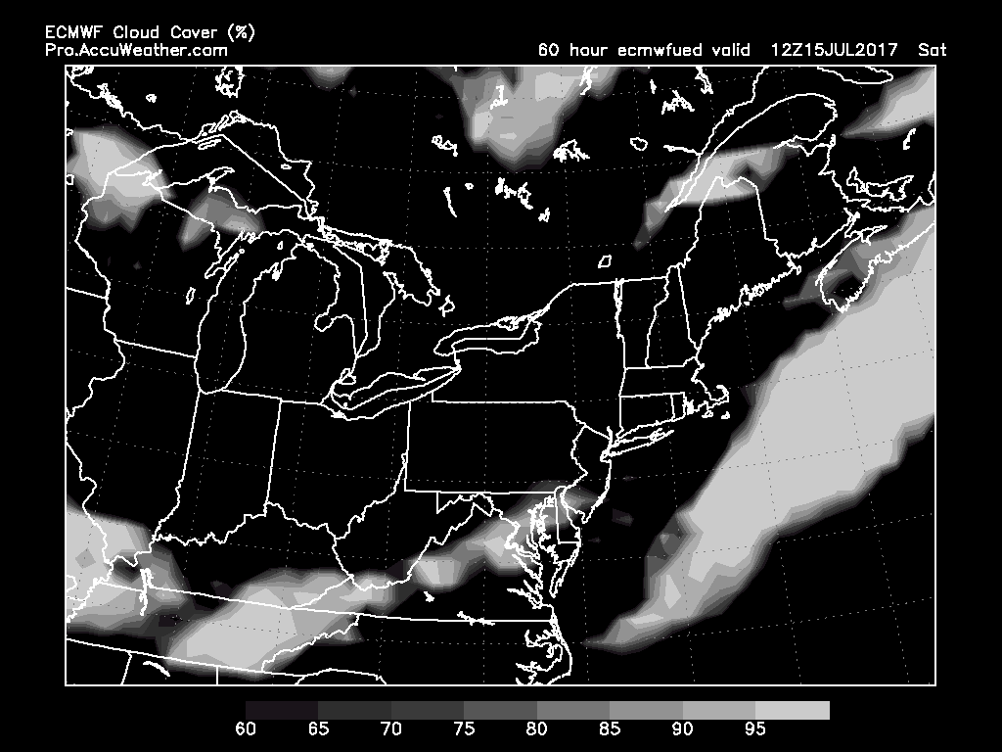
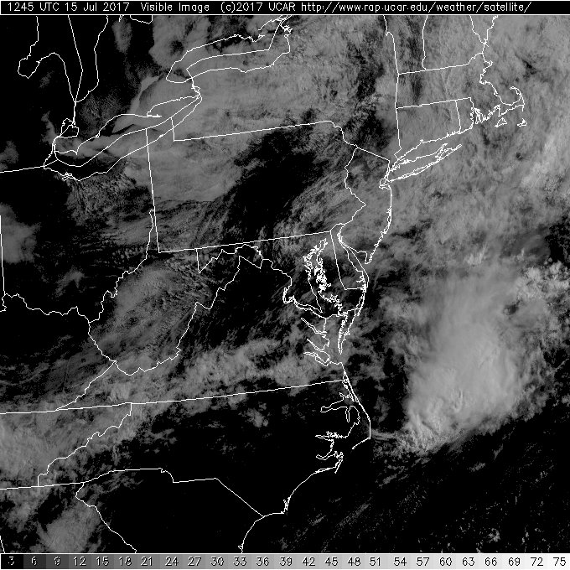
Saturday 7/15, 8:45am
(observed)
Saturday 7/15, 8am
(high cloud forecast from yesterday)
IR
Current pictures (left, 1245Z today), right is high cloud forecast from Thursday’s briefing Not bad.
Currently have scattered clouds at 10kft at KWAL.
Visible

Slide 5
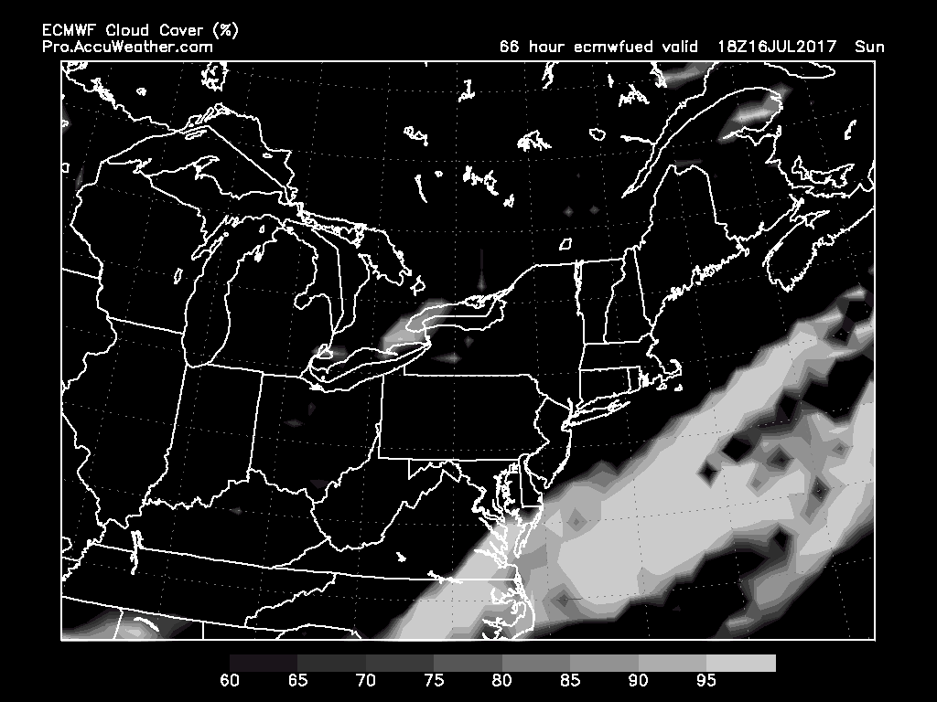
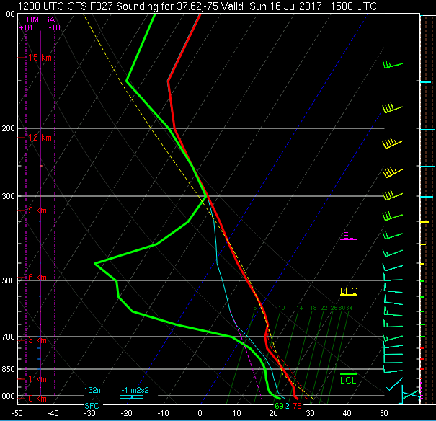
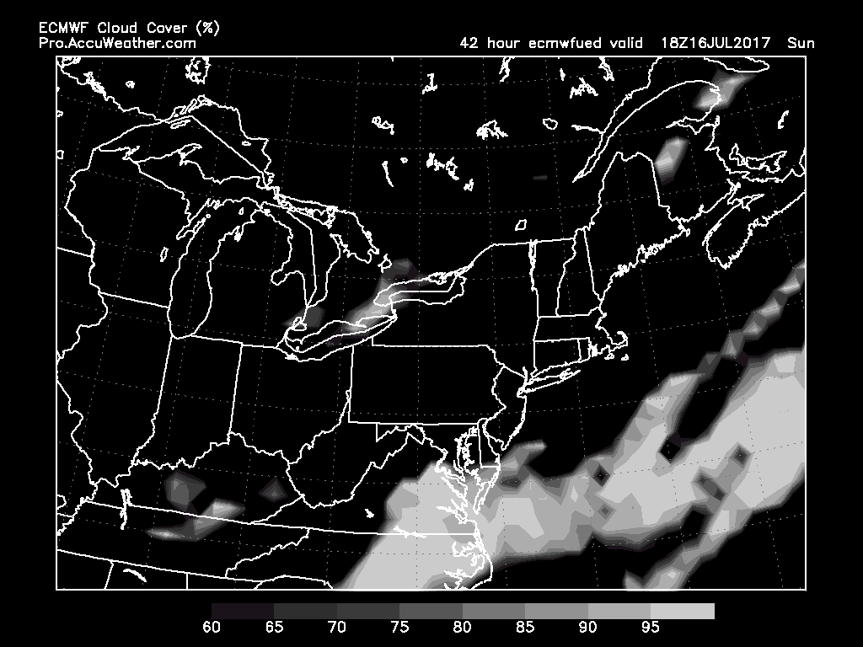
7/16 Sun 2PM
(66-hr forecast)
SUNDAY HIGH CLOUDS
Forecast comparison:
high cloud forecast from yesterday (top) vs. today’s forecast (bottom)
Arguably, things have improved (i.e., less clouds offshore NJ in today’s forecast)
Forecast sounding (GFS; off the coast of KWAL) indicate that high cloud base is ~30 kft (above aircraft ceiling)
7/16 Sun 2PM
(42-hr forecast)
7/16 Sun 11AM

Slide 6
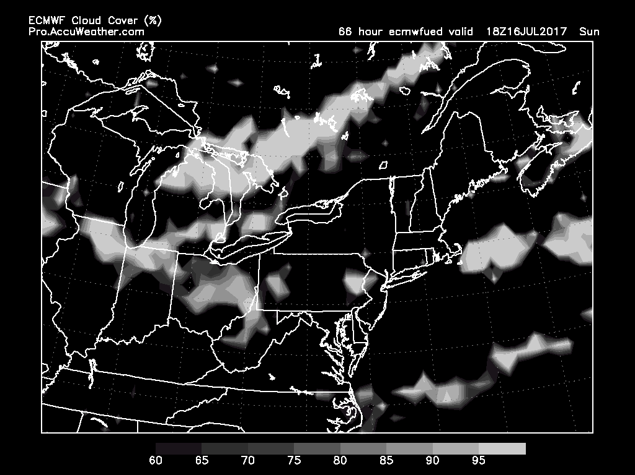
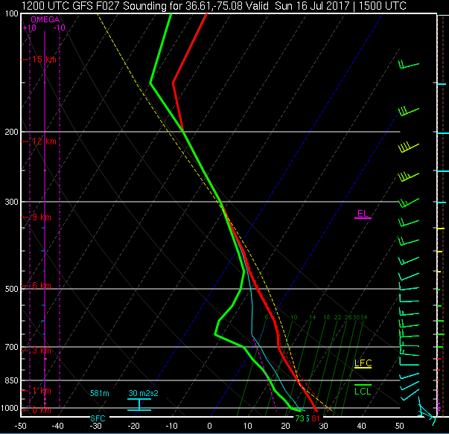
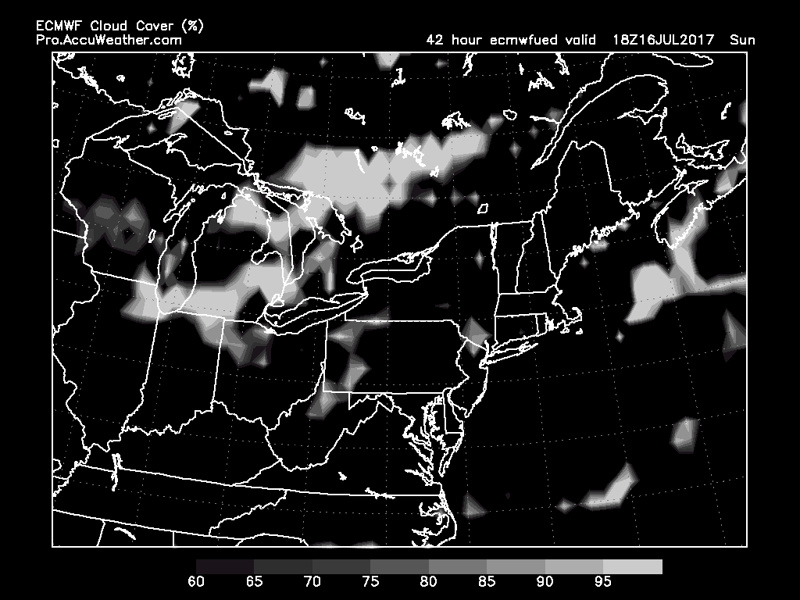
7/16 Sun 2PM
(66-hr forecast)
SUNDAY LOW CLOUDS
Low cloud forecast is stable - basically very little.
Indication of few low clouds off the coast of VA/NC border, but expect some middle clouds (with base ~20 kft) there also (see forecast sounding below).
7/16 Sun 2PM
(42-hr forecast)
7/16 Sun 11AM

Slide 7
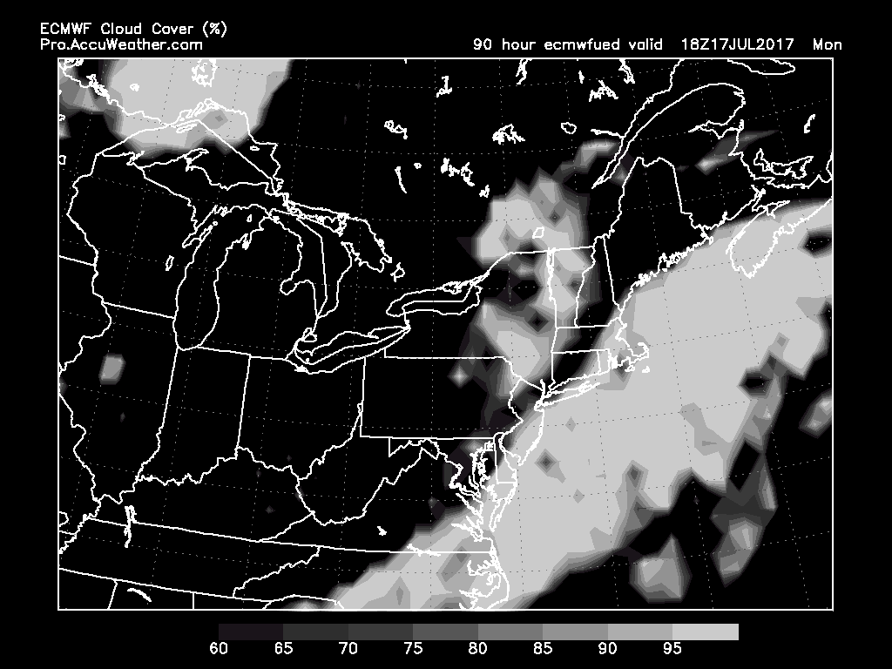
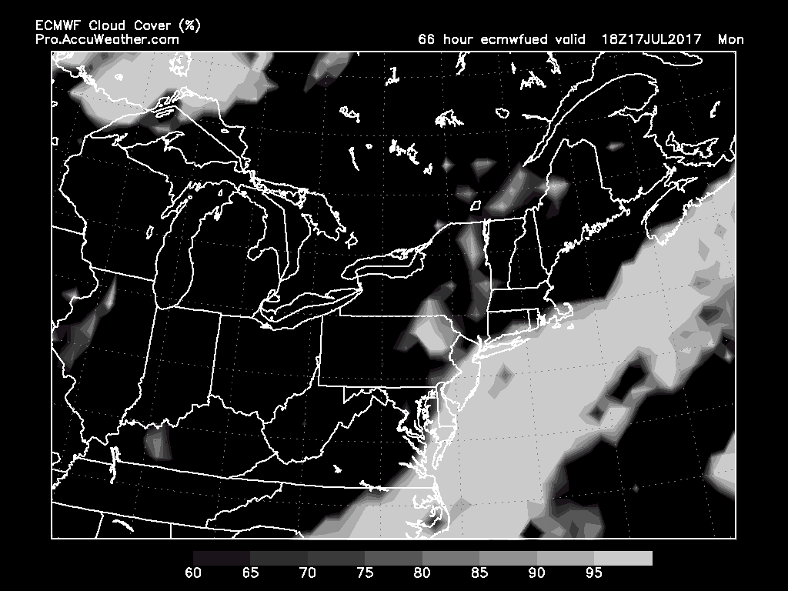
7/17 Mon 2PM
(90-hr forecast)
MONDAY HIGH CLOUDS
High cloud forecast is stable – vast region of high cloud cover
7/17 Mon 2PM
(66-hr forecast)

Slide 8
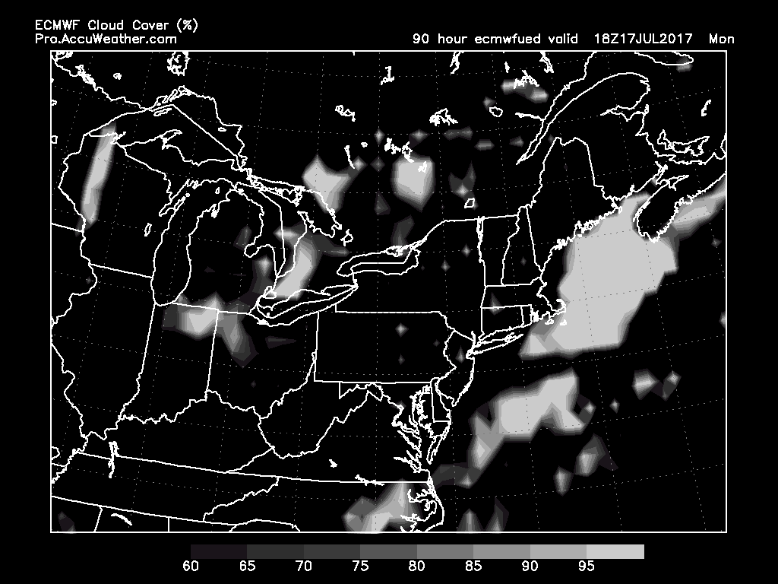
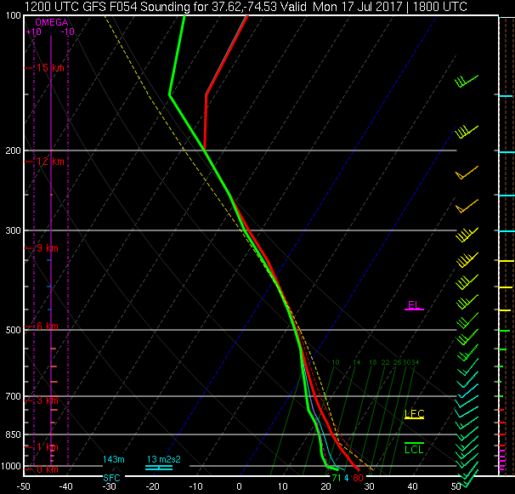
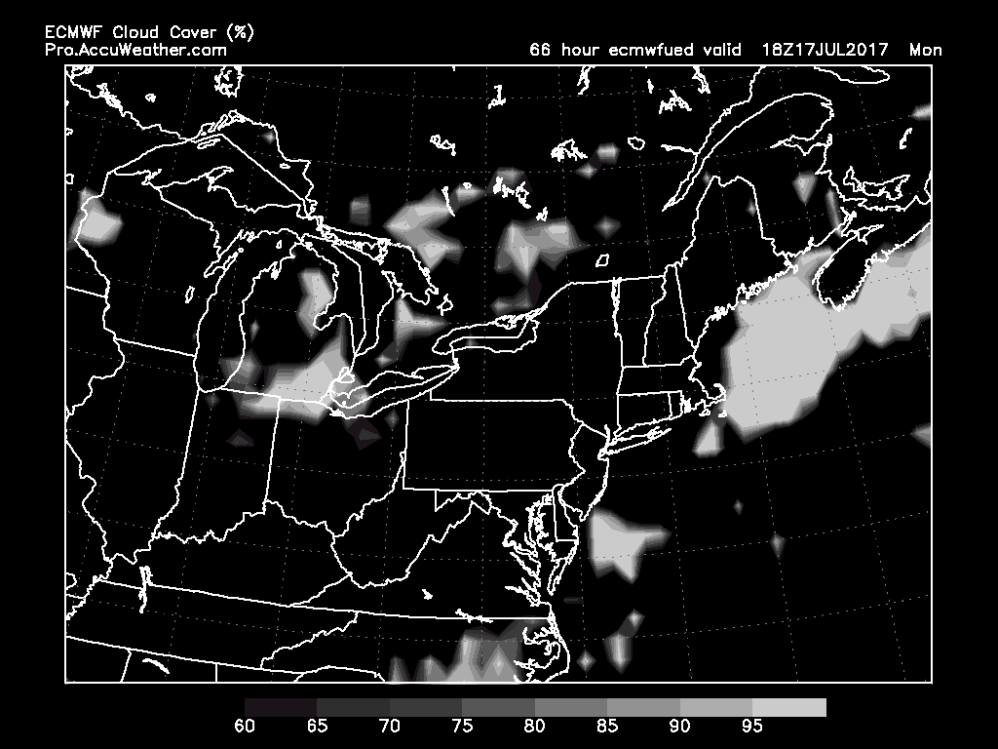
7/17 Mon 2PM
(90-hr forecast)
MONDAY LOW CLOUDS
Forecast very stable for this.
GFS (forecast sounding below) does not quite get the low clouds that EC does offshore, but both models suggest that low clouds are clearly accessible by the aircraft.
7/17 Mon 2PM
(66-hr forecast)
7/17 Mon 2PM

Slide 9
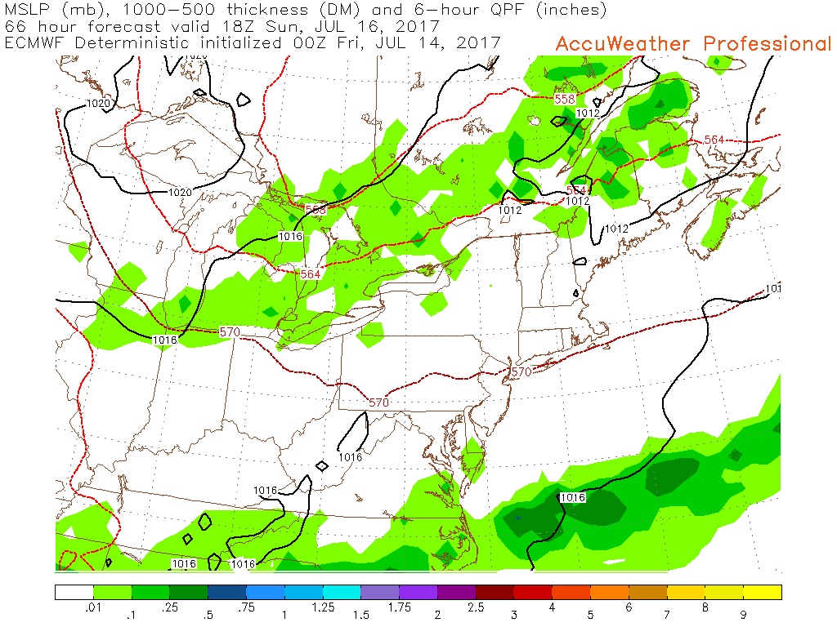
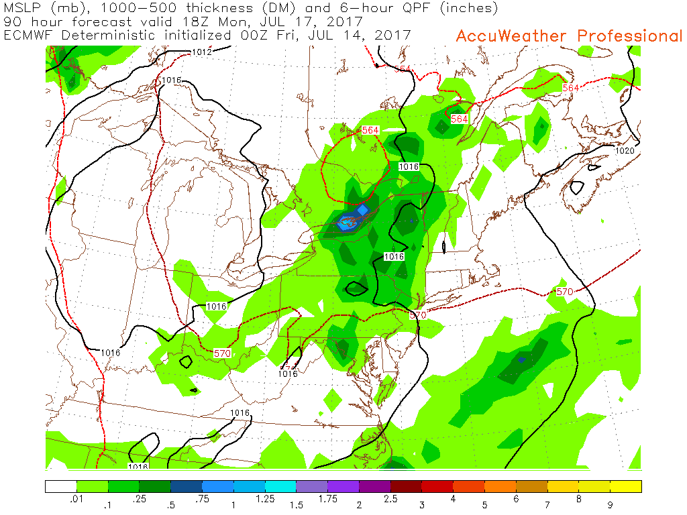
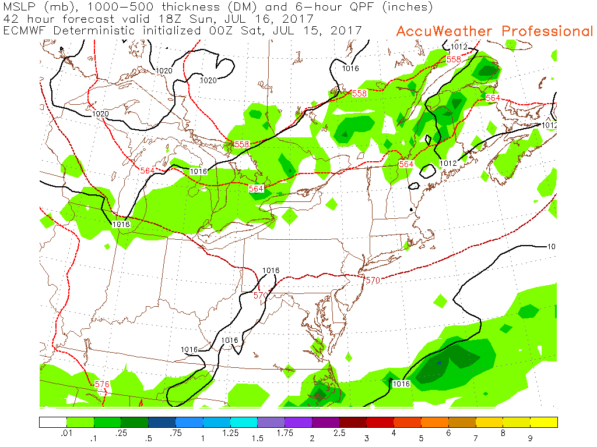
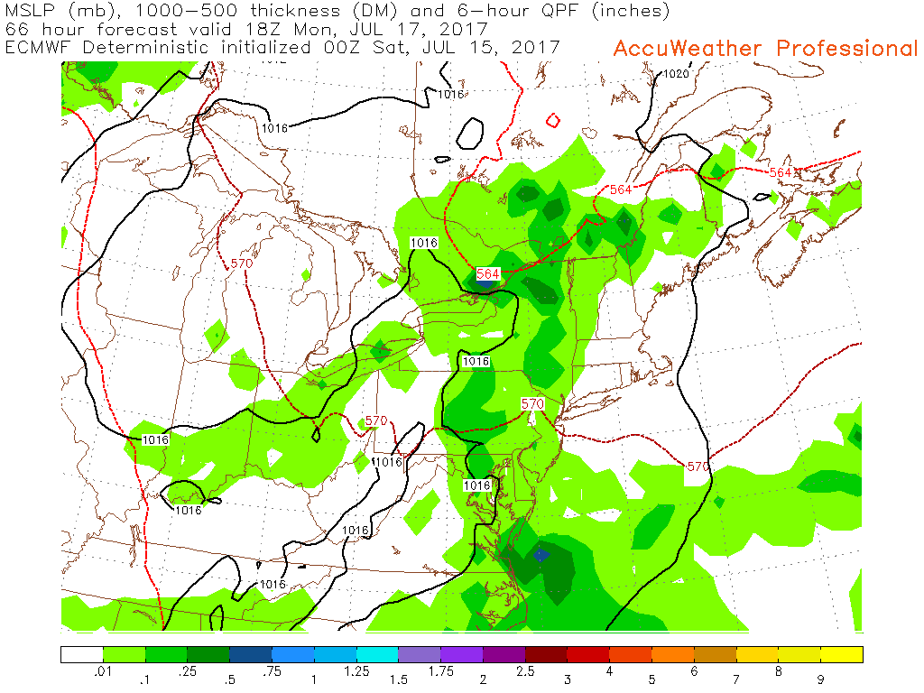
SUNDAY PRECIP
MONDAY PRECIP
7/16 Sun 2PM
(66-hr forecast)
7/17 Mon 2PM
(90-hr forecast)
Monday’s forecast is not stable. Precip, mostly convective this time of year, can be arbitrary to forecast, so “blob” at the VA/NC border is still highly uncertain.
Sunday’s forecast is stable – precip to the S-SE
7/16 Sun 2PM
(42-hr forecast)
7/17 Mon 2PM
(66-hr forecast)

