Slide 1
Weather Briefing for ORACLES test flight
Friday, July 14
(Bastille Day)

Slide 2
Summary
Trough moving in from the NW will yield > 50% probabilities of severe weather by this evening. Had some T-storms last night associated with a preliminary wave, now exiting.
Cold front passes late tonight and settles down near VA/NC border as associated trough stalls to the west of us, yielding quieter weather through Sunday. The front to the south dissipates by Monday.
Trough stalls just to the west of us, and amplifies a bit -- is not progged to move out until Wednesday (though EC is faster on this).
Very little low cloud (if any) offshore Saturday because of drying behind the front. Some areas of high RH at low levels appear offshore on Sunday, increasing Monday and Tuesday (GFS). EC shows increasing low cloud within range Sunday, more Monday. Models differ on the details/location of possible low cloud.
All this is related to the front/trough system, so there is likely to be: (1) few low clouds within range on Sunday, more Mon and Tue; (2) high clouds offshore (see also the 250mb RH plots from GFS); (3) some precip to the south-southeast.

Slide 3
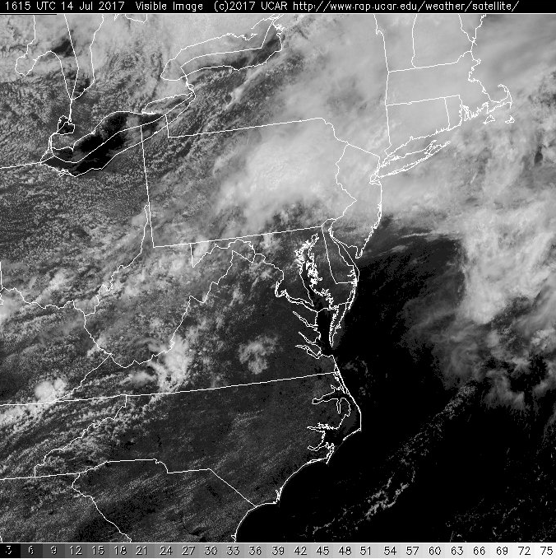
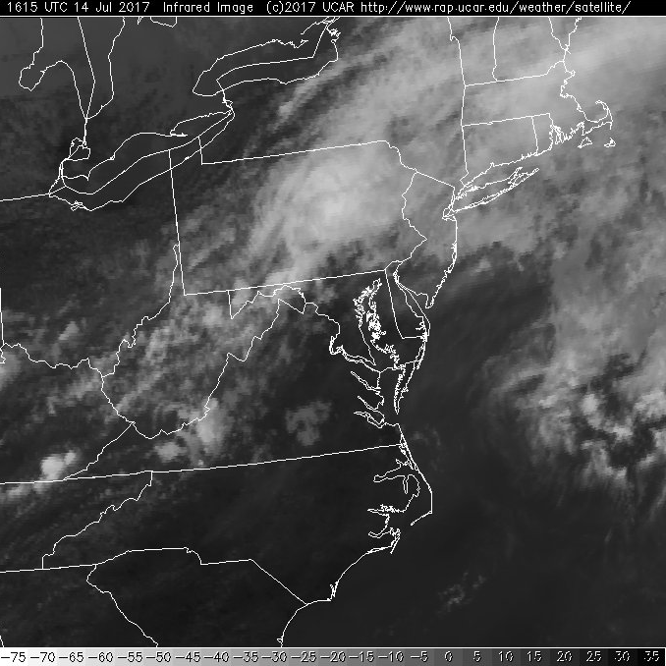
Visible
IR
1215 PM satellite image – mostly high cloud – Wallops reported a few low clouds.
T-storm last night

Slide 4
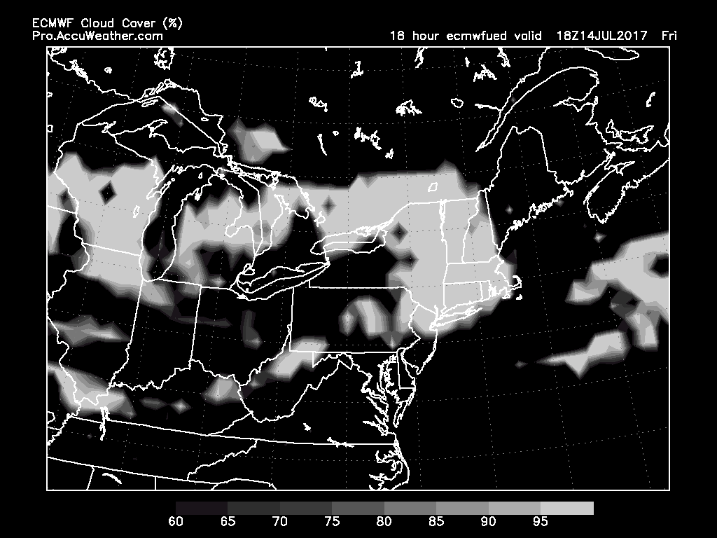
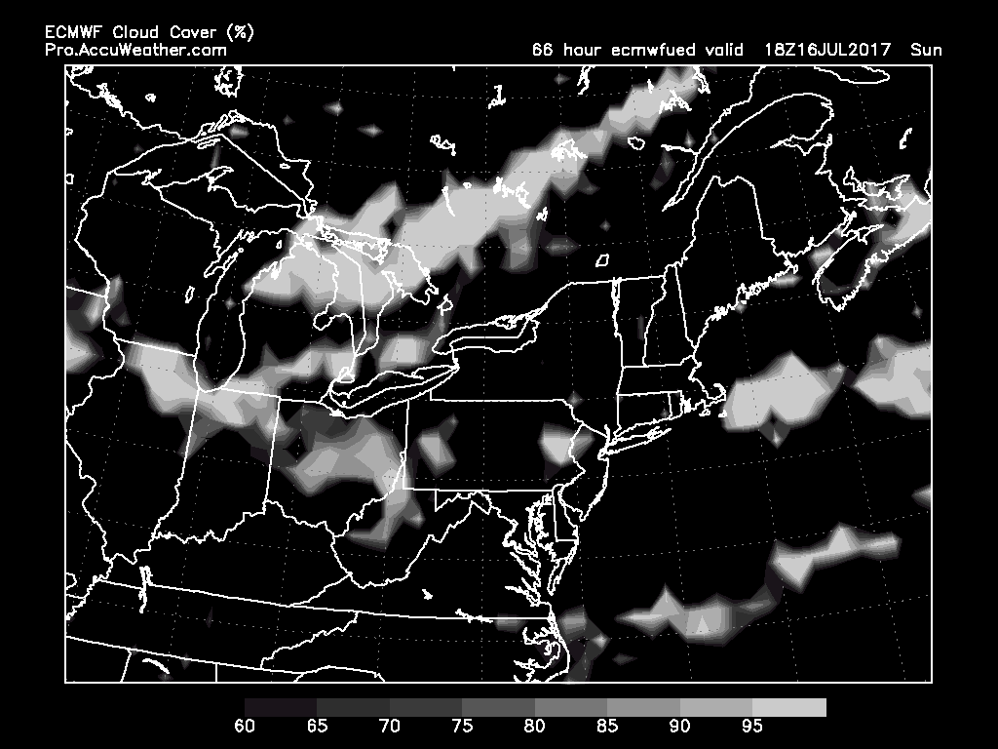
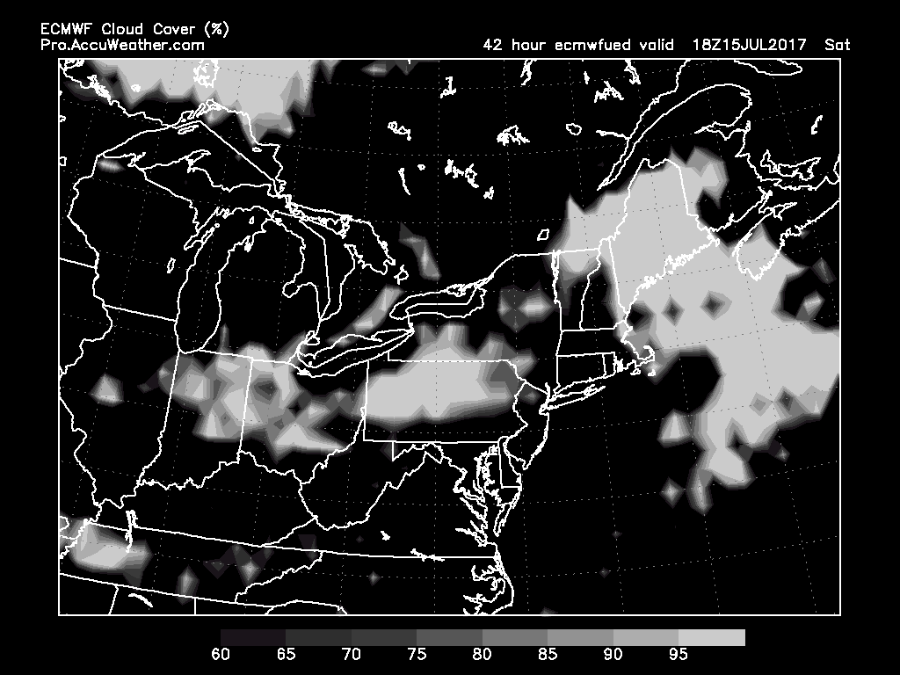
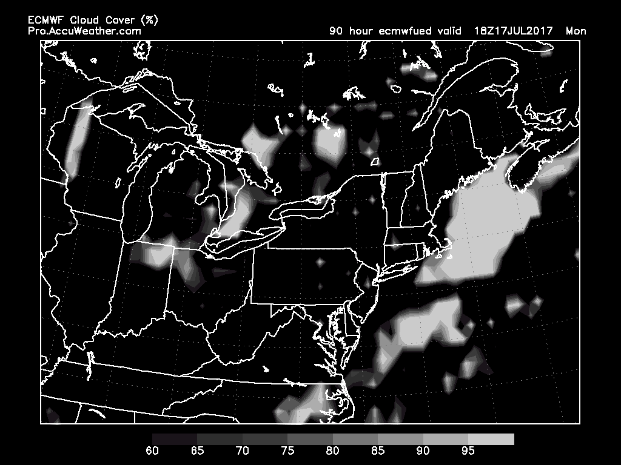
7/14 Fri 2PM
7/16 Sun 2PM
LOW CLOUD
7/15 Sat 2PM
7/17 Mon 2PM

Slide 5
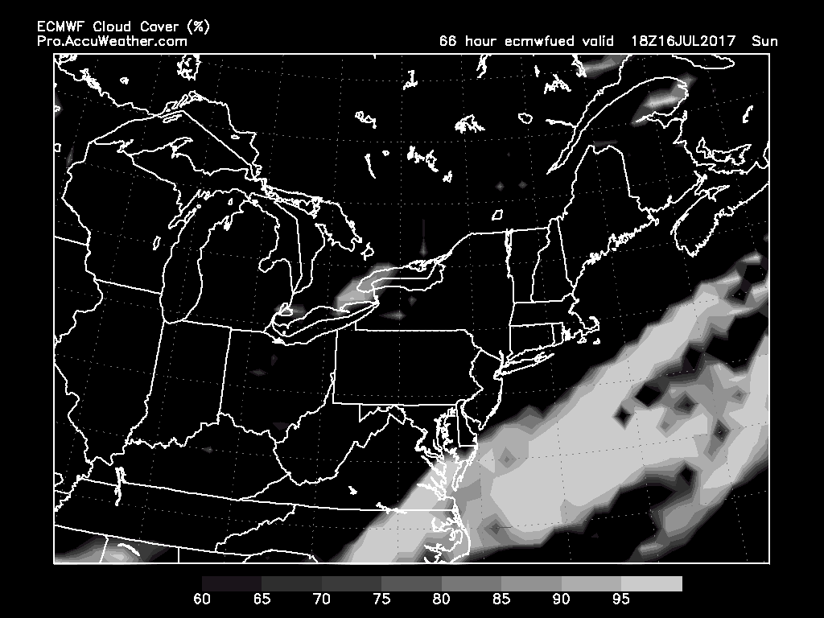
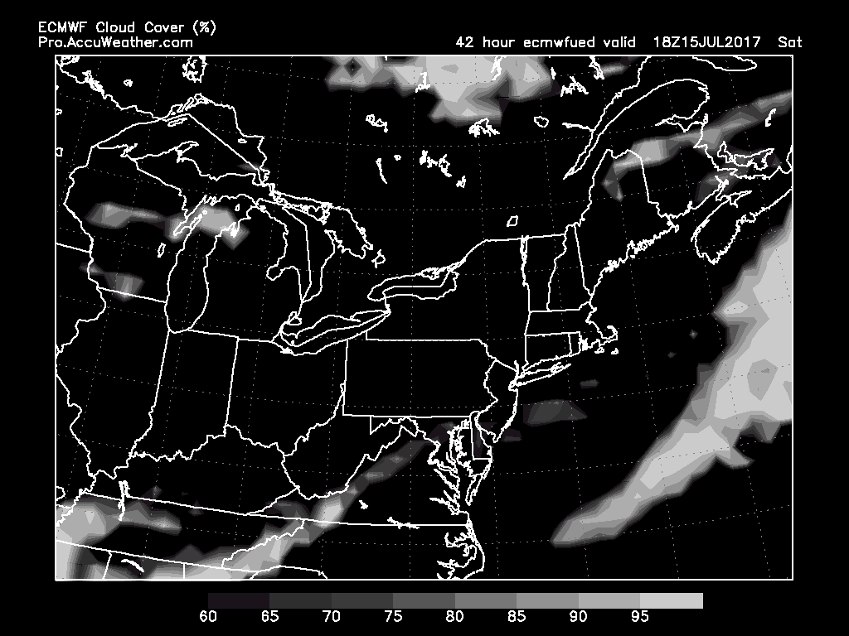
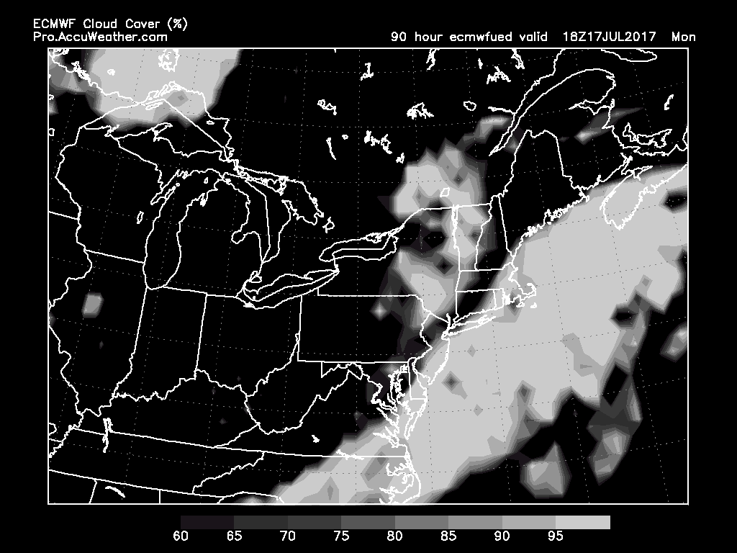
7/16 Sun 2PM
HIGH CLOUD
Increasing high cloud cover offshore from Sunday through Monday (and Tuesday). GFS generally agrees.
7/15 Sat 2PM
7/17 Mon 2PM

Slide 6
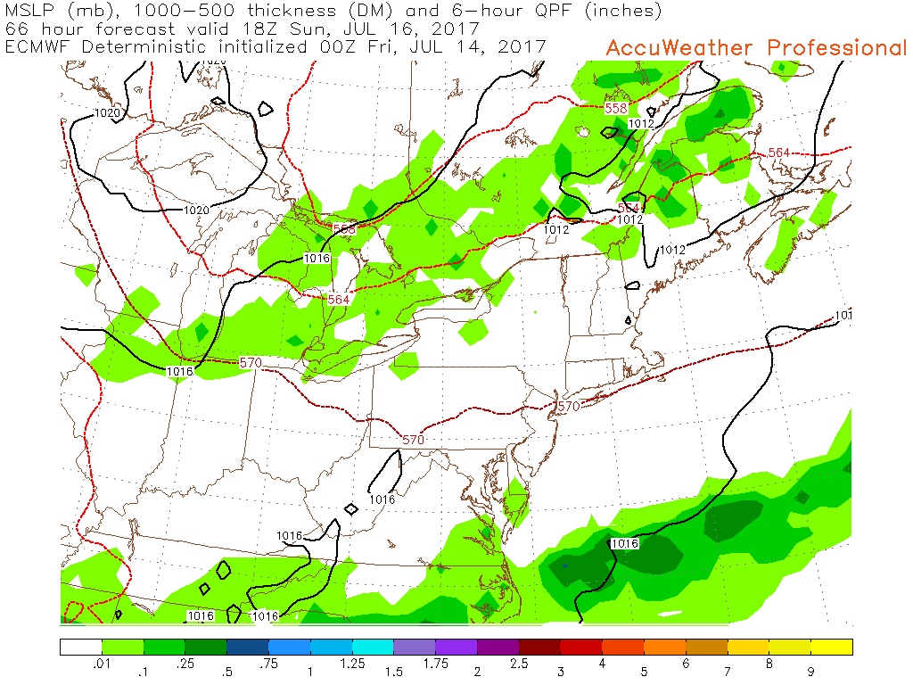
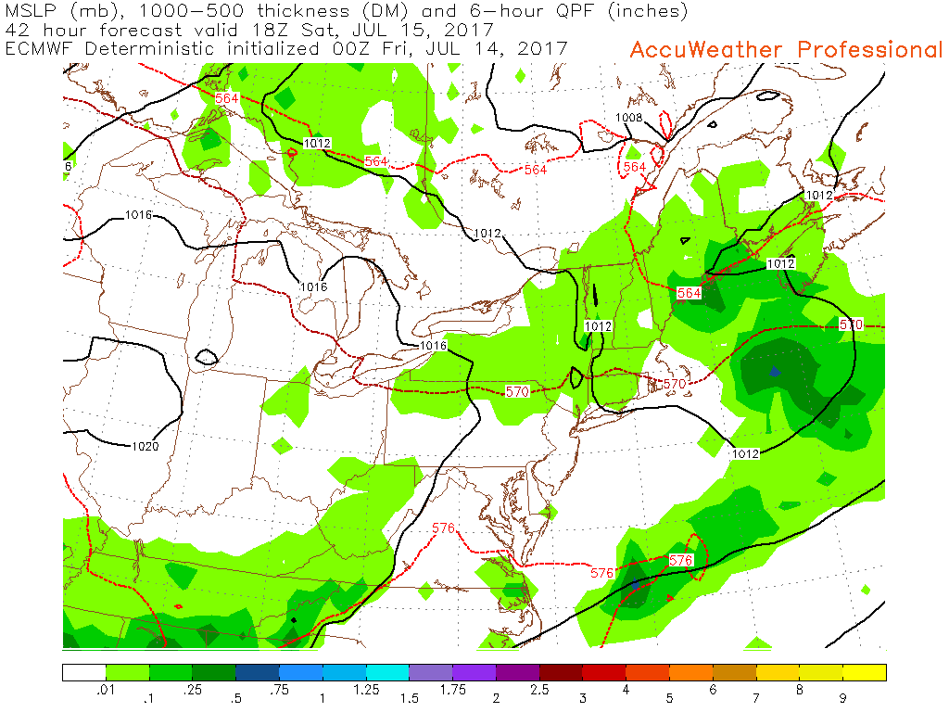
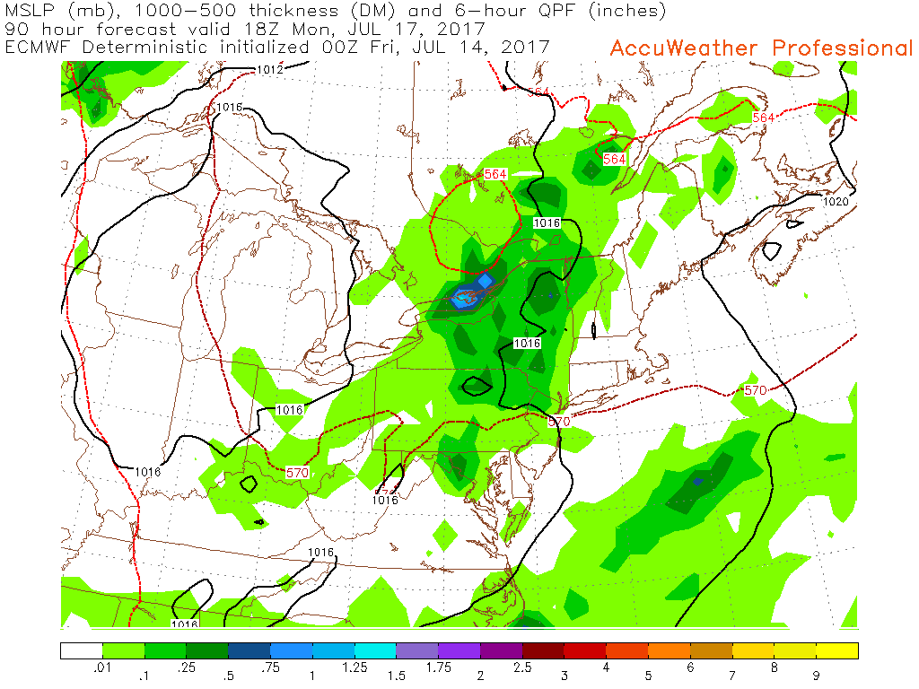
7/16 Sun 2PM
MSLP, 1000-500mb thickness, 6-hr precip
7/15 Sat 2PM
7/17 Mon 2PM

