Slide 1
Weather Briefing for ORACLES test flight
Thursday, July 13

Slide 2
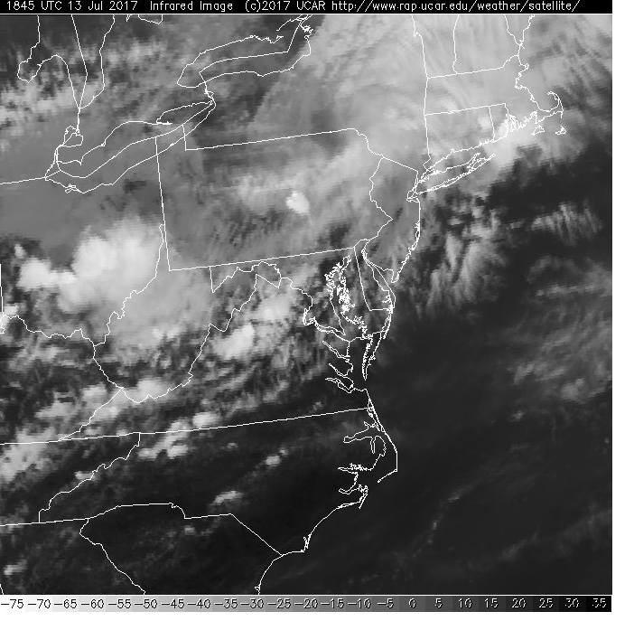
IR satellite imagery
2:45PM Thursday 7/13

Slide 3
Summary
Moderate ridge over mid-Atlantic coast with WSW winds locally, and a few low level clouds, and a broken deck of very thin high level clouds. Hot and humid. A wave in this “dirty ridge” yields T-storm chances tonight. Current Low level clouds appear confined to the near-coastal region.
Expect a trough to amplify and move in from the NW, producing T-storms Friday afternoon and Friday night. Front moves through and settles south of the VA/NC border stretching ENE ward into the Atlantic Saturday morning.
Latest runs suggest minimal low cloud cover over the Atlantic within range of the aircraft on Saturday (drier air following the front).
Sunday looks to be even drier offshore, as the front sags southward.
EC model is more aggressive in pushing the middle and high cloudiness associated with the front south of our area. So, EC suggests offshore clear skies Saturday, with GFS indicating some middle and high cloudiness offshore. However, both models have minimal RH at low levels on both days, indicating minimal low clouds off the coast on Saturday and Sunday.
Diurnal convection on land, coupled with offshore low level (925mb) flow, could yield some cloudiness offshore – this convection would be in the afternoon
Some precip expected along the front S and SE of Wallops

Slide 4
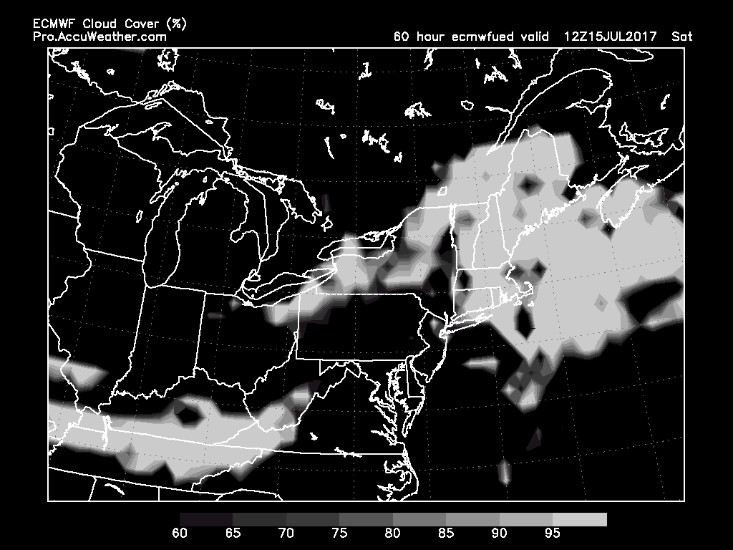
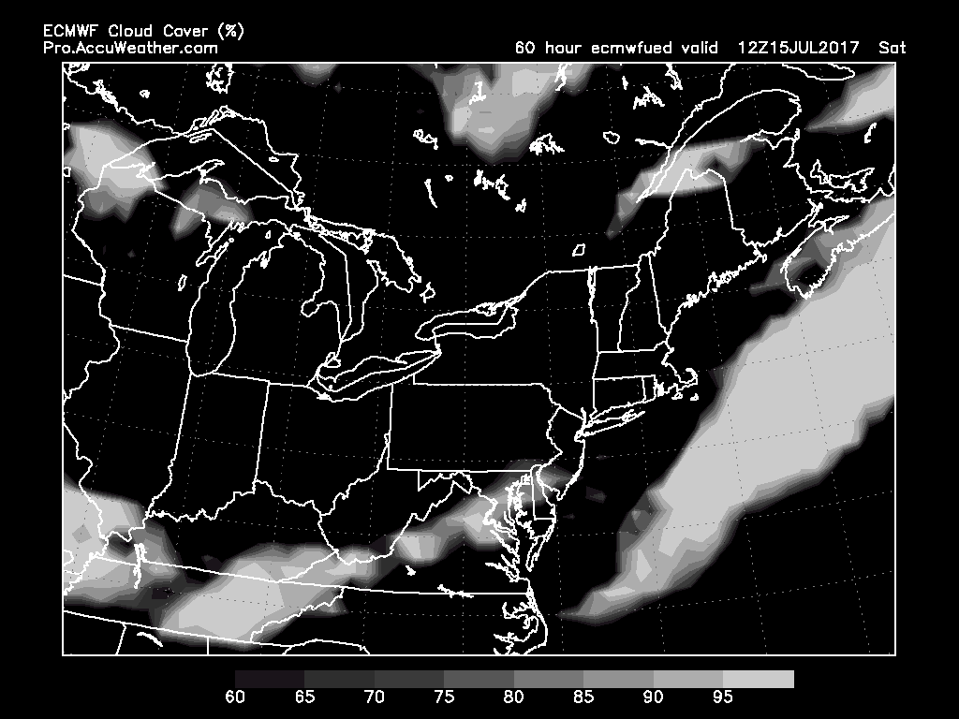
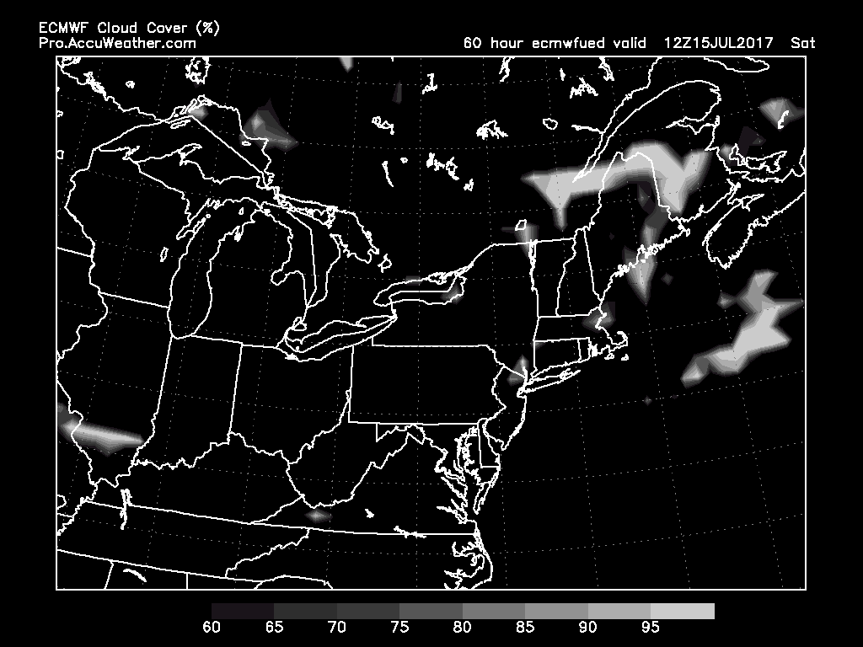
Low, Middle and High Cloud Cover
Low
Saturday, 8 AM, ECMWF
High
Middle

Slide 5
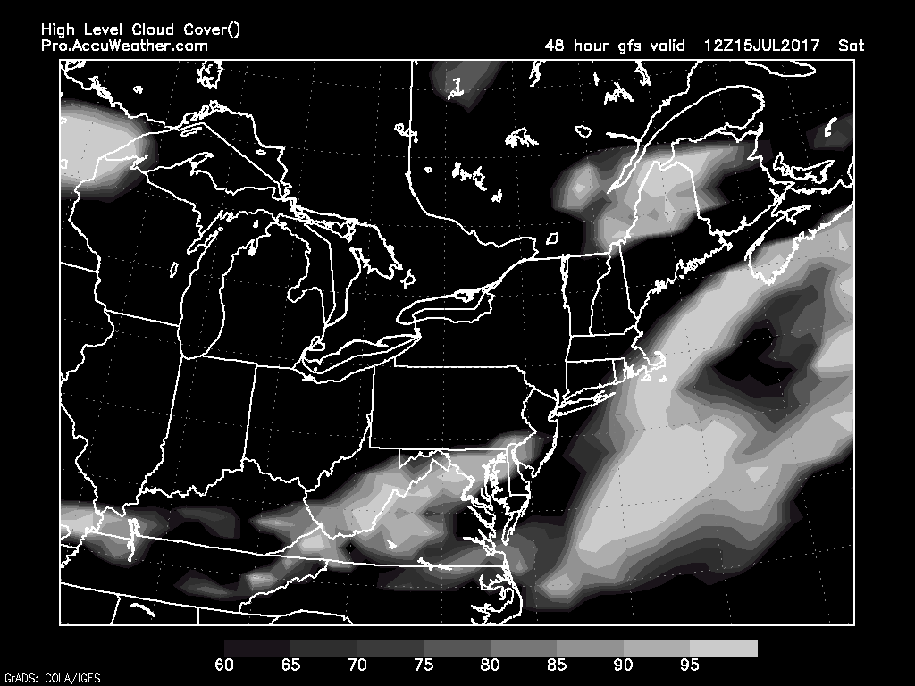
GFS has even less low cloud (not shown)
High cloud band has not advanced as
far east as the ECMWF (cf previous slide)
Saturday, 8 AM, GFS
High

Slide 6
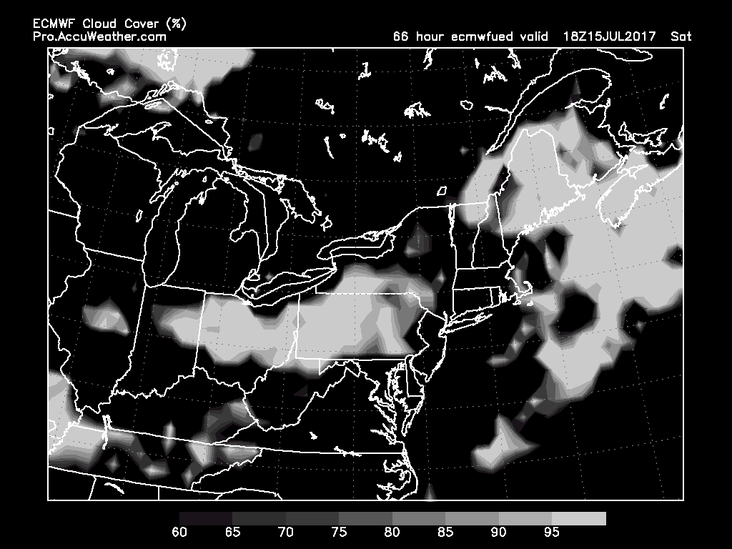
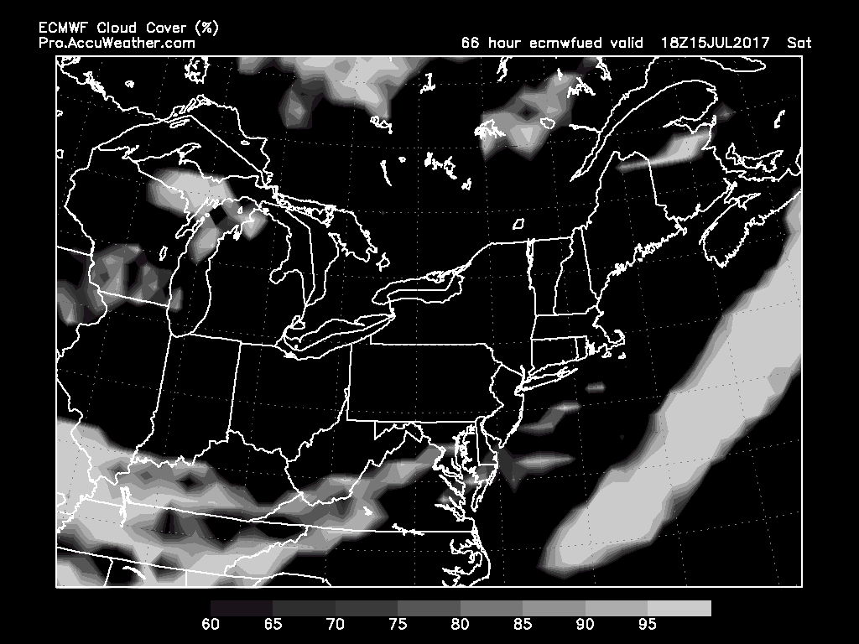
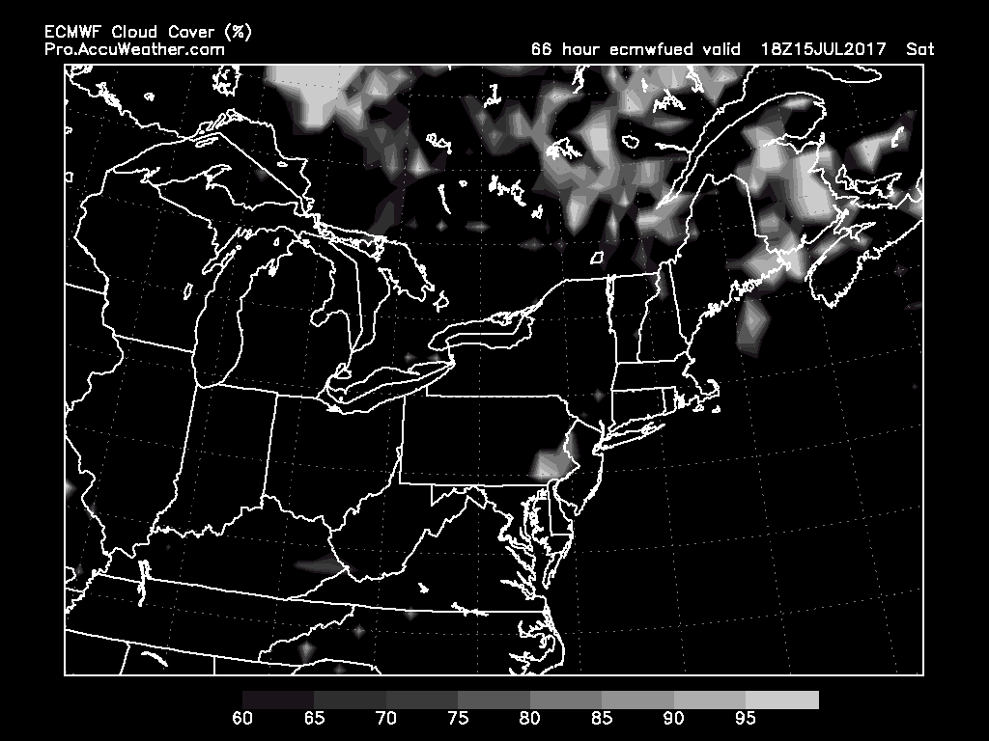
Low, Middle and High Cloud Cover
Low
Saturday, 2 PM, ECMWF
High
Middle

Slide 7
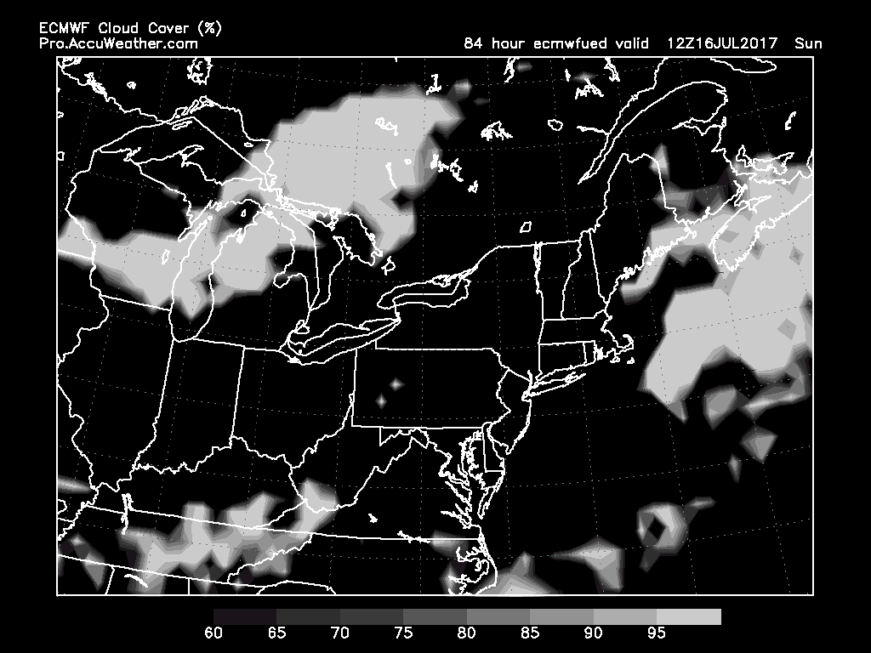
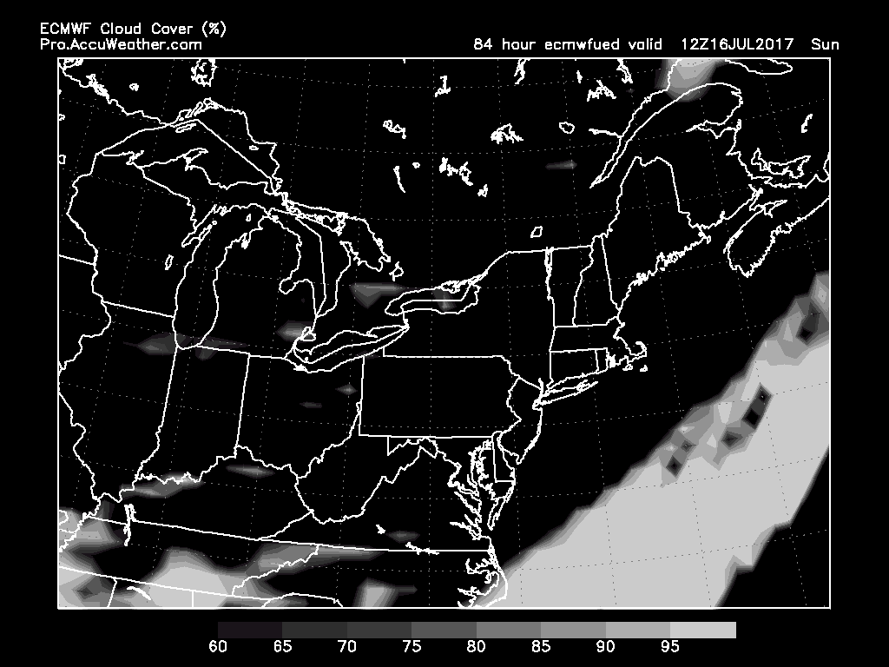
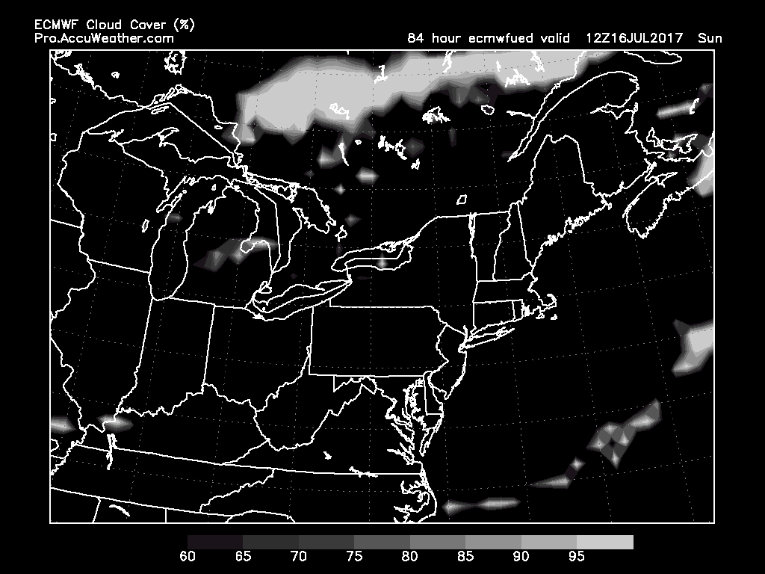
Low, Middle and High Cloud Cover
Low
Sunday, 8 AM, ECMWF
High
Middle

Slide 8
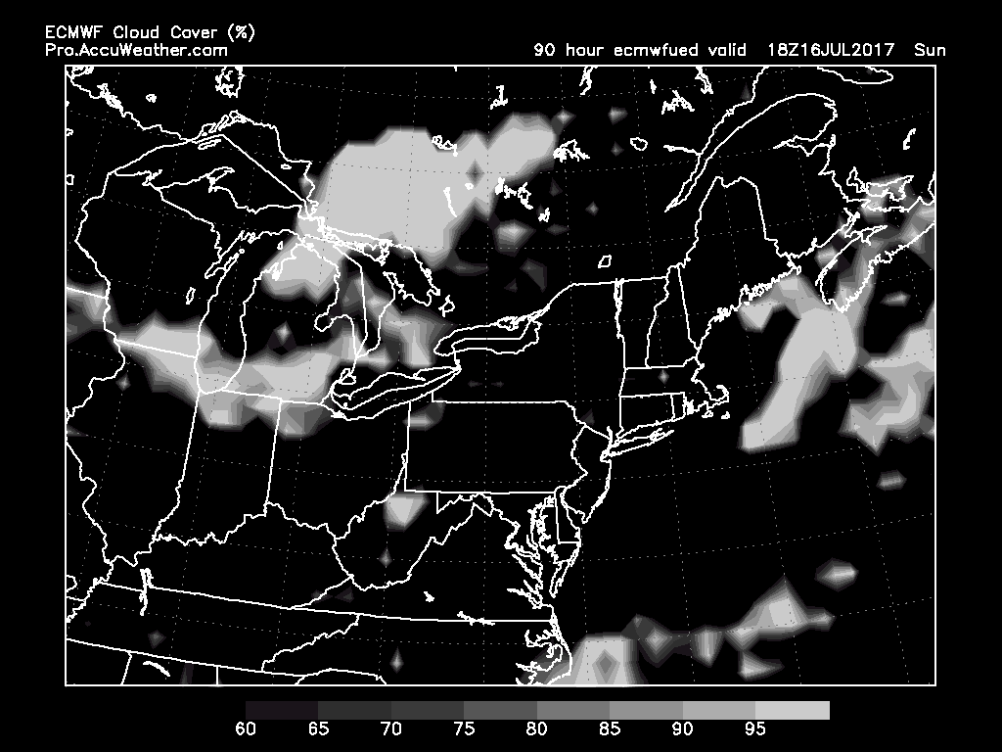
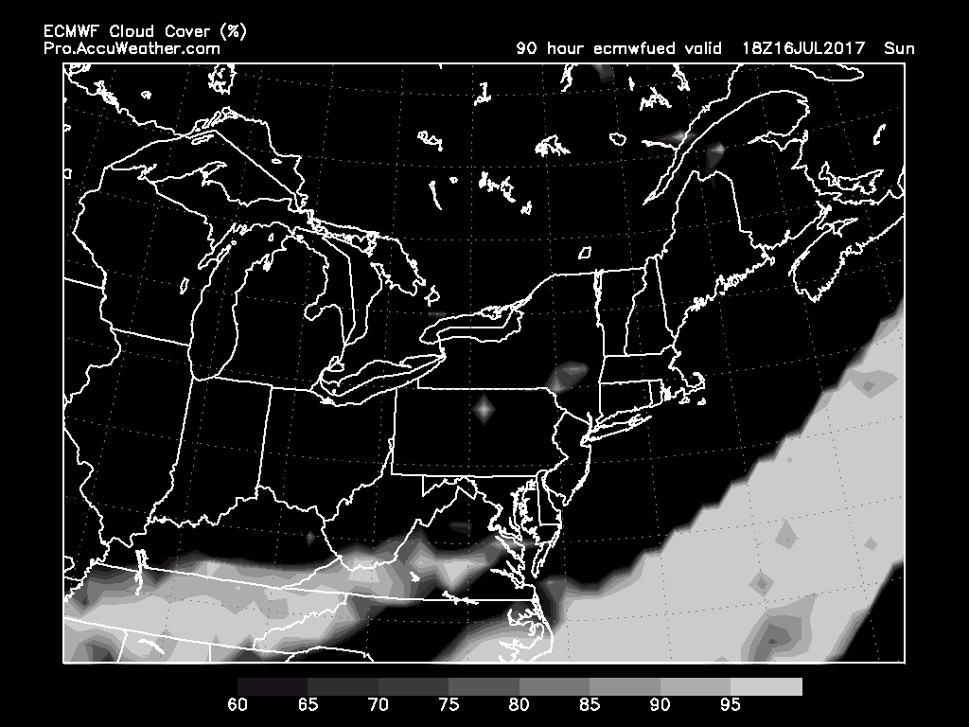
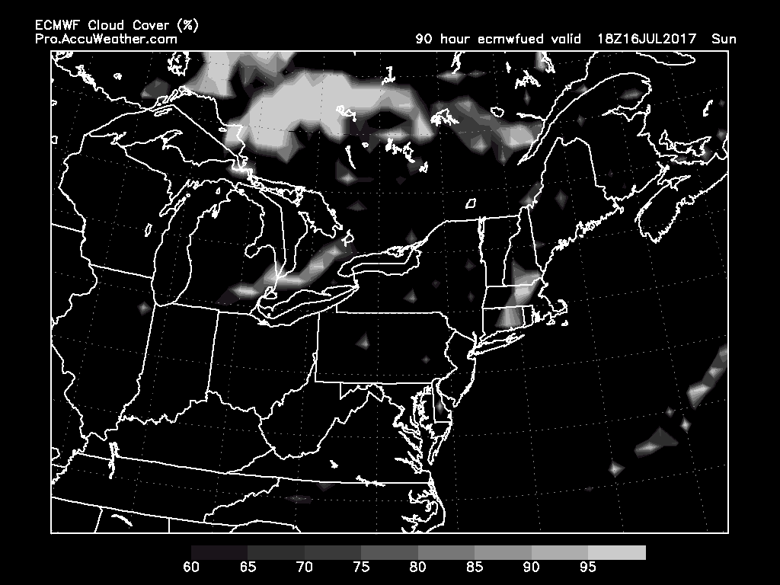
Low, Middle and High Cloud Cover
Low
Sunday, 2 PM, ECMWF
High
Middle

Slide 9
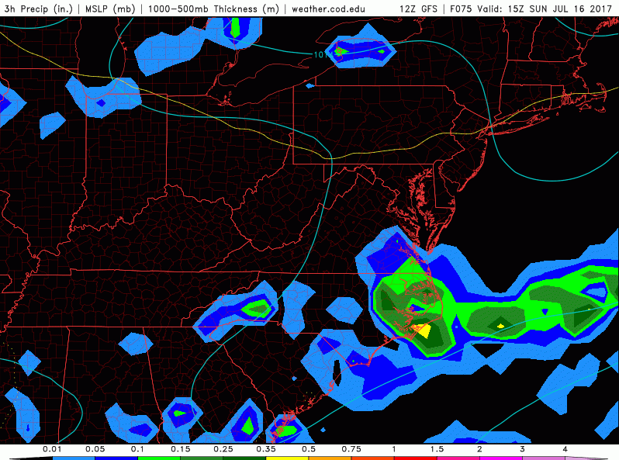
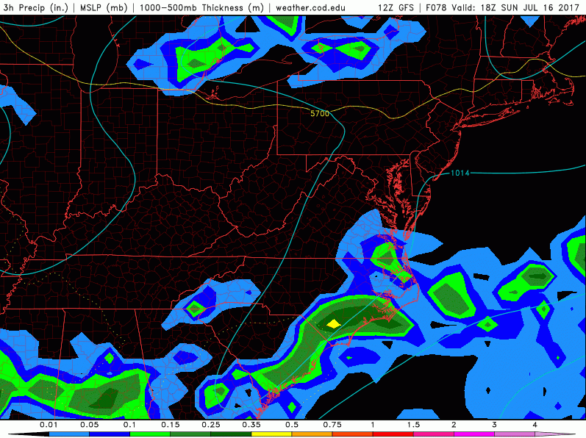
3-hr Precip, MLP, 1000-500mb Thickness
Sunday, 8 AM, GFS
Sunday, 2 PM, GFS
Precip (mostly convective) associated with the front to the S-SE

