Slide 1
ORACLES forecasting briefing Meteorology for 27-09-2016
Lenny Pfister

Slide 2
Tuesday, 20160927

Slide 3
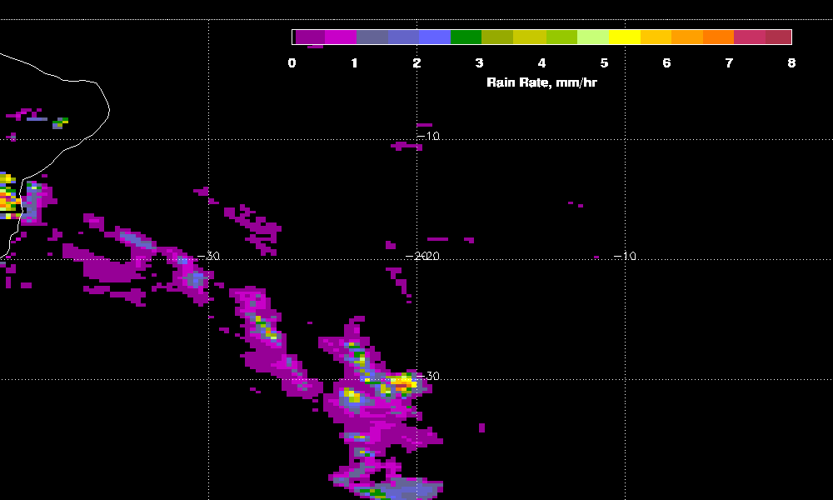
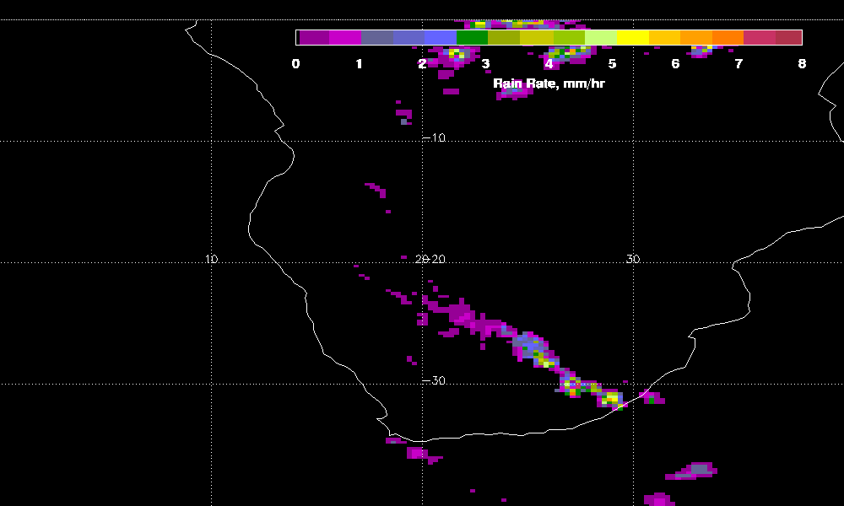
Trmm 3-hourly product does not show
any rain in range. Not sure if that means

Slide 4
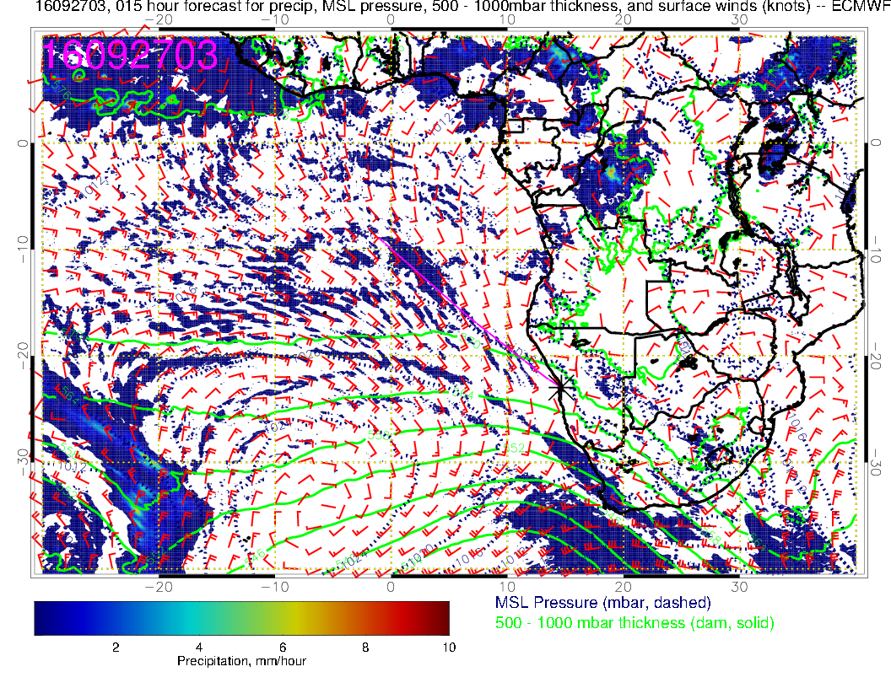
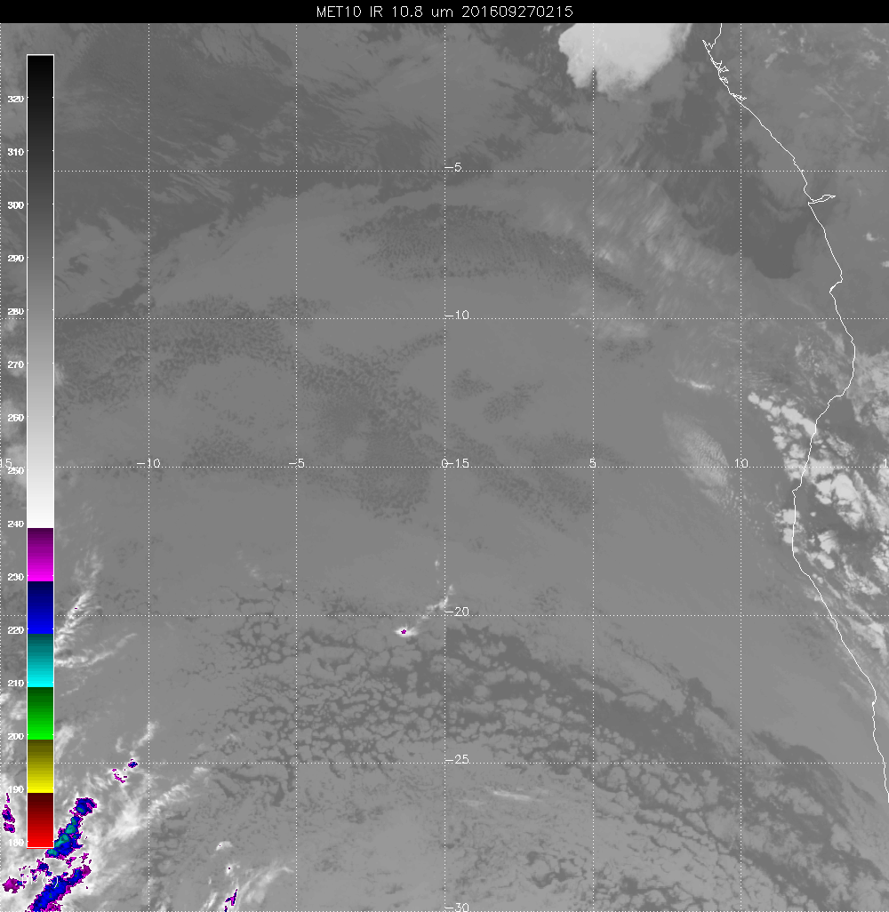

Slide 5
Precip south of us pretty much progged
to be over land by 12Z

Slide 6
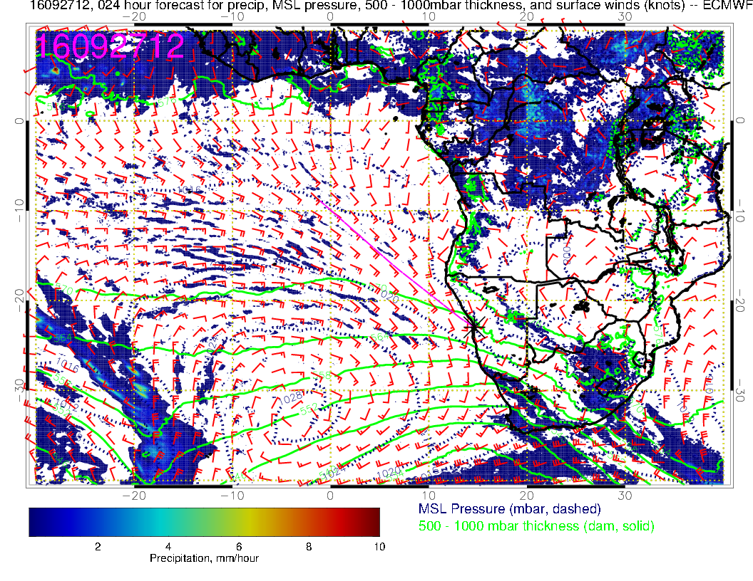
Given the lack of TRMM rain, I have concerns about
finding much, but if prog is right, won’t have to go out
as far. Definitely avoid the clear subsidence region behind
what’s left of the front

Slide 7
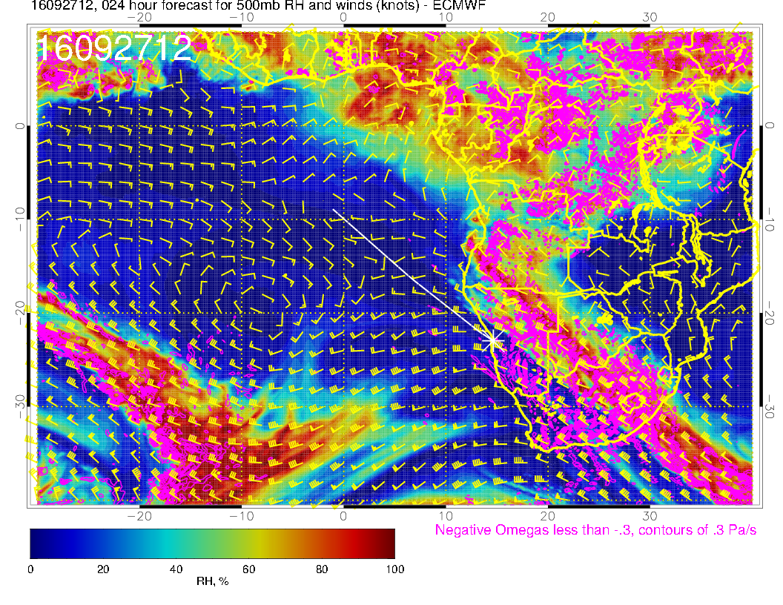
40 knot headwinds
going out. Not
a lot of time evolution,
tailwinds coming back

Slide 8
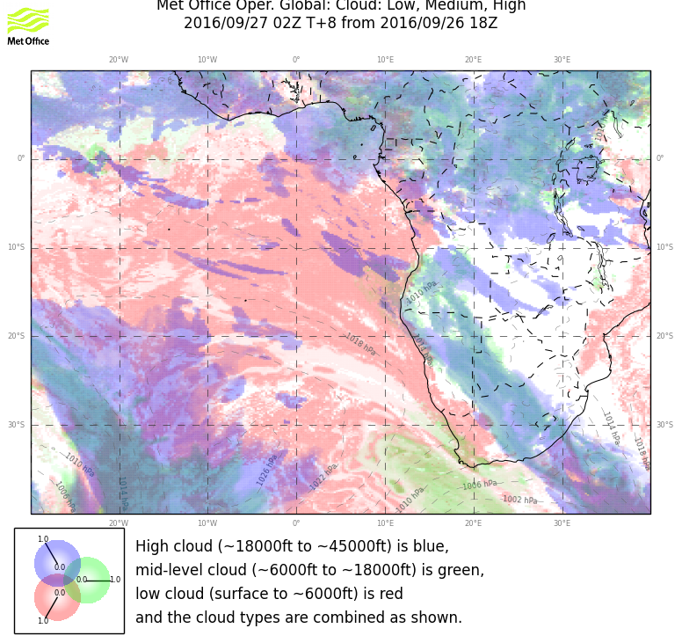
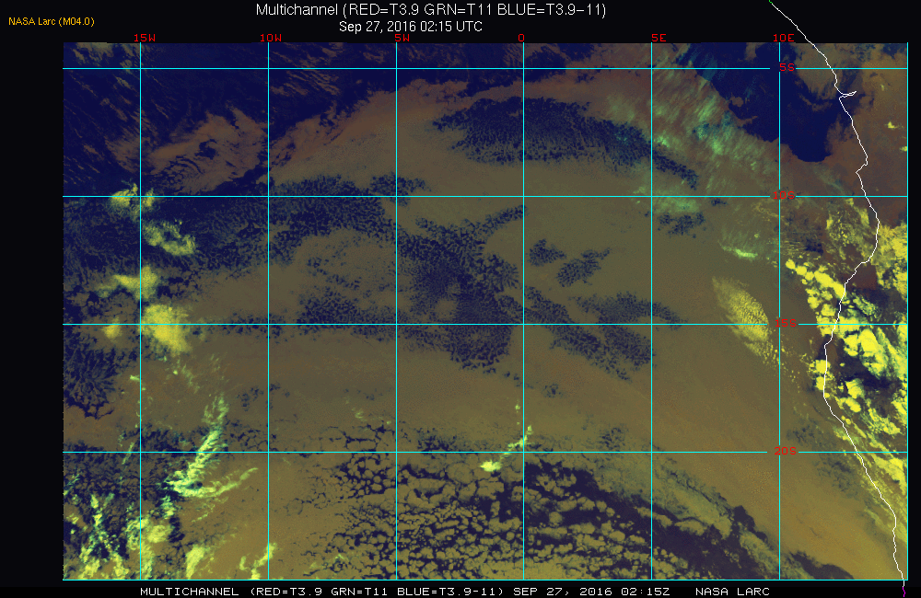
Neither model is getting everything. Animation suggests something near coast, but
traveling out. Should stay SW of the line indicated

Slide 9
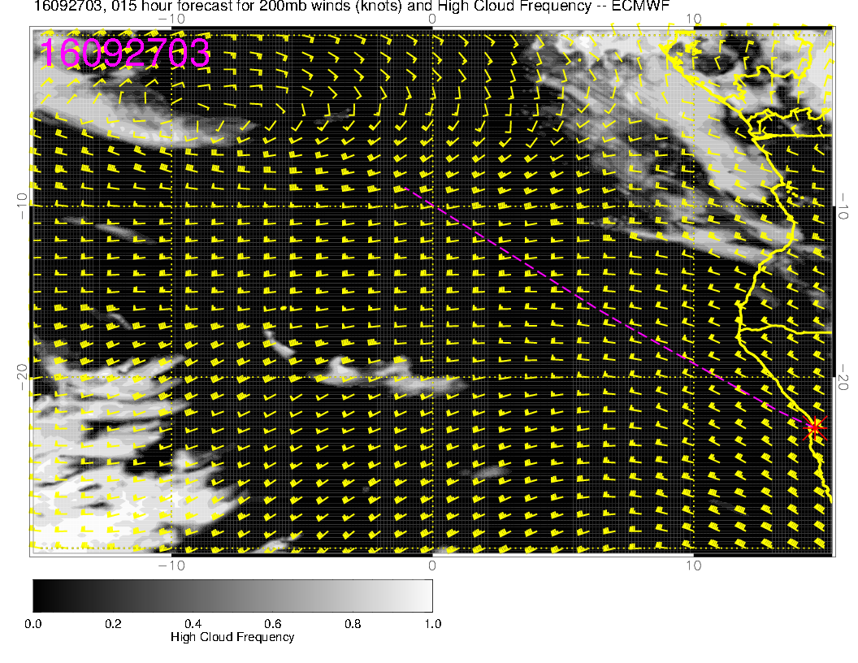

Slide 10
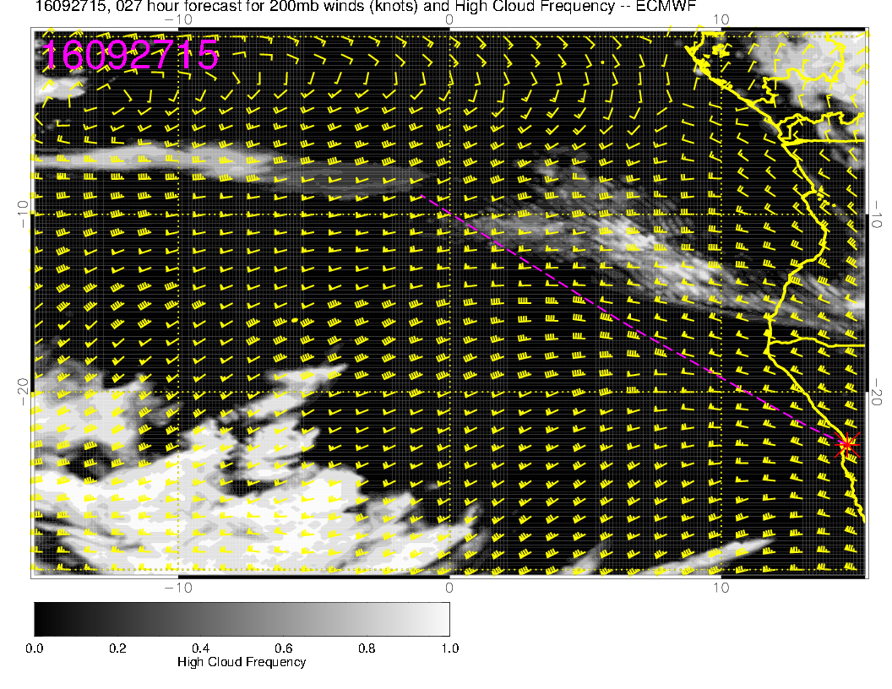
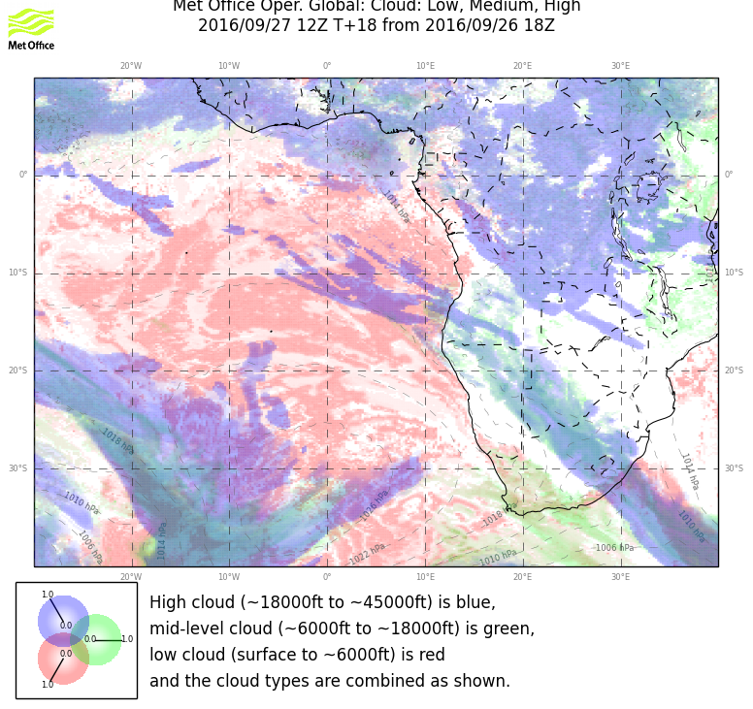
Not shown, but cirrus is actually moving south with time

Slide 13
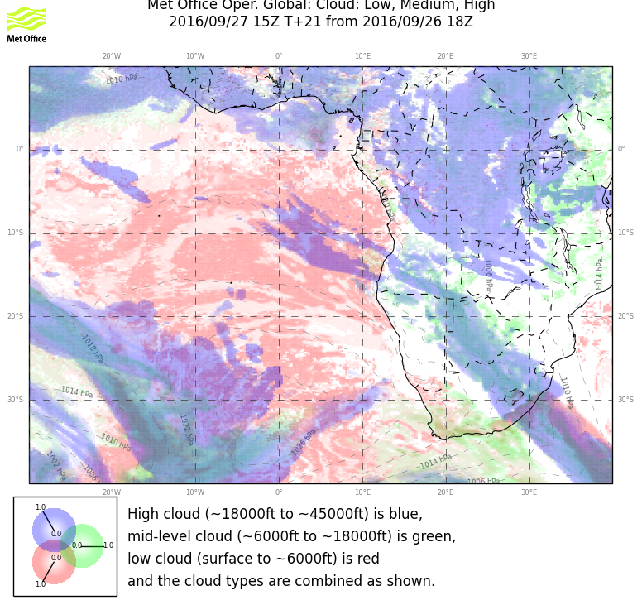

Slide 14
