Slide 1
ORACLES Forecast Briefing
(Aerosols)
27 September 2016

Slide 2
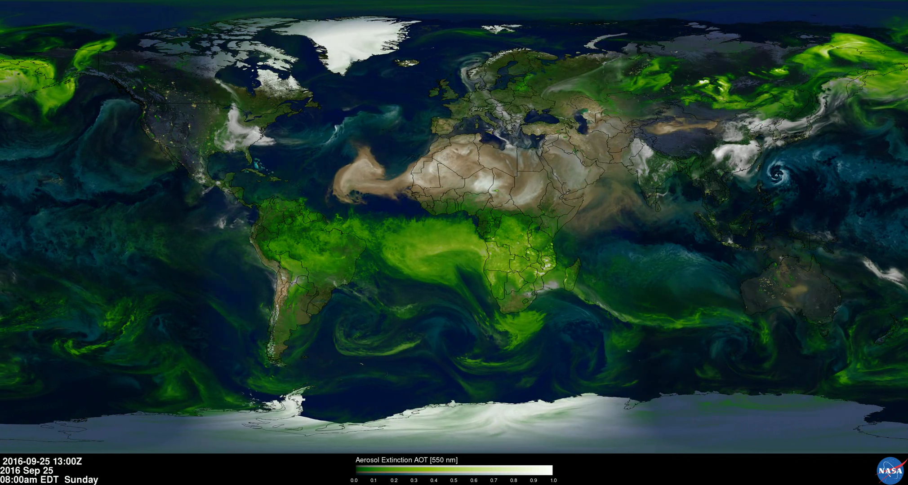
The Aerosol Week

Slide 3
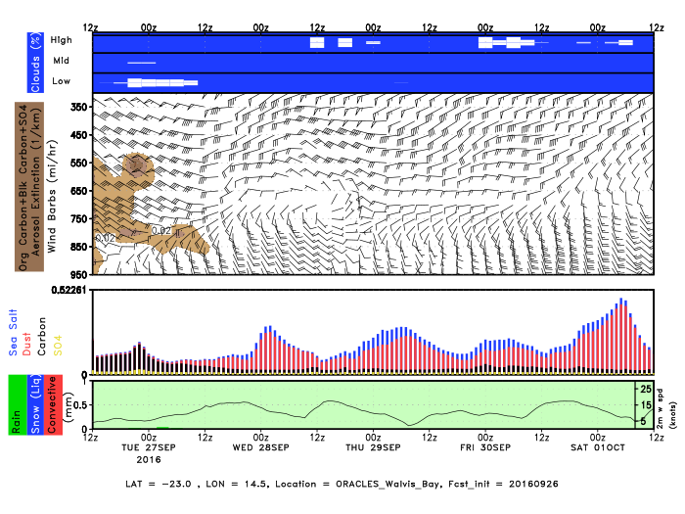
Walvis Bay
Dust
OC+BC+SO4

Slide 4
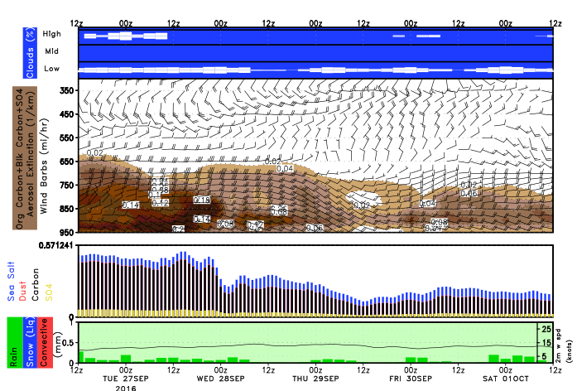
Ascension: GEOS-5 OC+BC+SO4

Slide 5
Tuesday 27 September 2016
Flight Day

Slide 6
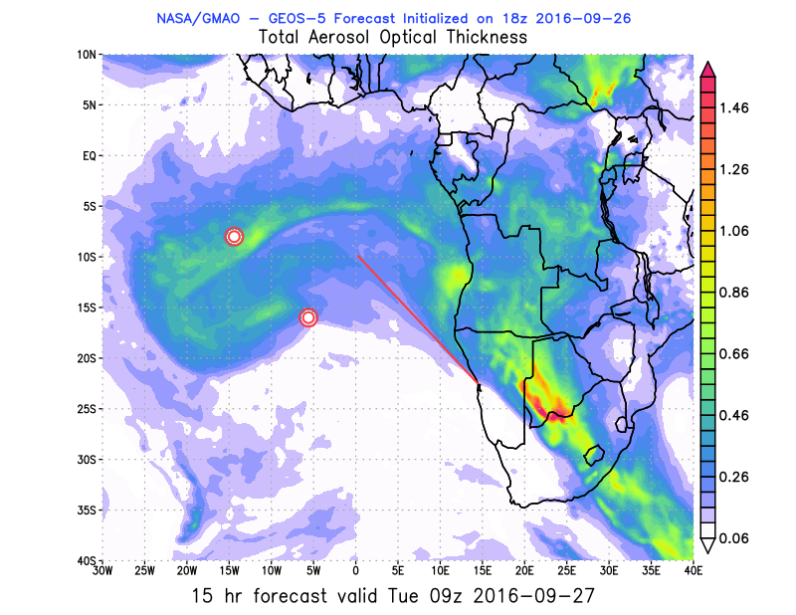
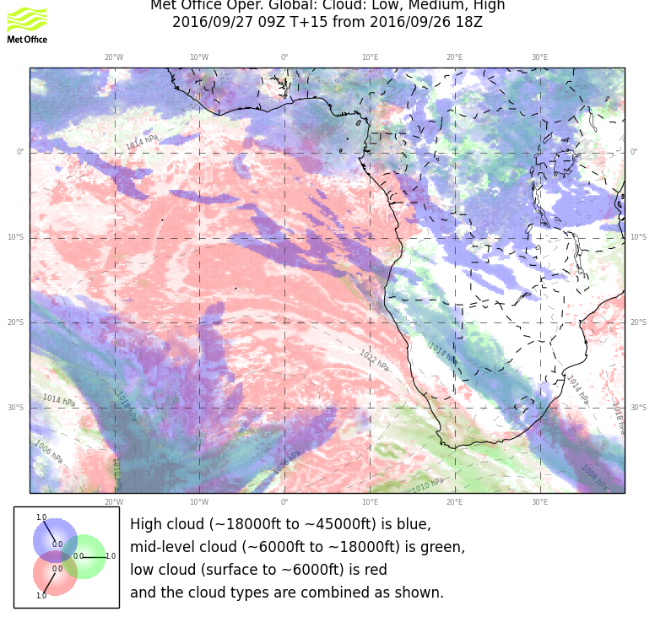
Tuesday, 27 Sep 2016 9z

Slide 7
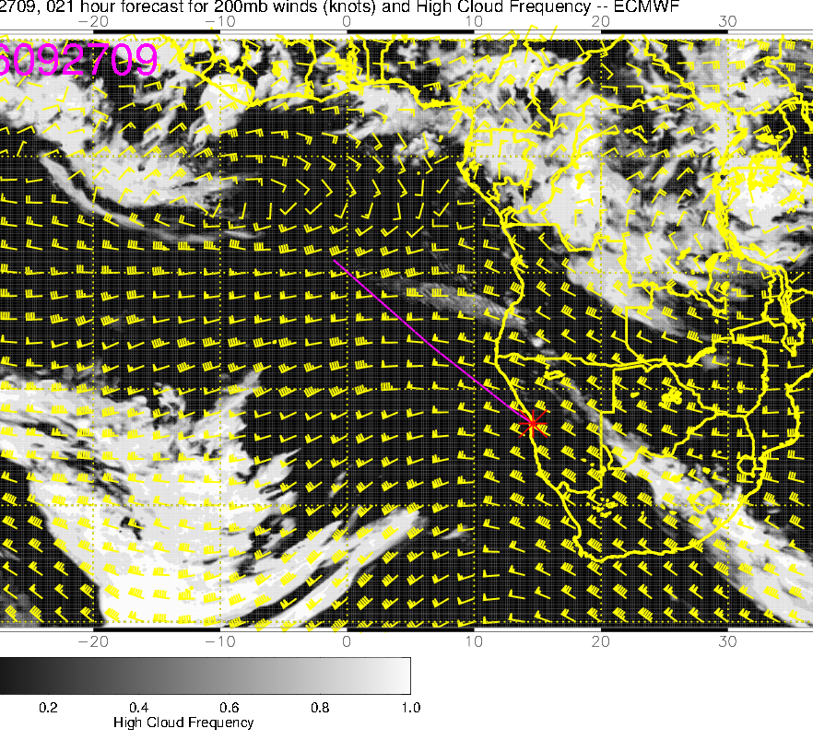
Tuesday, 27 Sep 2016 9z

Slide 8
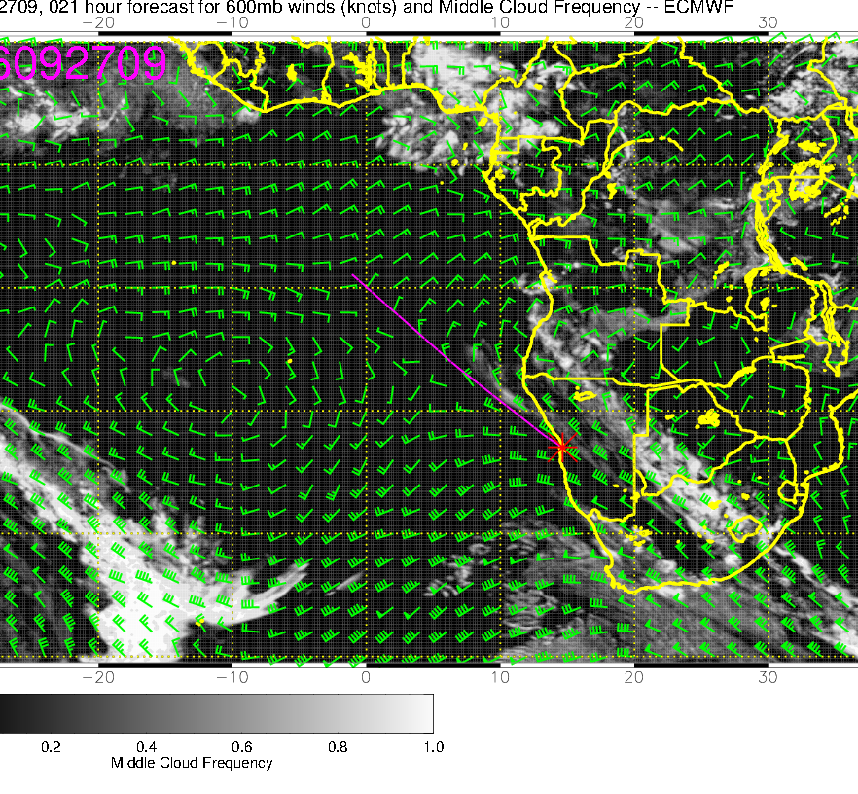
Tuesday, 27 Sep 2016 9z

Slide 9
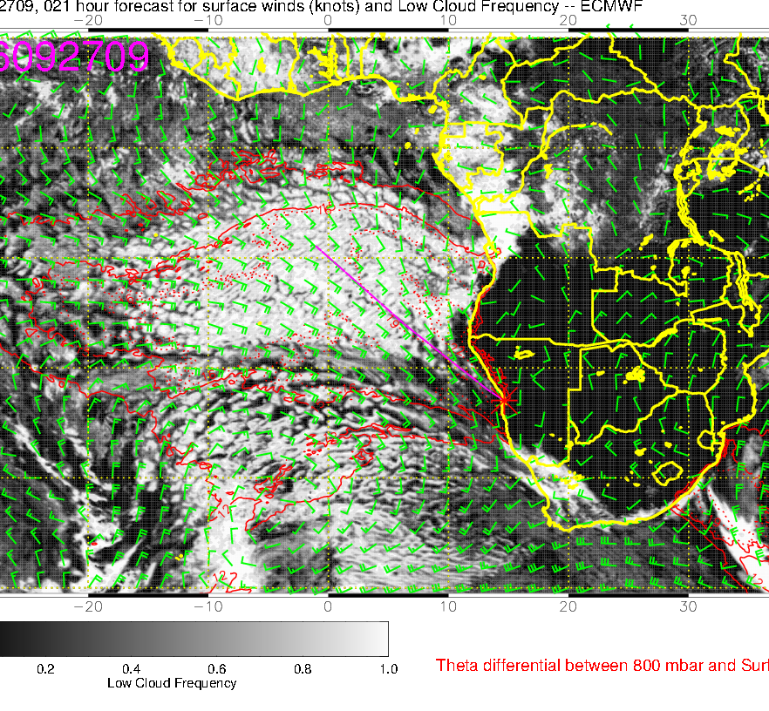
Tuesday, 27 Sep 2016 9z

Slide 10
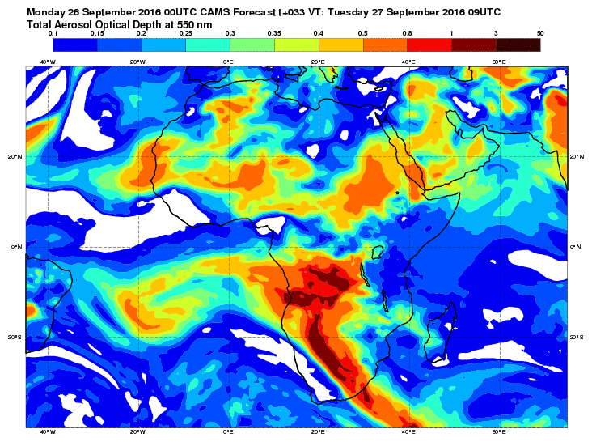
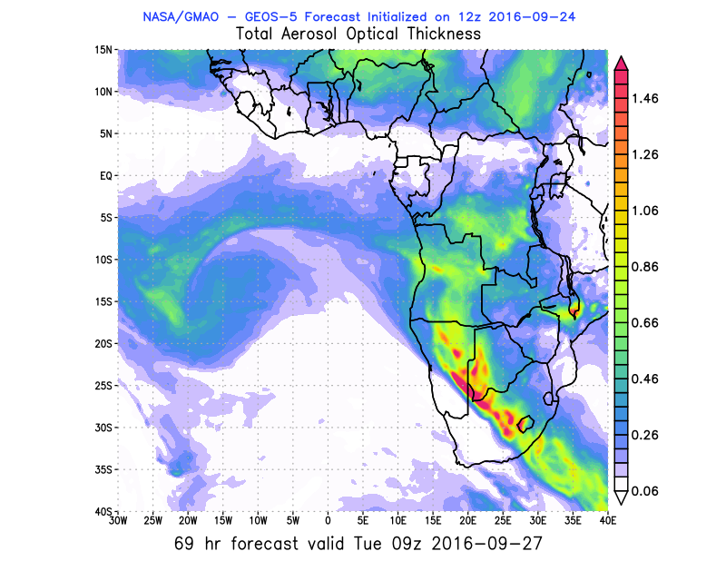
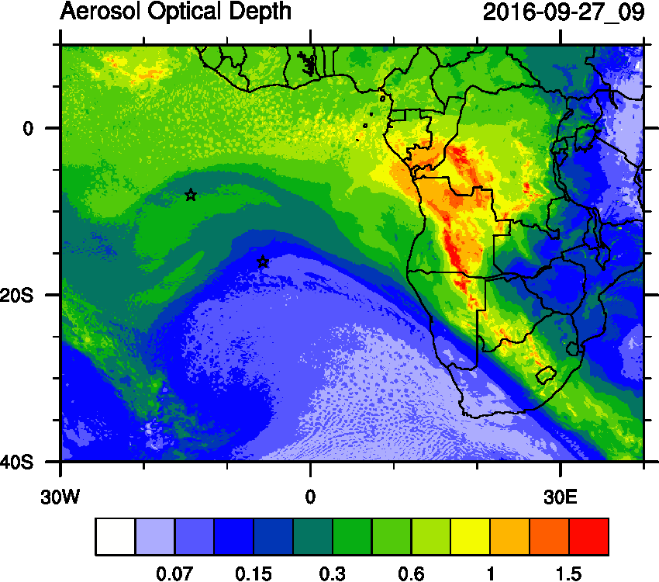
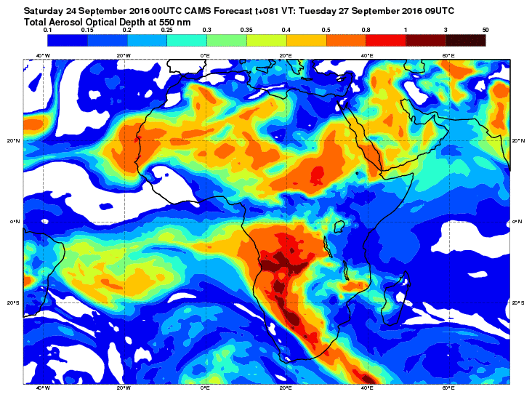

Slide 11
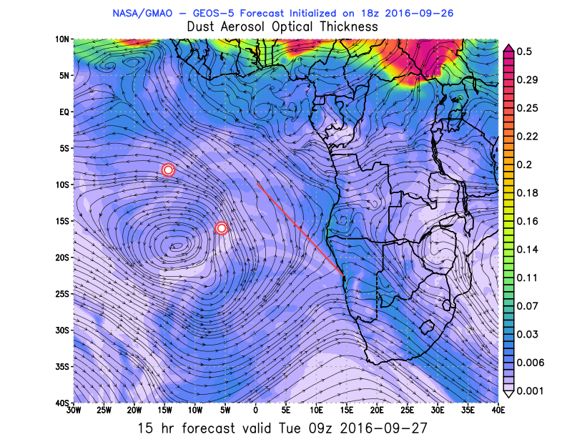
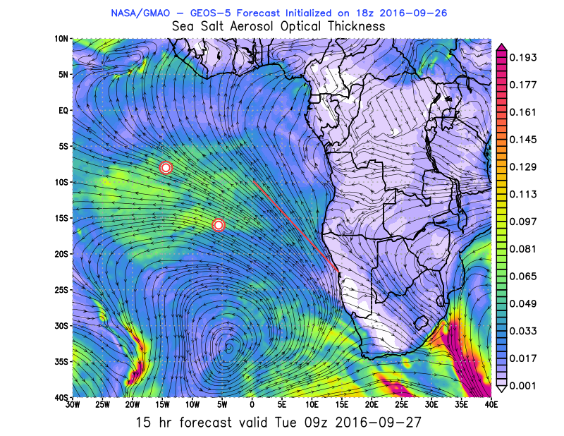
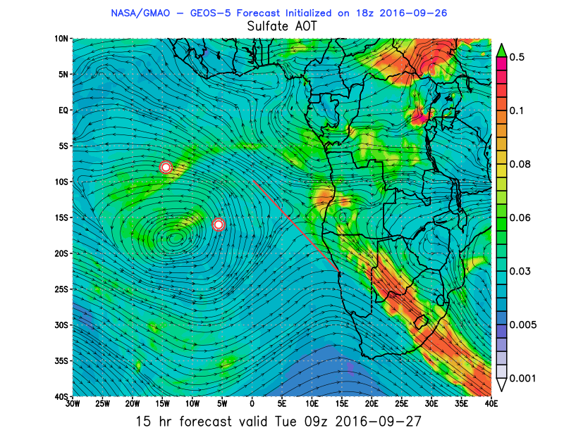
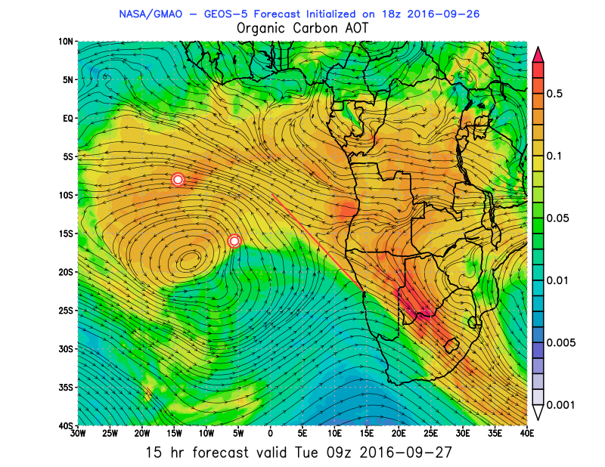
Tuesday 27 September 2016 9Z

Slide 12
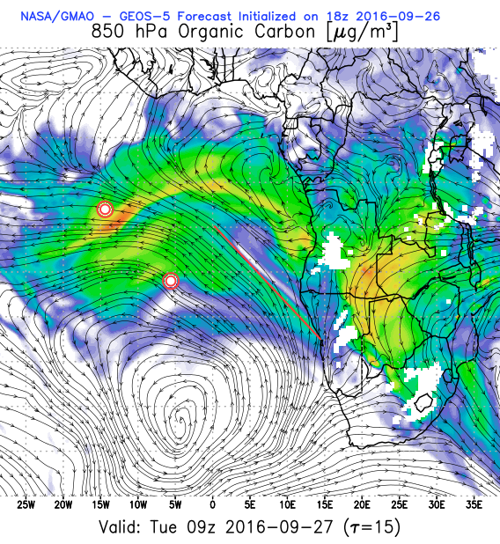
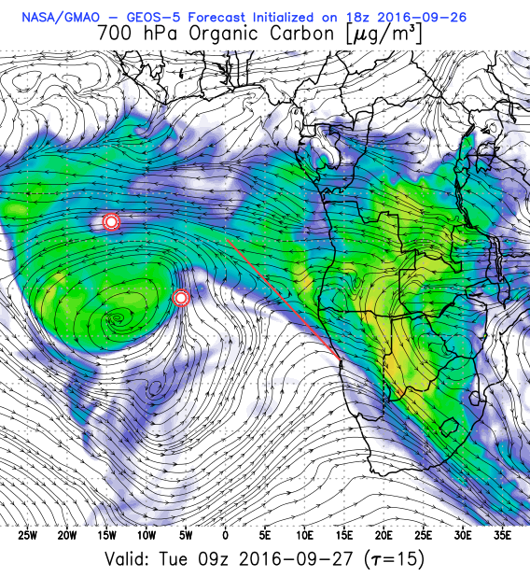
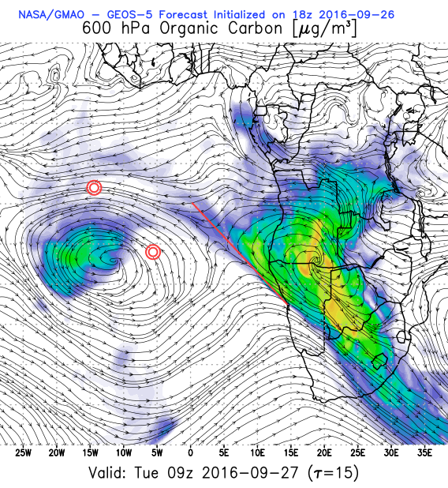
OC Tue 27 Sep 2016 9X

Slide 13
Wednesday 28 September 2016
Transit Flight

Slide 14
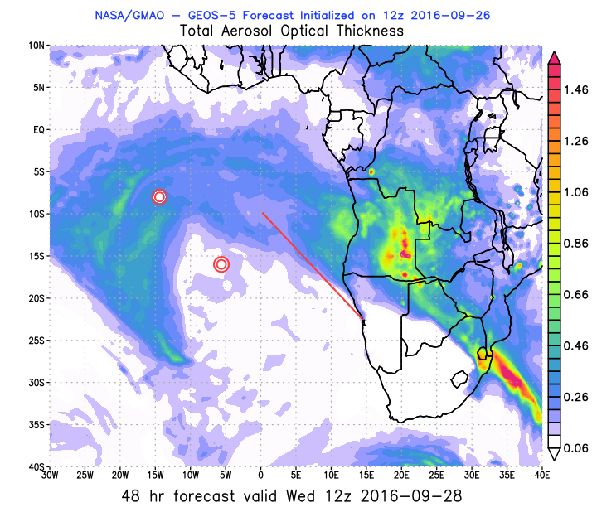
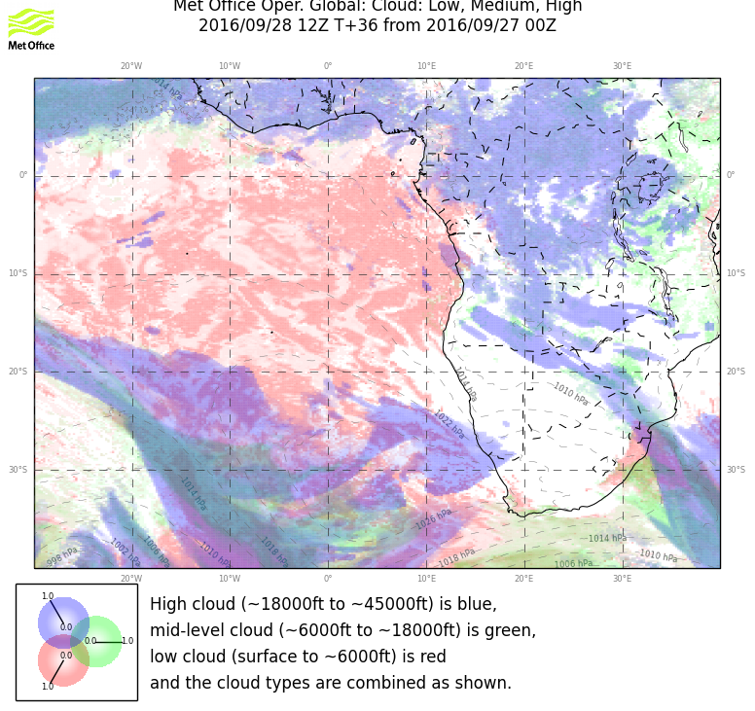
Wednesday, 28 Sep 2016 12z

Slide 15
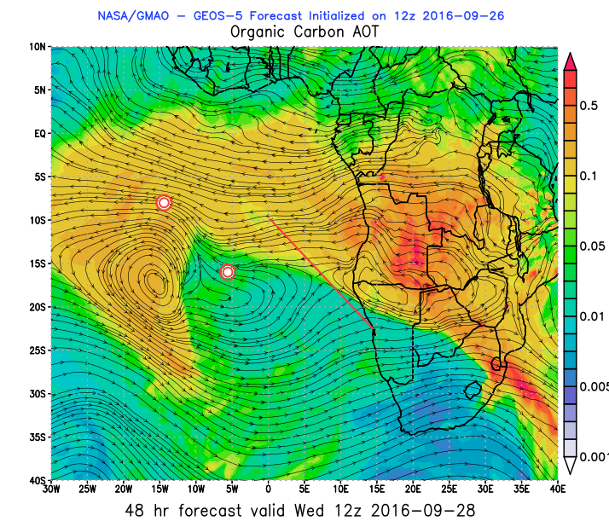
Wednesday, 28 Sep 2016 12z

Slide 16
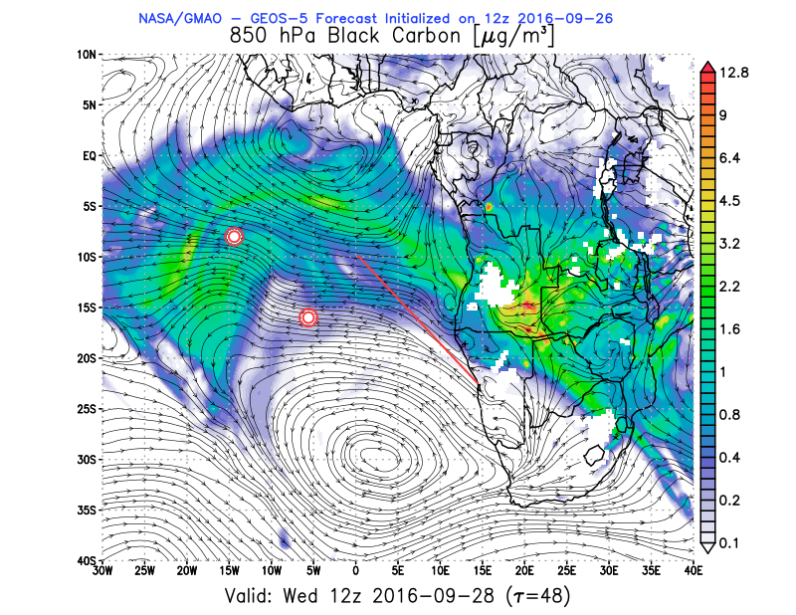
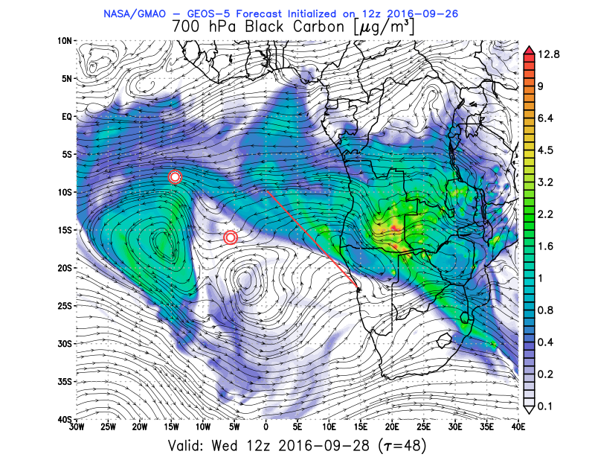
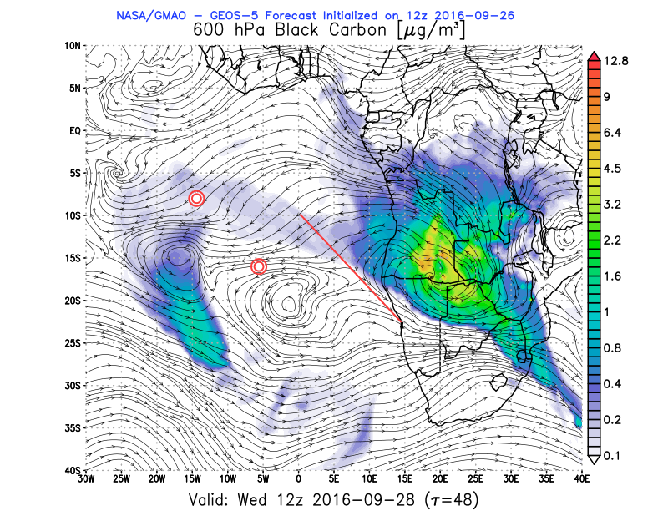
BC Wed 28 Sep 2016 12Z

Slide 17
Thursday 29 September 2016
Transit Flight

Slide 18
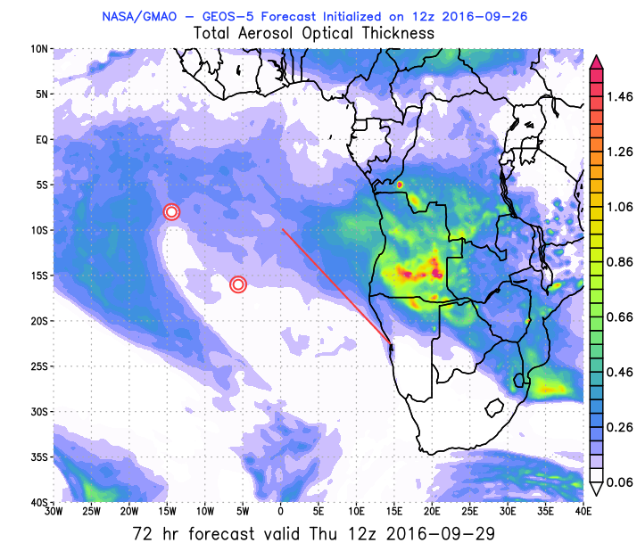
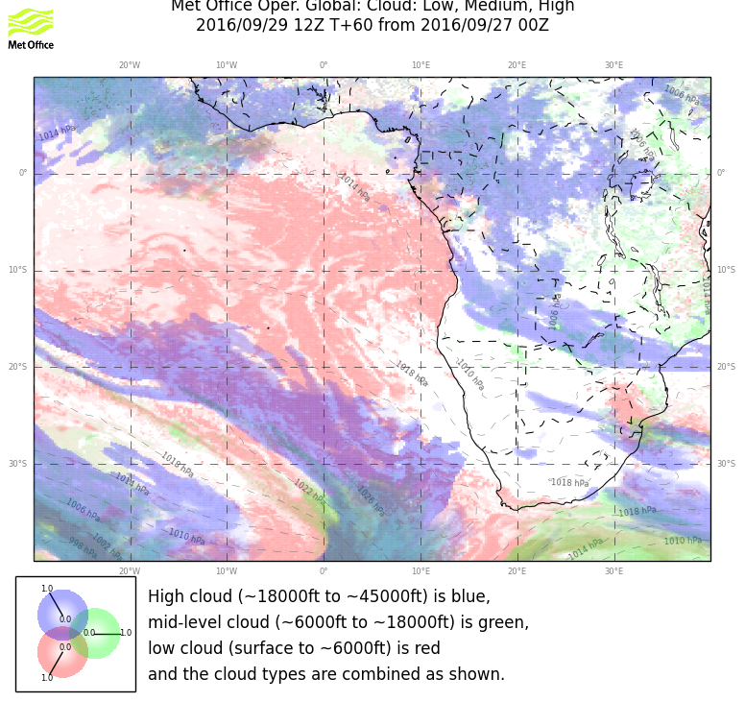
Thursday, 29 September 2016 6z

