Slide 1
ORACLES forecasting briefing Meteorology for 27-09-2016 and 29-09-2016
Lenny Pfister

Slide 2
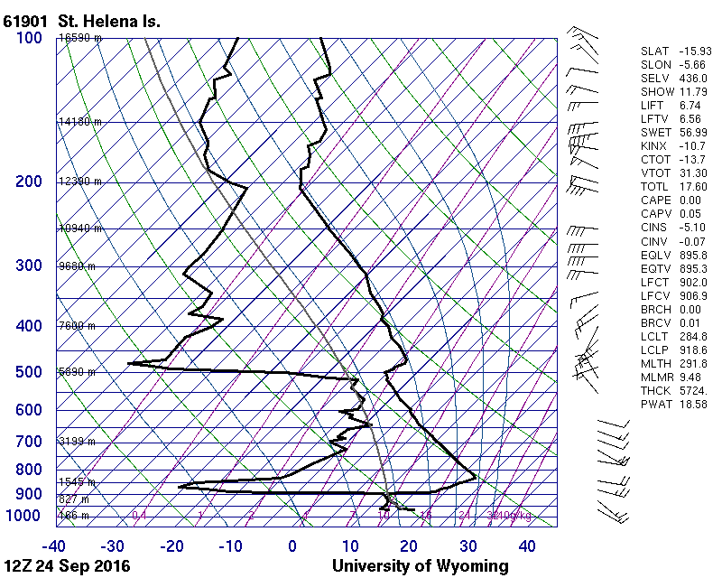
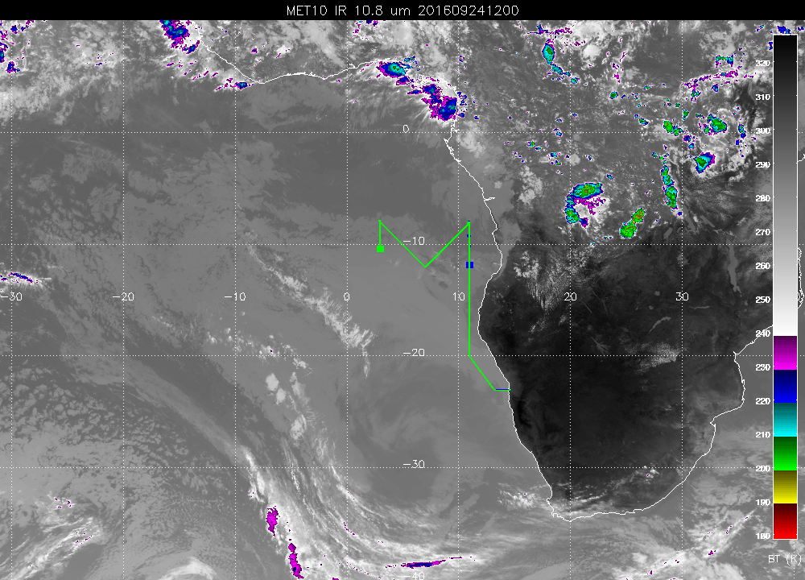
Persistent cloud in Saint Helena region. No obvious dry adiabat this time,
smoke is there at a variety of injections etc.

Slide 3
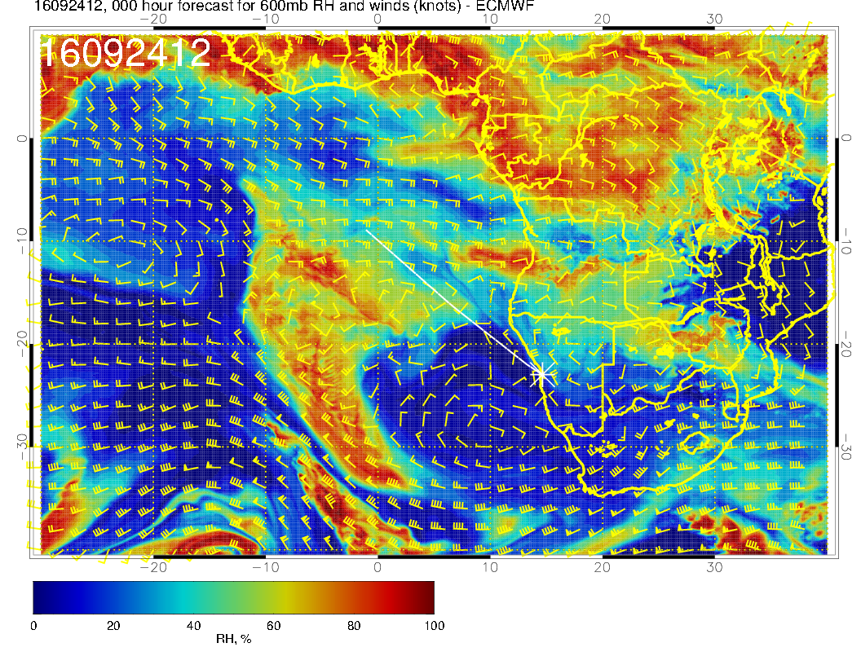
Persistent high RH near SH. RH distribution reflects something maintaining
the high RH and how the flow history has distributed water injections over
the continent.

Slide 4
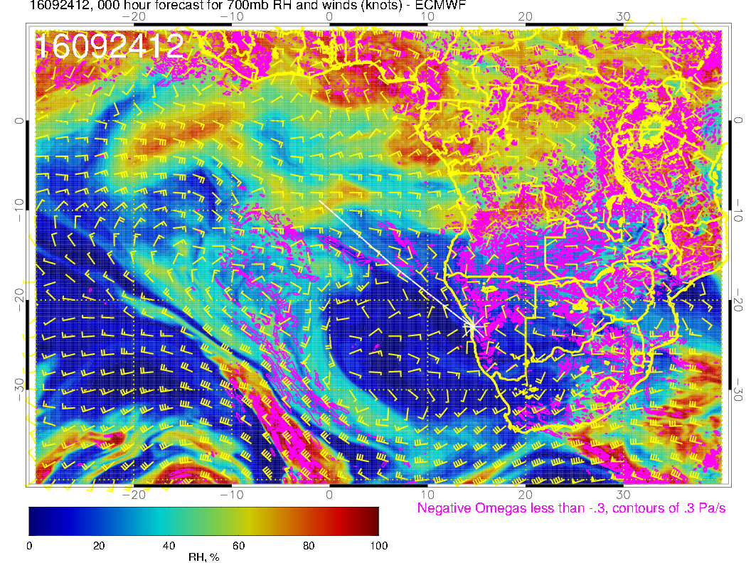
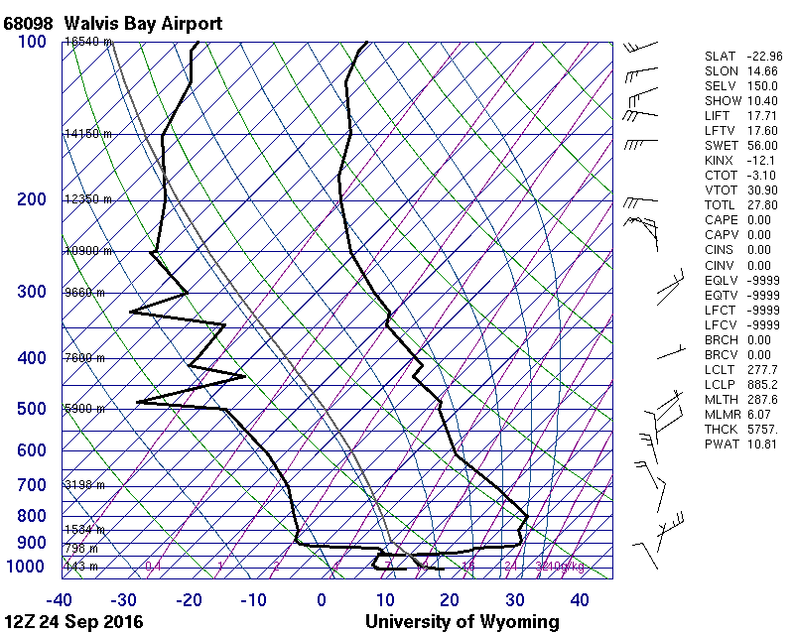
See low level dry adiabat, flow from NNW, really at the edge of a possible
plume from the north. May be just elevated mixed layer, no smoke. From interior

Slide 5
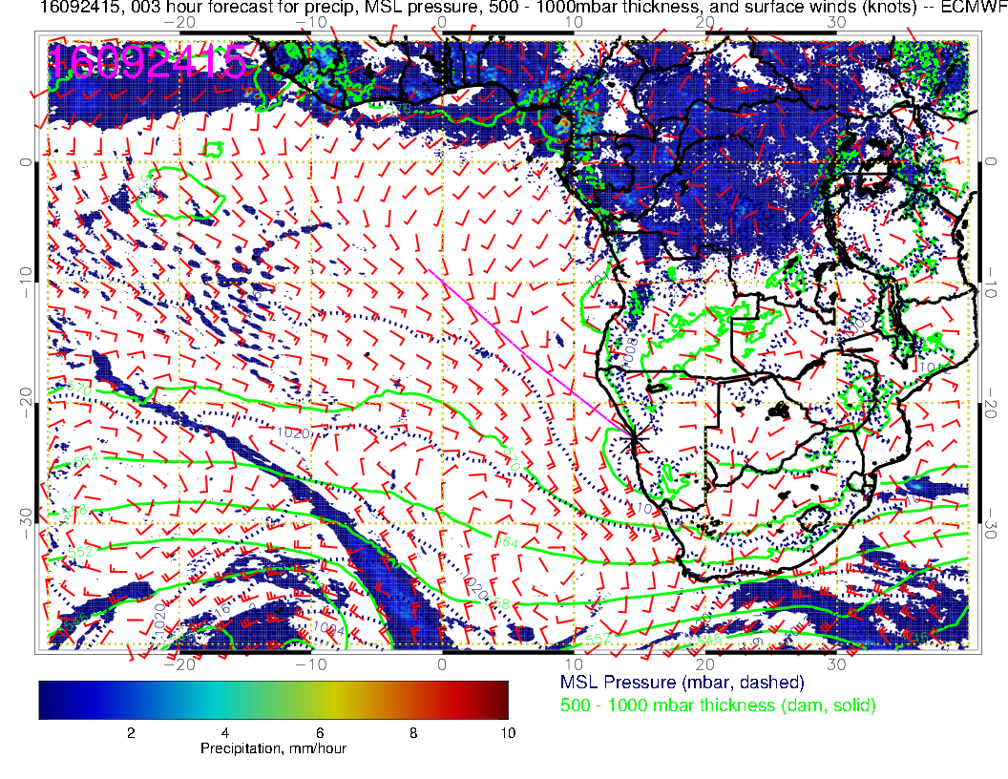
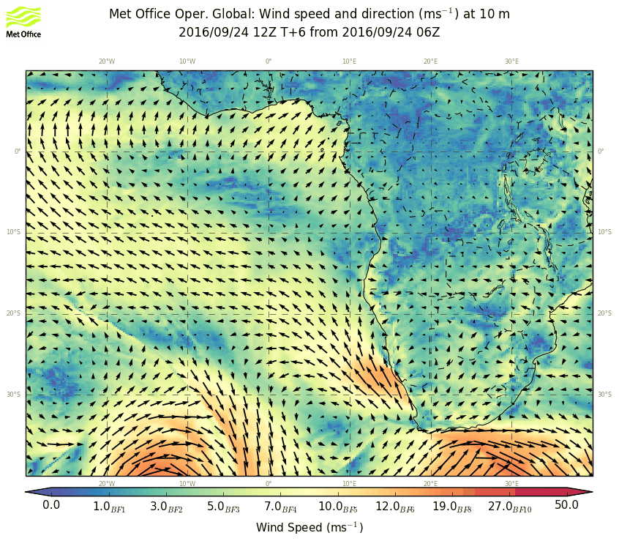

Slide 6
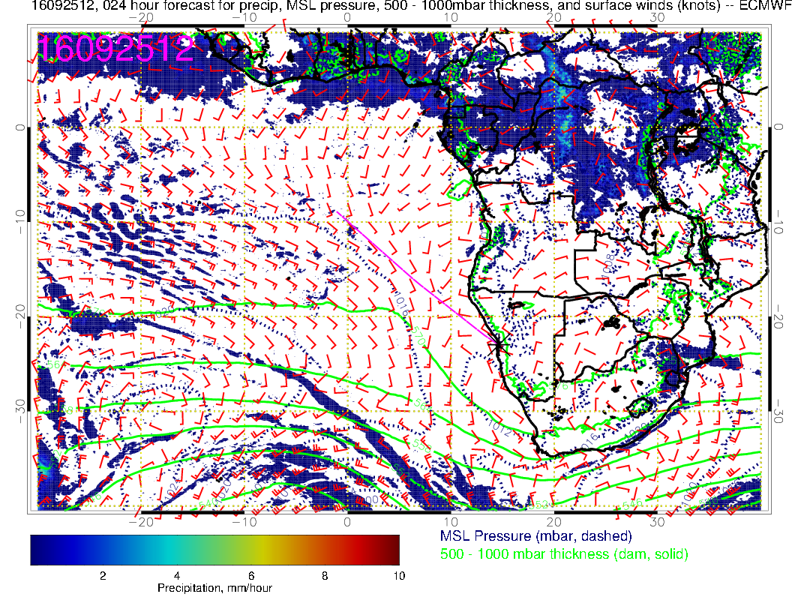
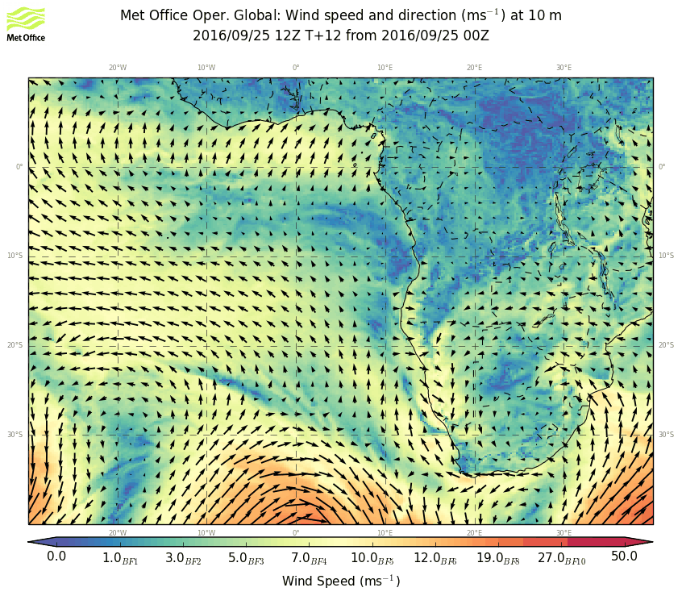

Slide 7
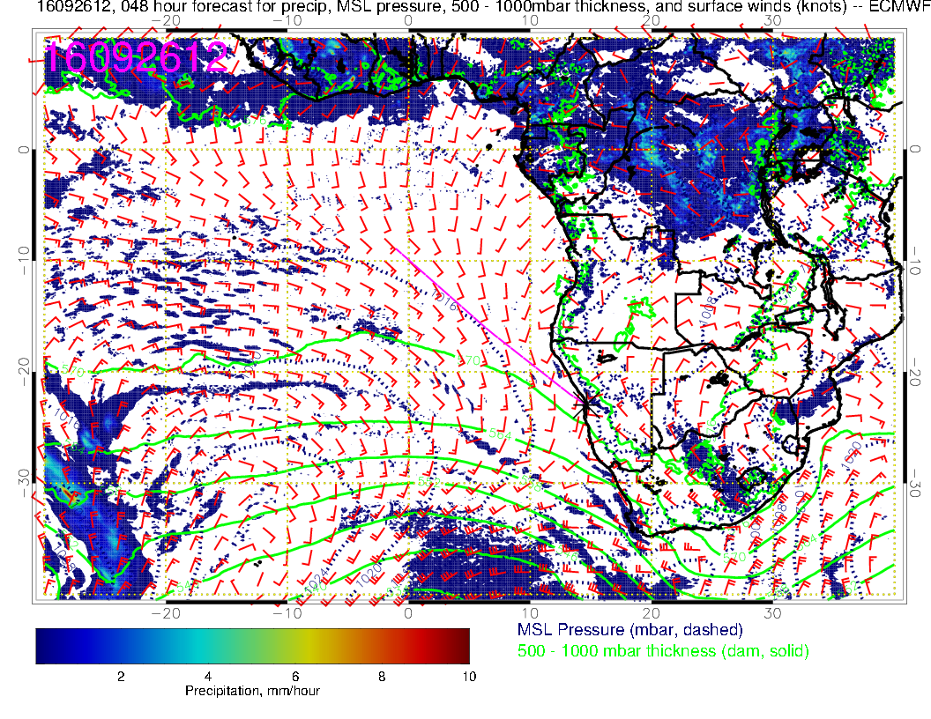
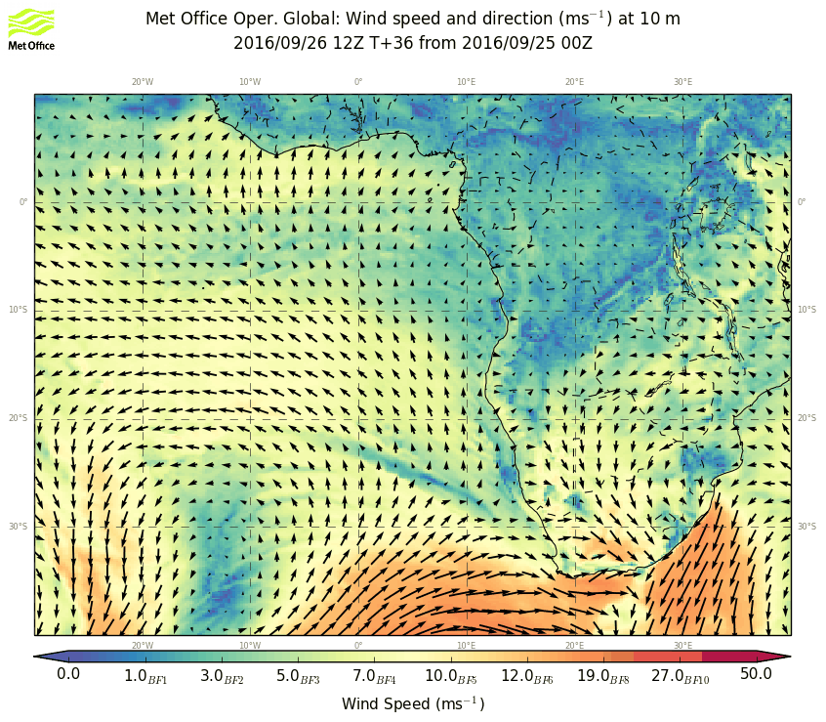

Slide 8
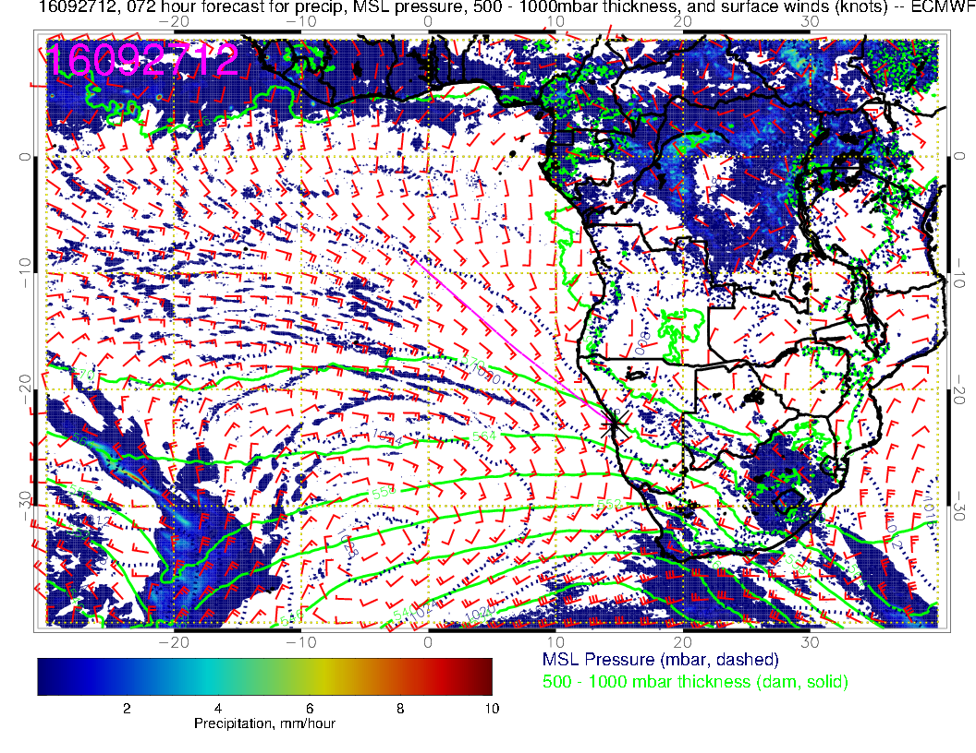
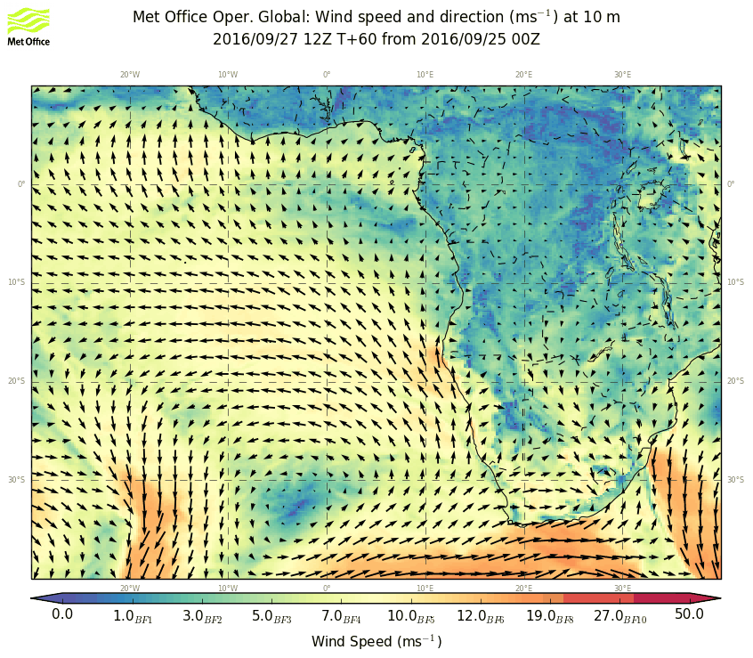

Slide 9
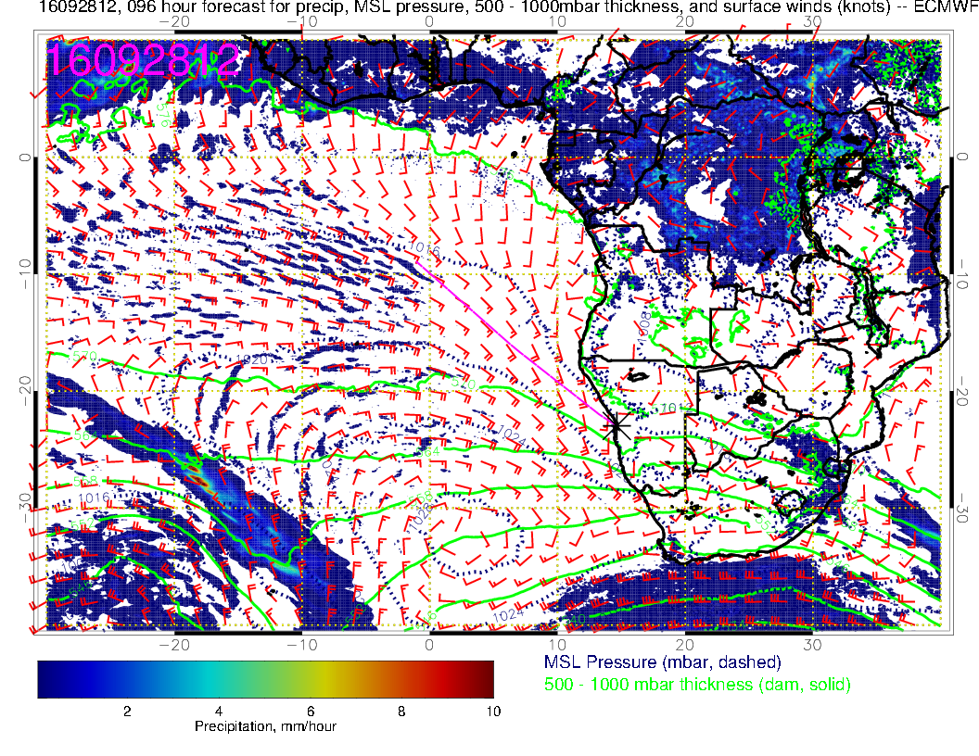
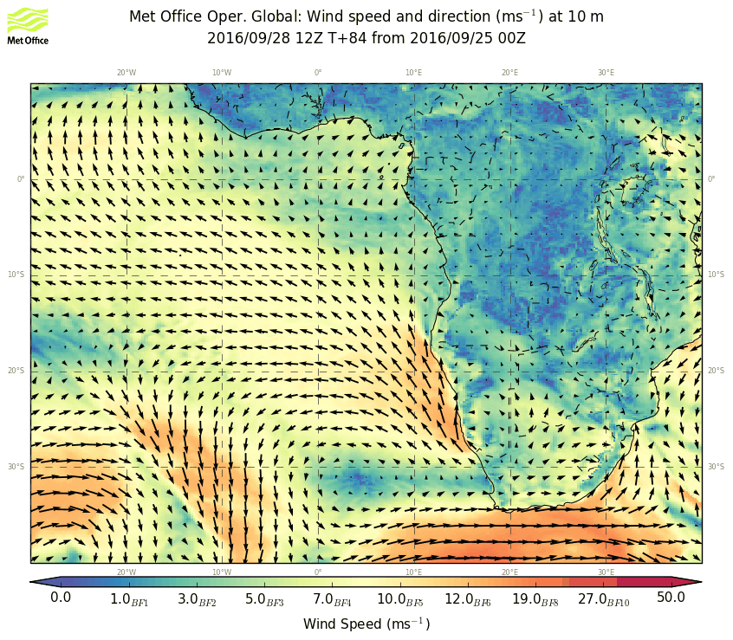

Slide 10
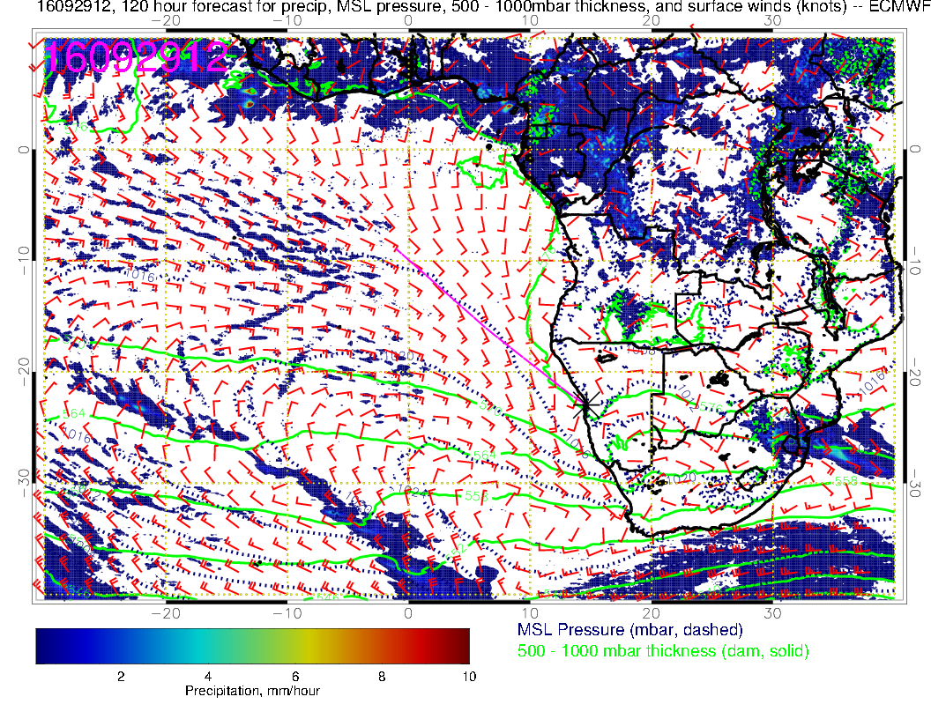
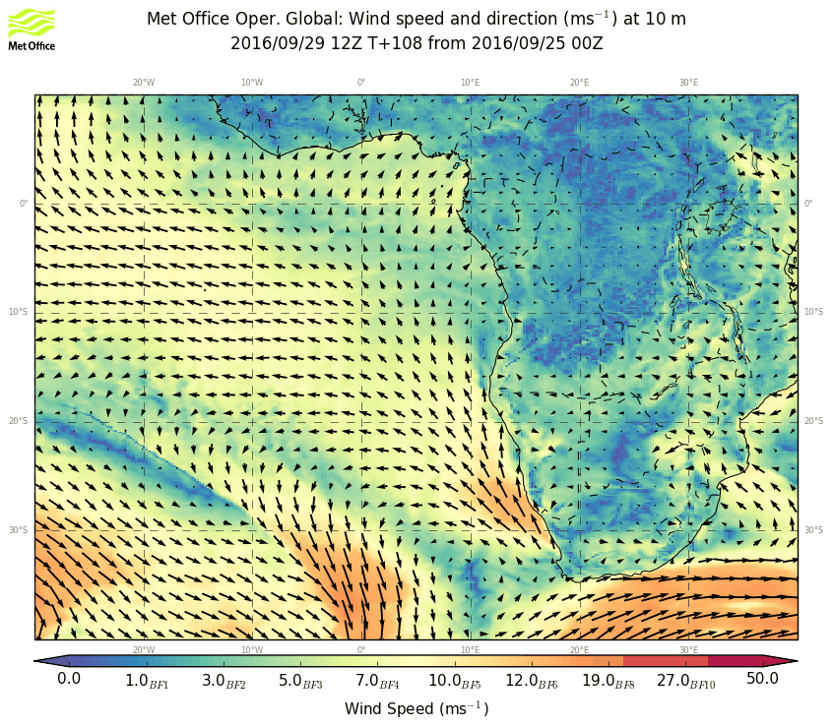

Slide 11
Tuesday, 20160927

Slide 13
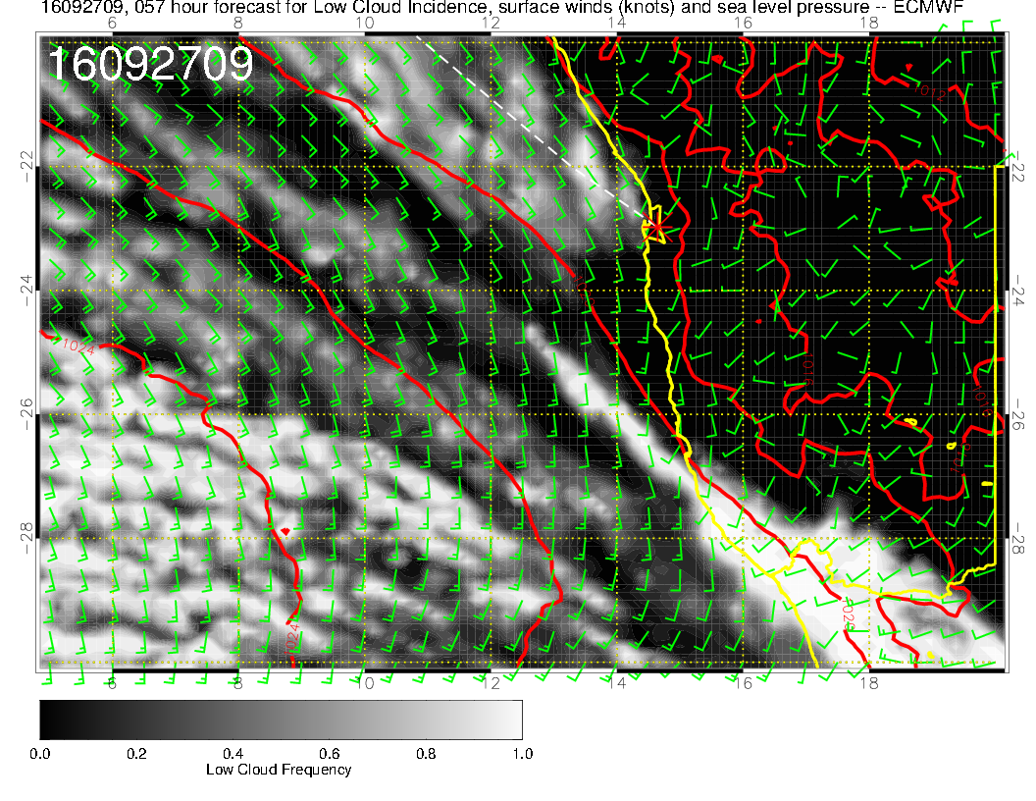
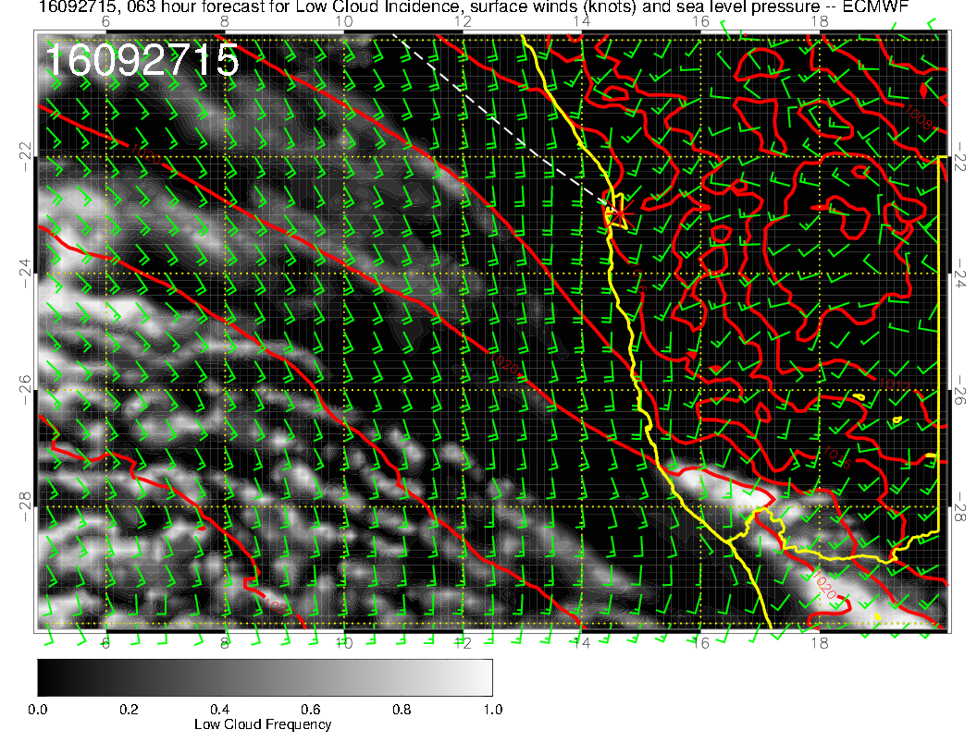
Post frontal situation, do not expect a lot of cloud problems. Winds 20 knots at 210 forecast, but pressure gradient clearly weaker than previous situation where we were still within limits, so expect flyability

Slide 14
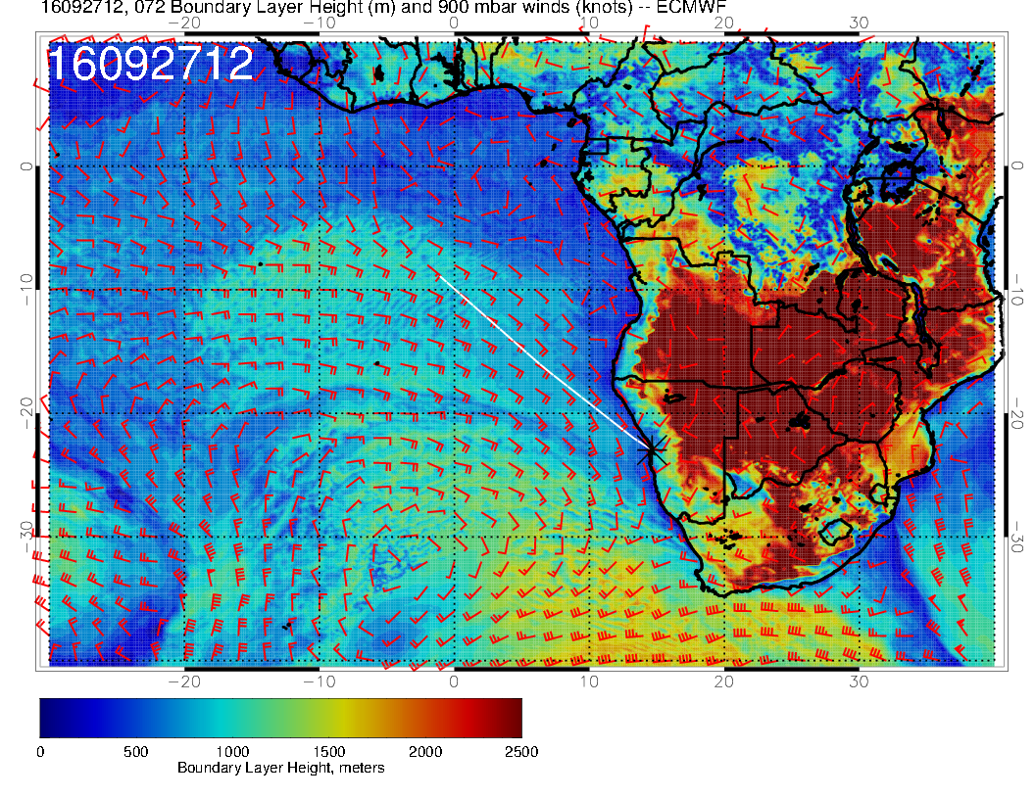
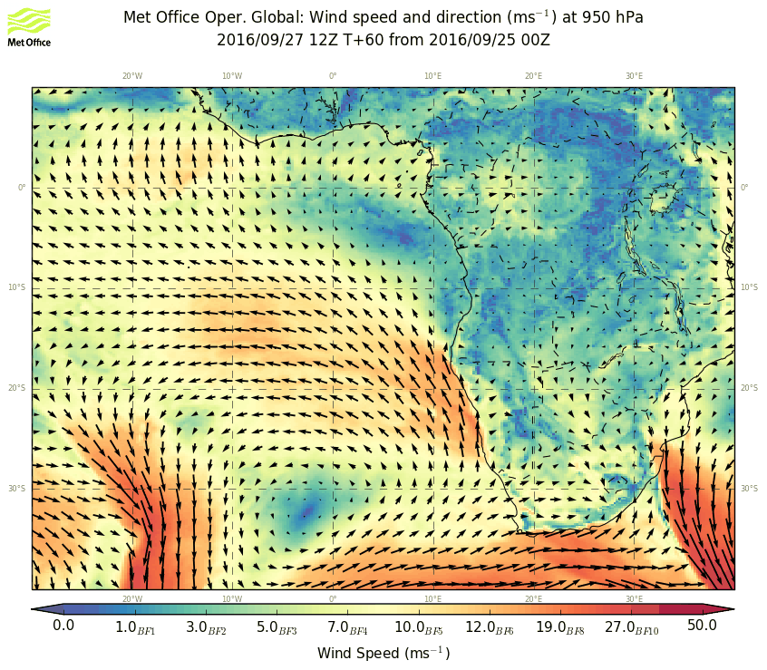

Slide 15
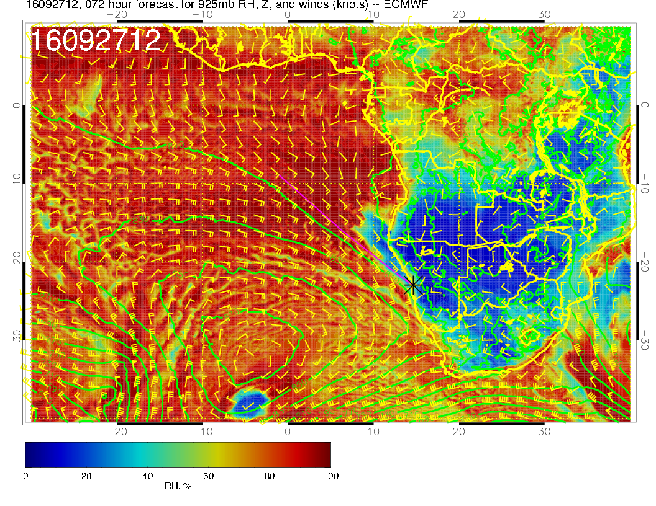
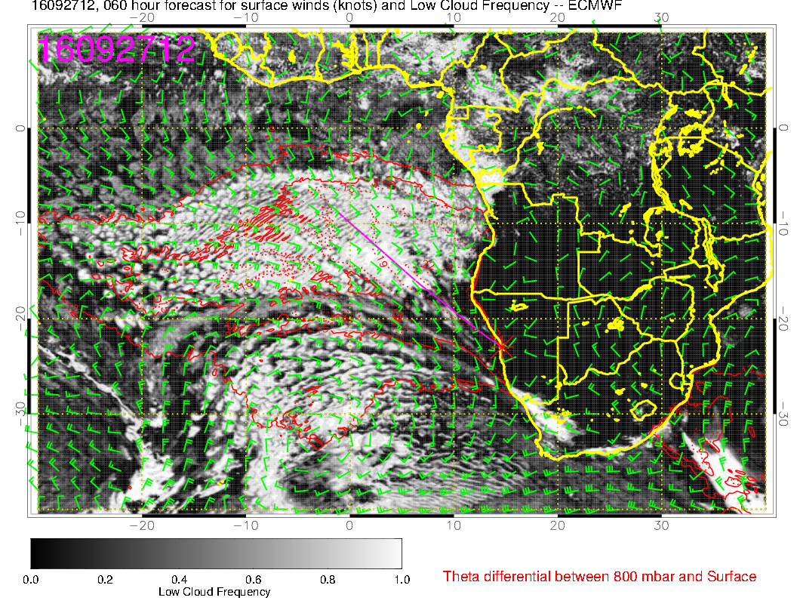

Slide 16
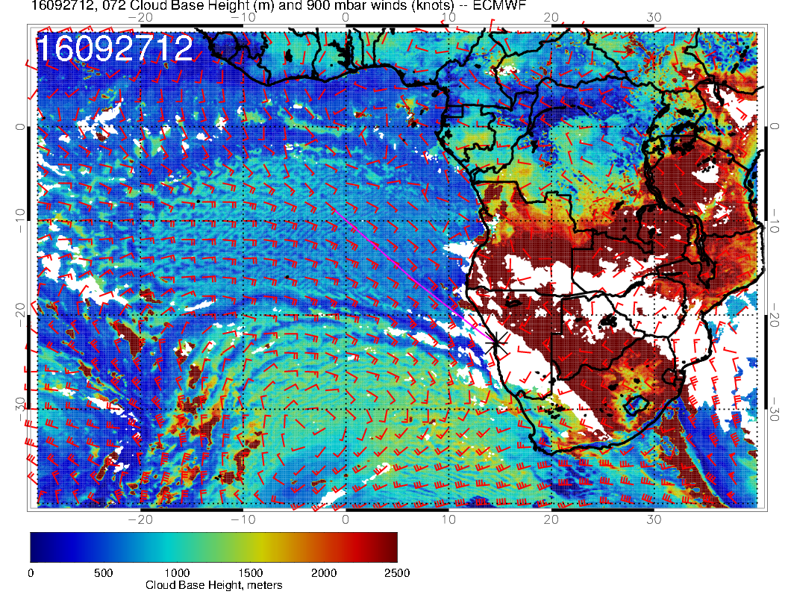

Slide 17
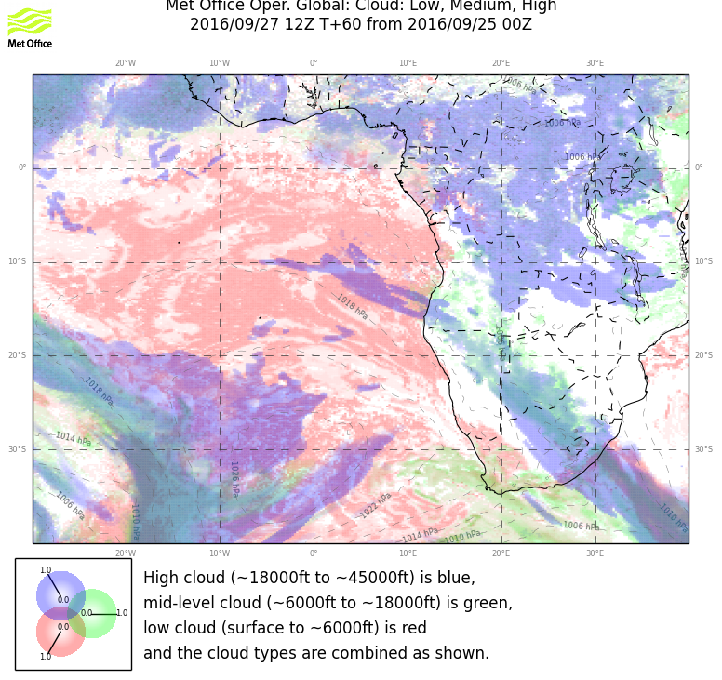

Slide 18
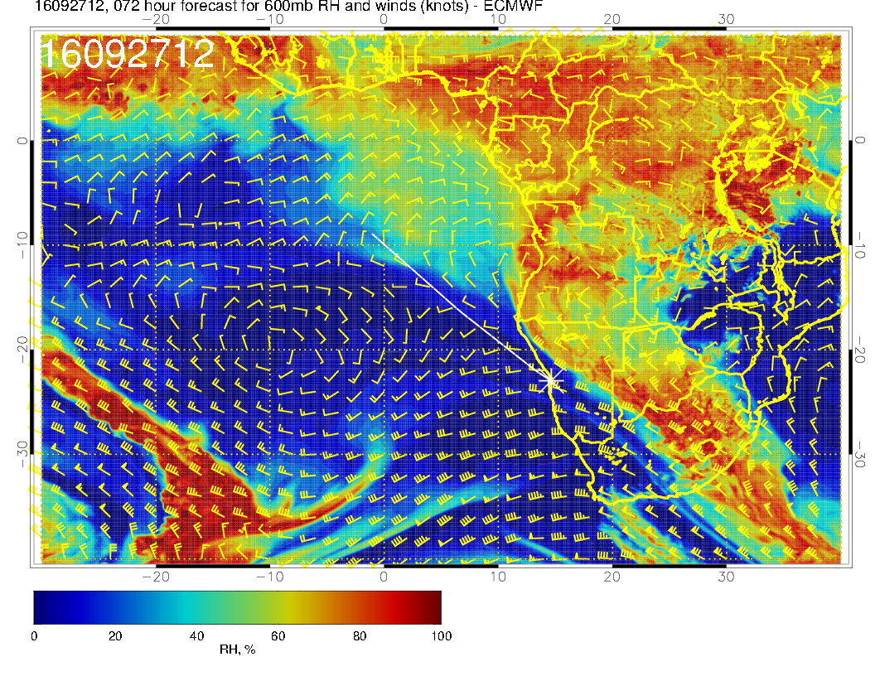
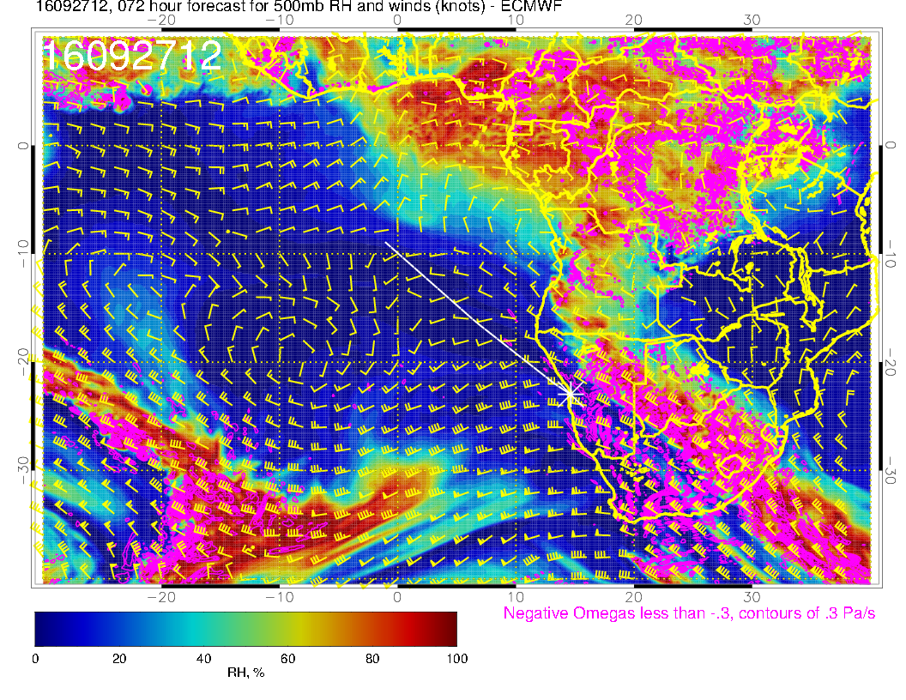
Dry except far north, flow into Atlantic is occurring at 0-5S, further south flow turns into continent

Slide 19
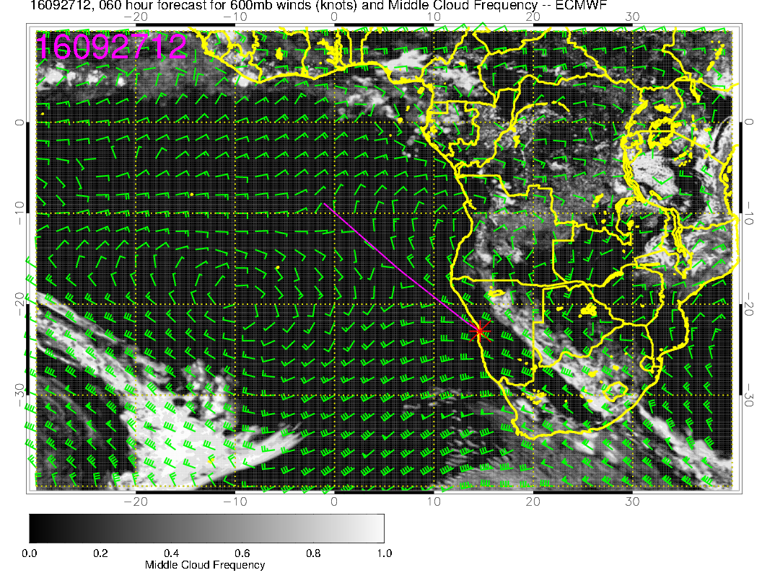
Middle cloud underdone in EC near Angola coast. But, tight turnaround circulation near Angola coast is sending all moisture mixed to midlevels back into the continent, so expect minimal mid level cloud

Slide 20
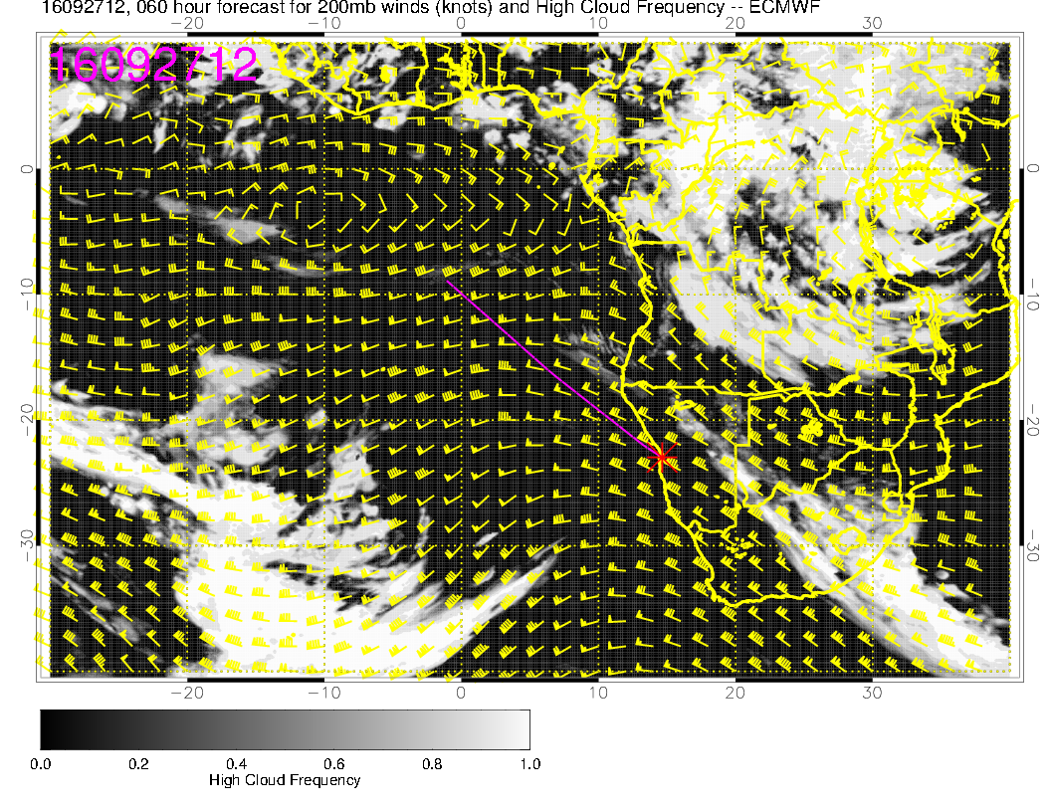
Model divergence across central belt. Expect some cirrus there due to trough. This argues against radiation work in this region because of risks to RSP and Air MSPI????

Slide 21
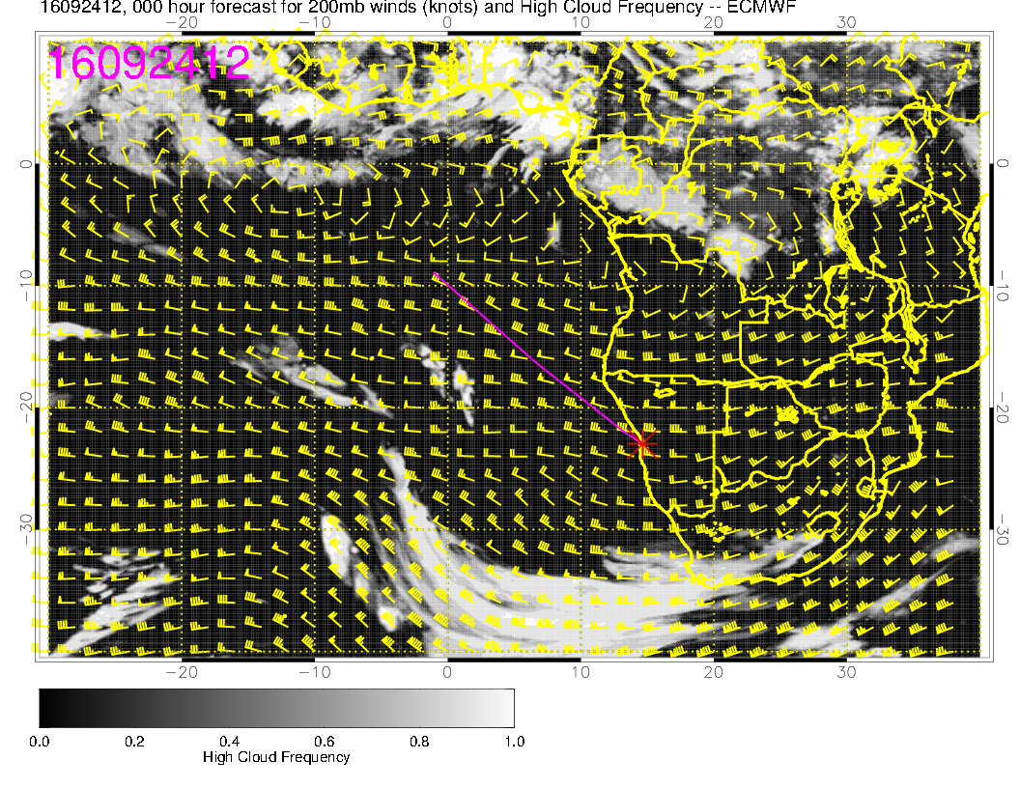
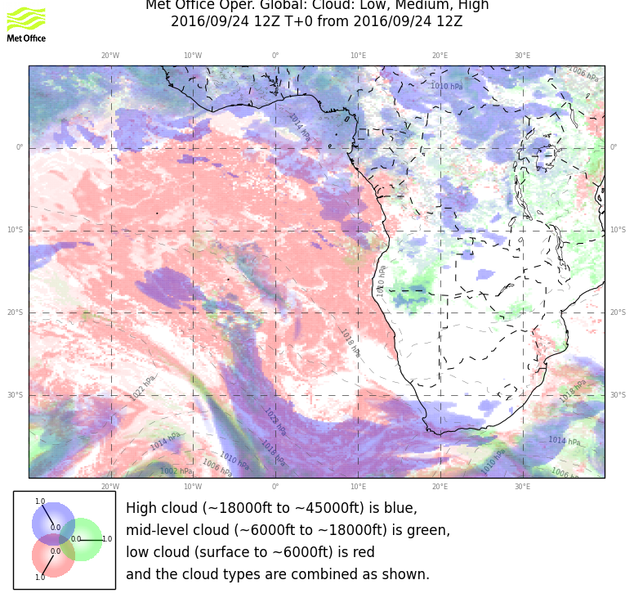
EC initialization (left) and UKMO for yesterday. A touch of cirrus (a band
at 8S was observed, I would say reality is closer to EC than UKMO

Slide 22
Wednesday

Slide 23
Next front is pushing the high just south of YWB, strong winds have moved south

Slide 24
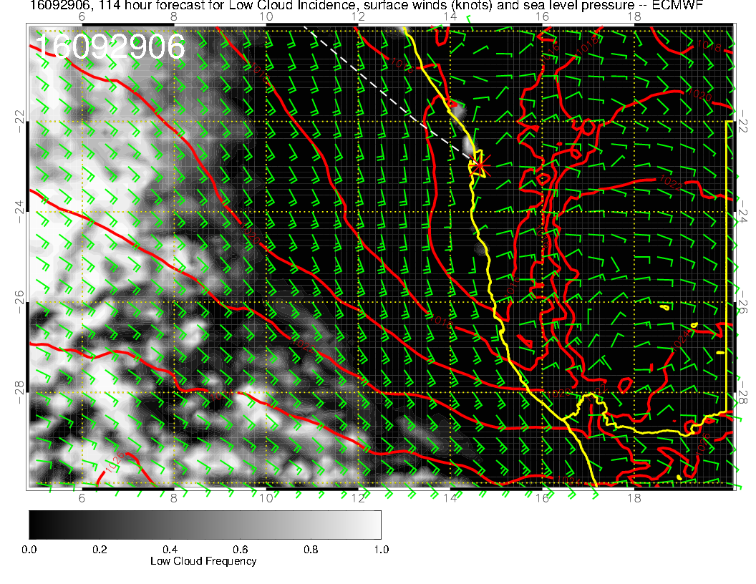
No landing forecast this time!! I will
leave that to the Met Office at Ascension.
Same kind of thing as before, though
the offshore component is stronger.
Winds are weak

Slide 25
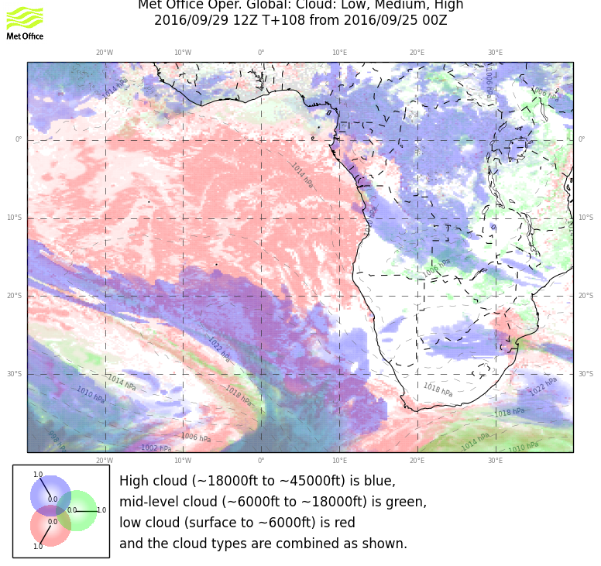
UKMO, usually “the coverer”, is also optimistic about low cloud at YWB

Slide 26
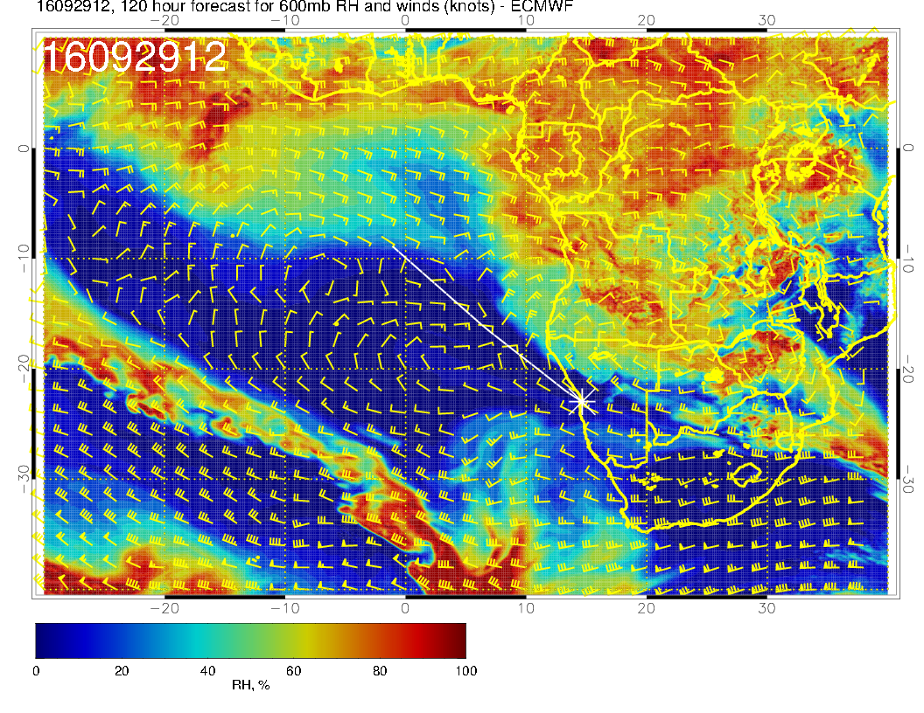
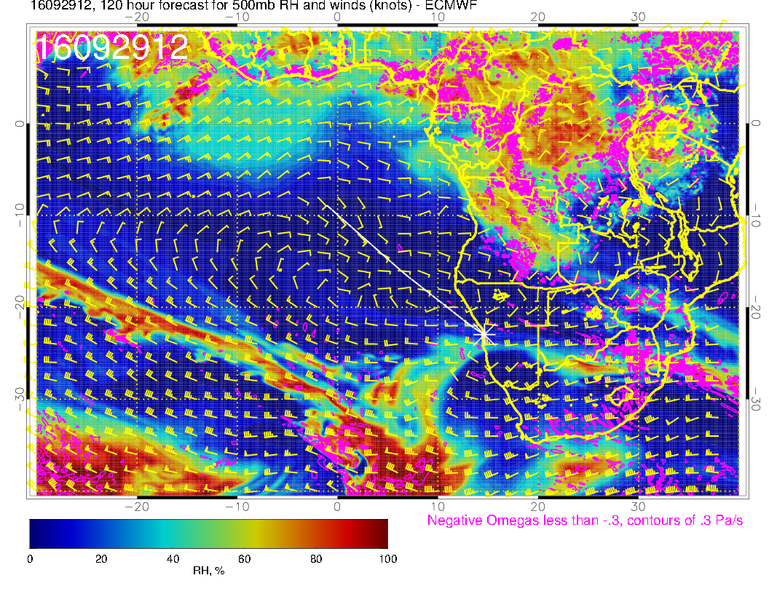

Slide 27
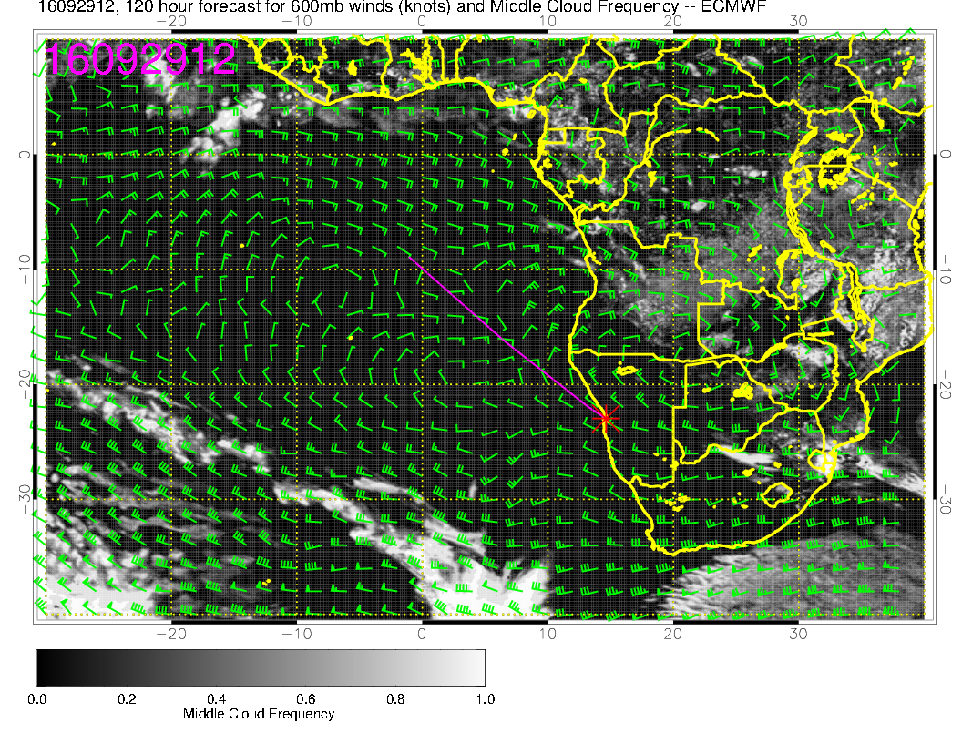

Slide 28
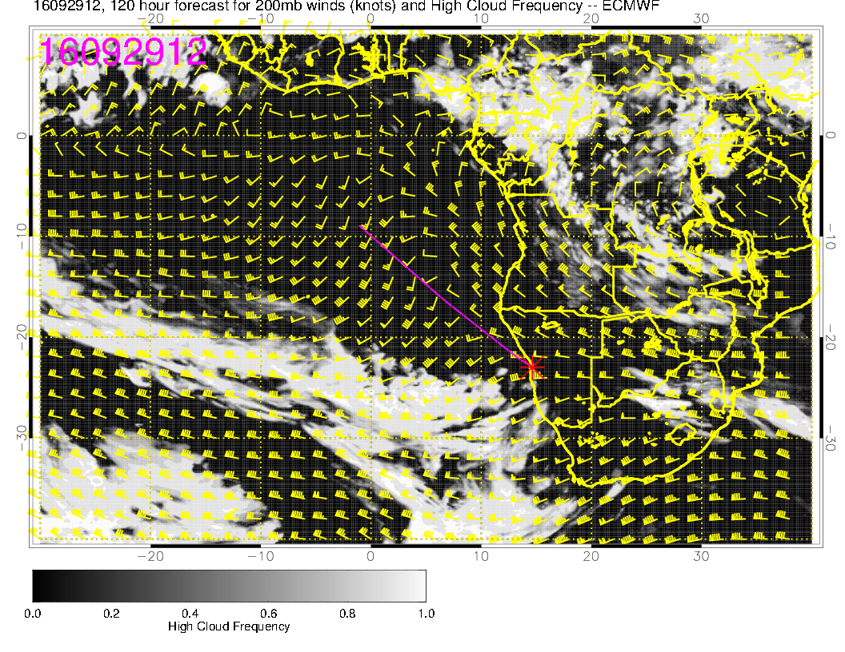
Looks pretty clear of middle and high cloud

Slide 29
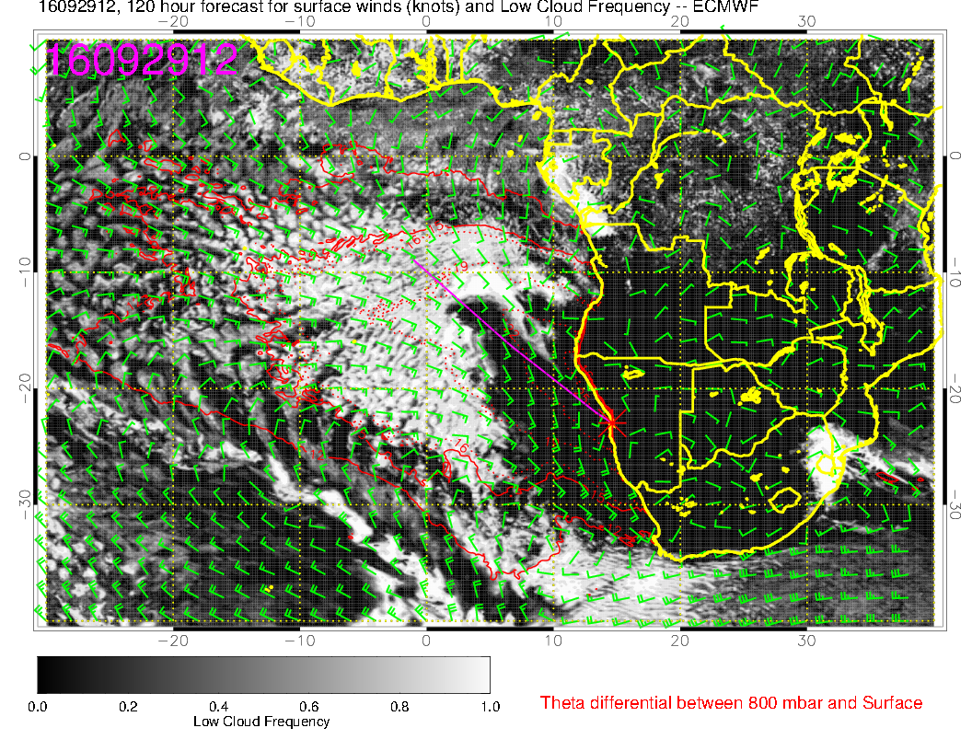

Slide 30
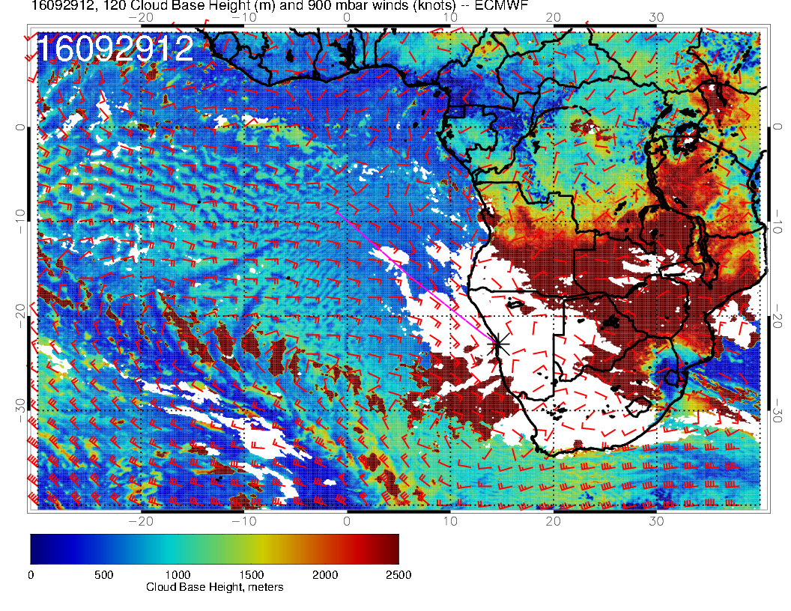
This cloud base height diagram may be a better visual indicator of cloud
presence in the “clear” regions

Slide 31
