Slide 1
ORACLES forecasting briefing Meteorology for 25-09-2016
Lenny Pfister

Slide 2
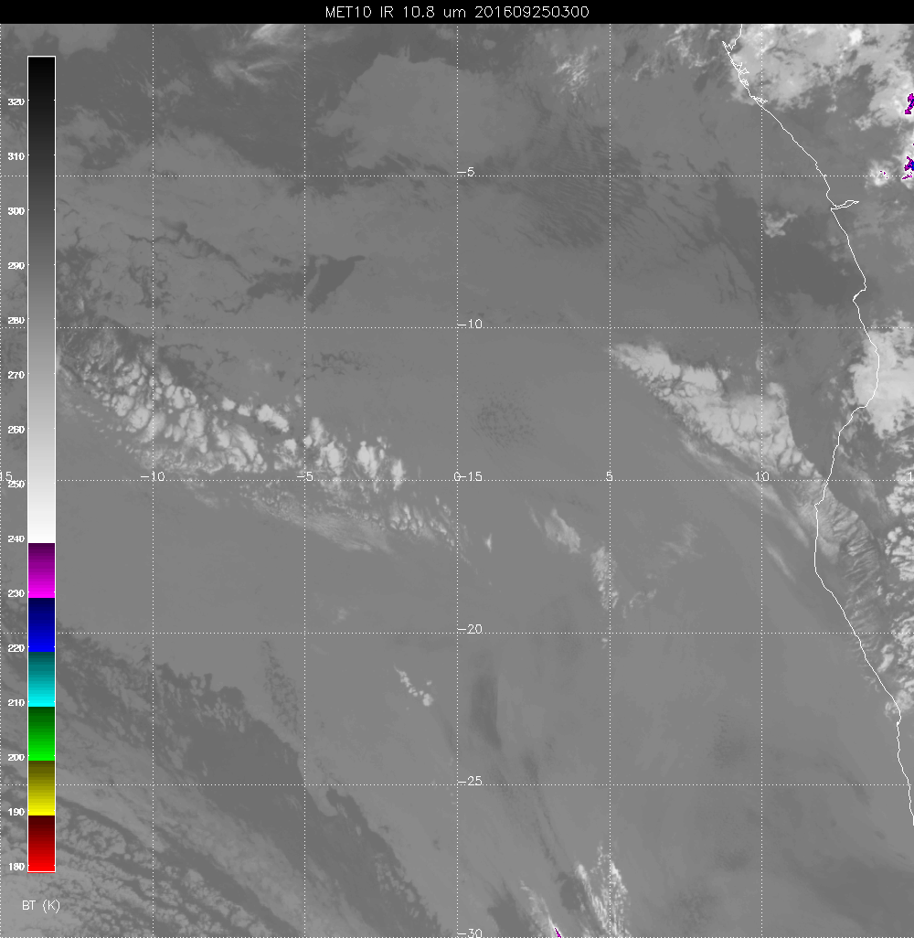
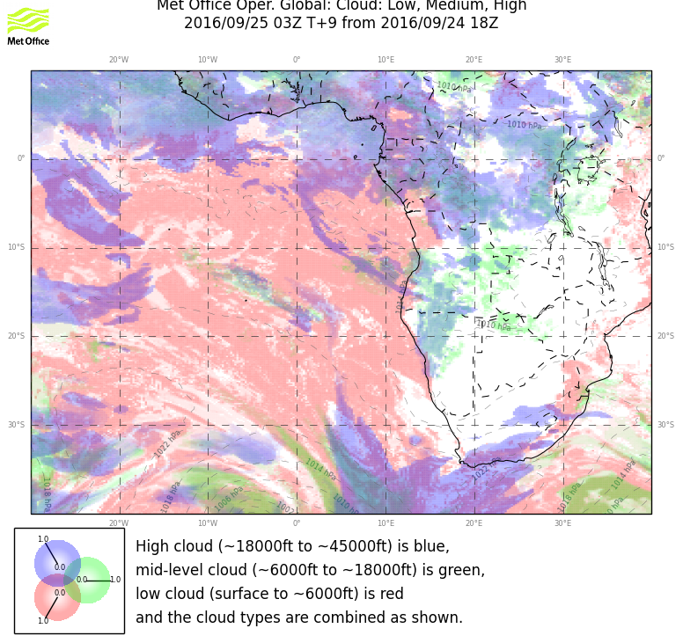
Cirrus streak not apparent in the image.

Slide 3
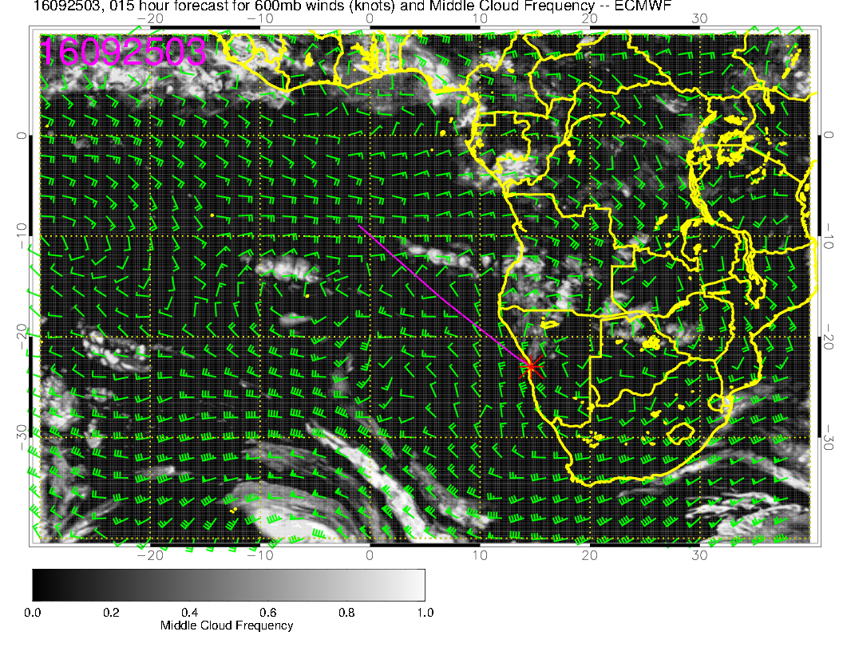
Right general area, but underestimated

Slide 4
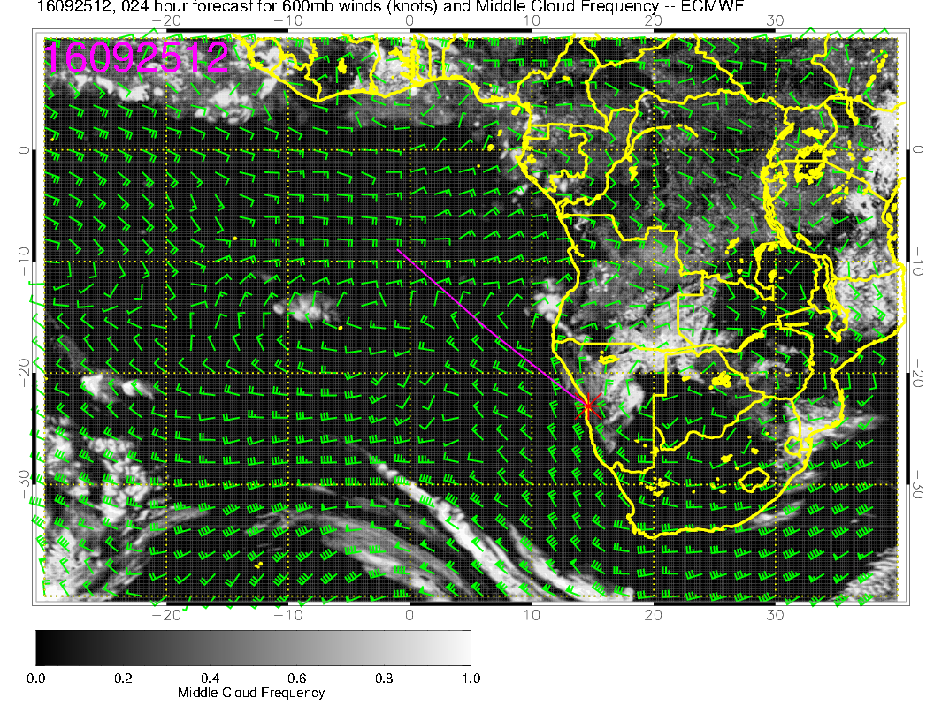
Diurnal disappearance.

Slide 5
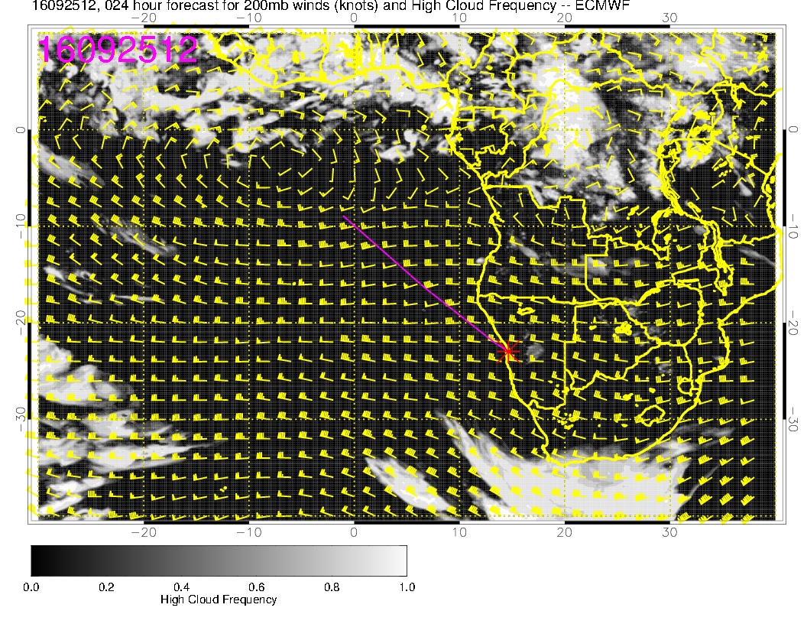
Minimal cirrus

Slide 6
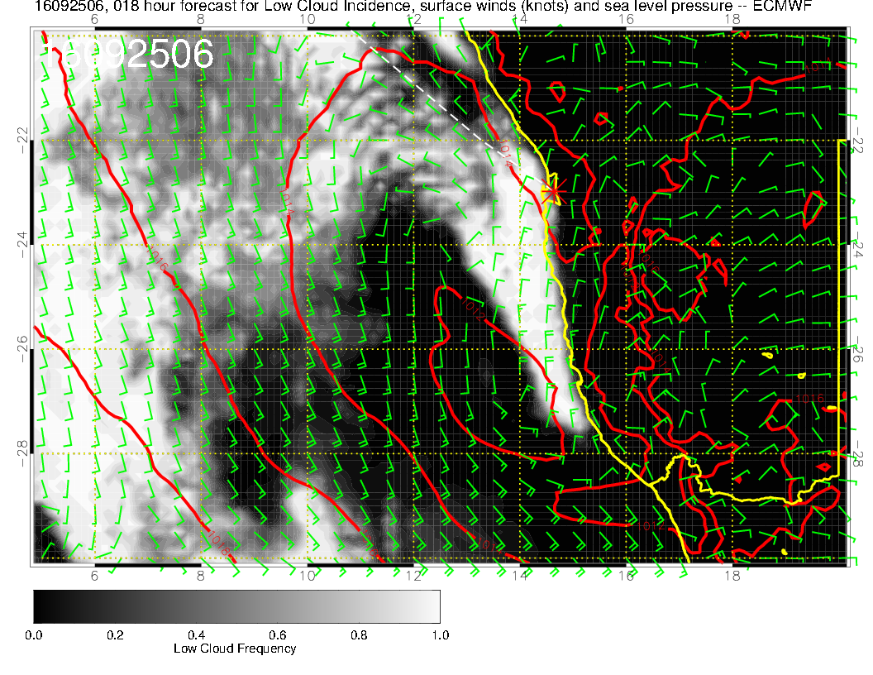
This morning. Some offshore
flow push keeping low clouds
at bay.

Slide 7
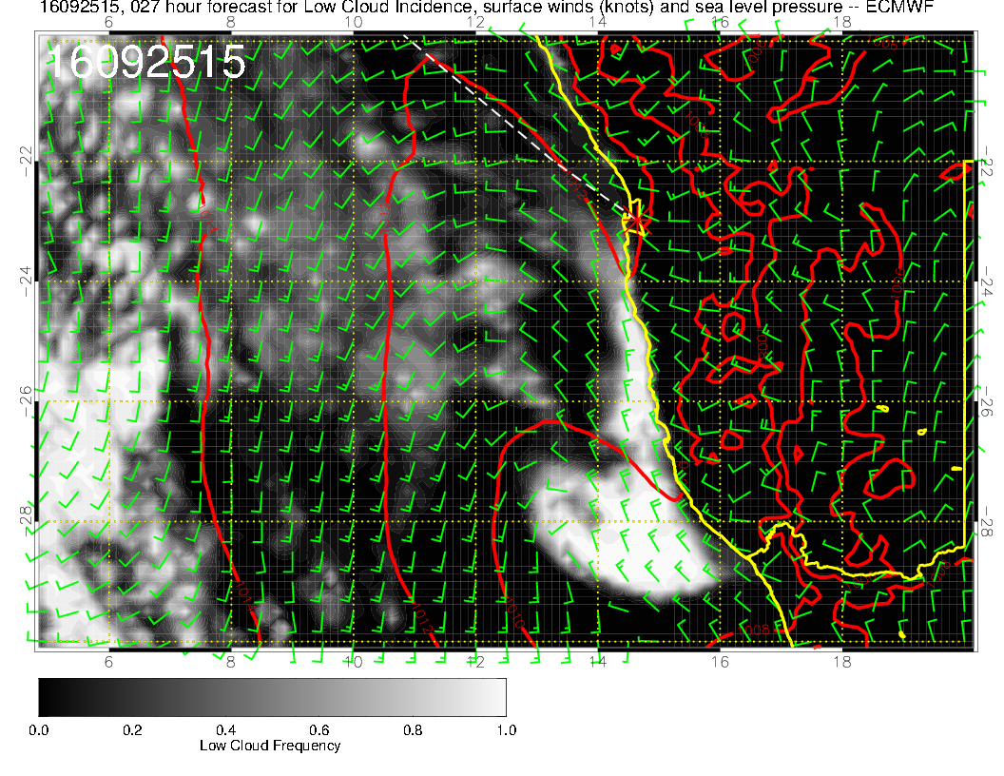
Low moves south (“coastal low”??). Winds 310-320 at 10 knots or so on landing

