Slide 1
ORACLES forecasting briefing Meteorology for 25-09-2016 – 27-09-2016
Susanne Bauer and Lenny Pfister

Slide 2
Sunday, 20160925

Slide 3
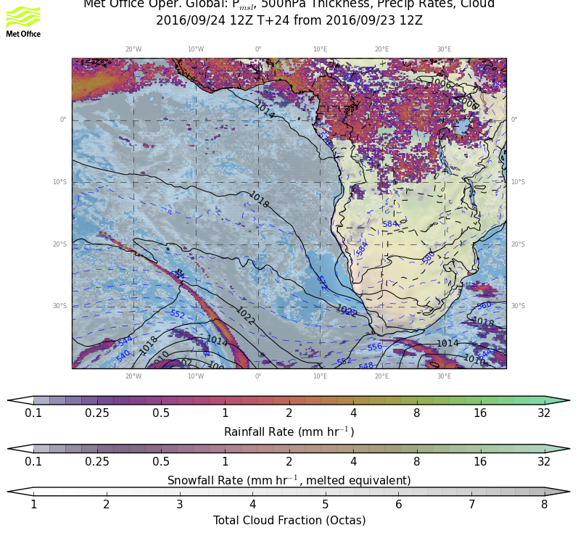
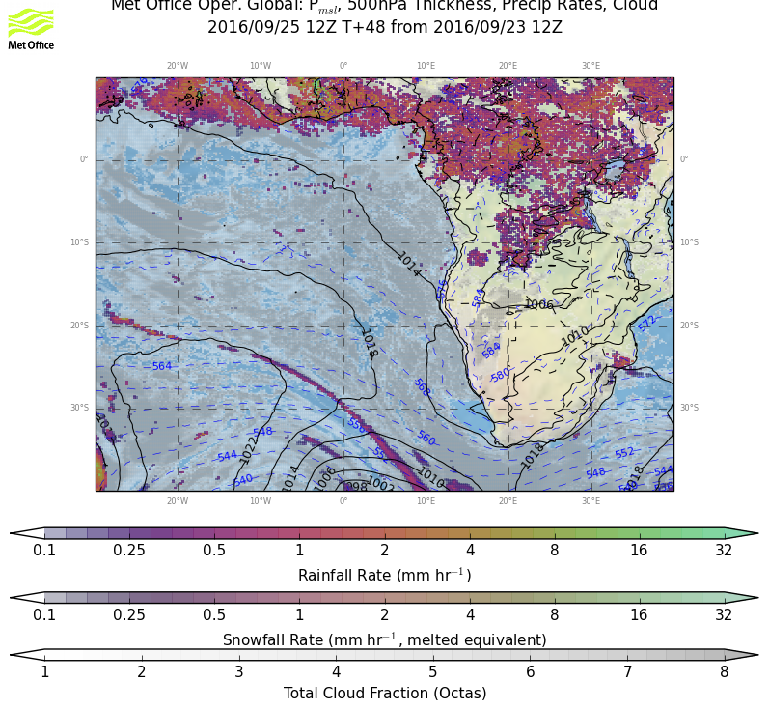
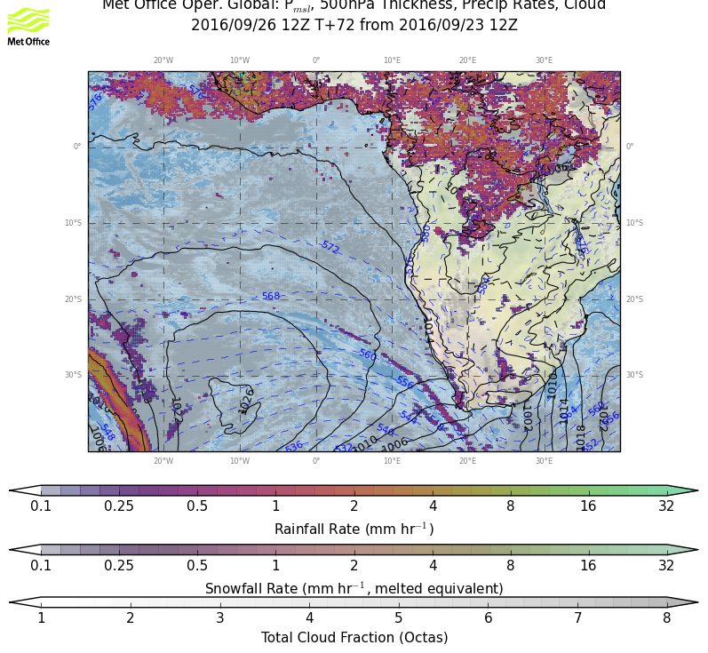
sat
sun
mon
Surface evolution Saturday-Monday:
Former low pressure system dissolved on Friday/Saturday, new system in the south east, pushing cold front that reaches RSA by Monday.

Slide 4
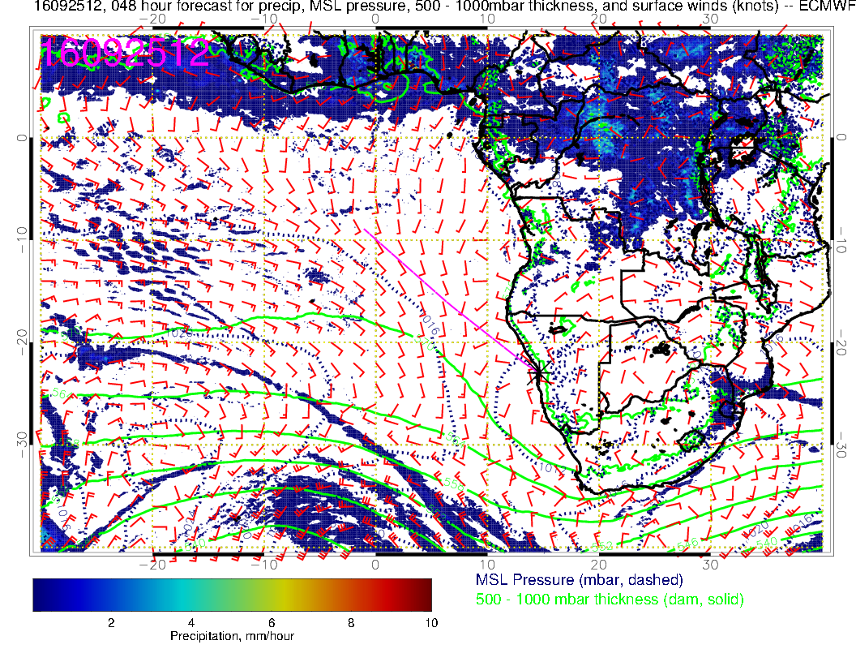
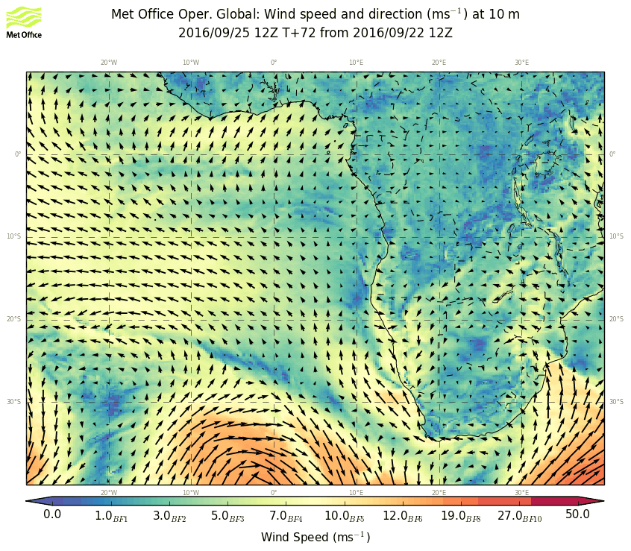
Surface condition Sunday: Weakening surface winds, with eddy circulation in YWB region, leading to changed surface wind directions compared to previous days. Note
High pressure region over Botswana, westward flow.

Slide 5
Similar to surface conditions, small cyclonic eddy offshore of YWB. Stronger winds associated with approaching wave/cold front, which will be touching the RSA west coast by Monday.

Slide 6
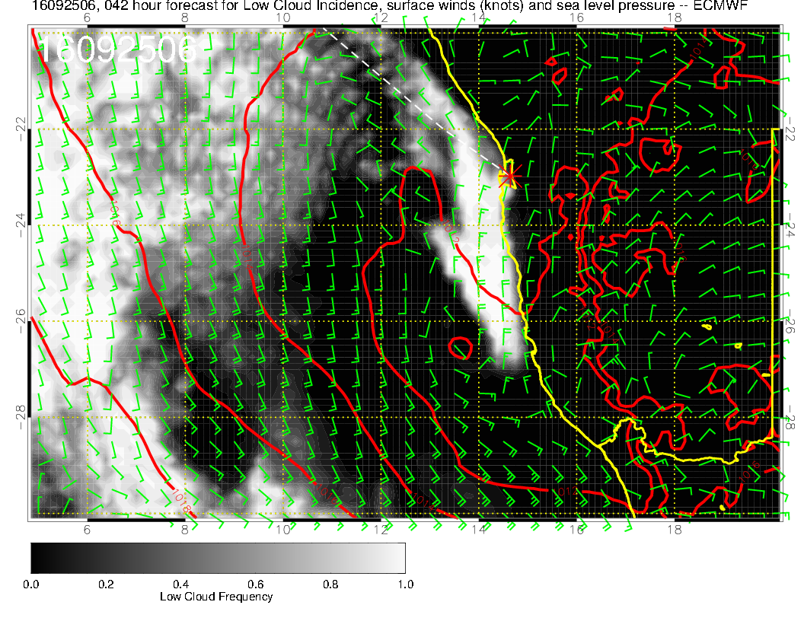
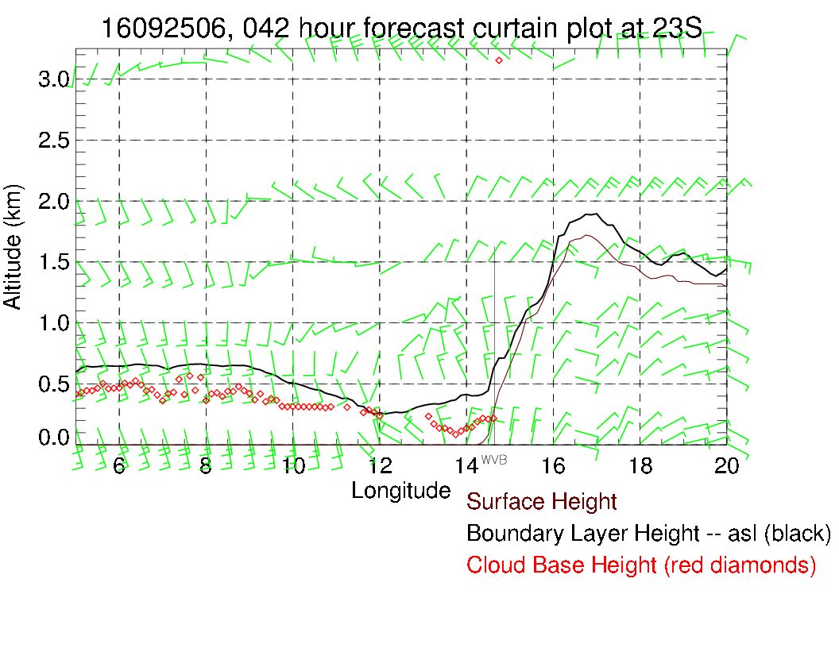
Eddy circulation is offshore, easterly wind pattern due to Botswana high. Believe major fog will be kept offshore.

Slide 7
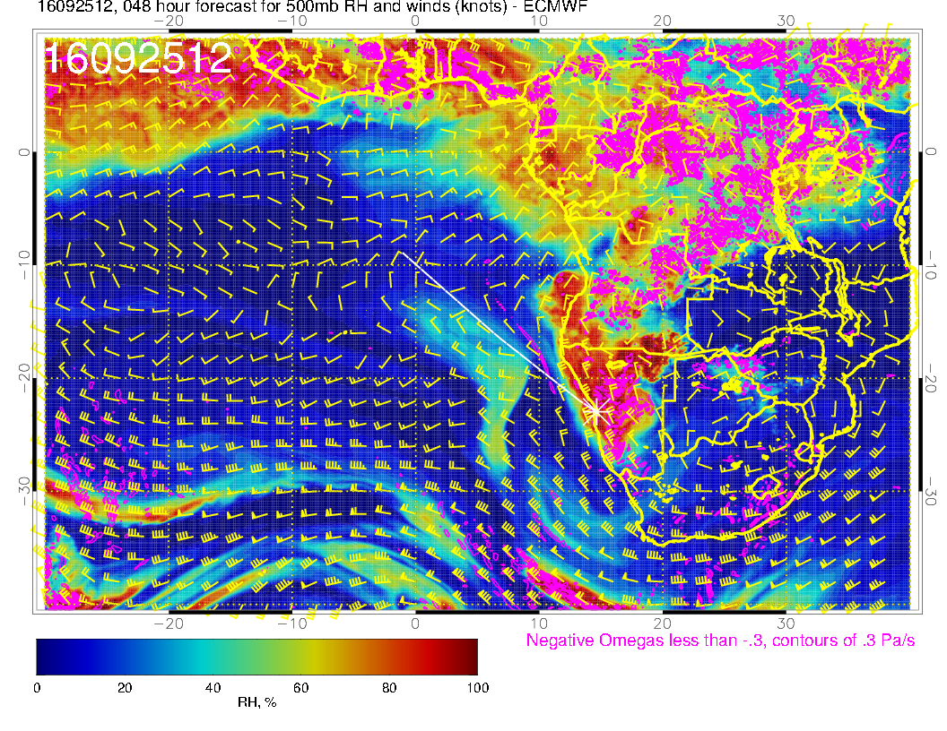
Forecast consistent with yesterday’s, except that the St Helena moisture blob has gotten angrier. Note that at 500mb, moisture from the BB region is sent over Namibia; rising motion from trough raises RH.

Slide 8
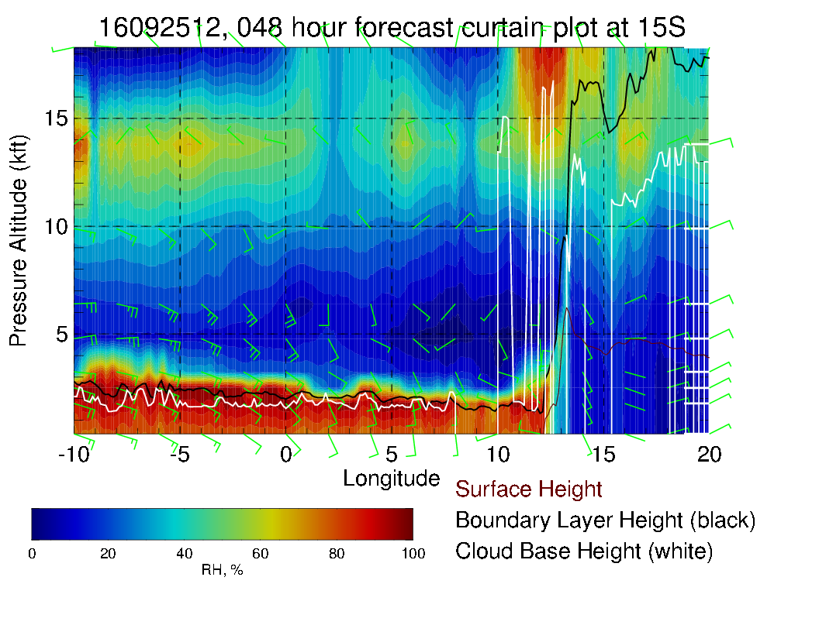
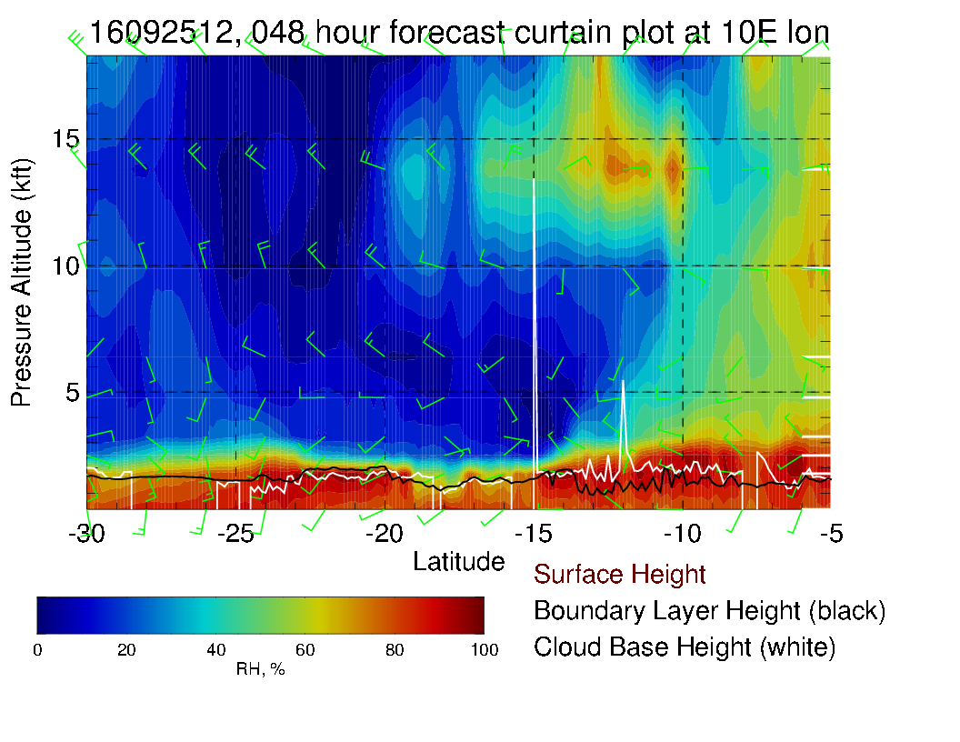
This is a high moisture injection. I need to raise the ceiling on my x-section plots!!

Slide 9
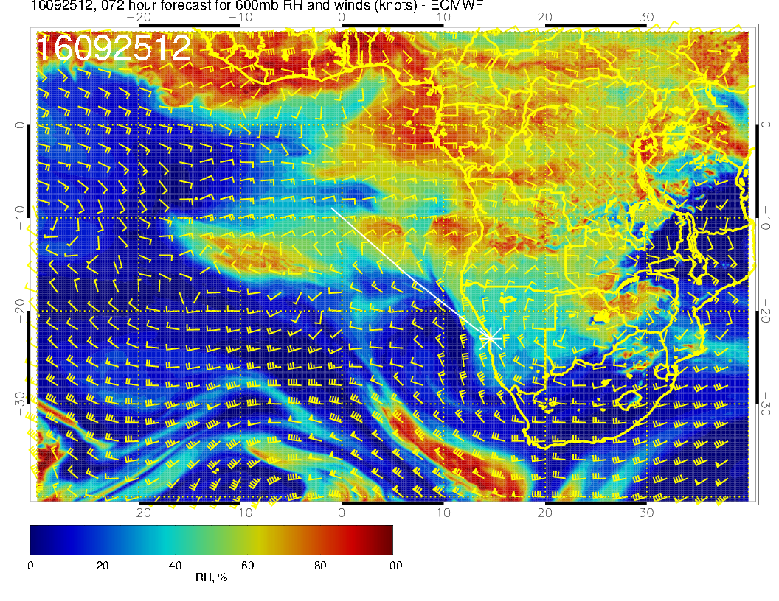
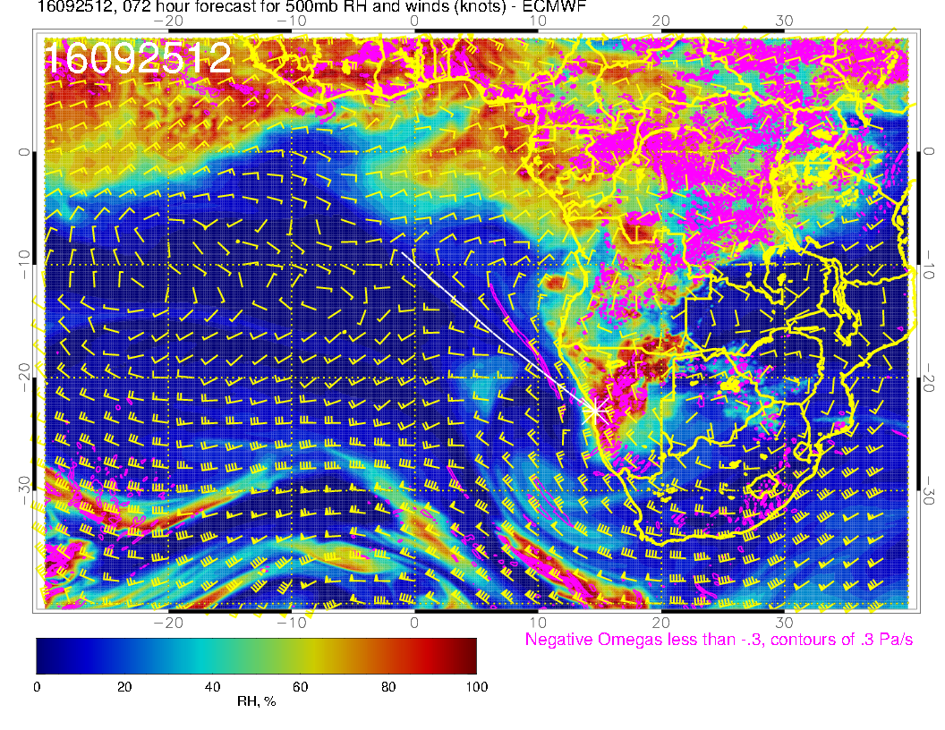
Old fcst for reference

Slide 10
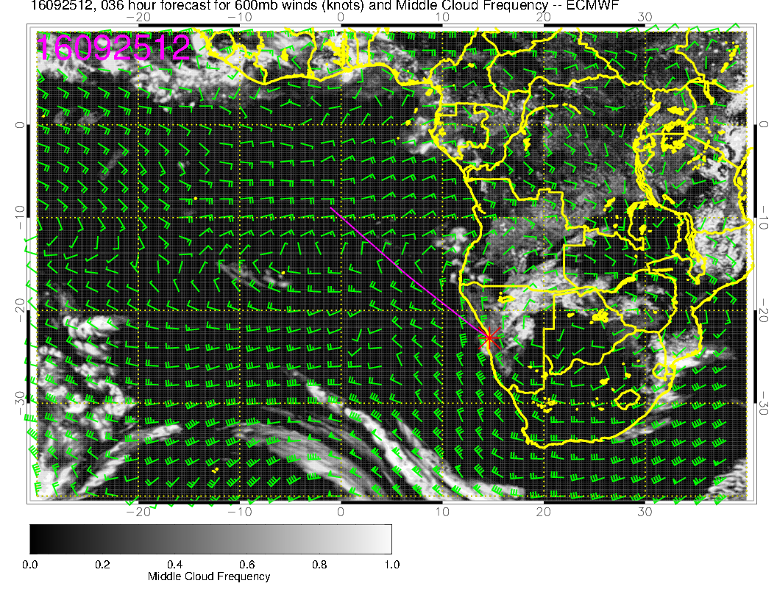
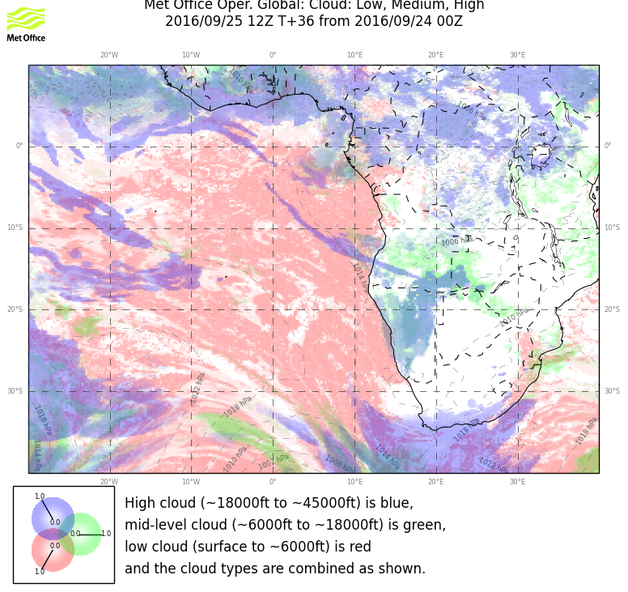
Mostly clear of Mid level clouds. Some cloudiness associated with outflow over Angola Bay. Backed off a bit from yesterday’s fcst

Slide 11
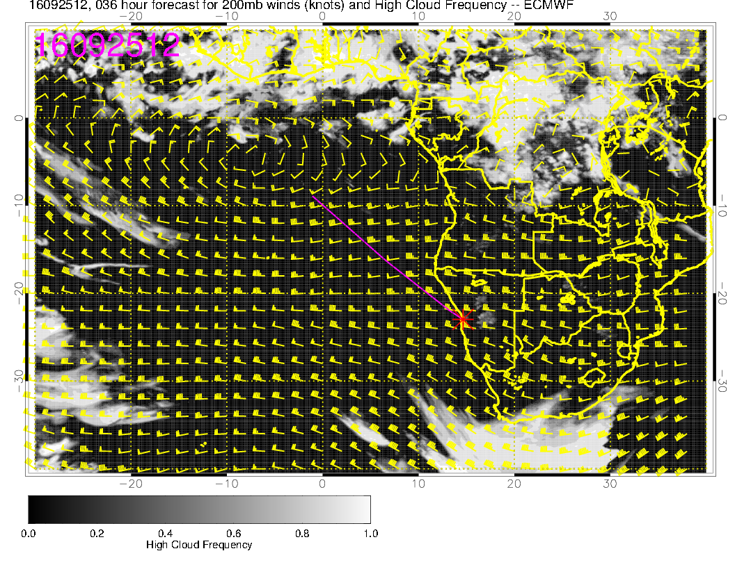
Latest UKMO puts a cirrus band across the top of our region

Slide 12
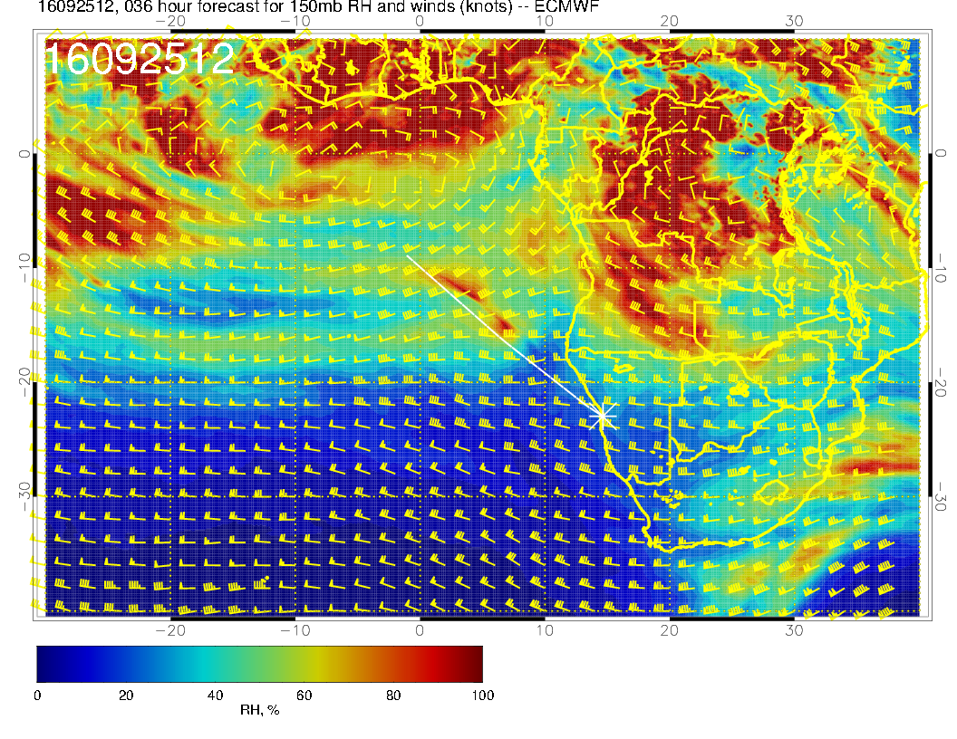
Some hint of this thing at high levels (45kft). UKMO tends to overdo high cirrus.

Slide 13
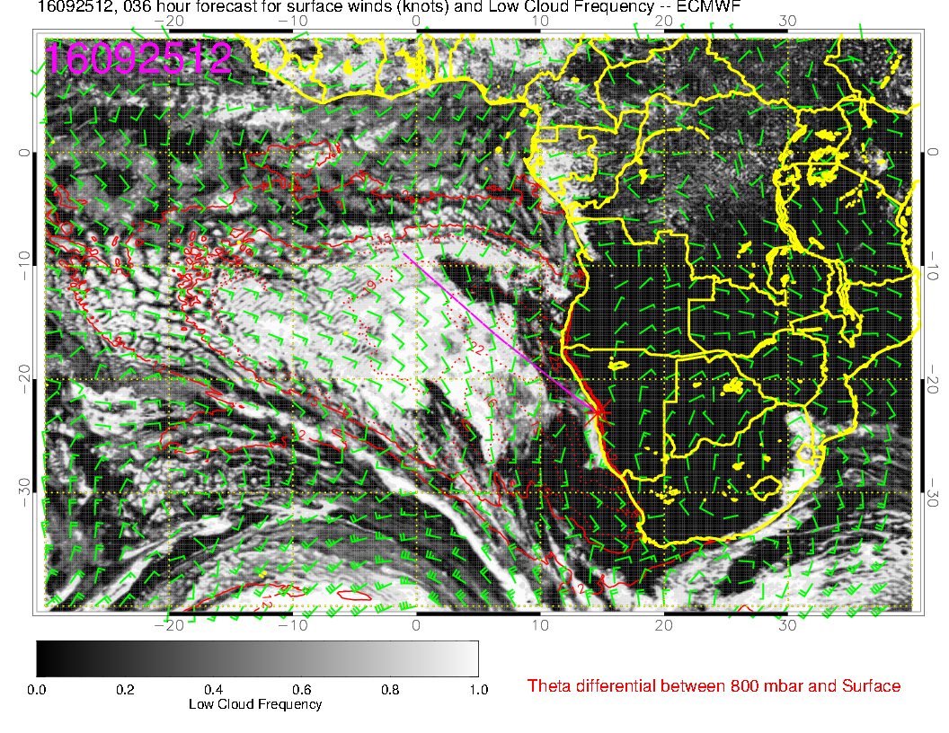
EC model shows clearing in our coastal areas with some cloudiness over YWB (this could be
caused by the small eddy circulation as seen in the previous plots), UK model does show
more low clouds close to the coast. Models disagree. Truth is somewhere in between

Slide 14
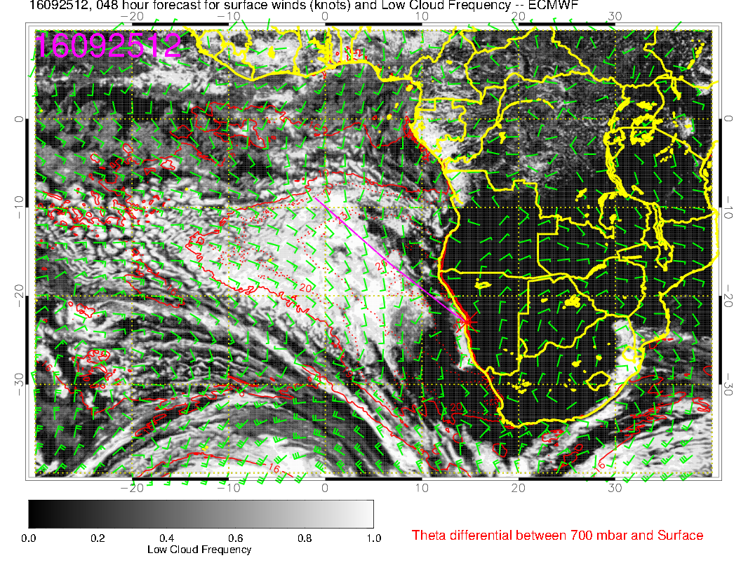
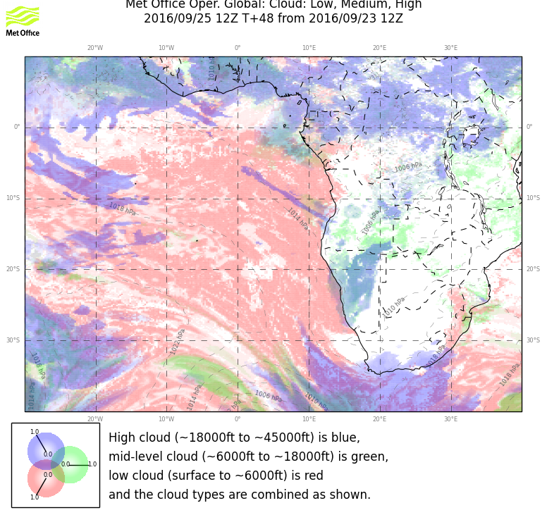
Earlier forecast

Slide 15
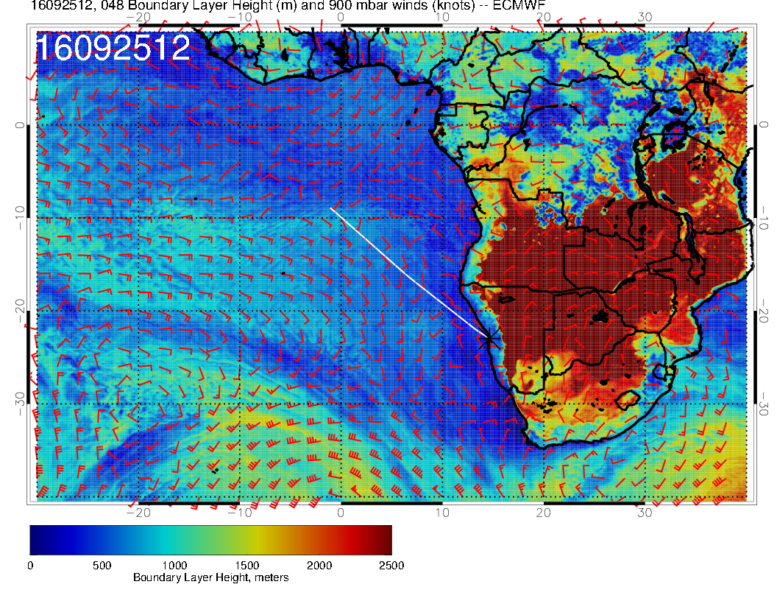
Significant cloud in EC goes with higher BL height. EC probably underestimates cloud in low BL height regions.

Slide 16
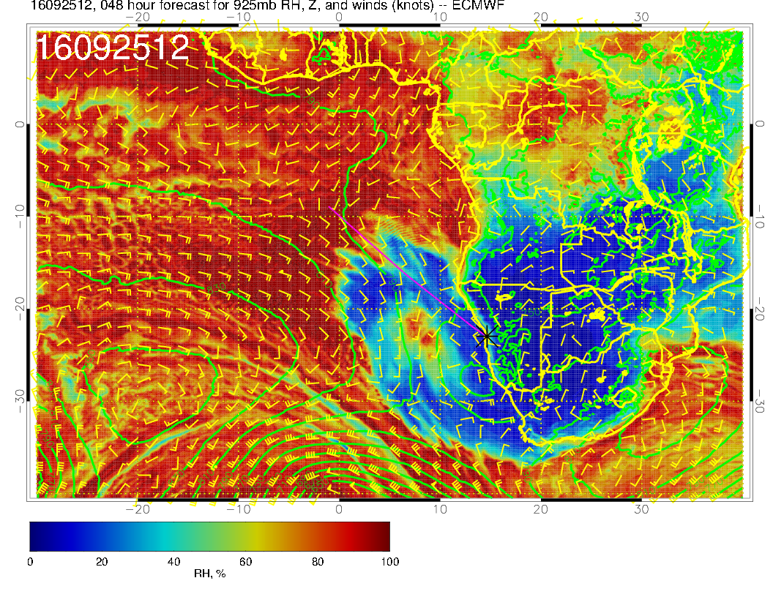

Slide 17
Monday, 20160926

Slide 18
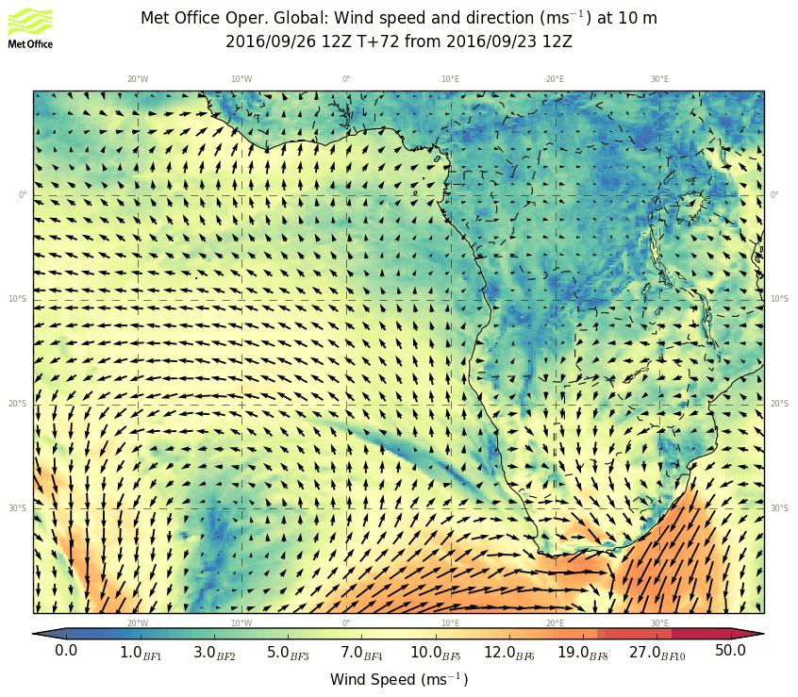
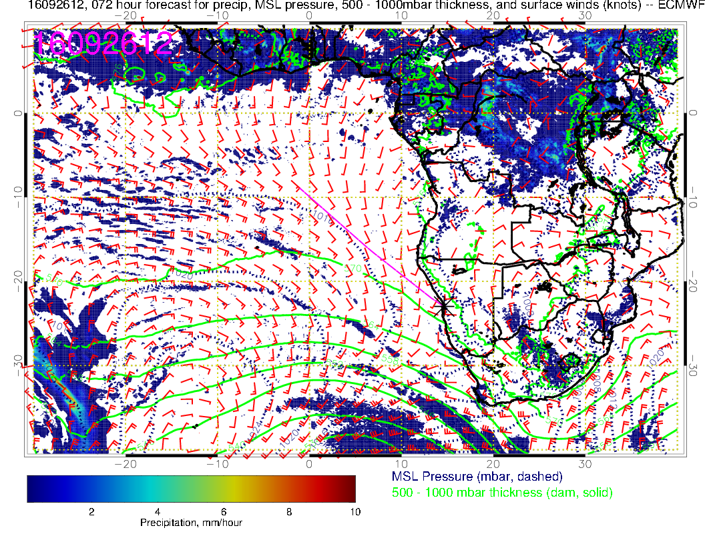
Surface condition Monday: Surface winds further weakened south of YWB, but stronger then the day before in the Sc area. Cold front is reaching the Southern tip of Africa. Botswana High moves eastward, more eastward surface wind component over Namibia.

Slide 19
Increased humidity moving in with the frontal system. RH in the SC area similar to the day before.

Slide 20
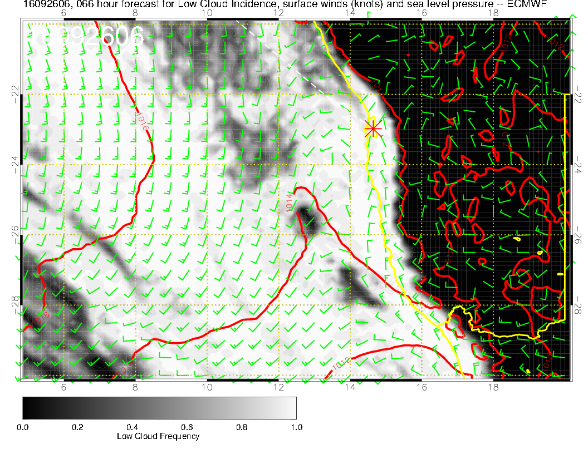
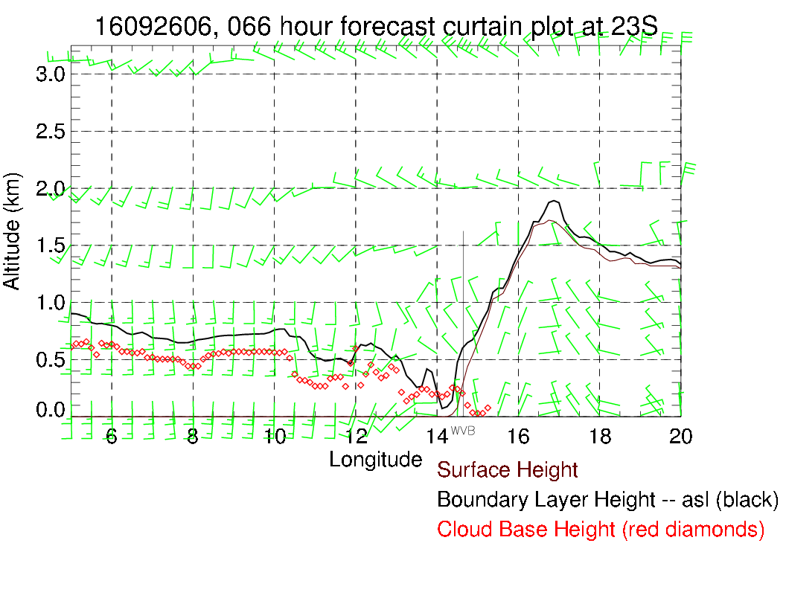
Prefrontal situation. Overcast expected, but prefrontal clouds usually don’t have low ceilings. Model actually suggests that, with 500-600 foot ceiling. Onshore flow. Landing OK.

Slide 21
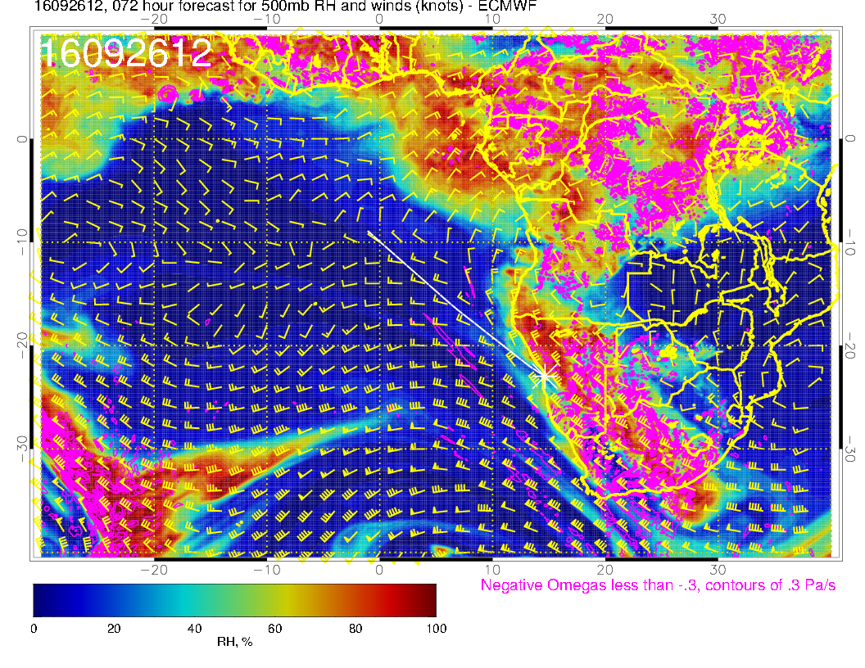
.
Stable forecast – flow into Atlantic now near 5S. Trough pushes eastward, but still mid-level cloud over Namibia forecast.

Slide 22
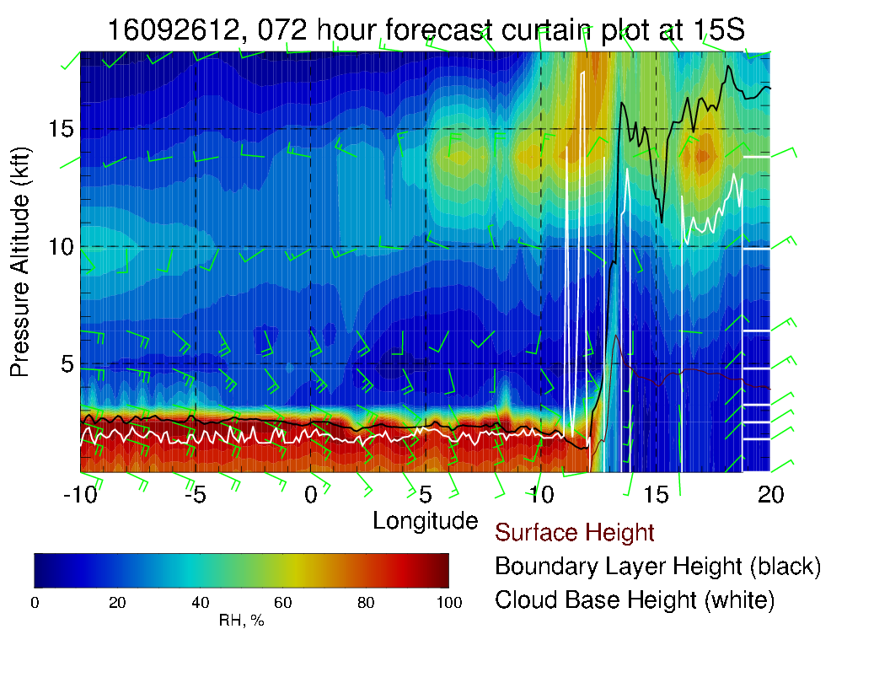
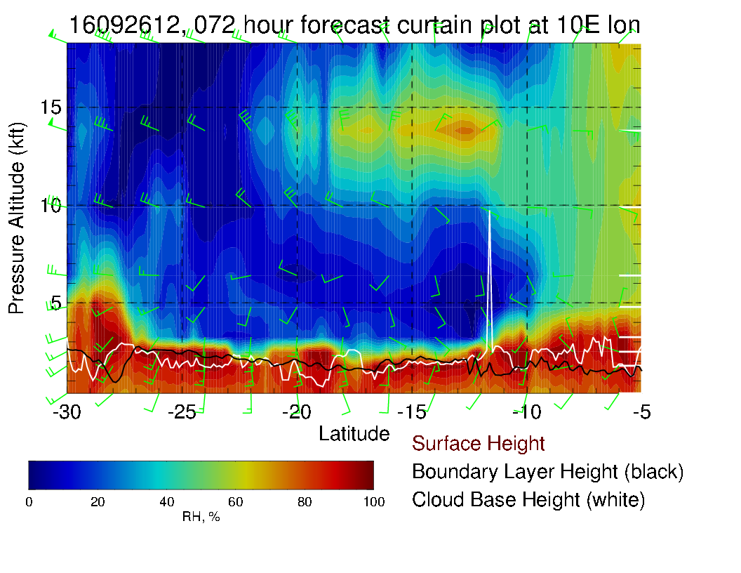

Slide 23
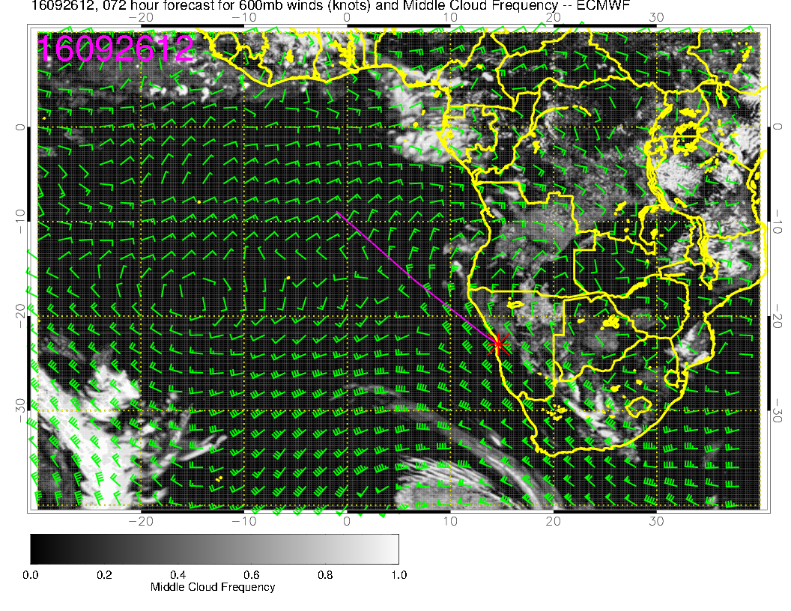
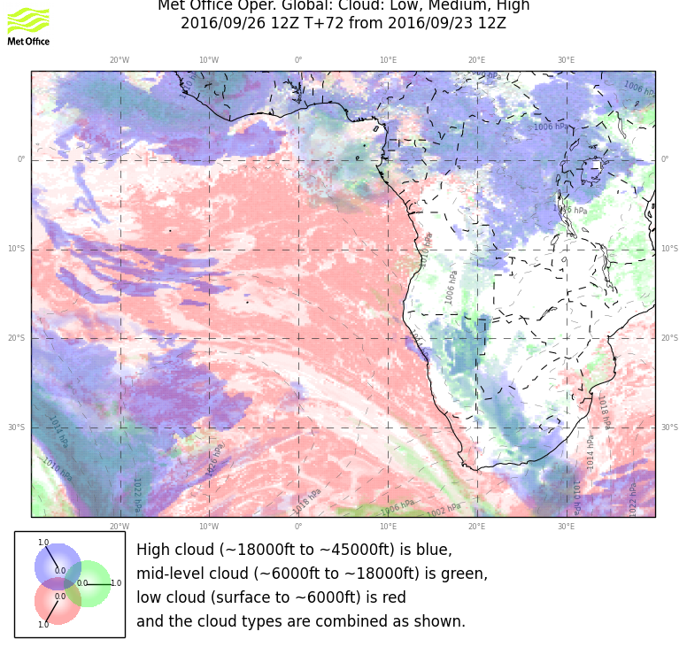
Mostly clear of Mid level clouds. Some mid level clouds over the Angolan Bay. Good model agreement.

Slide 24
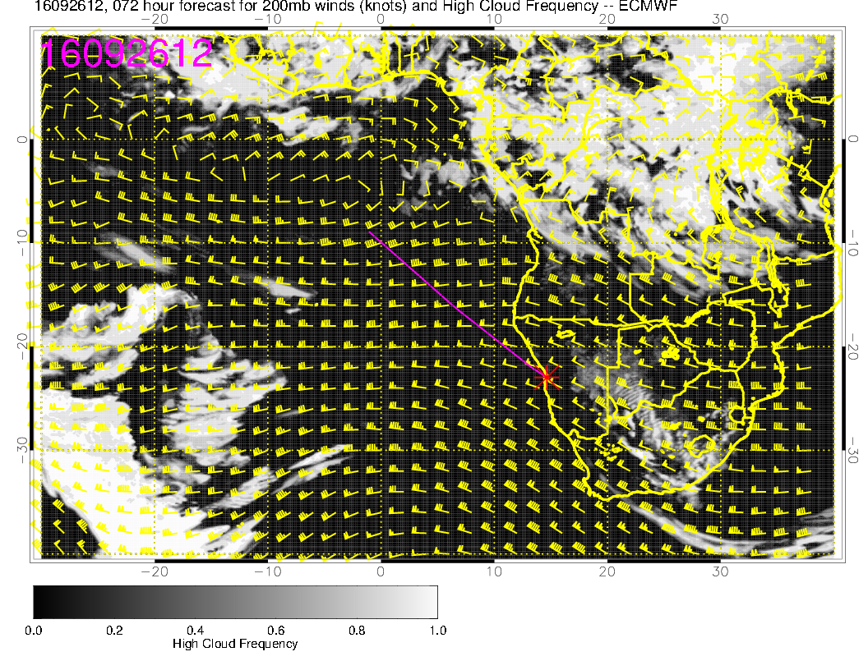
Models agree very well for Cirrus prediction, clear in our region.

Slide 25
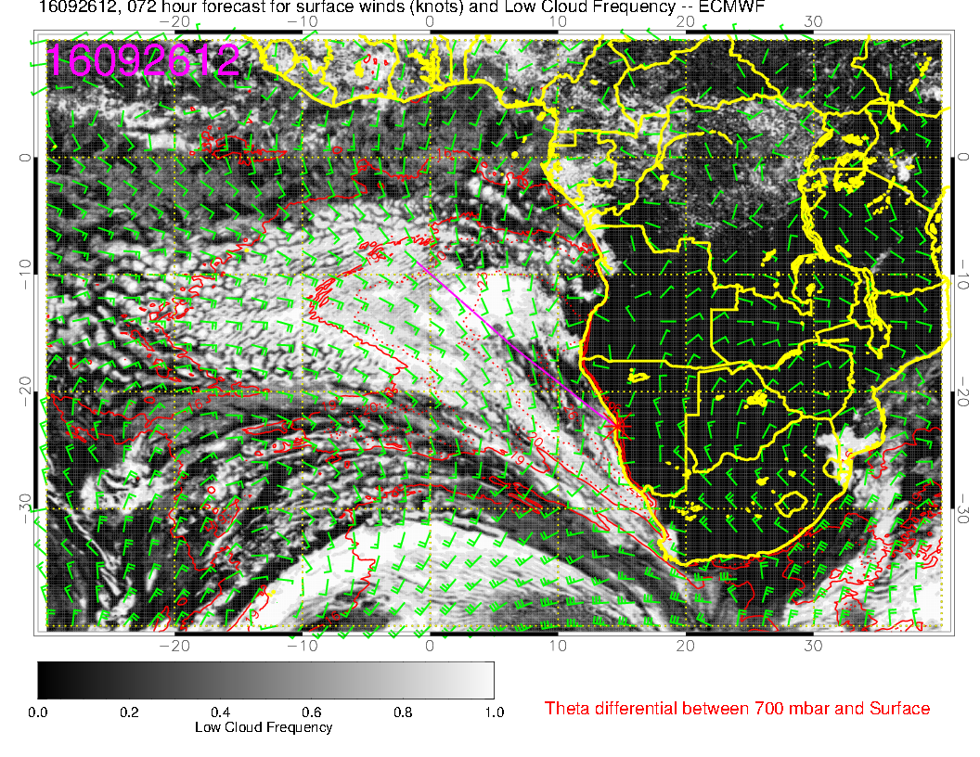
Good agreement between models. Forecast is stable, except that more clearing is predicted in EC
model.

Slide 26
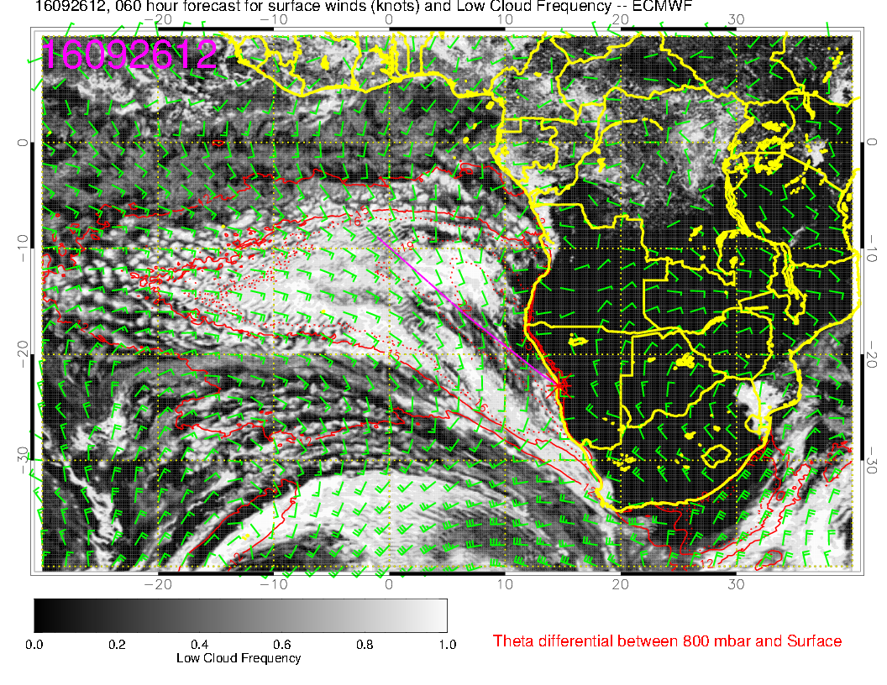
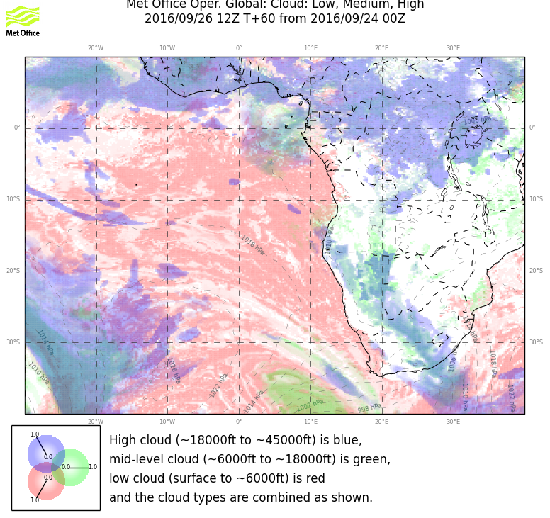

Slide 27
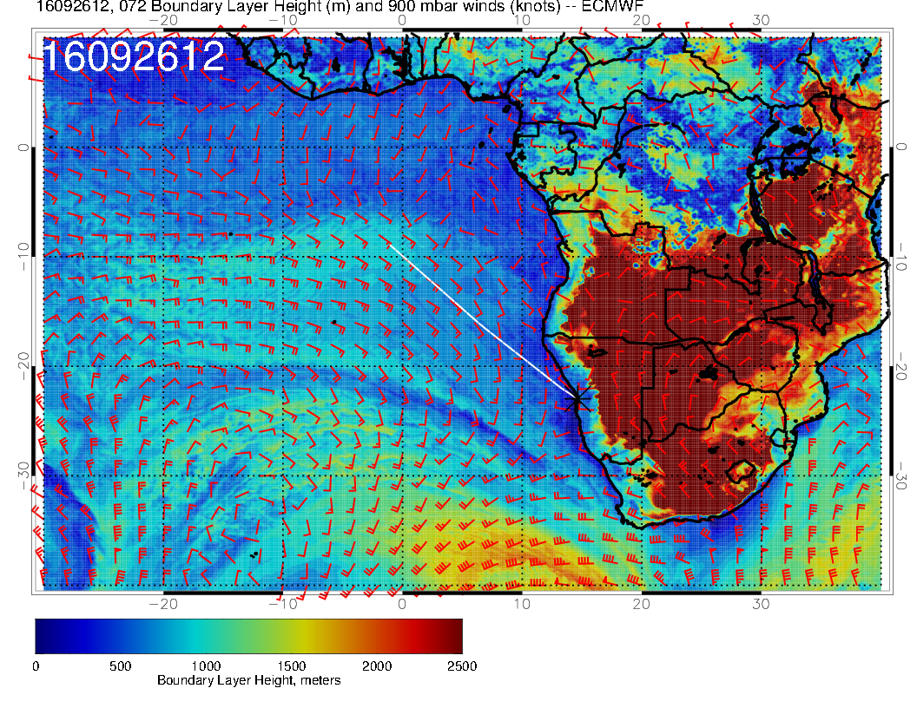
Significant cloud in EC goes with higher BL height.

Slide 28
Tuesday

Slide 29
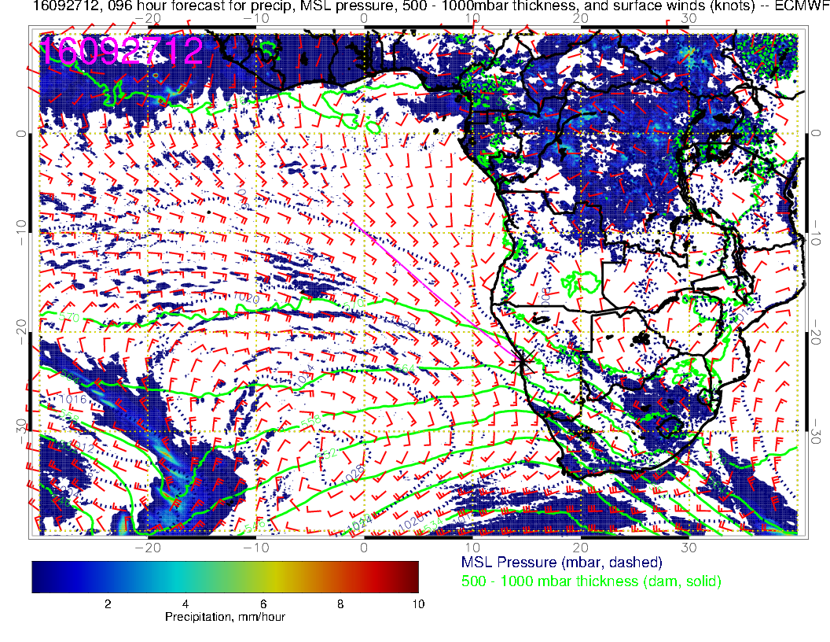
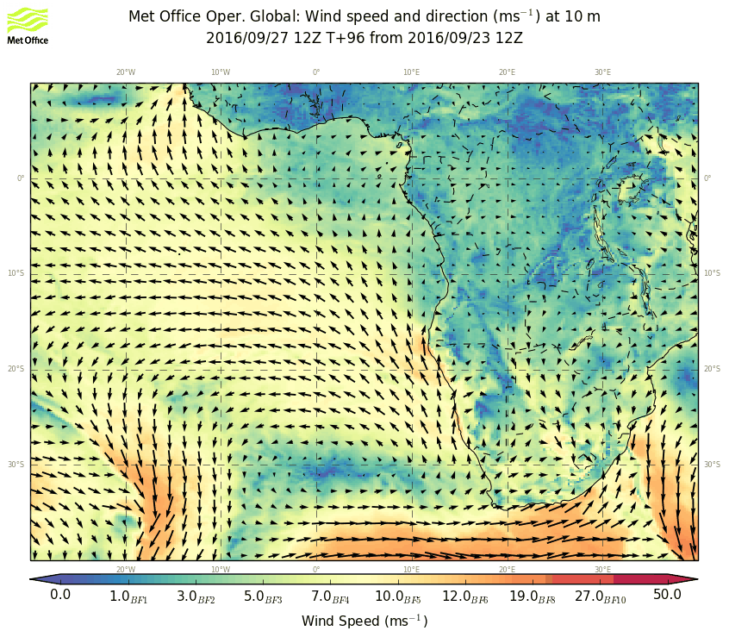
SH high becoming well established after front – new system developing at 20W.
Strongest winds at ANG/NAM border

Slide 30
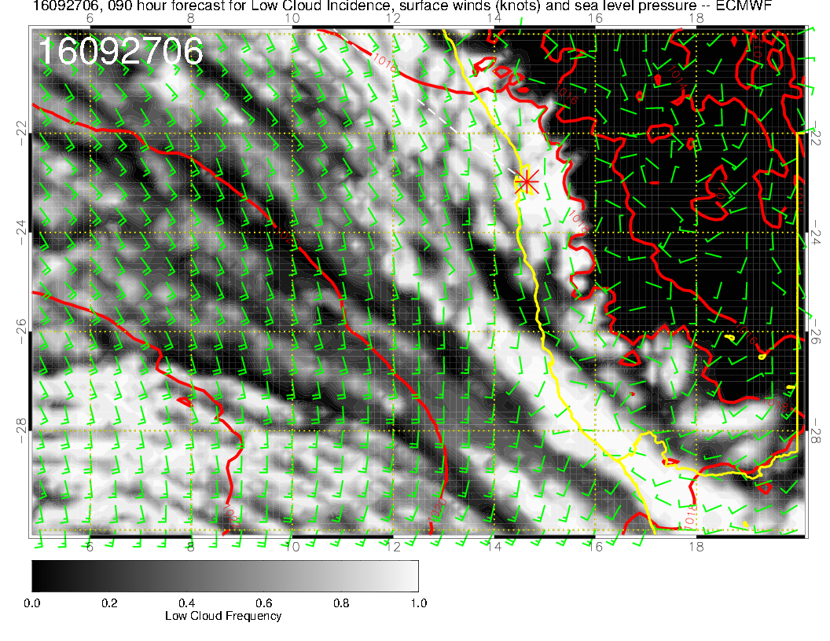
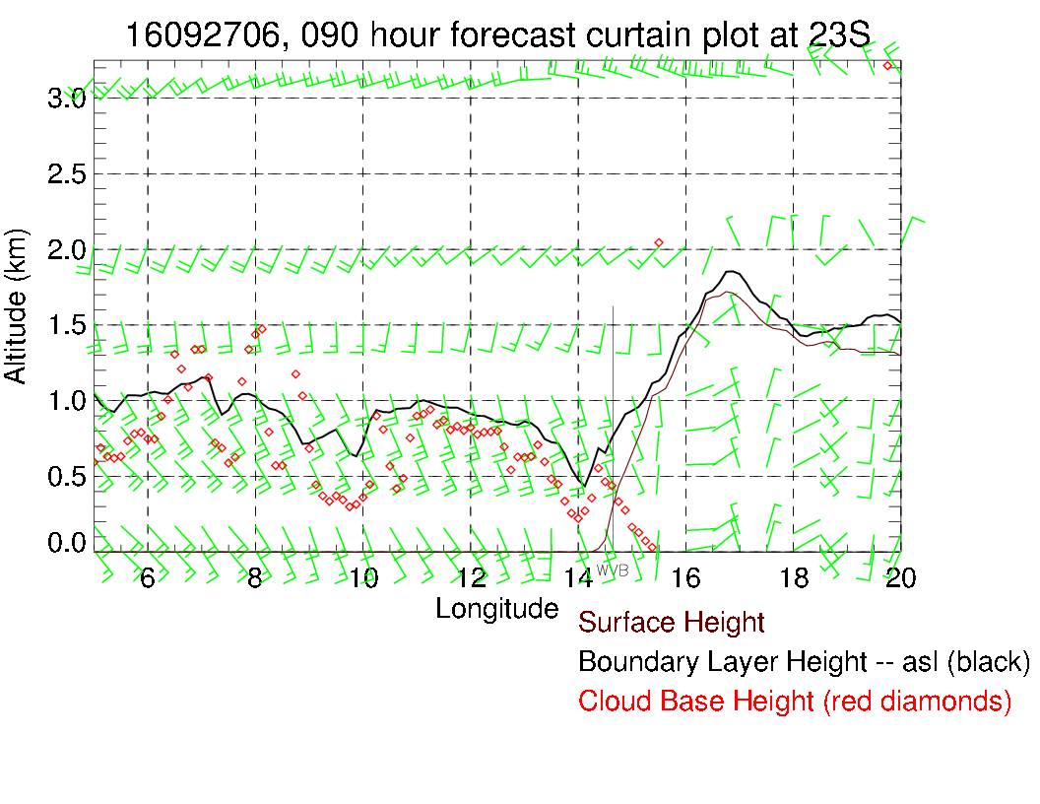
Plenty of cloud in the morning, but ceilings not that low.
Winds 210 at 20 at 5 PM, but decreasing thereafter.

Slide 31
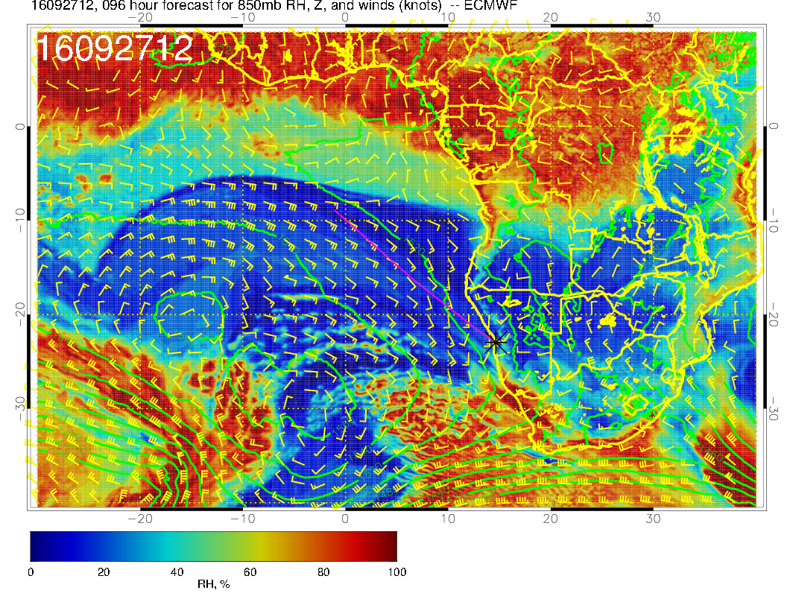

Slide 32
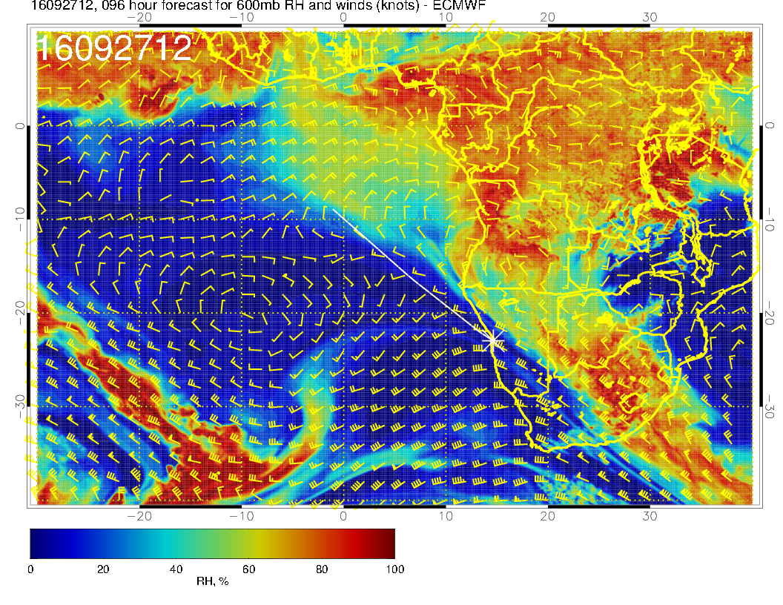
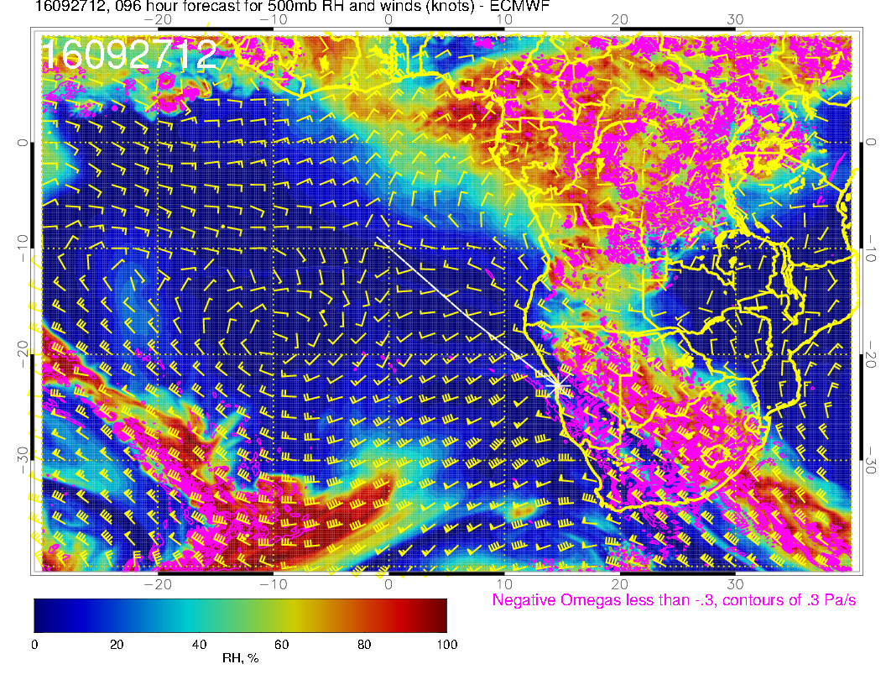
Main outflow from continent is now firmly established near the equator. Moisture generated by mixing and convection (further in the interior) is steered over eastern Namibia

Slide 33
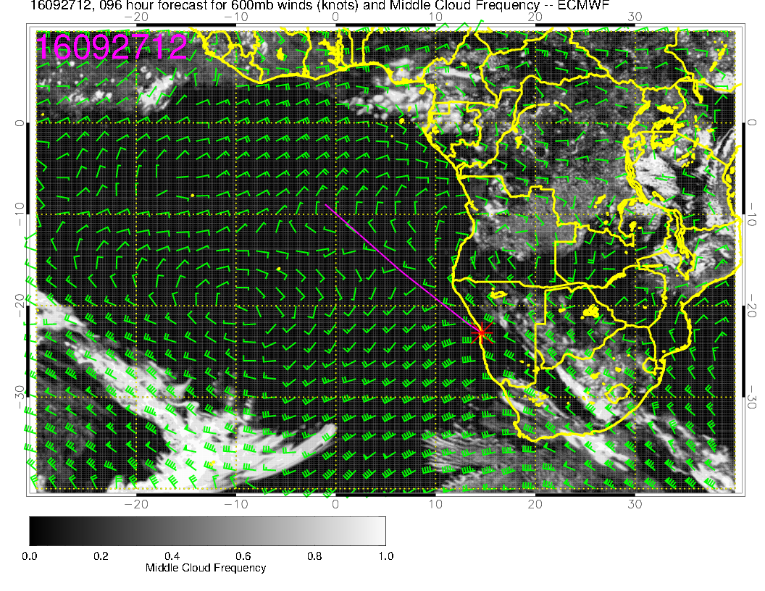
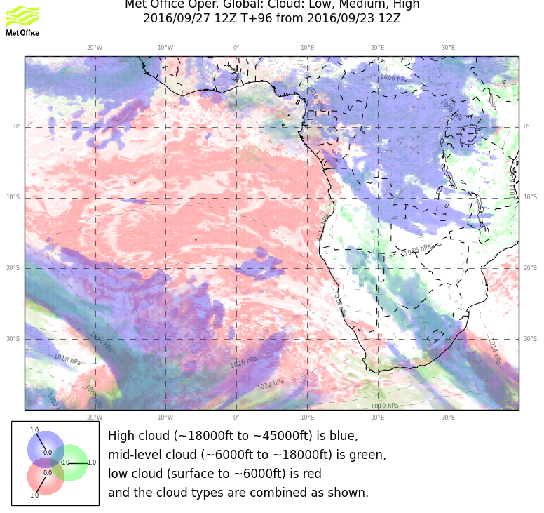

Slide 34
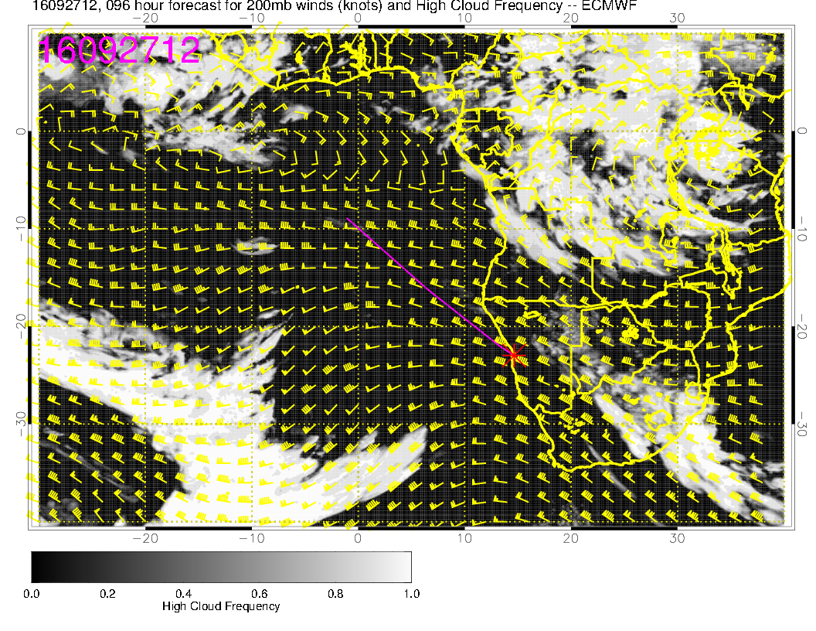
Cirrus could “impinge” on our operations to the south. UKMO
tends to overpredict the cirrus.

Slide 35
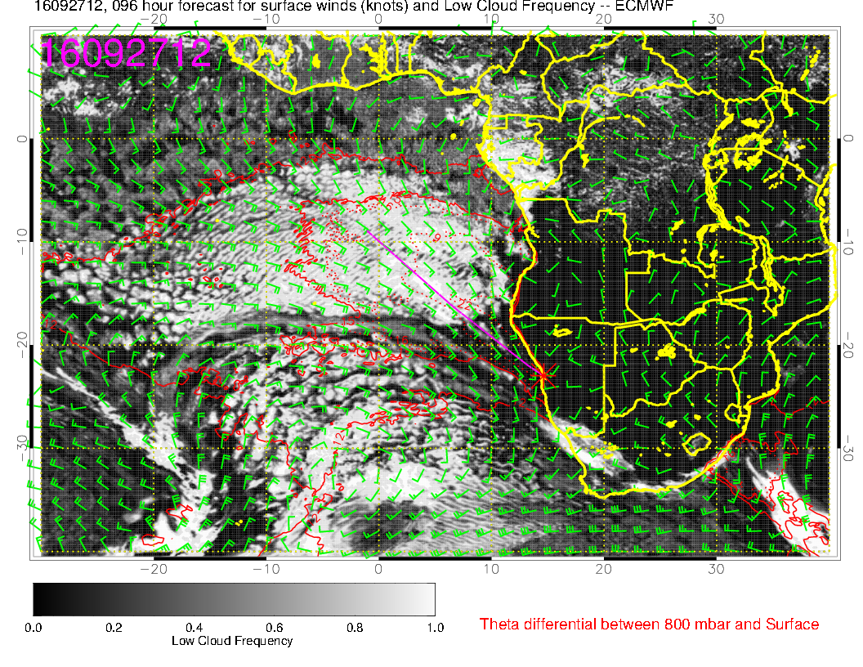
South of 20S, expect Sc to have a very different character to “classic” startocu.
Stability is smaller, both models show striations in the structure.

Slide 36
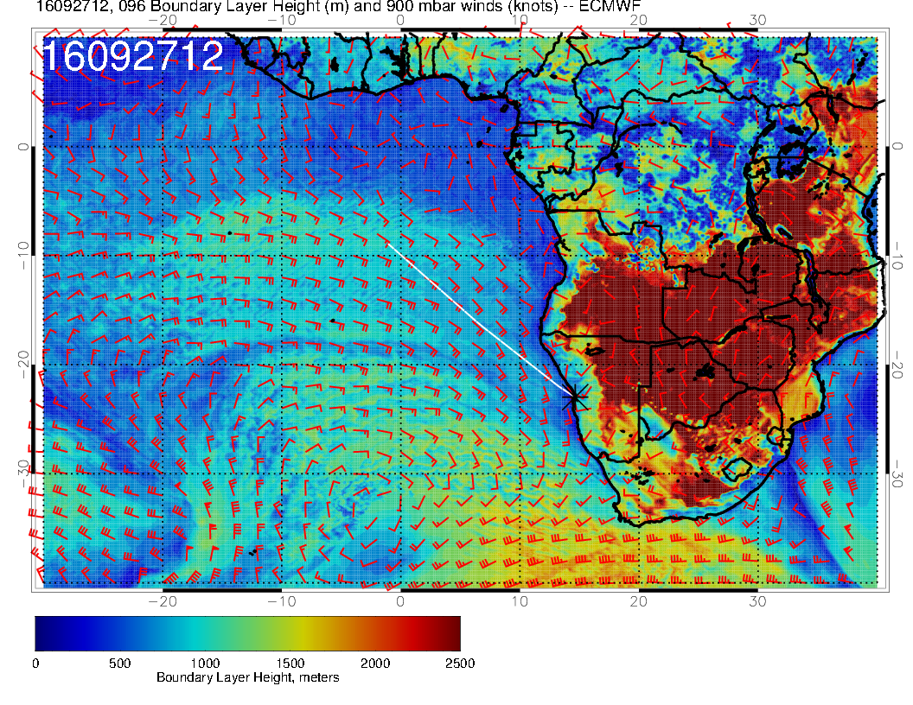
Can see front in BL height.

