Slide 1
ORACLES forecasting briefing Meteorology for 24-09-2016
Lenny Pfister

Slide 2
Airport Wx
Airport RH is 82%, DP about 48, temp about 54.
Stratus layer creeping southward, AP is overcast.
Ceiling right now should be 500-1000 ft based on automated stations.
NNE winds, weak offshore push.

Slide 3
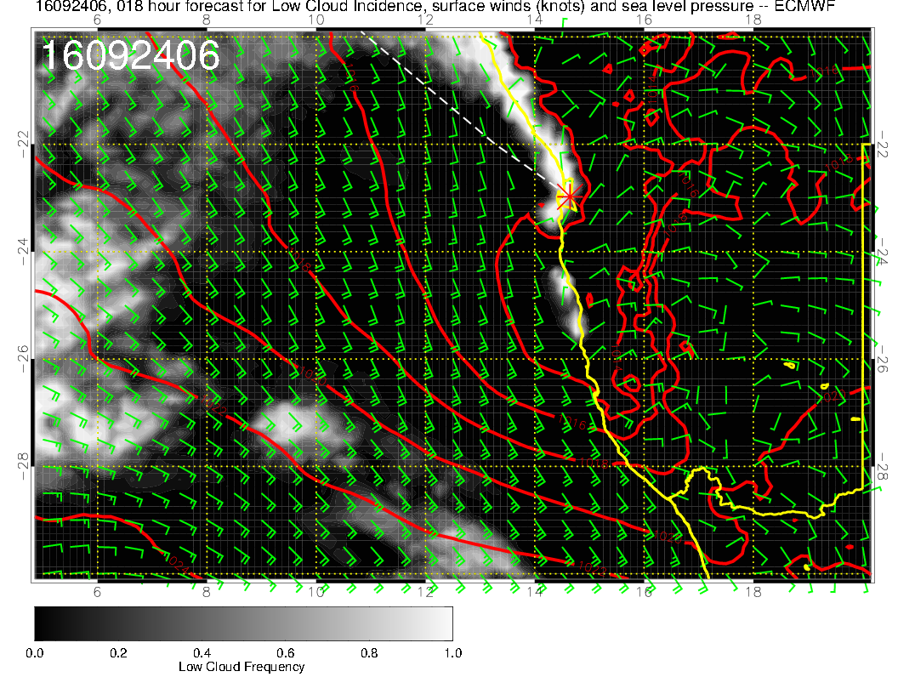
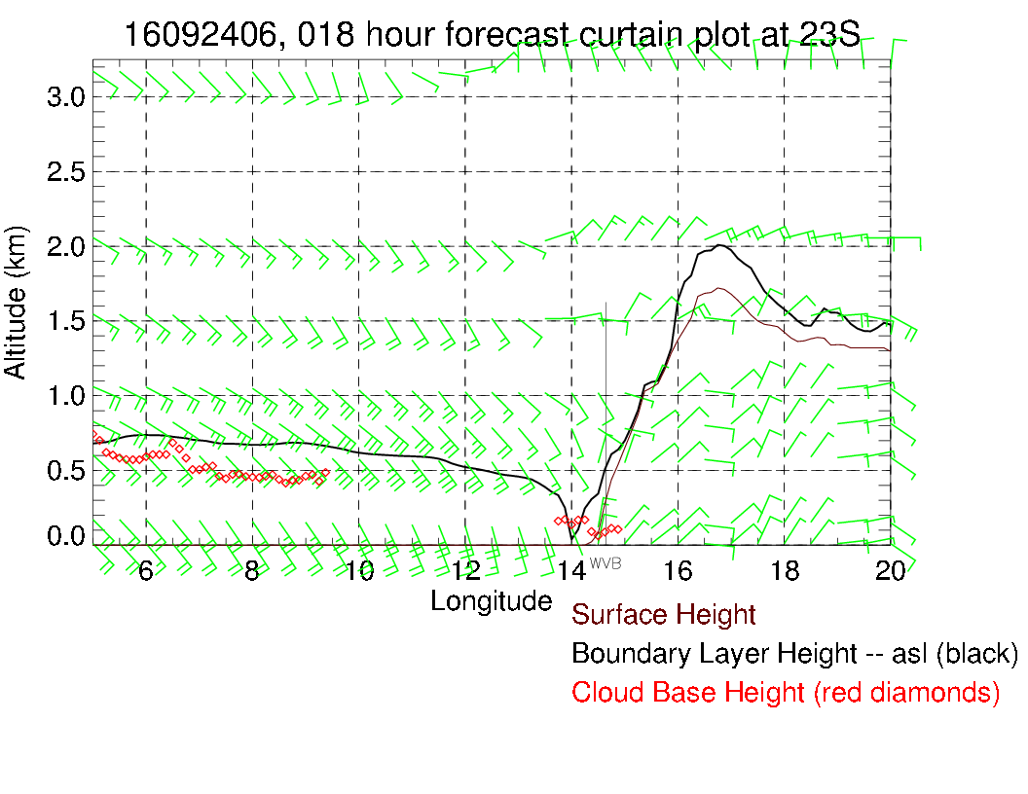

Slide 4
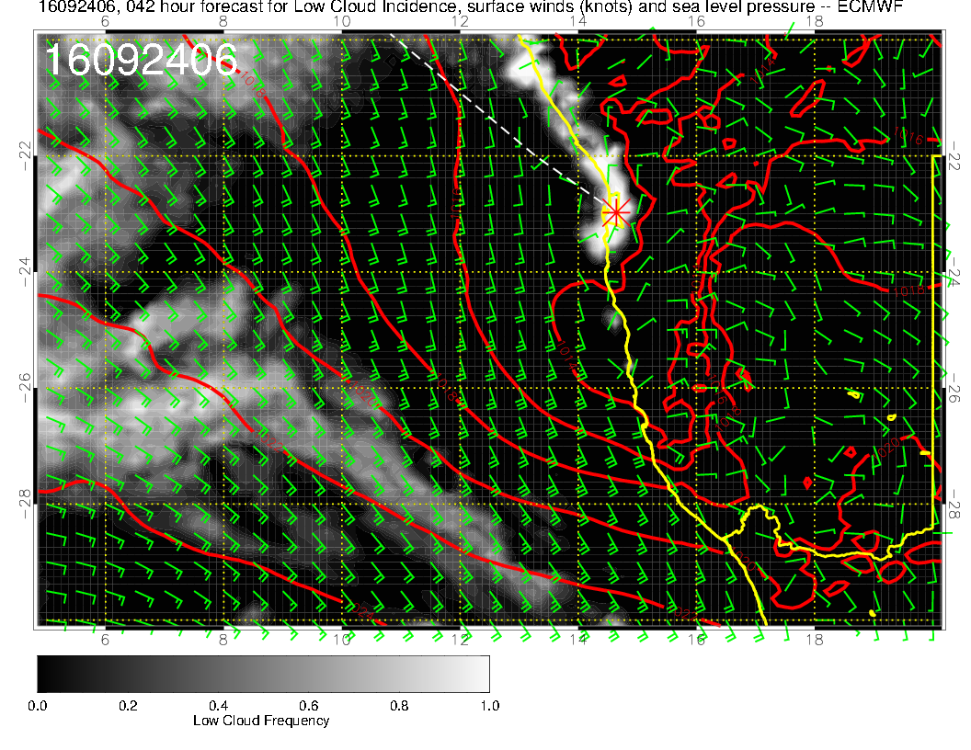
Stable model simulation on the small scale. Very low ceilings
forecast at 8 AM, low BL hgt, clearing before 11 AM. Model
forecast does not look dissimilar to Wednesday.

Slide 5
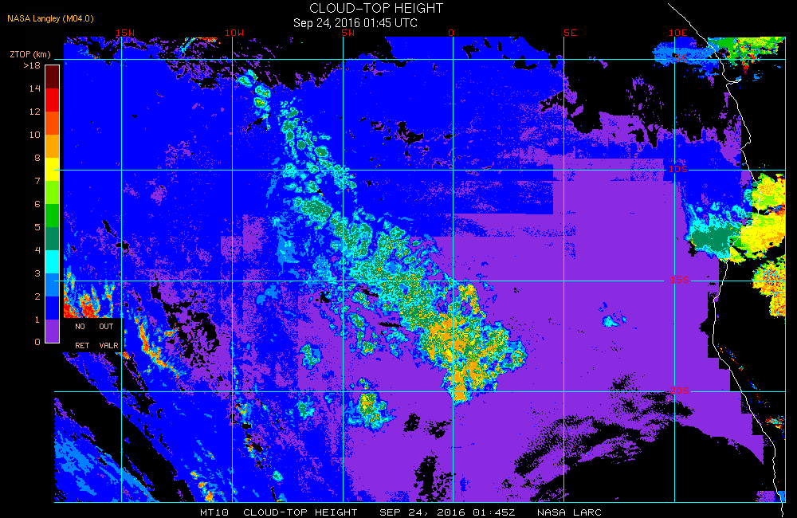

Slide 6
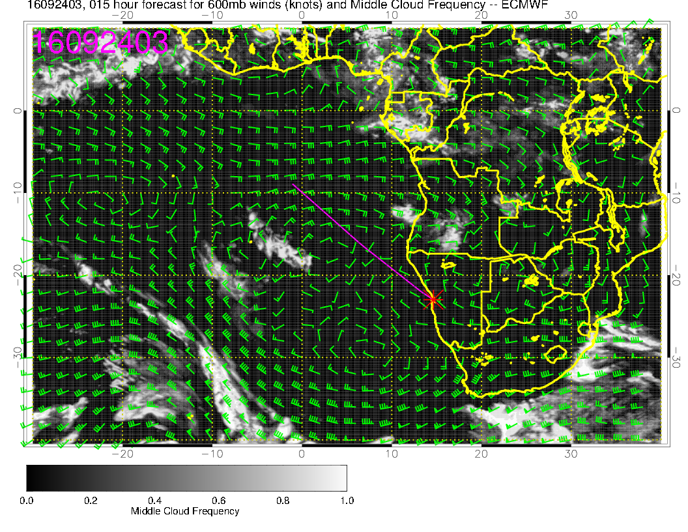

Slide 7
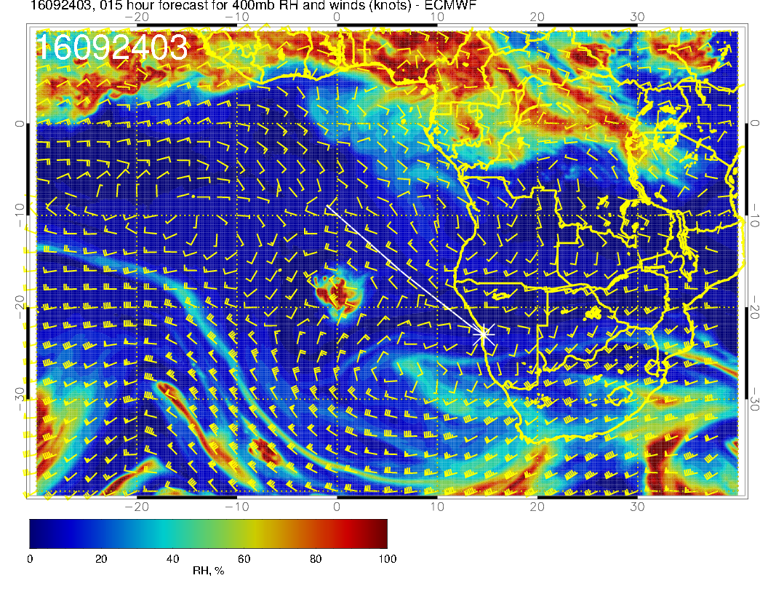
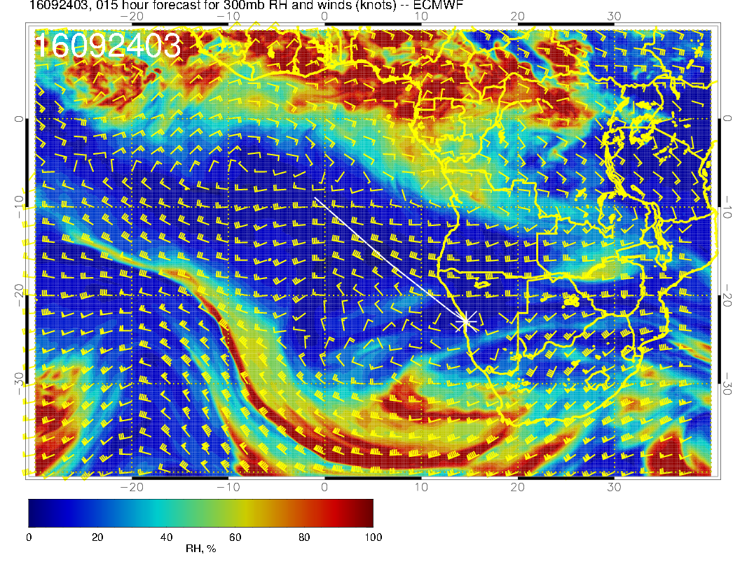

Slide 8
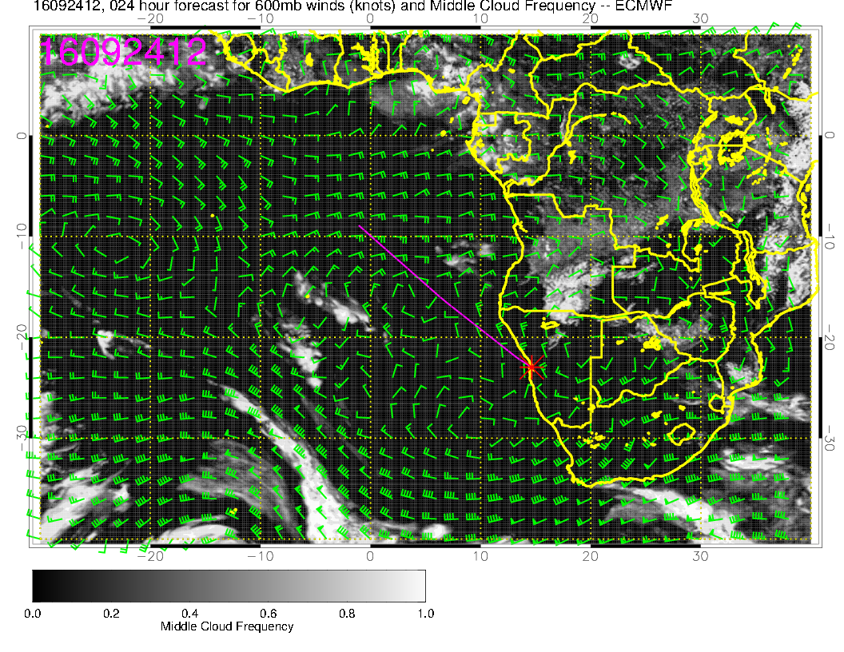
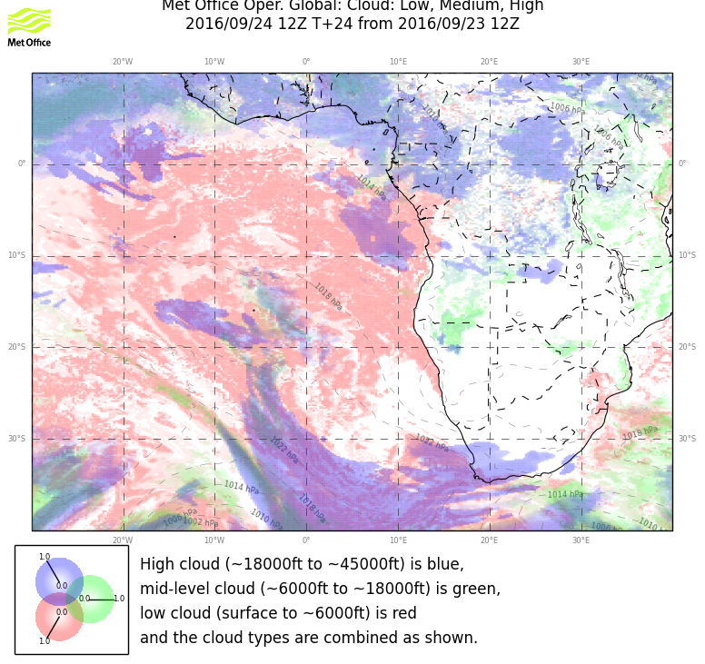

Slide 9
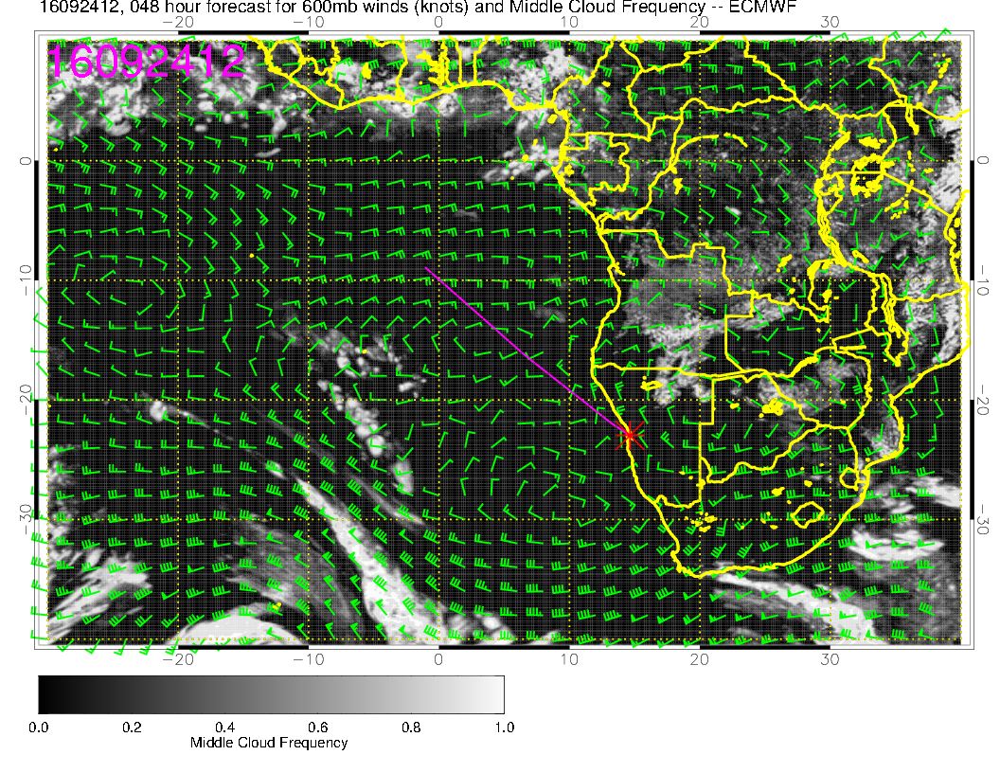
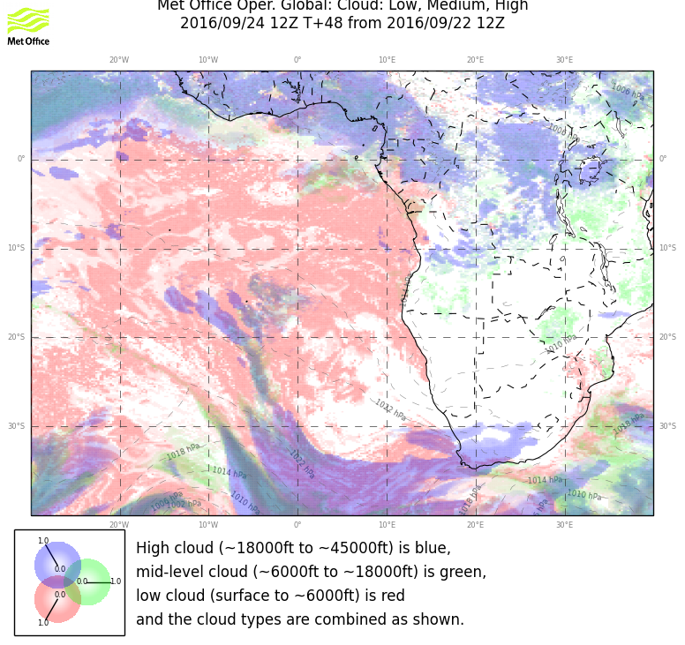
Mostly clear of Mid level clouds. Some cloudiness associated with humidity moving in from St Helena. Good model agreement.

