Slide 1
Sunday, 20160925

Slide 2
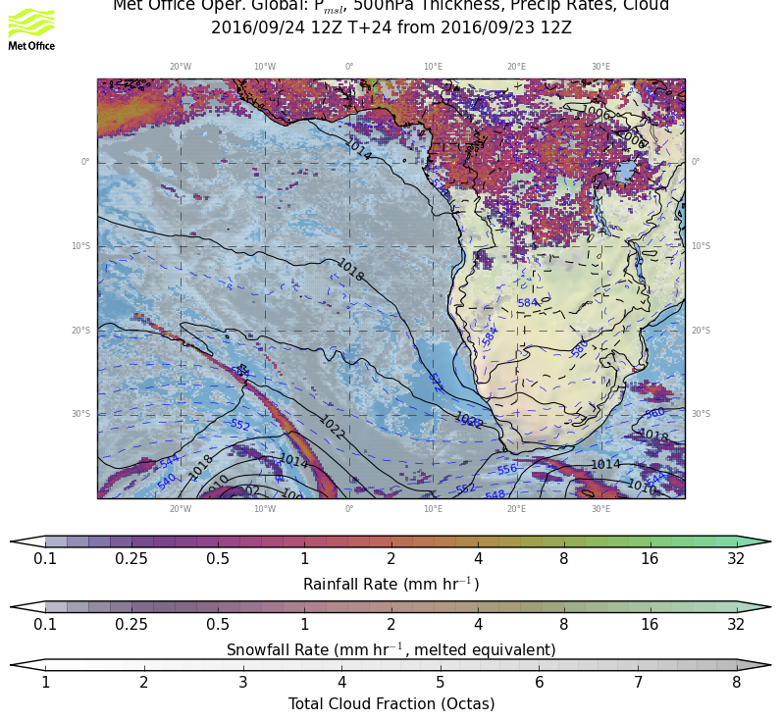
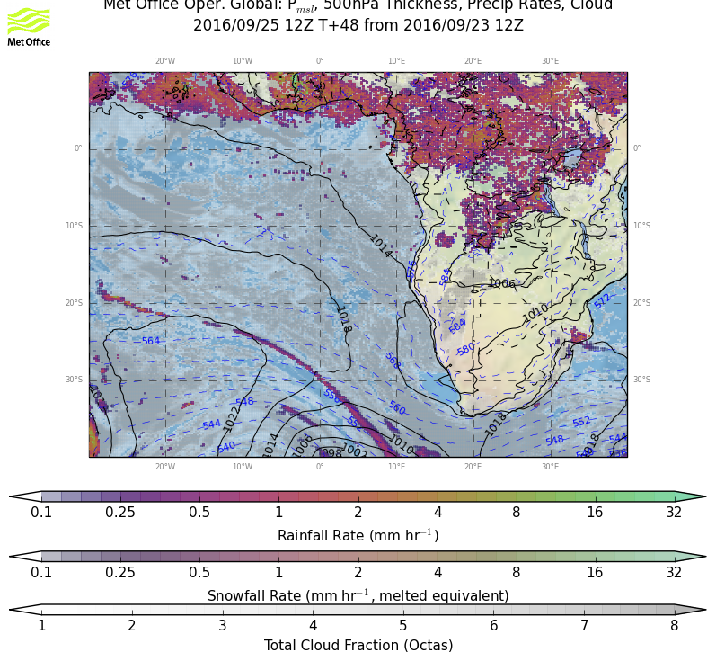
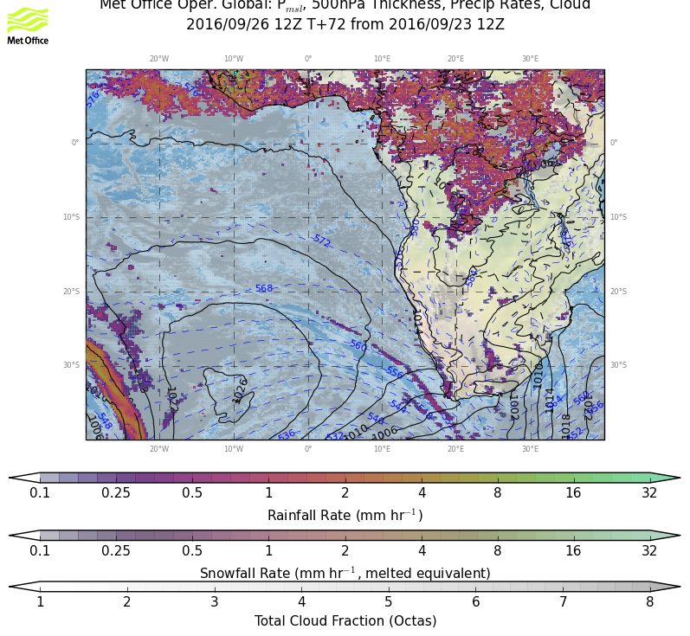
Surface evolution Saturday-Monday:
Former low pressure system dissolved on Friday/Saturday, new system in the south east, pushing a new cold front into the southern part of the plotted region.
The low pressure system pushing a cold front with the easterly wave pattern.

Slide 3
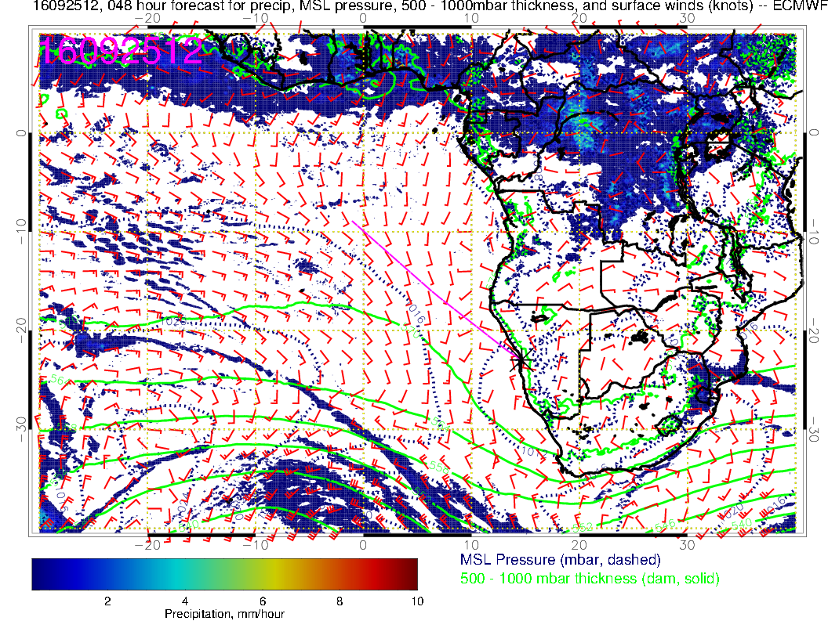
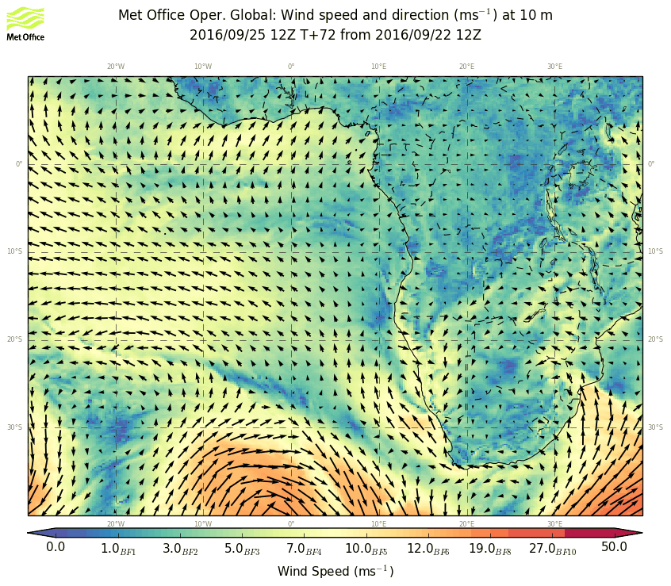
Surface condition Sunday: Weakening surface winds, with eddy circulation in YWB region, leading to changed surface wind directions compared to previous days.

Slide 4
Similar to surface conditions, small anticyclone over YWB. Stronger winds associated with moving in wave, which will be touching the South African coast by tomorrow.

Slide 5
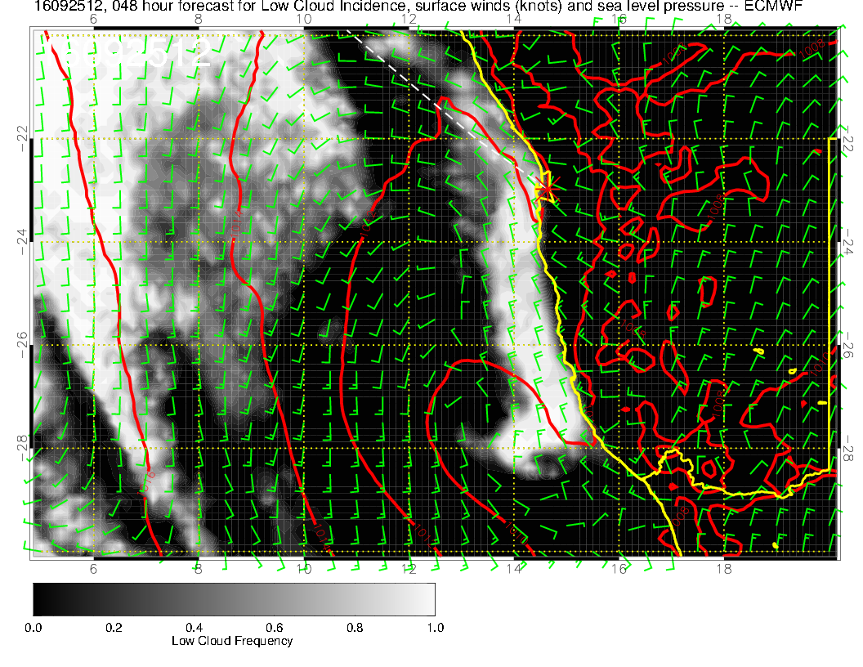
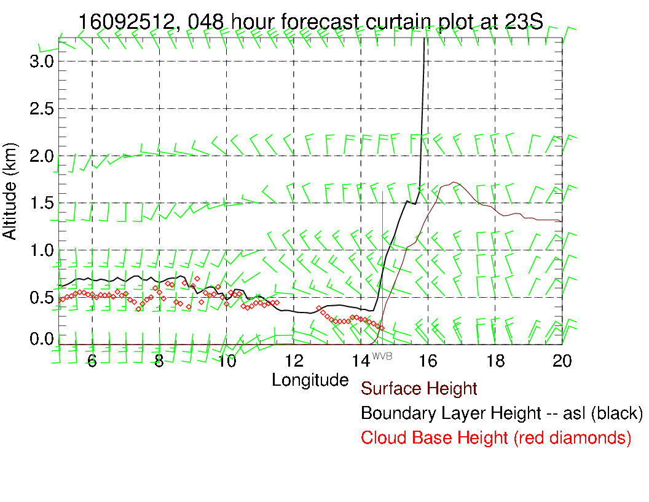
Dunno?

Slide 6
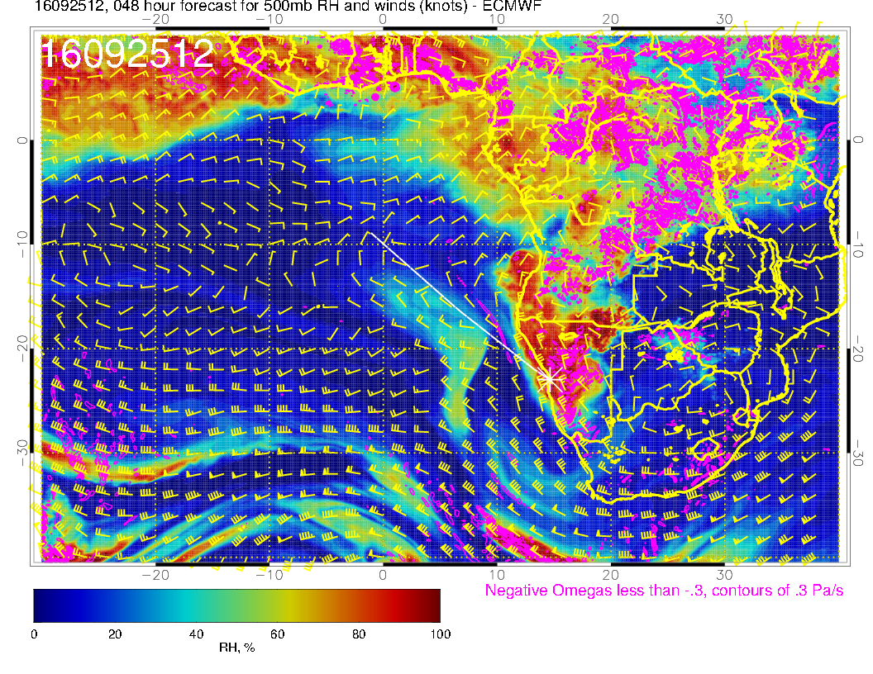

Slide 7
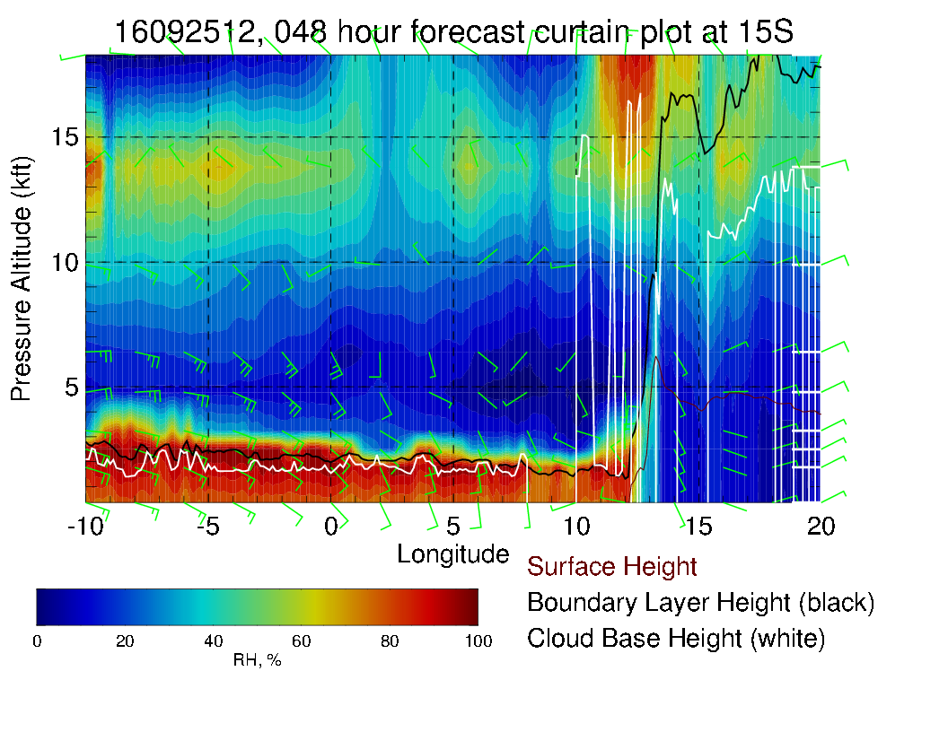
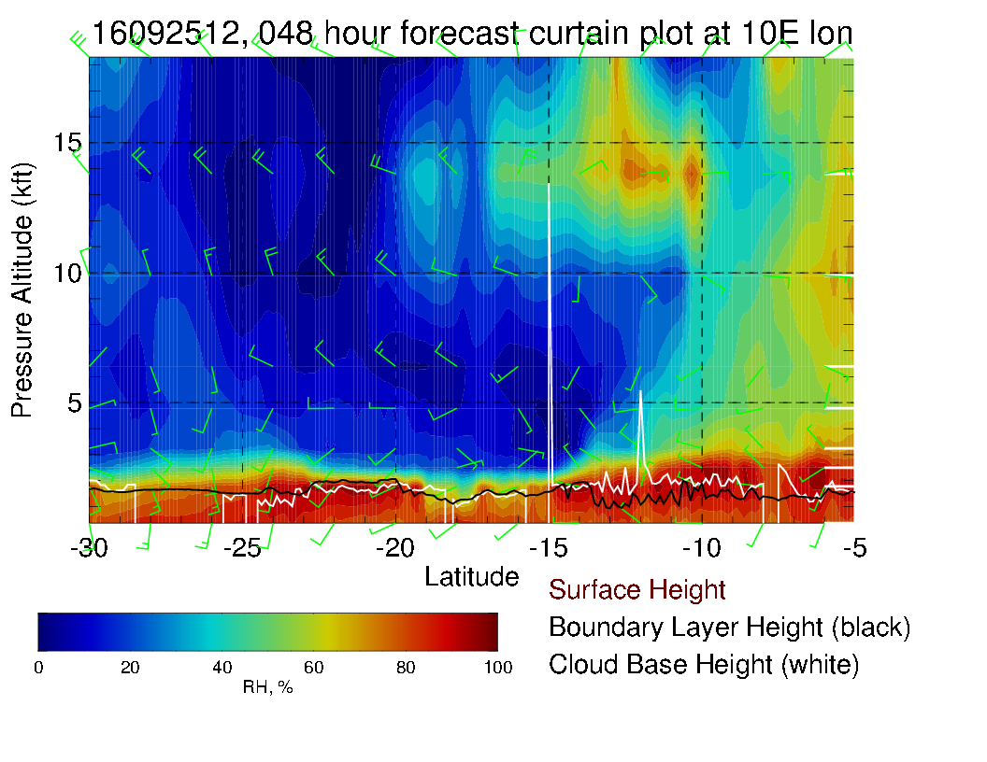

Slide 8
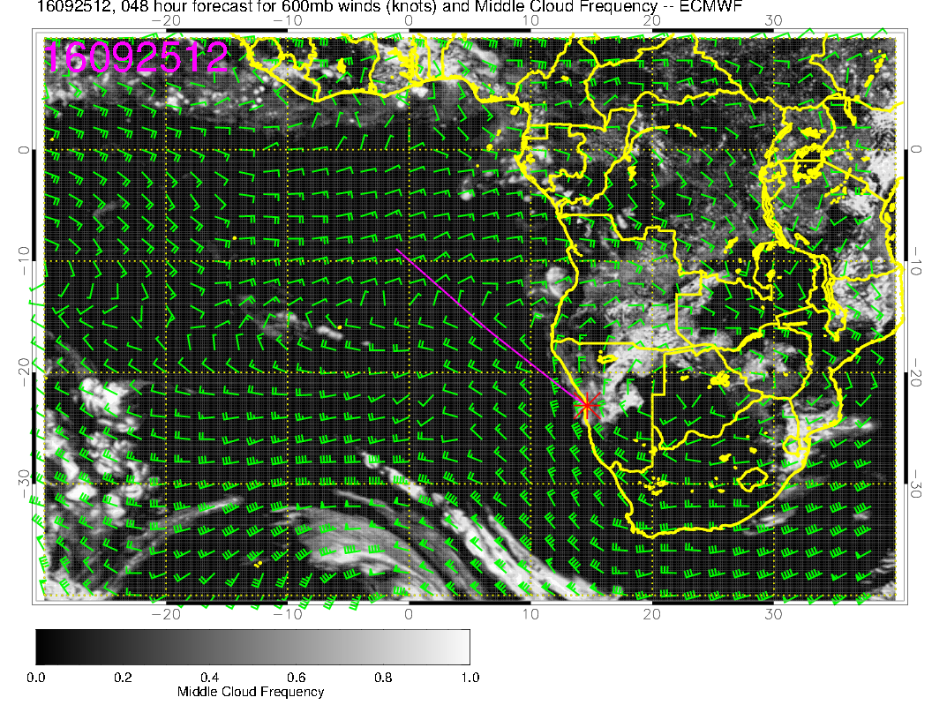
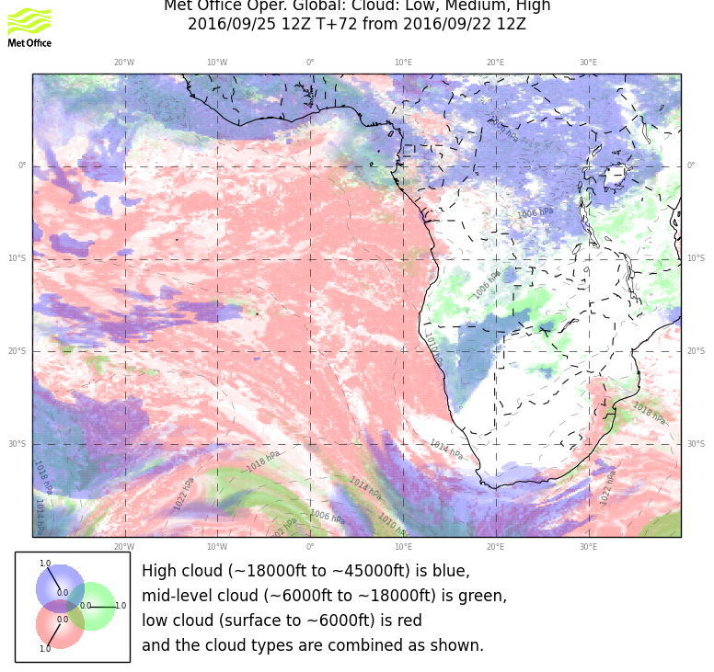
Mostly clear of Mid level clouds. Some cloudiness associated with convective outflow over Angola.

Slide 9
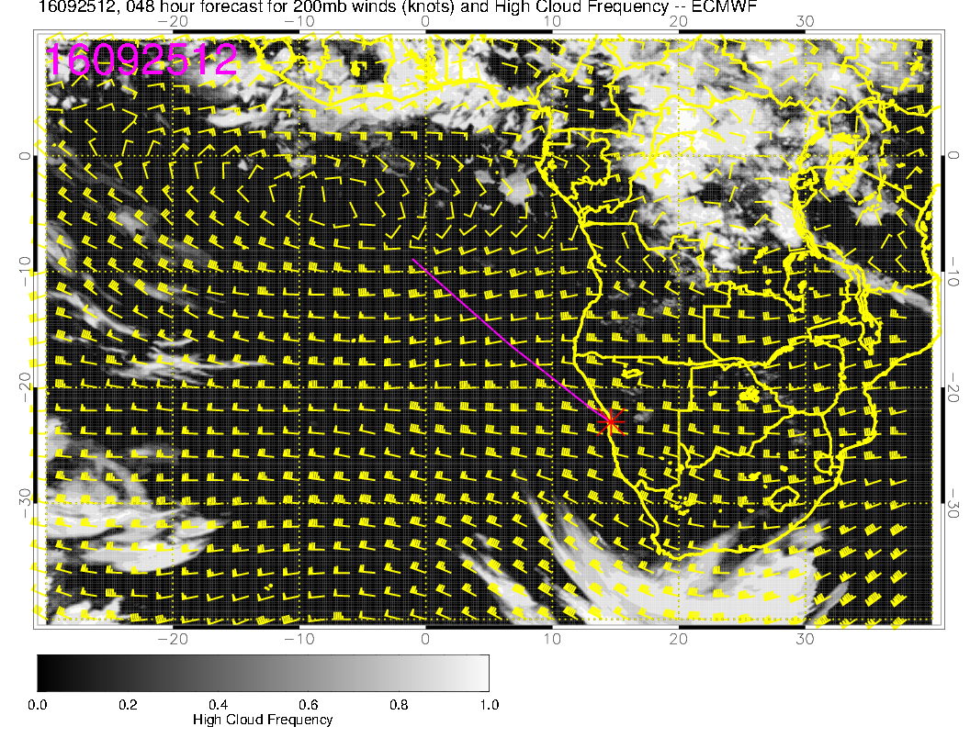
Models agree very well for Cirrus prediction, clear in our region.

Slide 10
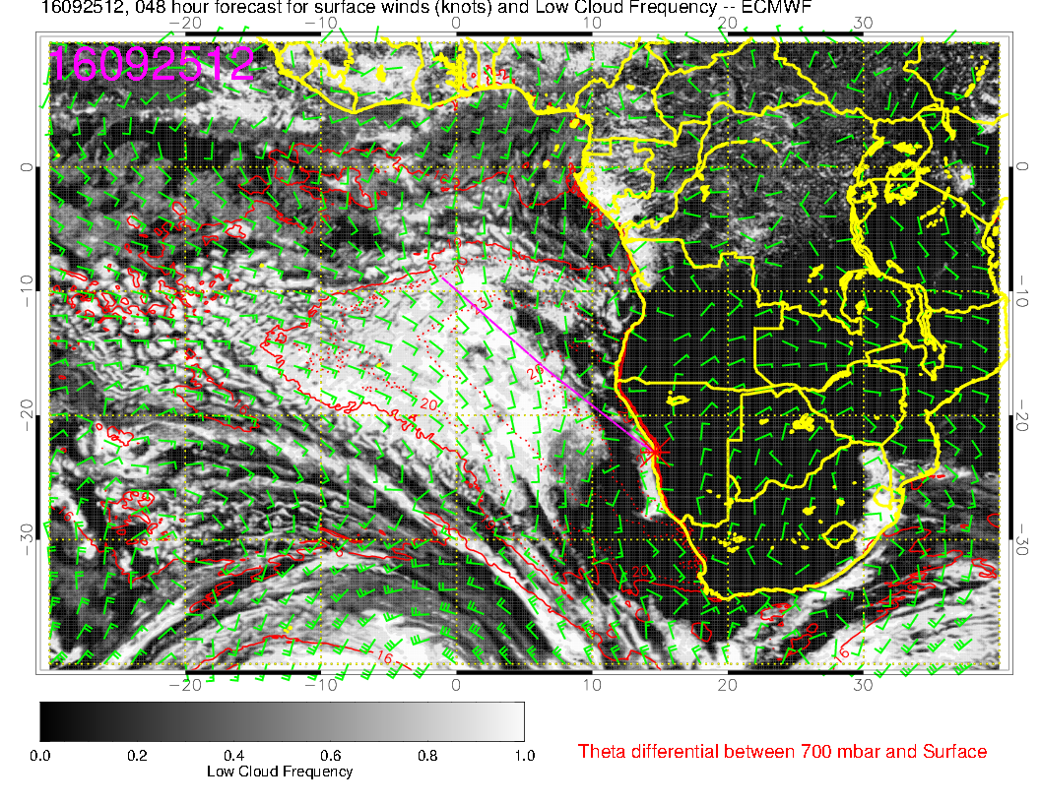
EC model shows clearing in our coastal areas with some cloudiness over YWB (this could be
caused by the small eddy circulation as seen in the previous plots), UK model does show
more low clouds close to the coast. Models disagree.

Slide 11
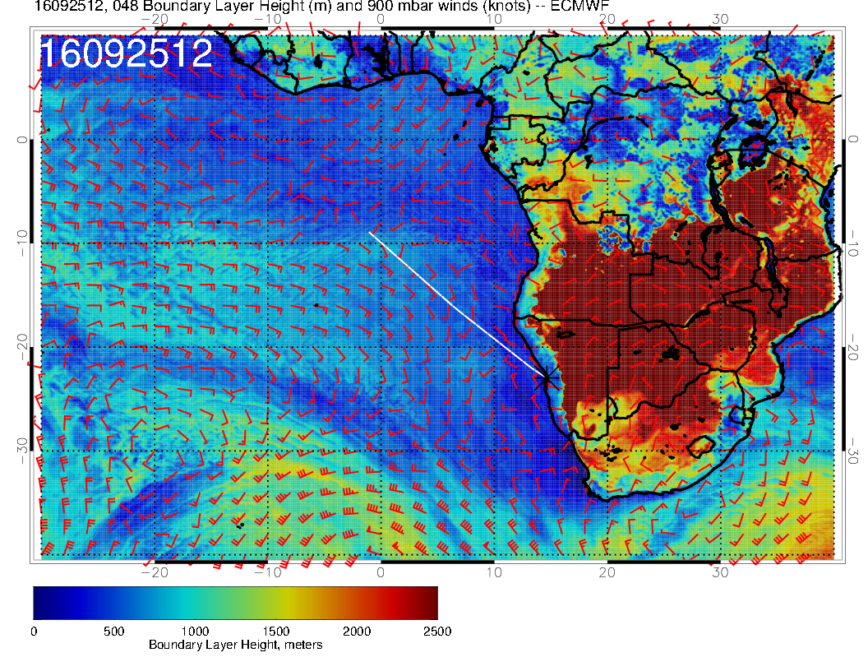
Significant cloud in EC goes with higher BL height.

