Slide 1
Monday, 20160926

Slide 2
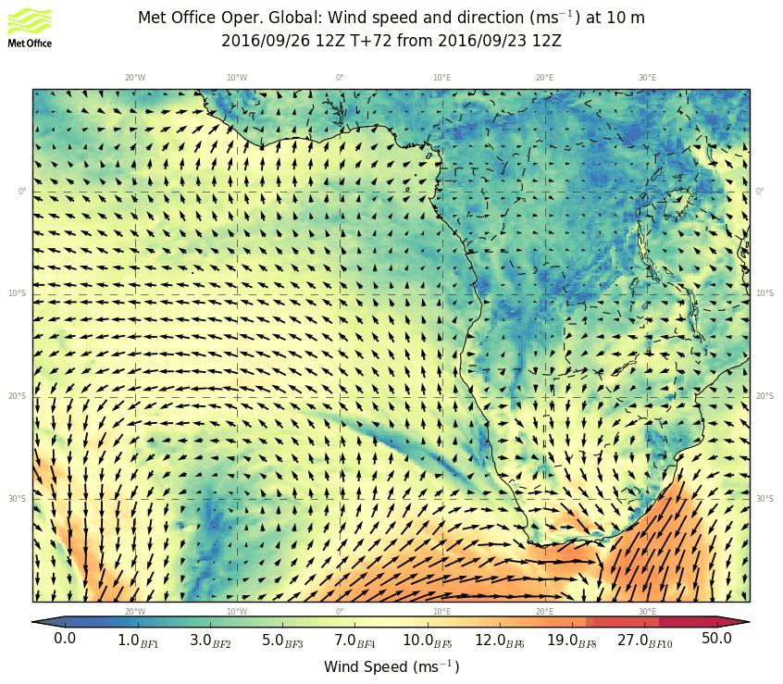
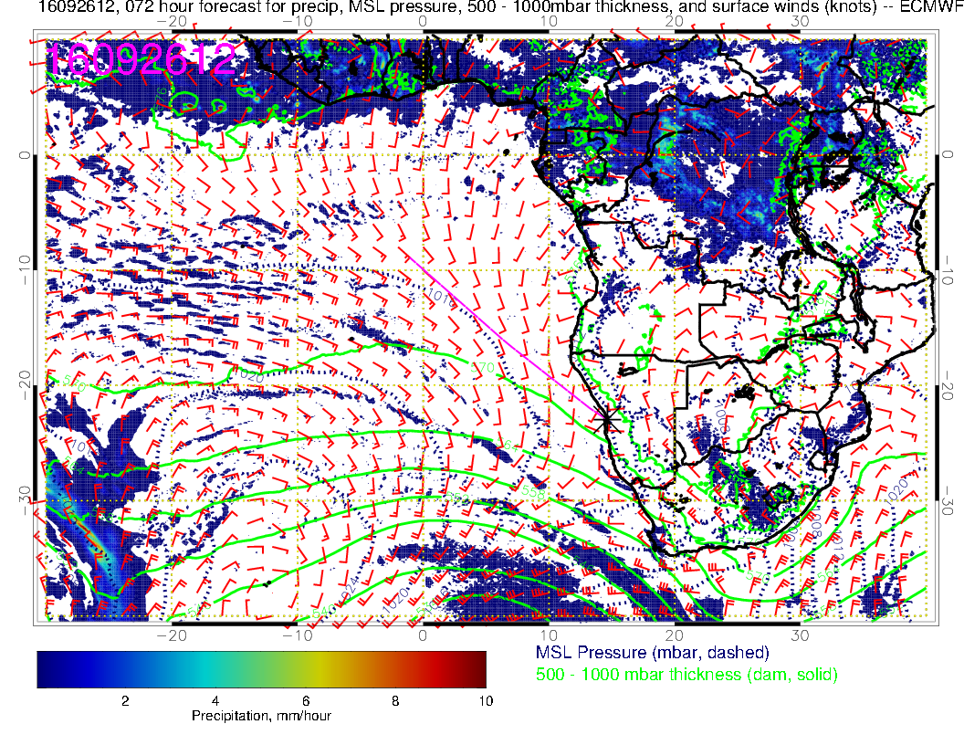
Surface condition Monday: Surface winds further weakened south of YWB, but stronger then the day before in the Sc area. Cold front is reaching the Southern tip of Africa.

Slide 3
Increased humidity moving in with the frontal system. RH in the SC area similar to the day before.

Slide 4
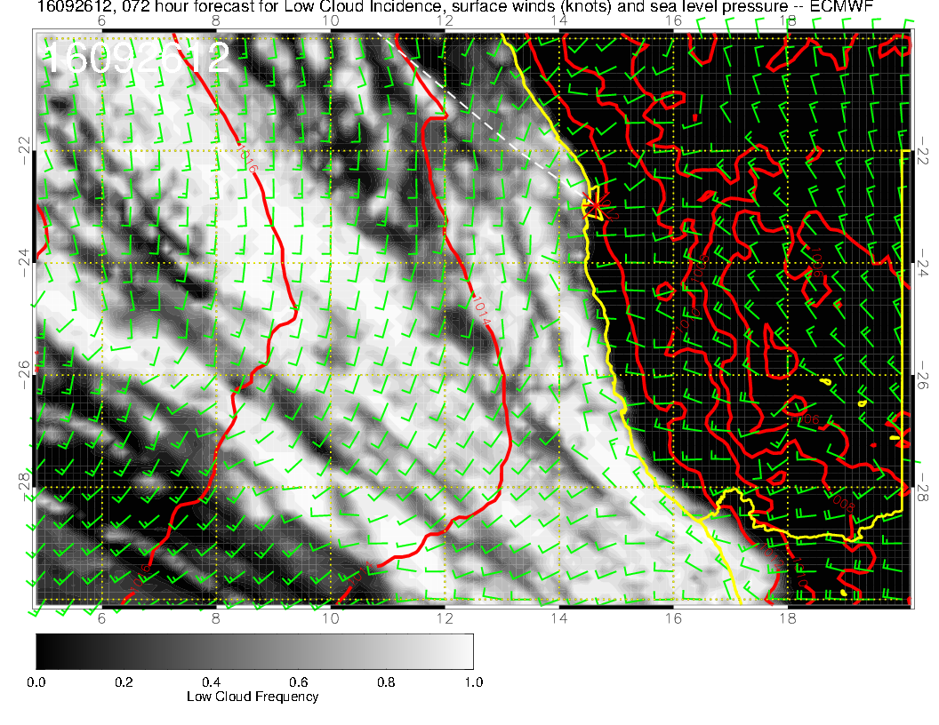
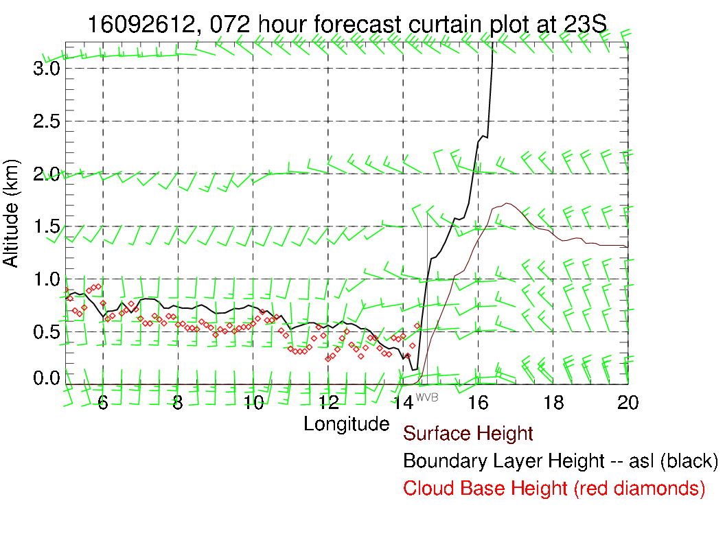
Dunno?. All cloudy again.

Slide 5
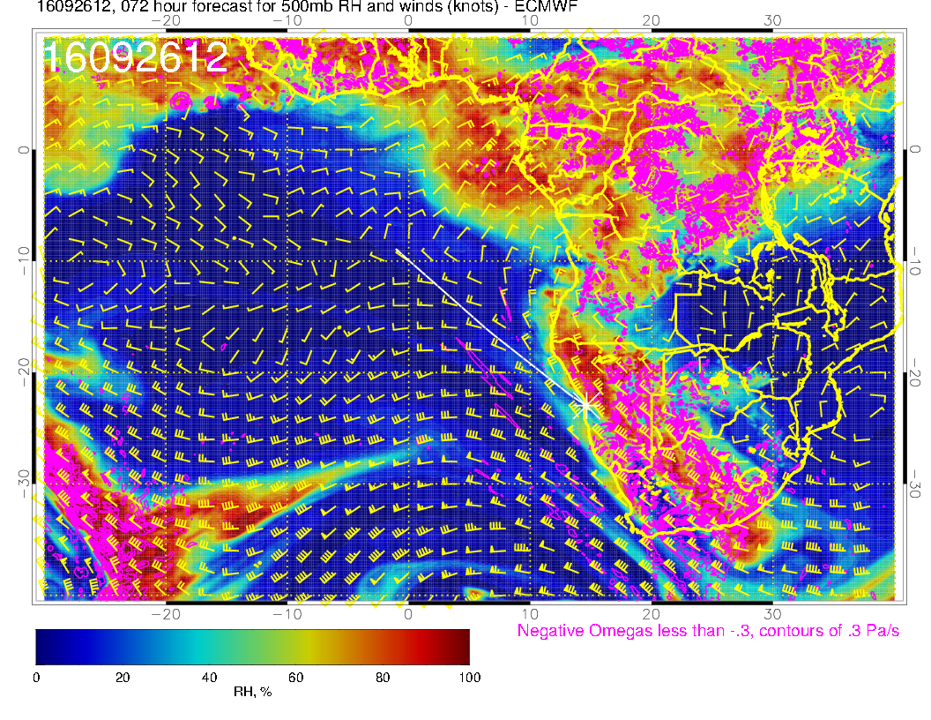
Anticyclone at 600hPa. Humidity in the area associated with continental outflow.

Slide 6
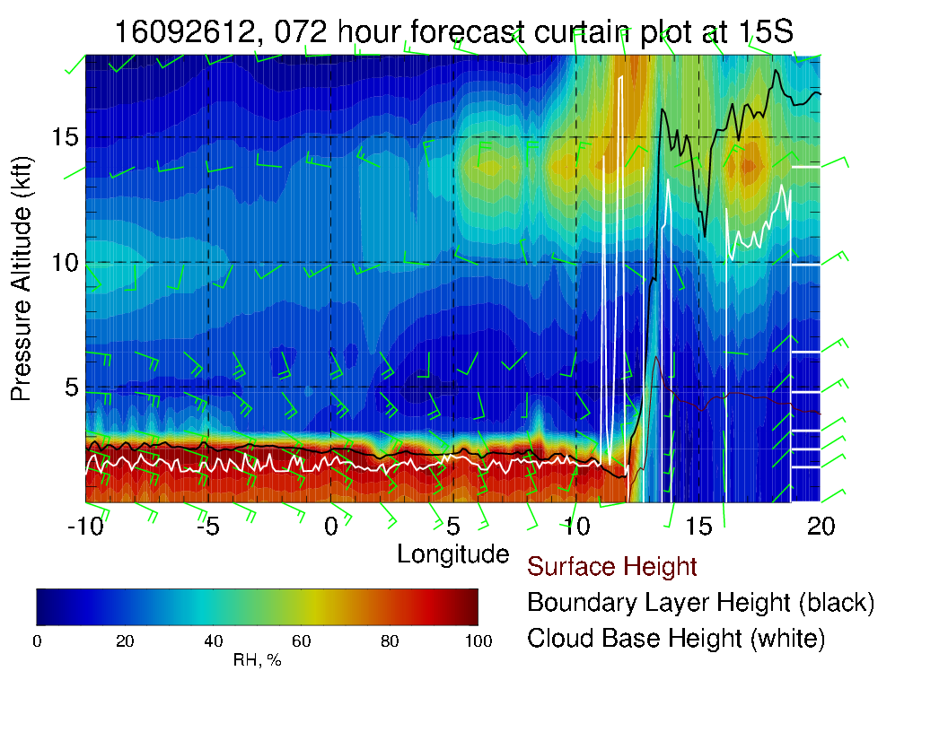
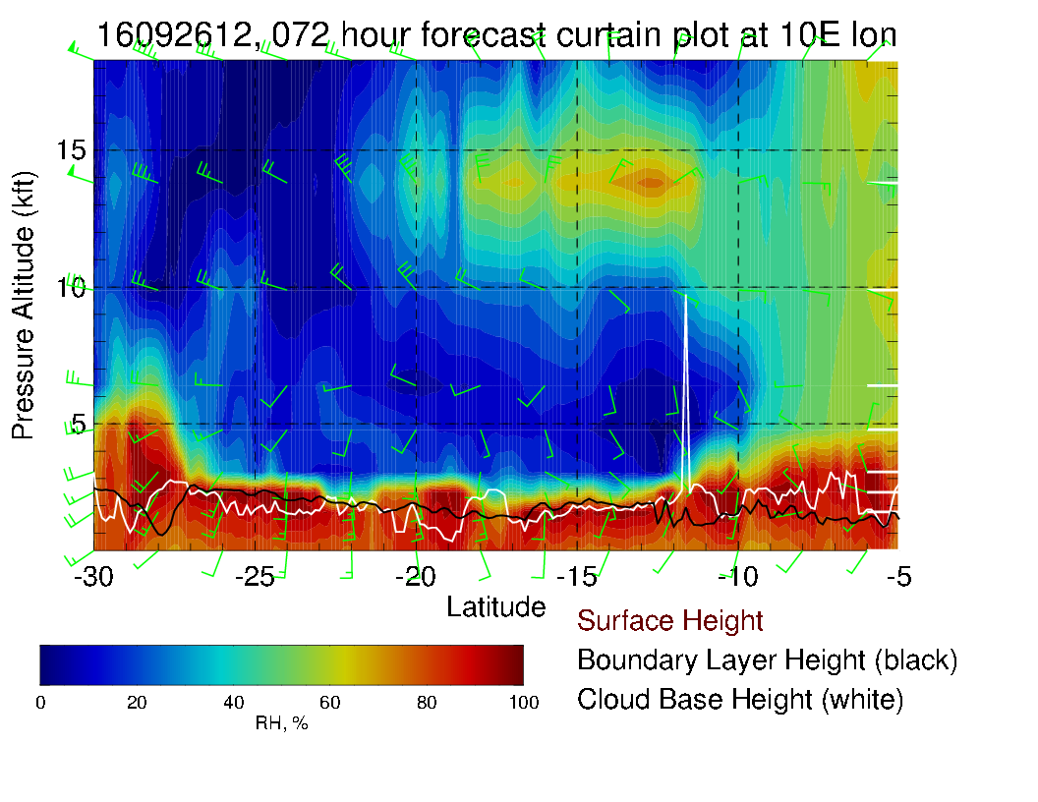

Slide 7
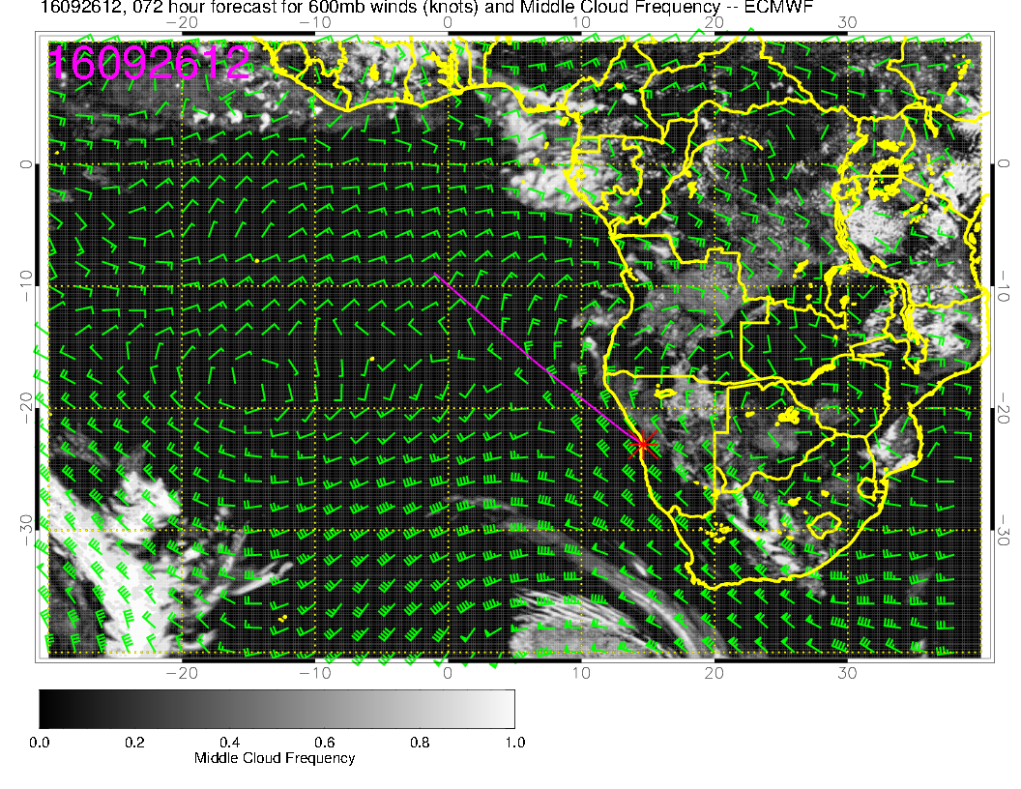
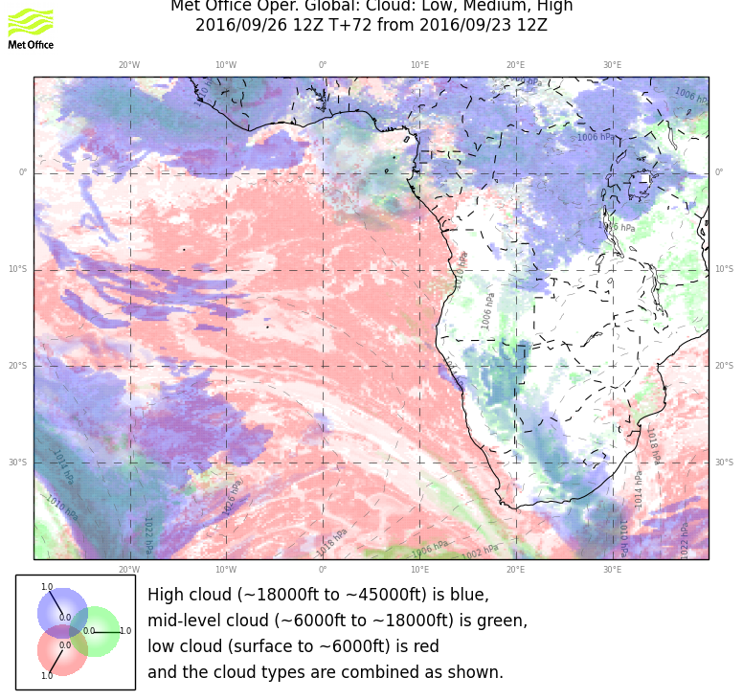
Mostly clear of Mid level clouds. Some mid level clouds over the Angolan Bay. Good model agreement.

Slide 8
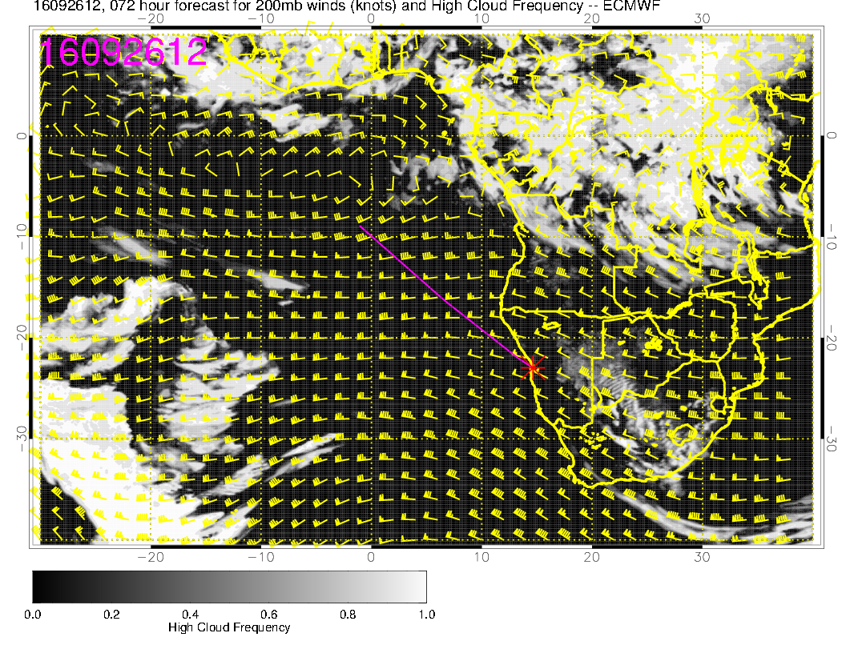
Models agree very well for Cirrus prediction, clear in our region.

Slide 9
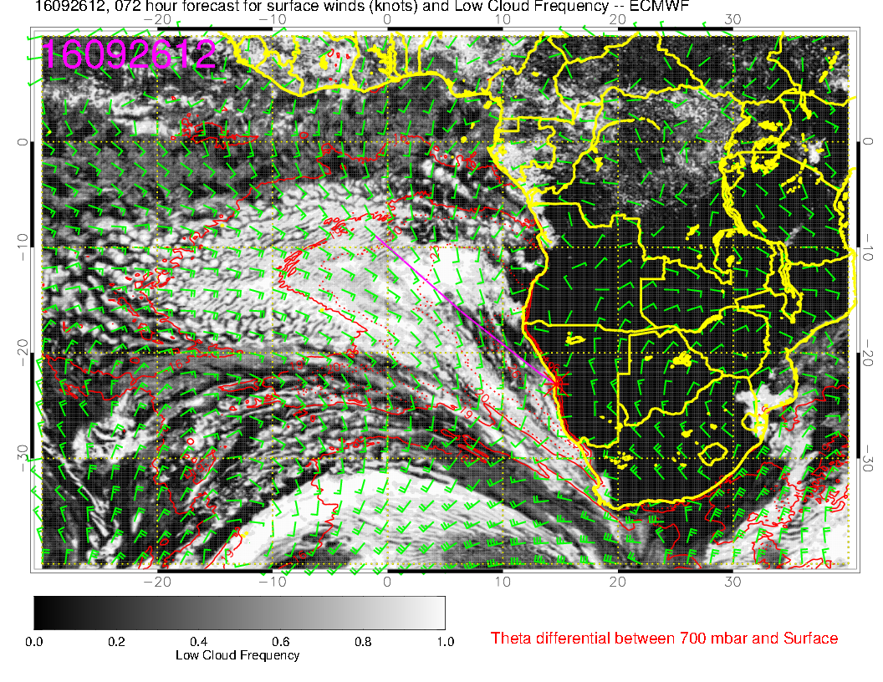
Good agreement between models. Forecast is stable, except that more clearing is predicted in EC
model.

Slide 10
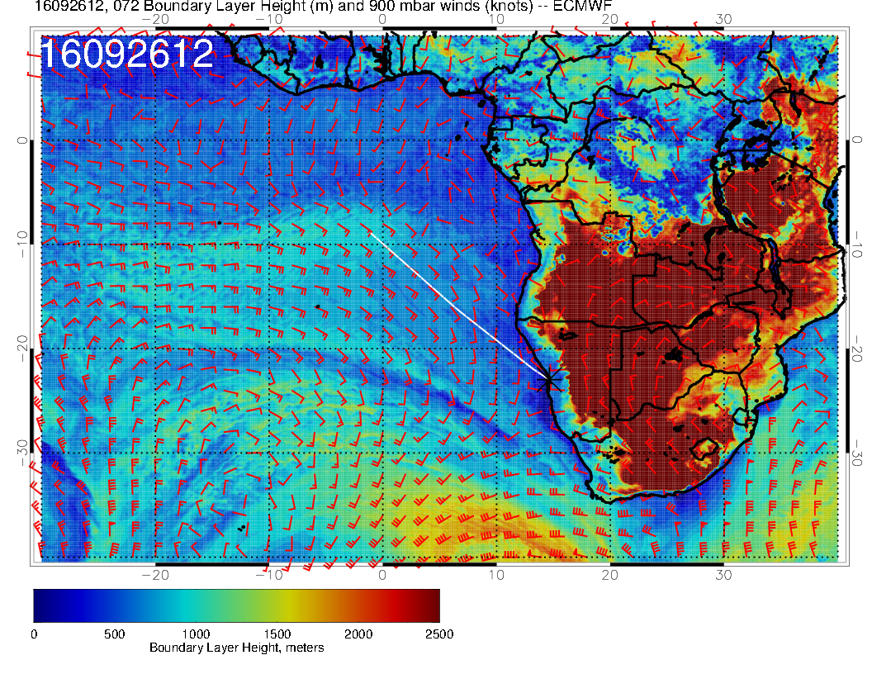
Significant cloud in EC goes with higher BL height.

