Slide 1
ORACLES forecasting briefing Meteorology for 24-09-2016 -- 27-09-2016
Lenny Pfister and Susanne Bauer

Slide 2
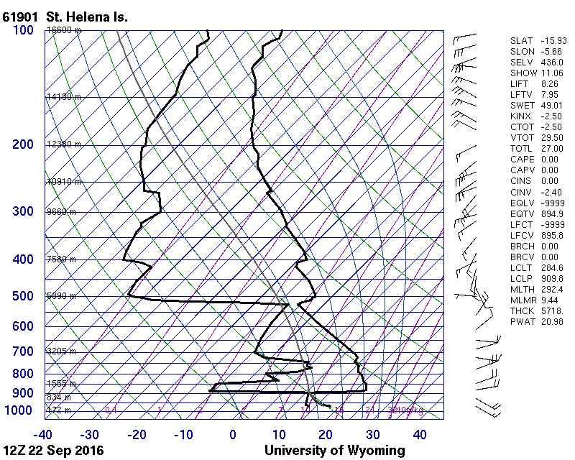
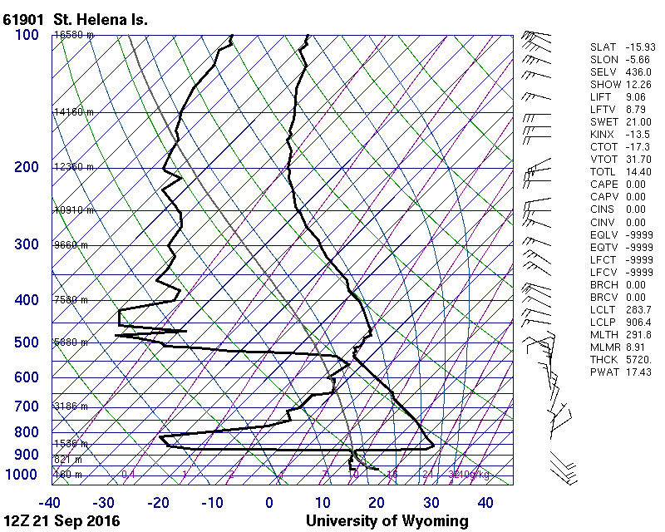
Overflew SH at about the time of this sounding, and top of da layer corresponds roughly with top of plume. Another less clear (less uniform DP) layer on the 21st – different theta.

Slide 3
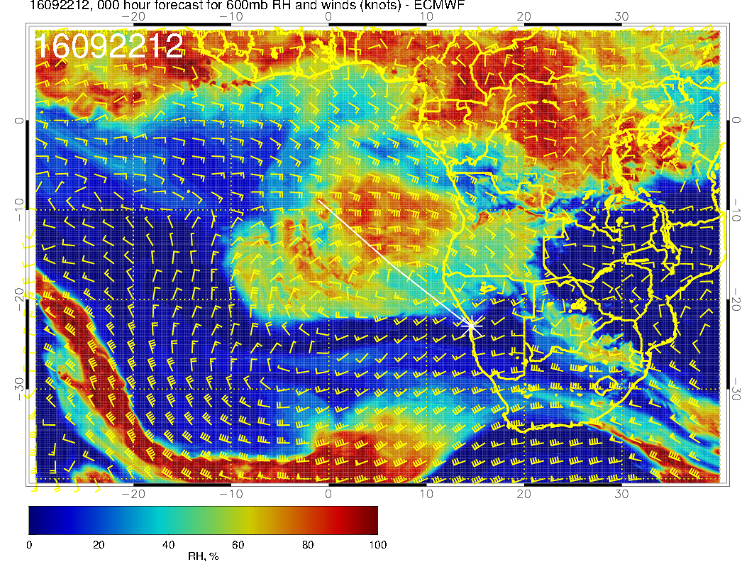

Slide 4
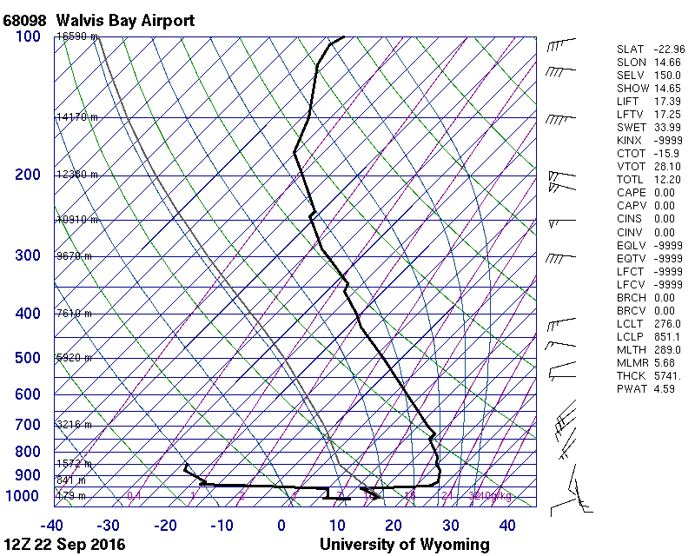
No such adiabatic layer at YWB,
not a surprise.

Slide 5
Saturday, 20160924

Slide 6
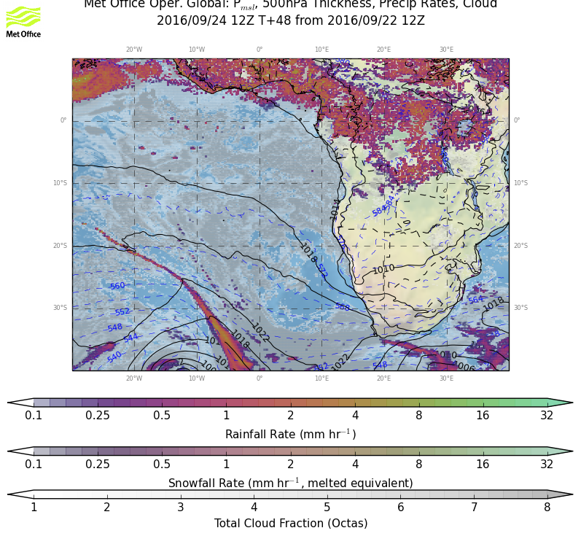
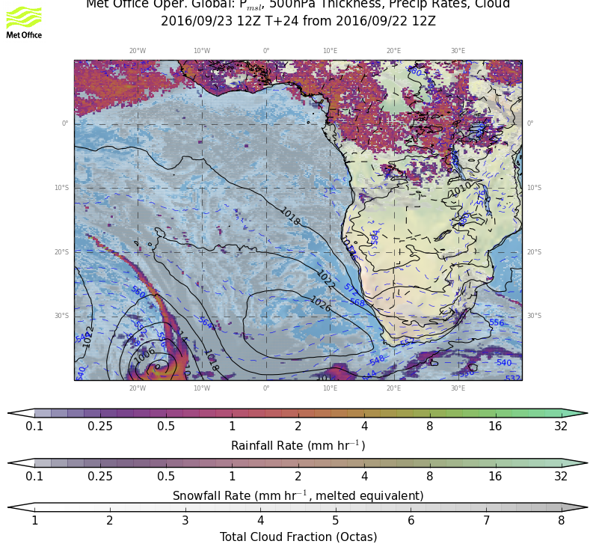
Surface evolution Thursday-Saturday:
Weakening low pressure system reaching Southern Africa, development of a new system in the south east, pushing a new cold front into the region.
The low pressure system leading to a anticyclone at surface level, leading to typical southerly winds off-shore of Namibia.

Slide 7
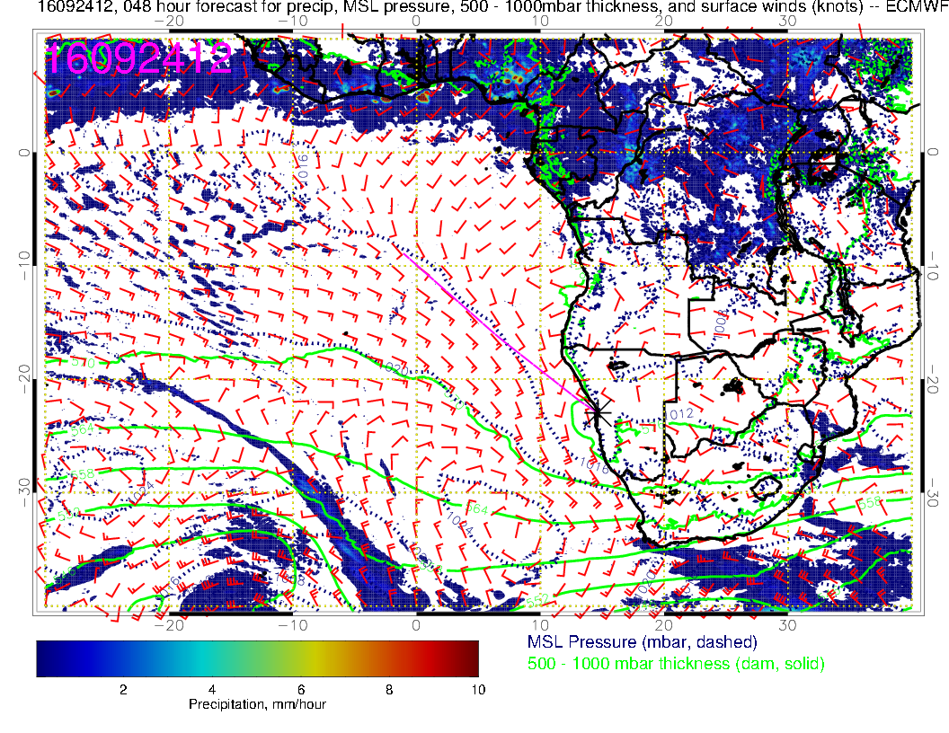
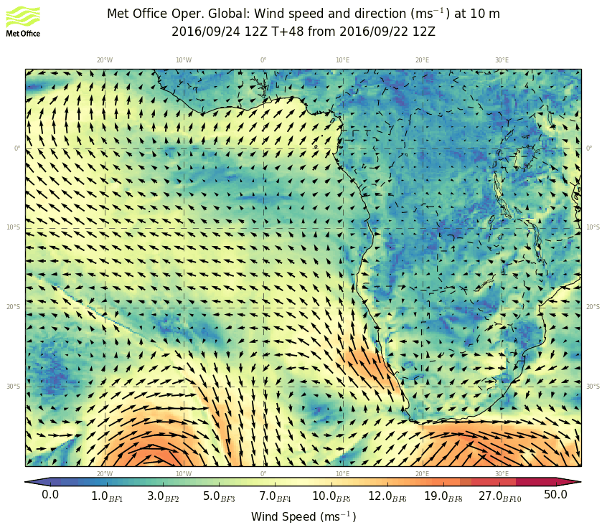
Surface condition Saturday: Stable forecast on the large scale. Strongest surface winds are now south of YWB region with an eddy circulation starting to develop near YWB

Slide 8
Similar to surface conditions around the Low
Anticyclone over the coast Congo/Garbon and northerly flow. This shows perhaps more clearly the northern limits of the classic “Sc” region than the surface map.

Slide 9
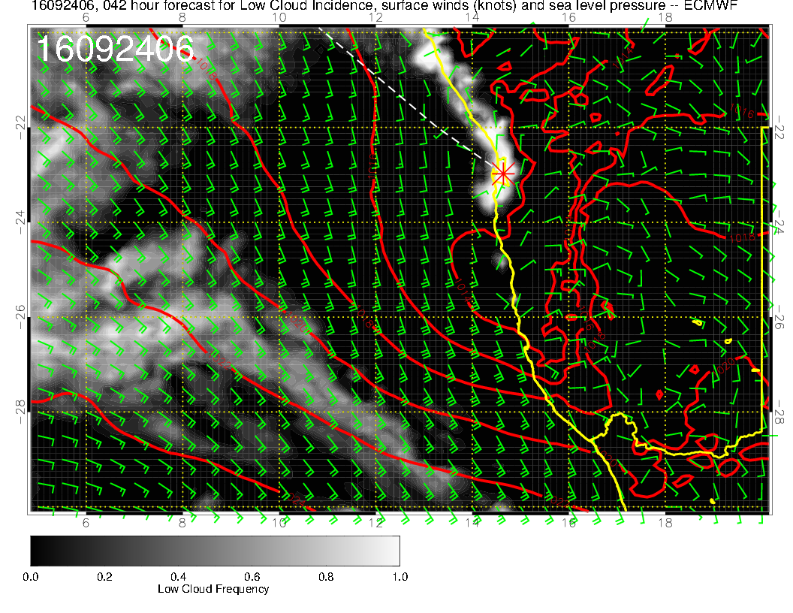
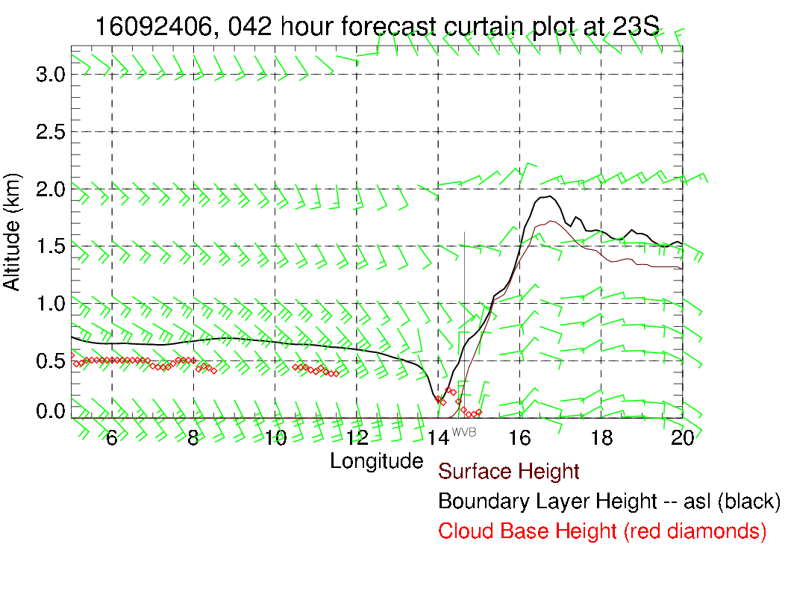
Stable model simulation on the small scale. Very low ceilings
forecast at 8 AM, low BL hgt, clearing before 11 AM. Model
forecast does not look dissimilar to Wednesday.

Slide 10
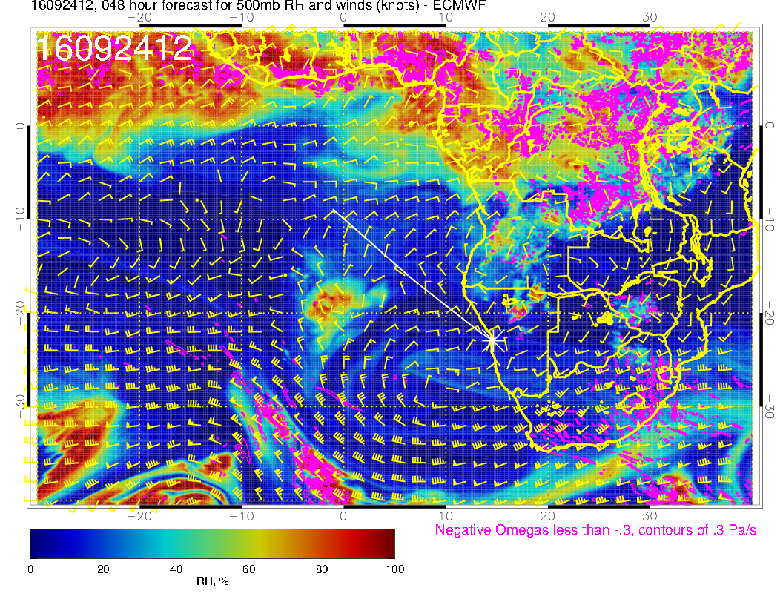
Humidity field moving in from St Helena. Swirling around the Anticyclone. Generally stable forecast – 500mb moisture more active than pre fcst.

Slide 11
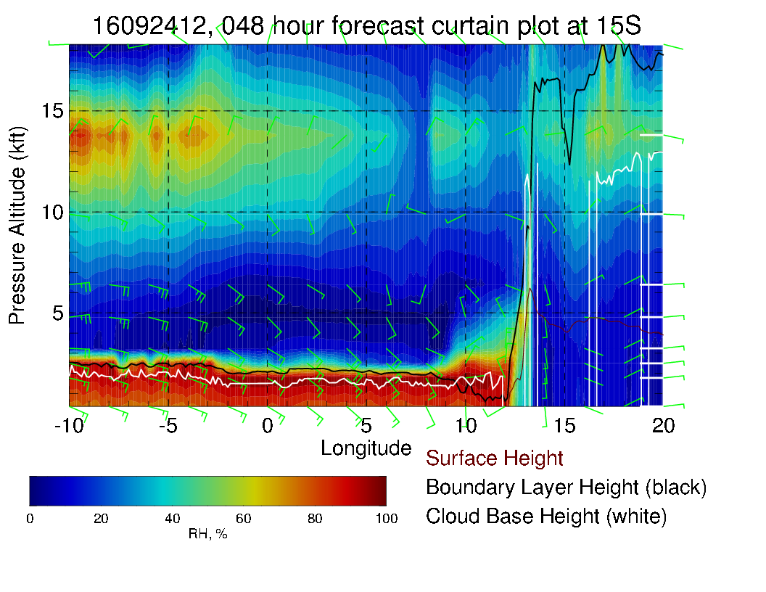
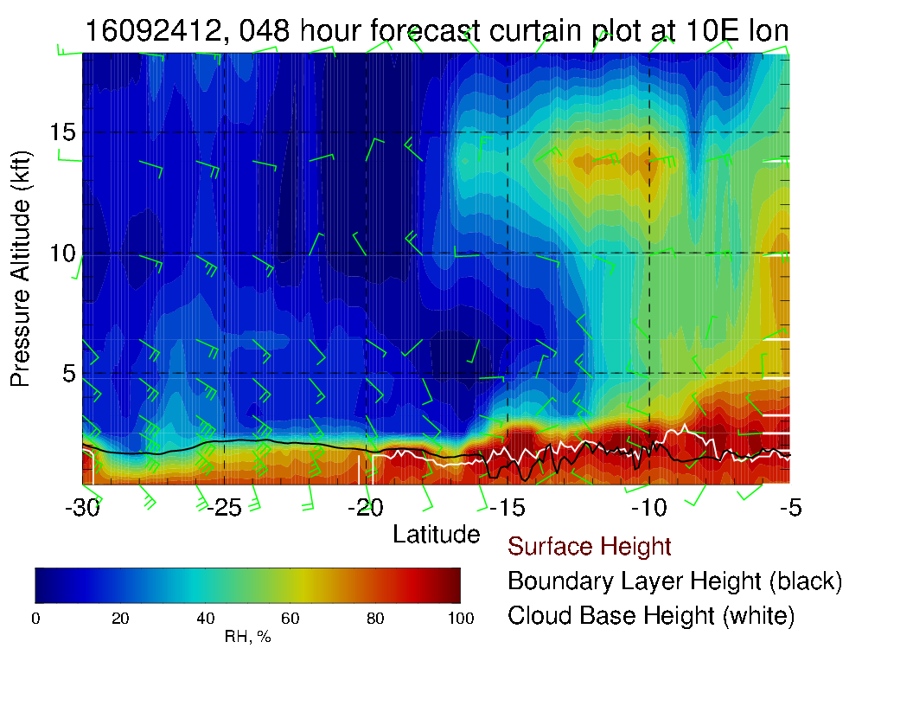

Slide 12
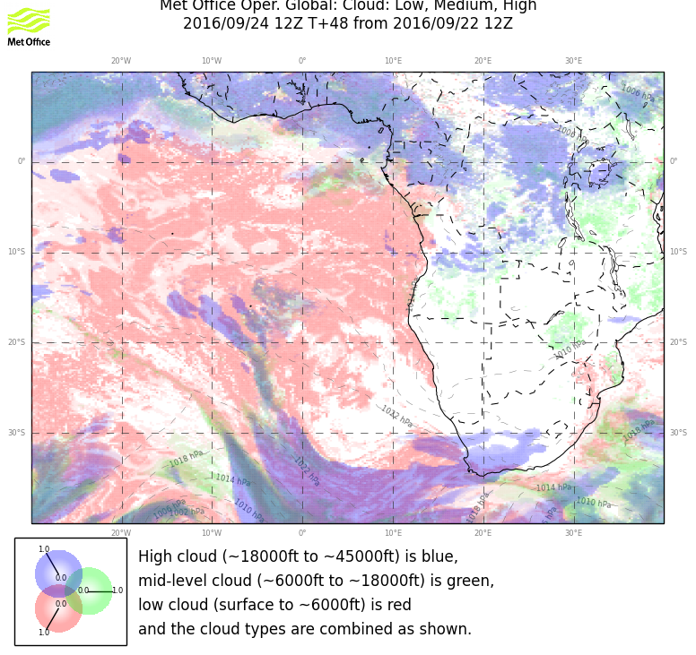
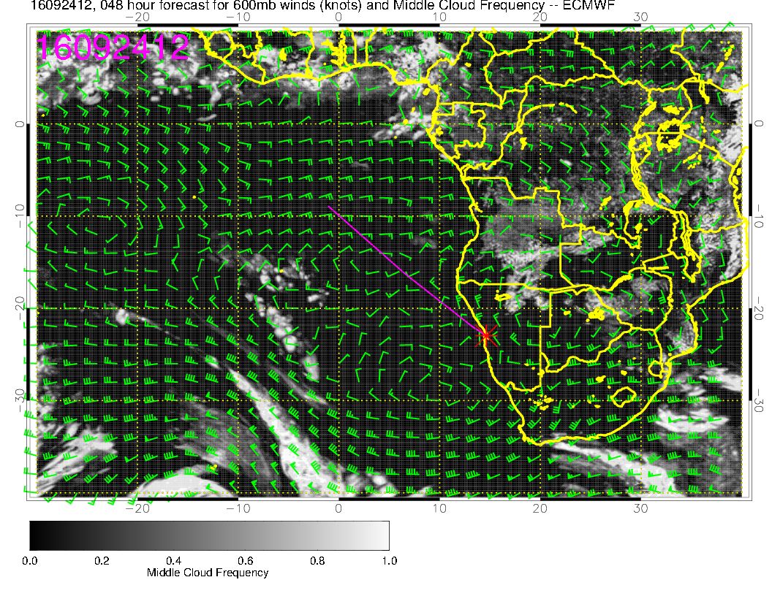
Mostly clear of Mid level clouds. Some cloudiness associated with humidity moving in from St Helena. Good model agreement.

Slide 13
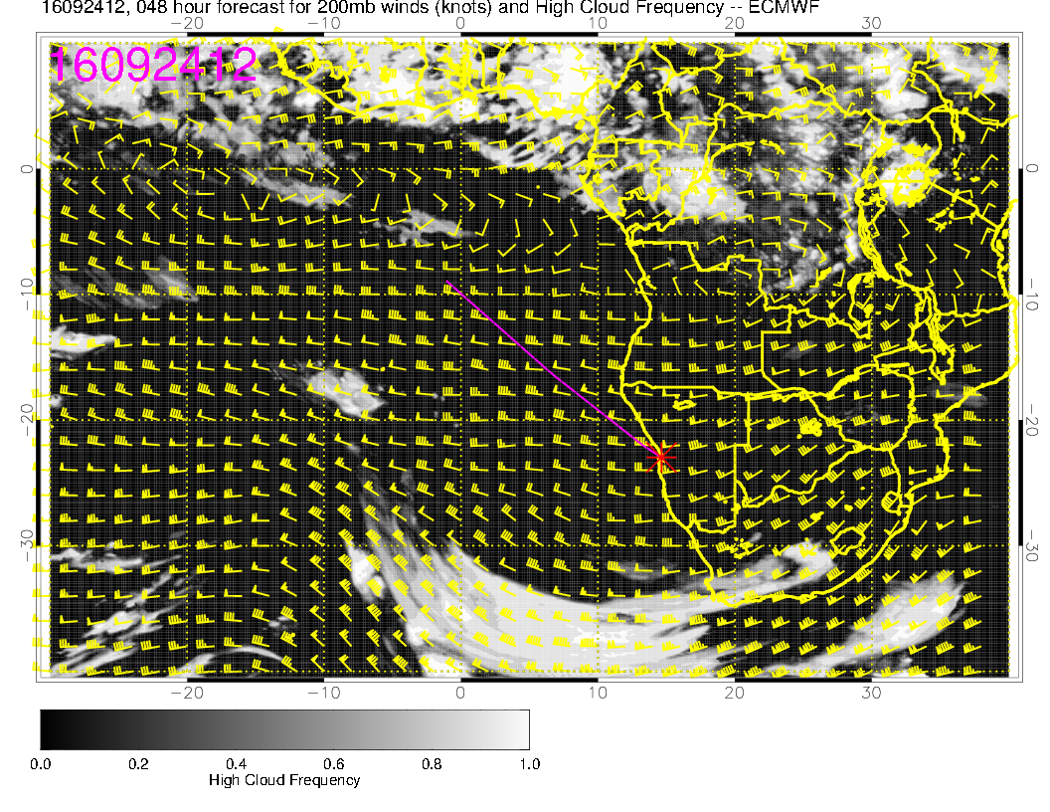
Models agree very well for Cirrus prediction, clear in our region.

Slide 14
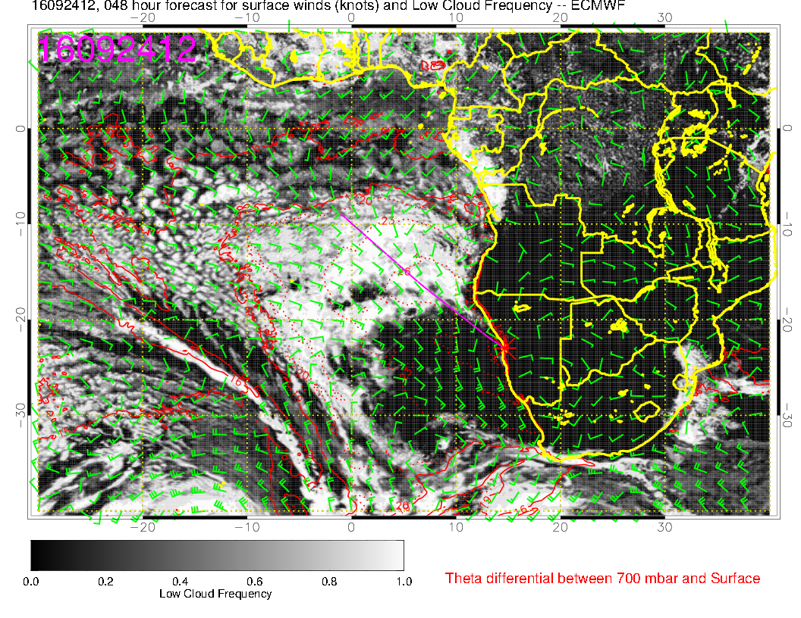
Good agreement between models up to 10S. North of 10S shallow boundary layers in EC model.
Forecast is stable, except that clearing has increased in EC model, which is probably excessive.
Note substantial hook in UKMO model; I believe related to eddy circulation.

Slide 15
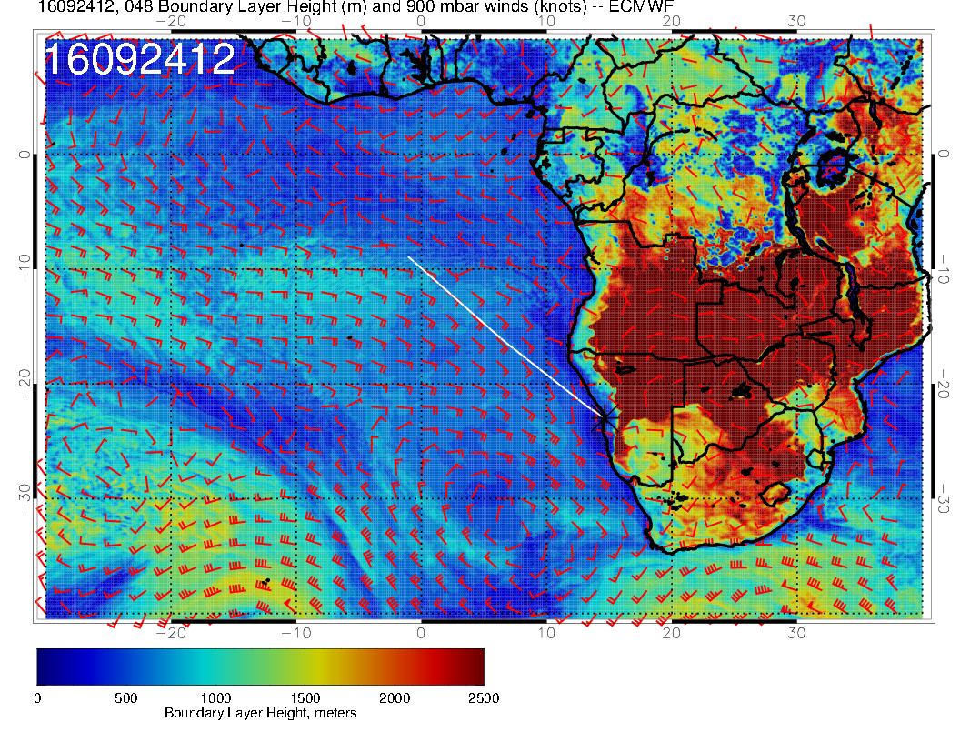
Significant cloud in EC goes with higher BL height.

Slide 16
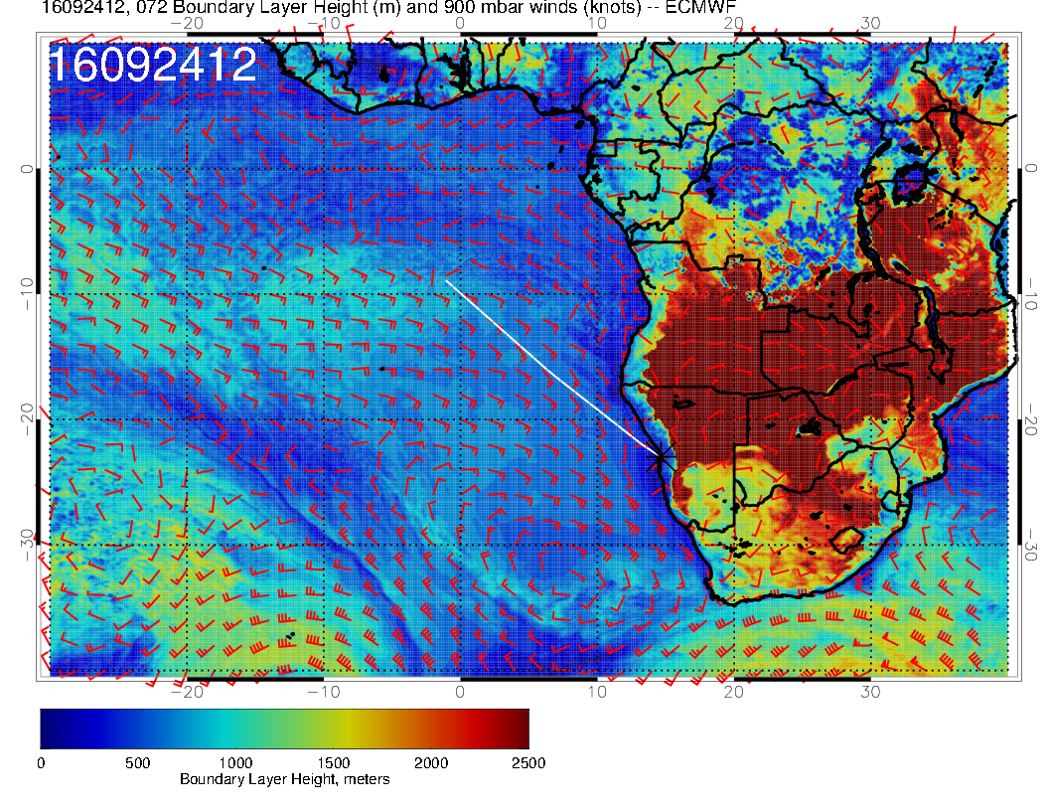
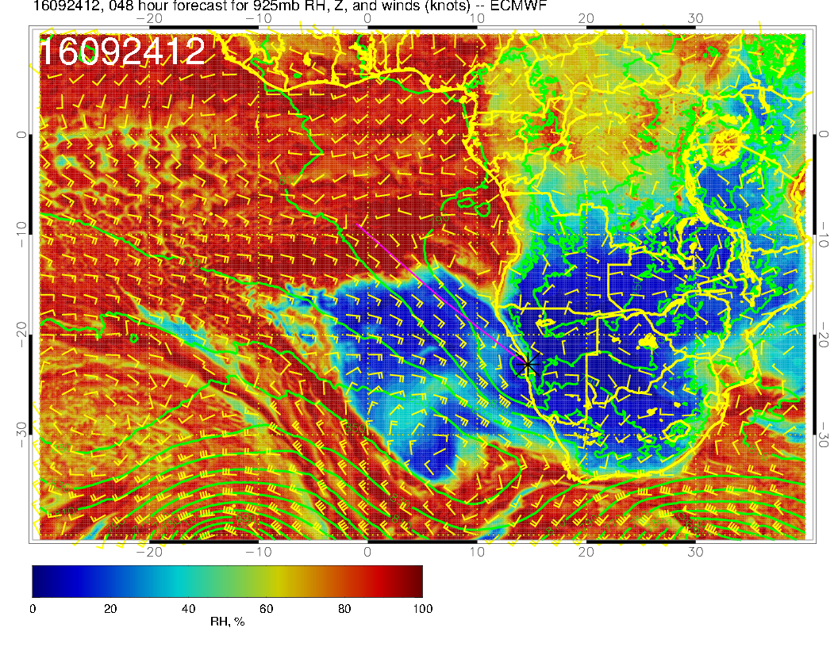
BL heights are not that low, but subsidence around high is generating drying which produces the clearing in the models

Slide 17
Sunday, 20160925 HDD?

Slide 18
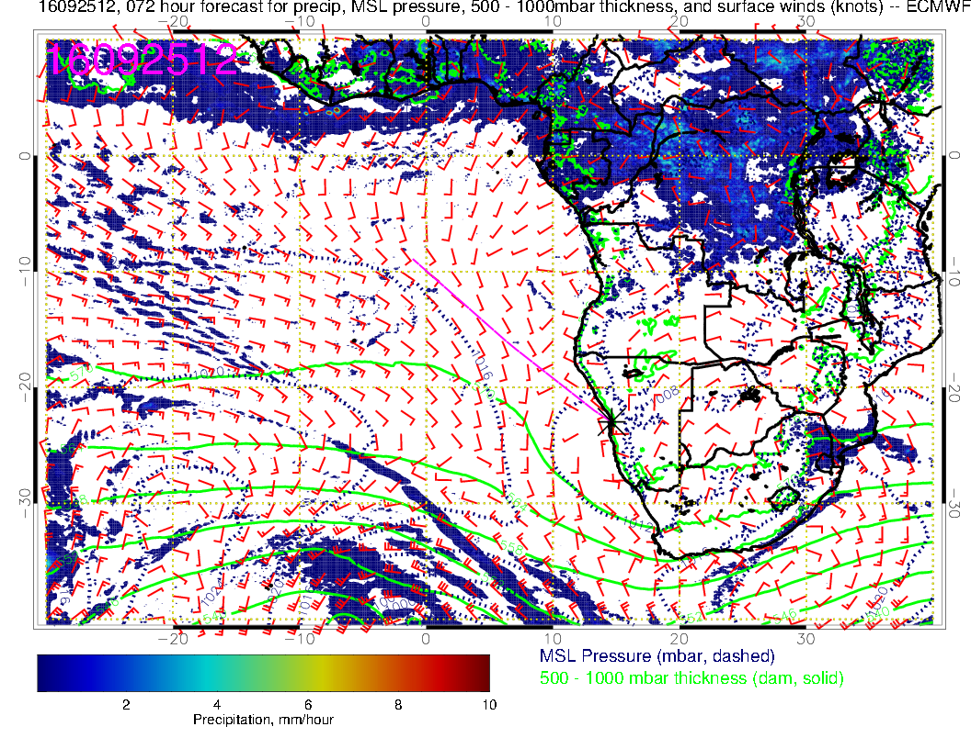
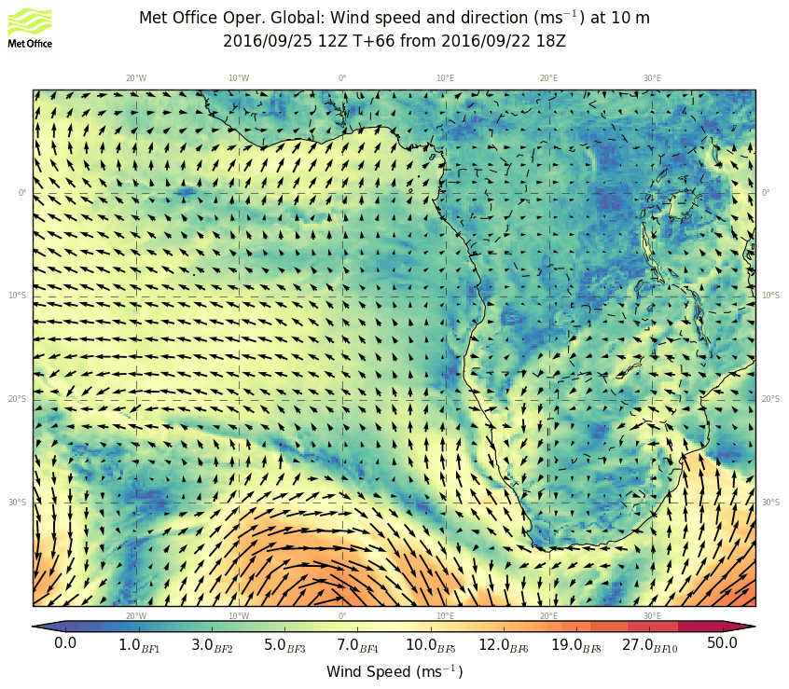
Stable forecast on the large scale. Note eddy
circulation near YWB. SH high reforming to the
west. Weak winds in our region.

Slide 19
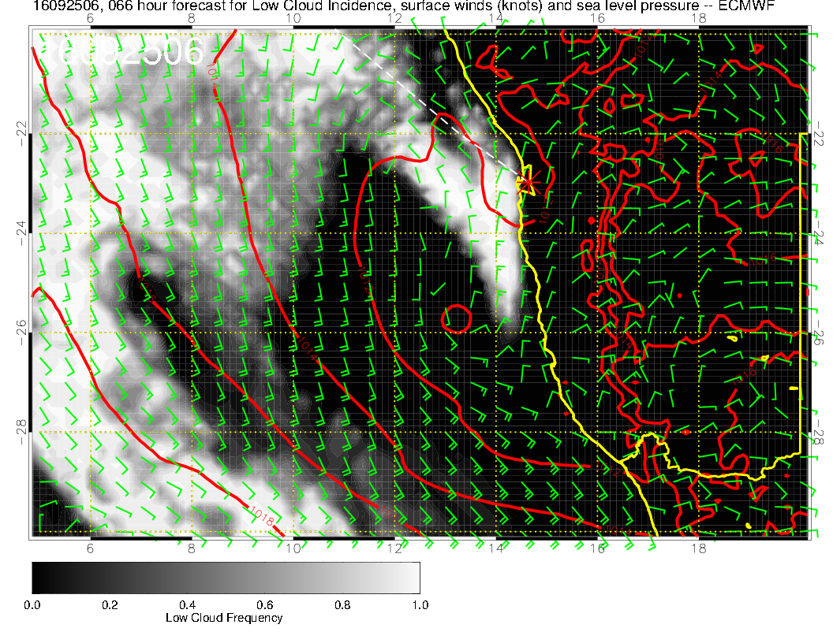
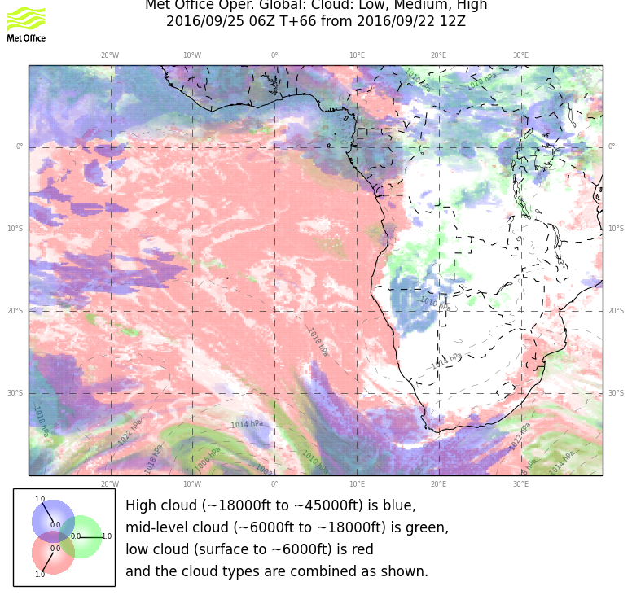
Morning offshore component (almost too marked an eddy circulation) and a low
offshore keep the major fog bank away in the morning. Landing looks better than
yesterday’s fcst, with fog bank offshore and to the south. Forecasts on this scale not stable yet. UKMO has significant cloud penetration into land at 6Z. Low BL heights overall in the region are not a good sign. It all depends on the near shore pressure gradient, and the models are not agreeing. ATTM, I think the offshore flow in the morning is significant, making this a better day than Saturday for morning ceilings

Slide 20
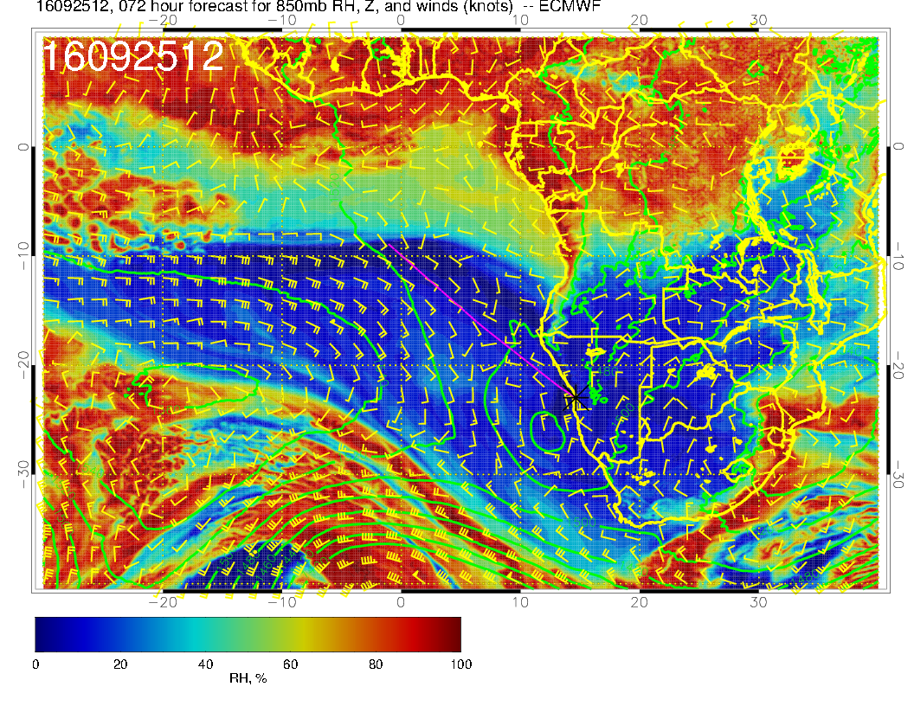
Eddy circulation very apparent at 5kft. Trough moving in and high reforming near 20W

Slide 21
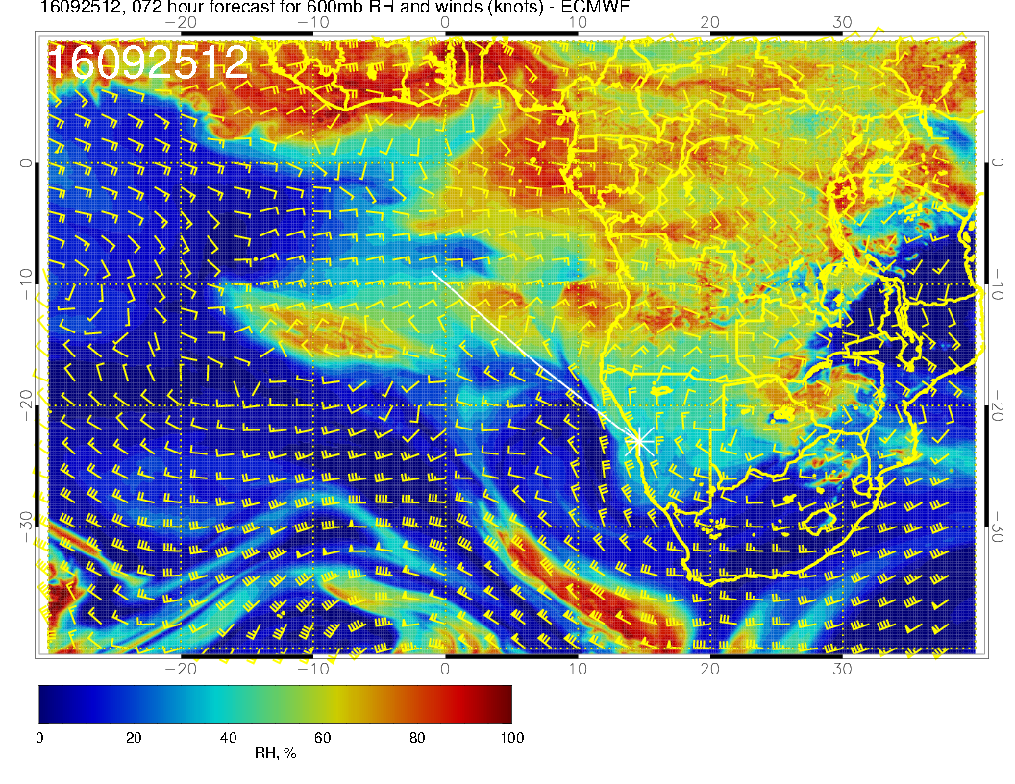
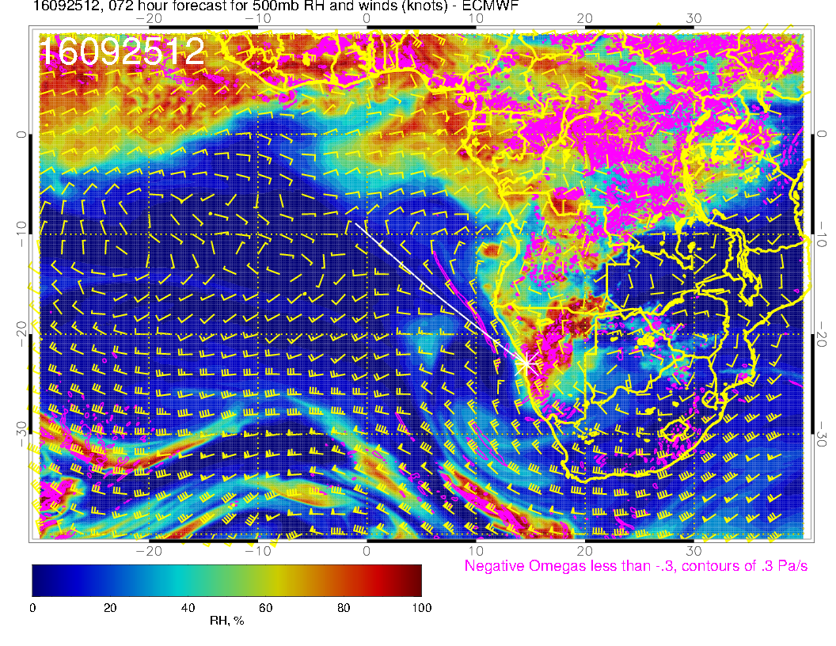
Trough moves in – mid-level cloud develops over Namibia. See train of moist regions following jet still extending out to Ascension. 600mb anticyclone develops over Botswana. Moisture blob at 600mb is part of GAP.

Slide 22
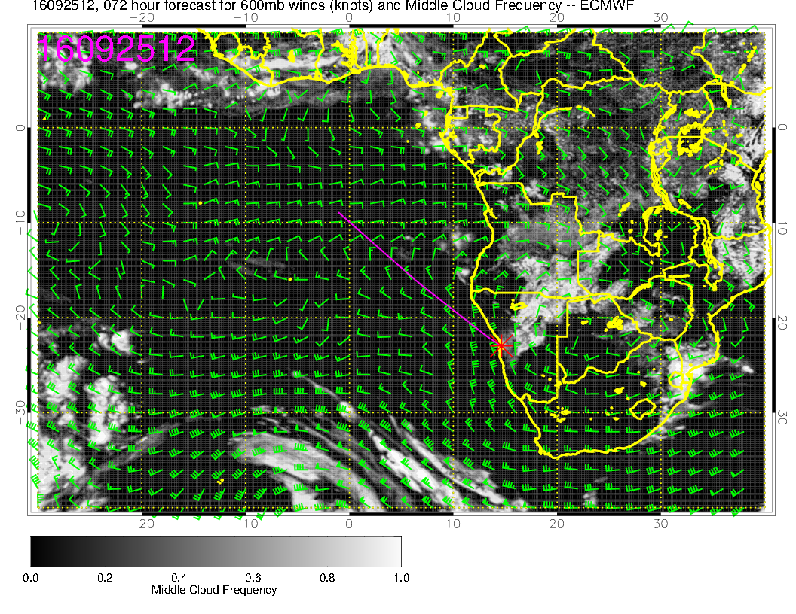
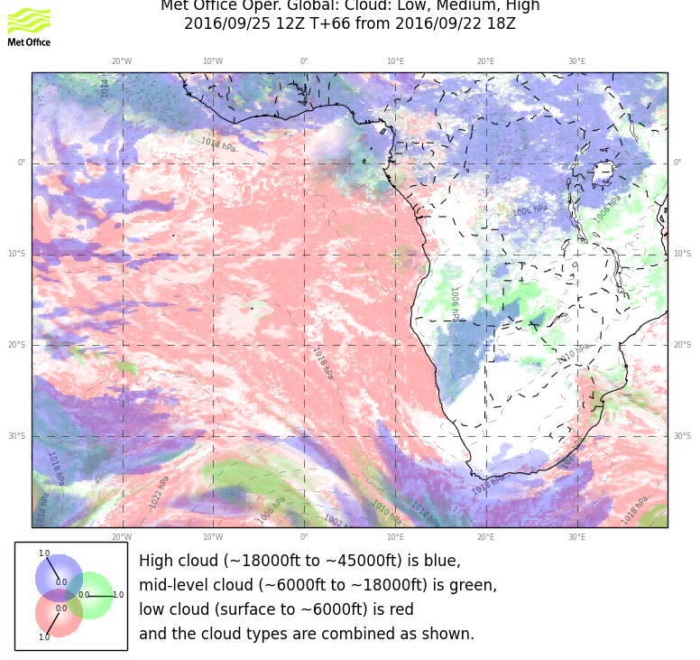
Models agree on extent and location of middle cloud (if you look closely enough). EC backing off a bit from yesterday’s fcst. Middle cloud over Namibia in both models.

Slide 23
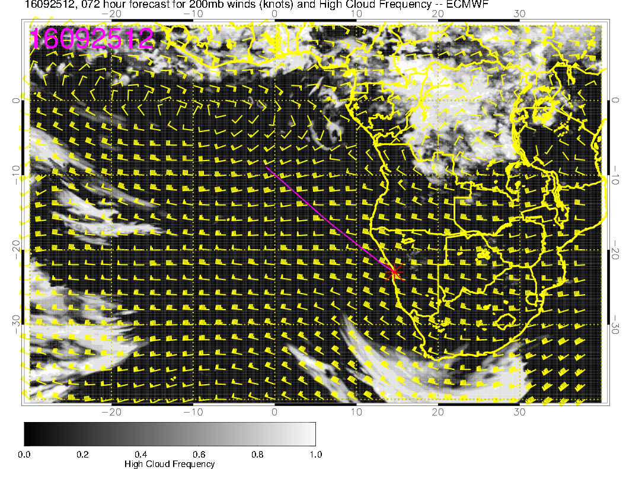
We are not seeing any cirrus in operating region.

Slide 24
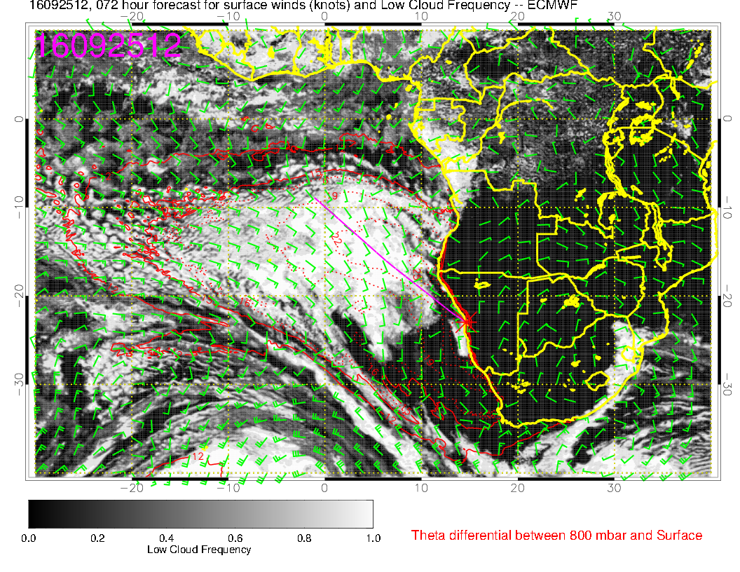
Some clearing expected, but less than Saturday. BL heights are going down, but more 925mb moisture. I don’t see a lot of nice APR3 cloud in our region (too low BL).

Slide 25
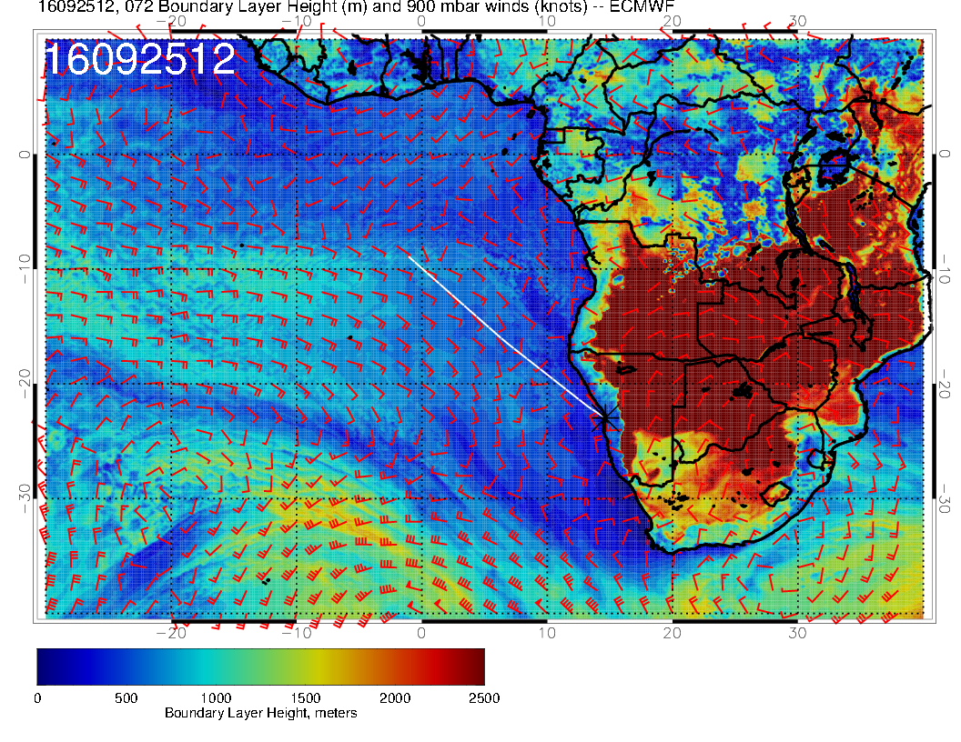
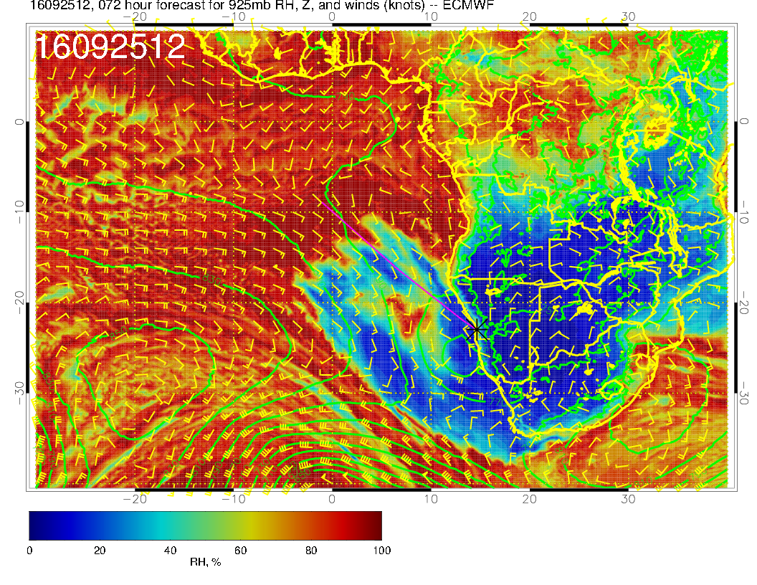

Slide 26
BL heights are not that low, but subsidence around high is bringing generating drying which produces the clearing in the models

Slide 27
Monday, 20160926

Slide 28
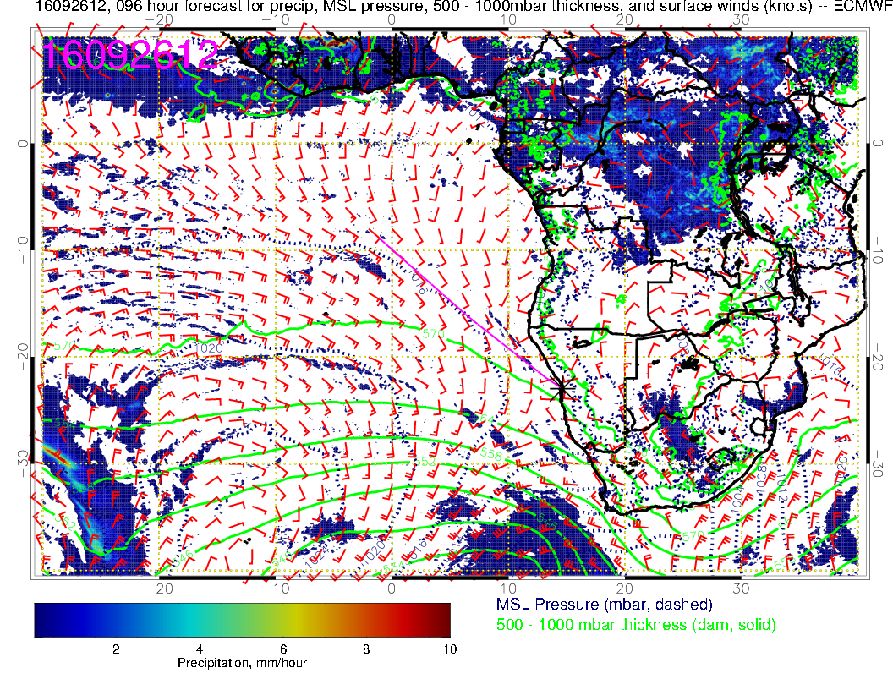
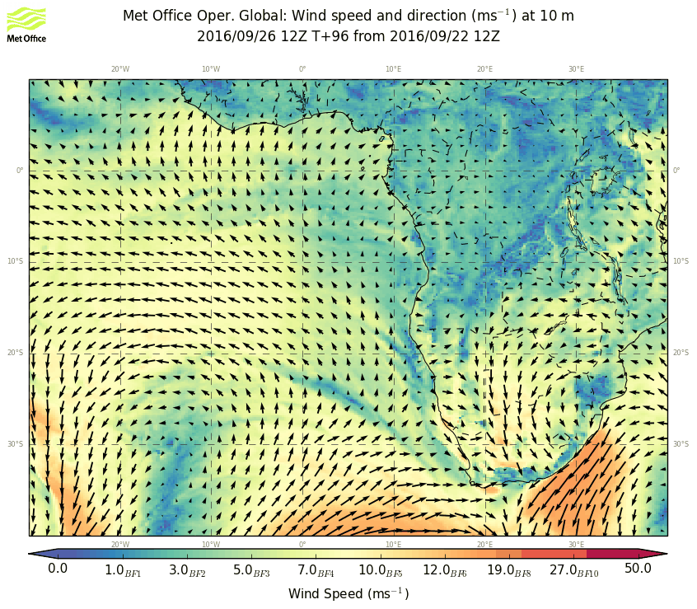
Dying front approaches us as SH high reforms and moves westward. Surface winds quite weak in our region, but as eastern high moves away there is much less offshore component over land

Slide 29
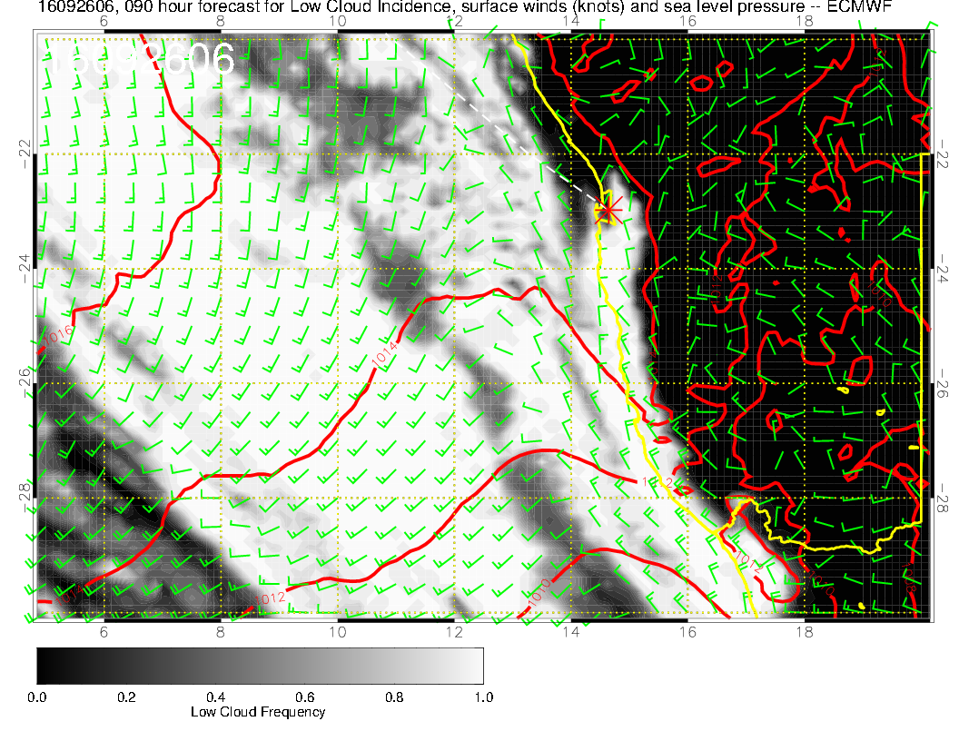
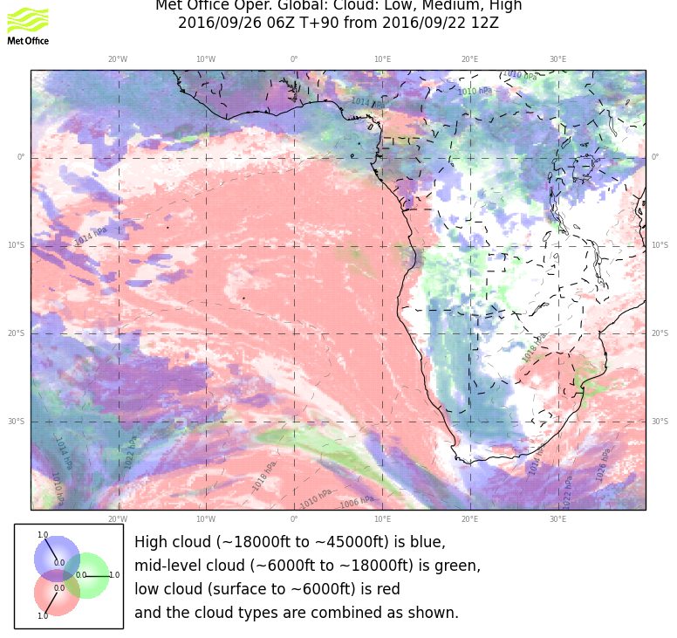
The last time we had a prefrontal situation, ceilings were reasonably benign. UKMO is in agreement keeping most cloud slightly south. I actually expect a “normal” day for ceilings
(CAVOK by 9AM). Landing OK because BL heights are up by then.

Slide 30
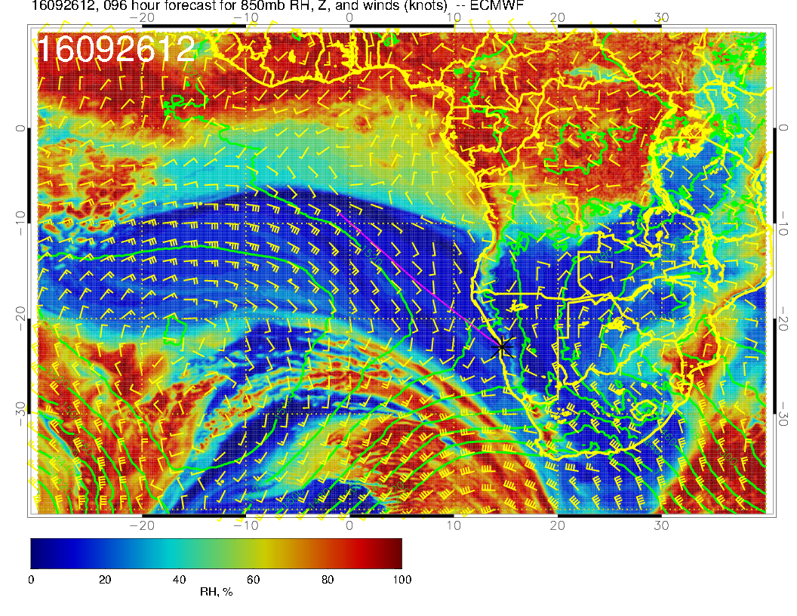

Slide 31
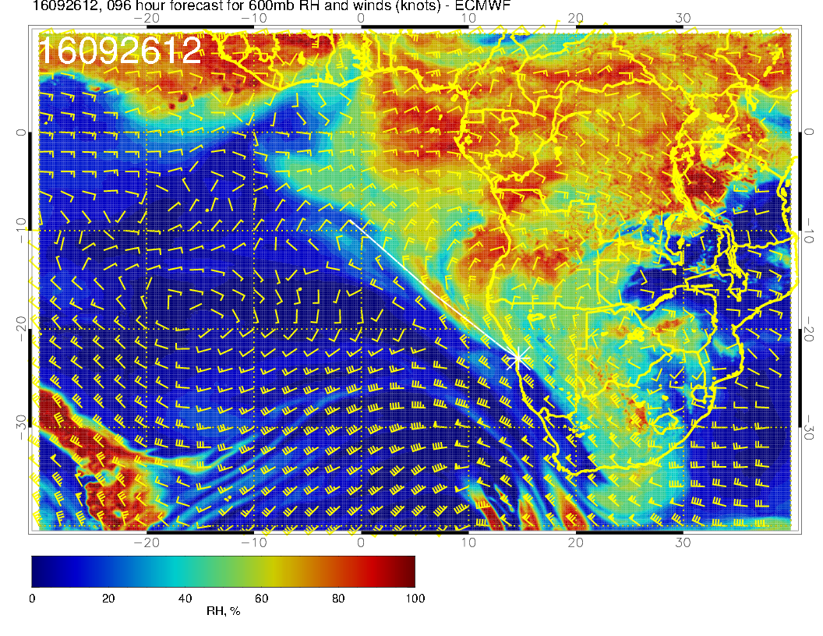
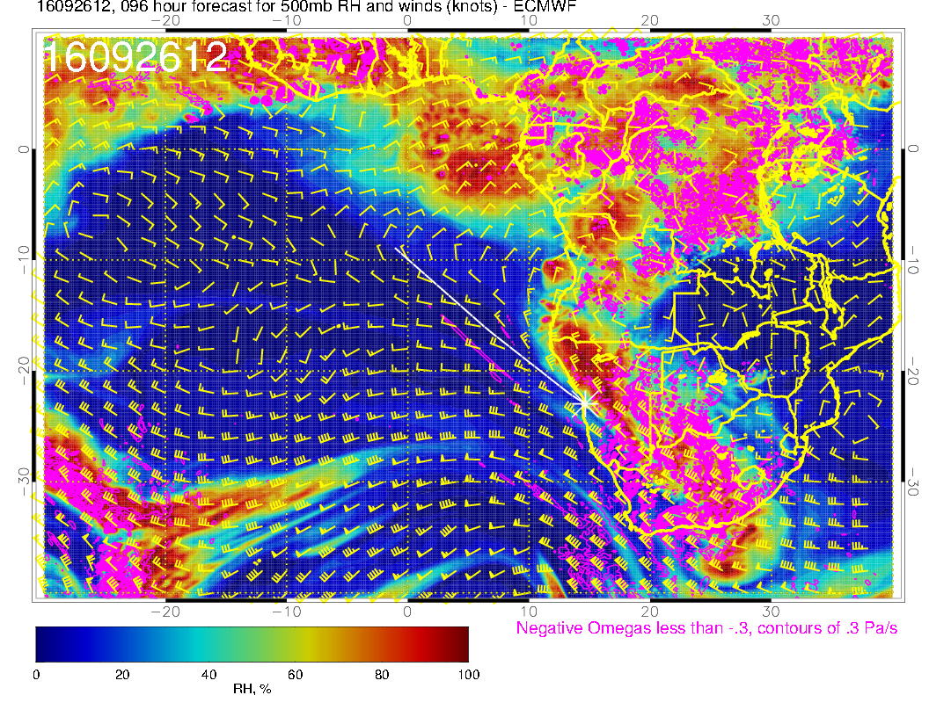
Midlatitude trought advancing faster than previous fcst, otherwise stable fcst. Strong westward flow shifts to equator where moisture comes from moist convection in rainy region

Slide 32
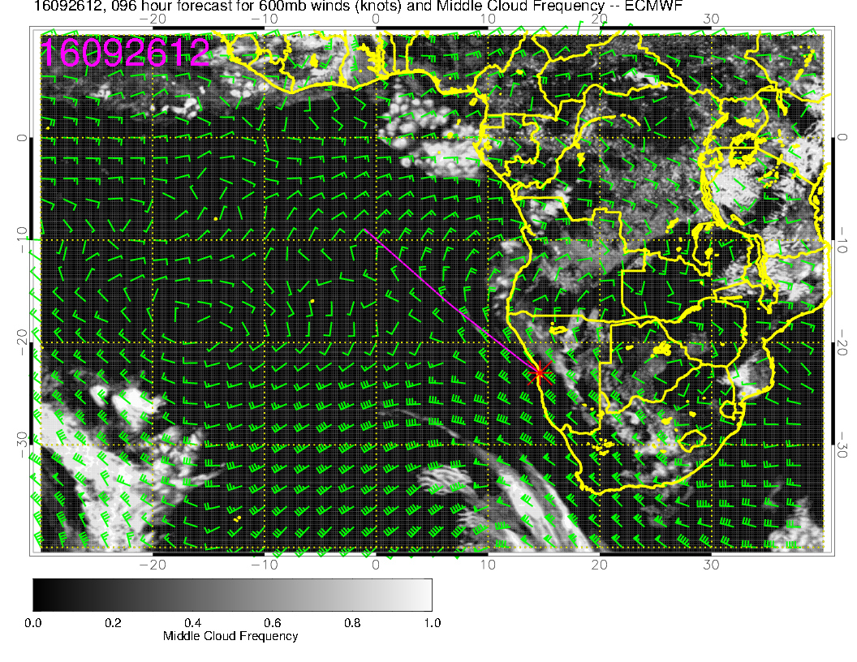
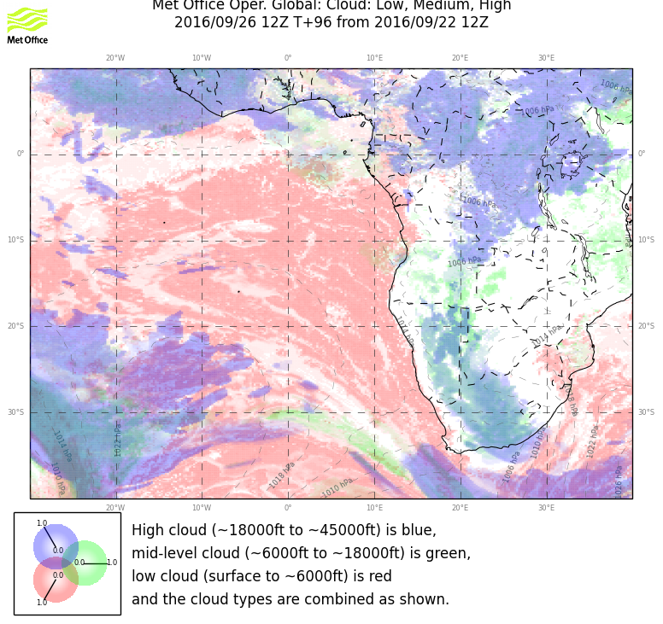
Forecasts consistent and stable.

Slide 33
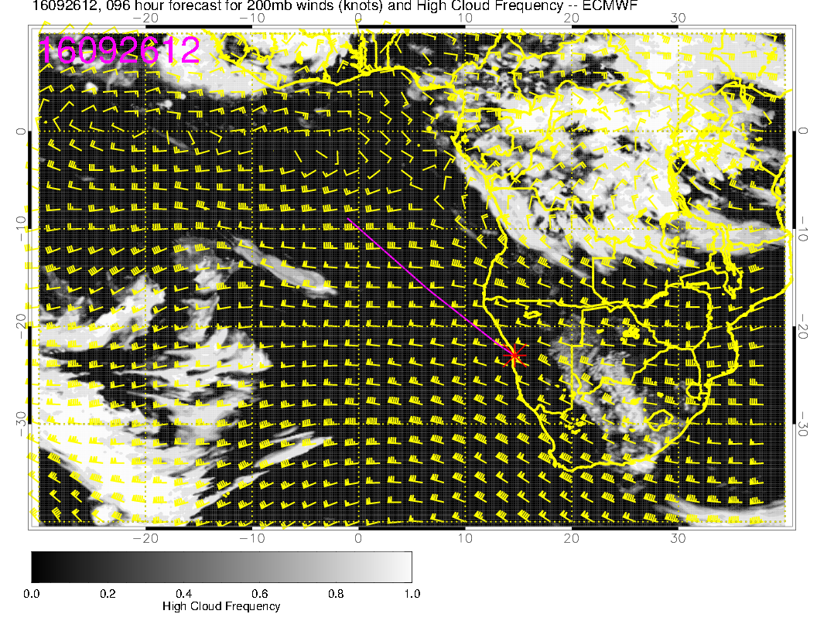
Divergence occurs at North Angolan coast.

Slide 34
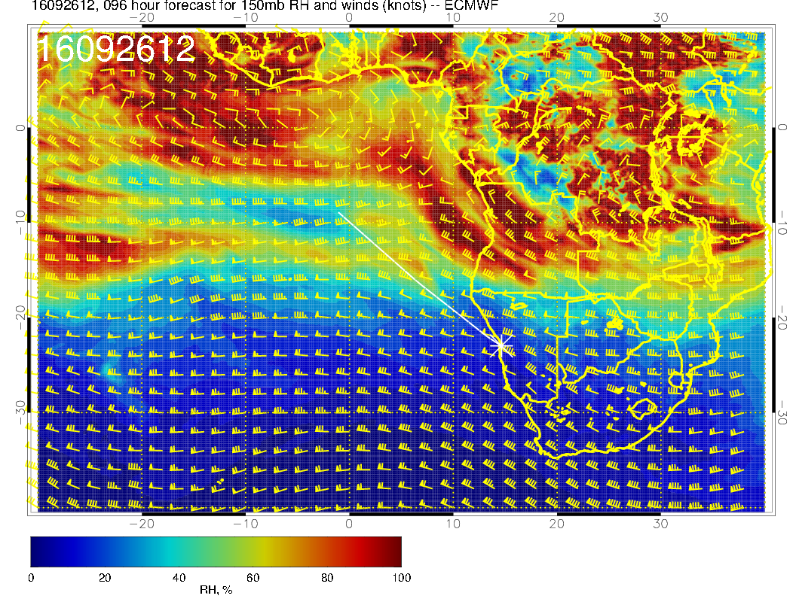
We may have to worry about cirrus near 12S. I said something similar yesterday, and
yesterday’s prog looks similar. Looks like flow running into cold Temps.

Slide 35
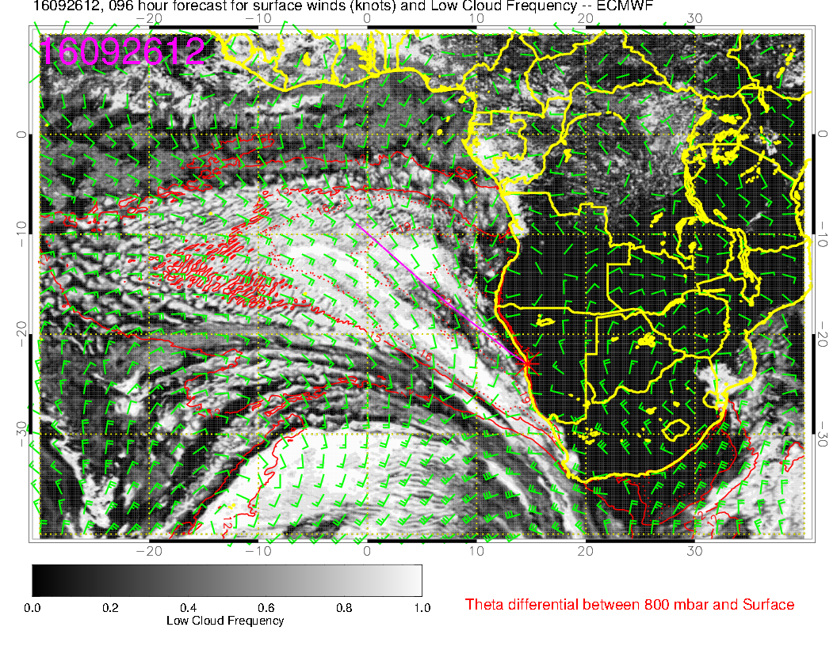
Consistent forecasts. Low BL heights near coast will probably give some clearing.
Character of clouds in Angola Bay will, as usual, be different.

Slide 36
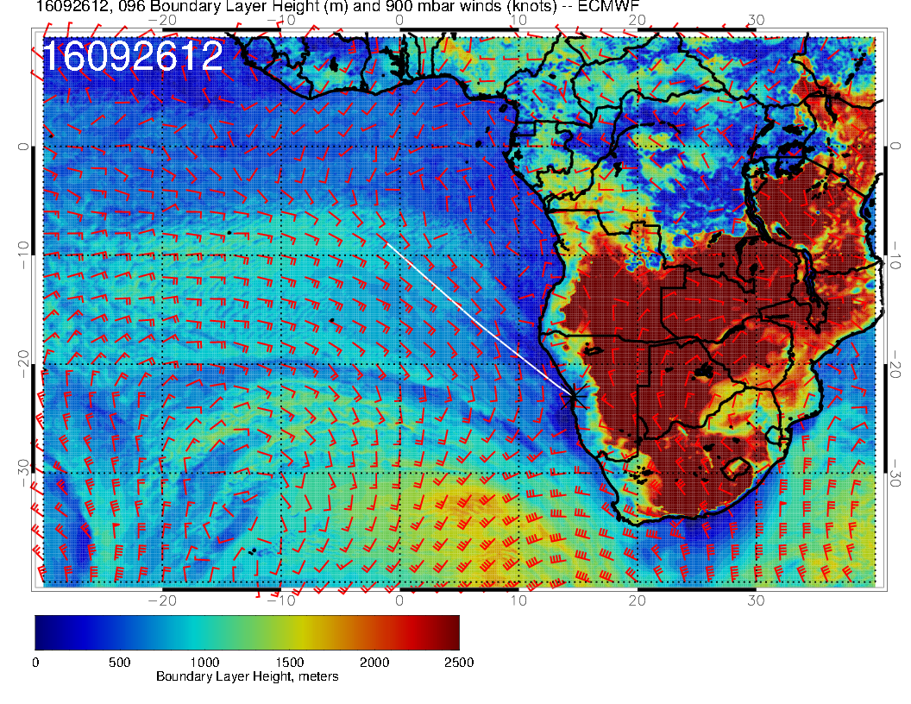
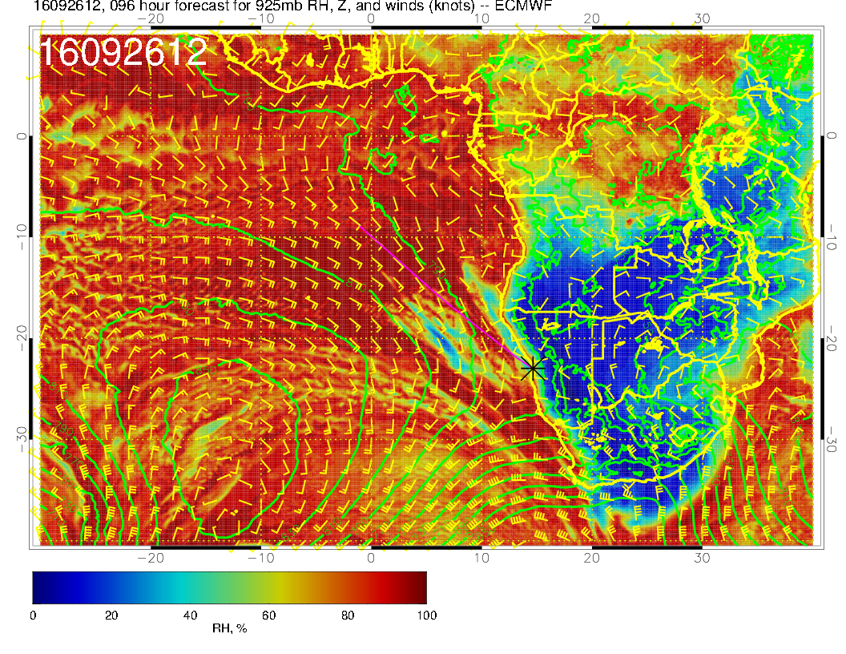

Slide 37
Tuesday, 20160927

Slide 38
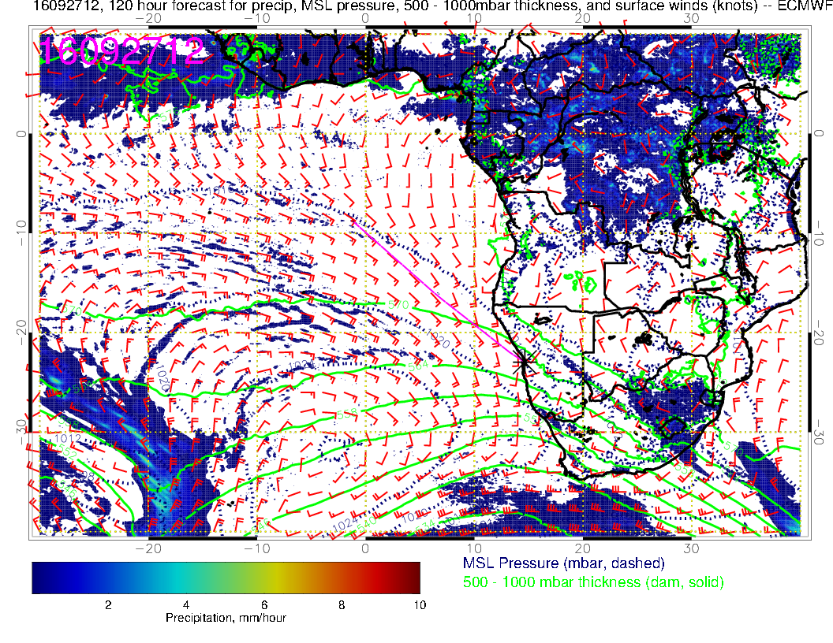
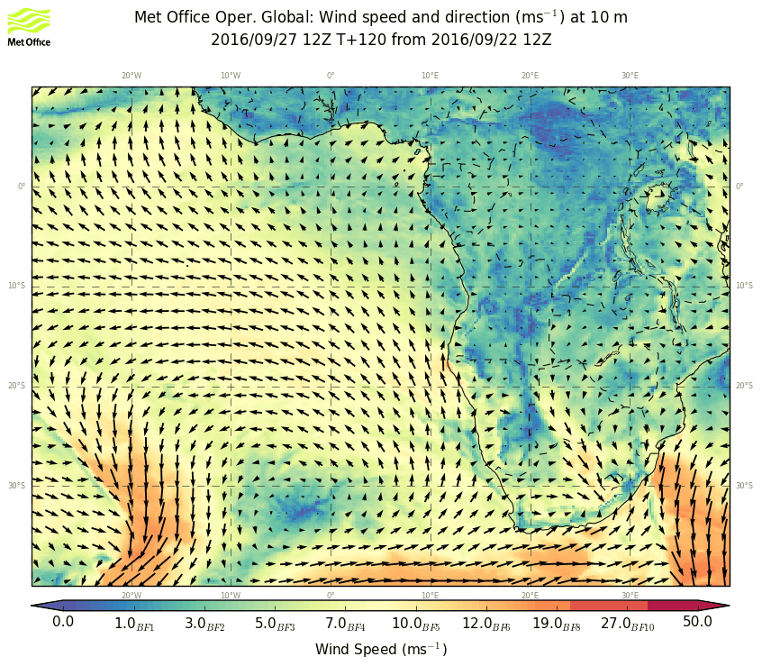
SH high reestablished, winds strengthen, but not particularly strong in our area, this
is not like the front that passed us by last week.

Slide 39
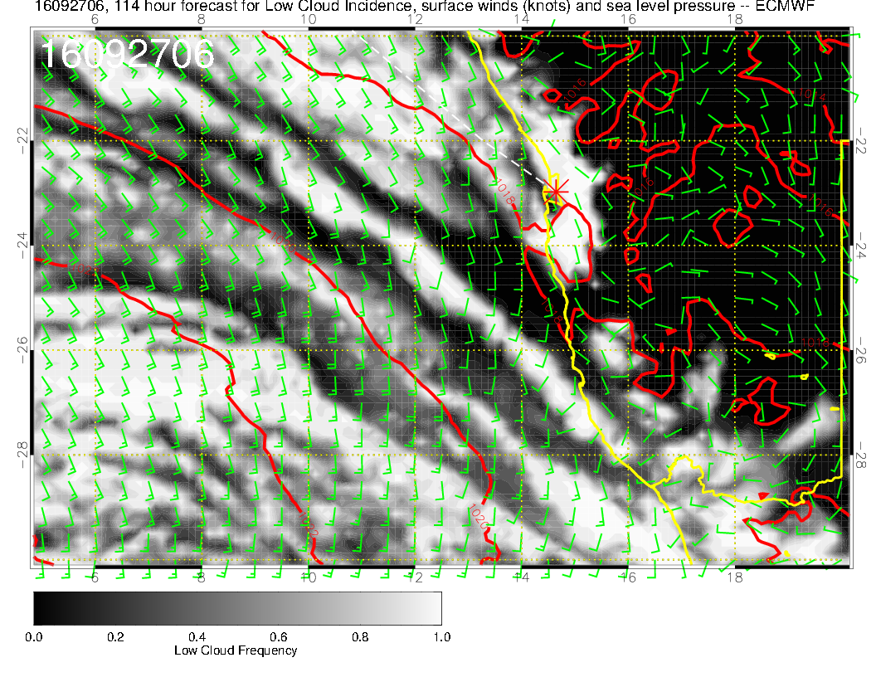
No wind issues, but both models have ample low cloud penetration inland. Not a strong front.

Slide 40
More of same. Moisture confined to Angola Bay, no real sign of 600mb anticyclone (well east), westward flow near equator, 500mb is dry

Slide 41
Middle cloud in Angola Bay, that’s it.

Slide 42
Trough produces some cirrus near YWB and at 20S, 0E.

Slide 43
Front has “scrunched” Sc region. At YWB latitudes it will be disturbed but not
cloud free. BL heights are up and there is ample 926mb moisture.

