Slide 1
ORACLES forecasting briefing Meteorology for 23-09-2016 – 26-09-2016
22-09-2016
Lenny Pfister

Slide 2
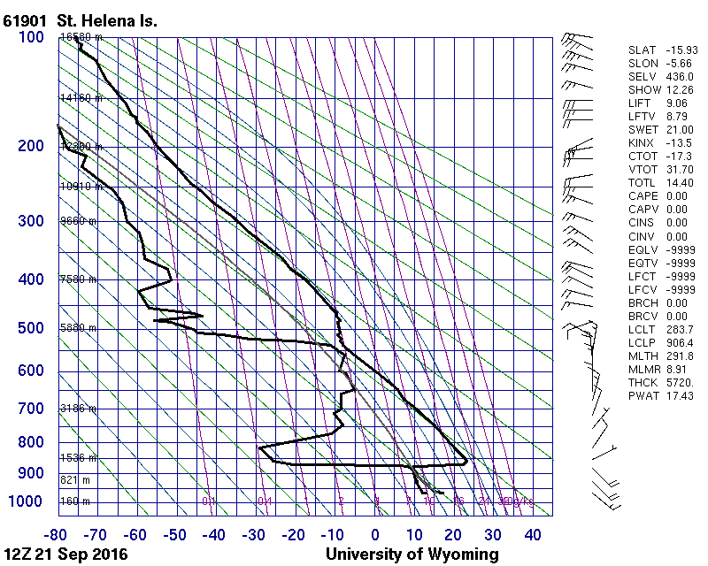
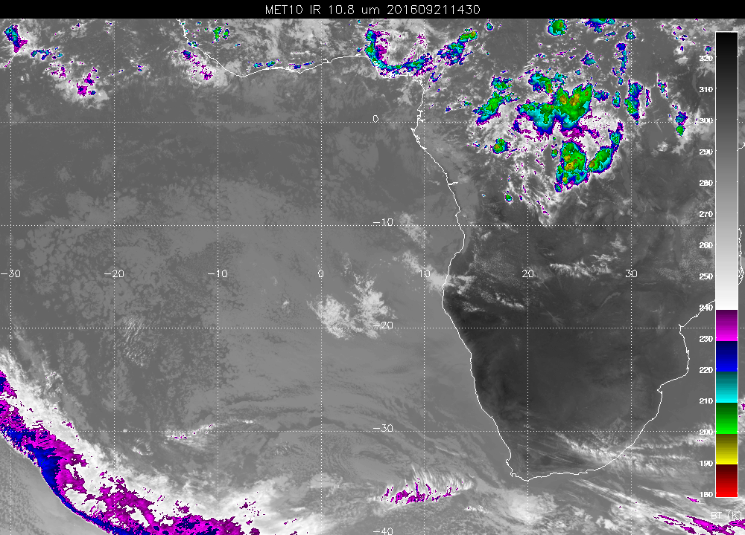
Yesterday’s sounding and sat pic
No YWB sounding available

Slide 3
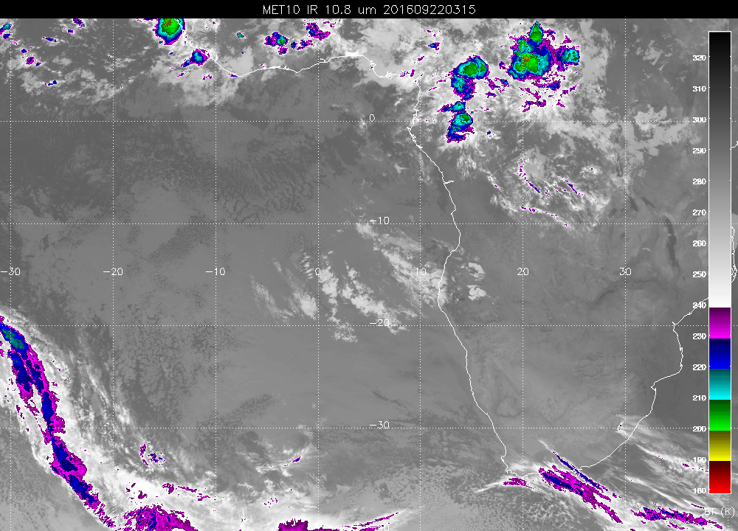
5 AM at the airport have 94% RH, winds WNW@2.
No observer yet, but ceilings must be low attm.
Note low cloud throughout operating region, including clear spots.
As much mid cloud as we have seen

Slide 4
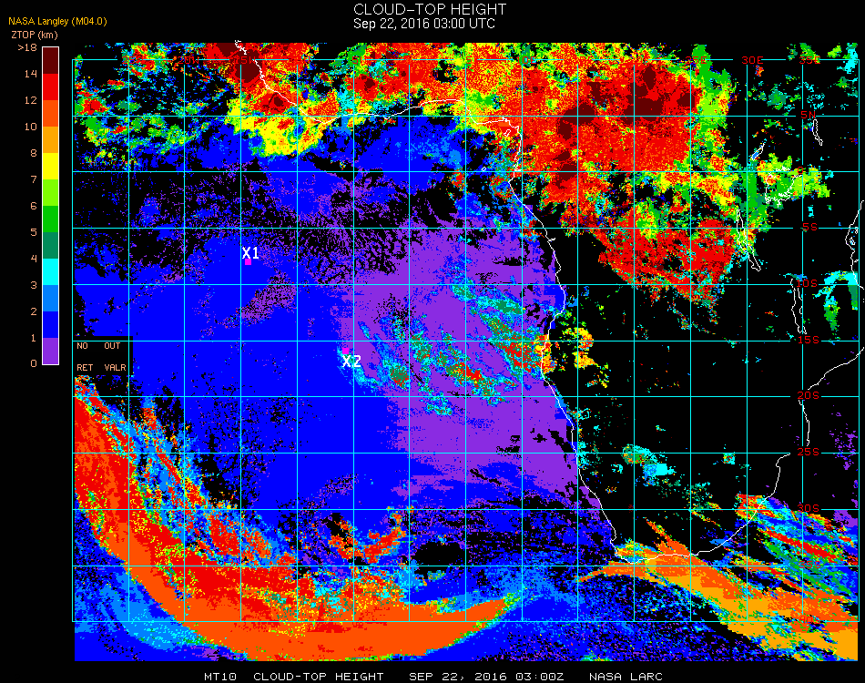
Over 9 km on the height of these clouds over Angola, and above 12 km out over the ocean???

Slide 5
Friday

Slide 6
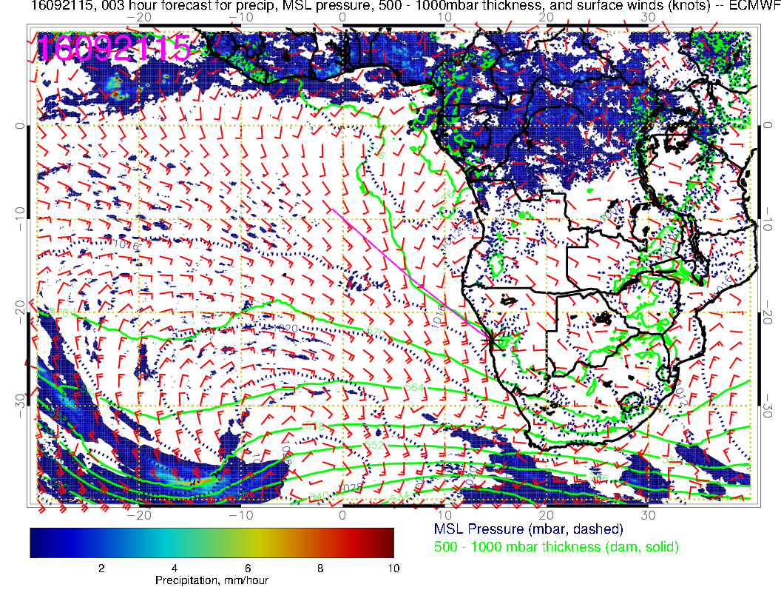
View development at
sfc since yesterday.

Slide 7
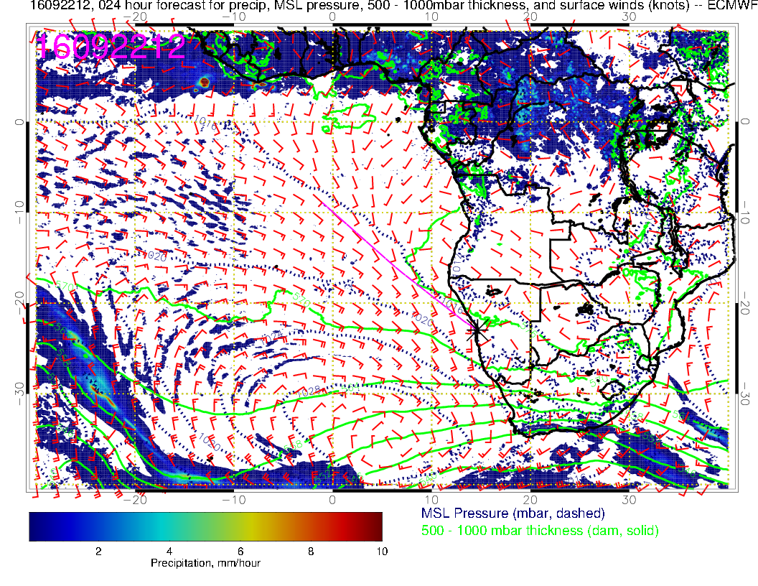
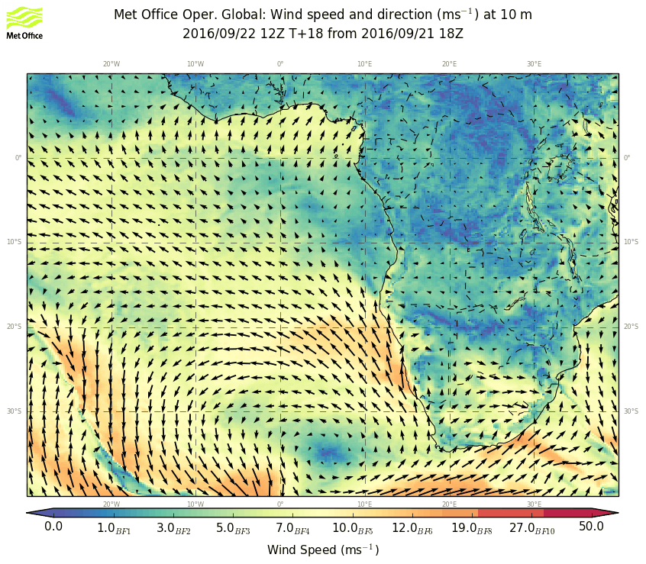
High strengthens and moves east for today. Winds strong near YWB.

Slide 8
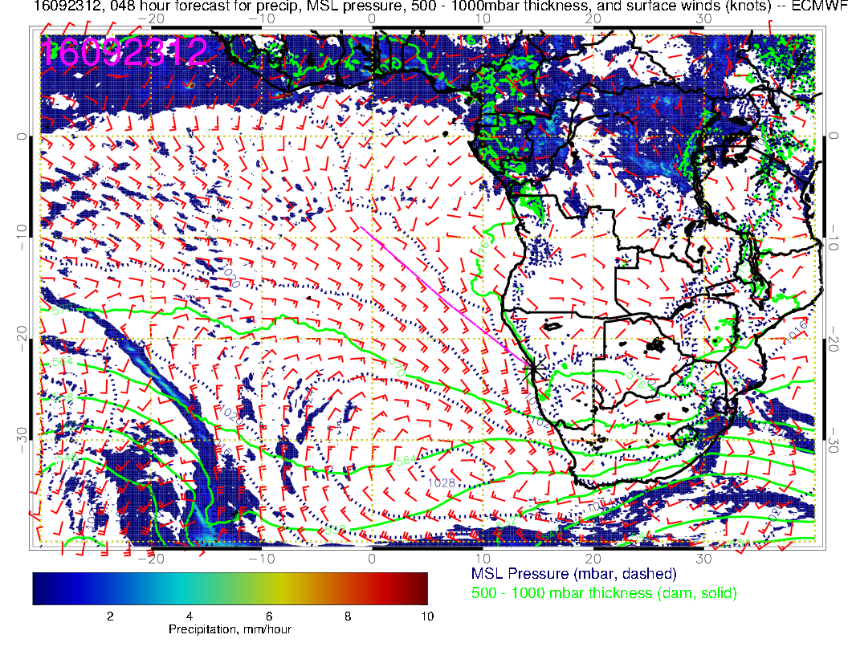
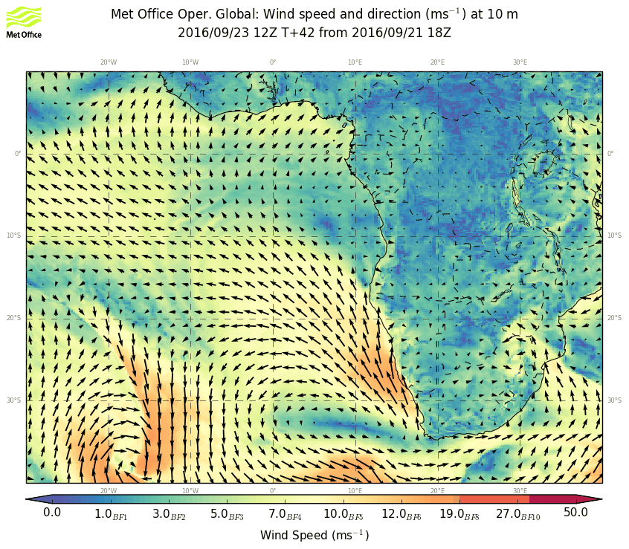
High moves further east and weakens and distends. Strong winds move south of YWB,
note spring storm developing near 20W.

Slide 9
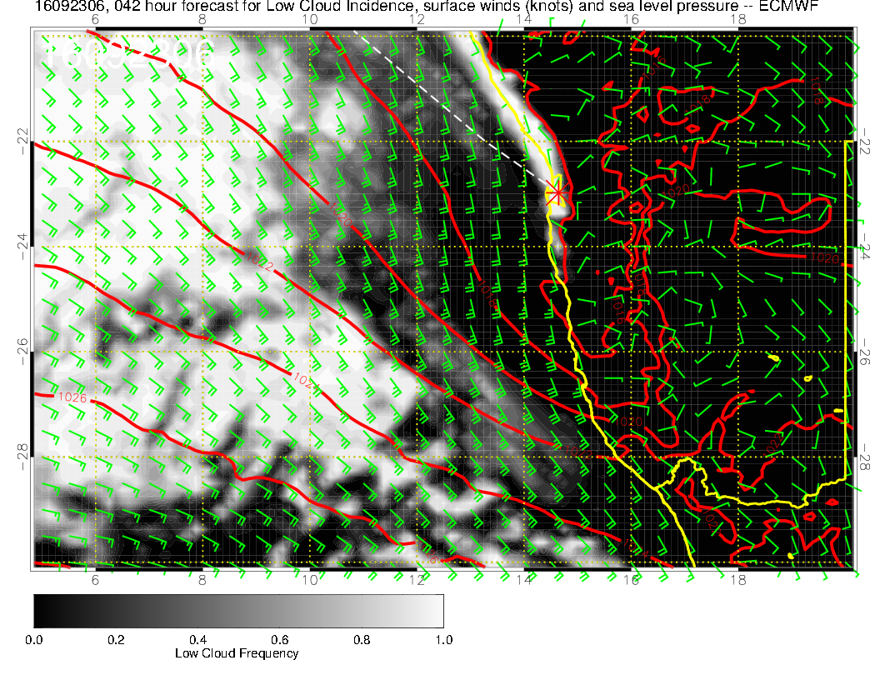
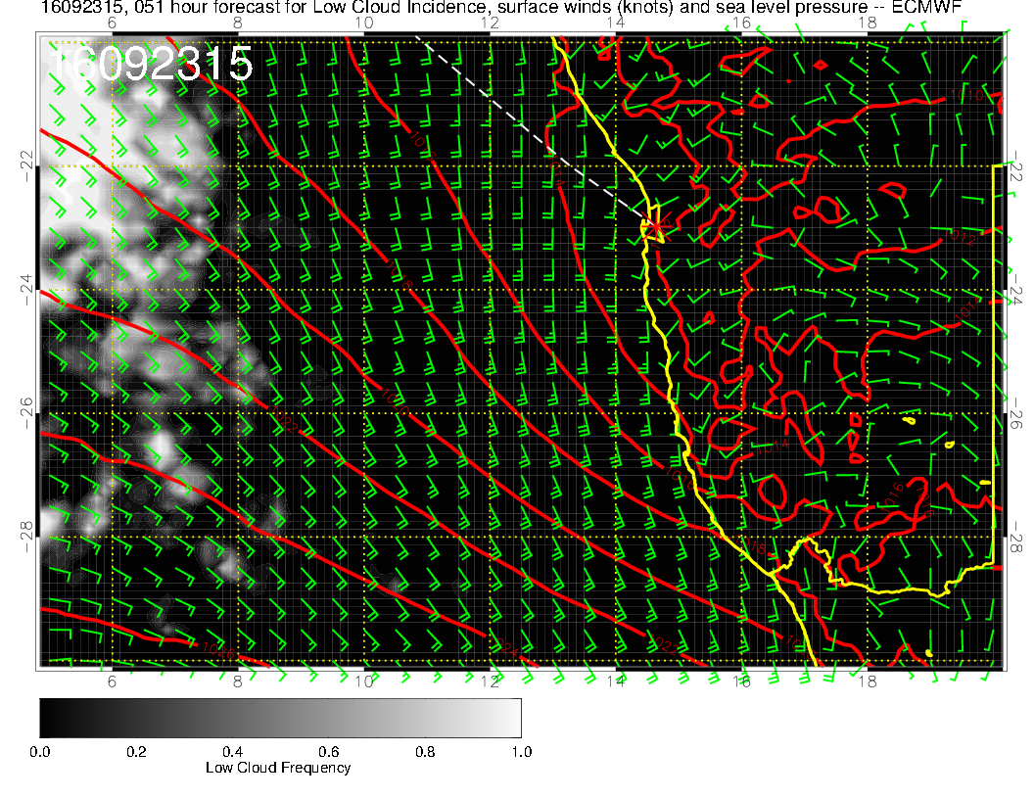
Expect lighter winds on landing, more cloud in the morning than today.

Slide 10
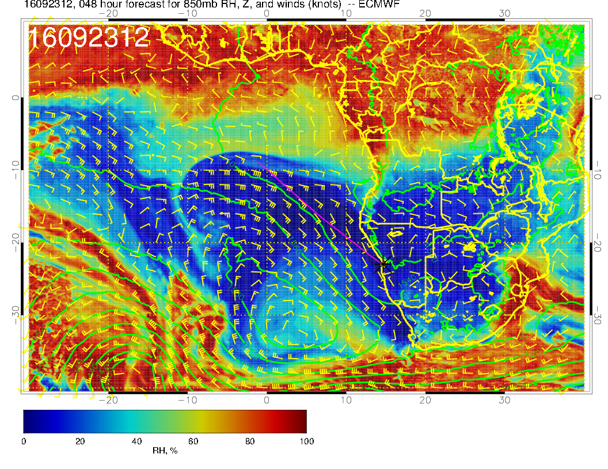
5kft – a lot like surface flow at this time – above cloud layer so very dry

Slide 11
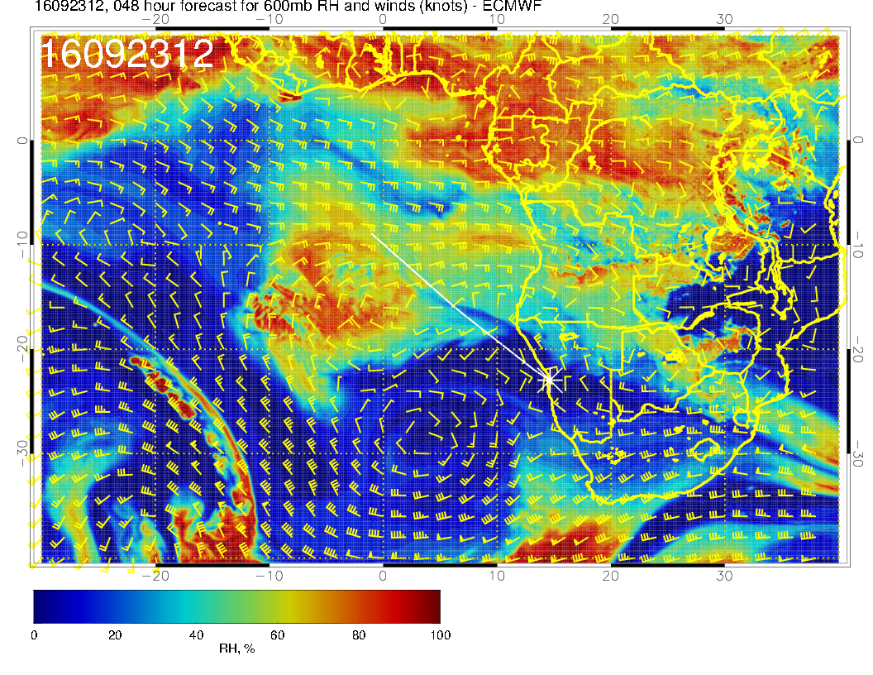
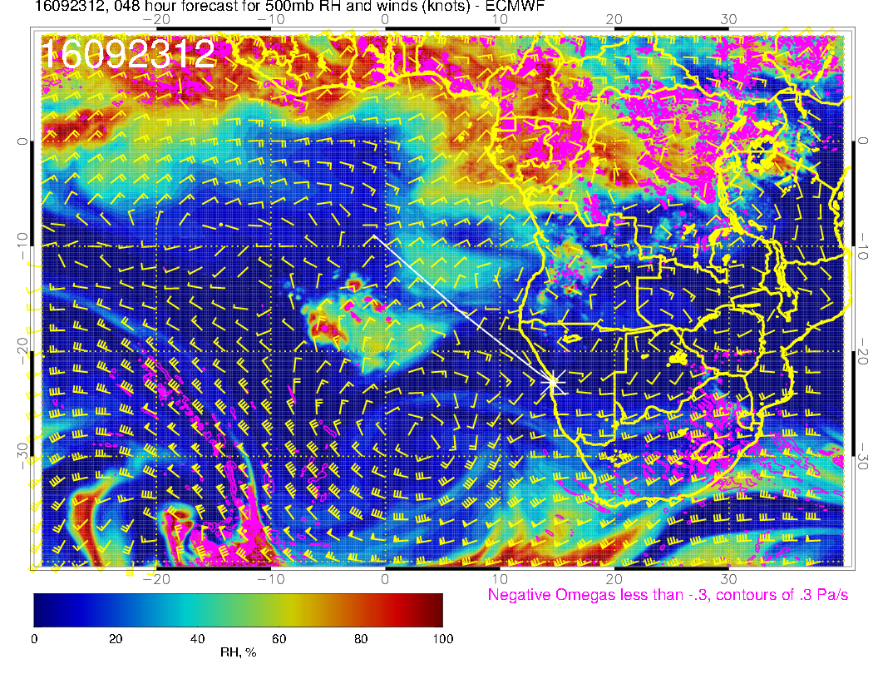
Similar to yesterday’s fcst. Active cloud system moved over St Helena, penetration to 500mb, following surges much weaker, trough pushing anticyclone eastward

Slide 12
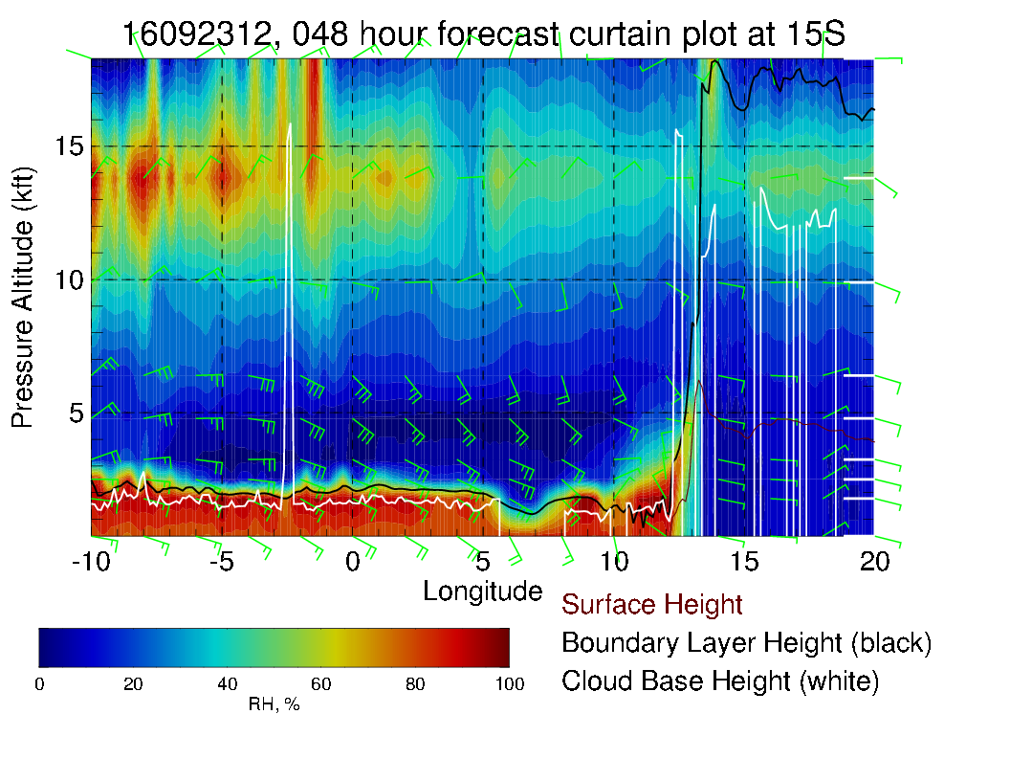
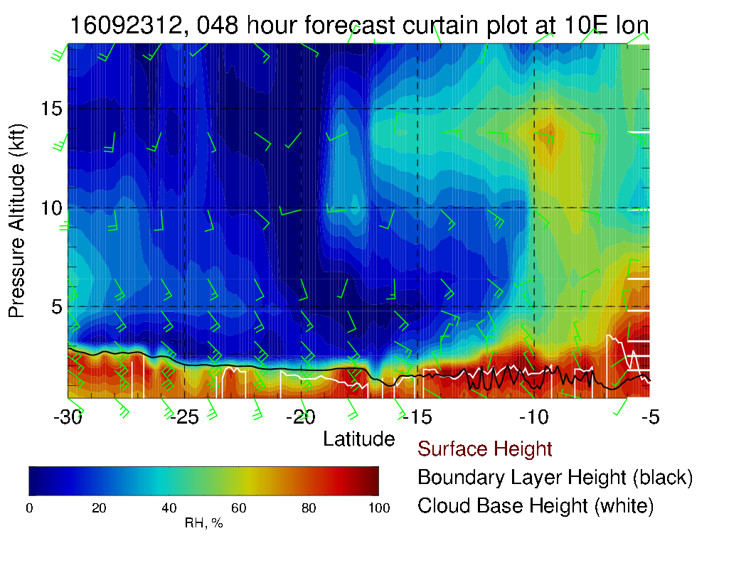
W-E XS at 15S (above) and S-N XS at 10E (right)

Slide 13
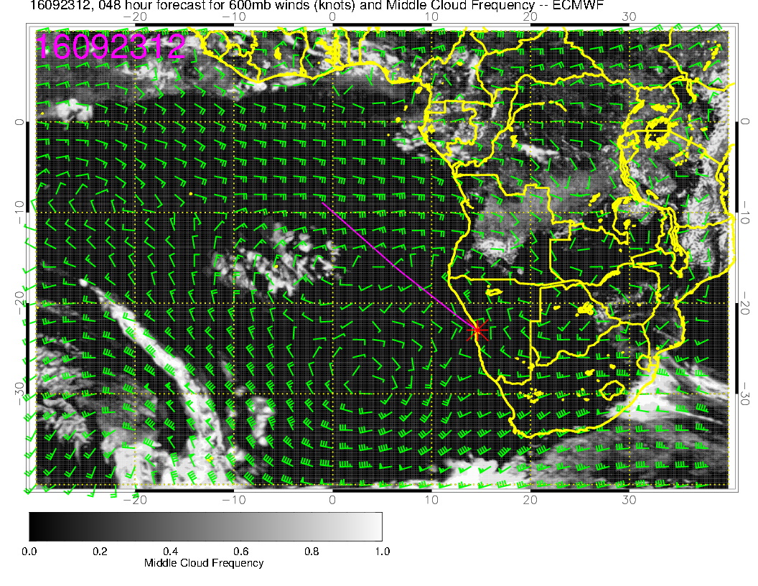
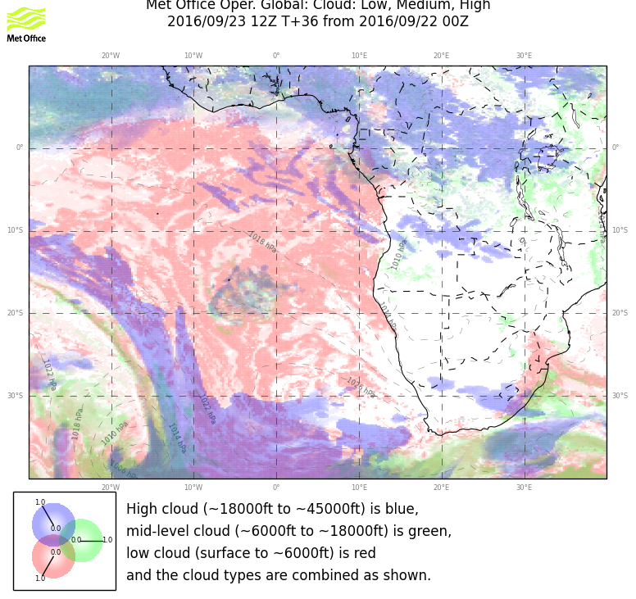
Reasonable agreement on middle cloud distributions – mostly out of our range.

Slide 14
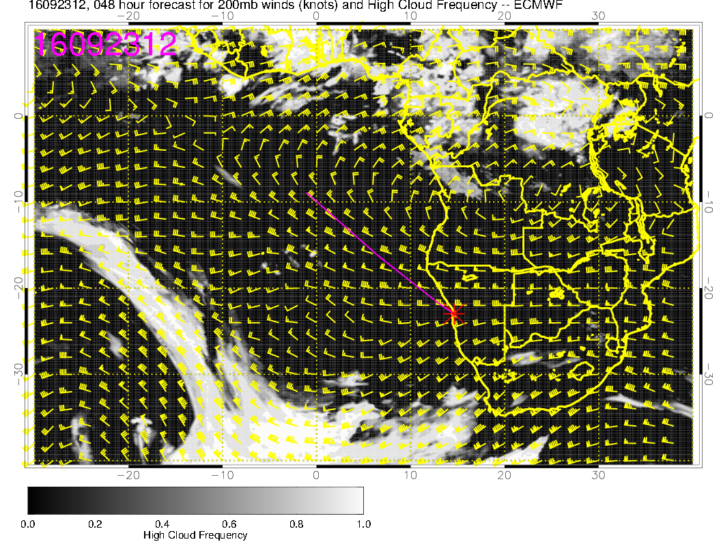
Absence of cirrus despite significant cross-equatorial flow.

Slide 15
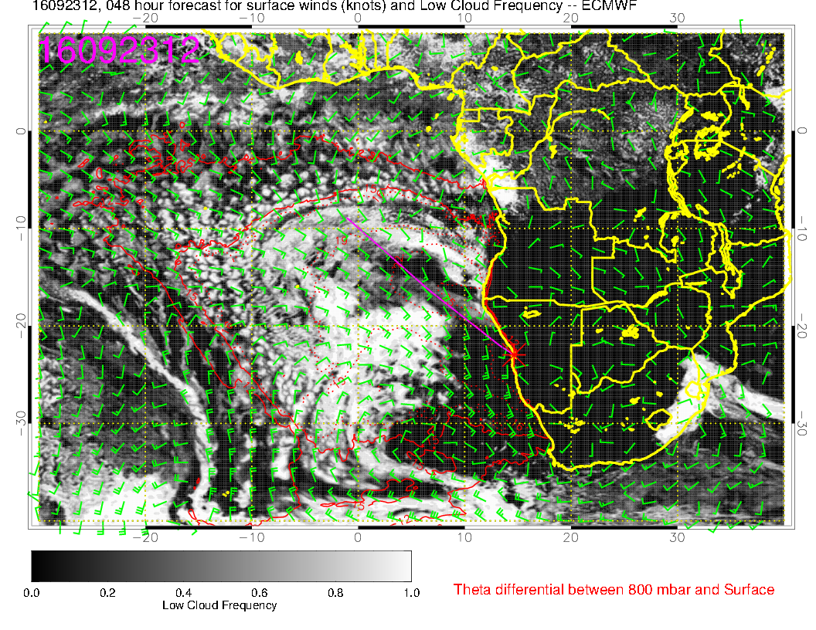
EC and UKMO forecasts maintain their difference in low cloud coverage
south of 20S

Slide 16
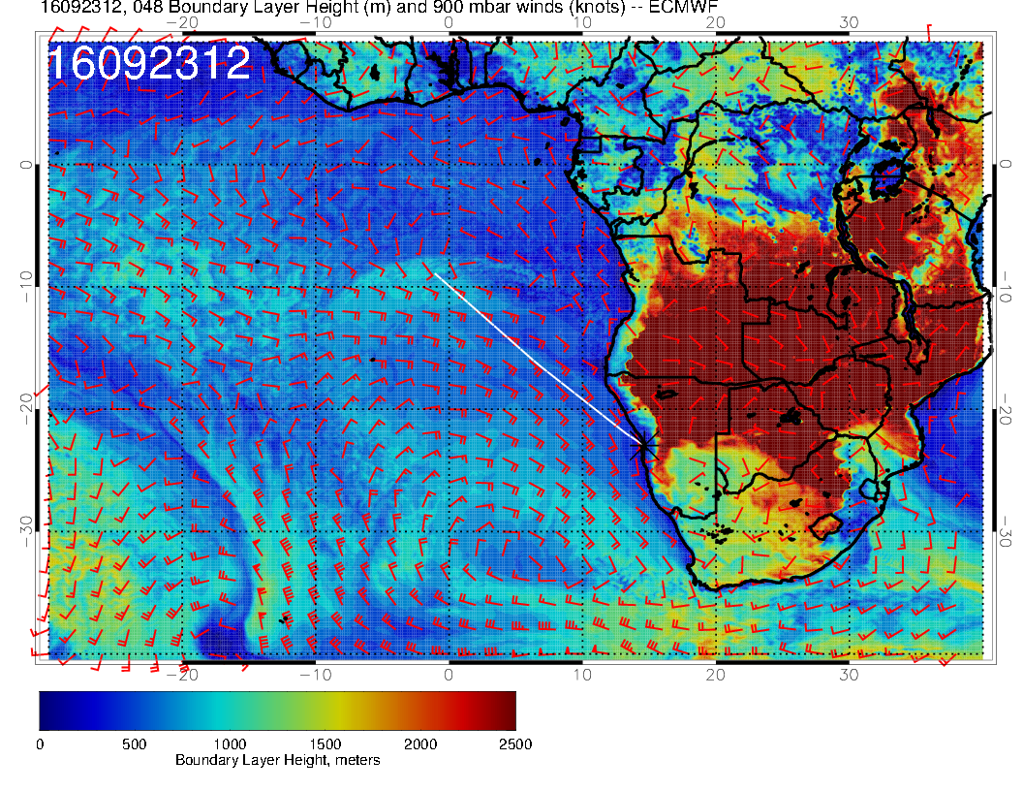
As before, significant cloud in EC goes with higher BL height and vv.

Slide 17
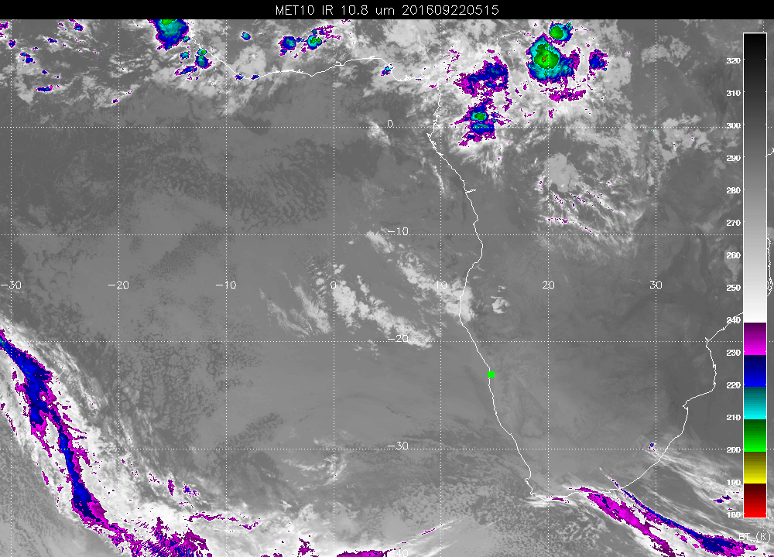
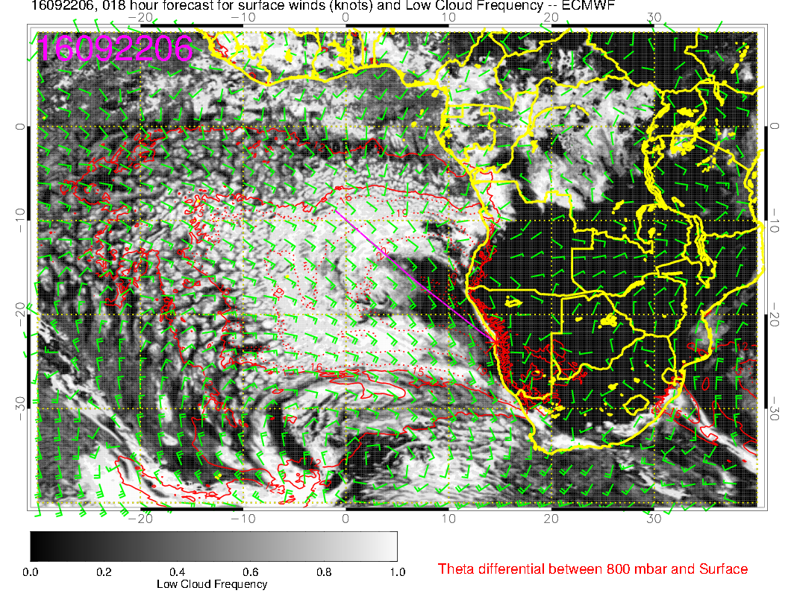

Slide 18
Saturday

Slide 19
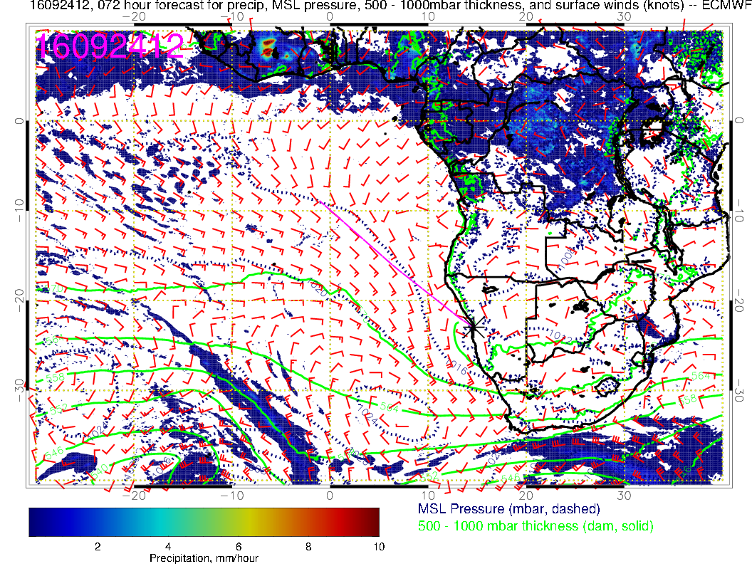
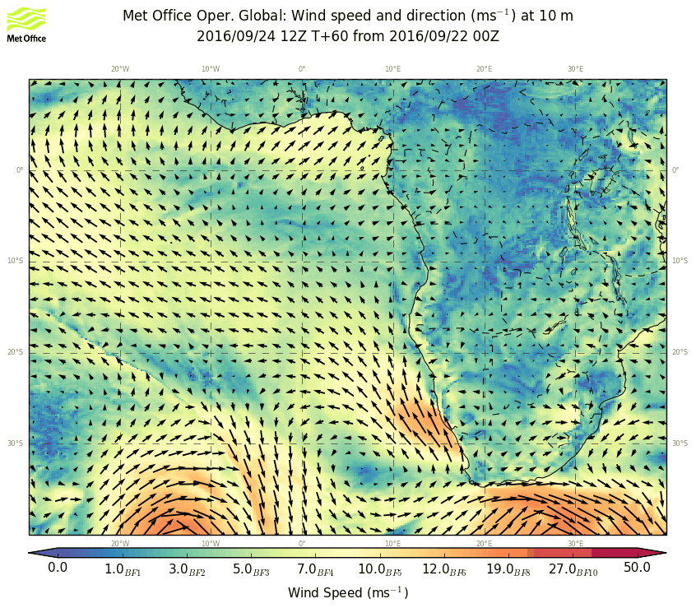
High weakens some more, maintains placement, eddy circulation develops near YWB

Slide 20
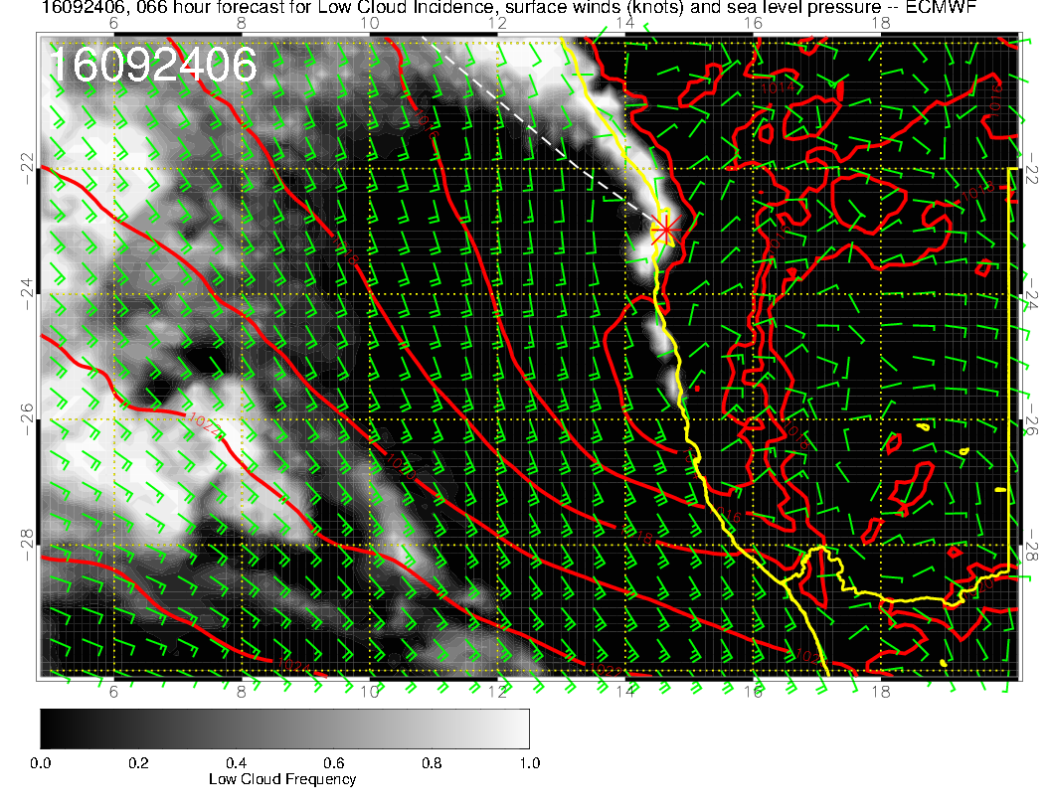
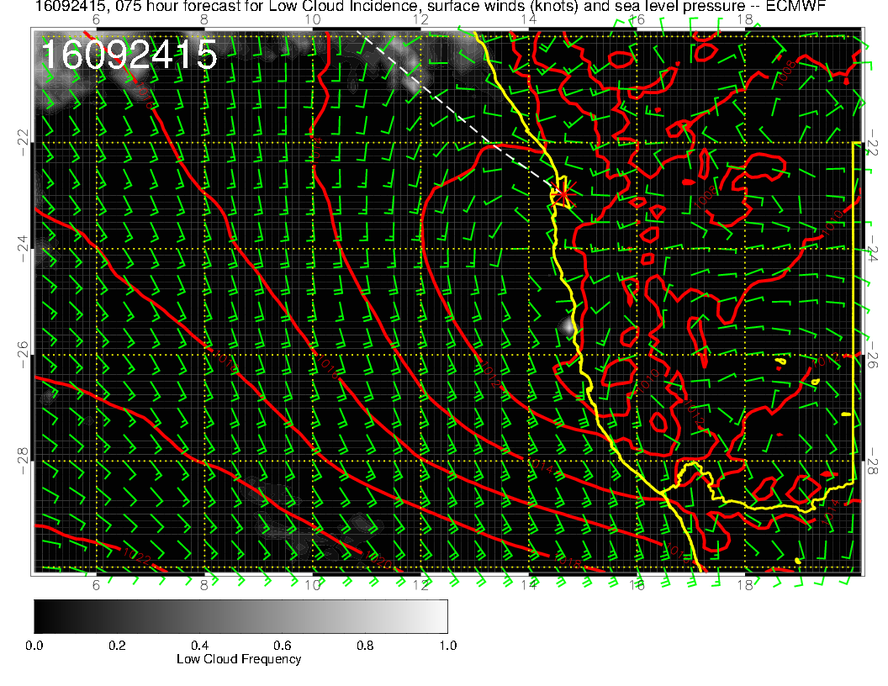
Eddy circulation exacerbates morning low clouds, mild winds in the evening

Slide 21
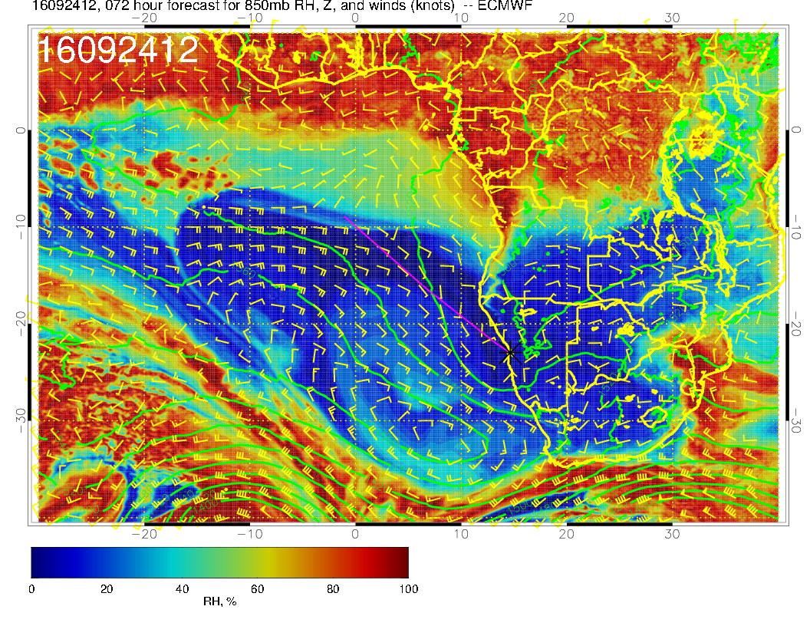
5kft – trough pushes high eastward – very similar to surface here.

Slide 22
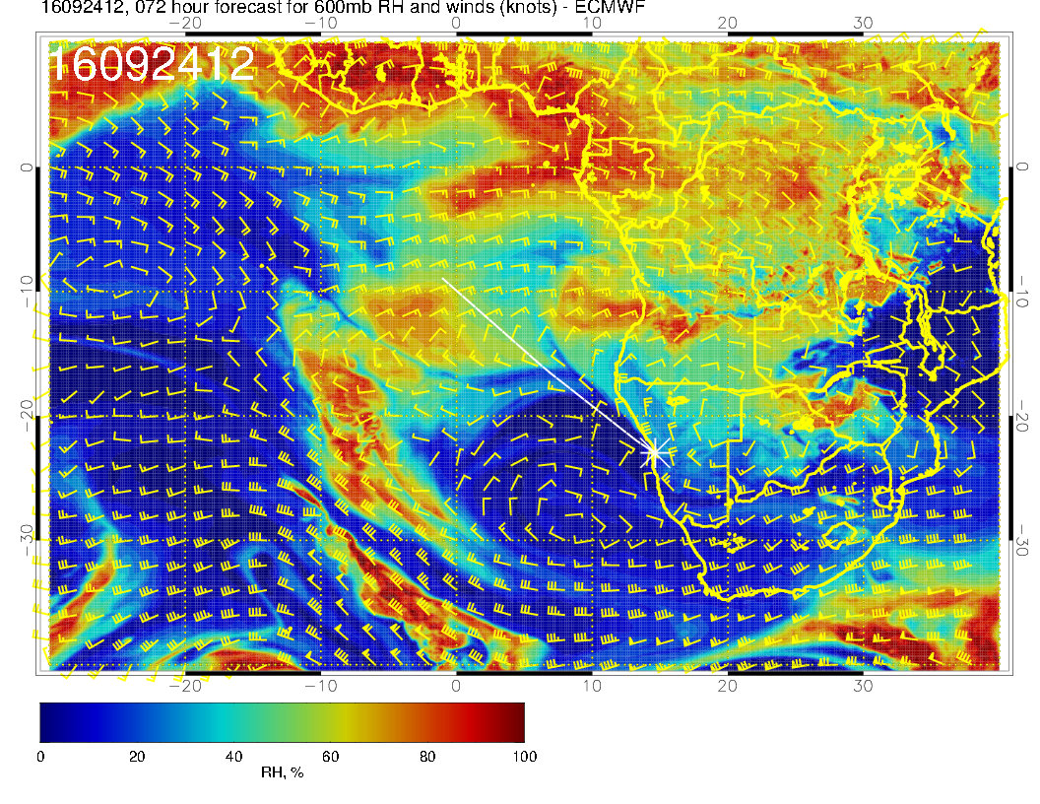
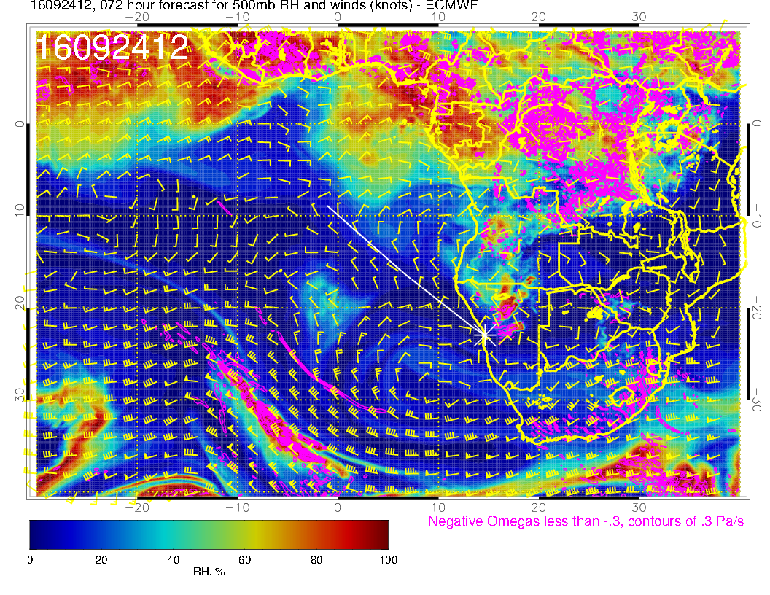
Finally forecasts are stable, very
similar to yesterday’s fcst. 600mb climo anticyclone starts to reappear? Midlatitude trough picks up moisture etc

Slide 23
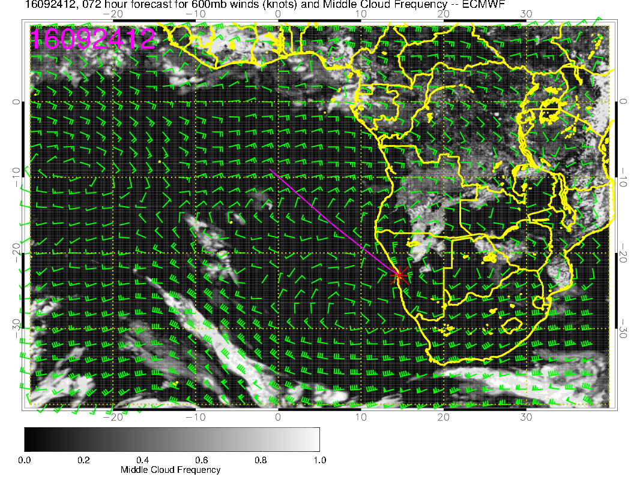
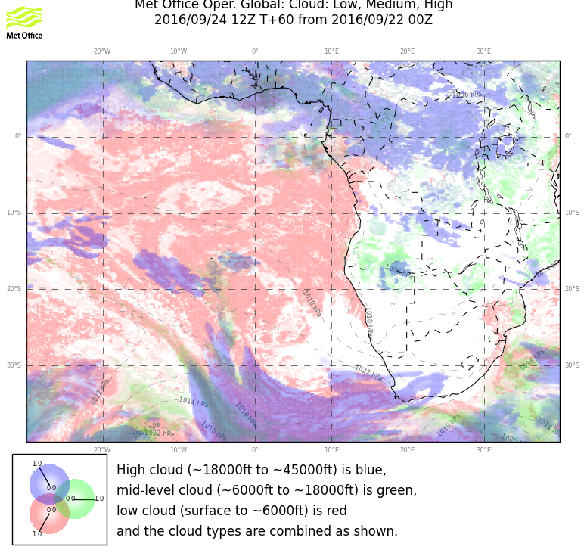
Be wary of assuming total clarity. Message is we will have much less middle cloud,
but patches in the morning that will probably mostly dissipate will still give me fits

Slide 24
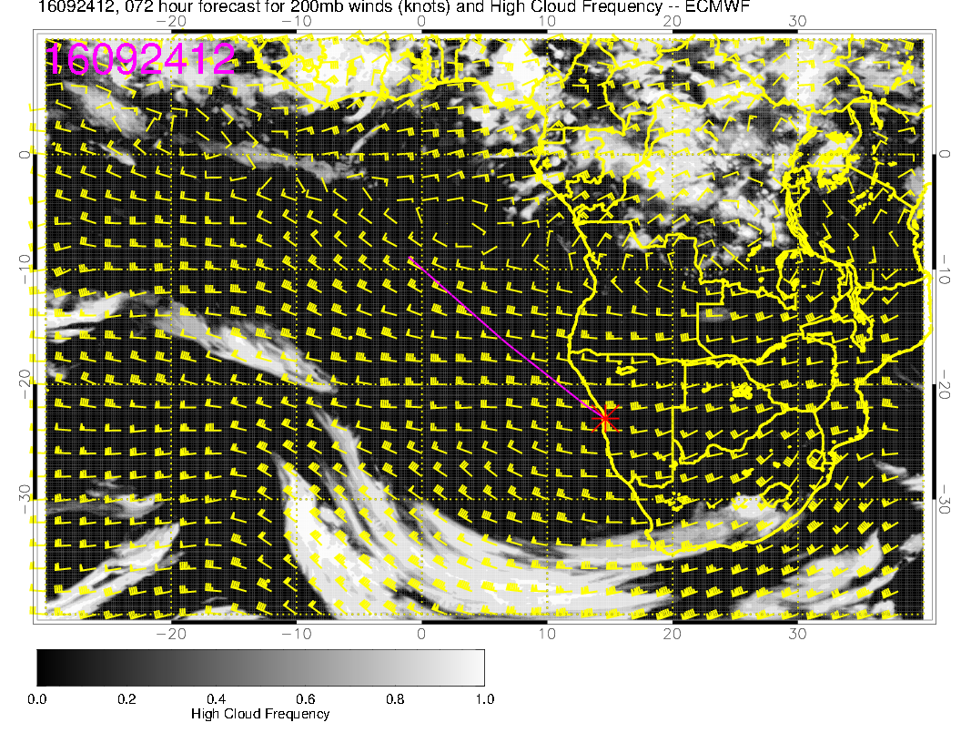
Be wary of assuming total clarity. Message is we will have much less middle cloud,
but patches in the morning that will probably mostly dissipate will still give me fits

Slide 25
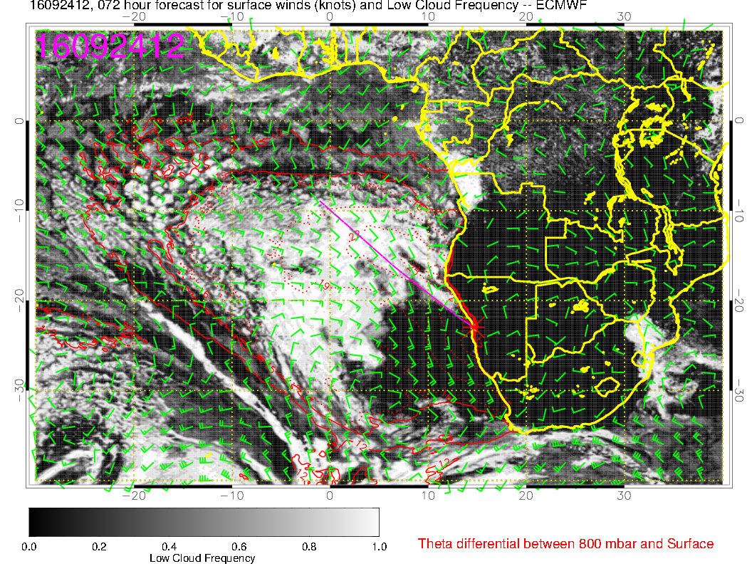
I
As in yesterday’s fcst, surprising agreement on clearing.

Slide 26
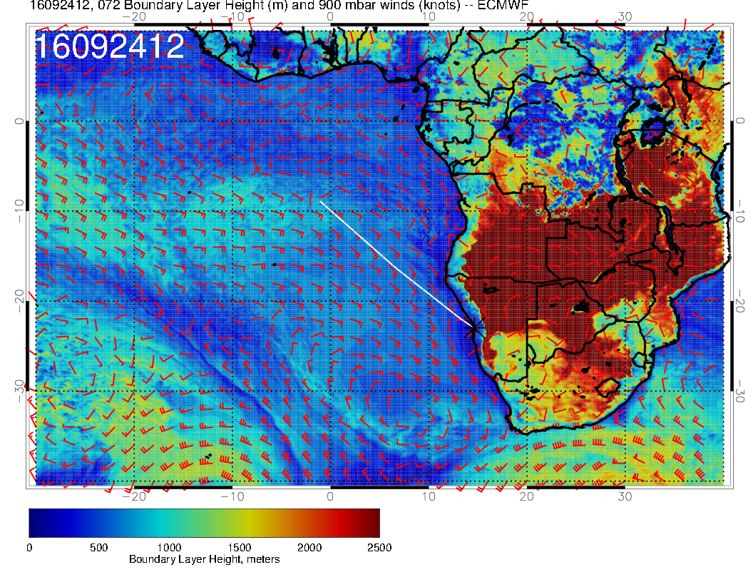
Low BL height is probably responsible. I think both models are overdoing it, we will have some low cloud in there.
I

Slide 27
Sunday

Slide 28
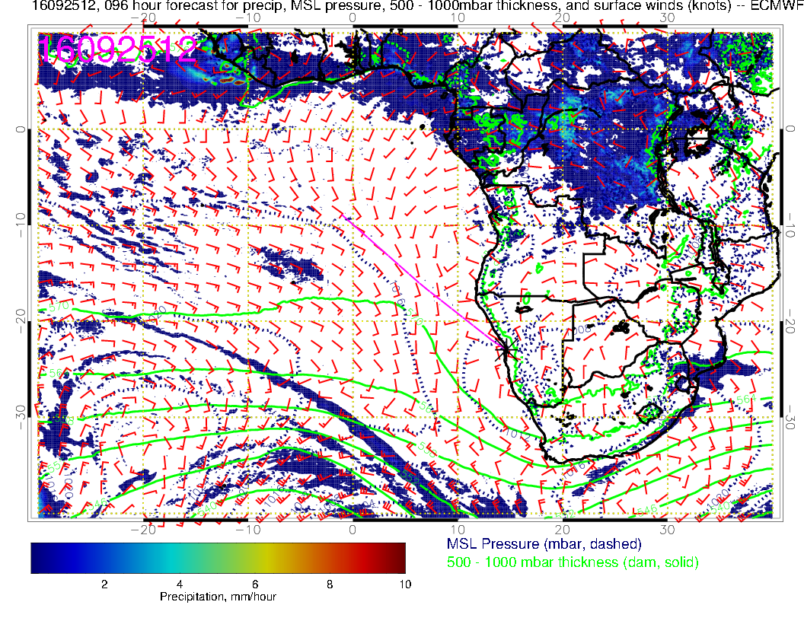
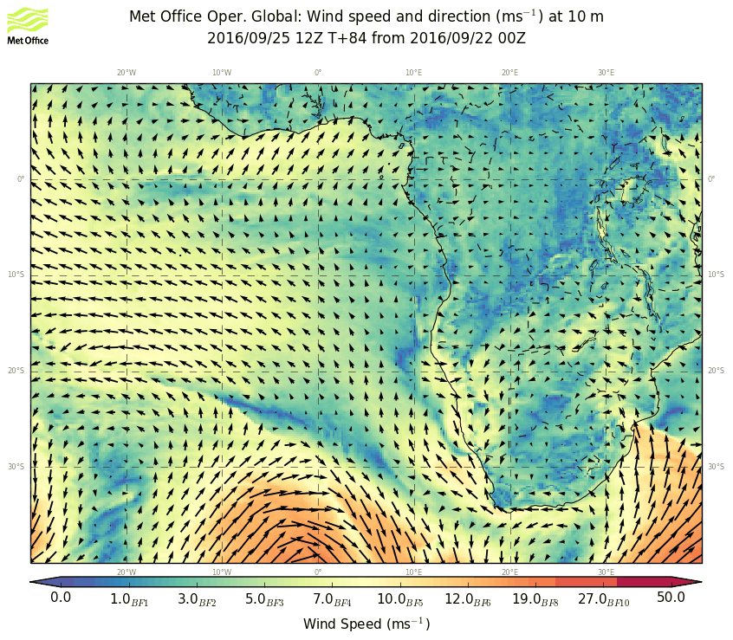
Trough moving in and breaking up the high, winds weak, even stronger eddy circulation at YWB

Slide 29
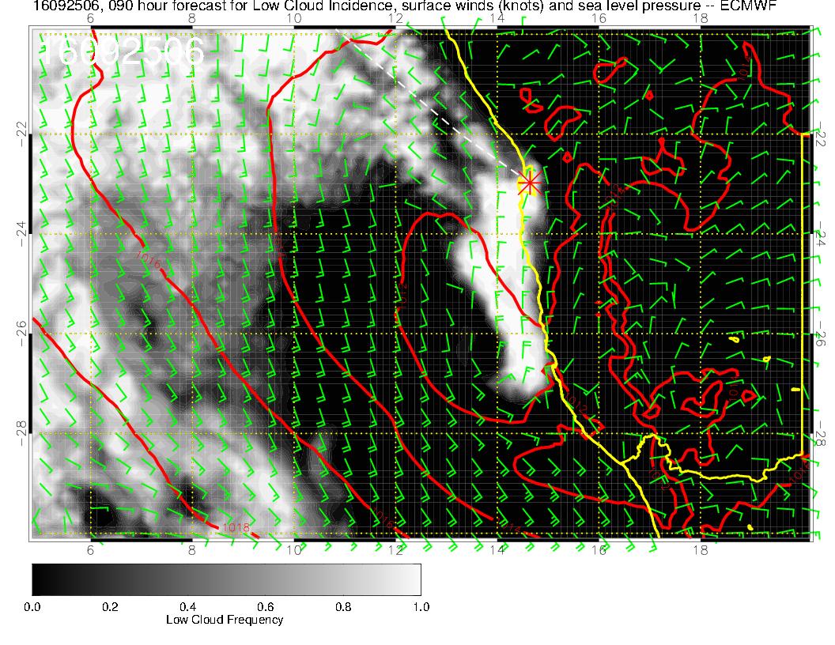
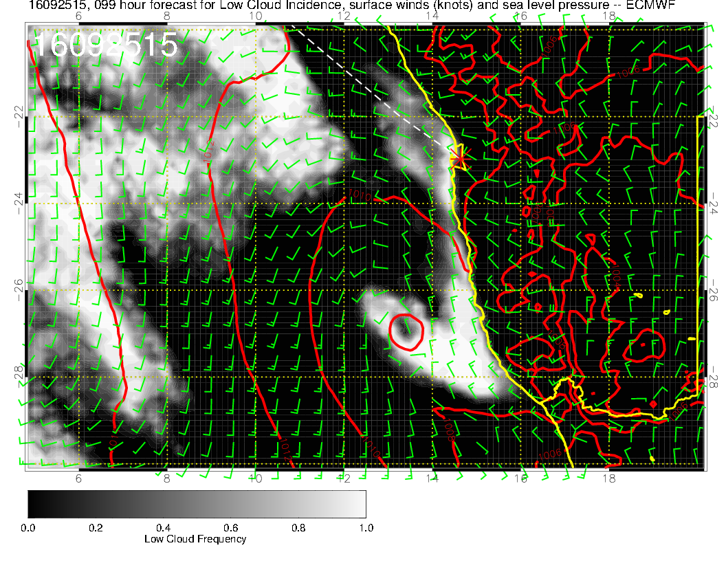
I don’t think this is as bad as that first Sunday, but need to be mindful of a possible sock in landing situation

Slide 30
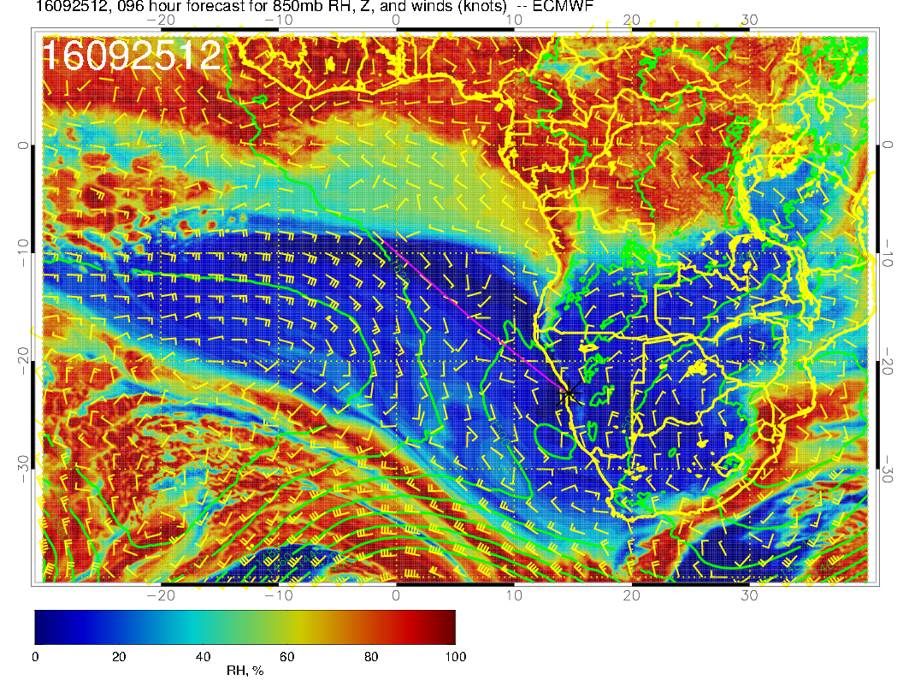
850 mb circulation follows surface.

Slide 31
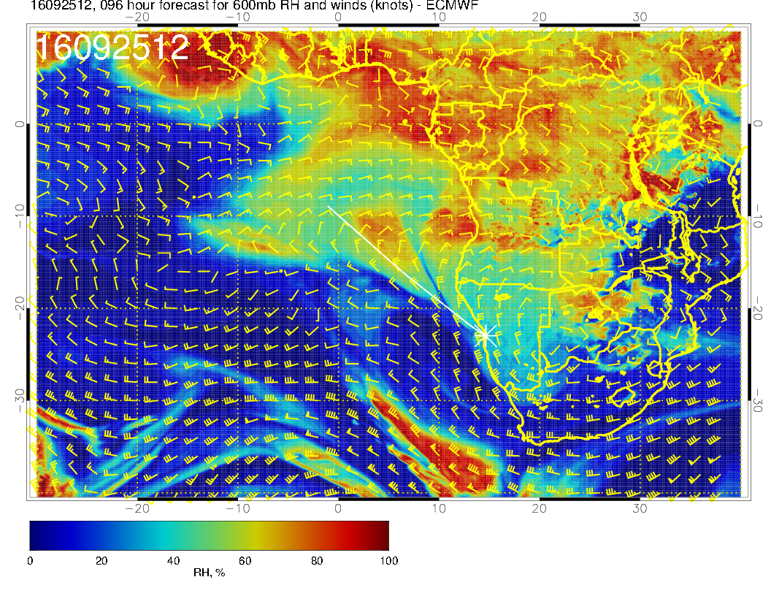
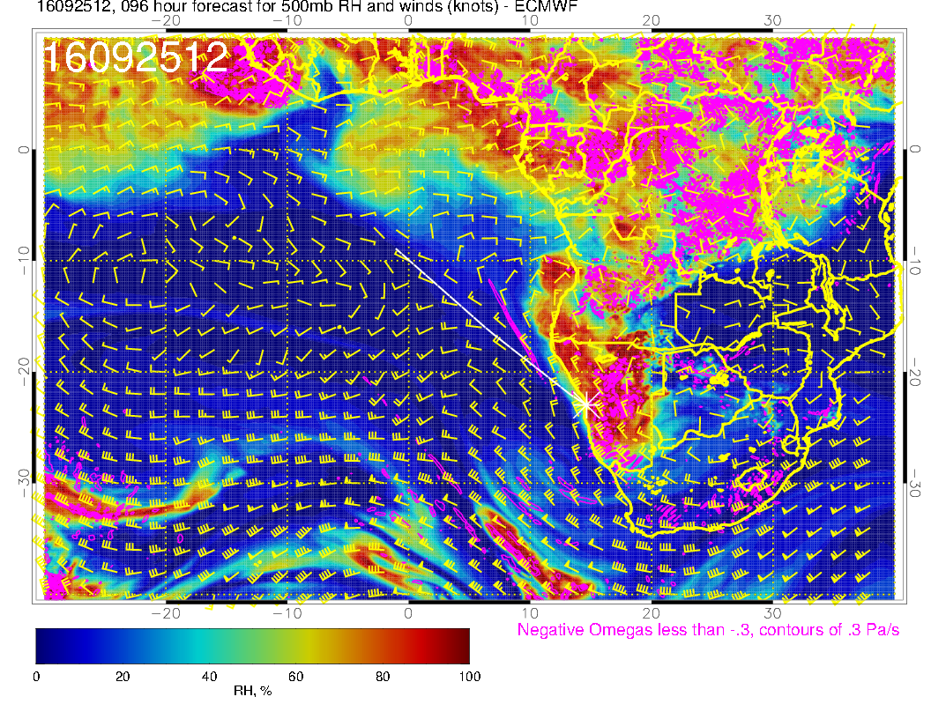
Midlat trough has progressed (obviously). Have hints of climo 600mb anticyclone over central southern Africa, but straight jet continues between 0 and 10S. Stable forecast. Clouds over Namibia.

Slide 32
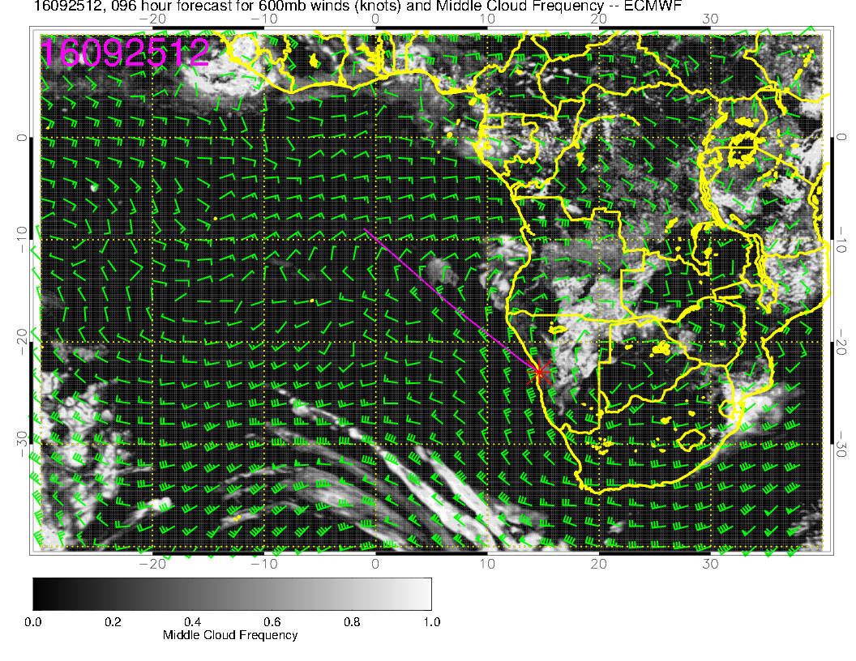
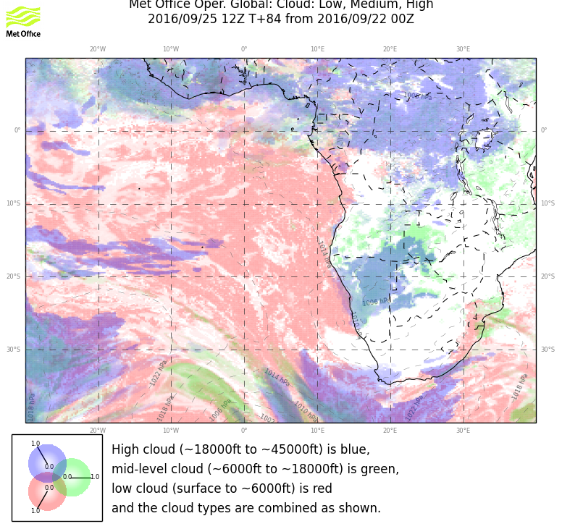
Disagreement as in yesterday’s fcst. Less cloud in EC than in yesterday’s fcst.

Slide 33
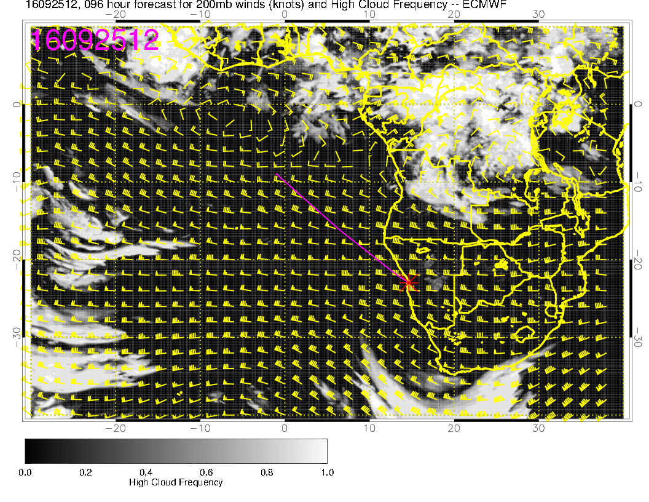
Absence of cirrus except near Angola. I think Angola bay is a likely place for cirrus
based on RH, but 96 hour fcst.

Slide 34
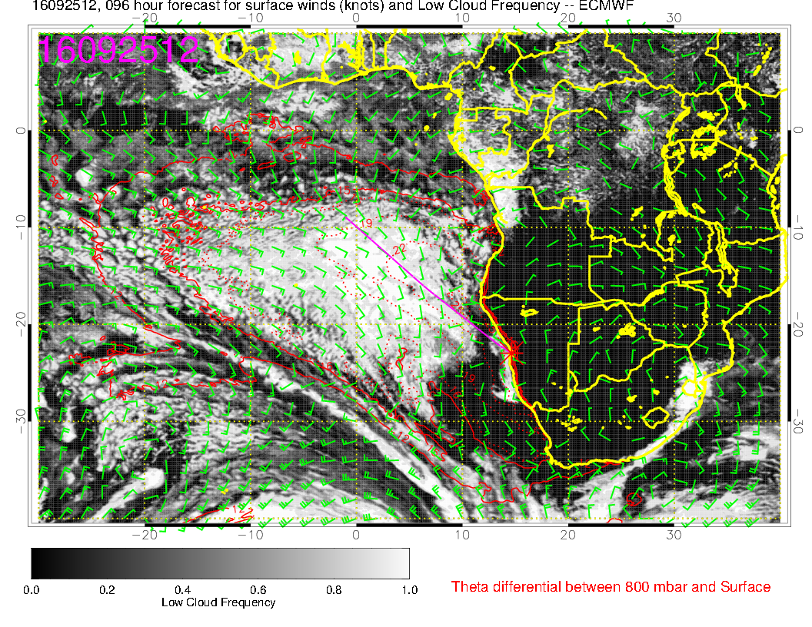
Pretty decent agreement. Absence of cloud where BL heights are low.

Slide 35
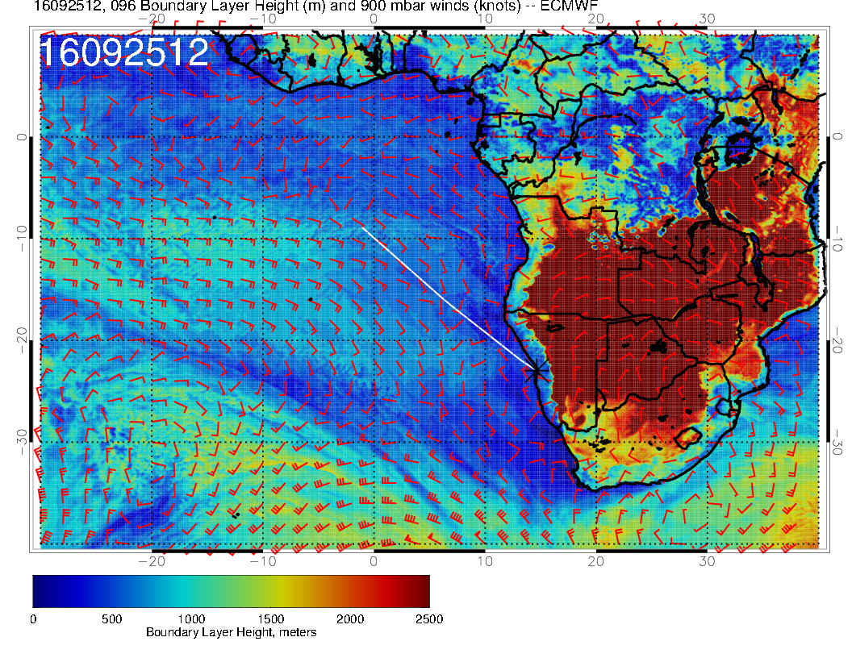

Slide 36
Monday

Slide 37
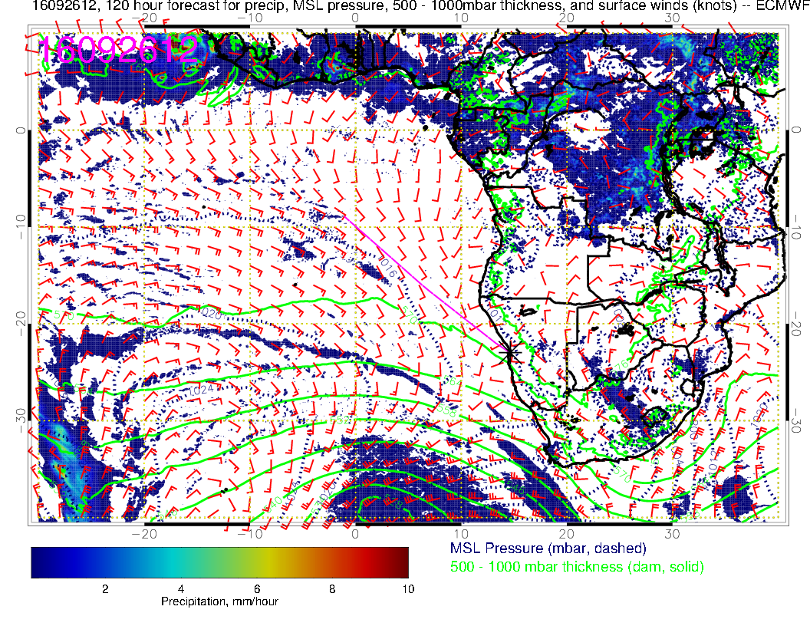
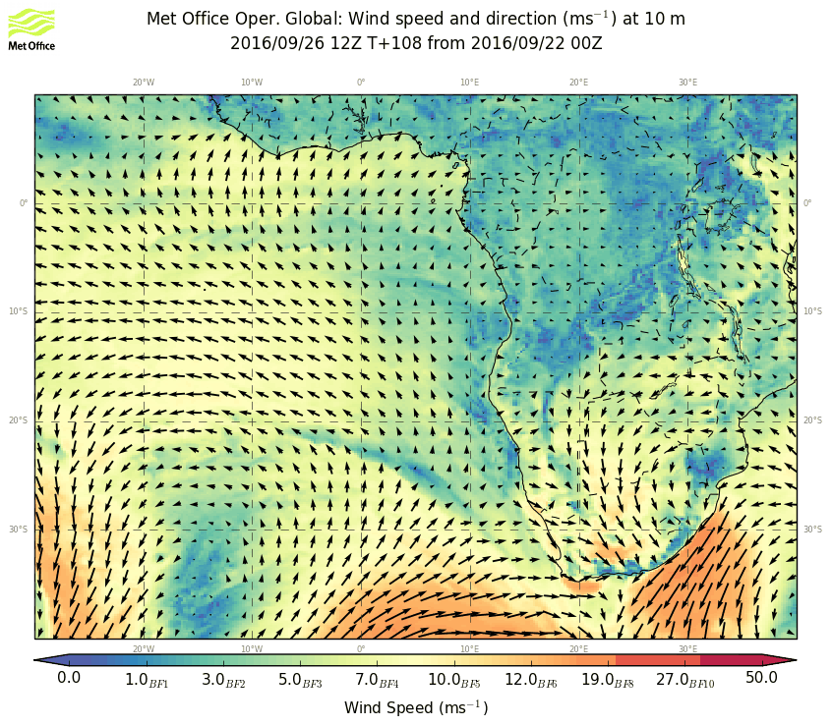
Good model agreement on front positioning. Strong spring storm (but not like
the last one). Weak winds in operating region.

Slide 38
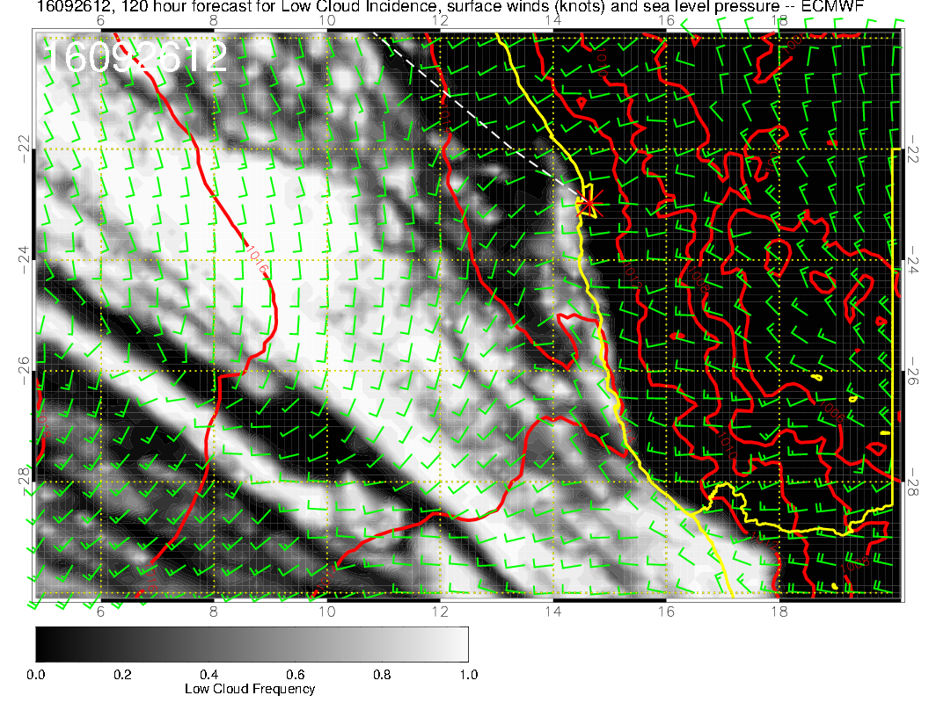
Conditions generally more favorable
than Sunday.

Slide 39
Again, overall circulation similar to surface.
Dry ahead of the front (subsiding air above inversion), getting
moister behind the front.

Slide 40
With deep trough moving in, 600mb is substantially dried out except near Angolan coast. Looks like a pretty active
moist region.

Slide 41
Basic model concurrence on middle cloud development in Angola Bay

Slide 42
Zonal flow “protects” us from tropical cirrus. For midlat storms, we are mostly
in a cirrus “gap.” North of 10S might expect more cirrus than model indicates.

Slide 43
Lots of low cloud in Sc region

