Slide 1
ORACLES forecasting briefing Meteorology for 22-09-2016
22-09-2016
Lenny Pfister

Slide 2
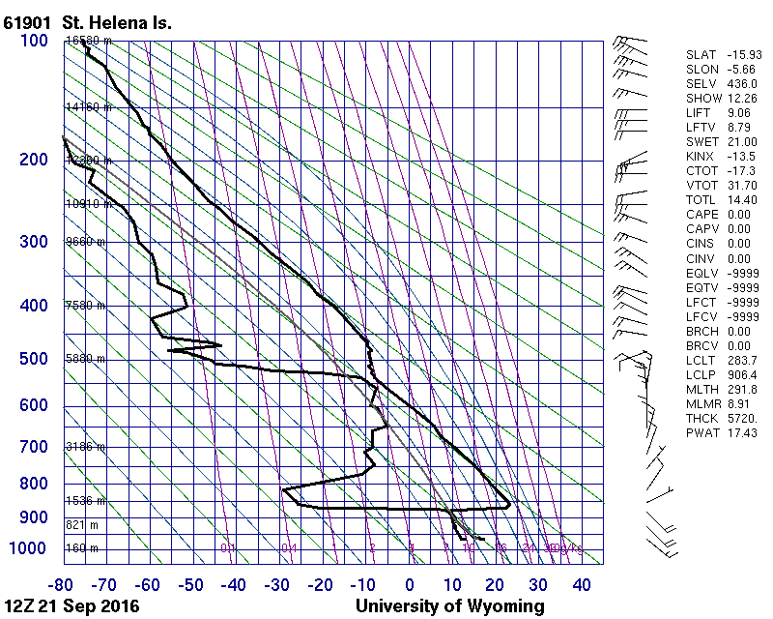
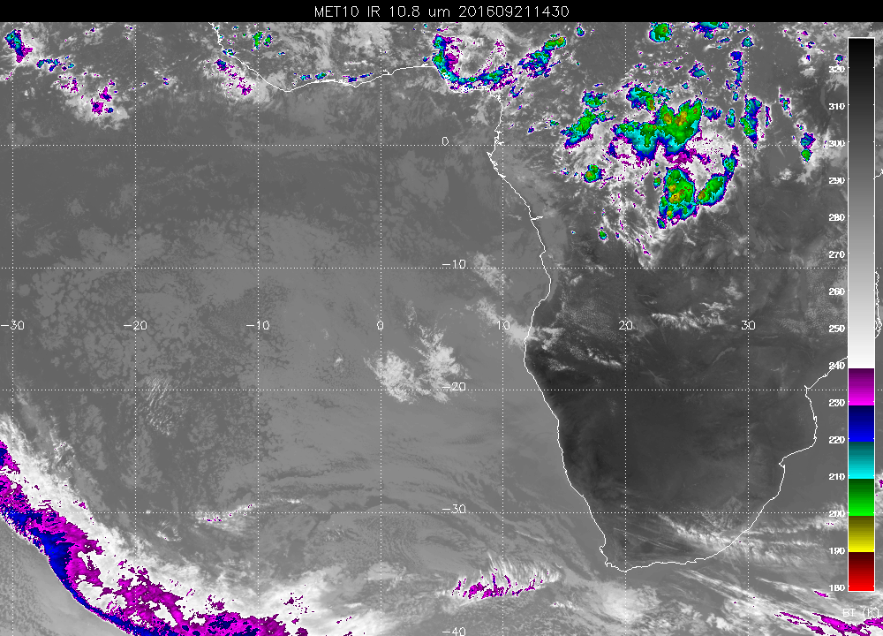
Yesterday’s sounding and sat pic
No YWB sounding available

Slide 3
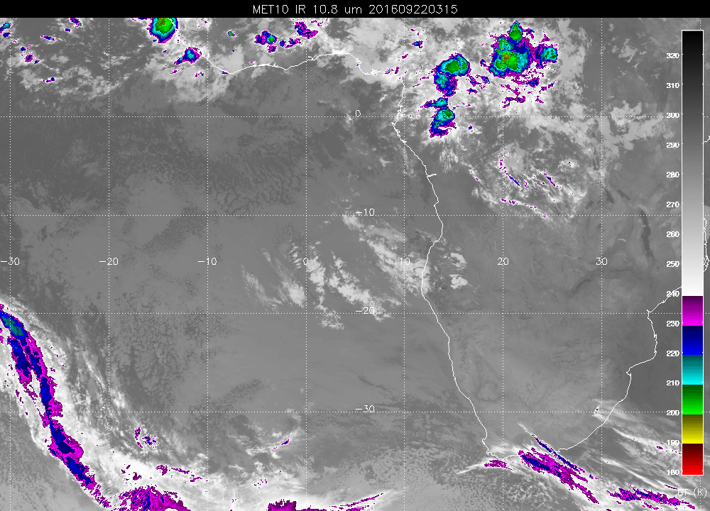
5 AM at the airport have 94% RH, winds WNW@2.
No observer yet, but ceilings must be low attm.
Note low cloud throughout operating region, including clear spots.
As much mid cloud as we have seen

Slide 4
Airport fcst for today
Had max winds of 14 knots down the runway yesterday. 11 AM ceiling was 300 feet.
Clearing sometime between 8AM and 11AM, sooner than yesterday.
Winds at 15Z (max) will be higher than yesterday, expect 17 knots at 215 (10-11 knots cross). Yesterday’s TAF (6 PM issue) is more favorable.
Winds will decrease after 15Z.

Slide 5
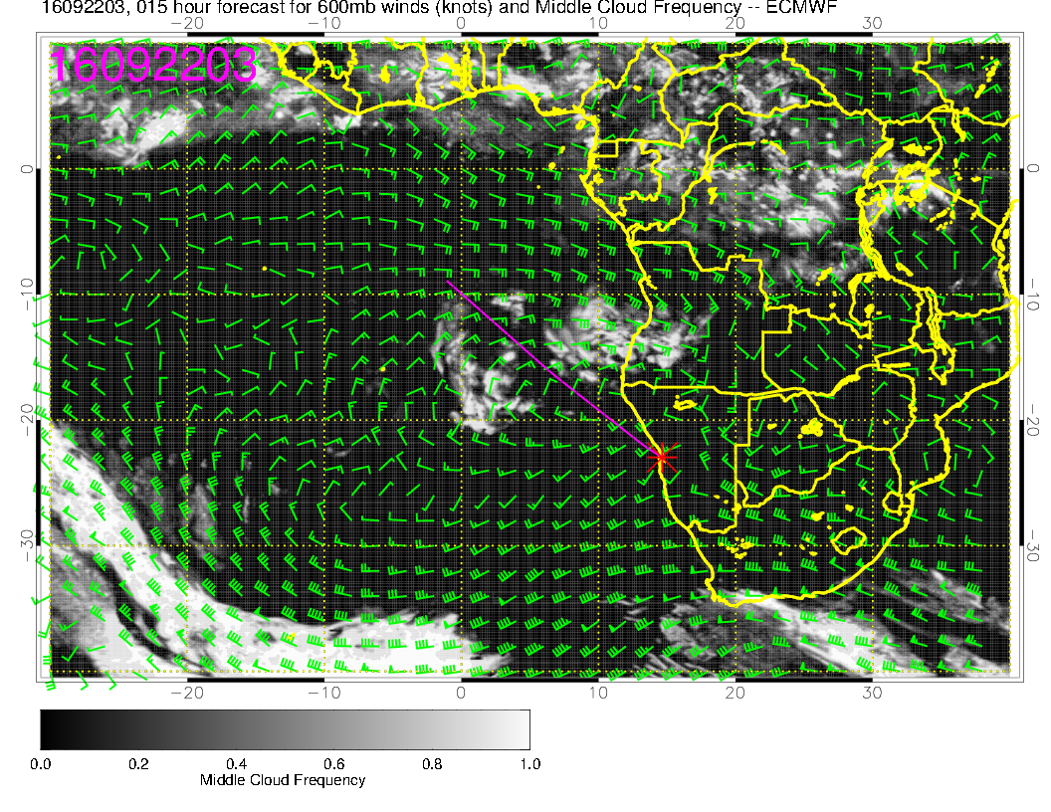
Cloud and prog now.

Slide 6
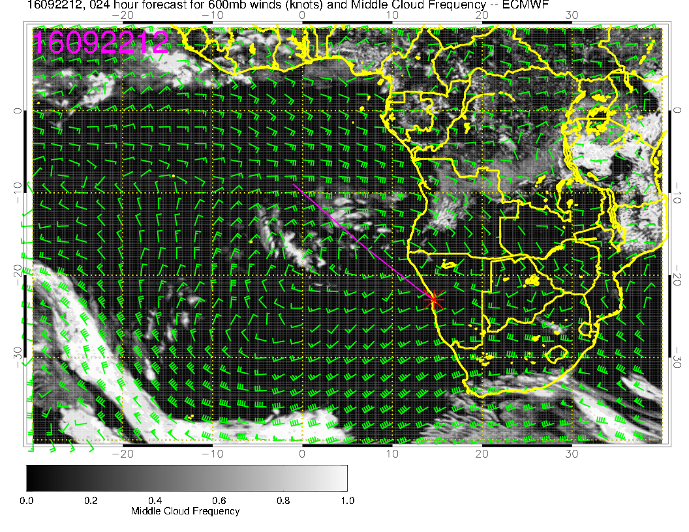
Prog at 2 PM today
Probably more dissipation than the model suggests, but we see fcsts are advancing these clouds more rapidly with shorter forecast hour.

Slide 7
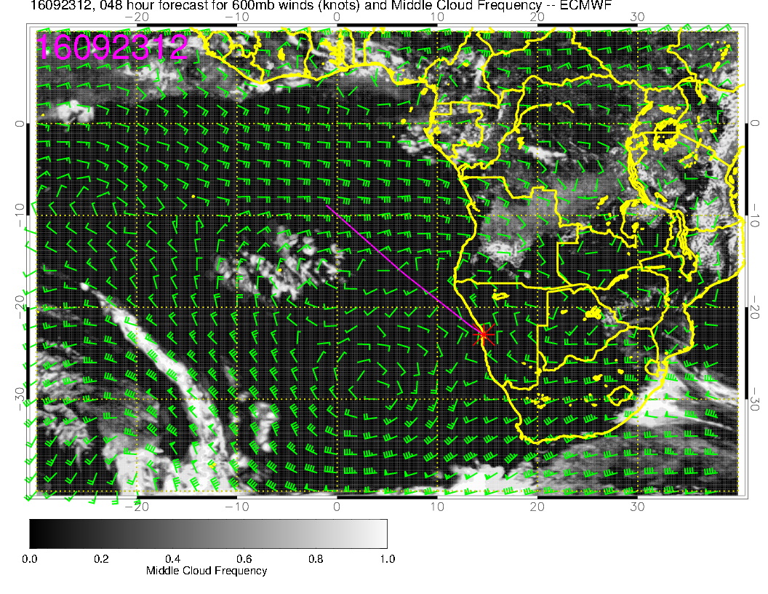
Friday – out of reach??

Slide 8
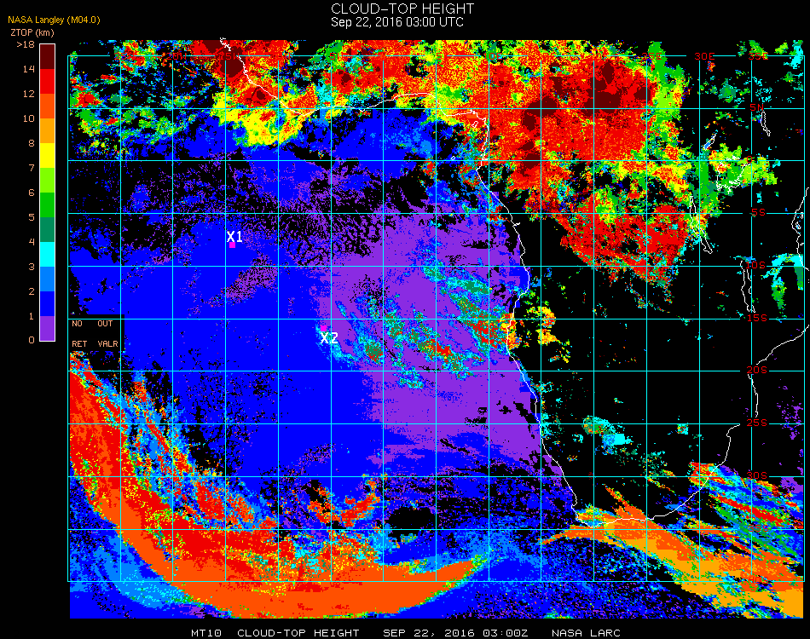
Over 9 km on the height of these clouds over Angola, and above 12 km out over the ocean???

