Slide 1
ORACLES Forecast Briefing (Aerosols)
22 September 2016

Slide 2
The Aerosol Week

Slide 3
Walvis Bay
Dust
OC+BC+SO4

Slide 4
Saint Helena: GEOS-5 OC+BC+SO4

Slide 5
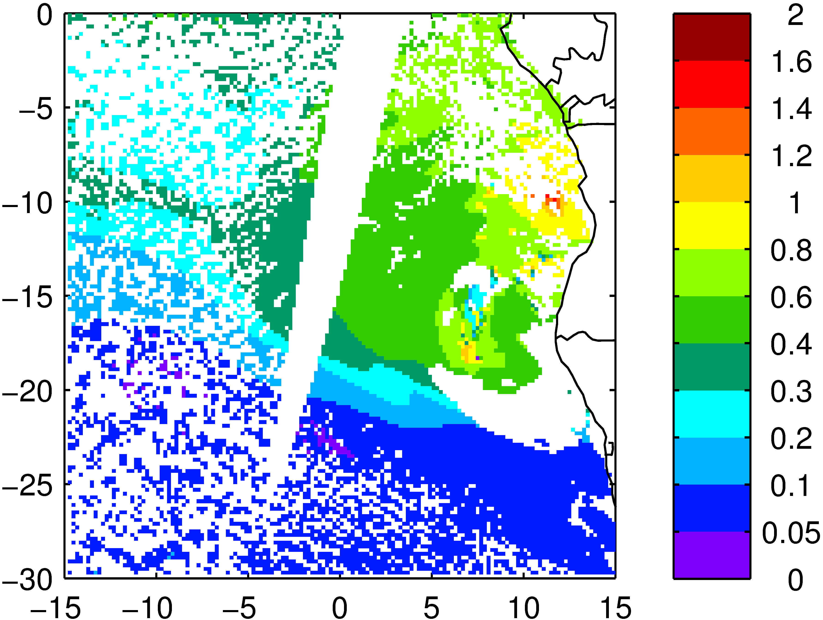
Sept. 21, 2016

Slide 6
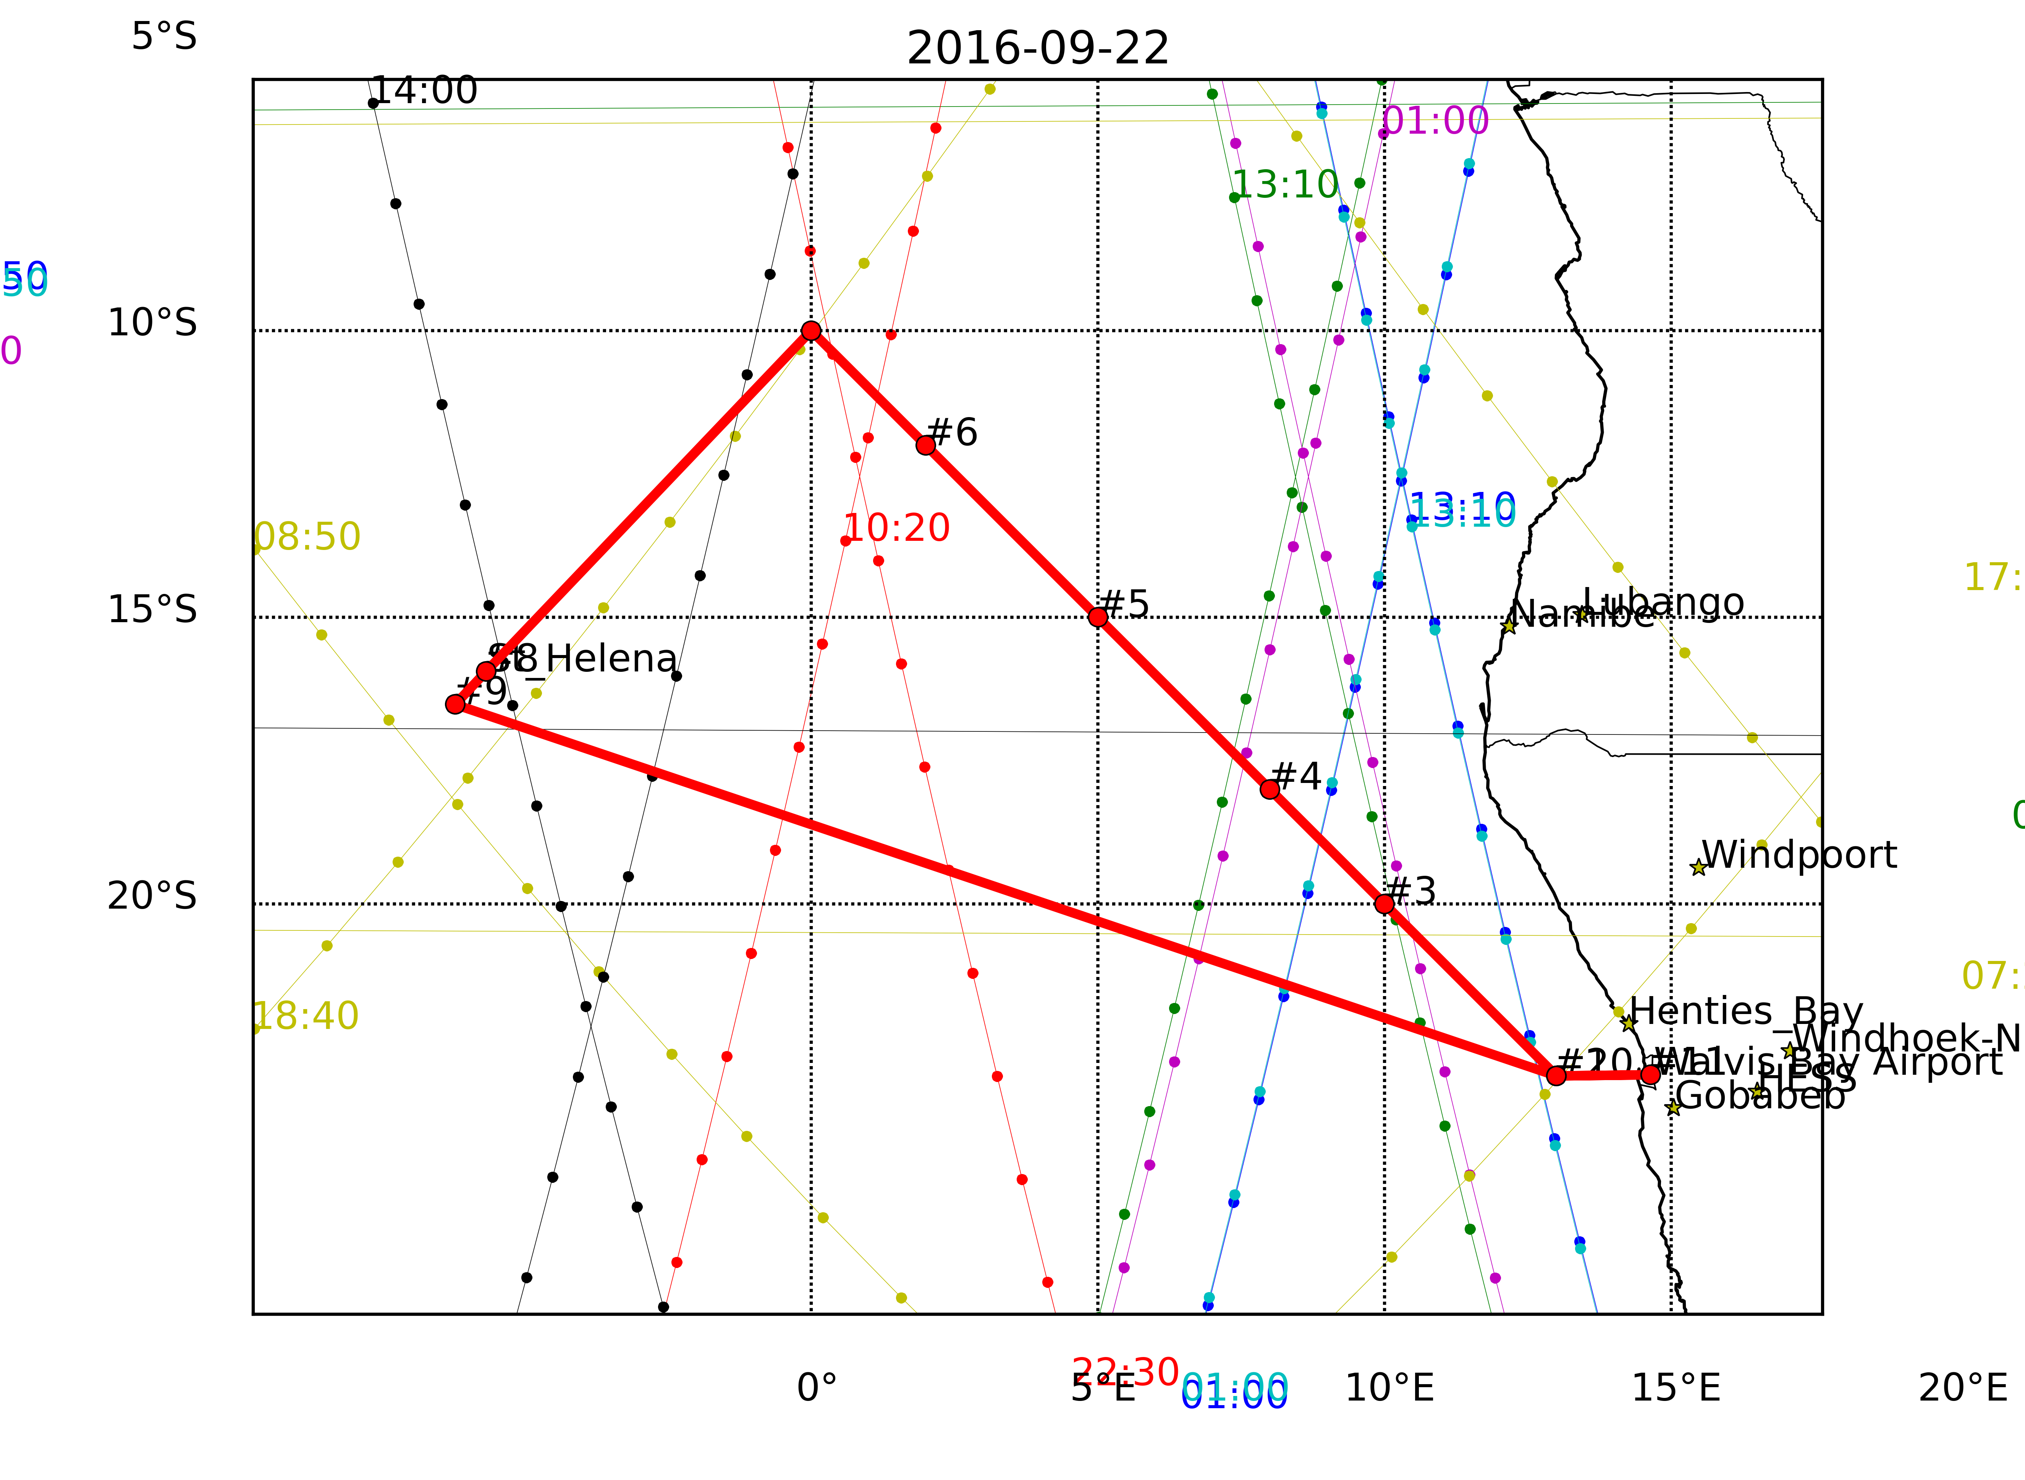
Thursday 22 September 2016
ER-2 Flight Only

Slide 7
Thursday 22 September 2016 9Z

Slide 8
Thursday 22 September 2016 9Z
HIGH

Slide 9
Thursday 22 September 2016 9Z
MID

Slide 10
Thursday 22 September 2016 9Z
LOW

Slide 11
GEOS-5 Curtains: Thu 22 Sep 2016

Slide 12
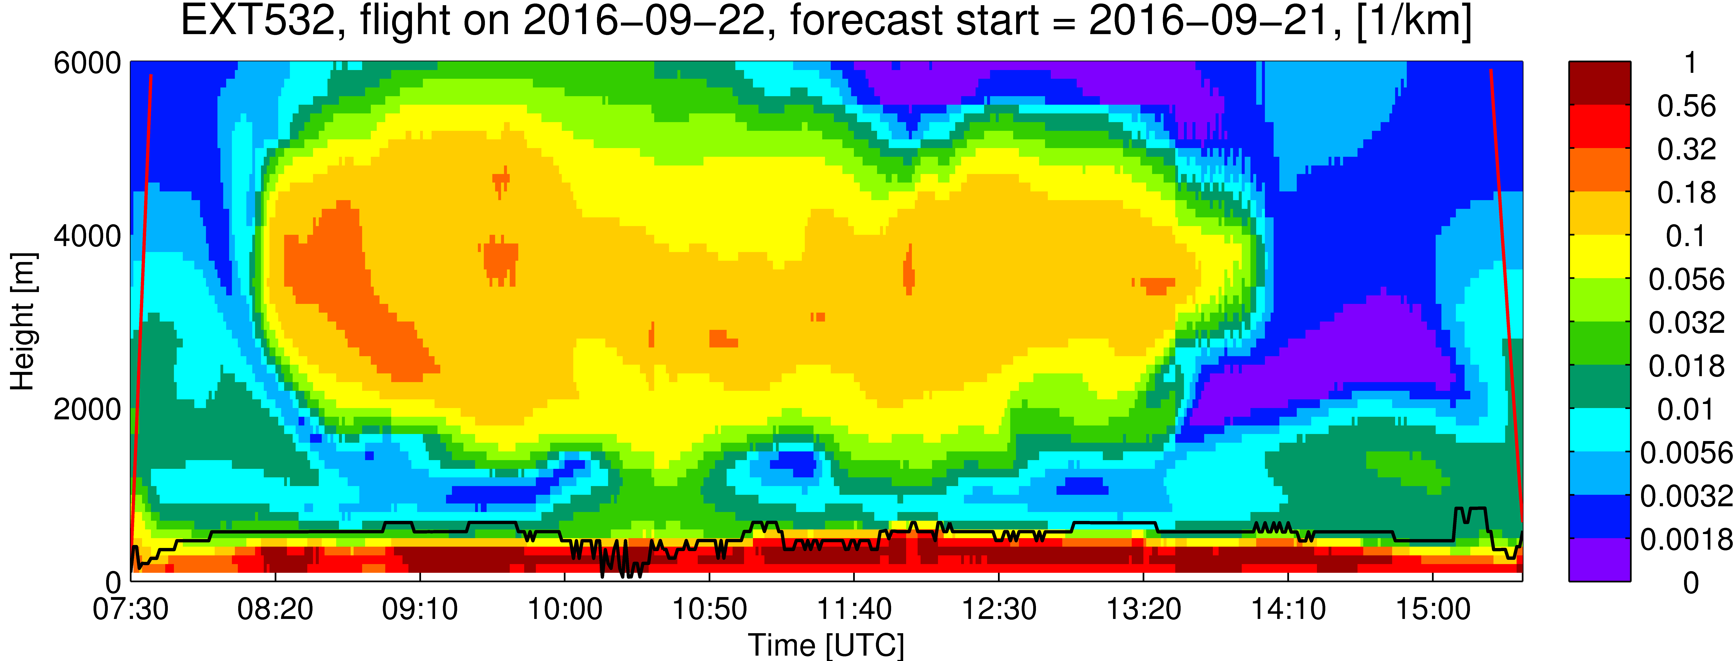
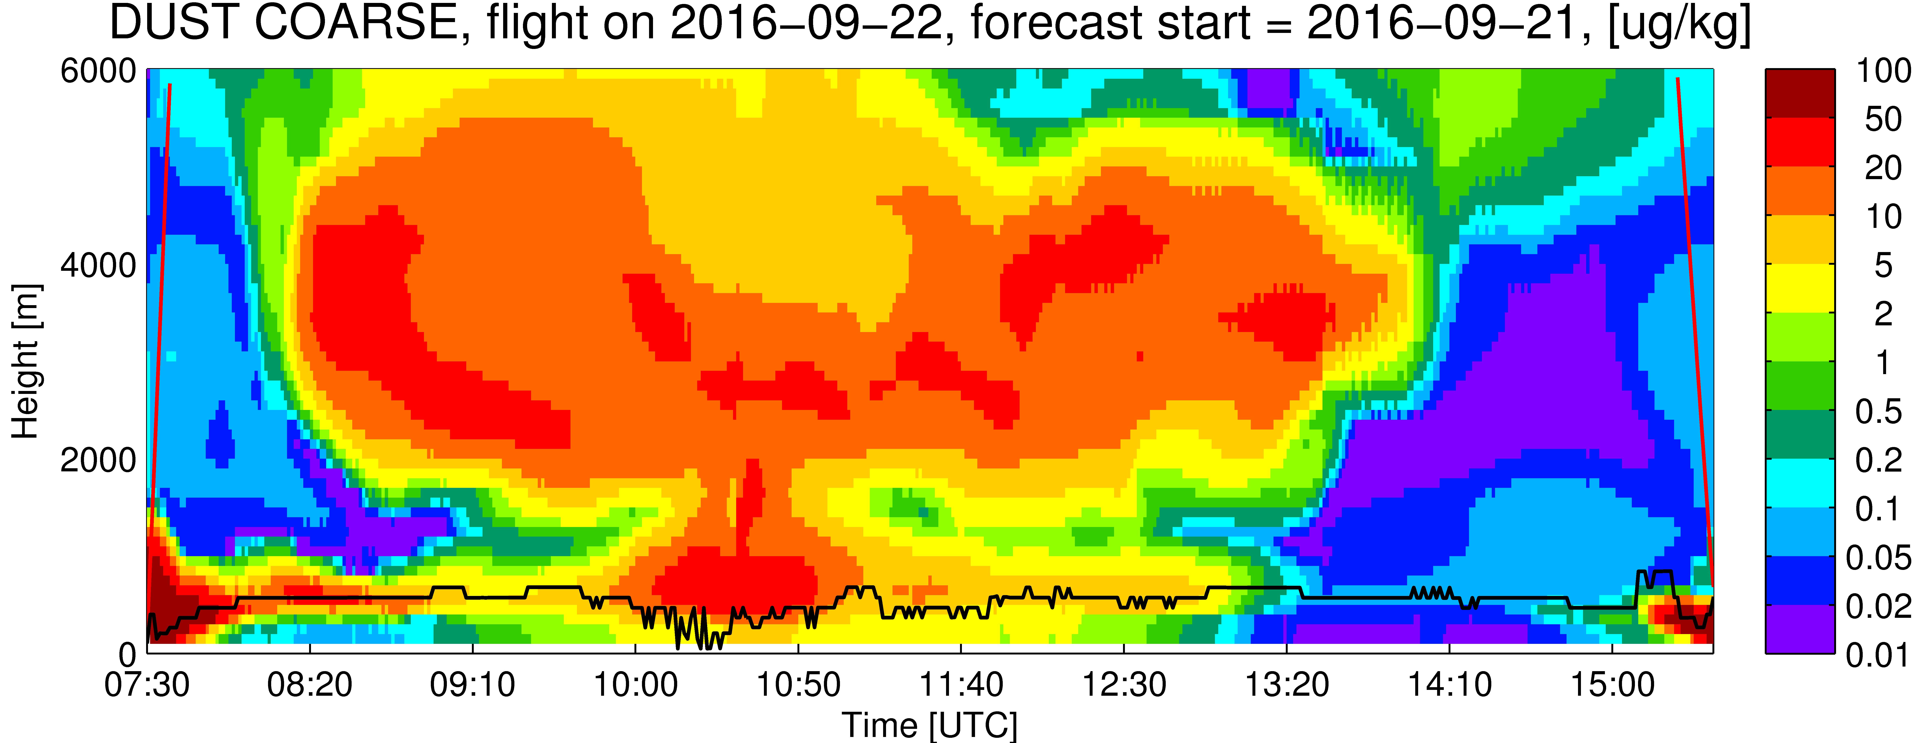
Sept. 22, 2016

Slide 13
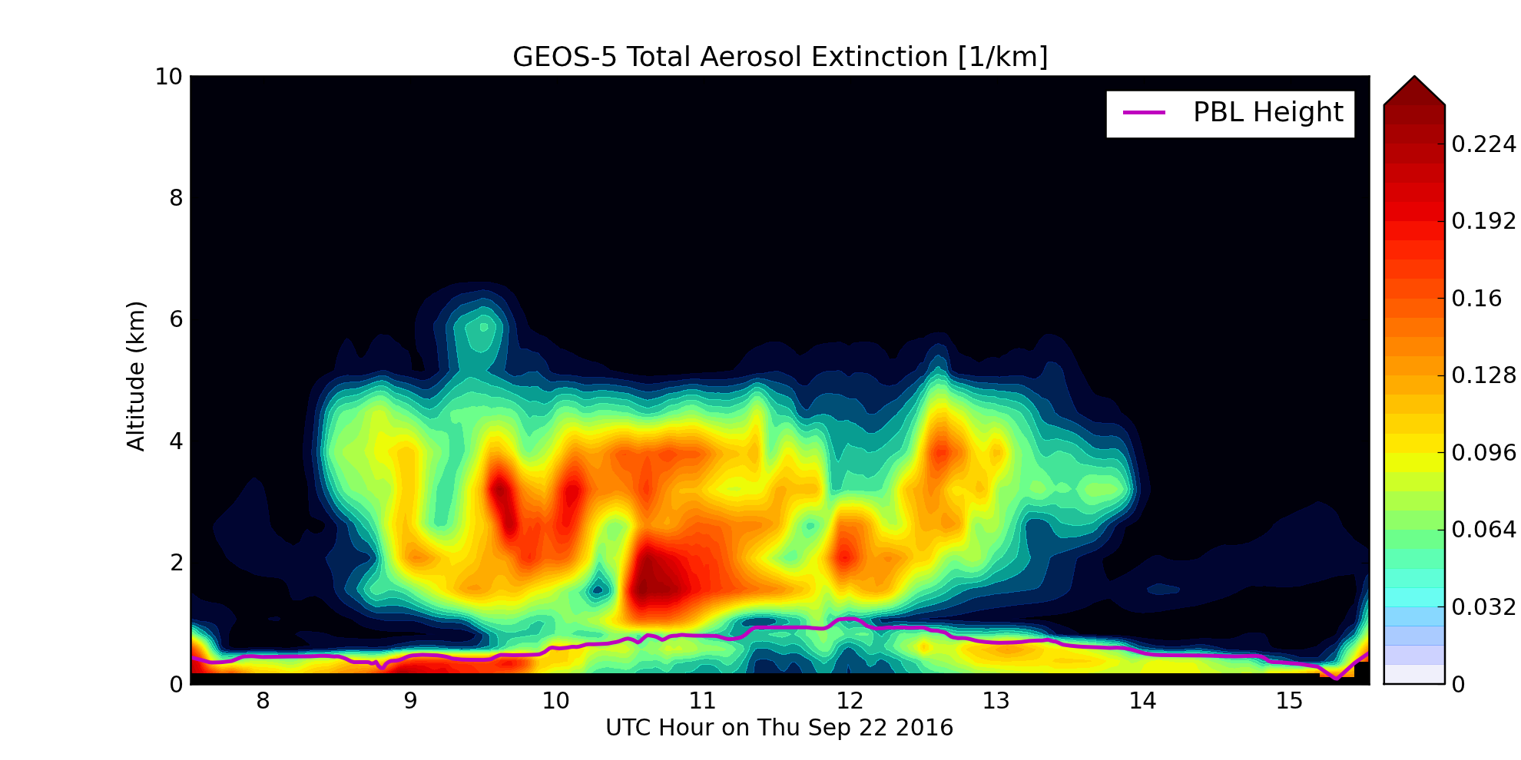
Sept. 22, 2016

Slide 14
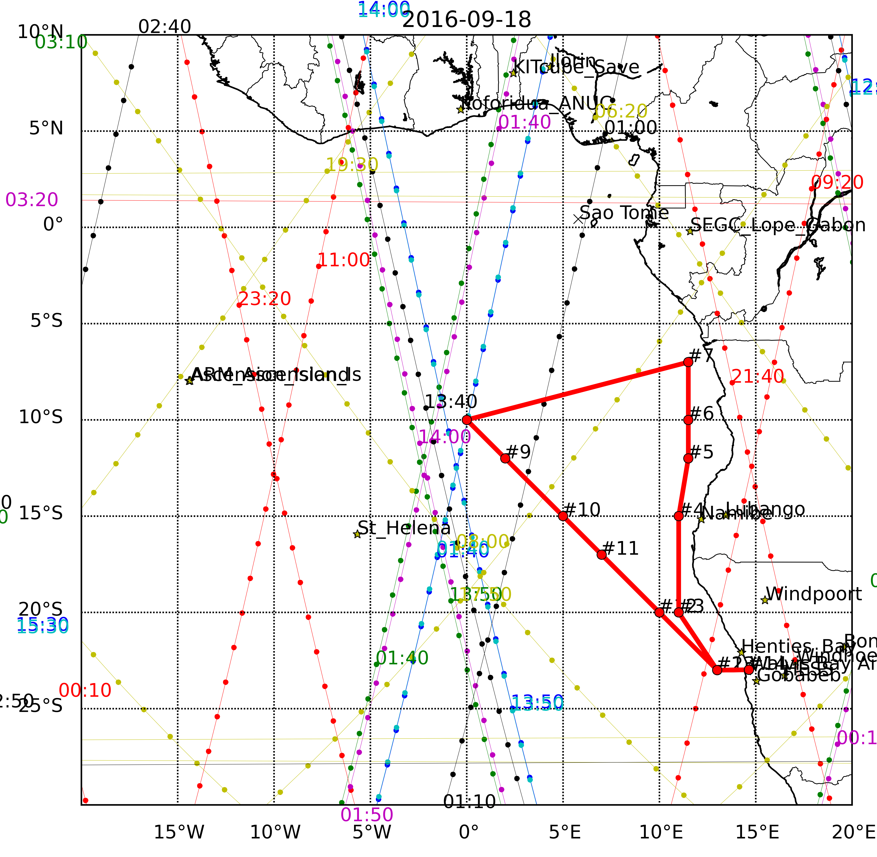
Friday 23 September 2016
Flight Day

Slide 15
GEOS-5 AOD, Fri 23 Sep 2016 9Z

Slide 16
GEOS-5 AOD, Fri 23 Sep 2016 9Z
HIGH

Slide 17
GEOS-5 AOD, Fri 23 Sep 2016 9Z
MID

Slide 18
GEOS-5 AOD, Fri 23 Sep 2016 9Z
LOW

Slide 19
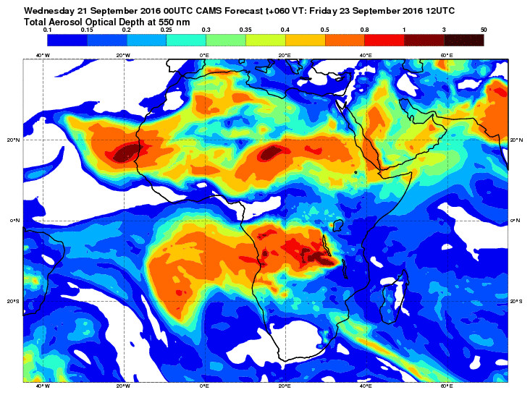
Sept. 23 (Friday)

Slide 21
Sept. 23 (Friday)

Slide 22
Sept. 23 (Friday)

Slide 23
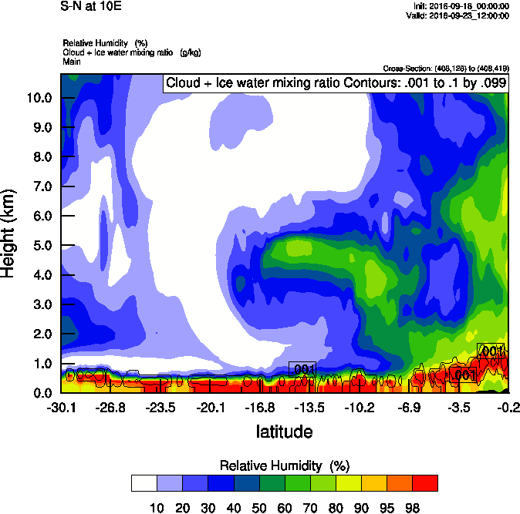
Sept. 23 (Friday) @10E
EXT
RH

Slide 24
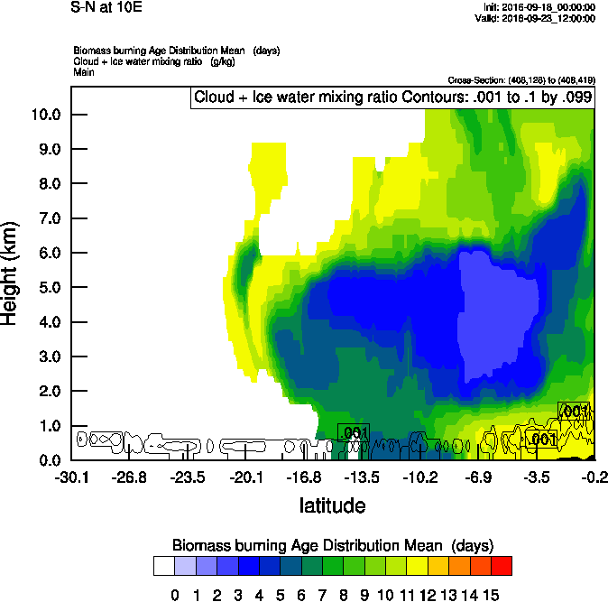
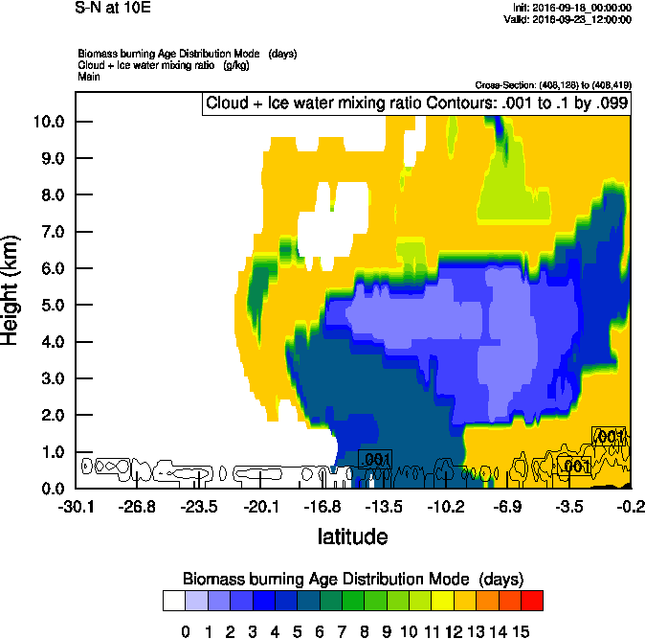
Sept. 23 (Friday) @10E
AGE-Mean
AGE-Mode

Slide 25
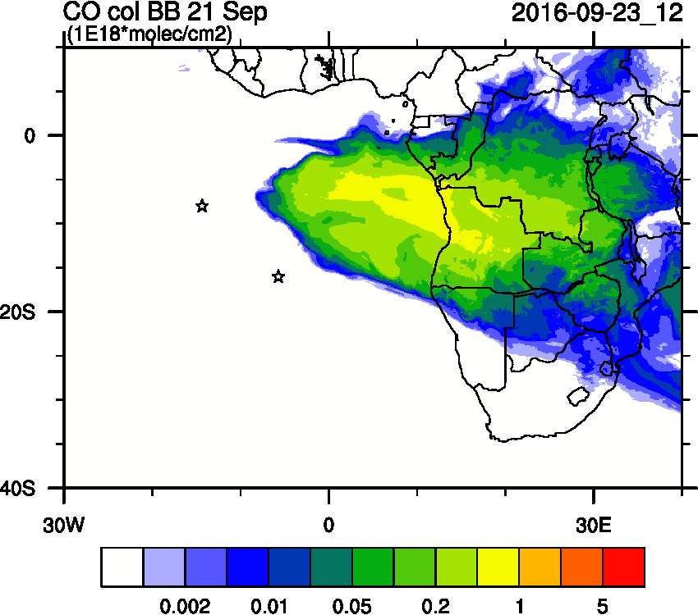
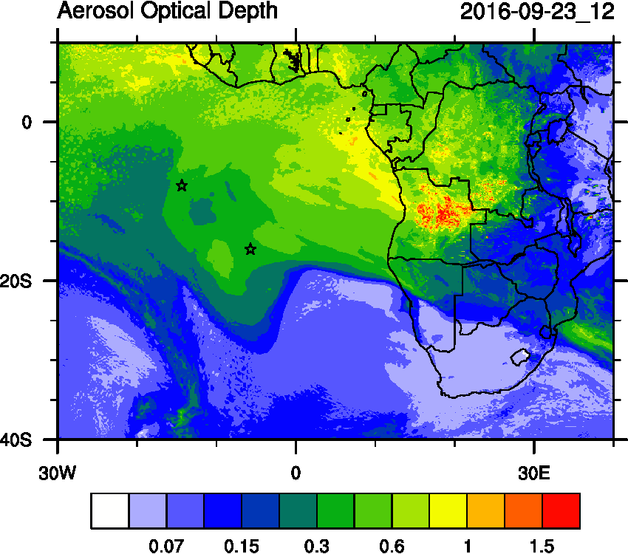
Sept. 23 (Friday) Smoke Age
Day 0

Slide 26
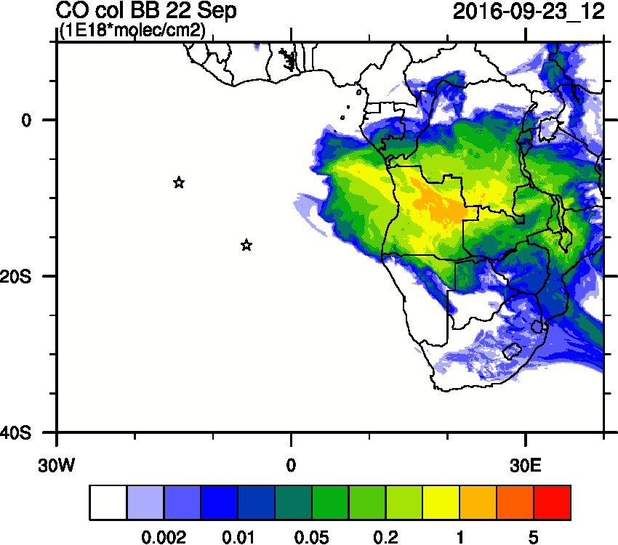
Sept. 23 (Friday) Smoke Age
Day 0
Day +1

Slide 27
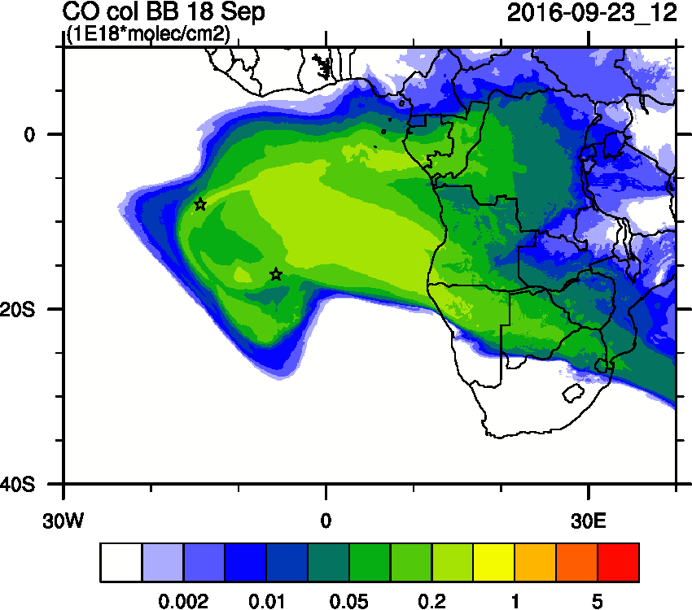
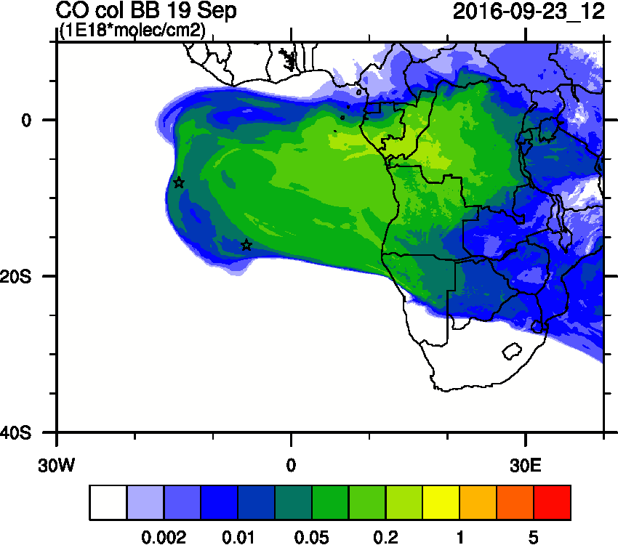
Sept. 23 (Friday) Smoke Age
Day -3

Slide 28
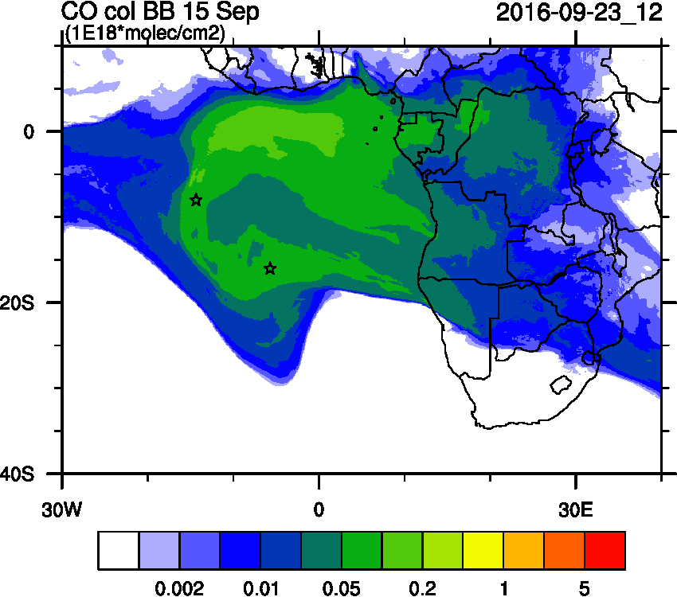
Sept. 23 (Friday) Smoke Age
Day -6

Slide 29
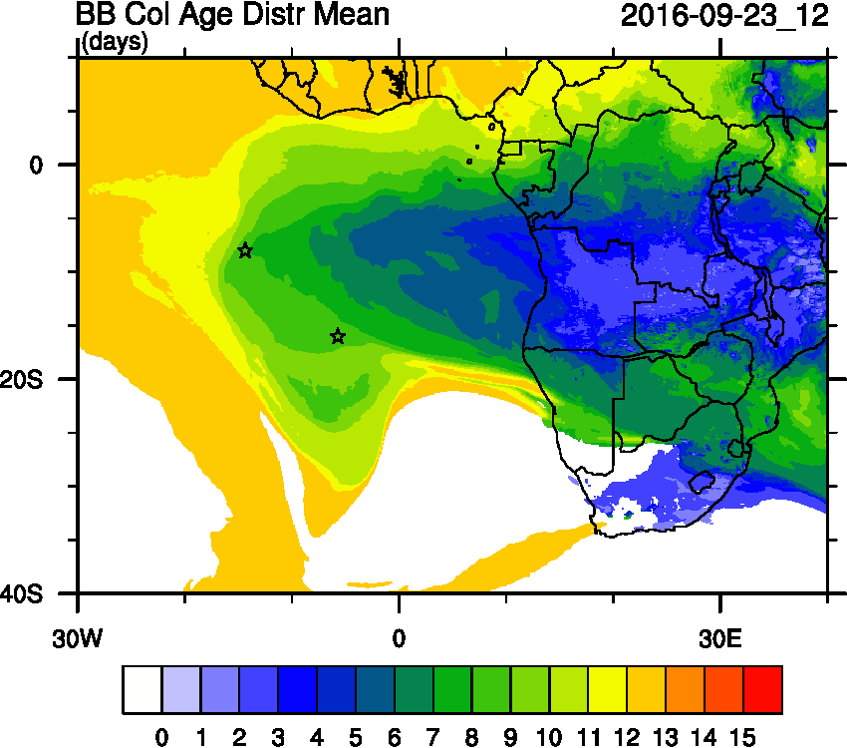
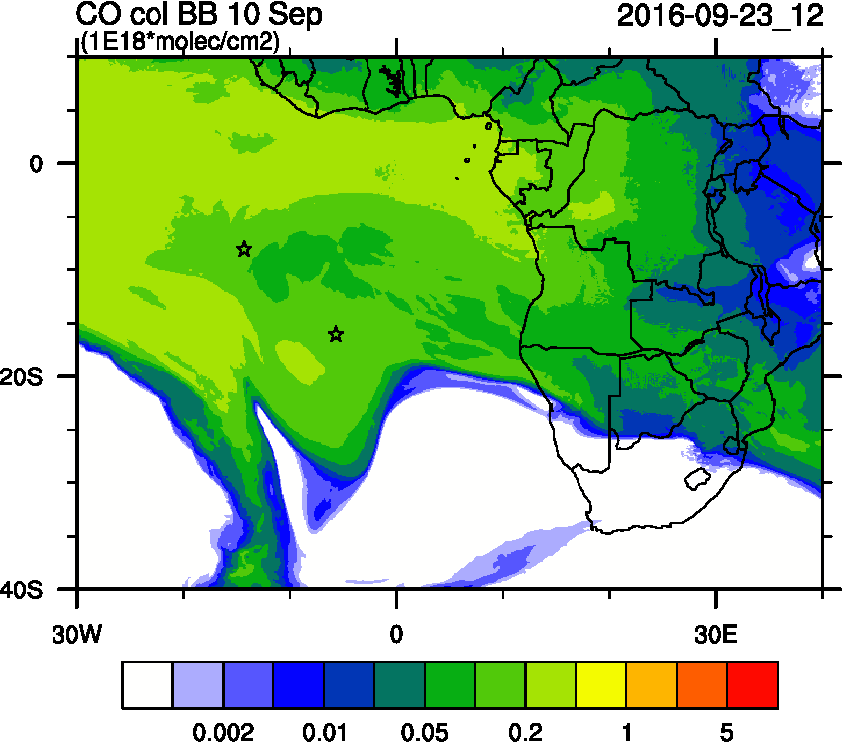
Sept. 23 (Friday) Smoke Age
Day-2
Day < 10

Slide 30
Sept. 23 (Friday) @10E

Slide 31
Sept. 23 (Friday) @10E
SO2
NO3
Dust

Slide 32
Sept. 23 (Friday)

Slide 33
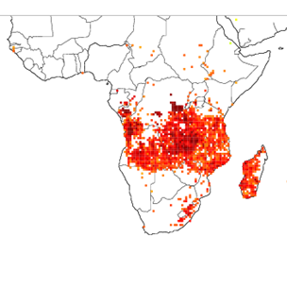
Sept. 23 (Friday)

Slide 34
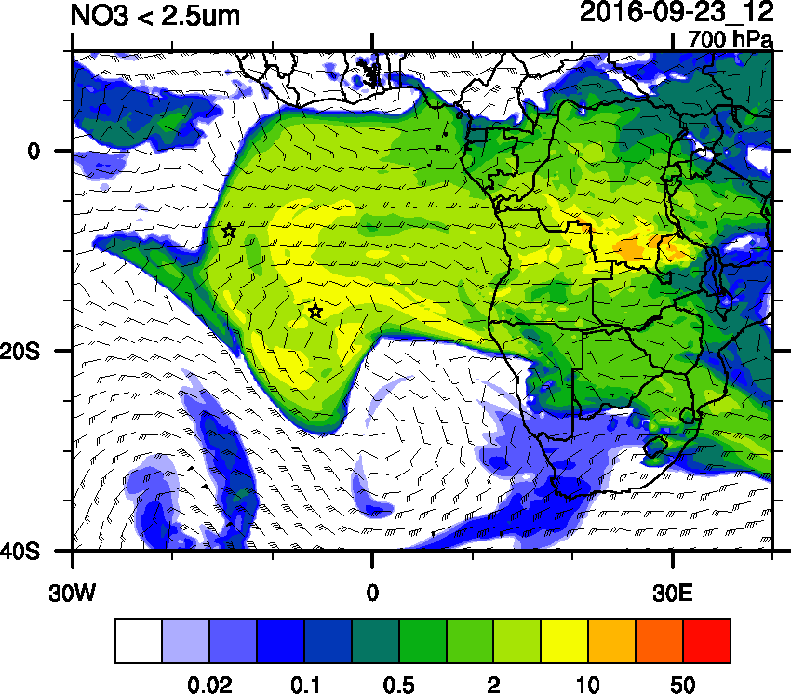
Sept. 23 (Friday)

Slide 35
Sept. 23 (Friday) @NW-SE

Slide 36
Sept. 23 (Friday) @NW-SE

Slide 37
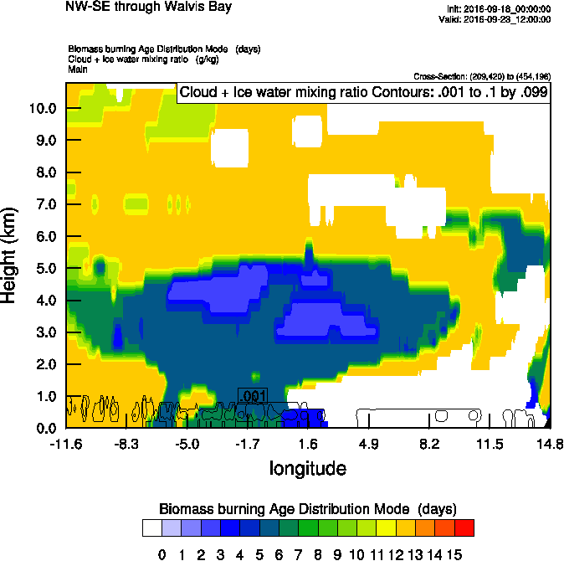
Sept. 23 (Friday) @NW-SE

Slide 39
GEOS-5 Curtains: Thu 22 Sep 2016

Slide 40
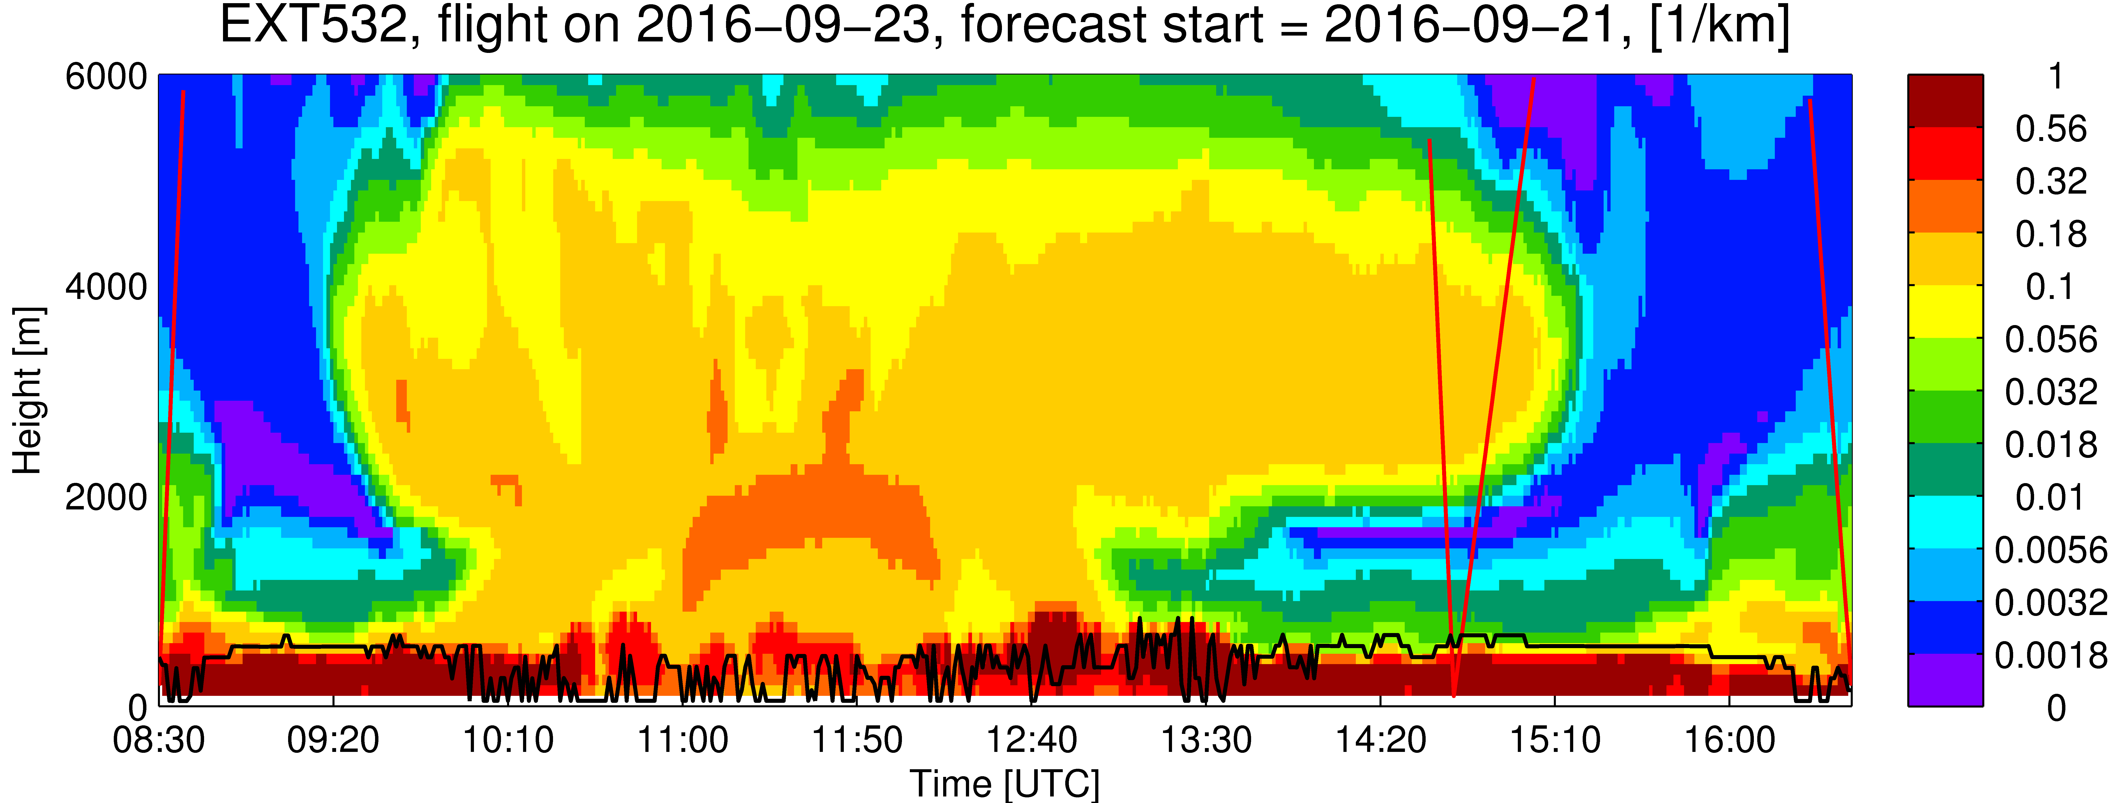
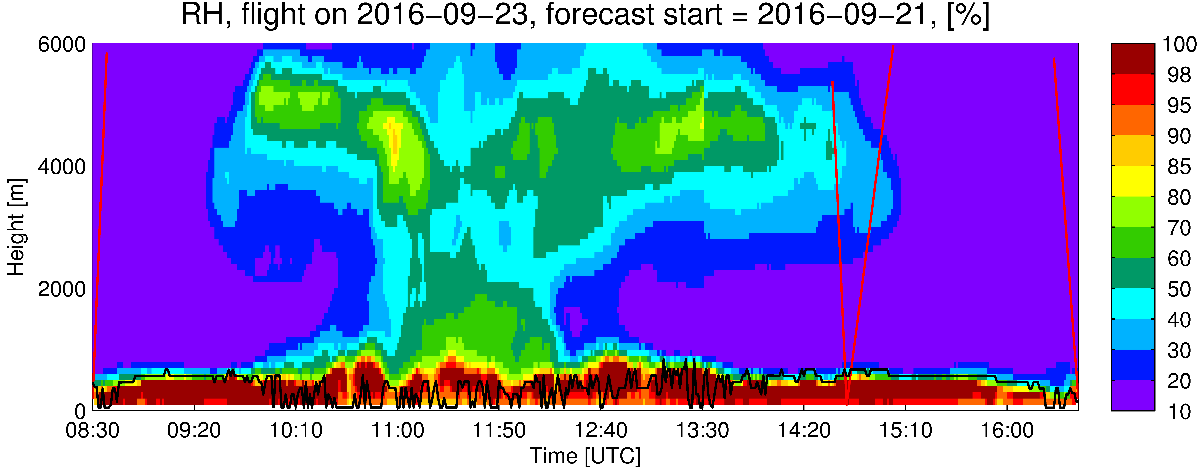
Sept. 23 (Friday)

Slide 41
Saturday-Sunday 24-25 September 2016
Non-Flight Day (Friday)

Slide 42
GEOS-5 AOD: Sat-Sun 24-25 Sep 2016 9z
Saturday
Sunday

Slide 43
GEOS-5 AOD: Sat-Sun 24-25 Sep 2016 9z
Saturday
HIGH
Sunday

Slide 44
GEOS-5 AOD: Sat-Sun 24-25 Sep 2016 9z
Saturday
MID
Sunday

Slide 45
GEOS-5 AOD: Sat-Sun 24-25 Sep 2016 9z
Saturday
LOW
Sunday

Slide 46
Saturday
Sunday

