Slide 1
ORACLES forecasting briefing Meteorology for 20-09-2016
20-09-2016
Lenny Pfister

Slide 2
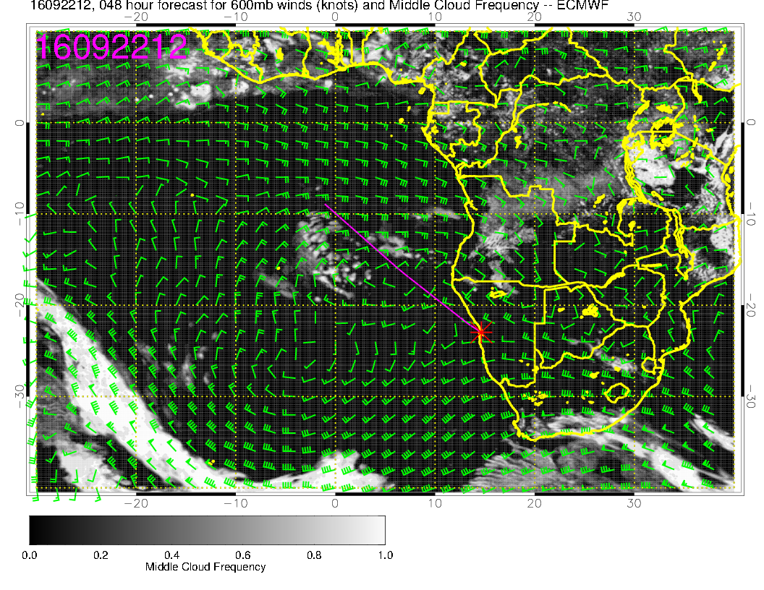
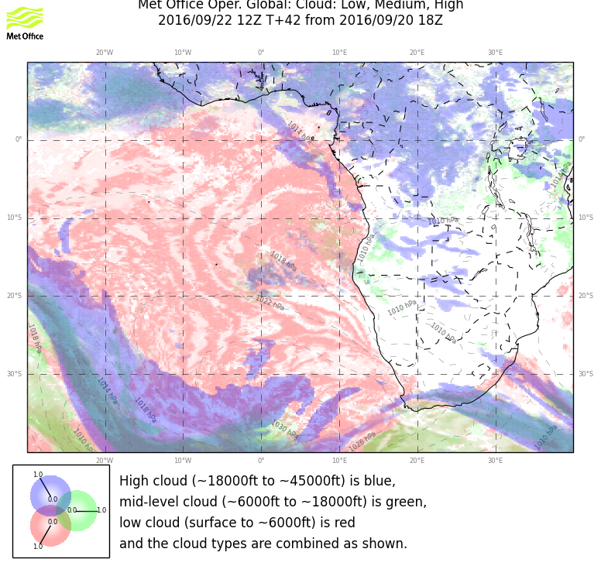
Mid cloud moving westward, not dissipating during flight period as much. UKMO shows more pronounced gap in cloud between the two surges. Definitely more advanced westward than previous fcst. UKMO fcsts more cloud than yesterday’s fcst.

Slide 3
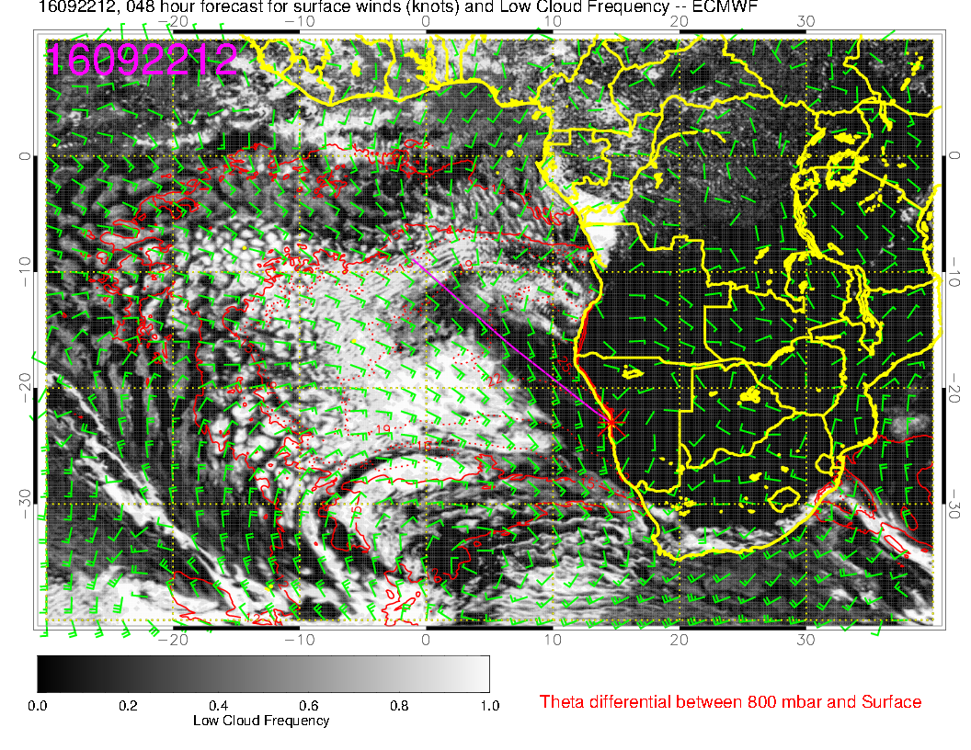
Still model divergence here. I do not see the tomahawk in the UKMO. Generally, both models show more low cloud cover than yesterday’s fcst.

Slide 4
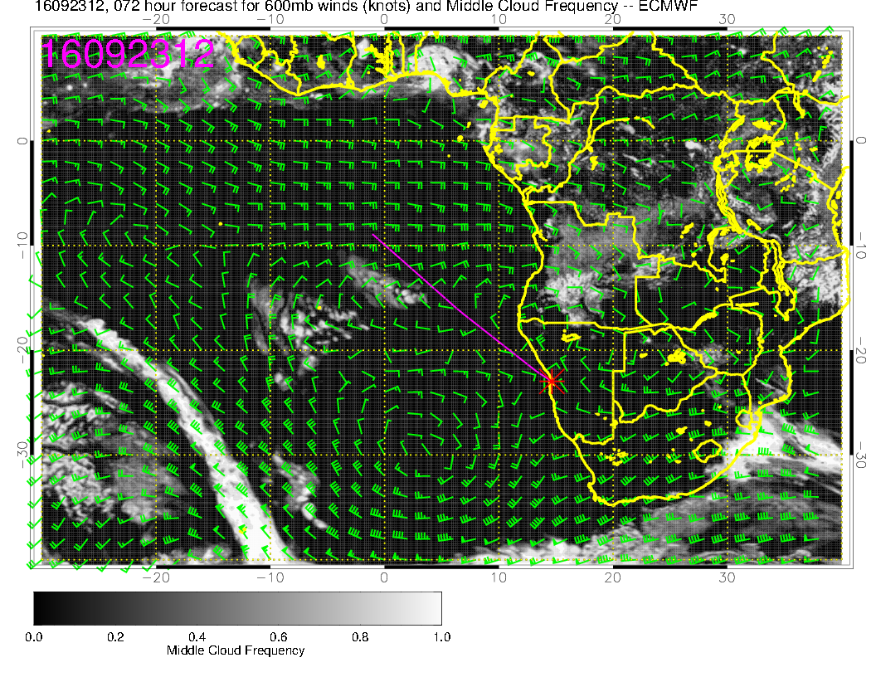
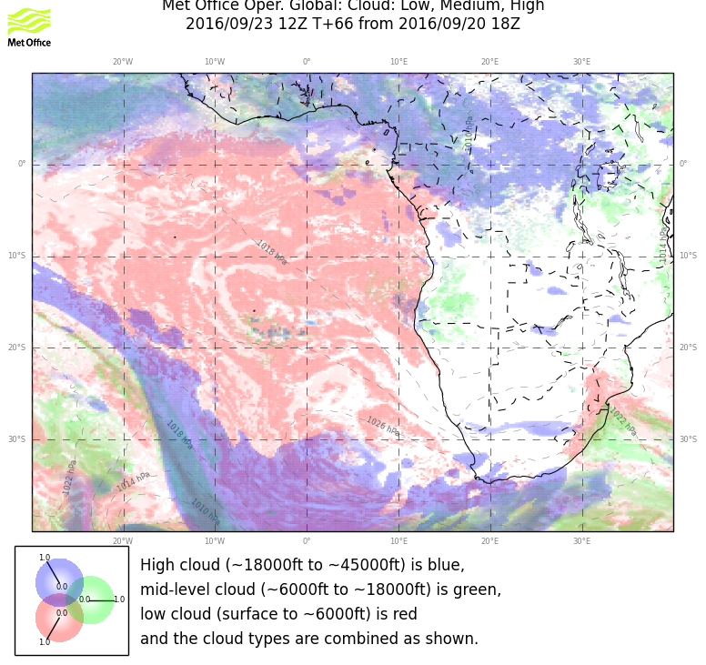
Middle cloud pattern substantially more aggressive than yesterday’s fcst in both models.

Slide 5
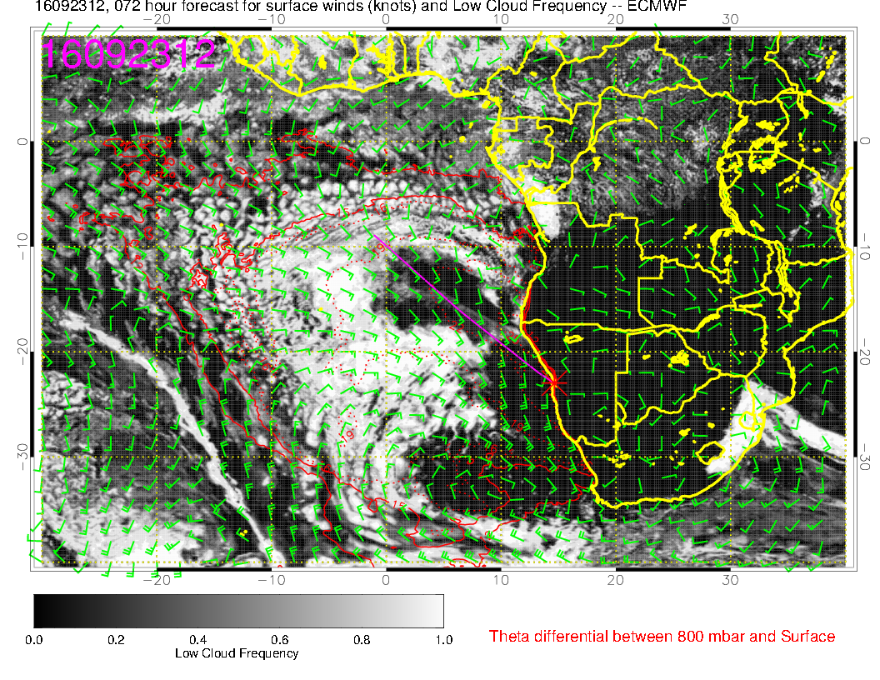
Quasi-clear region in EC from 11 to 18S goes with belt of lower BL heights. Clear region off
our coast makes sense with high and subsidence. Do not think clear region in UKMO between 20 and 30S and 0 and 10E will materialize. BL height is substantial there.

