Slide 1
ORACLES forecasting briefing Meteorology for 22-09-2016 – 25-09-2016
21-09-2016
Lenny Pfister

Slide 2
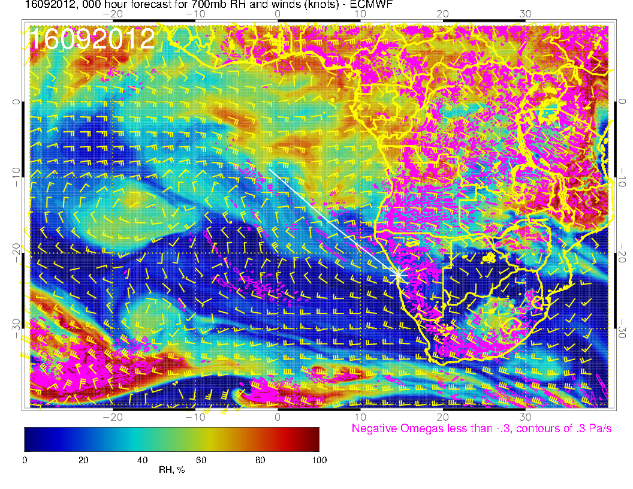
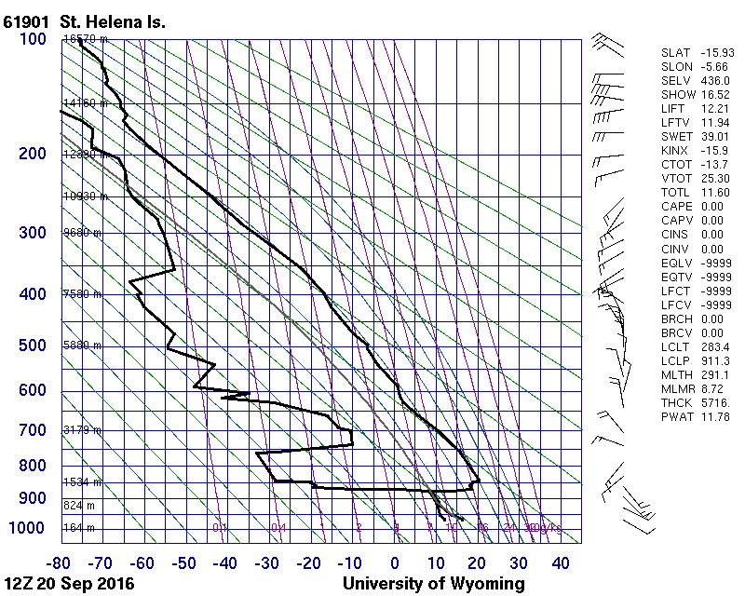
See return flow at 700mb – close to edge of high RH.

Slide 3
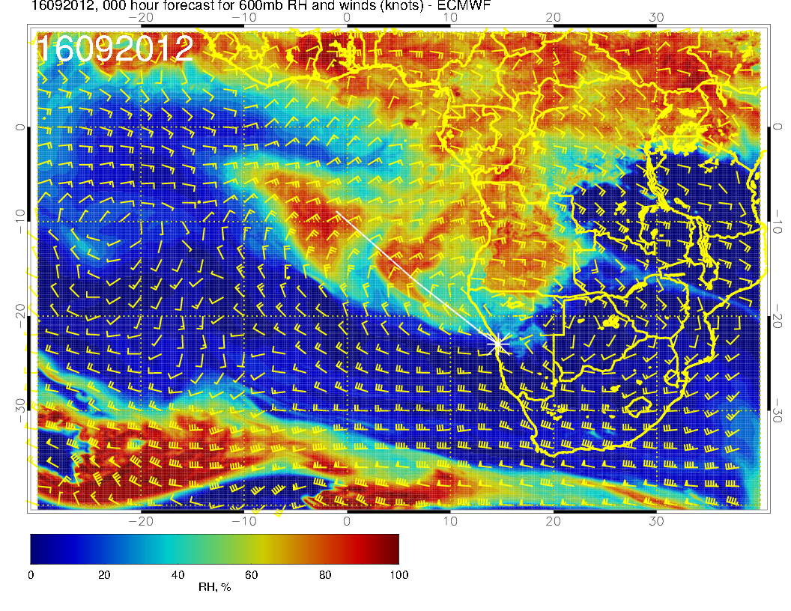
See return flow at 700mb – close to edge of high RH. 600mb plume stronger but positioned differently, drier air. Typical fluid shearing.

Slide 4
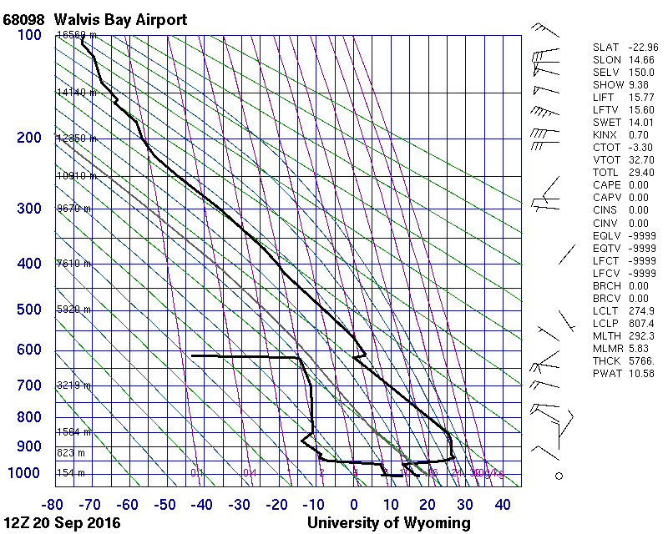
Yesterday’s YWB sounding. Looks like classic dry convective mixed layer.

Slide 5
Yesterday’s YWB sounding. Looks like classic dry convective mixed layer. Not quite to 600mb but can see at 700mb. Can see hint in 800mb initialization, but not at 850mb.

Slide 6
Thursday (1st btb, 20160922)

Slide 7
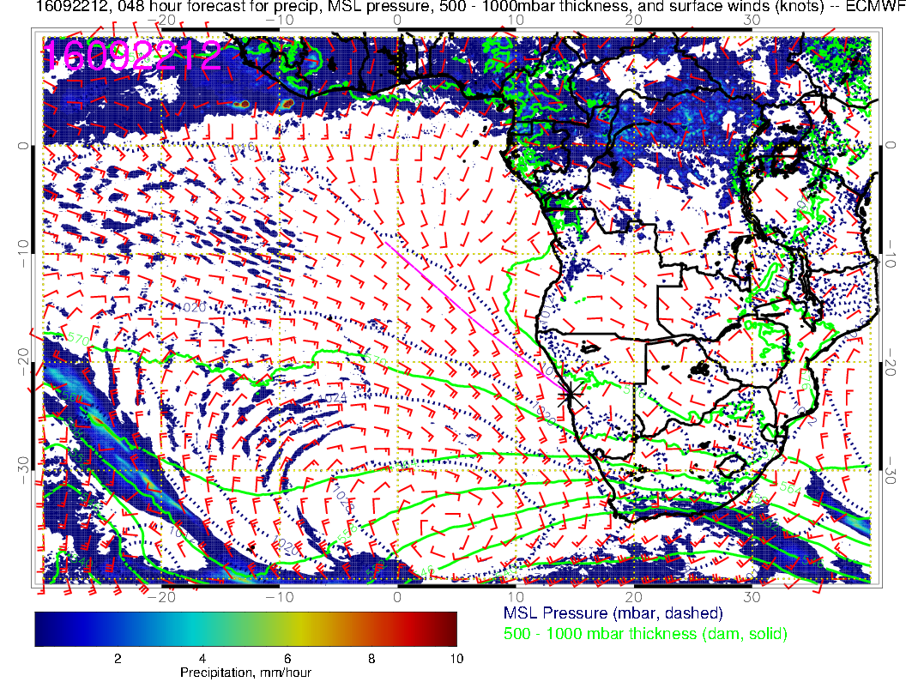
As promised, high is fully reorganized and strong, further east than yesterday’s prog by a bit.

Slide 8
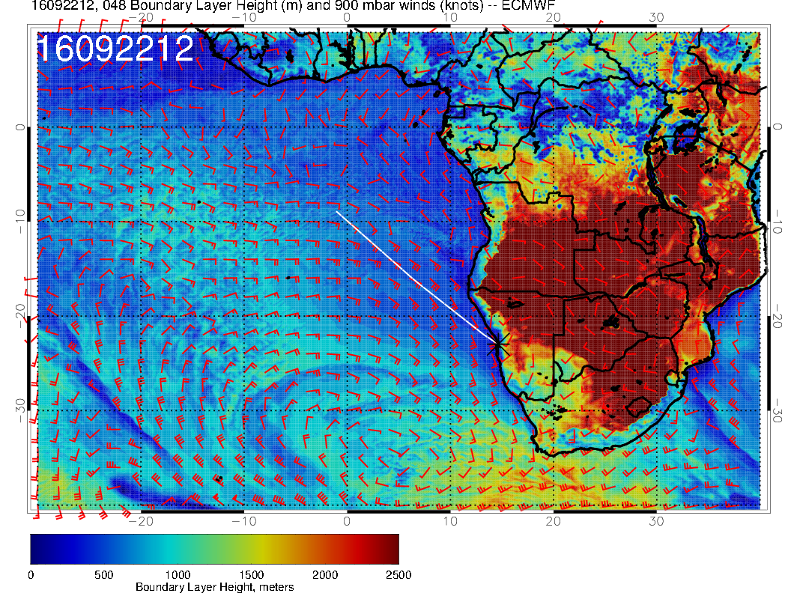
BL heights slightly higher than yesterday’s fcst.

Slide 9
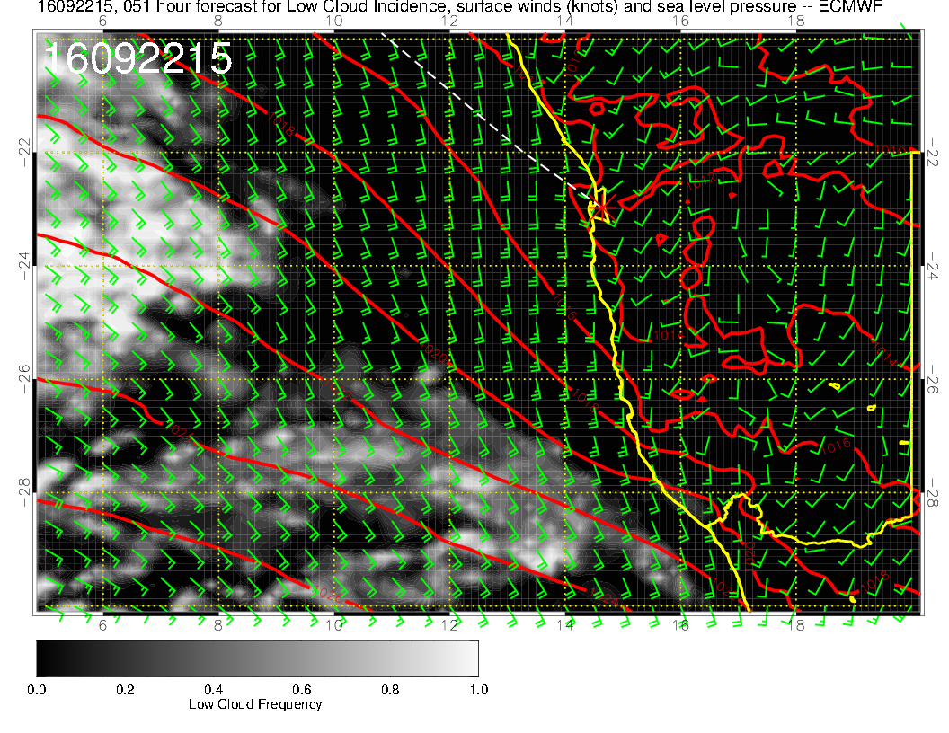
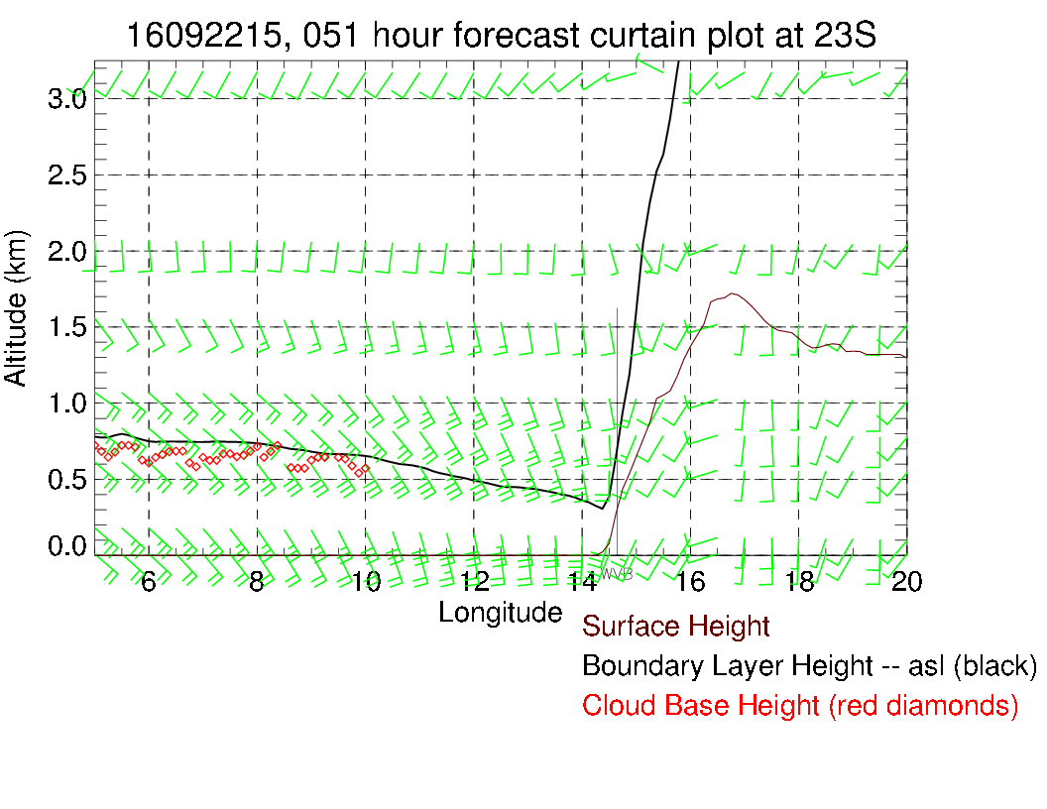
Landing forecast has not changed. Expect winds close to 210 15-20 knots at
5 PM, decreasing thereafter. Morning ceiling issues

Slide 10
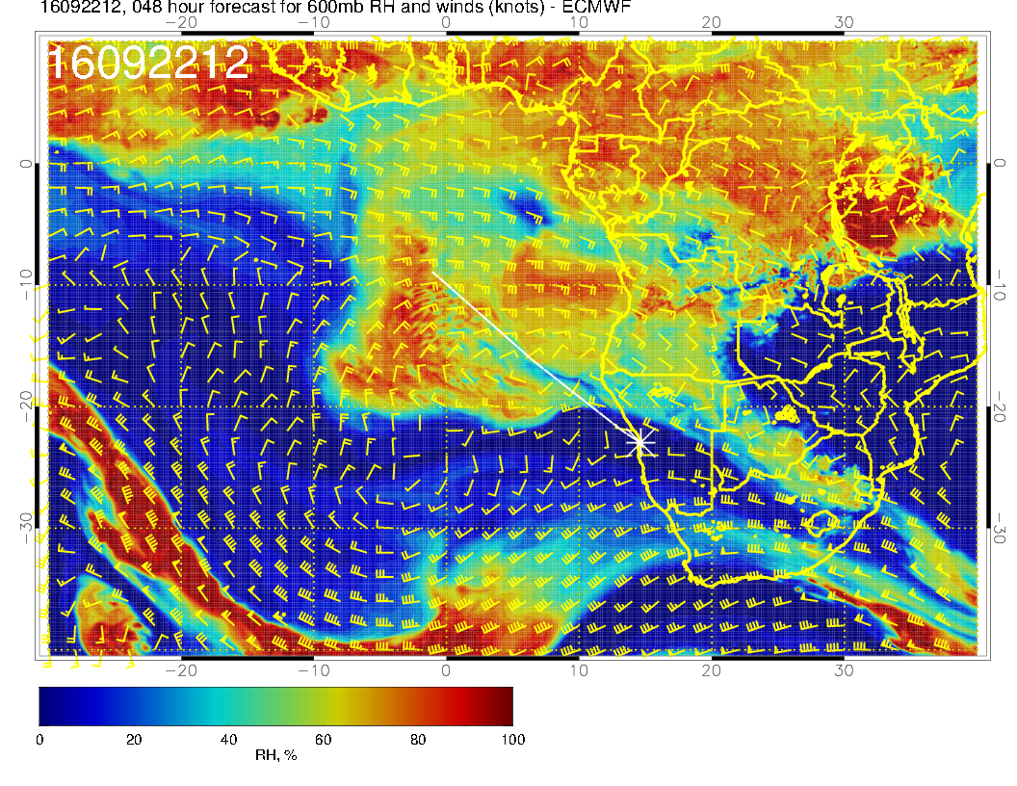
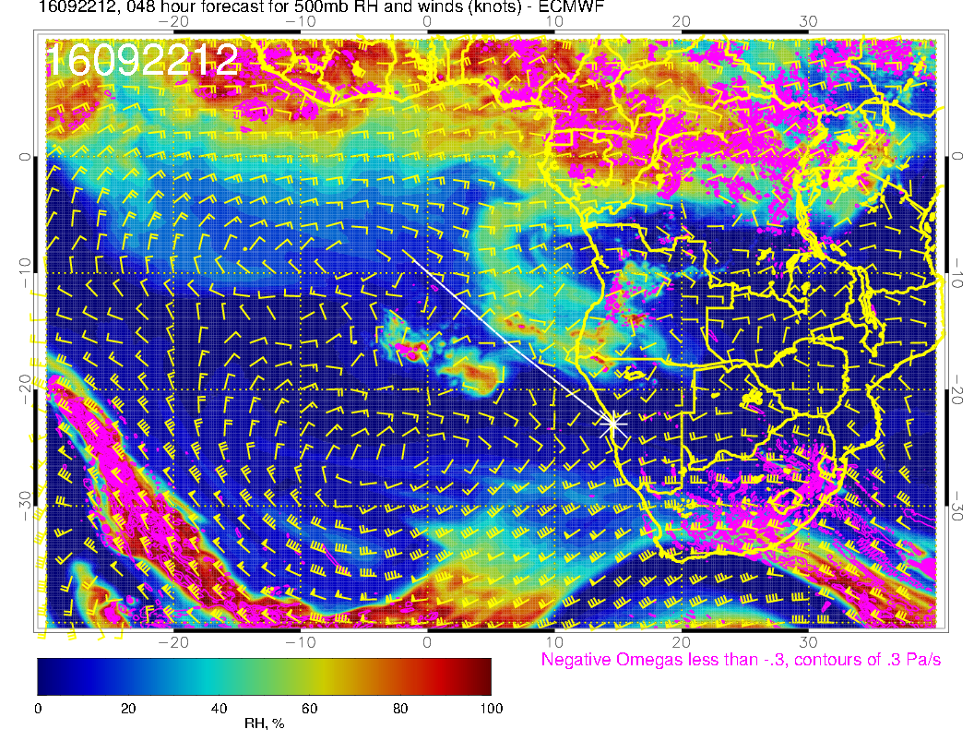
Two surges of RH, the first one more
advanced than yesterday’s fcst. Extends to St Helena. 600mb anticyclone becoming distended, the RH looks active

Slide 11
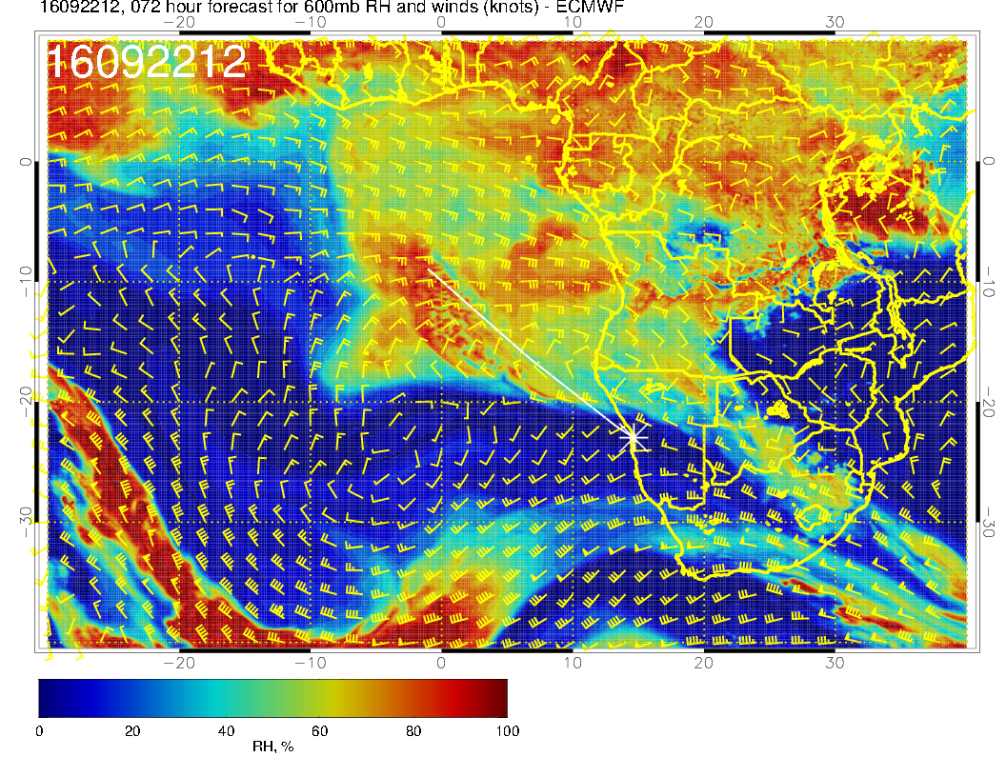
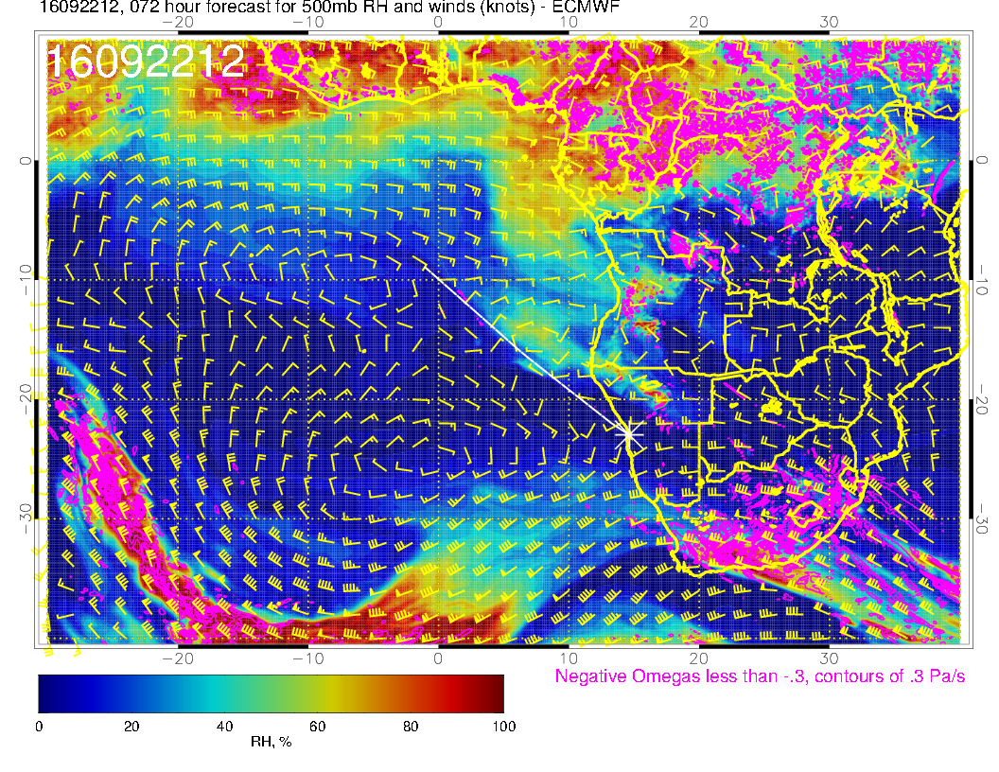
Yesterday’s fcst

Slide 12
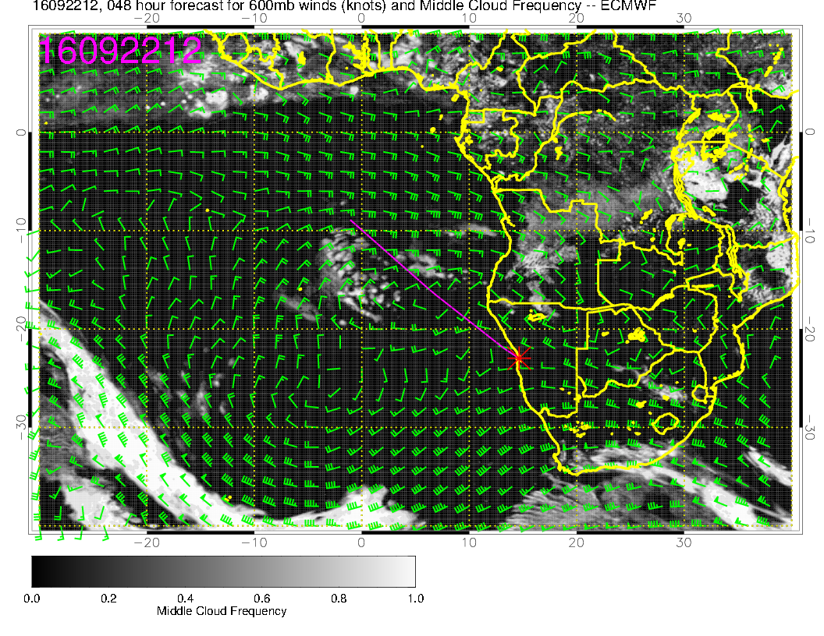
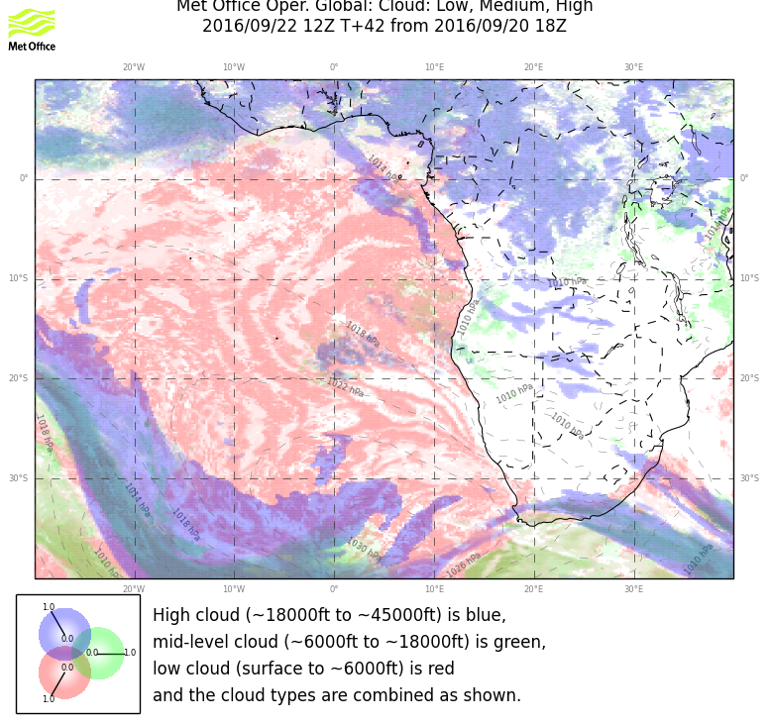
Mid cloud moving westward, not dissipating during flight period as much. UKMO shows more pronounced gap in cloud between the two surges. Definitely more advanced westward than previous fcst. UKMO fcsts more cloud than yesterday’s fcst.

Slide 13
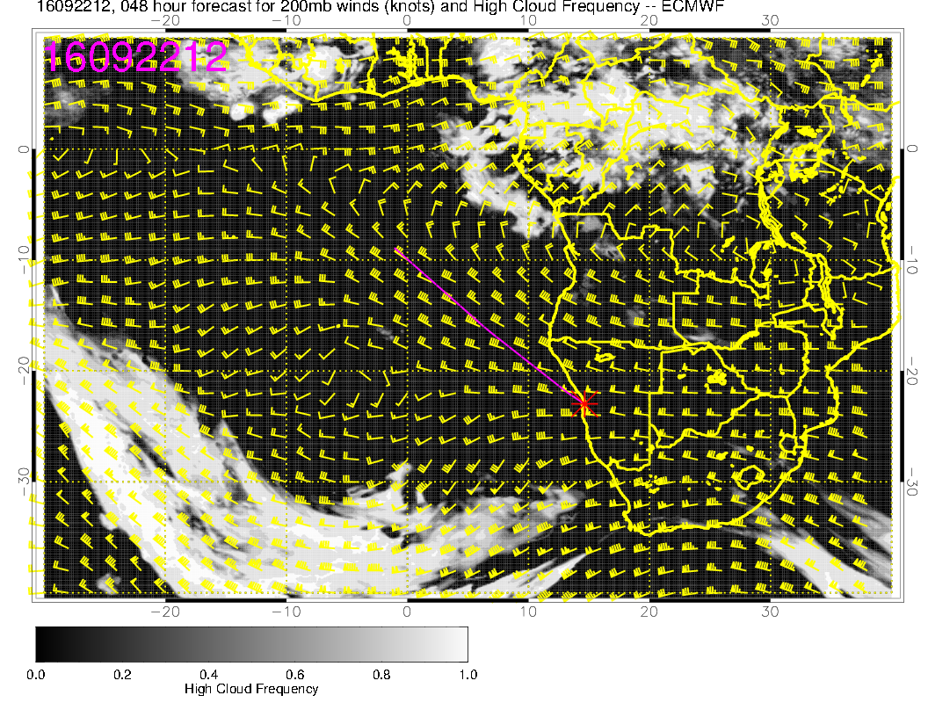
Absence of cirrus.

Slide 14
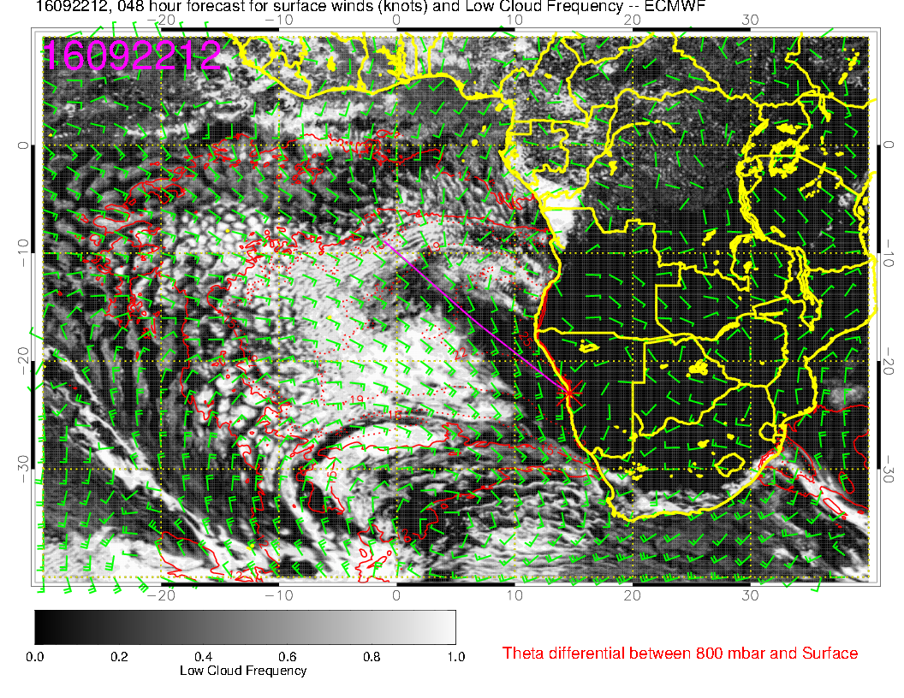
Still model divergence here. I do not see the tomahawk in the UKMO. Generally, both models show more low cloud cover than yesterday’s fcst.

Slide 15
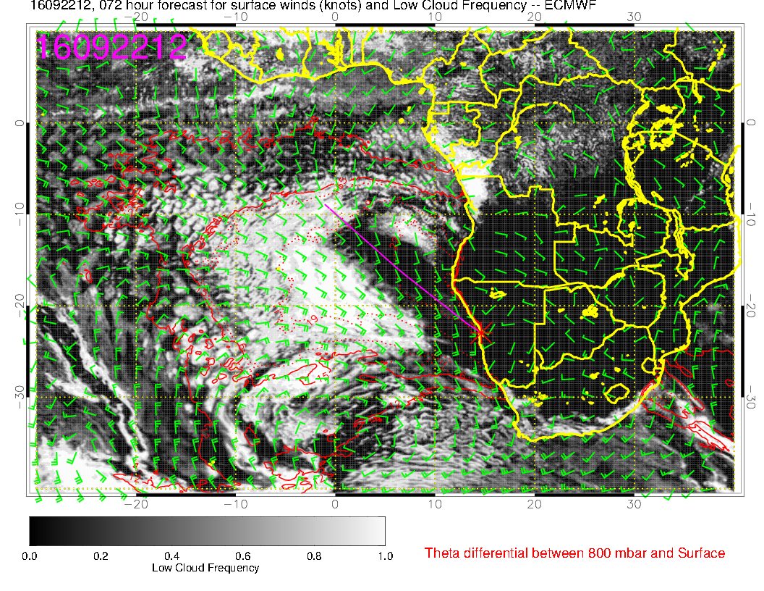
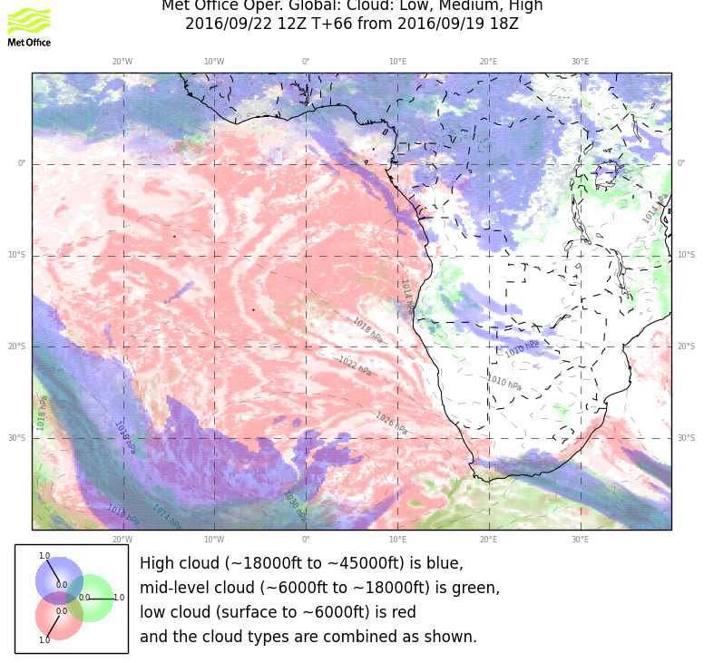
Yesterday’s fcst

Slide 16
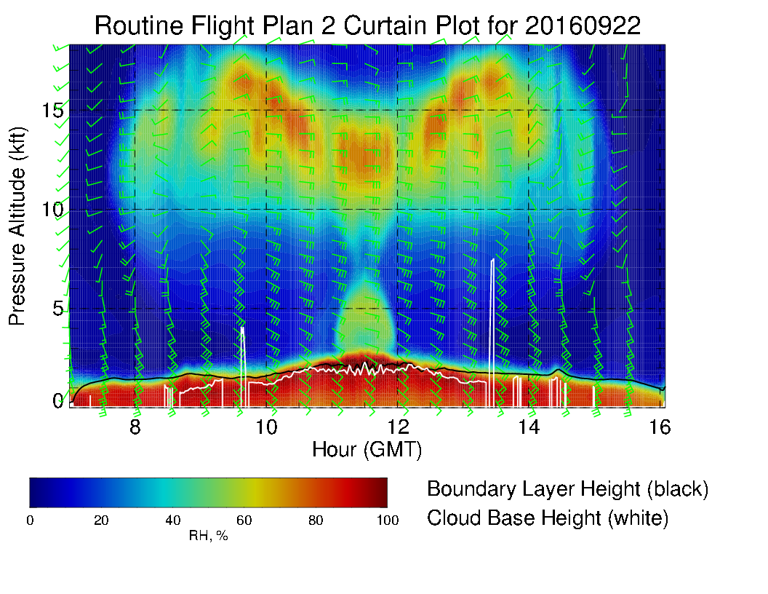
Routine plan suggests we might encounter some middle cloud. Clear regions near beginning and end.

Slide 17
Friday (2nd btb, 20160923)

Slide 18
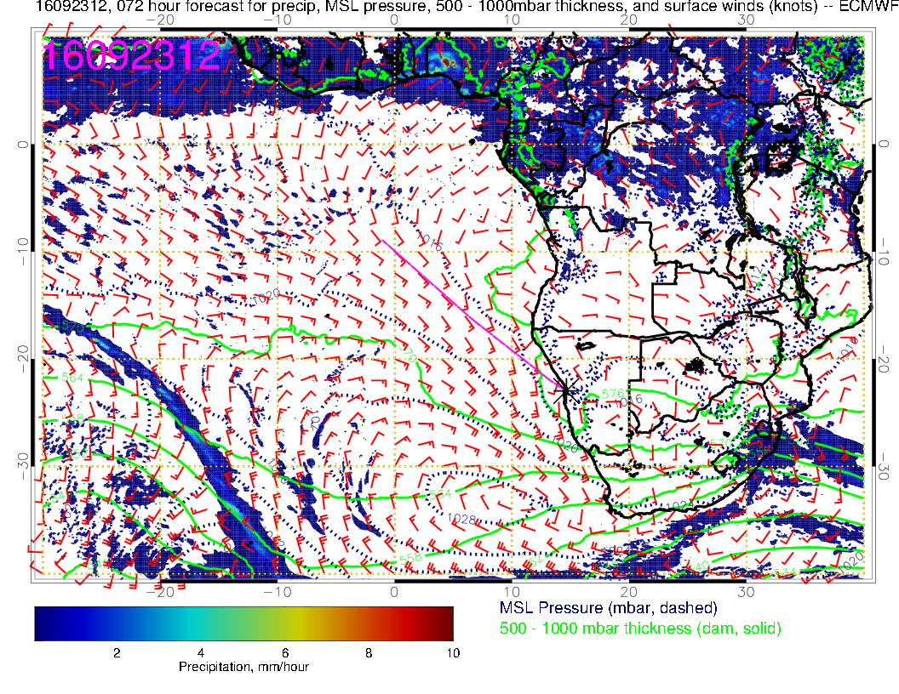
High moves further east. Not quite as strong as yesterday’s fcst or as on 20160922 (Thursday). Winds go down by 5 knots. Angola Bay “weak wind” region expands.
Ceiling issues in the morning – no wind issues in the afternoon.

Slide 19
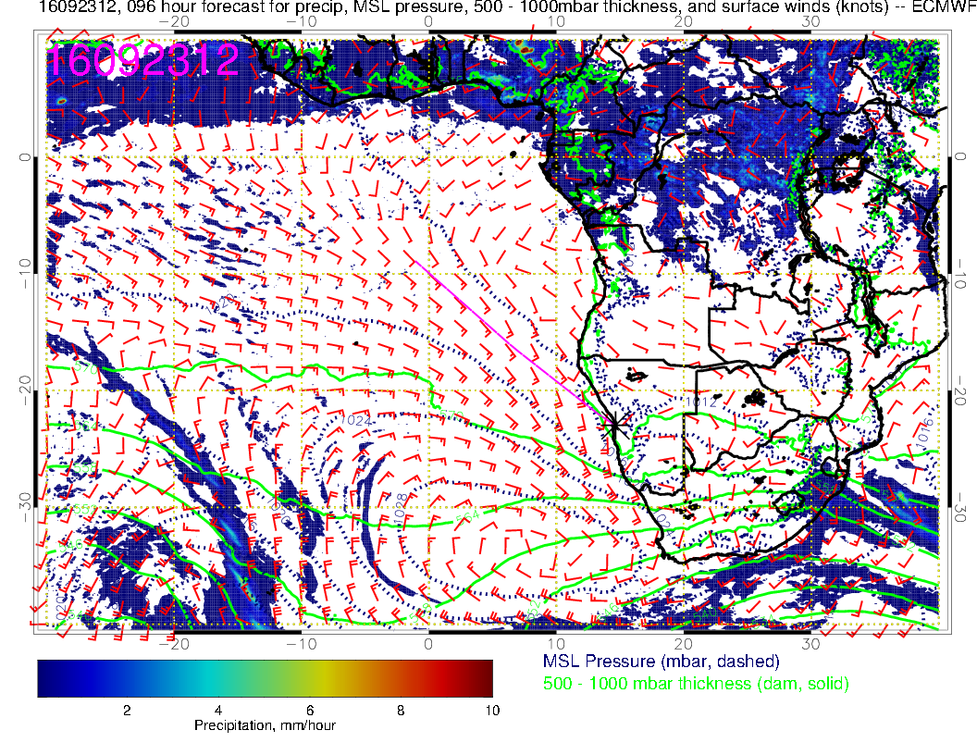
Yesterday’s fcst.

Slide 20
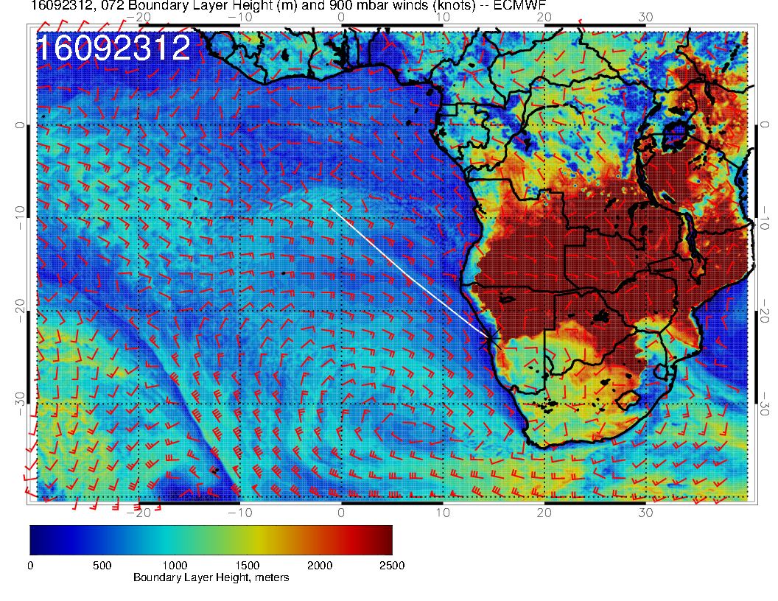
BL heights slightly higher
than Thursday. A bit
lower than ystdy’s fcst.

Slide 21
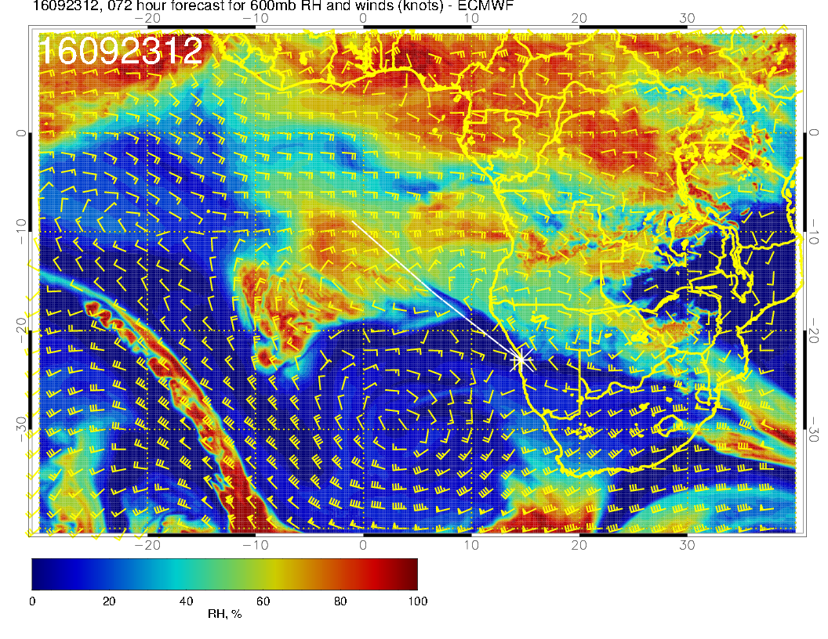
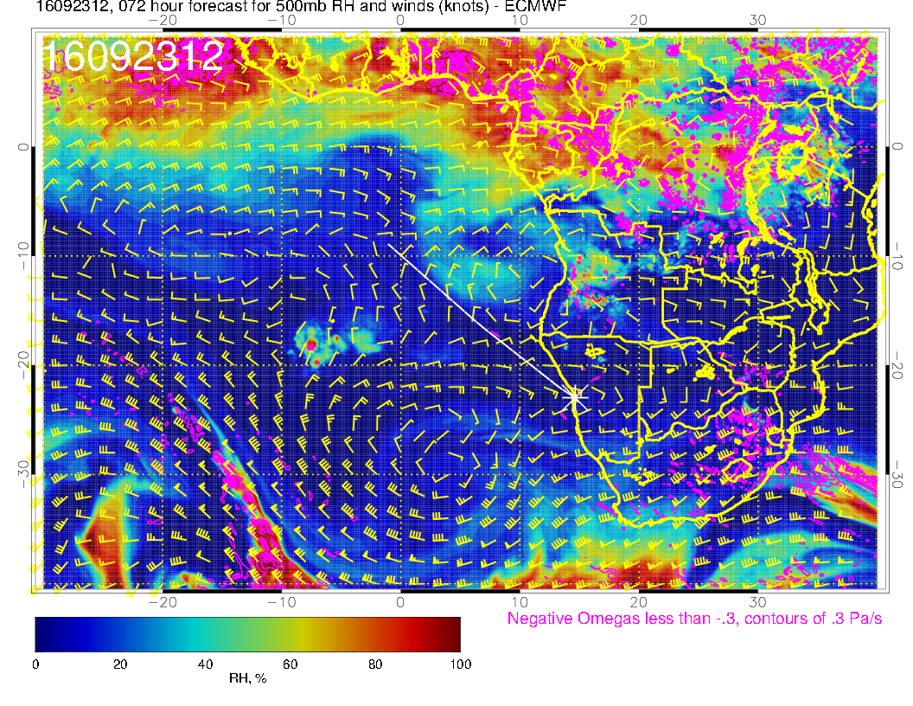
Generally more active pattern than in yesterday’s fcst (next slide), mostly in downstream RH surges. St Helena skies look to be interesting??

Slide 22
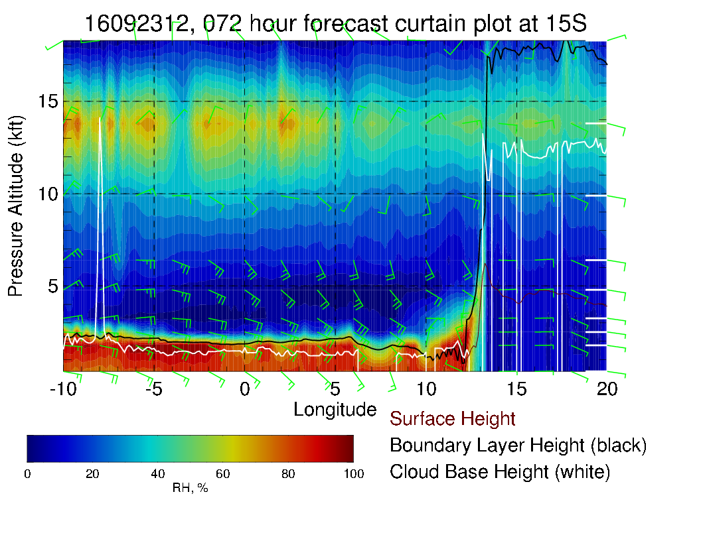
Yesterday’s fcst (not shown), is
less active in cross section, also shifted downward a bit at western longitudes.

Slide 23
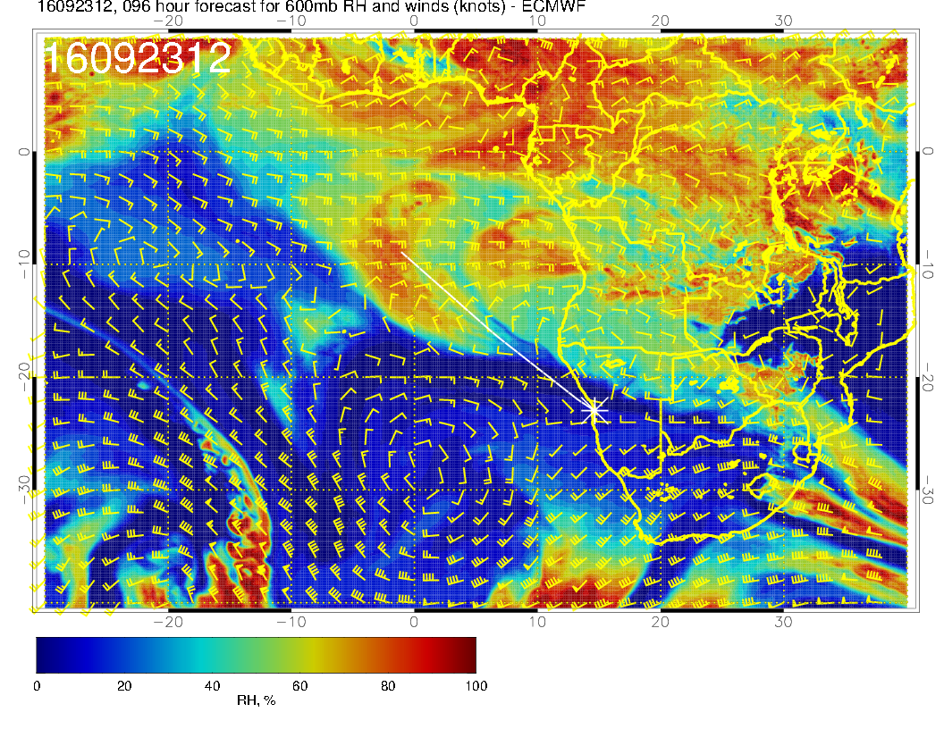
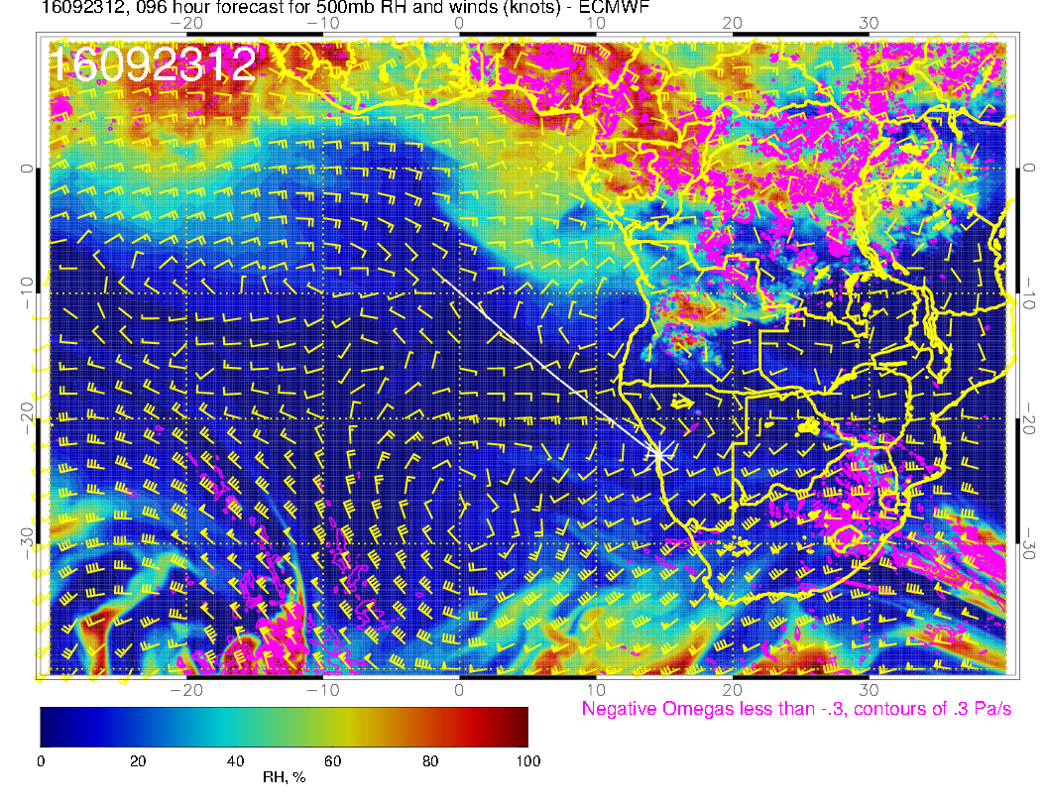
Yesterday’s fcst

Slide 24
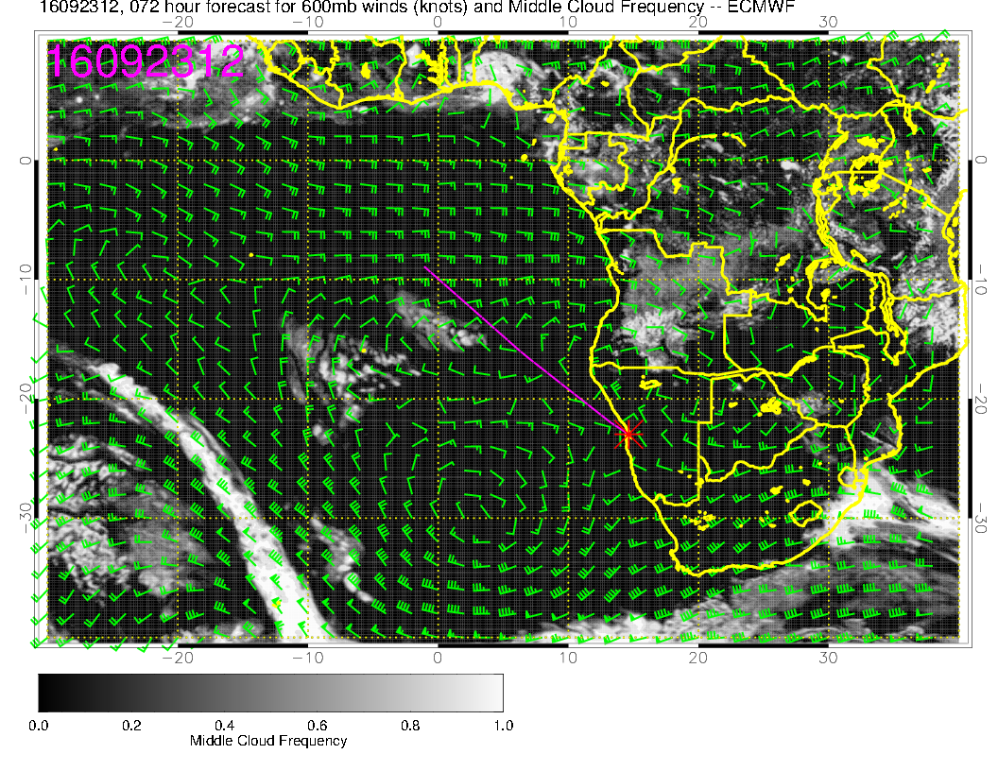
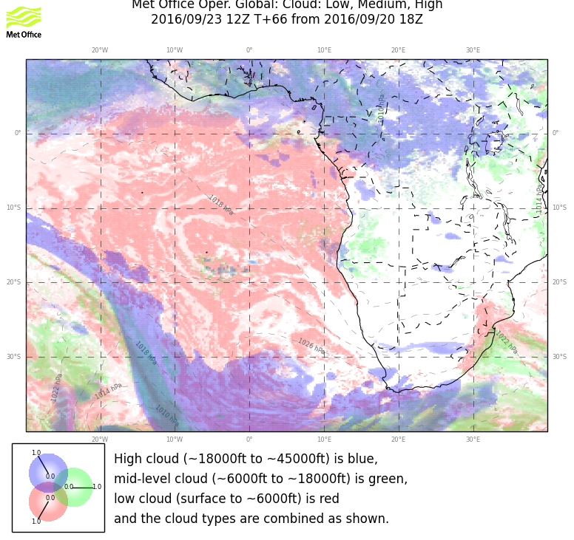
Middle cloud pattern substantially more aggressive than yesterday’s fcst in both models.

Slide 25
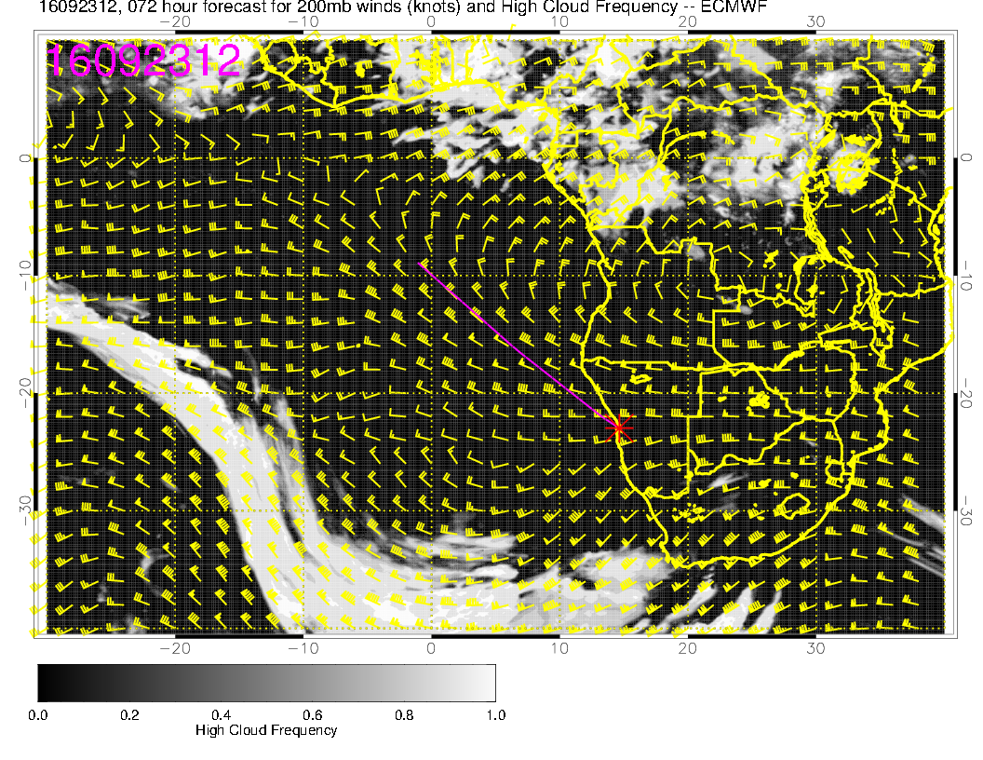
Model divergence at upper levels near south Angolan coast. Do not expect cirrus to materialize there.

Slide 26
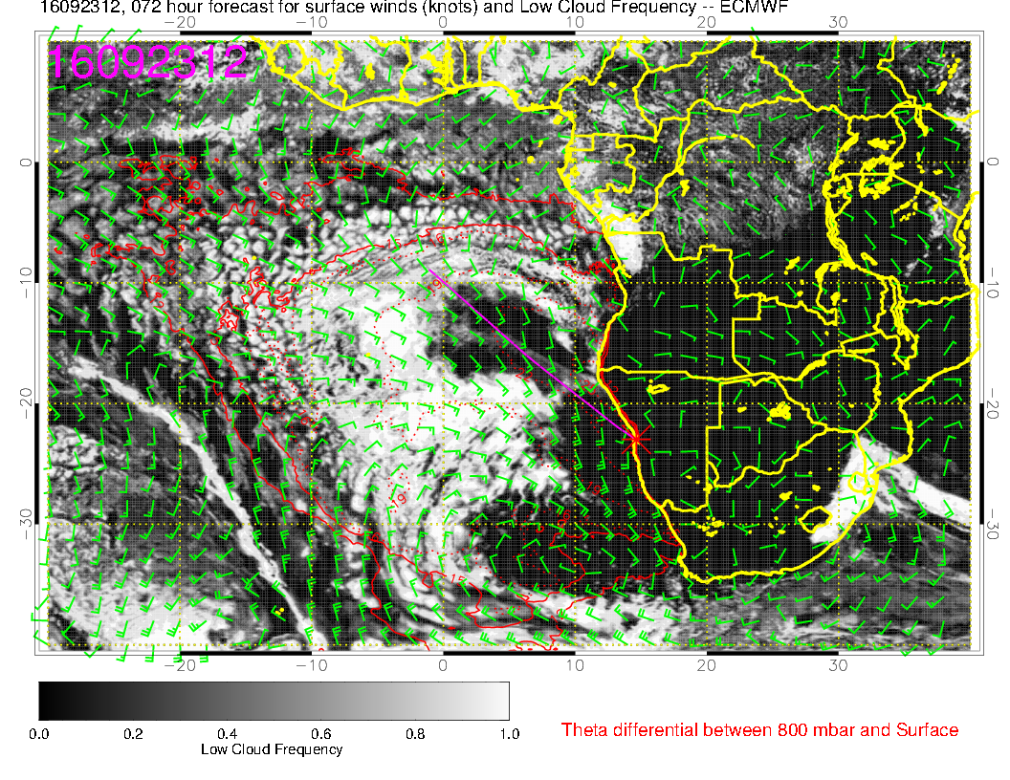
Quasi-clear region in EC from 11 to 18S goes with belt of lower BL heights. Clear region off
our coast makes sense with high and subsidence. Do not think clear region in UKMO between 20 and 30S and 0 and 10E will materialize. BL height is substantial there.

Slide 27
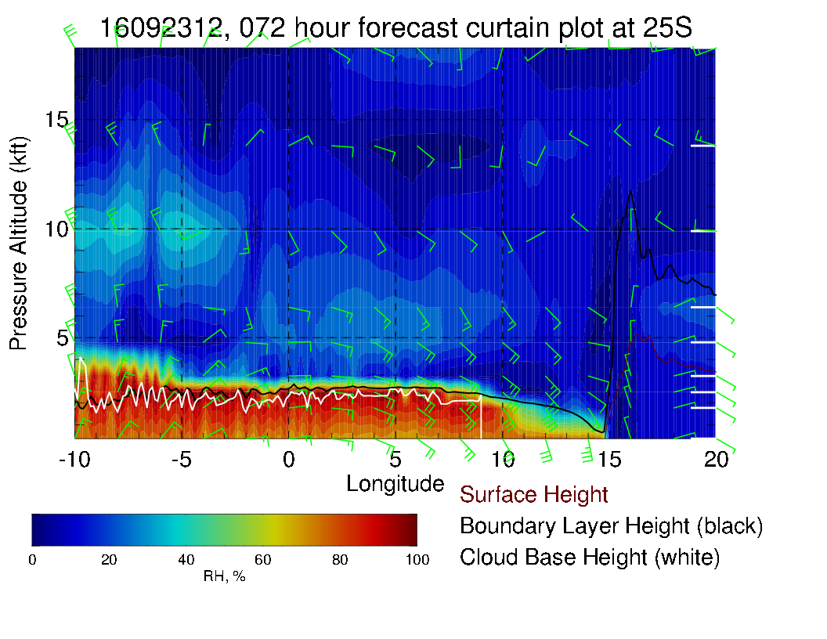
BL heights about a
km, ample cloud
west of 11E. Note
model disagreement

Slide 28
XS along 15S.

Slide 29
Saturday (no fly day, 20160924)

Slide 30
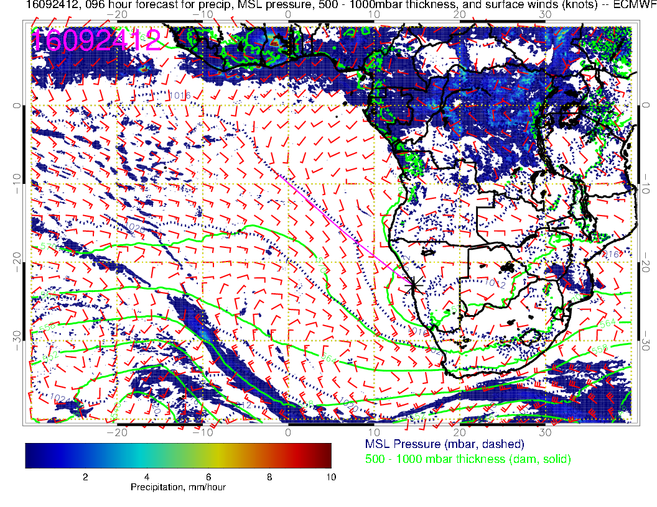
St Helena High impacted by approaching front, weakens, even more than in previous fcst. Except off of RSA west coast, generally weak wind conditions prevail.
Reverse eddy circulations appear down to YWB.
No wind issues. Morning
ceiling issues may be worse because of eddy circulations.

Slide 31
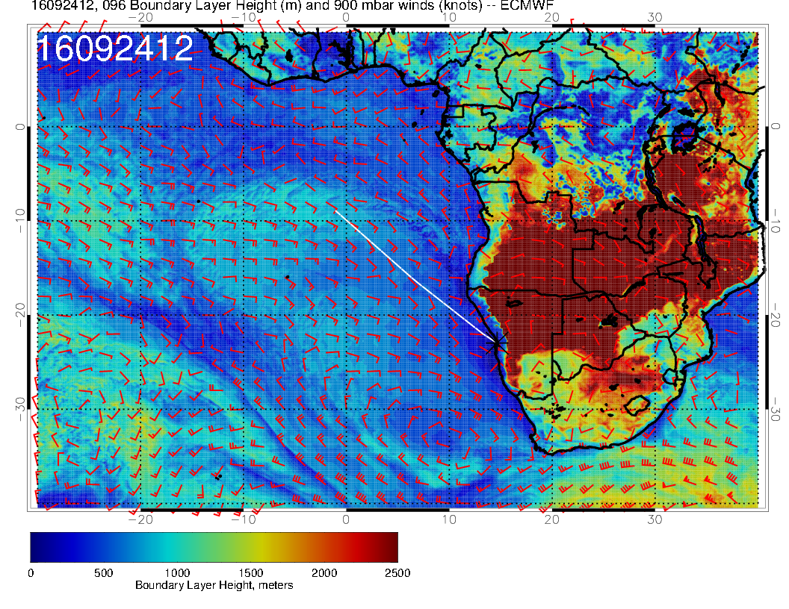
BL heights drop, both compared to Friday, 20160923 and compared to previous fcst.

Slide 32
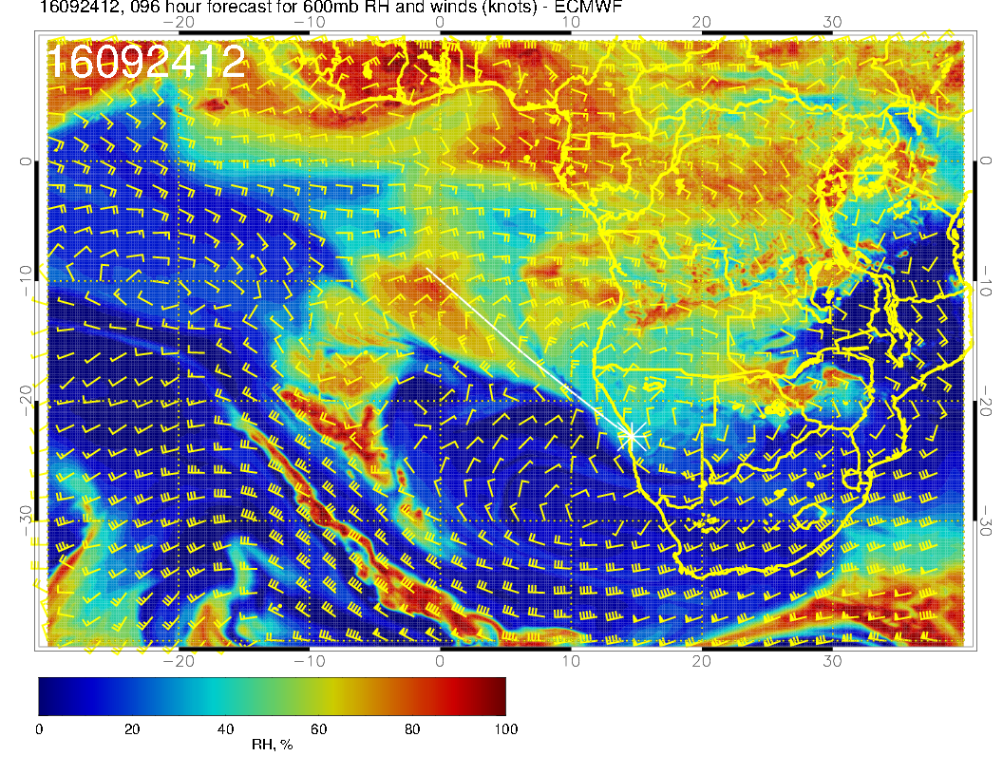
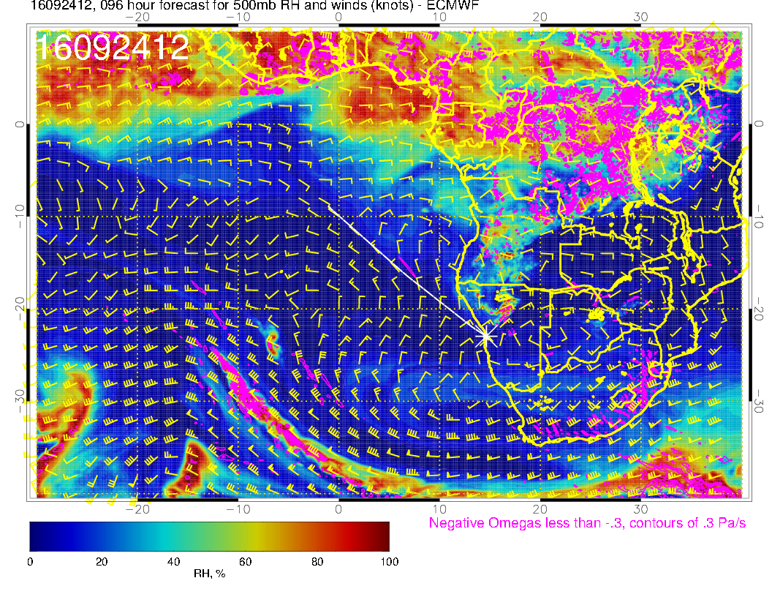
The A-train of moisture surges continues – older ones get caught up in the westerlies. 500mb activity weak

Slide 33
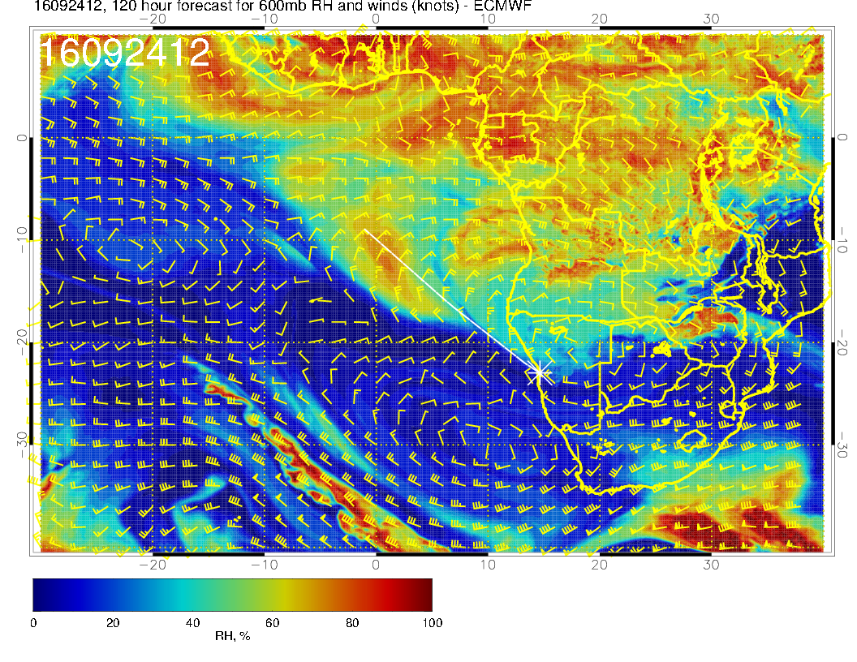
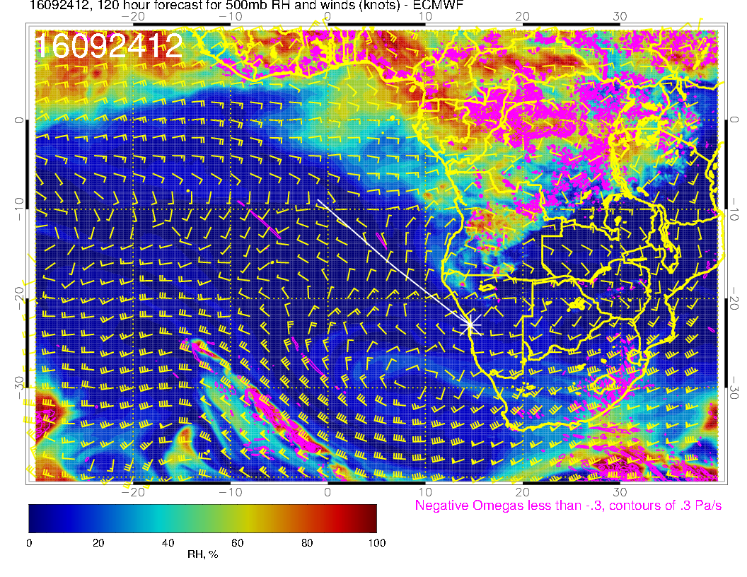
Yesterday’s fcst shows a stark contrast.

Slide 34
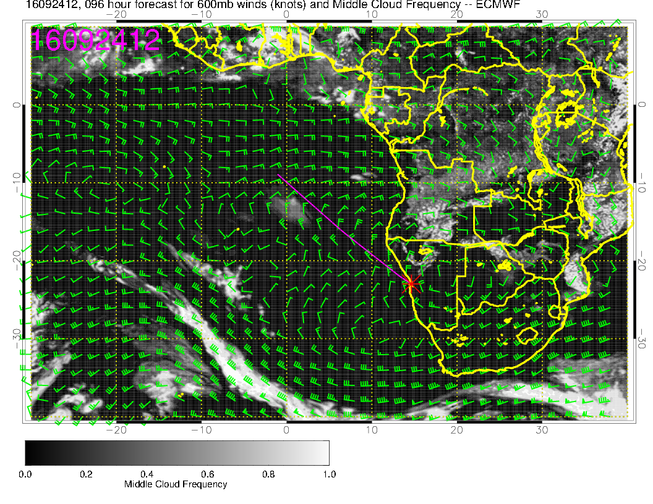
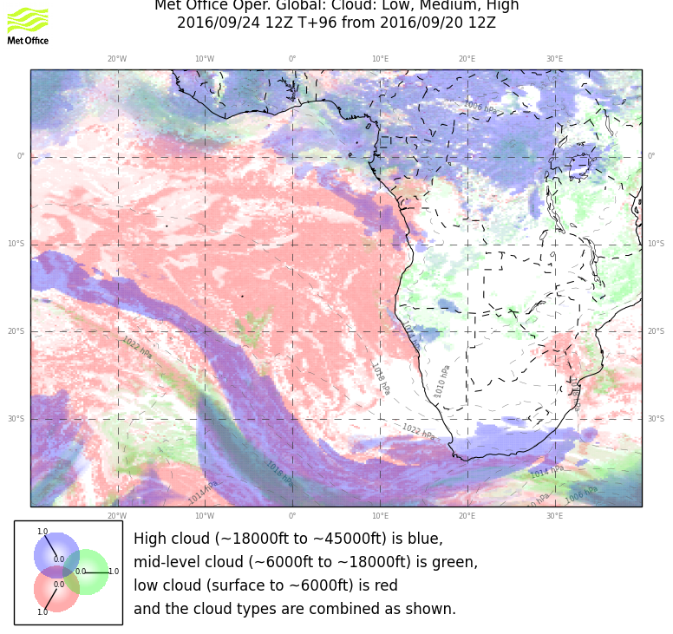
Not much high and middle cloud, but more than in yesterday’s forecast.

Slide 35
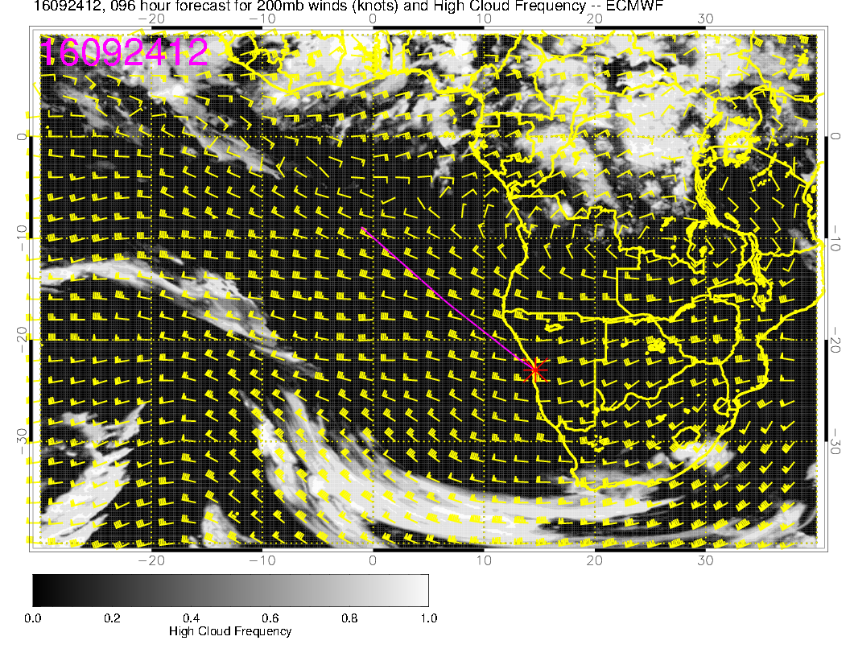
Absence of cirrus – midlatitude ridge, and strong tropical/subtropical flow from west – not much cross-equatorial flow. I see some higher RH’s at upper levels (150mb) developing along the Angolan coast – might see something develop in the fcsts in the next few days.

Slide 36
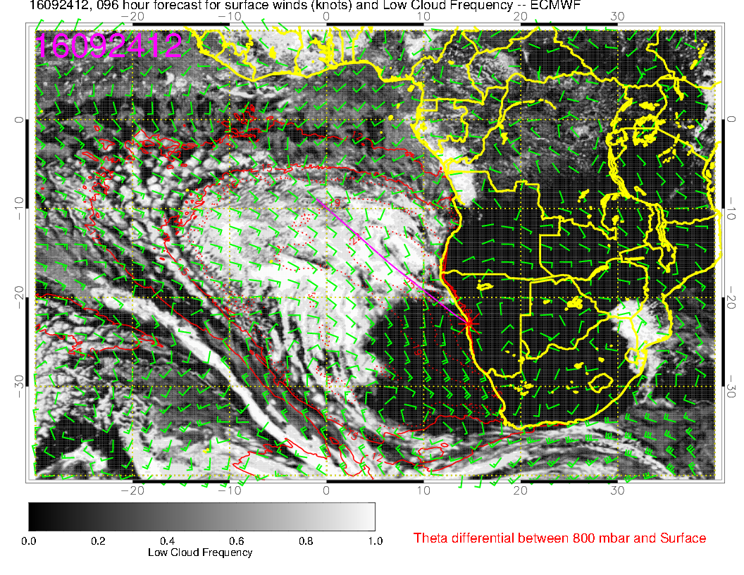
Surprising agreement this far out.

Slide 37
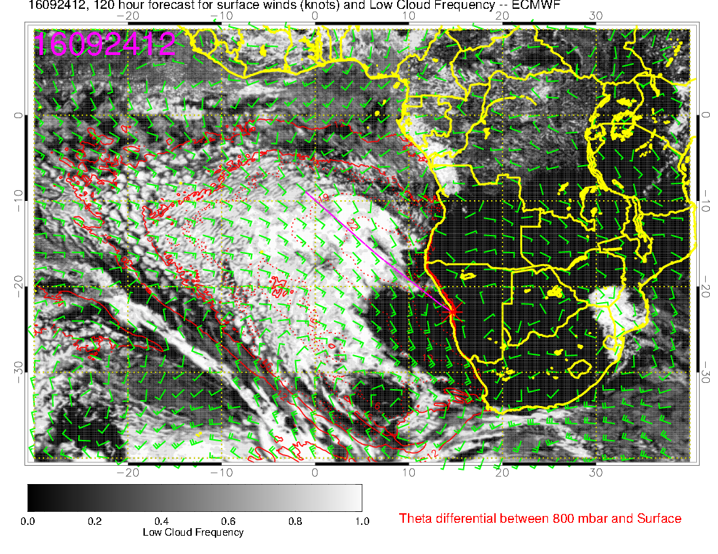
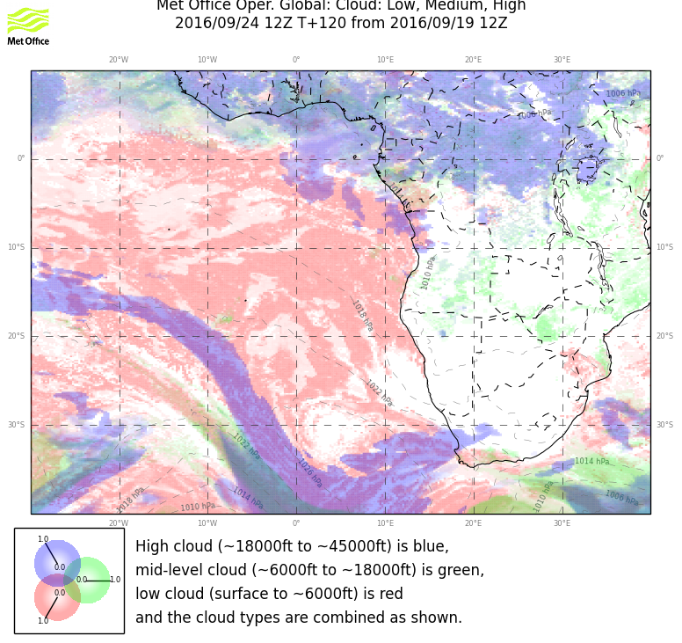
Stable forecast, too.

Slide 38
Sunday, 20160925

Slide 39
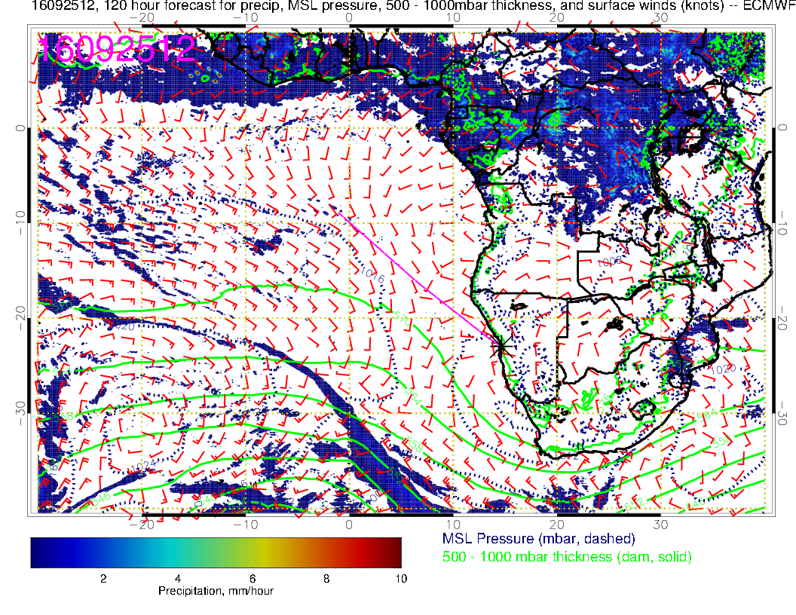
Another front approaches and the circulation weakens still more, northerlies develop along our coast – could get socked in – hard to say.

Slide 40
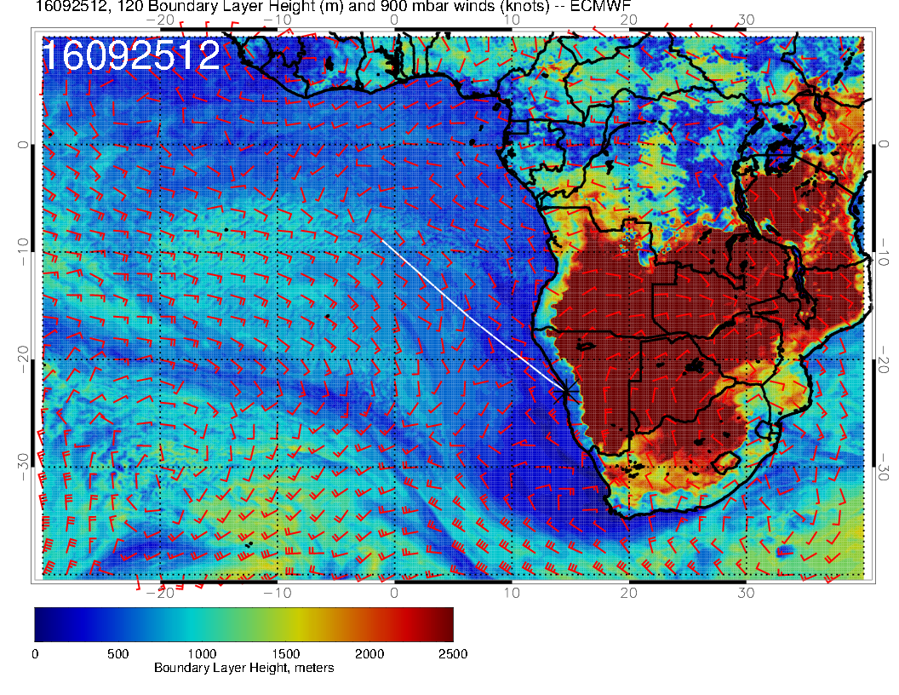
Low BL heights in a broad region along coast make me worry about fog in our area. I will not worry about this today – too far out – just something to think about.

Slide 41
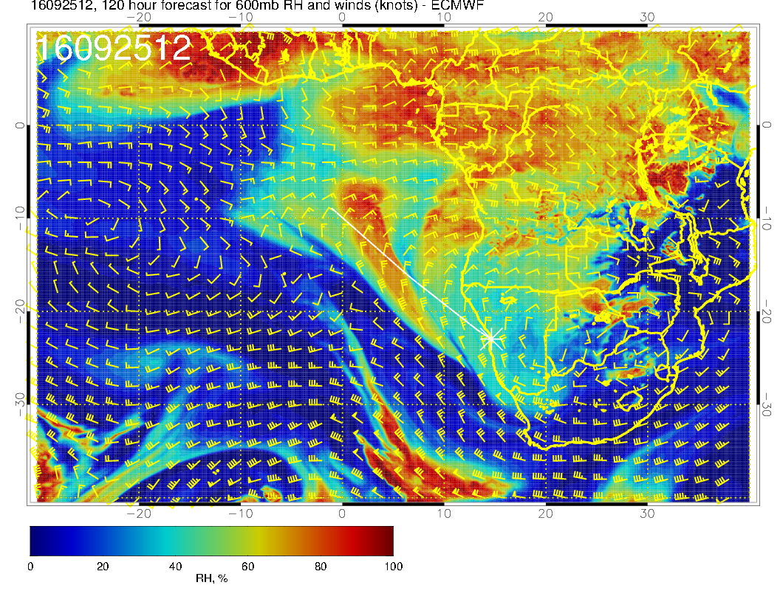
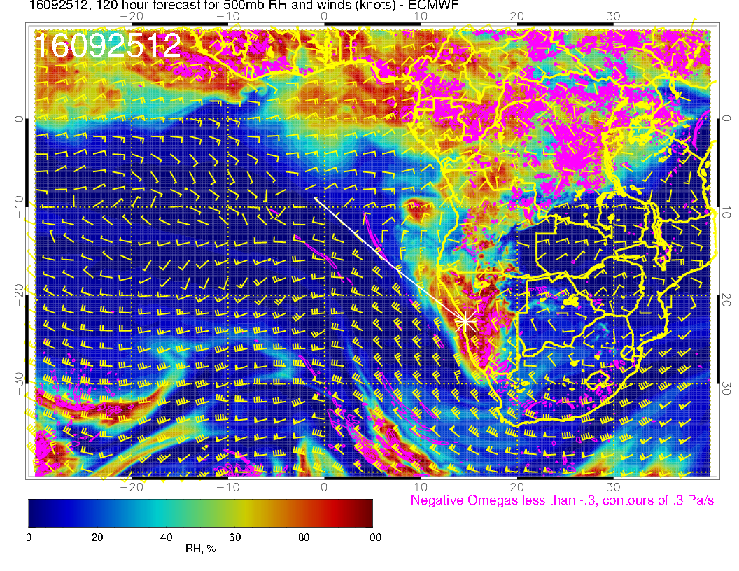
Some interesting developments at midlevels if this materializes. Strong amplifying trough near Greenwich meridian get some midlevel clouds over us

Slide 42
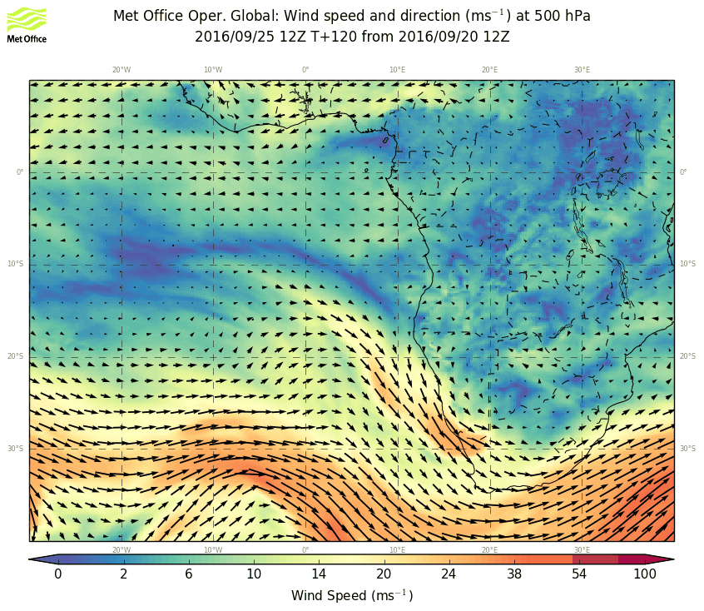
I would say the two European models agree pretty well on this development.

Slide 43
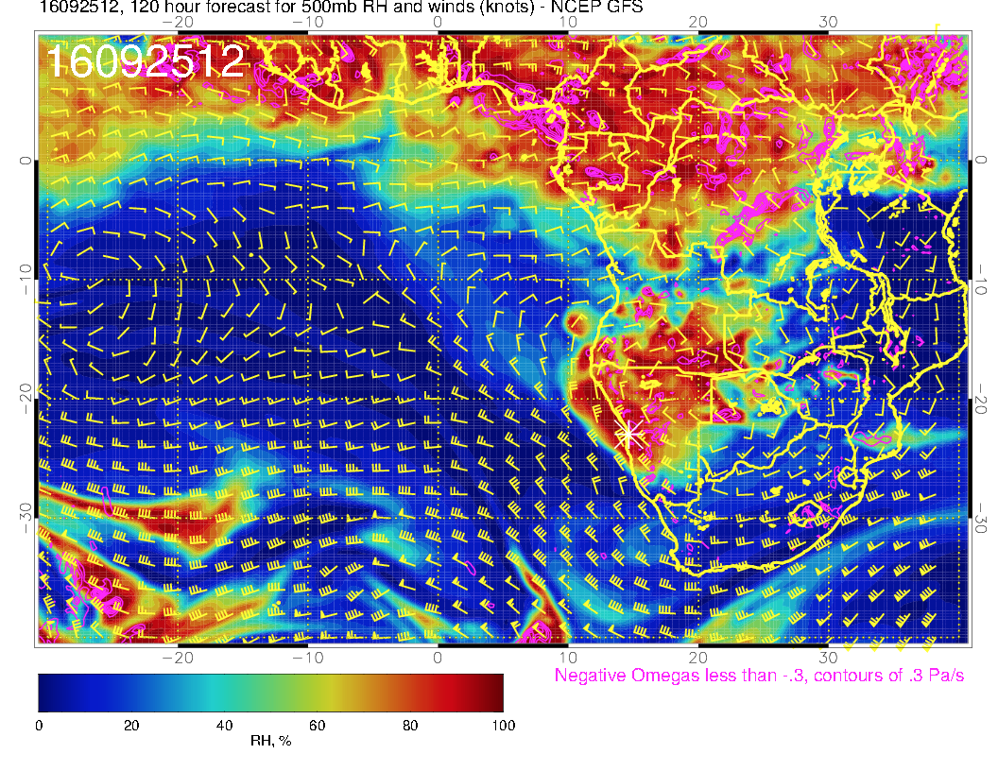
GFS is pretty similar too.

Slide 44
Decent consensus on SW African clouds, less so on oceanic mid-level clouds

Slide 45
Classification is a bit different, but only real difference is penetration of jet stream
cirrus to 23S near 7E.

Slide 46
Go with UKMO here (though slits could materialize). BL heights are low, lots of thin fog
covering the area off our coast (EC has the beginnings of the fog hook).

