Slide 1
ORACLES Forecast Briefing (Aerosols)
21 September 2016

Slide 2
The Aerosol Week

Slide 3
Walvis Bay
Dust
OC+BC+SO4

Slide 4
Gobabeb
Dust
OC+BC+SO4

Slide 5
Thursday 22 September 2016
Routine/Coordinated Flight

Slide 6
Thursday 22 September 2016 6Z

Slide 7
Thursday 22 September 2016 6Z

Slide 8
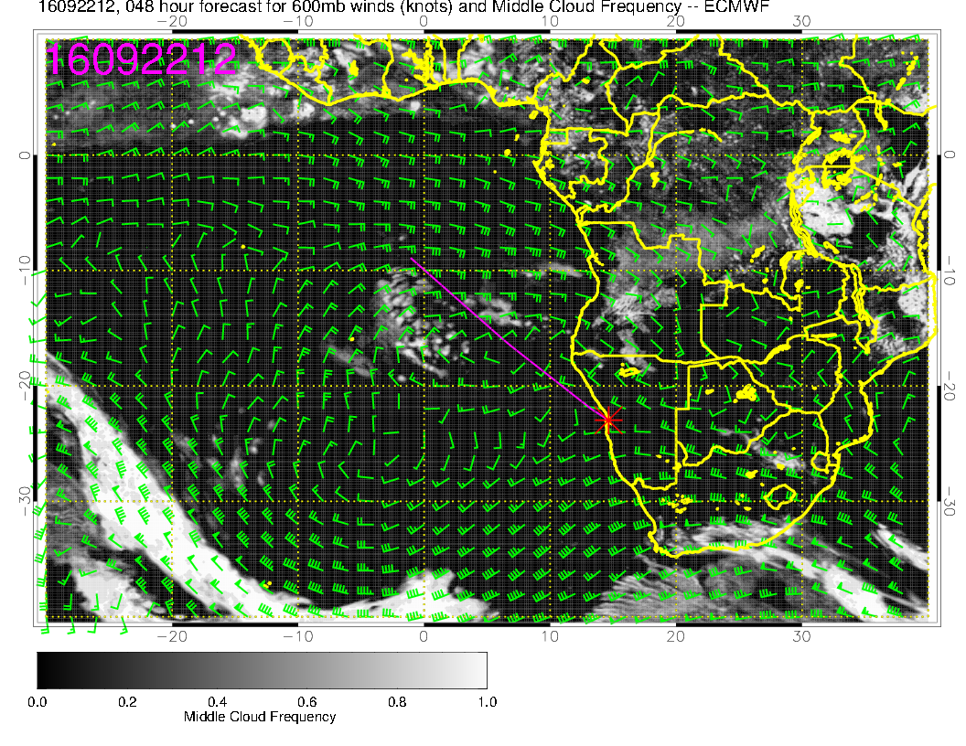
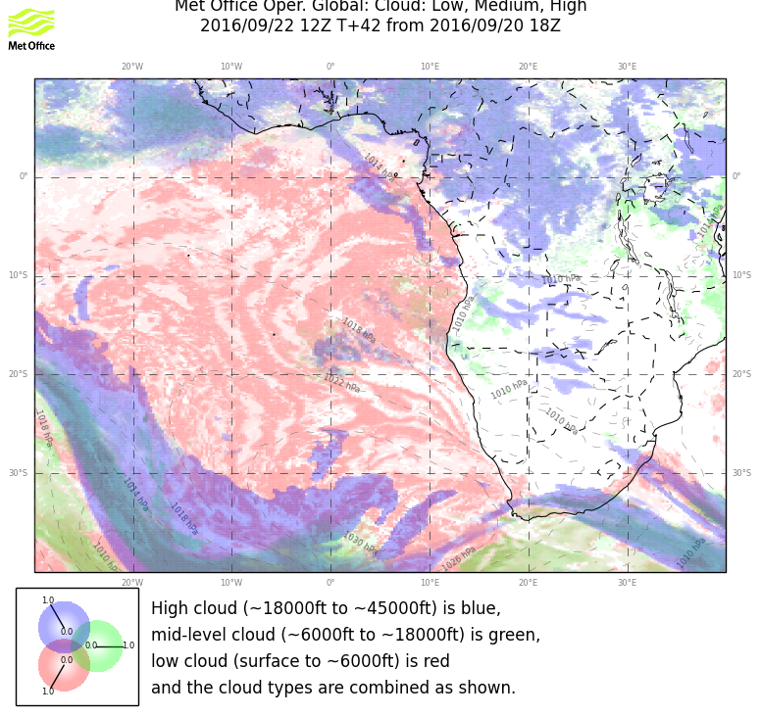
Mid cloud moving westward, not dissipating during flight period as much. UKMO shows more pronounced gap in cloud between the two surges. Definitely more advanced westward than previous fcst. UKMO fcsts more cloud than yesterday’s fcst.

Slide 9
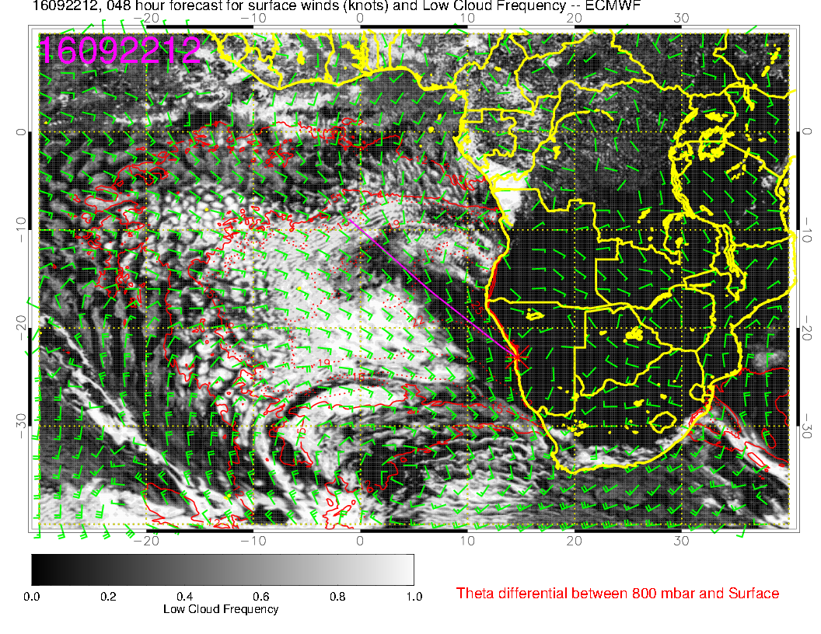
Still model divergence here. I do not see the tomahawk in the UKMO. Generally, both models show more low cloud cover than yesterday’s fcst.

Slide 10
September 22 12z AOD (update)

Slide 11
September 22 12z AOD (old)

Slide 12
NW – SE September 22 12z (update)

Slide 13
NW – SE September 22 12z
ACAOD
AOD
AGE-Mode
AGE -

Slide 14
N-S @10E September 22 12z AOD(n) NW-SE

Slide 15
N-S @10E September 22 12z AOD NW-SE
GEOSS
WRF

Slide 16
Friday 23 September 2016
Flight Day

Slide 17
GEOS-5 AOD, Fri 23 Sep 2016 9Z

Slide 18
GEOS-5 AOD, Fri 23 Sep 2016 9Z
HIGH

Slide 19
GEOS-5 AOD, Fri 23 Sep 2016 9Z
MID

Slide 20
GEOS-5 AOD, Fri 23 Sep 2016 9Z
LOW

Slide 21
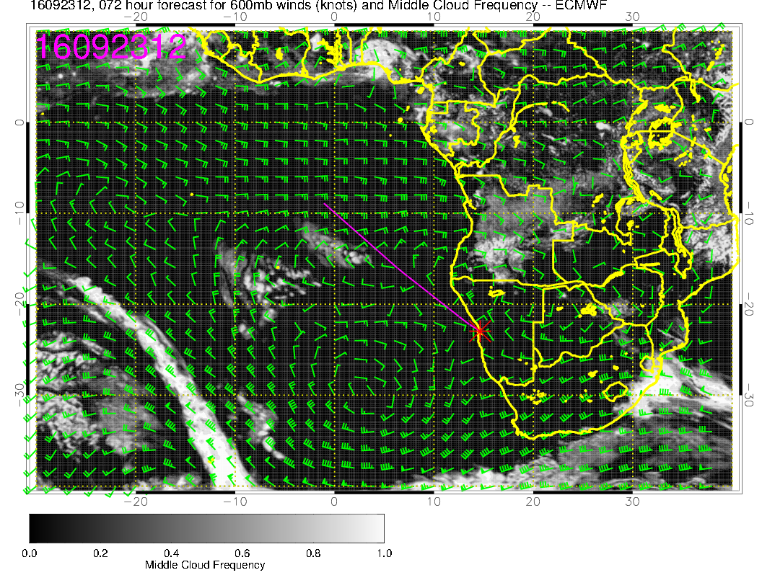
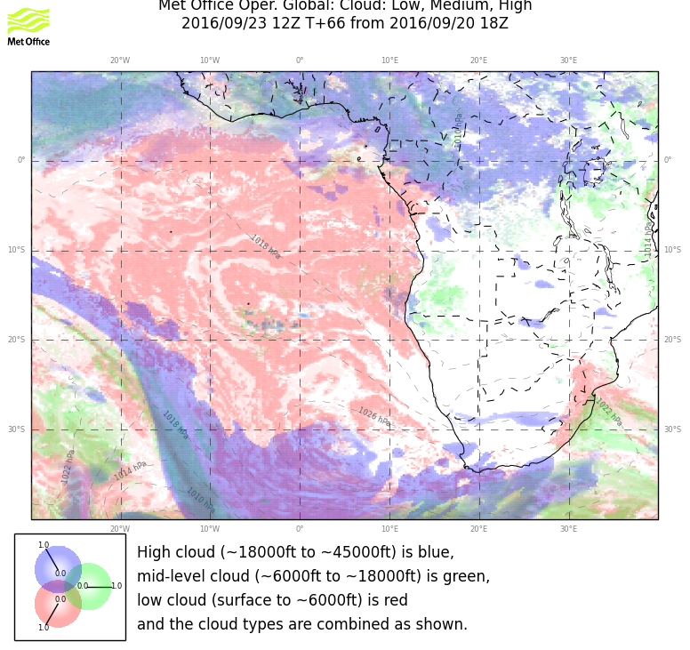
Middle cloud pattern substantially more aggressive than yesterday’s fcst in both models.

Slide 22
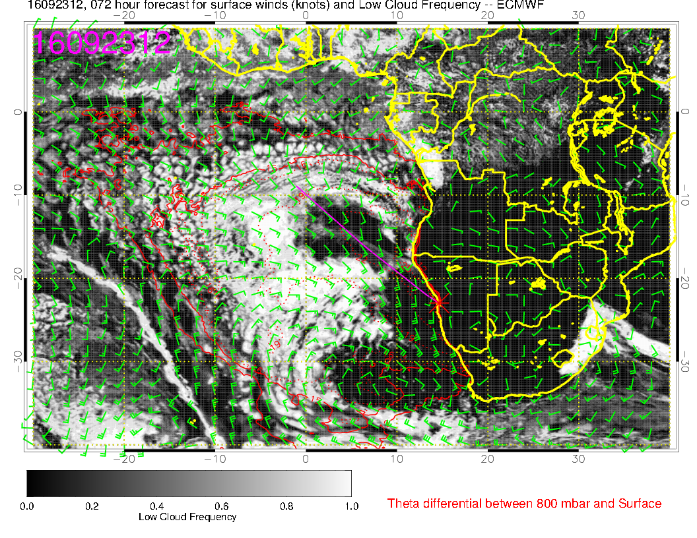
Quasi-clear region in EC from 11 to 18S goes with belt of lower BL heights. Clear region off
our coast makes sense with high and subsidence. Do not think clear region in UKMO between 20 and 30S and 0 and 10E will materialize. BL height is substantial there.

Slide 23
September 23 12z AOD (update)

Slide 24
Friday 23 12Z

Slide 25
W – E@20S September 23 12z

Slide 26
W – E@20S September 23 12z

Slide 27
W-E @25S September 23 12z AOD(n) W-E@20S

Slide 28
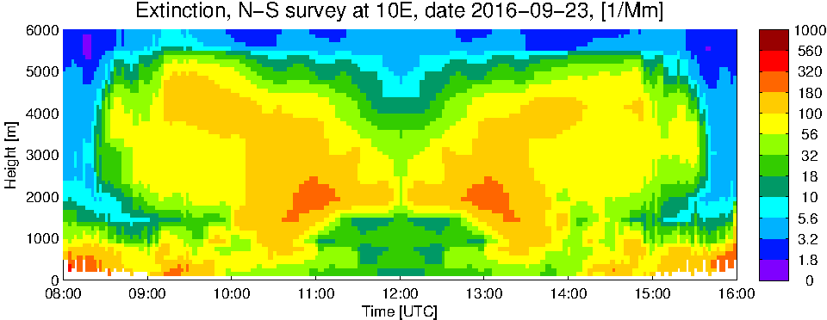
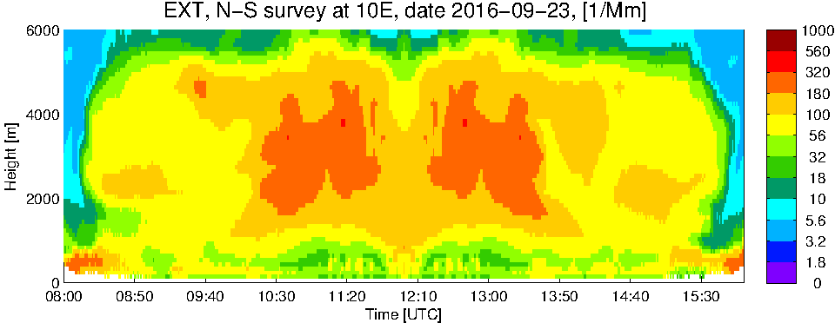
W-E @10E September 23 12z AOD(n) NW-SE

Slide 29
S-N@10E September 23 12z AOD(n)

Slide 30
Saturday 24 September 2016
Non-Flight Day (Friday)

Slide 31
GEOS-5 AOD, Sat 24 Sep 2016 9Z

Slide 32
Sunday 25 September 2016
Flight Day (Friday)

Slide 33
GEOS-5 AOD, Sun 25 Sep 2016 6Z

Slide 34
Clouds, Sun 25 Sep 2016 6Z
MID
HIGH

Slide 35
Forecast Consistency: Sun 25 Sep 2016 0Z

Slide 36
GEOS-5, Sun 25 Sep 2016 9Z

Slide 37
GEOS-5, Sun 25 Sep 2016 9Z

Slide 38
GEOS-5 NW-SE, Sun 25 Sep 2016

Slide 39
GEOS-5 N-S@10E, Sun 25 Sep 2016

Slide 40
GEOS-5 E-W@15S, Sun 25 Sep 2016

