Slide 1
ORACLES forecasting briefing Meteorology for 22-09-2016 – 24-09-2016
20-09-2016 (revised 3 PM)
Lenny Pfister

Slide 2
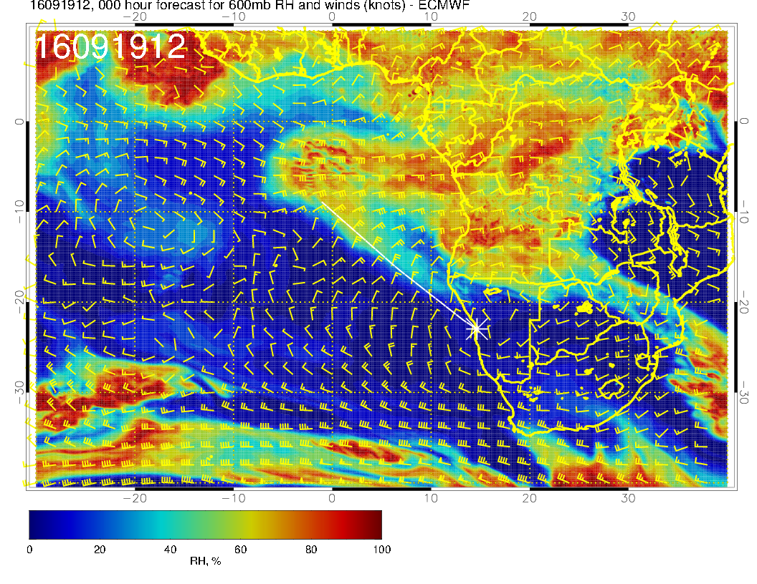
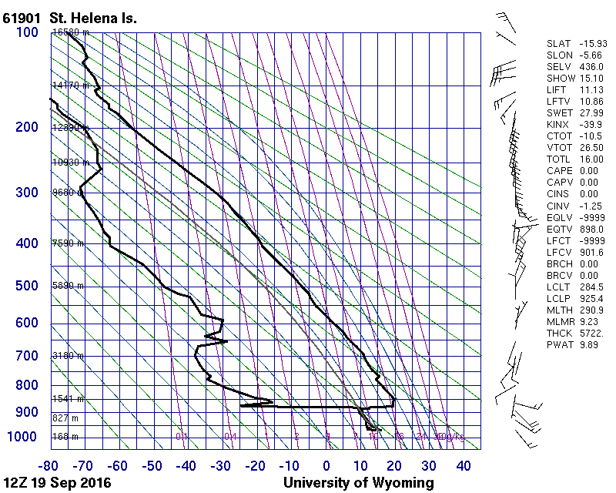
Do not see the enhanced RH we saw yesterday at SH (see a little bit), or much
of a “kink” at 600mb. SH is in dry air, not moisture plume

Slide 3
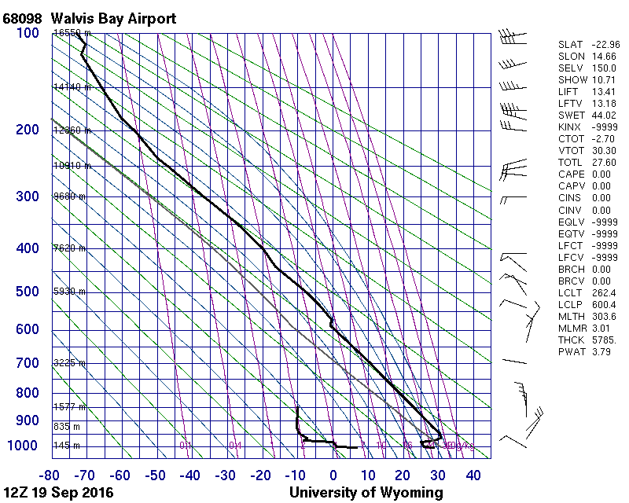
We have daily soundings 12Z at YWB – many of which are making Wyoming.
See kink at 600mb, along with wind shift. Note really low inversion. This is yesterday.

Slide 4
Thursday (1st btb)
Sequence of surface charts through week shows high strengthening and moving east (some weakening Sat). Stronger pressure gradients.
Higher BL heights than previous days.
Fog type hook continues Thursday over YWB, so expect ceiling issues.
Winds are strong in the PM, 210 at 18 knots, close to limits
At 600mb, high moisture generated on 9/20 is dissipating (subsidence) at or just SW of routine track.
Middle cloud consistent with 600mb moisture – major component over routine track, some scattered throughout operating region.
Little or no cirrus.
Ample low cloud north of 15S, significant clearing south of that.

Slide 5
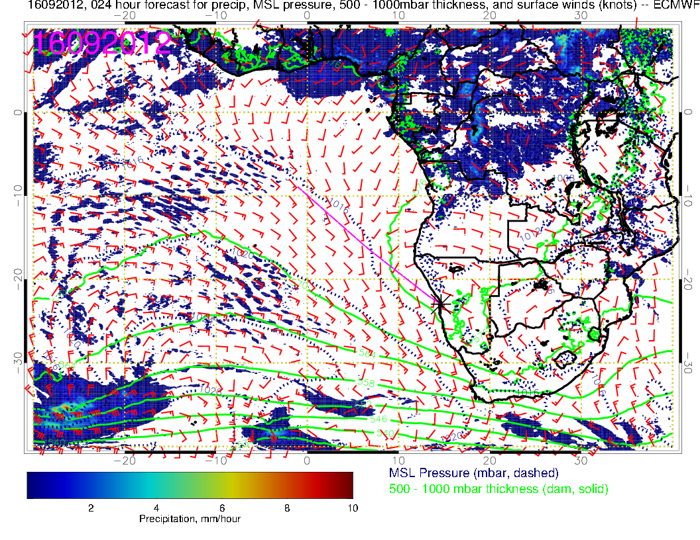

Slide 6
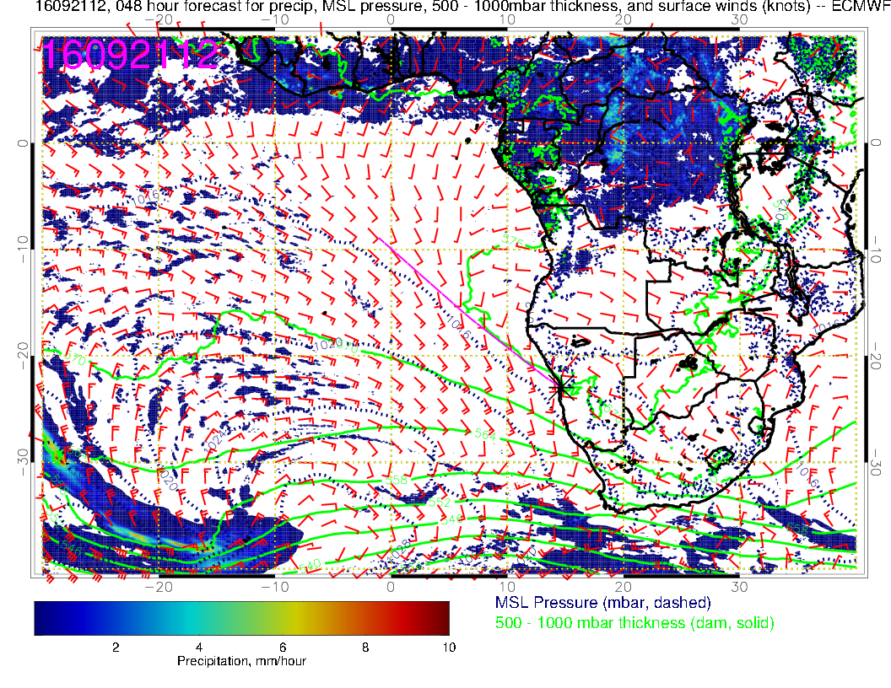

Slide 7
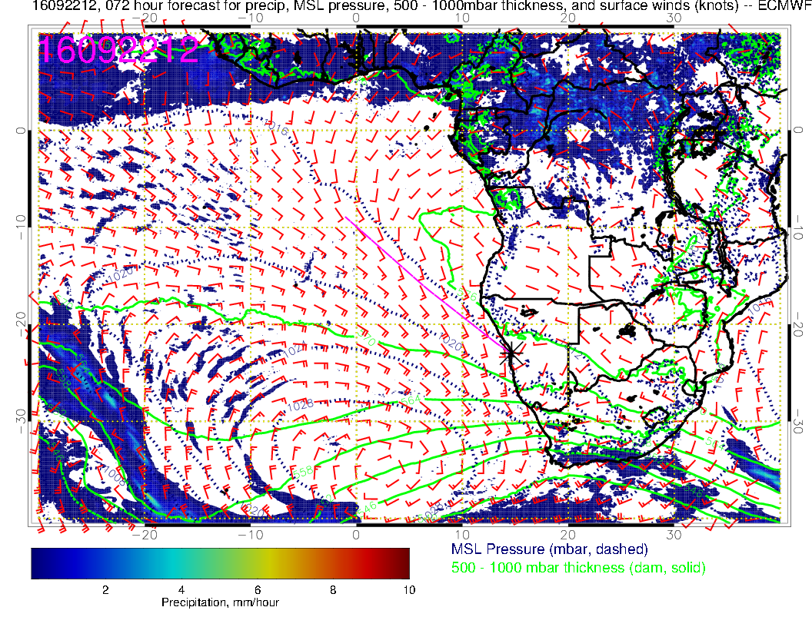

Slide 8
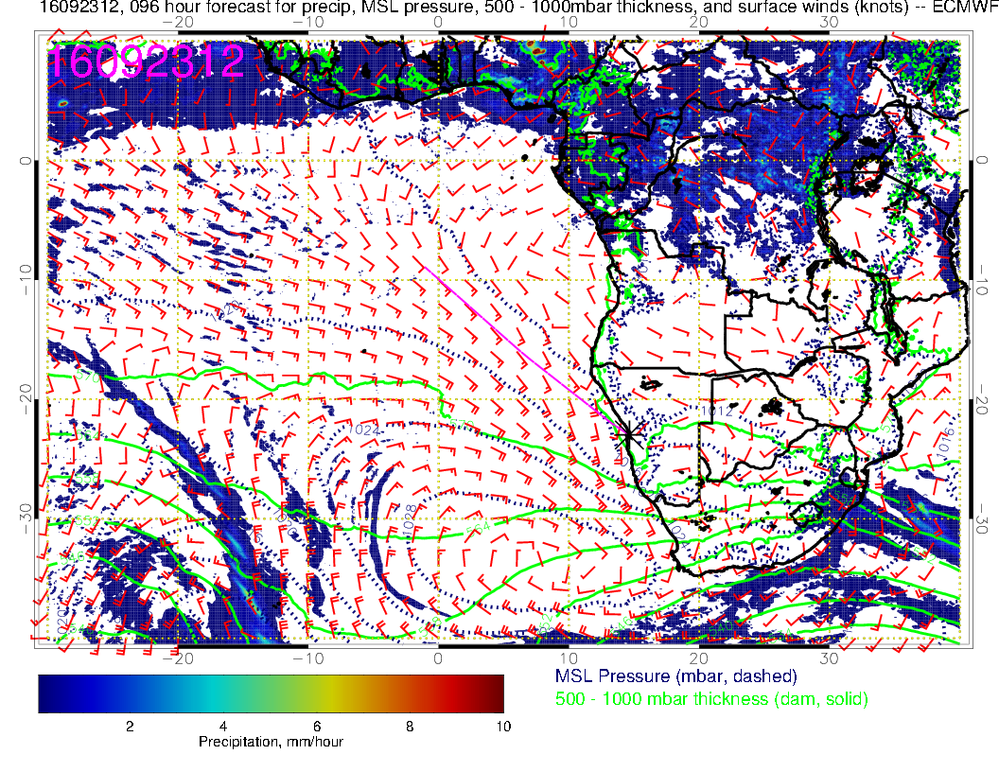
High moves closer, increasing winds near the coast.
Still a large region of weak surface winds around Angola bay.

Slide 9
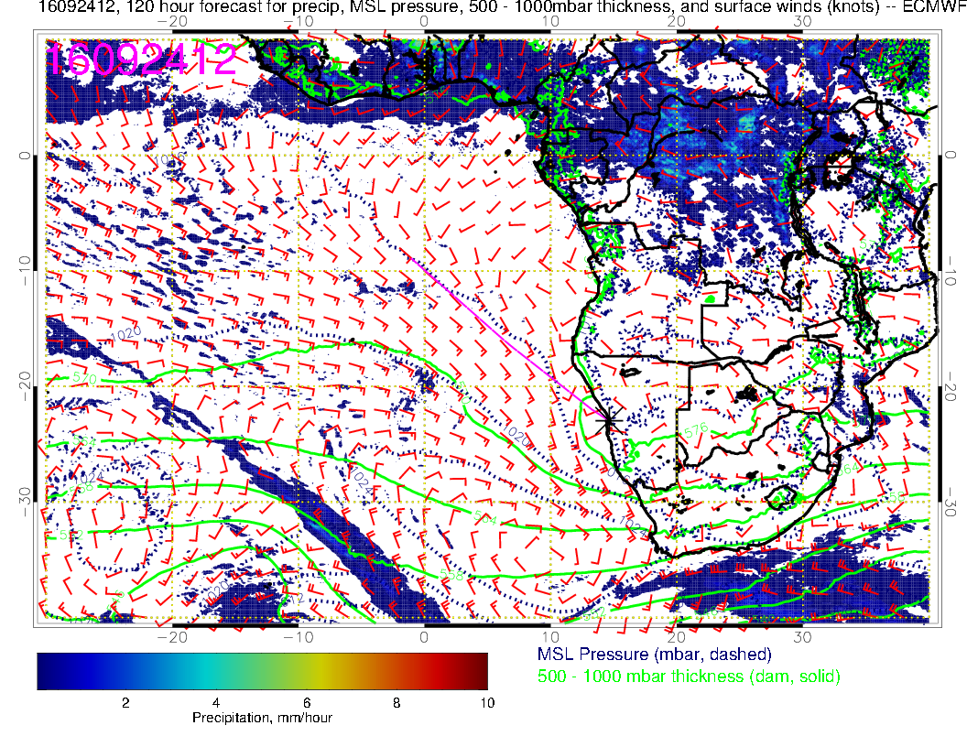
High moves closer to RSA. Eddy develops off central Namibia. Large weak flow region in Angola bight.
120 hour fcst – UKMO has high displaced westward by 3 degrees.

Slide 10
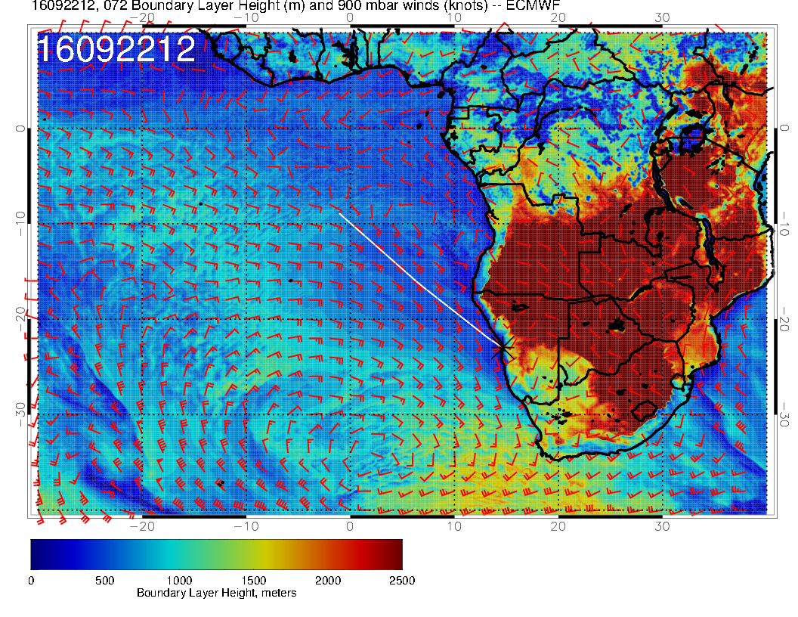
Much higher BL heights than previous days, and that includes YWB.

Slide 11
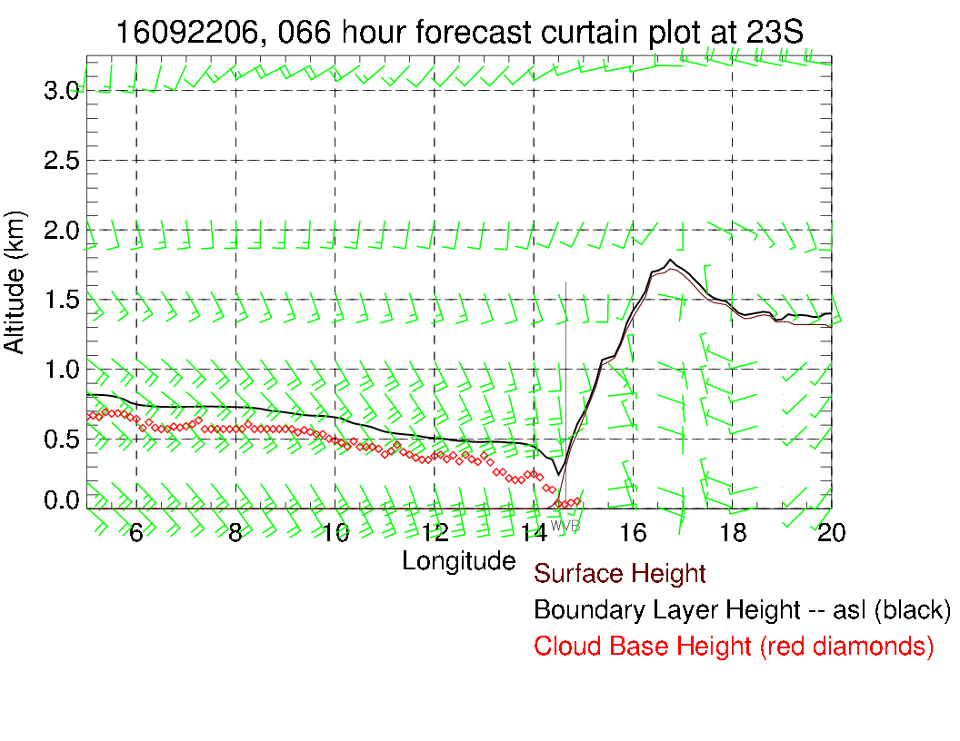
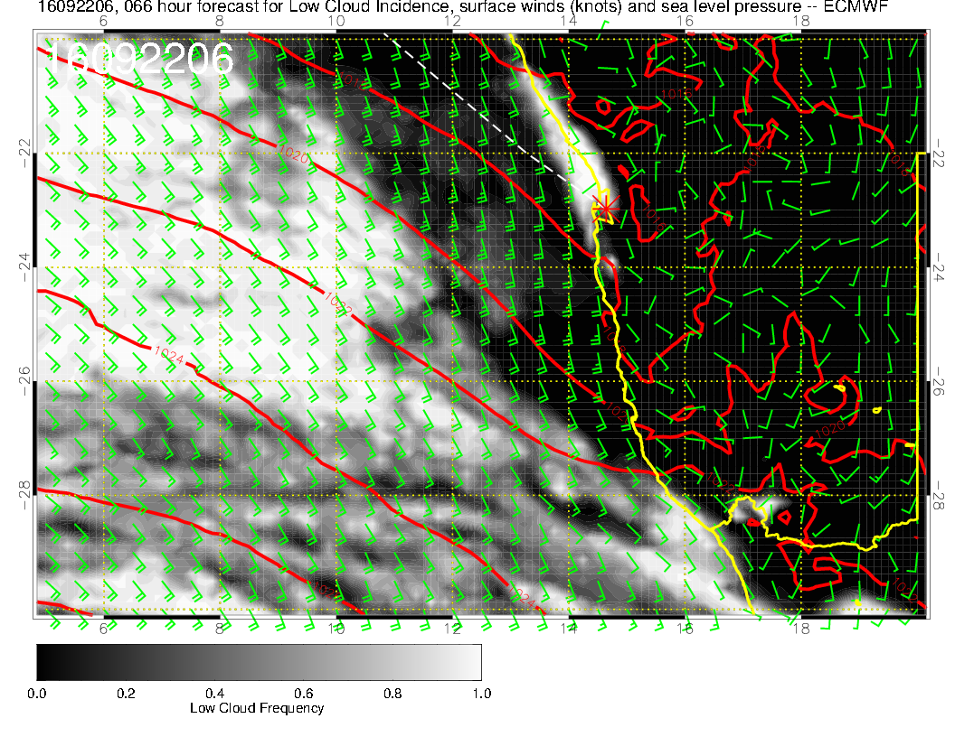
Still expect ceiling issues in AM

Slide 12
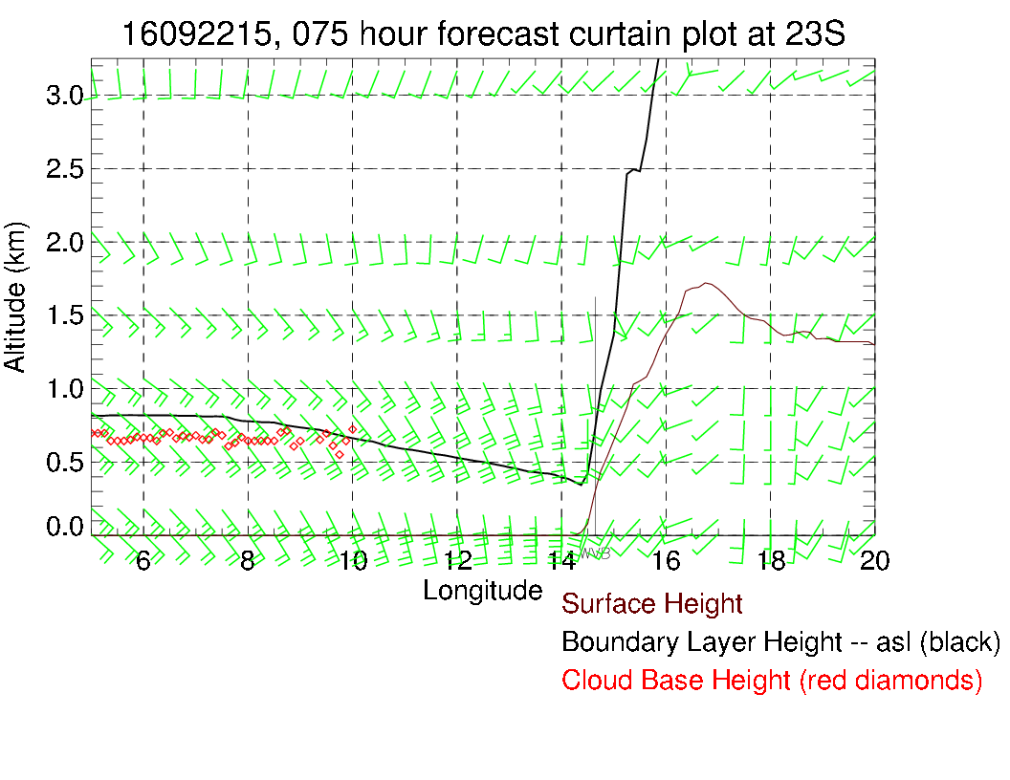
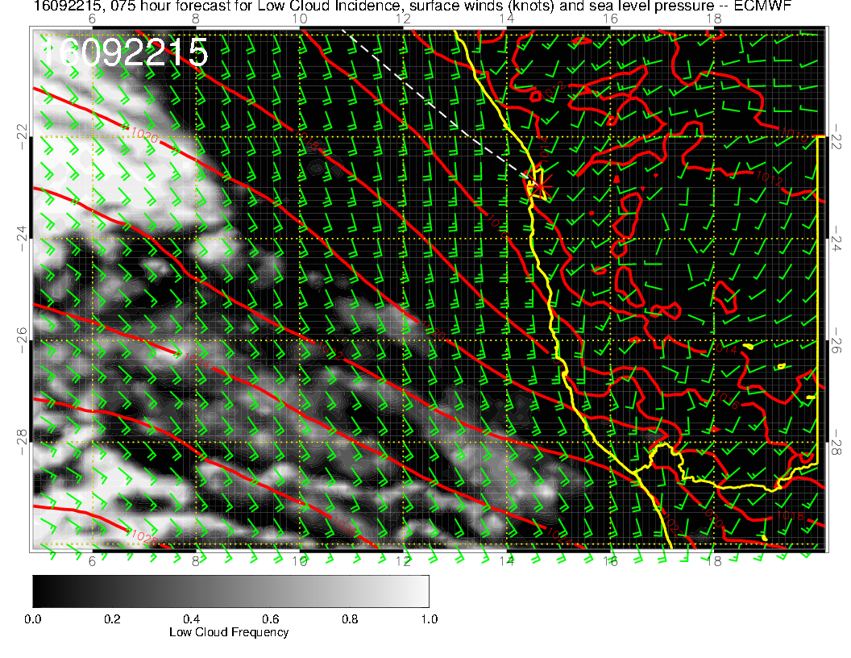
Looks a bit like Sunday for winds but BL height is higher.

Slide 13
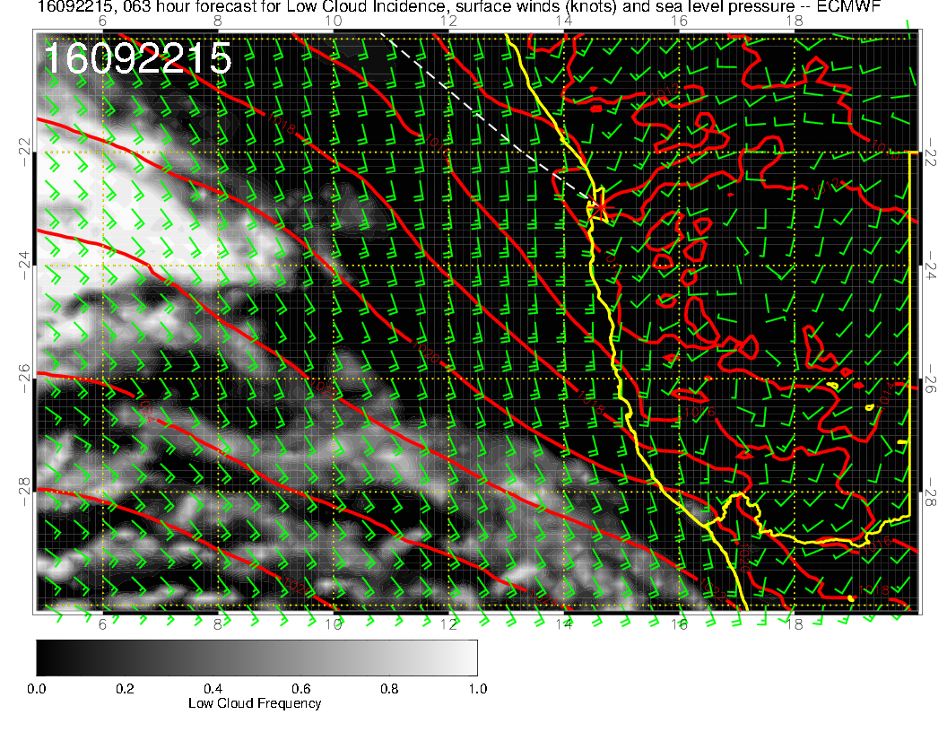

Slide 14
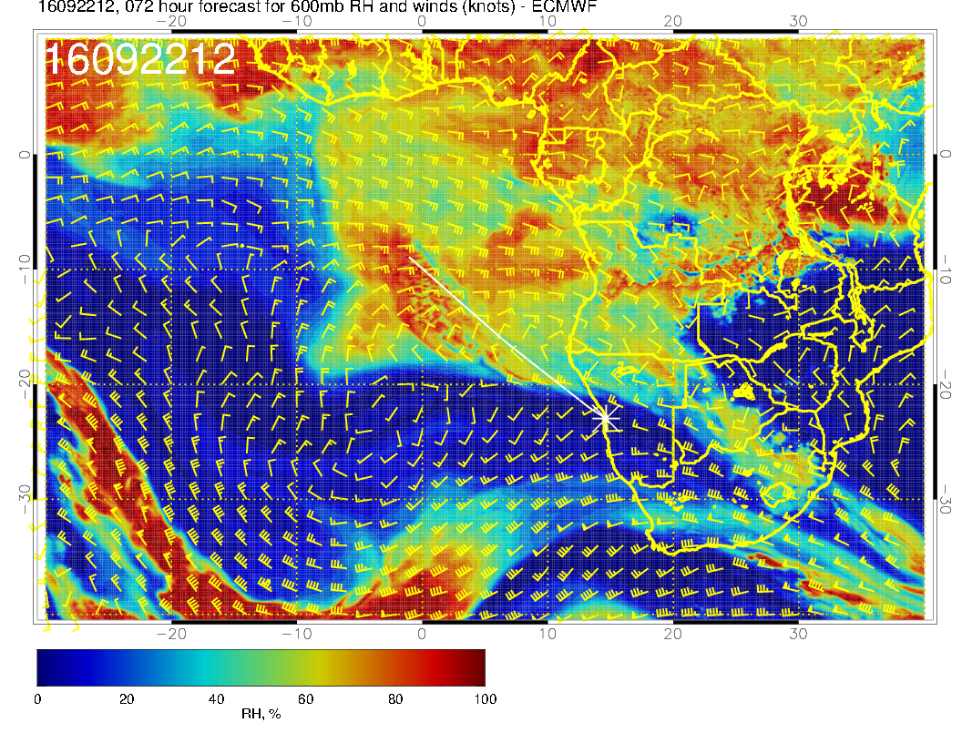
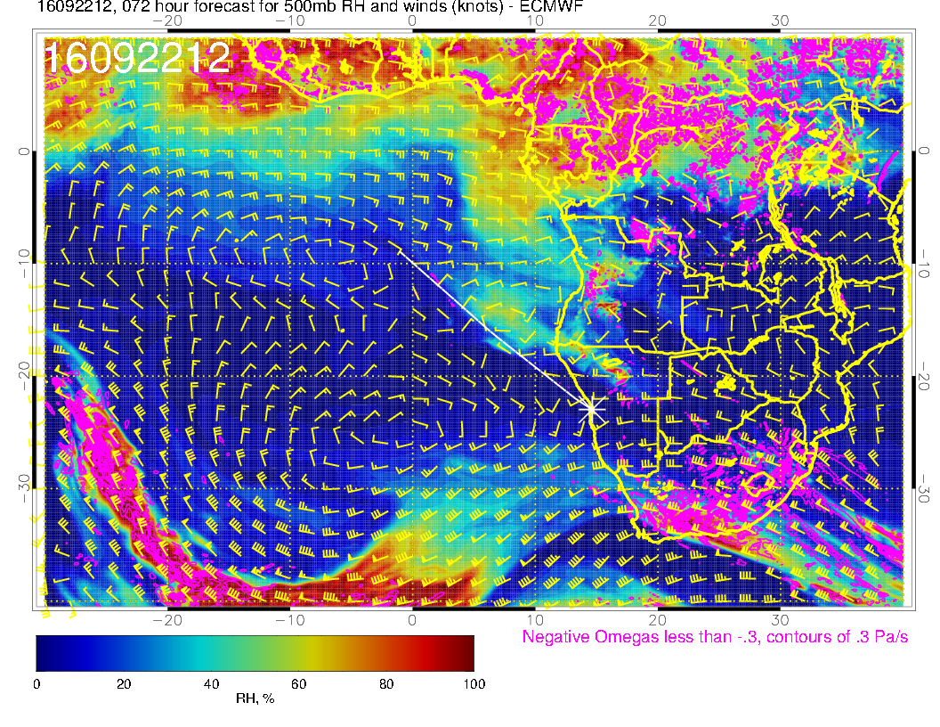
RH at 500mb less than previous days. 600mb anticyclone starting to be distended by midlat trough.
Plume reaches St Helena

Slide 15
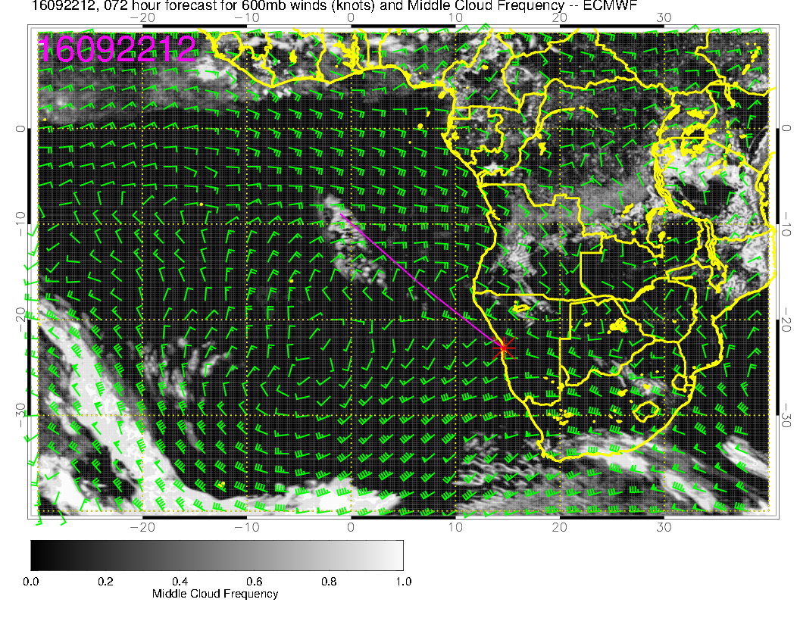
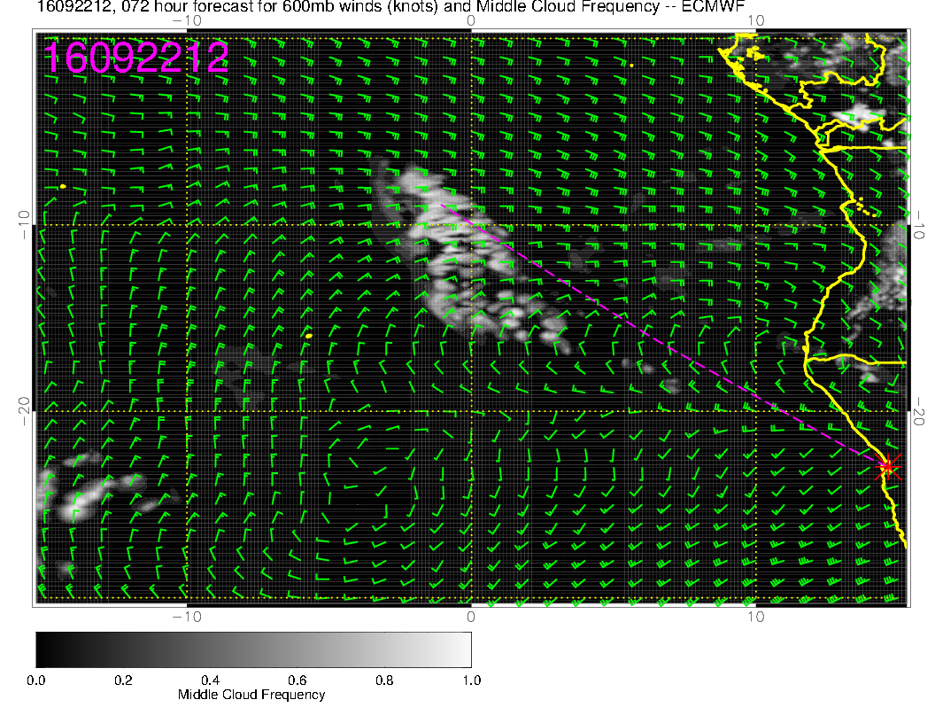
Mid level cloud scattered throughout region.

Slide 16
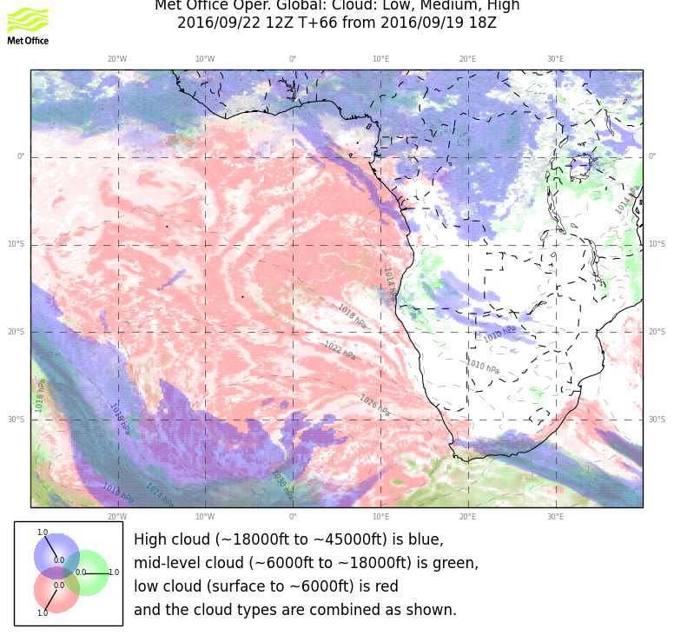
Mid level cloud scattered throughout region.

Slide 17
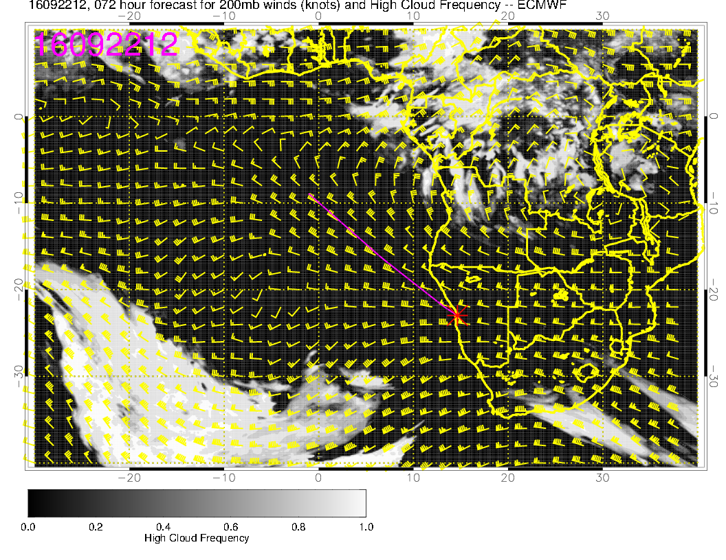
Models diverge on the high cloud forecast. I expect minimal
cirrus in forecast region on this day.

Slide 18
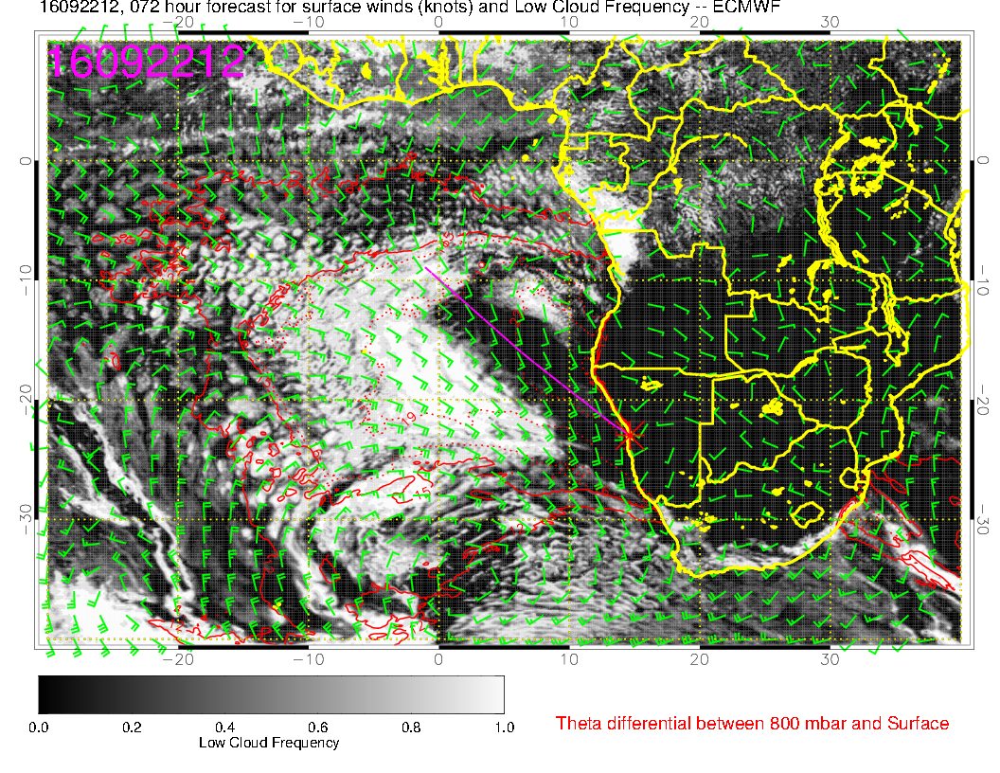
Some resemblance here – would expect ample low cloud north of 15S.
This is about the point (in forecast hours) where skill declines rapidly.

Slide 19
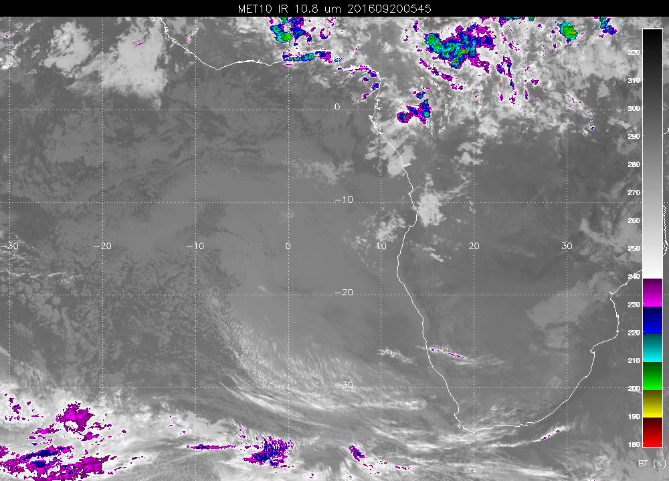
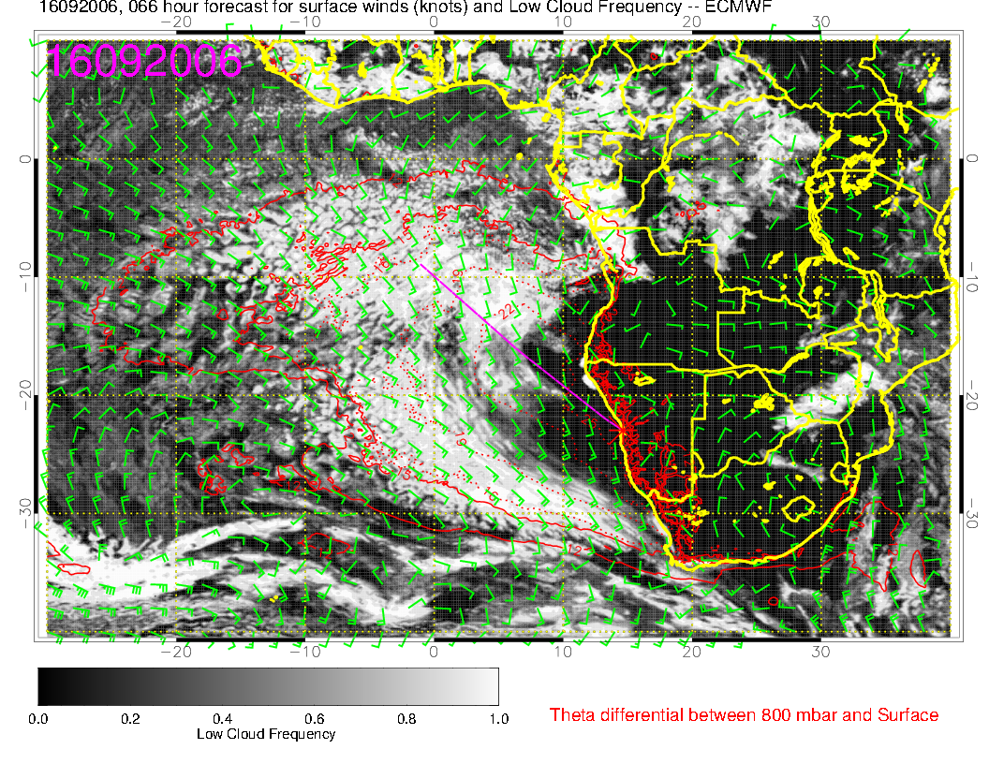
Similar forecast period shows model getting cloud clearing to central Namibia but clearly excessive clearing off Angola

Slide 20
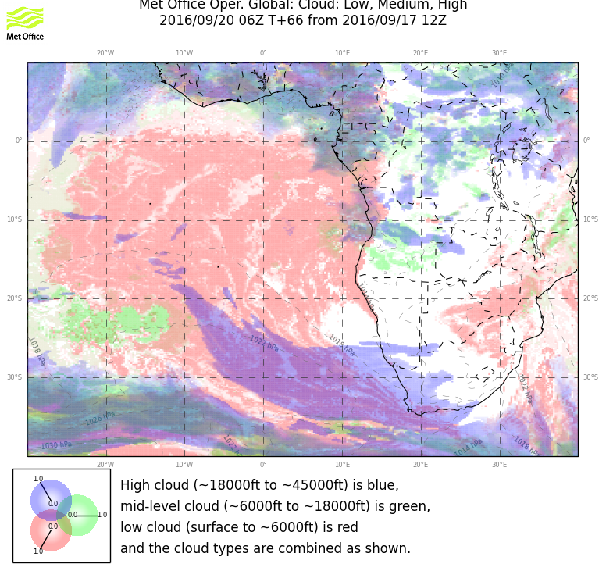
Similar forecast period shows UKMO model performing well on the low cloud incidence at 66 hours

Slide 21
Friday (2nd btb)
High moves east, similar strong winds to Thursday in operating region, but letting up near YWB.
Ceiling issues remain in the morning, but better than Thursday.
BL heights go up in operating region.
Middle cloud progressively decreases through the week.
No cirrus expected in operating region.

Slide 22
High moves closer, increasing winds near the coast.
Still a large region of weak surface winds around Angola bay.

Slide 23
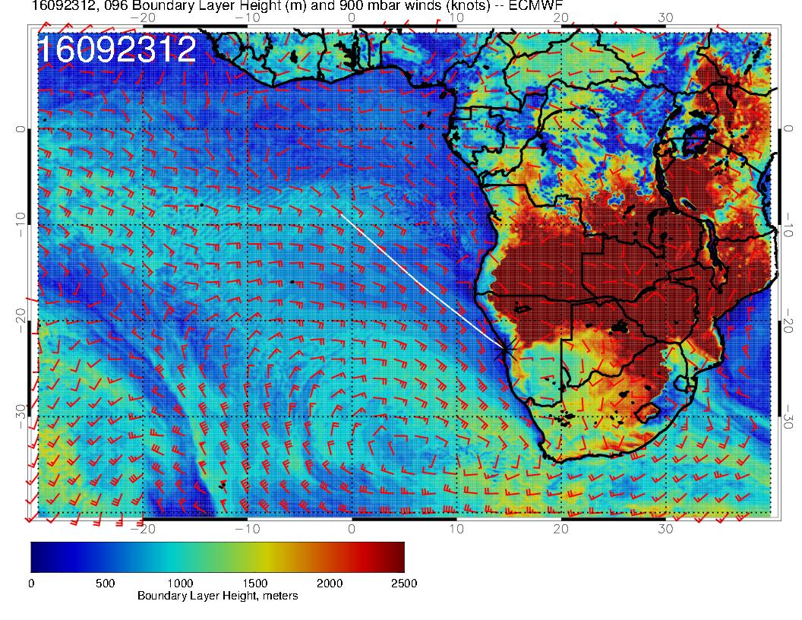
BL heights go up

Slide 24
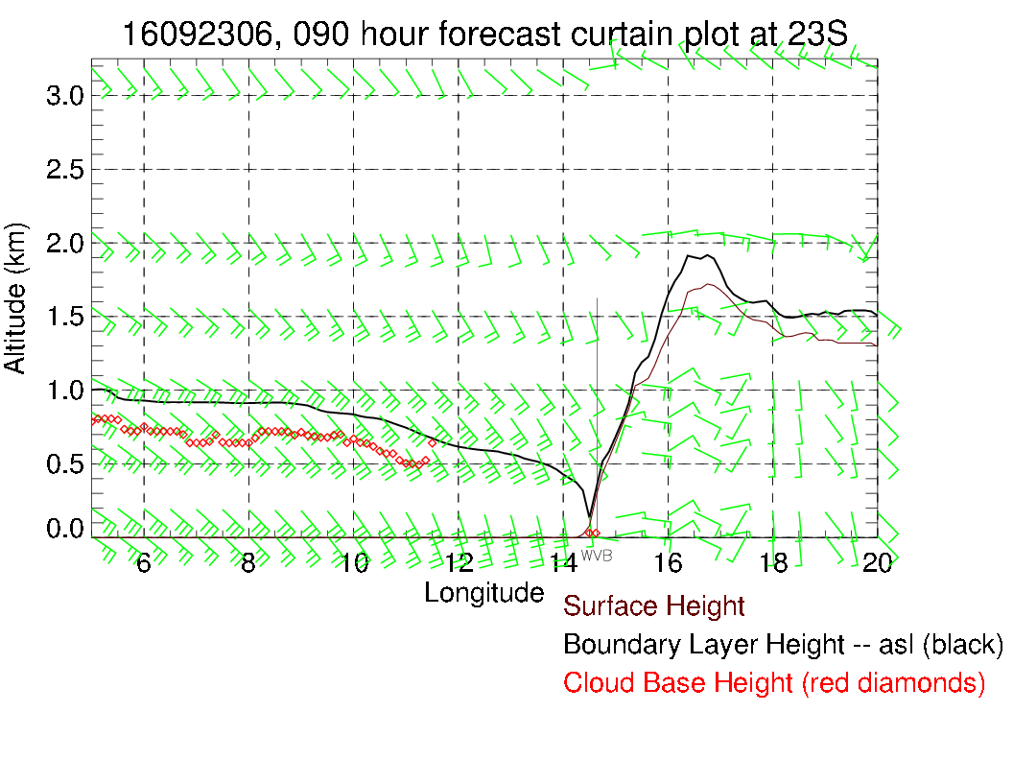
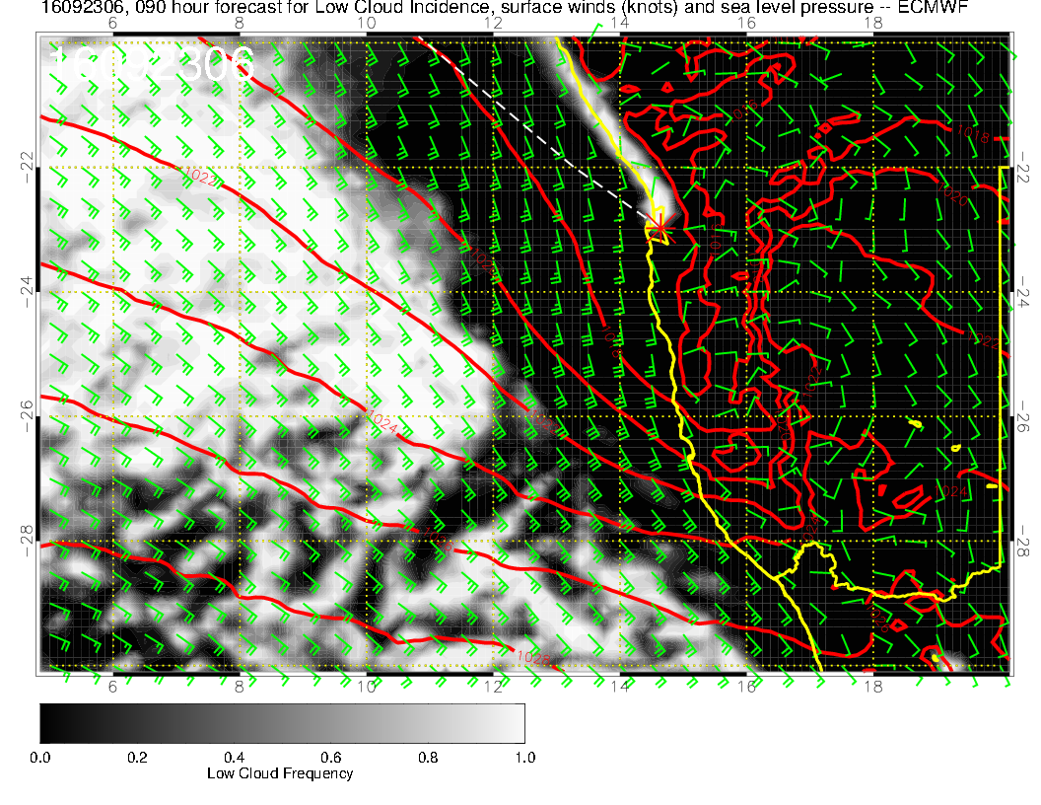
Expect fewer ceiling issues. Winds on landing OK (more westerly than on Sunday).

Slide 25
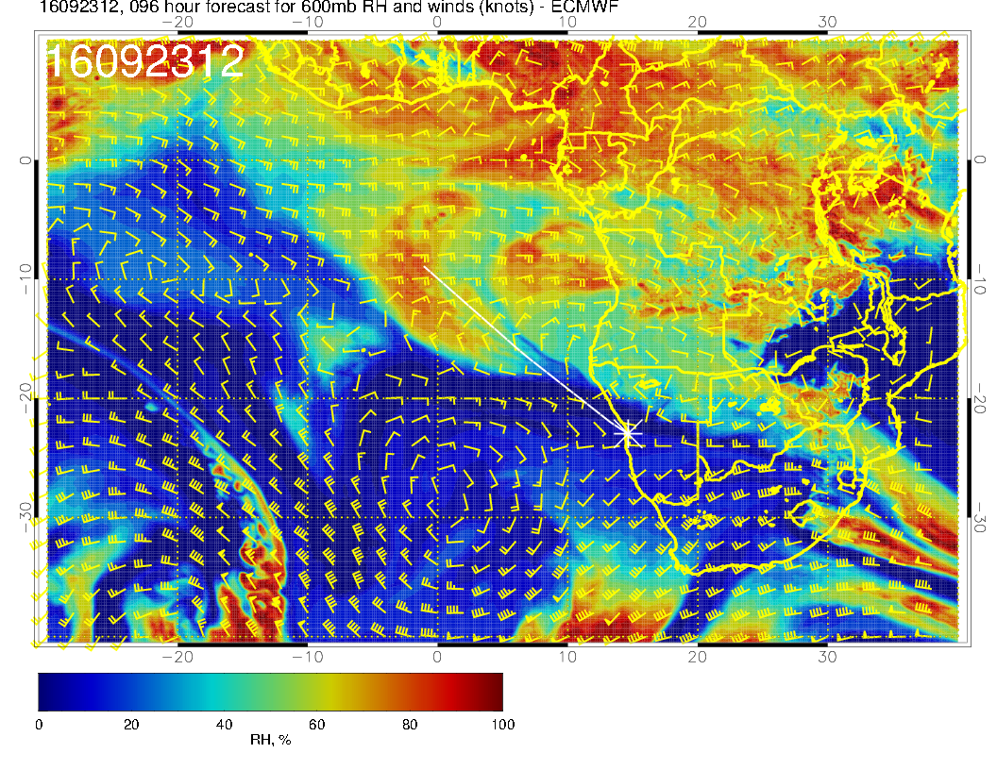
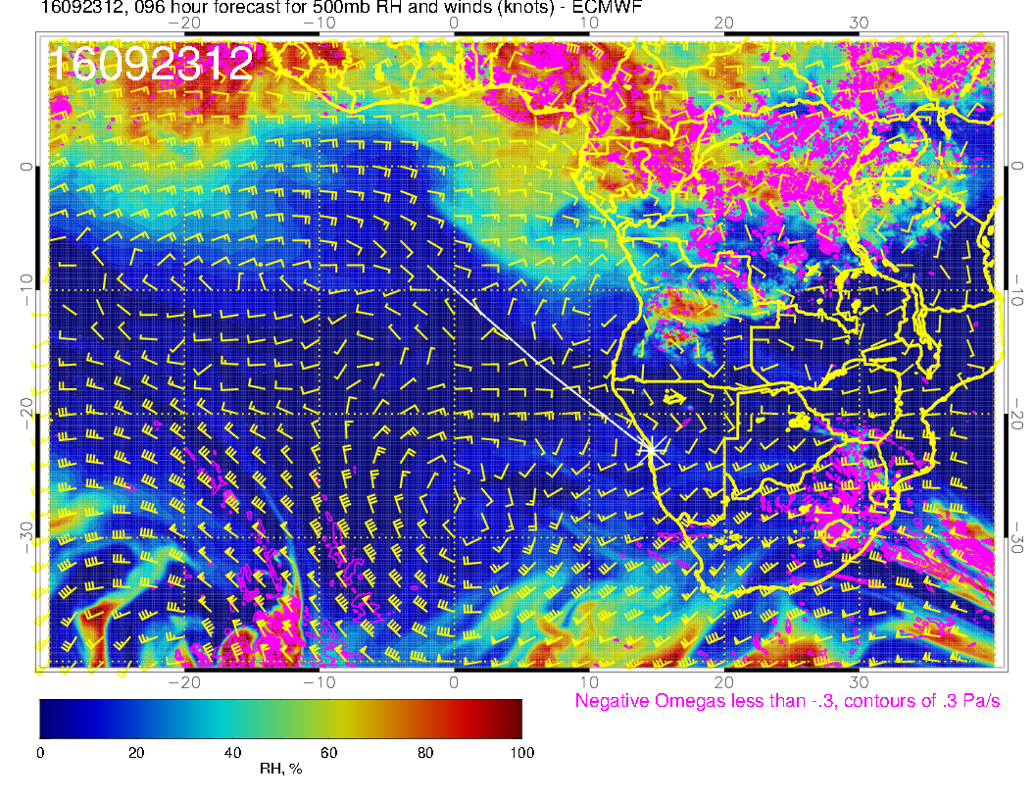
The next daily surge of moisture is more north of 10S.

Slide 26
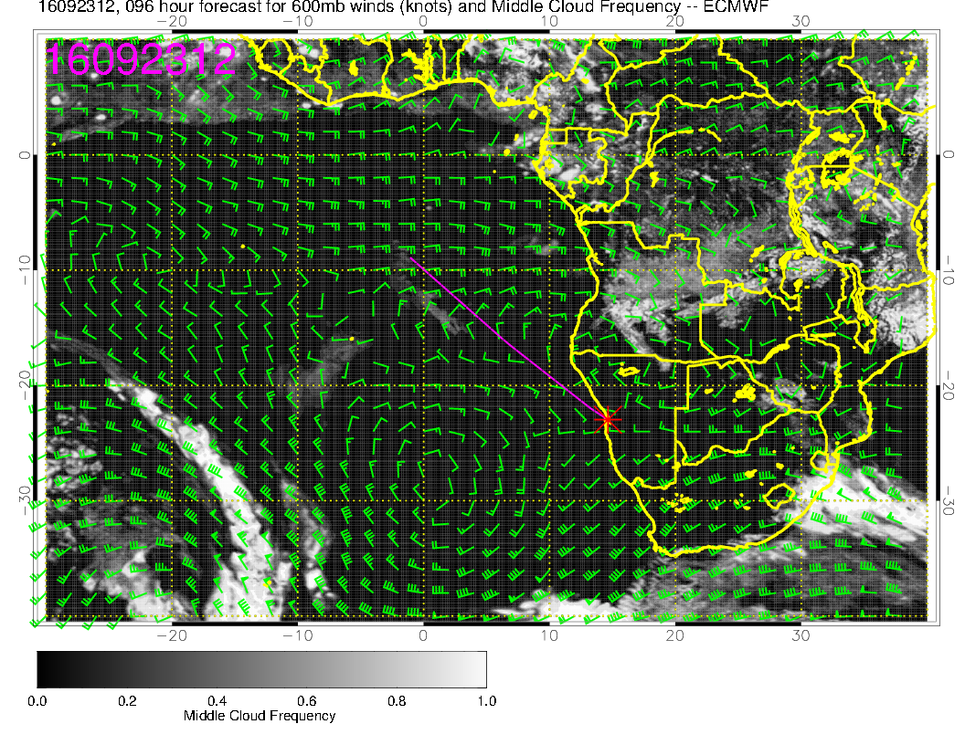
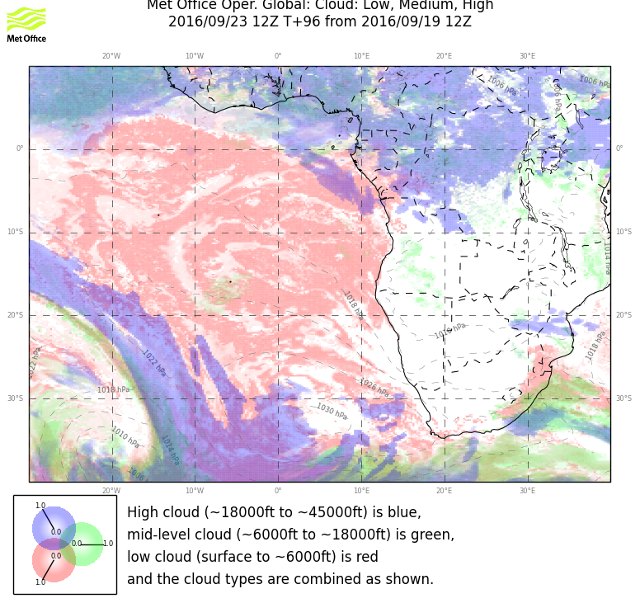
Middle cloud fcst consistent with this.

Slide 27
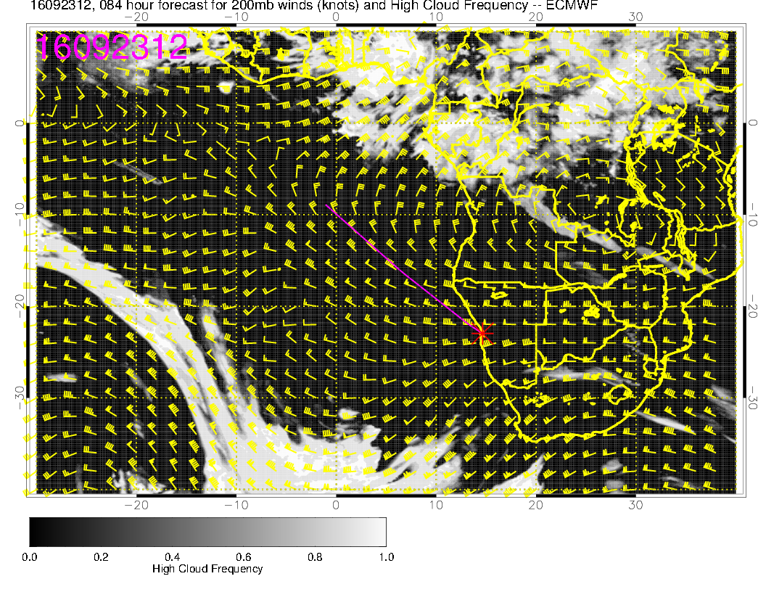
Expect no cirrus in operating region.

Slide 28
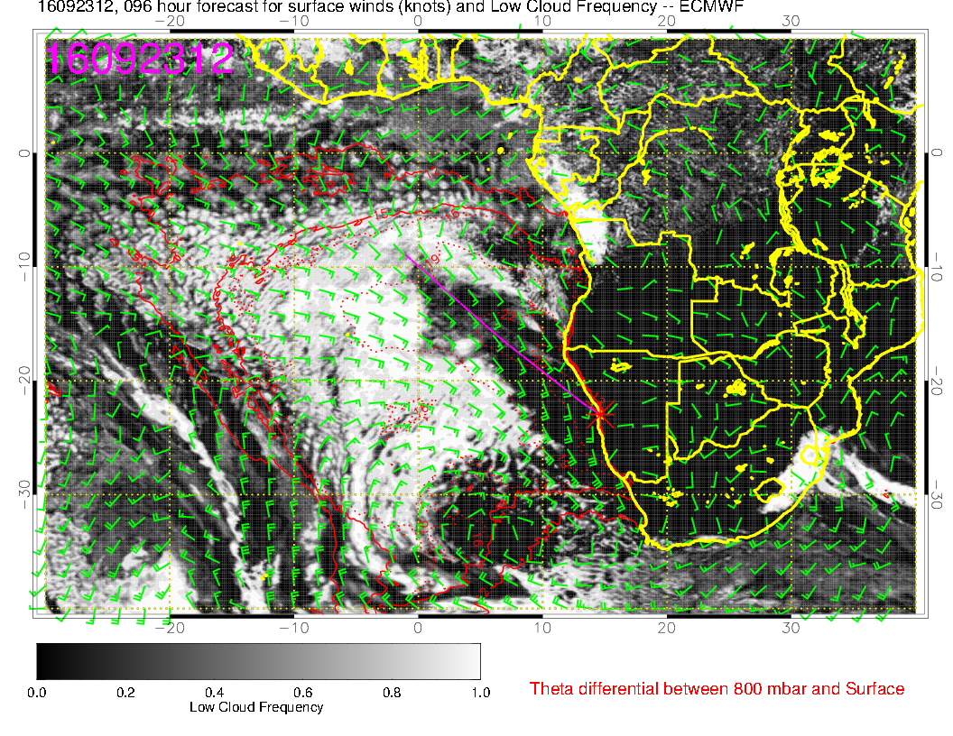
I believe the clearing off of Namibian coast based on stronger winds and stronger
subsidence from approaching high. Big clear region north of 20S is doubtful.

Slide 29
Saturday (no fly day)
High moves still further east.
An eddy develops near YWB, weakening winds but possibly raising morning ceiling issues.
Models forecast progressively less mid-level moisture from the continent, so minimal mid and high level cloud in operating region.
Ample low cloud with some clearing likely at YWB latitudes.

Slide 30
High moves closer to RSA. Eddy develops off central Namibia. Large weak flow region in Angola bight.
120 hour fcst – UKMO has high displaced westward by 3 degrees.

Slide 31
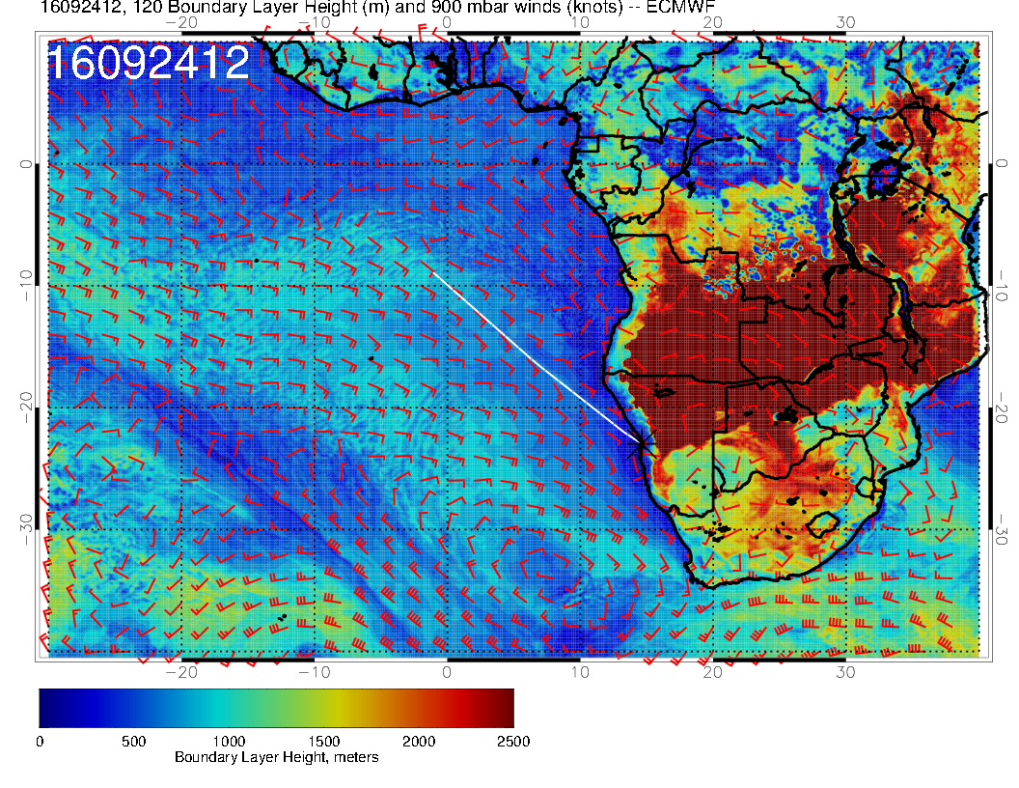
BL heights dropping somewhat

Slide 32
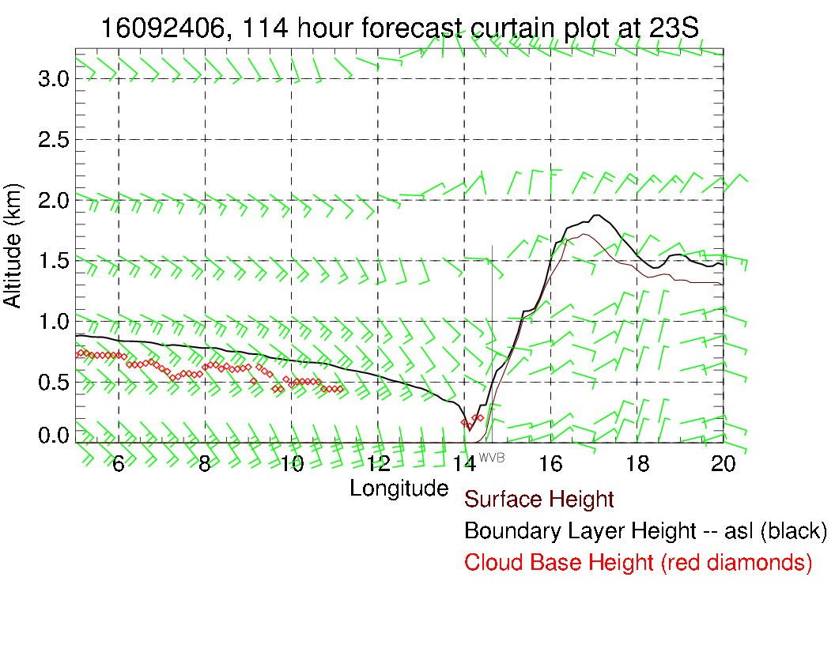
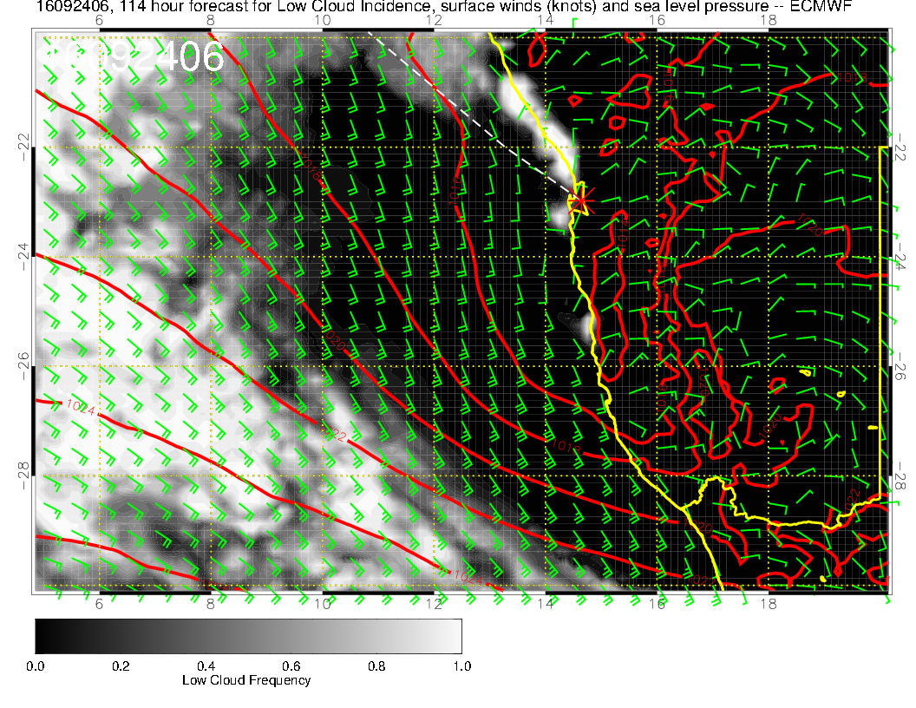

Slide 33
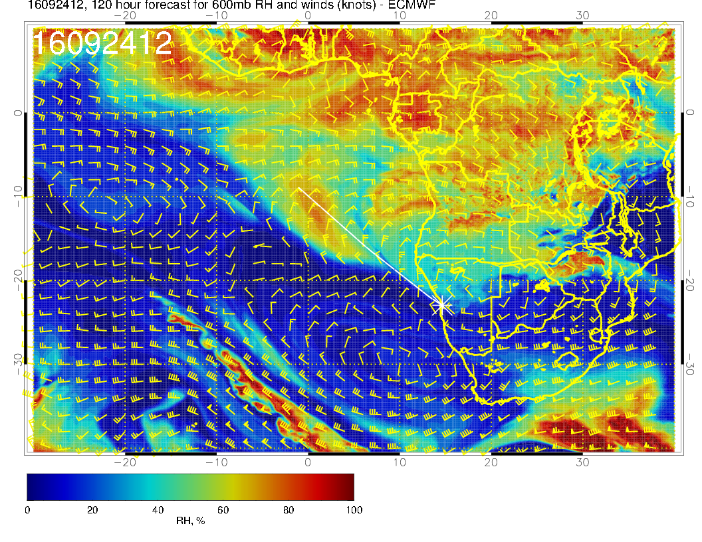
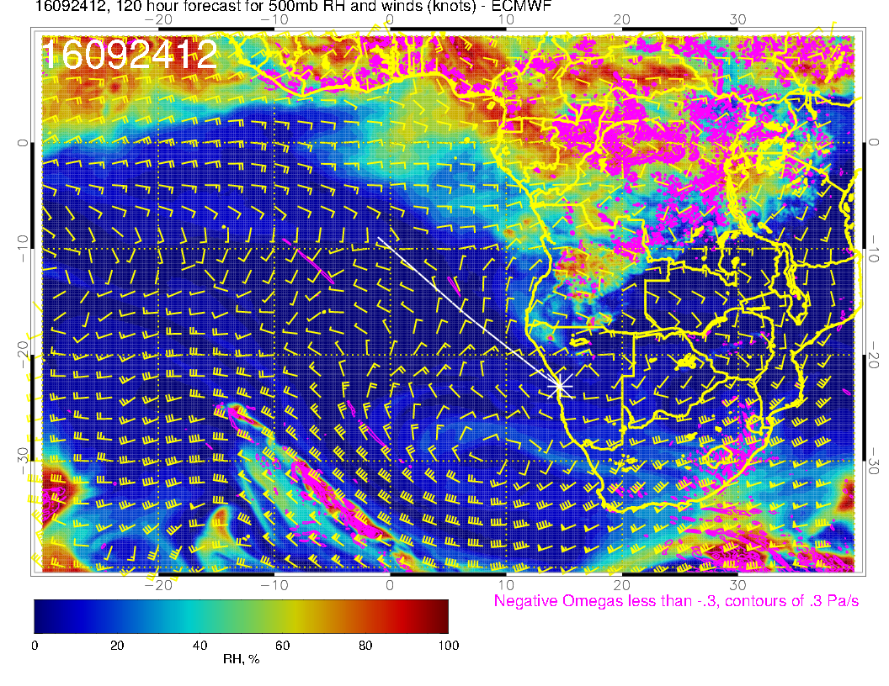
Next daily surge appears weaker, especially at 500mb

Slide 34
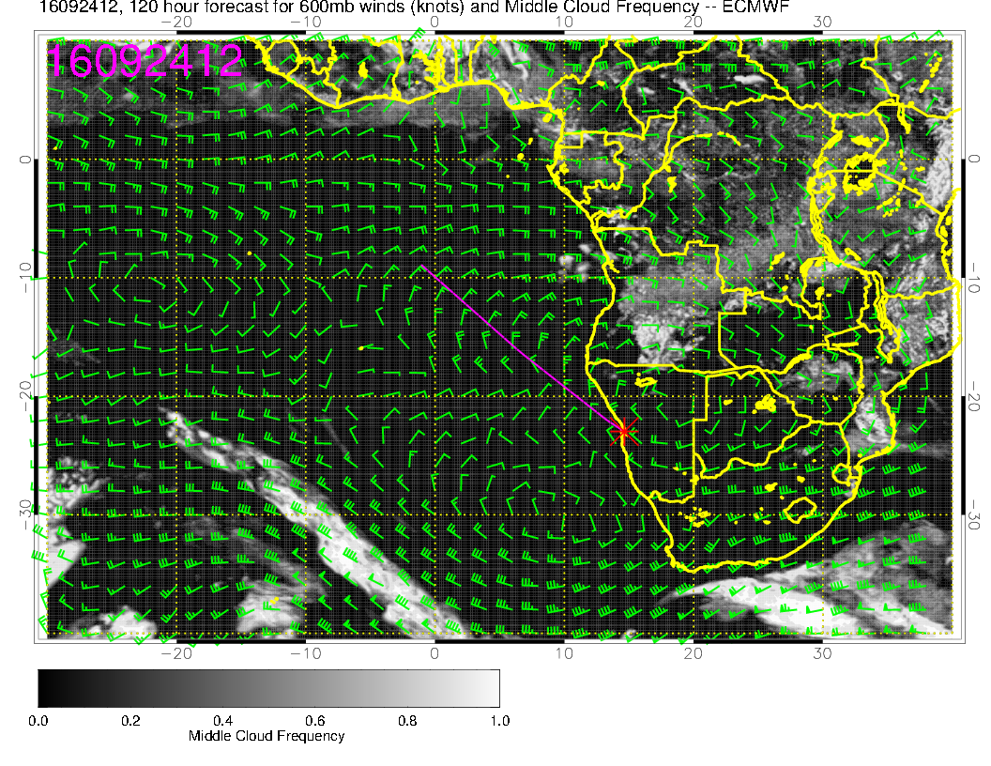
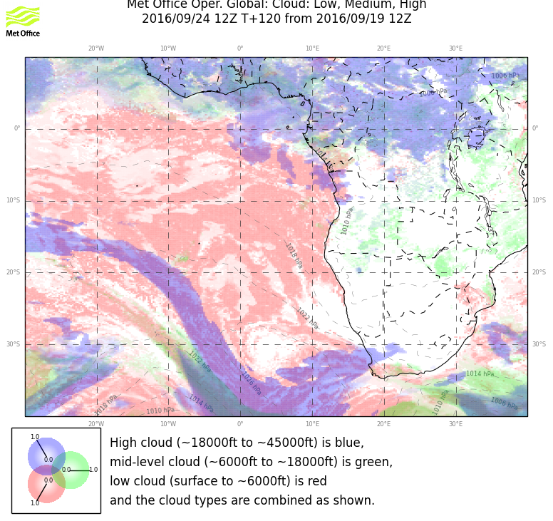

Slide 35
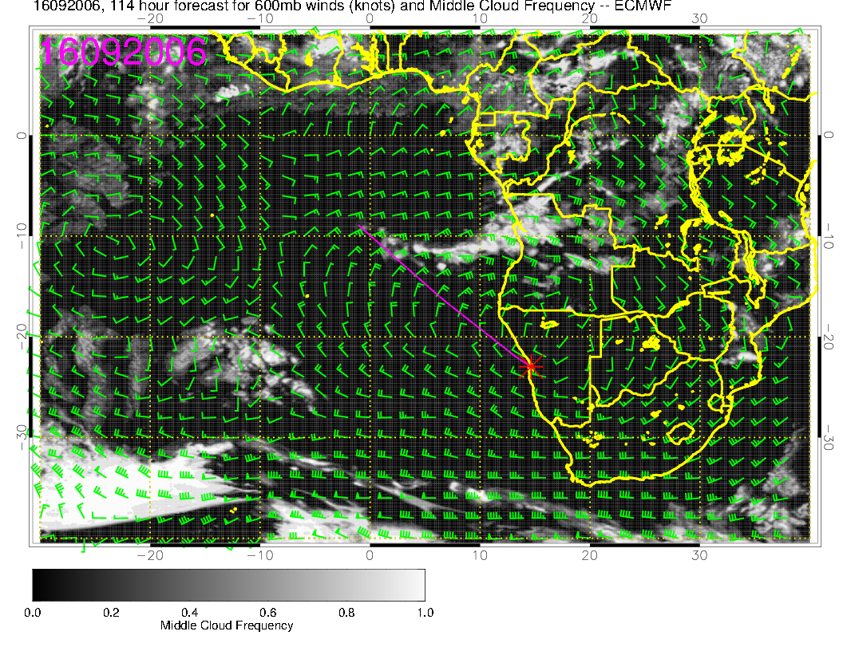
Are 114 hour fcsts worthless? I don’t have UKMO 114 hr fcst

Slide 36
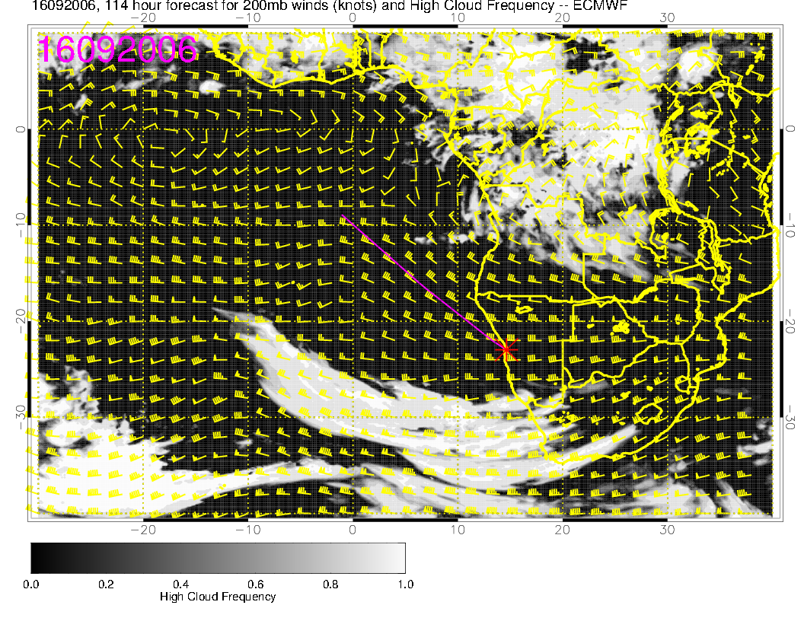
Are 114 hour fcsts worthless? I would say they are not worthless. This one has told us that
there is more than the usual amount of middle cloud, which is, overall, true. Position, of course is marginal.

Slide 37
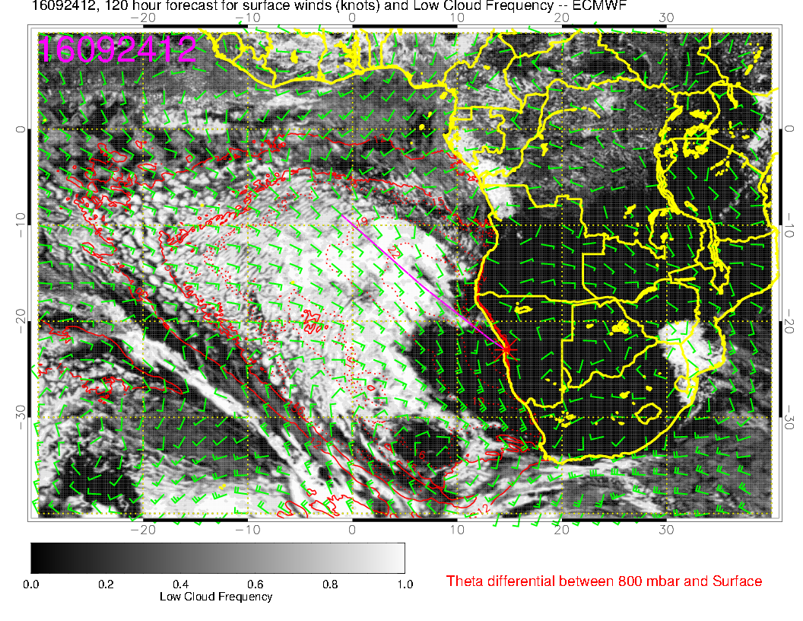
Notably, this far out, the model forecasts agree surprisingly.

