Slide 1
ORACLES forecasting briefing Meteorology for 20-09-2016
20-09-2016
Lenny Pfister

Slide 2
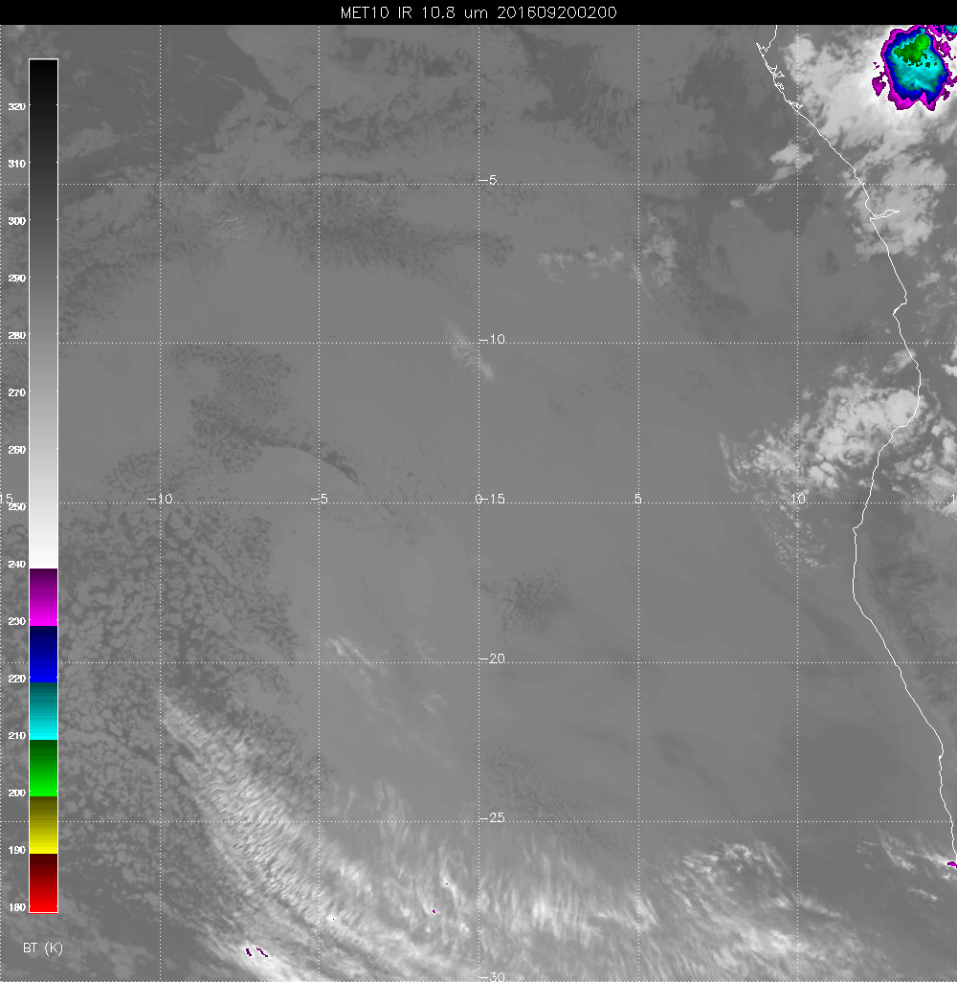
Low cloud, fog has been creeping down the coast through yesterday. Drizzle this morning. Some ceiling issues with early P-3 takeoff. RH at airport is 94% which suggests a pretty low ceiling right now.

Slide 3
Today

Slide 4
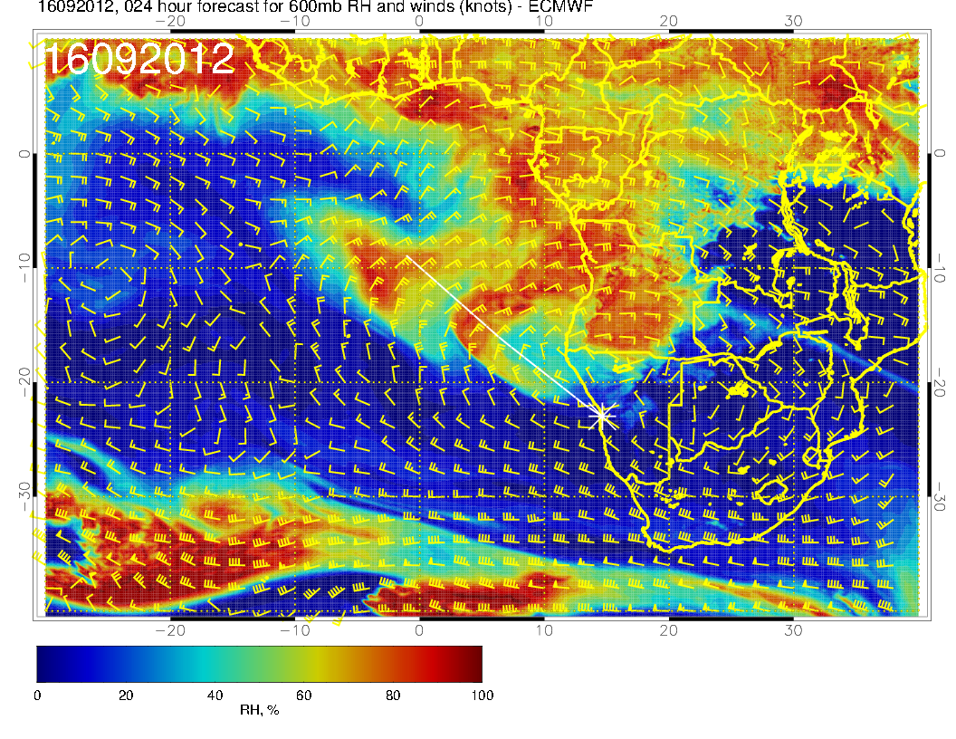
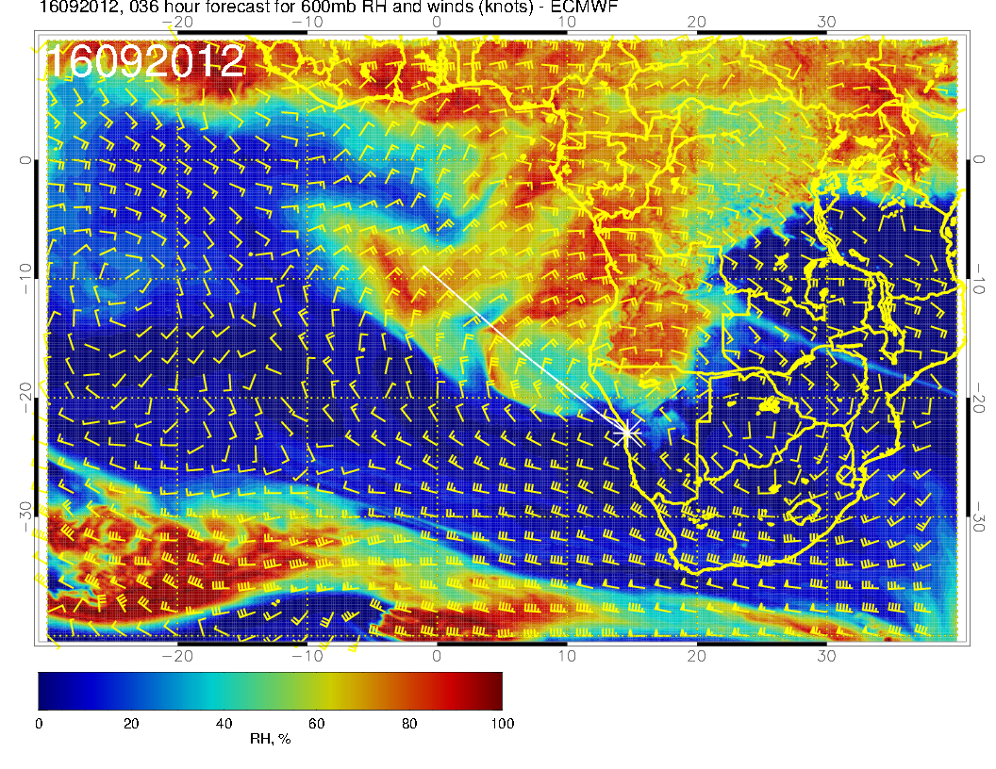
New (above) and old (right) are consistent

Slide 5
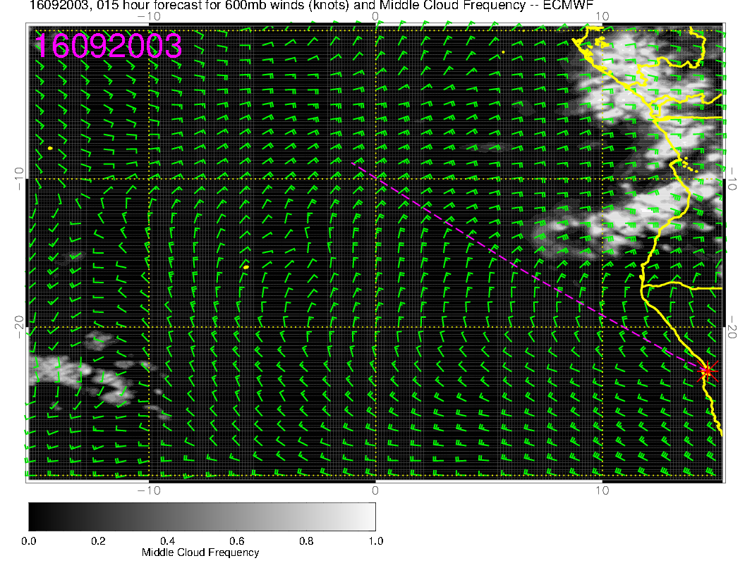
Prog is actually pretty good, even gets
the “beard” south of 15S, which is the
problem

Slide 6
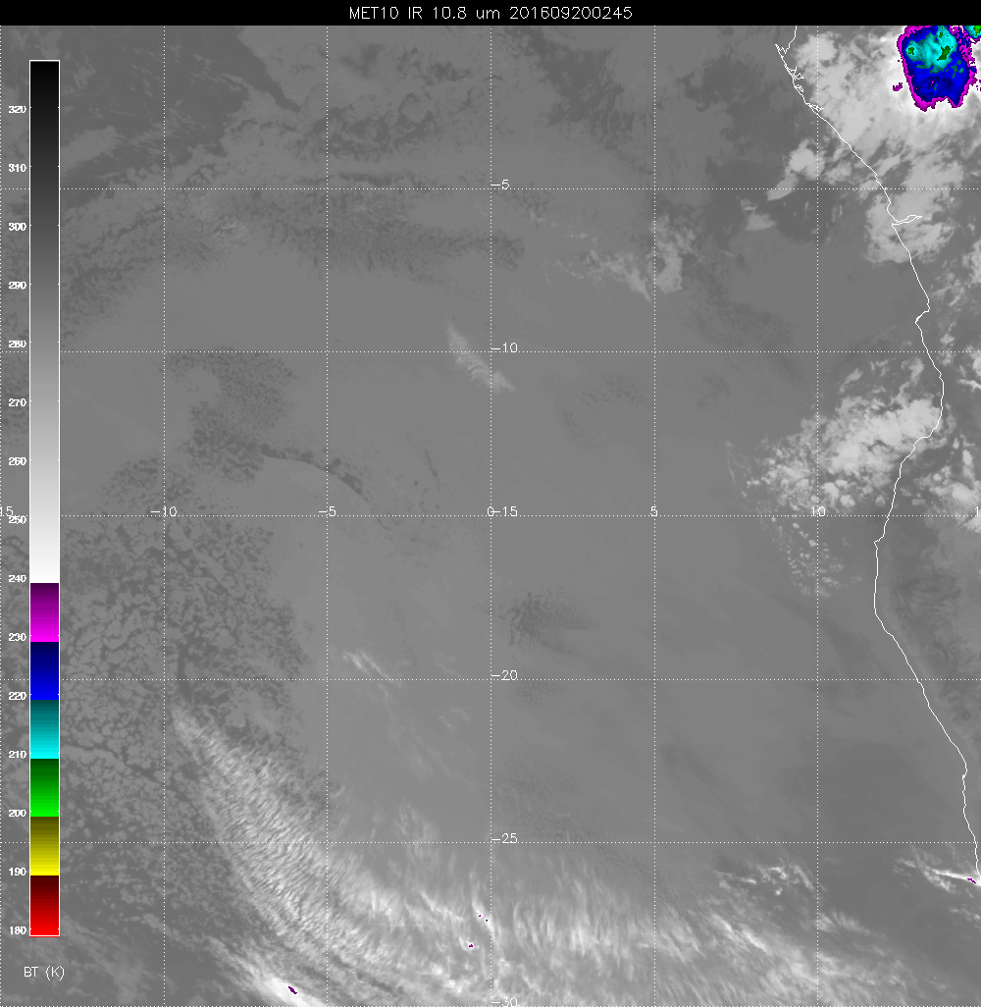
Not much dissipation in 45 minutes, but some movement. Based on experience, expect the 10.5E leg to be OK.

Slide 7
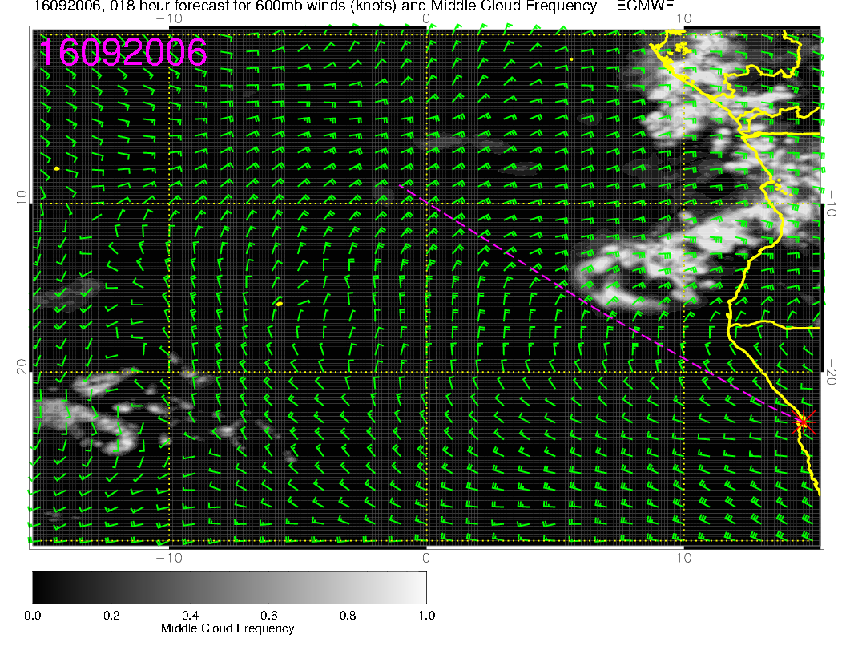
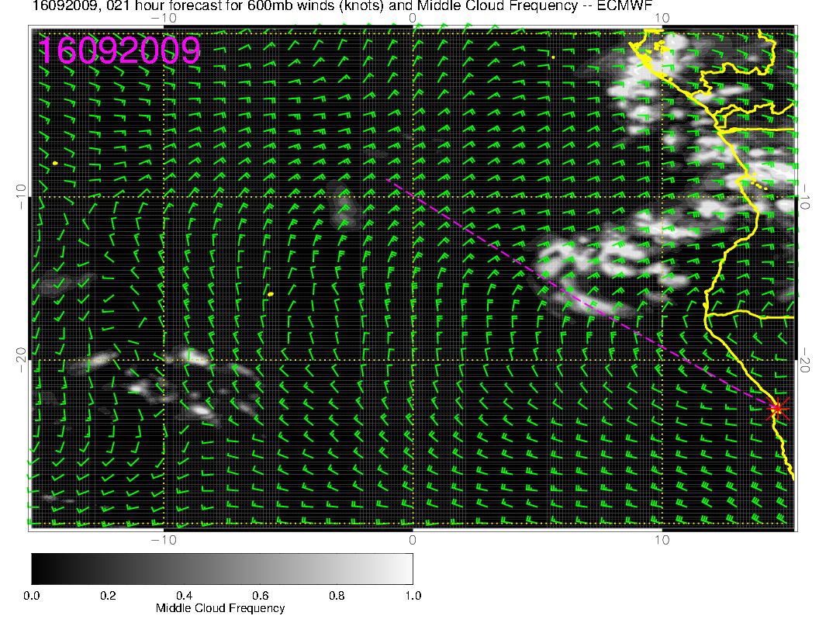

Slide 8
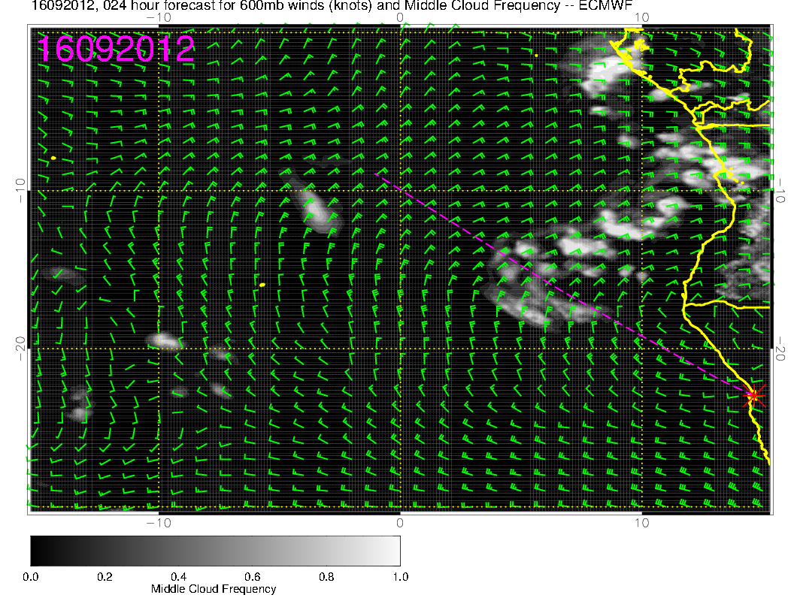
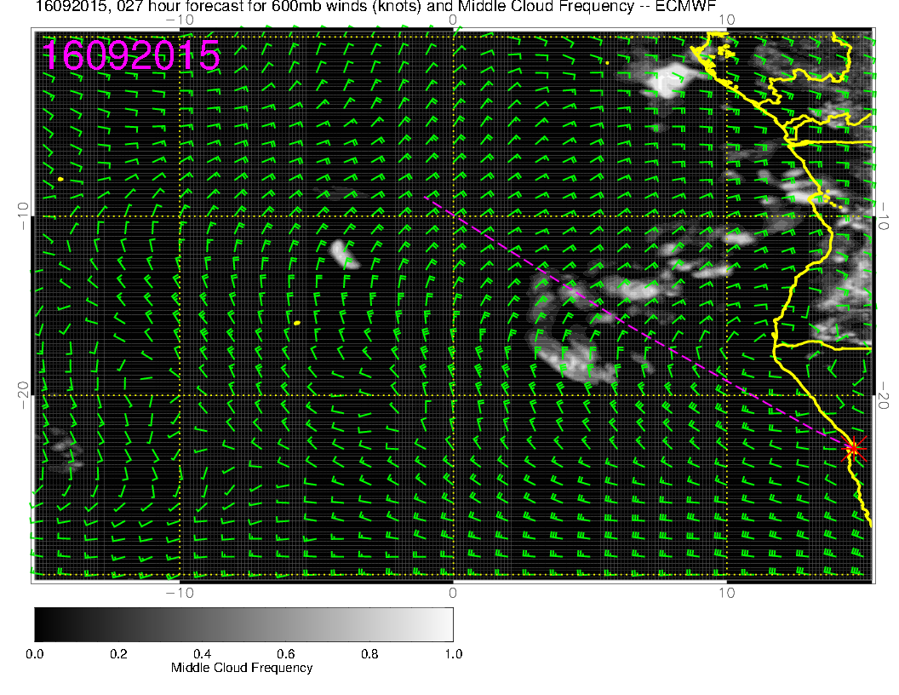
If the prog could be fully trusted, it looks dicey, but 10.5 leg should be OK and 9.0 leg has a shot. Good that 10.5 leg is first.

Slide 9
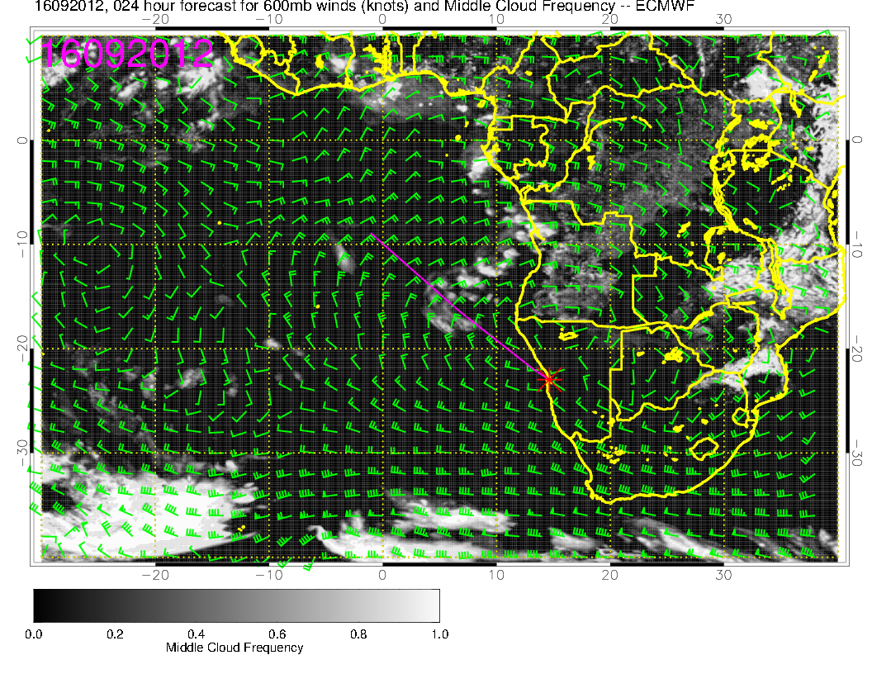
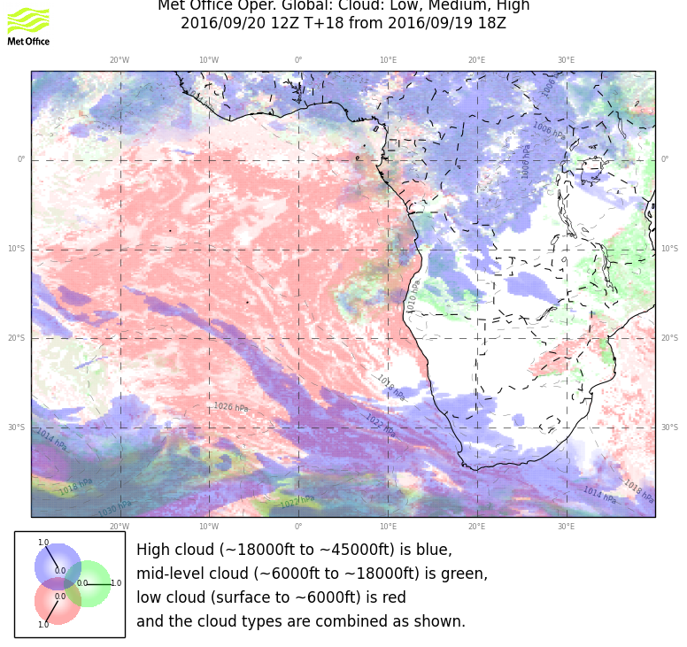
UKMO concurs on middle cloud

Slide 10
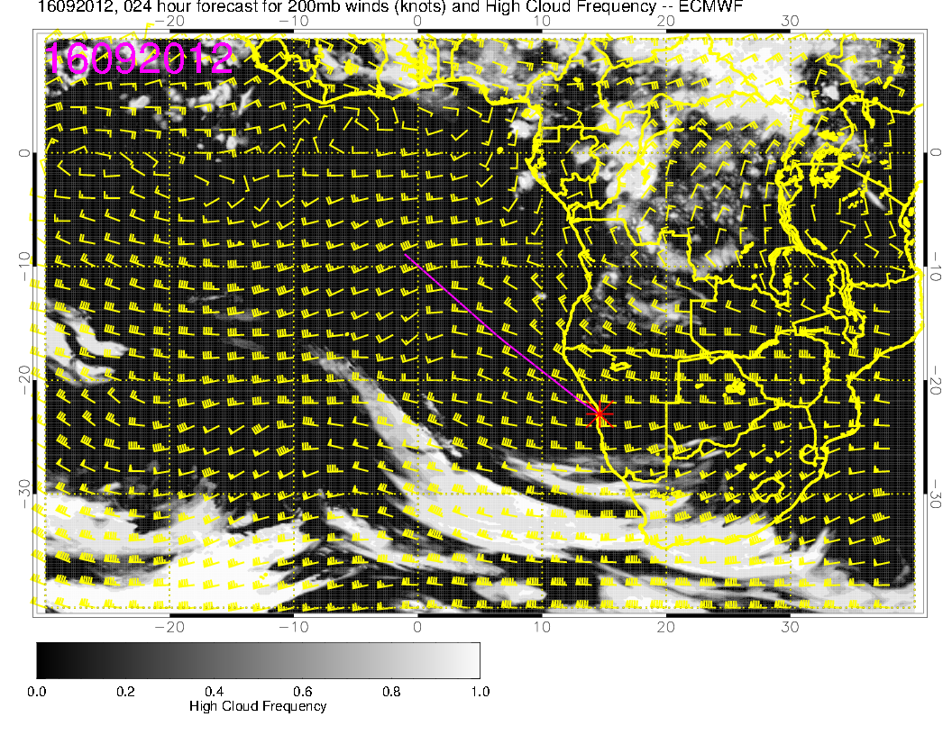
I wouldn’t worry about the cirrus forecast for UKMO. UKMO Forecasts a big splotch for current time, and it is not there.

Slide 11
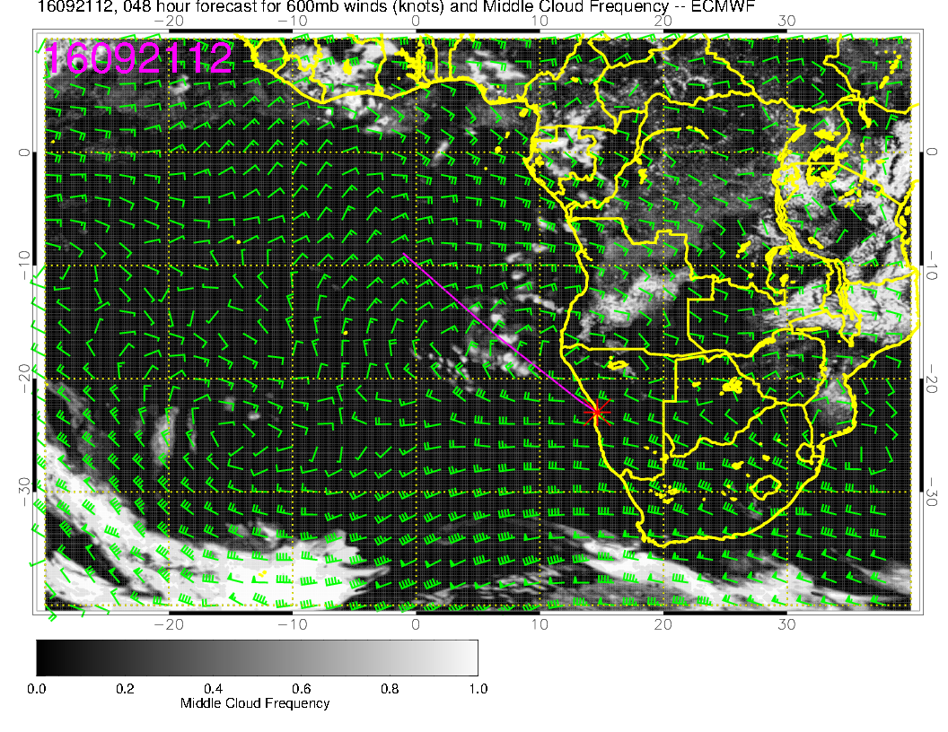
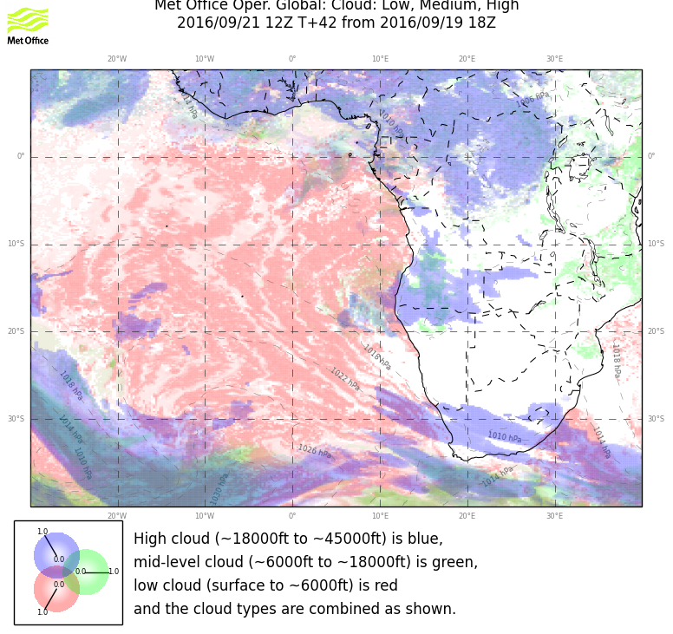
Tomorrow is worse. Cirrus overdone, but EC has some in
region of interest. So flying this flight tomorrow is worse.

Slide 12
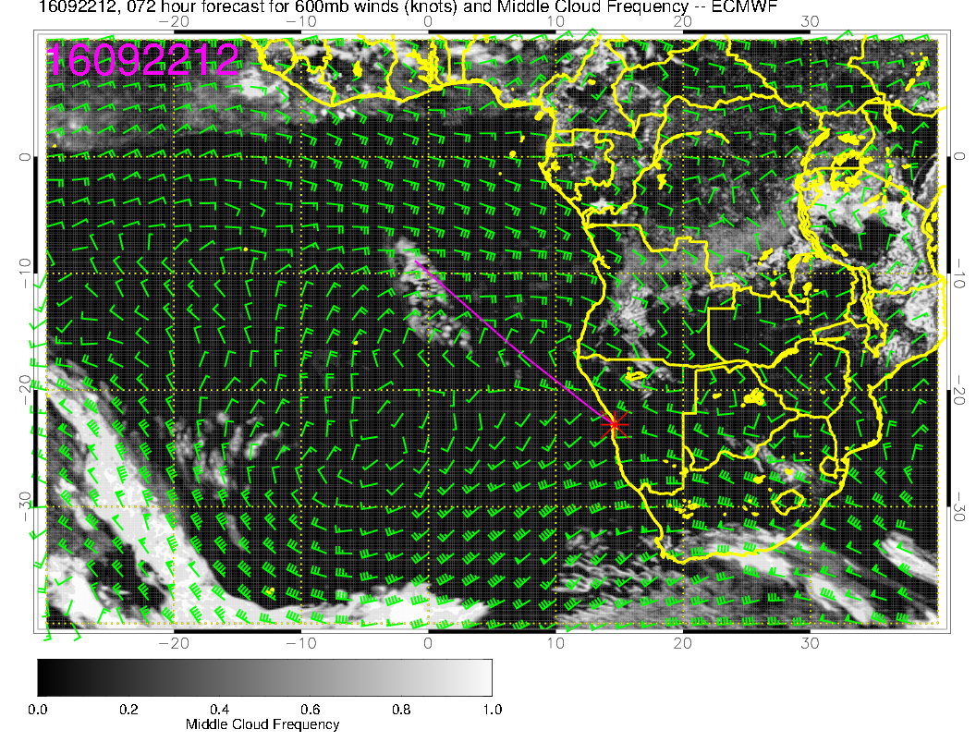
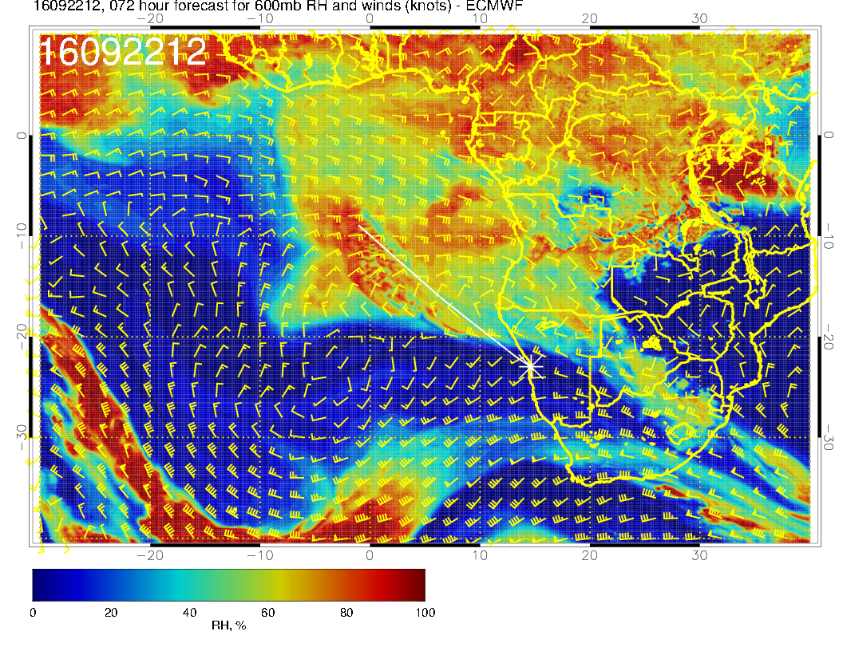
MC is rapidly dissipating on routine track, but still have some
areas associated with surge

Slide 13
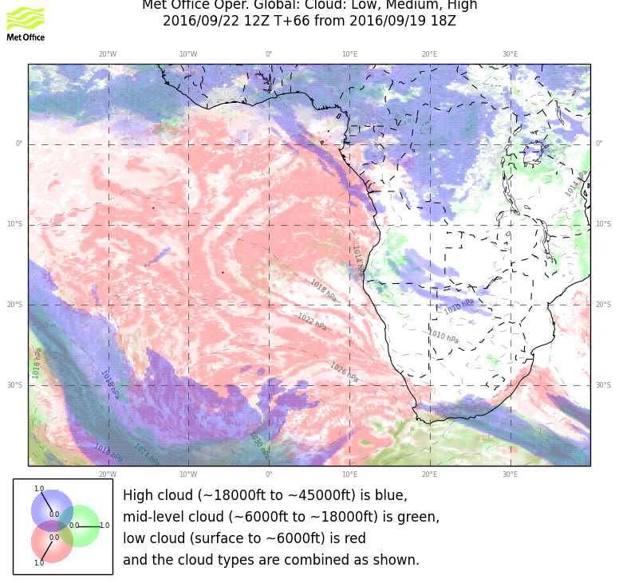
MC is rapidly dissipating on routine track

