Slide 1
ORACLES forecasting briefing Meteorology for 20-09-2016 – 22-09-2016
18-09-2016
Lenny Pfister

Slide 2
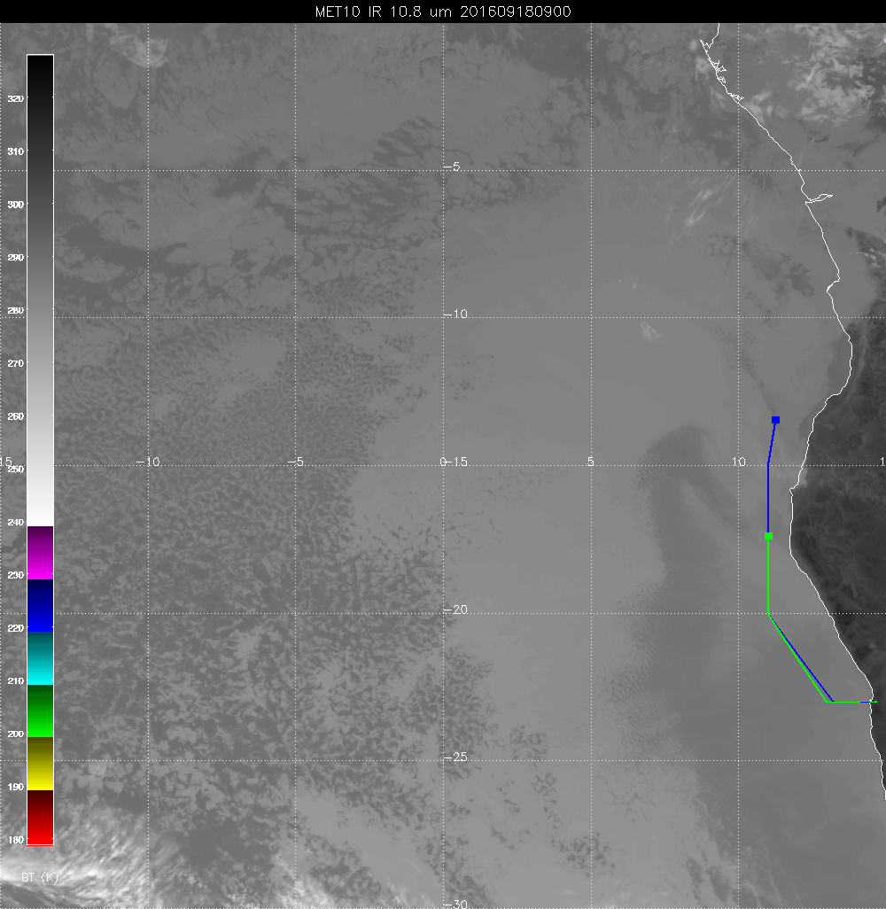
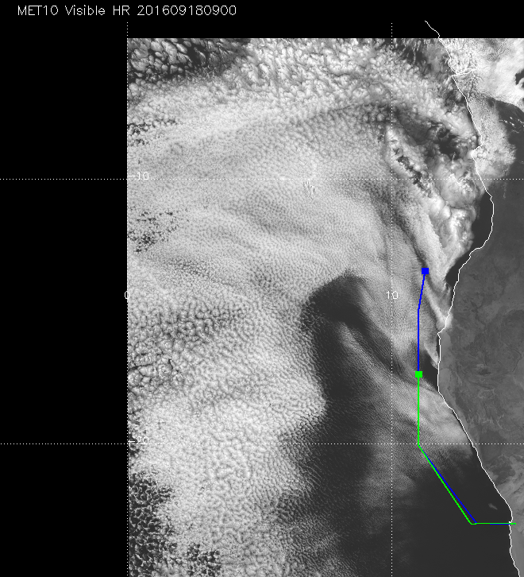

Slide 3
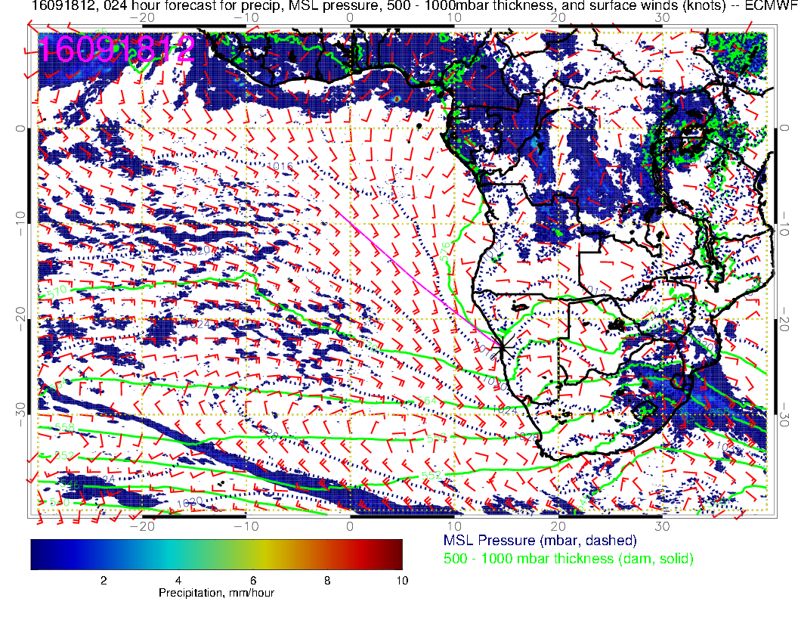

Slide 4
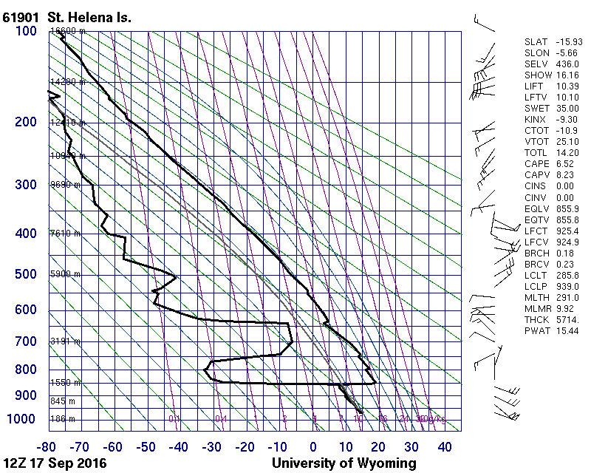
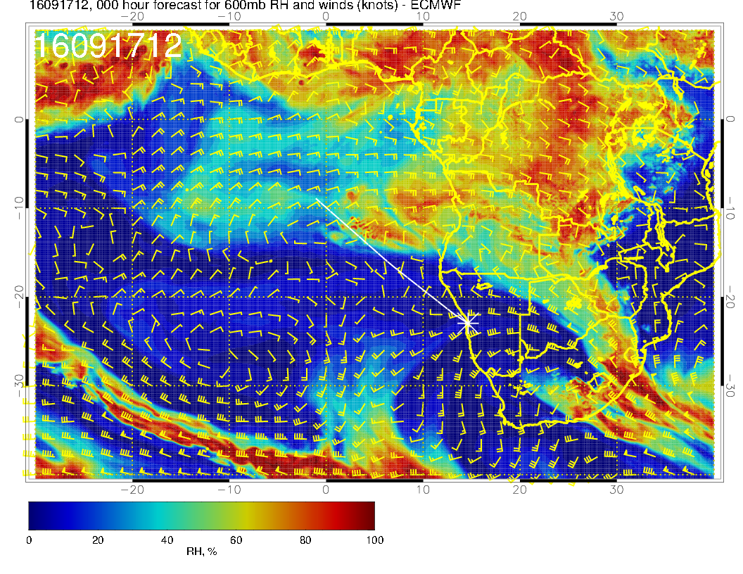
Just some obs. Yesterday had some moisture emerging, not yet reaching St Helena.
Some old mixed layer to 650 mb sitting over St Helena

Slide 5
Tuesday, 20160920
Winds much weaker on this day, minimal local cloud, no flyability issues.
600mb anticyclone developing rounded pattern with surge of moisture to 500mb moving swwrd over the SEA. RH pattern is significantly different from yesterday’s fcst, more broadly spread more to the north.
Corresponding mid cloud displaced northward and is less than yesterday’s fcst.
Expect no cirrus issues.
EC clearing still seems excessive. Some filling relative to yesterday’s fcst. Still expect UKMO 96 hour to be a better guide to low cloud presence.

Slide 6
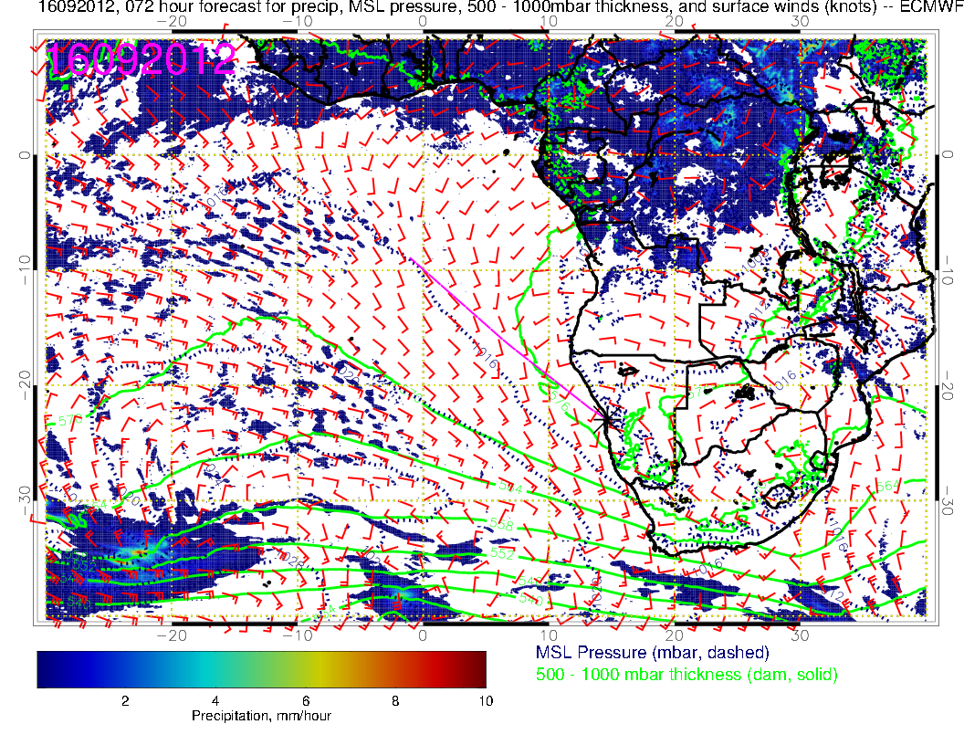
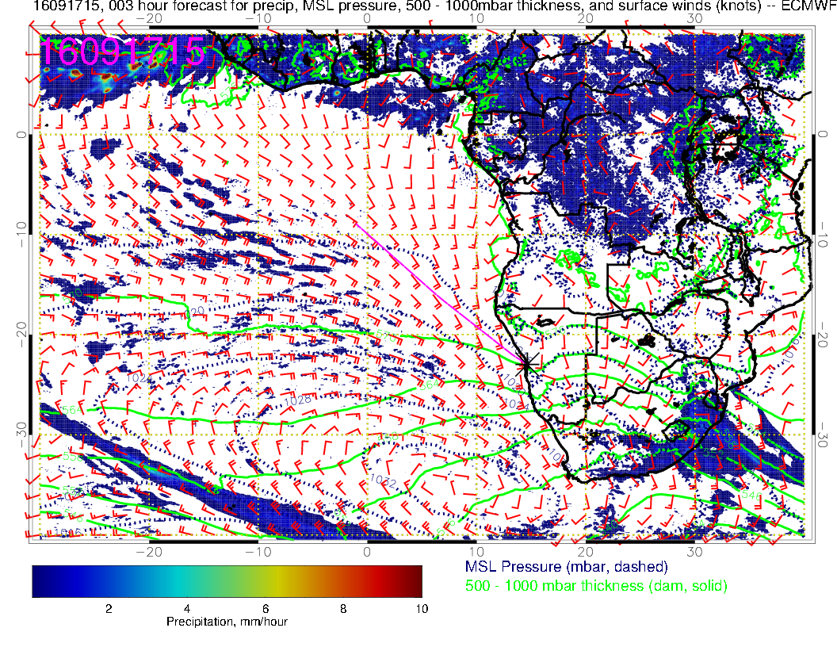

Slide 7
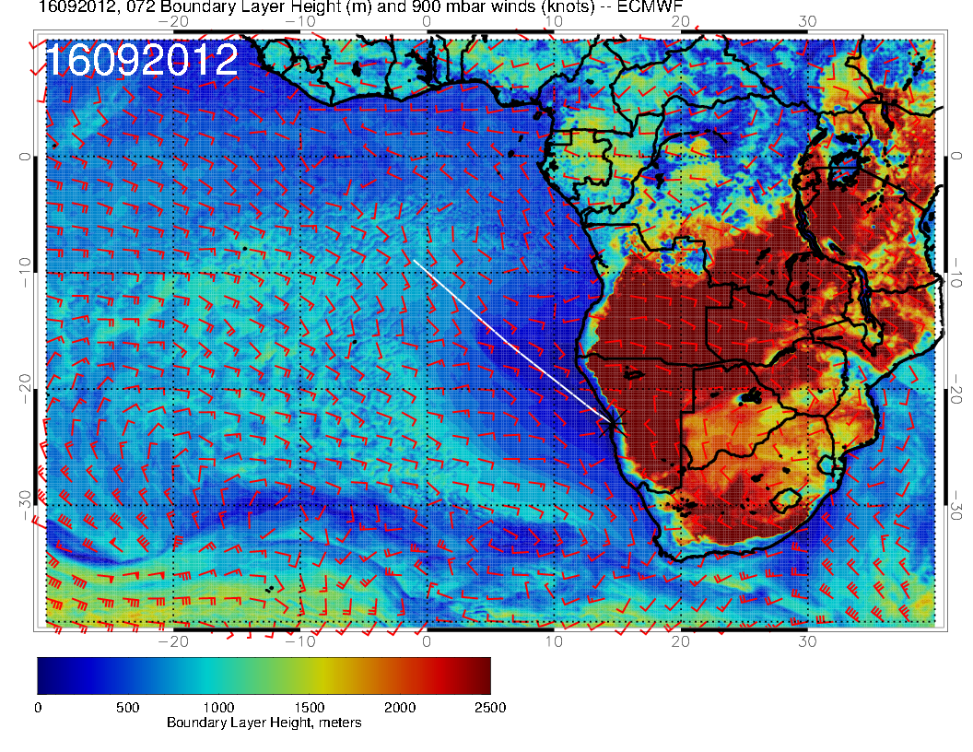
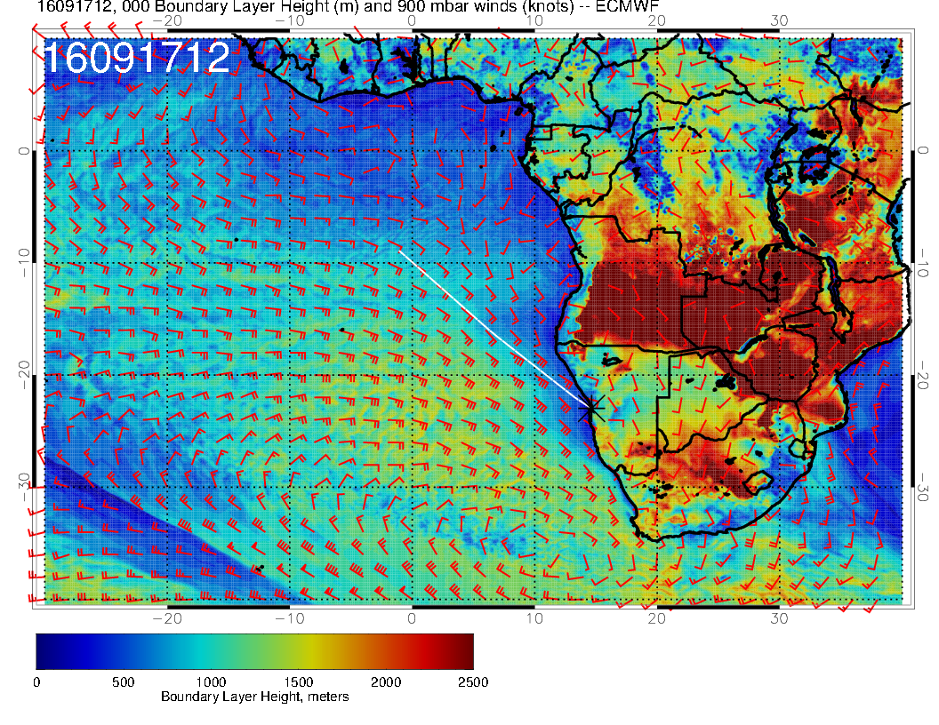

Slide 8
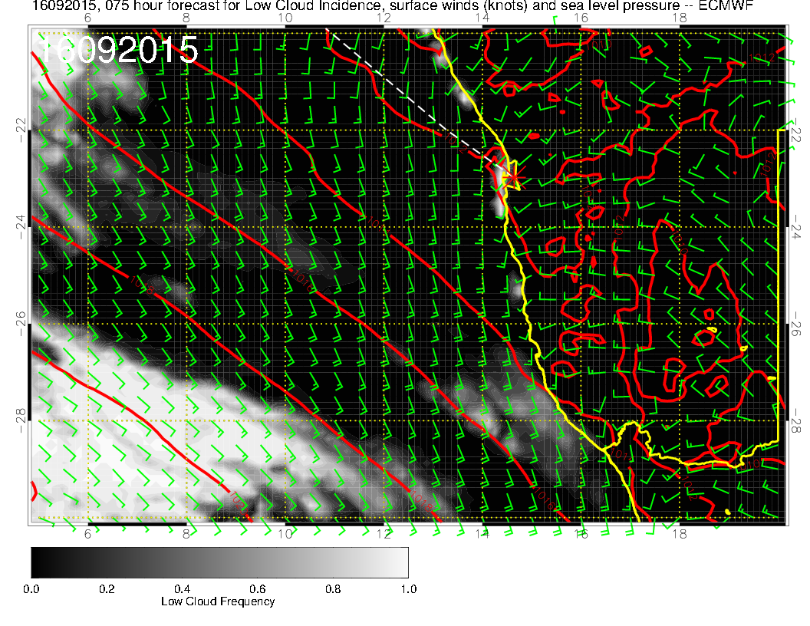

Slide 9
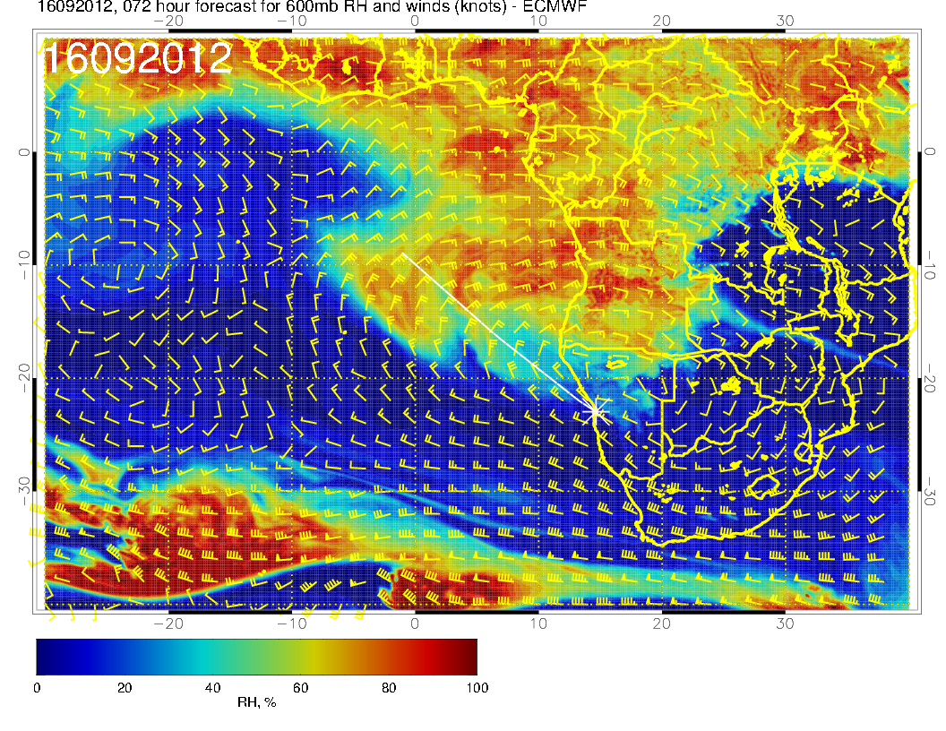
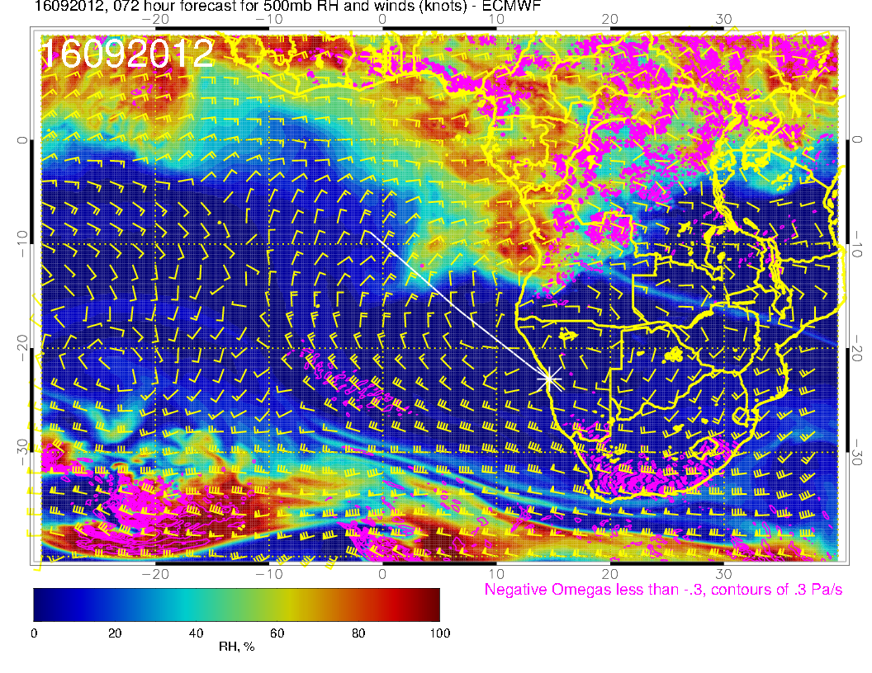
2016092012, 72 hour
600mb
500mb

Slide 10
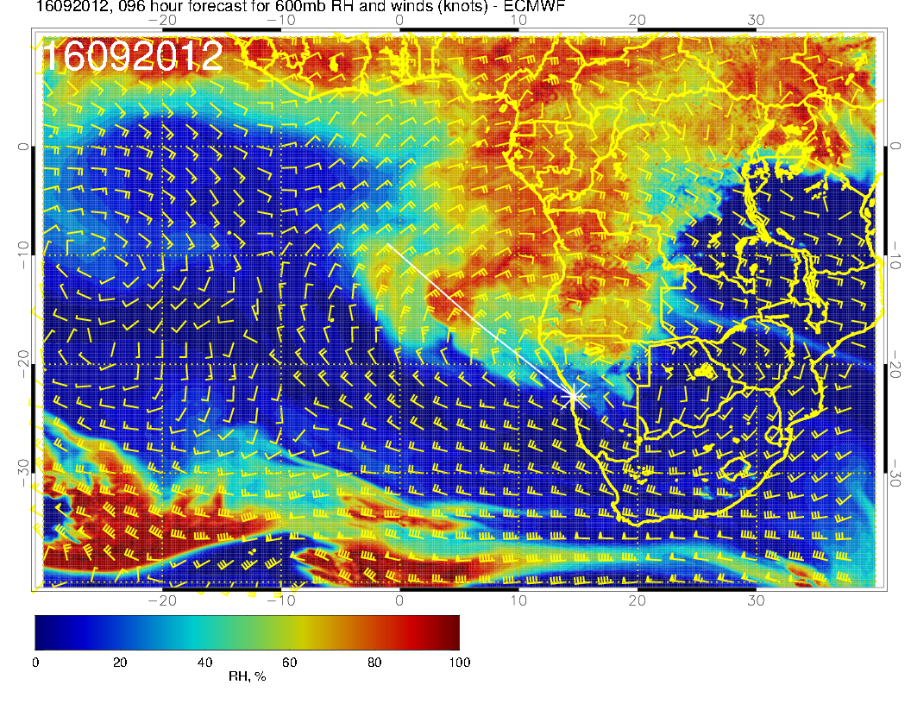
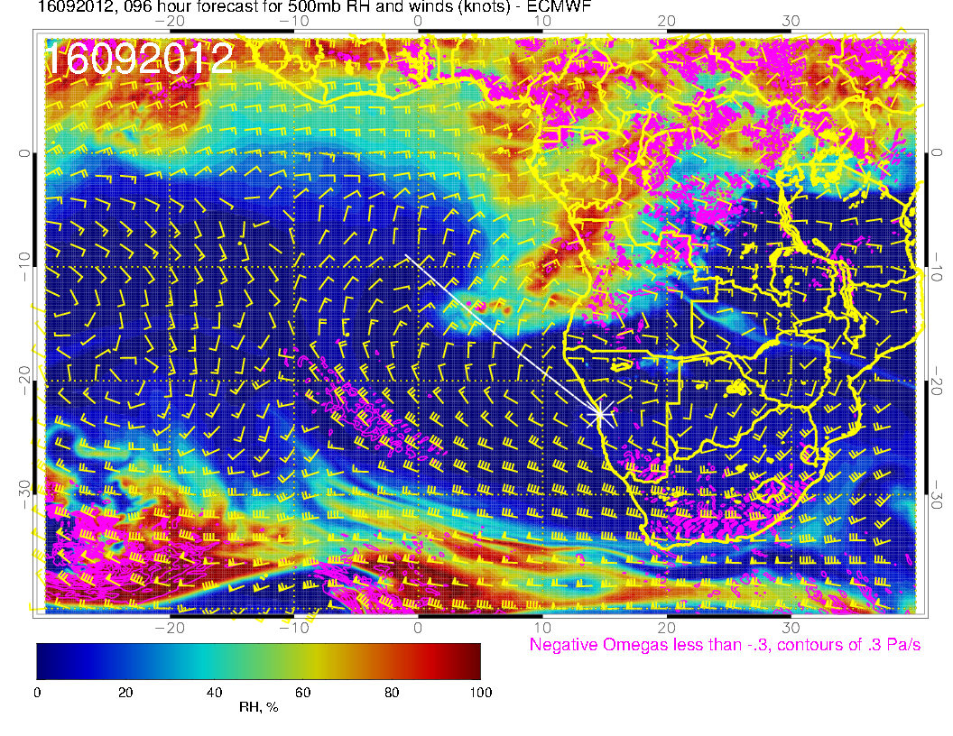
20160912, 96 hour

Slide 11
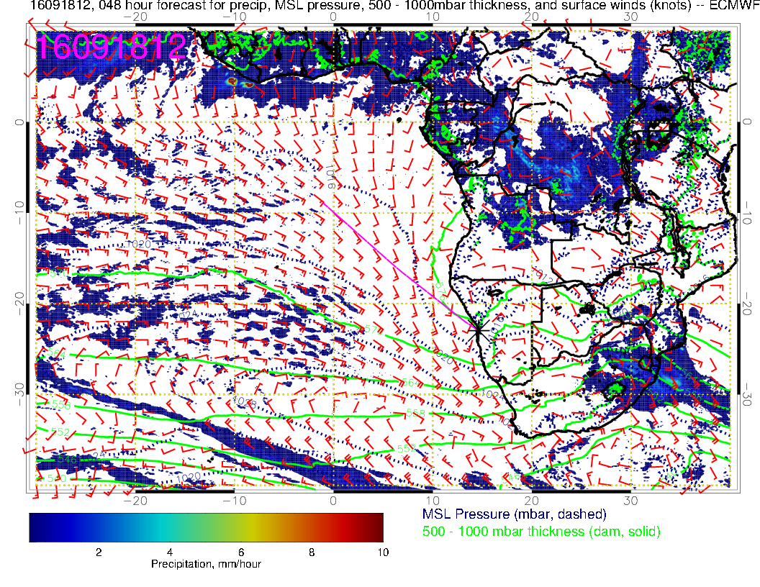
2 day “transit” (about 20 degrees of
lon in 2 days at 600mb). Old fcst of diurnal
max in convection has more in interior
than new fcst. Just a hypothesis.

Slide 12
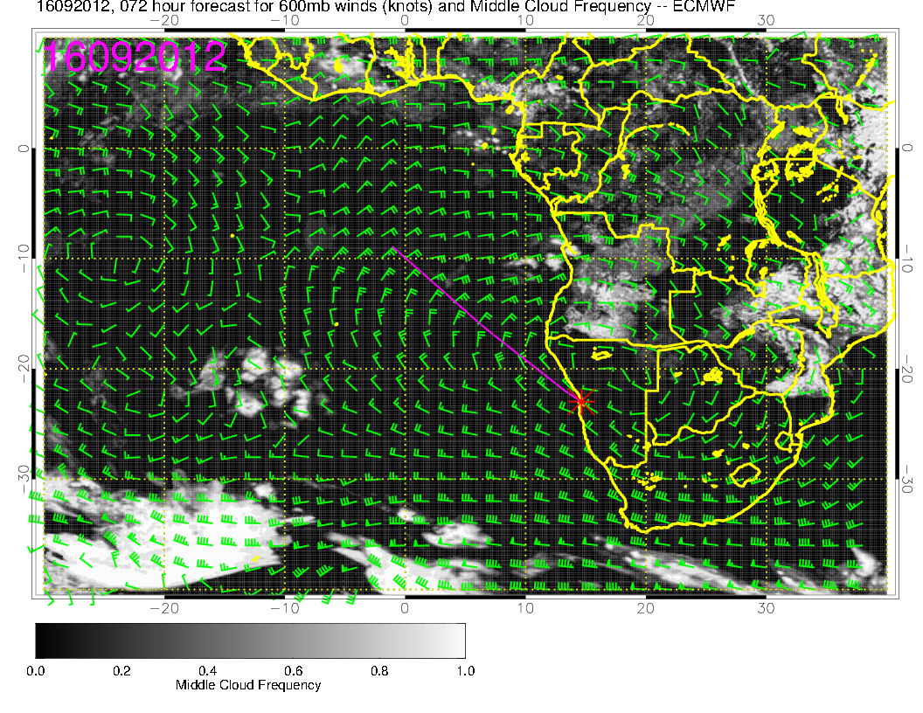
Mid level cloud.

Slide 13
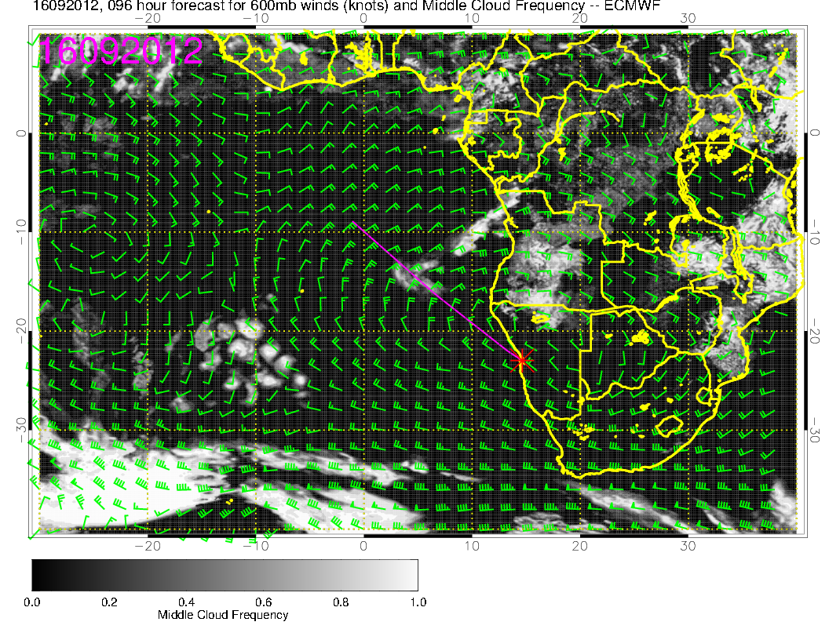
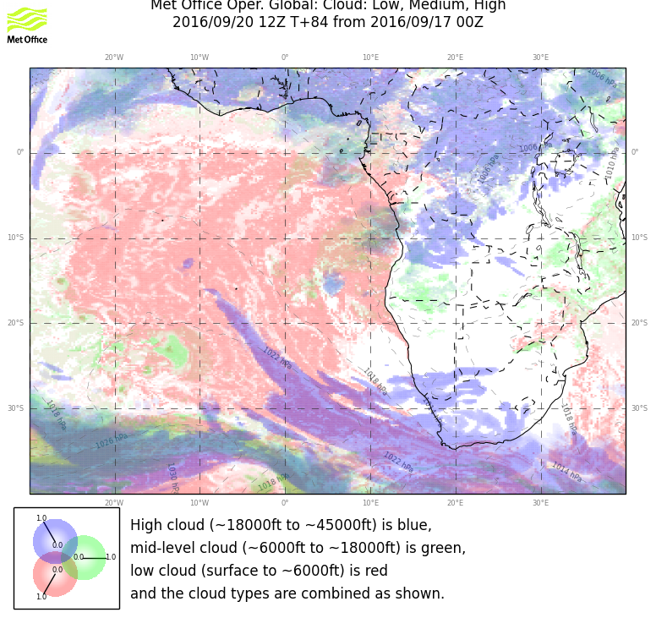
Mid level cloud, yesterday’s forecast – much more aggressive – difference consistent with RH differences (better be).

Slide 14
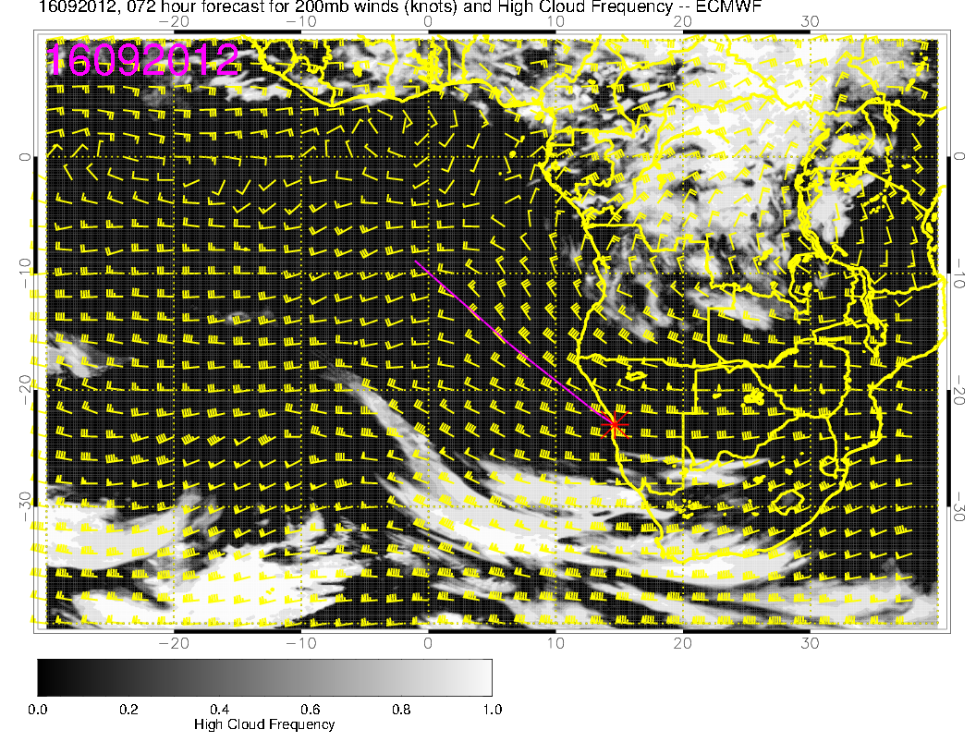
High cloud, about the same as yesterday’s fcst. Upper level RH and circulations consistent with this fcst.
Stuff at the NE edge, out of our planned range.

Slide 15
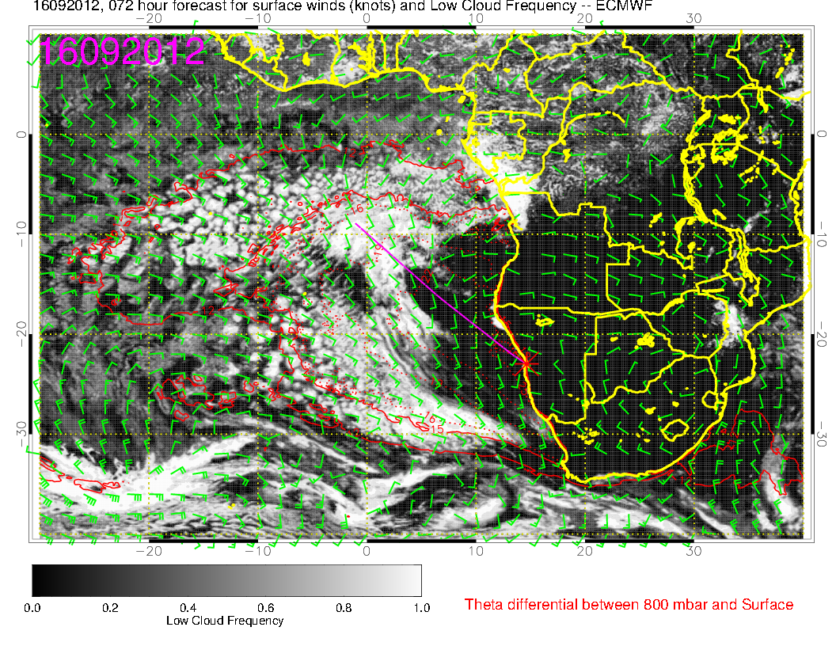
Filled in north of 10S. However, still very different from 96 hour UKMO. Note some splotches have appeared near 15S.

Slide 16
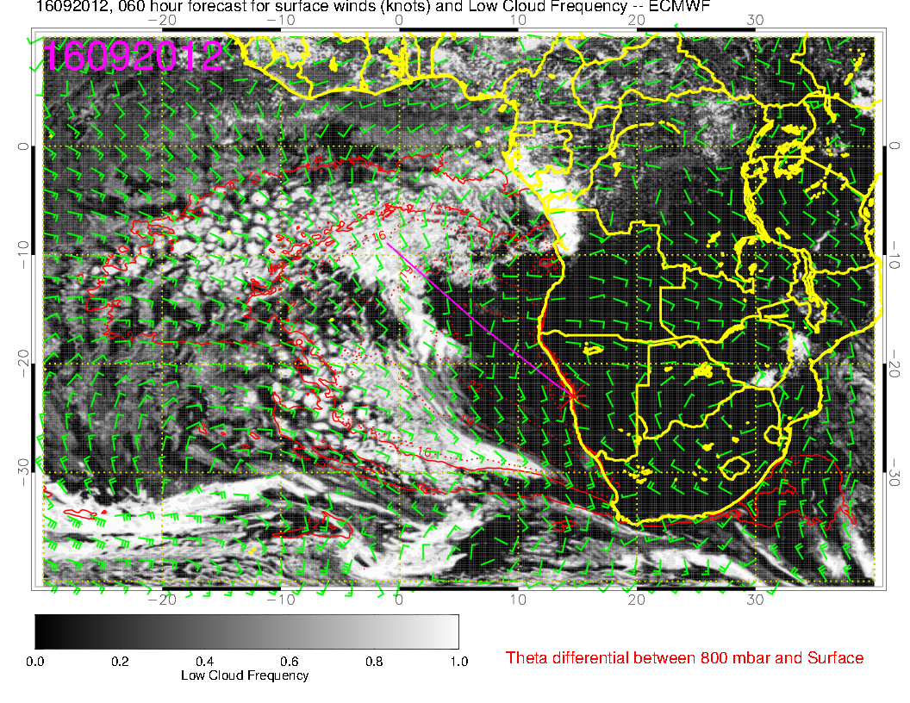
Most recent forecast

Slide 17
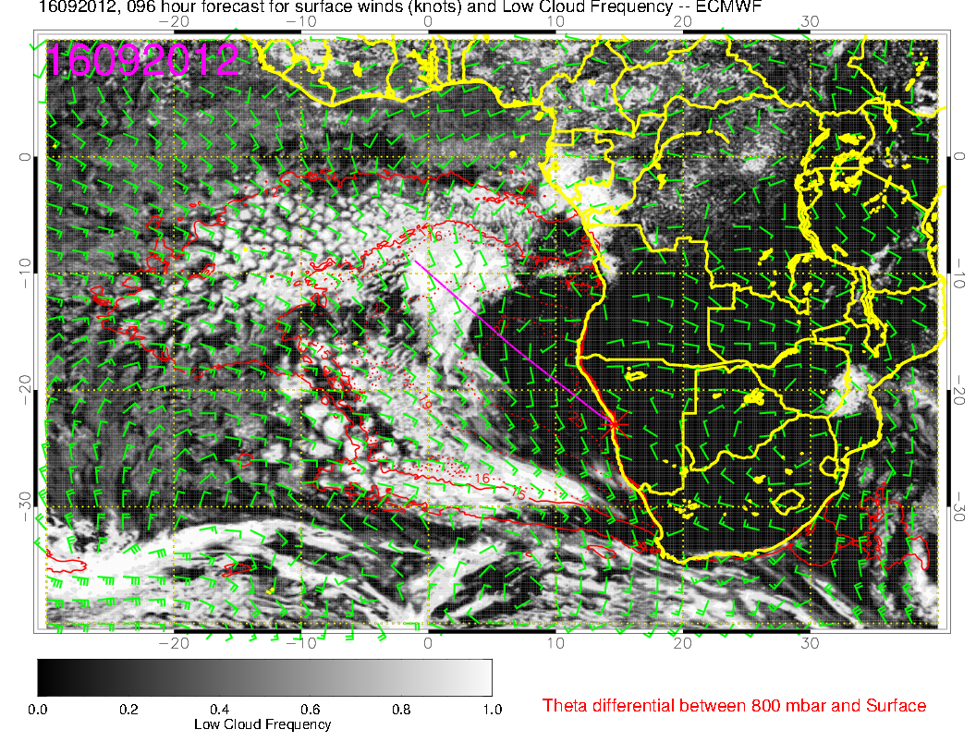
Old 96 hour forecast

Slide 18
BL height very low in broad region, and
EC tends to underpredict with these
low BL heights.

Slide 19
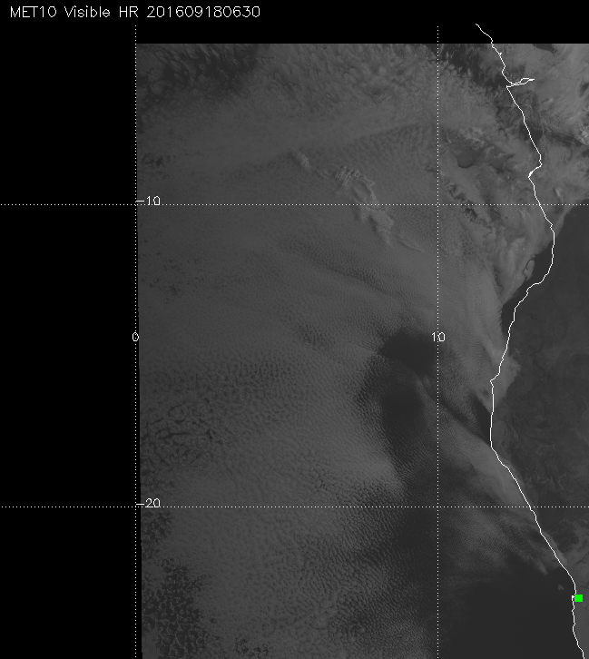
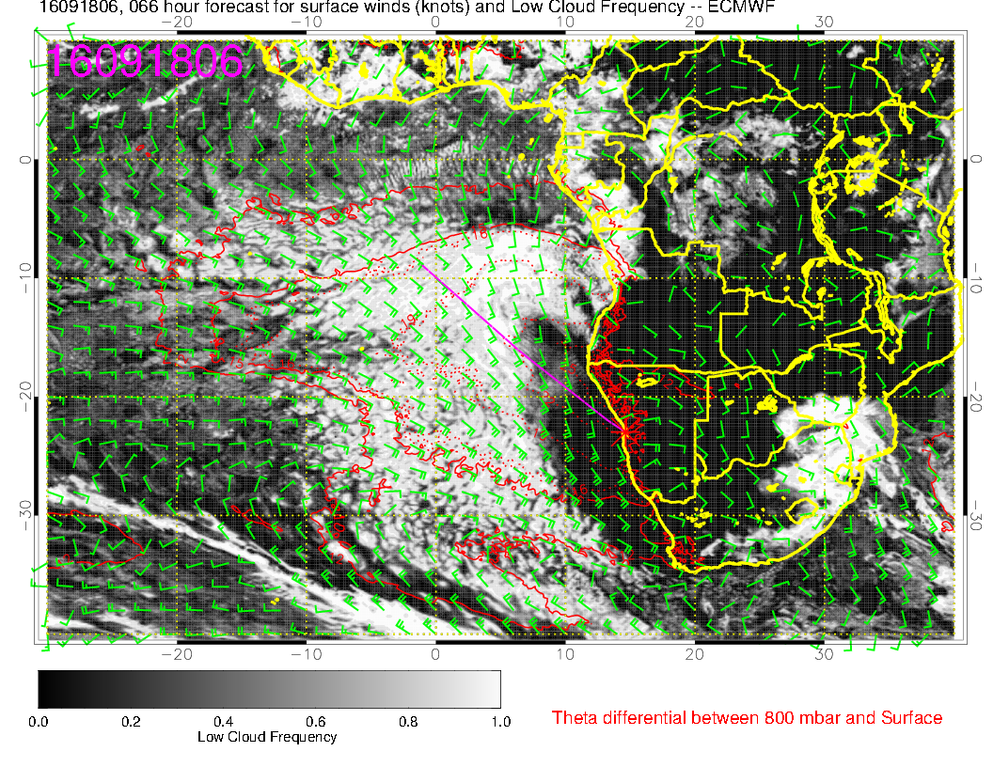
BUT, 72 hour fcst for now is PDG and BL heights are low.
I still forecast some low cloud in the near 15S based on general experience and trend of fcst.

Slide 20
Wednesday
ST Helena advances ahead of a low pressure system
Winds a bit strong locally, with more clouds
Moisture surge at mid levels continues, mid level clouds for this day less than previous forecast
Some high level cirrus may occur near coast, moister at high levels than Tuesday.
Low level clouds fill in, model divergence on details.

Slide 21
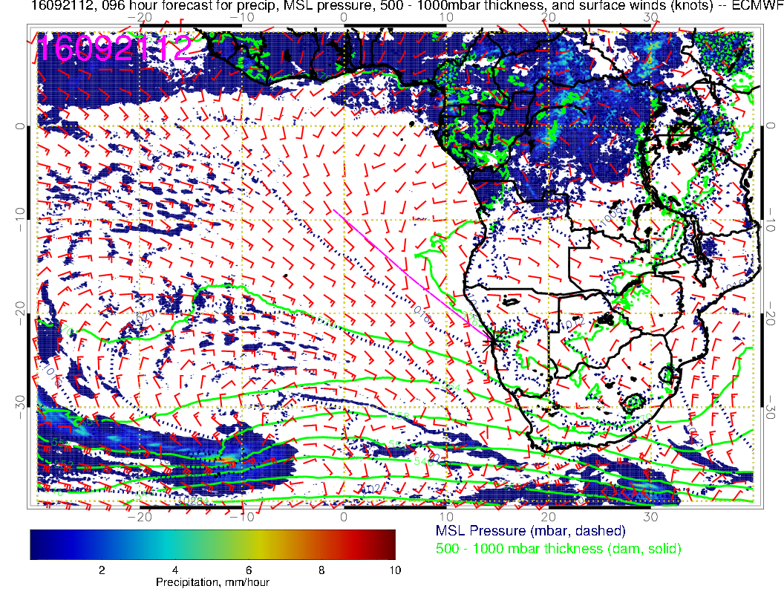
Wednesday
Tuesday
St Helena high advances again
followed by low pressure system
at 35S. Overall circulation in our region
is similar

Slide 22
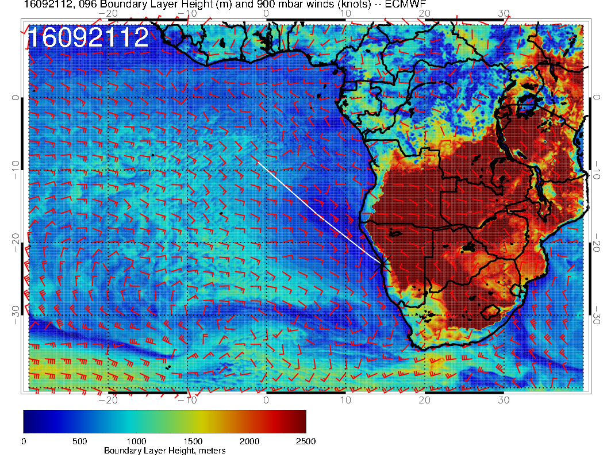
Wednesday
Tuesday
Boundary layers are generally deeper
than Tuesday.

Slide 23
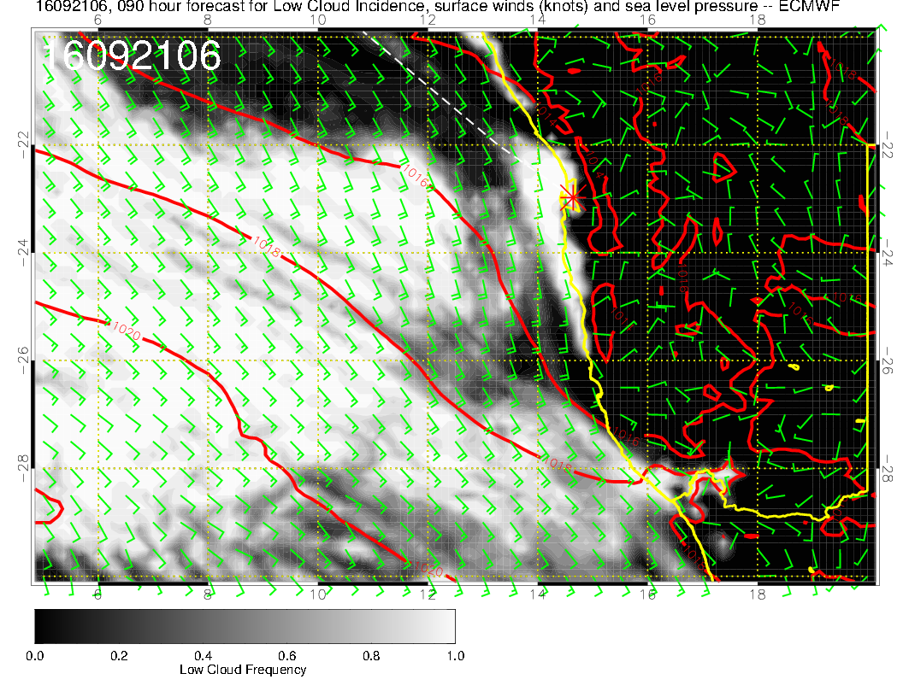
More cloud on TO. Local winds a bit stronger on landing, but will be OK.

Slide 24
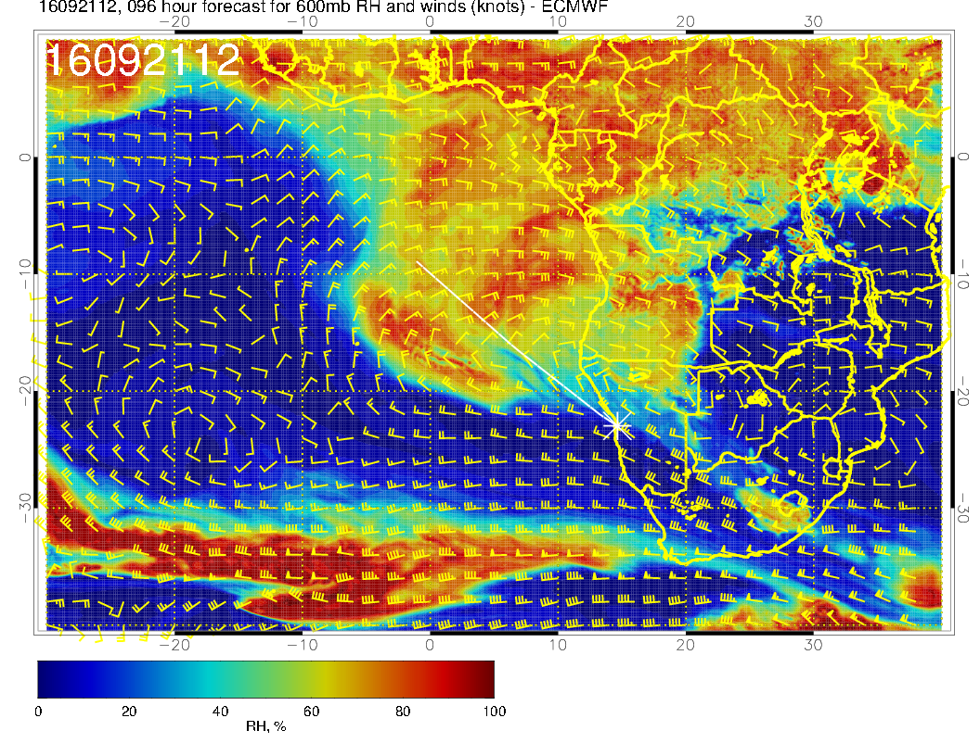
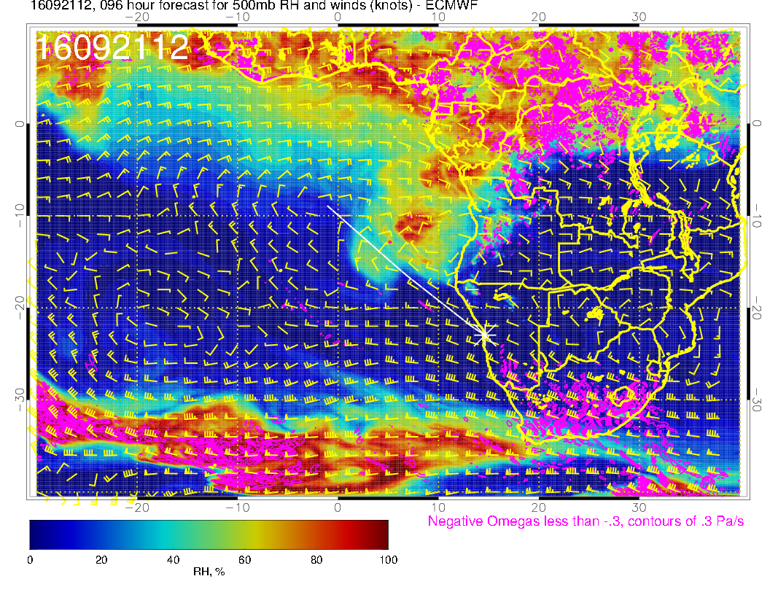

Slide 25
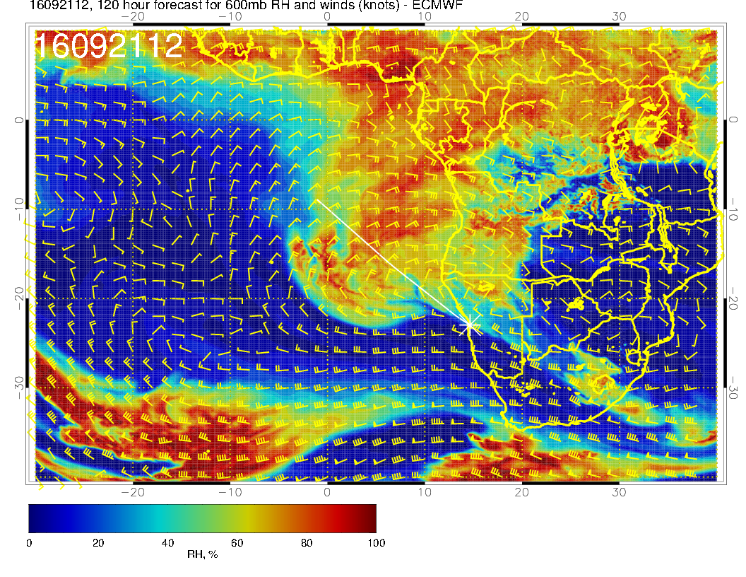
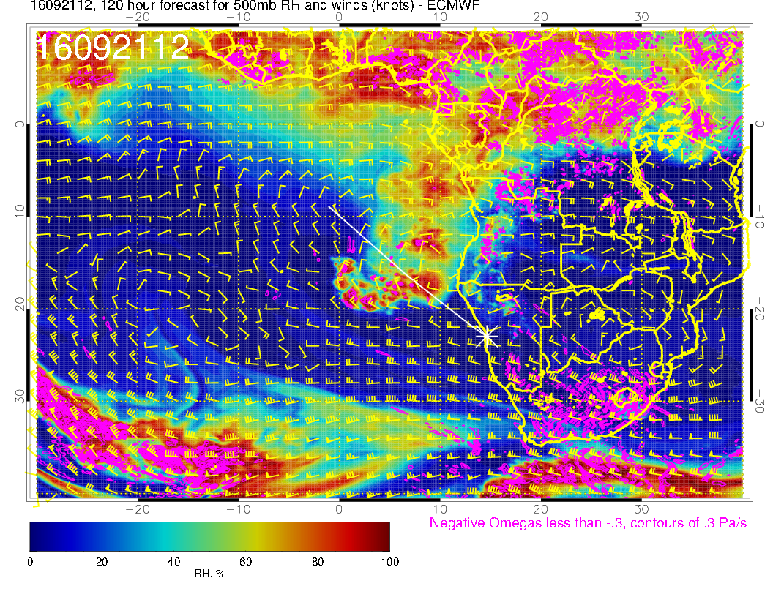
Old forecast, much more activity at
500mb, displaced southward relative
to new forecast

Slide 26
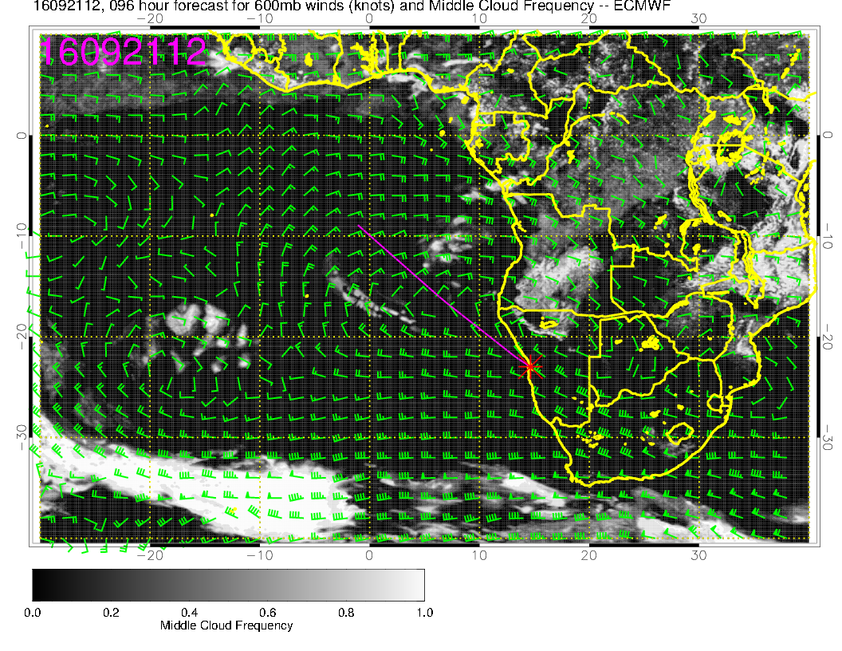
Again, much less aggressive than the 120 hour forecast (not shown)

Slide 27
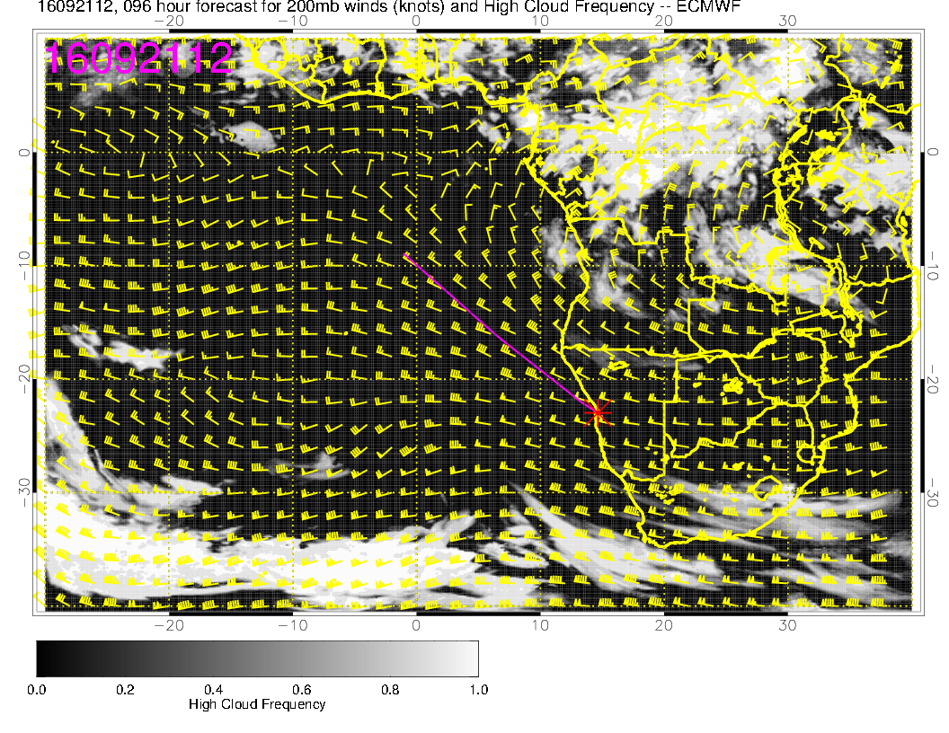
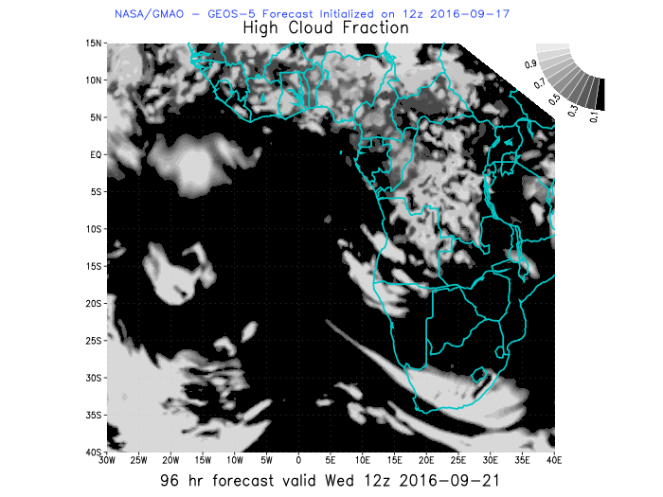
Models in rough agreement near central Angola coast and NE
corner. To be noted (not shown) is that RH at upper levels near
southern Angola coast is higher than on Tuesday.

Slide 28
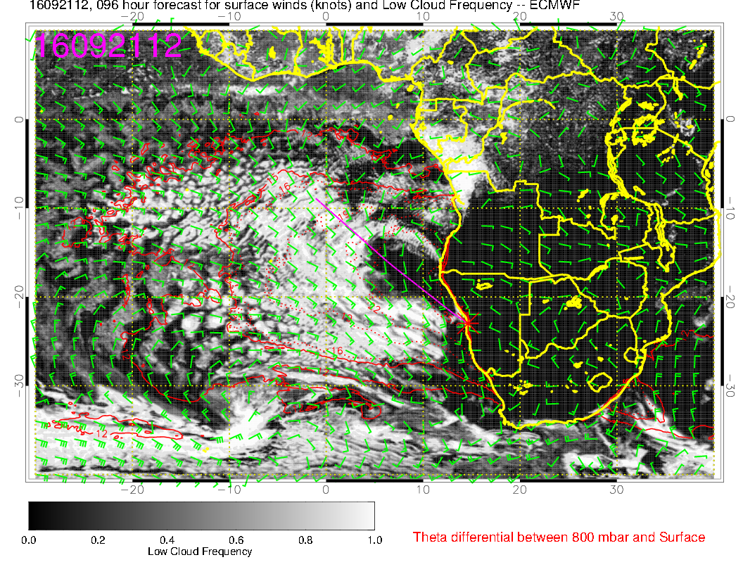
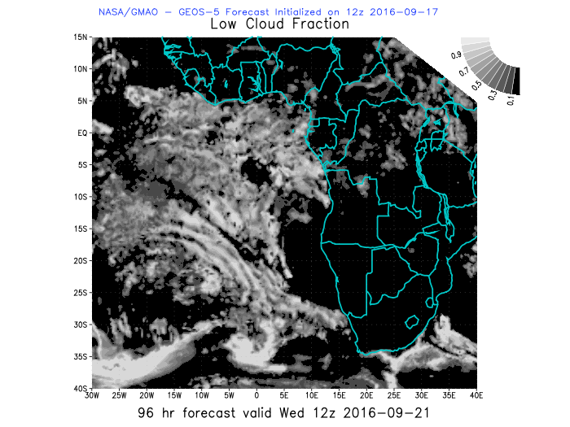
Some filling in at low levels relative to older forecast and older UKMO.

Slide 29
Clear spot corressponds roughly to low BL height. I expect some cloud there because
of this.

Slide 30
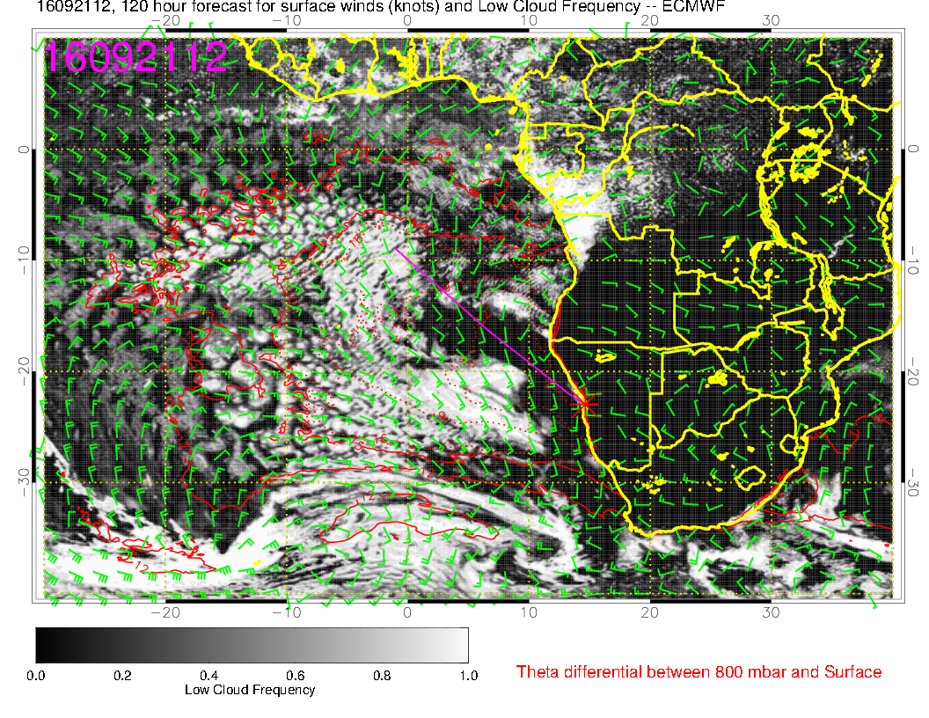
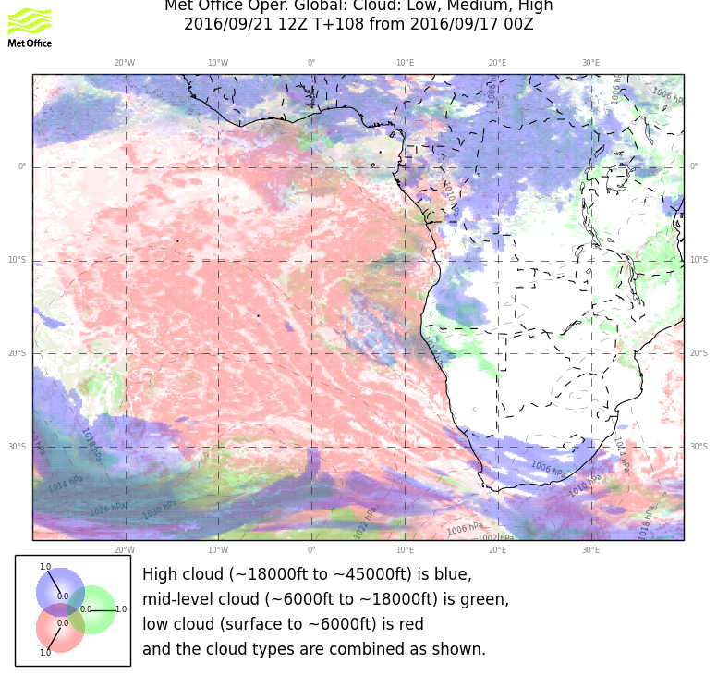
Old forecast for reference

Slide 31
Thursday

Slide 32
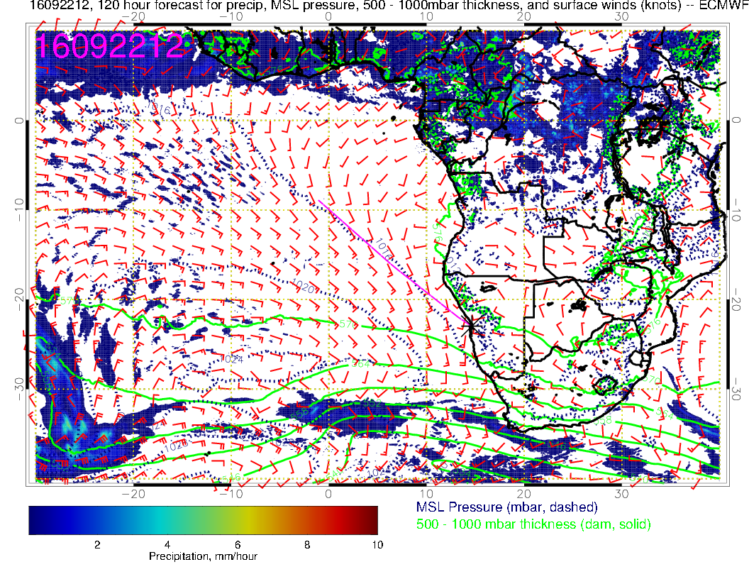
Developing low pressure system is splitting the high, which is near 10W.

Slide 33
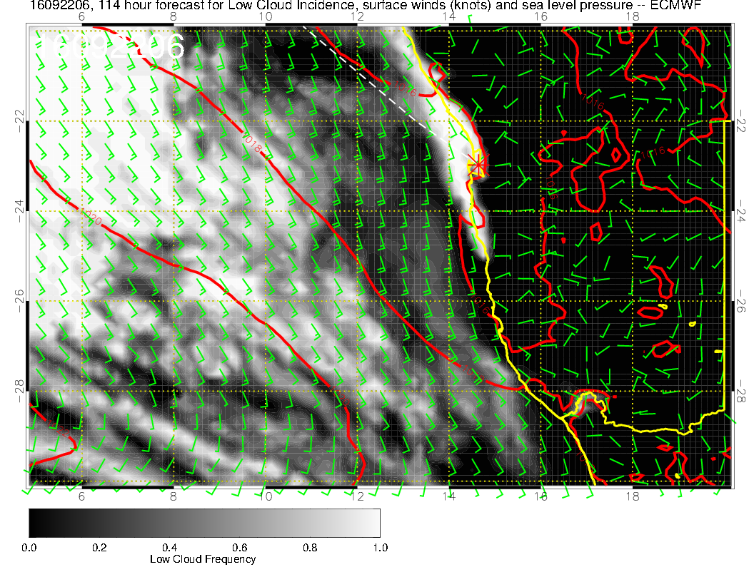
Some cloud in the morning, clearing in the PM; no wind
issues forecast (always the morning ceiling questions)

Slide 34
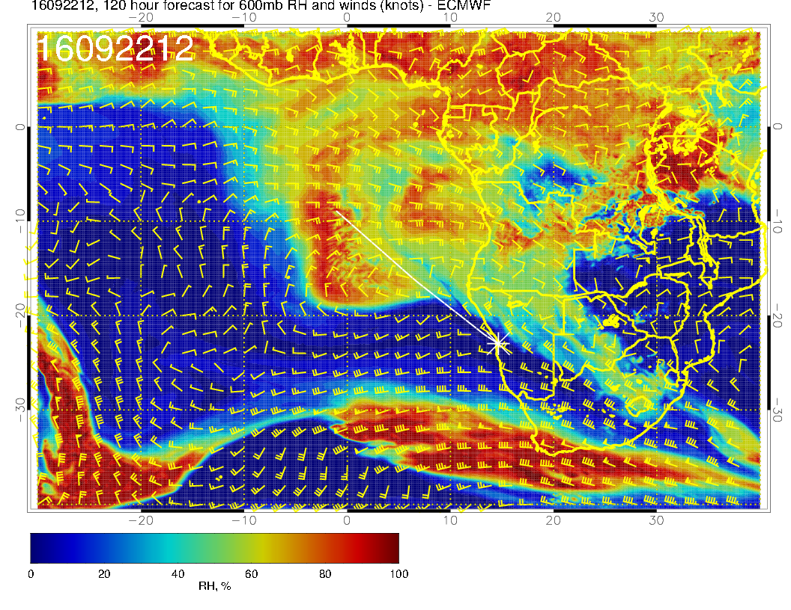
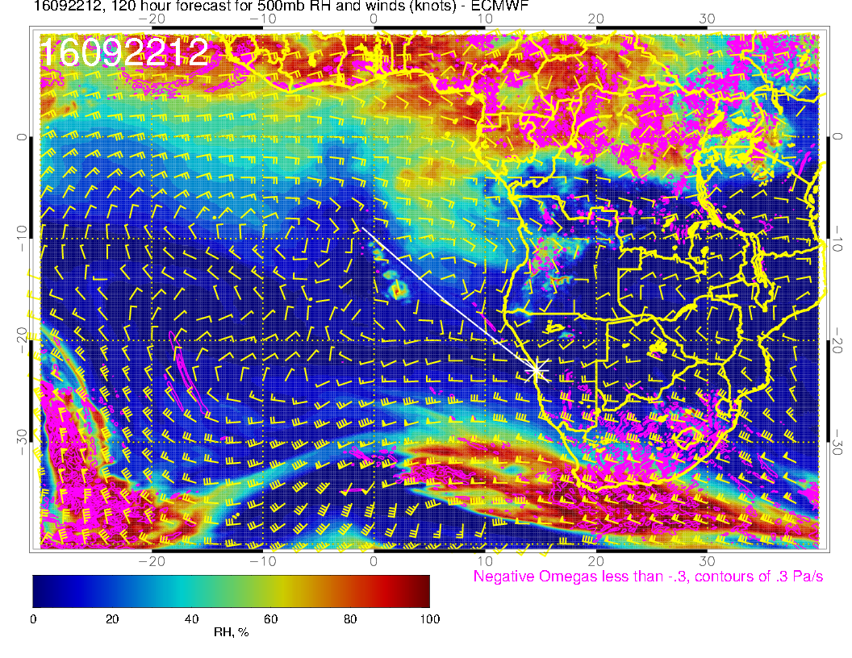
Less moisture at 500mb, surge moving westward, anticyclone being scrunched by developing trough. As yesterday, AC is west of its climo pos.

Slide 35
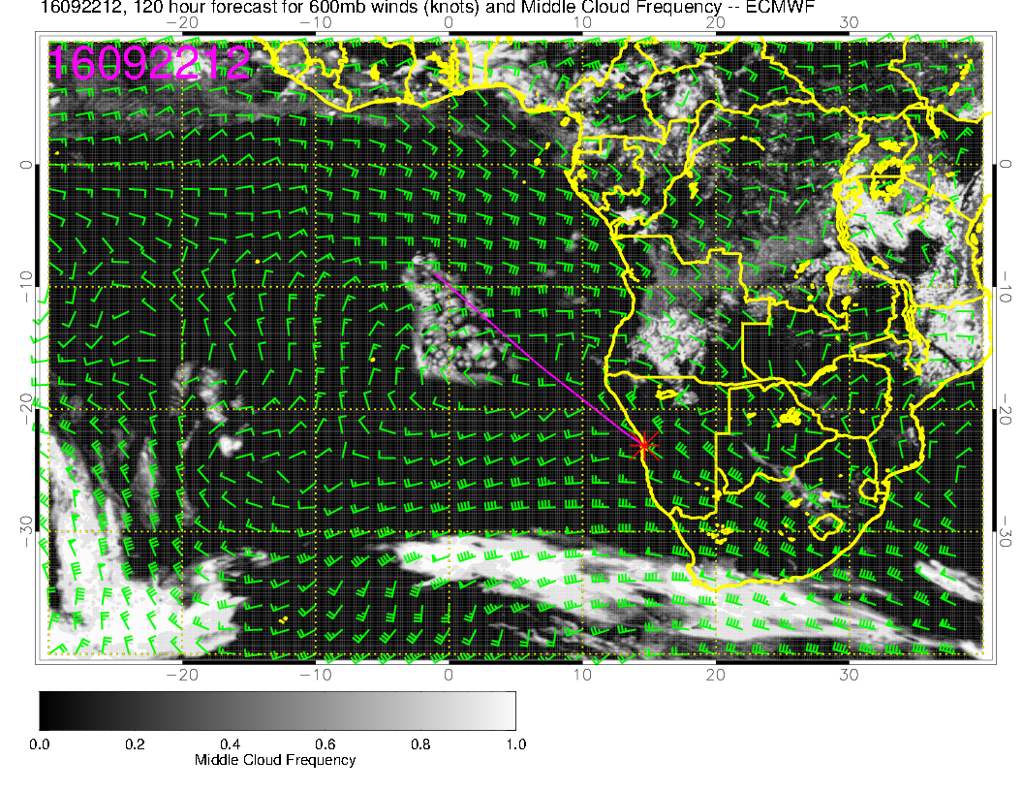

Slide 36
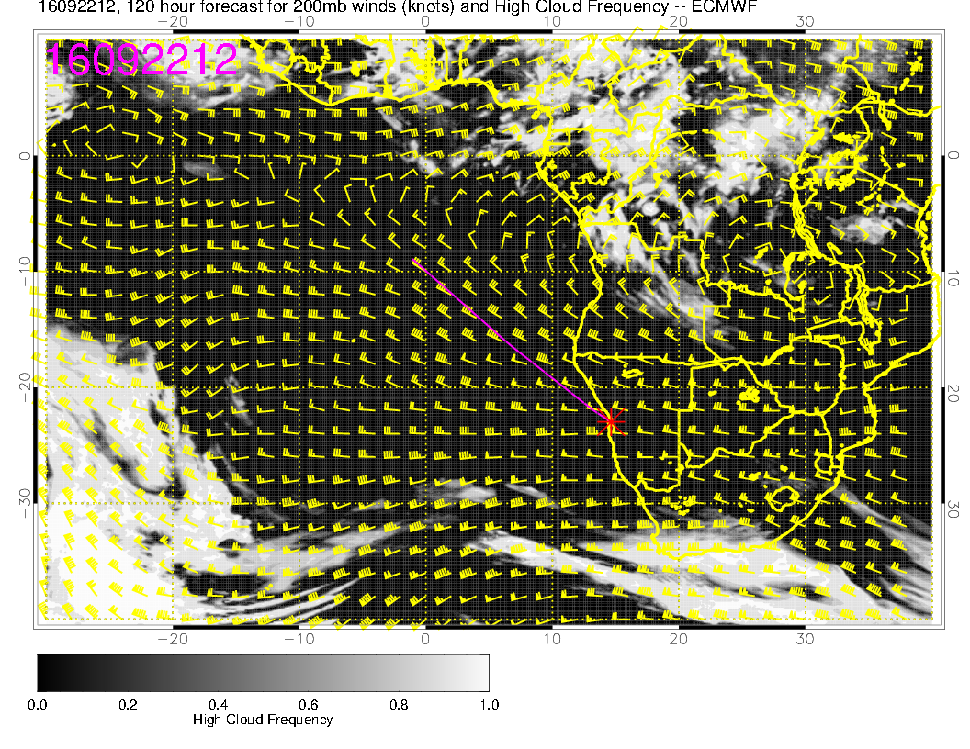
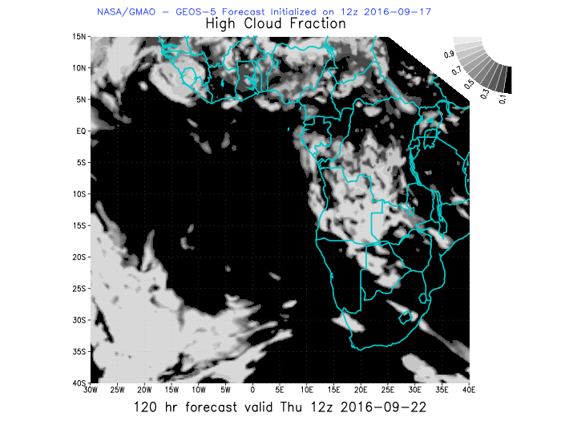
RH fields are consistent – generally drier than previous day

Slide 37
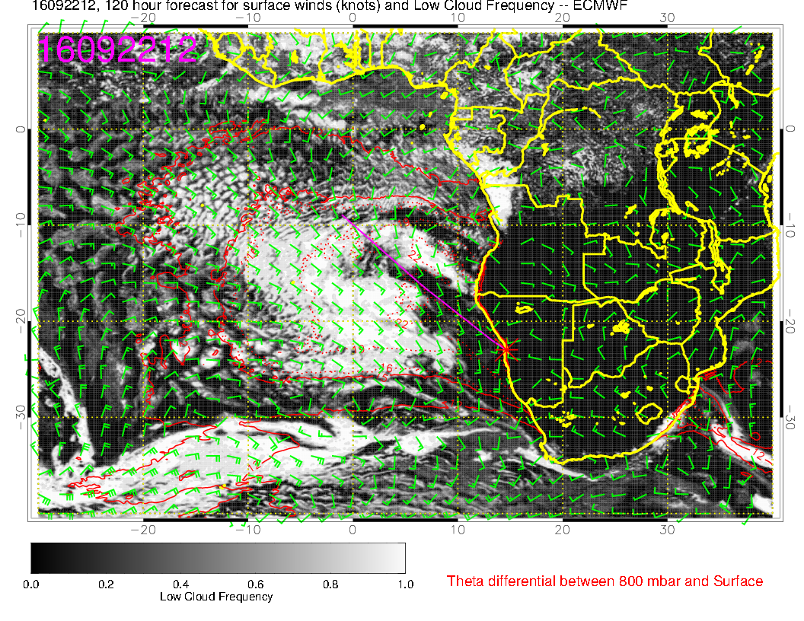
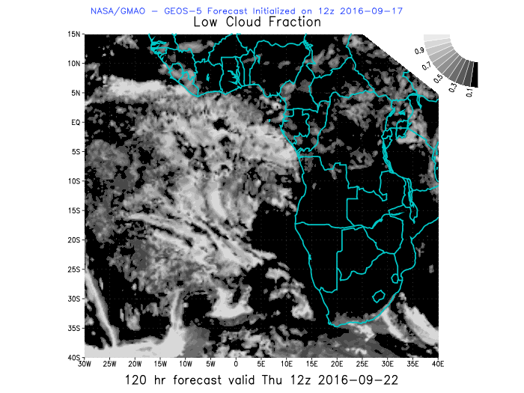

Slide 38
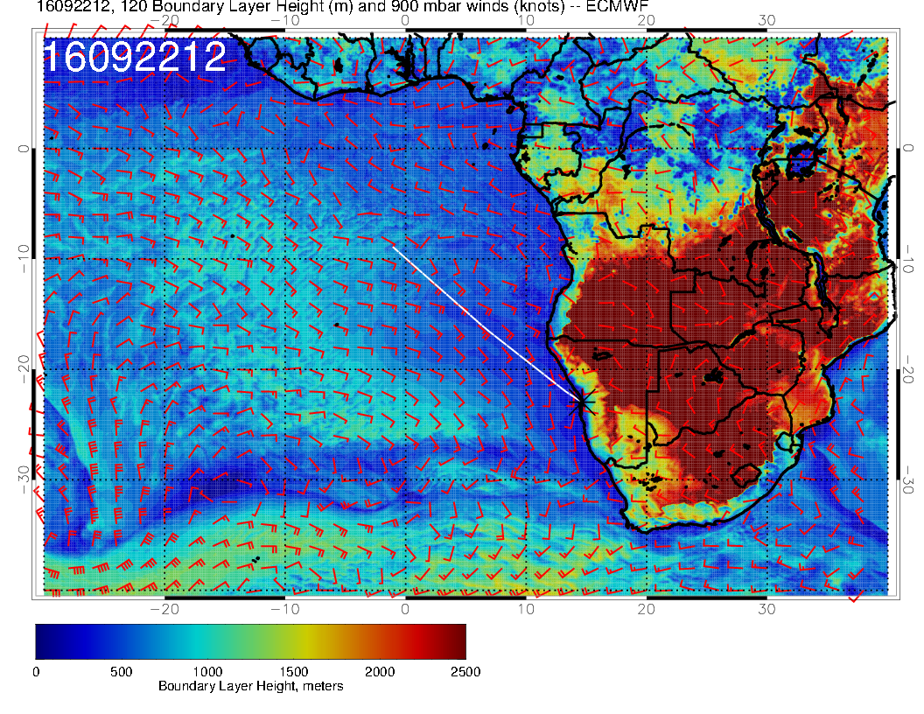
Angola bay region has flow curving in from the west. Basic message is continuing filling in and restoration of Sc.

Slide 39
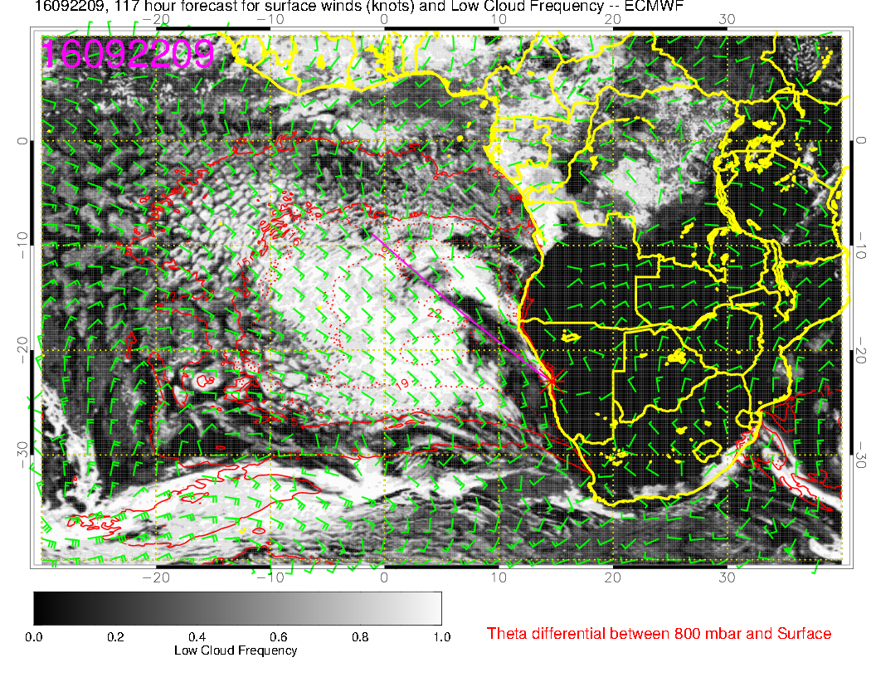
Model predicts quite a bit of diurnal variation.

