Slide 1
ORACLES forecasting briefing Meteorology for 18-09-2016
18-09-2016
Lenny Pfister

Slide 2
Sunday, 20160918
Prog indicates surface wind evolution in the afternoon very similar to yesterday. No ceiling issues. Winds will be less than 20 knots so only minor dust. Winds come down between 5 and 6PM.
Crosswind components at 4, 5, and 6 PM were 4., 4., and 1 knots respectively. Forecast for today is the same. TAF has more southerly winds with forecast crosswinds at 9.5 knots.

Slide 3
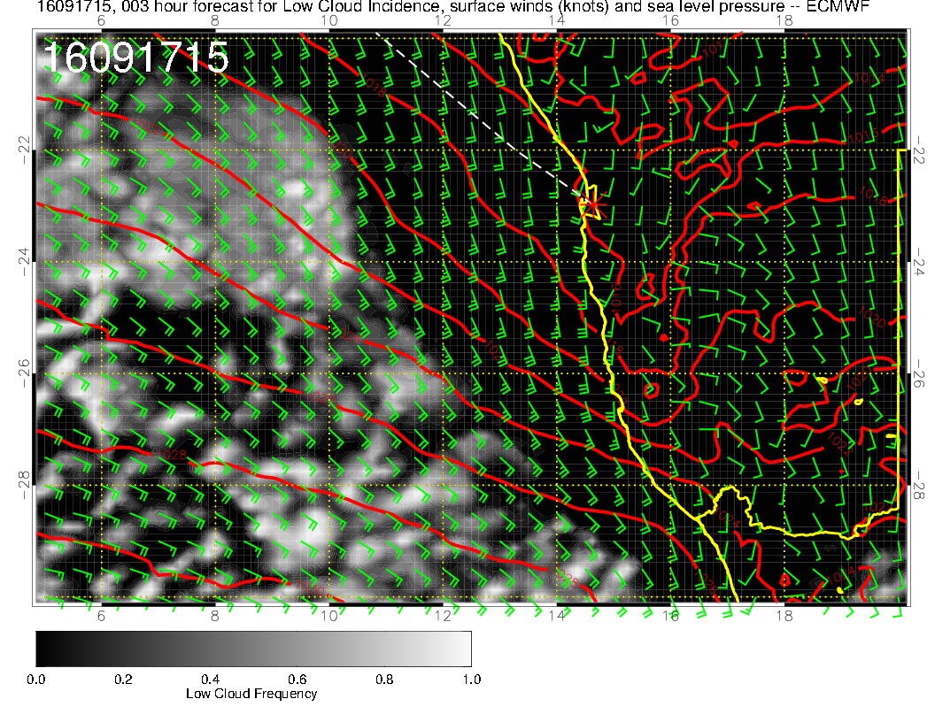
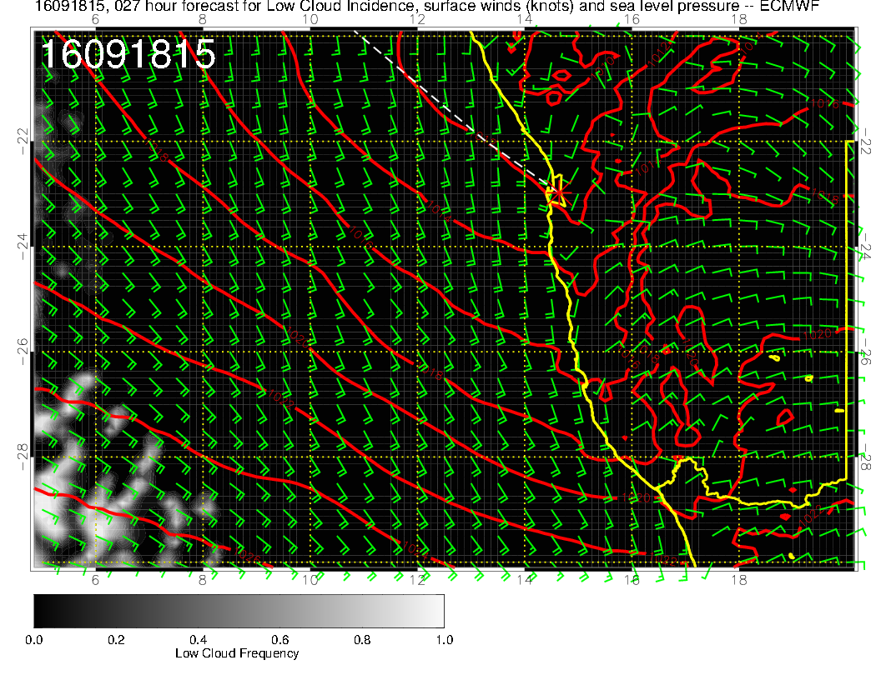

Slide 4
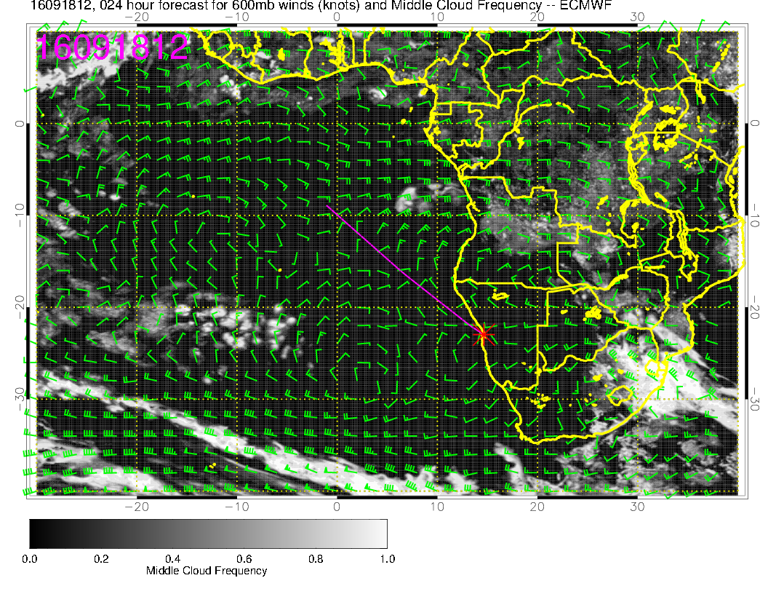
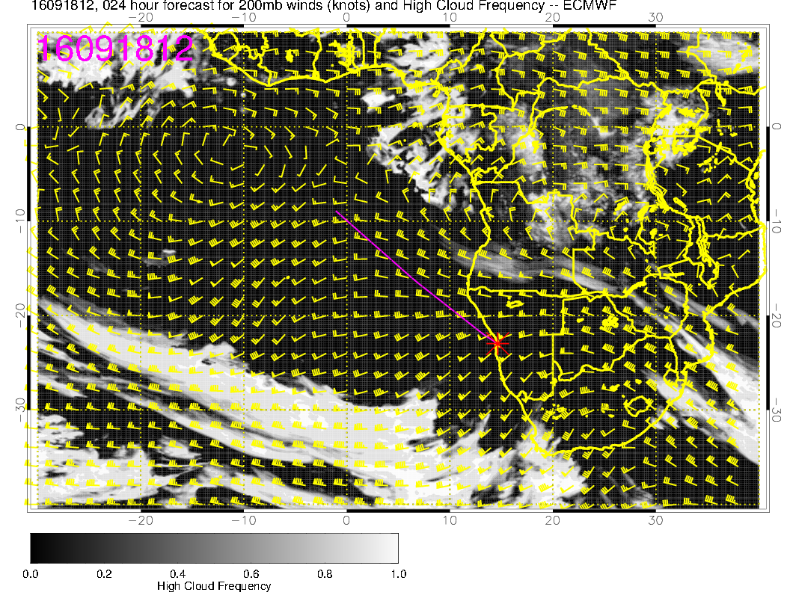

Slide 5
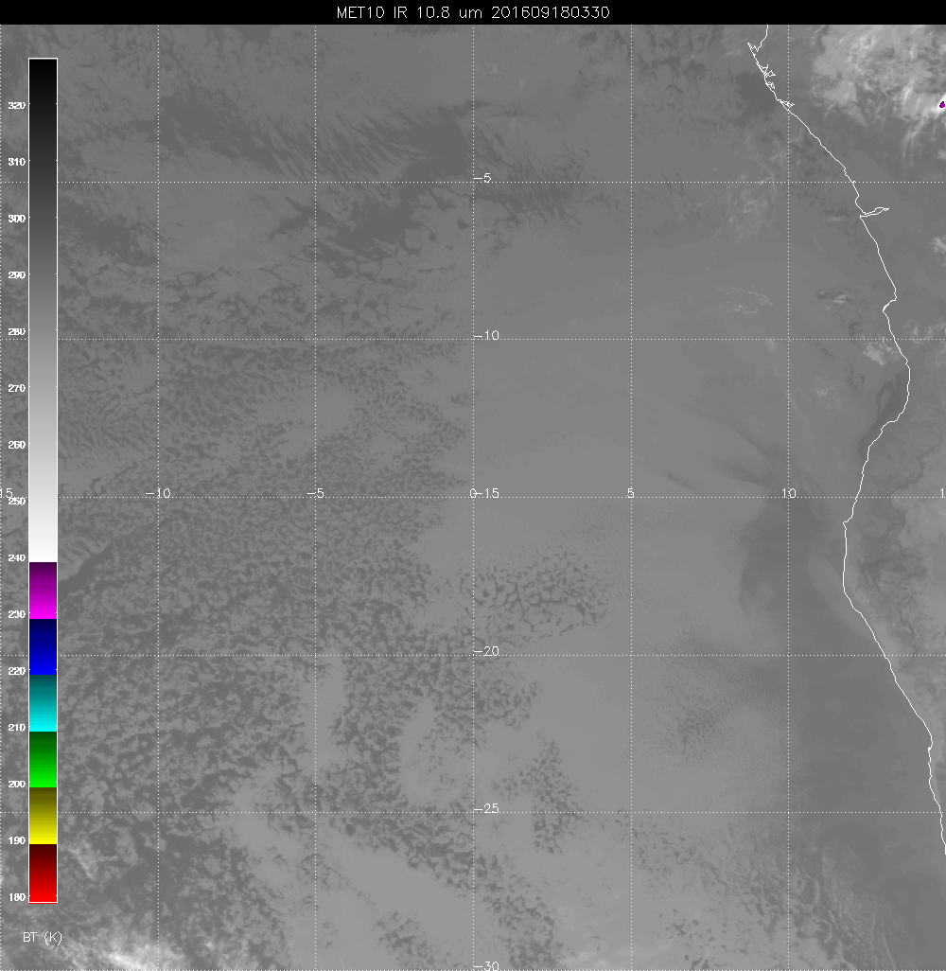
Cloud a little further south
than fcst.
Dissipating. May have none
at time of obs. More southward
trek a good sign for plume pos.

Slide 6
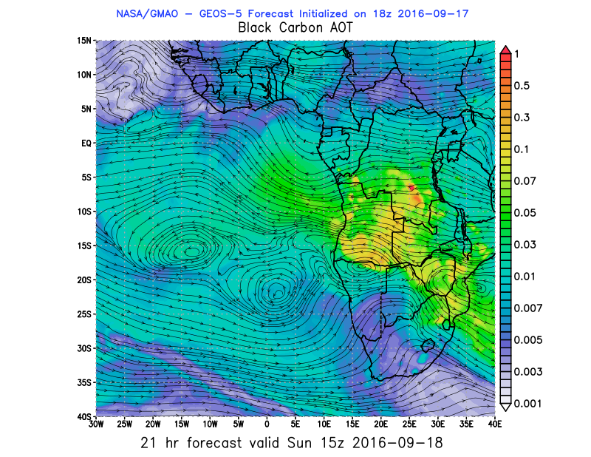
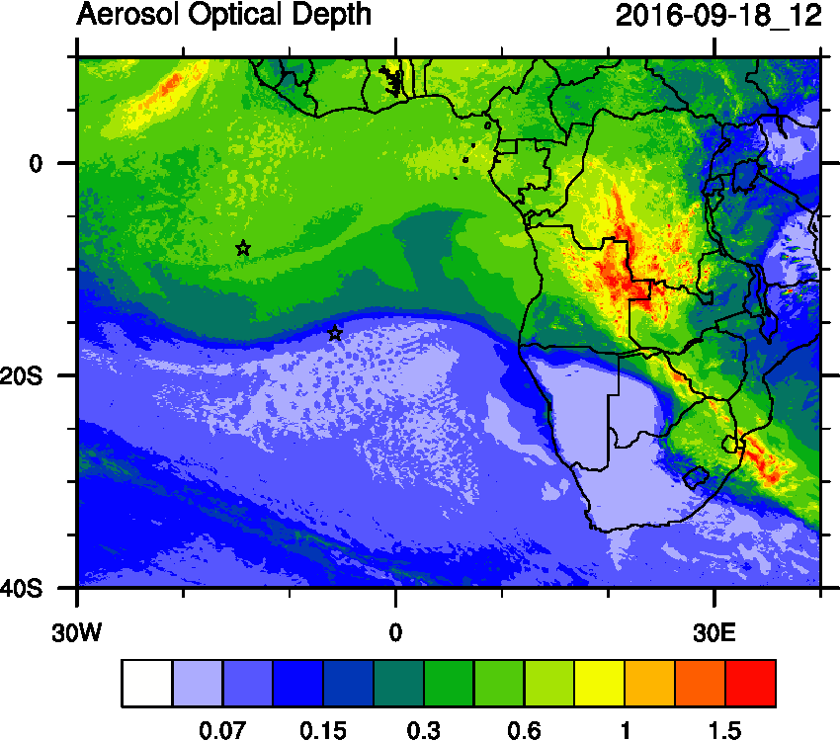
Hugging coast is a good idea. NCAR WRF has stuff further north.

