Slide 1
ORACLES Forecast Briefing (Aerosols)
18 September 2016

Slide 2
The Aerosol Week

Slide 3
Walvis Bay
Dust
OC+BC+SO4

Slide 4
Ascension Island

Slide 5
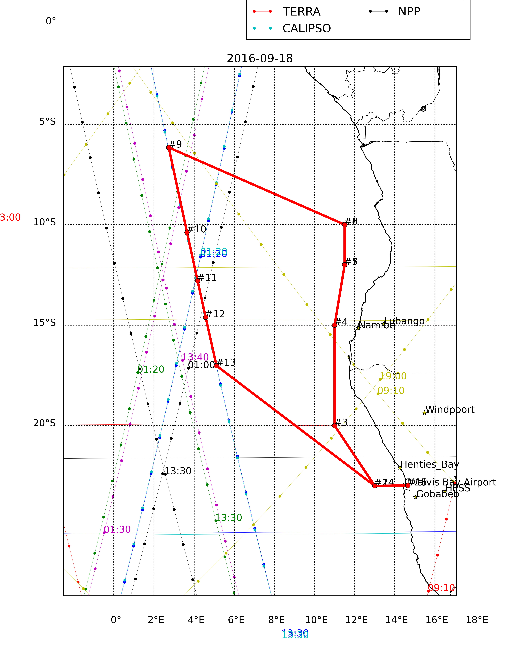
Sunday 18 September 2016
Flight Day

Slide 6
Sunday, 18 September 2016 9Z
MID

Slide 7
Sunday, 18 September 2016 9Z
HIGH

Slide 8
Tuesday 20 September 2016
Flight Day

Slide 9
72 hr
Forecast
Consistency
96 hr

Slide 10
Clouds & Aerosols - Tuesday 2016-09-20 9Z
HIGH

Slide 11
Clouds & Aerosols - Tuesday 2016-09-20 9Z
MID

Slide 12
Clouds & Aerosols - Tuesday 2016-09-20 9Z
LOW

Slide 13
GEOS-5 AOD on Tuesday 2016-09-20 12Z

Slide 14
GEOS-5 AOD on Tuesday 2016-09-20 12Z

Slide 15
BC GEOS-5
WRF: WFA

Slide 16
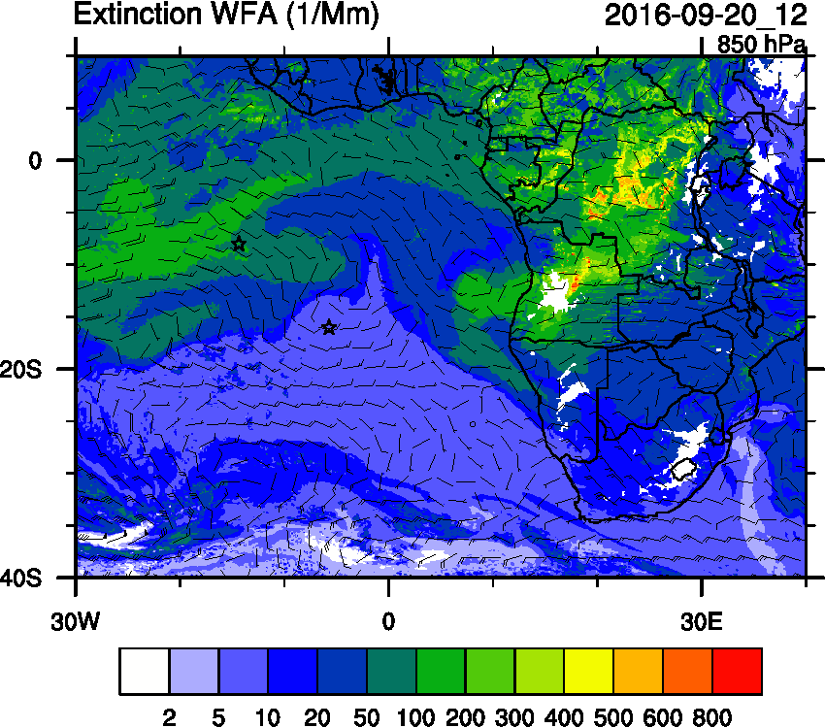
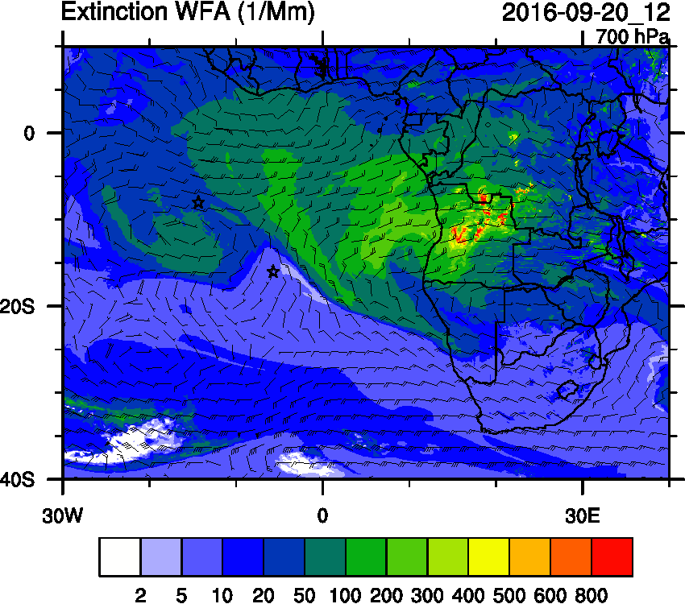
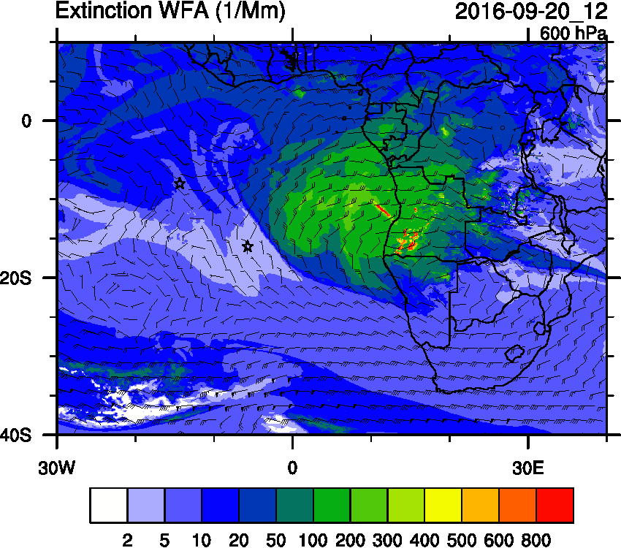
WRF: WFA Ext
WRF: BB Age

Slide 17
E-W@15S: Tue 20 Sep 2016 12Z

Slide 18
N-S@10E: Tue 20 Sep 2016 12Z

Slide 19
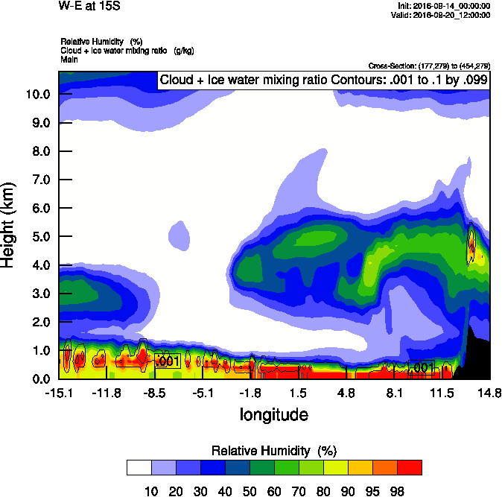
Tuesday Sept. 20

Slide 20
Wednesday 21 September 2016
TBD Flight/No-Flight

Slide 21
Wed, 21 September 2016 9Z
LOW

Slide 22
Wed, 21 September 2016 9Z
MID

Slide 23
Wed, 21 September 2016 9Z
HIGH

Slide 24
Wednesday Sept. 21

Slide 25
Wednesday Sept. 21
NW – SE Curtains

Slide 26
GEOS-5
WRF

Slide 27
Thursday 22 September 2016
Flight Day

Slide 28
Thursday Sept. 22

