Slide 1
ORACLES forecasting briefing Meteorology for 17-09-2016 – 10-09-2016
17-09-2016
Lenny Pfister

Slide 2
Sunday, 20160918
Distended high is stretched south of RSA. Strong winds continue offshore
Winds still strong tomorrow. Current official fcst for today still barely within limits (14.18 knots cross). Official fcst (yesterday 3 PM) was out of limits.
Based on experience from yesterday, cancelling tomorrow for winds is a real possibility.
600mb flow has a surge of moisture (to 500mb) exiting continent just north of 10S
Middle cloud just north of 10S, stable forecast (maybe intensifying).
High cirrus through middle of region – expect it to be there and very thin.
Ample clearing to 5E. Some model disagreement. Expect minimal cloud even to 15S.

Slide 3
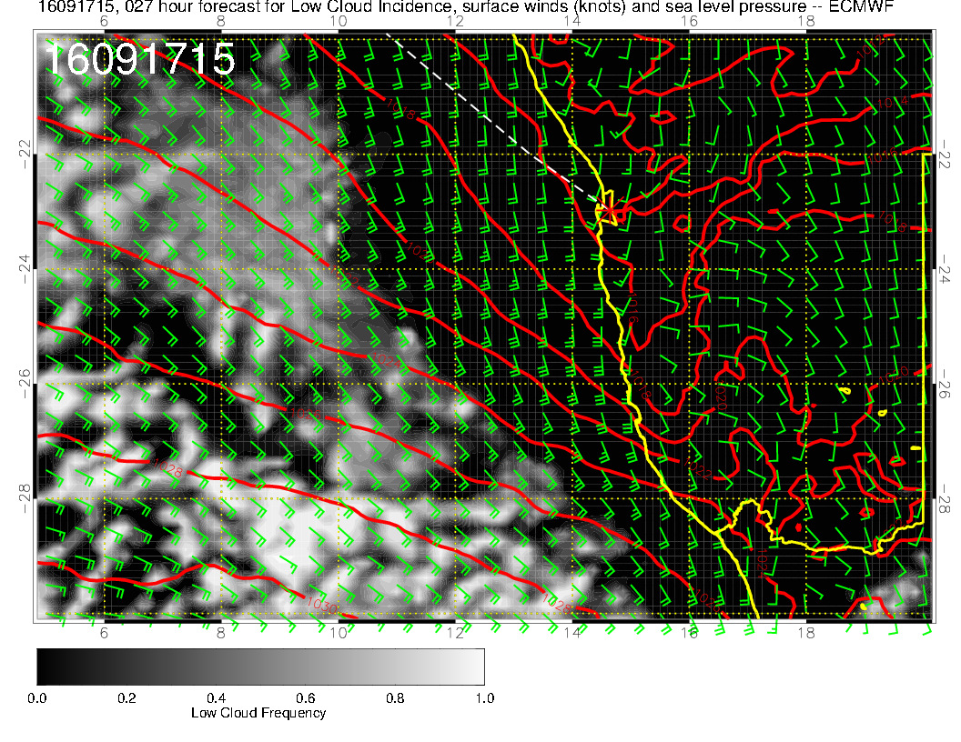
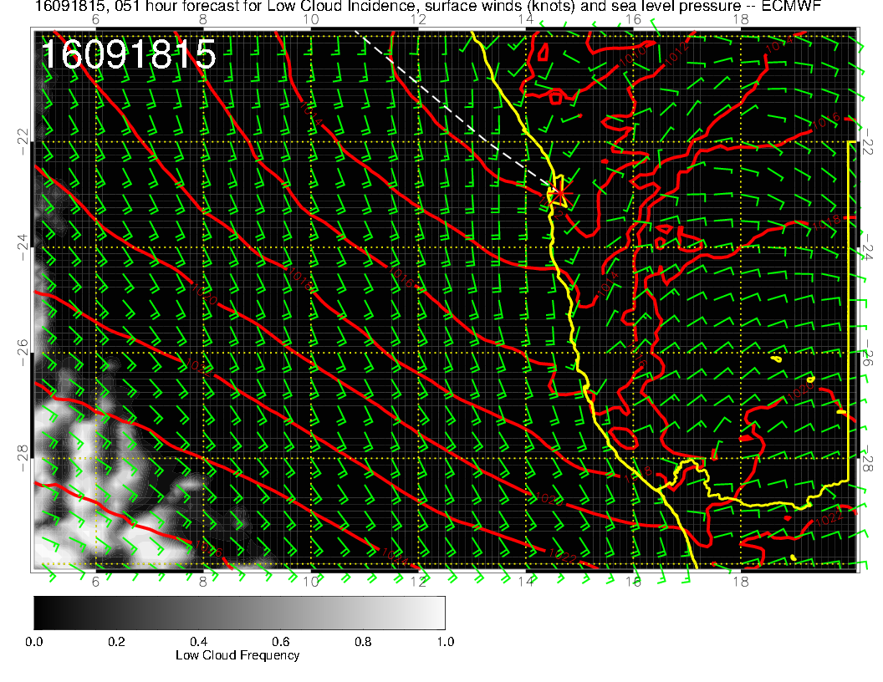
Shows no change in the winds and
angles at landing between today
and tomorrow

Slide 4
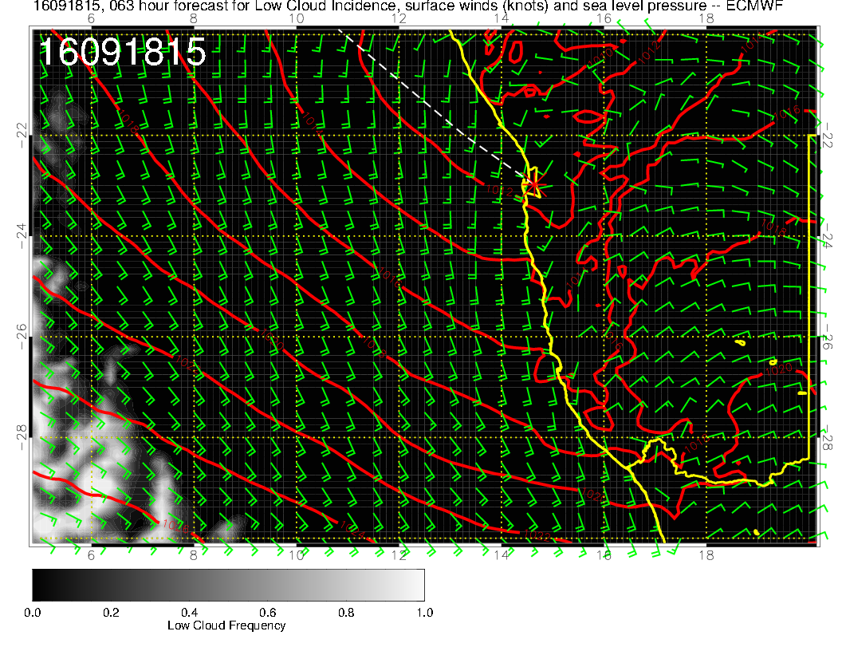
NEW
OLD
New forecast less favorable
than old

Slide 5
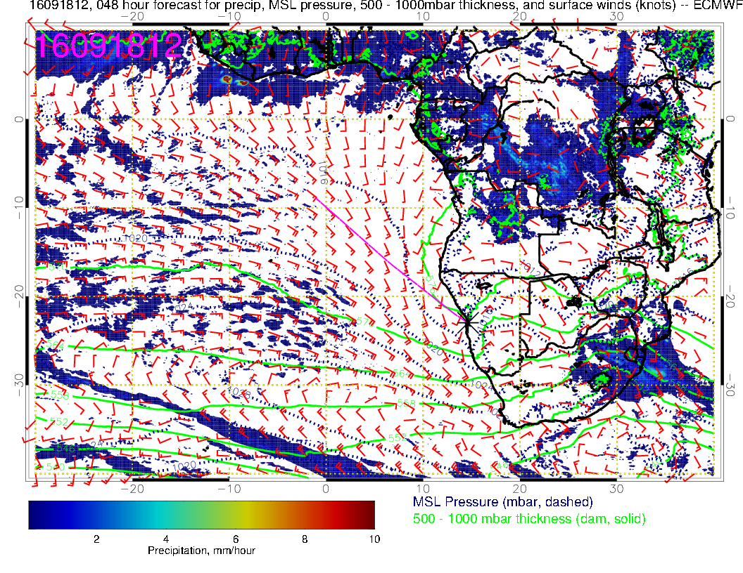

Slide 6
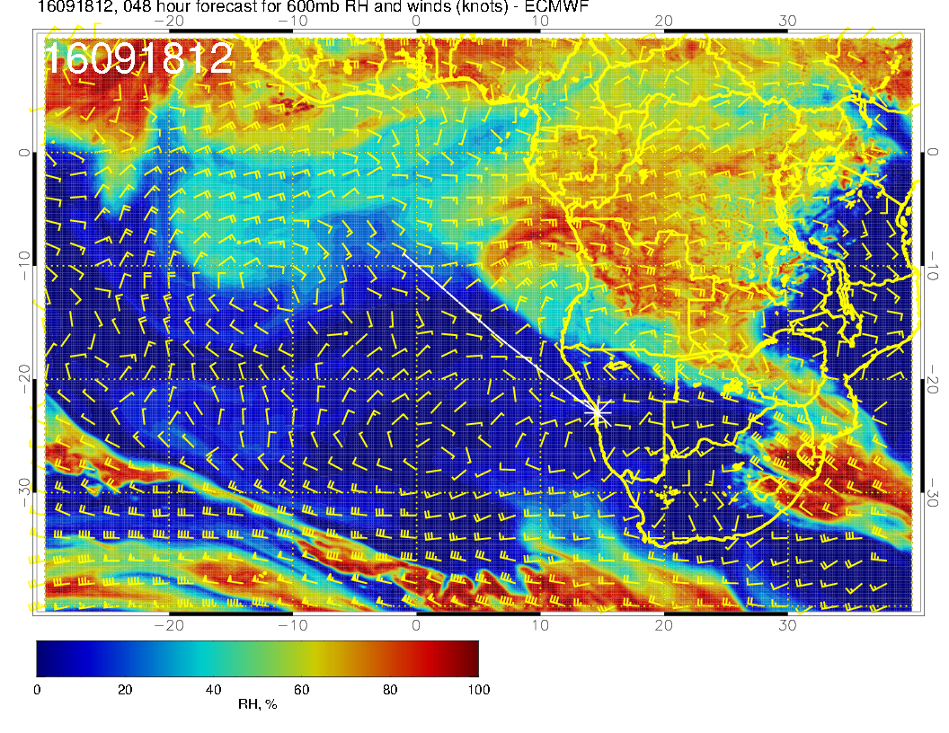
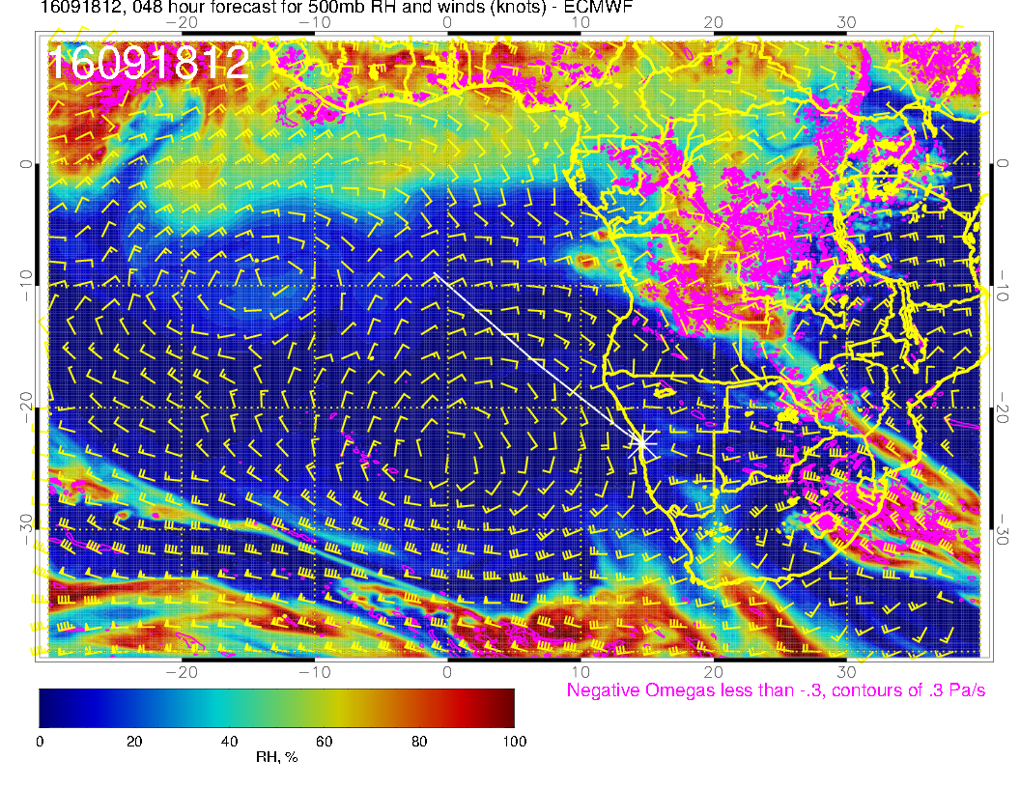

Slide 7
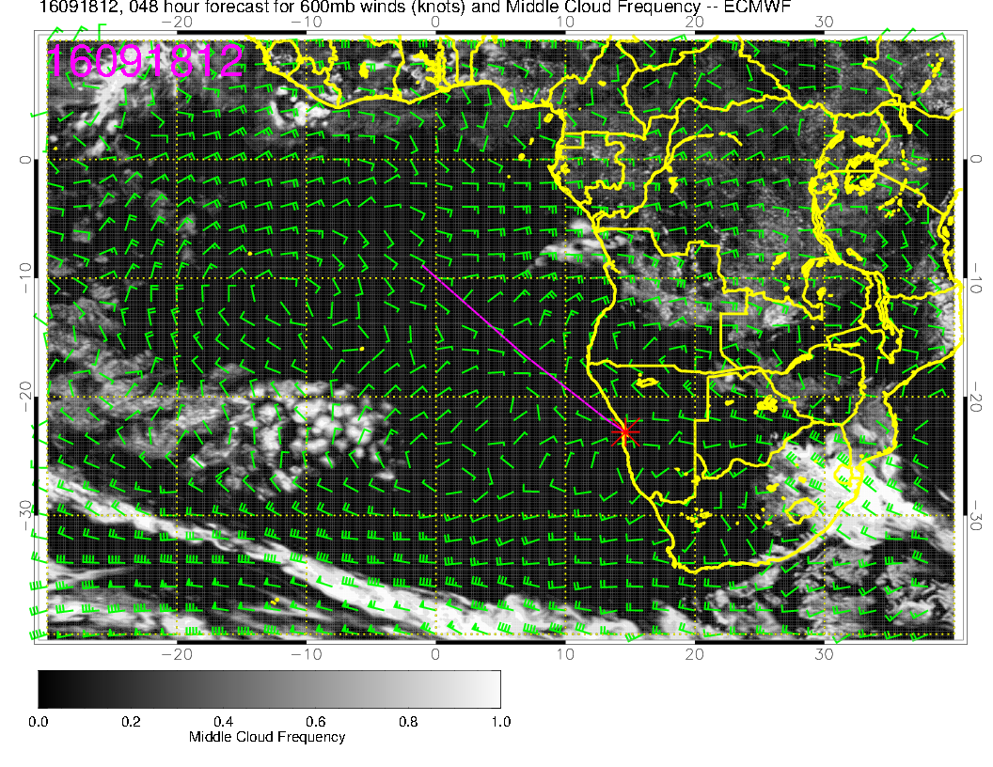
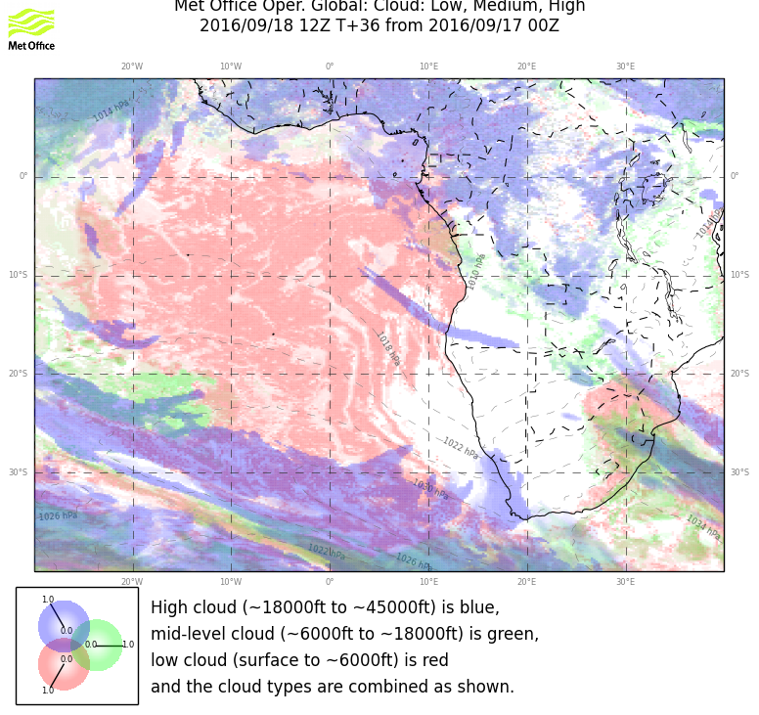
These mid-cloud forecasts are in rough agreement and are stable

Slide 8
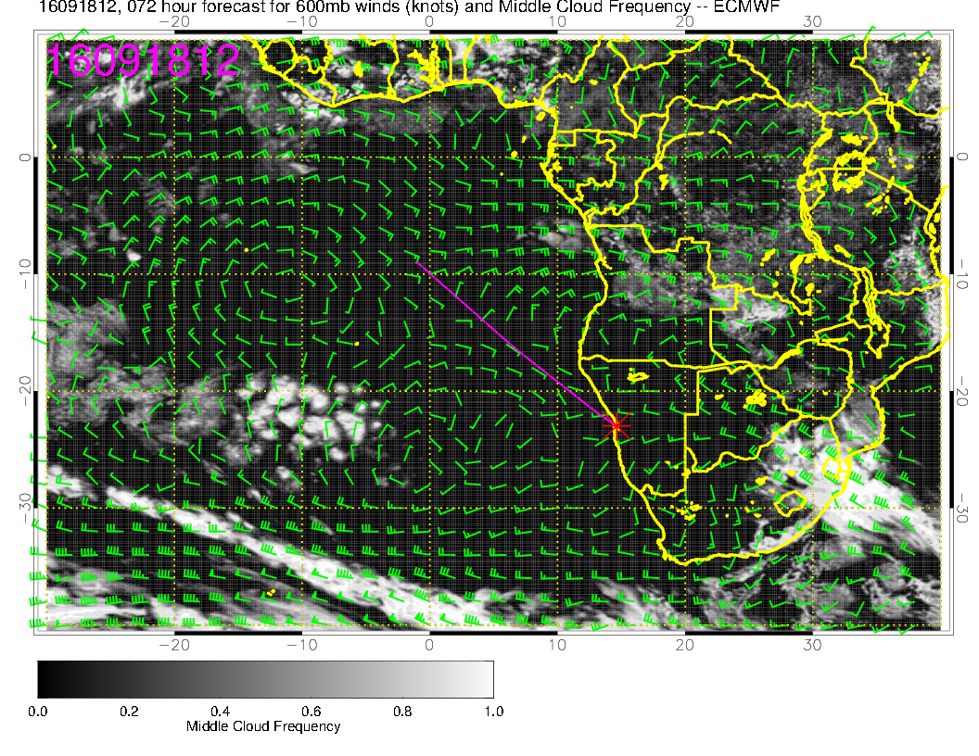
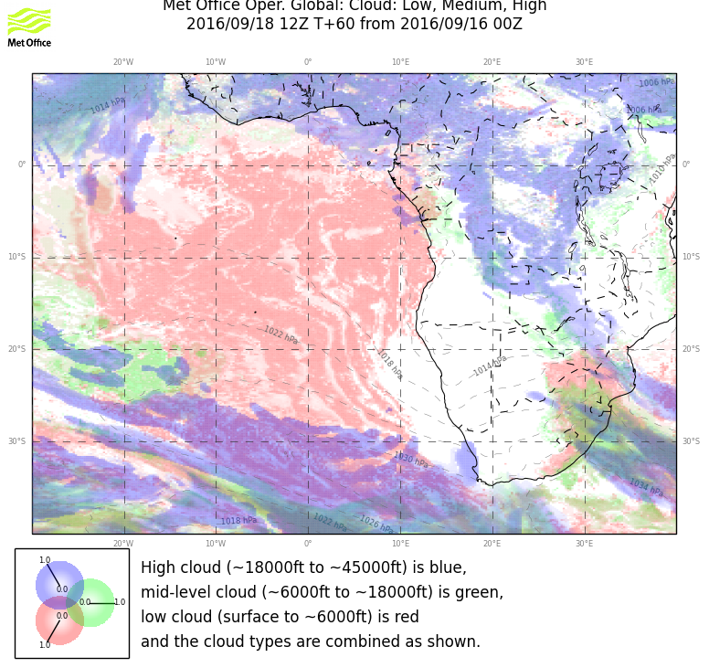
Yesterday’s forecast

Slide 9
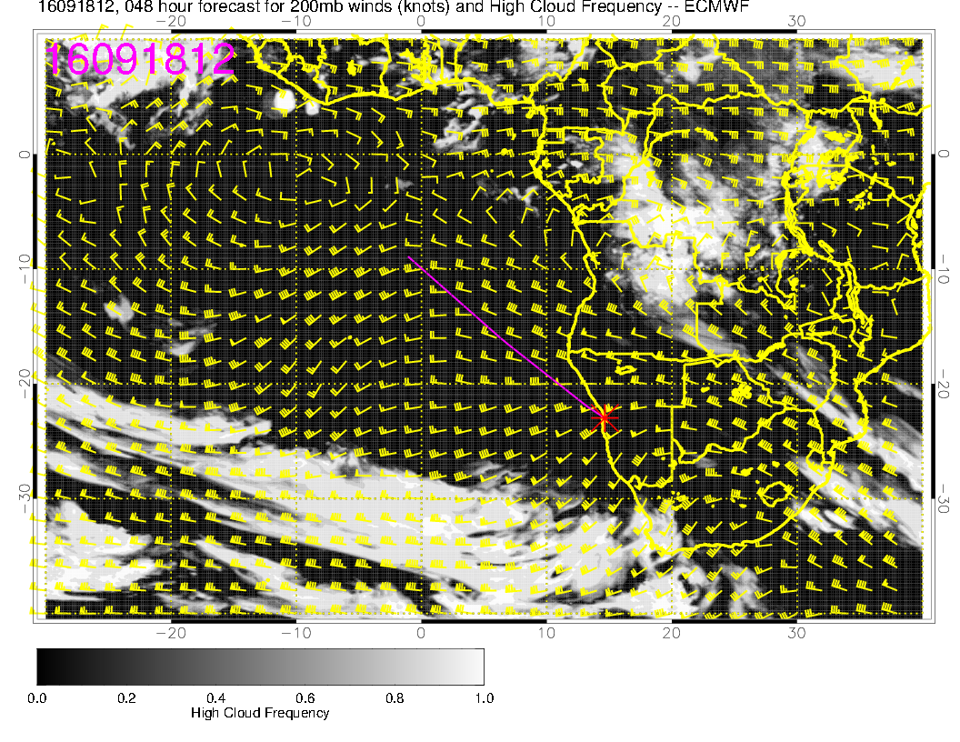

Slide 10
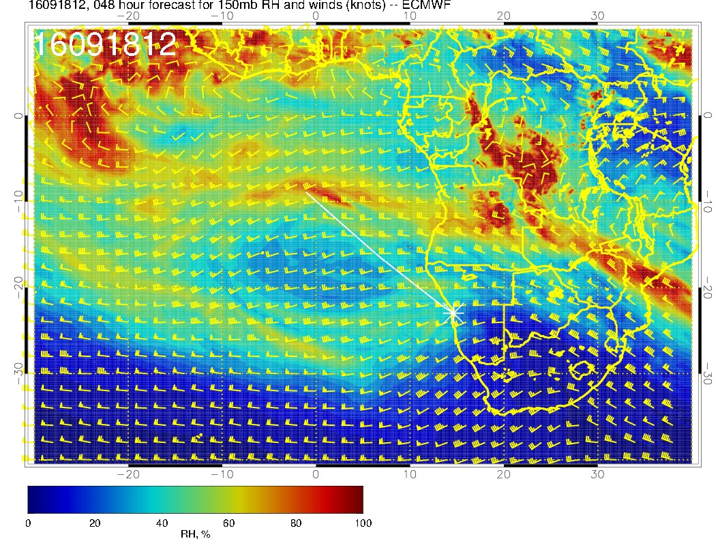
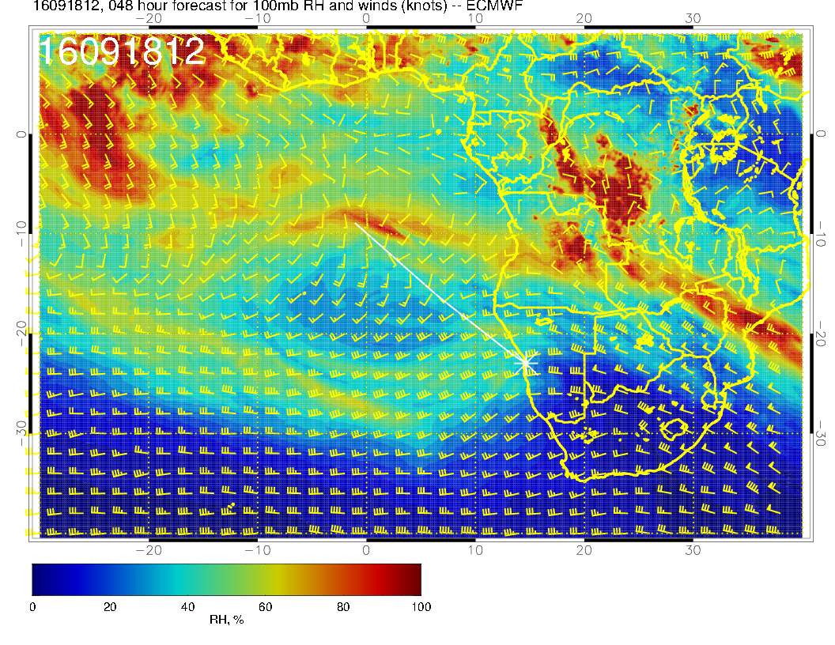
So, there is an RH band at high altitude. I think there will be very thin cirrus that the
HSRL can penetrate (yesterday) but other instruments (RSP, AIRMSPI) may have probs??

Slide 11
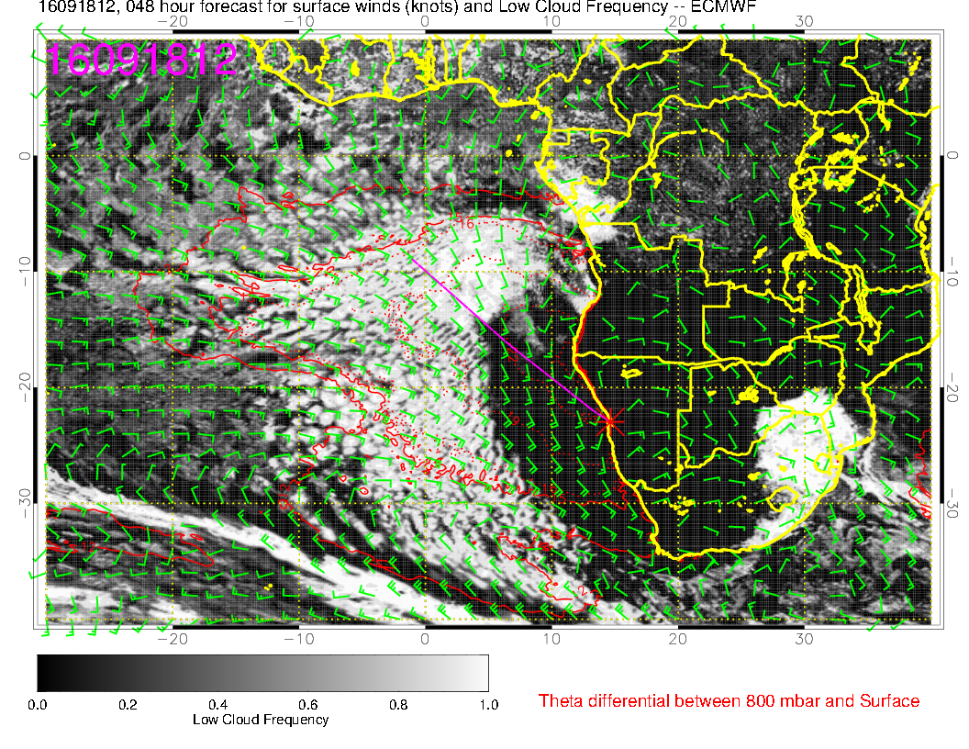
Expect minimal low cloud near coast to 15S based on verif (next slide).
Both models actually did pretty well for this morning.

Slide 12
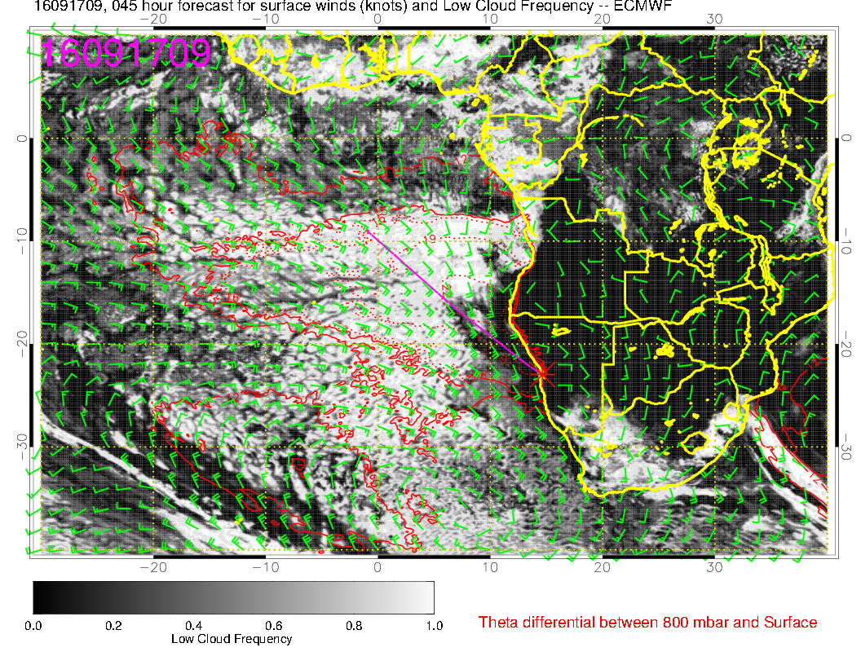
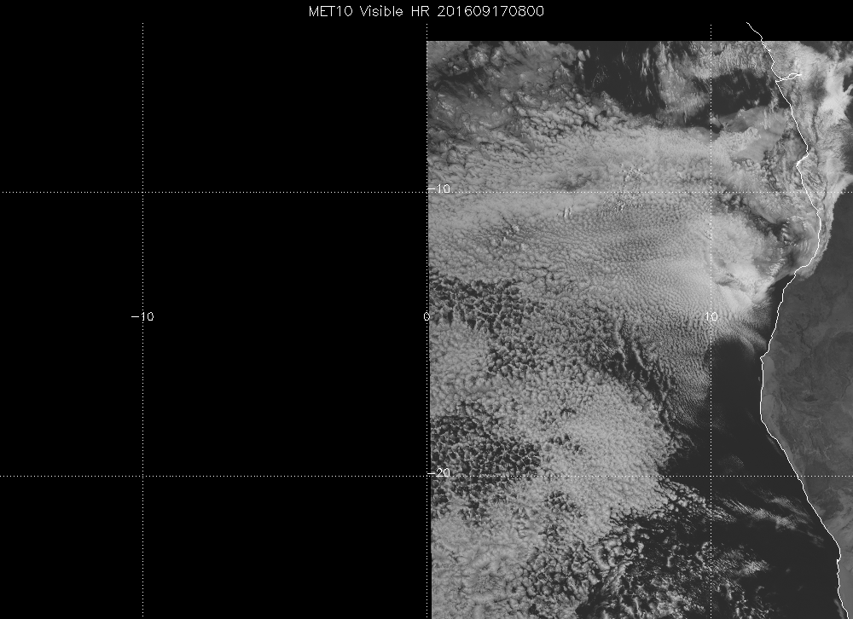
48 hour forecast for today, actually pretty good, even north of ang/nam border

Slide 13
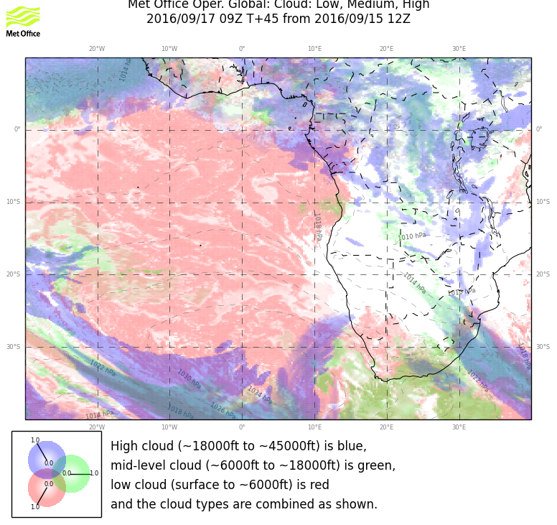
48 hour forecast for today, actually pretty good, even north of ang/nam border

Slide 14
Tuesday
Winds much weaker on this day, minimal cloud, no flyability issues.
600mb anticyclone developing rounded pattern (like yesterday’s fcst) with surge of moisture to 500mb moving swwrd over the SEA.
Corresponding mid cloud follows this in both models.
RH band (not shown) is reduced in value from Sunday – expect less or no cirrus except NE of 10S, 10E
Models diverge on low cloud forecast. EC clearing seems excessive.

Slide 15
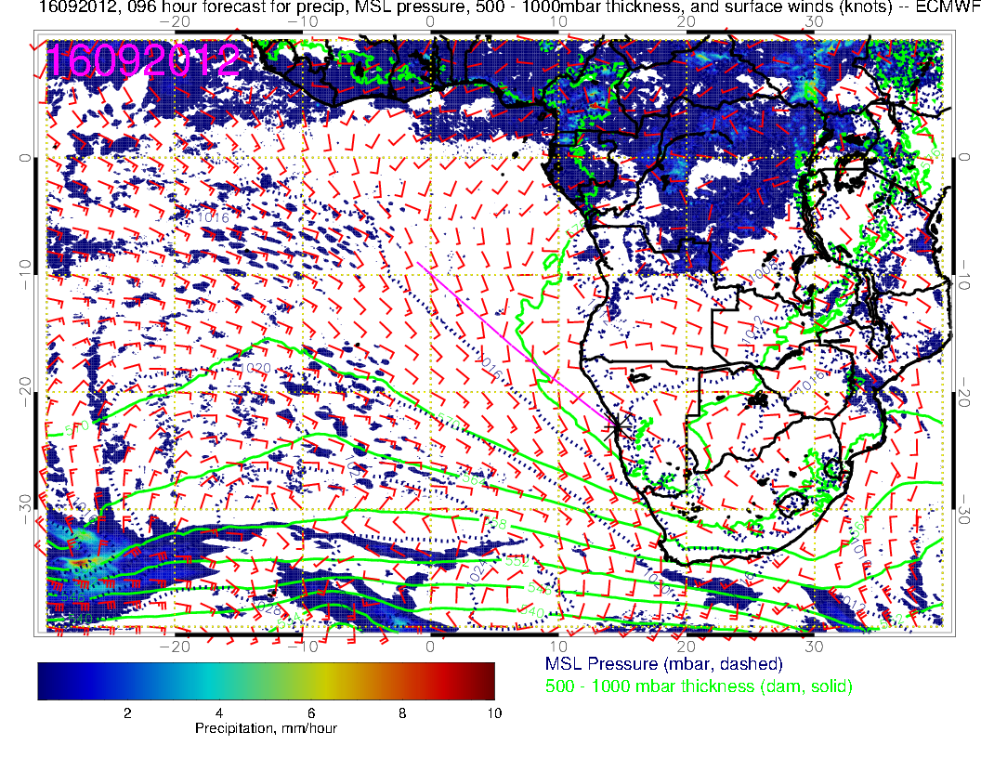

Slide 16
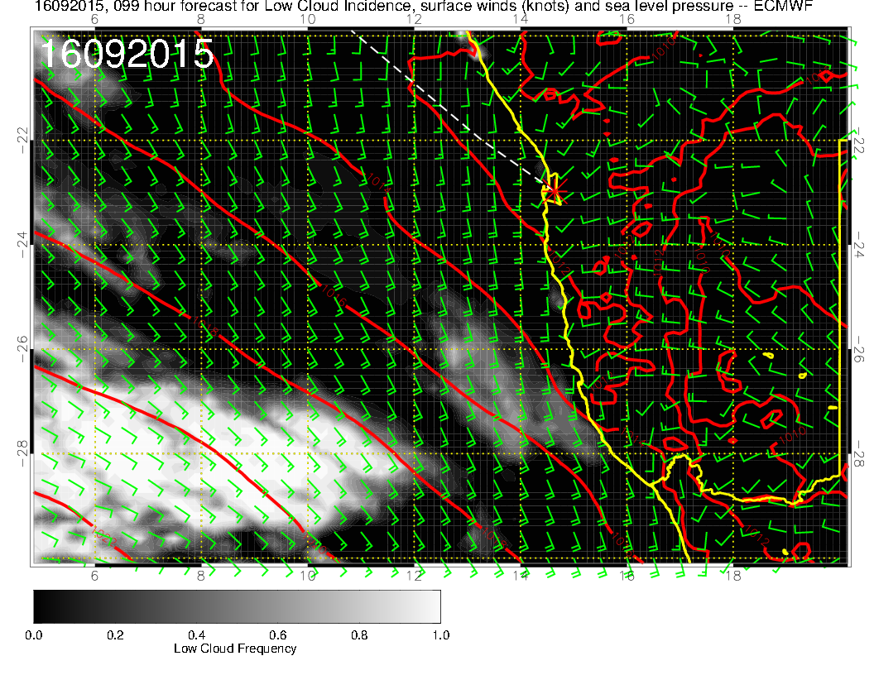
Flyable

Slide 17
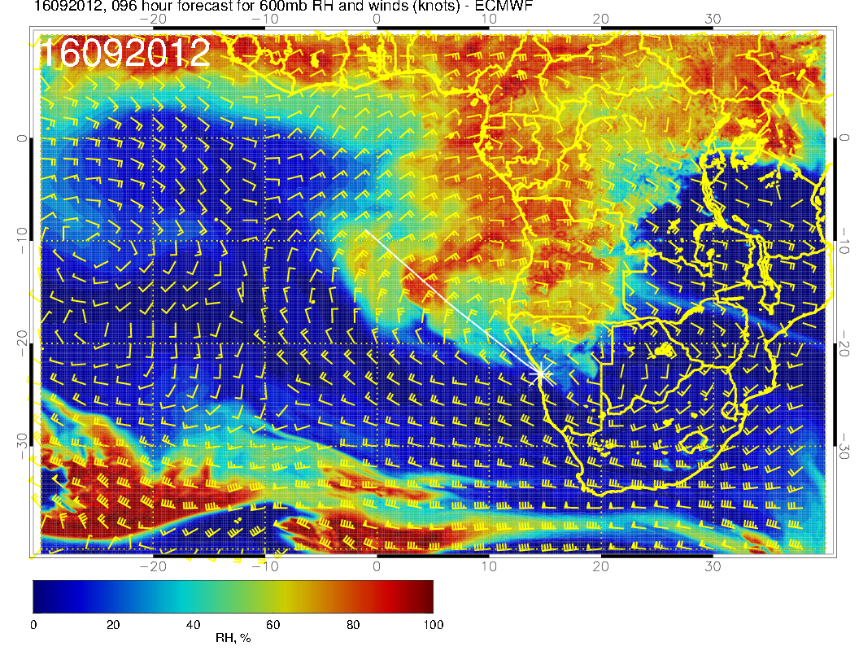
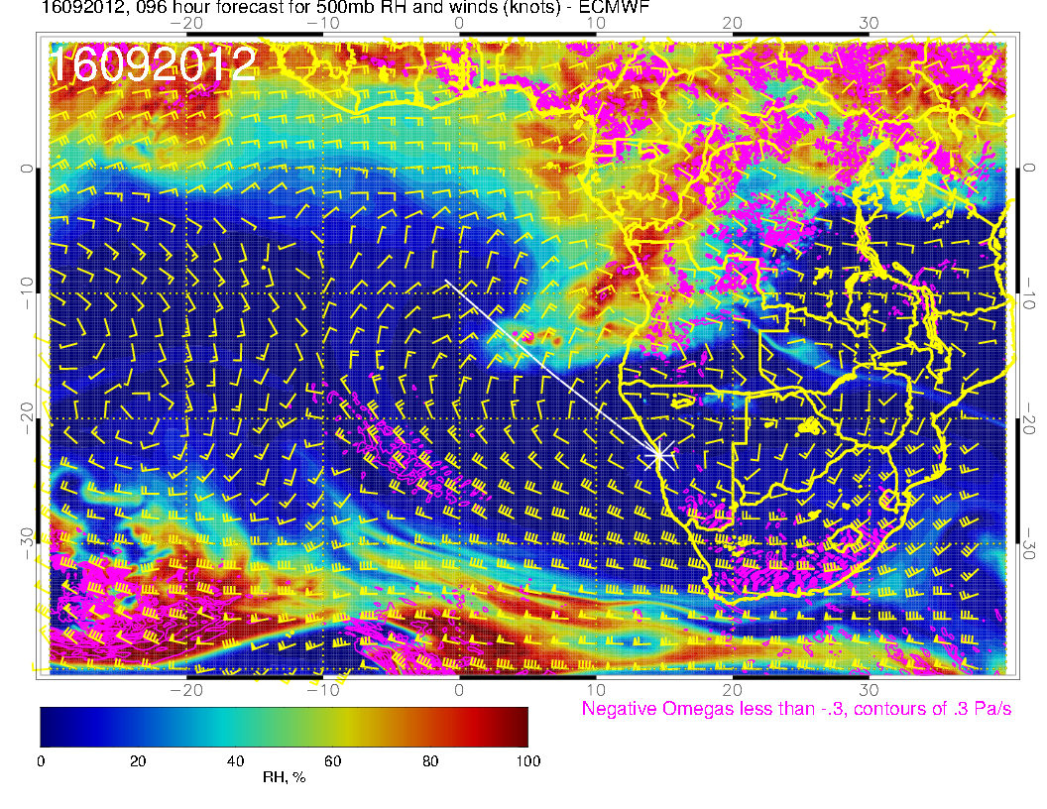

Slide 18
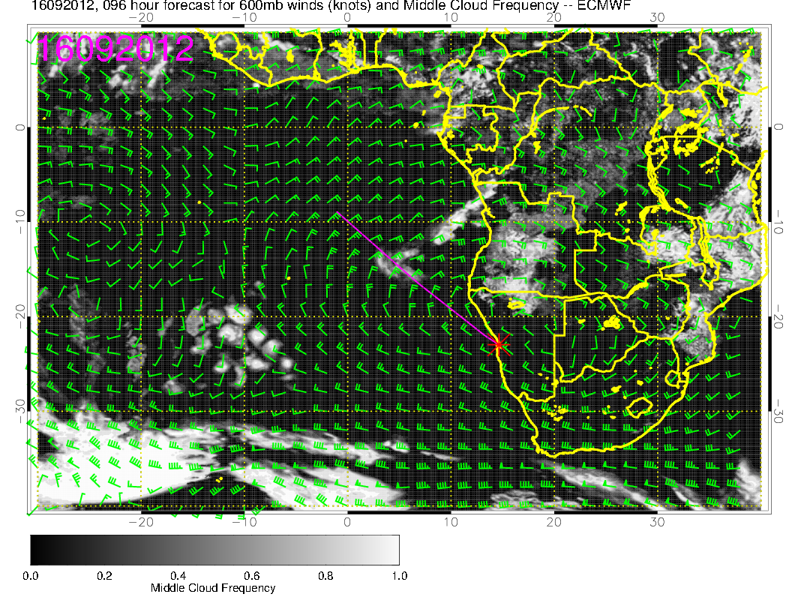
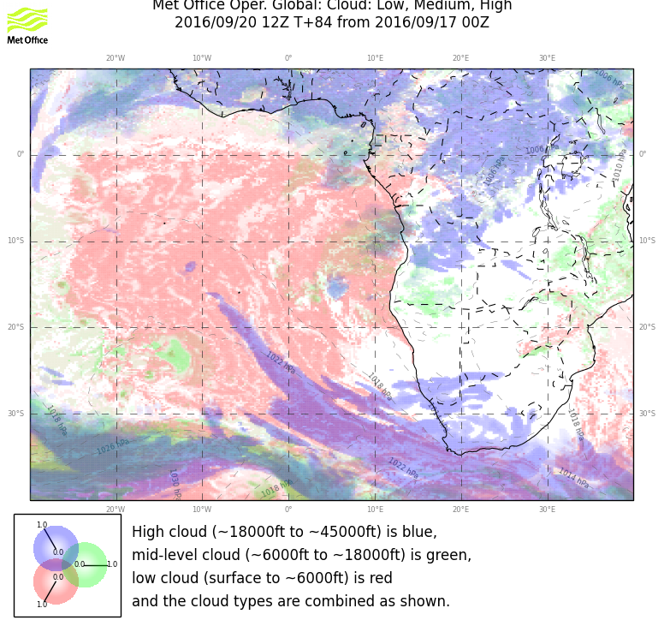

Slide 19
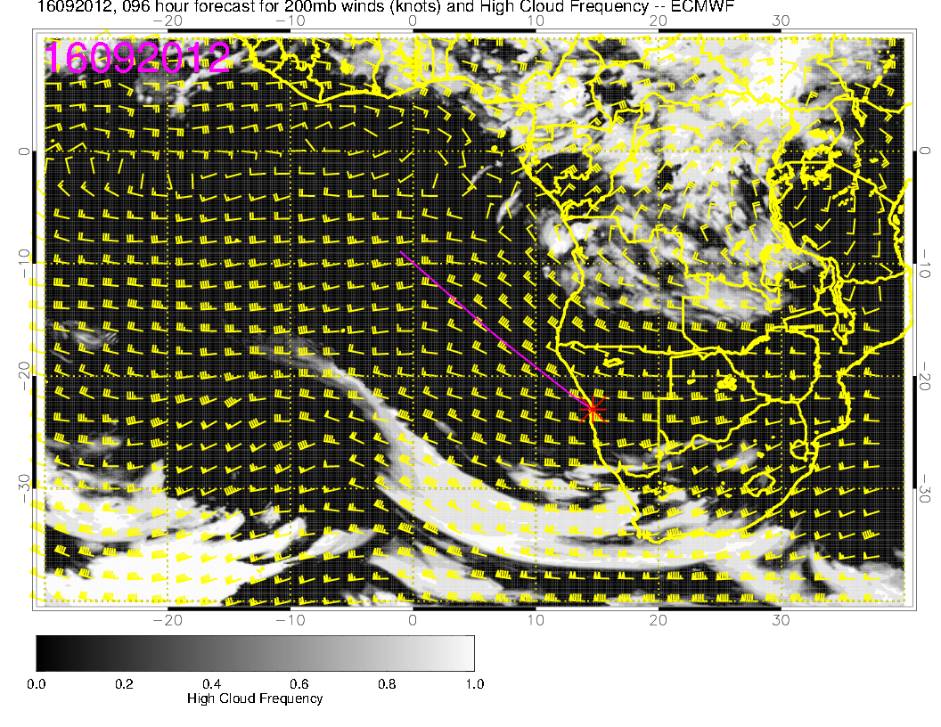
Blue splotch in middle (15S, 5E) has no corresspondent in RH plots, would
discount.

Slide 20
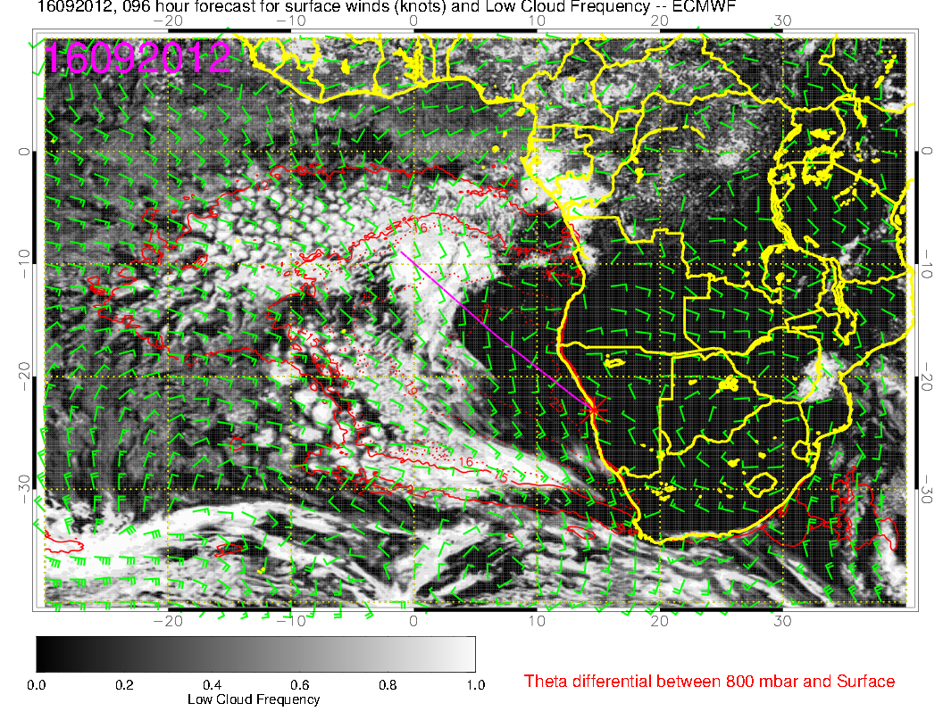
Forecasts diverge at 96 hours. I don’t think I have ever seen so much
“clarity” to 10S – tend to doubt it.

Slide 21
Wednesday
ST Helena high retreats to southern mid Atlantic as a weak front heads toward 30S.
Winds weaken, expect more clouds locally
Moisture surge at mid levels continues, and, arguably, mid level clouds intensify
Some high level cirrus.
Low level clouds fill in, model divergence on details.

Slide 22
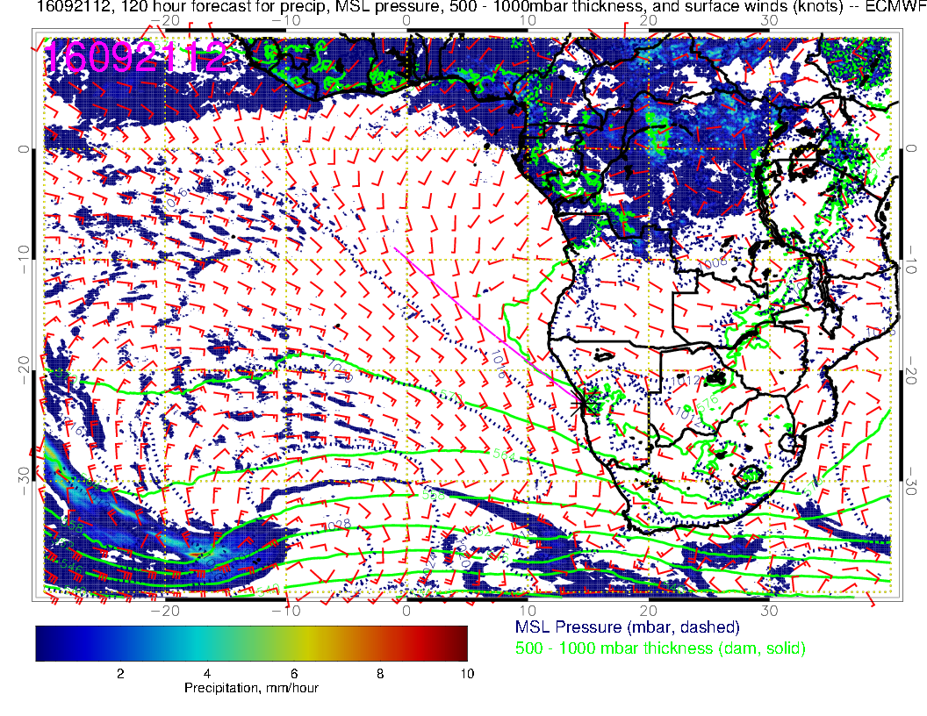

Slide 23
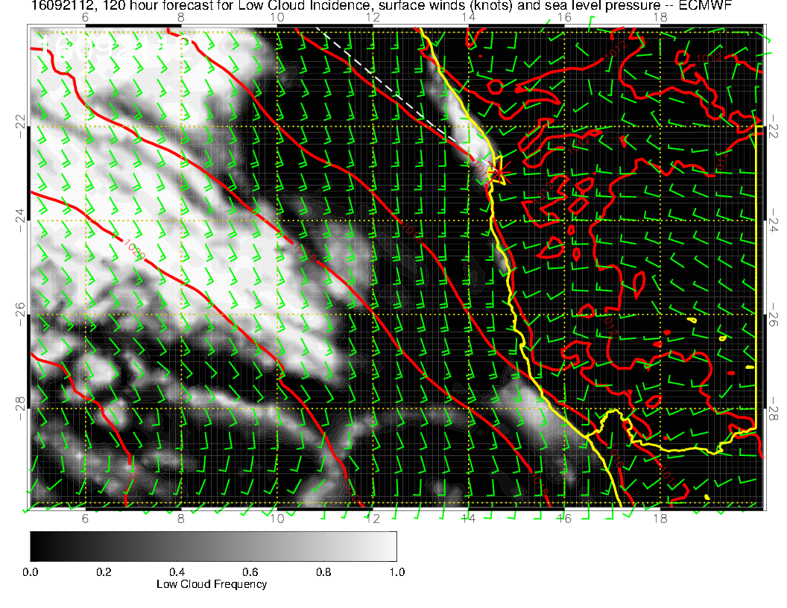
Start to develop low
clouds in our area.
Winds OK, the usual
ceiling issues in the AM,
OK this far out.

Slide 24
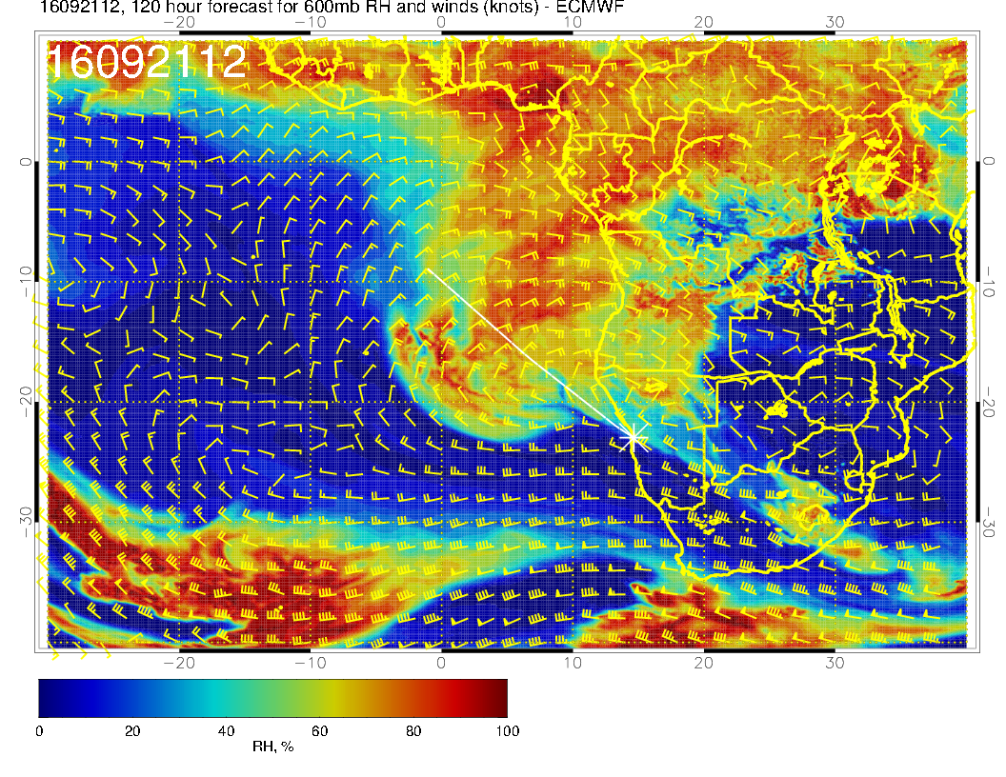
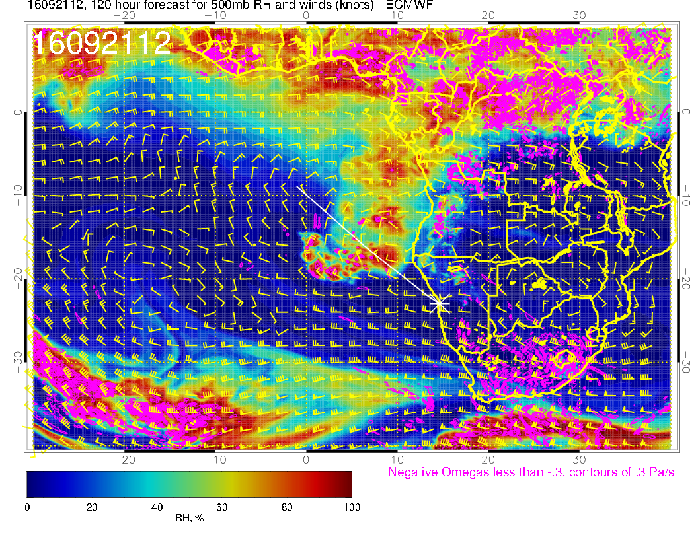

Slide 25
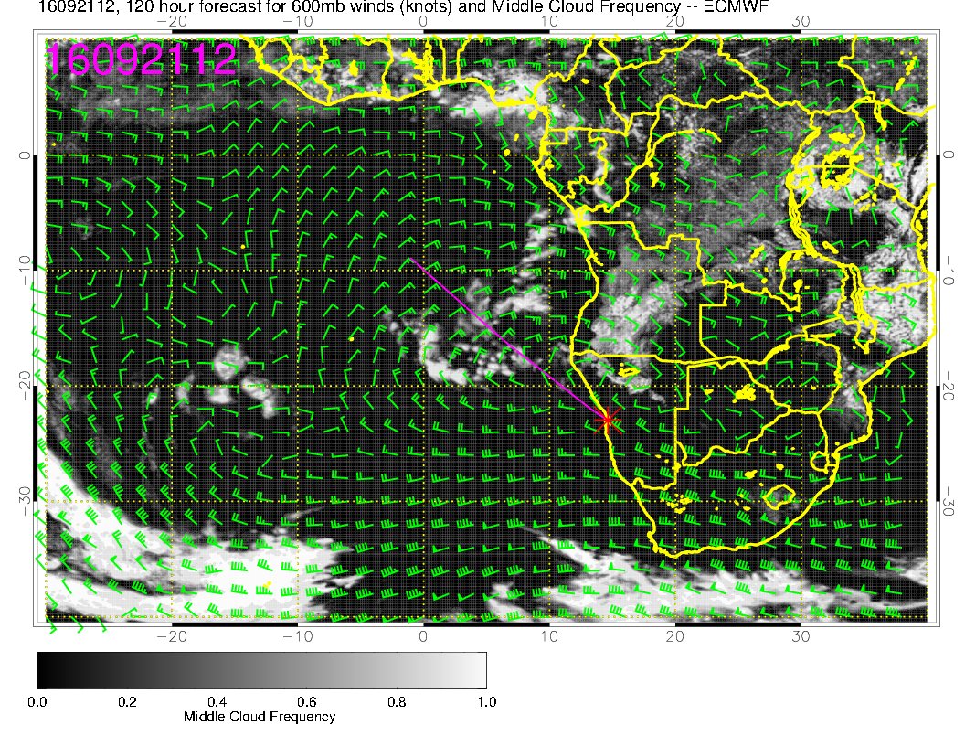
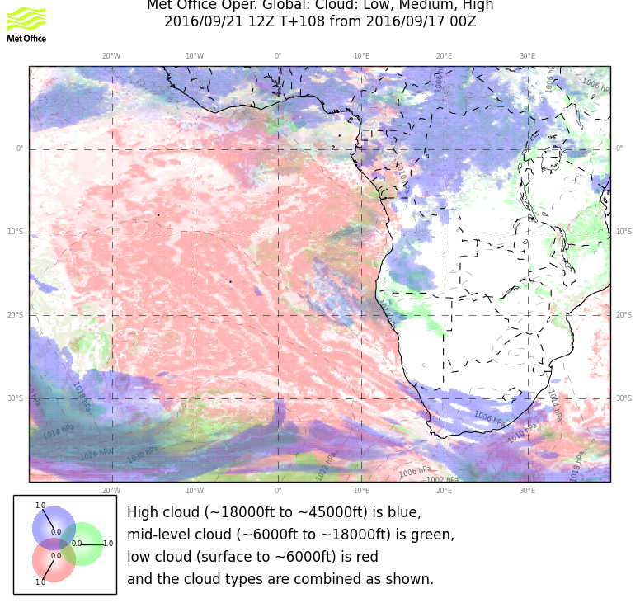
High cloud in UKMO is probably near 18kft, lower limit of their class

Slide 26
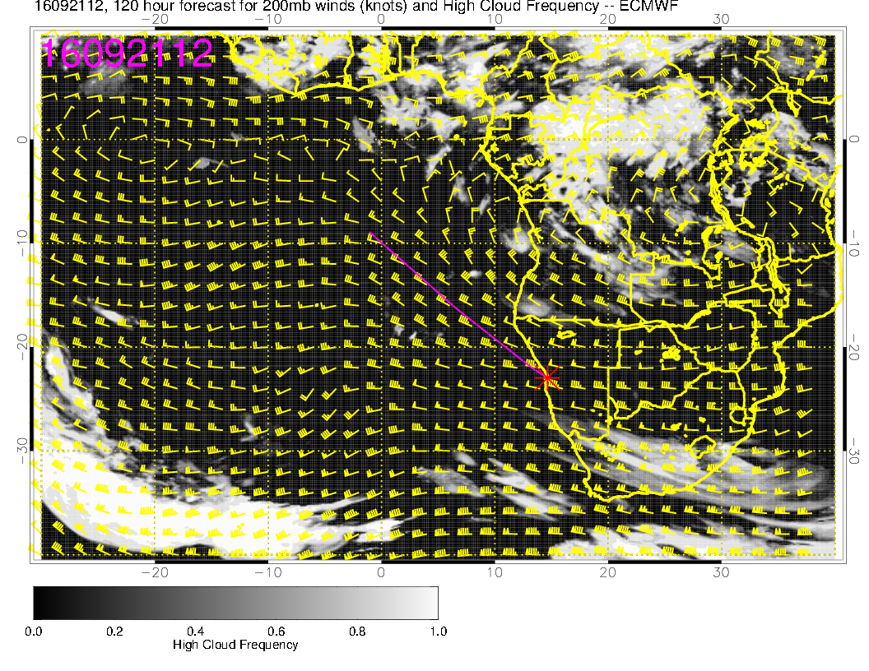
Looks to be convective outflow cirrus at 200-300mb (upper levels look dry).

Slide 27
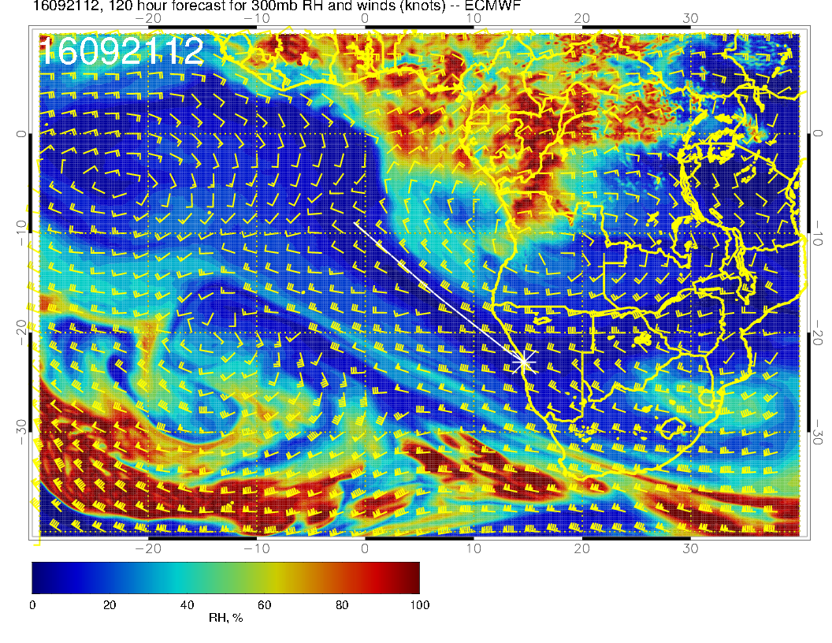

Slide 28
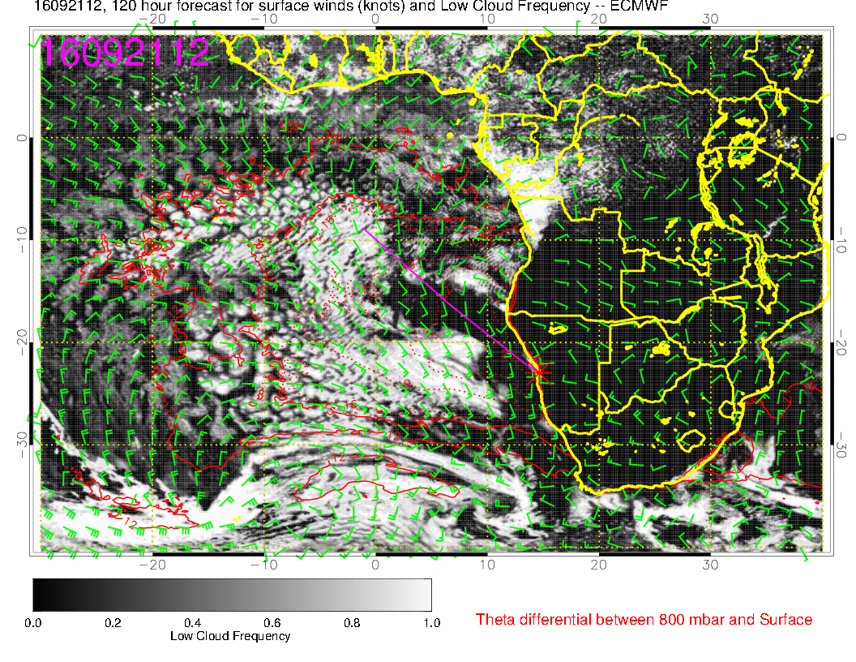
Models look divergent, but the message for both is that low clouds are filling in. I would not trust details at 120 hours

