Slide 1
ORACLES Forecast Briefing (Aerosols)
16 September 2016

Slide 2
The Aerosol Week

Slide 3
Walvis Bay
Dust
OC+BC+SO4

Slide 4
Ascension Island

Slide 5
Sunday 18 September 2016
Flight Day

Slide 6
September 18 12z AOD

Slide 7
September 18 12z AOD
DUST column

Slide 8
September 18 12z AOD
S-N 10E

Slide 9
September 18 12z AOD @ 10E
DUST
AOD
CO
O3

Slide 10
September 18 12z AOD @ 5 (top) and 10S
AOD

Slide 11
September 18 12z AOD @ NW to SE
AOD
CO

Slide 12
10 E

Slide 13
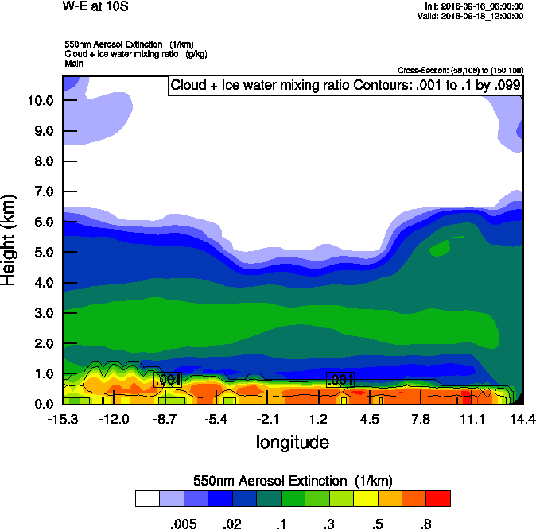
10 S

Slide 14
Above Cloud AOD 9-16-2016
Observation
WRF

Slide 15
Tuesday 20 September 2016
Flight Day

Slide 16
Clouds & Aerosols - Tuesday 2016-09-20 9Z

Slide 17
Forecast Consistency
96 hr
120 hr

Slide 18
GEOS-5 AOD on Tuesday 2016-09-20 12Z

Slide 20
GEOS-5 NW-SE Tuesday 20 Sep 2016

Slide 21
GEOS-5 E-W@15S Tuesday 20 Sep 2016

Slide 22
GEOS-5 N-S@10E Tuesday 20 Sep 2016

Slide 23
Wednesday 21 September 2016
TBD Flight/No-Flight

Slide 24
Clouds & Aerosols - Tuesday 2016-09-20 9Z

Slide 25
Clouds & Aerosols - Wed 2016-09-21 12Z

Slide 26
GEOS-5 NW-SE Tuesday 20 Sep 2016

