Slide 1
ORACLES forecasting briefing Meteorology for 17-09-2016 – 10-09-2016
16-09-2016
Lenny Pfister

Slide 2
Satellite animation, last 12 hours

Slide 3
Saturday, 20160917
Winds accelerate in post frontal situation, with high moving eastward and increasing pressure gradients.
Forecast to be flyable. Official forecast (TAF) available at about 1 PM.
Expect, as previously fcst, some middle cloud in northeast corner of operating region.
Midlatitude trough moving eastward, so do not expect jet stream cirrus.
Both models show minimal tropical cirrus – disappearing as progs get later.
Significant low cloud clearing into Angola coast

Slide 4
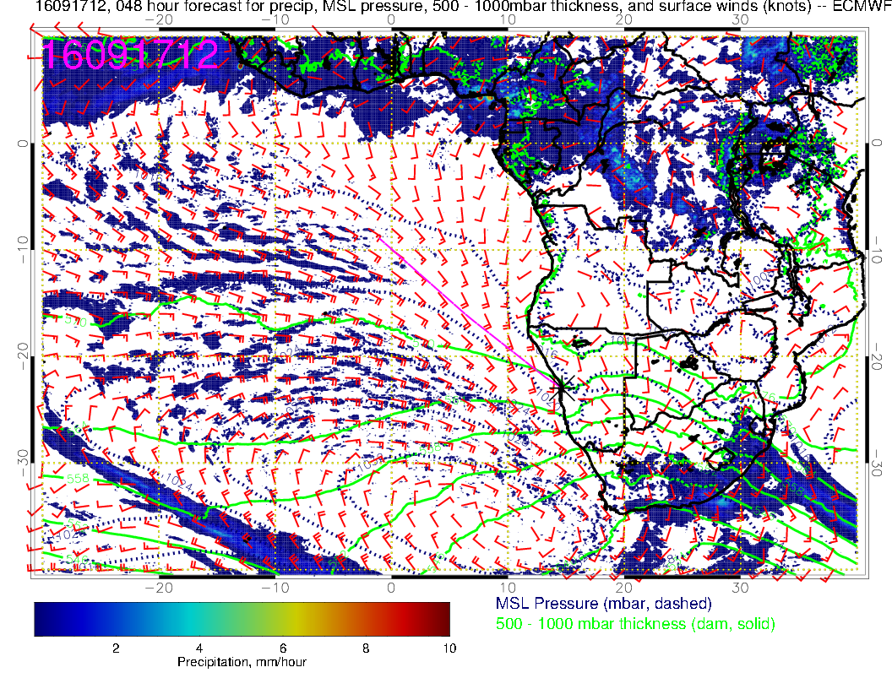

Slide 5
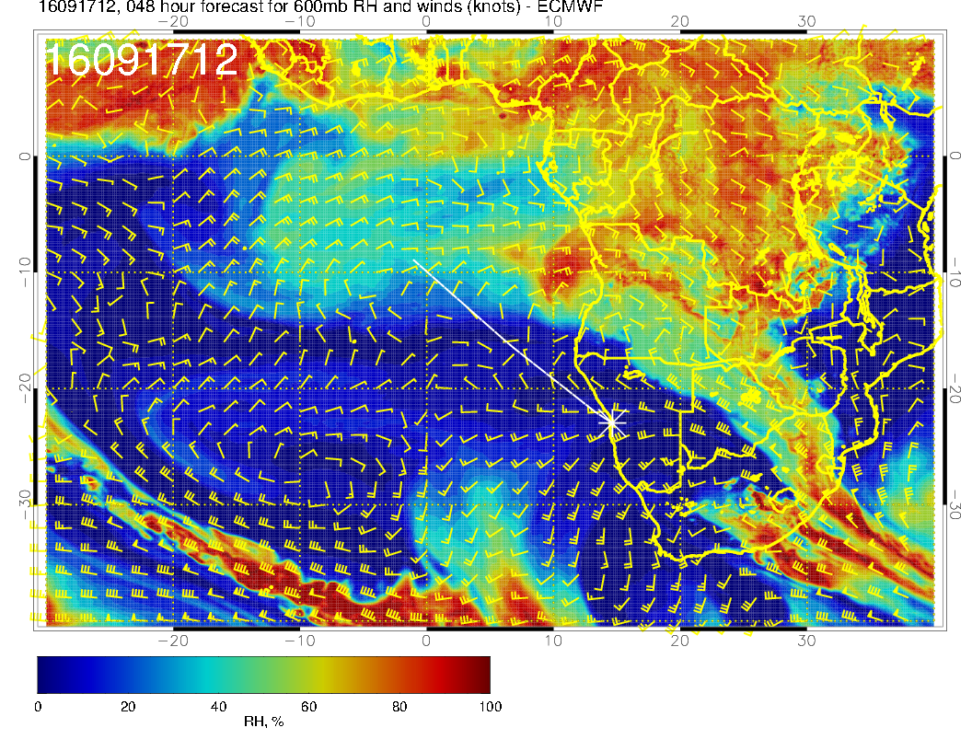

Slide 6
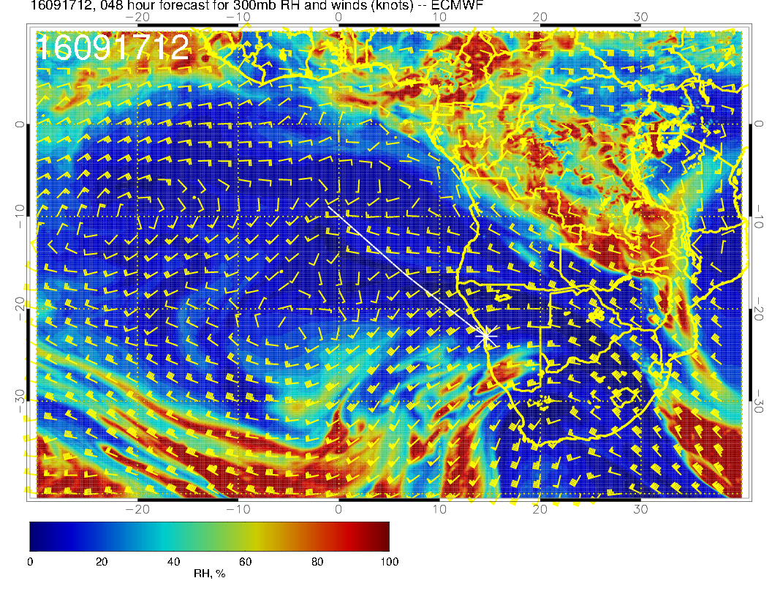
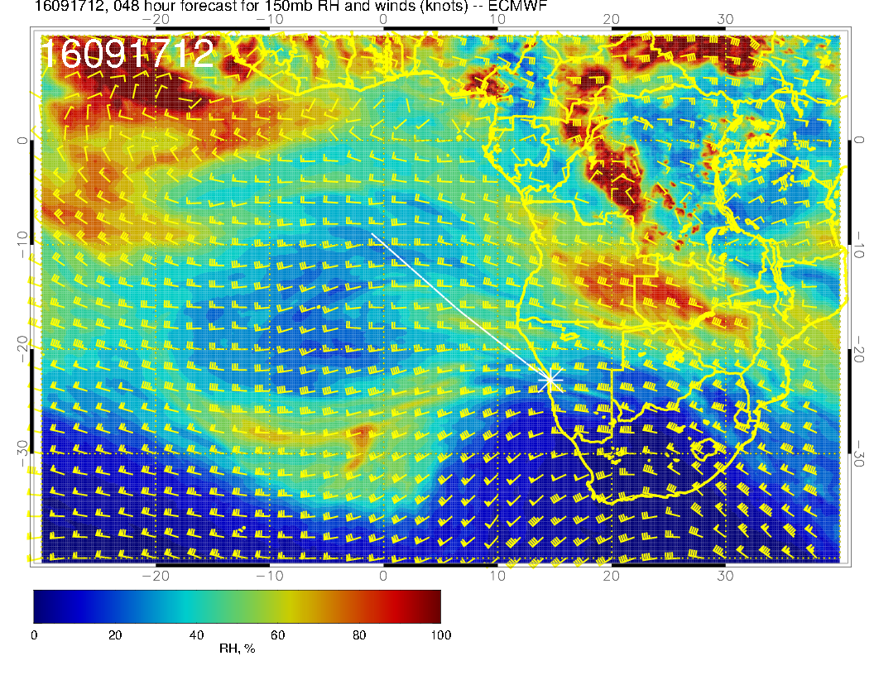

Slide 7
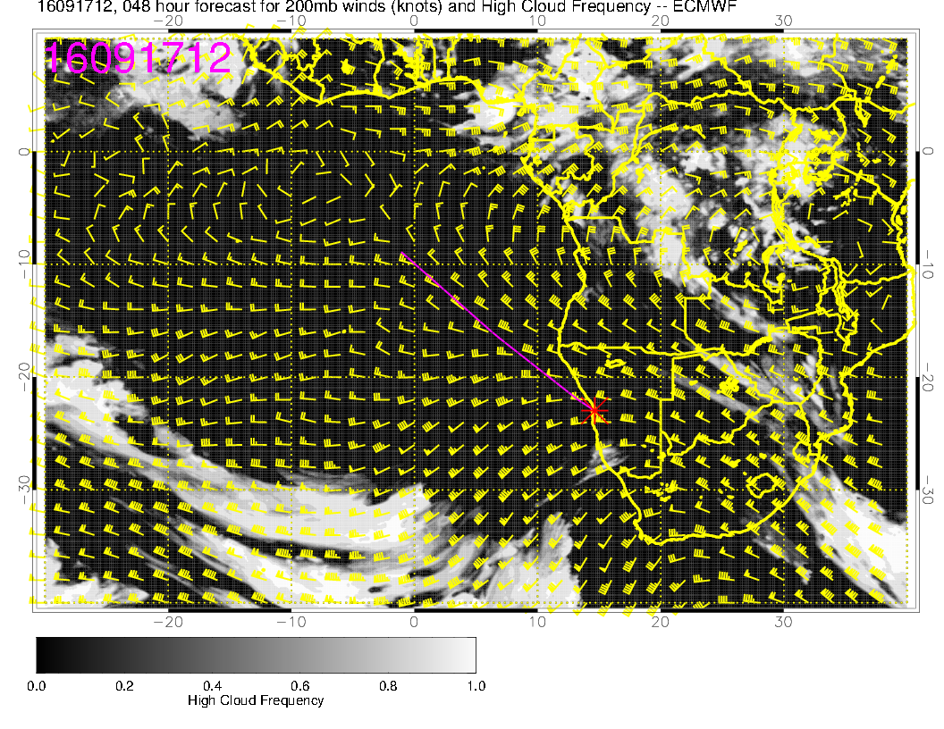
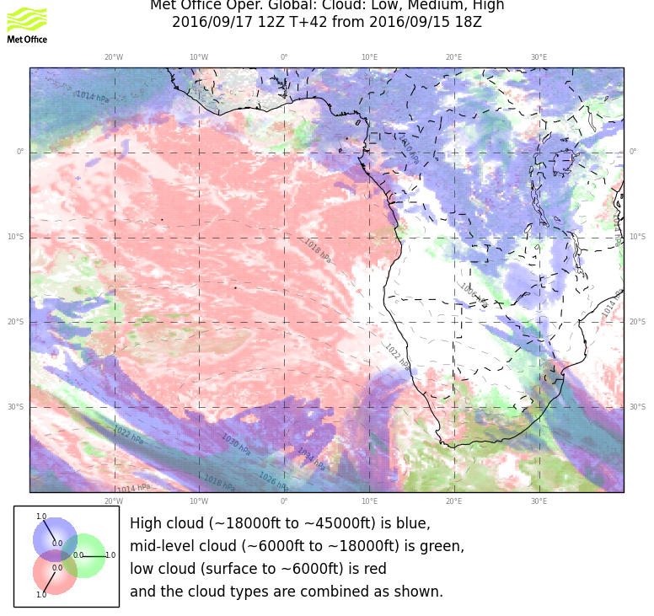
Both models are reducing their high cloud in the NE corner with succeeding forecasts.

Slide 8
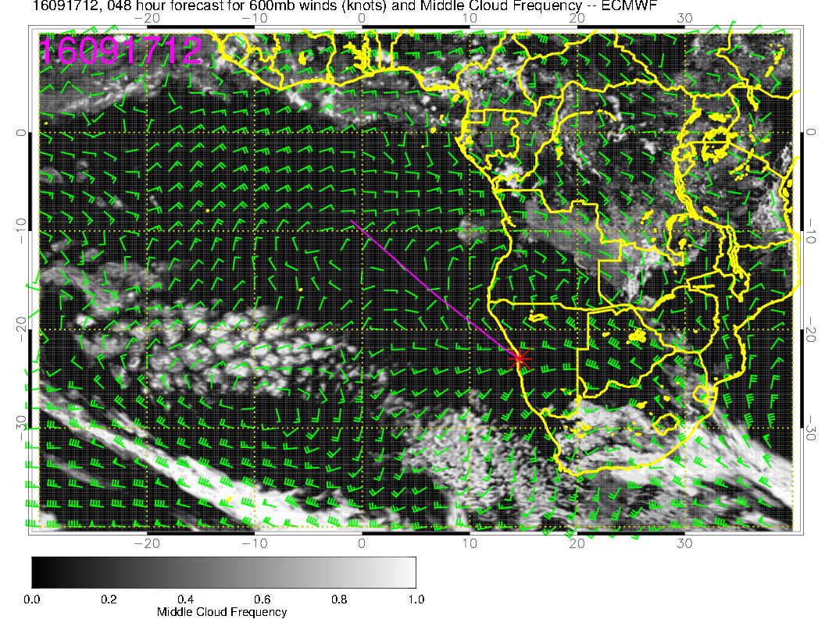
These mid-cloud forecasts are in rough agreement and are stable

Slide 9
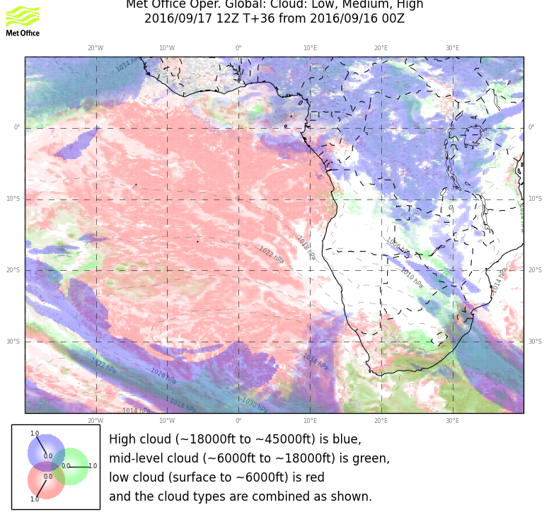
Later forecast -- stable

Slide 10
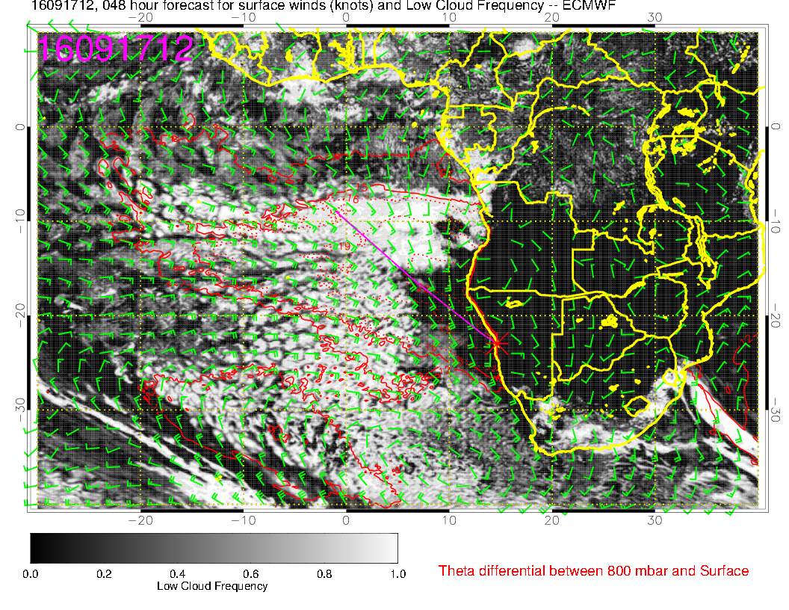
Large clear zone develops near the coast out to 6-8E. Subsidence associated with
incoming high. By Sunday, offshore flow develops in our region at 5kft (hgt of
topography), leading to lower BL heights and drying at 925mb. Clearing will
expand

Slide 11
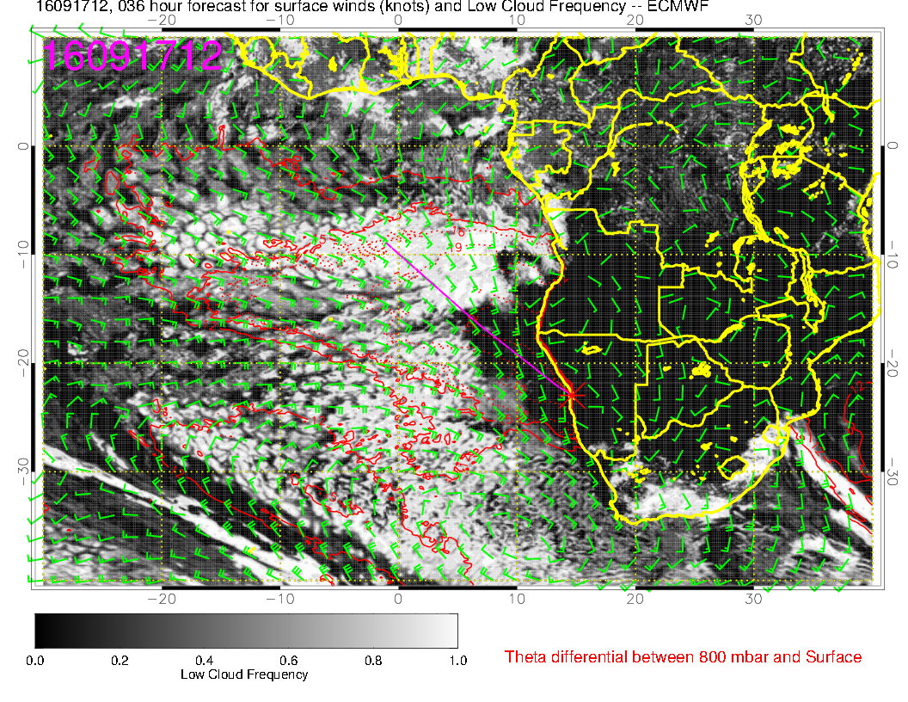
Later EC forecast

Slide 12
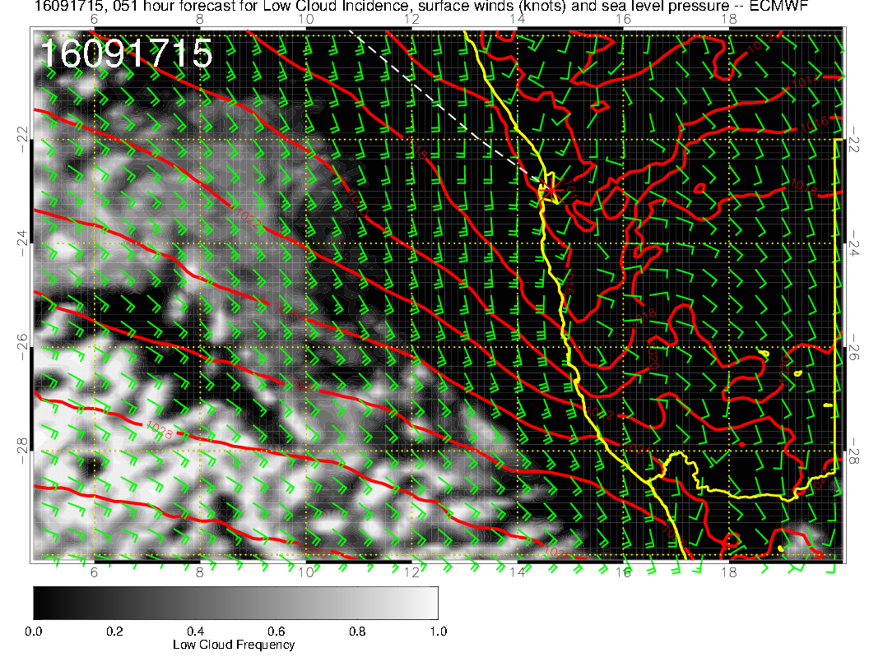
Stronger winds
on Saturday. Some
crosswind component,
but within limits.

Slide 13
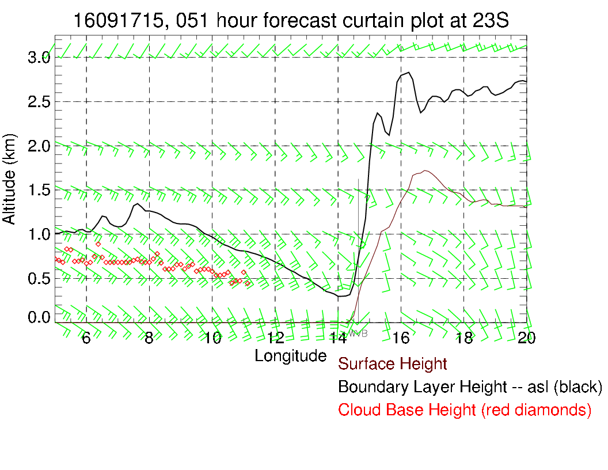
Prog indicates winds of less than 20 knots, with less than 13 knot crosswind component. Official TAF comes out at about 1 PM. Tomorrow should be flyable for ER-2.

Slide 14
Sunday
Weakening surface winds as the high following the front pushes south of RSA.
Offshore flow at 850 develops, BL heights go down over a broad region off the coast, with extensive low level clearing developing.
Mid level high RH over Atlantic shifts northward along with middle cloud.
Another, probably excessive, tropical cirrus forecast appears in the EC, decreasing with the most recent run.

Slide 15
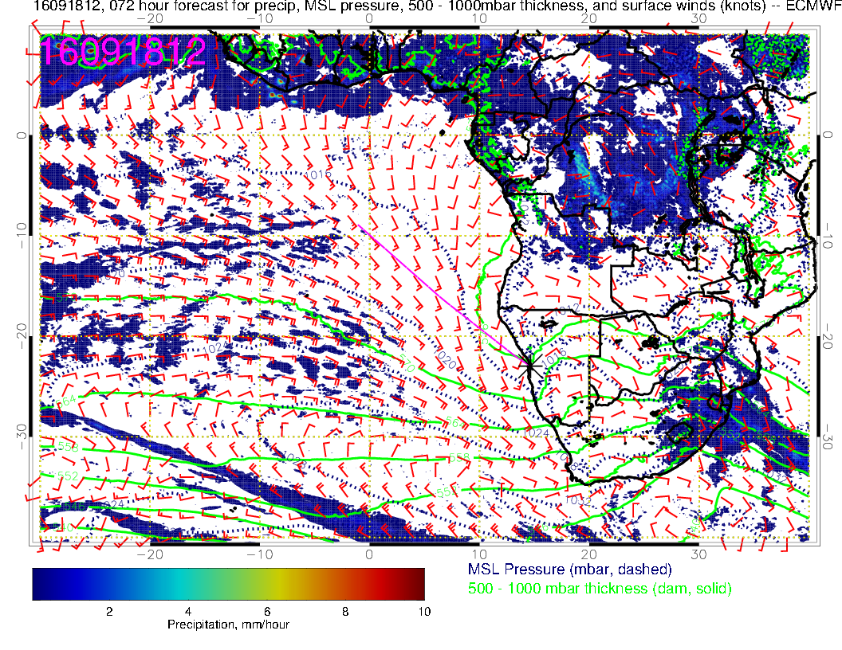

Slide 16
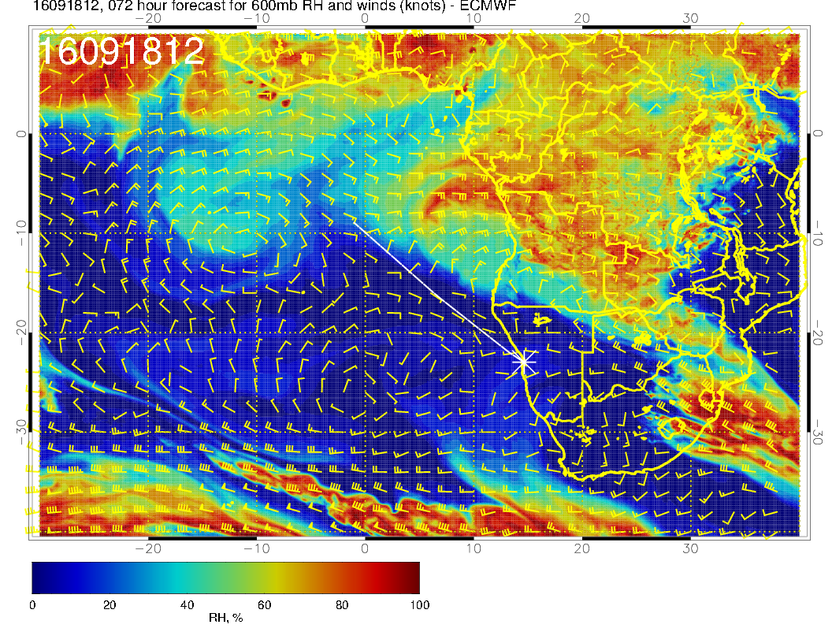

Slide 17
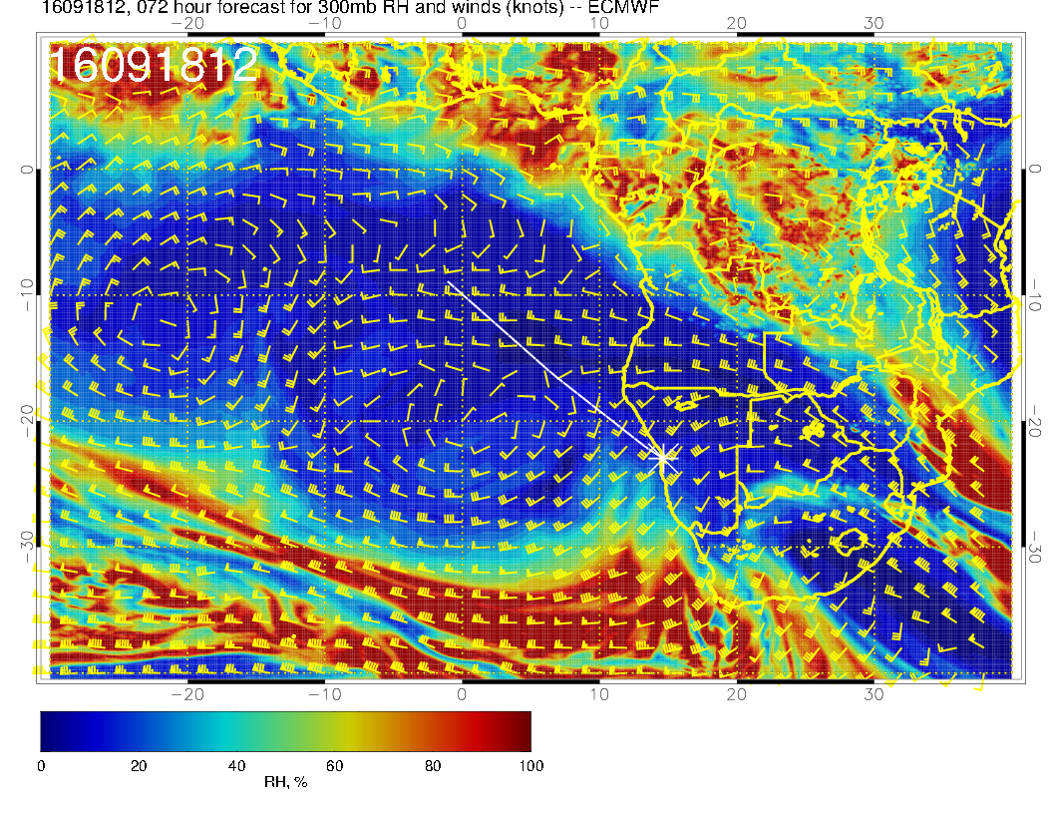
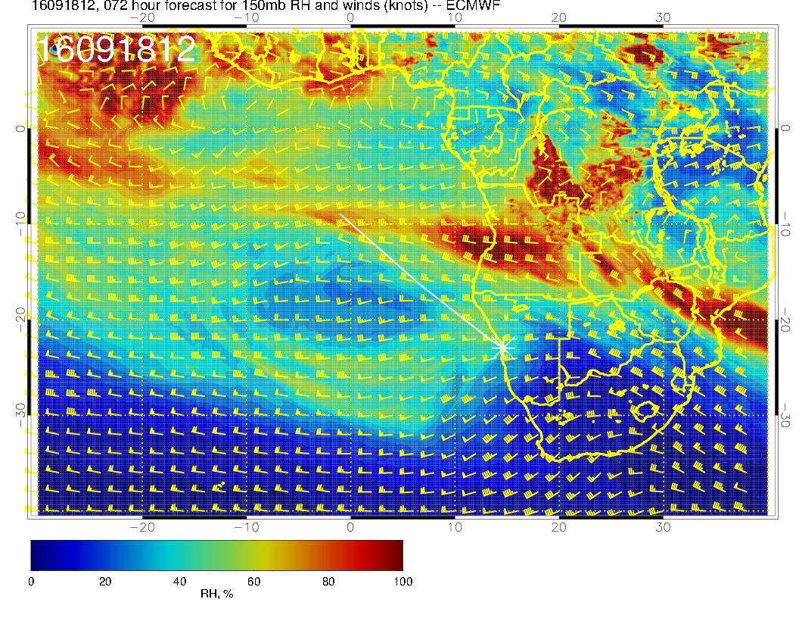

Slide 18
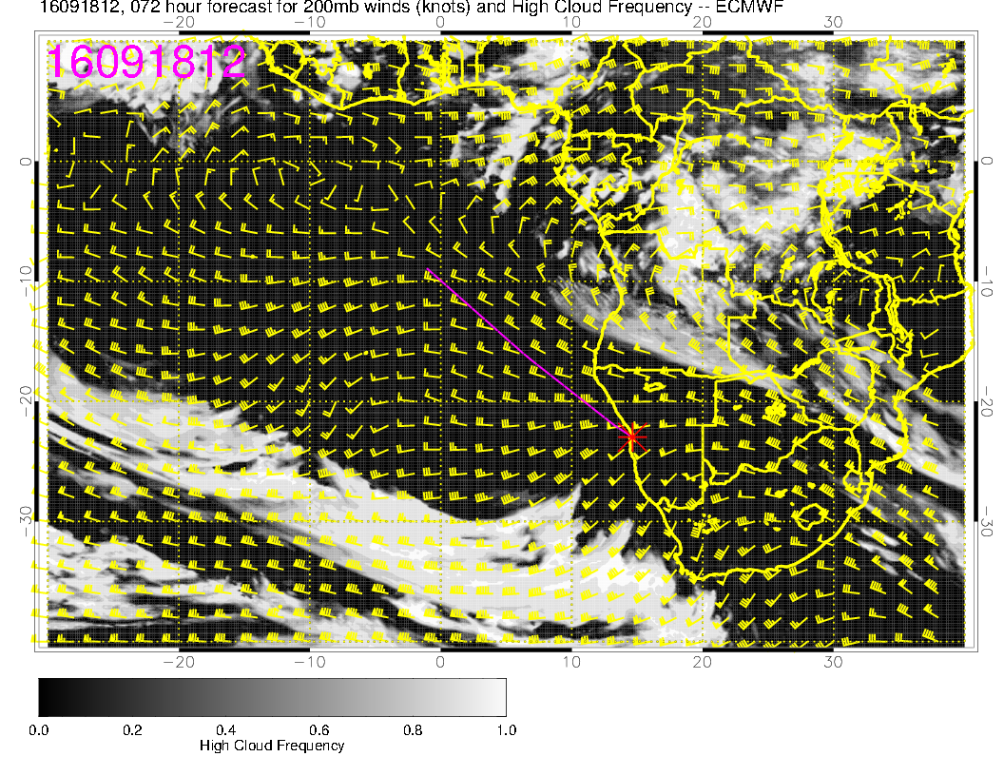
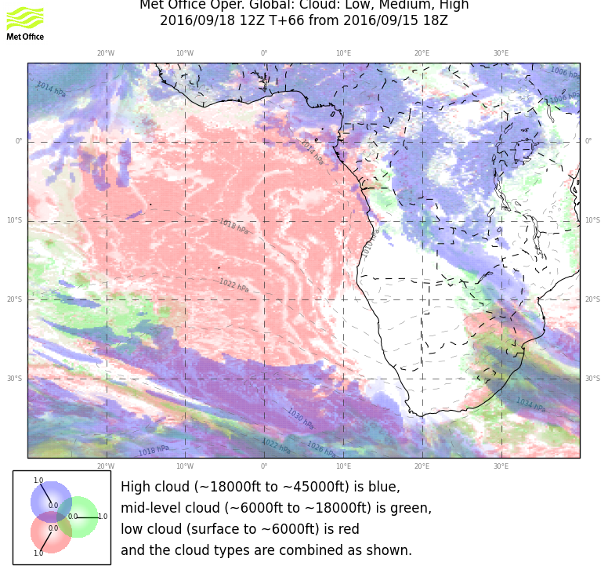
EC shows some high cloud near 10-12S off Angola coast. Consistent
with 150mb RH. Succeeding forecasts often reduce EC high cloud

Slide 19
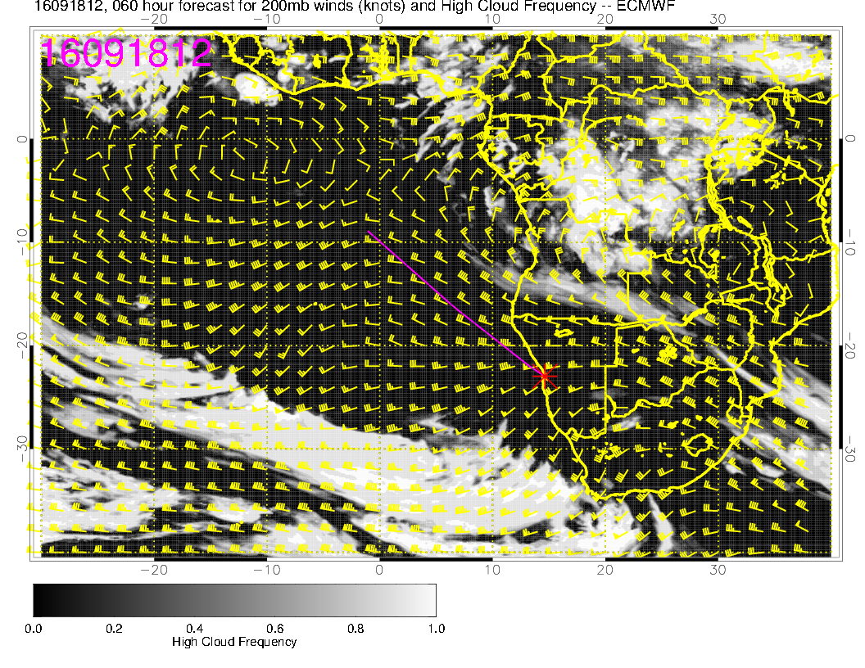
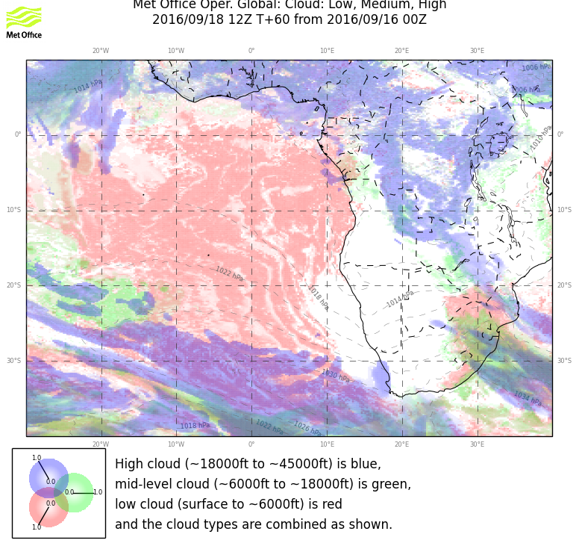
Later forecast (just in) shows reduced high cloud in EC forecast.

Slide 20
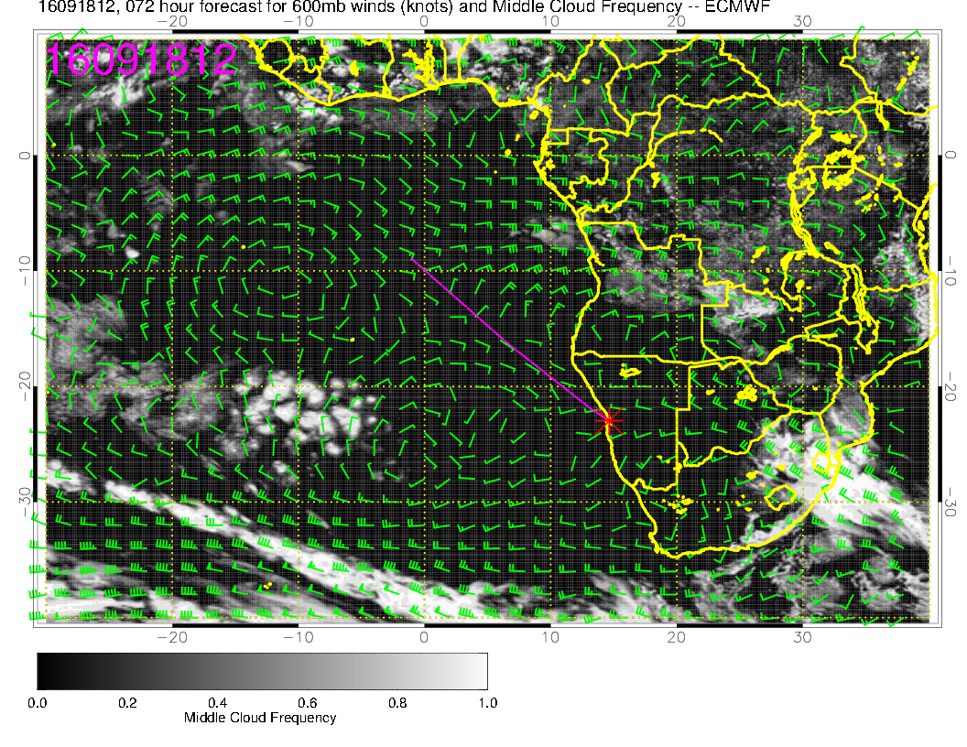
Middle cloud is pushed north, consistent with RH (I hope!!)

Slide 21
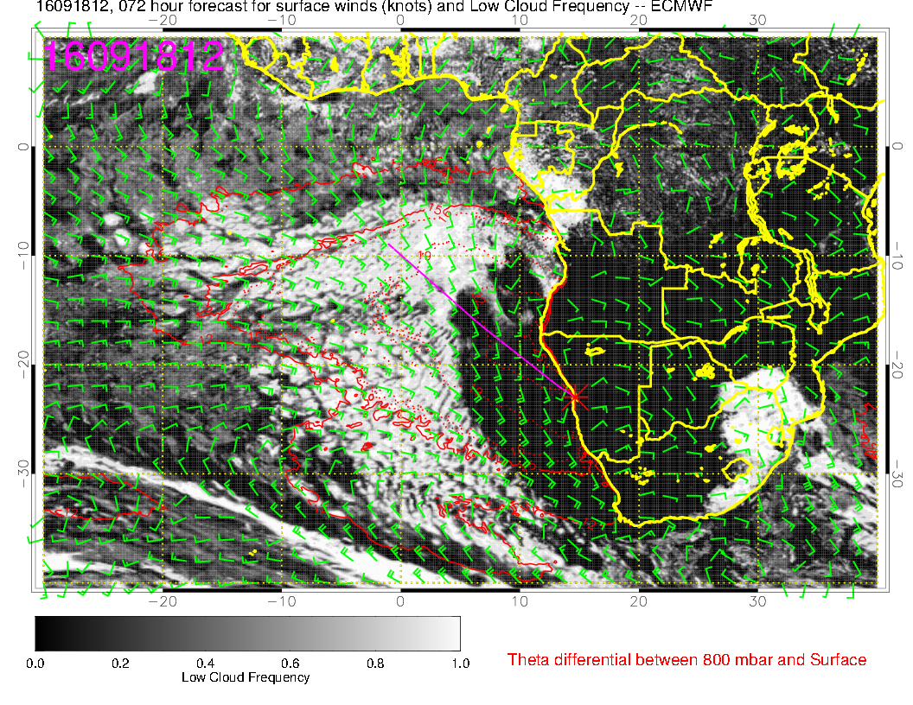
Huge clearing zone in both models. Surface high moves south of SA, generating
offshore flow at 850. BL height suppressed. Expect region north of Angolan border to have some cloud but with low BL, be thin.

Slide 22
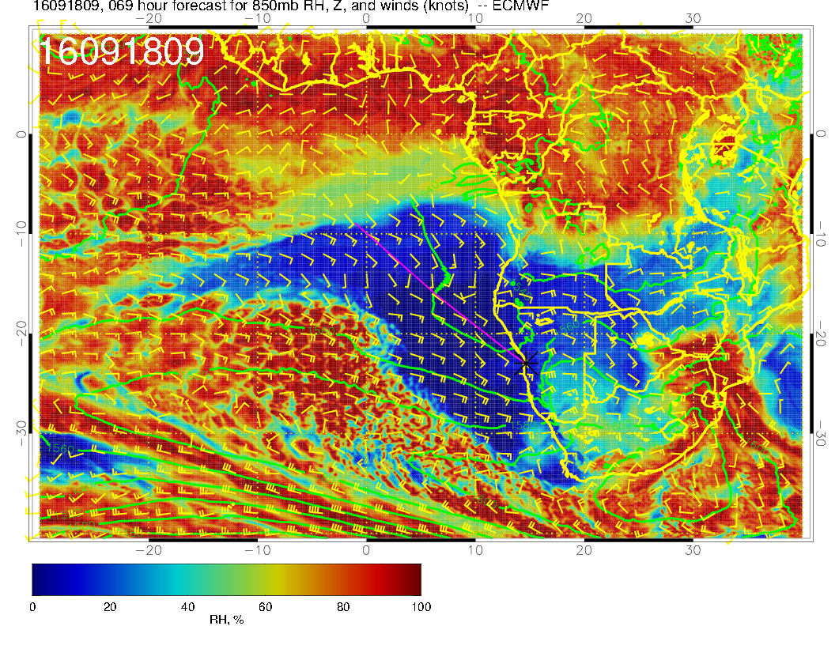
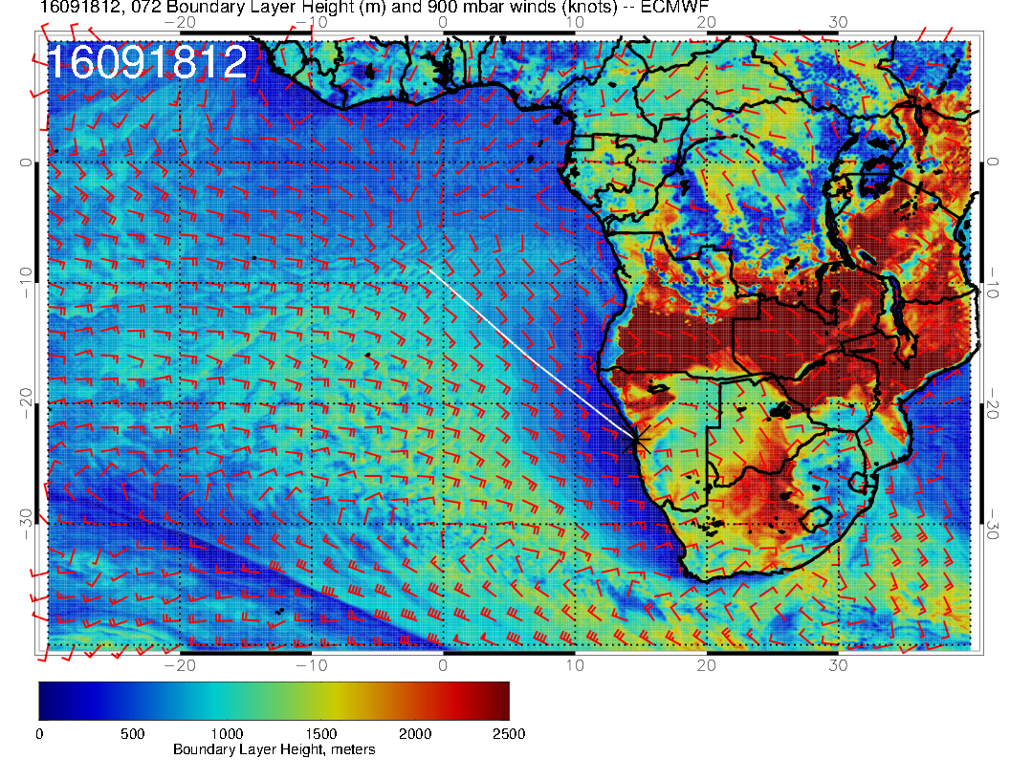

Slide 23
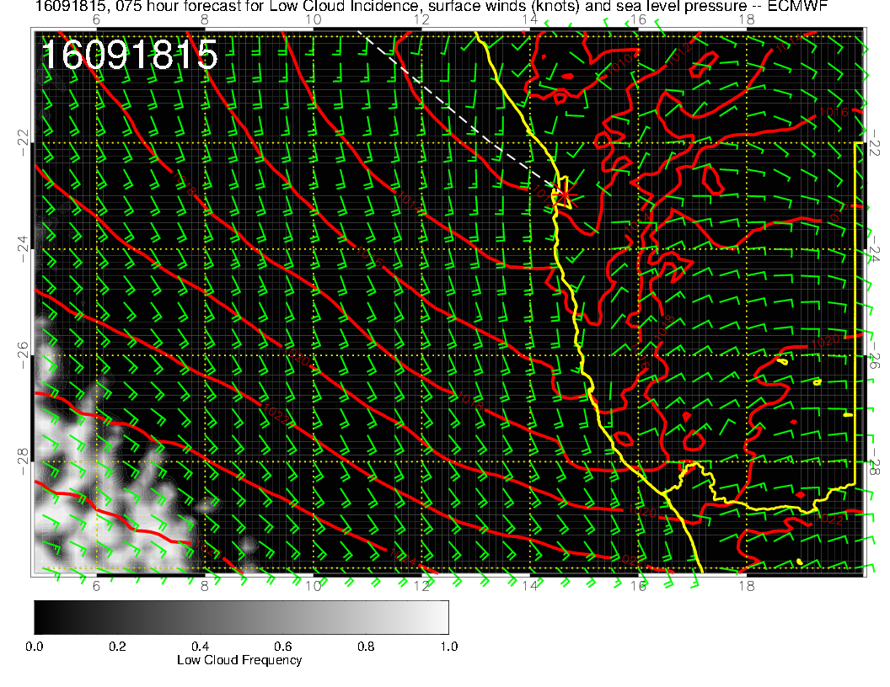
Winds at airport progged to be comparable to 20160917. Note decisive offshore flow inland.

Slide 24
Monday
Continued weakening of flow, surface high redeveloping, but pressure gradients still weak at our latitudes.
Low level clear region expands in both models, as does low BL height region.
Moisture push at 600mb, 600mb anticyclone is well-developed (September Climo)
High cloud forecast uncertain (depends on convection) – no jet stream cirrus

Slide 25
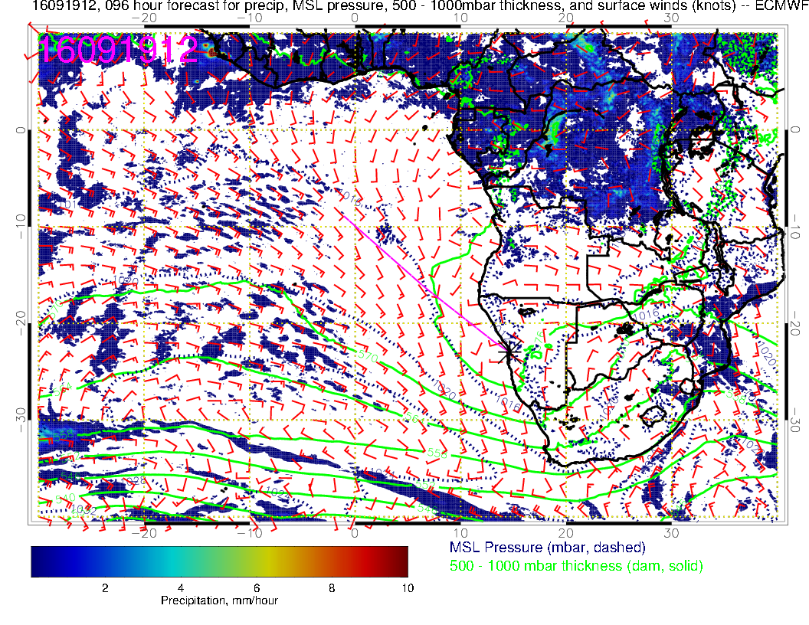

Slide 26
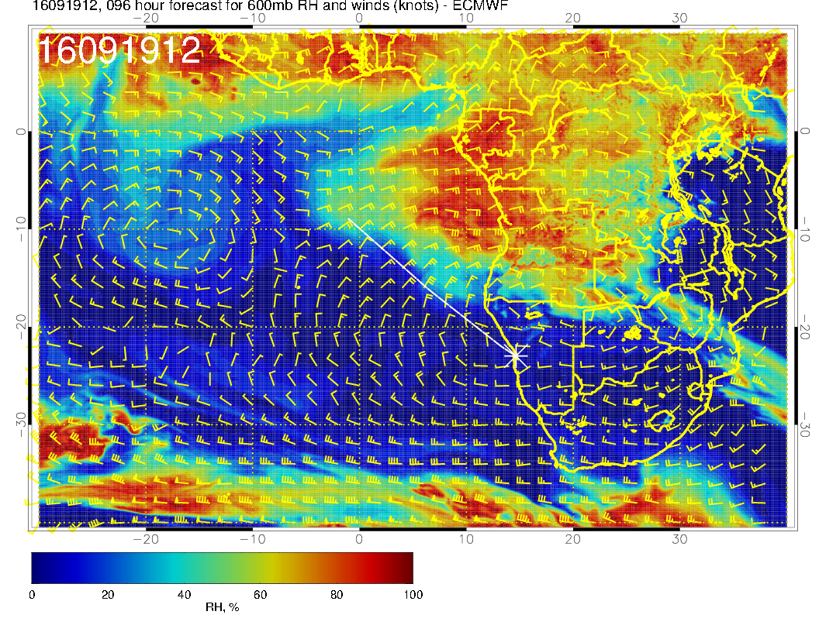
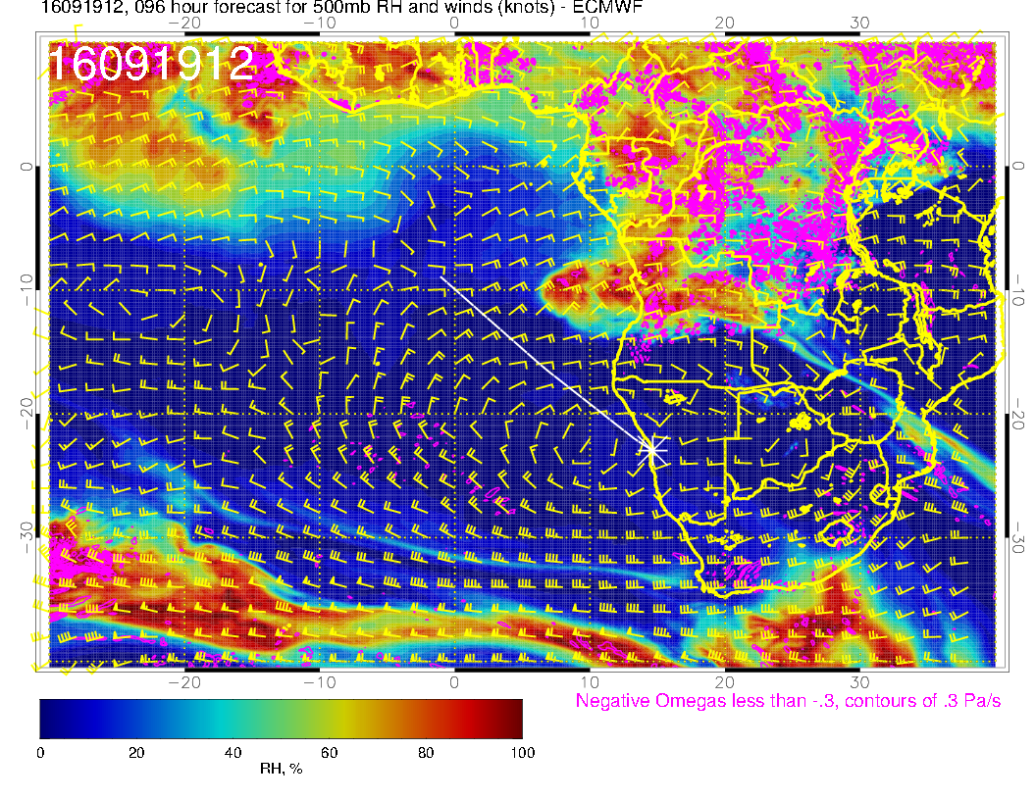
Westward push on Monday, 2016091912 with increased RH north of 12S. Also apparent at 500mb
600mb
500mb

Slide 27
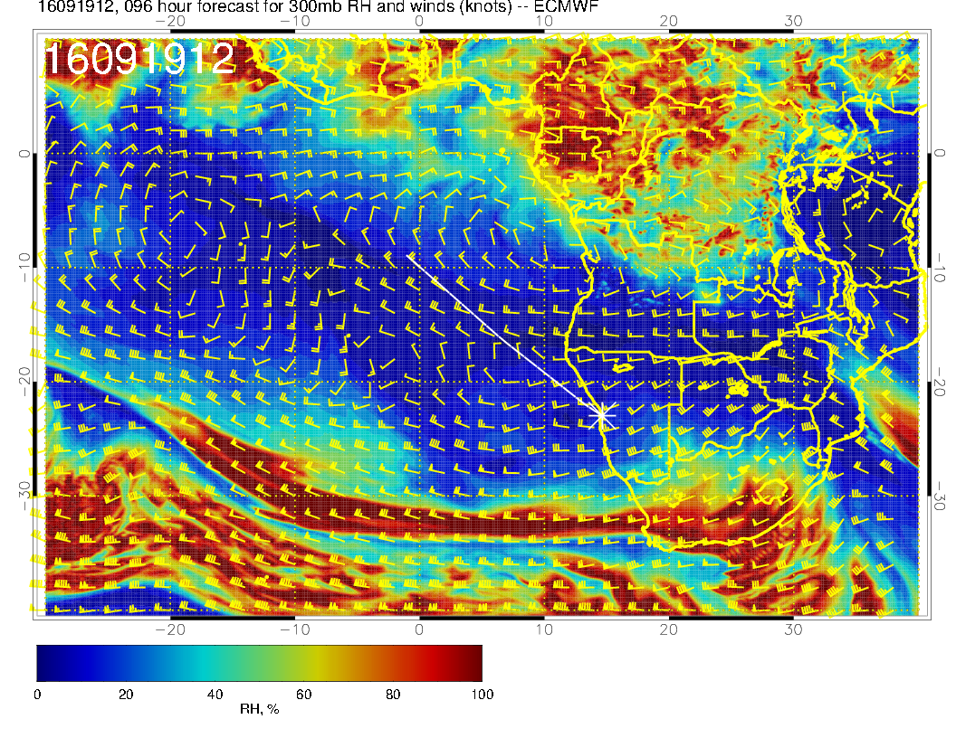
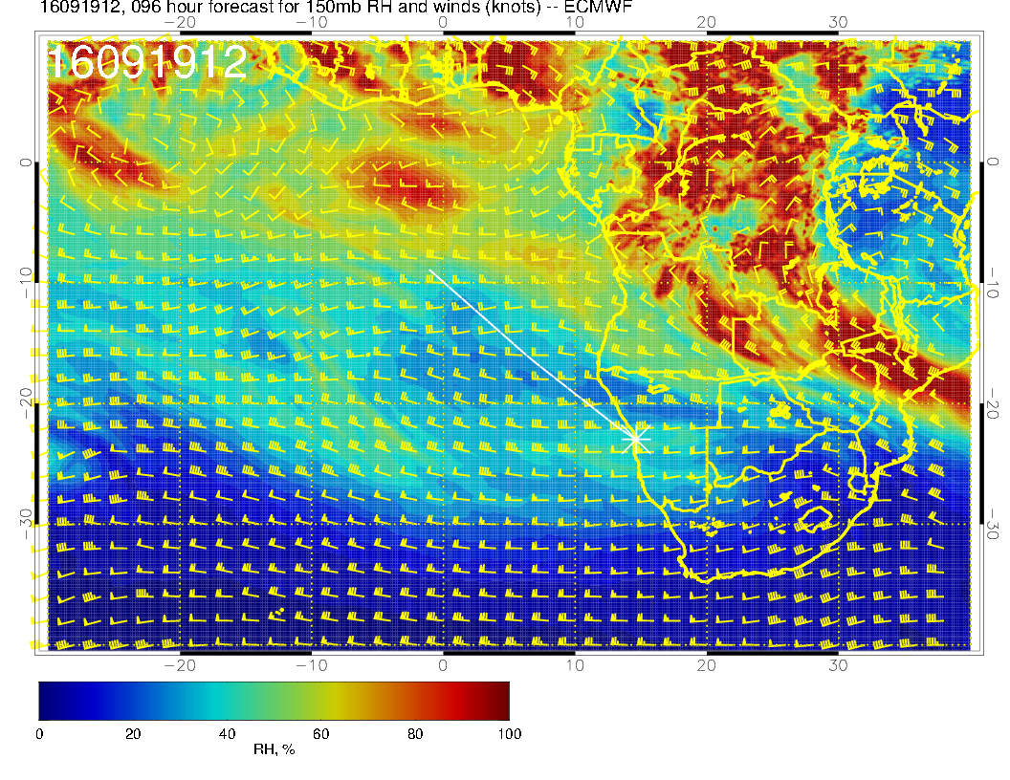

Slide 28
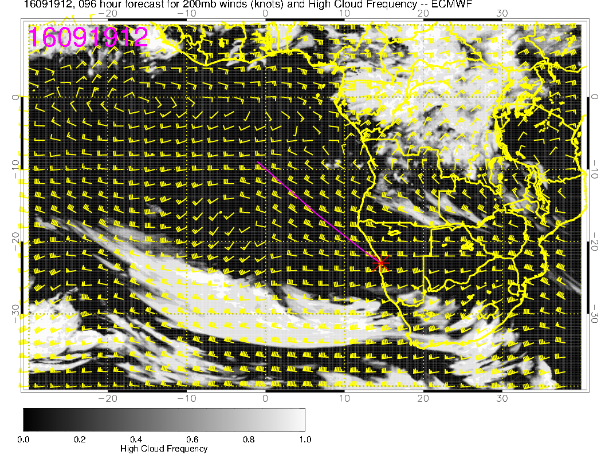
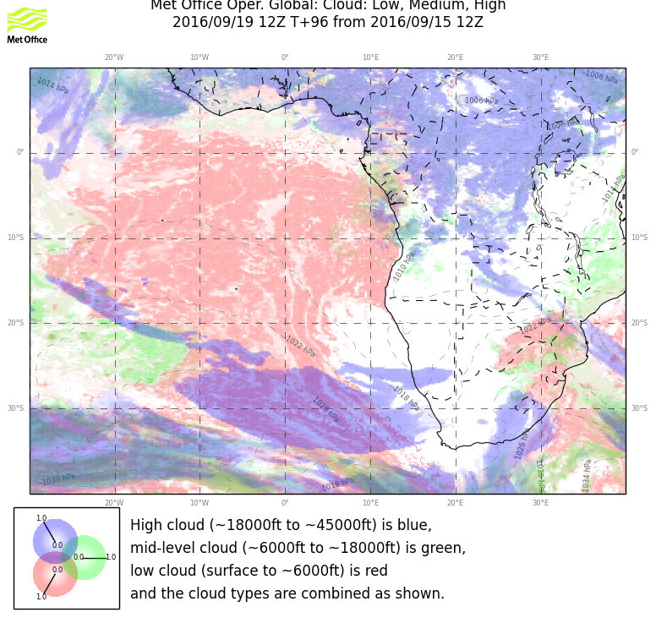
Complicated picture in NE corner of access region. Depends on convection
in the next few days, which is always perfectly forecast (:>)

Slide 29
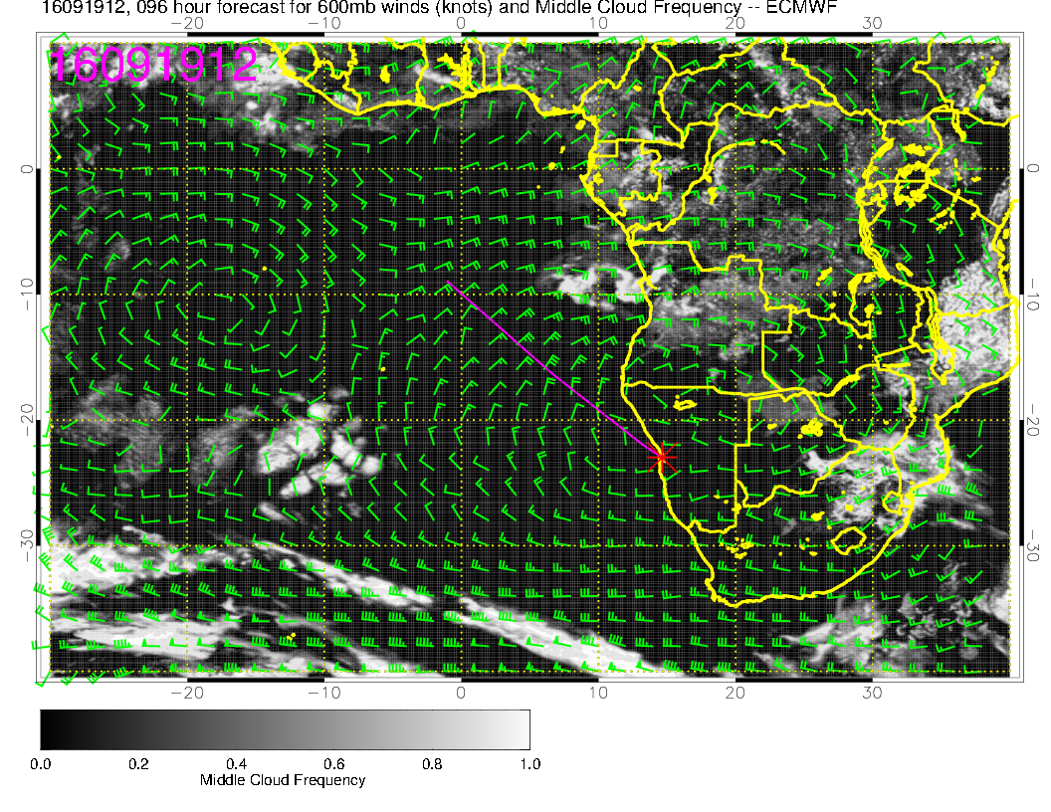
Not a surprise on the middle cloud, both models more or less agree.
Note a more rounded circulation pattern at 600mb

Slide 30
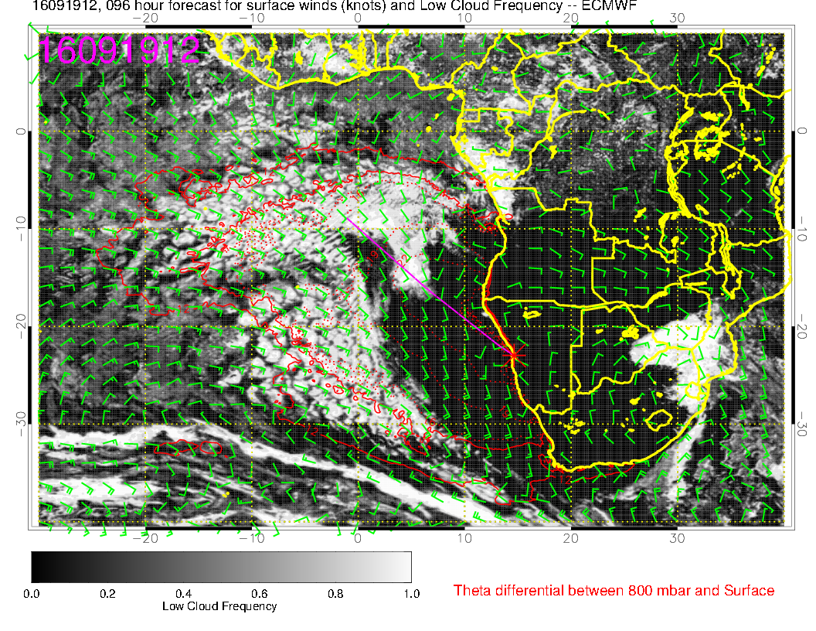
Huge clear region – UKMO probably more reasonable in northern portion, though
that is likely to be perturbed cloud (thin). Winds will be fine, some onshore flo

Slide 31
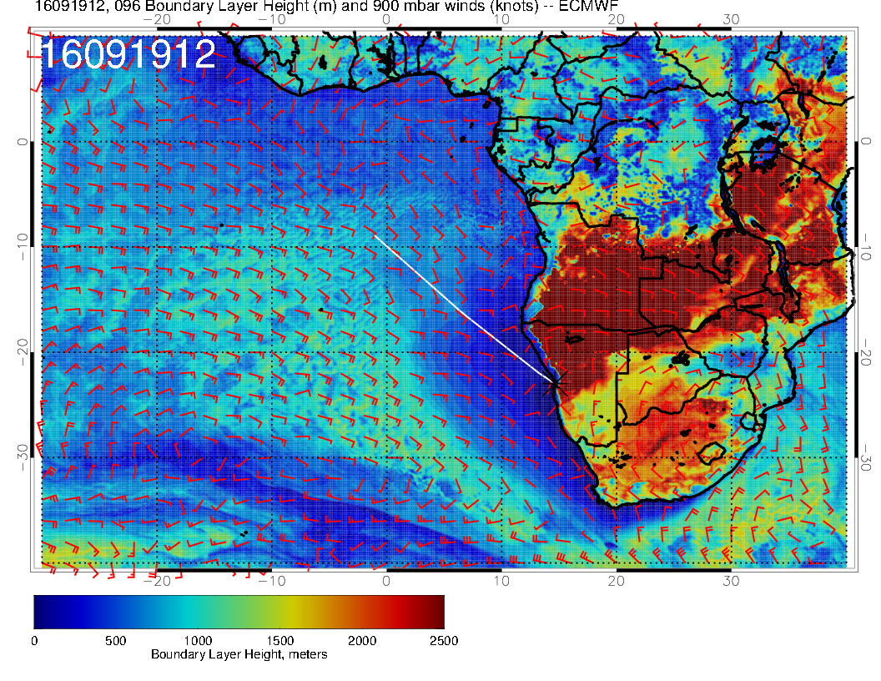
Large area of low boundary layer heights (lower than usual).

Slide 32
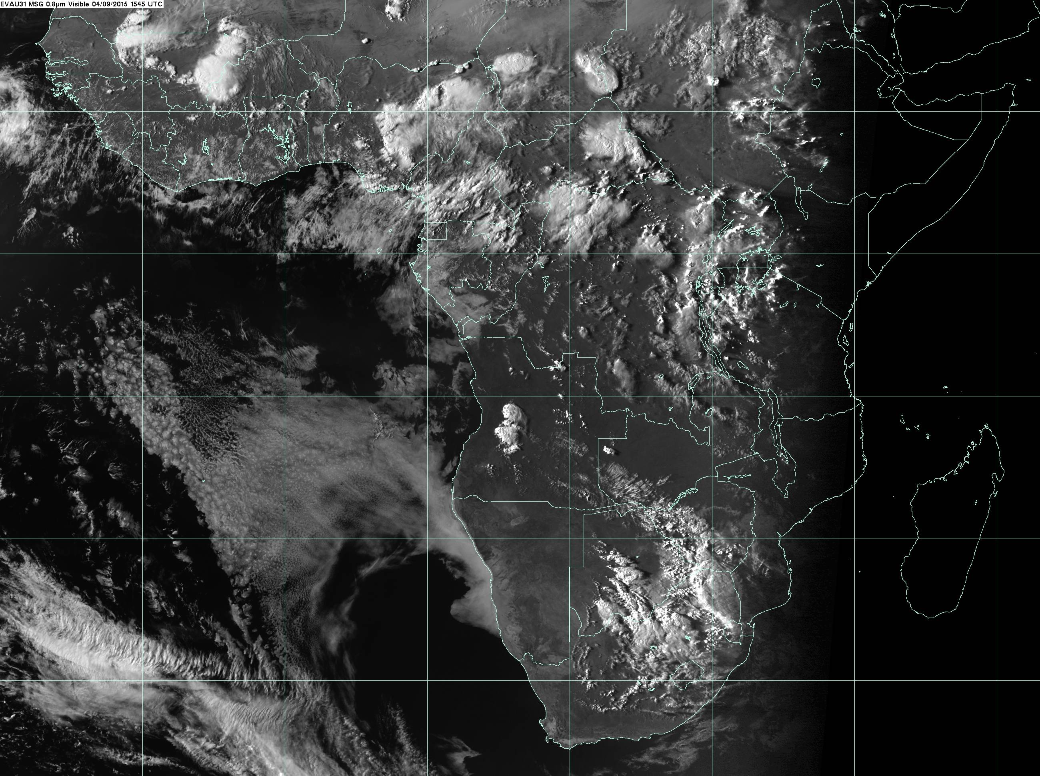
Last year sept 4.
Big clear regions DO
develop. Not the same synoptic situation.
Onshore flow in prog and low BL heights suggest we could get some fog penetrating. Last year it was OK.

Slide 33
Tuesday, 20160920
Significant middle cloud developing
Low level clearing reduced relative to Monday
High cloud forecasts diverge.
600mb circulation very rounded, very much like climo

Slide 34
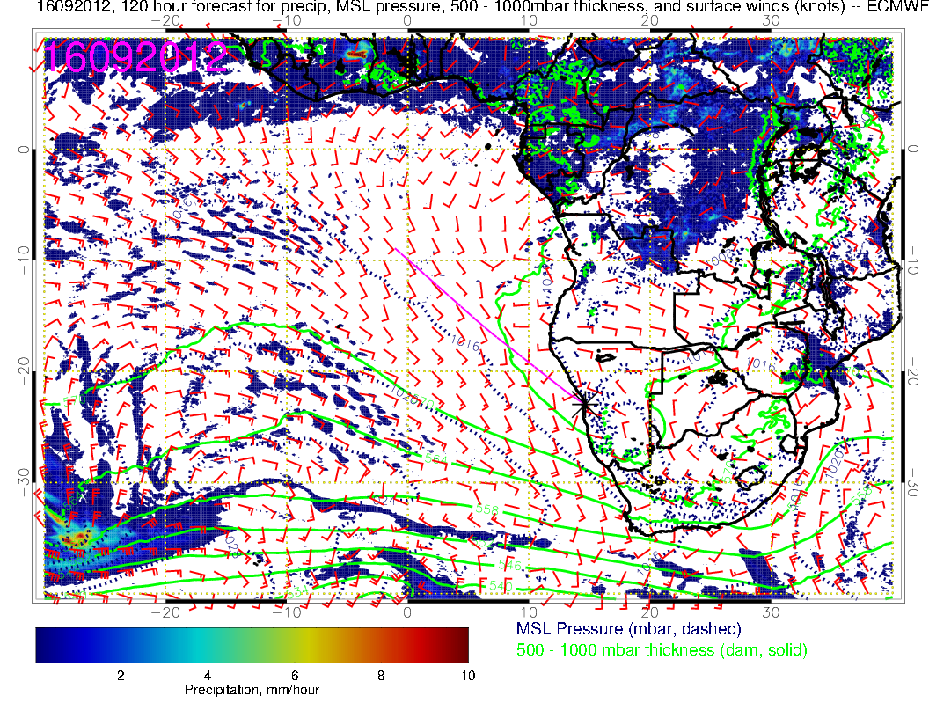
Good flow inland from Indian Ocean with convective development along trough. Weaker pressure gradients in SE Atlantic and weaker circulation.

Slide 35
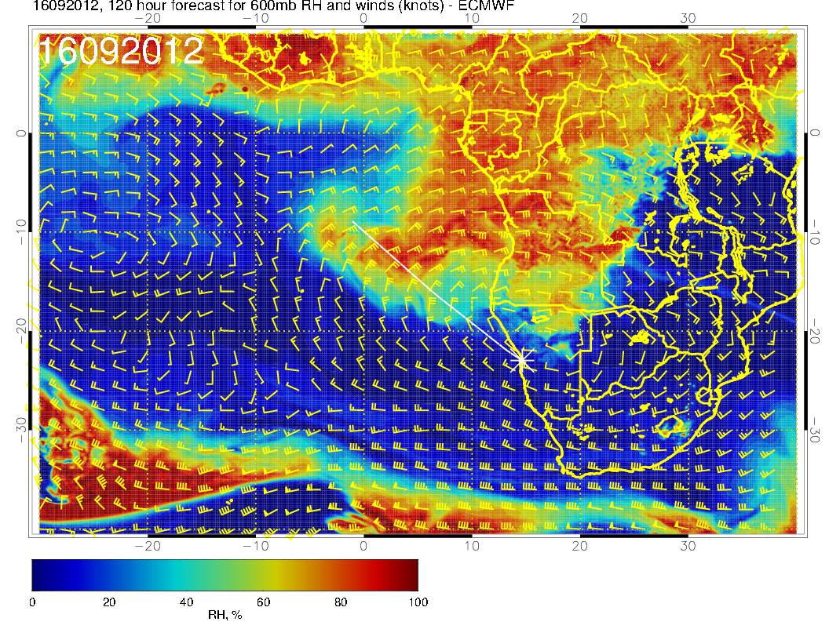
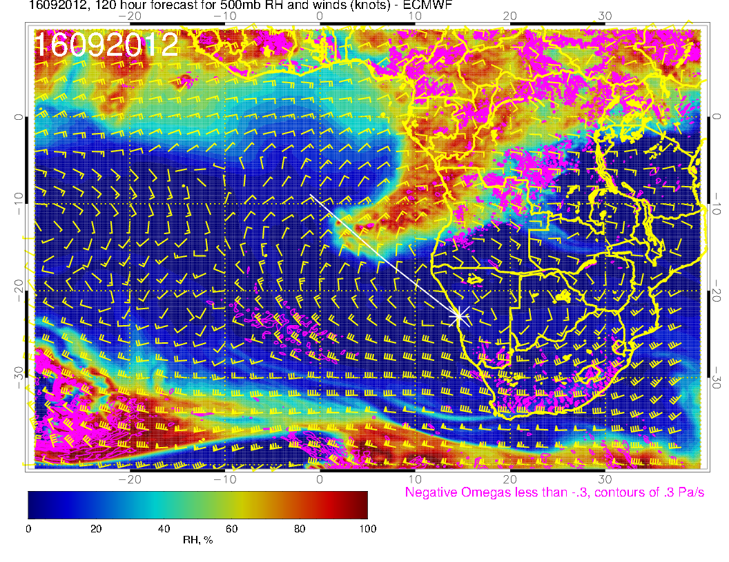
600mb anticyclone is near climo position now and is rounded (like climo). RH altitude penetration is high.
600mb
500mb
Arlindo noted wavy structure in circulation and aerosols

Slide 36
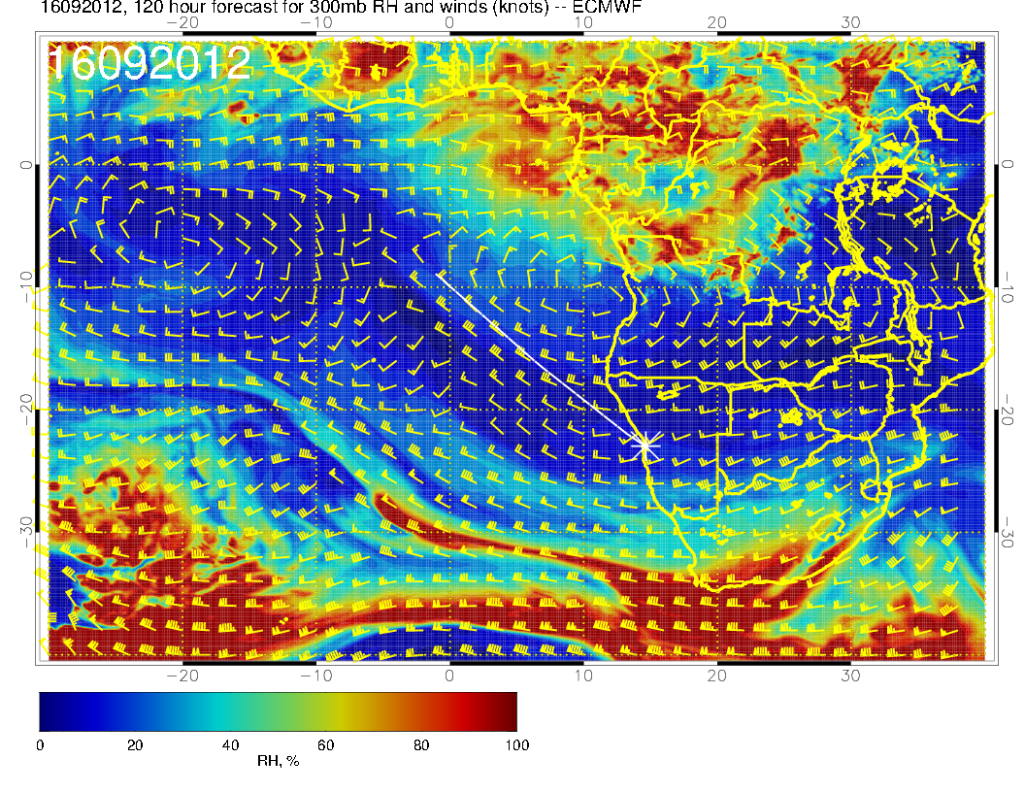
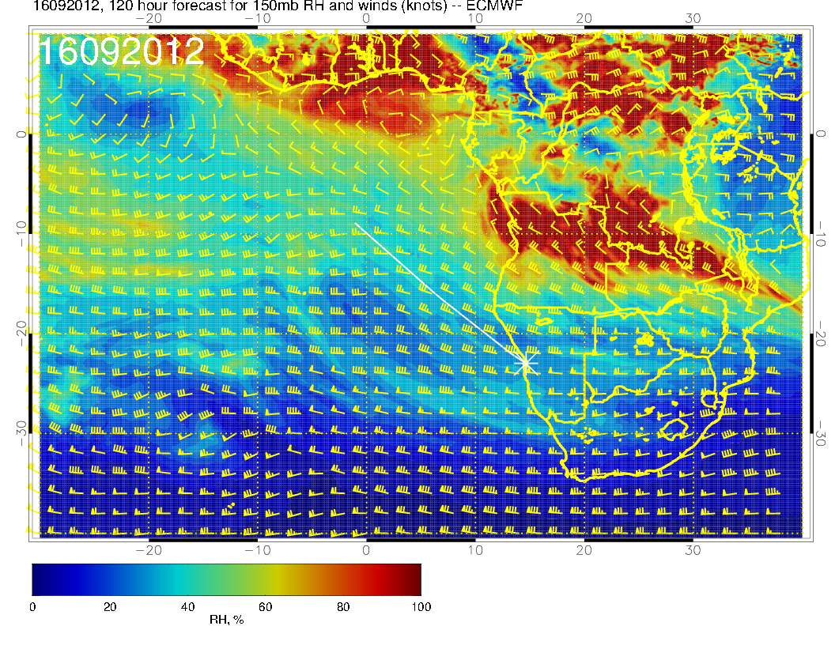
Some high RH in Angola bay

Slide 37
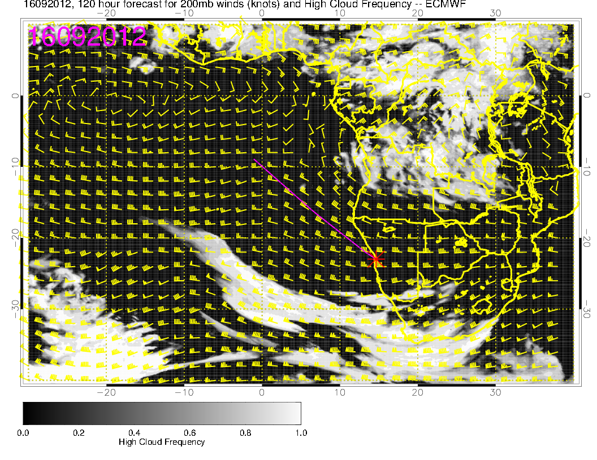
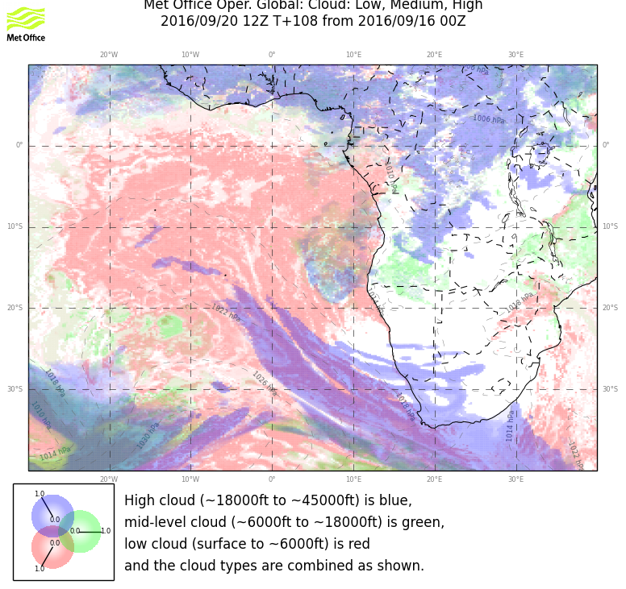
Models are diverging here for high cloud

Slide 38
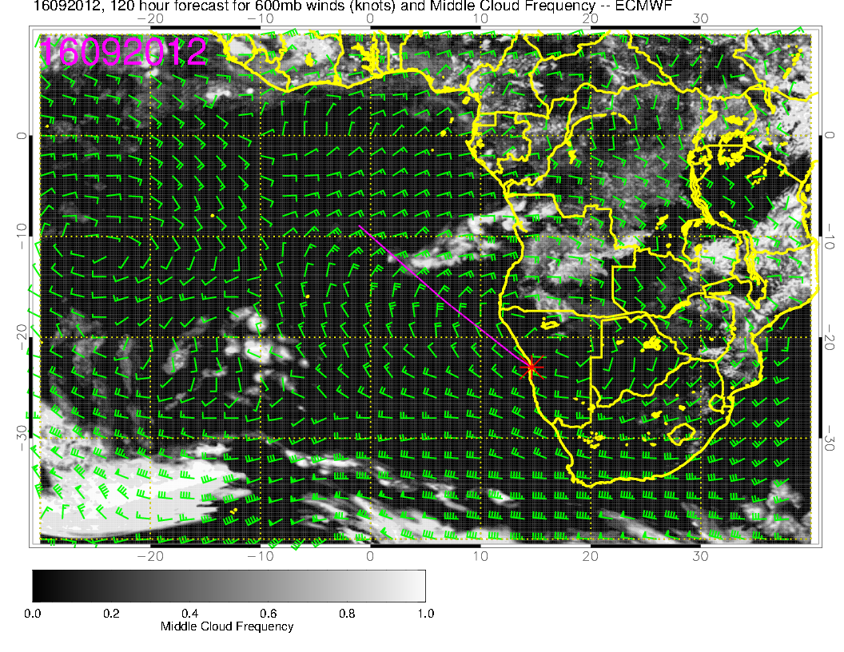
Both models put significant high and middle cloud in operating region.
High cloud is very uncertain because of convection. Middle cloud is consistent
with circulation development and RH – willing to believe it. Details differ

Slide 39
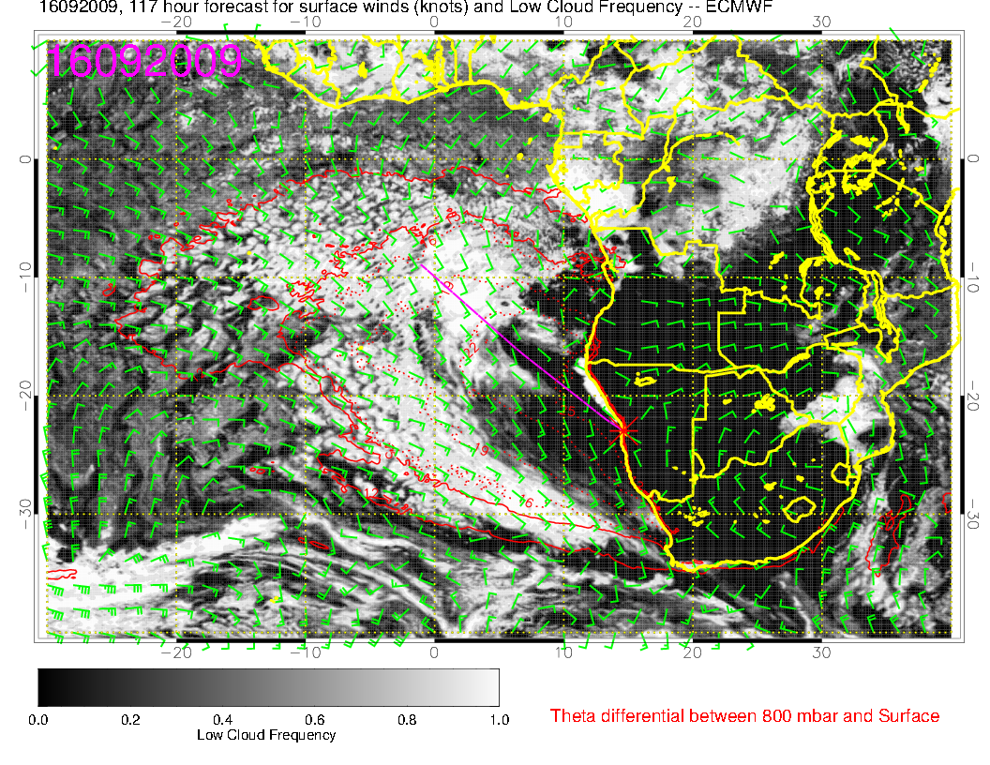
Clear region has contracted some in both models.

