Slide 1
ORACLES forecasting briefing Meteorology for 16-09-2016
16-09-2016
Lenny Pfister

Slide 2
Friday
Frontal passage occurring attm. RH of 55%, SSE winds of 5 knots.
Ceilings of 1kft, light easterlies forecast for takeoff.
TAF forecasts crosswinds on landing within limits. Ceiling and vis ok.
Front has an impact on low clouds and temperature structure in first third of track
Do not expect significant middle and low cloud, some apparent well off track at this time.

Slide 3
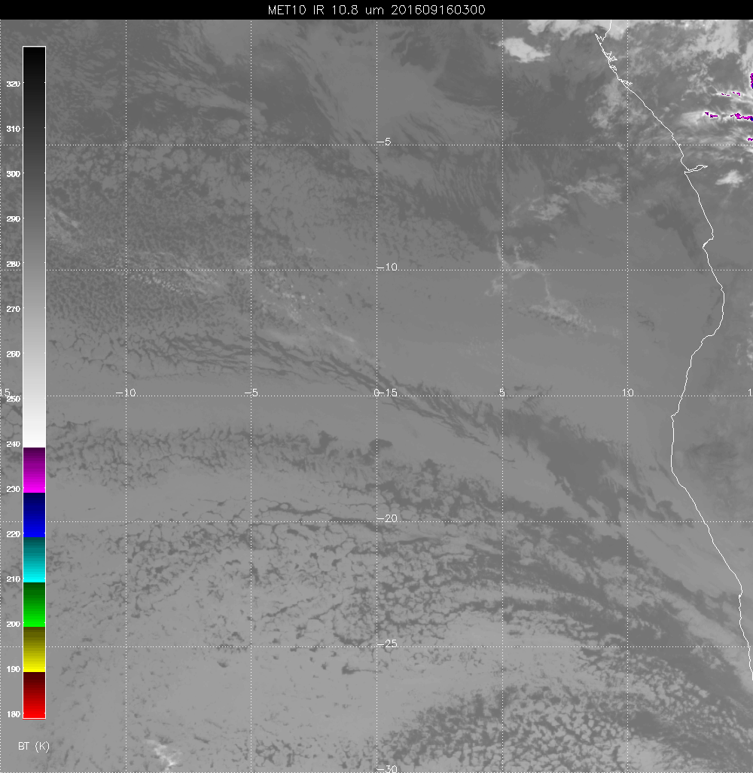
Latest image

Slide 4
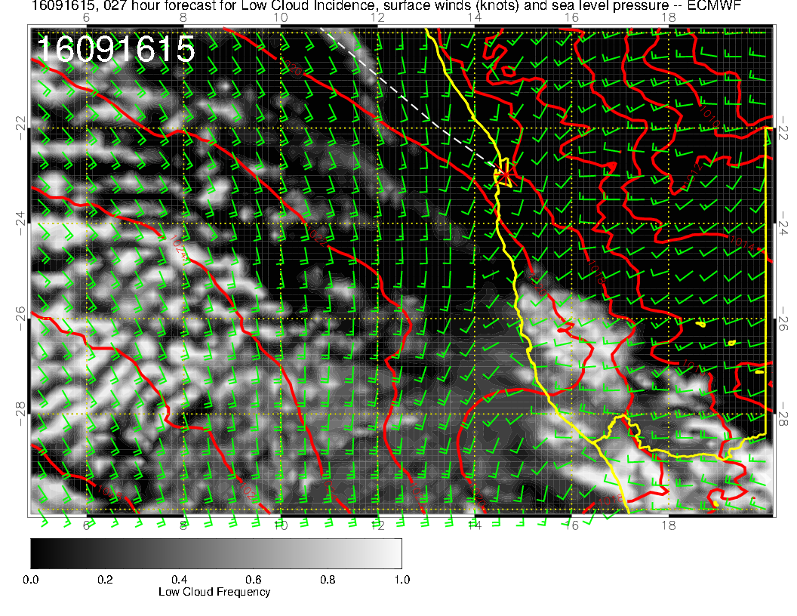

Slide 5
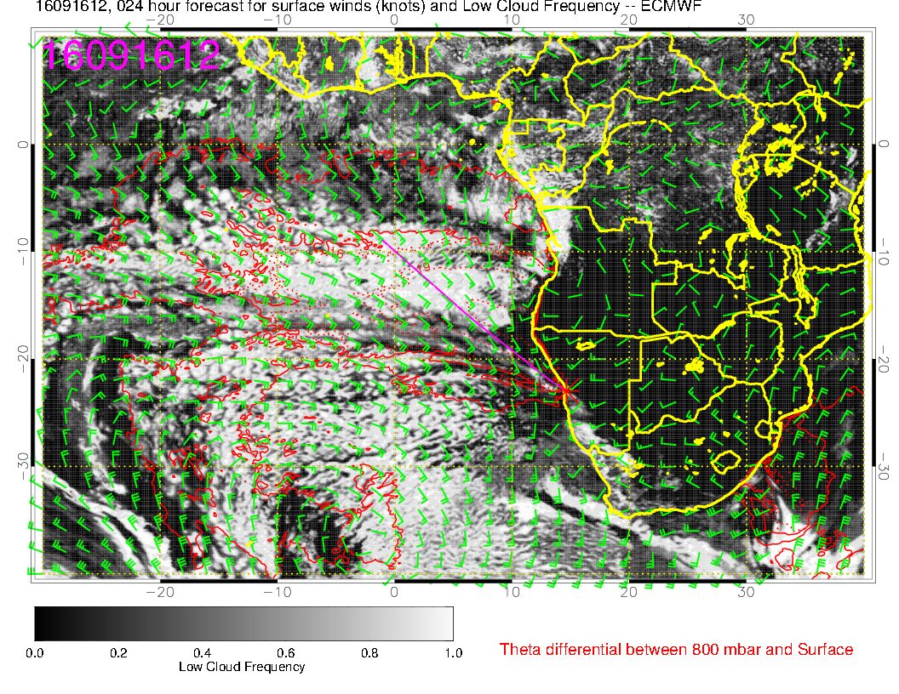

Slide 6
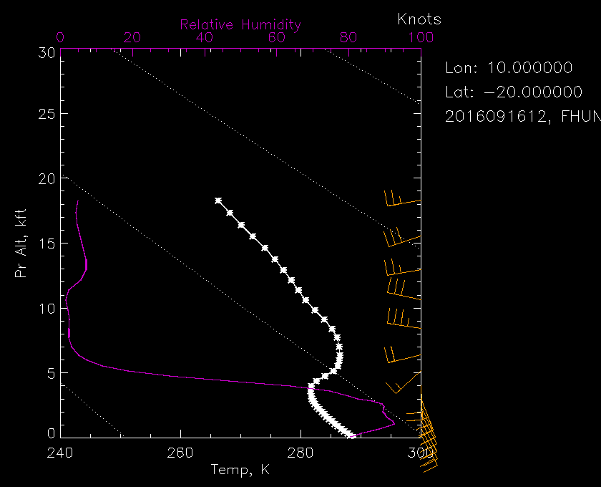
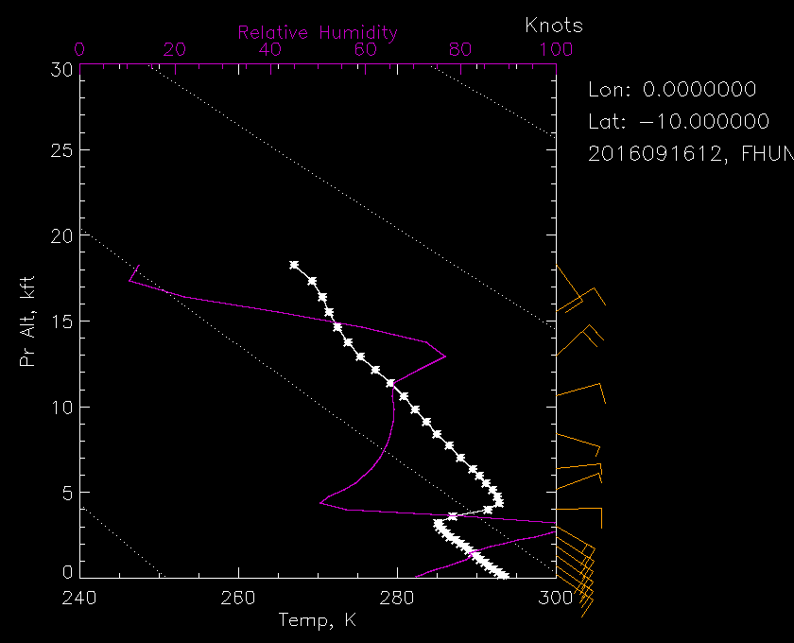
Soundings at beginning and end of track. Inversion still there but weaker.

Slide 7
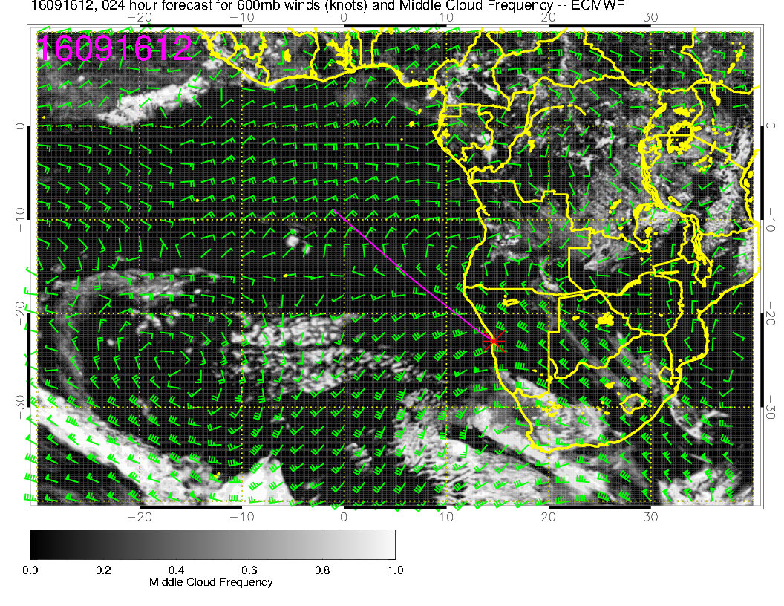
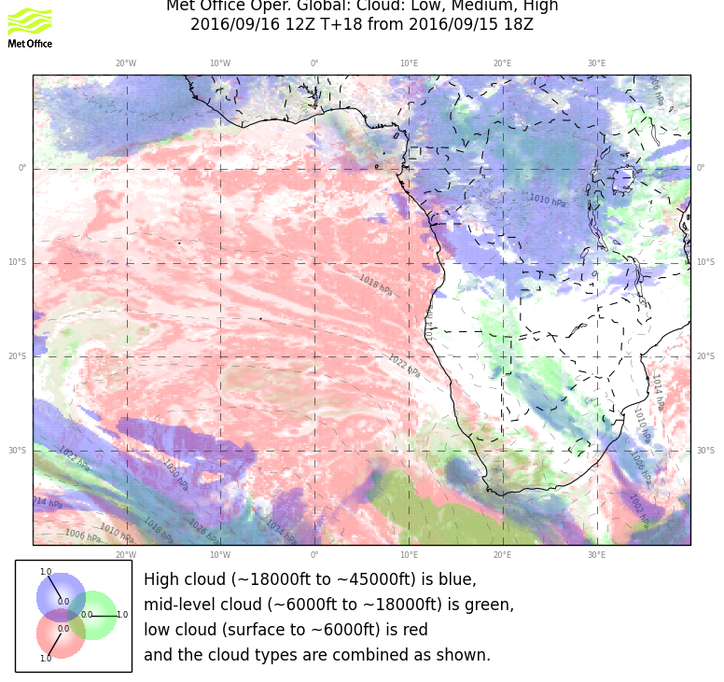

Slide 8
