Slide 1
ORACLES forecasting briefing Meteorology for 16-09-2016 – 19-09-2016
15-09-2016
Lenny Pfister

Slide 2
Friday
Frontal passage occurs near YWB early in the morning. Lots of post frontal clouds W and WNW of YWB.
Relatively dry at midlevels – no midlevel cloud expected except south of 20 near 0.
Some high cloud expected in Angola Bay
Sc region compressed to north of 18-20S

Slide 3
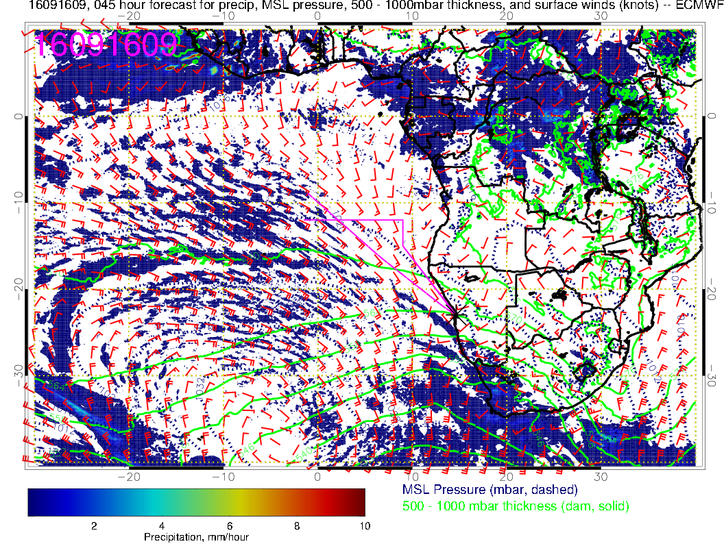

Slide 4
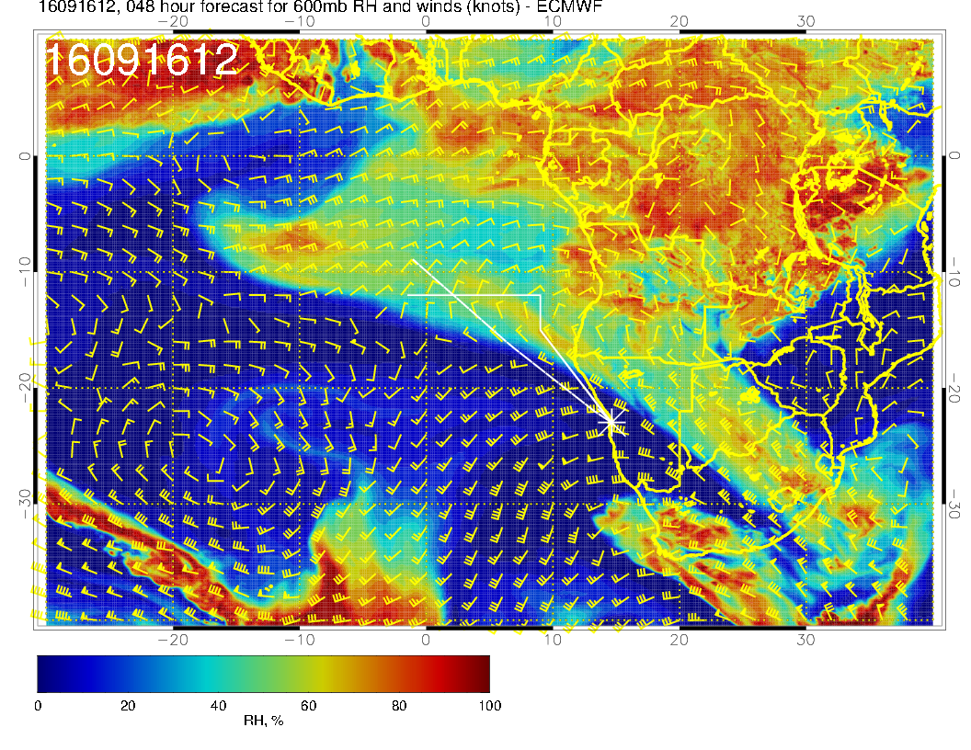
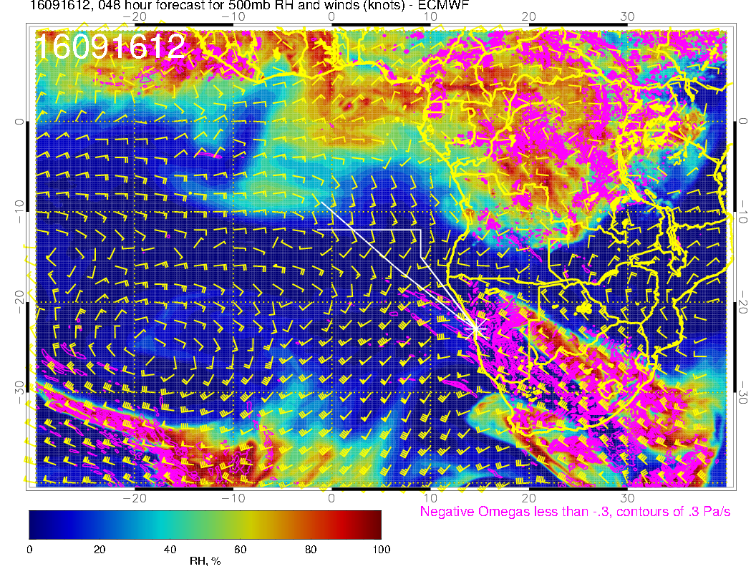

Slide 5
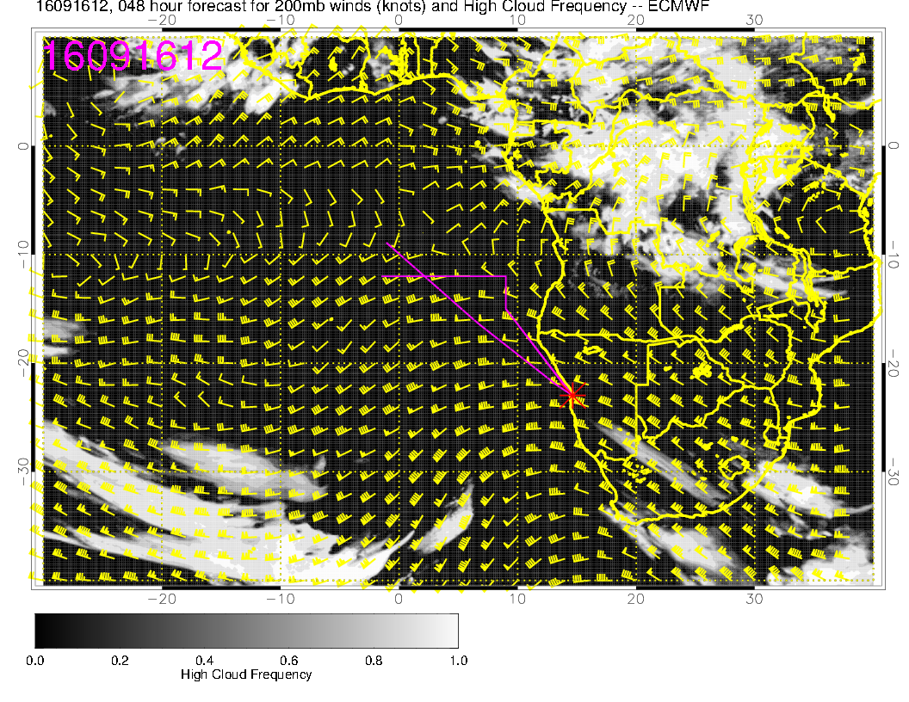
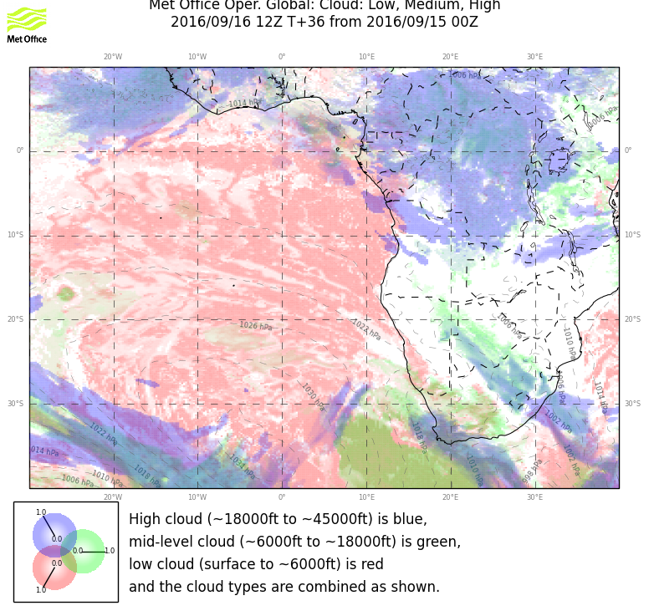

Slide 6
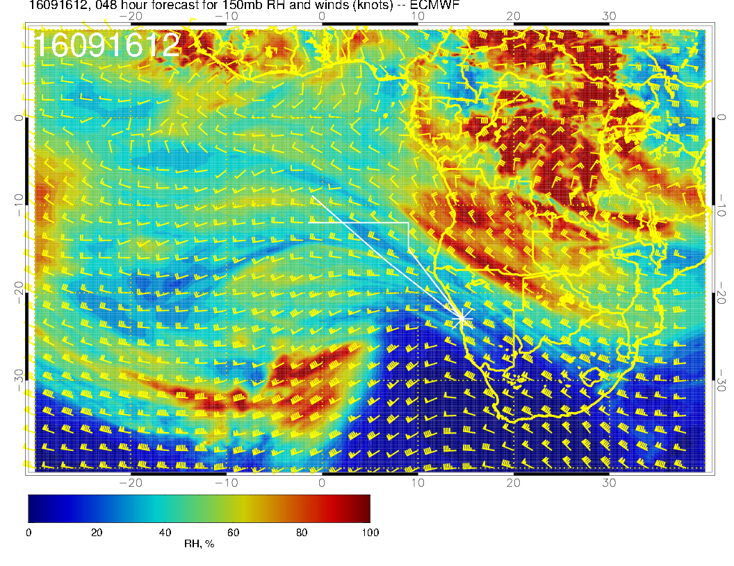

Slide 7
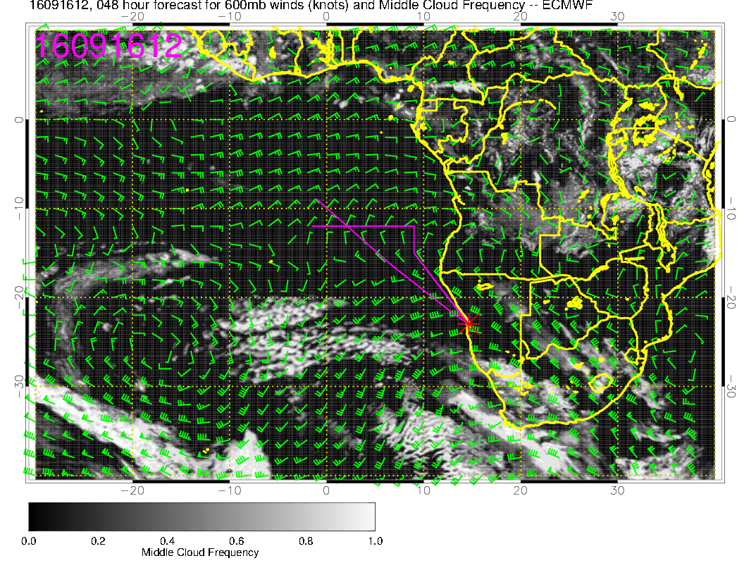

Slide 8
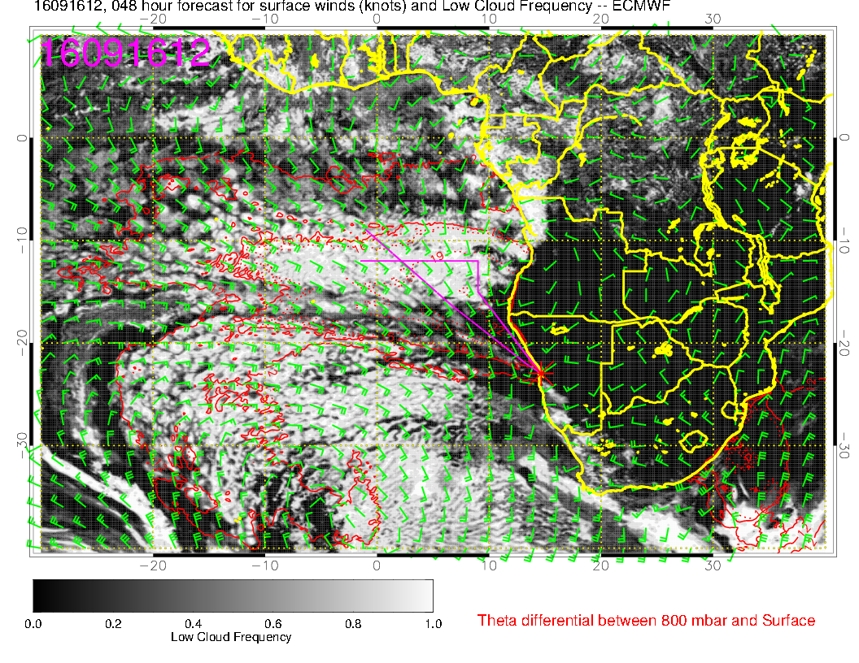

Slide 9
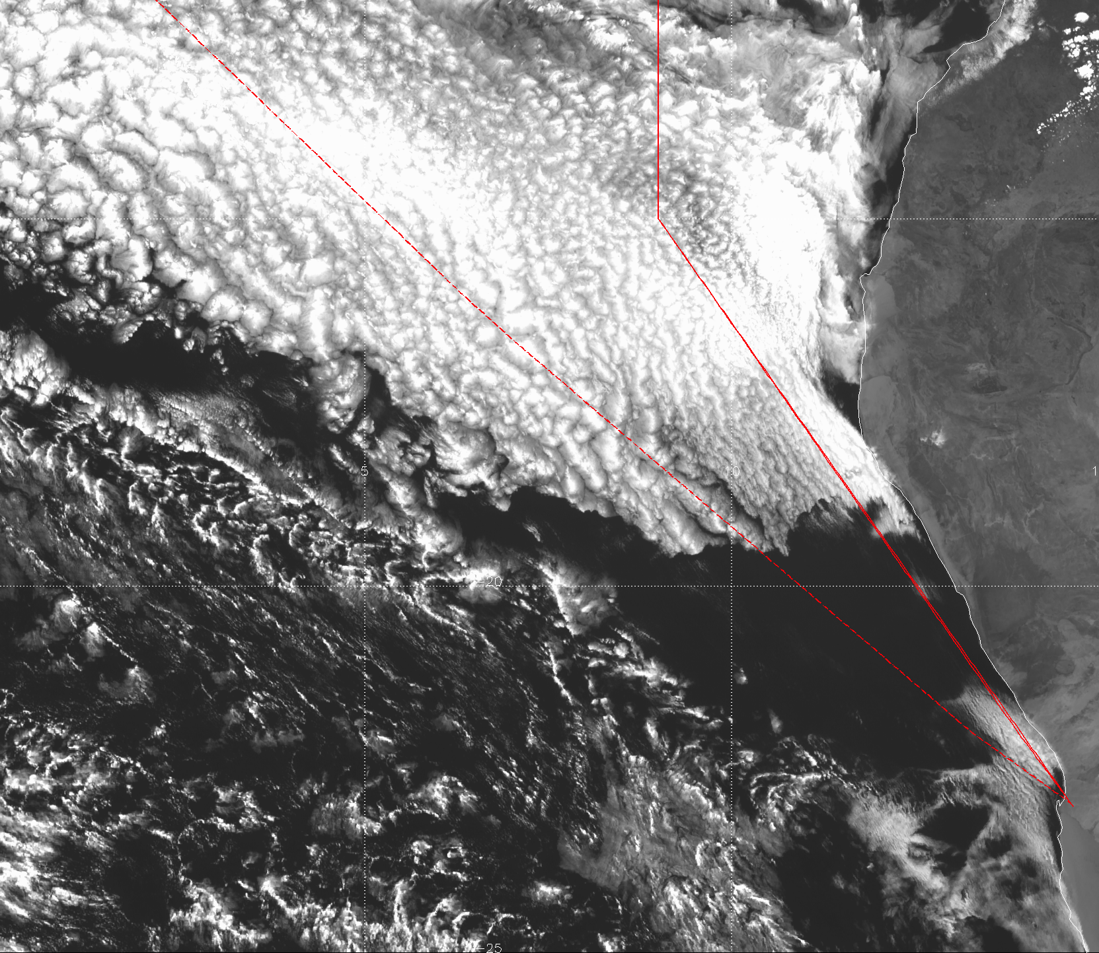

Slide 10
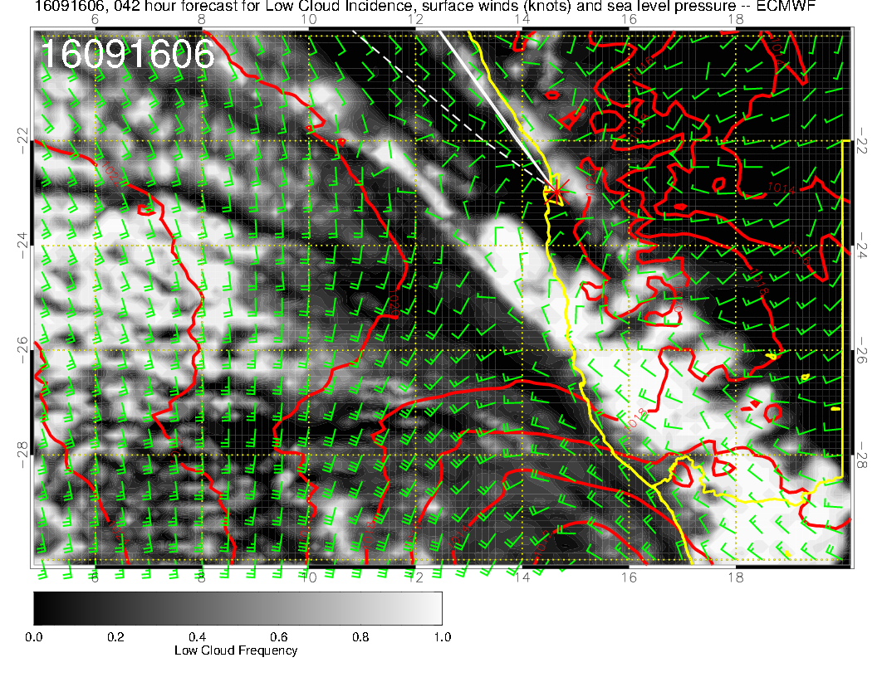
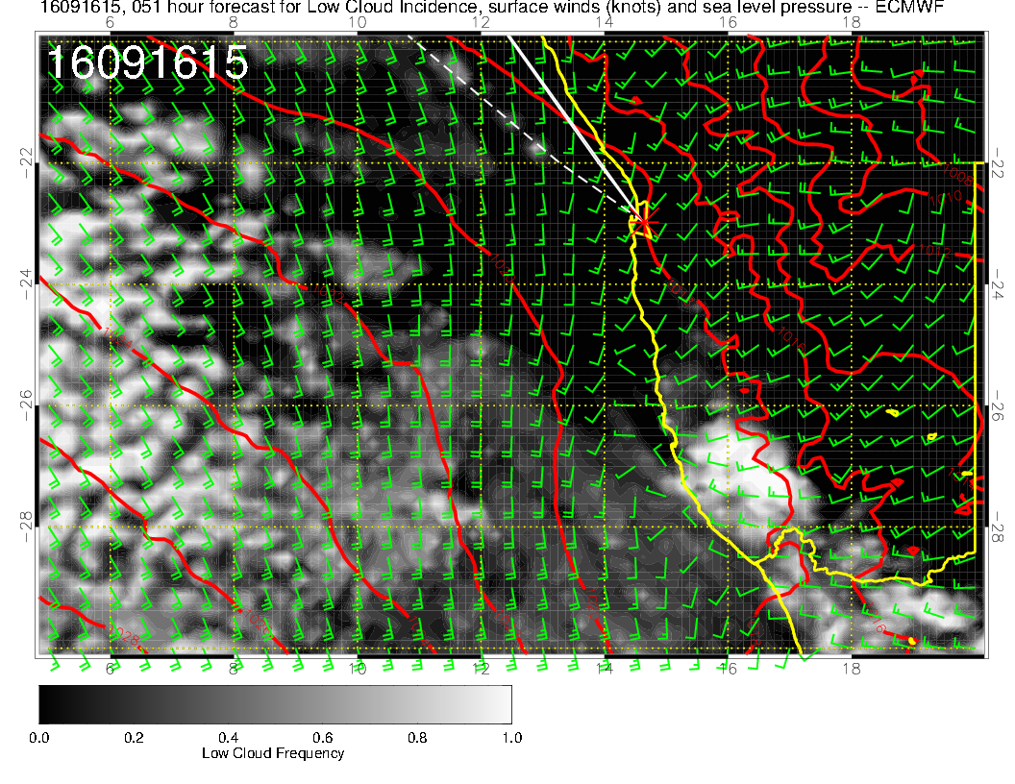

Slide 11
Saturday
Surface winds off the coast accelerate as high moves eastward. More subsidence, clear regions expand near coast.
Moist region at 600mb develops NE of 10S,10E in EC model. Some midlevel cloud in this region. UKMO model shows some, but less than EC. Trend of forecasts of cloud in this region (high AND low) is less cloud with later fcsts.
Clear regions of coast in both models to 12-14S and to west of 10E.
Strong winds on landing within limits. Dust possible.

Slide 12
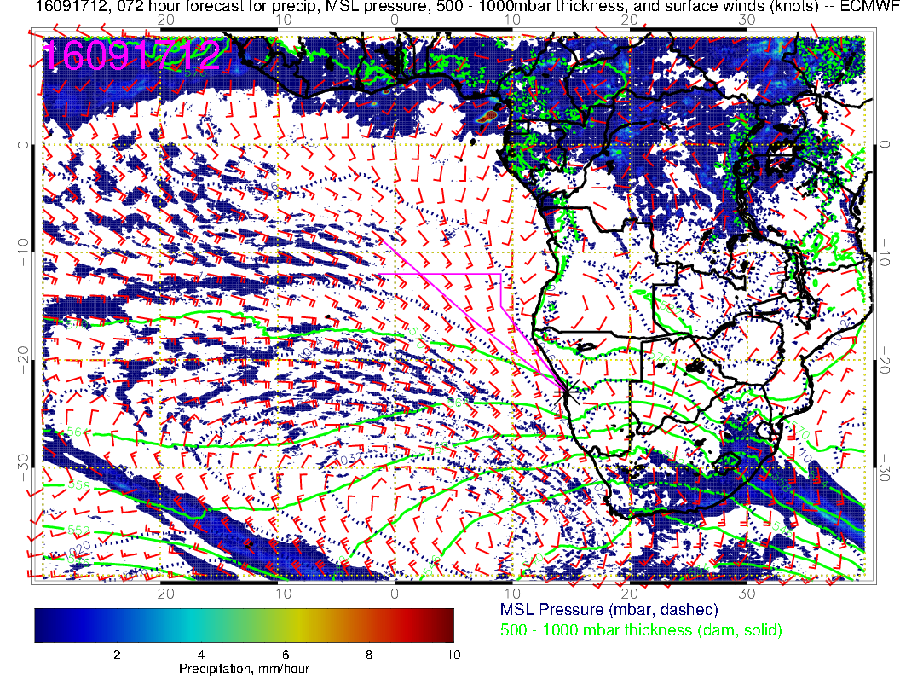

Slide 13
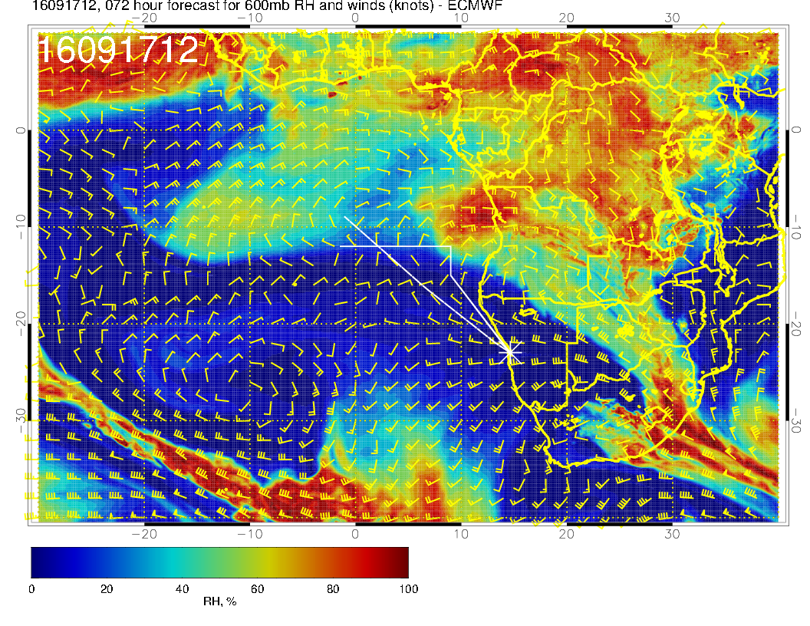
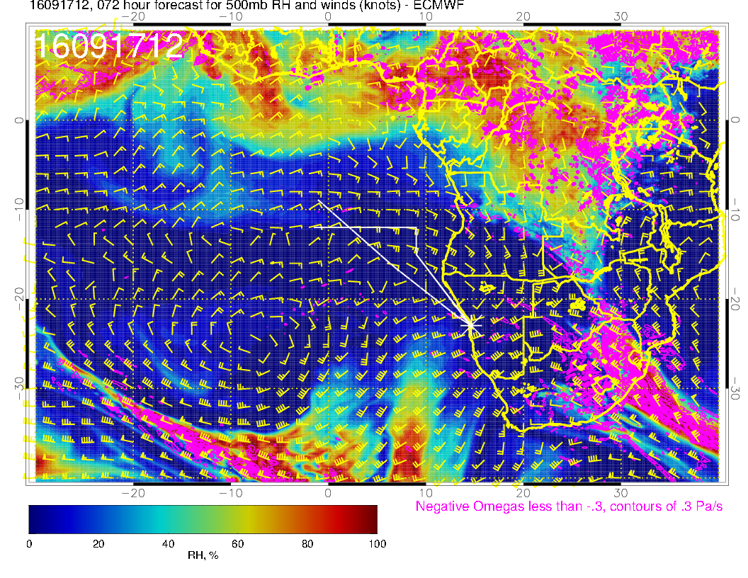

Slide 14
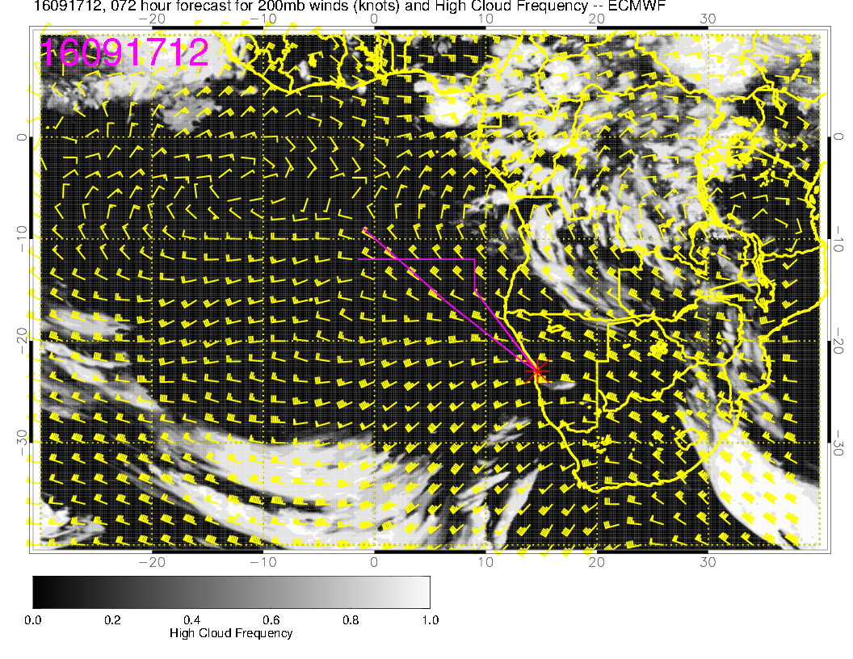
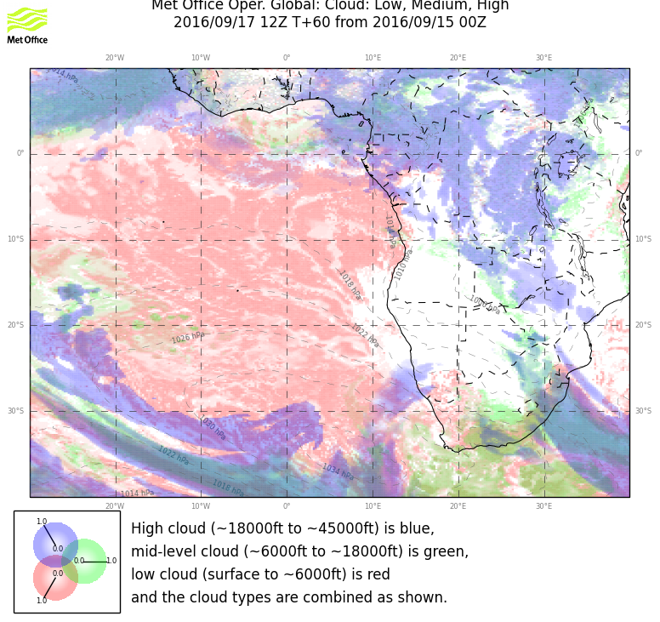

Slide 15
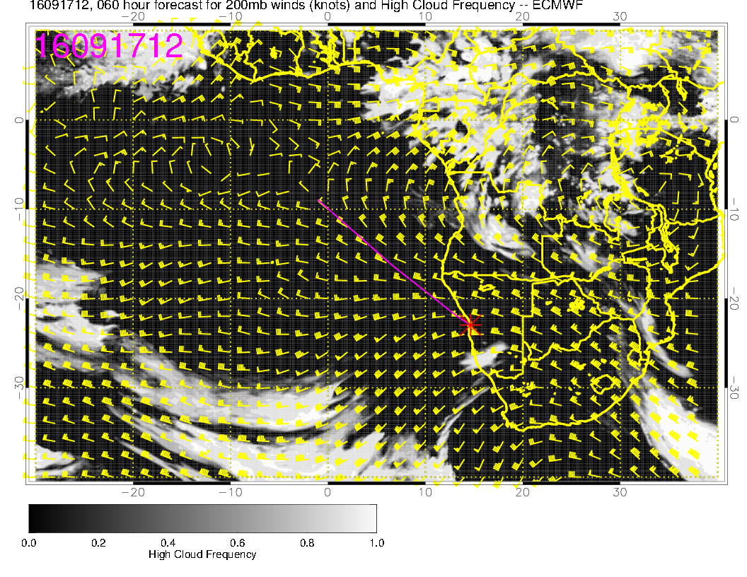
Newer EC forecast

Slide 16
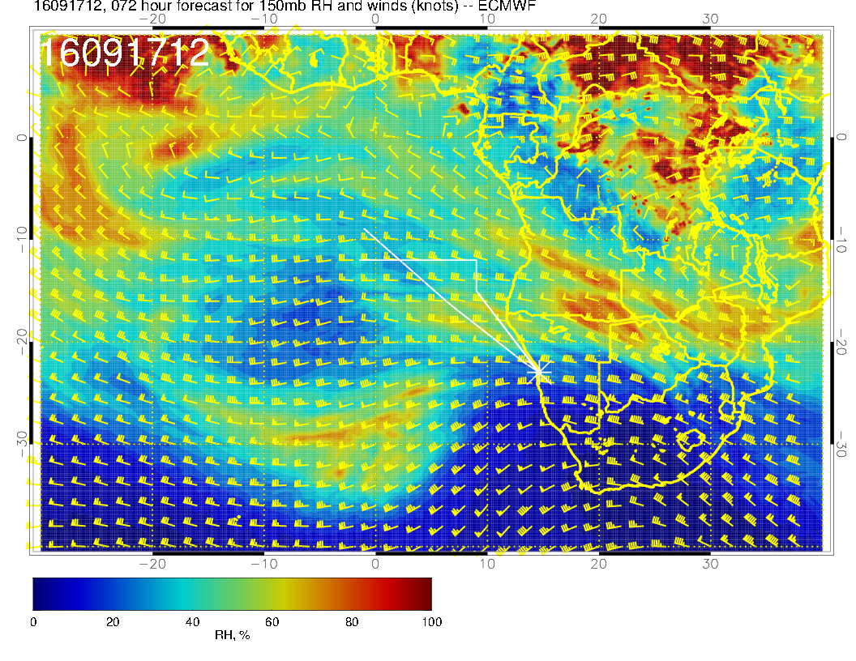

Slide 17
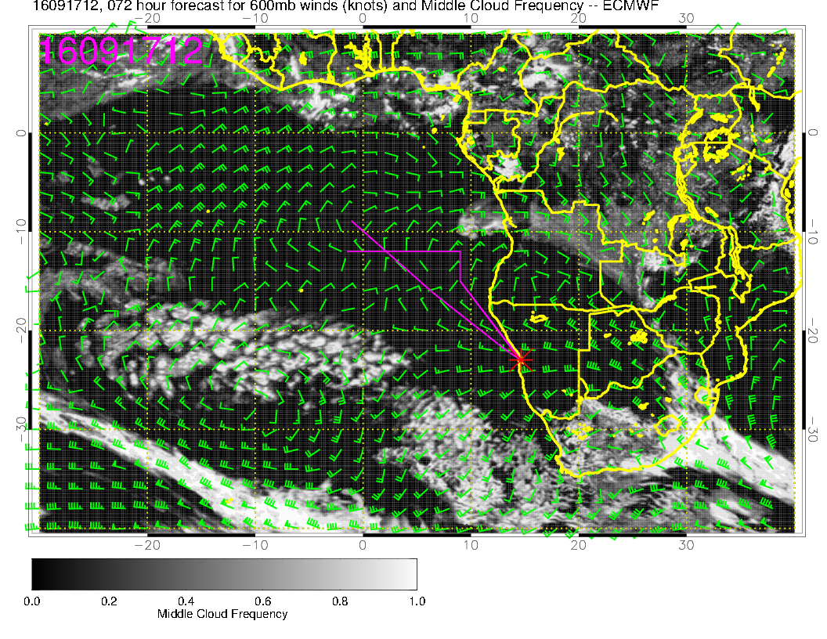

Slide 18
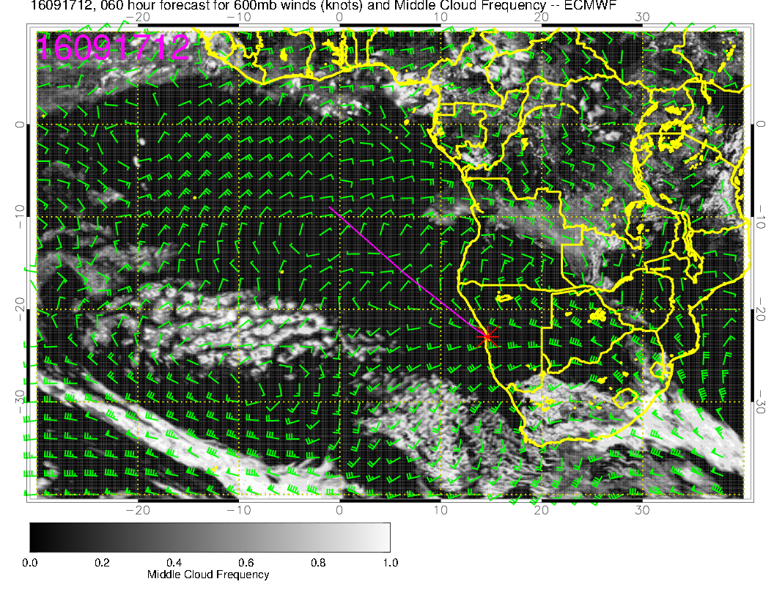

Slide 19
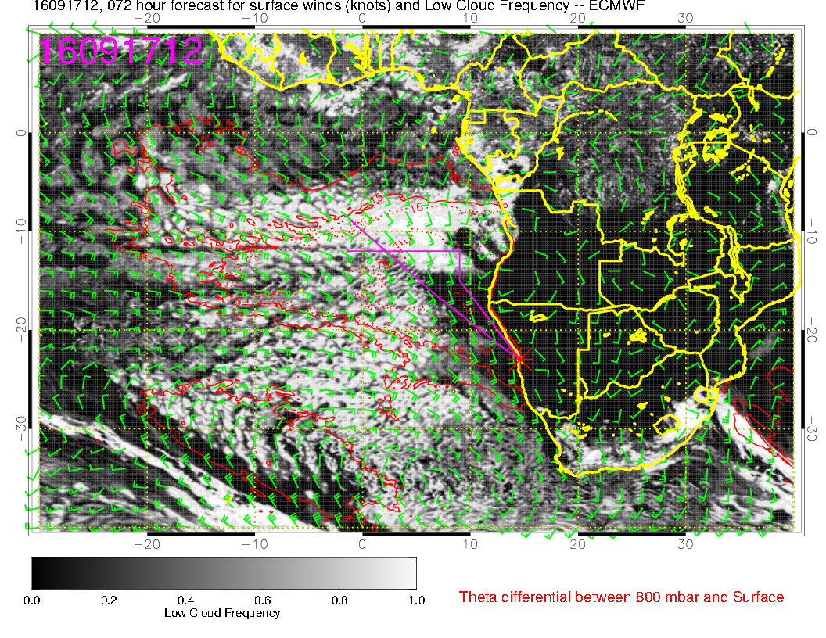

Slide 20
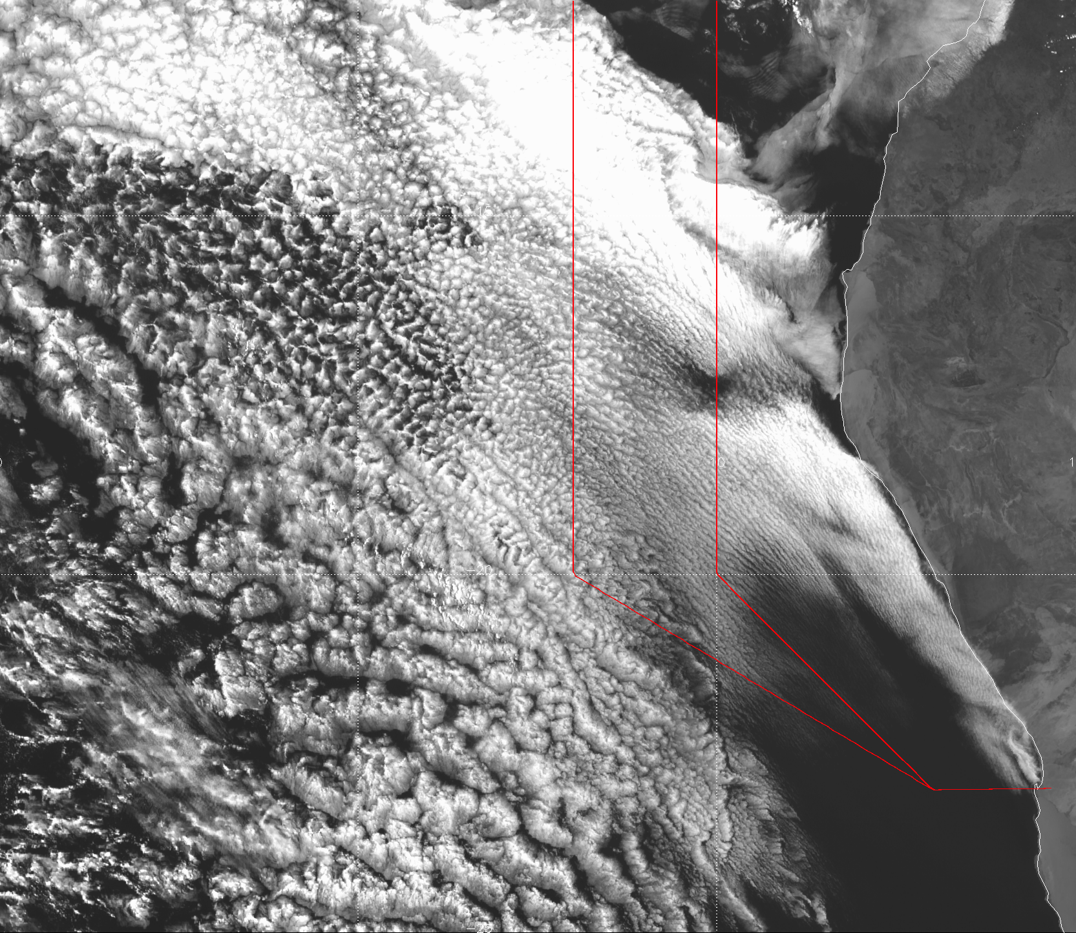

Slide 21
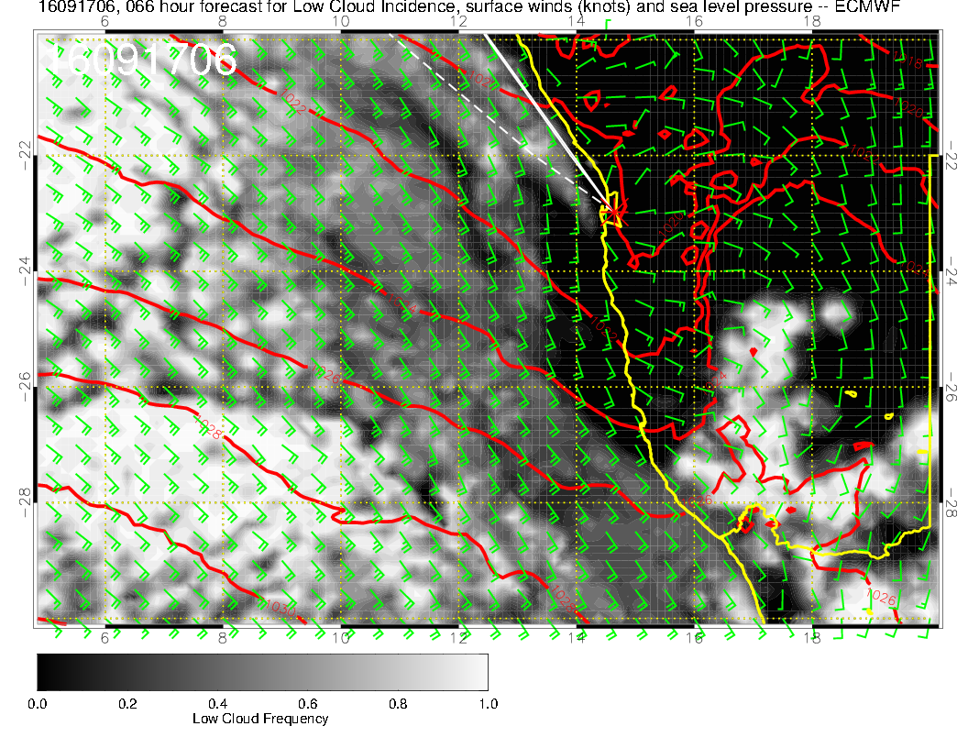
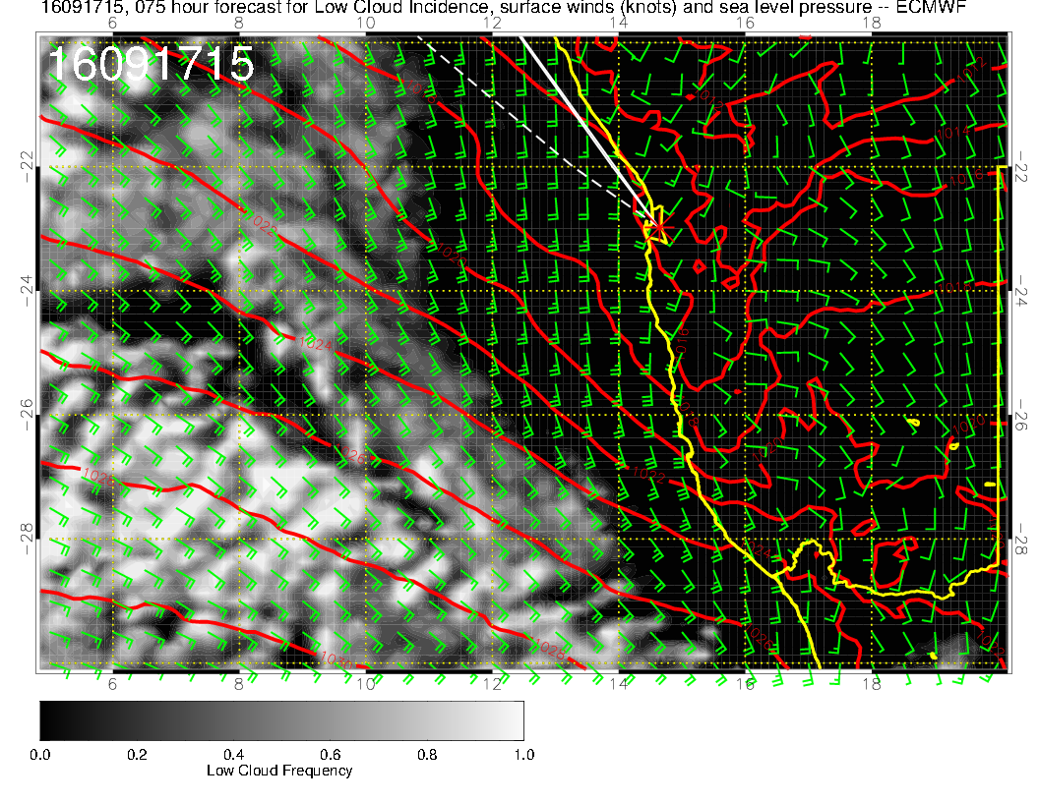

Slide 22
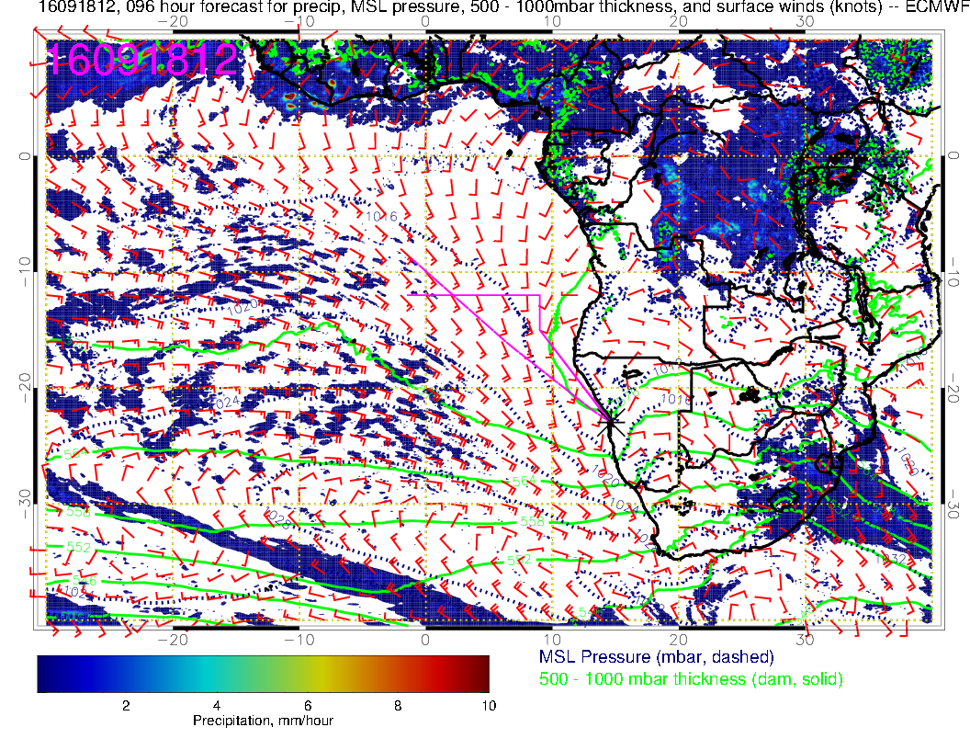

Slide 23
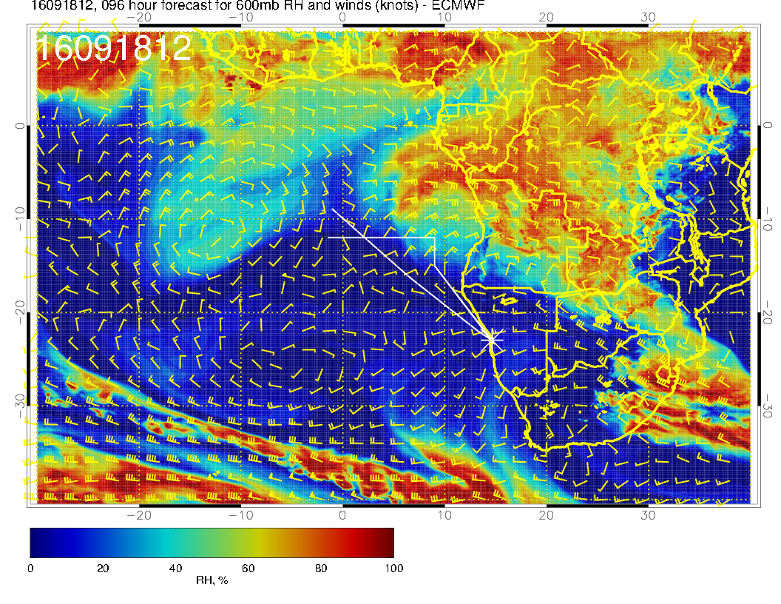
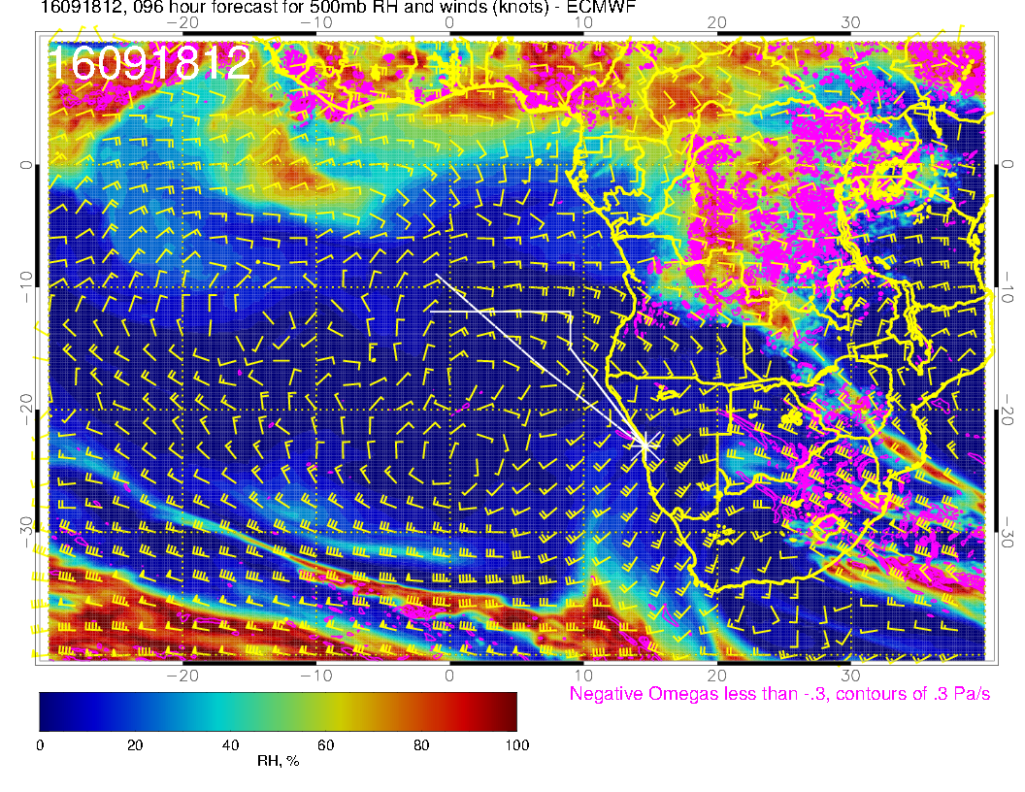

Slide 24
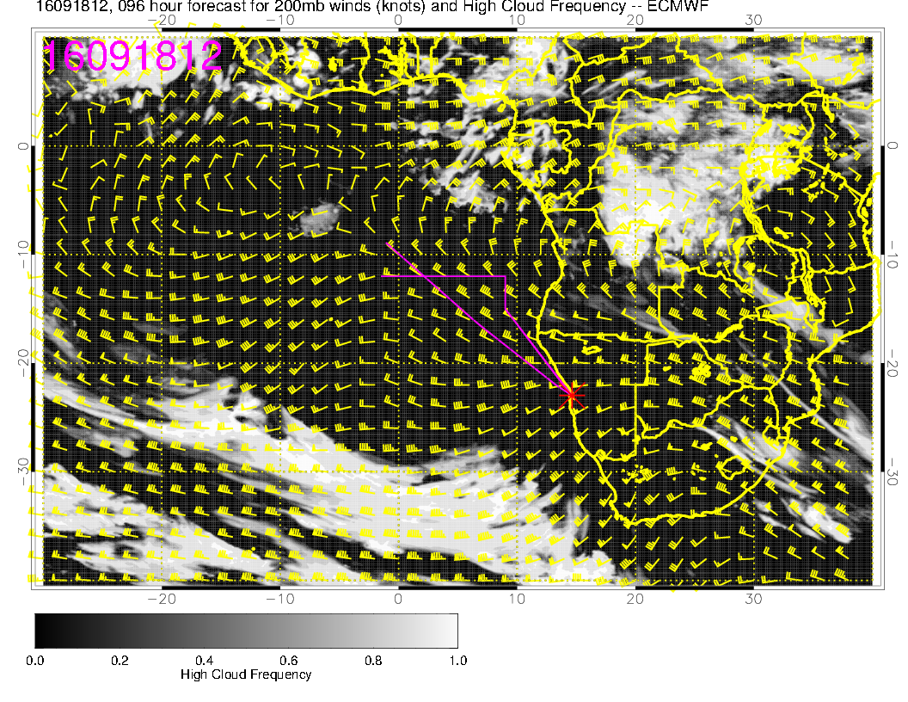
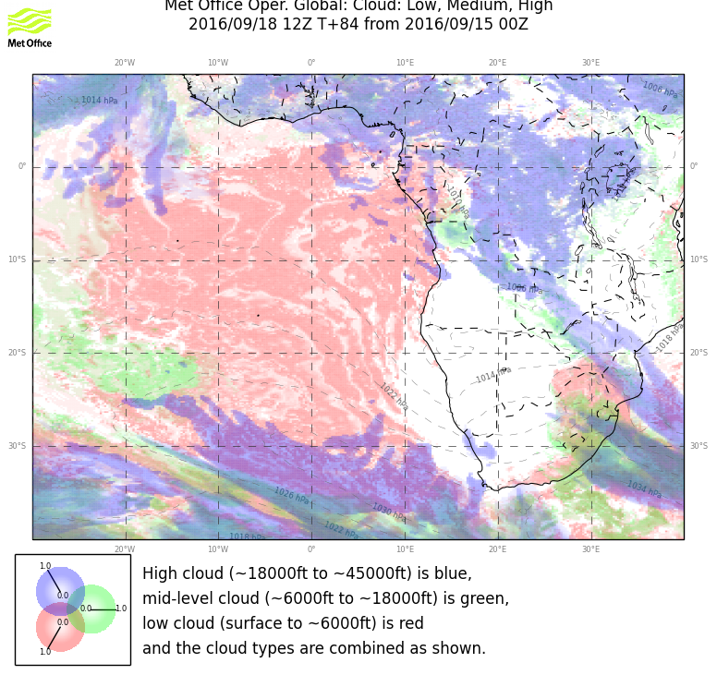

Slide 25
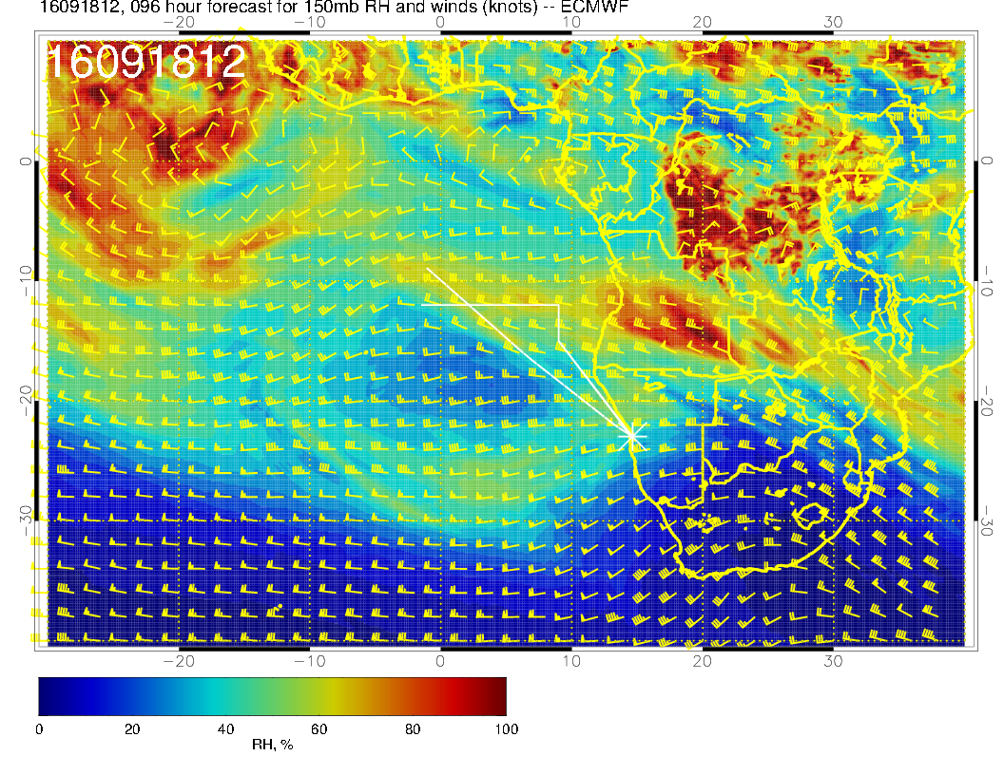
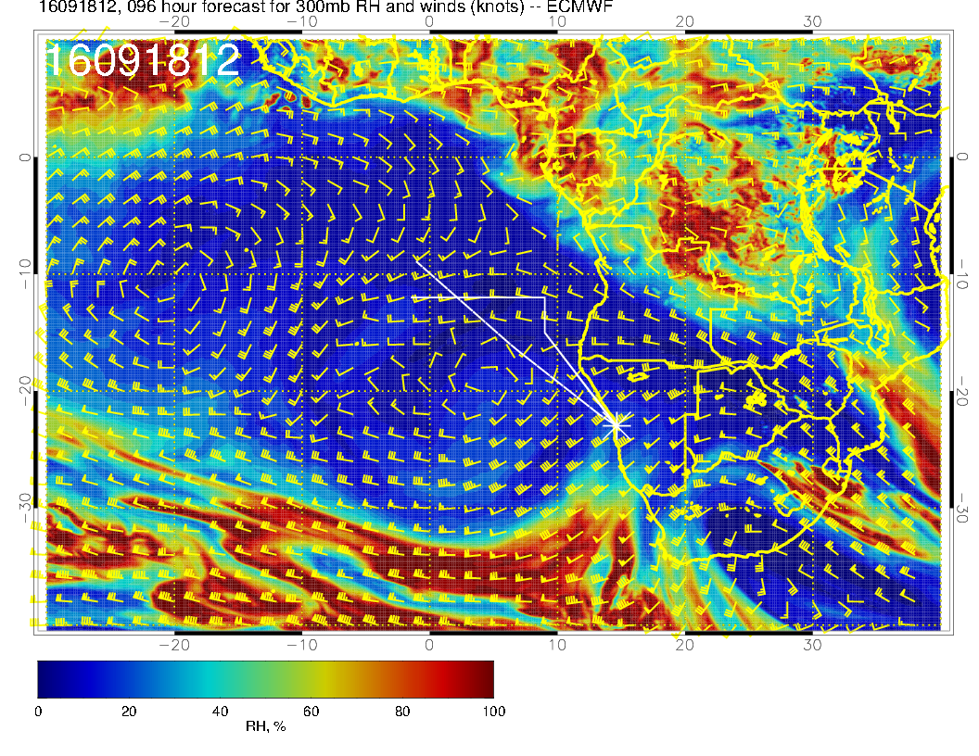

Slide 26
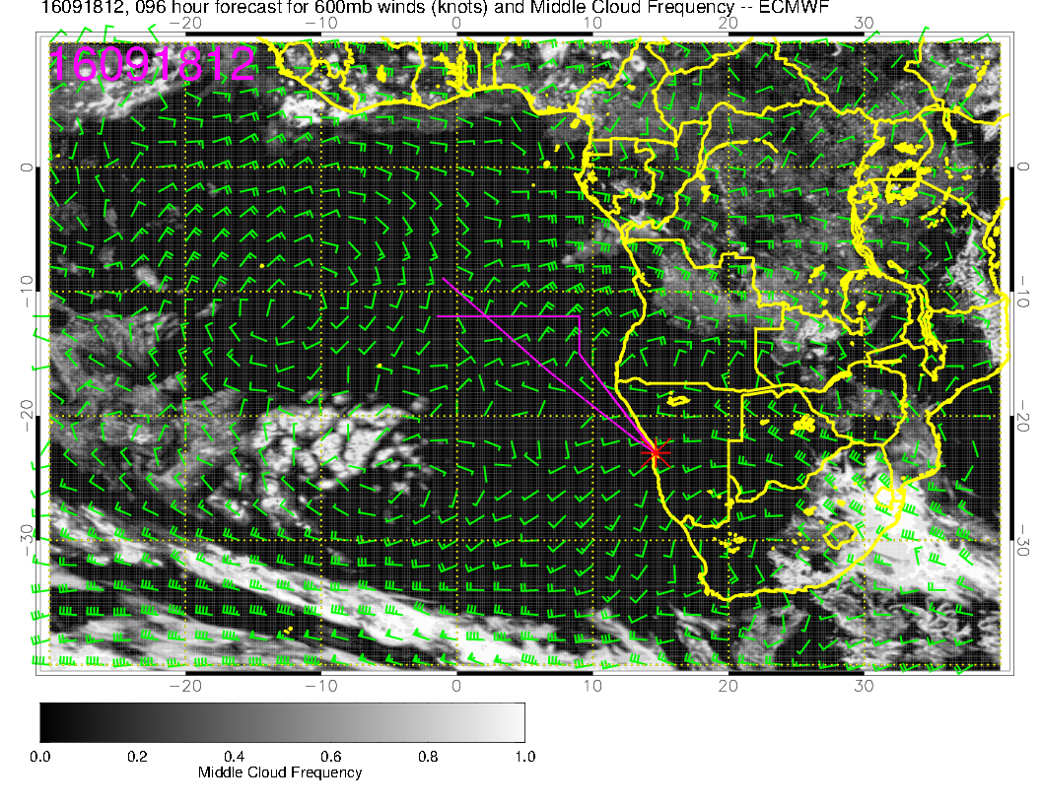

Slide 27
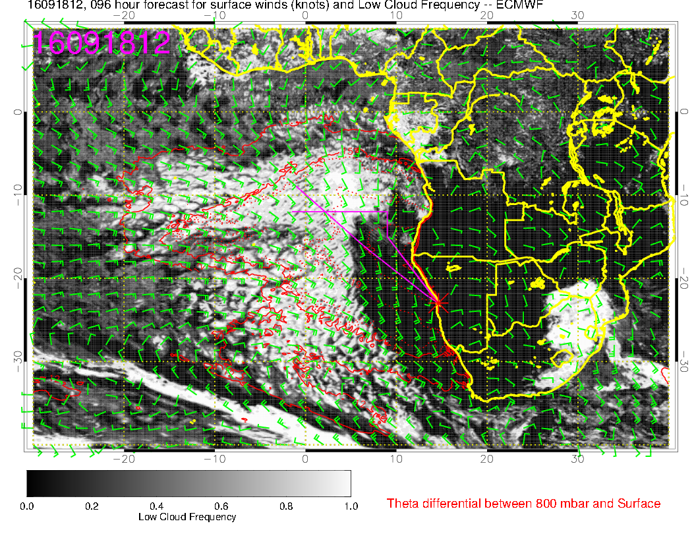

Slide 28
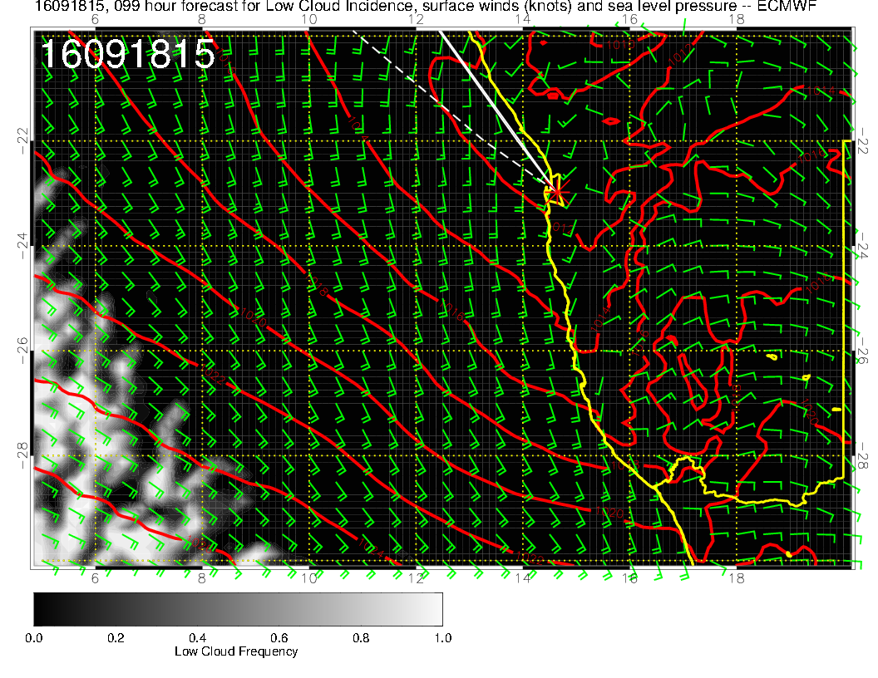

Slide 29
Monday
High has split, one well west and the other in the Indian ocean. Surface winds less, especially within 10 degrees of the coast.
Burst of midlevel moisture (appears now at 500mb in EC). Both models have significant mid level cloud north of 10S westward to 5E.
Both models show high level cloud north of 10S within 10 degrees of coast – convective outflow.
Both models show extensive clear regions in low cloud, but UKMO confines it to south of Angola-Namibia boundary – probably right. EC has an interesting finger of low BL heights pointing NWrd at Ang/Nam boundary latitude.

Slide 30
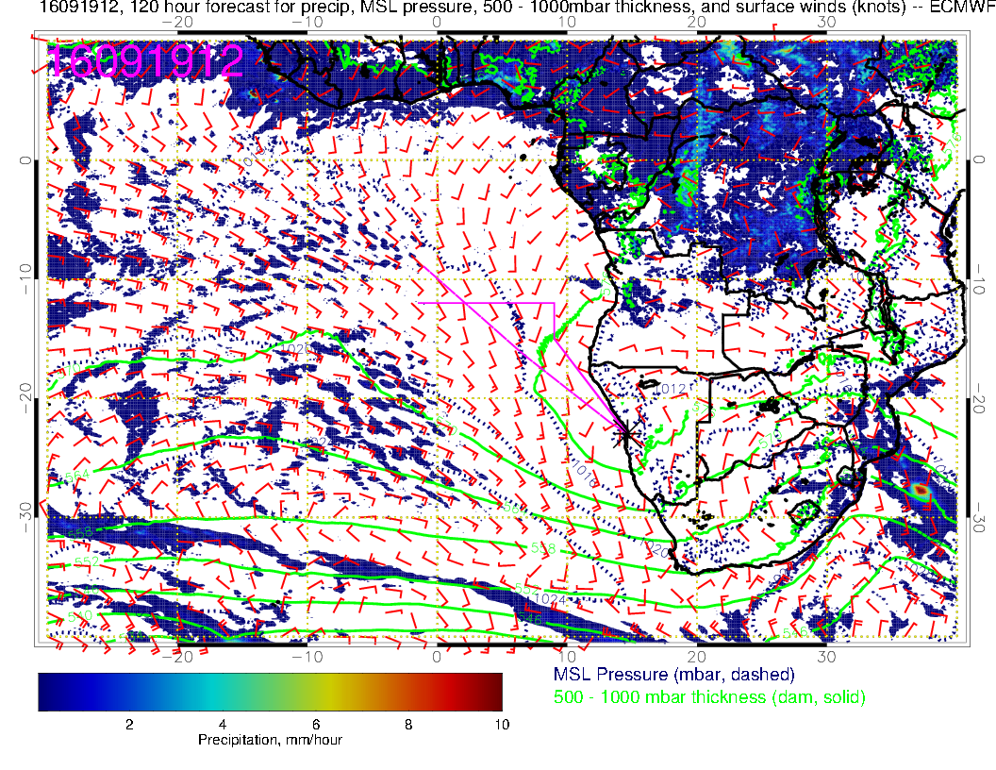

Slide 31
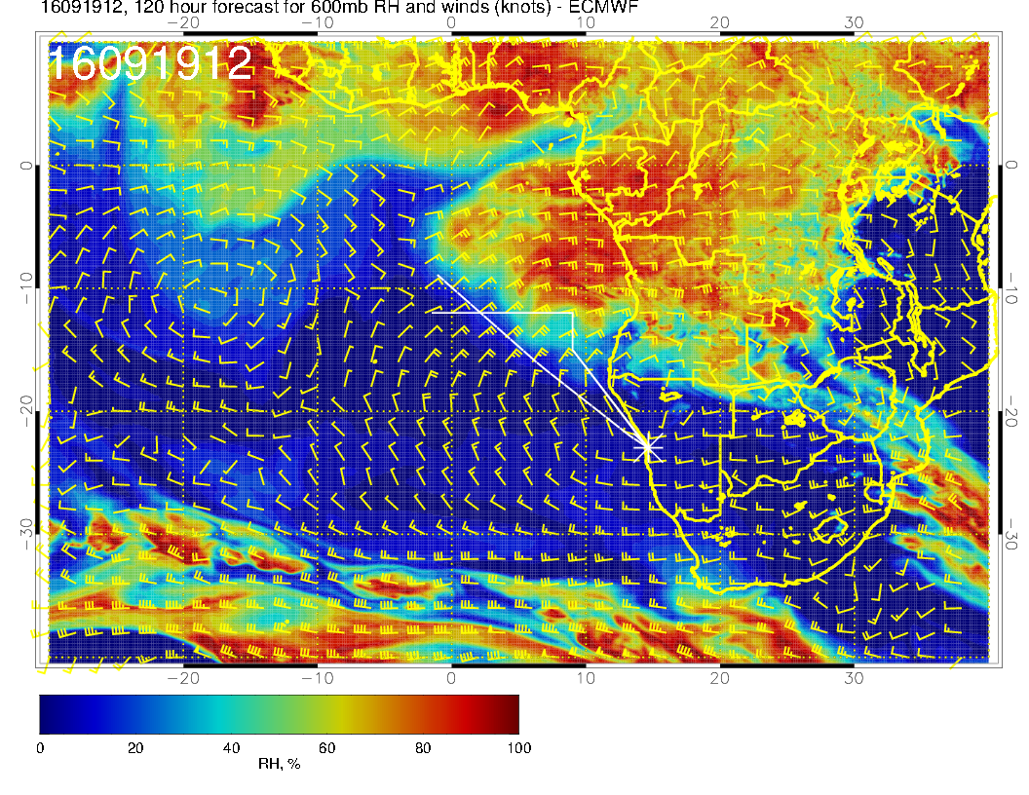
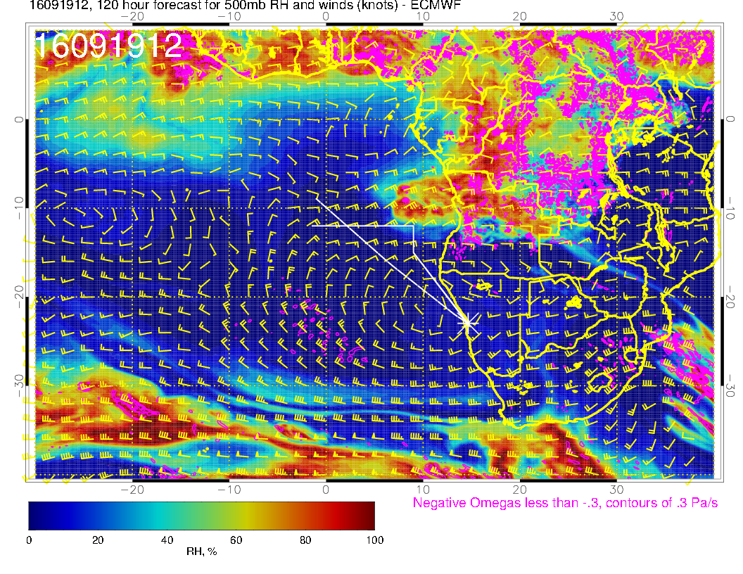

Slide 32
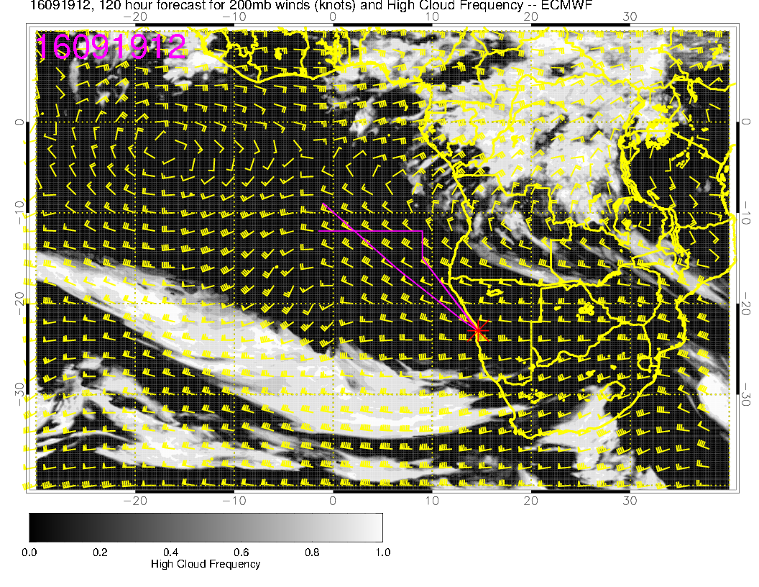
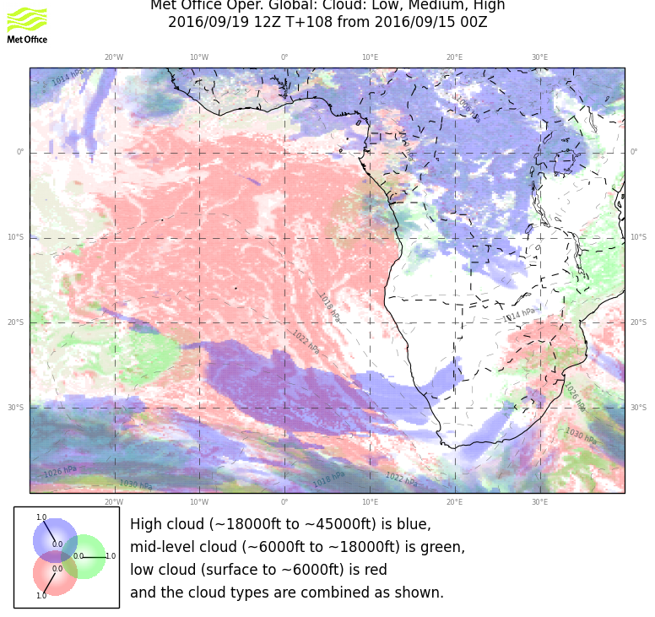

Slide 33
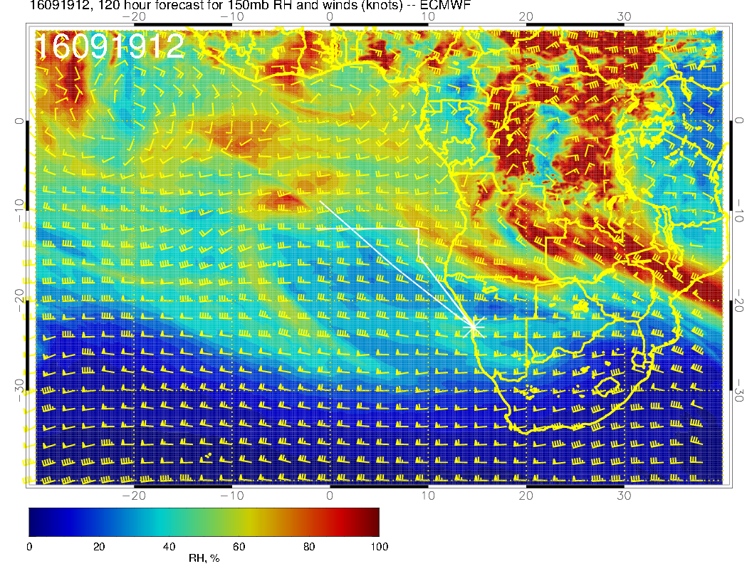

Slide 34
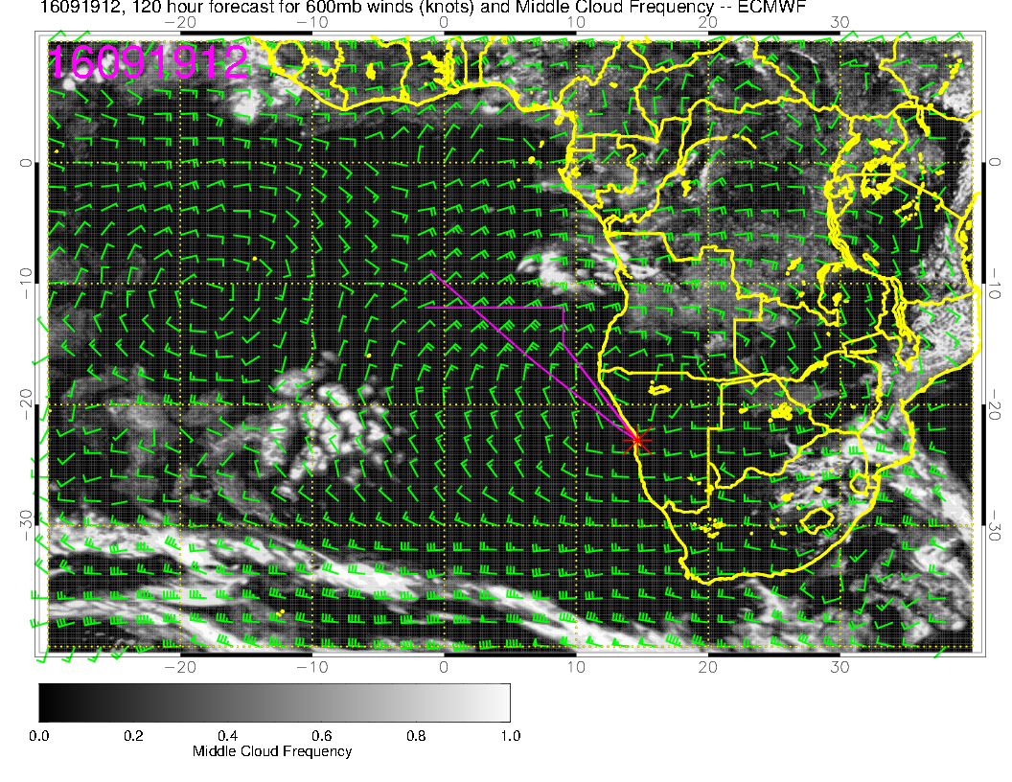

Slide 35
