Slide 1
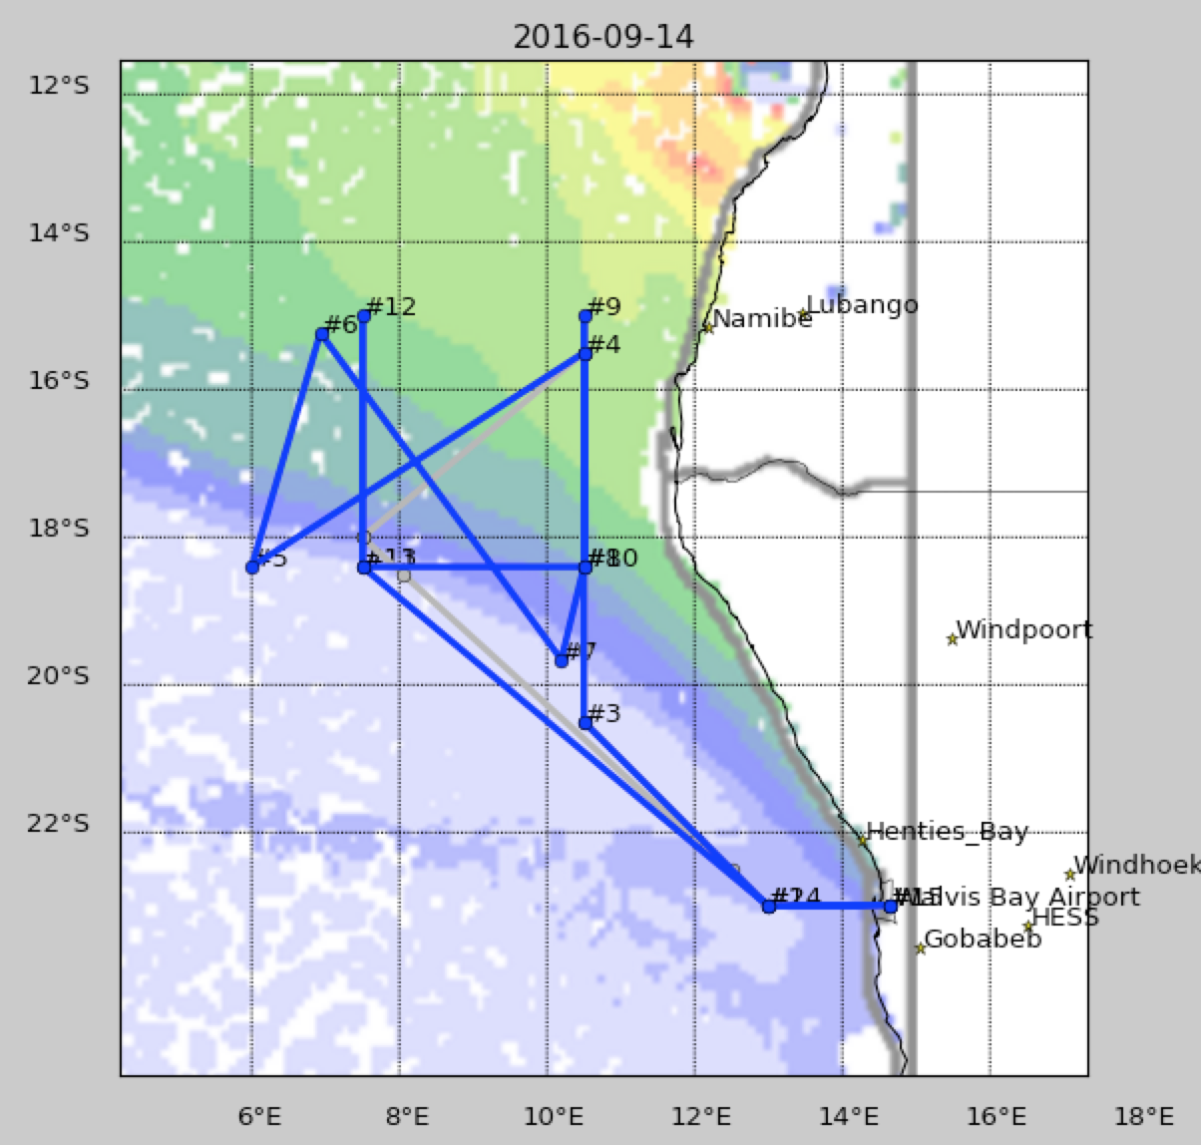
ER-2
Notes:
å

Slide 2
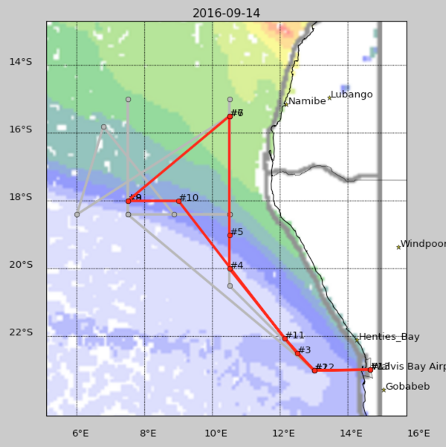
ER-2 coordination lines
Set up “wall” with stacked 10-min legs somewhere along these – location picked by flight scientist (cld/aer conditions)
A B C
P3
Radiation
Walls at
these points
Decide before TO whether we execute plan AC (as shown), AB, or BC
Notes:
å

Slide 3
Radiation Wall at one point each on two of the lines (A&B , B&C or A&C) ideal legs shown; order may change depending on conditions & timing relative to ER-2
FINISH
START
not pretty, and not drawn to scale!)

Slide 4
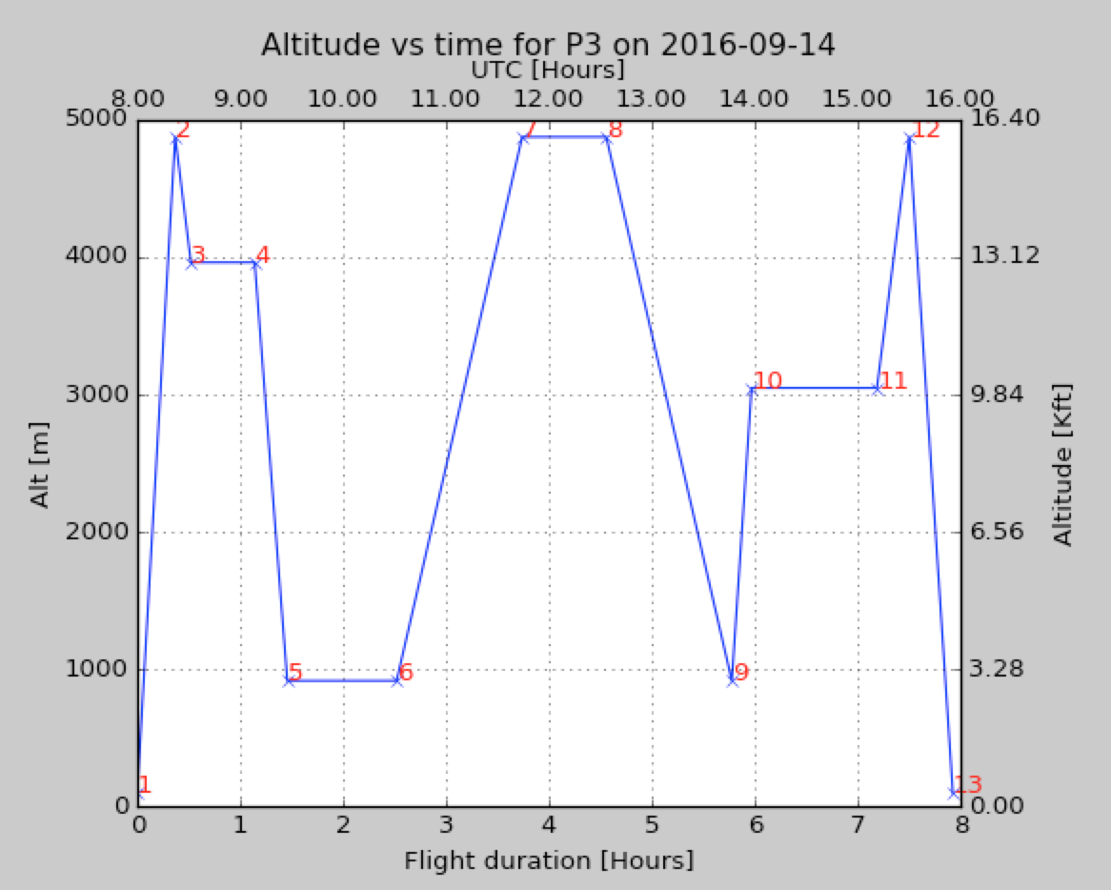
Notes:
å

Slide 5
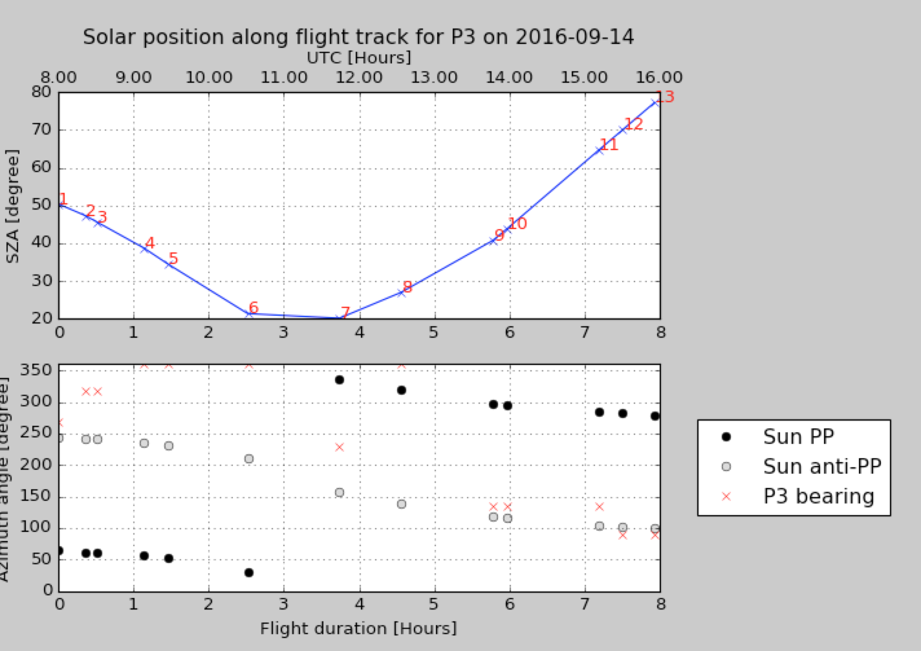
Notes:
å

